Slide 1
What inspires me is the deep love I have for the sciences and biological research. Nothing is more rewarding than enthusiastically sharing this knowledge with students. Watching a student who once believed he or she could never succeed in a science course gain increasing confidence throughout the semester is the greatest reward I could receive as an instructor.
—Kim Kyker, Oklahoma City Community College (OK)

Slide 2
There is nothing that inspires me and motivates me more than to have a student say, "I never understood math in high school, and now I don't know why. You have taught me that I really can understand math, and I'm actually enjoying it!"
—Gail Malmstrom, Oklahoma City Community College (OK)

Slide 3
I believe the students who learn how to think and who are pushed to higher expectations will be better equipped for the classroom-to-real-world transitions. By raising the bar of learning expectations, students can develop a confidence when they have completed a course they know is difficult.
—Jennifer Butler, Oklahoma State University Institute of Technology-Okmulgee (OK)

Slide 4
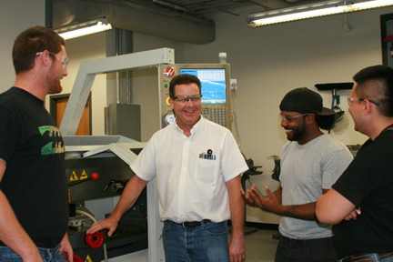
Manufacturing is leading the economic comeback in the US, and skilled machinists are at the core of an excellent industrial sector. We can assure our students they have outstanding career opportunities if they will show up and make the effort to learn.
—Andrew Geppert, Palm Beach State College (FL)

Slide 5
I believe in delivering quality with a constant eye on improvement. My purpose is to continue to learn, educate, and encourage others. I am passionate about life and the education process, and I never take for granted my impact on others and theirs on me.
—Ronnie Brannon, Palo Alto College (TX)

Slide 6
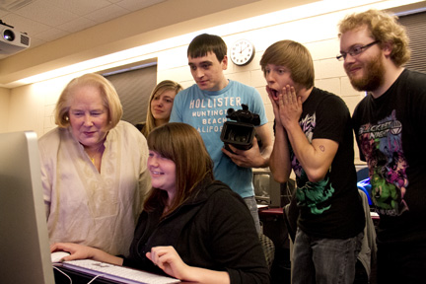
Education must aim for active use of knowledge and skill. Many students I encounter are unaware of their education and life goals. I believe a teacher not only must train students in the classroom, but also must help them become aware of their options for life. As Einstein said, “It is the supreme art of the teacher to awaken joy in creative expression and knowledge.”
—Ella Ruggles, Pellissippi State Community College (TN)

Slide 7
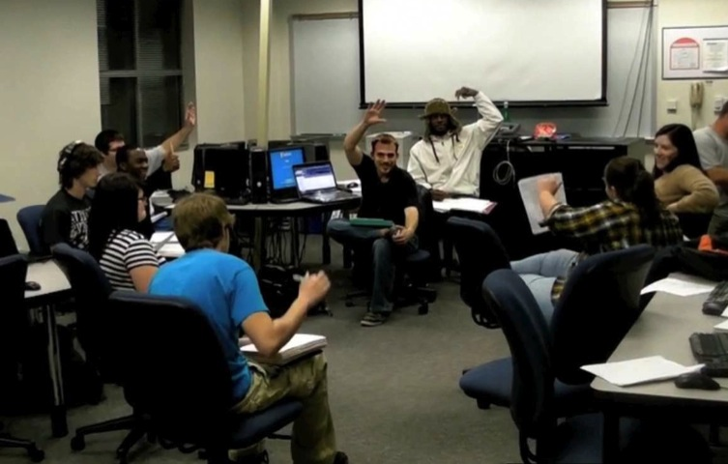
A student-centered approach is just empowering—and effective. Involve students in creating assignments; use materials relevant to their experiences and aspirations; give them a voice whenever possible; validate and build on existing abilities, rather than fixing deficits; use open-ended processes without wrong answers; treat adult learners as adults.
—Sara Salyers, Pellissippi State Community College (TN)

Slide 8
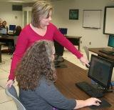
I believe that every student can learn and should be provided the opportunity to learn in a constructive and encouraging environment. My commitment to my students includes providing teaching methods to fit their learning styles. Because of this, I never teach a course the same way twice.
—Cassandra Warner, Piedmont Technical College (SC)

Slide 9
We have an urge to learn. Learning is easy in safe situations, when you feel the need to learn and can actively pursue the knowledge. It’s a teacher’s job to create those situations. Education is a human right.
—Elisabeth Goodwin, Pima Community College (AZ)

Slide 10
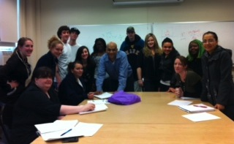
Students respond to the energy and enthusiasm I bring to class. Creating a positive and nurturing environment strengthens the foundation of a learner. I inject humor and collaborative problem-solving sessions in an attempt to build a sense of belonging and a responsibility to support each other and the community.
—Aemiro Beyene, Quinsigamond Community College (MA)

Slide 11
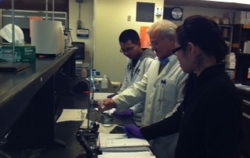
In order to be successful, individuals must enjoy what they are doing; apply themselves, and never give up! If they enjoy their lifelong ambition, they will be successful! To teach is to touch lives forever.
—Vincent DiTaranto, Quinsigamond Community College (MA)

Slide 12
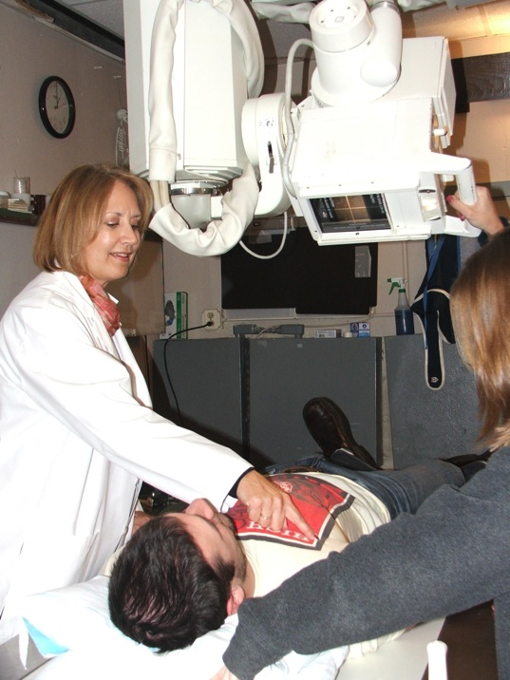
I try to bring as much imagination and energy to every class as possible, in an effort to model the dedication our graduates and future imaging professionals will need to bring to their own practice.
—Linda Lefave, Quinsigamond Community College (MA)

Slide 13
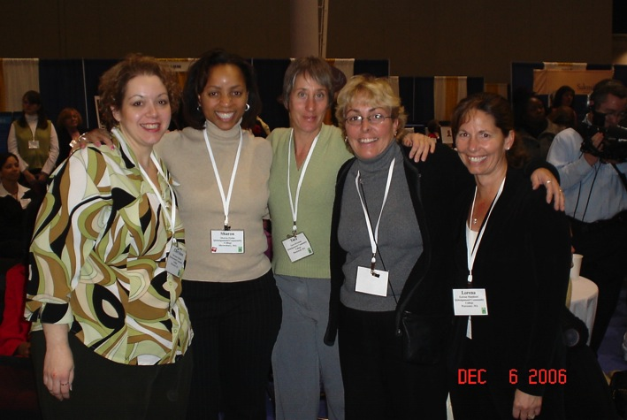
I am inspired and motivated by having the responsibilities that match my position and challenged above my position for growth. Challenging work, responsibilities and accomplishing them as a team inspires me to learn and grow in my organization. Working with my colleagues and sharing ideas thus reaching the desired goal for my institution as a whole.
—Sharon Wilbur, Quinsigamond Community College (MA)

Slide 14
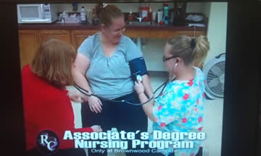
As an individual, registered nurse, nursing instructor, and now the inaugural Dean of the Associate Degree Nursing Program at Ranger College, my goal is to show caring before knowledge through encouraging, reaching, motivating, supportting, teaching, cheering, challenging, and inspiring.
—Marnita Guinn, Ranger College (TX)

Slide 15
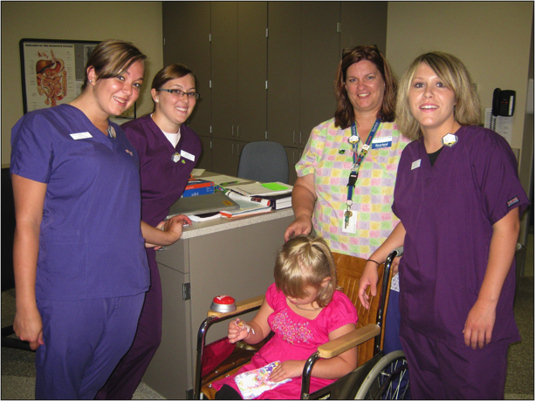
My role as an educator is that of a facilitator of learning—promoting the academic and clinical success of my students. As an educator and the gatekeeper for the radiologic science profession, I enthusiastically embrace the new technologies available to help my students succeed.
—Sandra Nauman, Riverland Community College (MN)

Slide 16
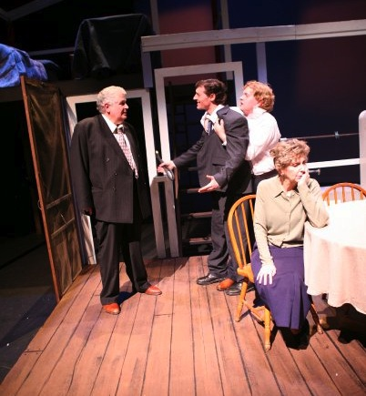
I am not sure how this theatre major ended up working in institutional effectiveness and research, but I do know that I have an abiding passion and commitment to the spirit of strategic improvement and to the continual learning that such a position demands, and I know that a little acting talent never hurt in working with faculty!
—Karen Brunner, Roane State Community College (TN)

Slide 17
Community colleges have a story to tell. They provide access to higher education to students who might otherwise consider college to be out of reach. Community college faculty members inspire those students every day. It’s an honor to be part of the team that tells this great story.
—Owen Driskill, Roane State Community College (TN)

Slide 18
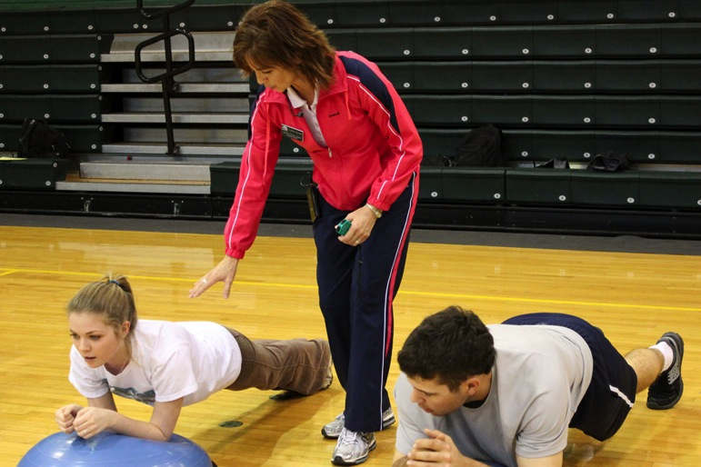
As a teacher, I may not be wealthy, but I am rich in ways for which no one can set a price. I love my work and am surrounded by students, who despite seemingly insurmountable life challenges, continue to strive to be better for themselves, their children, and their communities.
—Lynne Haynes, Rockingham Community College (NC)

Slide 19
My grandfather, a community college student who broke the cycle of poverty for his family, conducts himself with integrity and treats others with dignity. Knowing that I serve others from similar backgrounds encourages me to hold fast to the words integrity and dignity.
—Sarah Eyanson, Sacramento City College (CA)

Slide 20
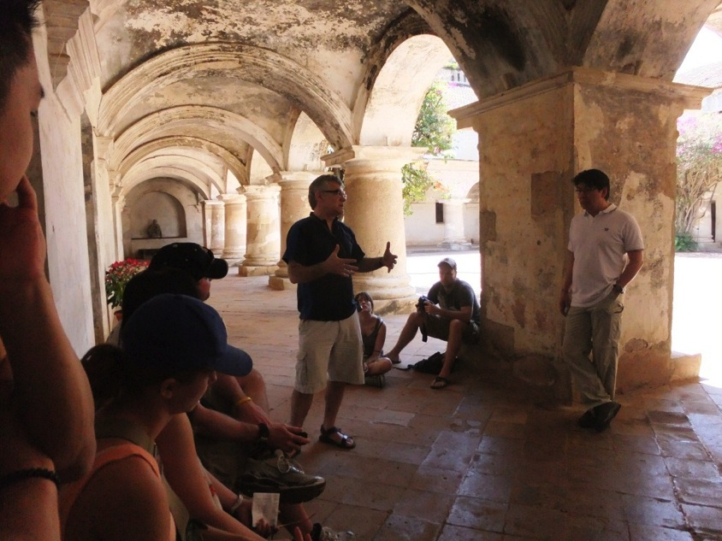
—Marc Bussiere, SAIT Polytechnic (AB)

Slide 21
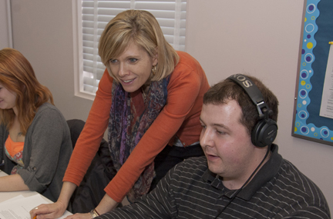
Providing students with a holistic approach to education that includes creating a sense of community in the classroom is the key to promoting excellence. In this environment, learners can be motivated to take risks, make connections, and find meaning in their studies.
—Lori Hanninen, SAIT Polytechnic (AB)

Slide 22
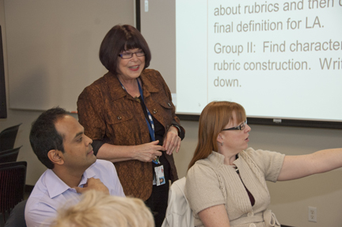
I always say I have the best job in the Polytechnic! When I see the changes faculty implement in their classrooms for their learners and the passion they show for trying new ideas, I know I made the right decision to become a faculty developer. I often wonder who is learning more—am I or are they?
—Moira MacLoughlin, SAIT Polytechnic (AB)

Slide 23
I delight in helping young learners develop their minds so they can see theoretical concepts to help diagnose problems. In my college days, I was inspired by my instructors. Now I teach in the same classroom that I sat in many years ago and hope that my students will leave as inspired as I did.
—Don Mason, SAIT Polytechnic (AB)

Slide 24
For many college students, the educational experience becomes one of the most memorable times of their lives. It is very rewarding to be a part of their journey. For a teacher, the ultimate inspiration is to have students and graduates say, “This program and my instructors have changed my life.”
—Peggy Noble, SAIT Polytechnic (AB)

Slide 25
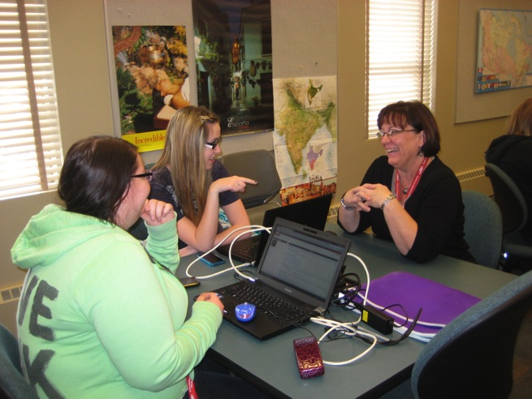
A keynote speaker at a previous NISOD Conference said, “You must teach the class you have, not the class you wish you had!” I remember those words each and every day. Every student is a unique individual; and our challenge, as instructors, is to teach in a manner that resonates with each individual personality.
—Jona Way, SAIT Polytechnic (AB)

Slide 26
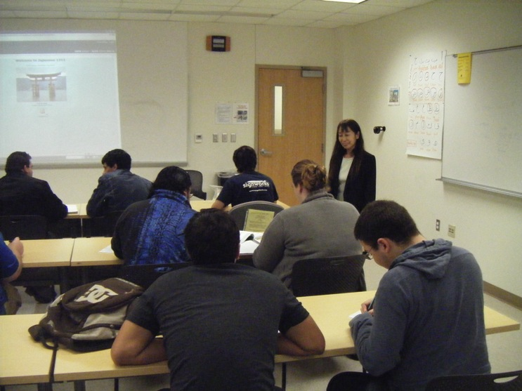
I believe in bringing my expertise and ideas to my class. I enjoy interacting with my students and creating a constructive language-learning environment together.
—Yuko Kawabe, San Antonio College (TX)

Slide 27
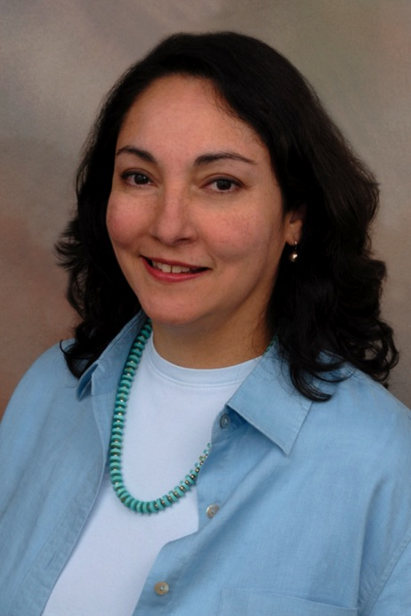
As a community college counselor and student development instructor, I see the adverse situations our students endure and overcome. So I feel privileged and blessed on a daily basis to be present when a student’s life is beginning to change for the better. Students work very hard to attain their educational goals—and often they give us much of the credit. One of my favorite things in life is to attend commencement and
cheer for students as they receive their diplomas.
—Lisa Menard, San Antonio College (TX)

Slide 28
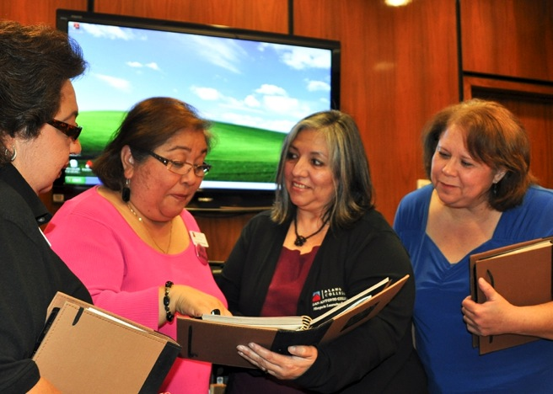
My mission in life is to advocate for people and lifelong learning. I believe everyone should have the opportunity to grow, both personally and professionally. It is my responsibility to help develop employees’ capabilities, to assist in increasing the capacity of our employees to act positively, to be responsive to students and fellow employees, and to build their skills so our students can succeed. What better job is there?
—Cynthia Price, San Antonio College (TX)

Slide 29
—Tim Banks, San Jacinto College District (TX)

Slide 30
I am in awe of many of my students. Their desire to succeed, even as they face monumental challenges, is what drives me to do my best in teaching them the information and skills they need in order to be successful.
—Lambrini Nicopoulos, San Jacinto College District (TX)

Slide 31
In our ABE Department, my desk faces the counter where students timidly walk up to inquire about our programs. ENCOURAGEMENT is what they need from the time they arrive to the time they complete. They need a counselor, a confidant, and a cheerleader. They appreciate knowing we care about them.
—Gloria Duran, Santa Fe Community College (NM)

Slide 32
A group of career and technical faculty developed a comprehensive 21st-century work skills model that touches the lives of thousands of students at their work sites every year. We are proud to prepare our students for careers in any field.
—Renee LoPilato, Santa Rosa Junior College (CA)

Slide 33
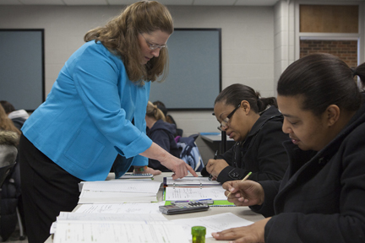
I love my job. Every semester is a new beginning. As instructors, we plant the seeds of hope and possibility that we trust will take hold. I think about what my students may become. My pharmacist was my pre-calculus student. You never know what the future holds.
—Sandra Kerr, Schoolcraft College (MI)

Slide 34
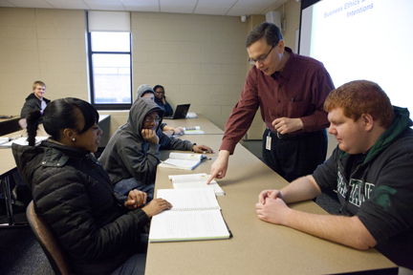
In my former role as a CFO, I had a great responsibility to many stakeholders. As a business instructor, I hold an even greater responsibility to even greater stakeholders—my students. I do not take this lightly, especially since it has a direct impact on their lives and the lives of their families.
—Gerard Mellnick, Schoolcraft College (MI)

Slide 35
Setting up a comfortable situation in the classroom is essential for learning to take place. Letting students know that I do not have all the answers and encouraging student input are important keys to learning. Getting across your "humanness" as the instructor and appropriately using humor can help relieve student anxiety.
—Ron Schilling, Scottsdale Community College (AZ)

Slide 36
Rumi stated, “Let yourself be silently drawn by the stronger pull of what you really love.” Love of my role as a teacher, the subject matter, and my chance to help others make a difference in their lives inspires and motivates me to thrive to be a better educator every day!
—Lisa Young, Scottsdale Community College (AZ)

Slide 37
I strive to make a difference in students’ lives by addressing their individual needs in a fun and exciting learning environment. I endeavor to present learning outcomes in a relevant and engaging manner. After more than 15 years, I am still rewarded by seeing students discover their own potential.
—Tom Babott, Selkirk College (BC)

Slide 38
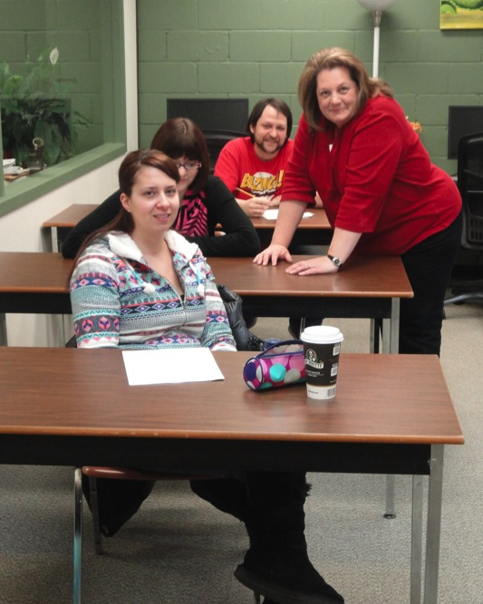
I work with a team that helps students with disabilities. I listen, with a sense of awe, to the students describe the hardships they have overcome to get to this stage. Despite the extra adversity, they undertake difficult programs that would challenge the majority of us. When I see them triumphant in successfully completing their courses of study, I am inspired to continue to help these courageous students achieve their goals.
—Nadya Sofonoff, Selkirk College (BC)

Slide 39
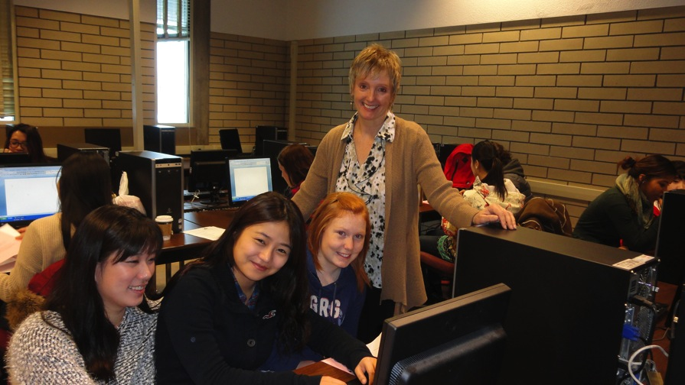
Working in the world of international education, I am able to embrace the beauty of diversity in students’ backgrounds, values, attitudes, and languages. Embracing diversity requires us to shift our focus and become more thoughtful, understanding, and compassionate individuals. As their teacher I strive to help students to embrace these differences and to realize how their uniqueness makes the world a more colourful place.
—Robin Trudel, Selkirk College (BC)

Slide 40
Our theatre students collaborate to create a most lively, immediate, and human art form, unfolding in the here and now, transporting spectators to the world of the play, where characters from history, fantasy, or our own neighborhoods, spool out their stories in the ether existing between spectator and performer. It’s exciting!
—Paul Luby, Seminole State College of Florida (FL)

Slide 41
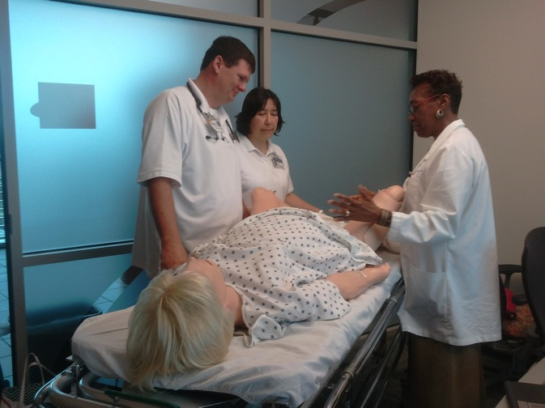
As a teacher I want to positively impact the future through my contributions in the present. Teaching affords me the opportunity to live my passion and work towards changing lives. Students want to learn; they want to know that we care. Let’s help them achieve their dreams.
—Maudrilla Thompson, Seminole State College of Florida (FL)

Slide 42
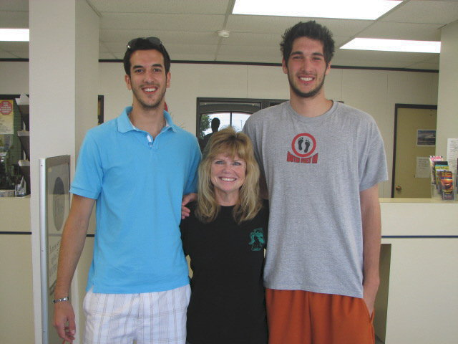
I learn from our students nearly every day. From their cultural backgrounds to their family life, to their view of the future, our students' views of life are awe-inspiring. These kids keep me young at heart even though I may be gaining old in age!
—Jerri Lynn Lyddon, Seward County Community College/Area Technical School (KS)

Slide 43
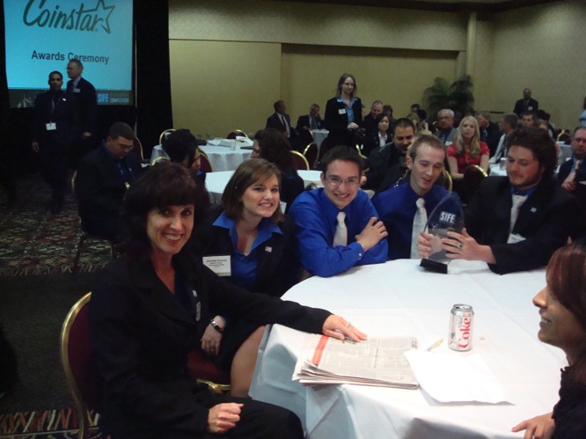
My one-word philosophy of education is care. Once my students trust that I truly care about them, then they are open to new learning experiences.
—Kimberly Thomas, Seward County Community College/Area Technical School (KS)

Slide 44
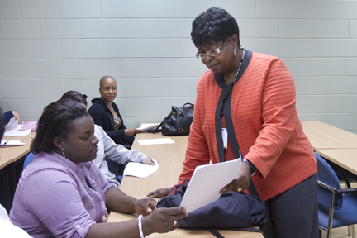
Impacting college students is just as rewarding as impacting young children. Helping students gain information and experience to prepare them for parenting and possibly teaching is extremely rewarding. Positively changing lives has never seemed like a job; it is a calling, a blessing.
—Carolyn Edwards, Shelton State Community College (AL)

Slide 45
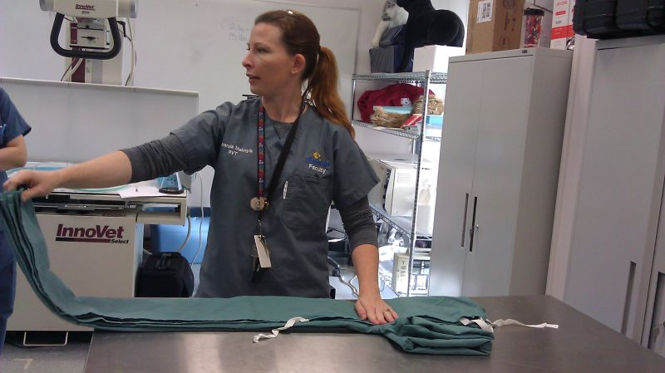
Everyday is a learning opportunity, for my students and for me. It is challenging to replicate situations and scenarios that are truly reflective of those that my students face in practice. The excitement that I feel when I think up a new method or technique to take into the classroom is invigorating. I can't wait to present it and have students assist me in developing it further and testing it out. Their dedication and eagerness to learn are inspiring, and the driving forces behind my continued passion for what I do. I can't imagine doing anything else, nor would I want to. This is where I was meant to be.
—Amanda Maknyik, Sheridan College (ON)

Slide 46
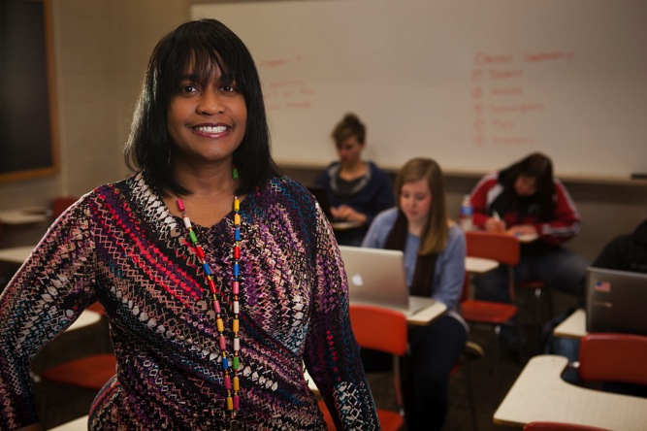
Unprecedented unemployment has transformed numerous citizens into struggling college freshmen. For that reason, I teach all of my students how to think critically when choosing careers in this ever-changing economy. I am honored when students walk into my classroom as they are entrusting me with something that is invaluable—their futures.
—Myra Bozeman, Sinclair Community College (OH)

Slide 47
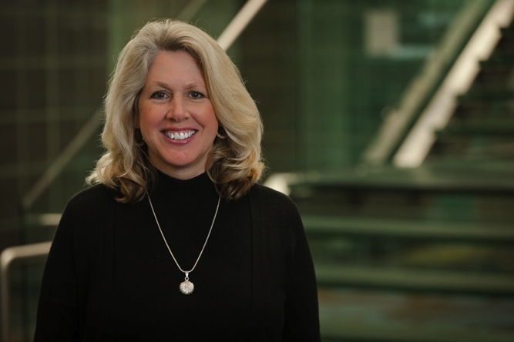
When former students come back to visit and mention that I taught them something about life that they still use today, I know that the effort I put into relationships is worthwhile. It gives me the energy to start all over again with a new cohort of students.
—DeAnn Hurtado, Sinclair Community College (OH)

Slide 48
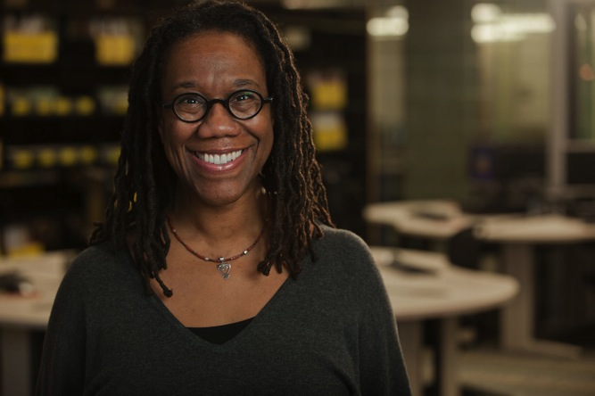
Students in the 21st century will be global citizens. I bring the world to my classroom through my own professional experiences and personal travels. We circle the globe from Tokyo to Accra. Students’ lens of ethnocentrism break down and crumble, and now they realize they too can dream bigger and make it happen.
—Lea Ann Lucas, Sinclair Community College (OH)

Slide 49
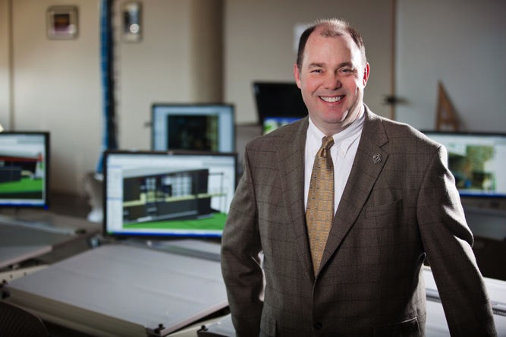
Helping students discover they can, when all they have been told is they can’t, is a tremendously rewarding experience. Helping them find a road to success, even if it isn’t in my program, is gratifying and humbling.
—Charlie Setterfield, Sinclair Community College (OH)

Slide 50
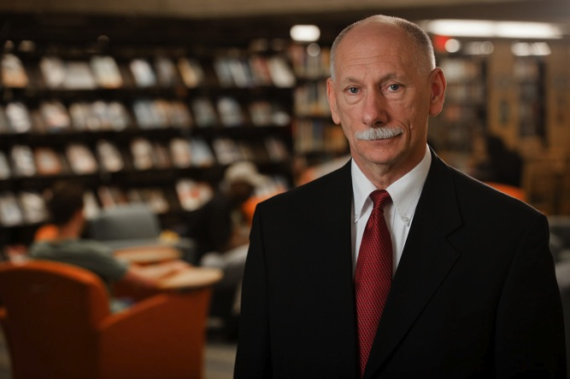
To me, each student is inspiring—his or her story, dreams, and goals. I seek to create a learning environment—a learning lab that promotes individual/personal experimentation, learning, discovery, and application resulting in a continuous stream of eureka moments! I foster an enthusiastic “all things are possible” culture of learning that embraces change!
—David Siefert, Sinclair Community College (OH)

Slide 51
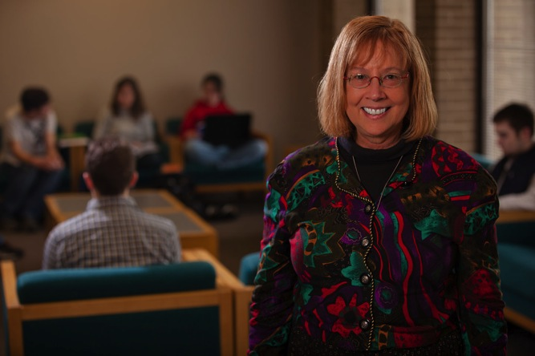
If I can develop a relationship with each student based upon listening, understanding, and empathy, and high but achievable expectations and healthy boundaries of mutual respect, then I have created the safety and nurturance for a student to grow and thrive, and the model of a healthy therapeutic relationship.
—Susan Sutton, Sinclair Community College (OH)

Slide 52
My strategy for success is to look at the big picture first. Then I can turn my attention to the details of the many projects and duties of an Administrative Assistant.
—Tanya Cowan, Somerset Community College (KY)

Slide 53
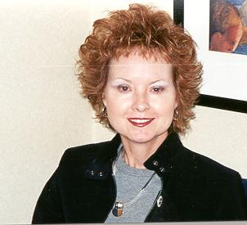
—Lois McWhorter, Somerset Community College (KY)

Slide 54
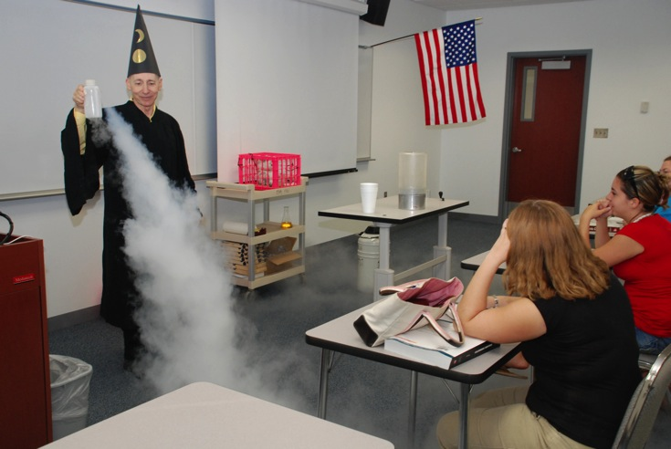
Students learn by doing. They learn from each other. Feedback helps. My chemistry students spend a lot of class time solving problems in groups and using clickers for instant feedback. Lab procedures get applied to real-world samples.
—Peter Hamlet, South Florida Community College (FL)

Slide 55
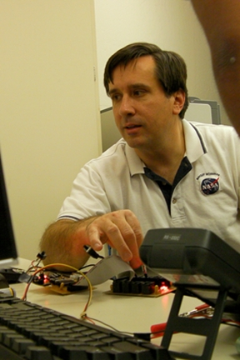
Next to family and close friends, my teachers have been the most influential people in my life. They exposed me to new ideas, challenged me to achieve great things, encouraged me to work hard, and listened when I needed a sympathetic ear. That is why I went into teaching.
—Timothy Frank, South Mountain Community College (AZ)

Slide 56
I am uplifted by that "Ah ha!" moment when a student suddenly understands the logic behind a software application, the excitement they express demonstrating their animation projects, or when they discuss how they might apply a skill learned in class to a personal or professional project in their world.
—Stephen Hustedde, South Mountain Community College (AZ)

Slide 57
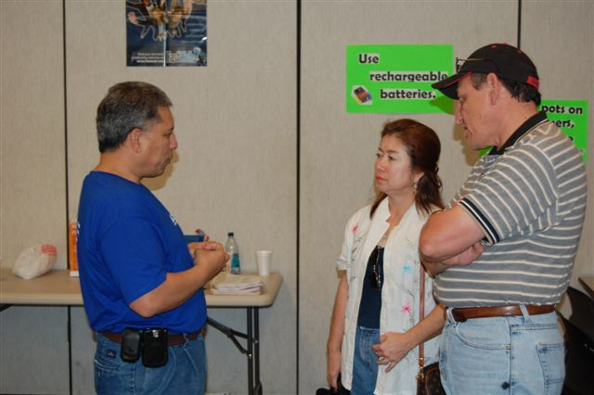
I have one of the most rewarding jobs anyone could ask for. I always look forward to seeing students start their first year of college, but I most enjoy seeing students walking down the aisle in their cap and gown on their graduation day.
—Miguel Carranza, South Texas College (TX)

Slide 58
I learned early that students respond to truth and passion. If you understand, believe, and have passion about the material, the students will respond in kind. Seeing a student use the patient care skills they learn in the classroom in the real world with proficiency, compassion, and expertise is gratifying. We can take the students by the hand, open our minds and hearts, and teach them the way.
—Magdalena Handy, South Texas College (TX)

Slide 59
To know that I'm making a difference in students’ futures by allowing them to be creative and polish their skills is the most rewarding feeling as an instructor.
—Oscar Hernandez, South Texas College (TX)

Slide 60
Any faculty member is required to have good credentials and experience, but also the ability to connect to students. This connection with students in classrooms helps make the learning experience more enjoyable. I would to see my students become successful in the real world.
—Roberto Ho, South Texas College (TX)

Slide 61
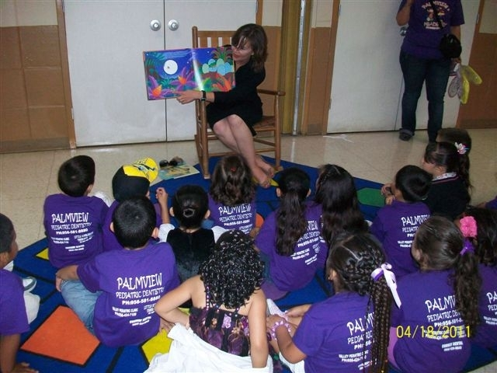
Community colleges play an integral role in increasing the educational attainment level in the regions they serve. The foundation must begin in kindergarten, developing a college-going culture where degree attainment is the standard, not the exception.
—Kimberly McKay, South Texas College (TX)

Slide 62
The task of engaging college students with varied range of learning abilities in scientific problem solving is a challenge. The strategy I implemented to tackle this task is Attention-Analysis-Learning (AAL) method. By involving an attentive mind in an active analytical exercise, one can accomplish effective learning.
—Ravindra Nandigam, South Texas College (TX)

Slide 63
After living and working in Europe for 30 years, I am privileged to be serving the unique population of the Rio Grande Valley of Texas, where I grew up. The driving force which is with me each day in my work—I teach people, not a subject. Reaching those individuals is the key to propelling them forward in this complex world.
—Judith Peabody, South Texas College (TX)

Slide 64
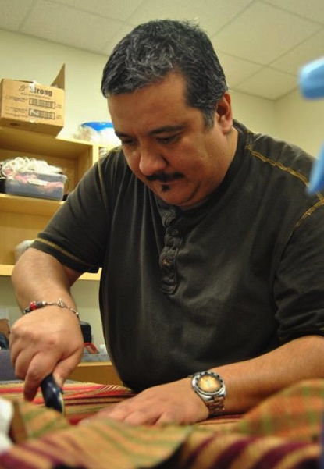
I believe everyone should discover his or her passion and allow it to be what fuels life's work. I believe my purpose is to teach and encourage my students to realize the power they have within, and to understand that the challenges we face in life are from ourselves.
—Joel Rodriguez, South Texas College (TX)

Slide 65
I am inspired by my students, especially those who are juggling multiple responsibilities in their lives yet are still able to carefully complete our class assignments and expect me to deliver excellent instruction. I am motivated by the support I receive from and the professionalism exhibited by my colleagues.
—Stevan Schiefelbein, South Texas College (TX)

Slide 66
Our department’s vision is to ensure that our students are challenged in our classrooms, not in our processes. It is our goal to remove barriers at every stage of the students’ college experience, facilitating completion and success.
—William Serrata, South Texas College (TX)

Slide 67
Growing up, I was always aware of the notion that my home, the Rio Grande Valley, was behind in numerous ways, compared to the rest of the country, including in educational attainment. My motivation is to help my neighbors escape the cycle of poverty by gaining marketable skills and degrees.
—Kristina Wilson, South Texas College (TX)

Slide 68
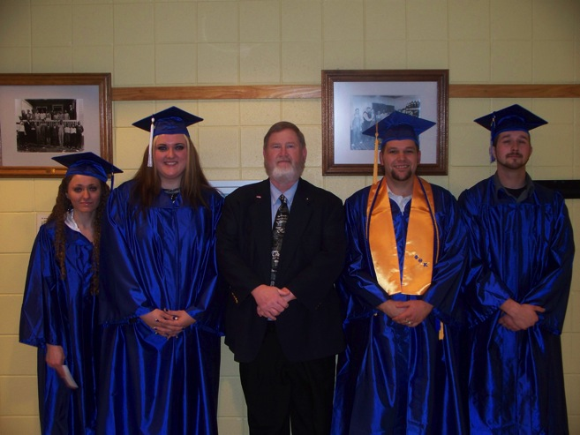
I fell privileged and honored to be a part of my students’ lives. I am delighted to be able to teach them science, technology, engineering, and mathematical skills that they take with them into the workforce and use the rest of their lives to make a great living.
—Gary Steenbergen, Southeast Kentucky Community and Technical College (KY)

Slide 69
—Angela Ransom, Southeastern Community College (NC)

Slide 70
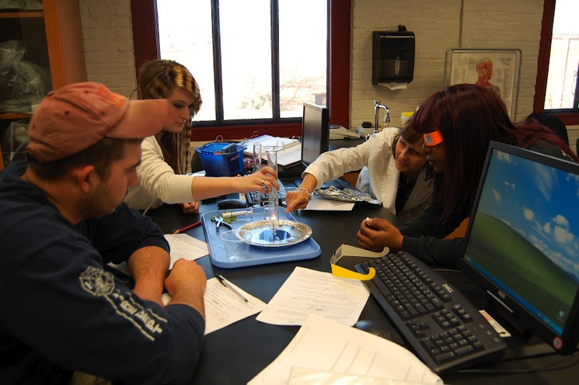
According to Gail Godwin, “Good teaching is one-fourth preparation and three-fourths theater.” Good teachers are prepared and constantly looking for new instructional tools, creative activities, and current information. If the teacher is organized and enthusiastic about the subject matter, the students are more likely to be eager to learn.
—Karen Fisher, Southside Virginia Community College (VA)

Slide 71
We are in the middle of challenging economic times. As a nursing instructor, I see students entering nursing programs for the purpose of finding a job and not infused with a love of caring for others. I accept the challenge to inspire the love of nursing into the students in our program and introduce them to a rewarding career.
—Leigh Moore, Southside Virginia Community College (VA)

Slide 72
Education transforms lives in ways nothing else can. To play a part in this life-changing experience is a privilege beyond words.
—Susie Mullins, Southwest Virginia Community College (VA)

Slide 73
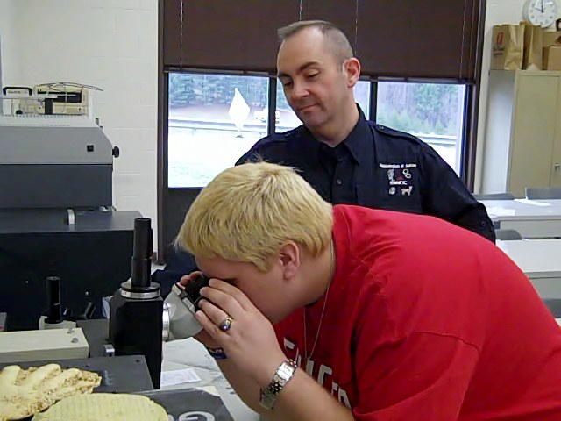
To be given the opportunity to teach is one of the highest honors that can be bestowed upon anyone. This is your chance to pass on what you have learned in the classroom and along life’s way. It is truly your time to make a difference in a life.
—Jerry Stinson, Southwest Virginia Community College (VA)

Slide 74
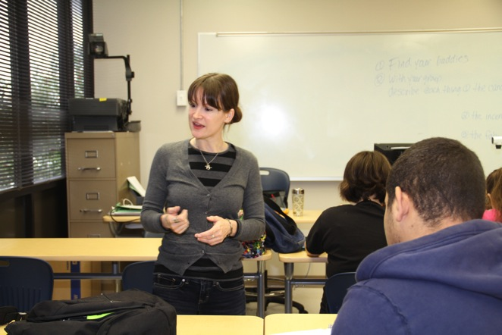
Teaching is an honor. When I enter the classroom, I am excited about the possibilities. I serve a diverse group of students, so I try different approaches to teaching English. I build rapport so my students can be fearless and goal oriented. Their hunger for success fuels me.
—Dorothy McCormick, Sowela Technical Community College (LA)

Slide 75
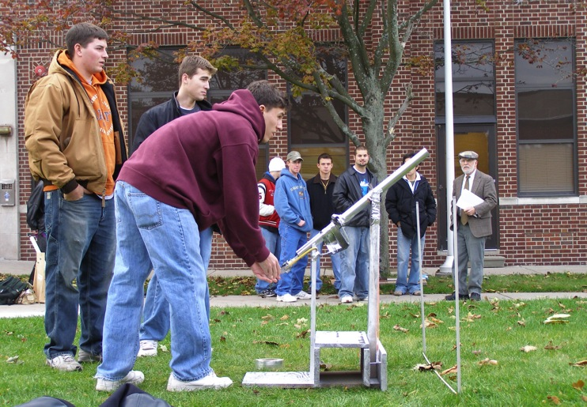
Teaching is an art. There is science behind it, but science cannot produce the spontaneous creativity that occurs in effective classrooms. Teaching is a performing art. I often tell students that if they are afraid of looking foolish in front of a live audience, then they should not go into teaching.
—Haddock Snyder, St. Clair County Community College (MI)

Slide 76
As educators, we help nurture students. As Francis Bacon wrote in Of Studies (1625), "for natural abilities are like natural plants, that need pruning, by study….” Teaching is a privilege. May we recognize that we share moments in time with students who seek to develop their natural abilities.
—Wendolyn Willison, St. Clair County Community College (MI)

Slide 77
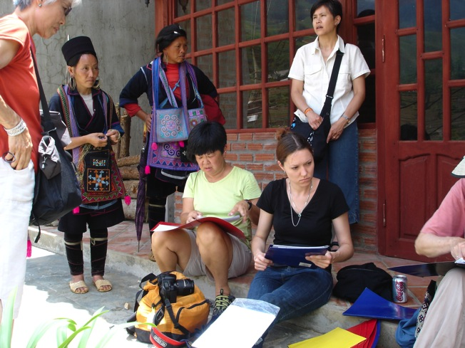
I have a social justice perspective. Many of our students have experienced unequal opportunity in their K-12 education. The community college offers opportunities to overcome such inequities. I see the community college as an agent of social justice, and I am proud to be a part of it.
—Andrea Nichols, St. Louis Community College (MO)

Slide 78
My work is very important to me because I know I may be the last person to forge a bond, that special connection with my students in order to help them attain the academic success that will lead to a better life for them and their families.
—Patricia Smith, St. Petersburg College (FL)

Slide 79
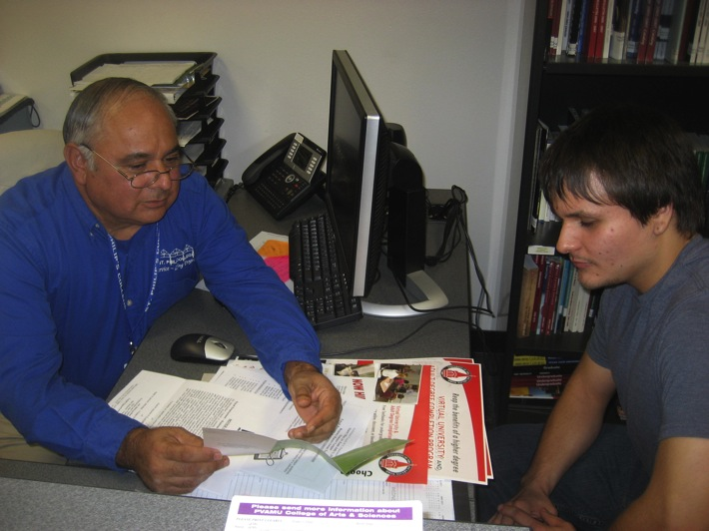
Twenty-seven years ago as a student affairs professional, I anxiously anticipated Parent Nights, HS visitations, and ancillary recruitment events. I drew immense satisfaction from relieving student and parent anxieties relative to going to college. Now towards the end of my career, I derive that same satisfaction authoring proposals, training educators and administrators, etc. At the end of the day, it all benefits our students.
—Larry Medina, St. Philip's College (TX)

Slide 80
In the fast-paced, ever-changing, increasingly globalized society in which we live, personal success hinges on a willingness and ability to continually learn. As an educator, I must first be an avid learner. Leadership by example enables me to encourage my students to persistently pursue new knowledge and skills necessary for achievement of life goals. Instruction should be learner-oriented, ongoing, valued, and evaluated, in order to best serve the needs of students. My teaching philosophy is best summed up in the following acrostic: Learner-oriented Ongoing Valued Evaluated
—Laura Miele, St. Philip's College (TX)

Slide 81
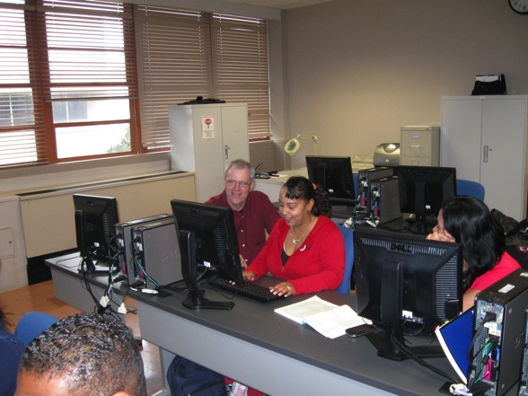
The challenge is to figure out how to make my students care about their own writing. I ask that they write from knowledge based on their own personal experience and direct observation. Through inquiry, revision, and rethinking, their skills develop; and the writing becomes informed, reflective, and nuanced.
—J. Michael Moran, St. Philip's College (TX)

Slide 82
Only through compassion can we connect with others in a deep and meaningful way. Only by connecting with others in a deep and meaningful way can we learn with our heart. Only by learning with our heart can we create the capacity to trust our true purpose in life.
—Karen Sides, St. Philip's College (TX)

Slide 83
As an instructor, I want my students to leave my class with two primary achievements. I want students to understand the material I present them, and I also want them to have learned how to research and problem solve to understand material they encounter in the future.
—Adam Carriker, Stanly Community College (NC)

Slide 84
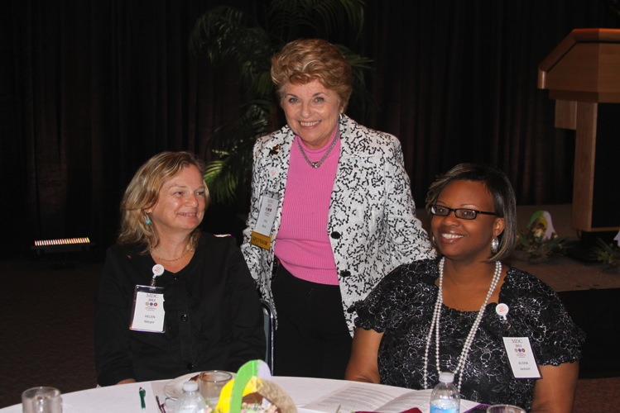
“I want to make a difference with people who want to make a difference, doing something that makes a difference,” John C. Maxwell observed. This is what inspires me to create opportunities for leadership development for faculty and staff of our College, and for the students in my Management Leadership classes. I believe that excellent leaders provide the foundation for institutions where our students can thrive. My passion is to guide the faculty and staff of today to become our successful leaders of tomorrow!
—Margaret Beck, State College of Florida, Manatee-Sarasota (FL)

Slide 85
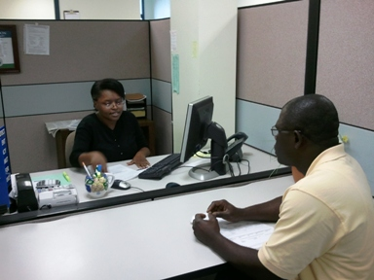
I believe the best gift we can give to students through conversation is listening. Listening is the most important part of communication because it involves participation and shows respect to the student speaking. When I am listening, I am conscious. When I respect others, then I am respected.
—Patricia Ramirez, State College of Florida, Manatee-Sarasota (FL)

