Slide 1
My level of engagement is the primary contributor to student success. I believe instructors must step down from their ivory tower to engage students in active learning with meaningful projects reflecting information trends of the professional world. I am a servant leader striving to differentiate to meet the needs of my diverse learners.
—Alexander Perez, Lake-Sumter Community College (FL)

Slide 2
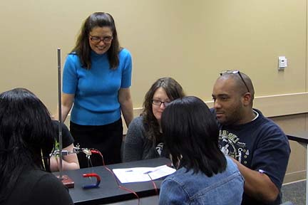
I am a huge advocate for active learning. Do something to engage the students. Active learning methods and models are limited only by the imagination and creativity of the instructor. I enjoy watching the "lightbulb" go on when an interactive exercise brings a lecture’s concept to life.
—Melissa Armentor, Lamar Institute of Technology (TX)

Slide 3
I believe in the old saying, “People will not remember what you said, or how you said it, but they will remember how you made them feel.” Treat all students and your peers with respect, and you will receive the same in return.
—Wilburn Lyons, Lamar Institute of Technology (TX)

Slide 4
As members of higher education, we are fortunate to be working with young minds and inspire them to achieve their educational dreams. Education equals empowerment, and empowerment leads to greater meaningful contributions to society. Thus, education is the key to a greater America.
—Marisela Rodriguez, Laredo Community College (TX)

Slide 5
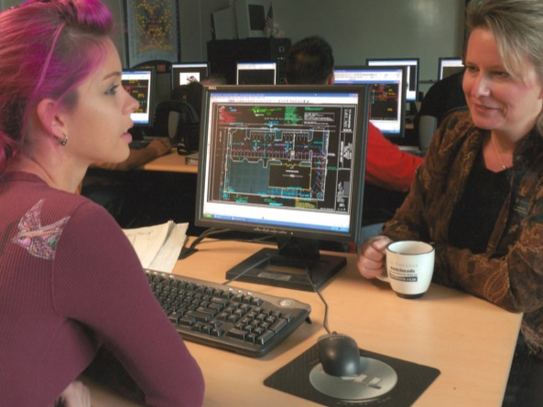
Just as learning goes beyond the classroom so must teaching! I believe it begins with a great attitude and excitement about being allowed to serve, and share skills, knowledge, and experience. My reward is seeing my students realize their academic goals and achieve success in their journey of life!
—Dana Caudle-Byal, Lee College (TX)

Slide 6
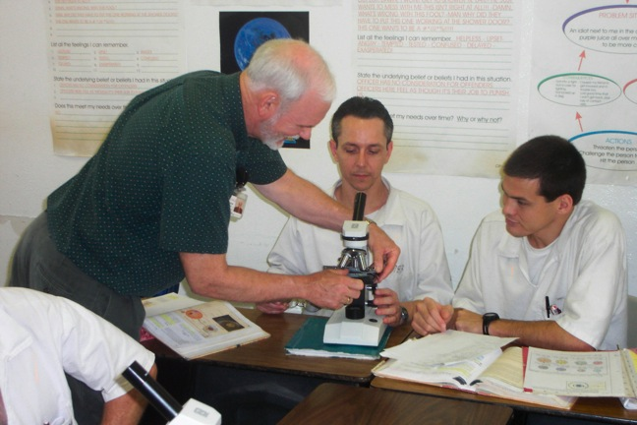
I prepare my students to expand their awareness of the world and gather the learning tools needed to shape their future. I do whatever it takes to instill confidence and the “can do” philosophy in them. I passionately strive to nurture my students in their voyage of becoming lifelong learners!
—Michael Gary, Lee College (TX)

Slide 7
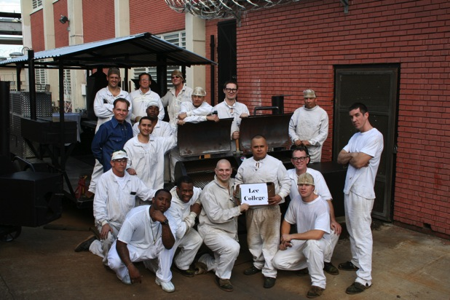
Teaching offender students makes a difference, not only in the lives of the students I teach but for society as a whole. Thousands of citizens are impacted when even one convicted criminal is rehabilitated and re-enters the world.
—Wayne Knuppel, Lee College (TX)

Slide 8
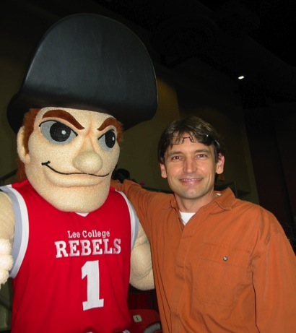
I live for the “light bulb moment,” that instant in time when you can actually see a student work through a concept and suddenly grasp it. Once I realized I had license to teach in different ways, I have seen that light bulb going off more frequently!
—Scott Nunez, Lee College (TX)

Slide 9
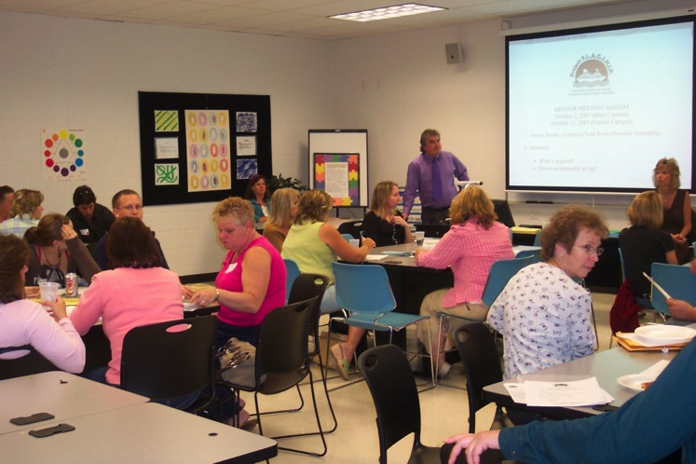
"What I love most about teaching are those "AH HAH" moments. An "AH HAH" moment is when a student you had as first-semester freshman starts acting and thinking like a teacher: "AH HAH! THEY GOT IT!"
—Joseph Davis, Lehigh Carbon Community College (PA)

Slide 10
It is often said that “life is a journey, not a destination.” This is the message I attempt to convey to my healthcare science students. Be present, be focused, think critically, strive for excellence, and develop your personal as well as clinical skills. Be a sponge, and enjoy the journey!
—Lori Madiara, Lehigh Carbon Community College (PA)

Slide 11
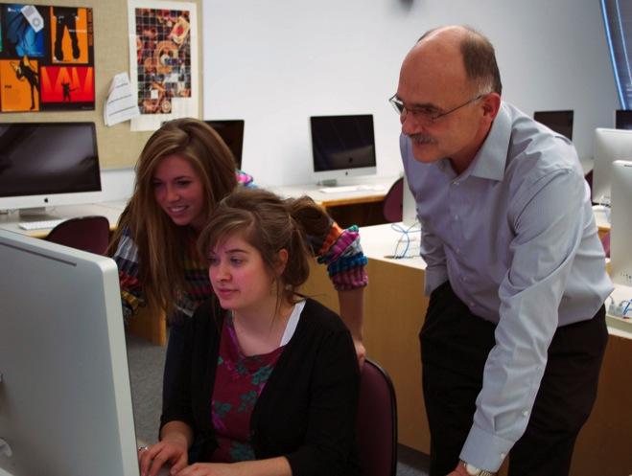
It is gratifying to watch students achieve goals beyond what they originally thought was possible and to help them discover some of the solutions to their own academic concerns. I intentionally expose them to a variety of learning environments, challenge some of their notions and assumptions, kindly encourage them to experience something different from the smorgasbord of educational opportunities, and then watch them grow and mature.
—Keith Dudley, Lethbridge College (AB)

Slide 12
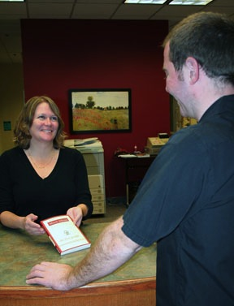
I have always believed that learning is its own reward. The most gratifying part of my job is helping students gain the skills they need to guide their own learning and experience its rewards for themselves.
—Fiona Dyer, Lethbridge College (AB)

Slide 13
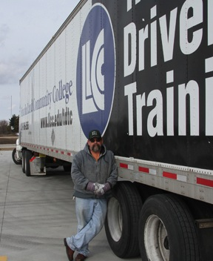
Theodore Roosevelt said: “No one cares how much you know, until they know how much you care.” The atmosphere of Lincoln Land Community College makes it easy to demonstrate care and concern for our students' success. It's been my privilege to work for this college and these students.
—Craig Norman, Lincoln Land Community College (IL)

Slide 14
On the first day of class, I tell my students that I will learn from them. I find it terrifically arrogant to think that I know it all or that learning stops. After all, the classroom is a true place of cooperative, collaborative learning that includes the instructor.
—Laura Taggett, Lone Star College–CyFair (TX)

Slide 15
We see the world through a lens of language. Learning to write well is not only conveying ideas to an audience, it is understanding self and community. It is taking control of the power of words—spoken and written—to shape the world and define our connection to it.
—Matthew Turner, Lone Star College–CyFair (TX)

Slide 16
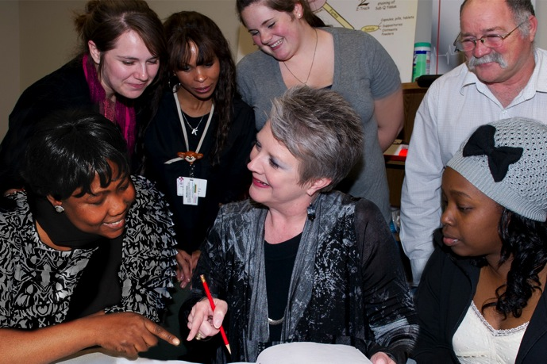
One of my favorite sayings is, "Life is all about how you handle Plan B." Counselors help students with Plan A, but I help my students so much more when we need a Plan B!
—Suann Hereford, Lone Star College–Kingwood (TX)

Slide 17
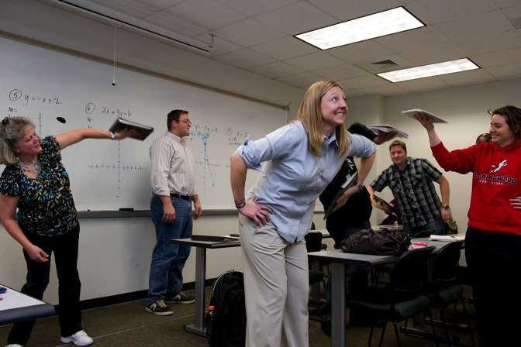
Math is simple:) Applying prior knowledge to new situations, students will use the persistence and problem-solving skills acquired from math courses in their life and future careers.
—Keturah Johnson, Lone Star College–Kingwood (TX)

Slide 18
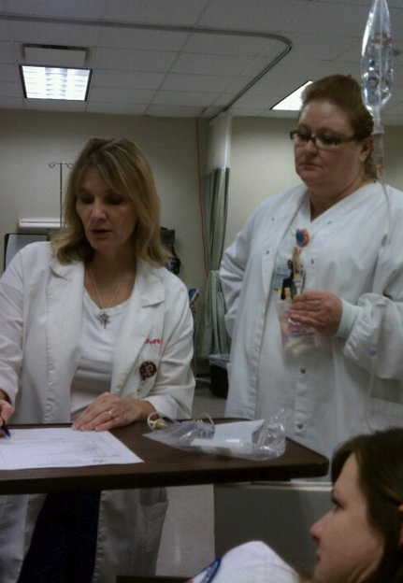
“You can’t stay in your corner of the forest waiting for others to come to you. You have to go to them sometimes” (Winnie the Pooh). I believe that is what teaching is all about; we are in this together, the students and I, to learn and enrich our lives.
—Renee Key, Lone Star College–Kingwood (TX)

Slide 19
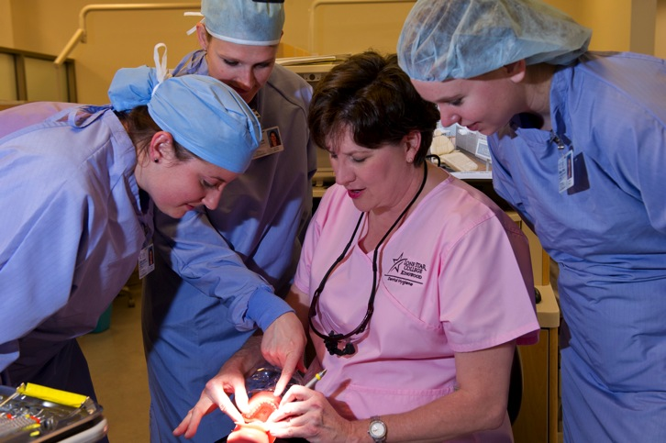
Changing lives. Isn’t that what it’s all about? Teaching is one of the greatest opportunities that I have to change someone’s life. Success, therefore, is taking someone where they are with what they have and molding them into what they want to be. What could be more motivating or satisfying?
—Maribeth Stitt, Lone Star College–Kingwood (TX)

Slide 20
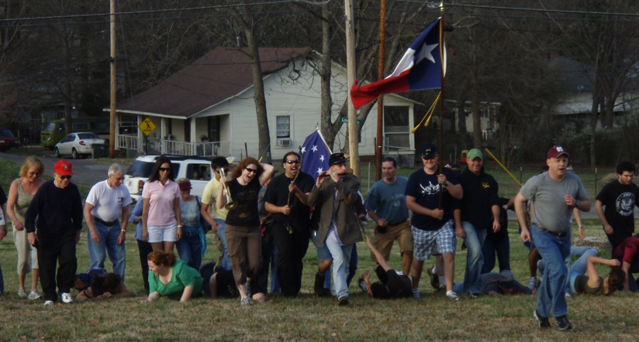
For me, teaching history is the art of narration. The spirits of the people who came before become the medium for the living. The spirits suffuse the living—me and the students, all at once and in the same way. History-telling activities in class are jointly experienced revelations.
—Craig Livingston, Lone Star College–Montgomery (TX)

Slide 21
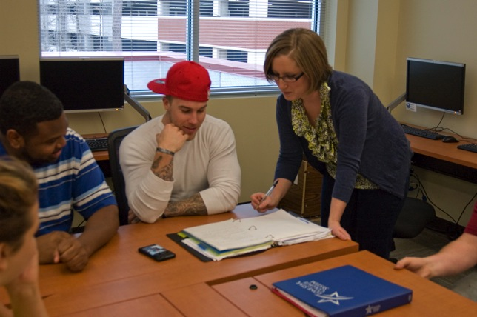
The diversity of the experiences of my students is what inspires me. I embrace the challenge of teaching a tremendous variety of individuals by appealing to their senses and emotions. I want to know what they enjoy and what gives them inspiration. Then I strive to serve as a constant reminder of why they chose to take the step towards a college education.
—Simone Rieck, Lone Star College–Montgomery (TX)

Slide 22
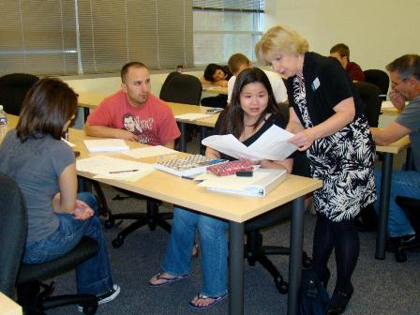
I believe students succeed in my class if they leave the course better off than when they began. They need to gain a deeper understanding of the accounting profession and business environment. I emphasize time management skills, critical thinking abilities, study habits, and soft skills needed in the workforce.
—Patricia Sendelbach, Lone Star College–Montgomery (TX)

Slide 23
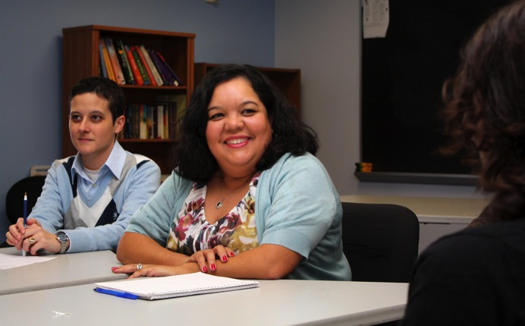
Everything I do is with the hope that in some small way I can repay the kindness of the amazing professors and mentors who taught me to love both my discipline and my profession. If I can change the way students look at their world, I consider myself and this effort successful.
—Janie Filoteo, Lone Star College–Tomball (TX)

Slide 24
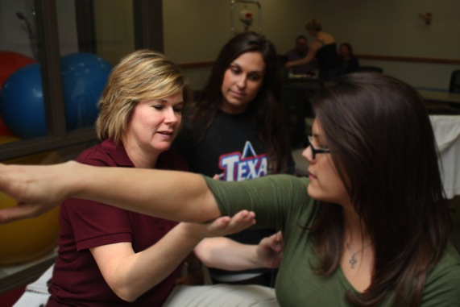
Having the opportunity to plant seeds and watch those seeds blossom within each student is inspiring. It is a pleasure to watch students mature and become contributing members of a profession—a profession that I love and about which I am passionate. Former students’ career-related successes further motivate me to strive for excellence.
—Stephanie Johnston, Lone Star College–Tomball (TX)

Slide 25
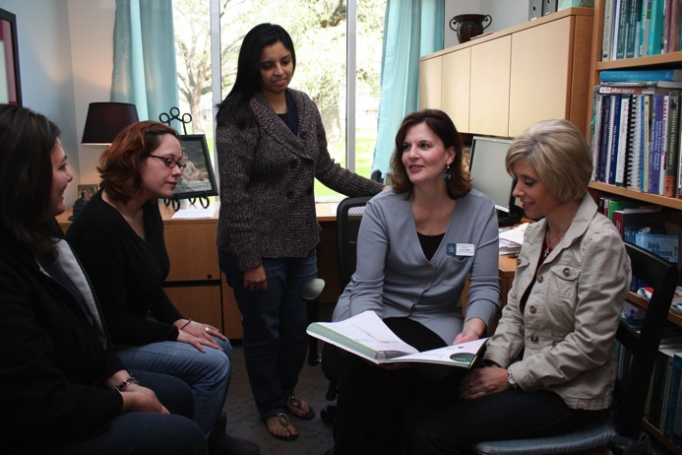
Having the opportunity to help students learn new information and make their own lives better from what they have learned motivates me to strive for excellence in the classroom. My goal is not only to teach students, but to inspire them toward learning for now and in the future.
—Terra Ruppert, Lone Star College–Tomball (TX)

Slide 26
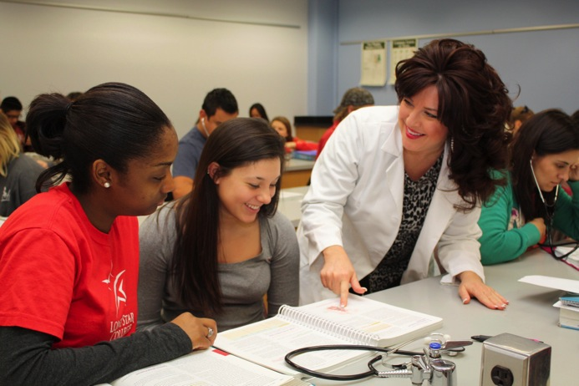
I believe that learning is not confined to the classroom but is the totality of intellectual and social experiences. I thoroughly enjoy creating opportunities for my students to explore and enjoy the world of science. The programs that I create build on my commitment to the natural and environmental sciences. By interacting with exhibits, conducting experiments, or handling live animals, students directly experience the world of science; and these experiences become both a base and a springboard for further scientific learning.
—Alanna Tynes, Lone Star College–Tomball (TX)

Slide 27
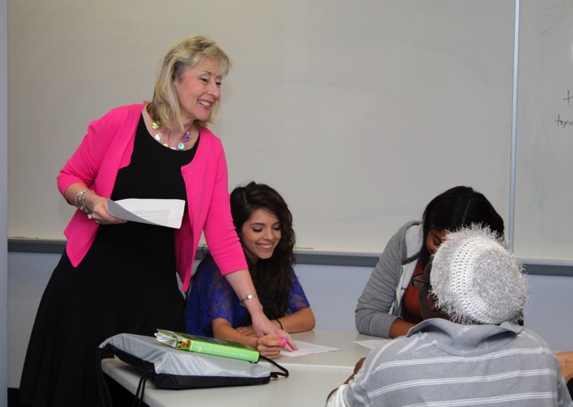
For me, “it’s all about students” is not a cliché, but it is what directs my efforts and keeps me inspired. Having the amazing privilege to influence students’ lives positively on a daily basis is one I do not take lightly. Staying focused on my students motivates me to give my best.
—Donna Willingham, Lone Star College–Tomball (TX)

Slide 28
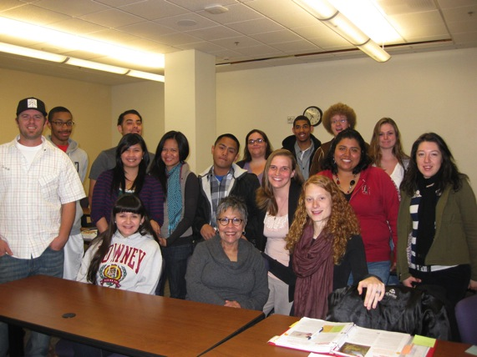
I have dedicated the last 21 years of my career to helping students achieve their greatest potential, and I find great joy in witnessing their transformation. Some of my former students are tenured professors at four-year universities, and some are now my colleagues. I am always inspired by my students.
—Phyllis Arias, Long Beach City College (CA)

Slide 29
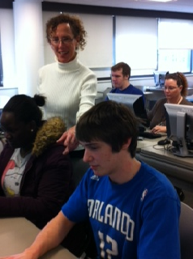
As a reference librarian, I am engaged with diverse students on a one-on-one basis and in a class environment during information literacy sessions. I am a facilitator—engaging students in the learning process while taking into account individual preferences, such as visual, aural, read/write, and kinesthetic ways of learning.
—Susan Paul, Lorain County Community College (OH)

Slide 30
If at the end of the day my students are a little more knowledgeable, a little more capable, and a little better off in their lives, then I know there is a reason for doing what I do.
—James Guiliano, Lord Fairfax Community College (VA)

Slide 31
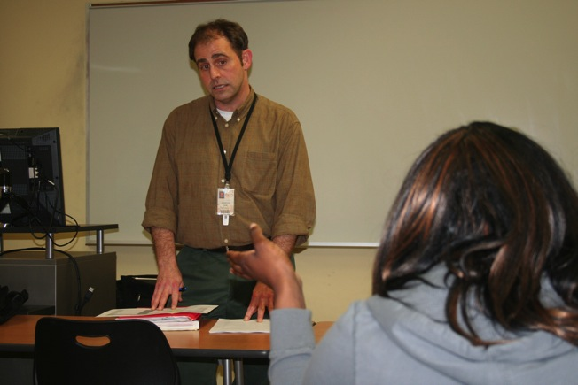
What inspires me most as a teacher are the relationships with people—students, colleagues, and others—that come about as a result of my teaching. I suppose there are many careers that involve meeting many people and making a difference in their lives, but few that seem quite as personal.
—Scott Higginbotham, Louisiana Delta Community College (LA)

Slide 32
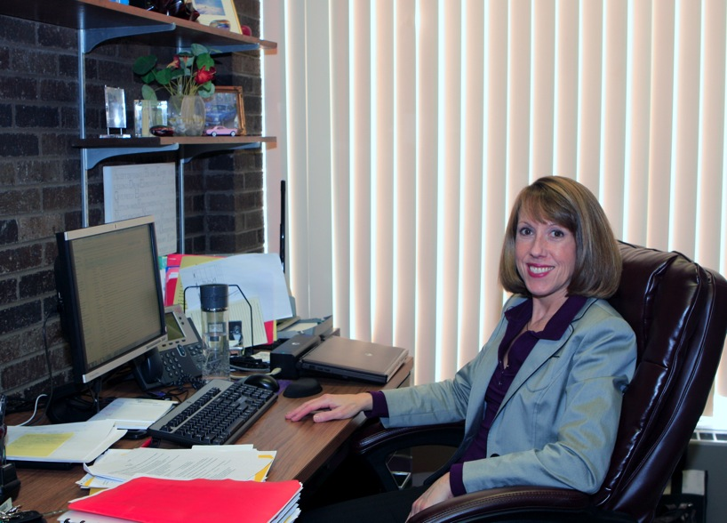
—Linda Bajdo, Macomb Community College (MI)

Slide 33
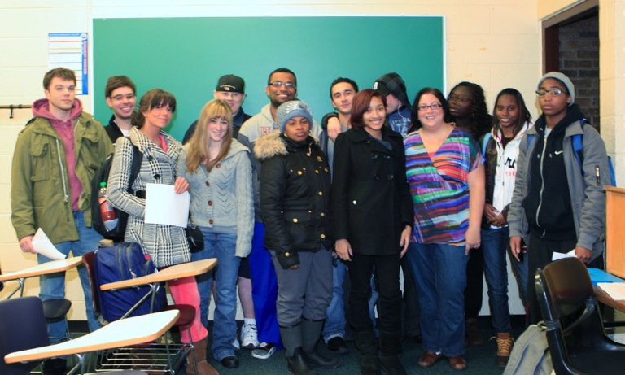
My students understand they are not nameless faces sitting at their desks, peering out at me. They are human beings with voices and minds; and while my role is instrumental in the further development of their writing skills, I also place tremendous importance on the evolution of their spirits.
—Nicole Castle-Kelly, Macomb Community College (MI)

Slide 34
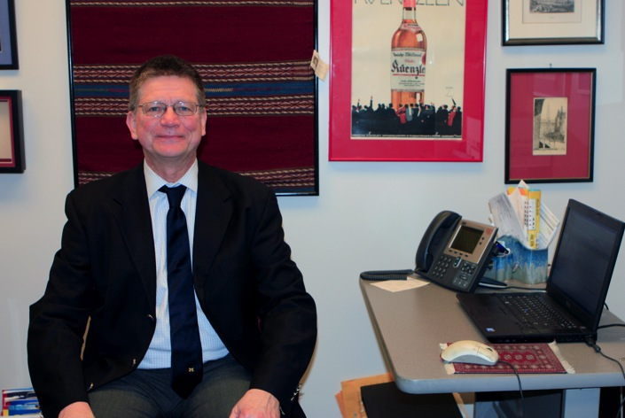
Individuals are made in the image of God. They are by definition good, intelligent, and capable of not just passing, but excelling. To this end, the educator explains how the subject relates to the individual's overall development and does so with respect and affection. By doing that, the educator helps the student learn more effectively.
—Gary Flemming, Macomb Community College (MI)

Slide 35
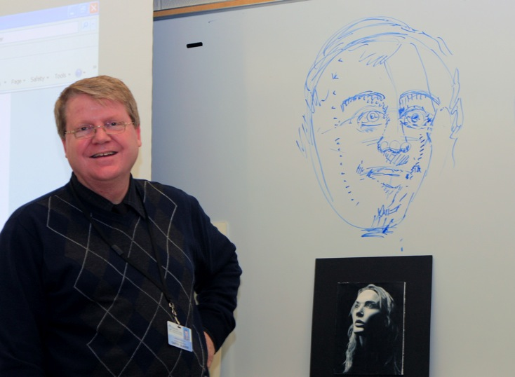
—Garth Glazier, Macomb Community College (MI)

Slide 36
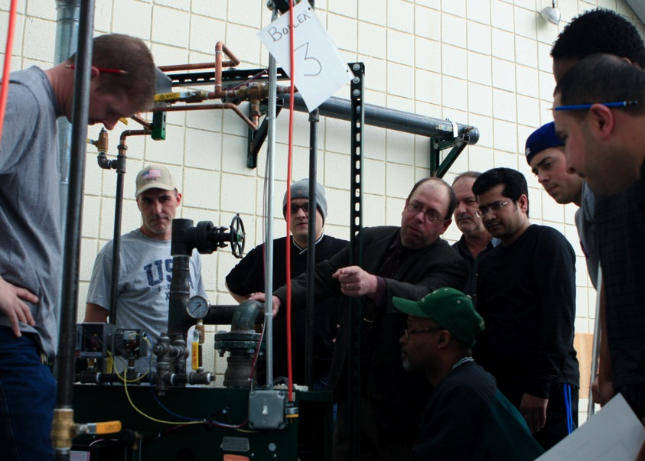
—Douglas Marlow, Macomb Community College (MI)

Slide 37
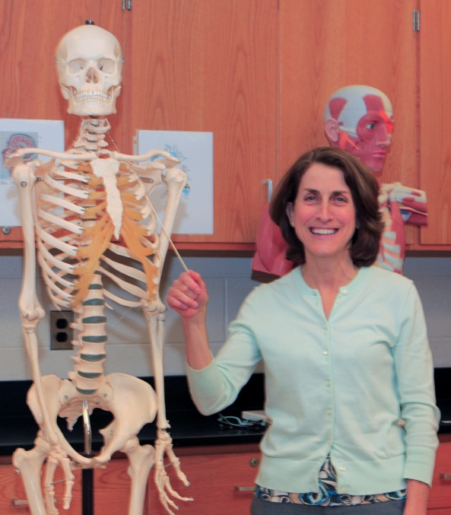
—Darlene Martin, Macomb Community College (MI)

Slide 38
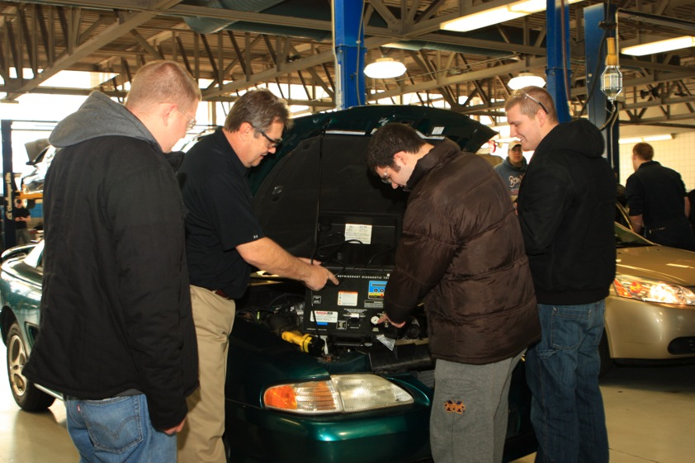
—Stan Urban, Macomb Community College (MI)

Slide 39
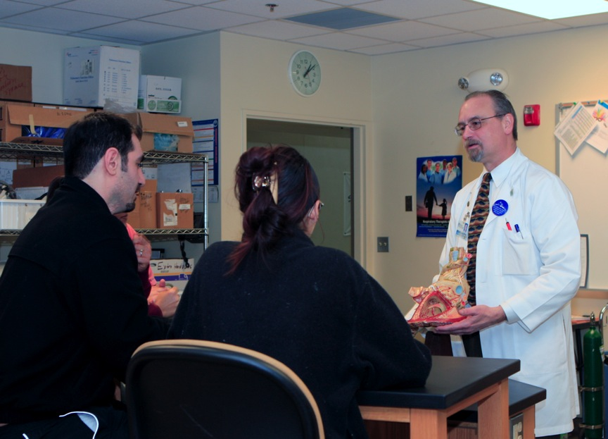
—Richard Zahodnic, Macomb Community College (MI)

Slide 40
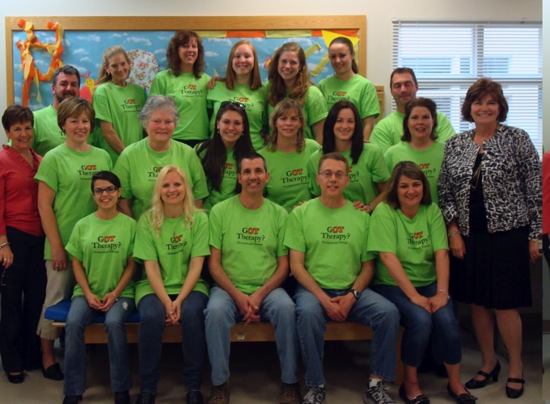
To have the opportunity to shape and inspire a new generation of occupational therapy practitioners is both an honor and a privilege. How many people are able to share their passion daily with other like-minded souls? I am blessed, encouraged, and challenged every day.
—Margaret "Maggie" Moriarty, Manchester Community College (CT)

Slide 41
Education is the most important gift one can give to another. Exposure to an environment that promotes learning leads to positive change.
—Donna Slone-Crumbie, Maysville Community and Technical College (KY)

Slide 42
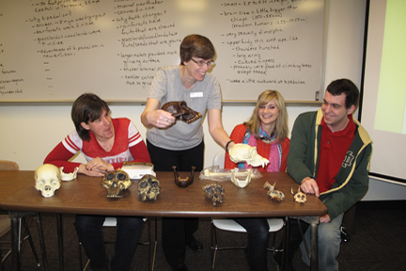
—Judi Cameron, McHenry County College (IL))

Slide 43
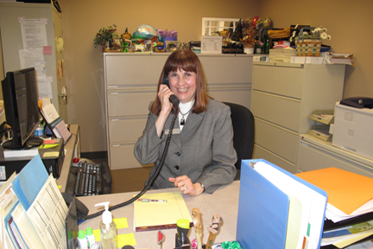
Assisting students with questions and concerns enables me to inform and shape their learning experiences in a positive manner. Bringing a sense of calm to an apprehensive student or removing obstacles from an instructor's path makes each day worthwhile. I take great pride and satisfaction in knowing that in part, I make a difference.
—Cheryl Galizia, McHenry County College (IL)

Slide 44
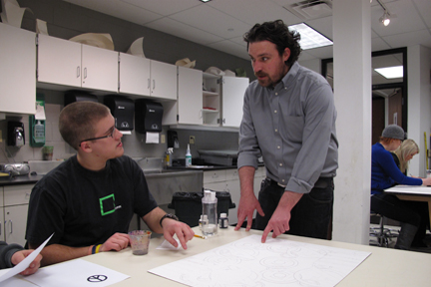
As an instructor of art, my goal is to develop the motivation, ambition, and responsibility needed for the growth and success of my students in their practice and in life.
—Matt Irie, McHenry County College (IL)

Slide 45
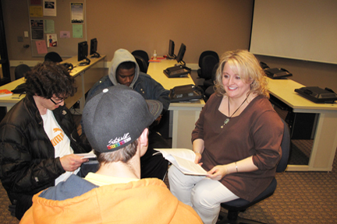
Education is not a one-way street in which knowledge flows directionally from teacher to students; rather, a sharing process should occur. If a day goes by in which I fail to learn something from my students, then I have not been doing my job in helping my students learn something from me.
—Cynthia Van Sickle, McHenry County College (IL)

Slide 46
I am truly blessed to do what I love to do for a living and to be able to better prepare my students for the business environment. Excellence Awards recipients demonstrate that we all truly make a difference in the lives of our students.
—Thomas Lowrance, McLennan Community College (TX)

Slide 47
Students are the greatest motivator. Their engaging, thought-provoking capacity for learning motivates me to be a better professor, role model, and communicator in and out of the classroom.
—Andria Ramon, McLennan Community College (TX)

Slide 48
Students are the beginning, the end, and the focus for everything that I do at McLennan Community College. Whether it is teaching students in my business classes, developing online courses that students will take, or creating support for online students, the students are the center of my attention.
—Staci Taylor, McLennan Community College (TX)

Slide 49
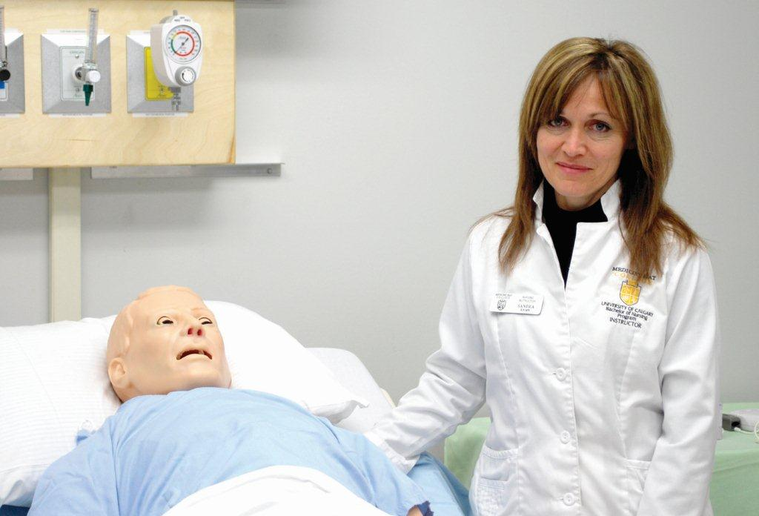
Nursing is mainly about the theory to practice connection, yet this can be a difficult transition for nursing students. As a teacher, I possess the power to create opportunities that allow this transition to happen. My greatest reward is observing that “connection” in the students.
—Sandra Fritz, Medicine Hat College (AB)

Slide 50
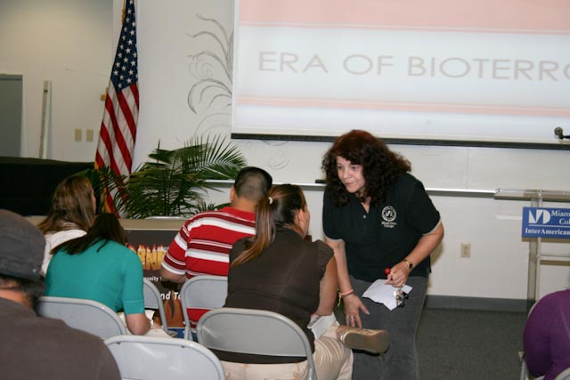
I believe in a student-centered environment with a pedagogical alchemy of knowledge about the material, creative opportunities to apply the knowledge, inspiration to inquire, motivation to continue, cheerleading for self-doubters, humor when confused, and positive reinforcement in goal achievement. The result of this mixture—a proactive, confident, and successful student.
—Miriam Frances Abety, Miami Dade College (FL)

Slide 51
Knowledge of mathematics is a passport to many career opportunities in different fields, but more importantly it is a student's passport to seeing the relevance of mathematics in their daily lives as global citizens. The mediocre teacher tells. The good teacher explains. The superior teacher demonstrates. The great teacher inspires.
—Lourdes España, Miami Dade College (FL)

Slide 52
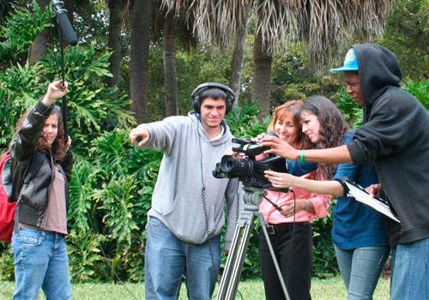
Students and teaching inspire me every day. I recognize that my students have different learning styles, abilities, and skills, and that they come from diverse ethnic, cultural, and socio-economic backgrounds. Keeping that in mind, I invariably explore educational avenues that provide students with an opportunity to learn, to change, and to grow.
—Ece Karayalcin, Miami Dade College (FL)

Slide 53
I challenge students’ perceptions of the world by bringing an upside-down globe to class and using cultural icons to explore society’s perception of women. Interacting with Genocide survivors connects them to history. My goal is to develop awareness and foster social responsibility through instruction, so they can make informed choices.
—Magdalena Lamarre, Miami Dade College (FL)

Slide 54
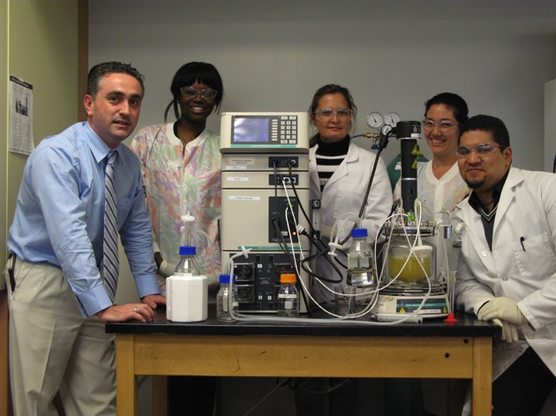
Influenced by the latest debates of our modern world, as educators there are challenges to be faced. We should not focus teaching just on delivering certain knowledge; we ought to be assured that our students will indeed utilize the learning outcomes to resolve real-life situations encountered throughout their lifetime.
—Juan Miguel Morata, Miami Dade College (FL)

Slide 55
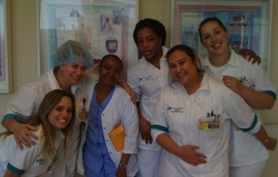
I am inspired and motivated by disadvantaged and abused women who despite the odds are successful in our rigorous nursing program. One student came to my office crying that her boyfriend, who was 30 years older, made her sleep on the floor every night because he could not bear to look at her. She expressed to me, “If I can just make it through this nursing program, I can change my life.” Well, I mentored her, and she graduated as a nurse and went on to complete her BSN. She changed her life!
—Lenora Yates, Miami Dade College (FL)

Slide 56
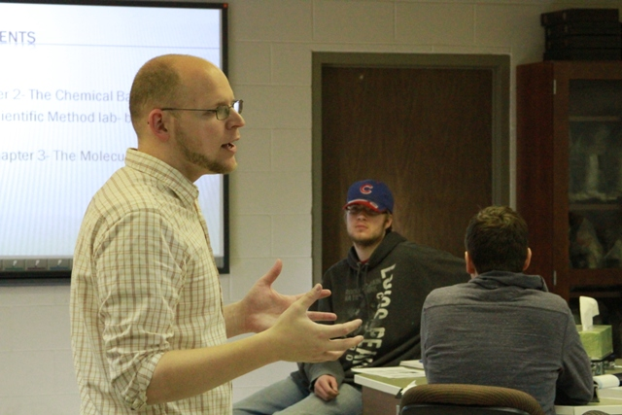
Everyday I get to share with students how biology applies to them. It explains how and why living things are the way they are. That’s what motivates me; seeing the light come on as they understand their world a little bit more! Teaching is my passion. I believe that as a teacher it is my responsibility to challenge students, guide them, and help them make connections.
—Robert Bogardus, Mid-Plains Community College (NE)

Slide 57
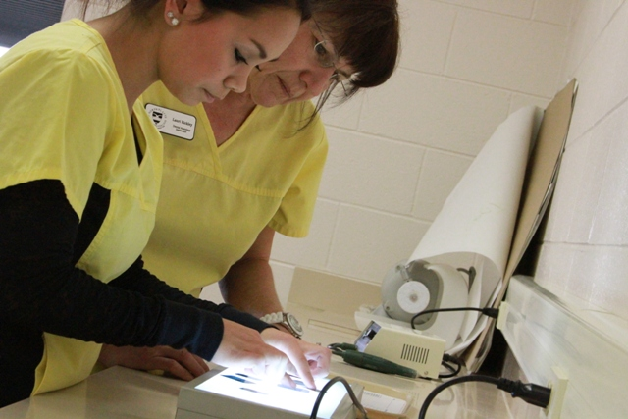
I am passionate about my field, and students feel it when they walk through the door on the first day of class. Together we create the learning environment; first in the classroom, then in the lab setting, and finally in the clinic. There are two philosophies I believe are crucial for success: 1) see one, do one, teach one; and 2) if you do not do, you will not be.
—Lauri Rickley, Mid-Plains Community College (NE)

Slide 58
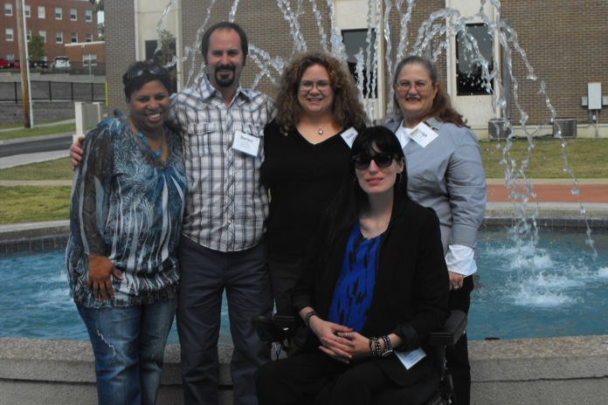
The most important skill I try to instill in my students is critical thinking. Who, what, when, and where are important, but it is the why that is most fascinating. What Iago does is important, but it is why he does it that engages the audience's mind.
—Michelle McMillen, Mid-South Community College (AR)

Slide 59
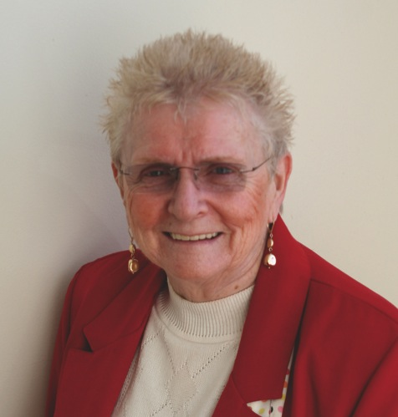
Children, and those who touch the lives of children, have always been my priority. My role as a teacher-educator is to guide my students in the understanding that the ideal educational experience for children is to have environments where all children, teachers, and families can benefit. Schools must become places where communities promote harmony and peaceful outcomes, where conflict resolution is practiced, and where power is distributed equally among all people.
—Nancy Tyler Higgins, Middlesex Community College (MA)

Slide 60
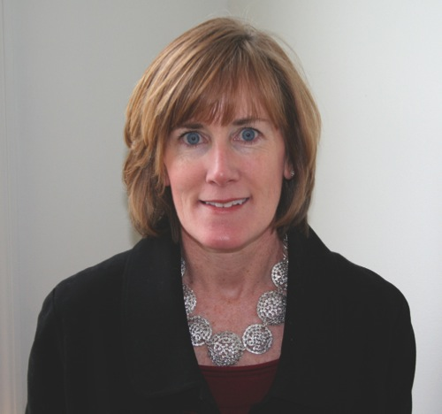
When I step into the classroom, I discover over and over again that I learn more from my students than they do from me. Their stories of struggle, their courage, and their honesty remind me that I have the best job in the world. After reading the story of Job from Hebrew Scriptures in a World Literature course, a group of students told me that we can’t know true happiness unless we have experienced loss; how’s that for wisdom and maturity? As long as I keep teaching, I will keep learning.
—Cathleen McCarron, Middlesex Community College (MA)

Slide 61
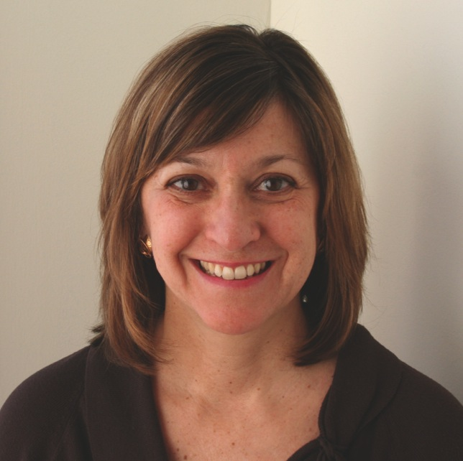
One of my favorite quotes about teaching is from Mark Van Doren: “The art of teaching is the art of assisting discovery.” This quote captures what inspires me in the classroom: Helping students to realize their own potential and thereby develop the desire to continue learning always.
—Donis Tatro, Middlesex Community College (MA)

Slide 62
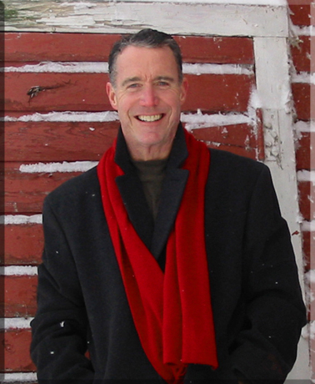
To be an effective teacher, I must attempt to perceive and evaluate my practice from the student's unique perspective. Learner empathy, I've come to realize, is about meeting and equipping the student at the base of the mountain rather than shouting instructions from its peak.
—Paul Carney, Minnesota State Community and Technical College (MN)

Slide 63
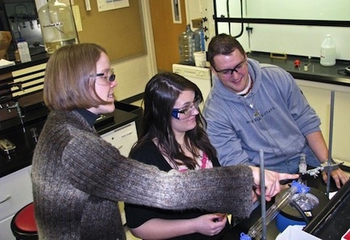
I always try to be a role model and a guide for student learning and discovery, but mostly I want my students to think. If you can get them to think about things when they're making breakfast or exercising, you've made an impact. Our world needs thinkers!
—Ramona Caswell, Minnesota State Community and Technical College (MN)

Slide 64
My students inspire me. I have the unique opportunity to get to know my students through their essays. I read about their trials, triumphs, and dreams, and I hope that in some small way I can enrich their lives as much as they enrich mine.
—Suzi Brown, Mississippi Gulf Coast Community College (MS)

Slide 65
—Adrienne Peek, Modesto Junior College (CA)

Slide 66
Engage with students. Speak with them. Ask them questions, and listen when they answer. Follow up and check in. Stay present. Remember that students are people, not products, and want to be treated as such. Don’t be so caught up in being a professor that you forget to be human, too.
—Amanda Colosimo, Monroe Community College (NY)

Slide 67
I am inspired by my students’ voices and their rich lives. Encouraging my students to find their voices and tell their stories is my greatest joy. Maya Angelou says, "There is no greater agony than bearing an untold story inside of you." By telling their stories, they become powerful.
—Tokeya Graham, Monroe Community College (NY)

Slide 68
—Christopher Riola, Moraine Valley Community College (IL)

Slide 69
It is my responsibility to provide my students with the skills they need to be successful in their educational goals and provide a framework and motivation for lifelong learning. I act as an informed classroom facilitator.
—Brian Gilligan, Morton College (IL)

Slide 70
An active writer, I model creative practice. Pursuing this craft, I share both my process and my writing, while providing a forum for students to create and present their own work. My major goal is helping students recognize and develop their unique voice, revealing the intrinsic value of their stories.
—Steven Parlato, Naugatuck Valley Community College (CT)

Slide 71
My philosophy for success in the classroom is very simple: Demonstrate a love for the subject matter. Put myself in the place of a student. Clearly communicate to the students what is expected. Follow the syllabus. Enforce the policies. Be fair. Be consistent. And, don’t ever forget to be human.
—Linda Jones, Neosho County Community College (KS)

Slide 72
I am a magician tasked with setting the stage for this experience called learning, not the rabbit. The rabbits are those I encourage to learn and excel. Each one is unique and encounters a different experience. My challenge is to help them find their strengths and how to use them.
—Karen Reid, New Mexico State University-Alamogordo (NM)

Slide 73
To me, understanding and appreciating a student's personal history, experiences, values, and sense of self (what some have called, "cultural capital"), and helping that student translate that cultural capital into reservoirs of personal strength instead of sources of shame, is the most important first step on the road to student empowerment. Often, what a student brings to the academic experience and what he/she believes to be a source of embarrassment, may, with transformational work, become a resource of pride, competence, and confidence in later endeavors. Pedagogically, this is the great second chance afforded by education—the universally desired "do-over" that tells us that it is never too late to grow and to change.
—Michael Curry, New River Community and Technical College (WV)

Slide 74
I'm a teacher and a trickster. George Carlin is my inspiration. Humor seems to keep people paying attention. I see my job as teaching critical thinking and as a guide to get my students through their courses. Seems to work for me and for my students.
—Roger Albert, North Island College (BC)

Slide 75
I am constantly inspired by my students. Students bring rich life experiences, cultural history, and enthusiasm for new ways of looking at the world and their chosen areas of study. Despite the stress of their complex and varied life situations, these adult learners are attentive and dedicated individuals.
—Laurie Bird, North Island College (BC)

Slide 76
What inspires me is the student’s courage. Many of my students have had very poor and sometimes traumatic experiences in their educational pasts, and to summon up the courage to try again is extremely admirable. It is now my privilege to help and encourage them to enjoy learning and finally succeed.
—Ken Jackson, North Island College (BC)

Slide 77
As an Aboriginal woman who has overcome numerous obstacles to obtain my academic dreams, I am motivated by the power of education to inform, empower, and ultimately heal. I am inspired by student persistence and honored to witness every “ah-ha” of self-discovery as students realize their own voice and potential.
—Laura Johnston, North Island College (BC)

Slide 78
My passion for teaching and learning is what motivates me. The students and colleagues I work with are my inspiration. I have learned humility, patience, empathy, integrity, and what a privilege it is to participate in a person’s learning journey. I believe learning and teaching are relational activities never done in isolation, and excellence is always shared.
—Betty Tate, North Island College (BC)

Slide 79
Students’ positive energy and enthusiasm remind me of the importance of being a mentor and role model. I am honored to play a role in their engagement and development.
—Virginia Jones, North Lake College (TX)

Slide 80
I prayed for a teacher to take an interest in my son and help him stay in high school, but it was easier for them to let him drop. Consequently, I will not give up on any student who is struggling. I can’t give money, but I have found a way to feed and clothe them by creating a campus thrift store, along with an open-door policy for listening.
—Kathleen Stockmier, North Lake College (TX)

Slide 81
The most exciting aspect of my work is to see the effects of my efforts pay off in a tangible way with students. It’s good to know that what I am doing makes a real difference in the quality of their research.
—John Koza, North Shore Community College (MA)

Slide 82
Watching my students value their life experiences and find joy in the challenging work they do in human services inspires me to strive for excellence. Receiving validation from my students, working collaboratively with others, spending time with my family, and dancing all renew my energy and keep me vibrant.
—Maggie LaBella, North Shore Community College (MA)

Slide 83
The people that I work with, animals that I care for, and now the students that I teach inspire me to do the best possible job I can. Seeing students of different ages, backgrounds, and ideals coming together to help one another is what makes the community college setting great.
—Sheila Magesky, North Shore Community College (MA)

Slide 84
As a professor of law courses in a career program, my teaching philosophy is to treat students the way I wanted to be treated when I was a student—with respect, fairness, and, where appropriate, flexibility—and to model learning strategies, study skills, organizational techniques, and professionalism.
—Judith Ciampi, Northern Essex Community College (MA)

Slide 85
In business and in life, one thing is constant: CHANGE. My vision aims to prepare students for it through technology, community outreach, and flexibility. I love watching students develop and work towards their academic goals, and ultimately toward the creation of small businesses. What a blessing teaching has been for me!
—Bernard (Bill) Zannini, Northern Essex Community College (MA)

Slide 86
I enjoy being a teacher. It is a privilege and honor when students remember that what they learned in class positively impacted their lives. It is exciting to learn from students the stories of their lives and realizing that I am learning from them.
—Laura Marshall, Northern Oklahoma College (OK)

Slide 87
The love of reading inspired me to teach others to read. Watching the very young to the very old pick up a book and start smiling always reminds me of B.F. Skinner’s observation, “We shouldn’t teach great books; we should teach a love of reading.”
—Cathy Moore, Northern Oklahoma College (OK)

Slide 88
Teaching is a complex partnership. The students challenge me creatively. In turn, I maintain high expectations and insist on critical and independent thought. The success of unconventional classroom activities—e.g., having students use their shoes to model chromosomes, or come dressed up to the final exam—inspire students and me.
—Gillian Backus, Northern Virginia Community College (VA)

Slide 89
I have a passion for the human body—both living and dead. I believe it is the most incredible machine there will ever be and consider myself lucky to be able to show students those wonders. As a veteran paramedic, I have been fortunate to deliver babies on living room floors and save lives of all ages. Most importantly, I send smart new paramedics out of my program every day, for which I am very proud.
—Holly Frost, Northern Virginia Community College (VA)

Slide 90
On a pathway to be a research scientist, I detoured into my first community college classroom. I encountered the students’ intense motivation, and I never walked out. I proudly, and hopefully innovatively, continue this educational mission. Now I work with our CETL, alongside faculty who are equally proud of this mission.
—Cindy Miller, Northern Virginia Community College (VA)

Slide 91
I believe my role as librarian is to help students understand that research is a process of discovery one uses to learn, not a series of steps used to find pieces of information. Their product, therefore, is a demonstration of what they learn, not what they find. Creating students who become aware of their own learning is my goal.
—Kevin Simons, Northern Virginia Community College (VA)

Slide 92
There are two kinds of teachers: those with knowledge and those who know where to find and evaluate information. As the second kind, my job is to see that those skills are transferred to our students. Information constantly changes; the ability to locate the best answers will last a lifetime.
—Ruth Stanton, Northern Virginia Community College (VA)

Slide 93
My students tell me that by working in an intergenerational class they learn firsthand how “purposeful play” is a deterrent to disease and chronic illness. While getting the benefit of “play,” my seniors enjoy being with younger people and are stimulated by their youth and vitality. Both groups develop a mutual respect and appreciation of each other’s perspectives. This shared experience has a lasting effect, inspiring me to continue with renewed enthusiasm and passion.
—Susan Thompson, Northern Virginia Community College (VA)

Slide 94
—Josh Michelena, Northern Wyoming Community College District (WY)

Slide 95
My passion to teach is the feeling of driving to school, not as driving to my job, but rather as driving to another opportunity to have an adventure in the classroom. When I send my students off around campus to collect data for a classroom assignment, they have a sense of belonging. This is where learning begins!
—Eddie Bishop, Northwest Vista College (TX)

Slide 96
My job is to teach the math material and get all my students ready to achieve their dream: GRADUATE with a degree. That is their dream! That is my goal! I never want them to settle for the lowest degree. You must go higher! Shoot for the stars!
—Javier Guerra, Northwest Vista College (TX)

Slide 97
It been said that when you are in your purpose, there is no competition. Therefore, as a selected winner speaking to future winners, if you are in your purpose, you and students win. There are only a few of us selected to celebrate the excellent teaching heart of many.
—Jesse Harbert, Northwest Vista College (TX)

Slide 98
I am fortunate to teach in the classroom, the clinical setting, and in the simulation lab. It is inspiring and rewarding to watch students learn and grow. I love what I do, and I strive to improve, based on student input, current evidence, and the sharing of creative ideas.
—Kathryn Fischer, Northwestern Michigan College (MI)

Slide 99
I'm motivated by how hard students work while facing other struggles: finding rides when the gas budget runs out, seeking community services, dealing with the hardships of day-to-day living, and then making time for learning—all because they understand the value of a college education. Isn't that truly inspiring?
—Dianne Owens, Northwestern Michigan College (MI)

Slide 100
—Peter Daupern and Lauren Perlstein
Norwalk Community College (CT)

