Slide 1
What inspires me is knowing that education is the key to a successful future. At each graduation ceremony, I see the joy of students and their family and friends. This confirms that the education of one person can change many lives. One small step can make a great impact.
—Erica Holmes, Halifax Community College (NC)

Slide 2
It is great serving as a mentor and helping others achieve their goals. This often involves stressing and exemplifying the importance of high standards, and stepping back, taking a secondary role, so that worthy others can have their time in the spotlight.
—Vera Palmer, Halifax Community College (NC)

Slide 3
Winston Churchill said: “Success is not final; failure is not fatal; it is the courage to continue that counts.” I share this statement with my students every semester. It is the mentality with which I teach, and I hope to instill this value in my students. The most complete learning almost always comes from an unsuccessful first attempt.
—James Baker, Harford Community College (MD)

Slide 4
I am driven to provide my students with information to assist them in their education and in achieving their goals.
—Joseph Cunningham, Harford Community College (MD)

Slide 5
George Eliot said, "What do we live for if not to make life less difficult for each other?" That is what good teachers do. They give their students the tools, the knowledge, and the strategies to make life less difficult, more rewarding.
—William Ekey, Harford Community College (MD)

Slide 6
When my students talk about their plans for the future, they remind me why I wanted to become a teacher. When I face my students, I can never forget that the smallest of actions can have remarkable consequences.
—Laura Hutton, Harford Community College (MD)

Slide 7
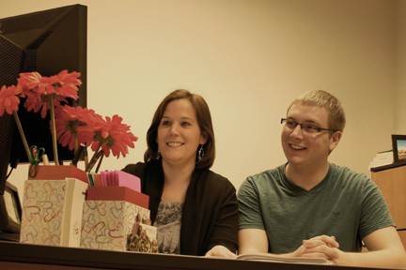
Many students enter counseling hoping they will be told what to do. However, the process involves empowering students to realize they have the capacity to create their own destiny. My hope is to instill a sense of confidence that further adds to the student’s determination to achieve their educational goals.
—Shelly Blanchette, Harrisburg Area Community College (PA)

Slide 8
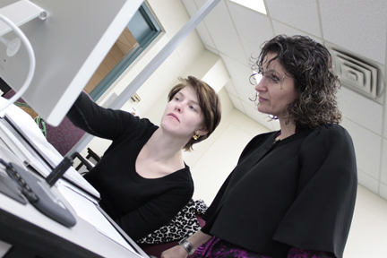
My greatest reward is watching students grow in confidence while acquiring skills and enthusiasm in learning. The fruit of my classroom is the exchange of ideas since learning is always a mutual experience for all.
—Marjaneh Talebi, Harrisburg Area Community College (PA)

Slide 9
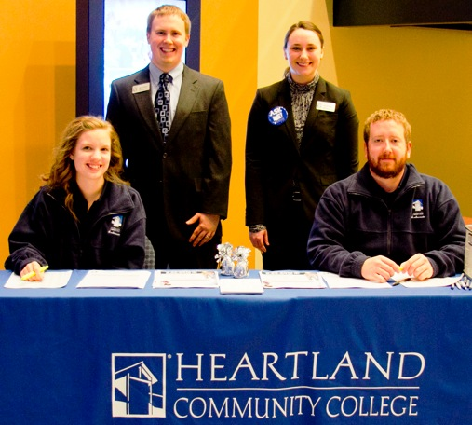
Carl Rogers stated that every organism moves towards “constructive fulfillment of its inherent possibilities.” Students come to college with a great deal of history. My goal is to help them succeed in their future, as best I can, in spite of my perceptions about their history.
—Jeffrey Graham, Heartland Community College (IL)

Slide 10
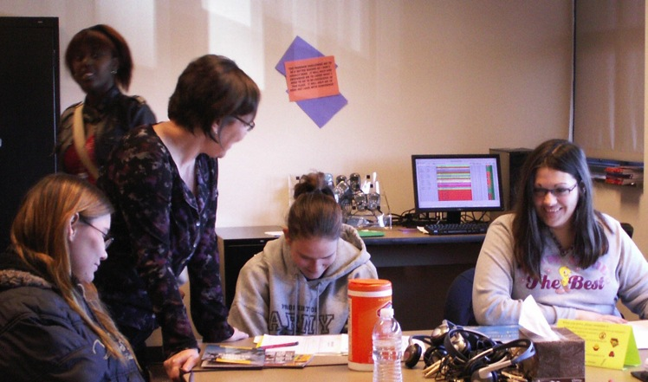
Guiding students in opening doors to the outside world and windows to the world within is the educator’s work. This is what called me to the classroom. What keeps me coming back is the excitement of my developmental reading students when they realize that the door and the window exist.
—Lisa Putnam Cole, Heartland Community College (IL)

Slide 11
I try to be an active college community member, which is what all college employees should do. Above all, my passion is for student success and engagement. Students are the reason we are, they are our customers, and they should be our first priority.
—Scott Taylor, Henderson Community College (KY)

Slide 12
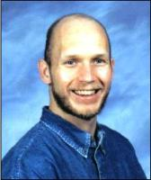
My goal in teaching humanities, both religion and ethics, is to instill a “love for learning” in students from diverse socio-economic, religious, and national backgrounds. Through careful attention to textual interpretation of Classical Great Books, and through a pedagogical emphasis upon improving writing, students are empowered for greater educational success.
—Robert King, Hillsborough Community College (FL)

Slide 13
Undergraduate biology education currently includes mass memorization of terminology. It is critical that we design our class presentations to stimulate conceptual comprehension and integration of principles. Students must be able not only to see the truth provided by the terminology and data, but also the beauty.
—Susan Miletta, Hillsborough Community College (FL)

Slide 14
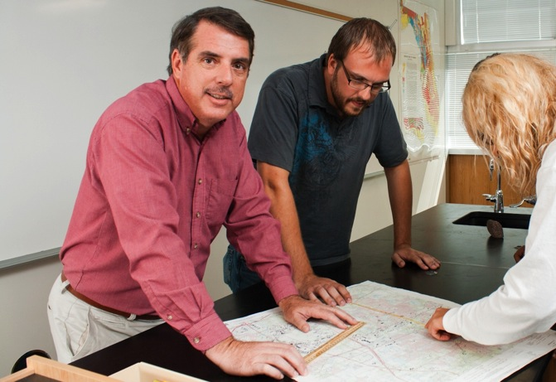
Working with just a tiny spark of curiosity, you can kindle the fire of enlightenment. Intrigue and captivate students with things that interest them, and you will start them down the path to understanding. When they start asking questions instead of wanting to be given the answers, you have succeeded.
—James Wysong, Jr, Hillsborough Community College (FL)

Slide 15
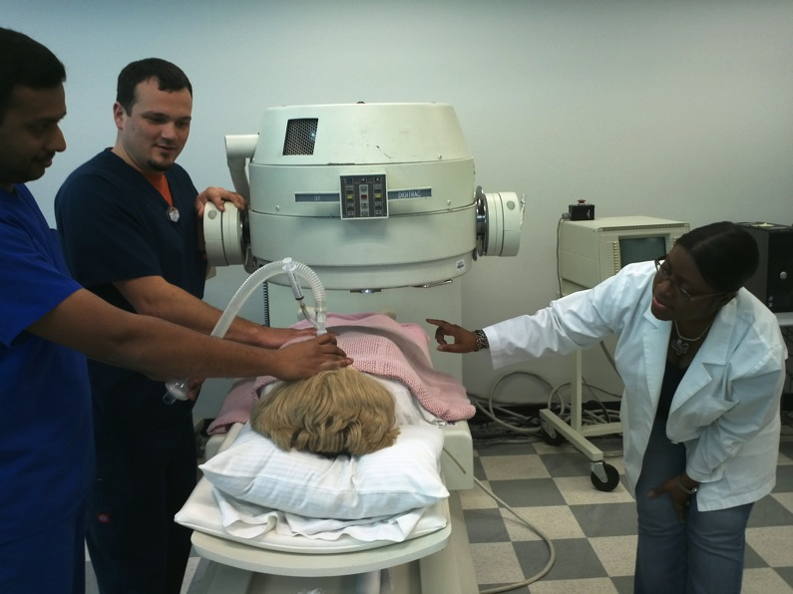
—Vikki Davis-Littleton, Houston Community College (TX)

Slide 16
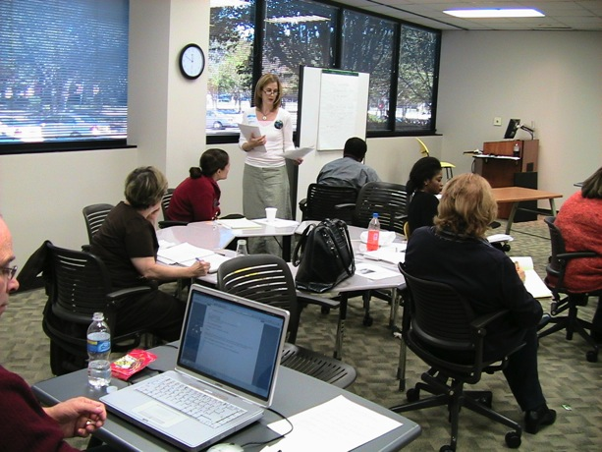
Marian Wright Edelman rightly observes, “You can’t be what you can’t see.” Therefore, I attempt to model the teaching/learning process in the classroom and the behavior of a lifelong learner outside it. The best moment occurs when students appreciate the connection between literacy and power. Then, their options and opportunities unfold.
—Melissa Miller-Waters, Houston Community College (TX)

Slide 17
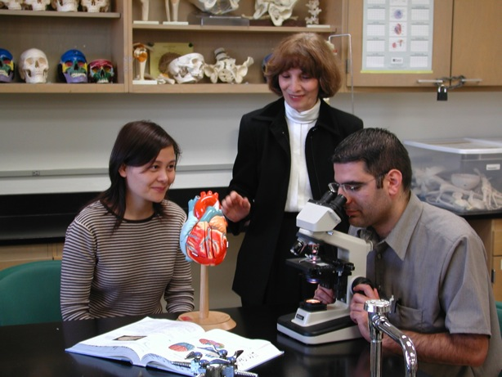
I am inspired when I see the look of accomplishment and satisfaction that comes over a student's face when he or she has mastered a concept. Knowing that a student will be able to continue on and be successful is what motivates me to continue being an educator.
—Mahtash Moussavi, Houston Community College (TX)

Slide 18
“No one rises to low expectations.” This quote is my inspiration to strive for excellence. My tools are creativity, innovation, respect, and rapport. My challenge is to inspire the quest for knowledge rather than acquiring points on a given scale.
—Sher'ri Turner, Illinois Central College (IL)

Slide 19
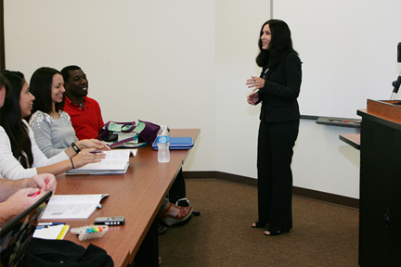
—Gale Cohen, Indian River State College (FL)

Slide 20
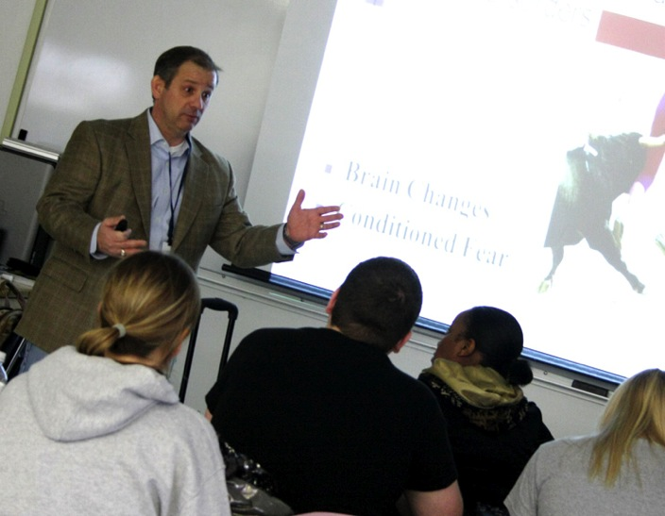
“You can't lead where you won’t go. You can't teach what you don't know. You can't be what you are not, and you can't give what you ain’t got.” —Old Army First Sergeant
—Shawn Haake, Iowa Central Community College (IA)

Slide 21
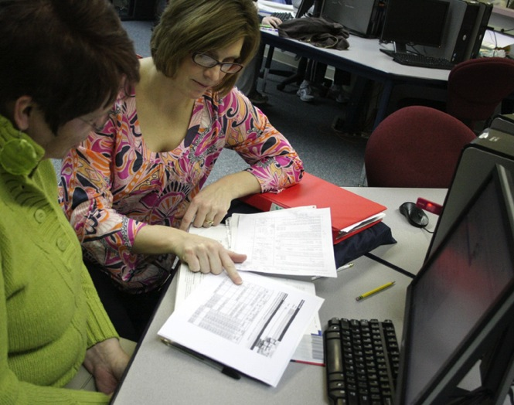
The show "The Biggest Loser" is currently my inspiration. As a teacher, I feel it is my responsibility to identify the teaching method that works for each student and challenge each mentally beyond their own awareness of their full potential.
—Stacy Johnson, Iowa Central Community College (IA)

Slide 22
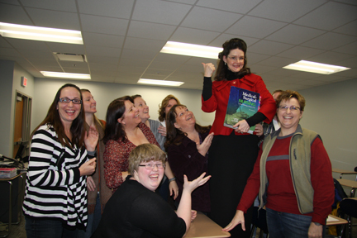
Student complexities prompt us to embrace evolving teaching methods, to reach out saying, "I want you to learn and learn it well.” We can then say we have successfully altered their course in life—offering role models about the power of motivational learning.
—Mary Buckley, Iowa Western Community College (IA)

Slide 23
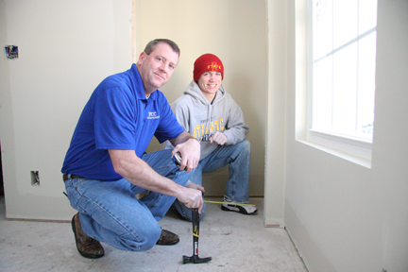
We must provide a learning environment that stimulates the minds and develops the skills of our audience. I envision that inspiration encourages curiosity, curiosity motivates thinking, thinking initiates movement, movement leads to conclusion, and conclusion enhances inspiration. This is a learning environment that promotes growth!
—David Hazlewood, Iowa Western Community College (IA)

Slide 24
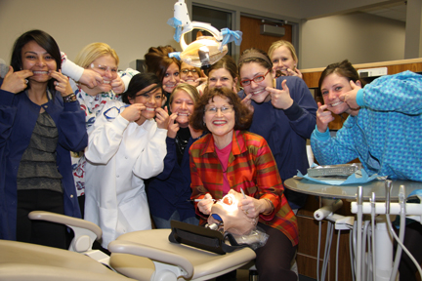
My desire to teach is kept burning through witnessing the light bulb turning on as students master skills and concepts. This moment of magic in teaching drives me to continue to give my best.
—Dorothy Polan, Iowa Western Community College (IA)

Slide 25
One of my students summed it up best—"Education changes lives...let it change yours." The opportunity to be involved with enhancing and forever improving the lives of our learners is powerful. It is my privilege to assist students in their educational journey!
—Ann Pross, Iowa Western Community College (IA)

Slide 26
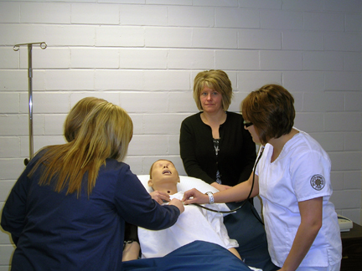
First you must connect with your students. Mentor them to be successful and professional leaders in the nursing profession. The overall goal is that someday the student can provide adequate care to my family member.
—Stacy Pulliam, Iowa Western Community College (IA)

Slide 27
My teaching philosophy is to offer my students an interactive learning experience, encourage them to learn to analyze theoretical information and apply gained knowledge in practice, and to infuse communication, leadership, and citizenship development skills into instruction.
—Eric Weuve, Iowa Western Community College (IA)

Slide 28
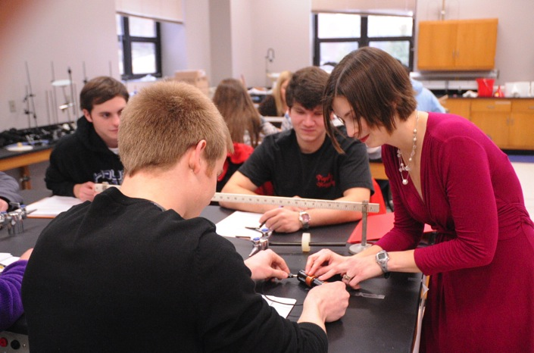
I strive to teach students to always push the boundaries of their understanding, think logically, and defend their conclusions. I love to see students who are initially very frightened and unsure develop confidence and pride in their ability to master a difficult subject and take on the next challenge in life.
—Betsy Chesnutt, Itawamba Community College (MS)

Slide 29
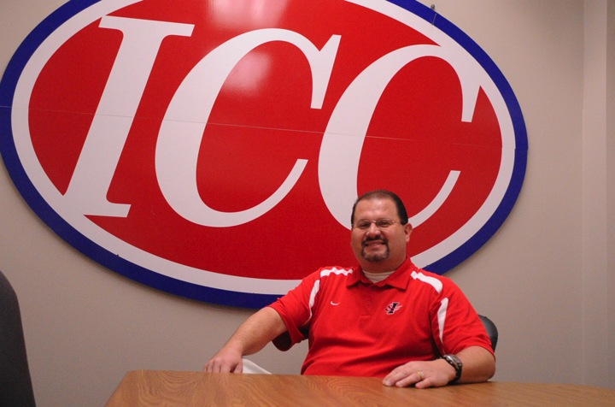
My inspiration comes from a strong desire to make a difference in society and the lives of others. I strive to help students become independent learners and encourage them to work hard to achieve their fullest potential. As educators, we can ignite their interest by guiding them in the beginning, but it is ultimately up to them to endeavor to achieve even greater things beyond the classroom.
—Jimmy Humphries, Itawamba Community College (MS)

Slide 30
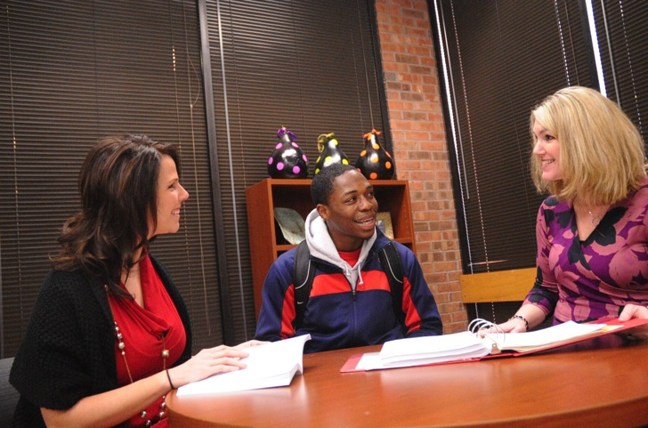
As Director of Advising, I have the opportunity daily to draw from education and life experiences to connect with students individually. My mission is to instill confidence in their hearts so that they can graduate with a degree, embrace life, and excel.
—Mande Miller, Itawamba Community College (MS)

Slide 31
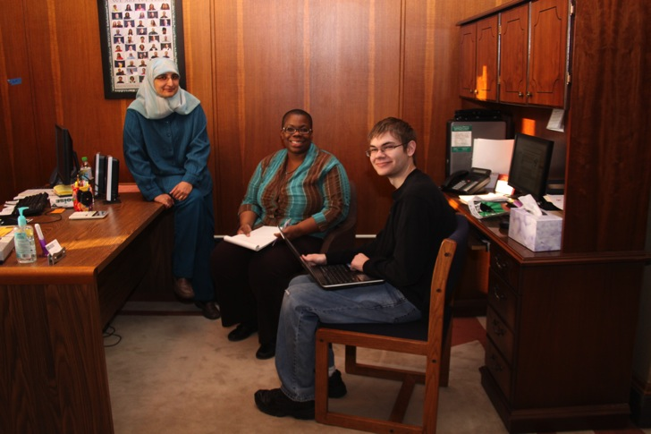
Working for and helping students is the most rewarding work experience I have ever had! Our students inspire me with their passion and persistence to want to improve their lives through education. Their drive, despite all of the challenges they face, is encouraging and admirable. Serving our students is an honor and a privilege for which I am most grateful.
—Anila Din, Ivy Tech Community College–Central Indiana (IN)

Slide 32
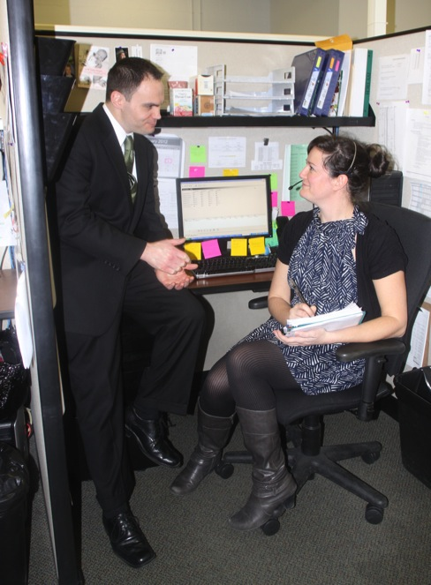
What motivates me is the ability to connect students with accurate information and support that are vital to their educational career path. The key component to student retention is providing a positive customer service experience. Through support and outreach, we break down barriers that impede student success.
—Matthew Diuro, Ivy Tech Community College–Central Indiana (IN)

Slide 33
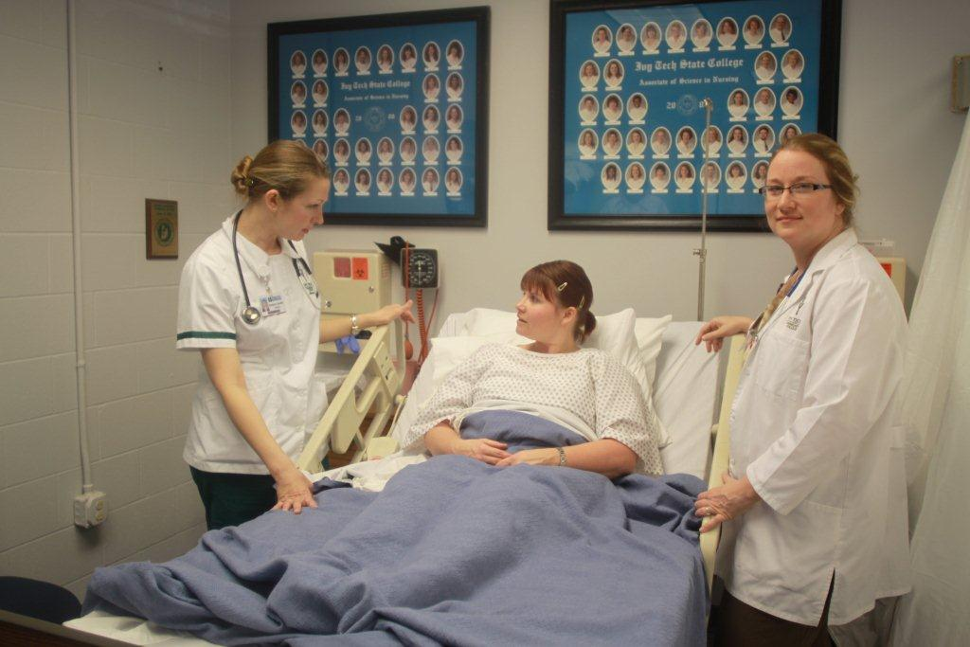
I strive to create an atmosphere of transparency, relevance, and engagement to help students identify what they need to know before they walk into a room to care for a patient, guiding student to a point where they can recognize suffering independently and make a difference.
—Lorie Hacker, Ivy Tech Community College–Central Indiana (IN)

Slide 34
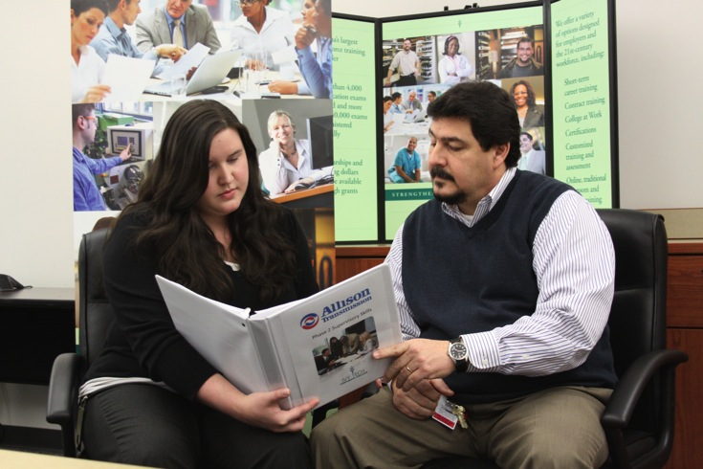
Creating an environment of student success always starts with creating realistic expectations, and then exceeding them at every turn.
—Ashley Nottingham, Ivy Tech Community College–Central Indiana (IN)

Slide 35
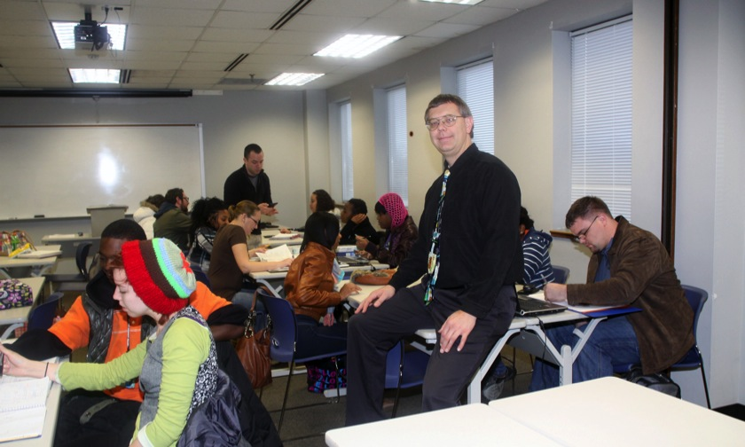
At the heart of education is the process of learning how to learn. At the heart of learning how to learn is the questioning process. Ultimately, it is questioning that propels the educational process forward. We must teach and encourage our students to ask pertinent questions!
—Donald Vondrak, Ivy Tech Community College–Central Indiana (IN)

Slide 36
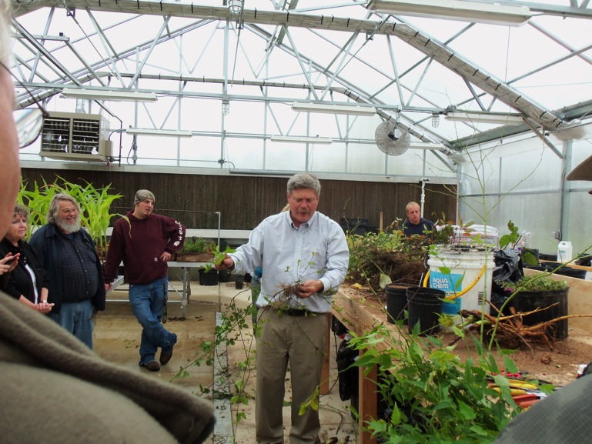
—John Rosene, Ivy Tech Community College–Wabash Valley Region (IN)

Slide 37
It is never late to learn. It is rewarding and motivating to be able to teach and see the difference education make in my students’ lives. I see the smiles on their faces when they understand the materials and reach their goals.
—Christina Marsh, Jefferson Community and Technical College (KY)

Slide 38
Learning should not be contained by four walls. When we were children, we learned by everything we did. Education by participation—whether a field trip, industry trade show, or simply sitting in the classroom—surrounds us, and my job is to motivate and connect.
—Daniel Hoerz, Johnson County Community College (KS)

Slide 39
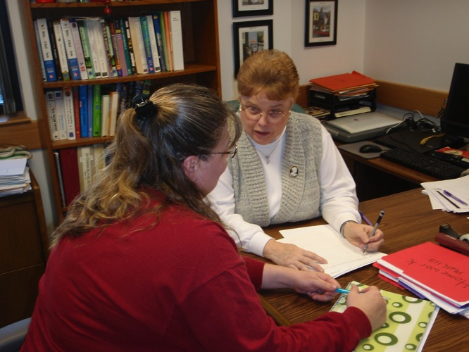
My teaching experience, by choice, has always been developmental mathematics. Helping students overcome their negative attitude towards math is crucial to their success. I use humor and technology to enhance their experience. I feel my enthusiasm helps turn my students on to mathematics.
—Susan Pettyjohn, Johnson County Community College (KS)

Slide 40
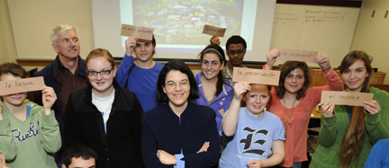
My goals are to encourage communication (beyond the present) and to appreciate the diversity of the Spanish-speaking world. I am always creating new projects consistent with objectives of the course to provide real-world applications. Can you say "sustainability" in español?
—Irene Schmidt, Johnson County Community College (KS)

Slide 41
I cannot be an effective instructor if I am not willing to be a student. I must look for opportunities to expand and enhance my knowledge in order to impart new and fresh ideas. Continuing to be a student will help me keep a balanced perspective as a teacher.
—Robert Beach, Kansas City Kansas Community College (KS)

Slide 42
Instructors really love having students who are eager and willing to absorb all the information that they want to give them, but the real challenge for instructors is the student that has various barriers to overcome. It is a great feeling to be able to help knock down a couple of those barriers and see improvements. Those are the students that we should be grateful for. They make us learn!
—Joe Mundt, Kansas City Kansas Community College (KS)

Slide 43
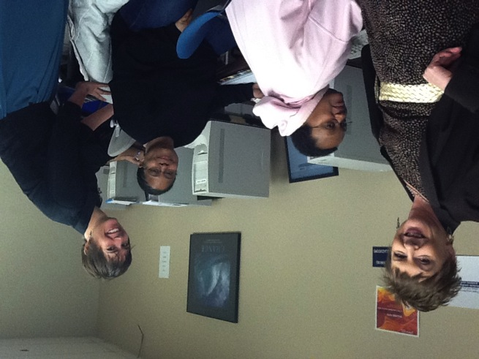
One of the most important concepts I can teach my student is how to determine the issue of a problem or situation. Once you understand the key question, the answer is within reach.
—Janet Velazquez, Kansas City Kansas Community College (KS)

Slide 44
My goal as an administrative assistant is to establish processes that keep work flowing smoothly and with consistency. This makes things much easier for the "next person," whether it's the next person in the workflow process, an immediate co-worker or supervisor, or the person who will be taking my job once I leave. It's also very important to be open-minded, approachable, and helpful to anyone (student, faculty, or staff) who approaches you with a request or question.
—Paula Warren, Kansas City Kansas Community College (KS)

Slide 45
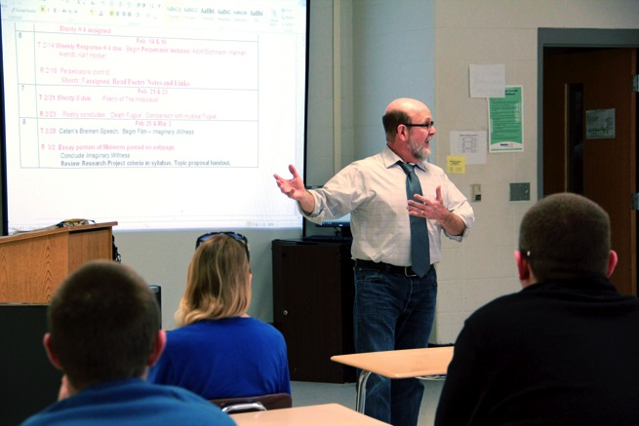
First and foremost, the best teachers are perpetual students. Follow your academic bliss, and pursue your intellectual curiosity down whatever unexpected pathways it discovers. Then, just try to keep the joy of learning from inspiring your students. I dare you!
—Gerald Adair, Kentucky Community and Technical College System (KY)

Slide 46
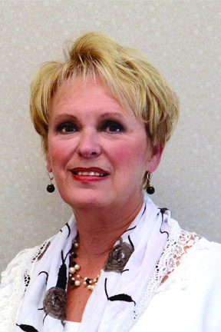
—Beverly Atwood, Kentucky Community and Technical College System (KY)

Slide 47
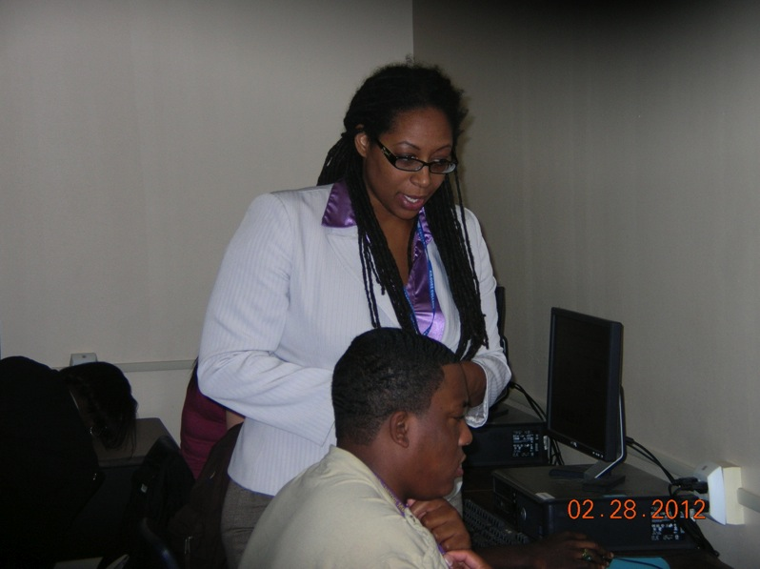
—Latasha Goodwyn, Kilgore College (TX)

Slide 48
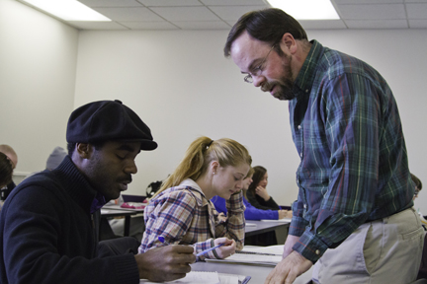
My goal as a teacher is to give students tools that they can use in their lives beyond my classroom. The facts and figures that they may learn in my classes are less important than having critical thinking skills that will help them navigate the complex world they will face.
—John Dawson, Kirkwood Community College (IA)

Slide 49
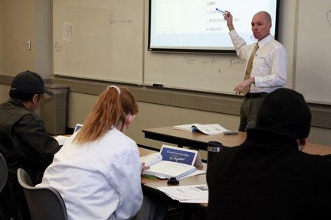
Students enter into a program of study with goals and aspirations that can easily become lost amid the distractions of life and its busy schedules. My mission is to help students retain clear sight of those aspirations: I seek to inspire, motivate, encourage, and lead by positive example.
—David Horsfield, Kirkwood Community College (IA)

Slide 50
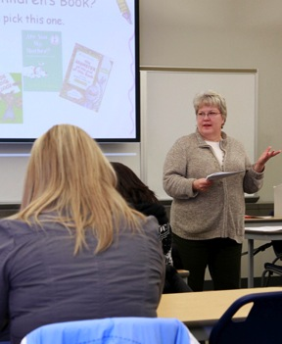
Preparation and strong relationships are essential ingredients for effective teaching. Daily, I am prepared to share my knowledge, expertise, and experiences. I also value student knowledge and experiences. I wonder what they will teach me today! My goal is to create an environment in which we all learn together.
—Melanie Nollsch, Kirkwood Community College (IA)

Slide 51
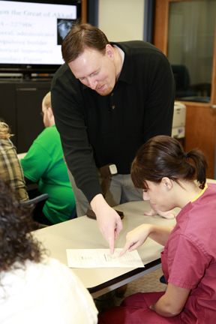
My job as a teacher is eventually to make myself irrelevant by giving my students everything they need—transmitting content, developing deeper-level thinking skills, and encouraging engagement and creativity, so they can become successful on their own as they learn and understand history throughout the rest of their lives.
—Jed Peterson, Kirkwood Community College (IA)

Slide 52
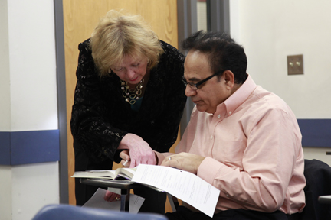
—Susan Skoglund, Kirkwood Community College (IA)

