Slide 1
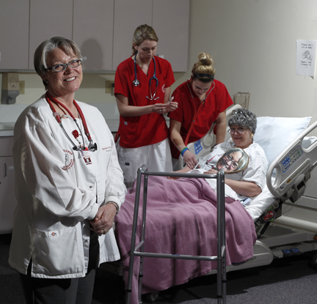
—Heather Huber, Casper College (WY)

Slide 2
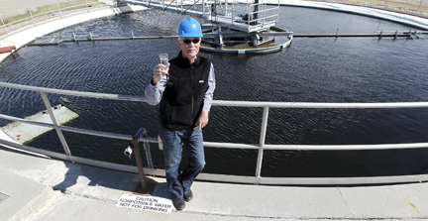
—Bill Mixer, Casper College (WY)

Slide 3
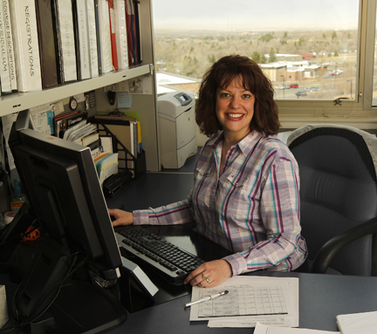
—Linda Nichols, Casper College (WY)

Slide 4
—Kristen Robinson, Casper College (WY)

Slide 5
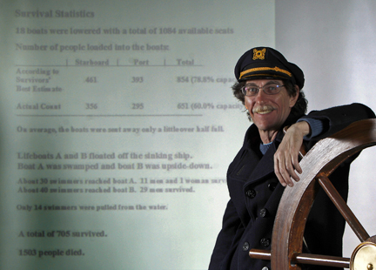
—Raymond Steinbacher, Casper College (WY)

Slide 6
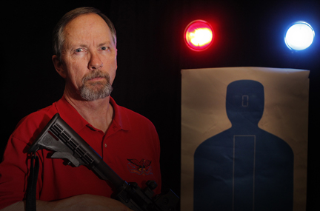
—Art Washut, Casper College (WY)

Slide 7
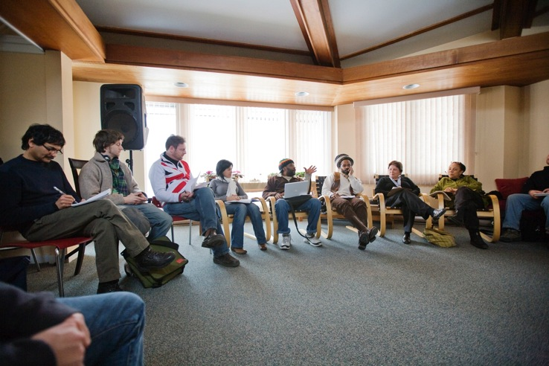
My students’ lives and experiences are important texts; their engagement, enthusiasm, and passion enrich the classroom environment. Encouraging students to be peer teachers and teachers of their teacher provides an opportunity to critique society’s cultural artifacts as well as the theories produced within their disciplines.
—Chet Singh, Centennial College (ON)

Slide 8
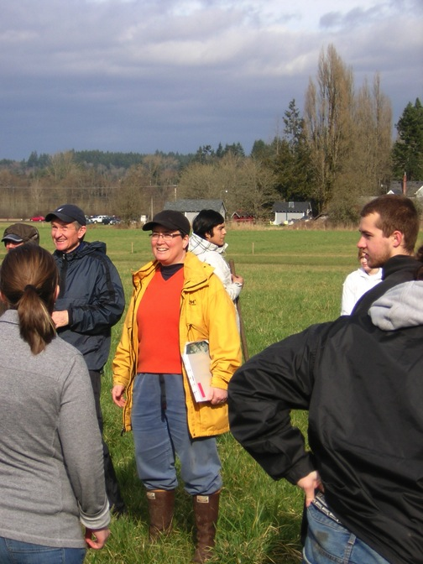
—Lisa Carlson, Centralia College (WA)

Slide 9
I tell my students that they will do well in whatever they choose to do if they have passion for it. My passion for massage therapy is that I would teach for free if I did not have to eat.
—Michael Matthews, Chattanooga State Community College (TN)

Slide 10
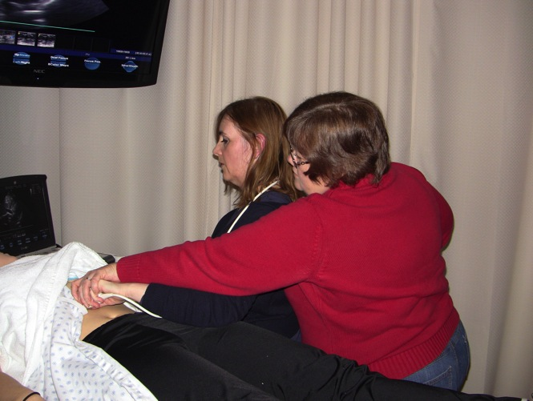
I try to exemplify an attitude of service and competence to my sonography students. My motivation to teach is continuously renewed by observing students learn and gain confidence in their newly acquired knowledge and skills. As medical professionals, they will have the privilege/responsibility of making a difference in someone’s life.
—Lori Robinson, Chattanooga State Community College (TN)

Slide 11
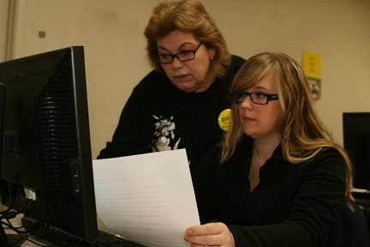
My beginning—My students: I hate math; never understood it; I’ll probably fail this class too; I am too old to learn this! Their end and my inspiration—Ms. Tula, thank you from the bottom of my heart; this is fun; I’ve learned so much; you made it so easy; you do care!
—Tula Mollas, Clover Park Technical College (WA)

Slide 12
I teach with humor and wit. I found early on in my teaching career that more students were paying attention to what I taught because they were waiting for the next humorous statement. If you can capture their attention and retain it, you can teach students wonderful things.
—Kevin Behr, Coastal Bend College (TX)

Slide 13
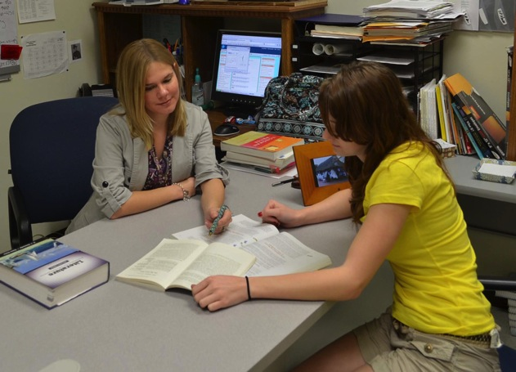
I get a thrill (sometimes goose bumps) when a student offers an insight about a short story or poem that I have yet to realize. In these moments, I remind students that I, too, am on the continuous journey of discovery—that this is the very nature of writing, reading, and learning.
—Anna Green Hazelrigg, Coastal Bend College (TX)

Slide 14
I enjoy teaching and helping others. This drives me to do good work with students. After being in higher education for 15 years, I am still eager to work alongside students and am excited to see students engaged in learning. I am truly passionate about the disciplines of sociology and psychology. I have a vested interest in passing knowledge onto others about something I value. I use the classroom as a perfect setting for guiding and influencing the next generation.
—Kelly Rea, Coastal Bend College (TX)

Slide 15
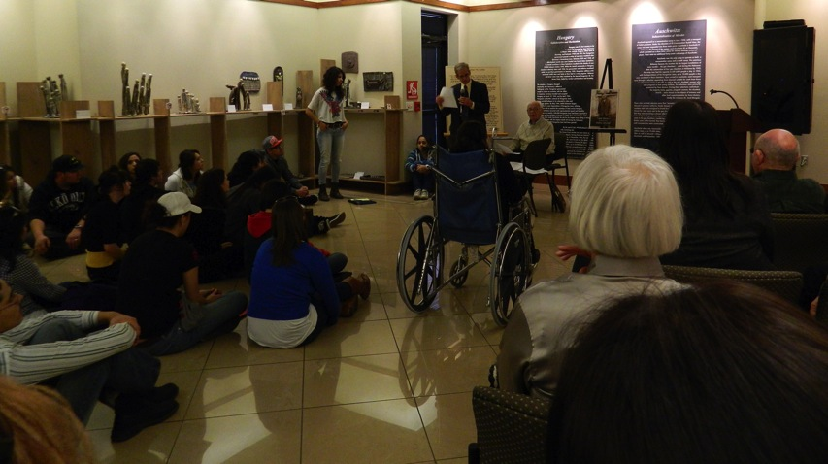
As each semester begins, I remind myself and the assembled students that "each life is a continuation of previous journeys. As our predecessors helped mold us into who we are, so too will we shape future generations." These words fuel and focus my passion for student learning, leadership development, and civic engagement.
—Dave Pettes, Cochise College (AZ)

Slide 16
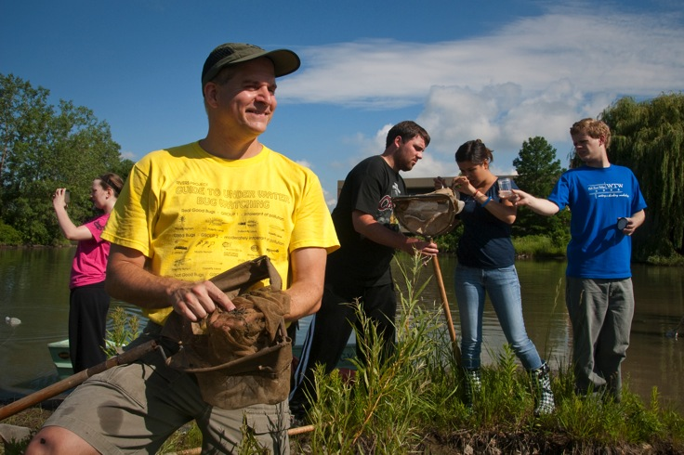
I can’t imagine doing anything else in life but teach. It fulfills a desire to show my profound gratitude for the gifts bestowed upon me by making a difference in the lives of students who sometimes struggle just to make it to class each day.
—Robert Remedi, College of Lake County (IL)

Slide 17
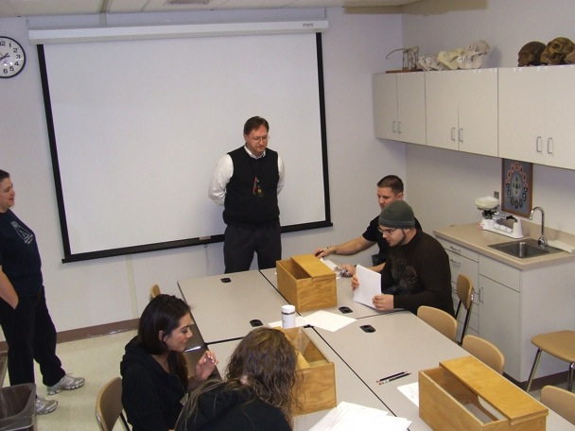
I am an educator. To "educate" is to "lead out of ignorance." My motivation is the somewhat rare advent of a student's proverbial light bulb turning on. When I perceptibly see someone progress from confusion to enlightenment, I can tolerate all the bureaucracy and paperwork that accessorizes the calling.
—Randy Simonson, College of Southern Idaho (ID)

Slide 18
William Butler Yeats once wrote, "Education is not the filling of a pail but the lighting of a fire." Presenting mathematical facts is not enough. Those may or may not last. I have done well when I can inspire my students to continue learning mathematics after the course is completed.
—Susan Strickland, College of Southern Maryland (MD)

Slide 19
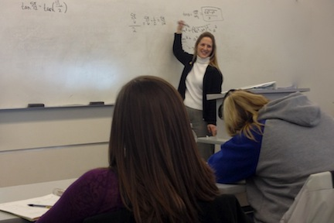
I find my energy and my joy when I walk in my classroom and connect with my students. My advice: Let your students know you as a person. You never know what story or comment might inspire them, but it is the personal connection that causes them to be listening when you tell that story or make that comment.
—Cathy Carson, College of Western Idaho (ID)

Slide 20
I cannot imagine a more alive place than a college classroom, and I am privileged that I get to work in that environment every day. So many of my students have overcome great obstacles just to get to class, which heightens my value for our precious time together. There are few things more delightful than seeing students master difficult concepts and come to believe in their own abilities.
—Kay Lynn Stevens, Columbia Basin College (WA)

Slide 21
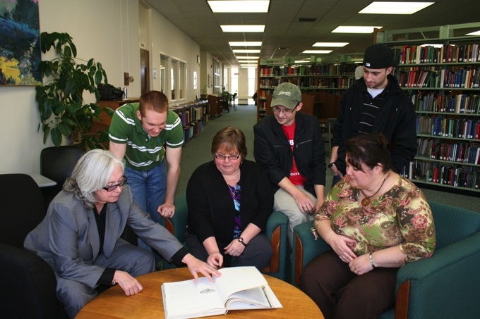
On a daily basis, I see lives changed by the opportunity to attend college. In many cases, these are non-traditional students. Not only are they changing their lives, but also the lives of their children and grandchildren. Nothing could be more rewarding or inspiring.
—Emily Siciensky, Columbia State Community College (TN)

Slide 22
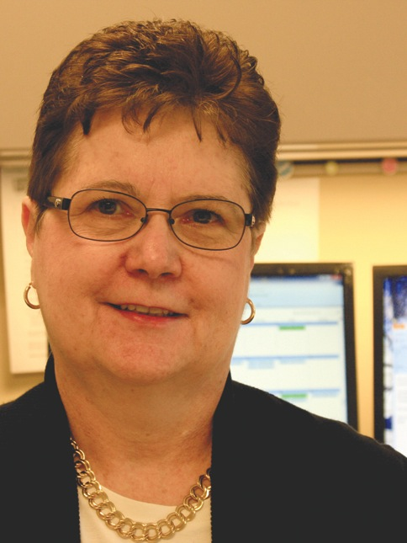
I am delighted to be a part of changing people’s lives for the better. It is exciting to watch the timid freshmen blossom into bold graduates. In the words of Desmond Tutu, “Do your little bit of good where you are; it's those little bits of good put together that overwhelm the world.”
—Suellen Avolio, Community College of Beaver County (PA)

Slide 23
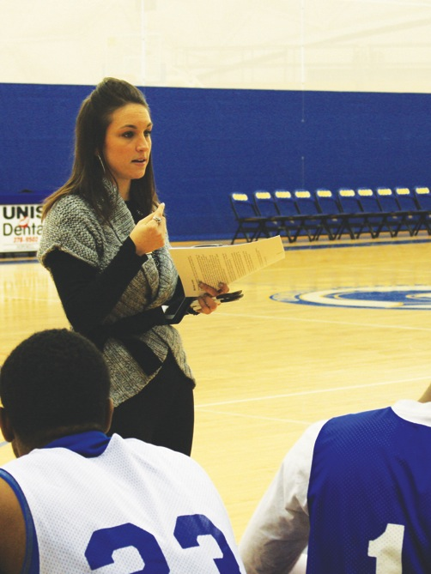
Michael Jordan says, “The minute you get away from the fundamentals, the bottom can fall out.” This observation motivates me in my work with the student athletes on campus. I am inspired to teach them fundamental skills to be successful in the classroom, on the court, and in life.
—Lauren Carfagna, Community College of Beaver County (PA)

Slide 24
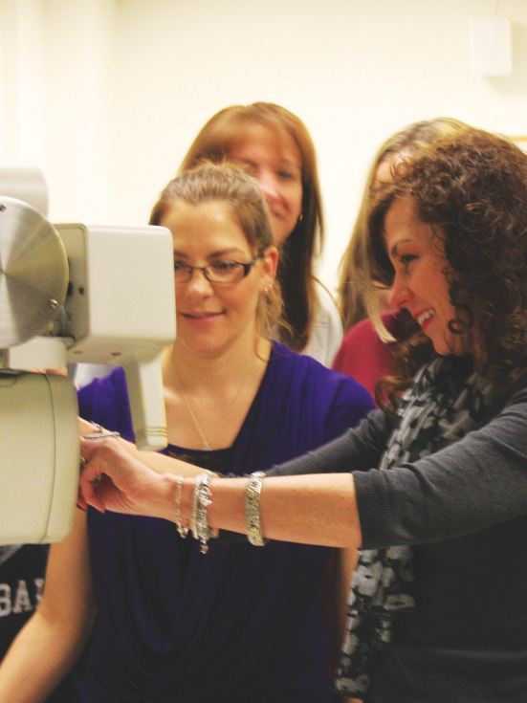
I believe being a teacher is an entrusted position that requires an understanding heart. My students and faculty inspire me daily to share my passion of quality care for all patients. I hope I can help light the way to inspire them to be dedicated and to persevere, regardless of the adversities they may face while journeying toward their goals.
—Joyce Cirelli, Community College of Beaver County (PA)

Slide 25
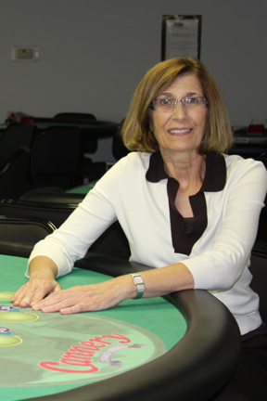
—Karen Deichert, Community College of Beaver County (PA)

Slide 26
Challenges facing graduates in today’s workforce provide unique opportunities to design learning outcomes for information technology courses using some lecture, some research, and plenty of hands-on experiences. This Chinese proverb says it best: “Tell me, and I'll forget; show me, and I may remember; involve me, and I'll understand.”
—Carl Dennis, Community College of Beaver County (PA)

Slide 27
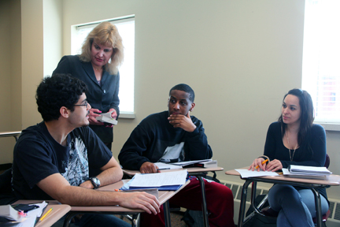
Teaching is my passion, and my students fuel that passion. Together we are a community of learners. With lots of kindness, support, respect, hard work, enthusiasm, and determination, we accomplish incredible things. It is my goal to give my students the best chance for success.
—Maureen Abbate, Community College of Rhode Island (RI)

Slide 28
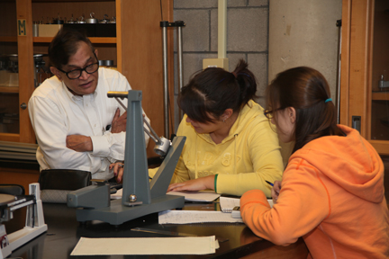
It is important to create a friendly environment in every classroom so that students don’t turn themselves off. I encourage students to develop independent thinking and be courageous in bringing in new ideas to understanding theory and solving problems. In my lectures, I always relate the subject material to practical applications into real life.
—Pranab Banerjee, Community College of Rhode Island (RI)

Slide 29
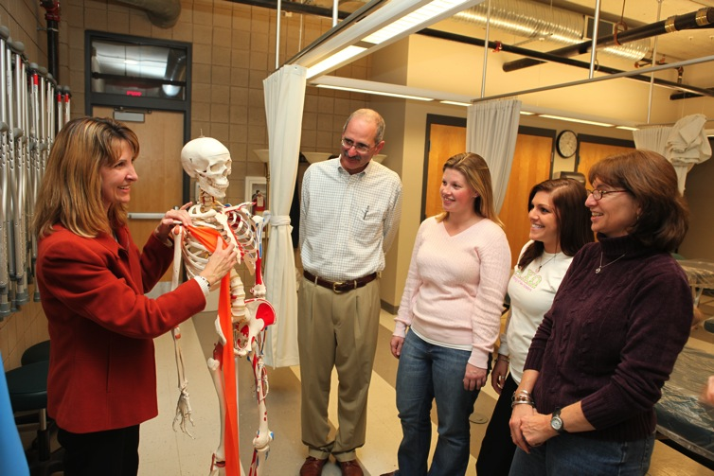
The transfer of accumulated knowledge is what allows the human race to advance, and there is no room for mediocrity in this process when our lifetimes are so short. Having a tireless passion for knowledge and excellence is infectious. I want my students to catch this from me and move forward to be positive change agents in the world.
—Jennifer Hurrell, Community College of Rhode Island (RI)

Slide 30
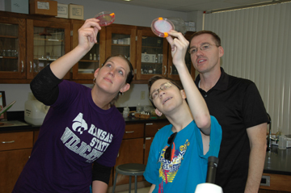
—Scott Layton, Cowley College (KS)

Slide 31
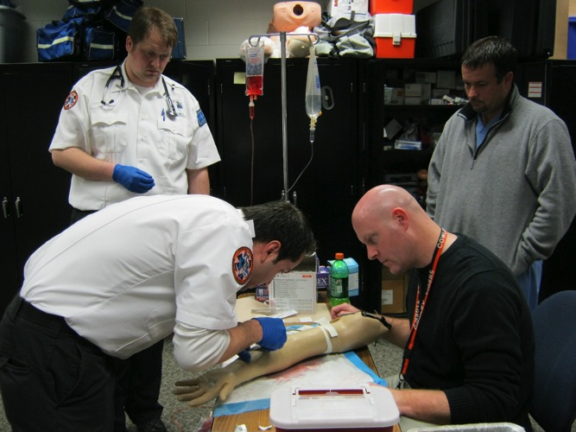
I try to integrate as much technology into the classroom as possible. I strive to inspire, motivate, and enhance the educational experiences of my students while maintaining a positive atmosphere. I emphasize the importance of research and becoming lifelong learners who can change their profession, if not the world.
—Deryk Ruddle, Cowley College (KS)

Slide 32
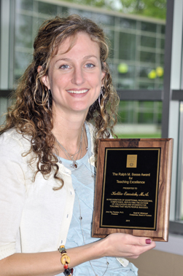
Inspire, empower, create! Ideally, I want students to feel personally changed and motivated. It is not about lecturing to students but about integrating new information into their lives and empowering them to use this information to make a difference. Teaching is a privileged position that demands humility and creativity.
—Kellie Emrich, Cuyahoga Community College (OH)

Slide 33
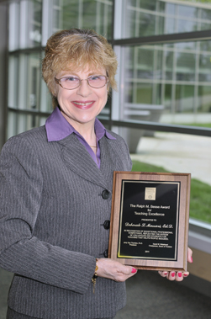
I am blessed to assist high-risk developmental math students in learning to learn math. Math anxiety is conquered. New study skills are implemented. Now, with the proper tools, we start to successfully learn algebra!
—Deborah Massari, Cuyahoga Community College (OH)

Slide 34
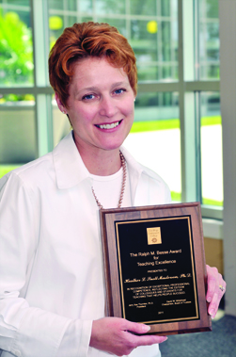
—Heather Snell Masterson, Cuyahoga Community College (OH)

Slide 35
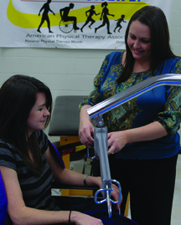
I feel that there is a strong need for dedicated, capable, and compassionate individuals who are excited about teaching the children, youth, and adults of this world. It is not just important for our students to achieve an education, but they must also grow with the knowledge attained and strive for lifelong learning. My goal is to challenge and motivate all of my students to be their best self.
—Sarah Brinson, Darton College (GA)

Slide 36
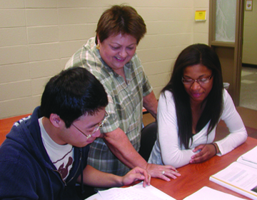
Each day I try to meet the challenges head-on with bulldog determination and a sense of humor. Seeing my students overcome their obstacles and succeed is all the motivation I need. They inspire me!
—Teresa Eberhardt, Darton College (GA)

Slide 37
Whether a student asks for help with a point of grammar, asks for advice regarding classes, or simply asks where to find something on campus, the student is really saying, "Please help me do what it takes to make my life a better one." That "big picture" plea is both humbling and empowering; it provides an adrenaline rush of educational strength that inspires me to give everything I have to lead the student to the sought-after answers. In turn, the student's eventual success rewards the effort taken every time.
—Steven Preston, Darton College (GA)

Slide 38
My goal is for the students to leave this program with a framework of knowledge, ethics, skills, confidence, and self-understanding that will lead them to act professionally and in the best interest of their clients. To accomplish that, they need my best day every day. They deserve nothing less. And when it all comes together, nothing is more beautiful or inspiring!
—Elizabeth Schenck, Davidson County Community College (NC)

Slide 39
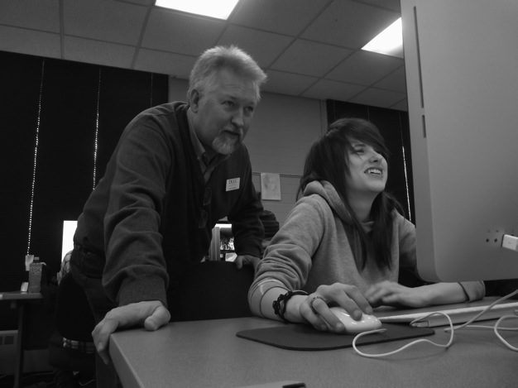
I am inspired by helping my students find a way to a successful future—a life with meaning. I always tell them to strive to be rich enough to not waste time. Part of my teaching philosophy is to constantly engage them and to make certain they are never bored. I always push them to understand what we do here is not work, but rather it is practice and an investment in their future.
—Carl Shatley, Davidson County Community College (NC)

Slide 40
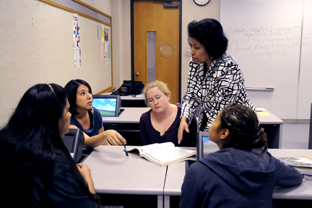
I am continuously inspired by the situations of my students. From the student who may soon be homeless to another who is a victim of family violence, they all give my teaching a purpose. I want all students to succeed and remind them that "si se puede" (yes, you can).
—Dolores Huerta, Del Mar College (TX)

Slide 41
Unlike many people I know, I enjoy going to work every day. Interacting with my students, helping them learn and grow is so satisfying. Their success is my success. I cannot imagine doing anything else.
—Marilyn Ciolino, Delgado Community College (LA)

Slide 42
I love teaching! LOVE IT! I learn something new every day, work with GREAT educators, and spend my time with people who are working toward goals and making their dreams come true. I feel like everything I have done, and everyone I have known, has led me to this. Teaching is a vocation and I feel so lucky to be a part of it.
—Janet Colletti, Delgado Community College (LA)

Slide 43
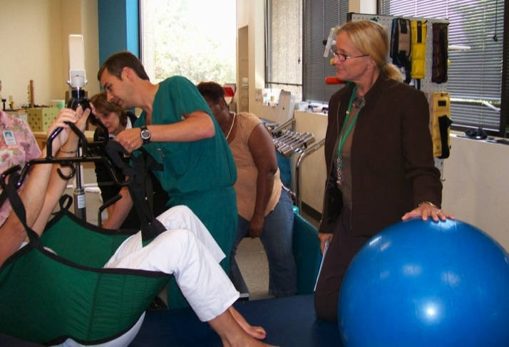
Responsibility must be taken for both teaching and learning by all parties in the learning community. This includes a commitment to lifelong learning, preparation for class by engaging in a deep reading of content, respectful engagement with peers in the learning community, and engagement with the instructor for help and support. As learners advance, I shift the power of control more toward them in order to promote empowerment and positive self-efficacy.
—Kim Uddo, Delgado Community College (LA)

