Slide 1
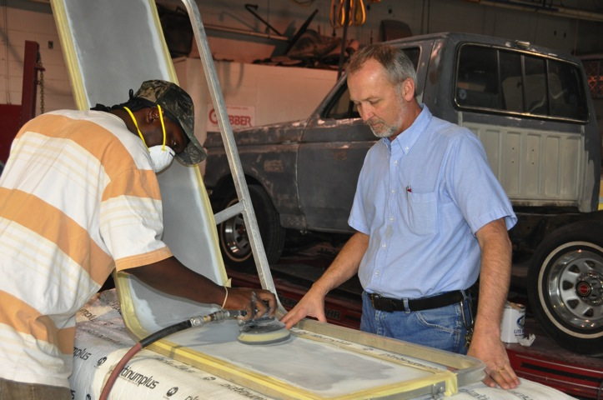
A few of the things I feel help me to be an effective instructor are consistency, fairness, respect, and humor. Be consistent with your instruction; do not throw curve balls. Students respond to lessons that do not include unrealistic outcomes. Be fair with your students. This goes a long way in ensuring that they are all treated equally and with respect. Respect your students. Finally, show a sense of humor. I have found that humor breaks the ice and oftentimes will pull shy students out of their shells.
—Bill Underwood, Albany Technical College (GA)

Slide 2
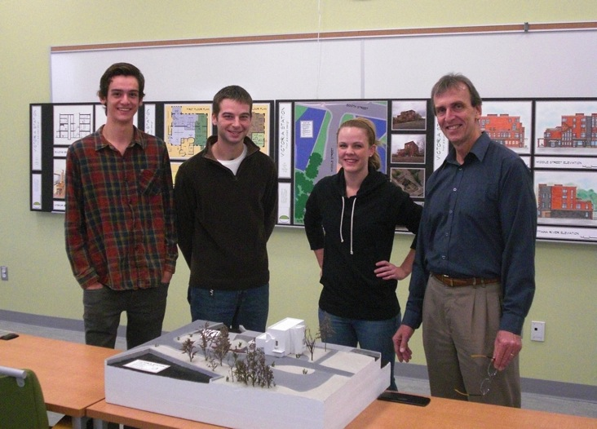
After many years in private practice, teaching is a new profession for me that has provided a fresh outlook on architecture. The positive energy and enthusiasm that my students bring gives me hope that the future is in good hands. Teaching is a privilege, and it is equally important to develop good students and mature adults who can have a positive impact on the world.
—Rick Briginshaw, Algonquin College (ON)

Slide 3
A former teacher once said to me that teaching was a privilege and a great responsibility, and this has always stuck. Now being a teacher myself, I am fortunate to work with colleagues who have that same philosophy. I firmly believe that great teachers, like great students, thrive in a positive and nurturing environment. We are all students at heart.
—Jason Machinski, Algonquin College (ON)

Slide 4
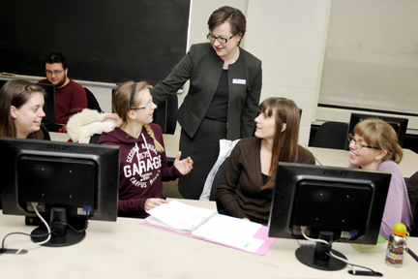
In teaching, I try to see things from the students’ perspectives and ensure that what I teach is relevant to them. In addition, I learn from my students and encourage them along their career paths. When they share their successes with me, it is the highlight of my day.
—Helena Merriam, Algonquin College (ON)

Slide 5
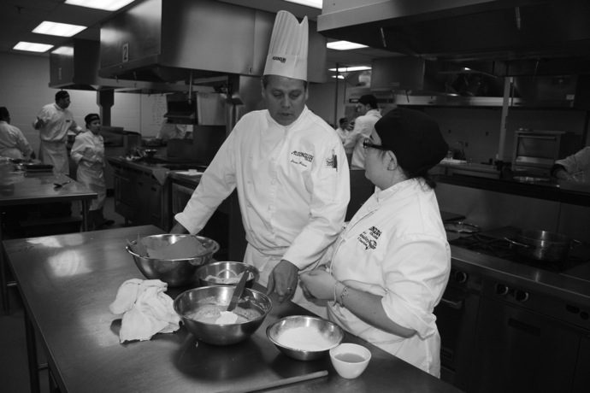
My teaching philosophy stems from Henry Ford’s remark: “If you think you can, or if you think you can't, you're probably right.” Connecting with students by embracing uniqueness and diverse learning styles challenges me to consider different strategies to engage them. Changing the cannot’s to can’s truly motivates me to teach.
—Steve Price, Algonquin College (ON)

Slide 6
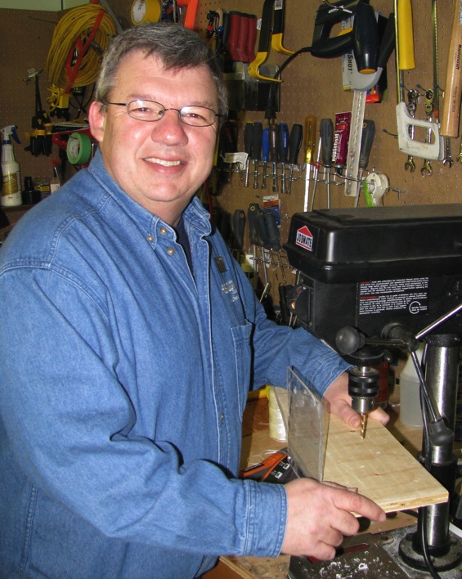
My position directly impacts the day-to-day operations of our facility; and, knowing that what I do allows students to learn, professors to teach, and staff to complete their duties, is very rewarding. Genuine, yet simple acts of kindness go a long way.
—Gerald Samson, Algonquin College (ON)

Slide 7
I am inspired by the STUDENTS! There is nothing more rewarding than creating a learning environment that engages them through creativity and interaction. Having the opportunity to encourage an individual’s passion to learn is what makes my profession so fulfilling. I thrive on the challenges involved in adopting—and adapting to—new technologies within the classroom. My energy is renewed knowing I can make a difference in someone’s life. What a privilege.
—Noni Stukel, Algonquin College (ON)

Slide 8
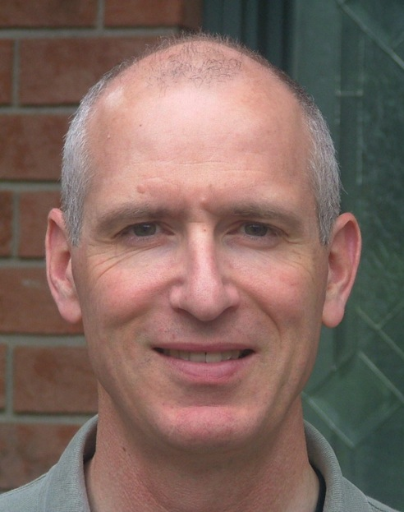
I am motivated by student success. I am a great supporter of inter-professional education and believe that through collaboration, we can cultivate innovation over tradition, encourage learning over teaching, manage risk over status quo.
—David Thibodeau, Algonquin College (ON)

Slide 9
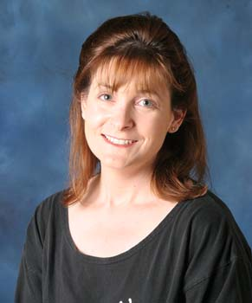
Teaching is an art that continues to inspire me. I am often in awe of the experience, initiative, and motivation that the exceptional adult learners I guide and inform possess. I firmly believe that learning is a life-long process that requires discipline, effort and a willingness to embrace new approaches and methods of learning.
—Sylvia Wieser-Picciano, Algonquin College (ON)

Slide 10
I love my work! As a teacher, I learn with my students, I engage in making democracy work, and I serve as an agent of social change. Community colleges change lives: I see this in my student’s eyes, feel it in my heart, and hold many memories in my mind.
—Cherie Snyder, Allegany College of Maryland (MD)

Slide 11
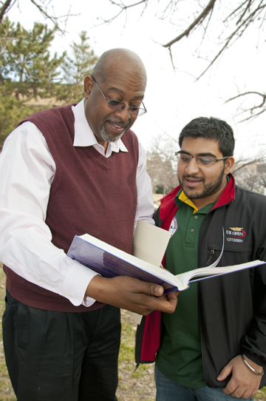
My role as teacher is to enroll students into valuing the Spanish language and learning about Hispanic cultures. One strategy that helps me to be successful is doing activities that mimic real-life situations, such as with games and humor, to allow students to desire to actively use the language.
—Thomas Edison, Anne Arundel Community College (MD)

Slide 12
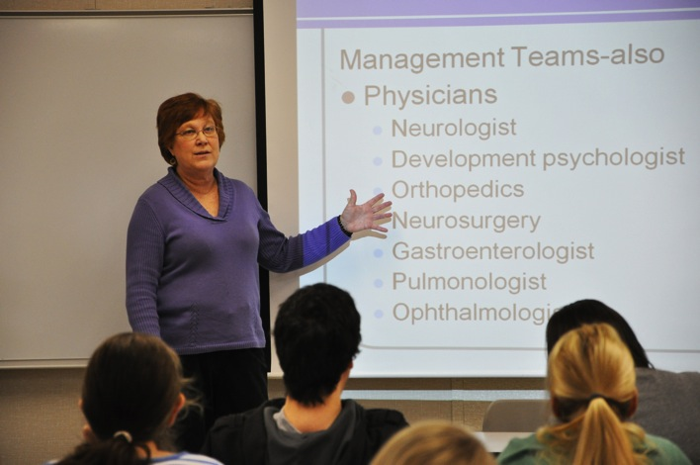
Strategies that I learned for teaching students for whom English is not a first language also applied to many of the other students in the classroom. Utilizing those strategies not only made the whole class more globally aware, but also promoted personal, college-wide and professional competencies.
—Susan Fox, Anne Arundel Community College (MD)

Slide 13
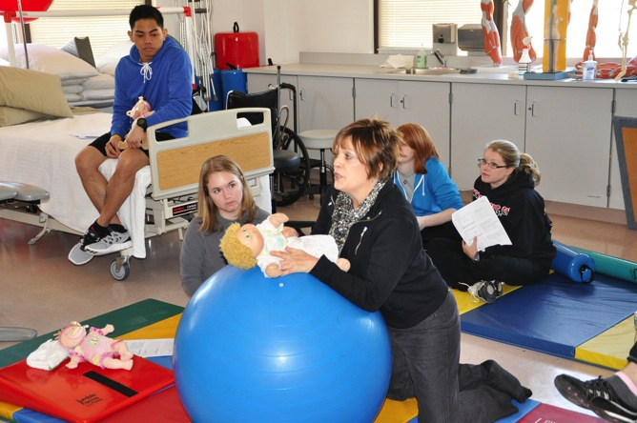
I am privileged to have the opportunity to assist students in discovering their inner potential and evolving into practitioners. I enjoy providing unique learning experiences that help them think critically. Through a student’s individual growth, I am continuously inspired to watch them become empowered to engage others in learning.
—Linda Johnson, Anne Arundel Community College (MD)

Slide 14
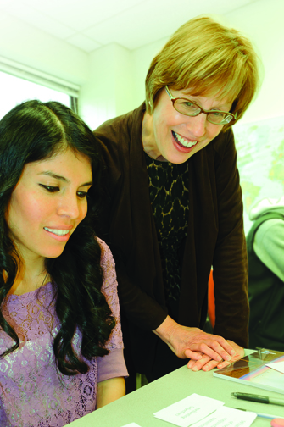
My passion is to get ESL students enthusiastic about language learning. Together, we explore contemporary topics through the lens of language. Encouraging students to express themselves creatively and to discover their voices in writing is both challenging and inspiring. What motivates (and humbles) me are these students’ voices as they reflect on the language learning process. As one student wrote: “It is much eas[ier] to fulfill a physical job rather [than] to write a small paragraph.”
—Anne Kennedy, Anne Arundel Community College (MD)

Slide 15
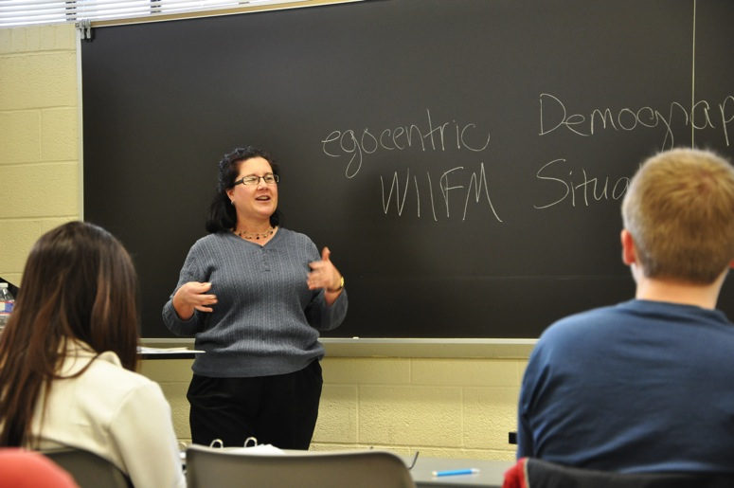
If I ever get bored, my students will be bored. I often find myself reviewing my materials and asking, "Does this still excite me? Is this still relevant? Do I LIKE teaching this content in that way?" If my answer is no, it's time to refresh, to incorporate new ideas and, hopefully, new energy into the classroom.
—Susan Kilgard, Anne Arundel Community College (MD)

Slide 16
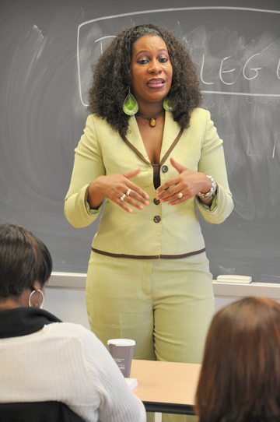
My goal is to educate, motivate, and elevate our next generation of future leaders. I want to equip them with the tools needed to be successful. This not only includes acquiring knowledge, but teaching students how to apply knowledge, be critical thinkers, and be students with integrity, a strong sense of self, and a great sense of humanity.
—Nicole Williams, Anne Arundel Community College (MD)

Slide 17
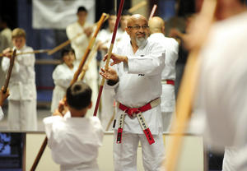
I developed as a Martial Artist while I was stationed on Okinawa, Japan. My inspiration to teach comes from how I was taught from my Karate teacher. I was taught to teach from the heart and that learning is a lifelong process. My motivation to teach comes from my students. Once I see their faces light up as they understand the forms and techniques they are learning, and the desire they display to learn the traditional style of Karate we all learn, I feel fulfilled as a teacher. Teach with your heart; be truthful to what you teach; be stern and fair, not biased; and see your students as a part of what makes you a better teacher.
—Francisco Aguilar, Arizona Western College (AZ)

Slide 18
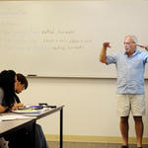
We teachers are blessed with such extraordinary opportunity to inspire and impact our students by challenging, encouraging, coaching, and rewarding them. Time will wash away much of our daily work, but we should show students the stars and send those who are willing to work on their lifelong voyage of learning.
—Light Bryant, Arizona Western College (AZ)

Slide 19
I am a firm believer that teachers can learn a great deal from one another. I am the teacher that I am today because of the generosity of countless others who have been willing to share and discuss teaching strategies, classroom materials, and learning activities. My motto: Class is never dismissed.
—Steven Lund, Arizona Western College (AZ)

Slide 20
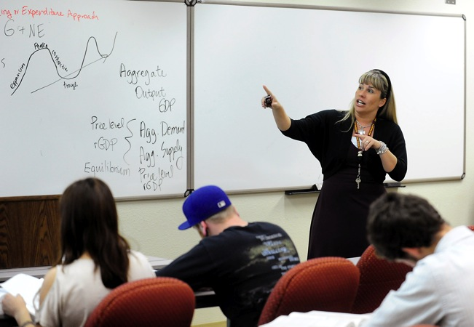
I love teaching economics. It’s an honor to help our students build a solid foundation which helps them to realize that economics is a dynamic part of our everyday lives. I absolutely love what I do!
—Michelle Sims, Arizona Western College (AZ)

Slide 21
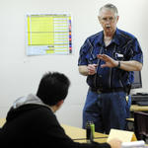
When my students ask me to wish them luck on a test, I tell them that they do not need luck if they are prepared! This works for me, and it will work for the students.
—David Sisson, Arizona Western College (AZ)

Slide 22
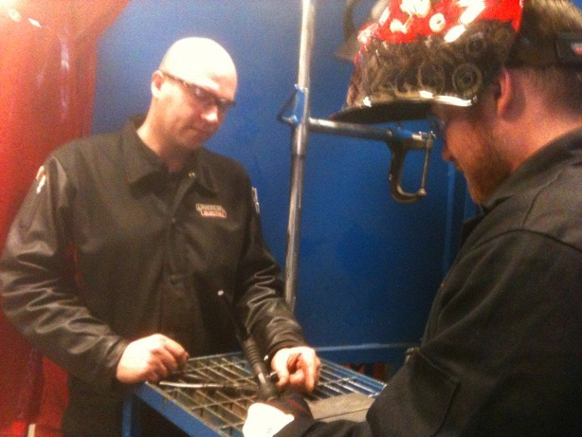
I teach technical skills to students who have perhaps never felt that they were good for anything in school. Helping them succeed and grow in confidence, knowledge, and skill is the most rewarding part of my profession. These students are the future of our industry and of our country, and I am proud to have an impact on them every day.
—Ken Beach, Arkansas State University-Newport (AR)

Slide 23
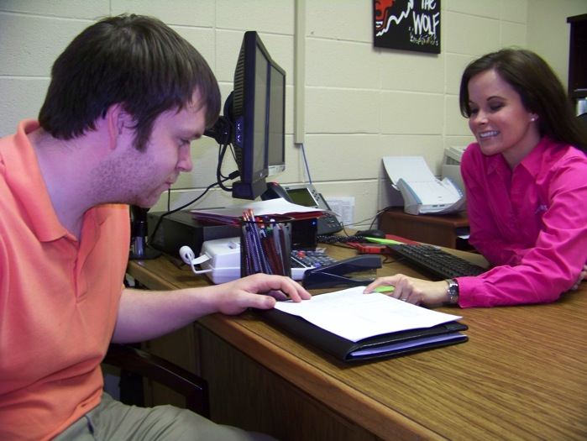
There is never enough time in the day to complete everything. There will be challenges that test the character of the students on their way to completing their goals. However, students must remember their goals and move toward them, and everything else will fall into place.
—Ashley Buchman, Arkansas State University-Newport (AR)

Slide 24
The overall community college experience is exhilarating. It is a unique privilege as an administrator to create and foster an environment of shared leadership that empowers faculty and staff to draw from their expertise and rich experience to shape high-quality learning environments that promote student success.
—Sandra Massey, Arkansas State University-Newport (AR)

Slide 25
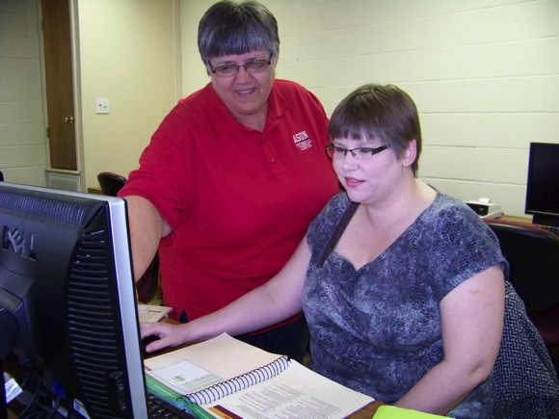
I learned early on in my teaching career that you don't always see the results while students are in class. Sometimes the results are seen the next year in another class, sometimes in a couple of years when you hear of a student's success in a job. Sometimes, never. Don't depend on good grades for understanding, but depend on solid teaching methods.
—Paula Morgan, Arkansas State University-Newport (AR)

Slide 26
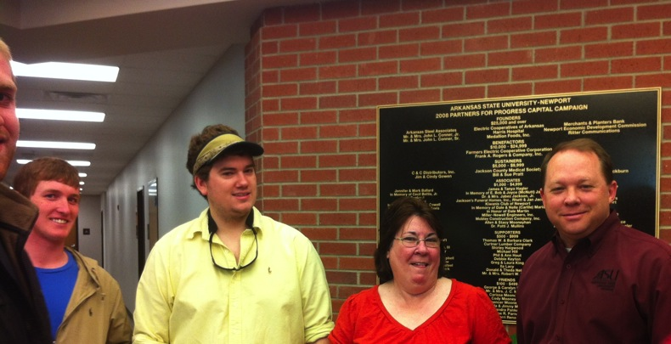
The greatest reward in education is that moment when a student realizes that his work in class is resulting in an improved quality of life for him and his family.
—Bentley Wallace, Arkansas State University-Newport (AR)

Slide 27
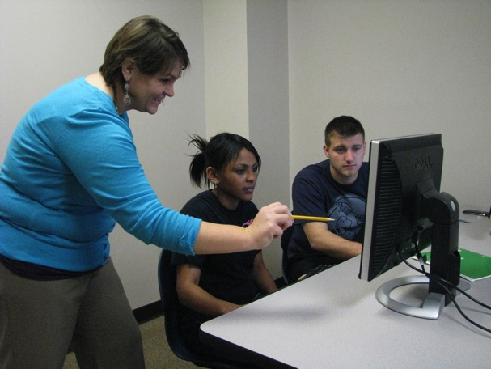
There is something immensely satisfying in watching students who insisted they could not do math at the beginning of a term succeed in the mathematics classroom. To instill in them the confidence that their hard work will pay off is my most important function as a teacher.
—Tressa White, Arkansas State University-Newport (AR)

Slide 28
The end result is what inspires me. All I need is to see students go out into the world of work and succeed, while knowing that when they came here they had little if any skills. This motivates me to work hard to help others.
—Richard Burnett, Ashland Community and Technical College (KY)

Slide 29
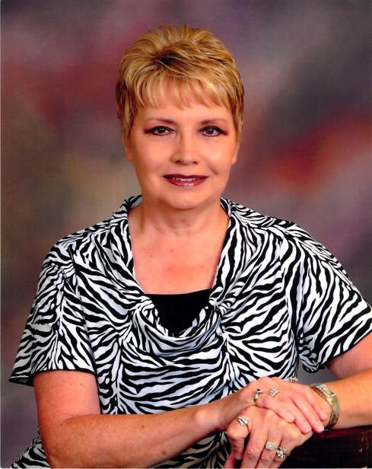
My happiest days at work are when our former students drop by the office to let us know where they are currently employed. When I hear them say they are now able to afford to take a vacation with their family or plan to purchase their first home or a new vehicle, it helps me realize in some small way I was a part of their success.
—Mary Lou Wallin, Ashland Community and Technical College (KY)

Slide 30
My goal is to become a world-class instructor equipped with the problem solving and thinking skills needed to provide outstanding services to students in need. One of my foremost objectives as a pharmacy technology instructor is to acquire skills and knowledge that will empower me to help minorities, the poor, and other under-served populations. I believe it is important to improve the health, quality of life and well being of communities through education, research, and services—beginning in the pharmacy.
—Robbie Howard, Atlanta Technical College (GA)

Slide 31
Teaching composition, rhetoric, and literature is like The Matrix. If I give my students the blue pill (reaffirming everything they already know), they will remain content yet intellectually asleep. If I give them the red pill (disrupting everything they know), they will awaken and think and do and be.
—Sonya McCoy-Wilson, Atlanta Technical College (GA)

Slide 32
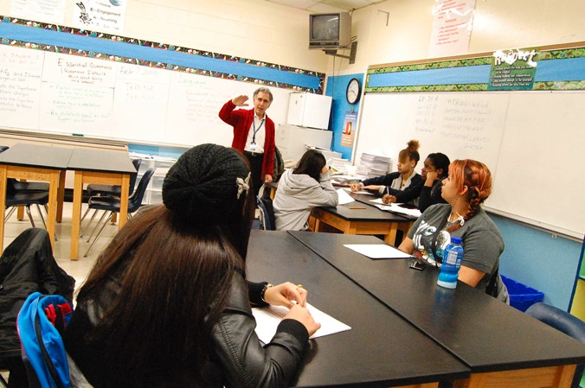
During junior high I felt lost and struggled in school. My parents were told I was incapable of college success. This motivates me to teach and write books with passion about college success. I help students set goals and see how the courses are relevant. This motivates them to succeed.
—Raymond Gerson, Austin Community College (TX)

Slide 33
I just feel grateful to have a college campus where I can work on new questions every day and call it my job. When students are able to share the wonder of it all, then I feel like my job has been well done.
—Russell Moses, Austin Community College (TX)

Slide 34
The key to effective teaching is partnering with my students in their educations. As their partner, I get to experience the anxiety and the thrill of learning with them. I get such satisfaction out of providing a hand-up when they need it and applauding their success when they don’t!
—Theresa Mouchayleh, Austin Community College (TX)

Slide 35
Go to class prepared to teach AND learn. Challenge and inspire students and be challenged and inspired by them. Give them tools to reach their goals. Show the rewards of success not only in your class but also in other classes and life! Remember to listen with your ears AND heart.
—Anne-Marie Schlender, Austin Community College (TX)

Slide 36
I have the opportunity and privilege to share life experiences and learn from a variety of people who have overcome life challenges and who are striving to live life to its fullest. As an educator, I see myself as a mentor, a facilitator, collaborator, and lifelong learner. I am inspired by my students; they provide new insight and challenge me to keep abreast of innovative teaching strategies to simulate the classroom as a real-life learning lab. I truly enjoy their families’ pride as they cross the stage at graduation and the thrill in their voices when they report they passed their national boards exam and landed their first job as an occupational therapy assistant.
—Kim Taylor, Austin Community College (TX)

Slide 37
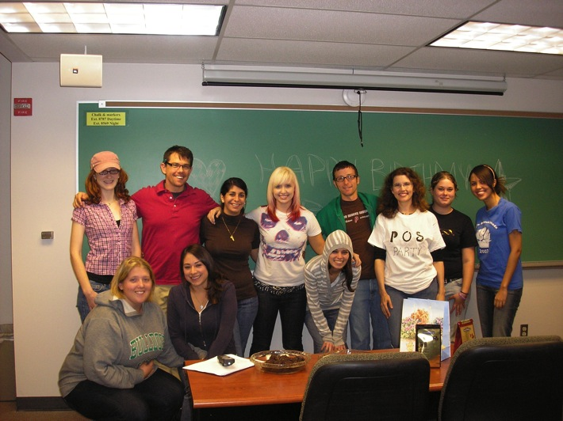
My goals are to make science accessible, usable, thrilling; to excite people about how psychological science can be of use to themselves and others; to give people tools for thinking and living; and to broaden perspectives and curiosity. And I can imagine nothing I'd rather do.
—Duana Welch, Austin Community College (TX)

Slide 38
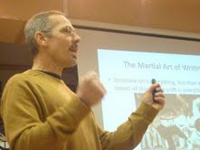
Writing is about communication. I'm always telling my students this. If I can't communicate how to write an essay, then I'm in trouble. Organization. Detail. Specificity of language. The same things I ask of them in their essays, I'm obligated to do in my teaching of writing. And that's what I try to do every class.
—Brian Yansky, Austin Community College (TX)

Slide 39
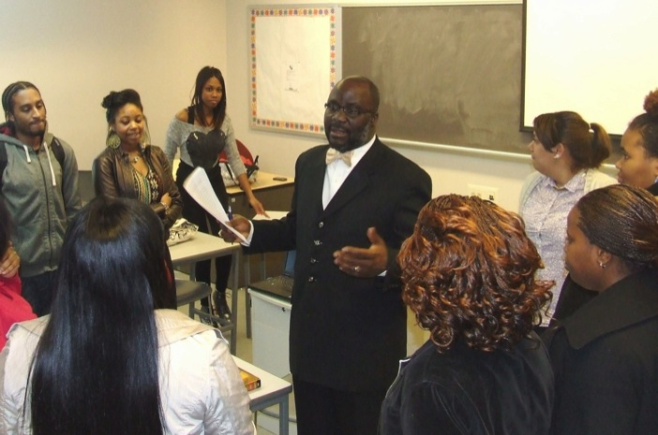
Teachers wield enormous power. I am humbled and grateful to be in a profession that allows me to make an impact on nation-building efforts. Community college teaching is the ultimate “high” in higher education!
—Solomon Omo-Osagie II, Baltimore City Community College (MD)

Slide 40
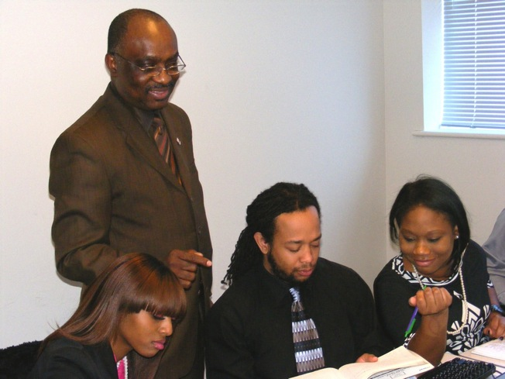
As a faculty member in information science, I am fascinated by the stamina and creativity of young minds as they explore technology in the classroom. The continuous and dynamic nature of technological change is powerful enough; the adaptability we’re seeing in students is inspiring!
—Chima Ugah, Baltimore City Community College (MD)

Slide 41
Teaching is my passion. I believe that as a teacher it is my responsibility to challenge students, guide them, and help them make connections. I provide them with a variety of activities and use various teaching methodologies to best accommodate each group of students every semester.
—Ana Boone, Baton Rouge Community College (LA)

Slide 42
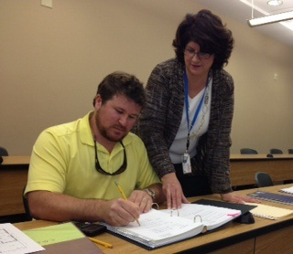
I am inspired and motivated by students’ eagerness to learn to estimate, plan and schedule, and manage projects—to become productive in the construction industry.
—Cindy Decker, Baton Rouge Community College (LA)

Slide 43
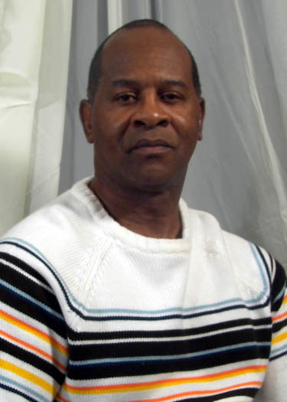
What motivates me to be the best teacher I can be is my desire to teach. Teaching is a passion of mine, and seeing the faces of my students light up with interest motivates me even more. I can relate every lesson to a life or shared experience and show students that the concepts they learn in class can be applied to everyday learning. Once they can make that association, no matter how miniscule it may be, they are eager to take part in the lesson for that day and better retain what they learn.
—Russell Hills, Baton Rouge Community College (LA)

Slide 44
A wise woman told me to treat people the way you want to be treated. I carry that spirit to class each day. When I was a student, I would feel ashamed and embarrassed to ask questions. I like to create an atmosphere for my students to feel free to ask questions and not be afraid of communicating with me.
—Dynechia Jones, Baton Rouge Community College (LA)

Slide 45
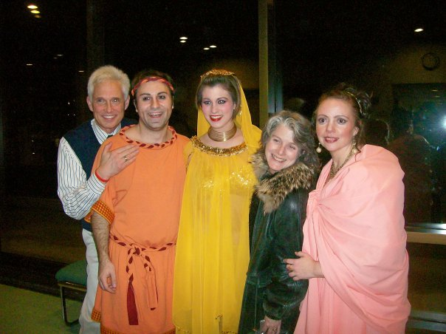
I am humbled to be receiving this award and to be representing Bergen Community College. To be honored for something I love doing every day of my life seems redundant.
—James Bumgardner, Bergen Community College (NJ)

Slide 46
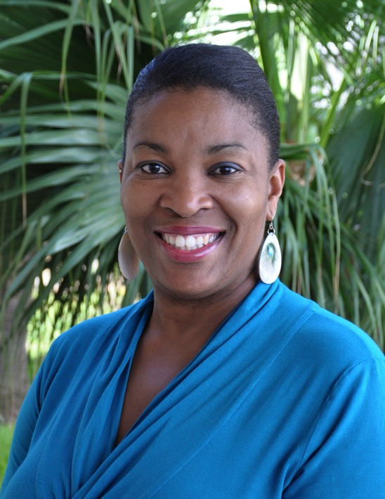
—Leonie Dill, Bermuda College

Slide 47
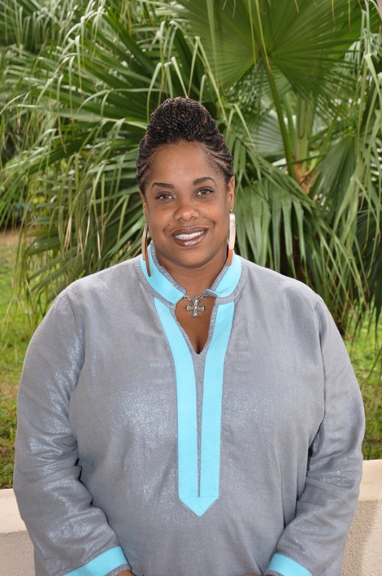
—Teneika Eve, Bermuda College

Slide 48
If my actions inspire others to dream, learn, and become, then my actions as teacher were successful. I strive to stimulate creativity and critical thinking, and promote excellence. Fairness places students on the same level of importance and creates a sense of trust, and creating a rich educational environment in which students believe they can achieve. Then, they do.
—Reitha Cabaniss, Bevill State Community College (AL)

Slide 49
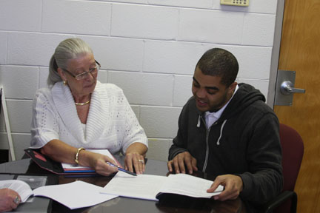
I am motivated by those who persist in pursuing their dreams, regardless of their personal circumstances. In 1999, I established an endowed scholarship for students with financial need and low GPAs, trusting that more low-income students will achieve their dreams and eventually “pay it forward.”
—Mazola Salmons, Big Sandy Community and Technical College (KY)

Slide 50
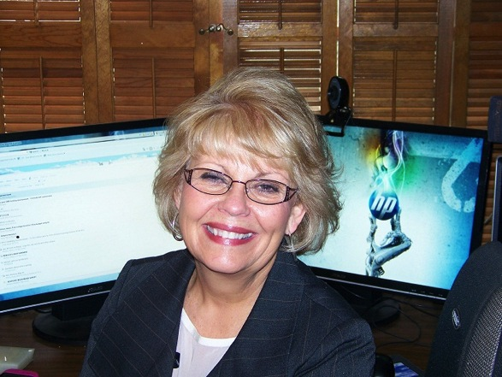
I am not afraid to try something new. My imagination helps me solve many problems. By blending the old with the new learning experiences, I am able to accommodate multiple approaches to learning.
—Paula Thompson, Big Sandy Community and Technical College (KY)

Slide 51
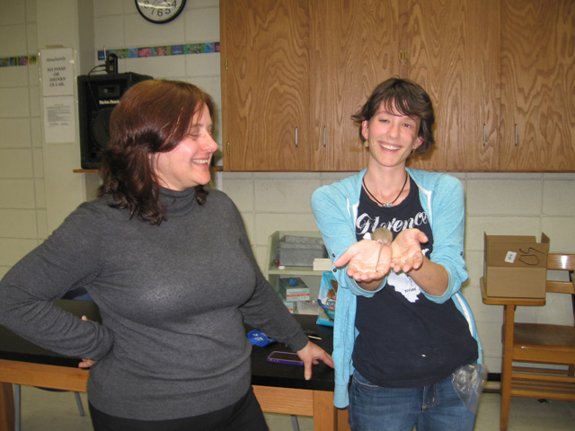
When I was a first-generation student, I faced difficulty overcoming financial, social, and psychological barriers to completing a college education. My primary purpose, as an educator, is to help my students scale the walls of the psychological barriers. Nothing gives me more joy than to see students’ self-esteem rise as they accomplish dreams they never thought they could.
—Kelly Kissane, Blinn College (TX)

Slide 52
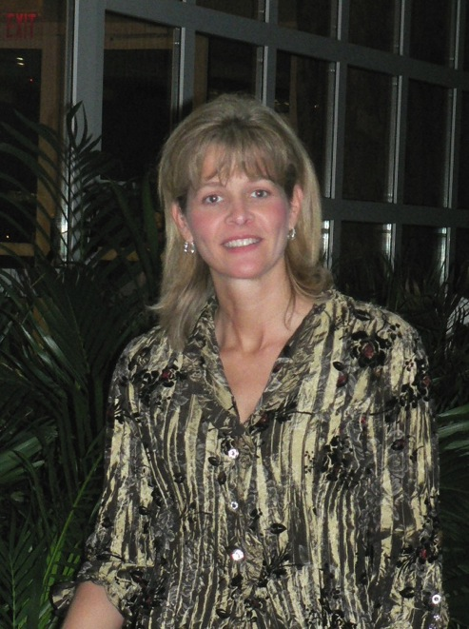
Being an ASL instructor lets me inspire students by instilling self-confidence and having a positive attitude to strengthen the ASL Program. Receptive and expressive skills are important when communicating with deaf individuals in American Sign Language. A willingness to devote time and effort by expanding horizons will break the communication barrier between hearing and Deaf communities—two worlds become one. Happy signing!!!
—Robyn Marcak, Blinn College (TX)

Slide 53
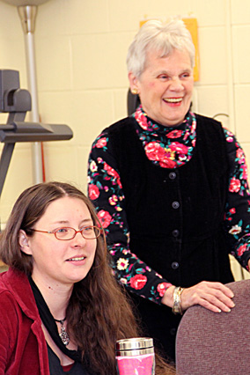
I delight in the diversity of students with varying needs and goals, often balancing children jobs, families, and personal and family issues. I continue to be challenged by their desire to learn, and their energy, commitment, and the elasticity of the human spirit inspires me to help them on their personal journey.
—Rowan Zeiss, Blue Ridge Community College (VA)

Slide 54
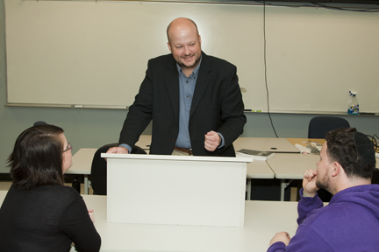
—Bob Alexander, Bossier Parish Community College (LA)

Slide 55
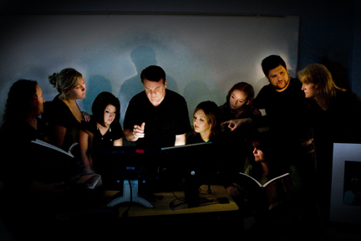
—Darrell Chitty, Bossier Parish Community College (LA)

Slide 56
I tell my students at the beginning of the semester: “We can do anything for 16 weeks.” Together, we find ways to engage ourselves in the learning process while many of life’s necessities become, temporarily, not as necessary. The time passes rapidly, and they find themselves visualizing their goals.
—Cammie Emory, Bossier Parish Community College (LA)

Slide 57
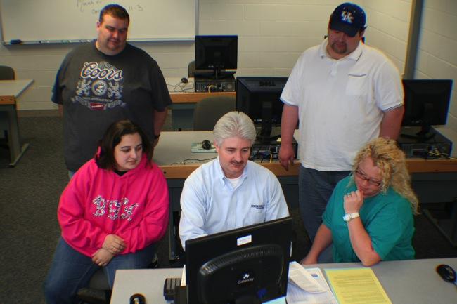
“Welcome to the Best Experience You Will Encounter in Student Services.” I have this statement posted on the front of my desk. I strive daily to be that first positive encounter for those new or potential students who walk through the doors of our campus to enroll at BGTC.
—Mark Powell, Bowling Green Technical College (KY)

Slide 58
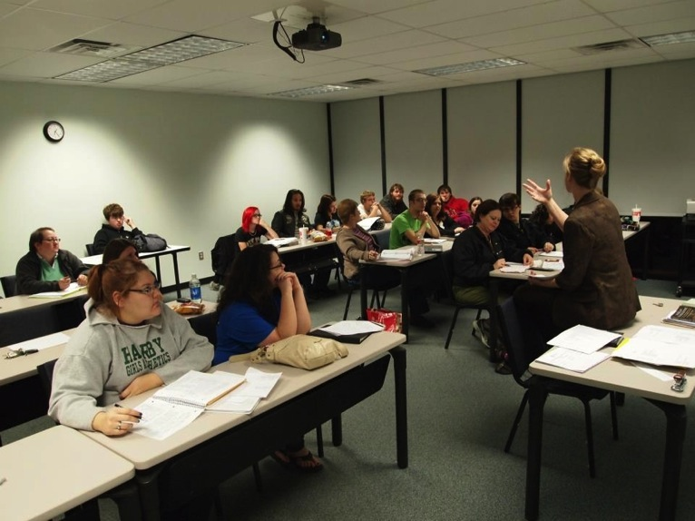
—Joy Kennedy-O'Neill, Brazosport College (TX)

Slide 59
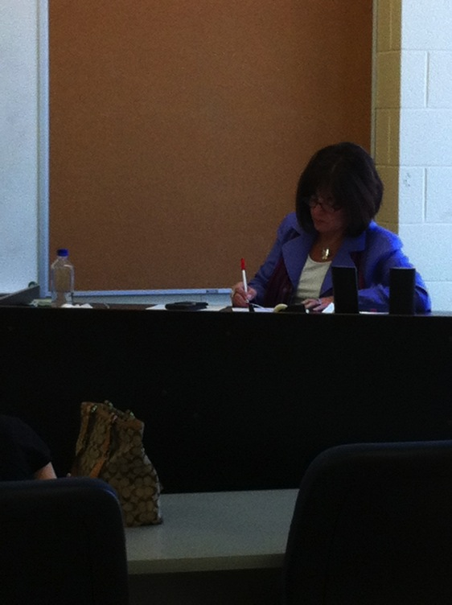
Students who ask questions and show an interest in the subject matter help their classmates. I always tell them, “There are no stupid questions.”
—Pamela Lopez, Bridgemont Community & Technical College (WV)

Slide 60
Education is a journey. I feel honored to be part of that journey for students. My inspiration and motivation come from the knowledge that the students will go on to be the inspiration for so many others.
—Melissa Cardelli, Bristol Community College (MA)

Slide 61
Just as I was inspired by my first grade teacher to work in the field of education, I aim to inspire my students to walk away as life-long learners in the field of technology, eager to tackle any challenges that lie ahead while aiming high enough to reach their own goals and aspirations in life.
—Rose Ferro, Bristol Community College (MA)

Slide 62
The aha! moment of sudden understanding, when students are able to connect what we re discussing in class with their own lives, is the greatest motivation and inspiration for my teaching. It is incredibly rewarding and humbling to know that I have contributed to their journey as lifetime learners.
—Donald Kilguss, Jr., Bristol Community College (MA)

Slide 63
Being the mail clerk here at BCC has been a great experience for me. I find that it is not difficult to do your job when you enjoy doing it. The fact that I am able to interact with people all day is something that I really enjoy.
—Joseph Pereira, Bristol Community College (MA)

Slide 64
My mission at Bristol Community College is to help my English as a Second Language students achieve their dreams by becoming proficient in English and mainstreaming successfully into their chosen fields of study at the college. My true reward is to see them graduate and become accomplished and productive members of the global community.
—Regina Pirtle, Bristol Community College (MA)

Slide 65
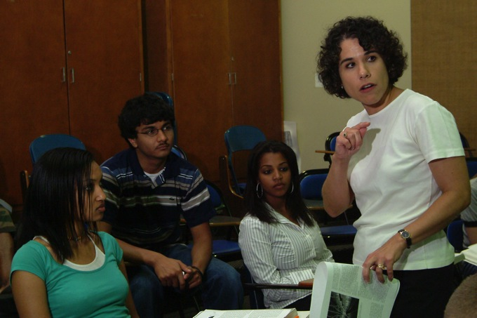
Each semester, I let my students know I am there to help them learn the material, complete the course successfully, and move on. They understand that as long as they do their part, this will happen. It is amazing how such a simple conversation can be so motivating to them.
—Adrien Cuellar-McGuire, Brookhaven College (TX)

Slide 66
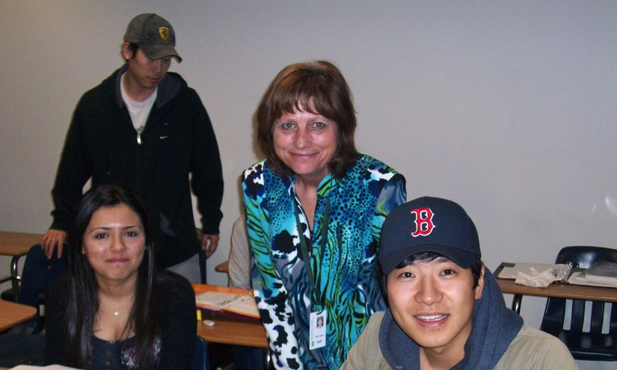
All of us should strive to learn another language. My passion is teaching ESL, English as a Second Language. The most rewarding part of my job is watching students become empowered as they increase their grasp of English. As Ludwig Wittgenstein said, “The limits of my language are the limits of my world.”
—Catherine Watkins, Brookhaven College (TX)

Slide 67
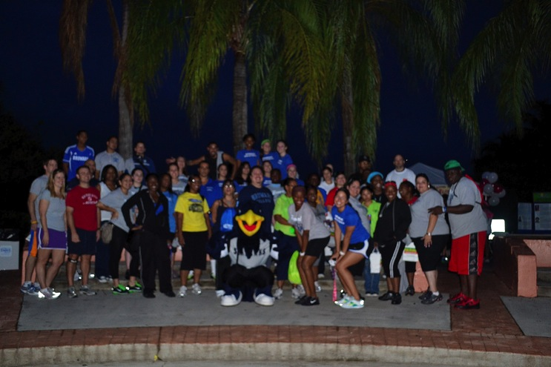
Empowerment is key. As a dean, when I meet with students, I never miss an opportunity to provide them with the necessary tools and/or resources to help them help themselves. Students need to create meaningful experiences for themselves in order for things to matter.
—David Asencio, Broward College (FL)

Slide 68
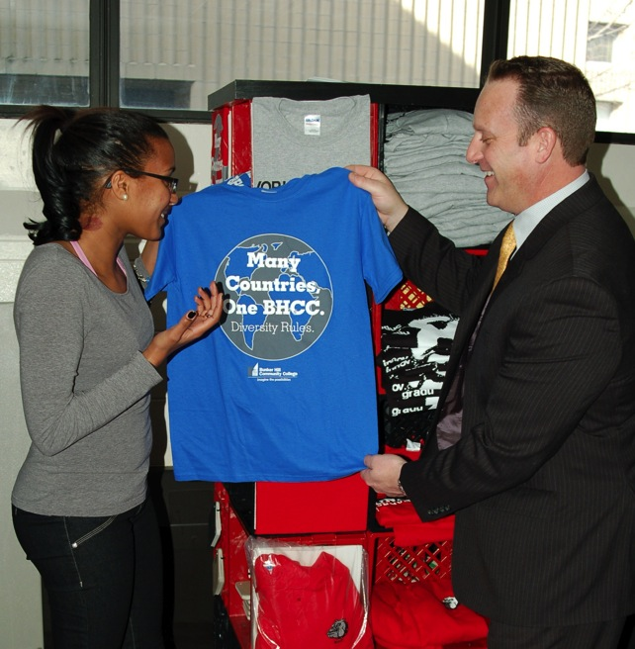
The best compliment I ever received from a student was “you inspired me to be better than I thought I could be.” This is a student’s ah-ha moment. Getting any student to that moment is my job. To know I played a small role in their success. It’s about them, not me.
—Anthony Fontes, Bunker Hill Community College (MA)

Slide 69
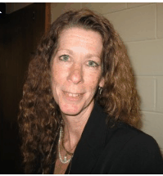
—Kathleen O'Neill, Bunker Hill Community College (MA)

Slide 70
Supporting students with open hearts and minds while providing them with options and offering various educational pathways is so important. Many of my students lack important life skills, and we must be open to meet students where they are in order to help them succeed in college and in life.
—Elizabeth Pabon-Szebeda, Bunker Hill Community College (MA)

Slide 71
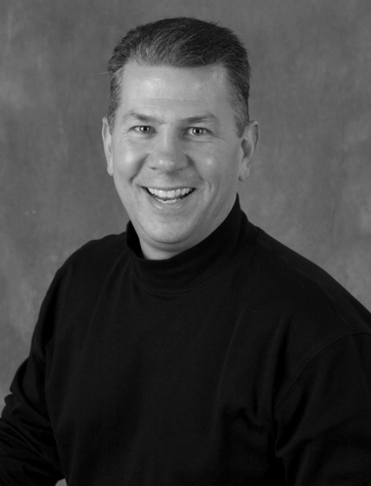
—Donald Tracia, Bunker Hill Community College (MA)

