Slide 1
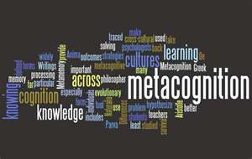
Metacognition: The Key to Equity and Excellence for All Students
Saundra Y. McGuire, Ph.D.
Ret. Assistant Vice Chancellor & Professor of Chemistry
Director Emerita, Center for Academic Success
Louisiana State University
Fellow, American Chemical Society & AAAS

Slide 2
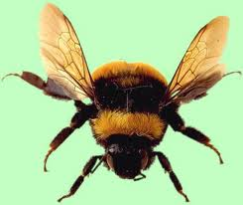

Slide 4
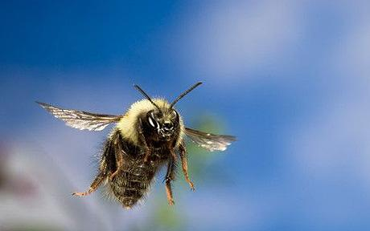

Slide 5
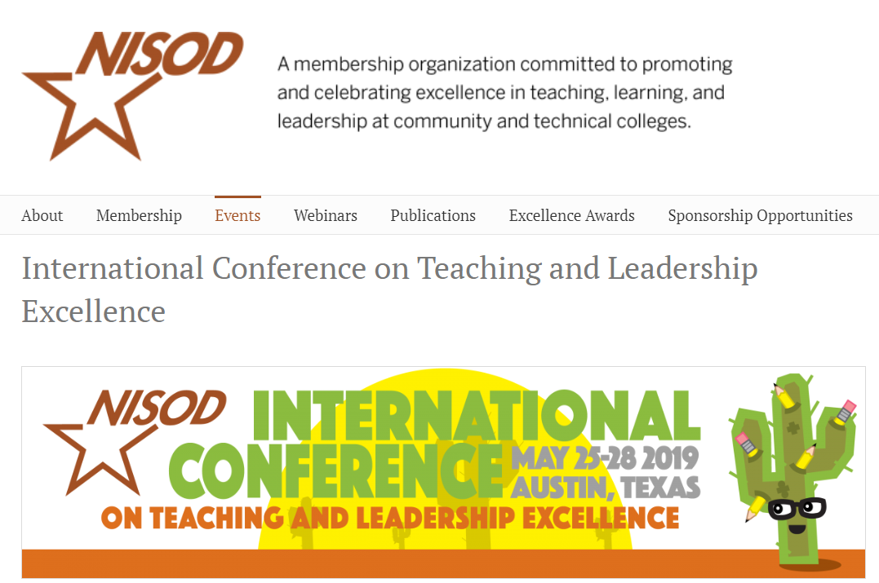
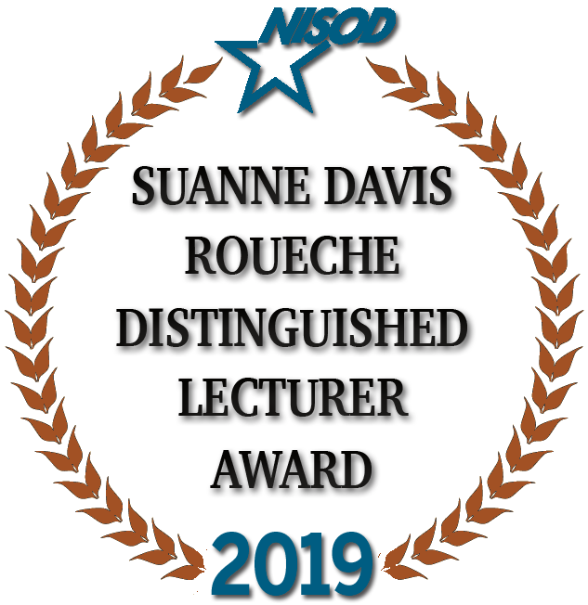
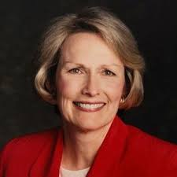

Slide 6
Metacognition: The Key to Equity and Excellence for All Students
Saundra Y. McGuire, Ph.D.
Ret. Assistant Vice Chancellor & Professor of Chemistry
Director Emerita, Center for Academic Success
Louisiana State University
Fellow, American Chemical Society & AAAS

Slide 7
What Do The Terms Equity and Excellence Mean?
Equity
reducing the discrepancy in educational outcomes between low-income and high- income students and between minority versus majority students.
Excellence
fostering among all students a high level of knowledge and skills necessary for success in the 21st Century
https://www.kaganonline.com/grants/Excellence&Equity.pdf

Slide 8
What is Metacognition?
The ability to:
think about your own thinking
be consciously aware of yourself as a problem solver
monitor, plan, and control your mental processing (e.g. “Am I understanding this material, or just memorizing it?”)
accurately judge your level of learning
know what you know and what you don’t know
Flavell, J. H. (1976). Metacognitive aspects of problem solving. In L. B. Resnick (Ed.), The nature of intelligence (pp.231-236). Hillsdale, NJ: Erlbaum

Slide 9


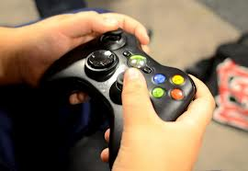
Why haven’t most students developed metacognitive skills?
It wasn’t necessary in high school
(or in some cases not even in college)

Slide 10
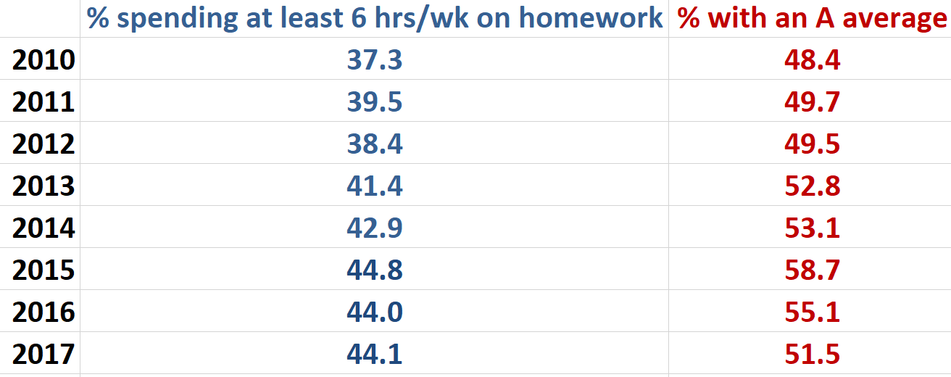
Data from UCLA Higher Education Research Institute (HERI)
First Year Student Survey – 2010 - 2017
www.heri.ucla.edu

Slide 11
What did most of your teachers in high school do the day before the test?
How do you think most students would answer the following?
What did they do during this activity?
What grade would you have made on the test if you had gone to class only
on the day before the test?

Slide 12
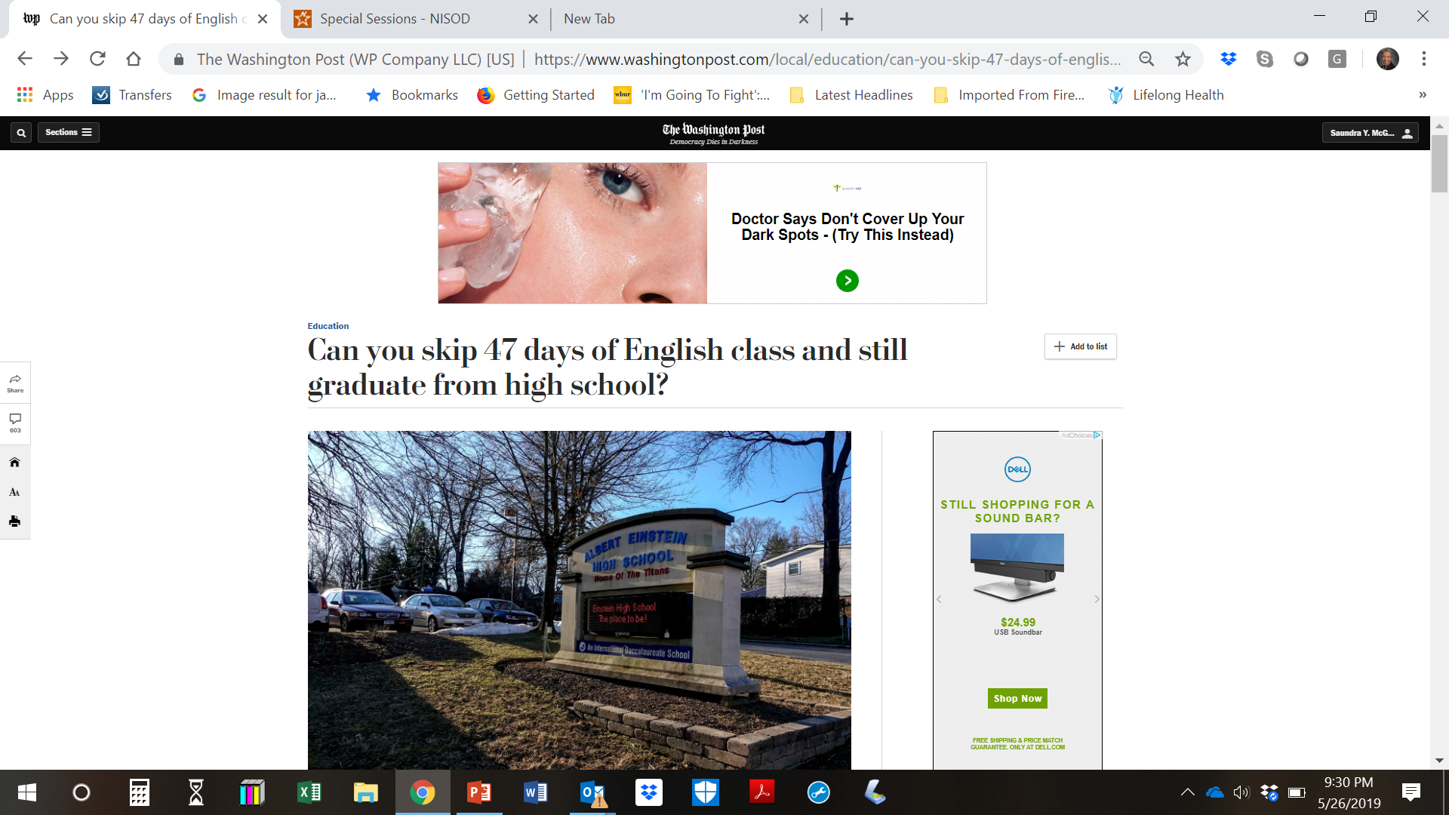
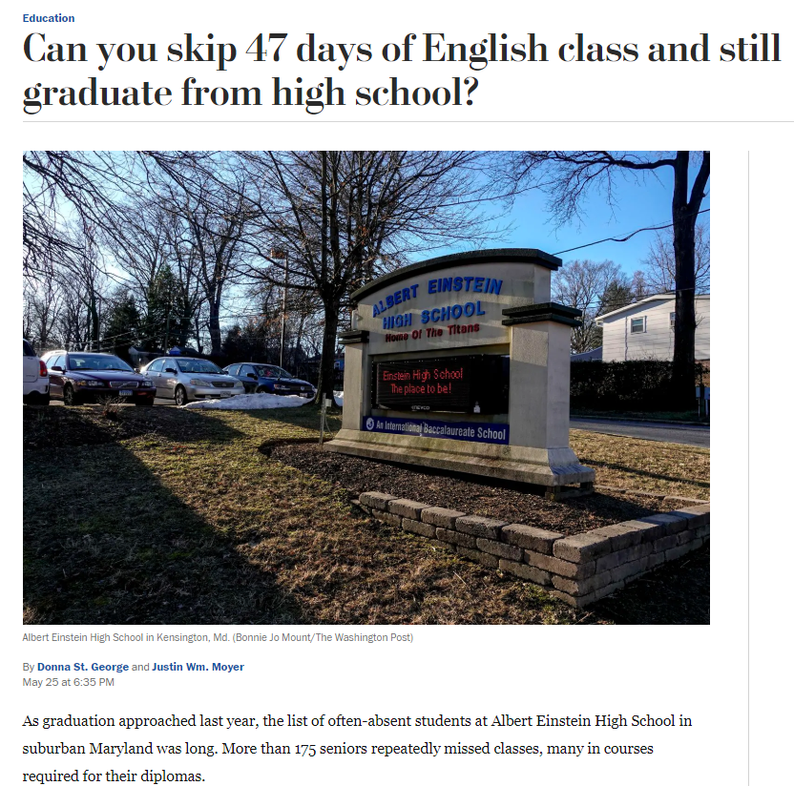

Slide 13

Faculty and Administrators Must Help Students Make the Transition to College
Help students identify and close “the gap”
current behavior current learning
(and grades)
productive behavior desired learning (and grades)

Slide 14
The Power of Metacognitive Learning Strategies
As described Lynn Futral*, Psychology Professor, Southern Crescent Technical College, Griffin, GA
It just hit me that since I have incorporated the presentation Metacognition: success through understanding learning styles, learning strategies, and study skills, these post-tests are remarkably showing that students are actually retaining this information. When I compare the data from two years ago, I can clearly remember how distressed I was that students weren't retaining this information, but the test scores I am receiving today?-- I am just blown away.
*email received on 5/9/2015

Slide 15
Data from Psych Prof at Crescent Tech CC
Received on 1/8/2014
Sample of 9 “at risk” students
Exam 1 avg | Exam 2 avg | Exam 3 avg | Exam 4 avg | Final Exam avg
62.7 | 77.0 | 78.2 | 82.0 | 82.6
“The final exam was comprehensive. The students were placed in teams and each team was assigned three chapters to review to the class in preparation for the final exam.”

Slide 16
Reflection Questions
What’s the difference, if any, between studying and learning?
For which task would you work harder?
A. Make an A on the test
B. Teach the material to the class

Slide 17
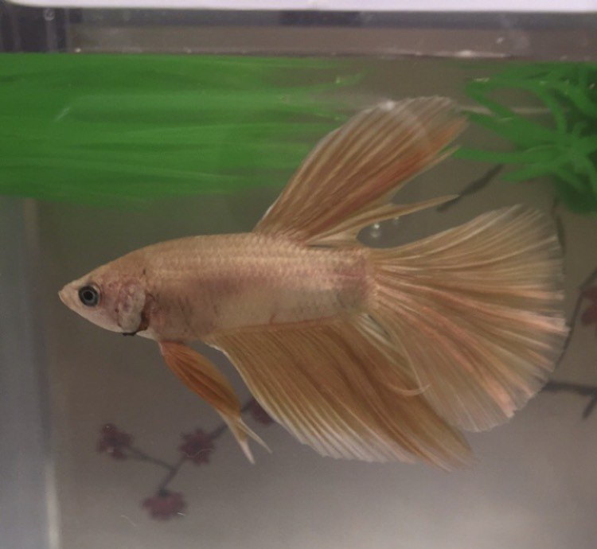
When Ty Taught His Betta Fish
First encounter on September 17, 2018
Email on October 25, 2018
Bio Exam Grades: 66, 98, 90; Final Grade B
Chem Exam Grades: 62, 83; Final Grade B

Slide 18
Impact of Teaching as a Learning Strategy
Ty, LSU First Year Student
Email Received on October 26, 2018
I attended more of the Supplemental Instruction (SI) sessions and the exam reviews. Before the exam reviews and SI Sessions I would try to answer as many of the questions as possible to see about where I was in terms of grasping the information, then at the exam reviews/SI sessions I would know what I needed to understand. Next after the reviews/SI sessions I would go to my room and “teach” the materials to my betta fish. The material I couldn’t explain, I would study more. I would continue that cycle until I could explain everything in my notes....

Slide 19
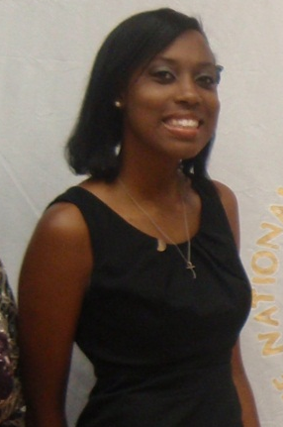
Dana, first year physics student
80, 54, 91, 97, 90 (final)
Problem: Memorizing formulas and using on-line solutions help for problems
Solution: Solve problems with no external aids and test mastery of concepts

Slide 20
Effective Homework Strategy
Study material first, before looking at the problems/questions
Work example problems (without looking at the solutions) until you get to the answer
Check to see if answer is correct
If answer is not correct, figure out where mistake was made, without consulting solution
Work homework problems/answer questions as if taking a test

Slide 21
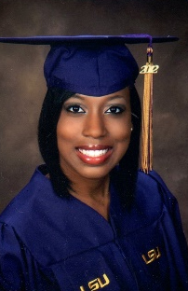
Dana Lewis –
Master’s Degree in Medical Physics
Univ of Texas MD Anderson Cancer Center
Practicing Medical Physicist as of 8/28/2016 when she completed her residency!

Slide 22
What we know about increasing learning
Active learning is more lasting than passive learning
-- Passive learning is an oxymoron*
Thinking about thinking is important
  Metacognition**
The level at which learning occurs is important
  Bloom’s Taxonomy***
  *Cross, Patricia, “Opening Windows on Learning” League for Innovation in the Community College, June 1998, p. 21.
** Flavell, John, “Metacognition and cognitive monitoring: A new area of cognitive–developmental inquiry.” American Psychologist, Vol 34(10), Oct 1979, 906-911.
*** Bloom, Benjamin. S. (1956). Taxonomy of Educational Objectives, Handbook I: The Cognitive Domain. New York: David McKay Co Inc.

Slide 23
Bloom’s Taxonomy
Creating
Putting elements together to form a coherent or functional whole
Making judgments based on criteria and standards through checking and critiquing.
Evaluating
Analyzing
Breaking material into constituent parts,.
Carrying out or using a procedure through executing, or implementing.
Applying
Constructing meaning from oral, written, and graphic messages
Understanding
Retrieving, recognizing, and recalling relevant knowledge from
long-term memory.
Remembering
http://www.lsu.edu/students/casmakebettergrades/successresources/CAS_Blooms.pdf

Slide 24
How do we teach students to move higher on Bloom’s Taxonomy?
Teach them the Study Cycle*
*adapted from Frank Christ’s PLRS system

Slide 25

The Study Cycle
4
Reflect
3
Review
4
Reflect
Preview
Preview before class – Skim the chapter, note headings and boldface words, review summaries and chapter objectives, and come up with questions you’d like the lecture to answer for you.
Attend
Attend class – GO TO CLASS! Answer and ask questions and take meaningful notes.
Review
Review after class – As soon after class as possible, read notes, fill in gaps and note any questions.
Study
Study – Repetition is the key. Ask questions such as ‘why’, ‘how’, and ‘what if’.
Intense Study Sessions* - 3-5 short study sessions per day
Weekend Review – Read notes and material from the week to make connections
Assess
Assess your Learning – Periodically perform reality checks
Am I using study methods that are effective?
Do I understand the material enough to teach it to others?
Intense Study Sessions
1 | Set a Goal | 1-2 min | Decide what you want to accomplish in your study session
2 | Study with Focus | 30-50 min | Interact with material- organize, concept map, summarize, process, re-read, fill-in notes, reflect, etc.
3 | Reward Yourself | 10-15 min | Take a break– call a friend, play a short game, get a snack
4 | Review | 5 min | Go over what you just studied
Center for Academic Success
B-31 Coates Hall ▪ 225.578.2872 ▪www.cas.lsu.edu

Slide 26
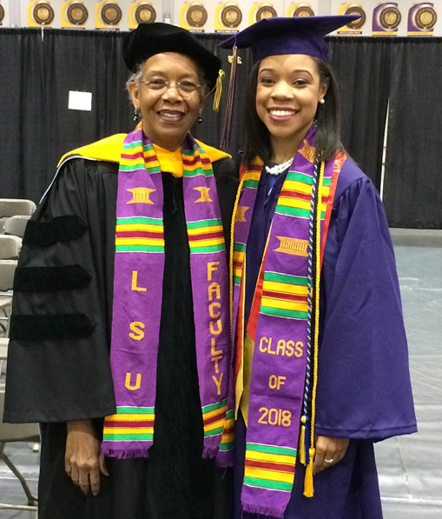
Brea Manuel, BS in Chemistry, 2018
Entered PhD Program at
Emory University on Full Fellowship in Fall 2018
The intense study sessions helped me most. I actually got A+ on 3 out of 4 of my finals using that method of studying. It’s important to use it everyday before finals week, and I think it would really benefit students during finals week.

Slide 27
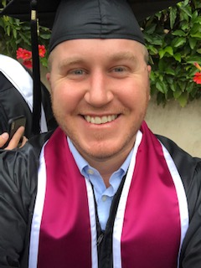
David Hall, BA in Psychology, May 2019
Westmont College, Santa Barbara, CA
Final Semester GPA: 4.00
(2.70 cum before using strategies; ≥ 3.20 each semester after using strategies; 3.06 final cum GPA)
Has accepted position as a substance abuse counselor
Currently applying to graduate school to pursue
Master’s degree in philosophy/theology

Slide 28
Resource David Used
McGuire, S.Y. (2015). Teach Yourself How to Learn: Strategies You Can Use to Ace Any Course at Any Level. Sterling, VA: Stylus

Slide 29
Teach Yourself How to Learn vs Success Course
Email received from David Hall on May 11, 2019
…more than anything your book gave me a structured way to approach studying strategically while that class …didn’t really resonate with me. It wasn’t a very difficult class and it was easy to pass with a good grade, but I didn’t leave that class with any tools that really gave me the structure and insight that I needed to actually put study strategies into practice. Your book and the examples you laid out gave a very clear and concise methodology that I was able to “plug in to,” whereas that class didn’t impress upon me my own ability to be able to study well. Your book and the examples you used and case studies you presented inspired me to believe that if it were possible for them, it was possible for me too!!!

Slide 30
Sharing Bloom’s and The Study Cycle Improved Learning
Dr. Kelter:
After the ND-Gateway workshop this August, I shared Dr. McGuire’s presentation with several of my colleagues and students in the ABEN department.
One ABEN student was struggling in his classes. I asked how he studied, and found he didn’t have good study habits. I shared the PPT with him on August 21, 2018, and also emphasized the content in slide 32 (Bloom’s Taxonomy) and slide 45 (Study Cycle). He wrote me an email today (September 7, 2018) and said:
“I actually am applying myself and changed my study and planning habits and it seems to be paying off already. I scored 114% on the first and only graded homework assignment so far and took the first exam on Wednesday and got 100%.”
I also applied the suggestion in Slide 14 to my class, and invited students to co-teach some lectures with me. They did a fantastic job by adding much more content and real world experience to the class. This is truly a wonderful experience for me because I saw students poured their passion and talent into the lecture.
Please extend my appreciation to Dr. McGuire.
Thanks,
Xinhua Jia, Ph.D., P.E. Associate Professor, Agricultural and Biosystems Engineering
North Dakota State University

Slide 31
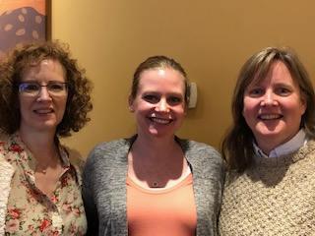
“Strategies to prevent cognitive overload: A team-based approach to improving student success and persistence in a gateway introductory chemistry course”*
Marguerite H. Benko*, Keith M. Vogelsang, Kristin C. Johnson, and Allison R. Babij
Department of Science, Ivy Tech Community College, Central Indiana, Indianapolis, Indiana
Until Fall 2013, the student success rate of a large introductory chemistry class…was 50%. …We then implemented a face-to-face class format based on The Study Cycle concepts presented by Dr. Saundra McGuire in her book “Teach Students How to Learn”. Curriculum revisions enabled faculty to deliver well-focused lectures, with access to supporting practice problems and labs that connected clearly with each week’s learning objective… Starting in Fall 2016, some sections introduced active and cooperative learning, which led to a steady improvement in the overall success rate, ending at 75% in Fall of 2018.
*Manuscript accepted for publication. Personal communication April 19, 2019

Slide 32
LSU Analytical Chemistry Graduate Student’s Cumulative Exam Record
2004 – 2005
9/04 Failed
10/04 Failed
11/04 Failed
12/04 Failed
1/05 Passed
2/05 Failed
3/05 Failed
4/05 Failed
2005 – 2006
10/05 Passed
11/05 Failed
12/05 Passed best in group
1/06 Passed
2/06 Passed
3/06 Failed
4/06 Passed last one!
5/06 N/A
Began work with CAS and the Writing Center in October 2005

Slide 33
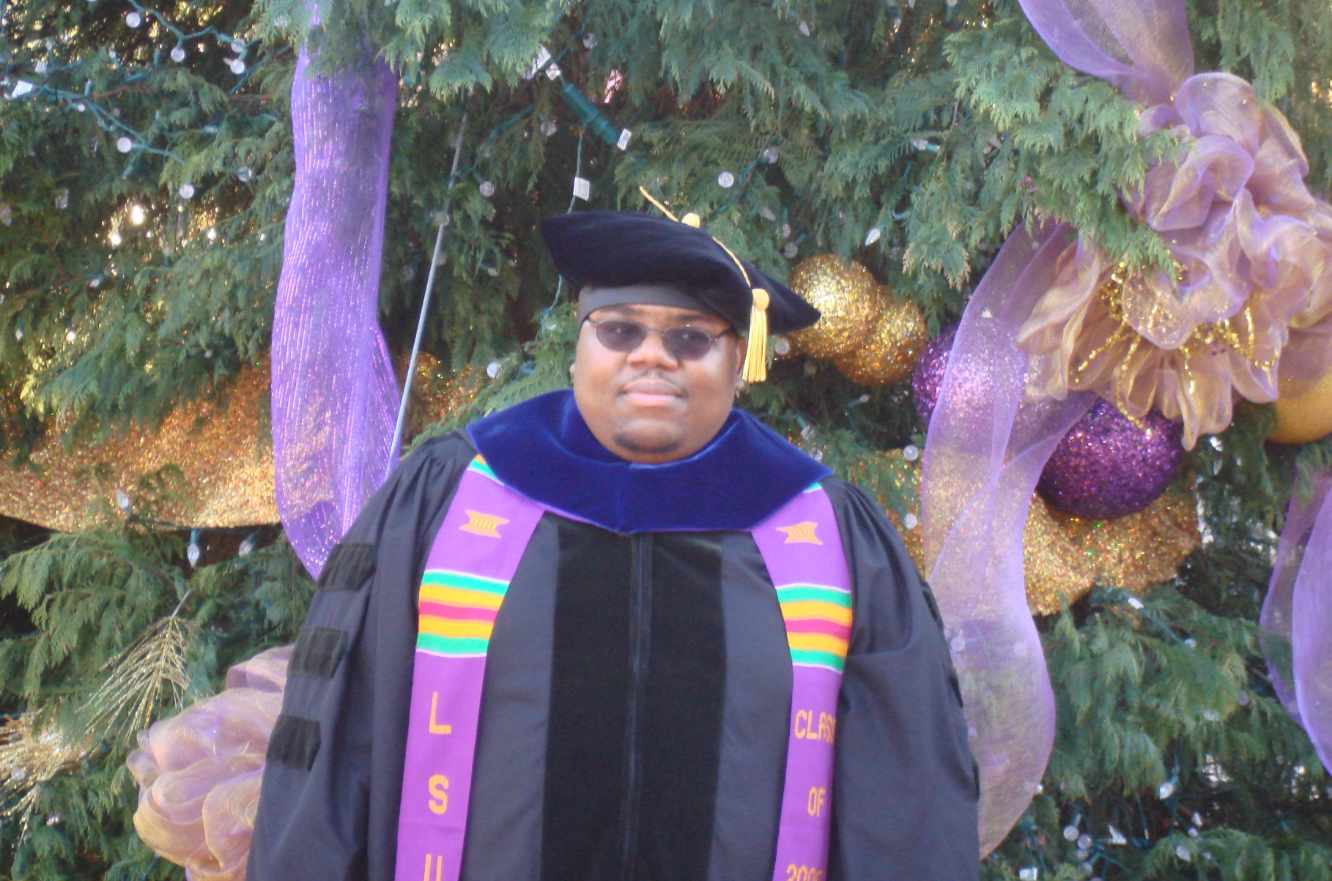
Dr. Algernon Kelley, December 2009

Slide 34
From a Xavier University student to Dr. Kelley in Fall 2011
Oct. 17, 2011
Hello Dr. Kelley. … I am struggling at Xavier and I REALLY want to succeed, but everything I've tried seems to end with a "decent" grade. I’m not the type of person that settles for decent. What you preached during the time you were in Dr. Privett's class last week is still ringing in my head. I really want to know how you were able to do really well even despite your circumstances growing up. I was hoping you could mentor me and guide me down the path that will help me realize my true potential while here at Xavier. Honestly I want to do what you did, but I seriously can't find a way how to. Can I please set up a meeting with you as soon as you’re available so I can learn how to get a handle grades and classes?
Oct. 24, 2011
Hey Dr. Kelley, I made an 84 on my chemistry exam (compared to the 56 on my first one) using your method for 2 days (without prior intense studying). Thanks for pointing me in the right direction. I’ll come by your office Friday and talk to you about the test.
Nov 3, 2011
Hey Dr. Kelley! I have increased my Bio exam grade from a 76% to a 91.5% using your system. Ever since I started your study cycle program, my grades have significantly improved. I have honestly gained a sense of hope and confidence here at Xavier. My family and I are really grateful that you have taken time to get me back on track.

Slide 35
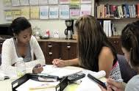
Conclusion
We can significantly increase learning by…
teaching students how to learn
making learning visible
not judging student potential on initial performance
encouraging students to persist in the face of initial failure
encouraging the use of metacognitive tools for deep and integrative learning

Slide 36
Additional References
Bruer, John T. , 2000. Schools For Thought: A Science of Learning in the Classroom. MIT Press.
Bransford, J.D., Brown, A.L., Cocking, R.R. (Eds.), 2000. How people learn: Brain, Mind, Experience, and School. Washington, DC: National Academy Press.
Christ, F. L., 1997. Seven Steps to Better Management of Your Study Time. Clearwater, FL: H & H Publishing
Cromley, Jennifer, 2000. Learning to Think, Learning to Learn: What the Science of Thinking and Learning Has to Offer Adult Education. Washington, DC: National Institute for Literacy.
Ellis, David, 2014. Becoming a Master Student*. Boston: Cengage Learning.
Hoffman, Roald and Saundra Y. McGuire. (2010). Learning and Teaching Strategies. American Scientist , vol. 98, pp. 378-382.
Nilson, Linda, 2004. Teaching at Its Best: A Research-Based Resource for College Instructors. Bolton, MA: Anker Publishing Company.
Pierce, William, 2004. Metacognition: Study Strategies, Monitoring, and Motivation.
http://academic.pg.cc.md.us/~wpeirce/MCCCTR/metacognition.htm
*Excellent student reference

Slide 37
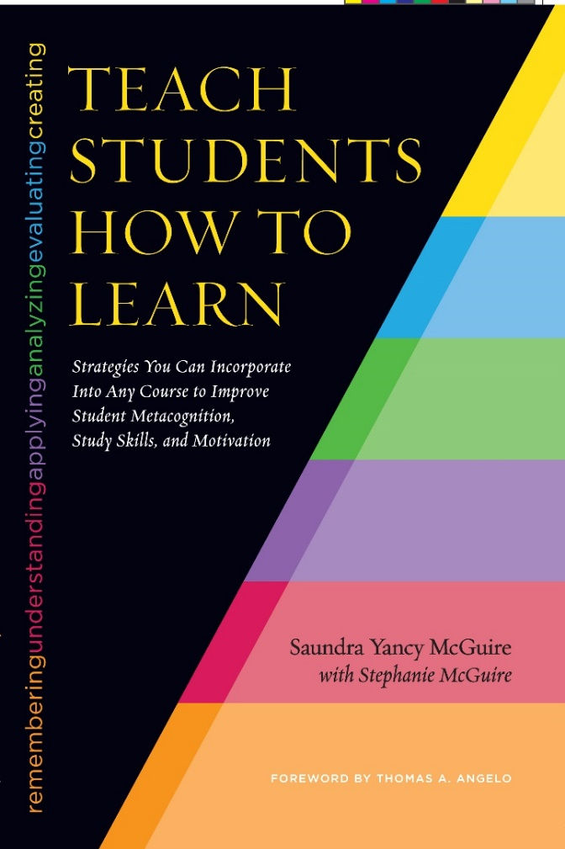
A Book for Faculty
Co-published in association with NISOD
McGuire, S.Y. (2015). Teach Students How to Learn: Strategies You Can Incorporate into Any Course to Improve Student Metacognition, Study Skills, and Motivation. Sterling, VA: Stylus

Slide 38
The Book for Students
McGuire, S.Y. (2018). Teach Yourself How to Learn: Strategies You Can Use to Ace Any Course at Any Level. Sterling, VA: Stylus

Slide 39
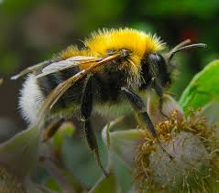
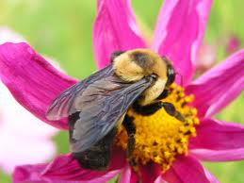
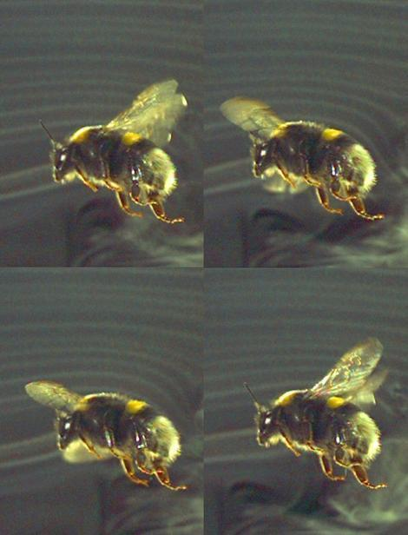
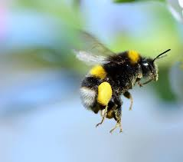
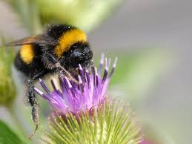
Why the Bumblebee CAN fly…

Slide 41
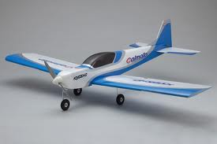
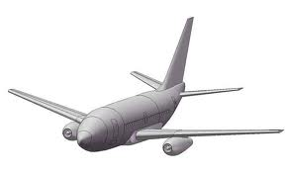



Slide 42
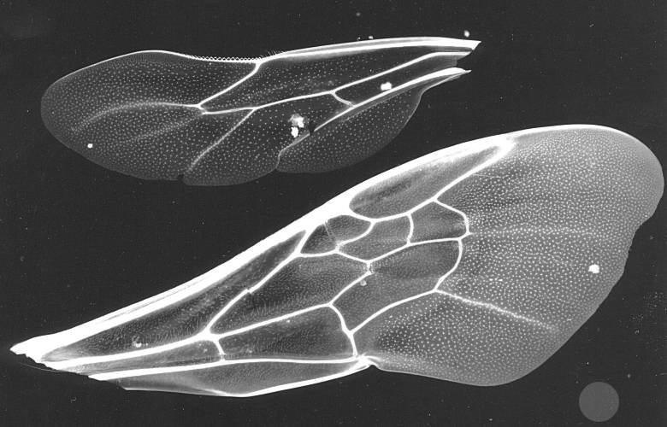

Slide 44
