Slide 1
Collaboration Connect With Me
Joey Bryant
Forsyth Technical Community College
March 28, 2017
Notes:
Collaboration – Connect With Me
In our global world, how do we communicate and do we communicate effectively? Someone once said that mobile devices have allowed us to connect with people half a world away while ignoring those across the table. As instructors, we challenge our students to communicate with each other inside a seated class, but how do we connect them in an online class? What steps can we take to help them continue those efforts after the semester ends? How do we encourage the development of the soft skills needed to be successful in the corporate world? Join me as we collaborate on ways to connect!

Slide 2
My Background
Program Coordinator at Forsyth Tech Community College
Over 30 years in Information Technology
Systems Software Designer
Project Manager
Database Administrator
Independent consultant
Communicated and collaborated with clients online

Slide 3
Collaborate VS Cooperate
We must understand the difference
Cooperation
Working or acting together for a common purpose or benefit
Ice Breakers
Groups
Collaboration
Work with another on a joint project
Groups
Projects
Sounds alike, right?
Can you cooperate and collaborate with communicating?

Slide 4
Why is Collaboration Important?
Develop needed skills
Teamwork
Negotiating
Feedback
Project management
Interpersonal/social
Critical thinking

Slide 5
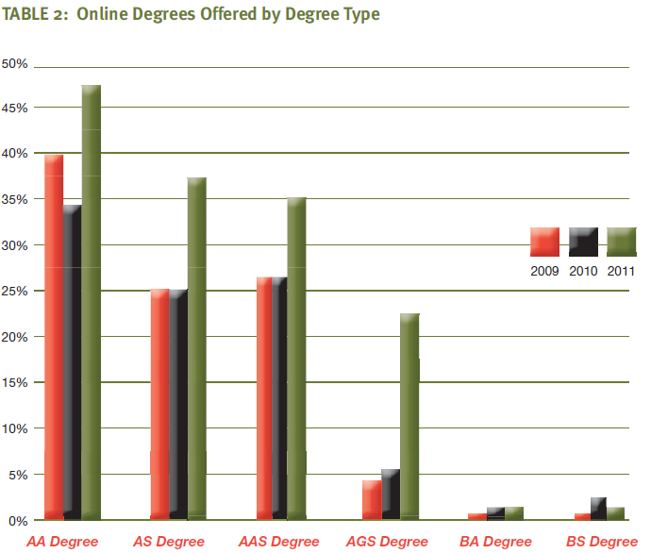
Instructional Technology Council Survey
At least 70% of coursework is completed online
78% of colleges/universities offer at least one full online degree program

Slide 6
What Do Students Think?
Builds bonds for others in same program
Students learn to collaborate in a virtual environment which is where education and corporate America is heading
Every job requires email and web based project correspondence
Teaches students how to work in these environments that are utilized in industry

Slide 7
What Issues Do Students See?
Getting students to collaborate outside the classroom
Severe time constraints
Students may not have access to resources/tools
Different schedules – lack of face-to-face interaction
Lack of participation by group members
Communication

Slide 8
How Can We Overcome Issues?
Can we utilize groups in online classes?
Yes – CTS285 and CTS289 are online project classes
Utilize Skype, AdobeConnect, Zoom, etc. for presentation and meetings
LMS has collaboration tools
Digital solution tools
Determine how to setup ways for students to communicate
Determine who belongs together in groups
Ask questions about schedules
Monitor time sheets/peer reviews
Ask for updates about participation

Slide 9
What Tools Can We Use?
Social media
Digital tools provide social media
I use ConnectYard in MindTap
Students are talking and sharing ideas with no assignments!
Conversations about recent events and on-campus events are being held
LMS has collaboration tools
Watch for FERPA violations

Slide 10
Other Tools
Skype for Business
Zoom
Join.me
Google Hangouts
Edmodo
Collaborize Classroom

Slide 11
Collaboration Connect With Me Questions/Comments
Joey Bryant
Forsyth Technical Community College
mbryant@forsythtech.edu
March 28, 2017
Notes:
Collaboration – Connect With Me
In our global world, how do we communicate and do we communicate effectively? Someone once said that mobile devices have allowed us to connect with people half a world away while ignoring those across the table. As instructors, we challenge our students to communicate with each other inside a seated class, but how do we connect them in an online class? What steps can we take to help them continue those efforts after the semester ends? How do we encourage the development of the soft skills needed to be successful in the corporate world? Join me as we collaborate on ways to connect!

