Slide 1
Informational Webinar:
NISOD 101: How to Engage
With NISOD
Brigitte Pentecost, Publications and Communications Manager
National Institute for Staff and Organizational Development

Slide 2
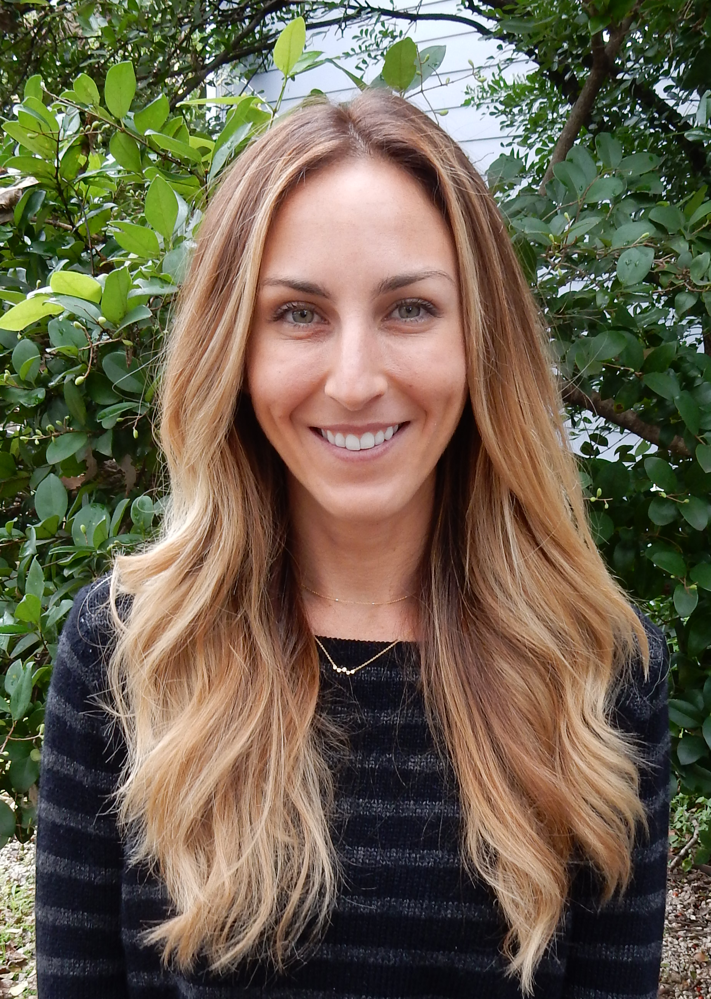
AGENDA
Innovation Abstracts
The NISOD Papers
#NISODProfiles
Member Spotlight
Brigitte Pentecost, Publications and Communications Manager
National Institute for Staff and Organizational Development
The University of Texas at Austin
nisod.org

Slide 3

Innovation Abstracts is NISOD’s flagship publication.
Pieces present ideas about programs, projects, and strategies that will improve your students’ learning and engagement.
  Pieces are faculty-focused
Accessed through the link in our weekly member newsletter, NISODirect, and the archives section of our website.
  Example of our weekly newsletter: https://conta.cc/2JBJ3MC (must be at a member college to receive)
Author Guidelines for submitting to Innovation Abstracts (there are also samples at the bottom of this page).
Useful blog piece: Innovation Abstracts - The 411
  Note: Innovation Abstracts authors receive $50 towards registration for our annual conference

Slide 4

The NISOD Papers is NISOD’s version of a white paper series and educates our audience or explains a particular issue relevant to community and technical college educators.
Pieces present ideas about professional development, emerging technologies, crisis communication, education reform, and more.
  Pieces can be institution-focused
Accessed through the link in our weekly member newsletter, NISODirect; the monthly nonmember email; and the archives section of our website.
  Example of our nonmember newsletter: https://conta.cc/2DEqxwG (anyone at a nonmember college can receive)
Author Guidelines for submitting to The NISOD Papers.

Slide 5
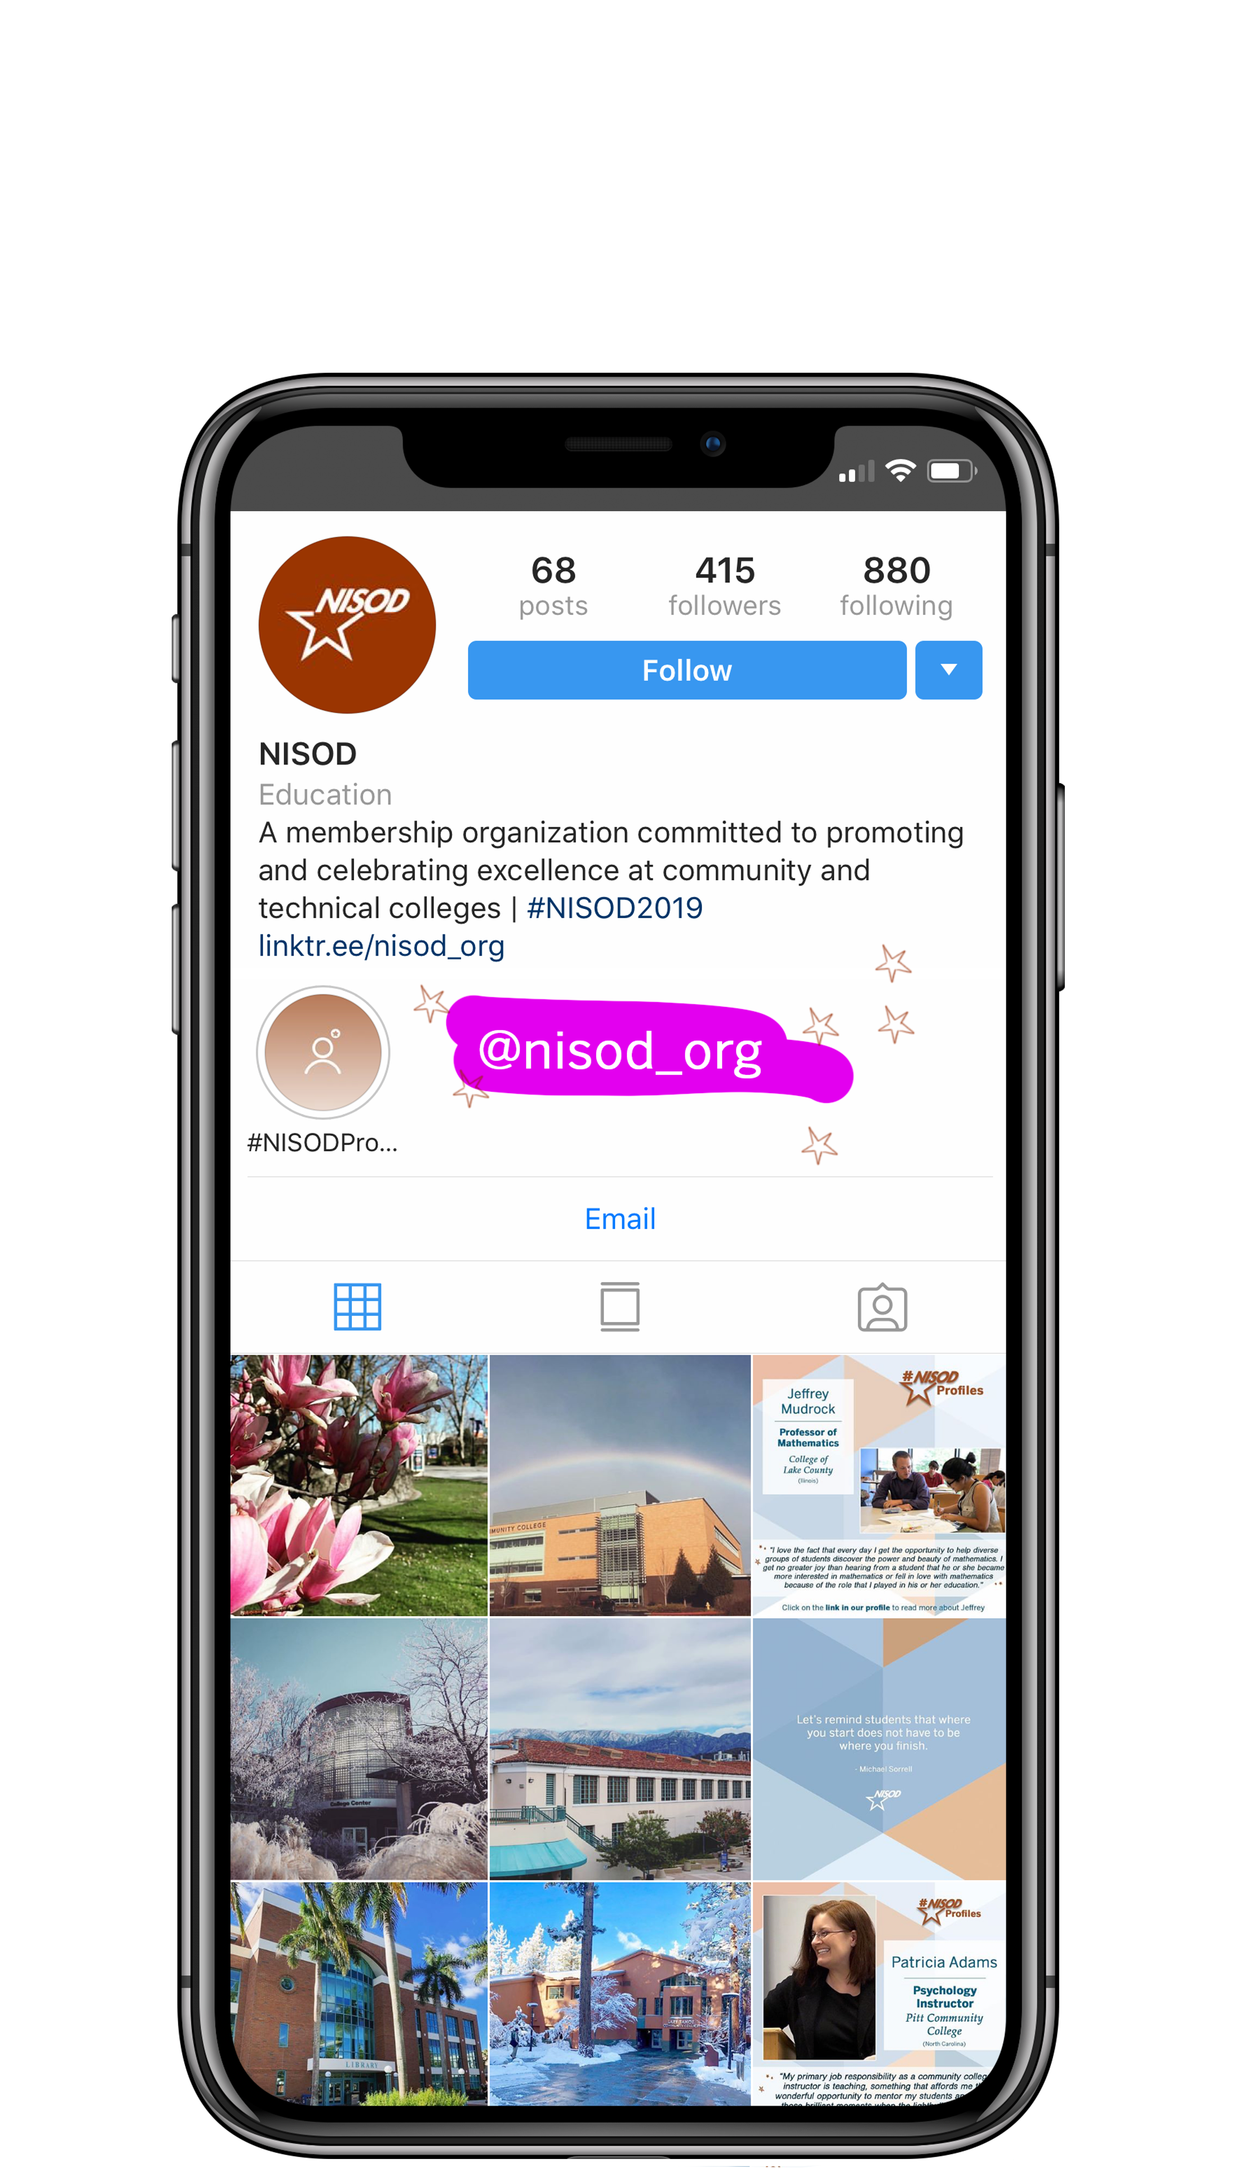

#NISODProfiles are profile pieces of individuals, groups, or programs at NISOD member colleges.
They serve as a way to connect our audience to colleagues.
Posts and profiles are currently accessed through our Instagram profile.
We just opened a submission page for public use.
Psst! Follow our Instagram (@nisod_org) for #commcollegeviews, giveaways, games, inspirational quotes, and more.

Slide 6
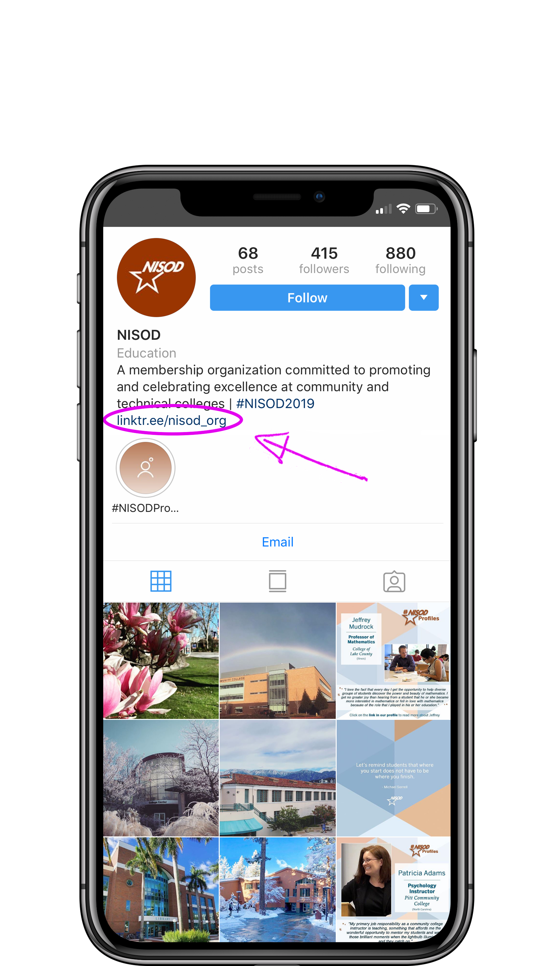
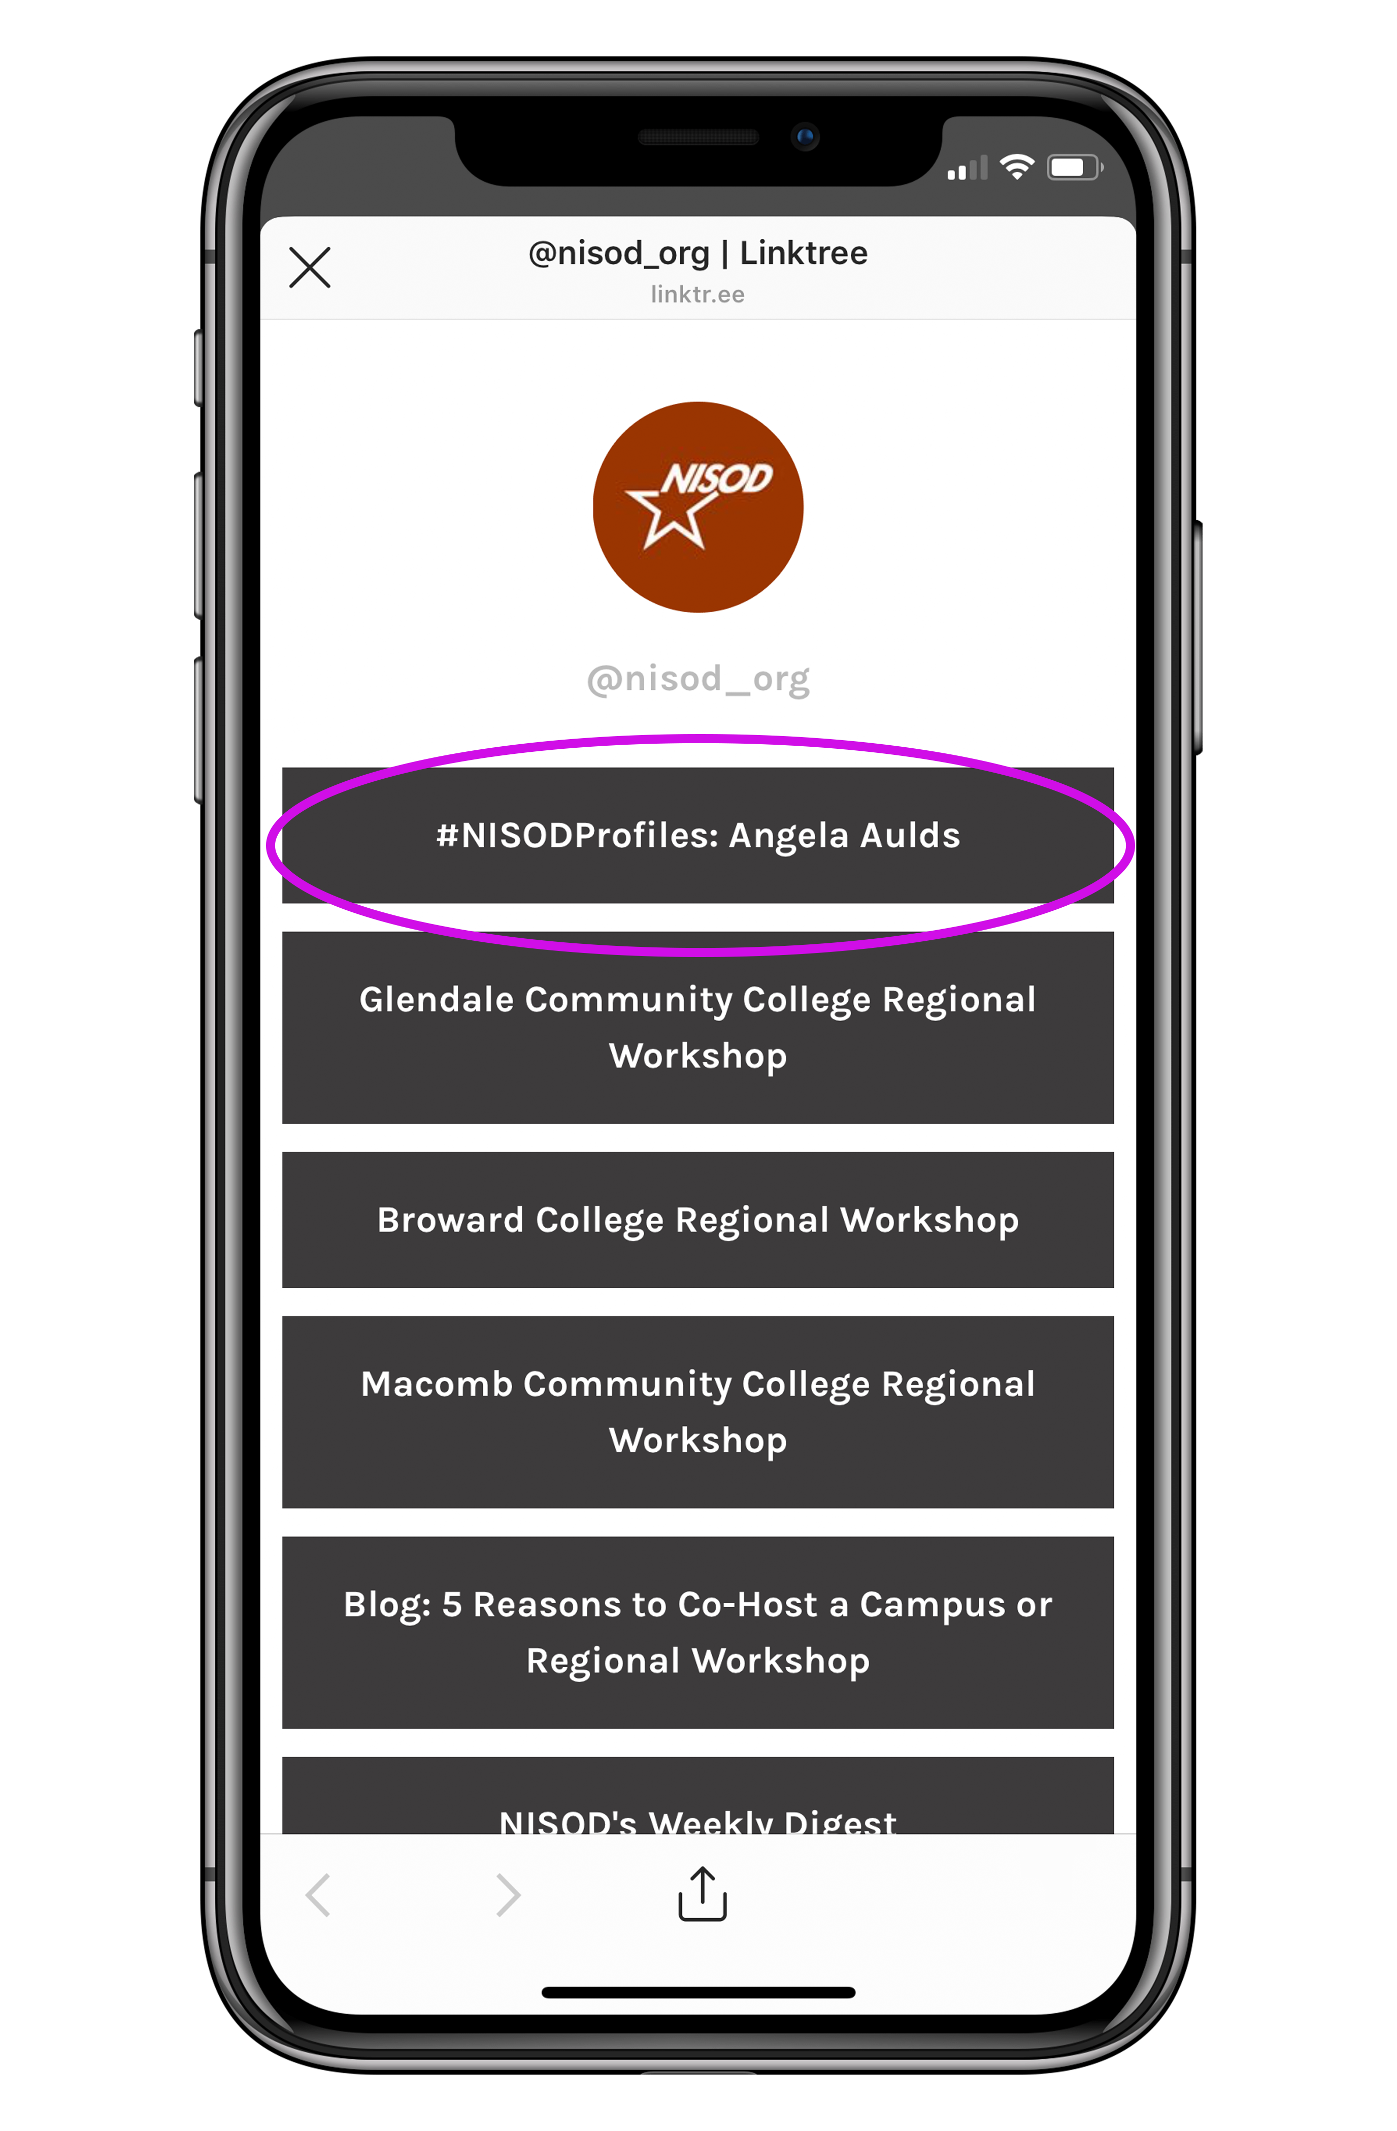
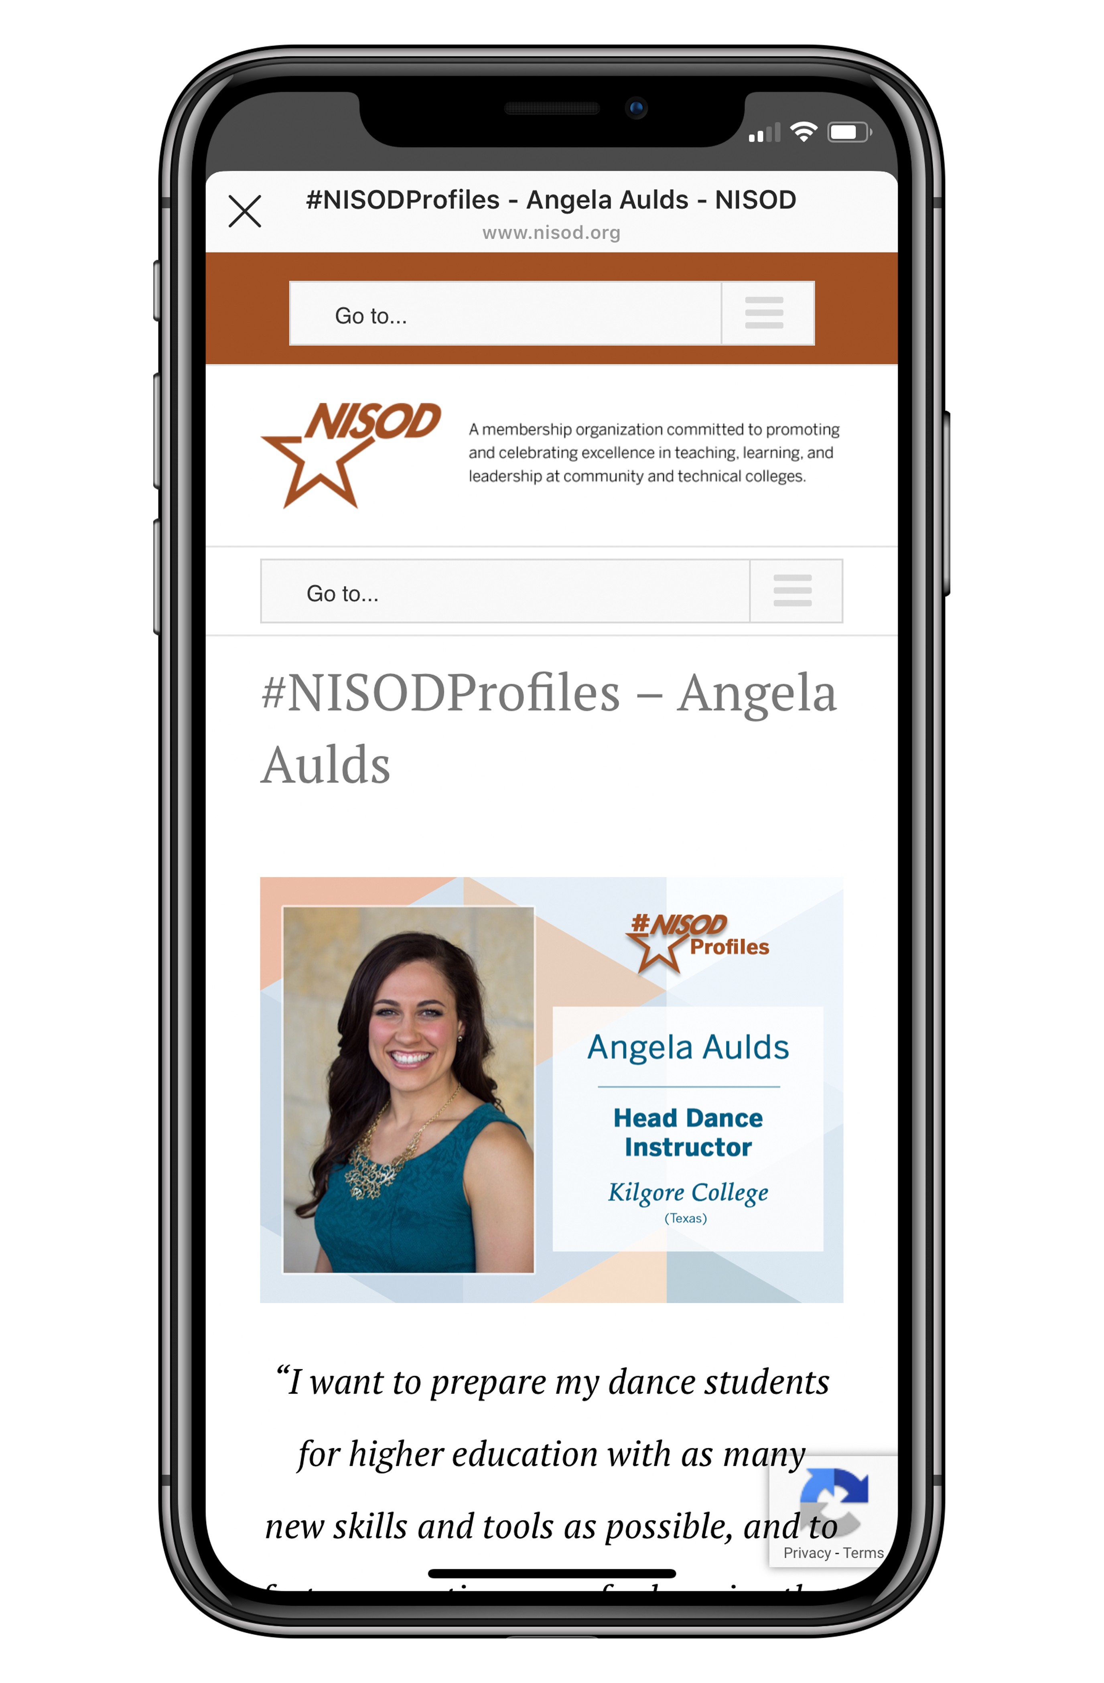

Slide 7

Member Spotlights are are profile pieces of our member colleges.
They serve as a way to connect member colleges to our audience to share their experience with NISOD and any exciting news on campus.
Spotlight posts are accessed through our blog and the link in our weekly member newsletter, NISODirect.
We actively solicit Member Spotlight submissions, but you are 100% welcome to email me if you’re interested in spotlighting your college and I’ll get in touch with your campus Liaison.
Here is a recent example of a NISOD Member Spotlight.

Slide 8
Questions?
Contact Information
Brigitte Pentecost
brigitte@nisod.org
(512) 232-3867
Sign up for our…
Member email list
Nonmember email list
Quick Links
Innovation Abstracts
Author Guidelines
The NISOD Papers
Author Guidelines
#NISODProfiles
Submission Page
Sample
Member Spotlight

