Slide 1
2019 Call for Presentations
Informational Webinar
Dr. Edward J Leach, Executive Director, NISOD

Slide 2
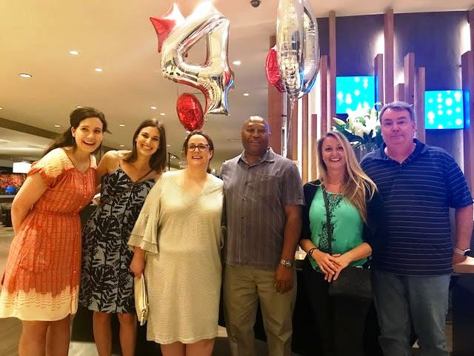
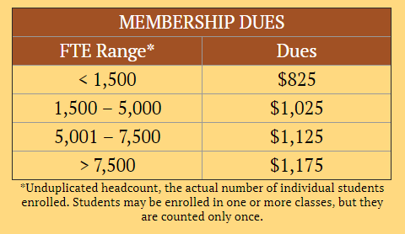
National Institute for Staff and Organizational Development (NISOD)
Established in 1978
The University of Texas at Austin
Mission
Benefits and Resources
www.nisod.org/benefits
“The country’s leading provider of professional development for community college faculty, staff, and administrators.” American Association of Community Colleges (February 8, 2016)

Slide 3
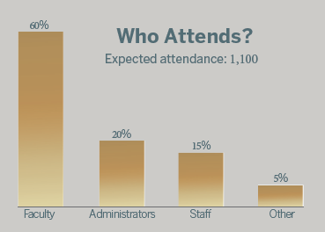
. . . the definitive gathering of community and technical college educators passionate about teaching and learning!
Austin, Texas - Live Music Capital of the World®
Conference Tracks
Career and Technical Education, Apprenticeships, and Internships
College Readiness, Remediation, ESL, and First-Generation Students
Competency-Based Education and Other Alternate Credentialing Strategies
Contemporary and Progressive Teaching, Counseling, and Advising Strategies
Emerging Issues and Trends at Community and Technical Colleges
Entrepreneurship, Strategic Alliances, and Collaborations
Evidence and Inquiry, Predictive Analytics, and Other Data Considerations
Faculty Hiring, Development, Support, and Governance
Guided Pathways and Other Completion and Transfer Efforts
Improving Diversity, Equity, and Inclusion
Libraries, Makerspaces, Fablabs, and Other Active-Learning Sites
Using Technology to Improve Student and Organizational Outcomes

Slide 4
Presentation Types
Preconference seminars
Fee-based, three-hour workshops
Saturday, 1:00 – 4:00 p.m.
Complimentary conference registration
Breakout sessions
Core of the conference
60 minutes
Interactive learning activities
$50 conference registration discount
Roundtable discussions
Personal and interactive setting
Substantive discussions and/or small group activities
Battery-powered laptop computer

Slide 5
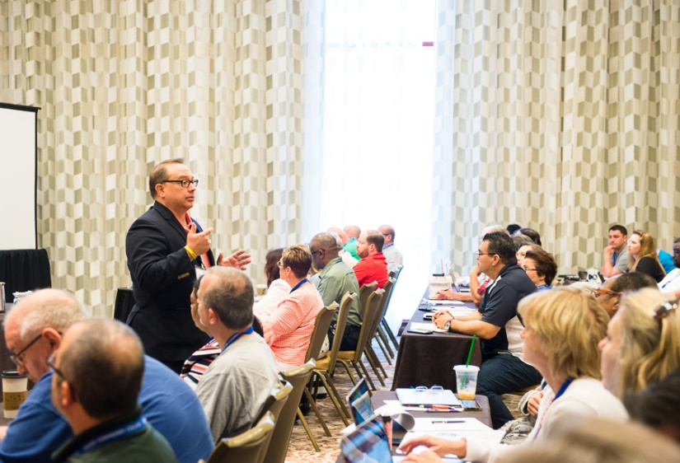
Selection Criteria
Well-written, with clearly stated learning outcomes
Relevance of the proposed solution or practice
Potential replicability of the proposed solution or practice
Development/demonstration of a promising new strategy
Opportunities for active learning
Contribution to the purpose of the conference
Overall standing among similar proposals
Multiple presenters/colleges
Sessions designed for classified staff

Slide 6
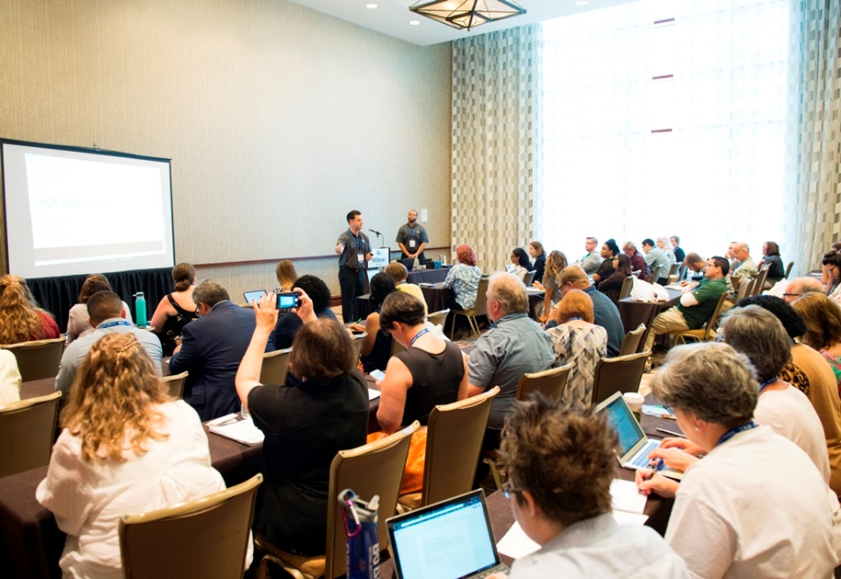
Why Present?
Presenters receive a $50 registration discount.
Professional development opportunity.
Expand your professional portfolio.
Collaborate with experts in the field.
Receive recognition for and feedback about your practice or program.
Be part of a dynamic community that has made NISOD’s conference the “must-attend” event for over 40 years!
Submit your presentation proposal at www.nisod.org/cfp!

Slide 7
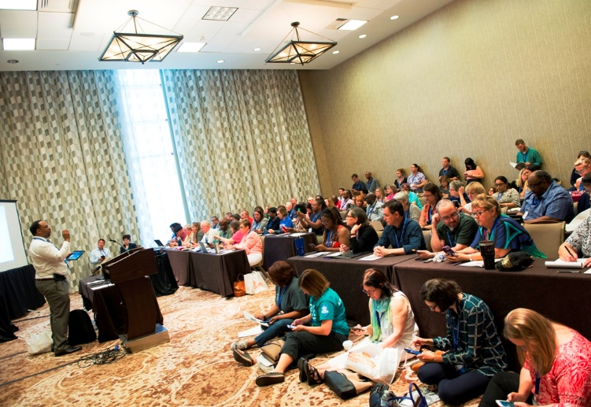
Deadlines
January 25, 2019 Deadline to submit proposal
February 4-8, 2019 Presenters notified about proposal selections
February 19, 2019 Presenter agreement forms due back to NISOD
February 25-March 1, 2019 Presenters notified by email when their sessions are scheduled
April 12, 2019 Super Early Bird Deadline ($100 Discount) Deadline to register to receive the $50 presenter discount
May 3, 2019 Early Bird Registration Deadline ($50 Discount) Hotel discount cut-off date
May 25-28, 2019 2019 International Conference on Teaching and Leadership Excellence

Slide 8
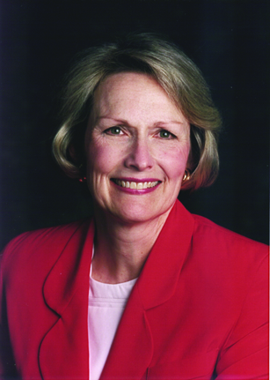
Suanne Davis Roueche Faculty Scholarships
NISOD’s director from 1985 to 2000
Faculty
Registration, travel, lodging, and a conference excursion
Application deadline: February 28, 2019
www.nisod.org/scholarships/

Slide 9
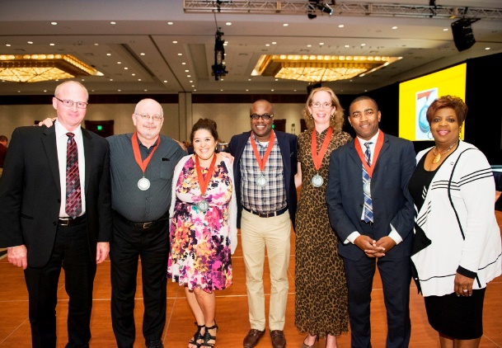
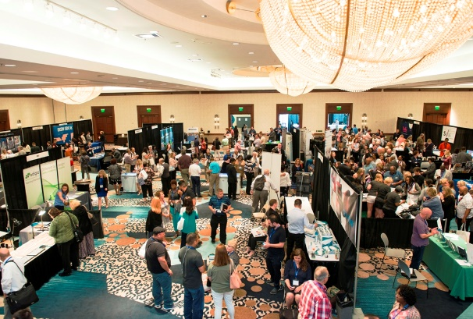
Conference Features
San Antonio and LBJ Presidential Library Excursions
Excellence Awards Dinner and Celebration
Exhibit Hall
Coffee breaks, refreshment breaks, receptions, and prize drawings
Administrator Series

Slide 10
Q&A
Dr. Edward J Leach
Executive Director, NISOD
ed@nisod.org

