Slide 1
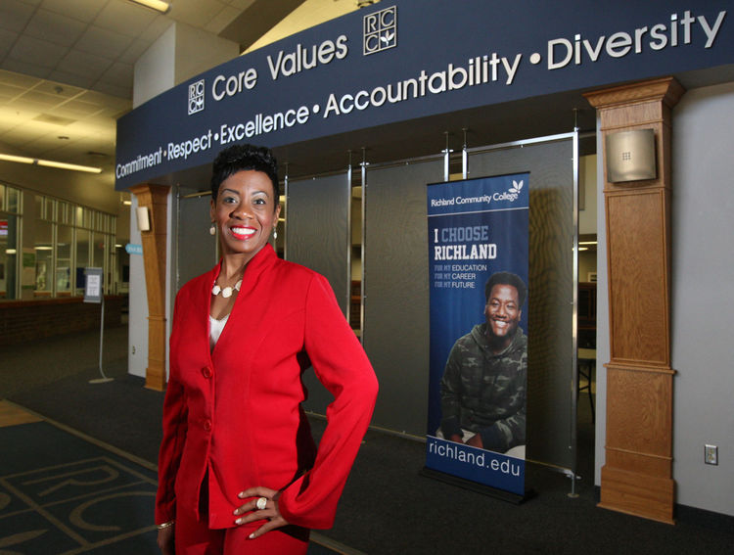
Student Engagement in College: The Heartbeat of Student Success- Part I
Dr. Jarmese Sherrod
Richland Community College
Decatur, IL

Slide 2
Pre-Question
What is the top area that you deem important in accomplishing Student Success?

Slide 3
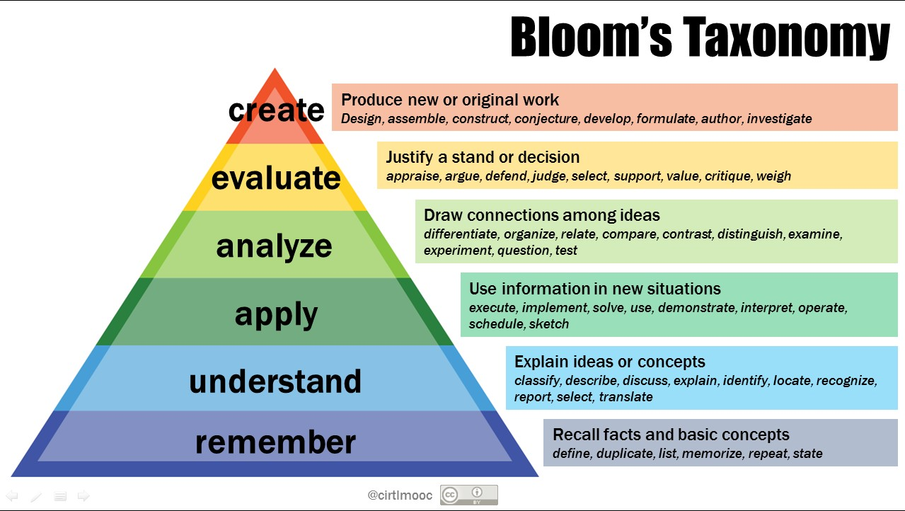
Applying Theories- Benjamin Bloom Taxonomy (Rev.2001)
Assessments & Group Projects
Weekly Sentence Skills and Writing assignments
SQ5R & SCANS Skill Assessment

Slide 4
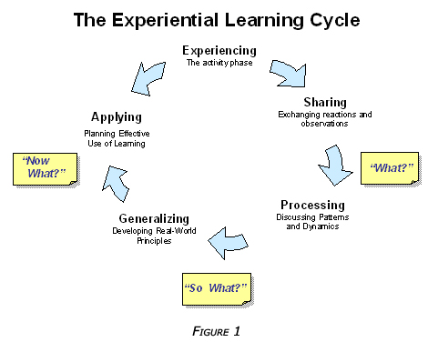
John Dewey’s Learning Theory
Modularized my courses & eliminated high price books
Active and Adaptive learning styles

Slide 5
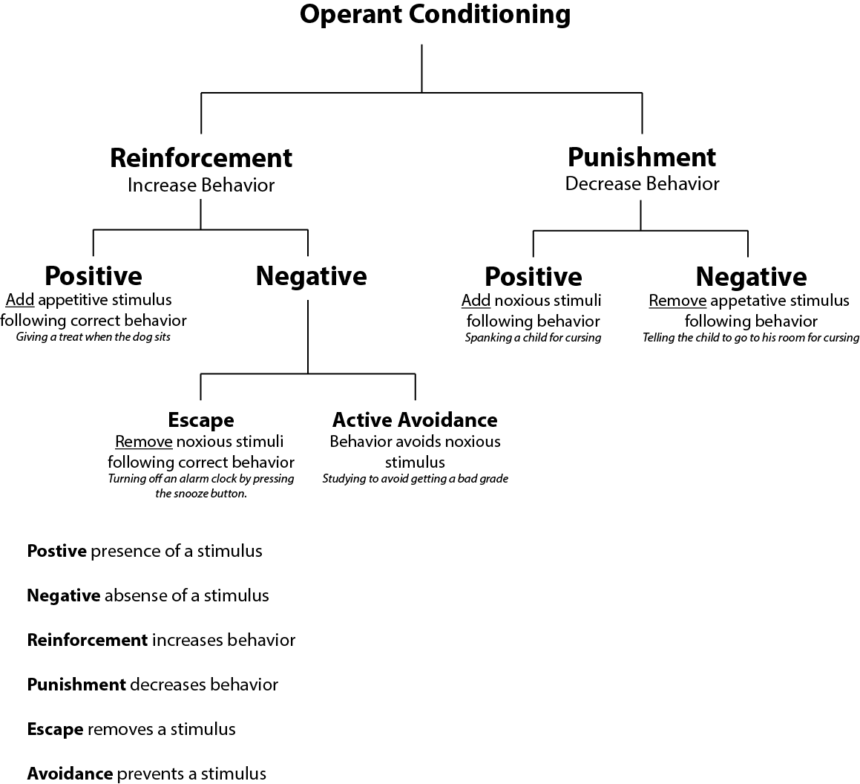
B.F. Skinner’s Operant Conditioning
Grammar Throw Down
Prizes
Praise

Slide 6
Actively engage students It’s my job…
Actively interact with the students and grade them through the learning objectives to produce outcomes
Encourage all students to ask questions and encourage deeper reflection in their writing
Stay focused and help students learn how to complete assignments
State the goals of the class, but I encourage students to find the path to that goal

Slide 7
Building Rapport It’s my job to…
Go above and beyond to make students feel welcome
Help students transition to a university setting and convey high standards for academic coursework
Help students adjust to the instructional setting, motivate and encourage them to develop effective writing skills
Provide a productive learning environment that will foster care and nurturing to all students who are in my class

Slide 8
Principles of Effective Facilitation It’s my job to…
Implement effective facilitation by providing clear explanations and feedback to the students
Be consistent in setting realistic expectations enforced by the College's policies and standards
Mentor students and coach experienced students to help them reach their goals
Discuss available options to help students build a better relationship with an academic counselor

Slide 9
Principles of Effective coaching It’s my job to…
Set a positive tone and create a courteous environment by promptly addressing the students questions in the class setting and in my mailbox
Get to know all my students so that they can feel comfortable enough to work with me during class time
Work with students and not lecture- I am looking for student assignments and class discussions that are descriptive and reflective on personal experiences

Slide 10
Giving emotional support It’s my job to…
To give emotional support and encouragement to help them feel comfortable in class
Give specific feedback and assist in improving students critical thinking abilities
Communicate high expectations
Be flexible, fair and positive at all times

Slide 11
Keeping things in perspective It’s my job to…
Understand that some students may have been out of school or transferring into college
Sympathize with busy work schedules and family life
To be aware that I am here to help and encourage them through this process of learning
To state "Don't feel intimidated by working face-to-face because we are in a community of successors and you hold the key to success"

Slide 12
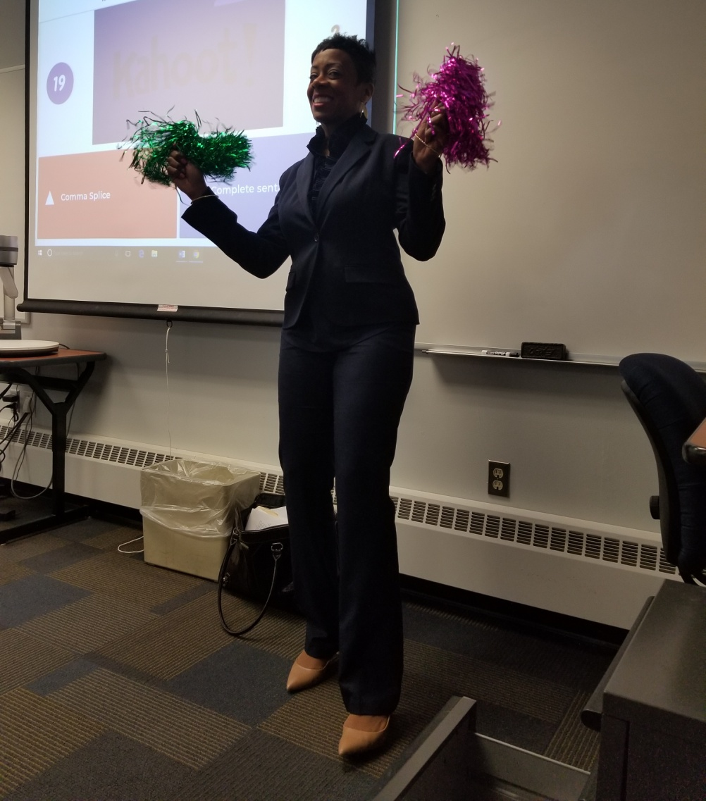
My Motto for all Richland Scholars
You hold the key to your door of success. No matter where you come from or what you go through and if you believe in yourself, you can achieve your goals and reach for success!
I tell them that I am their biggest cheerleader ☺

Slide 13
G.R.I.T. @ Richland
Growth Mindset- to develop/ to grow
Resilience-ability to become strong after something bad happens
Integrity/Instinct- adherence to moral or ethical principles/being honest or fair and a way of behaving, thinking, or feeling that is not learned
Tenacity- extremely persistent in adhering to or doing something

Slide 14
GRIT in the classroom-Resources & Assignment
GRIT by Angela Duckworth | Animated CORE Message:
https://www.youtube.com/watch?v=sWctLEdIgi4
Famous Failures
https://www.youtube.com/watch?v=zLYECIjmnQs
Inspirational movie about the meaning of "Grit“
https://www.youtube.com/watch?v=UGKSb_dSZ1I
Prompt: What Talents or Efforts (G.R.I.T.) do you need to apply to the Exit Exam to pass with a 7/7? You can use first person (the use of I) in this essay.

Slide 15
G.r.i.t.Power
Do you have G.R.I.T.?
What are your G.R.I.T. strengths?
How do you apply it to your daily routine?

Slide 16
Inside the classroom (Overview)
First Week
Exit Exam & Exit Exam Success Modules
Writing and Grammar Daily
Modularized Learning
Hybrid Developmental Courses
Critical thinking, Peer Editing & Grading
Active Learning (peer groups)
Grammar Group Exercises
Grammar Throw Down Competition
All of these help set students up for Success!

Slide 17
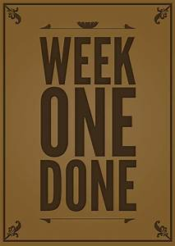
First Week
Writing Assessment on First day
7/7 Promotion
Get to Know Your Professor Group Game
Student Introductions
Student Expectations
Student-Teacher Agreement
Plagiarism Chat
Name to Picture Memorization
Technology Help with Canvas
The Goal Set Up

Slide 18
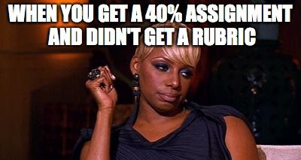
The Look students give you when they fail without a rubric

Slide 19
paragraph rubric
Paragraph Grading Rubric for English 095 & 097
Student Name: ______________________________________
To pass, the paragraph must score all six (6) marks in the “Yes” column.
Proficiency | Yes | No | Grader’s Comments
The paragraph has a topic sentence that is clear, complete and concise.
The paragraph has appropriate transitions.
The paragraph is well-developed, based upon the forecast of respective topic sentence, without straying off topic.
The concluding sentence provides a clear sense of completeness and closure.
The paragraph is written in formal, academic tone.
Few sentences are difficult to follow or have major grammar errors, especially fragments, run-ons, comma splices, subject-verb agreement errors, or tense errors.
Total

Slide 20
Exit exam & 5 paragraph rubric
Grading Rubric for English 097
Grader’s #_______________________________
Student ID# ___________________________________
To pass, the essay must score all seven (7) marks in the “Yes” column.
Proficiency | Yes | No | Grader’s Comments
The essay has an opener to help engage the reader’s interest.
The essay has a thesis statement that states the main idea of the essay.
The essay has an organizational pattern for paragraphs that utilizes topic and conclusion sentences.
The body paragraphs are well-developed, based upon the forecast of respective topic sentences, without straying off topic.
The conclusion paragraph provides a clear sense of completeness and closure.
The paper is written in formal, academic tone.
Few sentences are difficult to follow or have major grammar errors, especially fragments, run-ons, comma splices, subject-verb agreement errors, or tense errors.
Total

Slide 21
Exit EXAM SUCCESS MODULES
Welcome
Module 1: Introduction
Module 2: Formulating a Thesis
Module 3: Organizational Pattern for Paragraphs
Module 4: Body Paragraphs
Module 5: Conclusion Paragraph
Module 6: Writing in Formal, Academic Tone
Module 7: Avoiding Grammatical Errors
Module 8: View Pass & Fail Student Examples
Module 9: Student & Faculty Advice
Since 2015, approx. 400 students have taken and passed the modules.
At Richland, my role is to exhaust all of my resources to put student’s first and strive towards retention.

Slide 22
ENGL 097 Snap Shot Success
Year | # of students passed
Spring 2014 | 57%
Summer 2014 | 63%
Fall 2014 | 78% * Hired at Richland/implementation started
Spring 2015 | 82% * Served as Developmental Alignment Coordinator
Summer 2015 | 93% *
Fall 2016 | 93% *
My Courses only | Accelerated Models & Hybrid
Spring 2016 | 86%
Summer 2016 | 90%
Spring 2017 | 86%
Summer 2017 | 100%
Fall 2017 | 93%

Slide 23
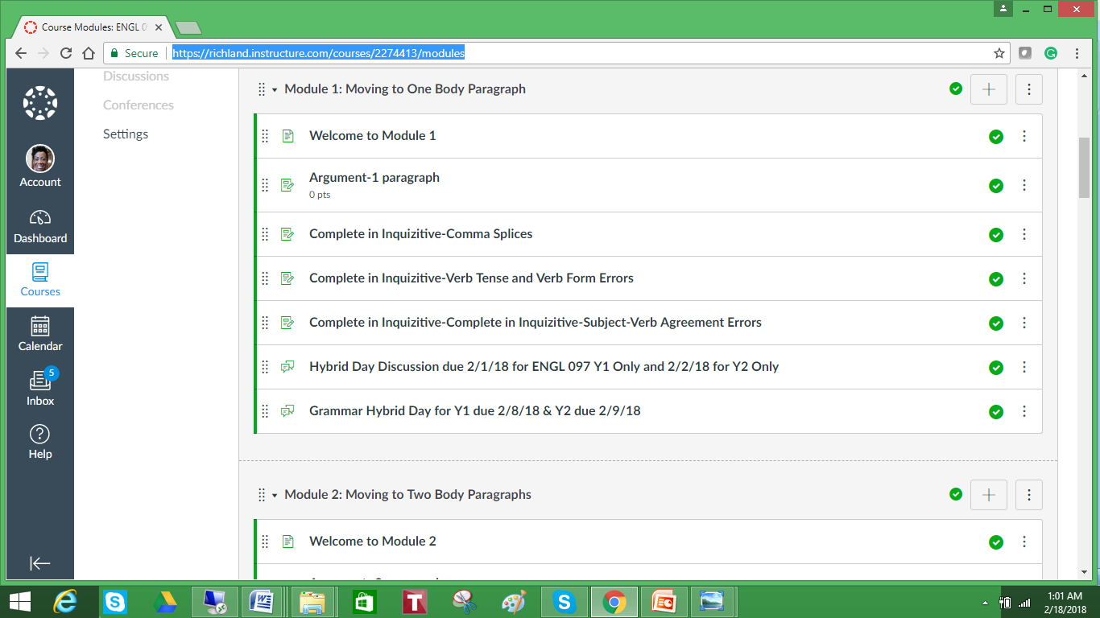
Modularized Courses & Hybrid Learning

Slide 24
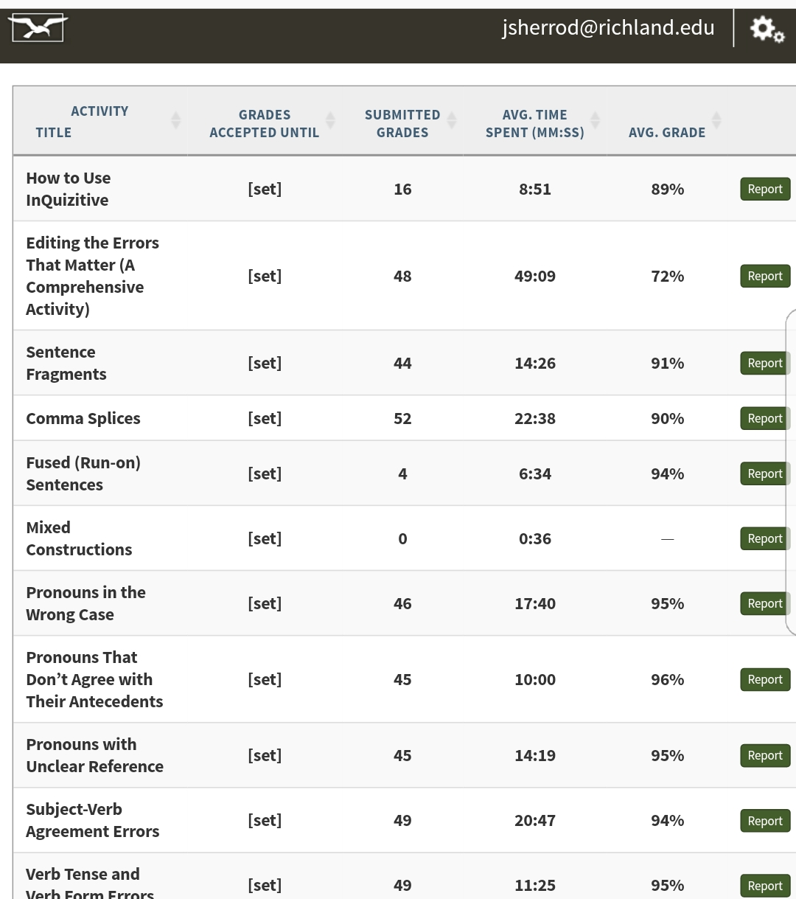
Practice Quizzes Inquisitive by W.W. Norton & Company

Slide 25
Critical thinking Peer Editing & Grading
15 areas on the sheet for revision advice
Songs are implemented for the harder areas
Grade with the numbers instead of detailed feedback
Students complete this process at least 3 times.
Students have to use the numbers, the class resources, and rely on peer support to make edit and revisions to accelerate to the next level. This process:
Helps students retain information
Uses their critical thinking skills to make cognitive decisions to score high
Teaches them accountability and how to present during conferences

Slide 26
My Writing Process
Conferences-In each assignment, students meet with me weekly. Here is a breakdown of my weekly scheduled assignments:
Part 1
Brainstorm on your one topic
Part 2
Follow the outline & complete the draft
Part 3
Peer edit your paper and make sure you eliminated your weaknesses
Do # 1 & 2 on the peer edit sheet
Bring the copy to class and DO NOT submit it online
Part 4
Peer Edit (outline version only)
Submit assignment in Canvas in paragraph form after revising areas of weaknesses (from peer edit and past conferences)
Conference with Dr. Sherrod
Make revisions and print out a hard copy
Conference with Dr. Sherrod
Remember that I am your greatest cheerleader in this class, and I want you to succeed on every assignment. Scholars, please ask for help if you are confused about anything. Good luck!

Slide 27
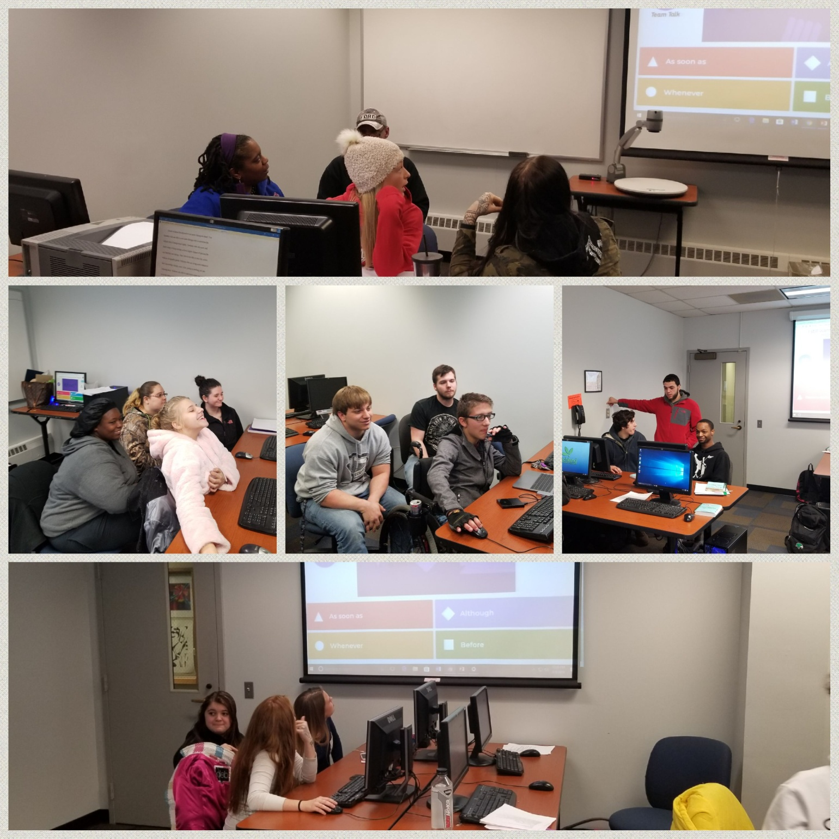
Grammar Throw down Competition

Slide 28
Laughs & Fun to their Favorite (Clean) Music

Slide 29
Celebration time

Slide 30
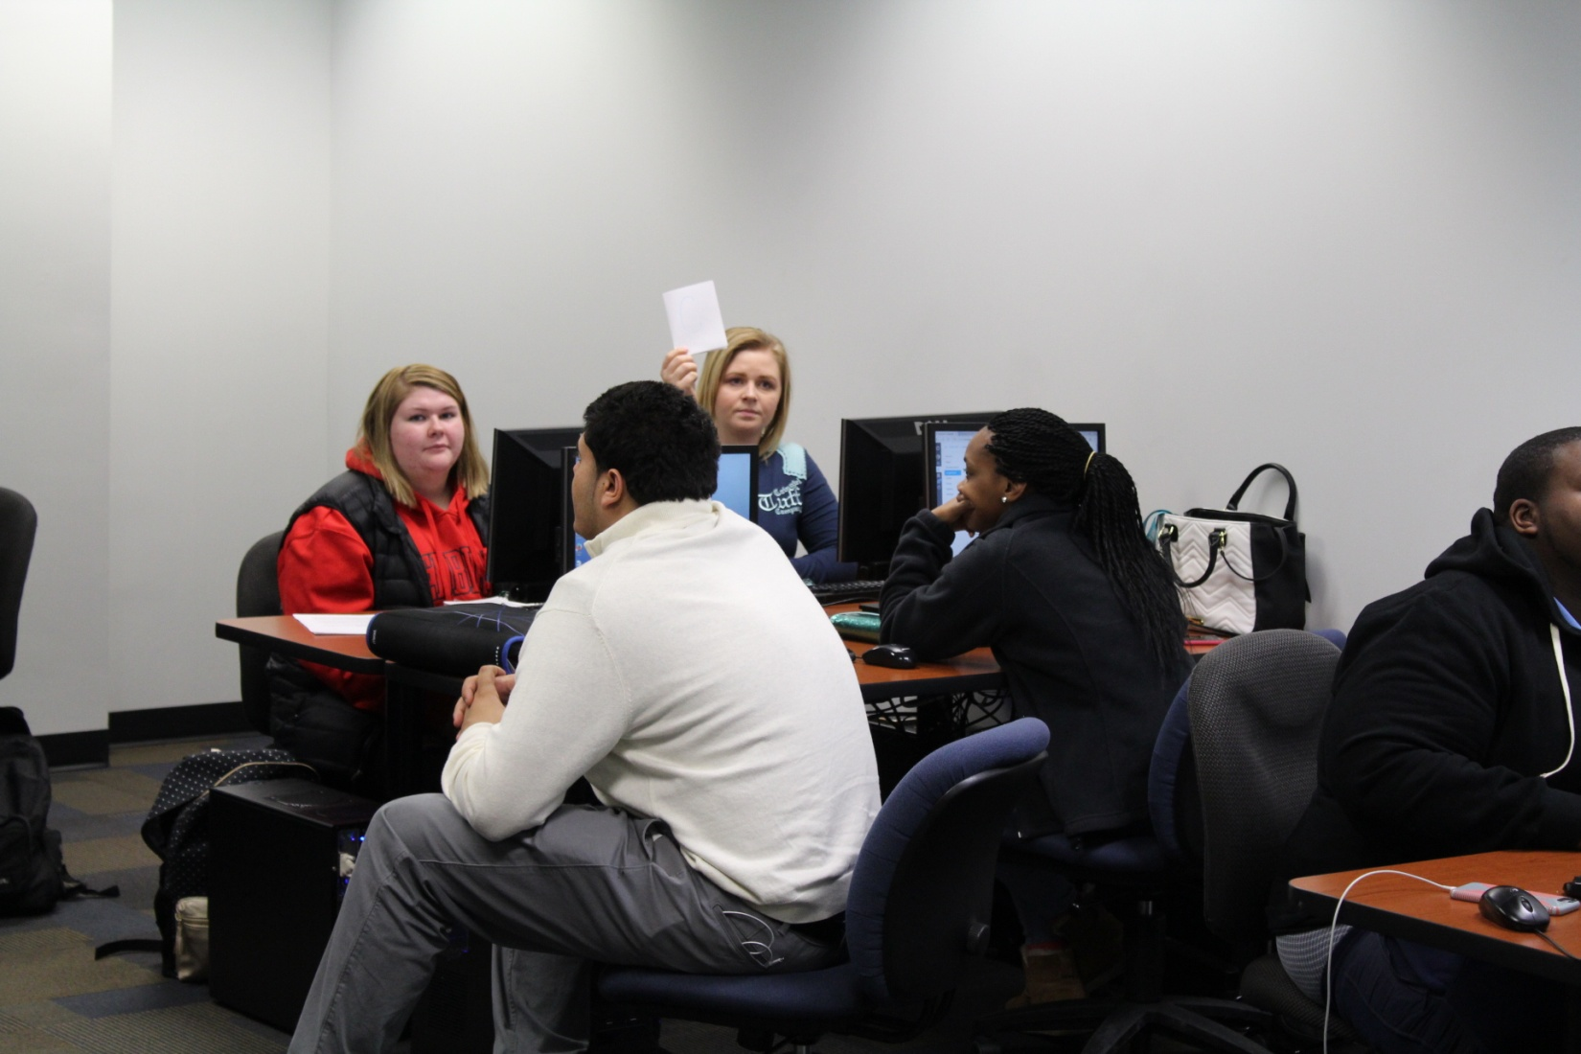
Grammar Group Collaborative Work

Slide 31
Grammar Group Collaborative Work

Slide 32
Team Work Pays off

Slide 33
Outside the Classroom (Overview)
Presence on Campus
Meeting with Students in the Cafeteria
Being Personal
Taking classes to Student Engagement Events
Volunteering to speak at all New Student Orientations
Taking on Mentees
Listening Only
Mandatory office hours during midterm “Needs Improvement” Contracts
Open Door Policy
Always available (via email)
Giving up office computer for hands-on tutoring during office hours

Slide 34
Office Hours Tutoring takeover

Slide 35
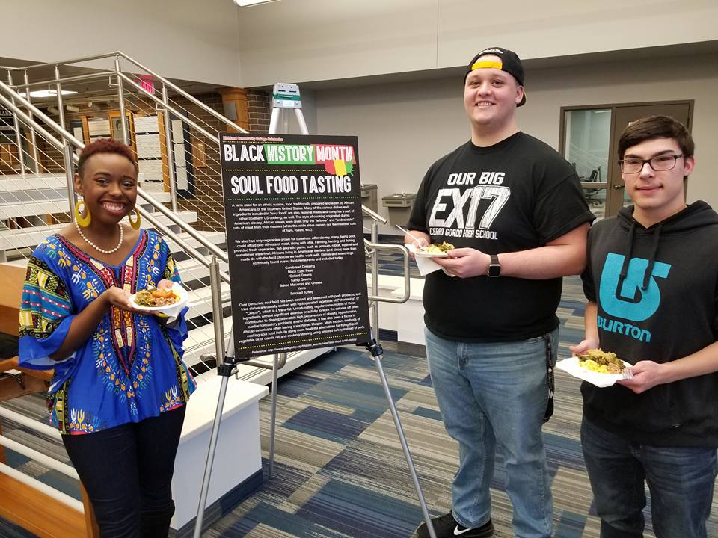
showing the value of student engagement

Slide 36
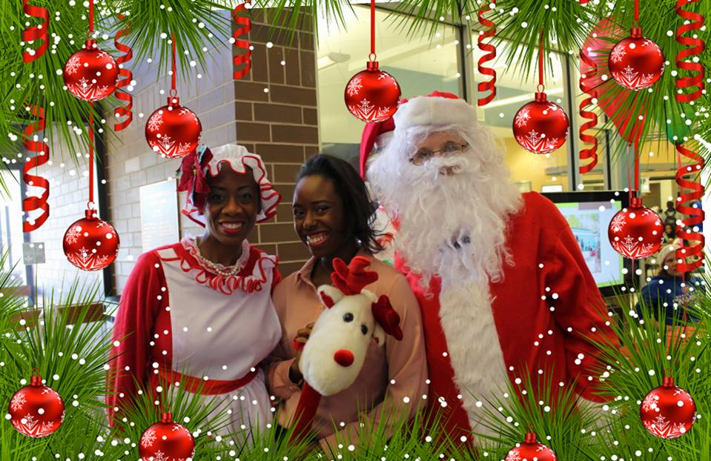
Willing to dress up for a good cause

Slide 37
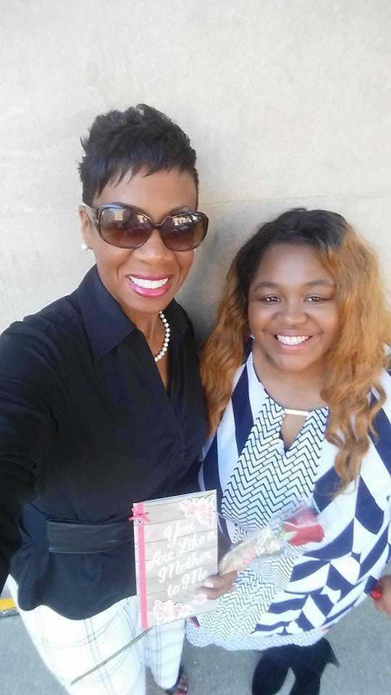
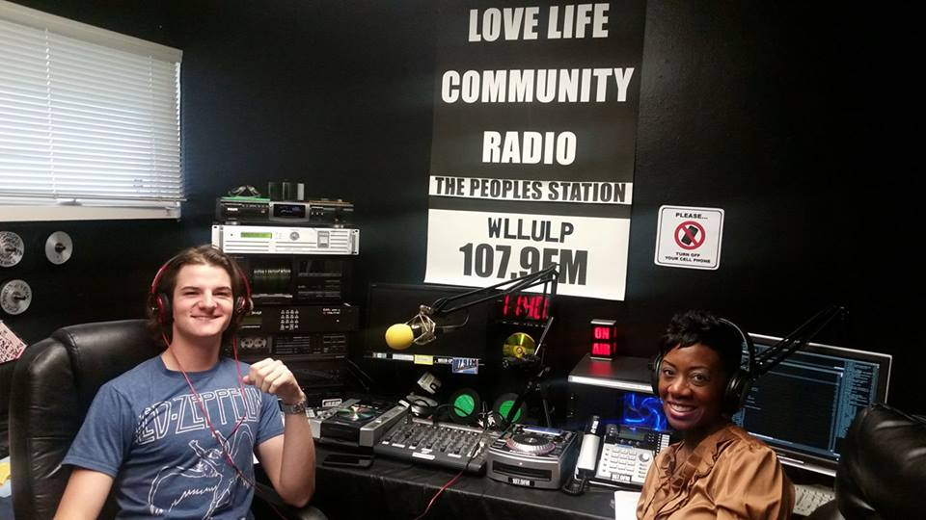
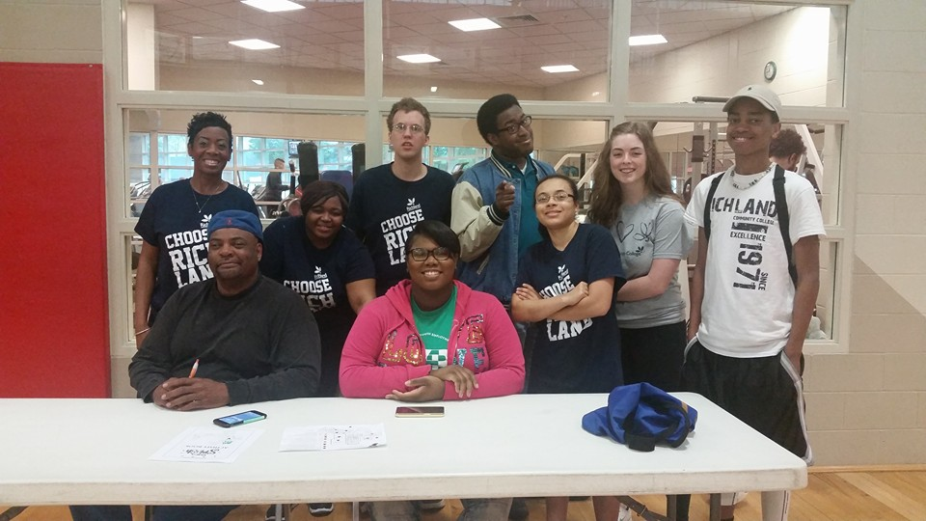
Always Student focused- student centered

Slide 38
Establishing Support through collaboration
Students
Advising
TRiO
Academic Student Success
Tutoring
Faculty
Administration
Community Advocates
* My success was not accomplished alone!
How can you start today by establishing support in your institution?

Slide 39
Post-question
What is the takeaway from today that you can use from my presentation to help you start your Heartbeat of Student Success at your institution?

Slide 40
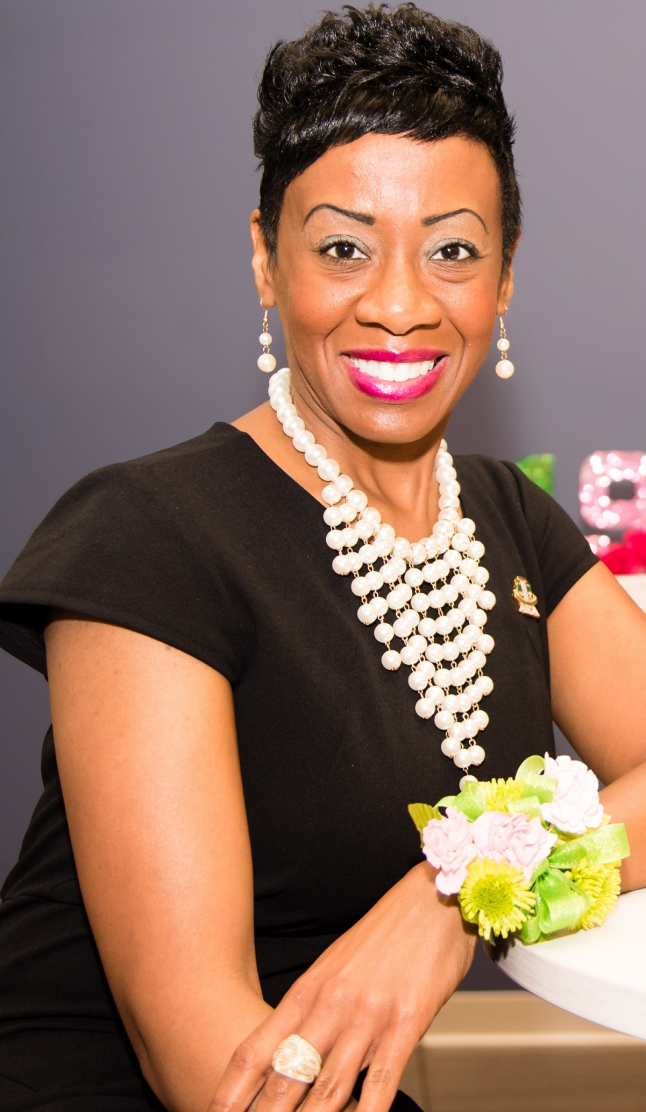
Thank you!
Dr. Jarmese Sherrod
Developmental English & Media
Richland Community College
C220
Decatur, IL 62521
jsherrod@richland.edu
217-875-7211 #6369
Richland's Core Values:
Commitment * Respect * Excellence * Accountability * Diversity
Any Questions?

