Slide 1
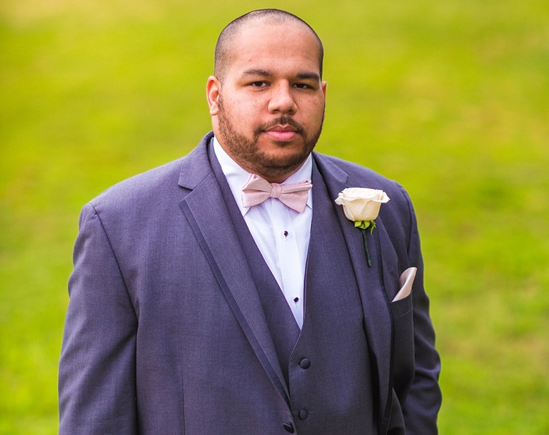
Having a daily opportunity to enhance someone's thought process is what I love about teaching, but seeing how students use this information to innovate and change the world around them is why I continue to teach.
—Jarrett Hedgepeth, Nash Community College

Slide 2
Using the knowledge I have gained from my own education to teach and inspire others is the most rewarding thing I have ever done. Seeing the impact I can have on students' lives will never grow old!
—Rebekah Robinette, National Park College

Slide 3
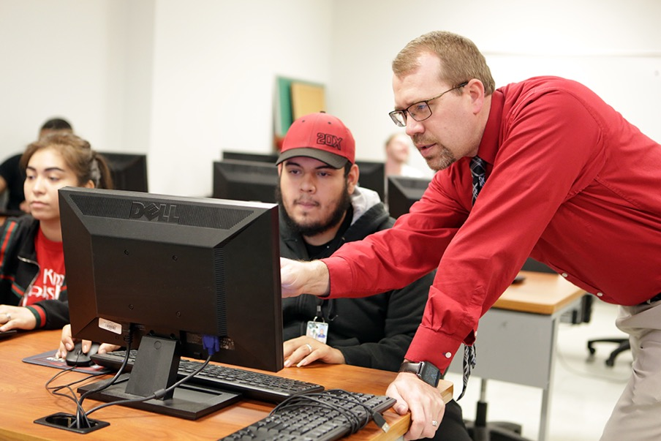
Patience, kindness, and support are what many students need in order to succeed. Our future is determined by the tenacity of our students. Make your mark. Don't be afraid to try new things and don't be afraid to fail. A new strategy may be what tips a student toward success!
—Brandon Ford, Navarro College

Slide 4
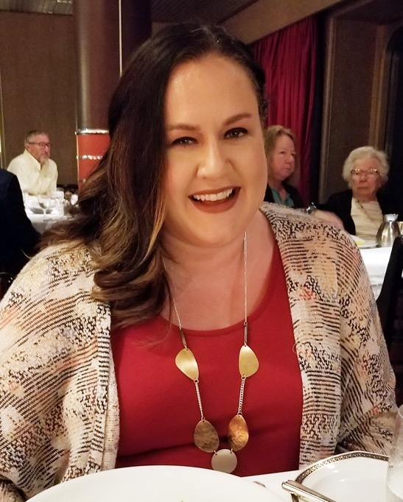
The book Oh, the Places You'll Go by Dr. Seuss is always in the back of my mind when I'm teaching. I can't wait to see where my students will go and what great things they will accomplish. They are the future and I hope to help them make it great!
—Jeanette Underwood, Navarro College

Slide 5
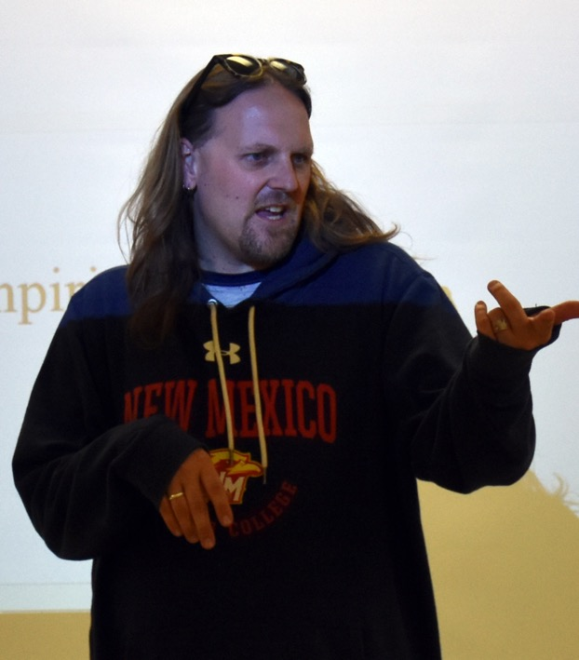
The best use of educational technology inspires, motivates, and engages students. Technology can help overcome challenges. The poor use of technology distracts instructors and students, therefore creating additional challenges. Dialogue with students helps us sort out the good uses from the poor ones.
—Dallas Hulsey, New Mexico Junior College

Slide 6
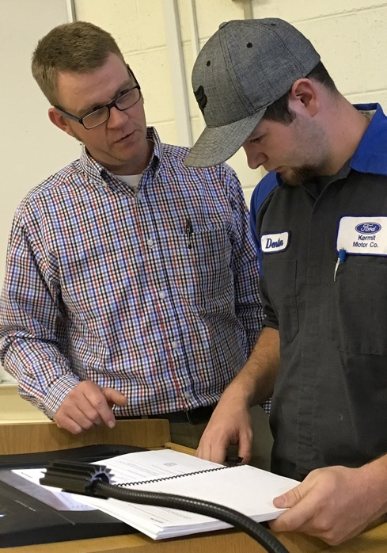
Many of the students who enter into the program are fresh out of high school with little experience in the automotive industry. Each semester their confidence, abilities, and desires grow. The more they want to learn and succeed, the more I want to deliver as much knowledge as possible.
—Kelley Williams, New Mexico Junior College

Slide 7
Students are my inspiration and motivation. Their success provides me with inspiration, and when students update me about their progress, I am filled with a sense of pride. Although life is hectic and busy, take time to help students. One assistance can make a difference.
—Cathy Aguilar-Morgan, New Mexico State University - Alamogordo

Slide 8
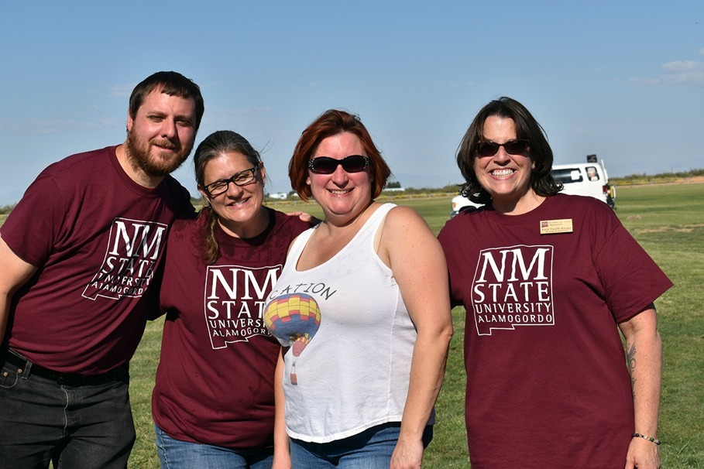
A student once told me that they never thought they could go to college, but they enrolled at our school because of something I had said to them. Whatever your role, reach out to students, employees, and the community. You never know whose life you will affect.
—Katie Pacelli-Klinger, New Mexico State University Alamogordo

Slide 9
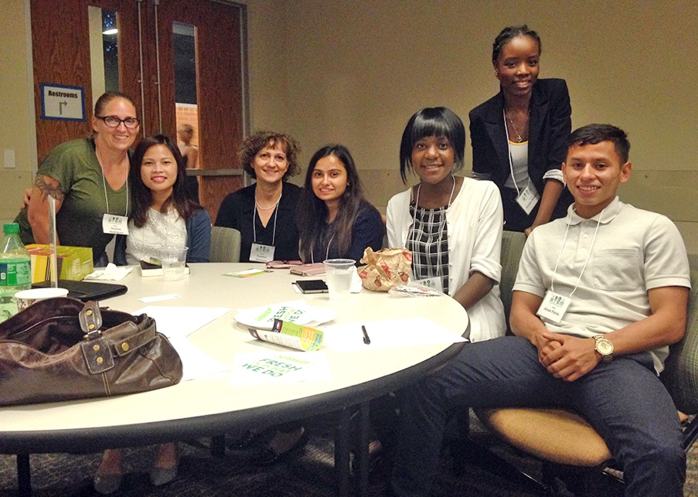
I “live in the moment” while teaching. Our innate yearning for truth leads students to appreciate chemistry’s inherent beauty. I experience deep satisfaction seeing students struggle and then succeed in comprehending difficult abstract concepts.
—Cynthia Simmons, North Lake College

Slide 10
I realize the importance of making sure my students possess the skills needed to contribute to society and industry. The innate talent and insights those students possess, suitably encouraged, will bring about a positive future for my grandchildren.
—Jay "Keith" Baker, North Lake College

Slide 11
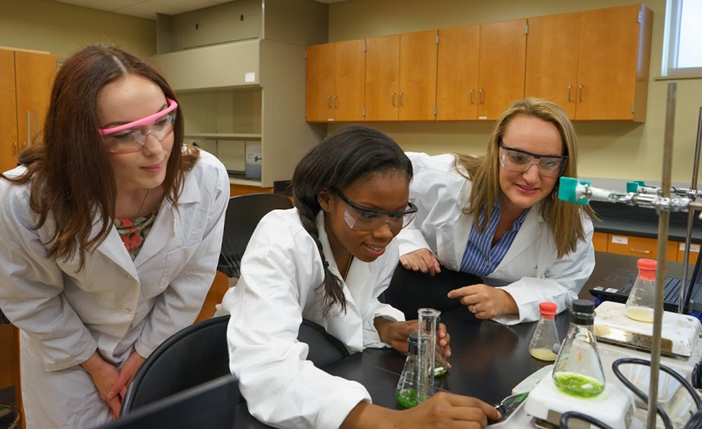
I strive to create a learning environment where students can improve their critical-thinking skills, collaborate with their peers, and communicate their knowledge. I hope that my enthusiasm inspires students to take ownership of their education and leave my class with the confidence they need to accomplish their goals.
—Marsha Adrian, Northeast Lakeview College

Slide 12
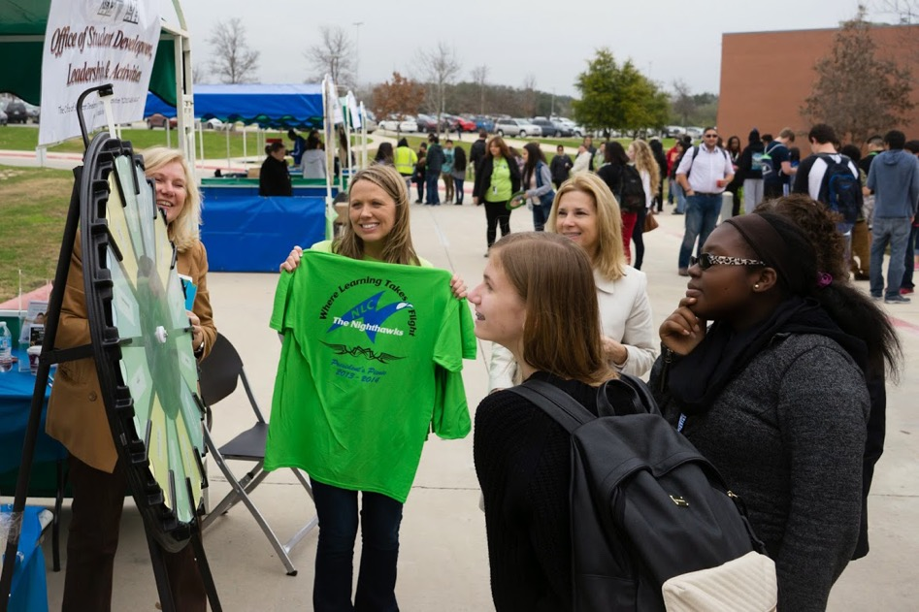
A successful teacher is not afraid to mix it up. Be creative and strive to engage, challenge, and inspire your students while remembering to let your students inspire you!
—Daisy Carmona, Northeast Lakeview College

Slide 13
I thought when I left the classroom to become a site director that I would no longer be teaching. I still teach students, but my teaching has expanded to include colleagues and community and civic leaders. No matter the role we are in, we are still in the business of teaching.
—Christopher Hitechew, Northeast State Community College

Slide 14
If my role is to just package and distribute knowledge at a fair price, I would be called a warehouse manager. But, if I strive to clarify for the next generation the complexities of life and invest my efforts in helping students become inspired and creative thinkers, then I am a teacher.
—Brian Baird, Northern Oklahoma College

Slide 15
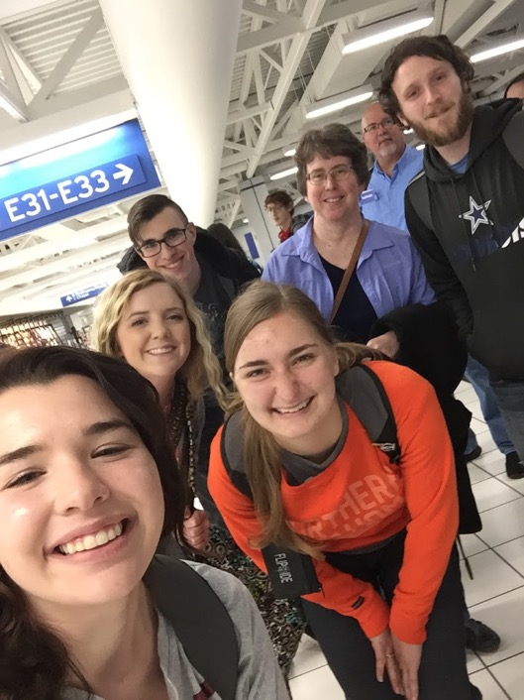
Steve Jobs said it best, “Do what you love. Have the courage to follow your heart and intuition. They somehow already know what you truly want to become.” This is my own life mantra. I share it with my students as they explore their own life possibilities.
—Tammy Davis, Northern Oklahoma College

Slide 16
Most of my inspiration for teaching comes from my students. I look forward to the questions that instigate the higher level of thought occurring in their minds. Don't just teach your subject, engulf yourself in what makes you love your subject and project that energy to your students.
—Christi Hook, Northern Oklahoma College

Slide 17
Through collaborative learning, students are able to build meaningful knowledge about the world and are able to apply what they learn towards improving their communities. My role is simply to guide students’ reflection, not only upon what they’ve learned, but why they learned and how they can use it.
—J. Marsh Howard, Northern Oklahoma College

Slide 18
I want to challenge students by having them engage, apply, activate, and disseminate their knowledge of and experiences with agriculture in many facets of their lives. I educate with a great passion by using my background and experiences in agricultural education, 4H, FFA, and farming to promote agricultural literacy.
—ADawn Nelson, Northland Community and Technical College

Slide 19
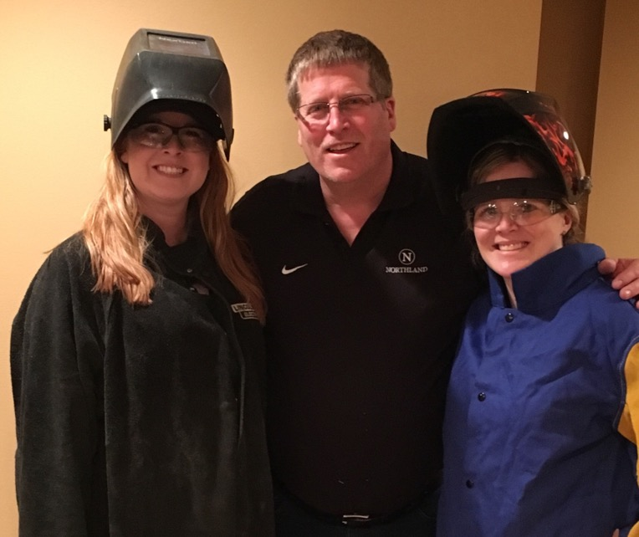
I have learned to teach from the heart. I have found that if I inspire my Welding Technology students to do their best, they will find success.
—Brian Suckow, Northland Community and Technical College

Slide 20
Each student’s learning method is unique, and I enjoy discovering techniques that help students maximize learning opportunities. I learn so much from my students' successes and triumphs, as well as through their struggles and obstacles. Students inspire me.
—Amy Fleming, Northshore Technical Community College

Slide 21
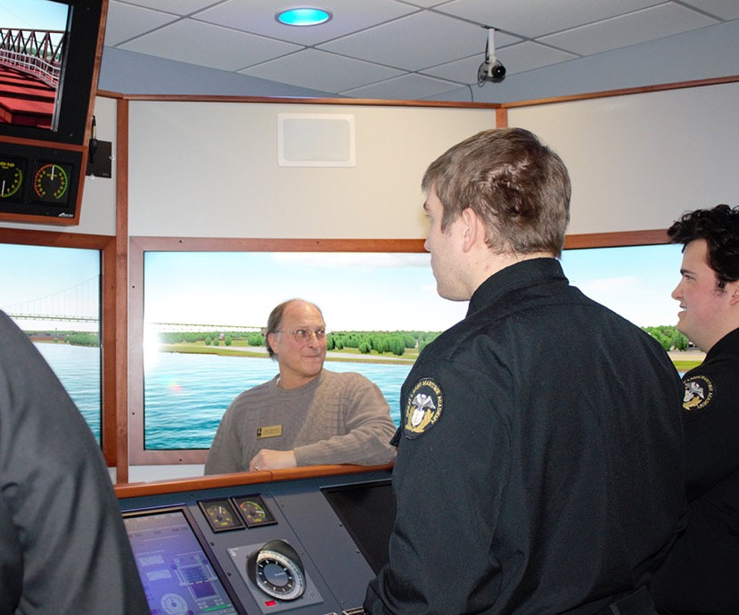
I draw motivation from my students' thirst for understanding how generalized concepts and theoretical knowledge transfer into real-world practical skills. Teaching is as much about mentoring as it is about educating.
—John Biolchini, Northwestern Michigan College

Slide 22
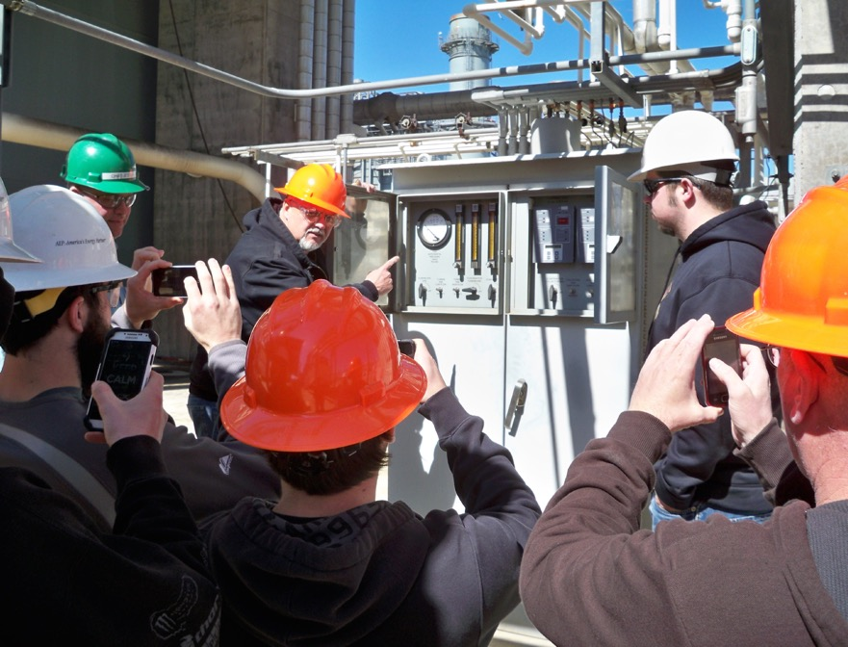
The joy is in the journey. Lifelong relationships take work to develop and are usually initiated by the instructor. Take time to appreciate the uniqueness of your students.
—Terry Hanzel, Oklahoma State University School of Technology

Slide 23
Be willing to accept new challenges and opportunities to grow as an instructor. Learning new material or different teaching techniques inspires me to teach each class better than the last one.
—Julie Byers, Oklahoma State University Institute of Technology

Slide 24
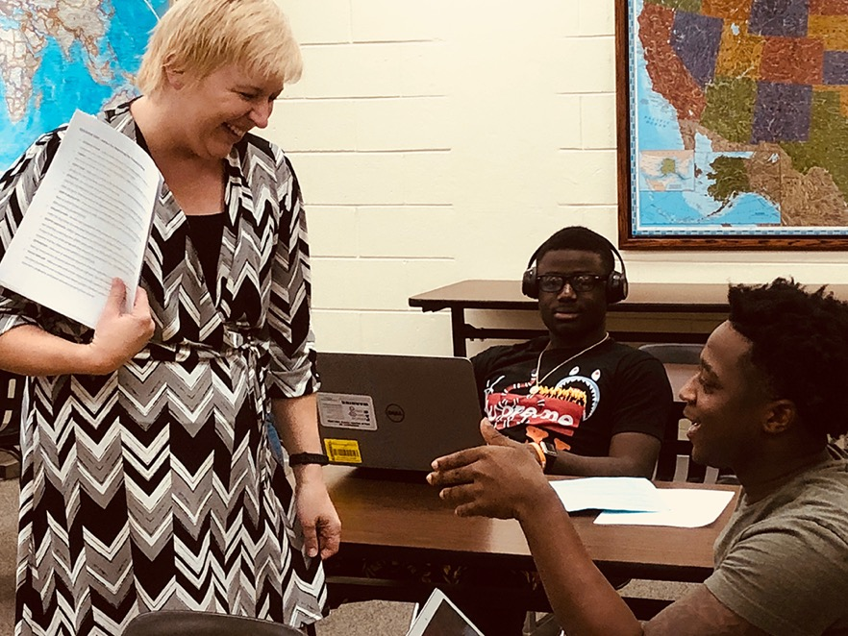
The love of my craft is what shines through in my classroom. When I am passionately teaching, I share lessons that really resonate with my students. Indeed, my love of instruction is often what helps students achieve excellence in their work.
—Laura Clouse, Palm Beach State College

Slide 25
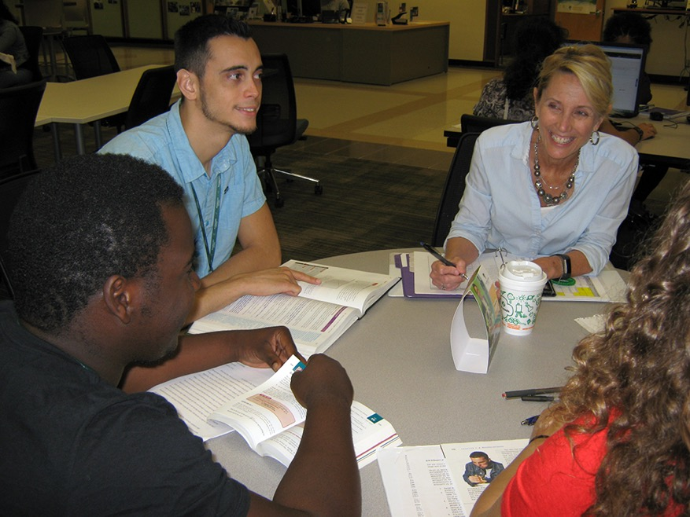
My goal is always to make it click! The moment the door closes and class begins, I push for the type of interaction that makes learning visible. When it happens, the class becomes my cheerleaders, and nothing motivates me more!
—Karen Pain, Palm Beach State College

Slide 26
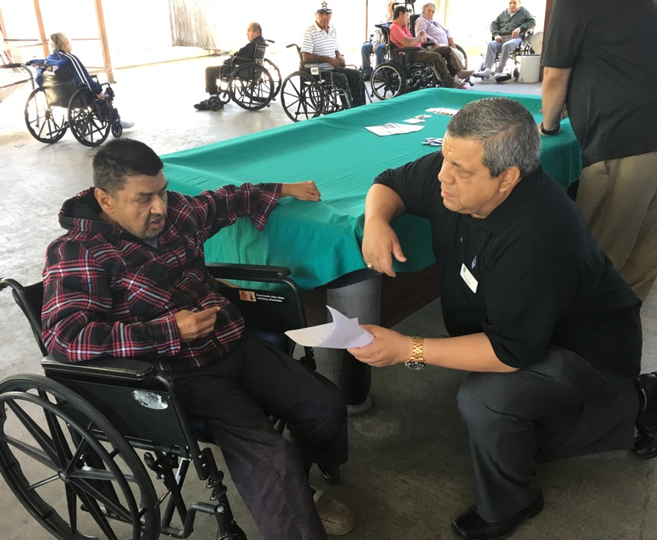
As a retired Marine, it's an honor to serve our military community on campus. Active duty members, veterans, and their family members are yearning to seek better lives for themselves, their loved ones, and their communities, and it brings me joy to see them accomplish their dreams.
—Vincent Bosquez, Palo Alto College

Slide 27
Serving first-generation students is beyond rewarding. Getting to know their stories, their reasons for being in school, and their aspirations keeps me motivated to be the best educator I can be.
—Monette Elizalde, Palo Alto College

Slide 28
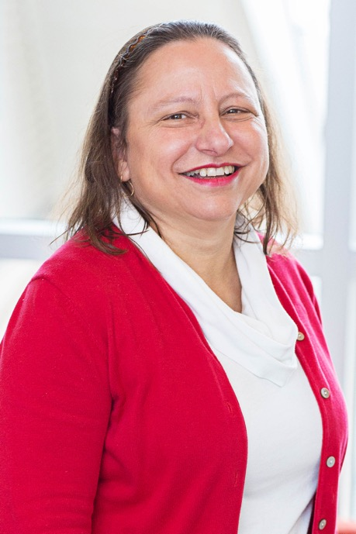
As a librarian, I help students find the information they need and teach them how to use the library's resources. Students leave knowing they did the right thing asking for help, that there are no stupid questions, and that they can always come back for more help.
—Tosca Gonsalves, Palo Alto College

Slide 29
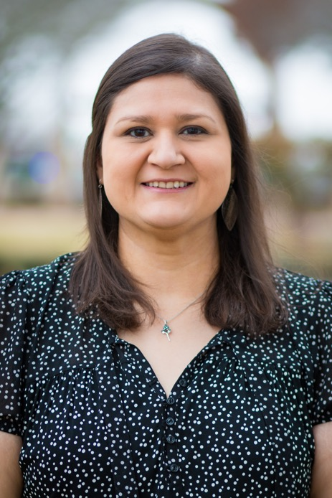
Advising is about building relationships, developing our diverse student population, and recognizing their value to our community and our future. I strive to ensure that Palo Alto College students are honored for their resilience, spirit, and commitment to their success.
—Arianna Lay, Palo Alto College

Slide 30
I am amazed by our students that come to school, work, and possibly even raise families. Despite having so much on their plate they continue to move forward. I see so much potential in our students and strive to help them reach their personal, academic, and career goals.
—Ronald Perez, Palo Alto College

Slide 31
My approach to academia is not to convey information, but to teach our students how to learn.
—Brad Chandler, Palo Alto College

Slide 32
In my classes, I encourage experiences, opportunities, and discussions that aim to solve real problems in the community. Typical student interests have ranged from starting food trucks to creating non-profit shelters for homeless seniors. Watching students make a difference in their lives, families, and communities inspires me.
—Dina Preston-Ortiz, Paradise Valley Community College

Slide 33
I often tell my students, "Study by explaining your handwritten class notes to yourself as you would to a class." When you learn to teach yourself you tend learn the subject more effectively.
—Vasanth Ramachandran, Pensacola State College

Slide 34
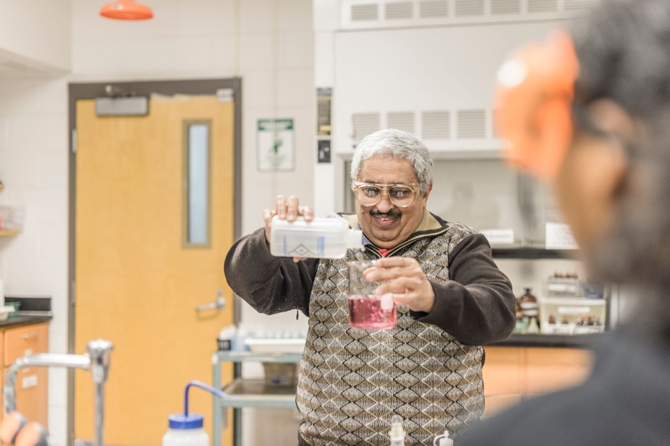
“Your success is my success and your failure is my failure”. This is a strong and encouraging statement to all my students throughout the years. Chemistry by itself is a hard subject, but with patience and innovation, I can change my students’ ability to comprehend and understand chemistry.
—Maher Atteya, Perimeter College at Georgia State University

Slide 35
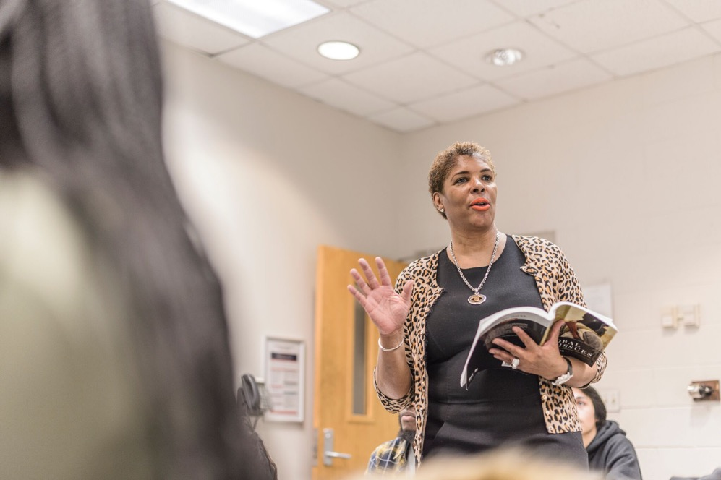
“I am successful when you are successful” is what I tell my students on the first day of class. For me, obtaining my degrees were just a means to success because it is when my students graduate that I feel the most successful.
—Crystal Garrett, Perimeter College at Georgia State University

Slide 36
Students will always have difficulties in one shape or form. Teachers who give those students a place where they can go for help when problems arise form relationships based on trust.
—Rosie Alvarez, Phoenix College

Slide 37
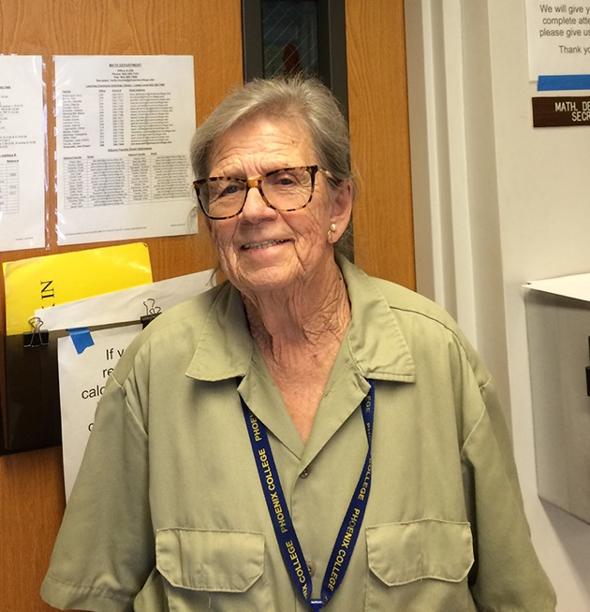
It's a great feeling helping someone have a great day.
—Verna Dabney, Phoenix College

Slide 38
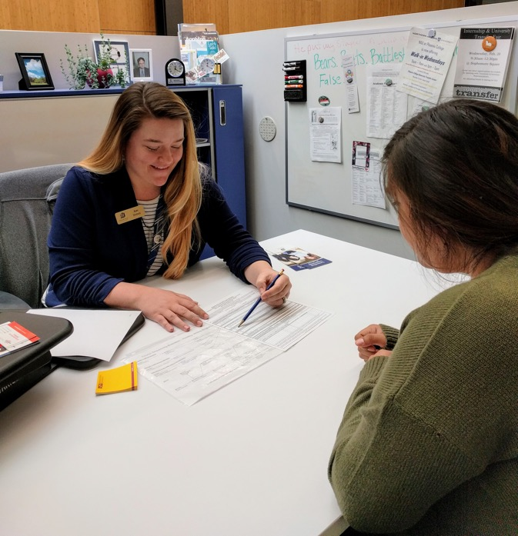
As an academic advisor with Phoenix College, I strive to cultivate an impactful and customizable approach to student services. I truly believe that as an advisor I have the opportunity to play a key role for students throughout some of the most important and valuable journeys they undertake.
—Ann Dodge, Phoenix College

Slide 39
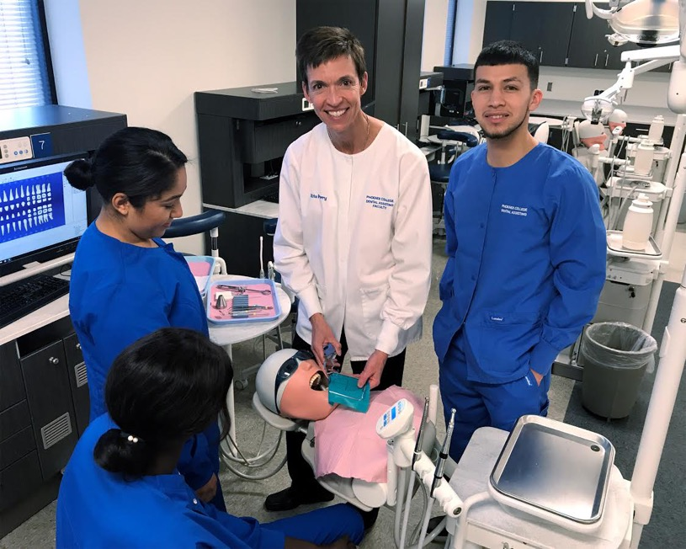
I feel energized when I walk into the classroom. My passion is connecting students to opportunities that they may not know exist, allowing them to witness a potential in themselves that needed tapping, and awakening them to an enthusiasm to learn.
—Rita Perry, Phoenix College

Slide 40
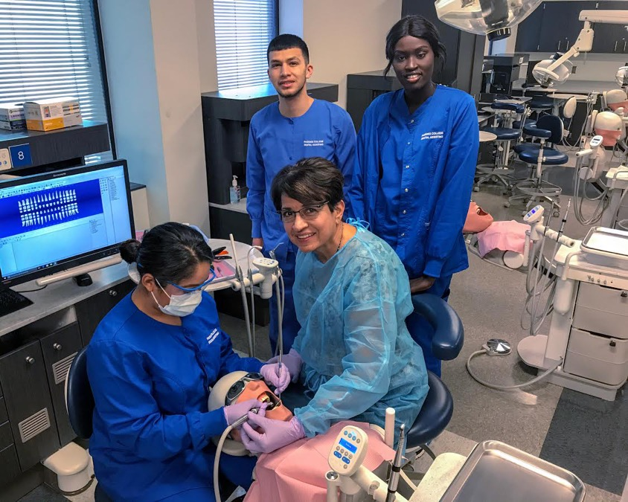
I love to encourage students and push them through the moments when they doubt that they can achieve a certain skill or succeed in a clinical experience. It gives me joy to observe students gain confidence as dental professionals. I enjoy being both a cheerleader and a counselor for them.
—Dolores Resendes, Phoenix College

Slide 41
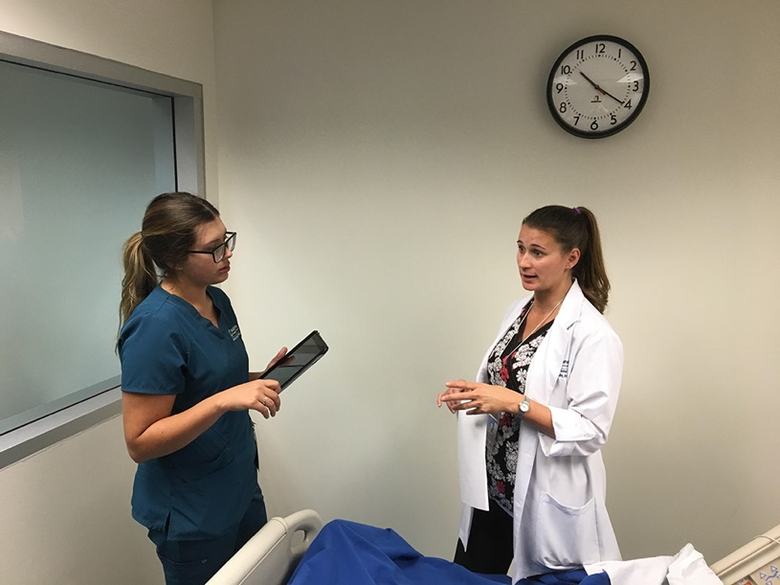
You are what you think about each day. I try to tell my students to build themselves up and to build each other up. Becoming someone of substance means every day you are changing and growing. Even if you are not growing fast, be proud of your progress.
—April Fulton, Phoenix Community College

Slide 42
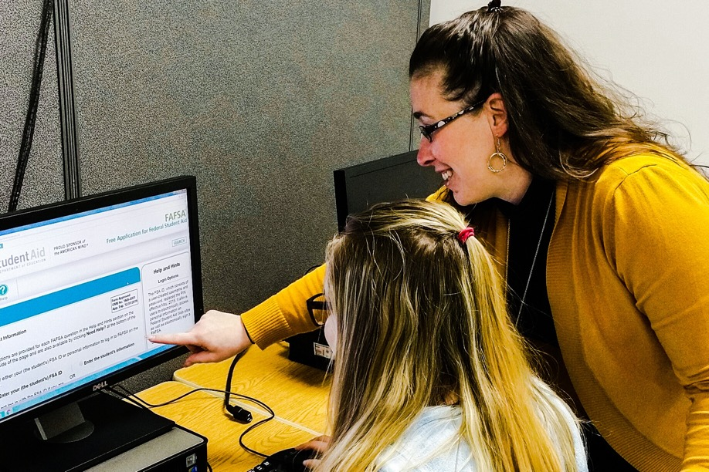
Work with passion when assisting your students in identifying what "success" means to each of them. Passion is the driving force that motivates me to lead our financial aid team and to teach in the classroom.
—Ashley Tennant, Pierpont Community and Technical College

Slide 43
I love design, and I love to teach students to become designers. Training students to be effective communicators and innovative visual artists sets them up for a viable career and a lifelong passion.
—Stephanie Dicken, Pitt Community College

Slide 44
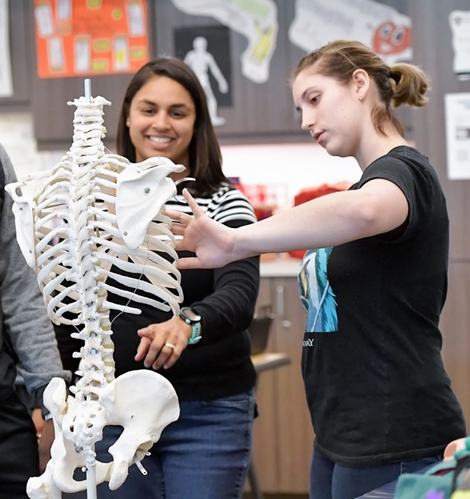
The object of education is to prepare the young to educate themselves throughout their lives. Learning is a process, students have preferences, and educators acquire strategies to teach. These are key components for enhancing lifelong learners towards higher academic degrees through targeted mentoring, academic support, and rigorous STEM-based projects.
—Suzanne Halverson, Polk State College

Slide 45
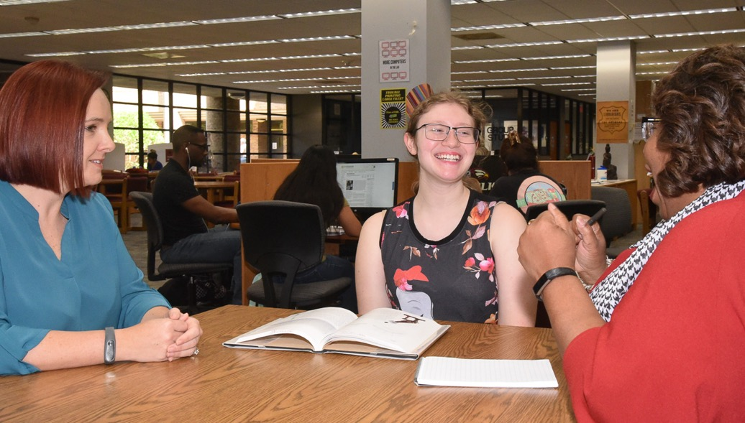
There is so much that goes on behind the scenes to help our students attain their education goals. As an academic administrator, I enjoy the planning aspects of working with faculty and staff to ensure that students enjoy their college experience.
—Gerene Thompson, Polk State College

Slide 46
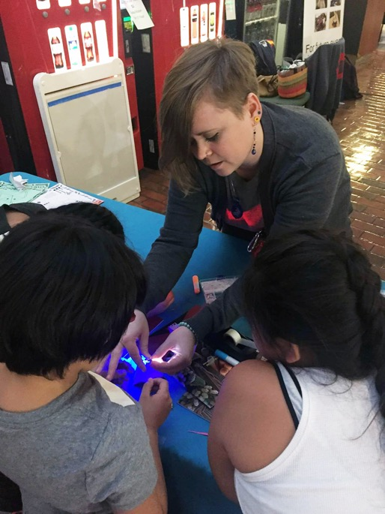
One of my favorite quotes by Jedidah Isler is, "STEM itself is an intersectional term, such that its true richness cannot be appreciated without considering the liminal space between disciplines." In my work, I strive to foster connections in STEM.
—Julia Betts, Portland Community College

Slide 47
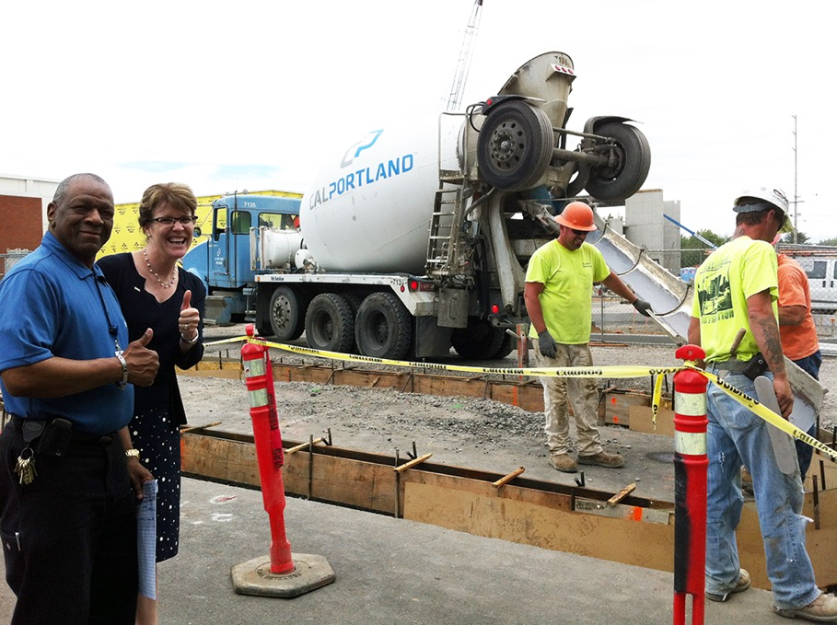
Sometimes all a person needs is a little perspective. Ralph Waldo Emerson said, "The purpose of life is not to be happy. It is to be useful, to be honorable, to be compassionate, to have it make some difference that you have lived and lived well."
—Frank Harris, Portland Community College

Slide 48
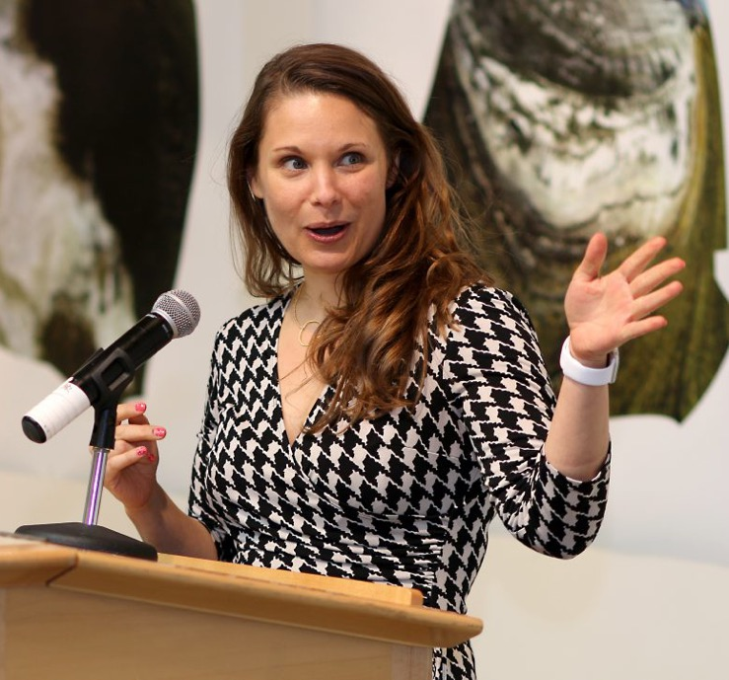
Every interaction is an opportunity for learning and growth. As a college administrator, I witness lives transformed by education. I too am changed as I learn each day from students, faculty, and staff. Inclusive and equitable environments that foster interdependence provide enrichment and growth for the entire community.
—Karen Paez, Portland Community College

Slide 49
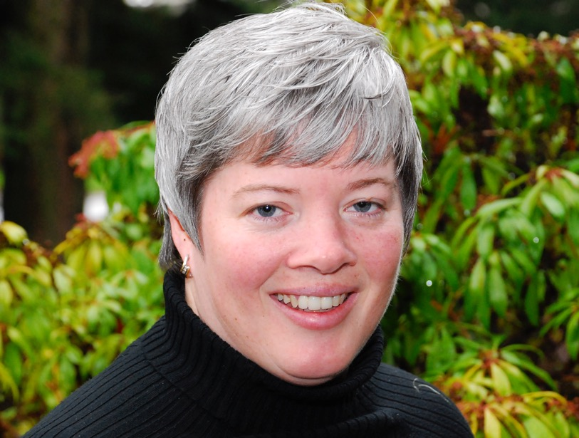
One of the greatest honors is to be recognized by an employee. This nomination came from an employee who was part of a program to complete a teach-out process. Supporting the program included moments of hard high-stakes situations. The faculty and staff team did an outstanding job!
—Jennifer Piper, Portland Community College

Slide 50
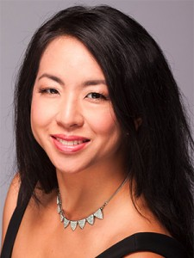
I want to help my students see beyond labels and self-limitations. They can be artists, writers, philosophers, and scientists because they all share a curiosity and passion in learning, creativity, and growth. There are no limits. They can do and be anything and everything.
—Ann Su, Portland Community College

Slide 51
I believe in providing a liberal education. A liberal education helps students develop a sense of social responsibility, as well as strong and transferable intellectual and practical skills such as communication, analytical and problem-solving skills, and a demonstrated ability to apply knowledge and skills in real-world settings.
—Edward Schwarz, Prairie State College

Slide 52
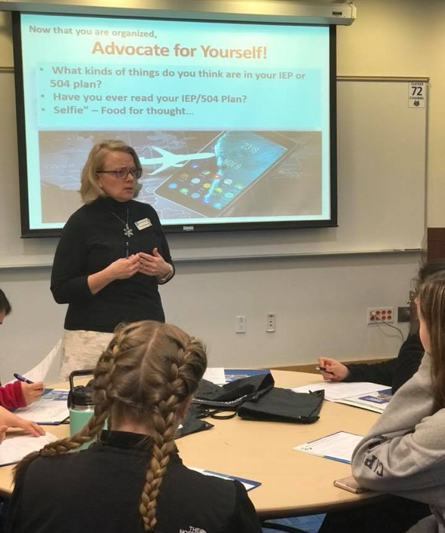
Every day I am inspired by the fortitude and resilience demonstrated by students with disabilities. More than anything, students with disabilities want to share how they have overcome barriers and help those who have experienced the same marginalization. Listen to these voices and appreciate that insuring access is everyone’s responsibility.
—Terri Rodriguez, Quinsigamond Community College

Slide 53
“Look for the learning” is the motto of any successful instructional designer. We are called to be lifelong learners that curate instructional best practices in order to elevate the teaching by the faculty we serve to ultimately positively impact students' learning experience.
—Ruth Ronan, Quinsigamond Community College

Slide 54
My role as a professor is to help my students believe in themselves. My students have truly inspired me. Despite difficult circumstances and many responsibilities, they choose education. It is an honor to serve in a role where I can encourage them and provide moral support.
—Anita Soracco, Quinsigamond Community College

Slide 55
One who teaches because it is their passion has much to offer the world! The opportunity to help students navigate their way towards reaching their educational and career goals through higher education has been a journey I have truly enjoyed.
—Evyonne Hawkins, Richland Community College

Slide 56
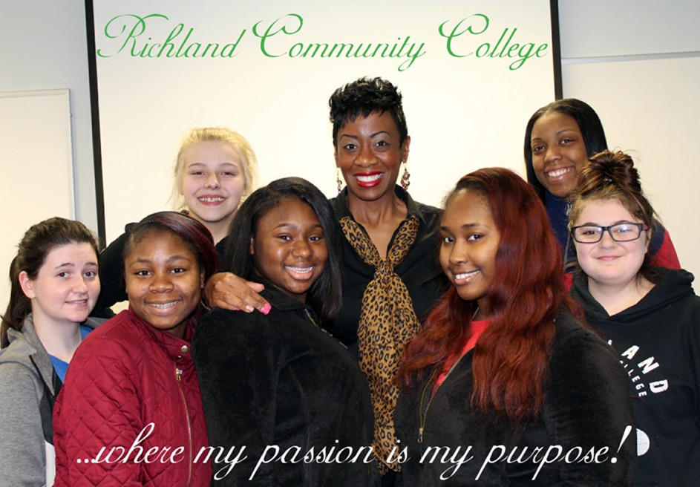
My life is rooted in Colossians 3:23! This scripture motivates me daily to serve and lead with a positive attitude. My success is driven by giving back and motivating others to strive and soar. My words of wisdom are work interdependently, have faith, and be of service to everyone.
—Jarmese Sherrod, Richland Community College

Slide 57
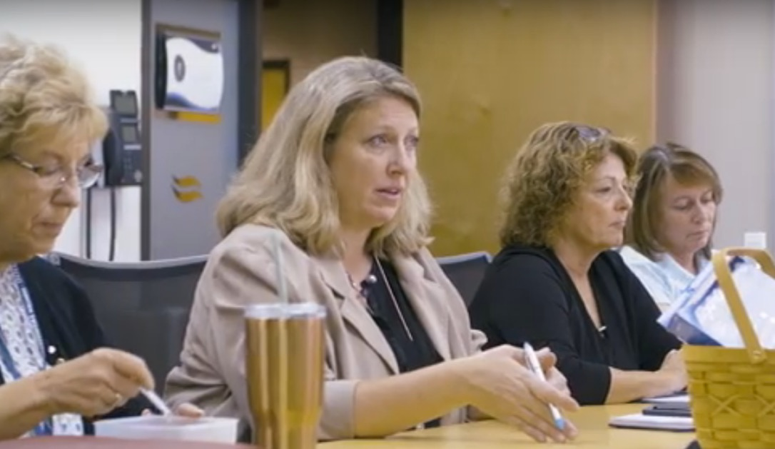
My pre-K12 teacher candidates remind me every day of their excitement and passion for learning and teaching.
—Jennifer Gresko, Rio Salado College

Slide 58
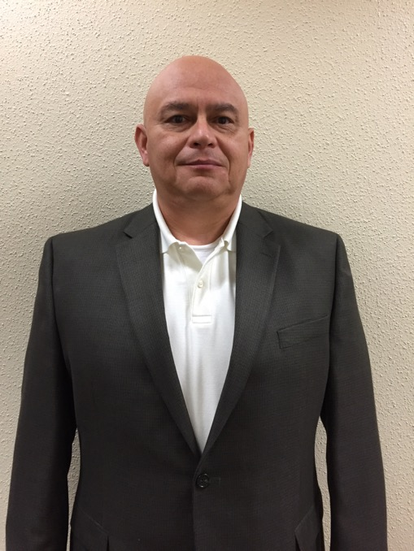
I want to be a positive influence on everyone I come across. If I can positively influence two people and they do the same for another two, eventually our world will become a better place. Always do your best. Strive to inspire others.
—Martin Davila, San Antonio College

Slide 59
I’m inspired to give 100% at work every day since I feel a strong personal responsibility to help students achieve their educational dreams. During challenging times, I remind myself to be positive and focus on finding solutions.
—Yescenia Flores, San Antonio College

Slide 60
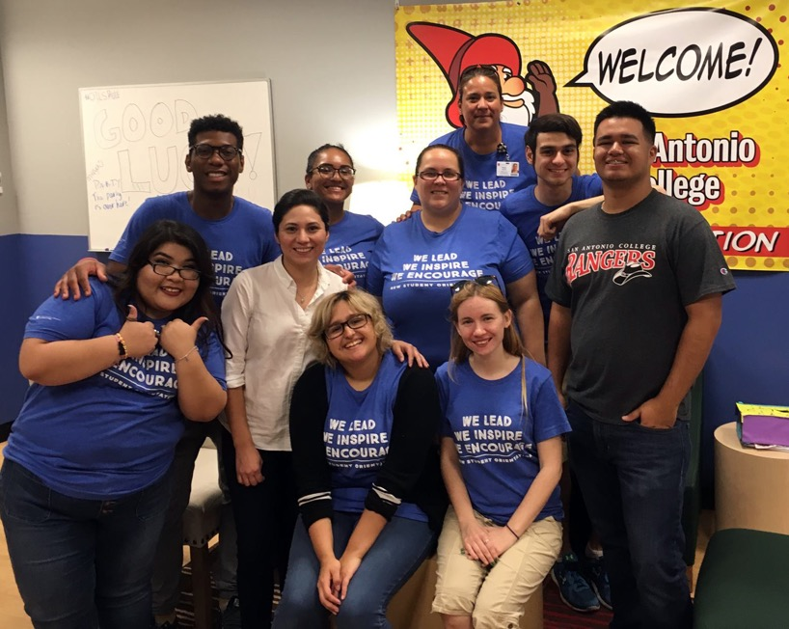
Watching a student celebrate his or her successes, both small and large, are the foundations for what inspires and motivates my work.
—Monica Garcia, San Antonio College

Slide 61
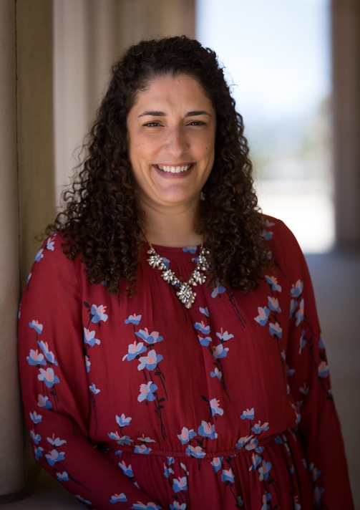
Educators play a role in changing the course of a student's life and it's important not to ever take that lightly. Use that as motivation to be better and do better everyday.
—Chaye Pena, San Antonio College

Slide 62
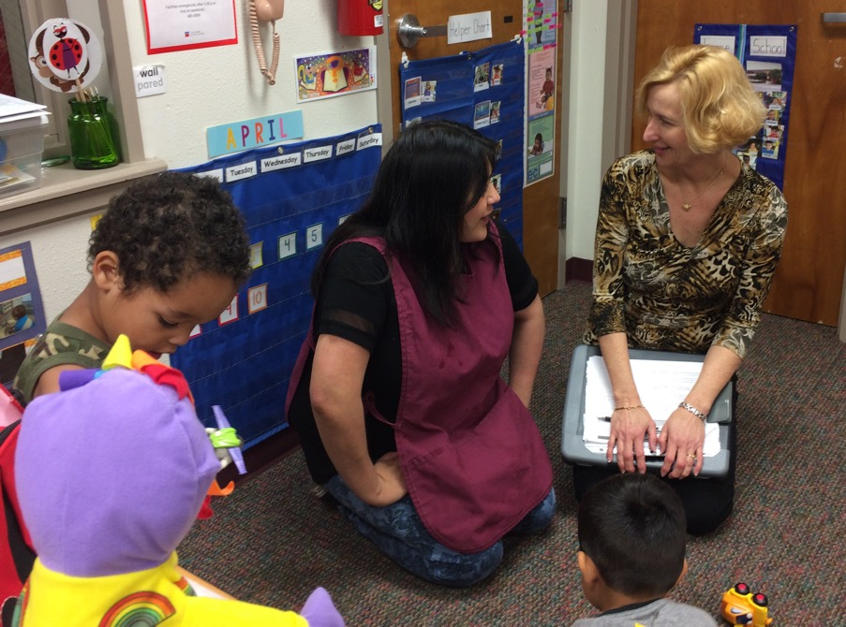
As a faculty member in Early Childhood Studies and an off-campus lab supervisor, I am privileged to coach students on a reflective approach to teaching as they work with very young children.
—Theresa Sinclair, San Antonio College

Slide 63
I love coming to work every day and sharing my passion for my career as an electrician by teaching the up and coming electricians of tomorrow. I witness minds opening and skills developing. I care about my students, not only as students, but as people as well. My goal is for student success!
—Julie-Claire Hamilton, Selkirk College

Slide 64
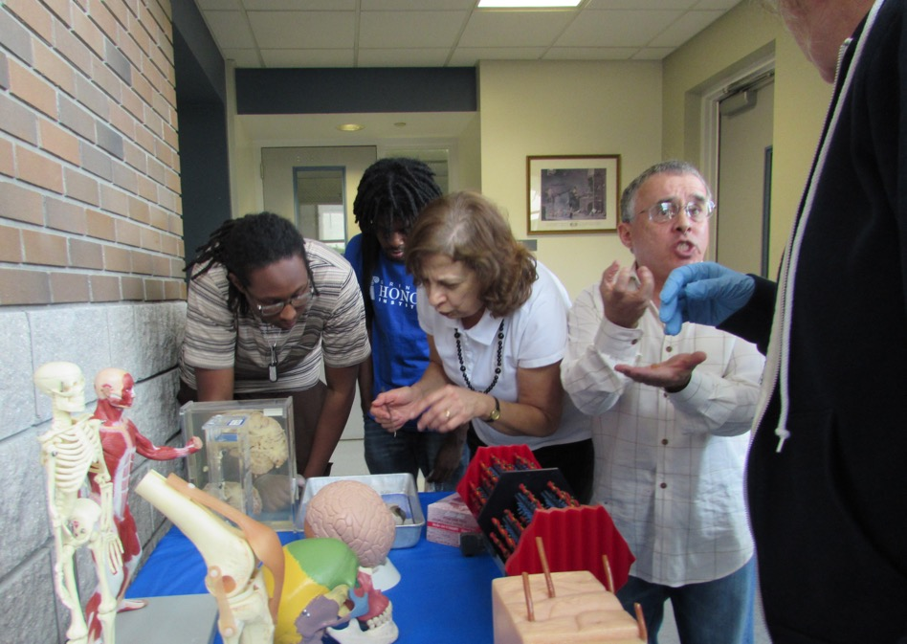
Being well-prepared for my classes, showing gentleness and consideration when interacting with my students, and participating in many professional development events to enhance my students’ learning experience gives me the confidence to say that I feel blessed to do what I love.
—Laila Nimri, Seminole State College of Florida

Slide 65
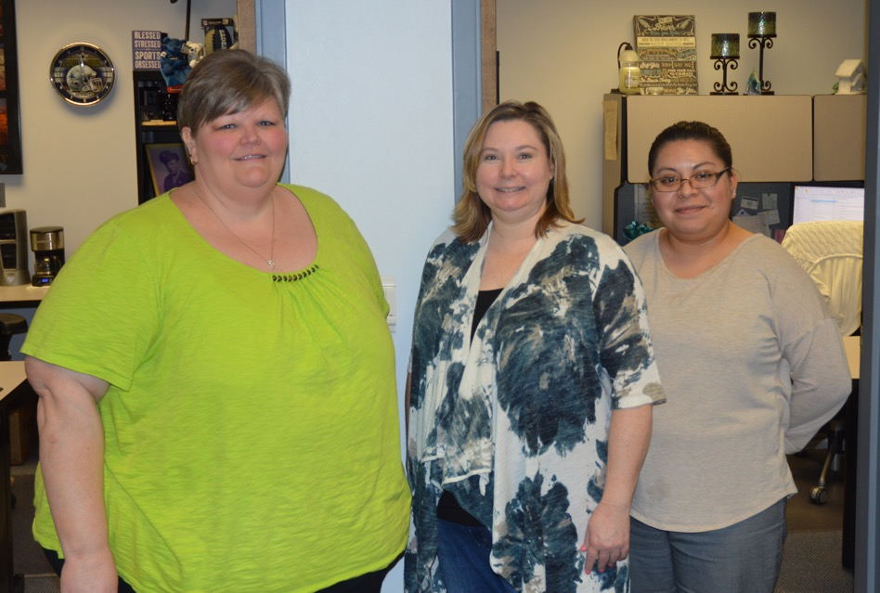
Faith, family, hard work, and fun equal a fulfilled life. This is the formula my parents lived by and taught me. My parents and their formula inspire me to care more about others, to give more to others, and to be better for others.
—Amy Knudsen, Seward County Community College

Slide 66
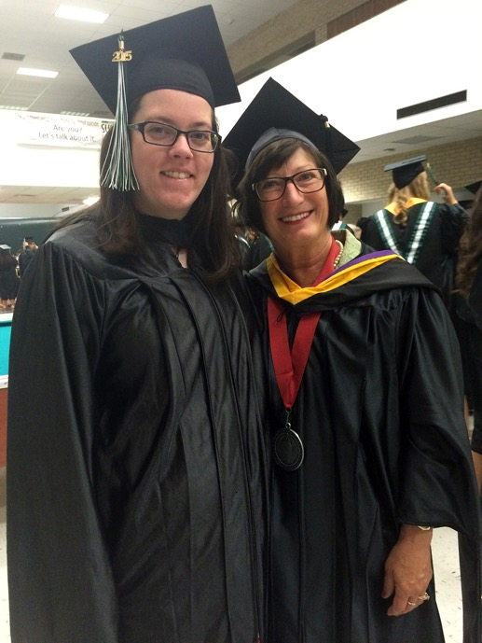
I am motivated by the students who strive every day to achieve their academic and personal pursuits. The students I work with continually remind me of how kind, gentle, and diverse the world can be. I am grateful to have the opportunity to learn and grow alongside them.
—Kate Mulligan, Seward County Community College

Slide 67
William Butler Yates said, "Education is not the filling of a pail, but the lighting of a fire." There is nothing more rewarding than witnessing that spark in a student's eye as that fire is being lit.
—Genevieve White, South Arkansas Community College

Slide 68
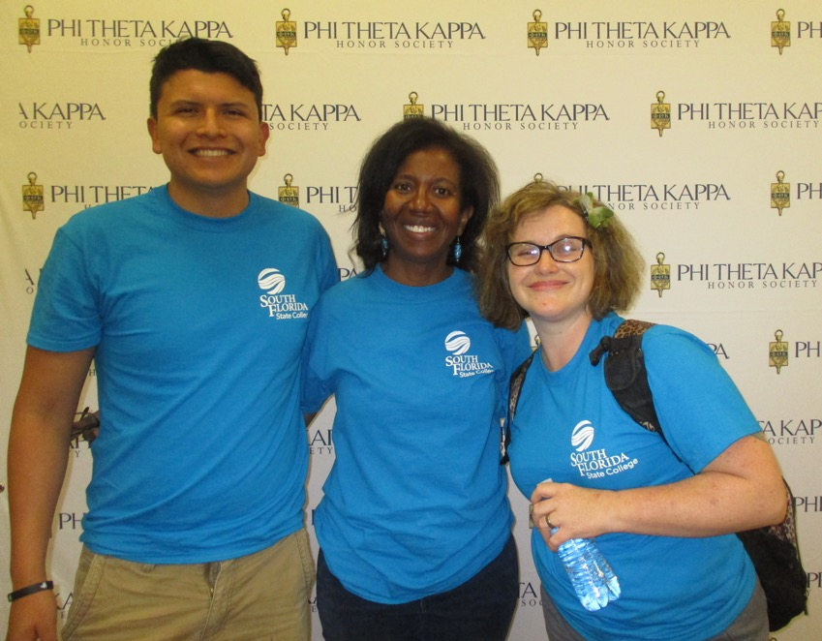
I enjoy working with students who are open to learning new ways of thinking about and conducting life’s activities. As a Sociology Professor, it’s my pleasure to witness the many “lightbulb moments” that occur as students study the inner workings of society.
—Sonji Nicholas, South Florida State College

Slide 69
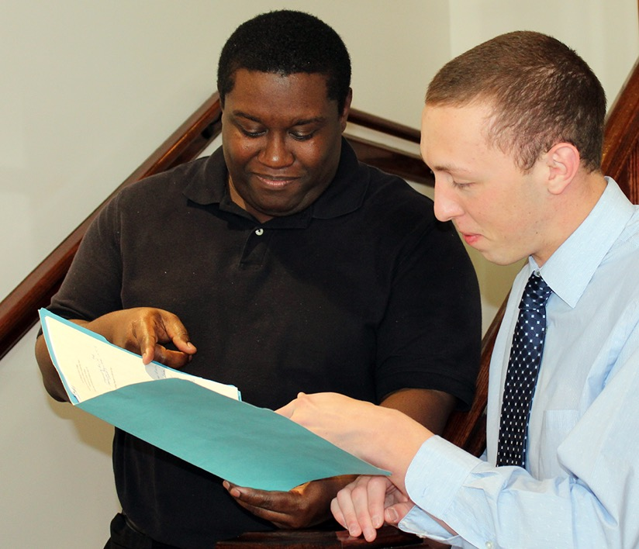
I am thankful for this award. It is a reminder that I am very fortunate to work with a team of people who are excellent themselves.
—Jerome Danner, South Georgia State College

Slide 70
As an academic advisor, I draw my strength and determination for success from each student I meet. I am constantly reminded how resilient we can be when faced with the most challenging and adverse situations. I am inspired to be a better person today because of the students I meet.
—Priscilla Price, South Georgia State College

Slide 71
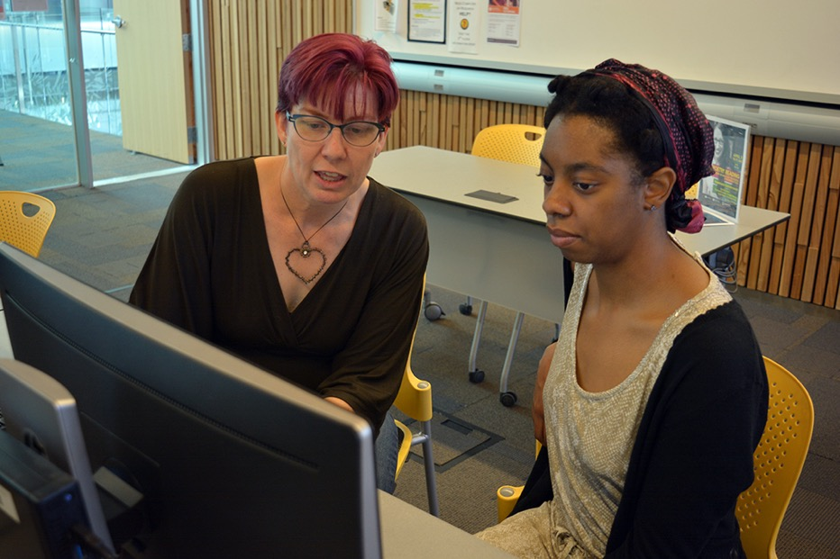
I love the challenge of finding new and interesting ways to connect the material students are learning to the knowledge they already have. My favorite part about teaching is seeing the “a-ha” moment on a student’s face and being a part of his or her growth!
—Nancy Deegan, South Mountain Community College

Slide 72
Students sometimes come into my office expressing regrets about aspects of their lives. I argue these are worth embracing, since enrolling in college suggests an inner fire to pick themselves back up. Without their regrets, the students may not be here ready to create the next chapters in their lives.
—Stephen Coate-White, South Seattle College

Slide 73
Love what you do and do it with your whole heart. Be genuine with others and do not be afraid to enter into their world. Live and learn each day from individuals you meet. Each person is unique and different, so learn from everyone you encounter.
—Celina Casas, South Texas College

Slide 74
Students carry more than just books, they carry their hopes and dreams. I am inspired by their drive and determination to continue towards their goals despite obstacles they might encounter. My privilege is to be their strongest advocate today so they can take care of our community tomorrow.
—Ana Karen Castillo, South Texas College

Slide 75
What truly drives me is seeing students accomplish something that they never thought possible, whether it be the ability to do math or attend a university. Seeing students accomplish their goals is the ultimate reward.
—Kelli Davis, South Texas College

Slide 76
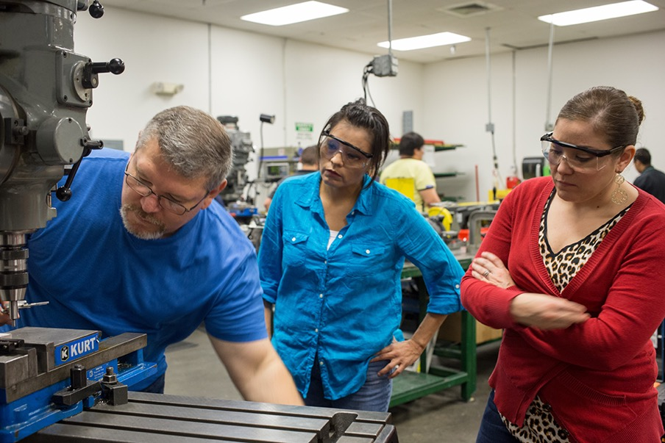
My challenge is to make myself obsolete to my students. I challenge them to learn and understand the class content to the point that they no longer need me. Once this happens, I know that I have not only completed, but exceeded my teaching expectations.
—Alberto Farias, South Texas College

Slide 77
Lessons learned after eight years as program chair: Effective leadership is only possible with a committed team. Have fun while you work and embrace change. Students are our most valuable assets.
—Daphine Mora, South Texas College

Slide 78
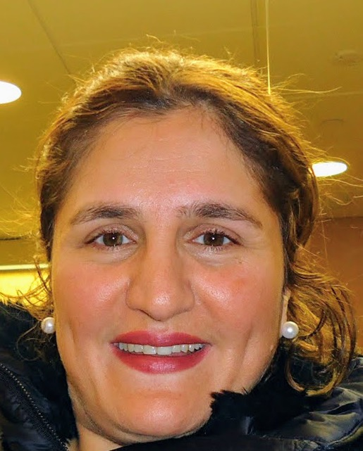
The academic success of my students is my success. I try to teach my students to think critically about biological concepts, rather than memorizing them. I hope to instill a love of learning in my students by sharing my own passion for learning and life.
—Samira Ziaei, South Texas College

Slide 79
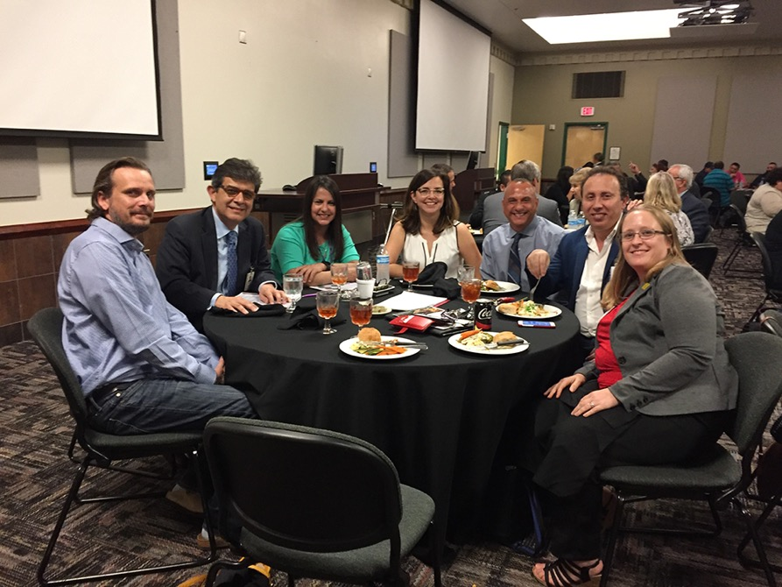
What motivates me and many of my colleagues is a desire to give young people the best opportunity in life by giving them the gift of education.
—Ricardo R. Olivares, South Texas College

Slide 80
Maya Angelou said, “Success is liking yourself, liking what you do, and liking how you do it." I have been blessed to do what brings me joy. As museum coordinator, I find great joy in sharing cultural art of the African Diaspora to connect students, faculty, staff, and community.
—Angelique Feaster Evans, Southern University at Shreveport

Slide 81
As a 30-year educator for SUSLA, it has been an honor to work with every area of the institution. Words that inspire me are, "Always set people up for success and never failure." Educators exist because we love education and students. Congratulations to all 2018 Excellence Award recipients!
—Vanessa Leggett, Southern University at Shreveport

Slide 82
I am inspired by the students and colleagues I serve. So many of them don't know how much you care until you show how much you care. Kindness is a small price to pay to make the difference in someone's life.
—Carolyn O'Neal, Southern University at Shreveport

Slide 83
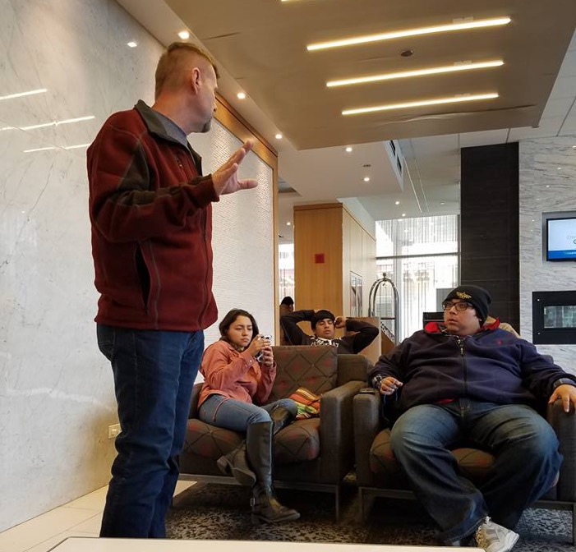
No grit, no pearl! The most notable duty that I have as a teacher is to inspire and model grit and gumption inside and outside the classroom. Perseverance, nerve, and resourcefulness are the attributes of those that realize their ambitions.
—Dennie Johnson, Southwest Texas Junior College

Slide 84
Teaching the next generation of Occupational Therapy Assistants is the most rewarding challenge I have had in my career. Students inspire me to be the best I can be. "Who dares to teach must never cease to learn."
—Sunny Anderson, Spokane Falls Community College

Slide 85
I work to create a community feeling at our transient school. A place for all of us to learn, to share, and to inspire.
—Janae Carrothers, Spokane Falls Community College

Slide 86
Students inspire and teach me daily to do better. I listen to students and I’m able to pass on great information to administration. I say that I have the best job on campus because I get to interact with the students that are involved in clubs and student government.
—Shelli Cockle, Spokane Falls Community College

Slide 87
While I know that I may not change the world, I can change my corner of it and make it better. When I see that something I have done made a difference, eased a process, and put a smile on someone’s face, I know I am where I belong.
—Anna Gonzales, Spokane Falls Community College

Slide 88
We all have the skills to positively influence students around us, but taking those skills and using them in a way students can understand subjects makes for an awesome and rewarding day. My personal mission is to “Inspire others to aspire greatness within themselves."
—Joseph Hernandez, St. Philip's College

Slide 89
Our commitment to student success should be the light that guides each of us as higher education professionals. Students first is not only a tagline, it is a commitment.
—Dr. Mordecai Ian Brownlee, St. Philip's College

Slide 90
At St. Philip’s College, we study philosophy to better understand ourselves and our world. This often means a deep dive into the topics your relatives say to avoid at Thanksgiving dinners and grappling with some of the most profound questions that have disturbed and challenged humanity from time immemorial.
—Andrew Hill, St. Philips College

Slide 91
I never imagined I would be teaching biology at a community college. However, this has been one of the best career choices I have ever made! Seeing the excitement that each discovery brings to students drives me to keep improving and making my classes more exciting.
—Matt Thomas, State College of Florida

Slide 92
We're so fortunate to have careers we truly love. Teaching, for me, is a great instrument for learning; it is not just about learning new ways of understanding content, but also new ways of understanding life itself!
—Andrew Swanson, State College of Florida

Slide 93
Horace Mann wrote that education is "...the great equalizer of the conditions of men..." In a world that still struggles with social justice, I am humbled that my work positively impacts all students. I am grateful for my role in students' quests to reach their greatest potential.
—Jaquelyn McNeil, State College of Florida

Slide 94
It is wonderful to work with students who often think they cannot pass chemistry and ultimately watch them succeed as I strive to engage, encourage, and empower them. I enjoy creating analogies and metaphors that help students create concrete images of abstract and challenging concepts.
—Frank Brown, Tallahassee Community College

Slide 95
Athletics provides a unique opportunity to engage students from different backgrounds and cultures and watch them work together towards a common goal in the classroom and in their respective sport. Their commitment as student-athletes motivates me to provide the best possible experience at Tallahassee Community College.
—Rob Chaney, Tallahassee Community College

Slide 96
A Namibian proverb tells us that, "Learning expands great souls." I consider it a great honor to work in an enterprise that seeks to expand the greatness found in the souls I consider to be not just my students, but fellow members of my community.
—Andrea Oliver, Tallahassee Community College

Slide 97
Frederick Nietzsche once wrote, “He who has a why to live for can bear almost any how.” As a teacher, to remain motivated and focused on the end result, I must know not only my what—my pedagogy and subject material—but I also must know my why.
—Kimberly George, Temple College

Slide 98
—Claudia Turner, Temple College

Slide 99
I always try to remember that students place immense trust in their instructors. Many are sacrificing things to attend school and better their lives. I remember back when I was in the same situation, which motivates me to provide the highest quality educational experience possible.
—Robert Hernandez, Texas State Technical College

Slide 100
Eleanor Roosevelt said, "The future belongs to those who believe in the beauty of their dreams." Working for TSTC has given me the honor of being a small part of the dreams of so many students, and that gives me a lot of joy.
—Patricia Carpio, Texas State Technical College - West Texas

Slide 101
Working in student affairs, I help students change their lives. Helping students complete an admissions application and take the first steps in their educational journey is the best part of my day. CCA's students motivate and inspire me to ensure education is accessible to everyone in our community.
—Felicia Sena, Community College of Aurora

Slide 102
To this day I thank life for the opportunity to work in education. To spend each day helping students discover their abilities and see their dreams become reality through education is the best job in the world!
—Yuli Chavez Camarena, Truckee Meadows Community College

Slide 103
John Maxwell said, “The mediocre teacher tells. The good teacher explains. The great teacher demonstrates.” When you connect with others, inspire them to overcome barriers and persevere through their educational journey. “Where there is no guidance, people fall, but in abundance of counselors there is victory.” Proverbs 11:14
—Casey Bromley, University of Arkansas Community College at Batesville

Slide 104
It’s a privilege to work for the greater good. To inspire even one person is a day well spent. Helen Keller said, "Alone we can do so little, together we can do so much." I believe that small steps combined make the biggest impact.
—Kelly Glover, Vance-Granville Community College

Slide 105
Teaching at Vance-Granville Community College has been the central passion of my adult life. I wear many hats at the college, but my most cherished time is spent in the classroom and lab exploring new material with students.
—Steve McGrady, Vance-Granville Community College

Slide 106
Being a police officer for 24 years, I got to serve people in a lot of different ways. After becoming a faculty member at Vernon College, I taught future police officers and supported the college mission by assisting the local community. It is great to give back!
—Michael Hopper, Vernon College

Slide 107
Walt Disney said, “Happiness is a state of mind. It’s just according to the way you look at things.” Despite many obstacles, my students have a smile and a willingness to learn. I hope that I inspire them as much as they inspire me each day.
—Amy Jones, Wake Tech Community College

Slide 108
Community college students bring the whole world into the classroom with them. As their tutor and teacher, I enjoy validating their experiences while helping them move beyond those experiences and helping them see the bigger picture of their choices and the importance of commitment and hard work.
—Amanda Sinodis, Wake Tech Community College

Slide 109
Teaching students to write as an act of discovery is a way of opening students' minds to the magic they have possessed all along.
—Karen Morris, Wallace State Community College

Slide 110
I want my students to learn that history is not just about the past, but that it is also about the present. My hope is that they will claim history as their own and see themselves reflected in the stories of those who lived long before them.
—Amy Powers, Waubonsee Community College

Slide 111
—Patrick Seitz, Waukesha County Technical College

Slide 112
Teaching is a profession in which one is always a student. Try something new, and do not wait until it is perfected, or you may not do it. As NIKE advertises, "Just Do It."
—Charlotte Brow, Wayne Community College

Slide 113
I admire the students attending Wayne County Community College in the Allied Health Department. Many students are raising families, attending school, and working while applying to programs. Their goals are to obtain certification or registration in the medical field. I am delighted to be a part of their learning team.
—Willie M. Singleton, Wayne County Community College

Slide 114
While I have many goals at WITCC, I can boil most of them down to a singular goal: To ensure the safety and well-being of every person that I have the opportunity to train. Safety is a behavior that we learn, and if properly trained, safety is contagious.
—Jason Ericskon, Western Iowa Tech Community College

Slide 115
I feed off the energy that I get from the interactions with my students. I teach communication. What I love is learning who my students are and helping them become who they want to be through the art and practice of communication.
—Jennifer Hough, Western Iowa Tech Community College

Slide 116
Charles is an adjunct instructor who teaches Philosophy and English at Western Iowa Tech Community College. He enjoys teaching to the diverse student population in his classes.
—Charles Polk , Western Iowa Tech Community College

Slide 117
I have never taken lightly the ability I have to influence and shape the future of my learners. I truly make it my personal mission to mentor and teach others in a way that allows discovery of things that can improve their lives, personally and professionally.
—Rebbel Henningfeld, Western Iowa Tech Community College

Slide 118
Cindy Prindle joined Western Technical College as an instructor in the Computer Support Specialist Program in 2015. She holds a master’s degree in Education/Professional Development and is a Microsoft Certified Master Instructor. We all have the potential of being servant leaders who embrace service learning in education.
—Cindy Prindle, Western Technical College

Slide 119
"Everybody can be great because anybody can serve," said Dr. Martin Luther King, Jr. Imparting this idea to students and encouraging instructors to teach using service learning is what I do every day. Service learning creates civic-minded citizens and it’s a method that helps learners be the most successful.
—Kari Reyburn, Western Technical College

Slide 120
Be the reason why someone smiles today!
—Brenda Bode, Wharton County Jr. College

Slide 121
As a theatre teacher, I am honored to impart skills to students that will stay with them forever. Being able to stand comfortably in front of others and articulate their thoughts and feelings will carry them through wherever life may take them. My students' success is my greatest joy.
—Jami Hughes, Wharton County Junior College

Slide 122
Inspire your students to continue learning, even after they have left your classroom.
—Lara Ondruch, Wharton County Junior College

Slide 123
As a lifelong learner, I find that the best way to keep learning is through teaching. When my students think their own thoughts, speak their own minds, and fearlessly express their unique personalities, I feel that the students and I have succeeded because we grow together!
—Mushira Shamsi, Wharton County Junior College

Slide 124
American author, Zig Ziglar said, “Your attitude, not your aptitude, will determine your altitude.” This quote motivates me to smile, work hard, and be thankful. I am inspired by my students and their ability to persevere despite the tremendous obstacles and barriers they face.
—Stacie Curtis, Zane State College

