Slide 1
Helping others meet their goals and objectives motivates me to do my very best each day. I enjoy working with faculty and students and look forward to opportunities to identify efficiencies in their processes that make their lives easier.
—Leonor "Lenny" Arredondo, Alamo Colleges District

Slide 2
Albert Einstein said, “Not everything that can be counted counts, and not everything that counts can be counted.” Collecting data is important, but it is more important to collect the right data and understand why it matters. Inspiring students to succeed is vastly more important than collecting data, but harder to measure.
—Velda Villarreal, Alamo College District

Slide 3
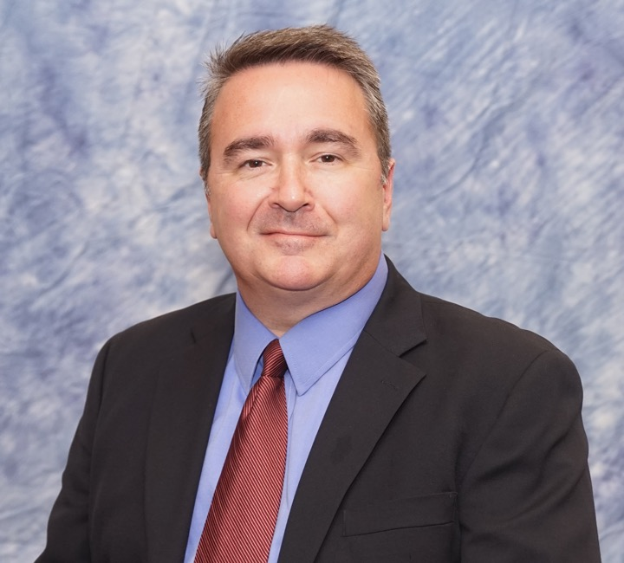
"A hundred years from now it will not matter what my bank account was, the type of house I lived in, or the kind of car I drove - but the world may be different because I was important in the life of a child." - Author unknown
—Shayne West, Alamo Colleges District

Slide 4
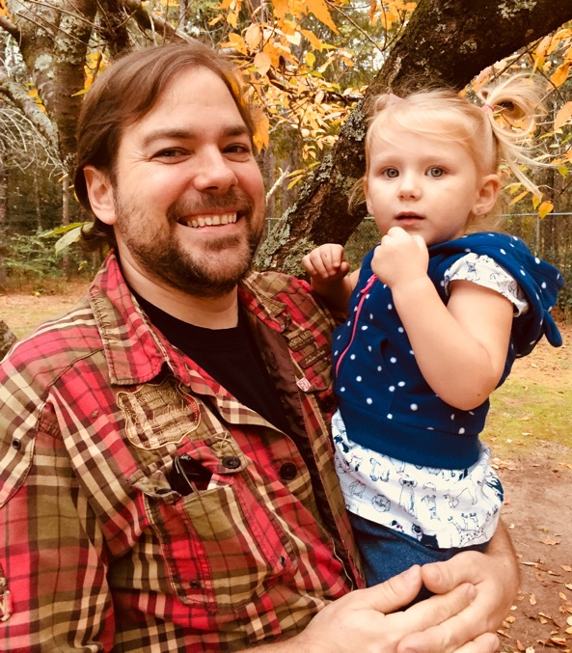
Albert Einstein said, "Out of clutter find simplicity; From discord find harmony; In the middle of difficulty lies opportunity.” I remind my students that few things are easy in the beginning, but with the right amount of time and effort, they will be.
—Jason Beaver, Albany Technical College

Slide 5
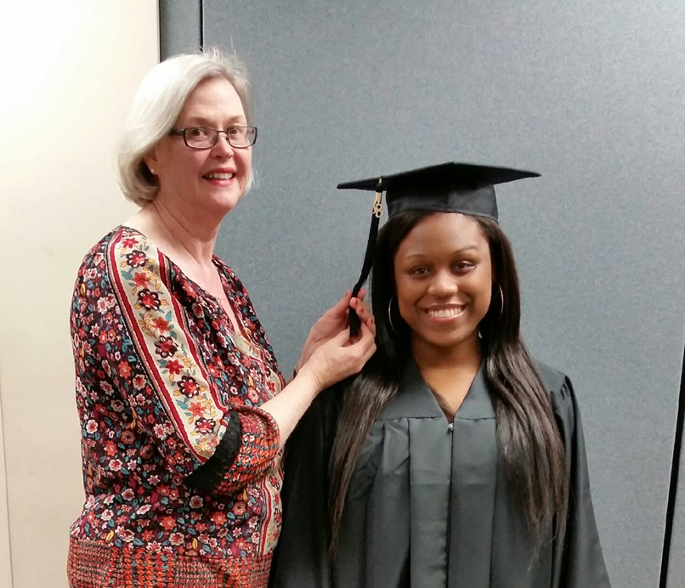
I’m happy helping others achieve their goals. There is nothing more rewarding than asking students probing questions and listening to them debate and discuss the questions.
—Suzann Culpepper, Albany Technical College

Slide 6
Daily, instructors meet students where they are in life to assist them get to where they want to be, by being both inspiring and educational. When students enjoy learning, they’re likely to propel their motivation to succeed. We must equip students for a lifetime of success, not just a moment of success!
—Judy Jimmerson, Albany Technical College

Slide 7
There’s not a lot that you have control over in life, but you can control whether you continue to strive to do better. That is what inspires me. When I do better, my students, colleagues, and college benefit. When my efforts transform another person’s learning experience –that is success!
—Tamra Alexander, Algonquin College

Slide 8
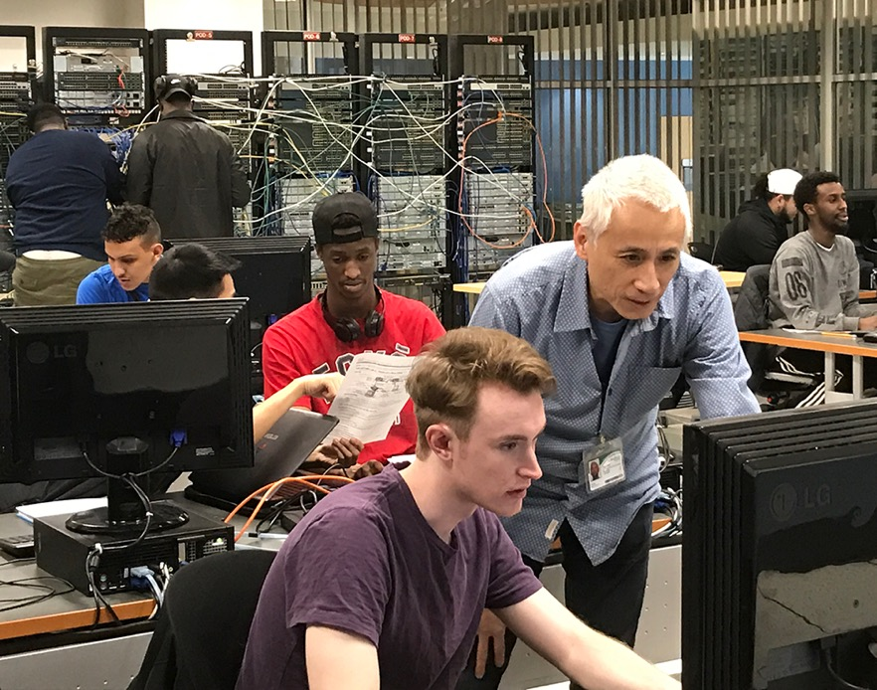
By 1991, I’d spent over a dozen years in technology, from being a co-op student to being the vice president of operations. Struck by an alarming number of employees accredited with diplomas and degrees, who lacked critical knowledge and skills to fulfil their role, I began teaching to be part of the solution.
—David Bray, Algonquin College

Slide 9
I'm here to help students succeed with their academic goals. I want to make sure we do whatever we can to help them achieve success. Seeing students enter college for the first time is great, but nothing can surpass the feeling of watching them graduate.
—Matthew Broughton, Algonquin College

Slide 10
It is my privilege to work with our students and help them get one step closer to their career goals. Supporting them through the challenges to their successes is very fulfilling and energizing. Students inspire me daily as I help guide them through this journey.
—Cheryl Giff, Algonquin College

Slide 11
After many years as a self-employed carpenter I feel very fortunate to have transitioned to teaching with great colleagues at Algonquin and having the opportunity to pass along my experience and knowledge to a new generation of carpenters. It inspires me to strive to do my best each day.
—Greg Kenny, Algonquin College

Slide 12
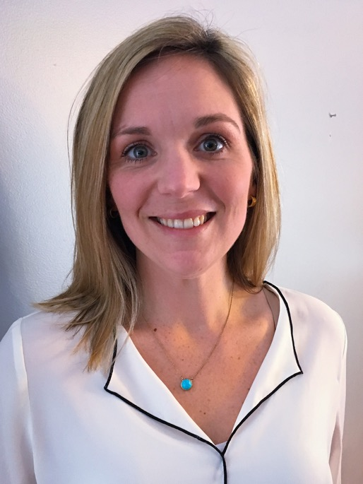
I am inspired by having the good fortune to share in students' successes, especially while they overcome many of life’s obstacles. I am further motivated by the community of the college. I enjoy the ability to work within a great team with whom I can work, share, and learn.
—Melissa Langlais, Algonquin College

Slide 13
Feeling inspiration is a magical moment that fills one with gratitude and hope for amazing possibilities. I am honored to experience this by witnessing the growth of students’ dreams, excitements, trepidations, resilience, and achievements. This motivates me to adapt, innovate, and continue to engage in new ways.
—Angela Nuelle, Algonquin College

Slide 14
Lessons should always finish with questions not answers. Answers, though important, tend to be the end of a thought or thought process. A question is a new beginning and a way to challenge the status quo.
—Michel Philion, Algonquin College

Slide 15
As a teacher and lifetime learner, I strongly believe in animated classroom interactions and presenting content in a style conducive to student participation and exploration. In my opinion, roleplay activities, interactive technology, peer evaluation, and teamwork are essential to develop learners' confidence and to prepare them for their future employment endeavors.
—Antonios Vitaliotis, Algonquin College

Slide 16
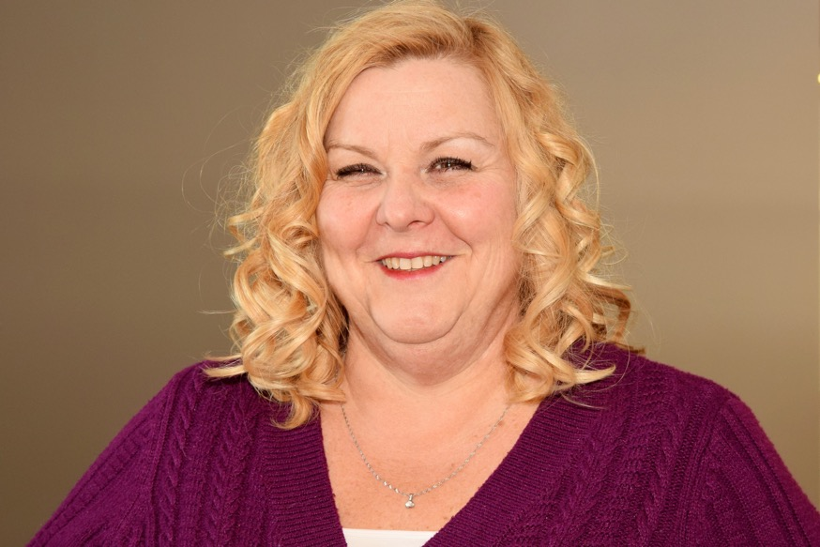
As a student success specialist, it is my mission to transform hopes and dreams into lifelong successes. I am excited by education, how it changes people, the places they live, and the lives they influence. Being a mentor is key to my success and always inspires me.
—Shelly Waplington, Algonquin College

Slide 17
Giving students the opportunity to be successful is a tremendous privilege. There is much more at stake than just what we endeavor to accomplish inside the classroom. Outside of our walls is a world that needs the BEST part of each of us. Find that and share it!
—Beckie Compton, Angelina College

Slide 18
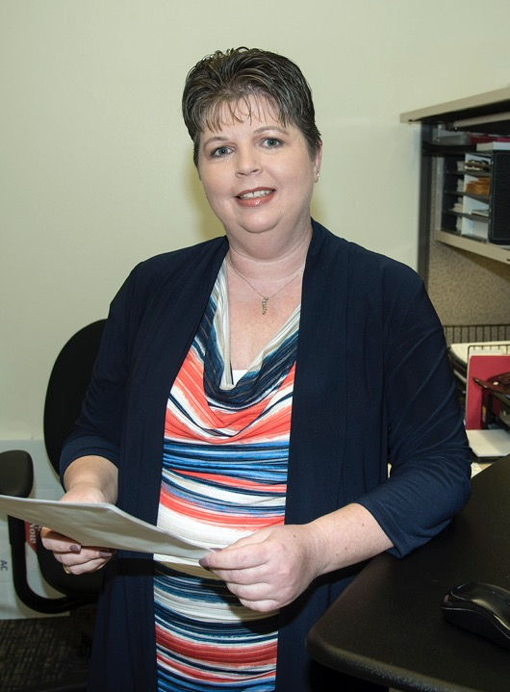
For me, motivation comes from knowing that the work I do helps students achieve dreams that they once thought were impossible. As Audrey Hepburn said, “Nothing is impossible, the word itself says ‘I’m possible!’”
—Janice Huffman, Angelina College

Slide 19
Every day in the classroom is a great day. Most days I learn as much from my students as they do from me. The door to the classroom closes, and we create a wonderful world where government and politics can be studied, then discussed.
—Debra Jenke, Angelina College

Slide 20
While striving to help my students become passionate learners and creators, my own life has been enriched.
—Robbie Roach, Angelina College

Slide 21
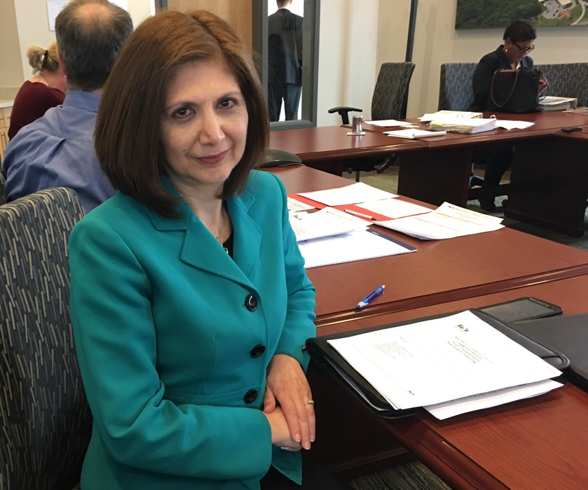
I am honored to be part of this amazing institution and to have the opportunity to collaborate with such dedicated faculty and staff, and leveraging technology to engage our students at each stage of their college journey to help them reach their full potentials.
—Shirin Goodarzi, Anne Arundel Community College

Slide 22
Anne Arundel Community College has provided me with the opportunity to use my skills and my passions to collaborate with faculty and staff on important projects. I am a proud community college graduate and I am honored to give back and continue to support the mission of community colleges for future generations!
—Lisa Sanford, Anne Arundel Community College

Slide 23
My ability to inspire students pales in comparison to their ability to do the same for me.
—Kenneth Dale, Arizona Western College

Slide 24
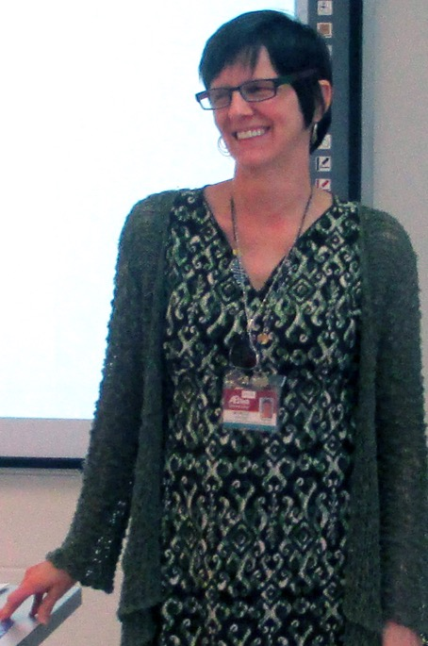
My goal is to co-build individualized experiences to serve the whole student. Guiding students through reading and writing processes includes collaborating with students one-on-one in and outside of class, appealing to their optimal co-learning and co-teaching styles, and co-creating a gradual release of responsibility that encourages students to confidently work independently.
—Michelle Payton, Asheville Buncombe Technical Community College

Slide 25
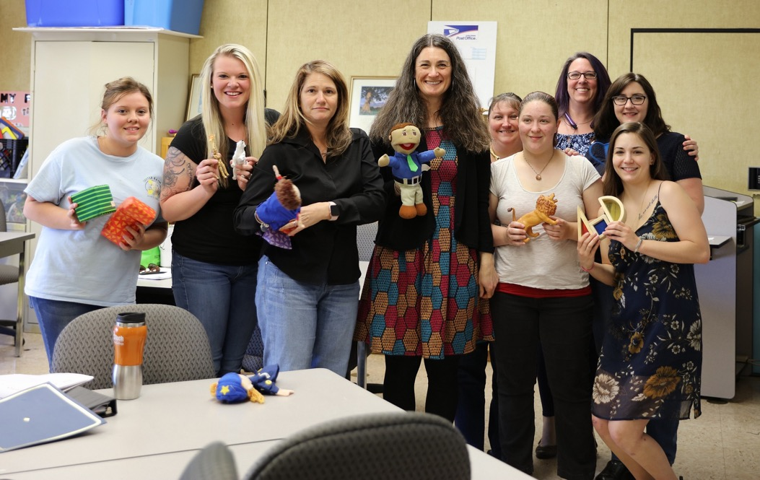
Fred Rogers said, “Anyone who has ever been able to sustain good work has had at least one person who has believed in him or her.” I walk into my classroom believing in my students and leave knowing that they believe in me. Together, we do good work.
—Tamara Reynolds, Asheville-Buncombe Technical Community College

Slide 26
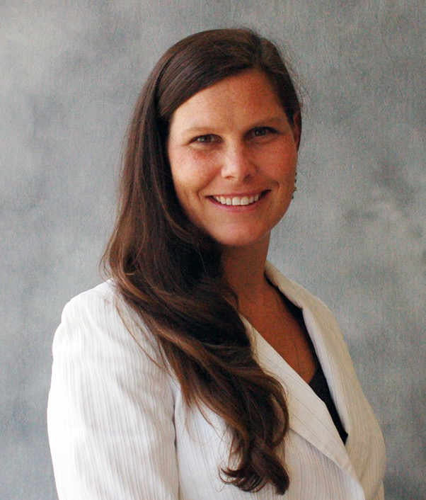
I am dedicated to serving my community through my role as an educator. Dr. Martin Luther King’s quote, “Life’s most persistent and urgent question, ‘What are you doing for others?" motivates me to persevere in my work when faced with challenges and limited resources.
—Page McCormick, Ashville Buncombe Technical Community College

Slide 27
Ten years ago, I left a well-paying corporate job determined to use my talents to make a positive impact on the world. Working in higher education has not only given me the opportunity to realize my dream, but it has enriched my own life immeasurably.
—Nancy Hernandez, Austin Community College

Slide 28
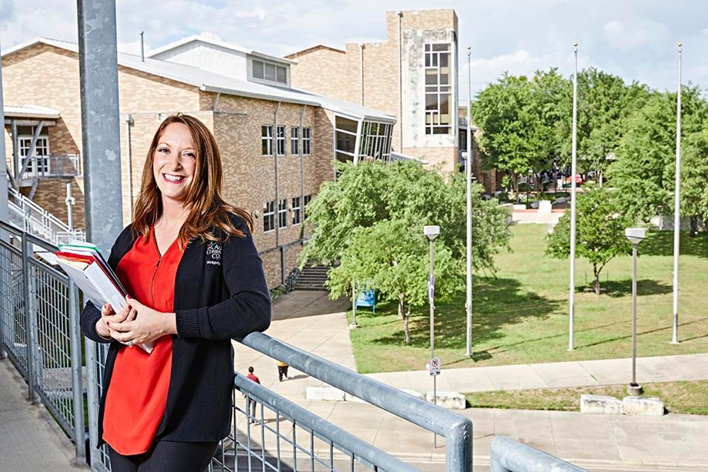
Everyday my students humble me with their passion to learn and grow no matter what barriers they have to cross to get there. Faculty need to stay relevant, interested, engaged, and creative in their delivery and integration of the real world to provide learning experiences that are practical.
—Michelle Fitzpatrick, Austin Community College

Slide 29
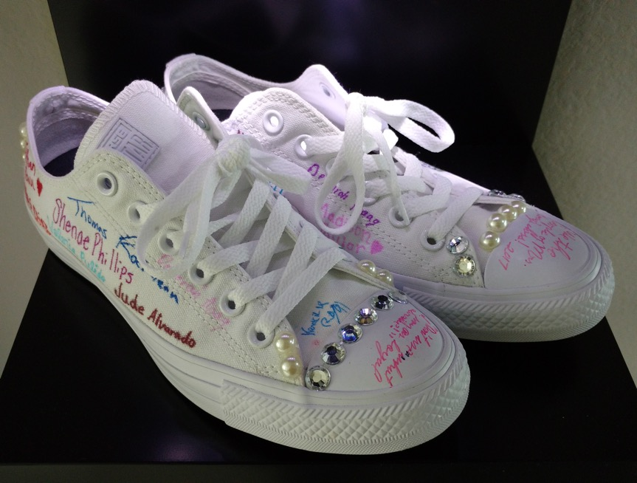
When students respectfully debate the issues without rancor against opposing points of view, I am encouraged for the future.
—Deborah Hoag, Austin Community College

Slide 30
It feels satisfying to be nominated by your peers. There have been times when I entertained thoughts about whether I was too hard on my students or if my expectations were too high. I have quickly erased those thoughts because it is right to aim for excellence.
—Solomon Iyobosa Omo-Osagie II, Baltimore City Community College

Slide 31
Community Colleges are often left out of discussions pertaining to American higher education; they need to be given a seat at the same table when these issues are discussed. Often, a community college education is equal to or better than the first two years at a four-year school.
—Robert Highley, Bergen Community College

Slide 32
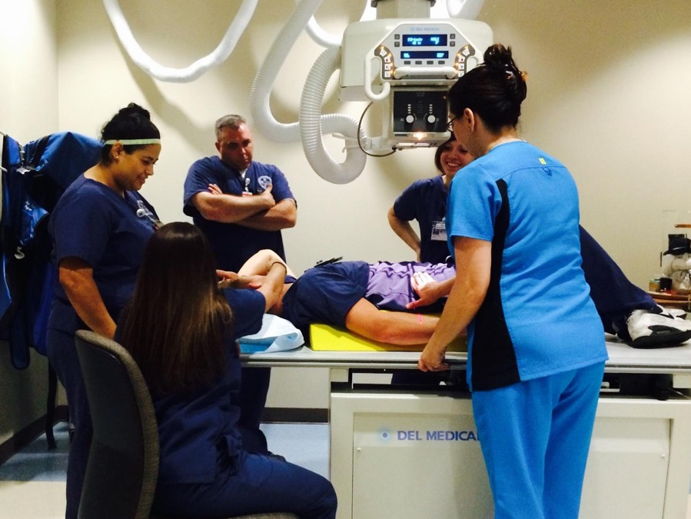
I remember to this day what it felt like to be a student in a Radiologic Technology program. It is the experiences I had with those who invested in me that inspires and encourages me every day to give back to my students and profession.
—Debra Allbritton, Blinn College

Slide 33
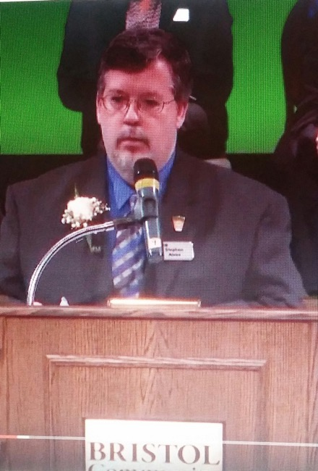
I feel like I have come full circle. Returning to teach at the college where I began my career as an RN has been very rewarding. I feel I am very fortunate to have the opportunity to give back and to help future nurses reach their potentials.
—Stephen Alves, Bristol Community College

Slide 34
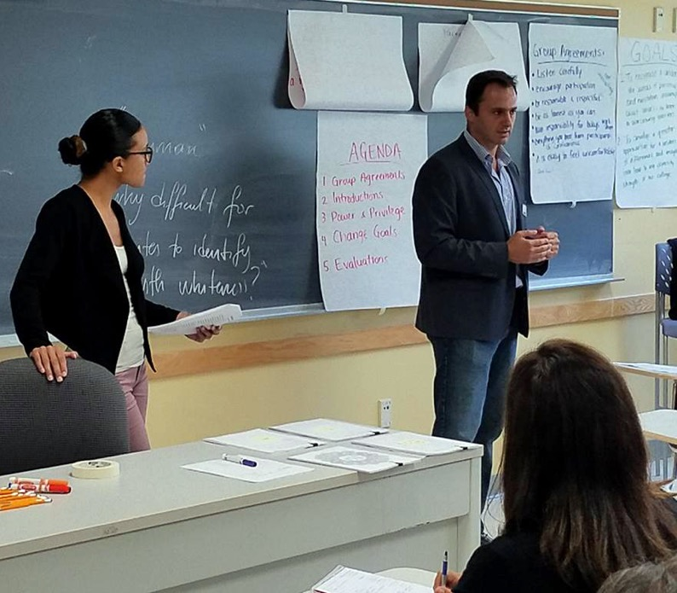
I am inspired by the poetry, art, and creativity that stems from my students’ funds of knowledge and experience. I am therefore academically and scholarly invested in progressive social justice education aimed at fostering transformative social change.
—Engin Atasay, Bristol Community College

Slide 35
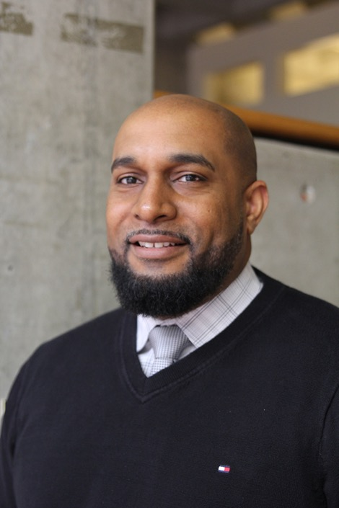
Teach the student not just the subject. Our students need guidance and leadership throughout their educational journey. Whether we like it or not, it is a responsibility we cannot and should not avoid as educators.
—Rob Delaleu, Bristol Community College

Slide 36
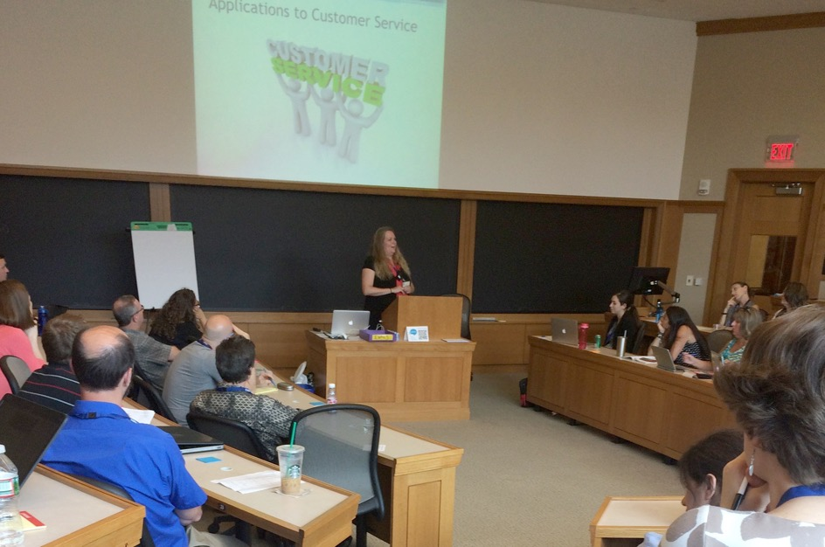
As the disability and deaf services coordinator at Bristol Community College, it is an honor to be recognized at such a pivotal time in higher education. Together, we will improve student retention and experience by owning the spirit of universal design in our classrooms, facilities, and communication.
—Julie Jodoin-Krauzyk, Bristol Community College

Slide 37
I always tell my students that the only way to really, truly master something is to have screwed it up massively at least one time. As Thomas Edison said, "I have not failed; I've just found 10,000 ways that won't work." Don't be afraid to explore!
—Katie Ruggieri, Bristol Community College

Slide 38
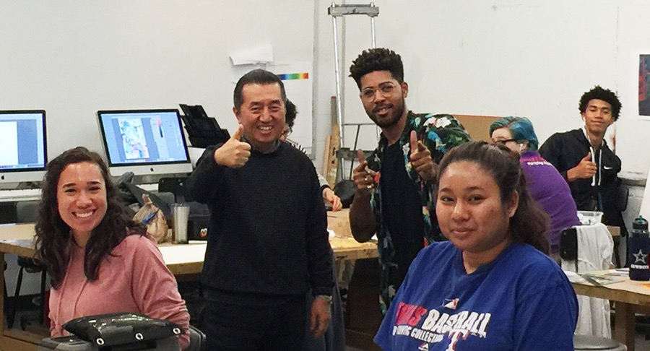
For me, teaching is a lifelong journey. I am able to share my knowledge and experience because it is a constant practice of reassessing what I know. So, my ongoing dream is to support students' journeys and expand their visions and goals through education.
—Chong Chu, Brookhaven College

Slide 39
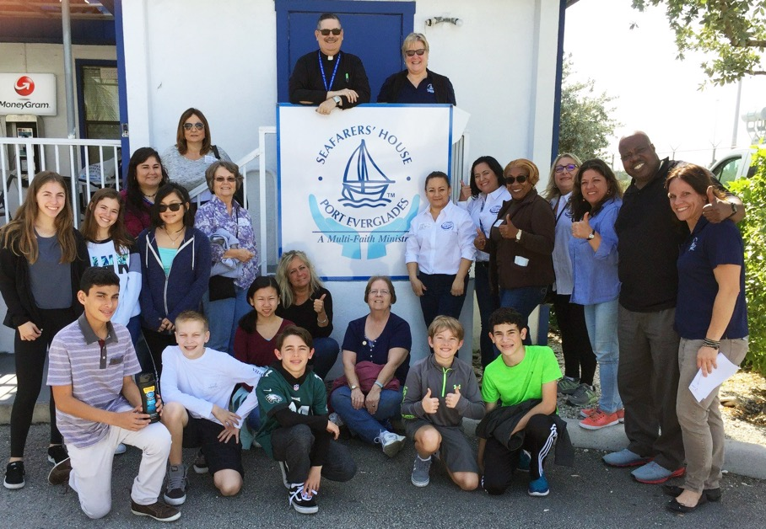
Knowledge, discipline, and organization equals success. I see my students for their potential and believe students will rise to the high expectations. I encourage them to get the highest ROI from each class. Their profit is the knowledge gained. I encourage them to invest in a master's program at the best universities.
—Tulia (Tuly) Badillo, Broward College

Slide 40
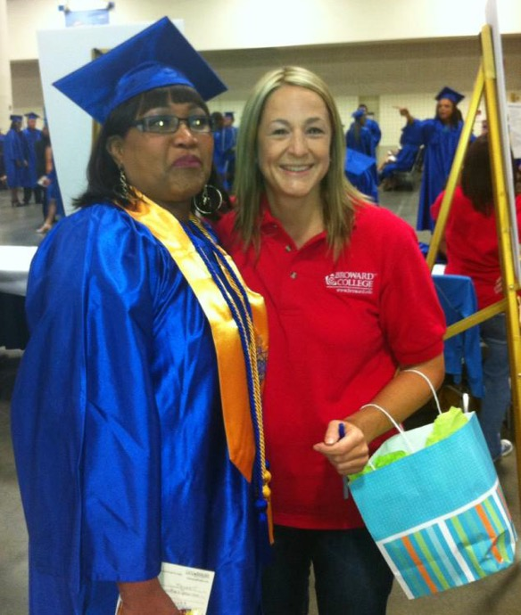
Professor Michele Marshall is an advocate of the CPL program that offers students an opportunity to earn credit for knowledge learned outside of Broward College. Students can earn college credit if they completed a program in high school, completed an industry certification, or participated in professional development or military service.
—Michele Marshall, Broward College

Slide 41
My passion for education and being of service to others is what inspires me. Active engagement is key for students' success. Be respectful, kind, and flexible is my mantra. One size does not fit all. Understand the uniqueness of each person and tailor your teaching and mentoring experiences accordingly.
—Sylvia Riviello, Broward College

Slide 42
Movement lessons are life lessons. What happens inside and outside the studio is permeable, as life and dance merge to become one. Movement themes are key for me in educating the dancer and the human.
—Daniela Wancier, Broward College

Slide 43
I am extremely honored and humbled that my institution has put their faith in me to lead and mentor our student ambassador program. Not only do they keep me on my toes, but they inspire me to be a better version of myself each day.
—Sherika Attipoe, Calhoun Community College

Slide 44
Great teaching and intense learning occur when mind and heart work together. When we have high expectations and help students believe they can reach them, we can change the world.
—Donna Estill, Calhoun Community College

Slide 45
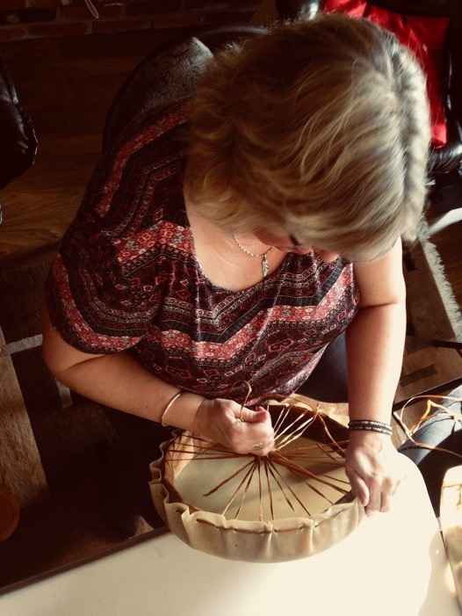
For the past 27 years, my work has consisted of assisting Indigenous students start their educational journeys at an early literacy level and end by completing certificates and diplomas in various disciplines. What a joy. Most of my work was in one of satellite campuses at a Community Learning Partnership.
—Wendy McDonald, Camosun College

Slide 46
To know that I am contributing to the wellness of Indigenous communities brings so much meaning and joy to my life. I get to work with some amazing people who are changing the world and, in all honesty, are changing me. I have immense gratitude for this award and recognition.
—Sandee Mitchell, Camosun College

Slide 47
Every day I wake up with gratitude in my heart because I have the opportunity to witness students’ journeys to success. It’s such a privilege and honor to support students the same way I was once supported. I love that I get to give back!
—Suzanne Wilkinson, Camosun College

Slide 48
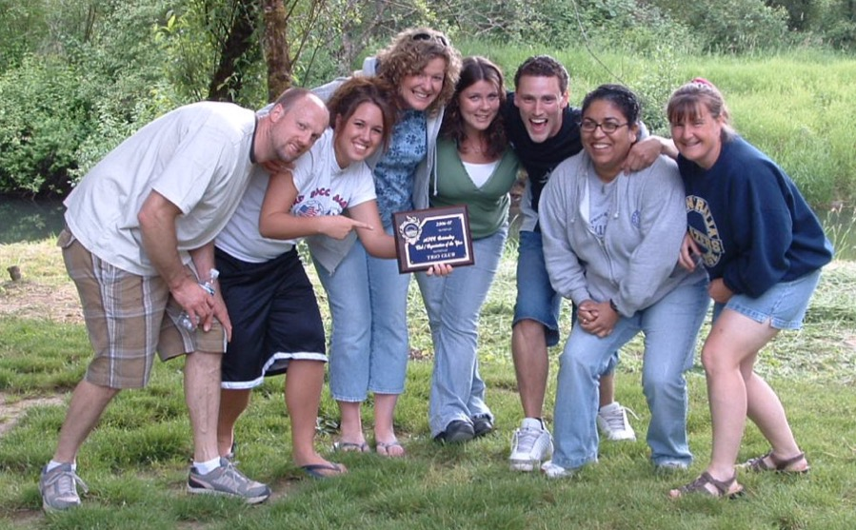
“Be fearless in the pursuit of what sets their soul on fire!” When my students finally see their unlimited potential and are able to stand strong and be proud of who they are and what they have accomplished, I feel an unmeasurable amount of value in what I do.
—Cindy Broadbent, Centralia College

Slide 49
“The best way to learn is to teach." By team building we promote the concept of teaching each other.
—Jim Gordon, Clover Park Technical College

Slide 50
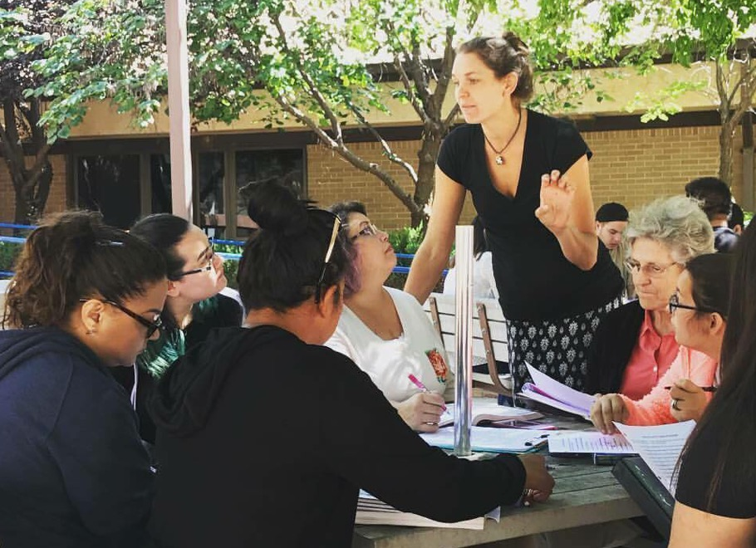
It has been my honor to be selected for the NISOD award! Keeping abreast of the best learning practices and making connections with every student has served me well in the field of education. It has also been my privilege to experience expert mentoring from talented colleagues!
—Erin Thomas, Clovis Community College

Slide 51
As the financial aid director, I aim to help students grow to their fullest potential. What inspires me are students and their successes. Whether students are seeking inspiration or just looking for a pick-me-up during the day, I mentor them so they meet their goals.
—Karen Emmer, Cochise College

Slide 52
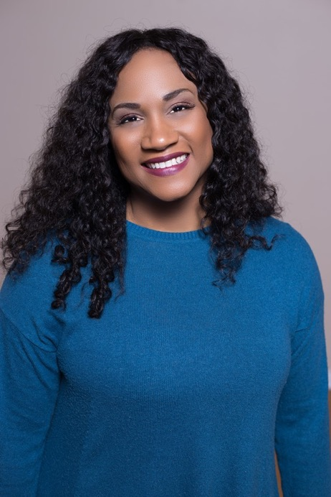
Teaching is not just a profession, it’s a calling. It is an opportunity to engage in shared knowledge and inspired creativity. As my students work to develop their academic skills, they challenge me to create new pathways to guide them to their individual levels of success. I love my job!
—Candace Cooper, Collin College.

Slide 53
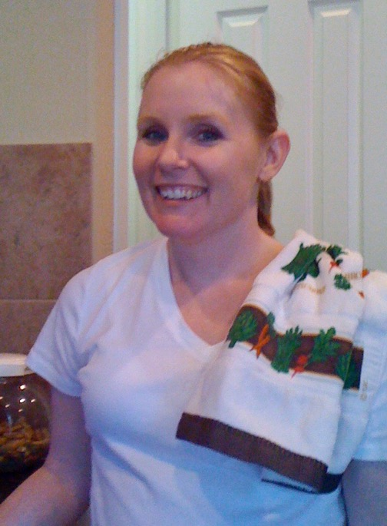
Colleagues and students appreciate organization and consistency. I try to provide both in my position.
—Tammi Gupta, Collin College

Slide 54
Gail Goodwin said, “Good teaching is one-fourth preparation and three-fourths theatre.” I am so passionate about the education process that I used to joke I burned over 500 calories an hour, and my Fitbit confirms it! If I’m teaching or interacting with students, there is energetic movement involved!
—Jeni Long, Collin College

Slide 55
As an educational-success team builder, I empower dual-credit students, guiding them along as they embark upon lifelong scholarly adventures, while offering them the best gift I ever received from the professor who taught me its value: my respect, and hoping by the semester’s end to have earned theirs.
—Karrie Newby, Collin College

Slide 56
In 1999, I landed my dream job working as an associate professor in the Counseling Department at Columbia Basin College. Being a former very undecided student myself, and now having the opportunity to guide students into their own satisfying career has been an amazing opportunity.
—Carrie DeLeon, Columbia Basin College

Slide 57
When I meet with a student, I make sure to build a relationship. This relationship goes beyond academia. I am mindful that every student comes with a story. So I hear their struggles and barriers they have overcome and it allows me to motivate and advocate for them beyond the classroom.
—Elizabeth Hernandez Osorio, Columbia Basin College

Slide 58
I love working in a community college environment and helping our students navigate their first years in college. Helping a student choose a career path and become a successful graduate are some of the things I enjoy most about my job.
—Mary Beth Chally, Columbia State Community College

Slide 59
The best part of my job is directly working with students. I enjoy helping them explore possible majors and career choices and eliminating barriers to their successes.
—Gena Ryan, Columbia State Community College

Slide 60
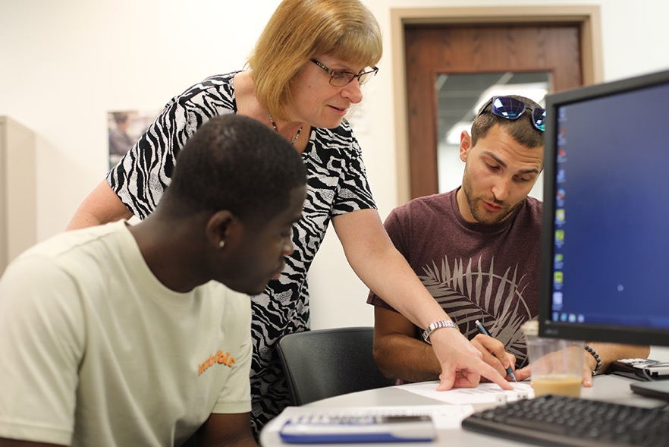
“Good teachers are able to weave a complex web of connections among themselves, their subjects, and their students so that students can learn to weave a world for themselves.” - Parker Palmer. What an honor it is to assist my students as they weave a new world for themselves!
—Elizabeth Betzel, Columbus State Community College

Slide 61
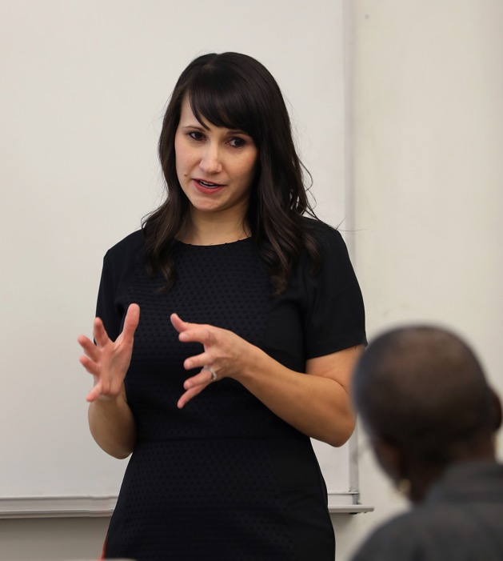
I'm inspired by my students' struggles and their persistence. I provide genuine encouragement to help students be successful.
—Nicole Brandt, Columbus State Community College

Slide 62
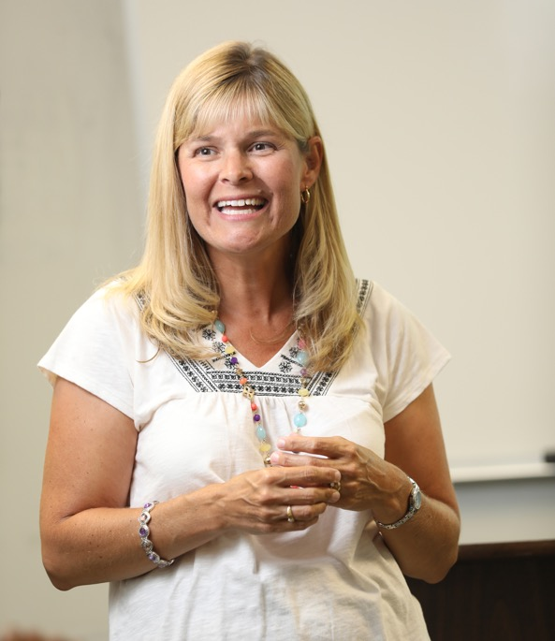
My students inspire me every day by showing me that regardless of the inequitable start to life we are dealt, we can overcome our challenges when someone believes in us, and more importantly, when we believe in ourselves. They make me a better teacher and a better person.
—Kelli Nowlin, Columbus State Community College

Slide 63
I have committed my life to expanding the minds and horizons of youth and fellow teachers. Through arts-integrated projects, thematic courses, and campus-wide events, this vision has been manifested. Long live the teaching of writing and literature for the betterment of us all!
—Carmen Livingston, Community College of Allegheny County

Slide 64
By whatever means possible, teach students to develop their own original voices. Students in my English composition seminars investigate persistent social, cultural, economic, and environmental problems. Semester after semester, I am reassured that my students have the vision, intellect, talents, and skills necessary to improve our world.
—Angela Gaito-Lagnese, Community College of Allegheny County

Slide 65
Teaching is like watching birds learning how to fly. When the student soars off, you know you've done your job well.
—Rebecca Senkowicz, Community College of Allegheny County

Slide 66
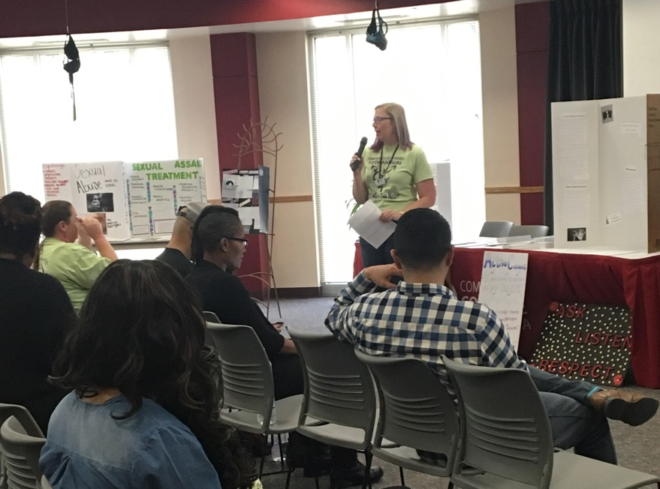
Audre Lorde said, “It is not our differences that divide us. It is our inability to recognize, accept, and celebrate those differences." I strive to create an intersectional teaching environment in which the student truly feels seen in all of his or her identities and valued in our learning community.
—Jennifer Dale, Community College of Aurora

Slide 67
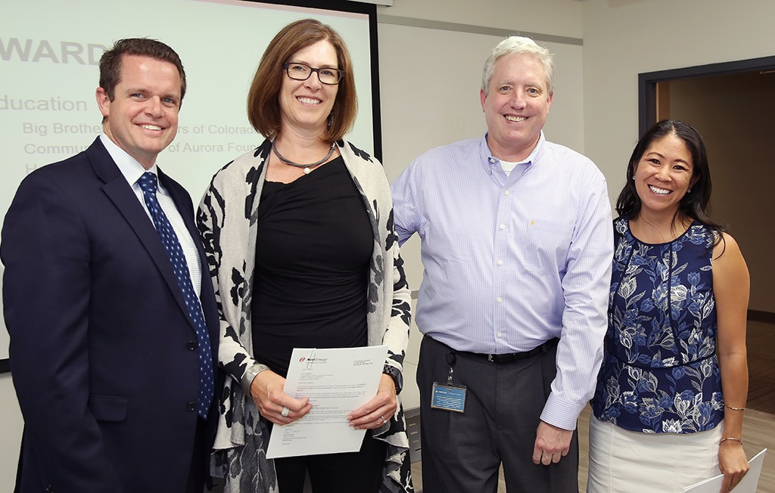
I am motivated by my collaborative colleagues at Community College of Aurora who are willing to innovate and push the envelope in order to achieve the best for our students.
—Janel Highfill, Community College of Aurora

Slide 68
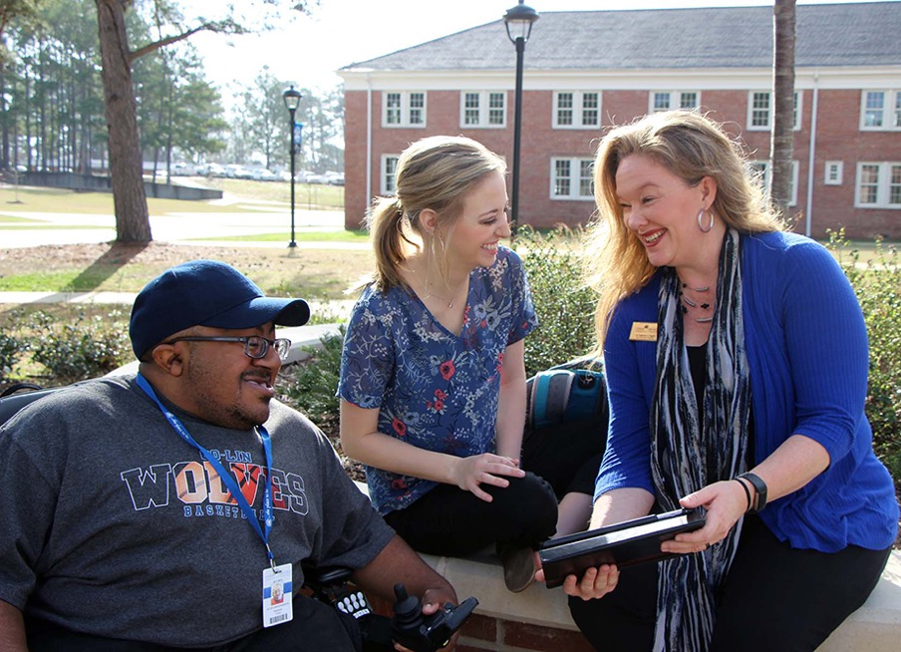
Reed Markham said, “Successful leaders see the opportunities in every difficulty rather than the difficulty in every opportunity.” I strive to make each task, student issue, and classroom challenge an opportunity to make things better. Listening, caring, and positivity are at the root of all decisions.
—Stephanie Duguid, Copiah-Lincoln Community College

Slide 69
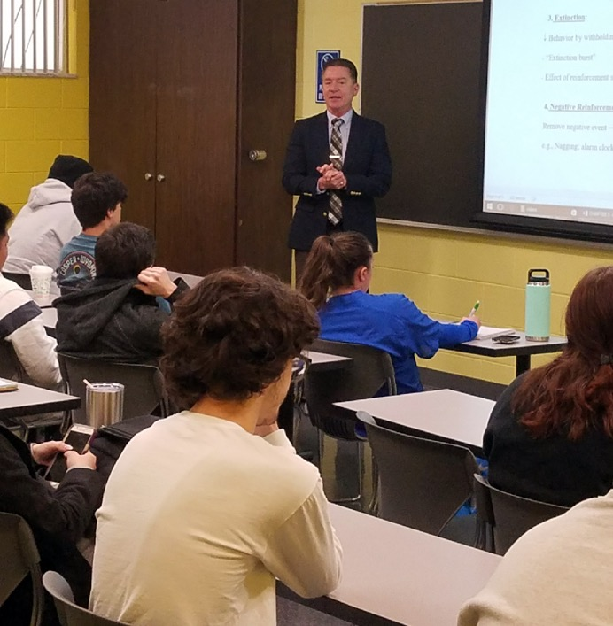
—Richard Rogers, Daytona State College

Slide 70
I am passionate about making people successful. To that end, we have motivated and supported staff to be creative in all aspects of their programs. With the support of the college, we have enhanced pathways supporting vocational and technical students from high school into two- and four-year programs.
—Frank Snyder, Daytona State College

Slide 71
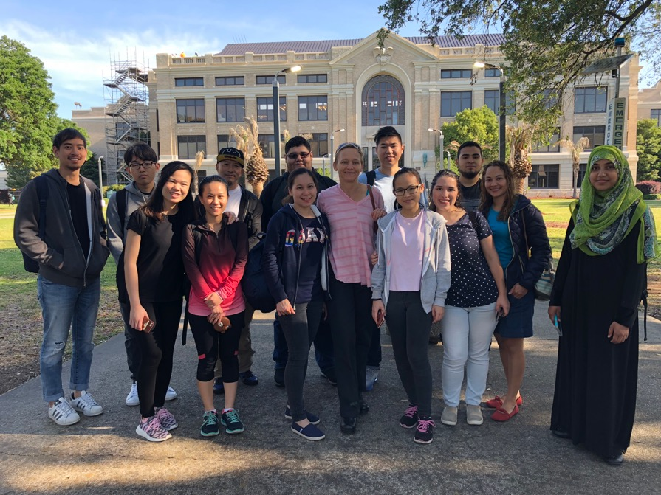
We are always moving, interacting, attracting, and repelling each other. Enjoy the journey, love what you do, and be the best you.
—Marlene Friis, Delgado Community College

Slide 72
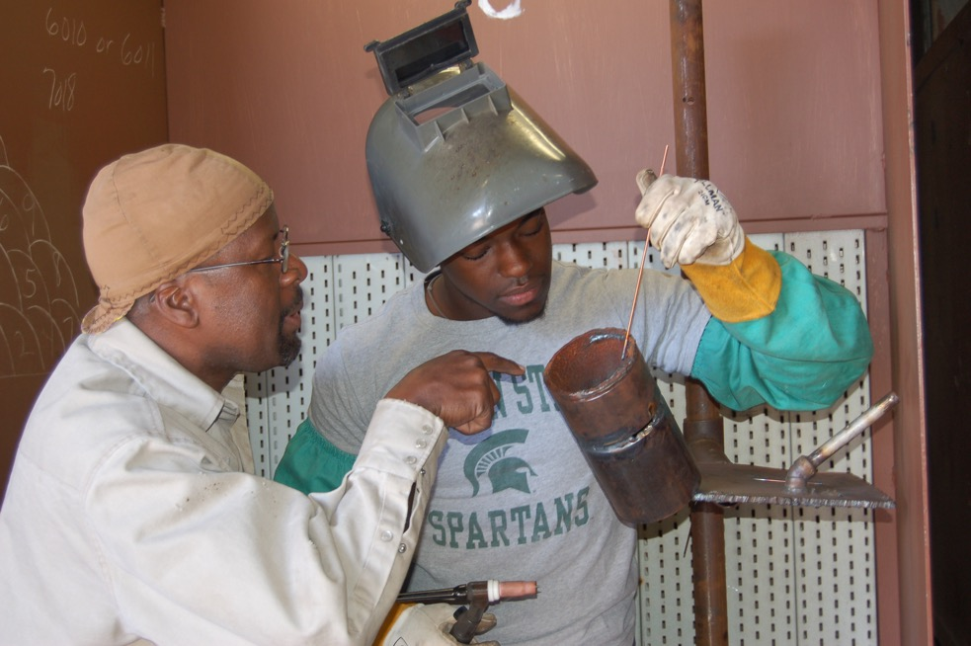
Anthony J. D'Angelo said, “Develop a passion for learning. If you do, you will never cease to grow." With that quote, I am reminded of a student I taught. His name was Ron Lackings. With the stress of everyday challenges, he never gave up. Today Ron is a welding instructor.
—William Wilson, Delgado Community College

Slide 73
My teaching philosophy is student-centered. In MLK’s words: “Education is to teach one to think intensively and to think critically. Intelligence plus character, that is the goal of true education.” I strive for excellence in teaching and learning by treating my students fairly, respectfully, and always with compassion.
—Kassandra Ramirez-Buck, Eastfield College

Slide 74
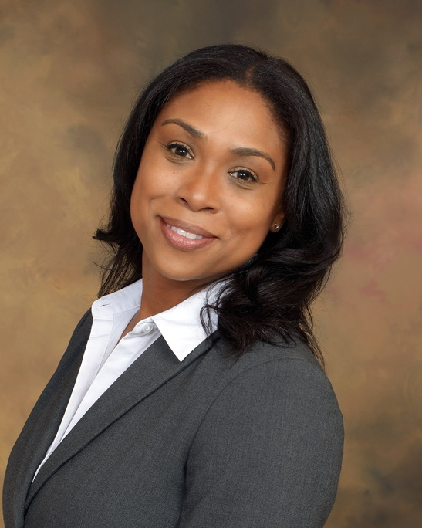
I noticed a distressed student who was unsure where she’d parked her car. I asked her about the purpose of her visit as we walked toward the buildings adjacent to her parking lot. She was so grateful she bear-hugged me. Never take for granted what may impact a student’s success. Be kind!
—Tricia Thomas-Anderson, Eastfield College

Slide 75
I am humbled to be recognized as a recipient of the NISOD Award. Teaching is my passion. It is highly rewarding to see my students achieve their academic and career aspirations. To better serve my students I thrive to keep myself up to date with the emerging trends in education.
—Divya Ajinth, Elgin Community College

Slide 76
I tell all my students that teaching young children is a privilege. Parents are putting their precious children into our care. It is not a job to be taken lightly. I enjoy helping students because they will become the teachers of our future leaders!
—Dawn Munson, Elgin Community College

Slide 77
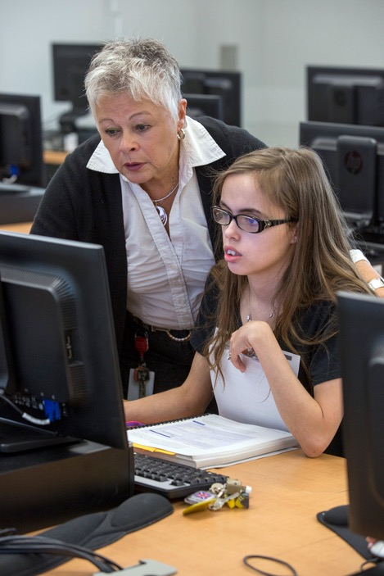
Be available to students for questions. Some may be too shy to ask, watch for body language that says, “I don’t understand." Incorporate stories to help students remember difficult concepts. Show how to do the task, but also show how to figure it out if they forget the steps.
—Mary Peterhans, Elgin Community College

Slide 78
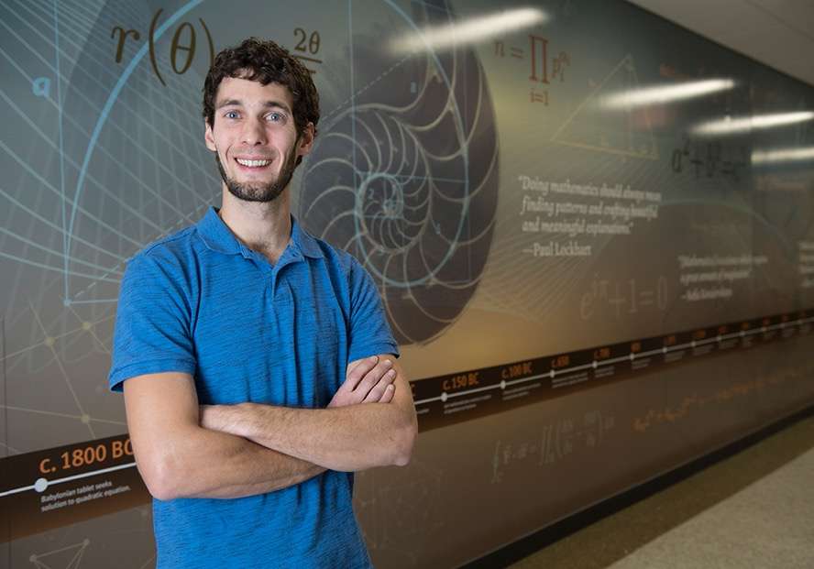
What inspires me to strive for excellence in my teaching is my core belief in the God-given abilities of my students to create and think critically. For this reason, I seek to inspire my students to ask probing questions, make important connections, and communicate mathematical justification effectively.
—Greg Wheaton, Elgin Community College

Slide 79
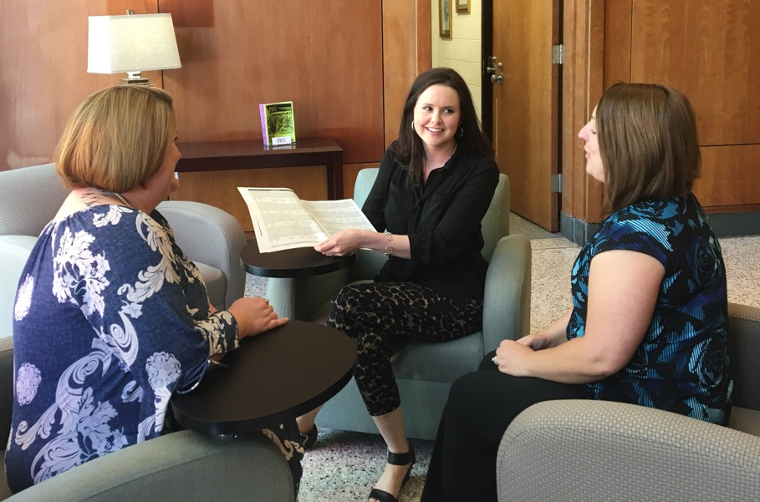
As a college administrator, I have been afforded the opportunity to work with students, faculty, staff, administrators, and community leaders. No matter the position I’m in, as long as we are willing to work together, the outcome is better than we could ever accomplish on our own!
—Amy McLamb, Fayetteville Technical Community College

Slide 80
Take that first step in understanding what someone is asking.
—Mary Mitchell, Fayetteville Technical Community College

Slide 81
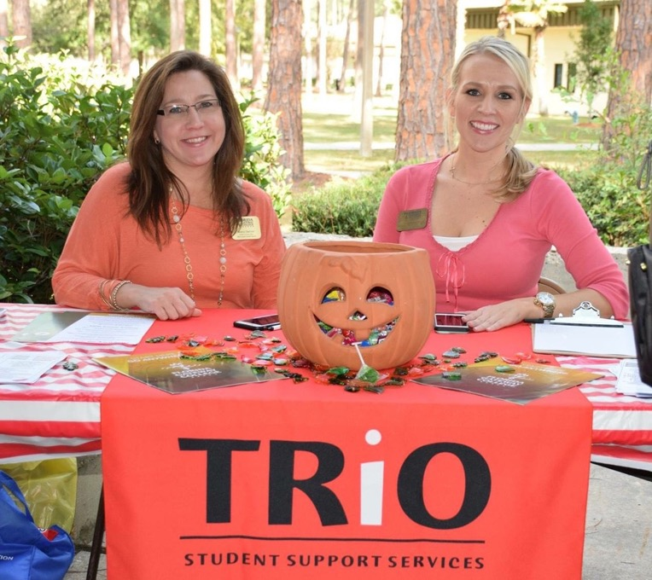
—Elizabeth Allison, Florida Gateway College

Slide 82
When you study mathematics, you learn about the relationship between numbers and patterns. When you teach mathematics, you learn how to help others understand the beauty of these relationships and how they can apply it to their everyday lives.
—Pedro Mora, Florida Gateway College

Slide 83
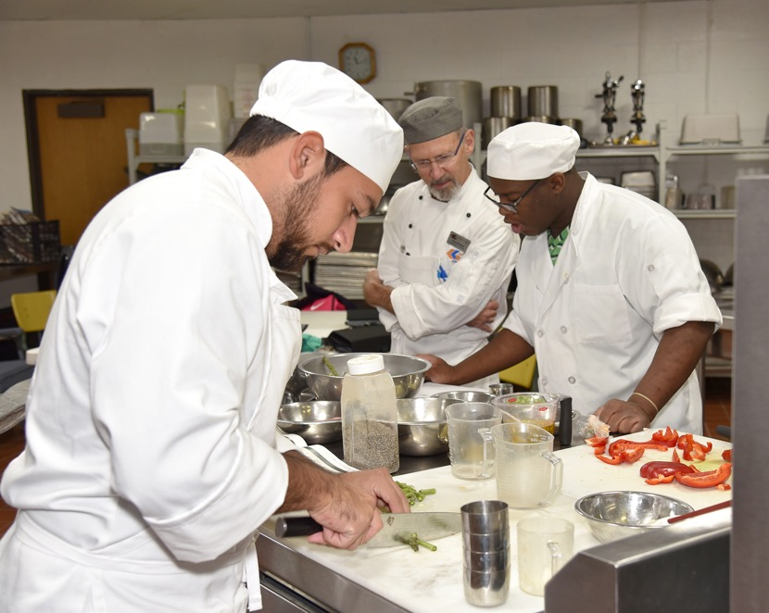
Even after teaching for 13 years, it is still a magical moment for me when students are exposed to new foods, cooking techniques, and terms. It is a privilege to share the knowledge of food.
—Paul Mendoza, Galveston College

Slide 84
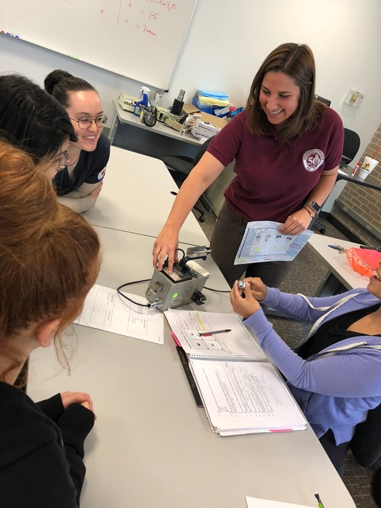
The opportunity to transform an individual into a successful nuclear medicine technologist and colleague is my goal for each student I encounter. It’s my privilege to develop the minds of future technologists with access to a valuable education, practical knowledge, and experiences, as well as my passion for the profession.
—Rebecca Montz , Galveston College

Slide 85
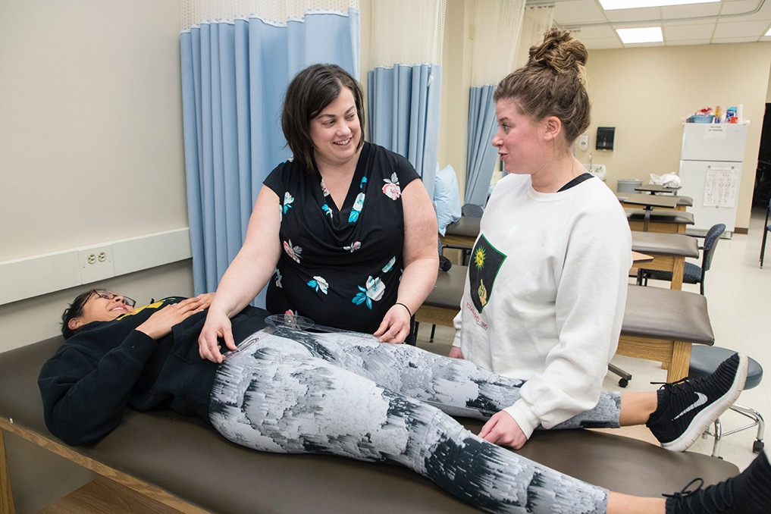
I am honored by the award. However, instead of honoring my teaching excellence, I think the true spotlight should be on the excellence of my students. Their perseverance as they pursue their dreams makes me shine as an instructor.
—Traci Gotz, Gateway Technical College

Slide 86
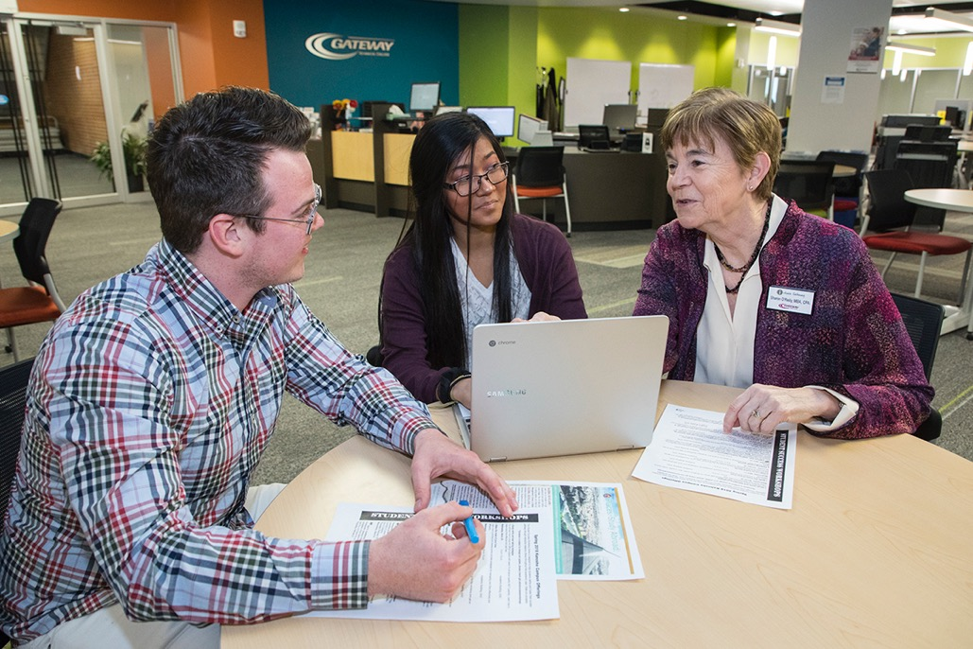
I am inspired by our vision to “make life-changing educational opportunities a reality.” My passion is helping students see things in a different way, removing obstacles, feeding their curiosity and confidence, and inspiring them to become lifelong learners, as well as improving the structure to do so.
—Sharon O'Reilly, Gateway Technical College

Slide 87
The more I can relate concepts to the real world, the more these concepts become tangible, and as such, students develop a true understanding rather than just empty memorization. When students can make these connections, math is no longer something to be feared, but rather something to be embraced.
—Manal Rizek, Gateway Technical College

Slide 88
Within my classroom, everyone has dual citizenship: teacher and student. By encouraging everyone to immerse themselves in learning we can evolve into critically-thinking citizens. Creating lifelong learners means that I have given students the tools necessary to build on knowledge and connections that will last beyond a semester of study
—Jennifer Bigelow, Genesee Community College

Slide 89
Teaching in a technical college gives me the opportunity to inspire students in my community to achieve their goals, provide for their families, and improve their communities. It also allows me to help provide my former peers with a workforce that has been trained to meet their specific needs.
—Kye Haymore, Georgia Piedmont Technical College

Slide 90
My professional philosophy is simple: seek growth, change, and be open to surprises. This philosophy has served me well inside and outside the classroom. With an open heart and mind, I can be an asset to the students and the institution that I strive to serve.
—Jessie Hayden, Georgia State University - Perimeter College

Slide 91
Teaching sociology is incredibly rewarding because I’m able to journey with students as they begin to understand the complexities of group behavior; to identify how factors like culture, race, class, and gender impact society; and to critically examine the social world in which they live.
—April Dove, Greenville Technical College

Slide 92
—Carla Cole, Guilford Technical Community College

Slide 93
3D printing is the "hook" that draws the student in. From there, the possibilities are exciting!
—David Antol, Harford Community College

Slide 94
Life always involves learning and we must see the connection between learning and real life. I believe active learning that engages students in the learning process, by participating in meaningful learning activities, and thinking about what they are doing, is the best way to connect learning to life.
—Supawan King, Harford Community College

Slide 95
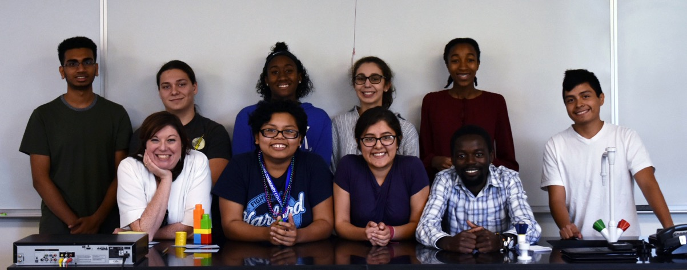
How does one define a successful career? My proudest achievements as a teacher come from the successes that are not my own. Those students who struggle the most, but who work with me to learn how to learn inspire me to keep going when the grading piles up!
—Jaclyn Madden, Harford Community College

Slide 96
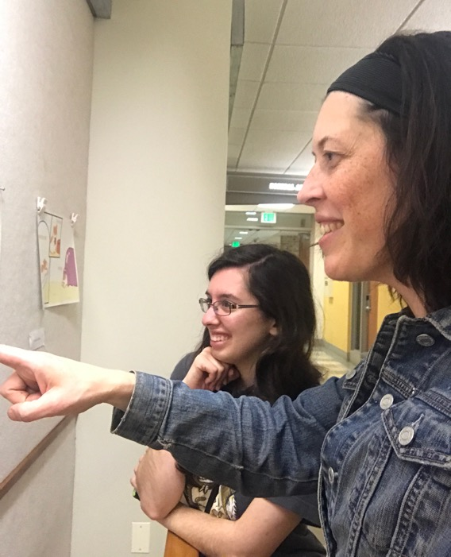
Teaching has less to do with imparting information and more to do with building relationships and modeling behaviors. The creative process is more important to teach than any technique. I provide students opportunities to play, lose themselves in process, make things without purpose, and to fail and try again.
—Heidi Neff Chuffo, Harford Community College

Slide 97
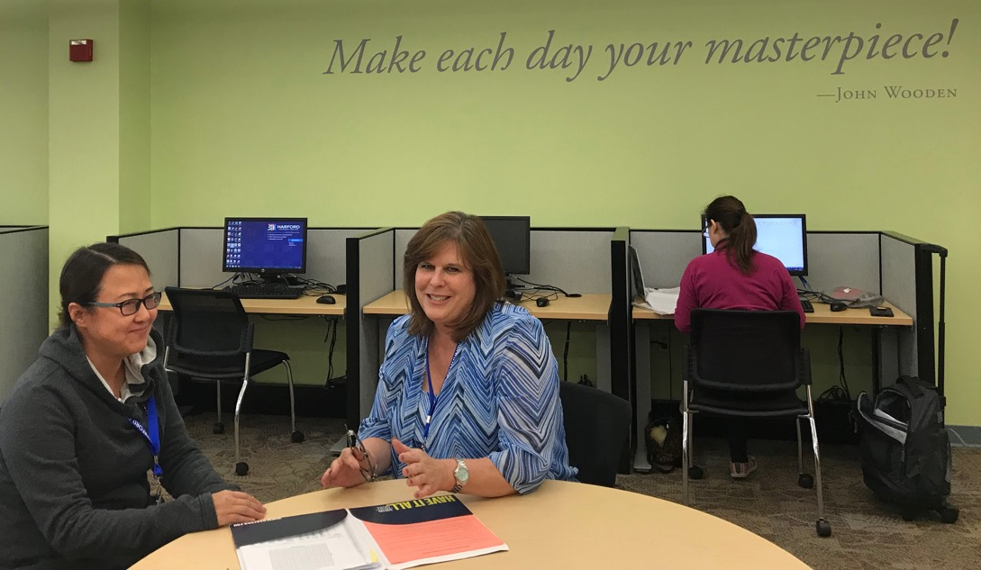
As learning center manager, my focus is to have our team united in the pursuit of providing excellent service and support to our students by having a positive attitude, being engaged and genuinely interested when conversing, and making someone’s day by speaking a kind or encouraging word.
—Pamela Runge, Harford Community College

Slide 98
Trust is built by being one-on-one with learners. Today’s students distrust instructors and the learning process. Gaining trust is accomplished through relationships.
—Sara Crill, Harrisburg Area Community College

Slide 99
Nightingale said, “One’s feelings waste themselves in words, they ought to be distilled in actions which bring results.” Nurses are positive forces in patient care. These words guide me as I help my students achieve their goals.
—Caren LaRue, Harrisburg Area Community College

Slide 100
I aim to achieve three student goals: competence, confidence, and continuous learning. I believe students must be capable in their nursing practice. Increased competence increases confidence. Additionally, an appreciation for the importance of continuous learning is critical, since nurses must never stop improving their practice.
—Loretta O'Neill, Harrisburg Area Community College

Slide 101
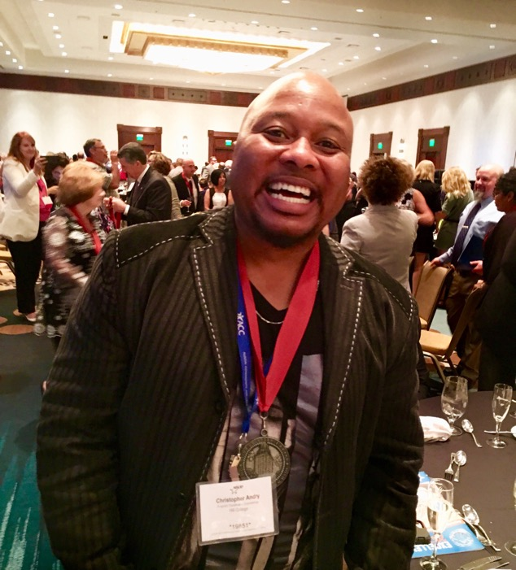
Dr. Benjamin Mays wrote a poem called God's Minute, that explains, "we only have one minute with 60 Seconds in it." I love being a teacher; it's one of the most positive ways to make my minutes count.
—Christopher Andry, Hill College

Slide 102
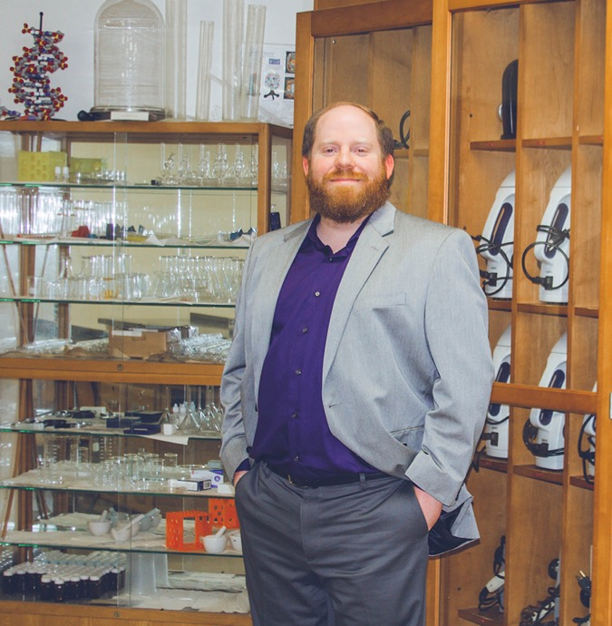
The art and magic of discovery is something that keeps me excited, especially when students see life through a microscope for the first time. "Try to make sense of what you see...be curious." -Stephen Hawking
—Aaron Warren, Hill College

Slide 103
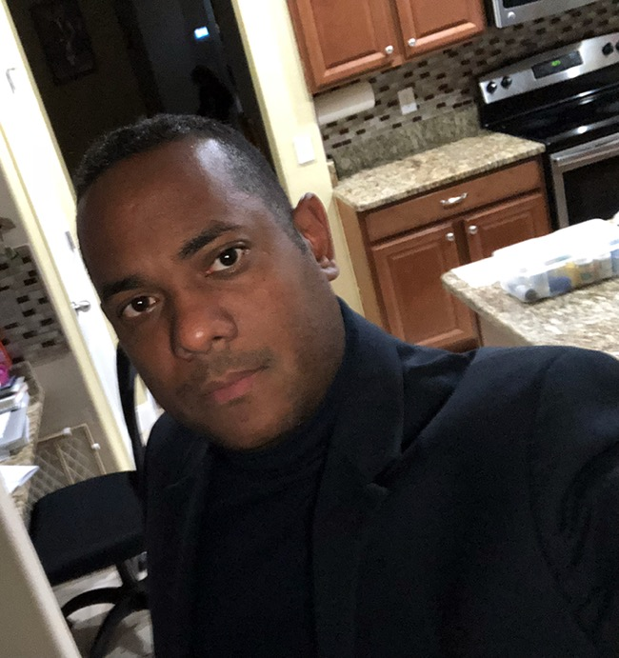
Live to do as much as you can, for as many as you can, for as long as you can.
—Kenneth Compres, Hillsborough Community College

Slide 104
I love teaching students career and life skills and providing encouragement throughout their academic journey. Ultimately, I get to see our culinary graduates at restaurants and hotels all “grown up” and realize once again that what we do as educators goes far beyond the classroom. We truly transform lives.
—Fred Jaeger, Hillsborough Community College

Slide 105
I am a teacher and educator because I want to change the world. My teaching techniques consist of peer-instructional method lectures, group discussions, and laboratory-based experiments.
—Sujit Mondal, Houston Community College

Slide 106
Teach because you want to, not because you have to. Model being a learner by learning from your students. Be open and honest and transparent. Pass on the value of self-reflection. Assist students in understanding that a college education involves more than the classroom.
—June Keller, Houston Community College

Slide 107
My philosophy is that students have within themselves the ability to succeed, and my job is to guide them and inform them of the resources they have at their disposal. Many of our students have complicated lives, and to effectively mentor and encourage them, we need to have empathy.
—Annie Tsui, Houston Community College

Slide 108
I used to think that the word “intervene” was negative, but now it guides my practice. I am a proud intervener. If it is well timed, strategically delivered, and filled with encouragement, a teacher’s intervention can lead to a rewarding learning experience.
—Lara McInnis, Humber College

Slide 109
Seeing my former nursing students provide quality care to their patients motivates me to continue doing what I love to do. I am humbled to be a part of their nursing career and honored to work alongside them. It’s truly a rewarding experience!
—Beverly Solesky, Indian River State College

Slide 110
Seeing the confidence and sheer joy of teachers actively engaged in arts integration professional development workshops highlights the value and impact of educational support for teachers. Professional development programs can inspire teachers and bring positive energy into the classroom.
—Angel Mercier, Johnson County Community College

Slide 111
Enjoy learning! There is something to be learned every day, especially when things do not go as planned. Find enjoyment in making improvements instead of dwelling on what didn’t work.
—Kristin Ciesemier, Joliet Junior College

Slide 112
As a college employee for the past 15 years, my goal has always been to bring a helpful and friendly presence to the college and to those in need of my services. This award is a real honor and I'm proud to be recognized by NISOD. Thank you.
—Jeff Fisher, Joliet Junior College

Slide 113
I am blessed to work in higher education and assist students in pursuing careers and employment successes. Every day I am grateful for the opportunity to equip students with life-changing knowledge, resources, and skills. My passion lies in my ability to influence, motivate, and inspire my students and my team.
—Bridgett Larkin Beene, Joliet Junior College

Slide 114
I love what I do because every day is different with the students that I work with. Being a first-generation/low-income college student comes with many challenges and barriers. These students inspire me to give them the best experience possible while attending Joliet Junior College.
—DeAndre Butler , Joliet Junior College

Slide 115
My passion for teaching incorporates one of my personal qualities of caring for others and our society. Teaching is about sharing knowledge between teachers and students and assisting in the development of processes.
—David Fonteno, Kilgore College.

Slide 116
I believe the qualities of effective teachers can make a difference in students' daily lives and have a direct influence in enhancing students' learning.
—Widad Abedelwahab, Lamar Institute of Technology

Slide 117
Facilitators and administrators are the leading agents cultivating the atmosphere necessary for growth and prosperity. I remind myself daily that everyone dreams uniquely in order to create an attitude that ignites another’s desire to construct his or her personalized definition of success.
—Angela Clark, Lamar Institute of Technology

Slide 118
Excellence in music is partly achieved by technical and analytical skills. These skills are a double-edged sword as they can and often do take the place of intuitive expression and emotion. I help students balance these two 'yin and yang' aspects of music performance.
—Carl Richardson, Lamar State College Port Arthur

Slide 119
The cosmetology industry is not just about styling hair; it’s a recession free industry that allows you the artistic ability to change your clients' outward appearances as well as their inner feelings about themselves. Passion, drive, and determination will take this career as far as you want it to go.
—Amanda Smith, Lamar State College-Port Arthur

Slide 120
In my class, students are encouraged to answer critical-thinking questions by providing explanations and making sense of final answers, not just solving problems. I am inspired by the way my students answer questions. They can think and solve problems that relate to the community and physical world.
—Orlando Patricio, Laredo Community College

Slide 121
As educators, it is our duty to seize every opportunity to share our knowledge and experiences with our students so they become better equipped to make sound decisions when faced with choices that can elevate their academic, social, and career trajectories.
—Weymon Holloway, Lawson State Community College

Slide 122
I have worked with nursing students for more than 35 years. I have discovered that whether students are successful or not in their pursuit of a degree, they are concerned whether the faculty understands how difficult the process is. I have learned to demonstrate caring behaviors towards my students.
—Shelia Marable, Lawson State Community College

Slide 123
An educator’s philosophy of teaching should be student-centered. Students should know that there are no limits to success and failure is not an option.
—Alice Milton, Lawson State Community College

Slide 124
What most people call brilliance is just an action upon inspiration from God. I suspect excellence is no different.
—Shawanda Thomas, Lawson State Community College

Slide 125
I am driven by a shared vision of student success and holistic achievement that involves the academic, self-actualization of every student that I encounter. Every student is a success story in the making.
—Gary Andrews, Lehigh Carbon Community College

Slide 126
The line “attitude reflects leadership” from the movie Remember the Titans has been a statement that I strive to convey in all my interactions, whether they be with students, colleagues, or individuals I supervise. Speaking the language of possibility versus impossibility opens the doors of discovery and learning.
—Bill Nykiel, Lethbridge College

Slide 127
Teaching by using hands-on simulation within interprofessional health care environments has provided me a global perspective on collaborative learning. I am inspired by watching students push themselves, embracing their vulnerabilities, and building psychological resilience through supportive adversity and peer connection. Remember to always challenge boundaries, embrace change, and foster authenticity!
—Sheri Wright, Lethbridge College

Slide 128
I openly admit that I accept failure in my classroom. My failures have created the educator I am today. Life is full of trials, tribulations, upsets, setbacks, and failed attempts. As educators, we should teach our students how to face failure rather than avoiding it at all costs.
—Wade Hescht, Lone Star College

Slide 129
I dislike and love math, but multiplication was hard! Our students can sympathize. The beginning of my math career was a test. I believe students wish to be challenged.
—Mari Menard, Lone Star College - Kingwood

Slide 130
As an Irish immigrant, I learned that through hard work, determination, and the help of many, I could live the true American Dream. Let’s strive to motivate our students to believe in and live their dreams.
—Dominic Beggan, Lone Star College Montgomery

Slide 131
It is said, "Give a man a fish and you feed him for a day. Teach a man to fish and you feed him for a lifetime." Equipping students to achieve their goals gets me out of bed every morning. I get to do what I love.
—Erin Miller, Lone Star College North Harris

Slide 132
Whether its online or face-to-face, students need a professor who can inspire them. Being a professor gives us the unique opportunity and the privilege of being able to stimulate students' inner talents and resilience.
—Nina Javaher, Lone Star College System

Slide 133
The transition to college can be a bumpy road for many students. I see my role as easing this transition by providing my students with a supportive environment.
—Kimberly Mori, Lone Star College-CyFair

Slide 134
As a nurse educator, my ultimate goal is to create dynamic and reflective learners who are not afraid to express their curiosity and creativity. Learners who discover new pathways continually challenge and elevate the nursing profession.
—Linda Vogel, Lone Star College-Montgomery

Slide 135
Like many of my students, at one time, I was a defeated individual. Macomb was my last chance to greatly improve my life. Macomb transformed me from a statistic to a success. I’m thrilled to be receiving a NISOD award because it reflects back on this institution that saved me.
—Cassandra Swiderski, Macomb Community College

Slide 136
My mom would say, "The world is full of great, kind people. If you cannot find one, be one." My college classrooms are full of great, kind people who are dedicated to the pursuing success. Being an educator is a gift I don't take lightly.
—Lynea LaVoy, Madison Area Technical College

Slide 137
Bring to life the passion each student holds, in every topic that can be imagined. Impact tomorrow by influencing the mind of a student today.
—Bart Allen, Madisonville Community College

Slide 138
My heart is working with Baptist Campus Ministry. Since we are a community college, we have students from all walks of life. We all need encouragement. I am blessed to work with students in an area that encourages them in their educational and personal lives.
—Connie Harralson, Madisonville Community College

Slide 139
I center my teaching by using effective teaching strategies. The educator’s responsibility is to be the content expert in the subject, have kinesthetic skills, and assist students in becoming competent in the area of practice. I emphasize to students that they are here to make a change in society.
—Cynthia Doby, Malcolm X College

Slide 140
Each discussion with my colleagues is an inspiration, challenging me to elevate my crafts and reaffirming my commitment to our students. I am indebted to these passionate, talented, and selfless educators at Malcolm X College whom I am fortunate to call friends, mentors, and comrades.
—Chiju Huang, Malcolm X College

Slide 141
I believe students need to actively participate in their education to experience learning that is meaningful. Deep learning and critical thinking take place when students discuss concepts with classmates and share their knowledge and past experiences.
—Jennifer Piltawer, Malcolm X College

Slide 142
My goal as an instructor is to instill a confidence in each of my students that they are lifelong learners, seekers of knowledge, and that they have the ability to conquer problems, in the classroom and in life.
—Michelle Powell, McLennan Community College

Slide 143
I’m inspired by my students every day as they learn more about themselves while engaging with course materials. Students are seeking mastery, purpose, and to become their best selves. If I can help them, then I’m helping change the world. Daily, I encourage students to master something.
—Eric Thompson, Metropolitan Community College

Slide 144
Students respond best to instruction when they feel the instructor cares about their learning and their futures. Students won't be motivated if they are simply given a list of rules and regulations. Motivation comes from having a true concern for students.
—Marcia Vergo, Metropolitan Community College

Slide 145
It has been said, “If you can’t do, teach.” During the 30-years I spent as a healthcare administrator, I found it was teachers who became the doers. When we needed an expert to help with a serious issue, it was a teacher who got the call.
—Howard Boardman, Metropolitan Community College Omaha Nebraska

Slide 146
Academic advising is teaching and learning. My goal is to encourage development of critical-thinking skills and a sense of responsibility in each student I advise. What excites me is when students connect who they are and who they want to become with what they are learning.
—Elyse Max, Metropolitan Community College-Penn Valley

Slide 147
Student don't always believe they belong or will succeed. I share with students my belief in their abilities until they can internalize that belief. It has been my honor to provide that support and to know that when each person on campus serves in this role, students thrive.
—Yvette Sweeney, Metropolitan Community College-Penn Valley

Slide 148
I just love helping others. Higher education has been an awesome vehicle that I have had the privilege to hitch a ride on to fulfill that purpose. Through it all I love to teach students to starve their nightmares and feed their dreams.
—Terrell Tigner, Metropolitan Community College-Penn Valley

Slide 149
Ultimately, I strive to provide my students hands-on material, applicable case study scenarios, and collaborative opportunities to enhance their collegiate scientific experience. As Martin A. Schwartz said, "Science is beautiful. It allows us to bumble along, getting it wrong, feeling fine as long as we learn each time."
—HaLea Messersmith , Mid-Plains Community College

Slide 150
I am grateful every day to get paid to share ideas I believe are important for everyone to know. In addition, I get to spend time with students who share their enthusiasm, joy, and concerns about the future with me. Through them, the best parts of me will live on.
—Clay Grizzle, Mid-Plains Community College/McCook Community College

Slide 151
Technology supports and impacts students, faculty, and staff. As project manager, I am a team member responsible for ensuring that the implemented solution actually addresses the stakeholder’s needs. This requires extensive communication, collaboration, follow-up, and agility. I love having students on my teams—they absorb quickly and have great ideas!
—Harriet Beasley, Montgomery College

Slide 152
I love my students and my co-workers because we are all trying to grow and make the world a better place. What better job could there be than working in education where new ideas and experiences are everywhere.
—Roberta Buckberg, Montgomery College

Slide 153
There are two great rewards for me as a teacher. One is when I can see the light bulb turn on for a student, meaning that they understand something in a new way. The other is when I see my former students and they greet me with a smile.
—Henry Noel Caballero, Montgomery College

Slide 154
When I moved from teaching to program management, I was concerned I would lose the connection with learners. However, through inclusive and transformational leadership I have remained involved in all aspects of education with some of Montgomery College's most vulnerable learners. Leadership does not happen from behind a desk
—Nancy Newton, Montgomery College

Slide 155
I believe that we all can learn and understand. I also believe that learning has to be meaningful, even in some abstract concepts like chemistry. “Education breeds confidence. Confidence breeds hope. Hope breeds peace,” said by Confucius.
—Solomon Teklai, Montgomery College

Slide 156
My passion is learning and growing through knowledge. I strive to pass this passion onto my students. As Maya Angelou says, “Don’t just teach because that’s all you can do. Teach because it’s your calling. And, once you realize that, you have a responsibility to your students.”
—Ann Forrestal, Montgomery County Community College

Slide 157
I love learning about new developments in biosciences and their impact on society. I’m told my enthusiasm for science surfaces in the classroom. It is gratifying to see students become curious and ask questions. I strive to challenge students and I enjoy watching them rise to their potential!
—Christopher Harendza, Montgomery County Community College

Slide 158
As a teacher, my job is not to tell students what to think. My job is to make sure that they think. Critical thought is essential in society, and my goal is to ensure that students learn these skills and gain confidence to be critical thinkers and engaged citizens.
—Meagan McManus, Motlow State Community College

Slide 159
Everyone has an opportunity to accomplish the goals they have set for themselves. I believe in the saying, “No student left behind." When students struggle, I believe in encouraging them to stay focused, to keep it moving, and to finish strong no matter the obstacles ahead.
—Cherlyn Shultz-Ruth, Mountain View College

