Slide 1
My greatest joy as a mathematics instructor has been seeing my outstanding students participate in the annual contest sponsored by the American Mathematics Association for Two-Year Colleges. Some of these students have received full scholarships to complete their degrees and a few have earned scholarships to graduate and have published research. What could be better than this?
—Cynthia Allbee, Tarrant County College District (TX)

Slide 2
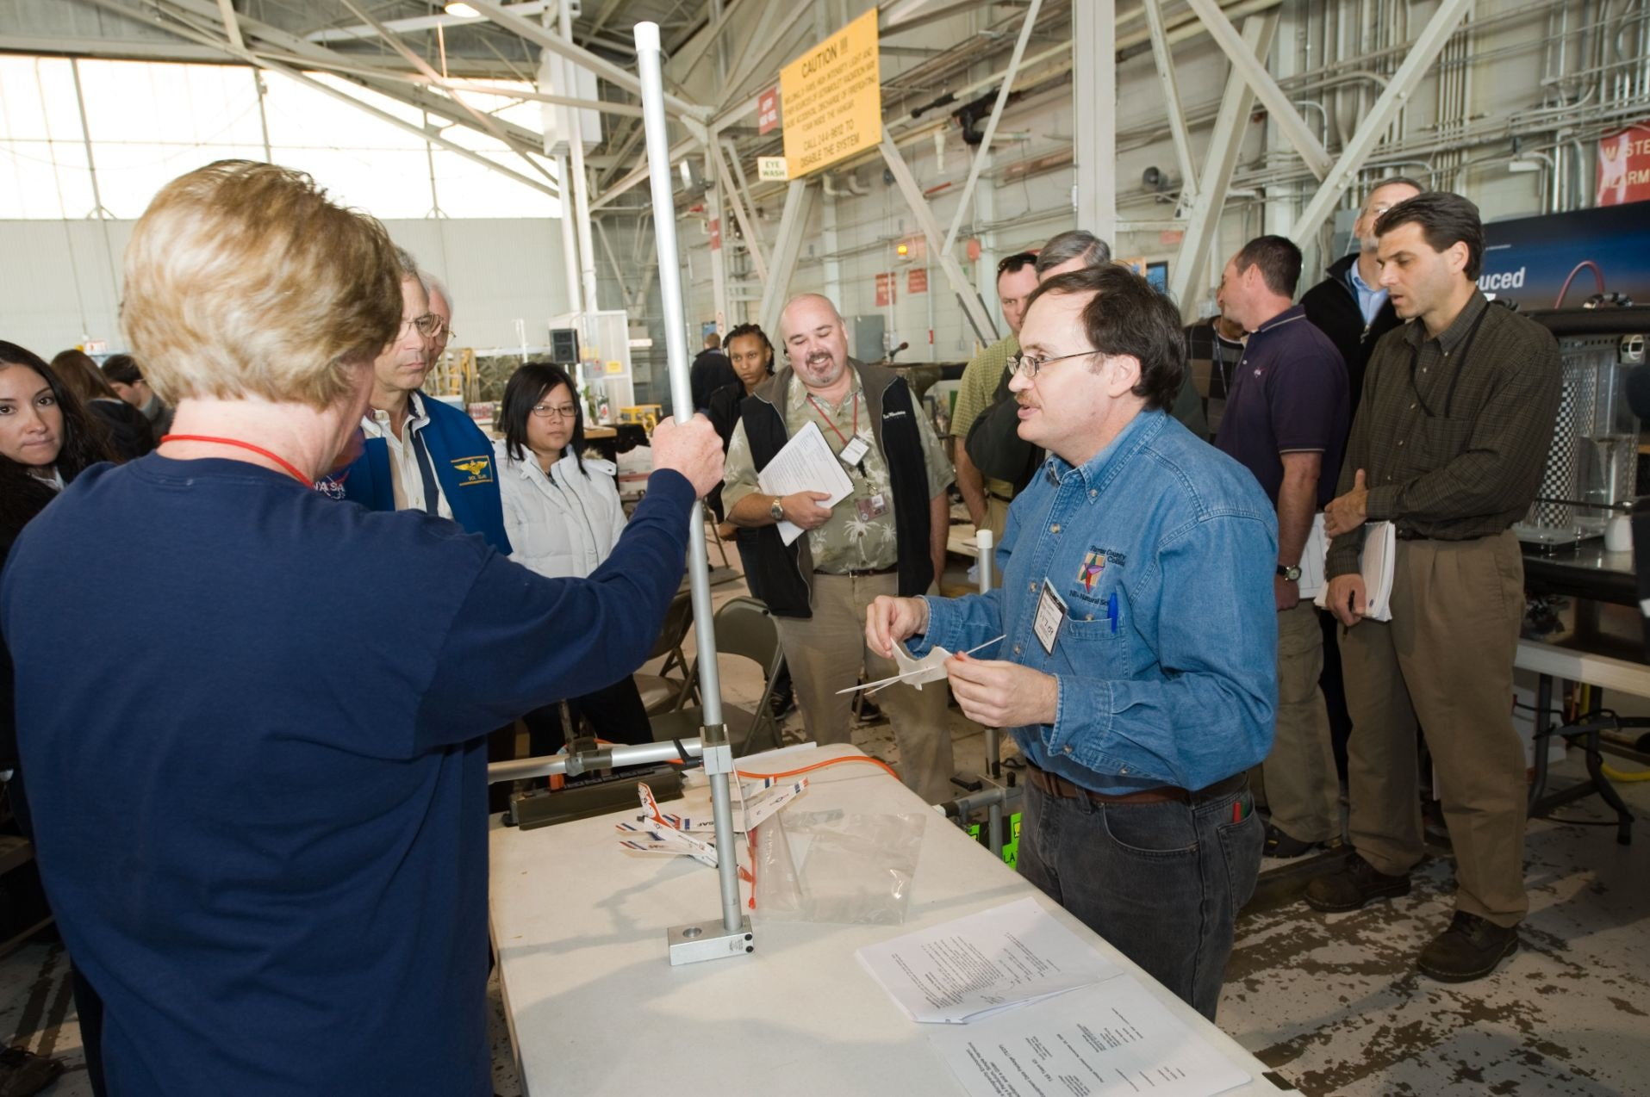
Teaching is leadership in the classroom. Enthusiasm is contagious. If students want to learn, they will do so. The mark of a good teacher is the ability to make students want to learn.
—Raymond Benge, Tarrant County College District (TX)

Slide 3
President John F. Kennedy stated, “Let us think of education as the means of developing our greatest abilities…and greater strength for our nation.” I am determined to use real-world experiences in the classroom. This provides students the opportunity to take what they learn in class and apply it immediately.
—Ernie Gines, Tarrant County College District (TX)

Slide 4
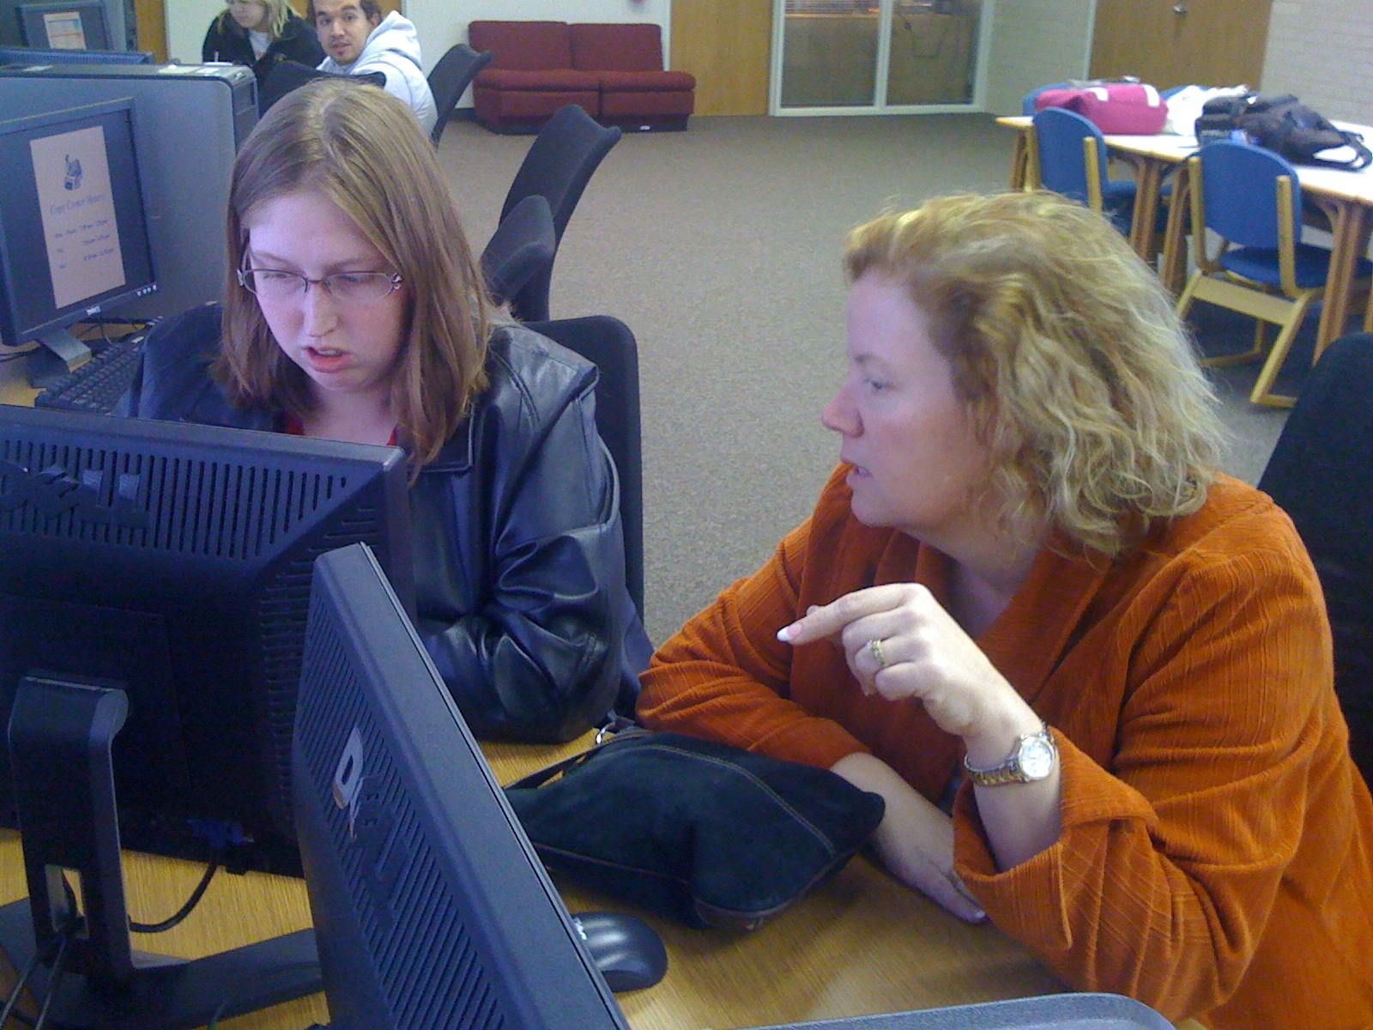
Remain willing to scrap things that aren't working, and be brave enough to try new things. Share what is working with colleagues, and learn from them as well.
—Christine Hubbard, Tarrant County College District (TX)

Slide 5
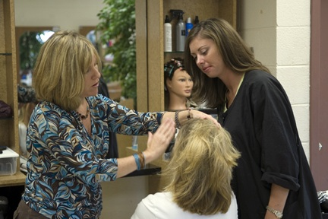
Helping students learn a trade, enabling them to be self-sufficient, is what drives me. I strive daily to provide a learning environment that is non-threatening, encouraging, and productive. Each student is important. After all, the student is the customer!
—Libby DeLoach, Technical College of the Lowcountry (SC)

Slide 6
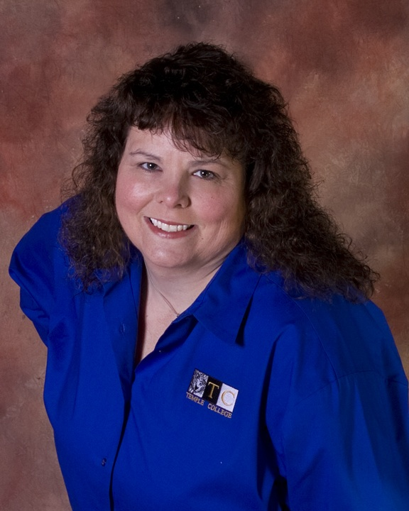
The strategy that helps me the most in the classroom is to do my best to reach all types of learners. I use audio, visual, and kinesthetic stimulation in my classroom, as well as technology to facilitate the learning process.
—Kimberley Clawson, Temple College (TX)

Slide 7
John W. Gardner sums up what excellence means to me, “…doing ordinary things extraordinarily well.” As the campus authority on TSI, excellence means striving to do my best in everything. Glorifying God in all I do enables me to achieve excellence and guides my commitment to student success.
—Christi Alderman, Texas State Technical College System

Slide 8
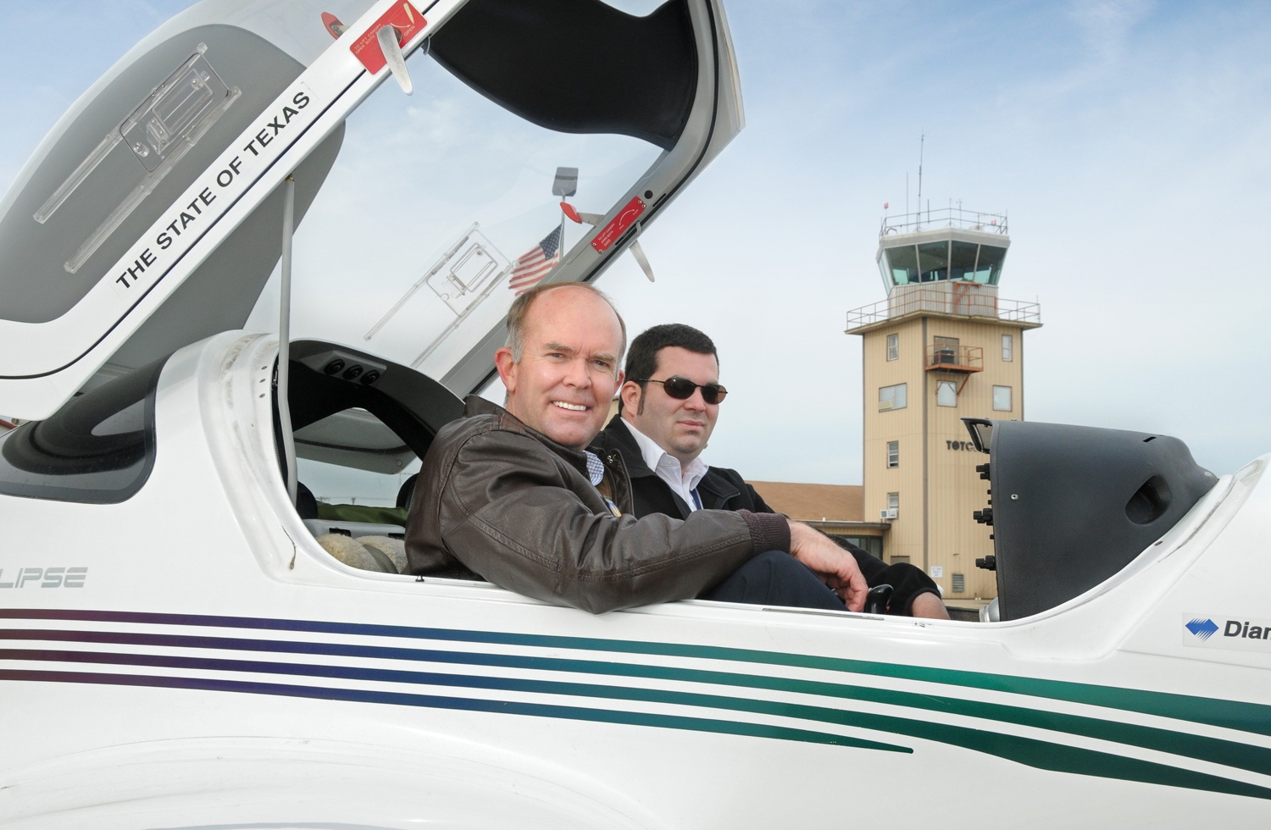
TSTC Aviation is committed to raising up the next generation of Texas Airmen in a demanding learning environment focused on technical and professional development. Building on our 40-year history of quality aviation programs, our faculty and staff are developing a variety of new courses designed to meet Texas aerospace industry needs well into the 21st century.
—Jeff Beene, Texas State Technical College System

Slide 9
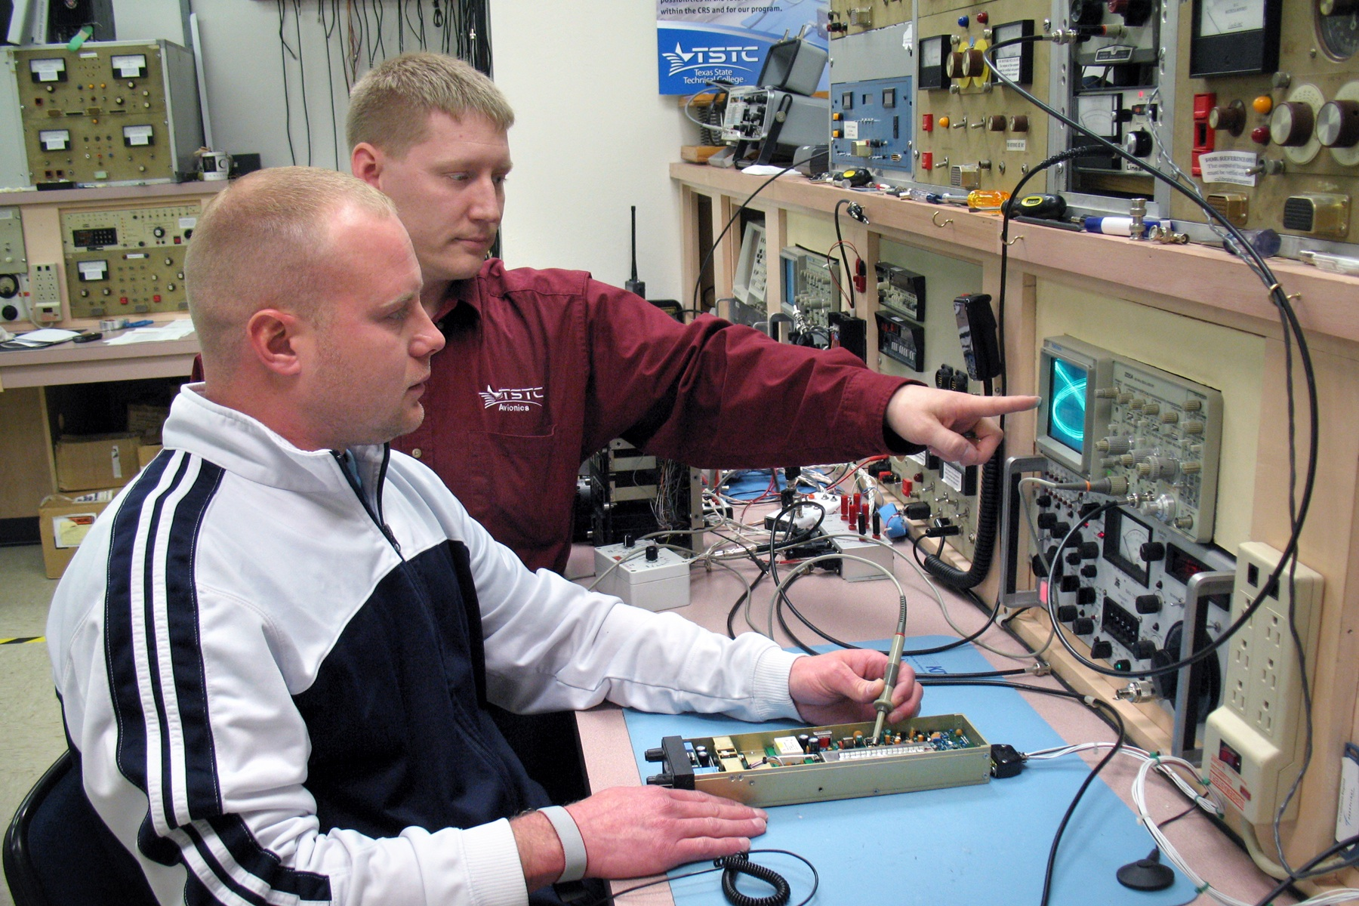
Sometimes we allow ourselves to be boxed in by what was done in the past or what other people think a school like TSTC does. If we make ourselves think beyond this to a different paradigm, then our technologies will open to working more directly with industry providing a more interesting environment for faculty as well as providing students with unique learning environments that better prepare them for industry.
—James Bryant, Texas State Technical College System

Slide 10
I am part of TSTC’s new paradigm in College Readiness by creating alignments, exchanges, and integrations with K-12 and other higher education institutions into TSTC. Our work opens the pipeline for achievers at all levels, and by helping students be ready for TSTC, I’m helping them be ready for life.
—Javier De Leon, Texas State Technical College System

Slide 11
Excellence is achieving the highest result without compromising integrity. As we move to the new paradigm, I am committed to finding new validation tools for skills assessment. Utilizing industry standards and assessments, we will reward customers for the knowledge and skills they have acquired, and provide avenues for training they desire.
—Cathy Fontaine, Texas State Technical College System

Slide 12
Excellence is always striving to be better tomorrow than today. To achieve excellence, one must embrace change and always look to raise the standards of everyday work activity. Encouraging and supporting co-workers are vital parts of a successful organization. Additionally, mentoring students will lead to successful graduates.
—Lorie Greenrock, Texas State Technical College System

Slide 13
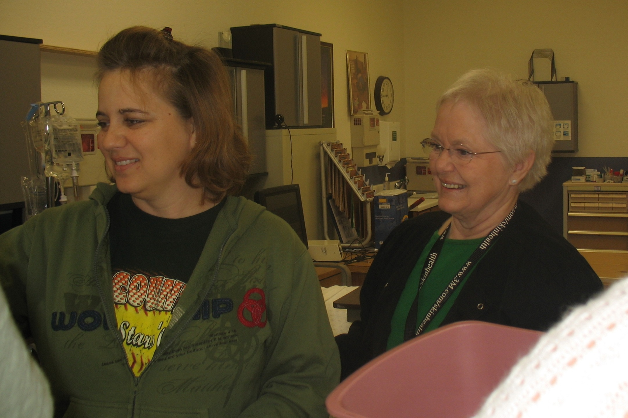
Teaching adult learners is in itself an activity of giving and sharing. Helping change the lives of adults is an honor. Helping adults achieve a dream and alter their destiny is a privilege that benefits the instructor and the student. We are indeed fortunate to be involved in their journey.
—Sherry Herrington, Texas State Technical College System

Slide 14
Excellence is the end result of respect. If you respect people, if you respect the world you live in, and, ultimately, if you respect yourself, you’ll always do your best—anything less would dishonor your principles. If you always do your best, excellence will be the outcome.
—Richard Lowder, Texas State Technical College System

Slide 15
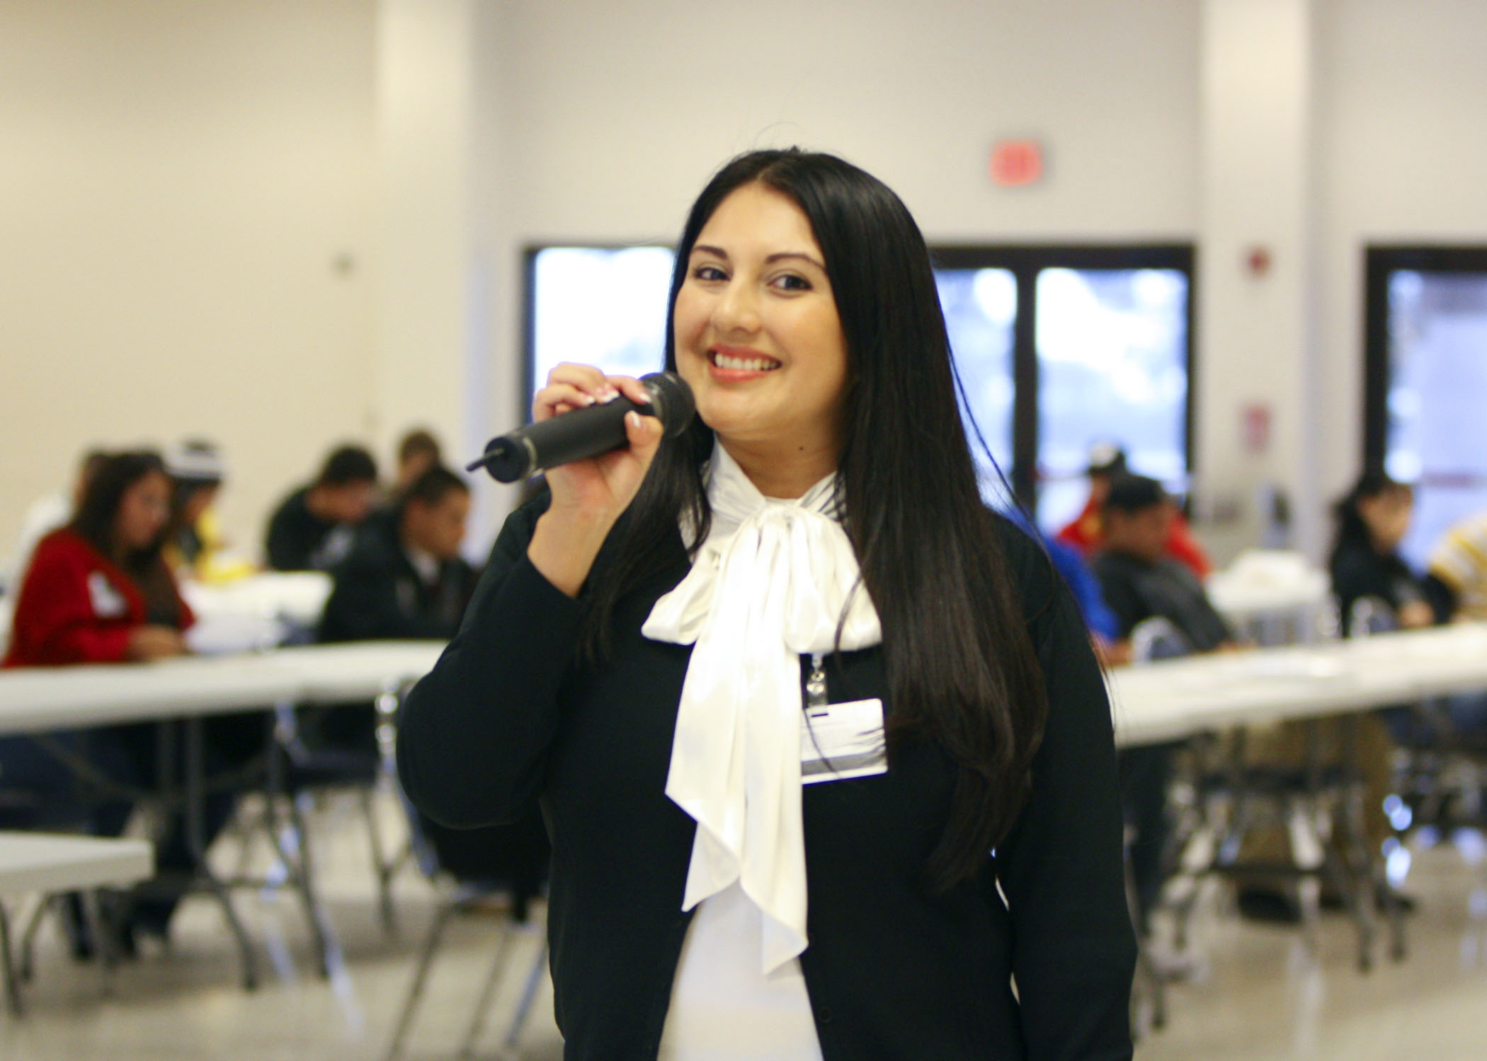
Sharing the new opportunities brought about by TSTC’s innovative educational paradigm has been a great personal experience and reward. Taking a lead in presenting students with unconventional technical and academic channels allows them to visualize many pathways to success.
—Dora Olivares, Texas State Technical College System

Slide 16
As the project manager for Image Now, I am committed to a successful implementation by providing excellence in training. Our internal processes must not be barriers or hindrances, and customer service is paramount. Image Now has increased our ability to assist our customers efficiently and effectively, both internally and externally.
—Rhonda Parker, Texas State Technical College System

Slide 17
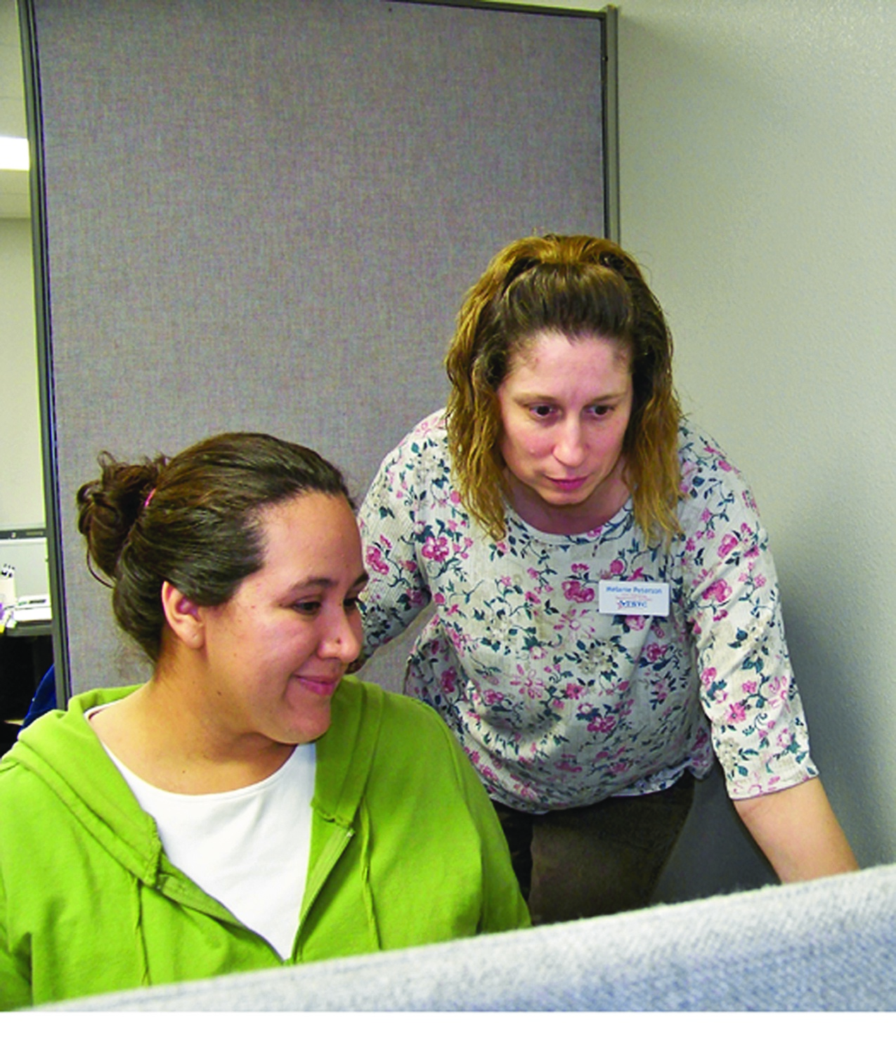
As Departmental Secretary for TSTC Publishing, I embrace the Success Only Learning Environment and the Paradigm Shift Concept philosophies through working with our interns by providing a professional workplace environment conducive to learning. Finishing tasks on time and teaching interns entrepreneurial spirit sets the tone for success in this office.
—Melanie Peterson, Texas State Technical College System

Slide 18
Excellence is something I strive for in all that I do. It not only means going above and beyond, but also giving more than you think is within. It is taking the extra step, so you can look back and smile knowing you have excelled in work, life, and yourself.
—Sylvia Robinson, Texas State Technical College System

Slide 19
Excellence is doing the best you can and always doing the right thing, even when no one is watching. I have helped make an innovative difference by working with system-wide bookstore and financial services personnel to standardize month-end accounting entries and have served on a system-wide committee to design and implement a new chart of accounts.
—Albert Srubar, Texas State Technical College System

Slide 20
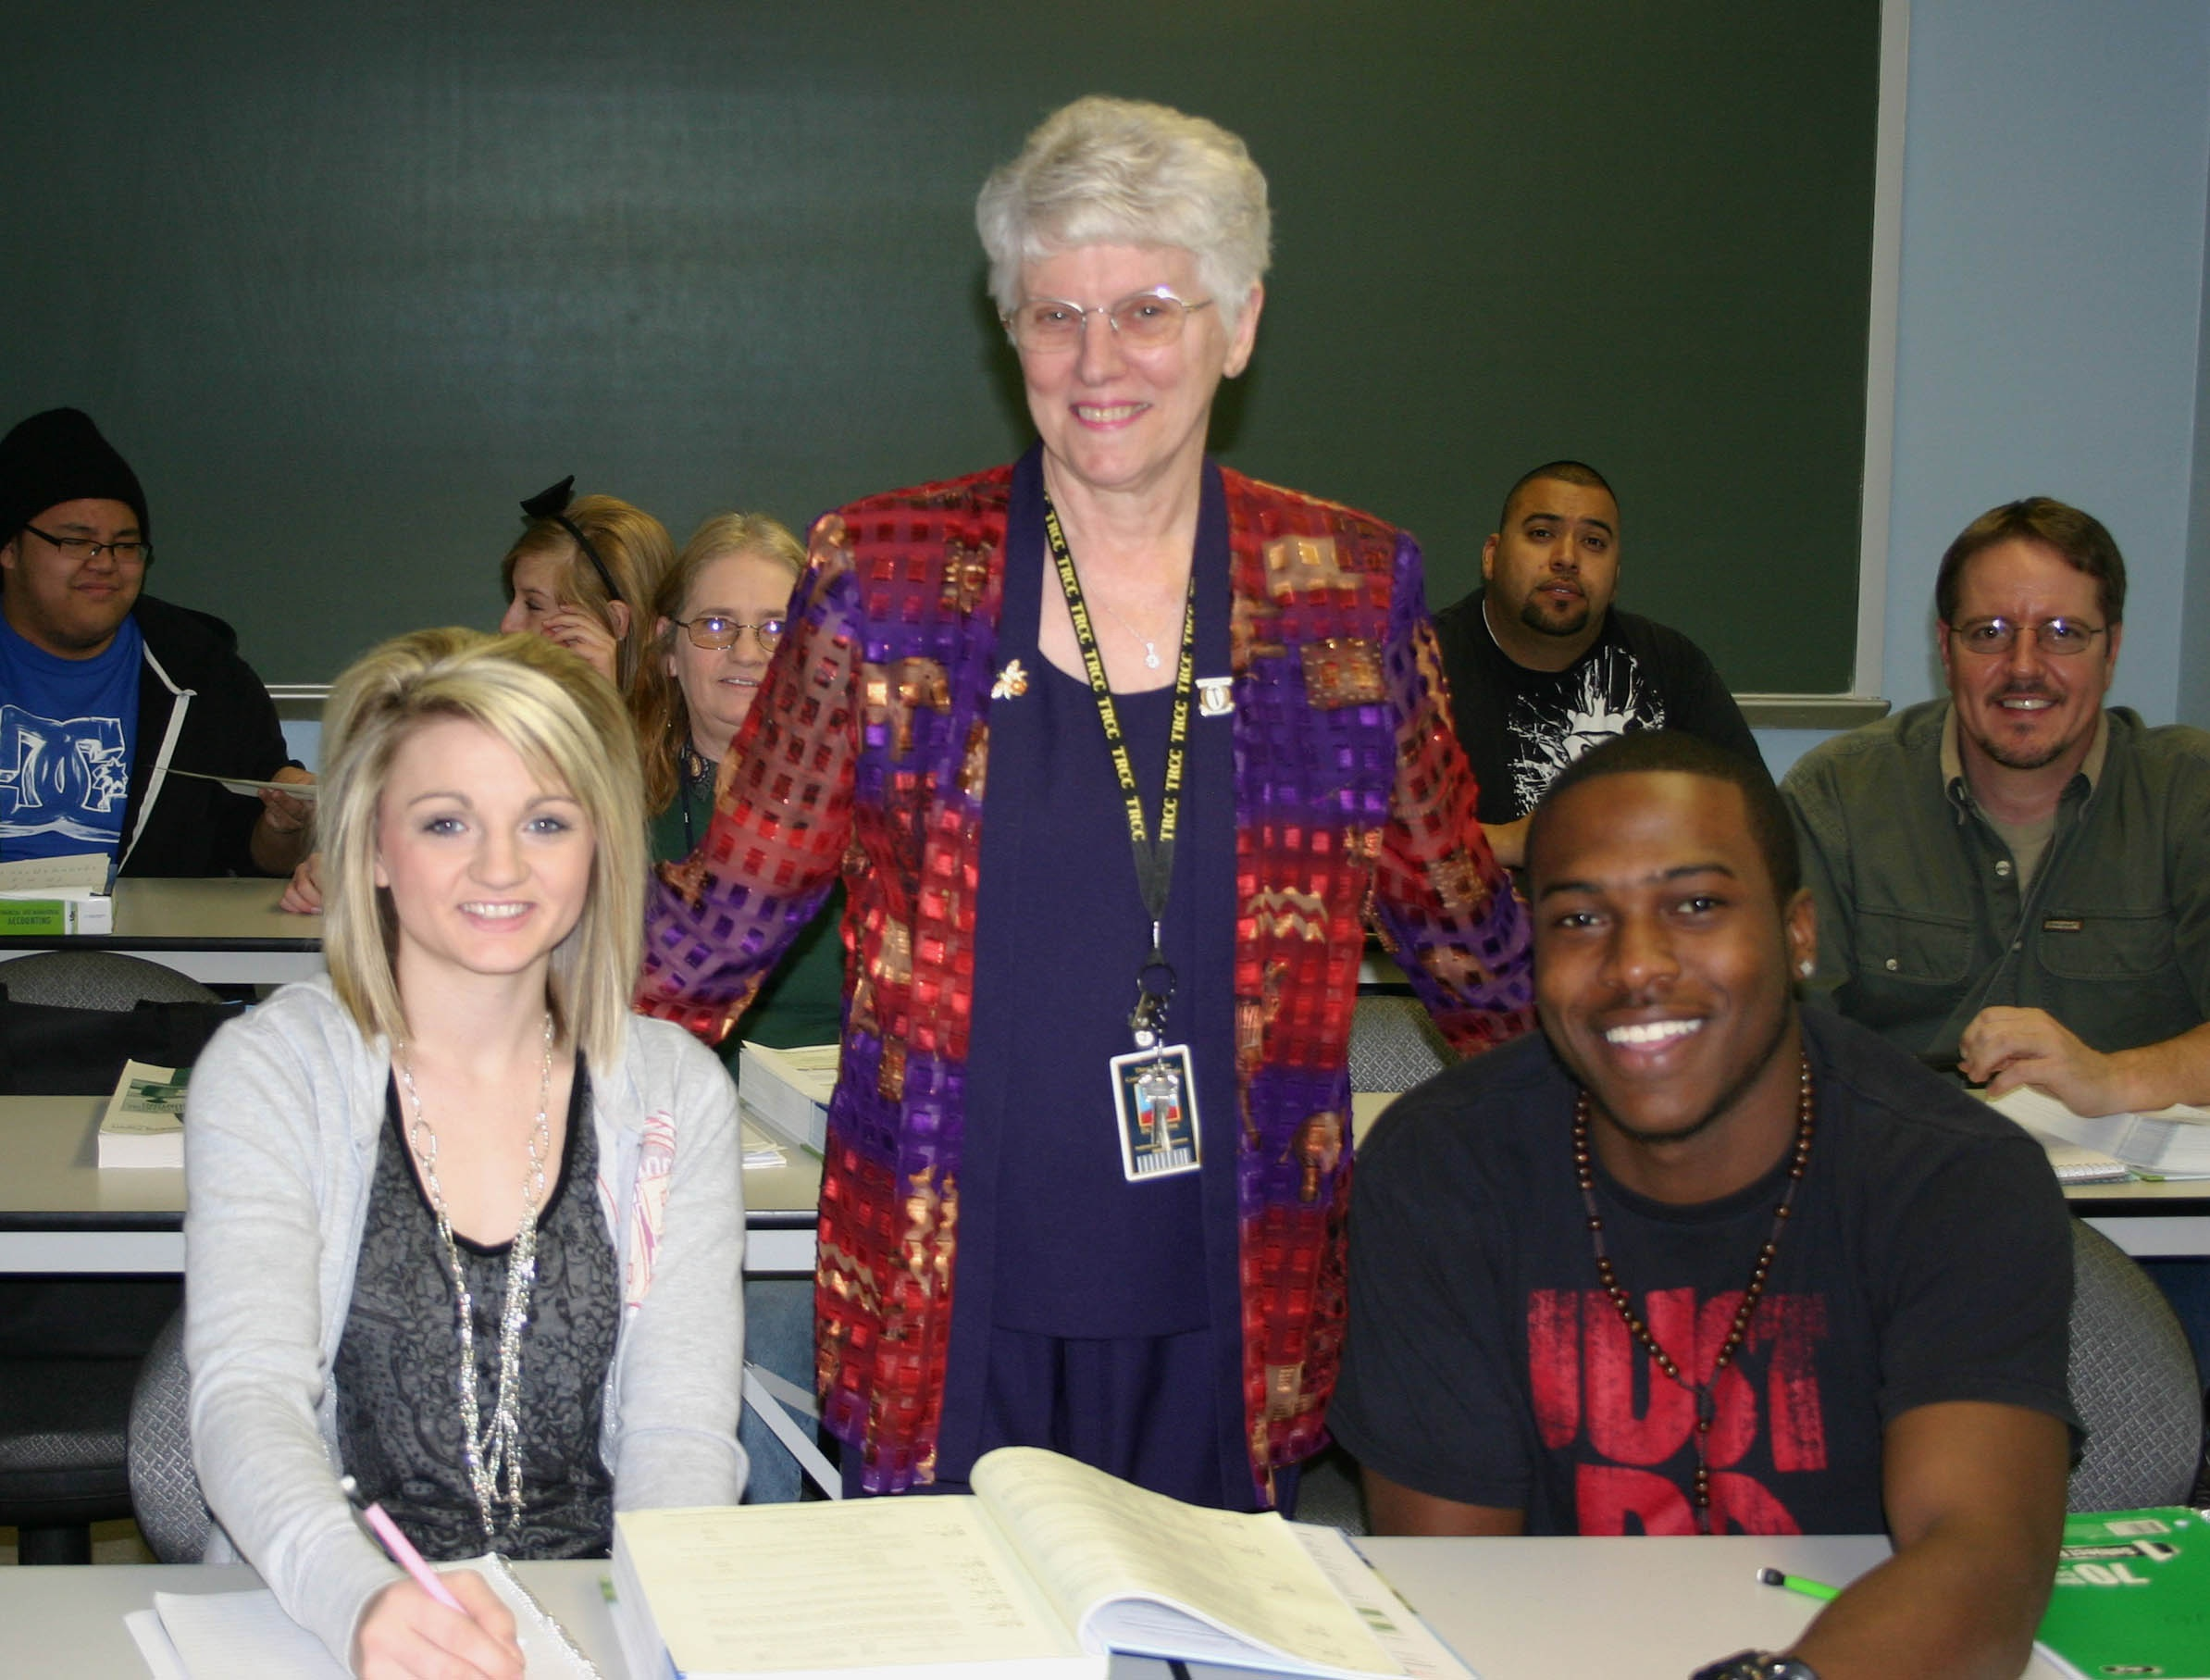
Students come to college with needs, and they often are scared. I take delight in reassuring them with a favorite saying: ''It's your Attitude, not your Aptitude, that determines the Altitude to which you can climb.''
—Helena Ruhl, Three Rivers Community College (MO)

Slide 21
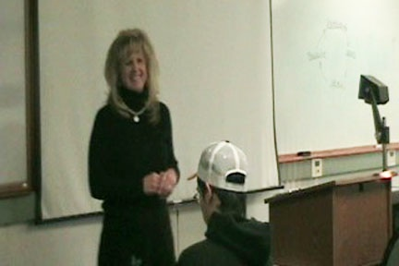
Teaching is like breathing. I love the classroom.
—Debbie Skousen, Treasure Valley Community College (OR)

Slide 22
I have always been reserved and fearful of public speaking; but when it comes to talking about math and science, the spirit takes over.
—Kurt Ehlers, Truckee Meadows Community College (NV)

Slide 23
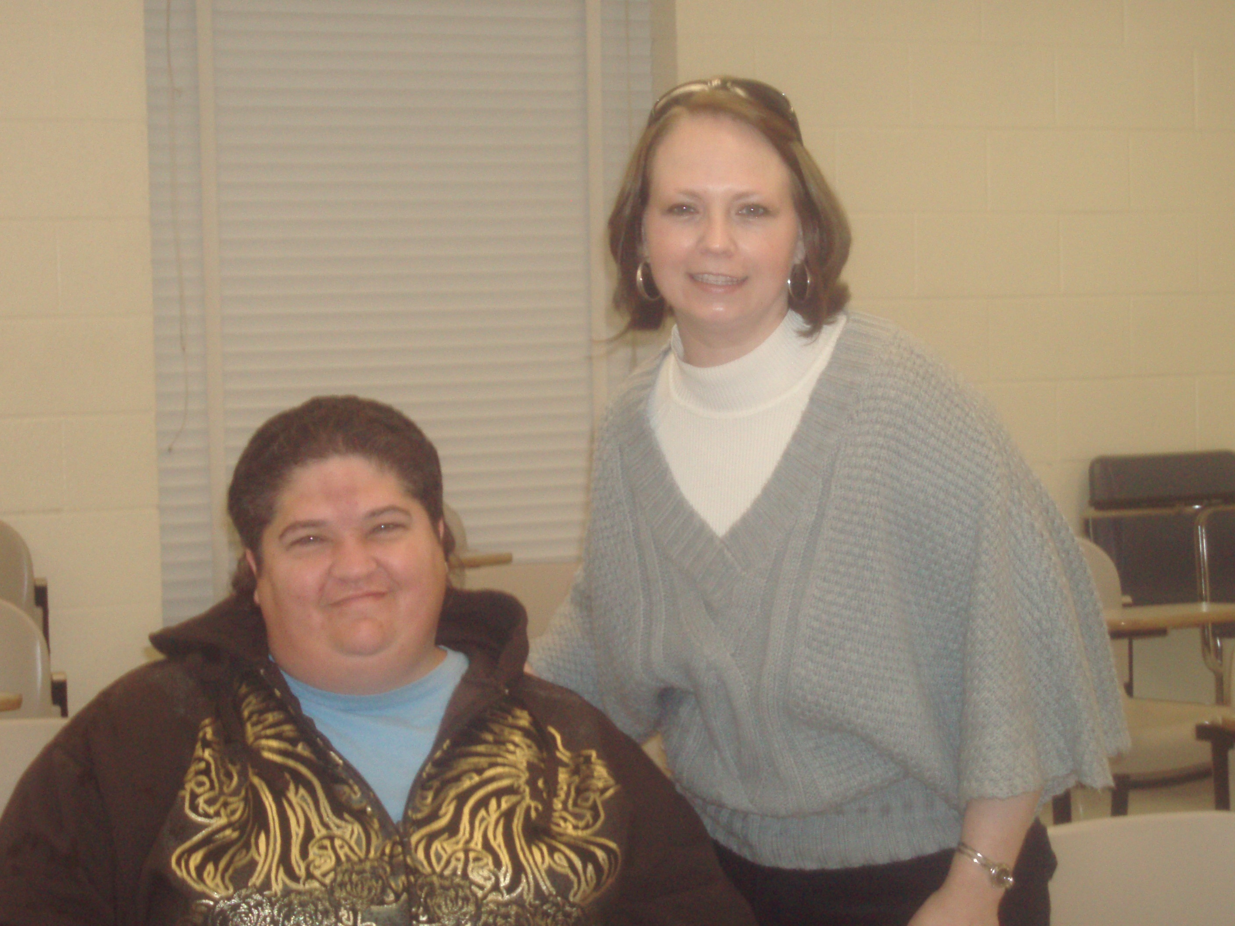
Students thirst for knowledge, even when they do not think they do. It is my job to help them realize they are thirsty! When they take their first big gulp of knowledge, an amazing thing happens. They thirst for more!
—Kathrine Murray, Tyler Junior College (TX)

Slide 24
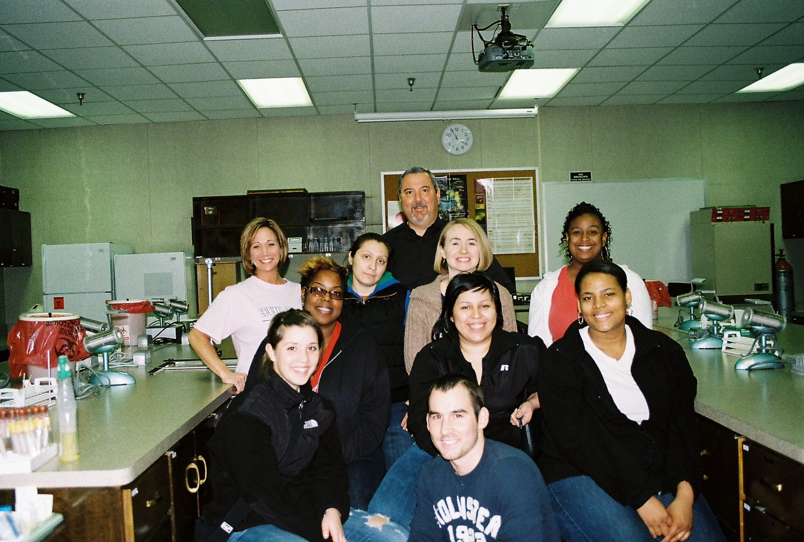
We have taken on the challenge to help students not only learn about their chosen subject, but about themselves.
—Jason Waller, Tyler Junior College (TX)

Slide 25
My goal and purpose is to break down barriers that prevent a student from reaching his or her educational potential.
—Dennis Broadwater, University of Arkansas Community College at Batesville

Slide 26
Support staff members are the caregivers of the institution. They nurture every aspect of the college experience, from application to graduation. Thus, it is with honor and dignity that I stand among those who are often unseen where learning is taking place; but yet without them, the learning process would not go forward.
—Lea Ramsey, University of Arkansas Community College at Batesville

Slide 27
It is my job to open every student’s eyes to the joys of learning. To do that, I remind myself that each student is a child of God and that my job is to help them achieve their full personal and academic potential.
—Staci Shupe, University of Arkansas Community College at Hope

Slide 28
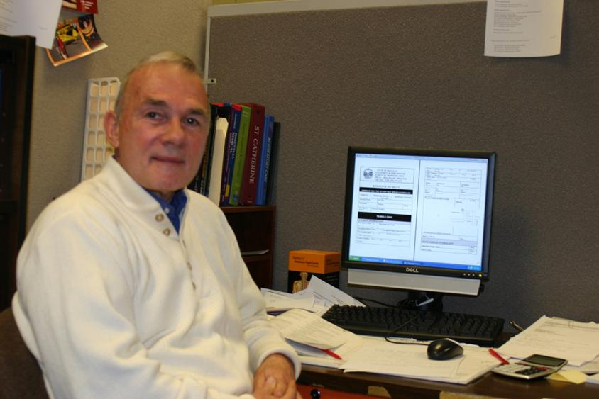
Catch the student doing something right. This will engage and motivate them to excel.
—Charles Miller, University of Montana College of Technology

Slide 29
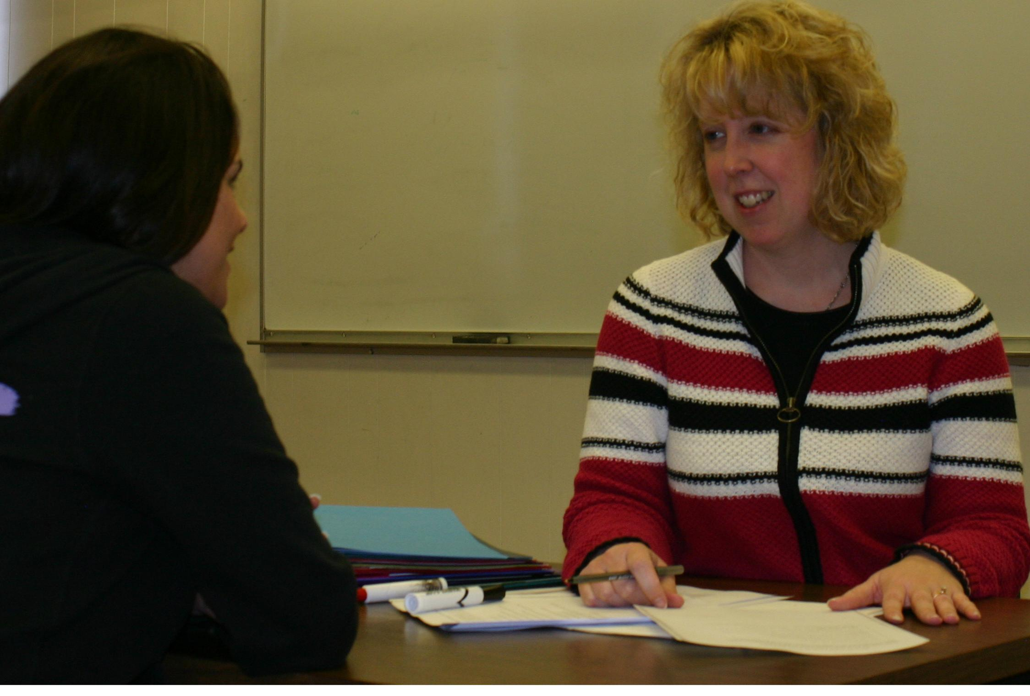
I believe that education is not a product we pass to our students, but a process we inspire within them. My hope is to create an environment that encourages students to embrace this process, setting personal learning goals and finding a passion within themselves to achieve them. My reward in teaching communication studies is watching students use their knowledge to uncover injustices, improve the climate of their personal and professional relationships, practice their democratic voice, and become a voice for others.
—Kim Reiser, University of Montana College of Technology

Slide 30
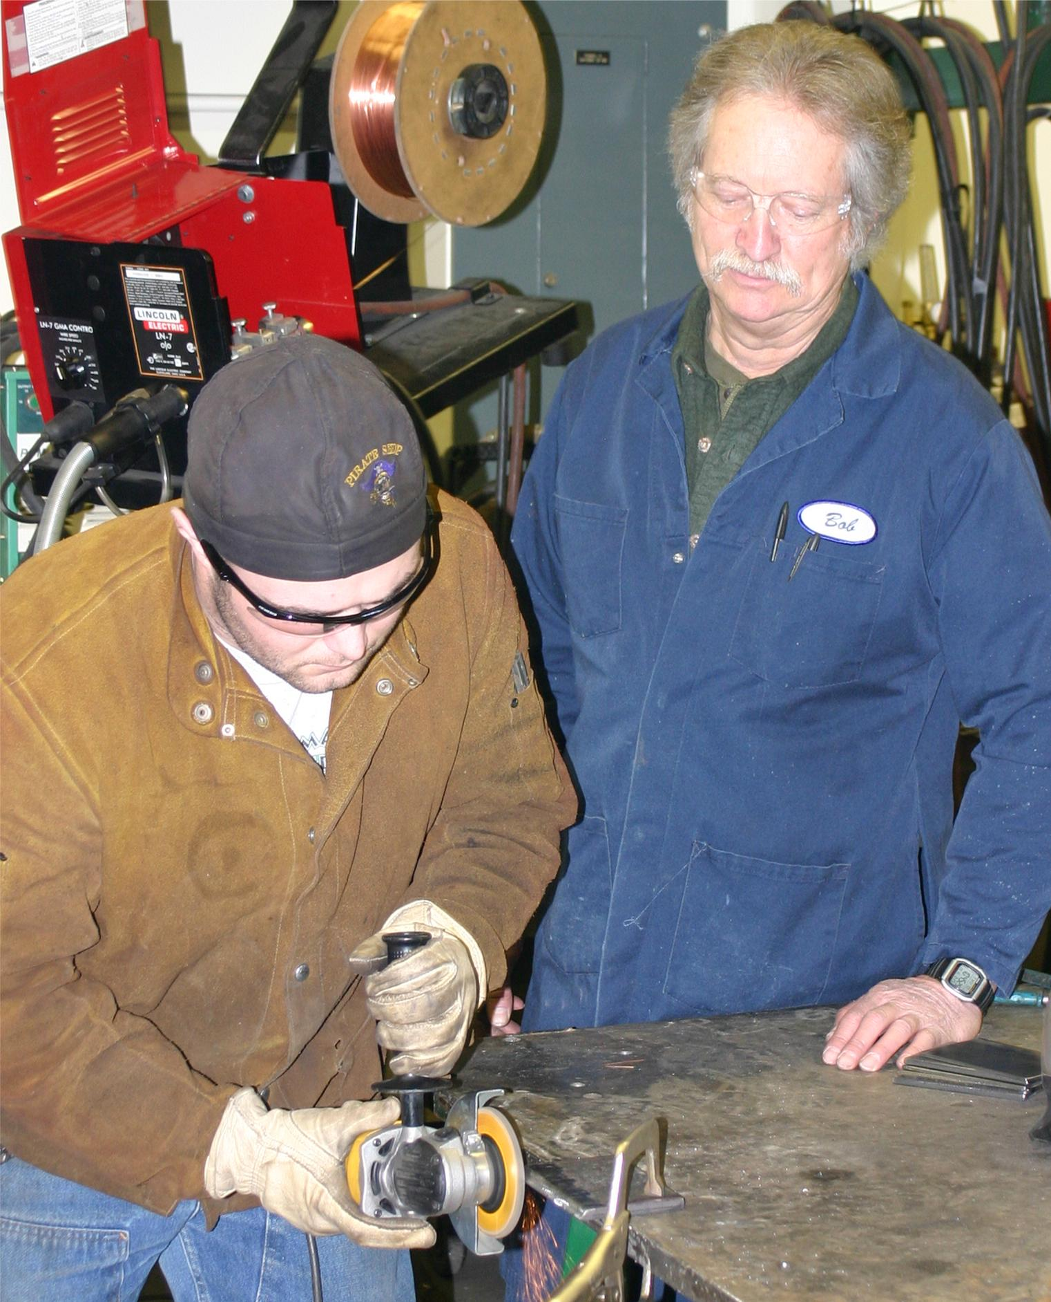
An educator holds the key to unlock the driving motivation and unique combination of success for the student. For the educator to gain the reward of accomplishment, he or she must present information to the student in sincere, tangible terms. Having a full understanding of the material and the desire and ability to deliver the material is fundamental in gaining respect from the student. For the student, the educator can “bring it all home” by talking in terms of “relevance” and “attainability.” Encourage the student, provide praise when goals are met, and lead by example.
—Robert Shook, University of Montana College of Technology

Slide 31
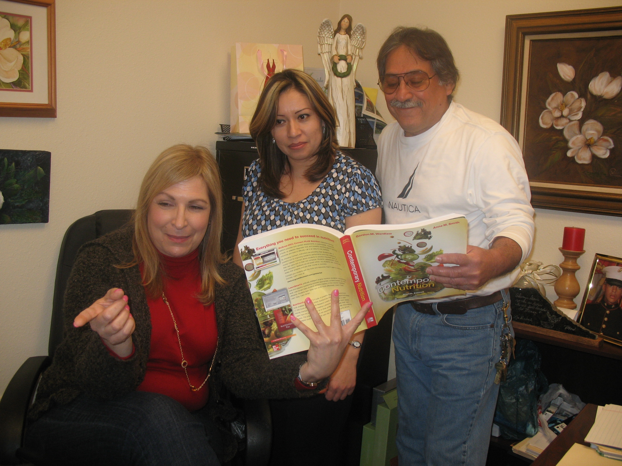
Teaching 100% online has given me the opportunity to relate to my students in a different manner. I make sure that students receive prompt and courteous email responses.
—Shamina Davis, University of Texas at Brownsville/Texas Southmost College

Slide 32
Students are my driving force! I live to work with students and see how they succeed and grow as individuals. I am committed to technical education as I understand how much students everywhere can benefit from workplace skills.
—Irma Jones, University of Texas at Brownsville/Texas Southmost College

Slide 33
I strive to take my students on a path of discovery that often leads many to recognize their potential. If when they leave my classroom they leave with a greater understanding of what they can offer and contribute to the world, I have made a small contribution to our common future.
—Dania López-García, University of Texas at Brownsville/Texas Southmost College

Slide 34
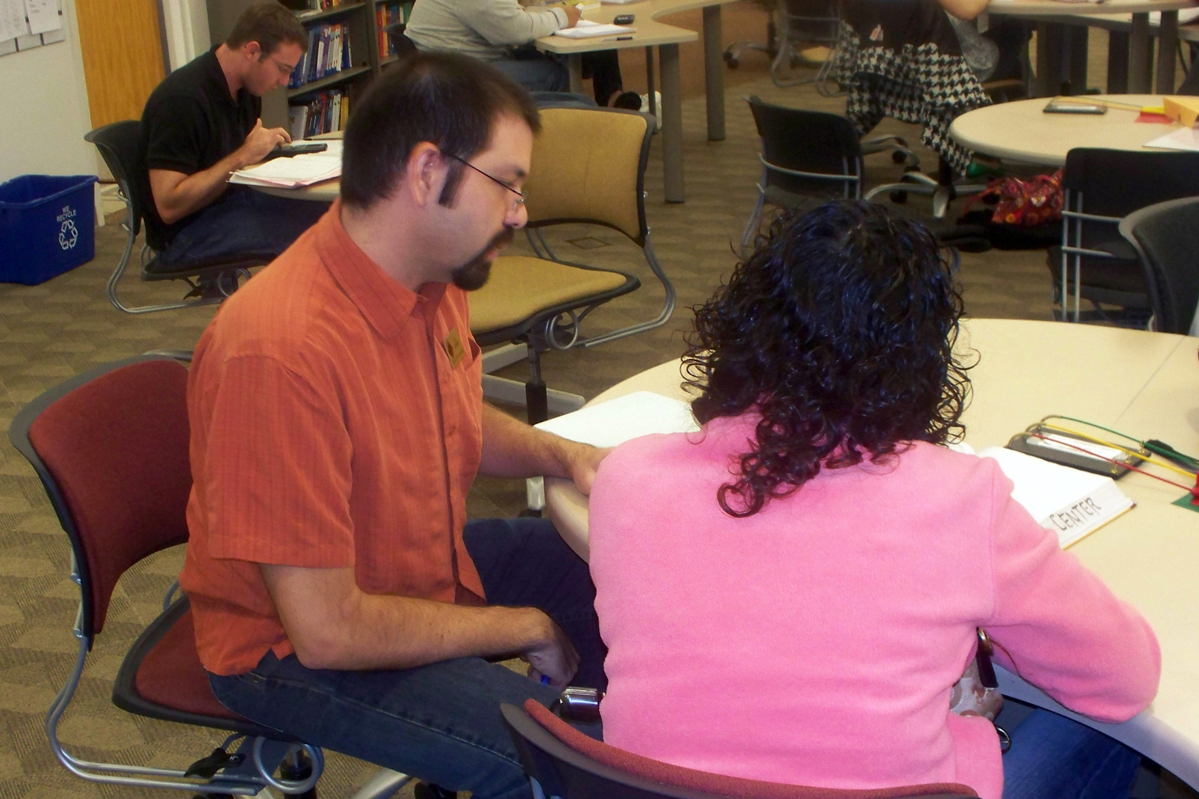
Find the tools, learn to use them, use them! Did it work? If not, refine and try again. If it did, refine and share with your colleagues. Oh, by the way, there are new tools out there. Start the cycle again.
—Joel Berman, Valencia Community College (FL)

Slide 35
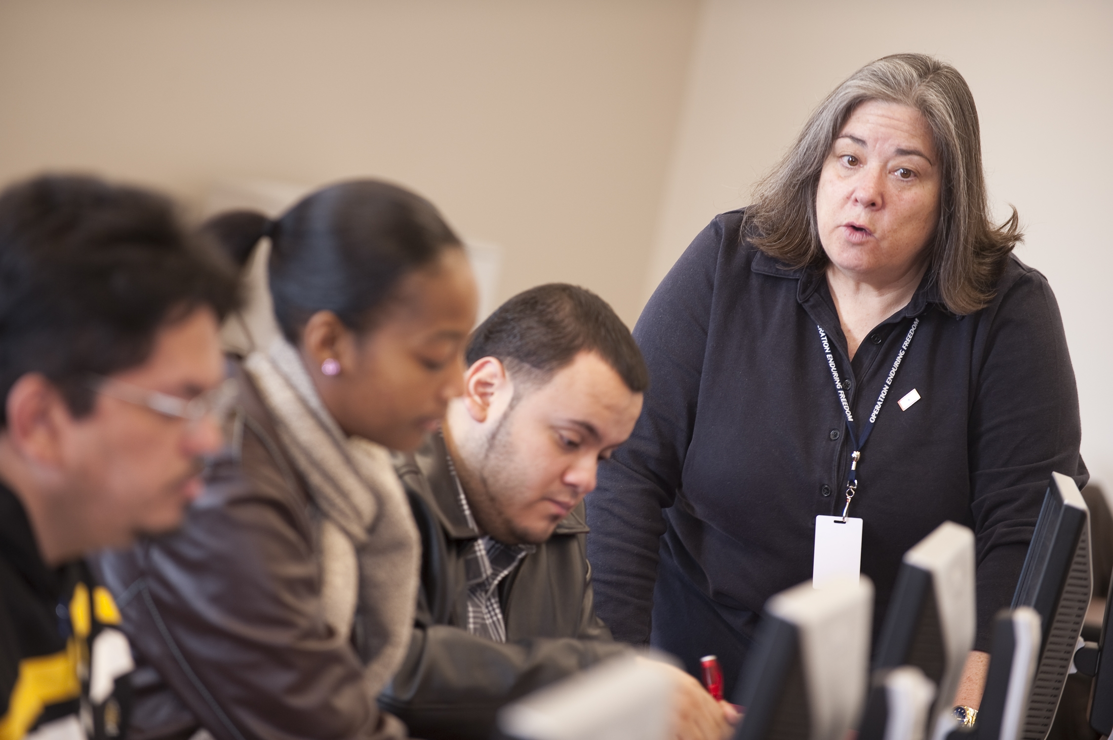
Relevance—teach what students need to be successful in their careers.
Analysis and application—ensure students recognize the why, as well as the how-to. Integrity—model it and expect it.
Sense of humor—never lose it; try to share it.
Empathy—understand the uniqueness of others.
—Carin Gordon, Valencia Community College (FL)

Slide 36
Education doesn’t guarantee success in life. What is guaranteed is how reactions to success and failure will always be a reflection on that individual. A teacher is a guide on the side by ensuring that success and failure do not become an end but the beginning of understanding and perseverance.
—Debra Hollister, Valencia Community College (FL)

Slide 37
Teaching takes heart—the heart to put students first. Only then can you open yourself up to the possibility of continual improvement and let your ego take a back seat to finding out what works.
—Celine Kavalec-Miller, Valencia Community College (FL)

Slide 38
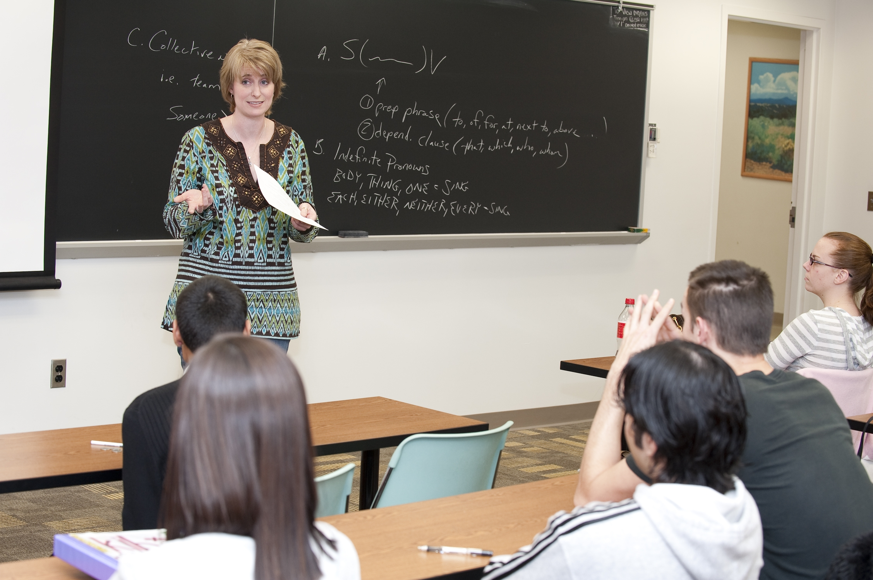
I want to help my students develop the analytical skills necessary to articulate provocative insights of the world around them as they continue to learn throughout their lives. I am motivated by a desire to instill in my students that same curiosity that kept me up reading so many nights.
—Shari Koopman, Valencia Community College (FL)

Slide 39
Sharing my passion for people and my expertise in nursing has provided much satisfaction as I watch students overcome many obstacles and adversities to be successful in the nursing program. They provide my motivation and inspiration to continue in nursing education. It is my honor to help shape the future of the professional nursing workforce.
—Cathy Bolton, Vernon College (TX)

Slide 40
I love teaching because what I do matters to another person.
—Cindy Coufal, Vernon College (TX)

Slide 41
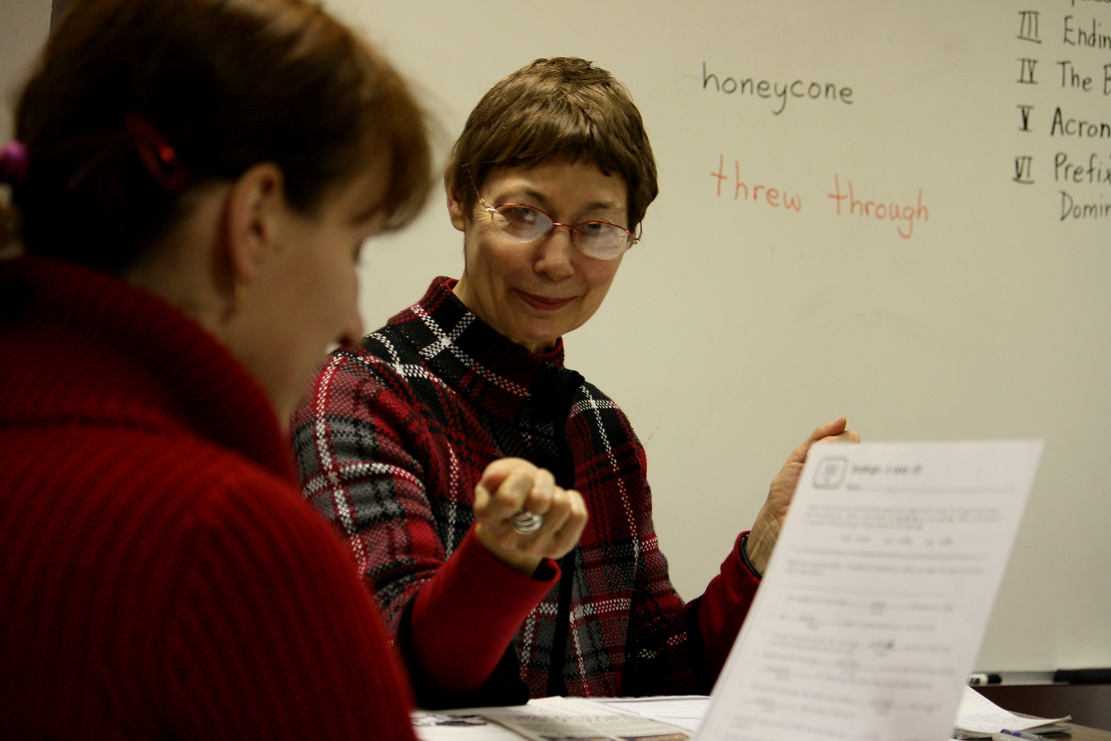
American culture is as important to teach as English, because culture is embedded in the meaning of our vocabulary. Adult ESL students have knowledge but lack English to express their ideas. We recognize and try to use their knowledge in class.
—Ellen Cobb, Wake Technical Community College (NC)

Slide 42
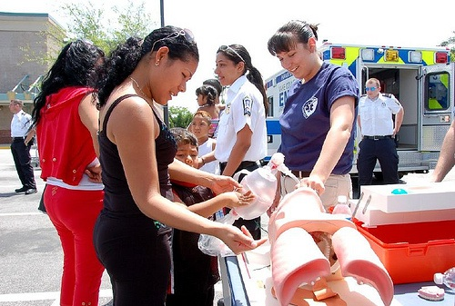
I try and create “real-life” classroom scenarios. By adding real patients, fake blood and other body fluids, and background noise, the students can experience and feel the real stress of EMS. I want my students to be more prepared to handle the emotional, most difficult side of the career.
—Stephanie Fraccola, Wake Technical Community College (NC)

Slide 43
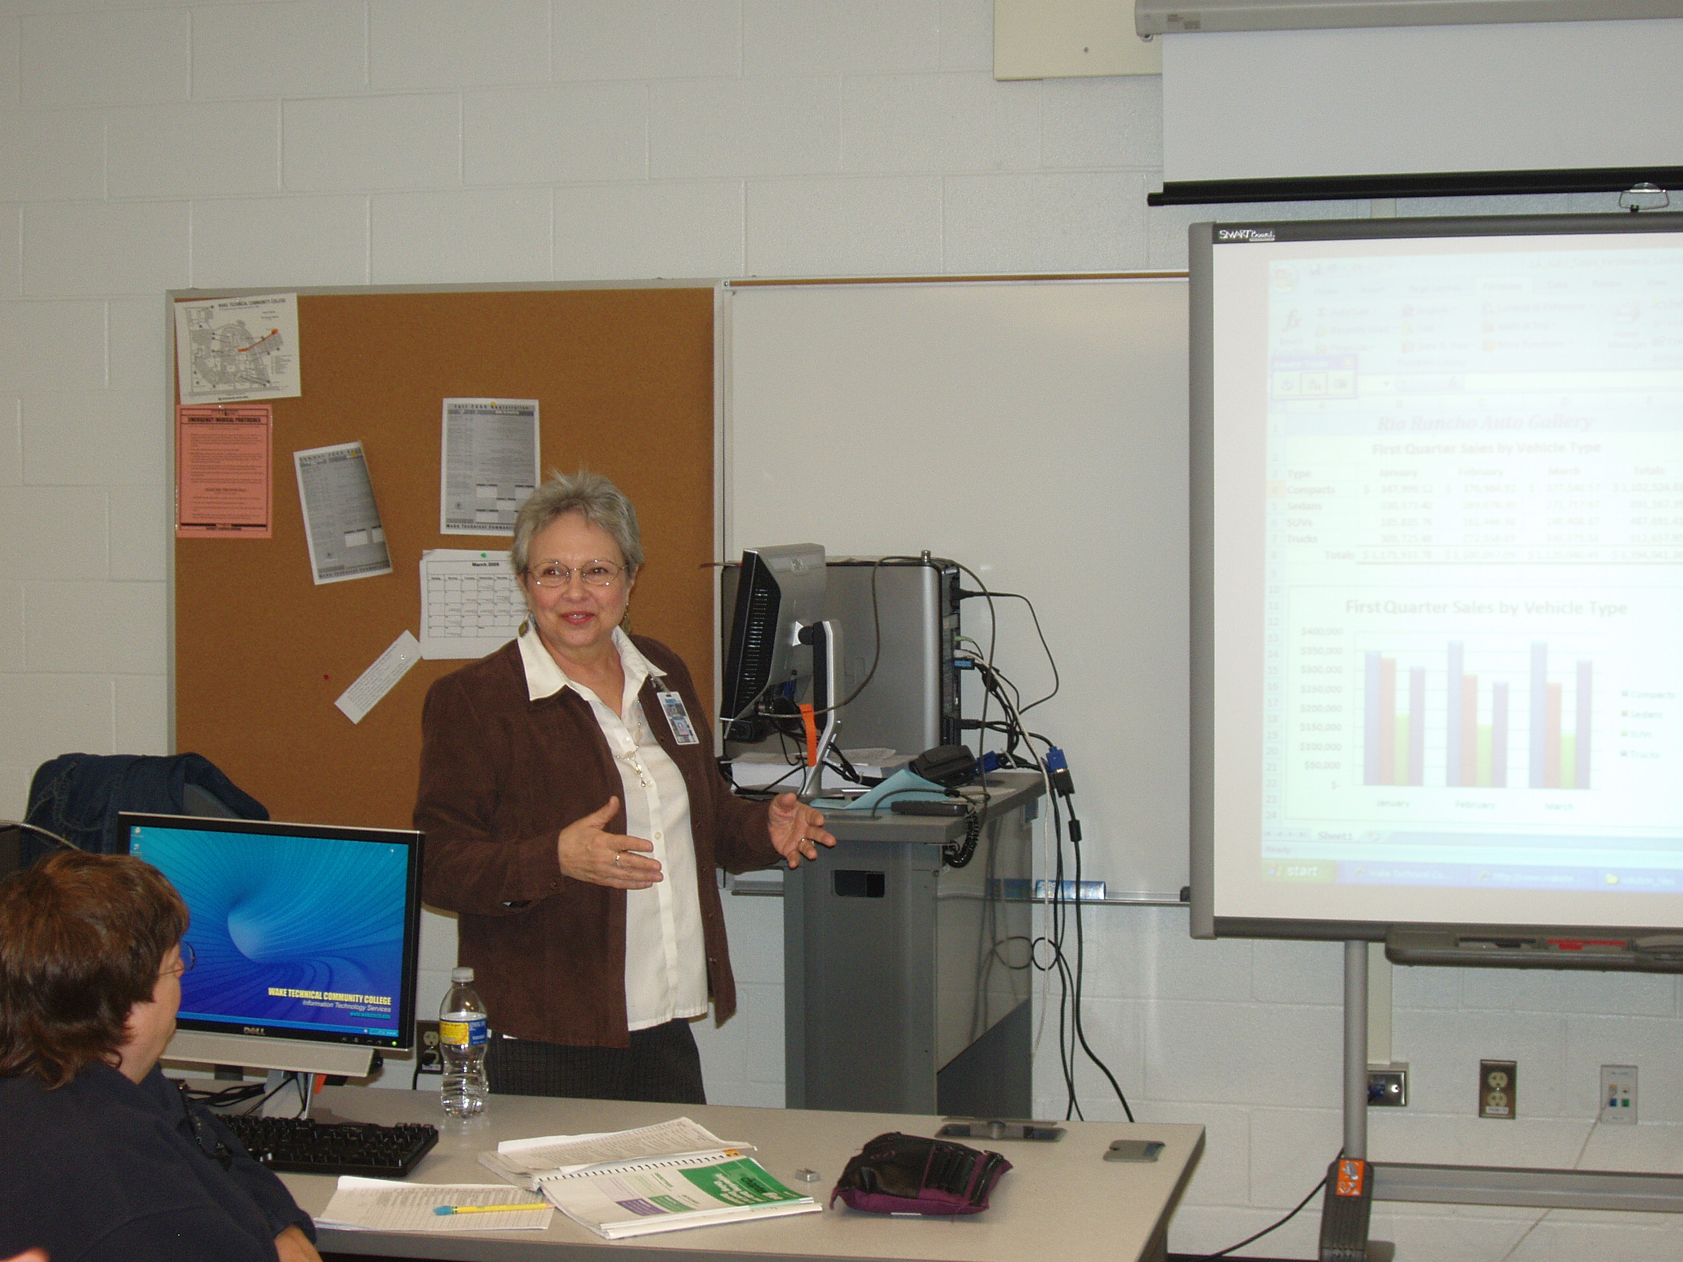
Becoming a teacher was, for me, a mission to figure out how to make learning experiences engaging, meaningful, and enjoyable. Did I find the answer? Not completely. But I did discover that there is always someone on life’s dusty road who gives a thirsty learner a cup of cool water. Imagine my delight the first day I realized that I was the one passing out the water!
—Linda Tucker, Wake Technical Community College (NC)

Slide 44
It may not seem like a Development Director would have impact on students, but it is rewarding to know that funded proposals, scholarships established, and special events provided through my department assist students by enhancing academics, providing financial assistance, and expanding cultural arts experiences.
—Suzanne Harbin, Wallace State Community College (AL)

Slide 45
Art Linkletter said, “Kids say the darnedest things,” and our students ask the darnedest questions. I teach because I like to learn, and part of that learning comes from the questions students ask that I never thought to ask myself and from another perspective which can be humbling, if not daunting.
—Patricia de Boom, Waubonsee Community College (IL)

Slide 46
The best part of teaching carpentry is showing a student the proper way of performing a task. In return, the student may reply, when asked how he learned the task, "You showed me, remember?"
—Daniel Erdman, Waukesha County Technical College (WI)

Slide 47
The more we grow, the more successful we become. Knowledge expands the way we live.
—Thomas Howard III, Wayne County Community College District (MI)

Slide 48
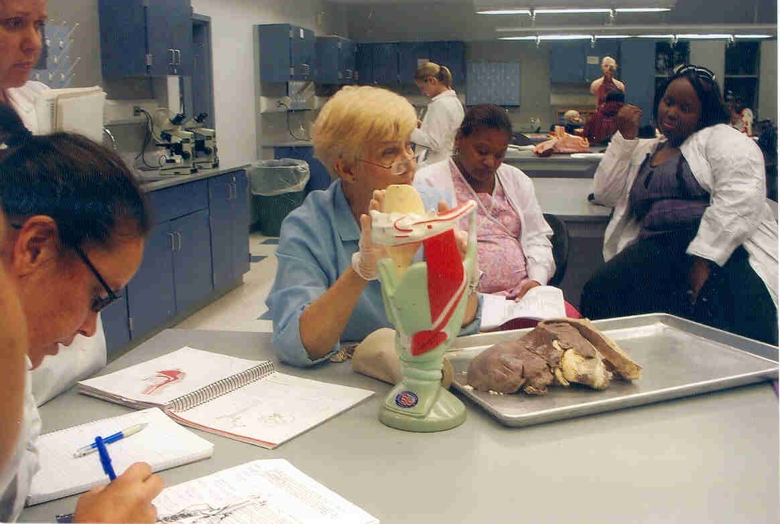
Really know your material. Explain basic concepts. Learn your students' names—use them. Encourage students to ask questions. Be on time, be fair, be honest. Offer many opportunities for assessment. Help students develop good study habits—how to make guesses and how to think critically and analytically. Have fun!!!
—Sandra Kotulis, Wayne County Community College District (MI)

Slide 49
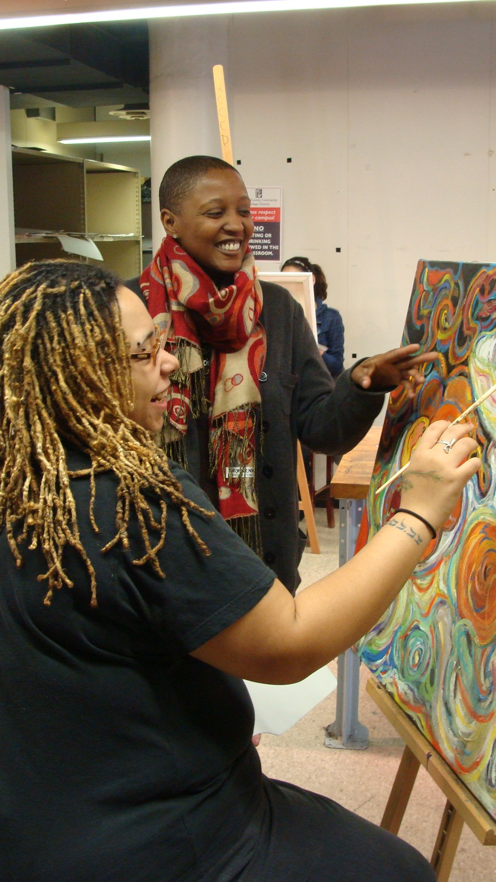
As a teacher of the visual arts, I focus on students understanding the importance of art and culture in their lives, as they discover that through their creative skills they increase opportunities and further their educational goals. The arts provide a multitude of resources and enriching experiences.
—Jocelyn Rainey, Wayne County Community College District (MI)

Slide 50
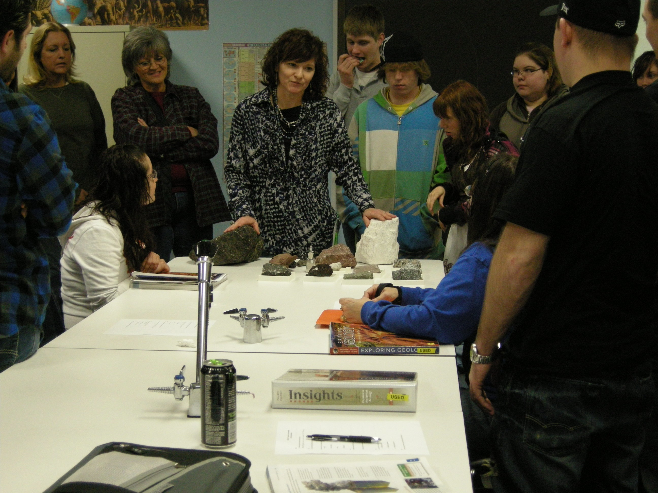
Setting off a spark in a student is incredibly fulfilling. The opportunity to have a positive effect on students by offering them an experience they will always remember is a privilege I have been given and will never take for granted.
—Lori Gouge, Weatherford College (TX)

Slide 51
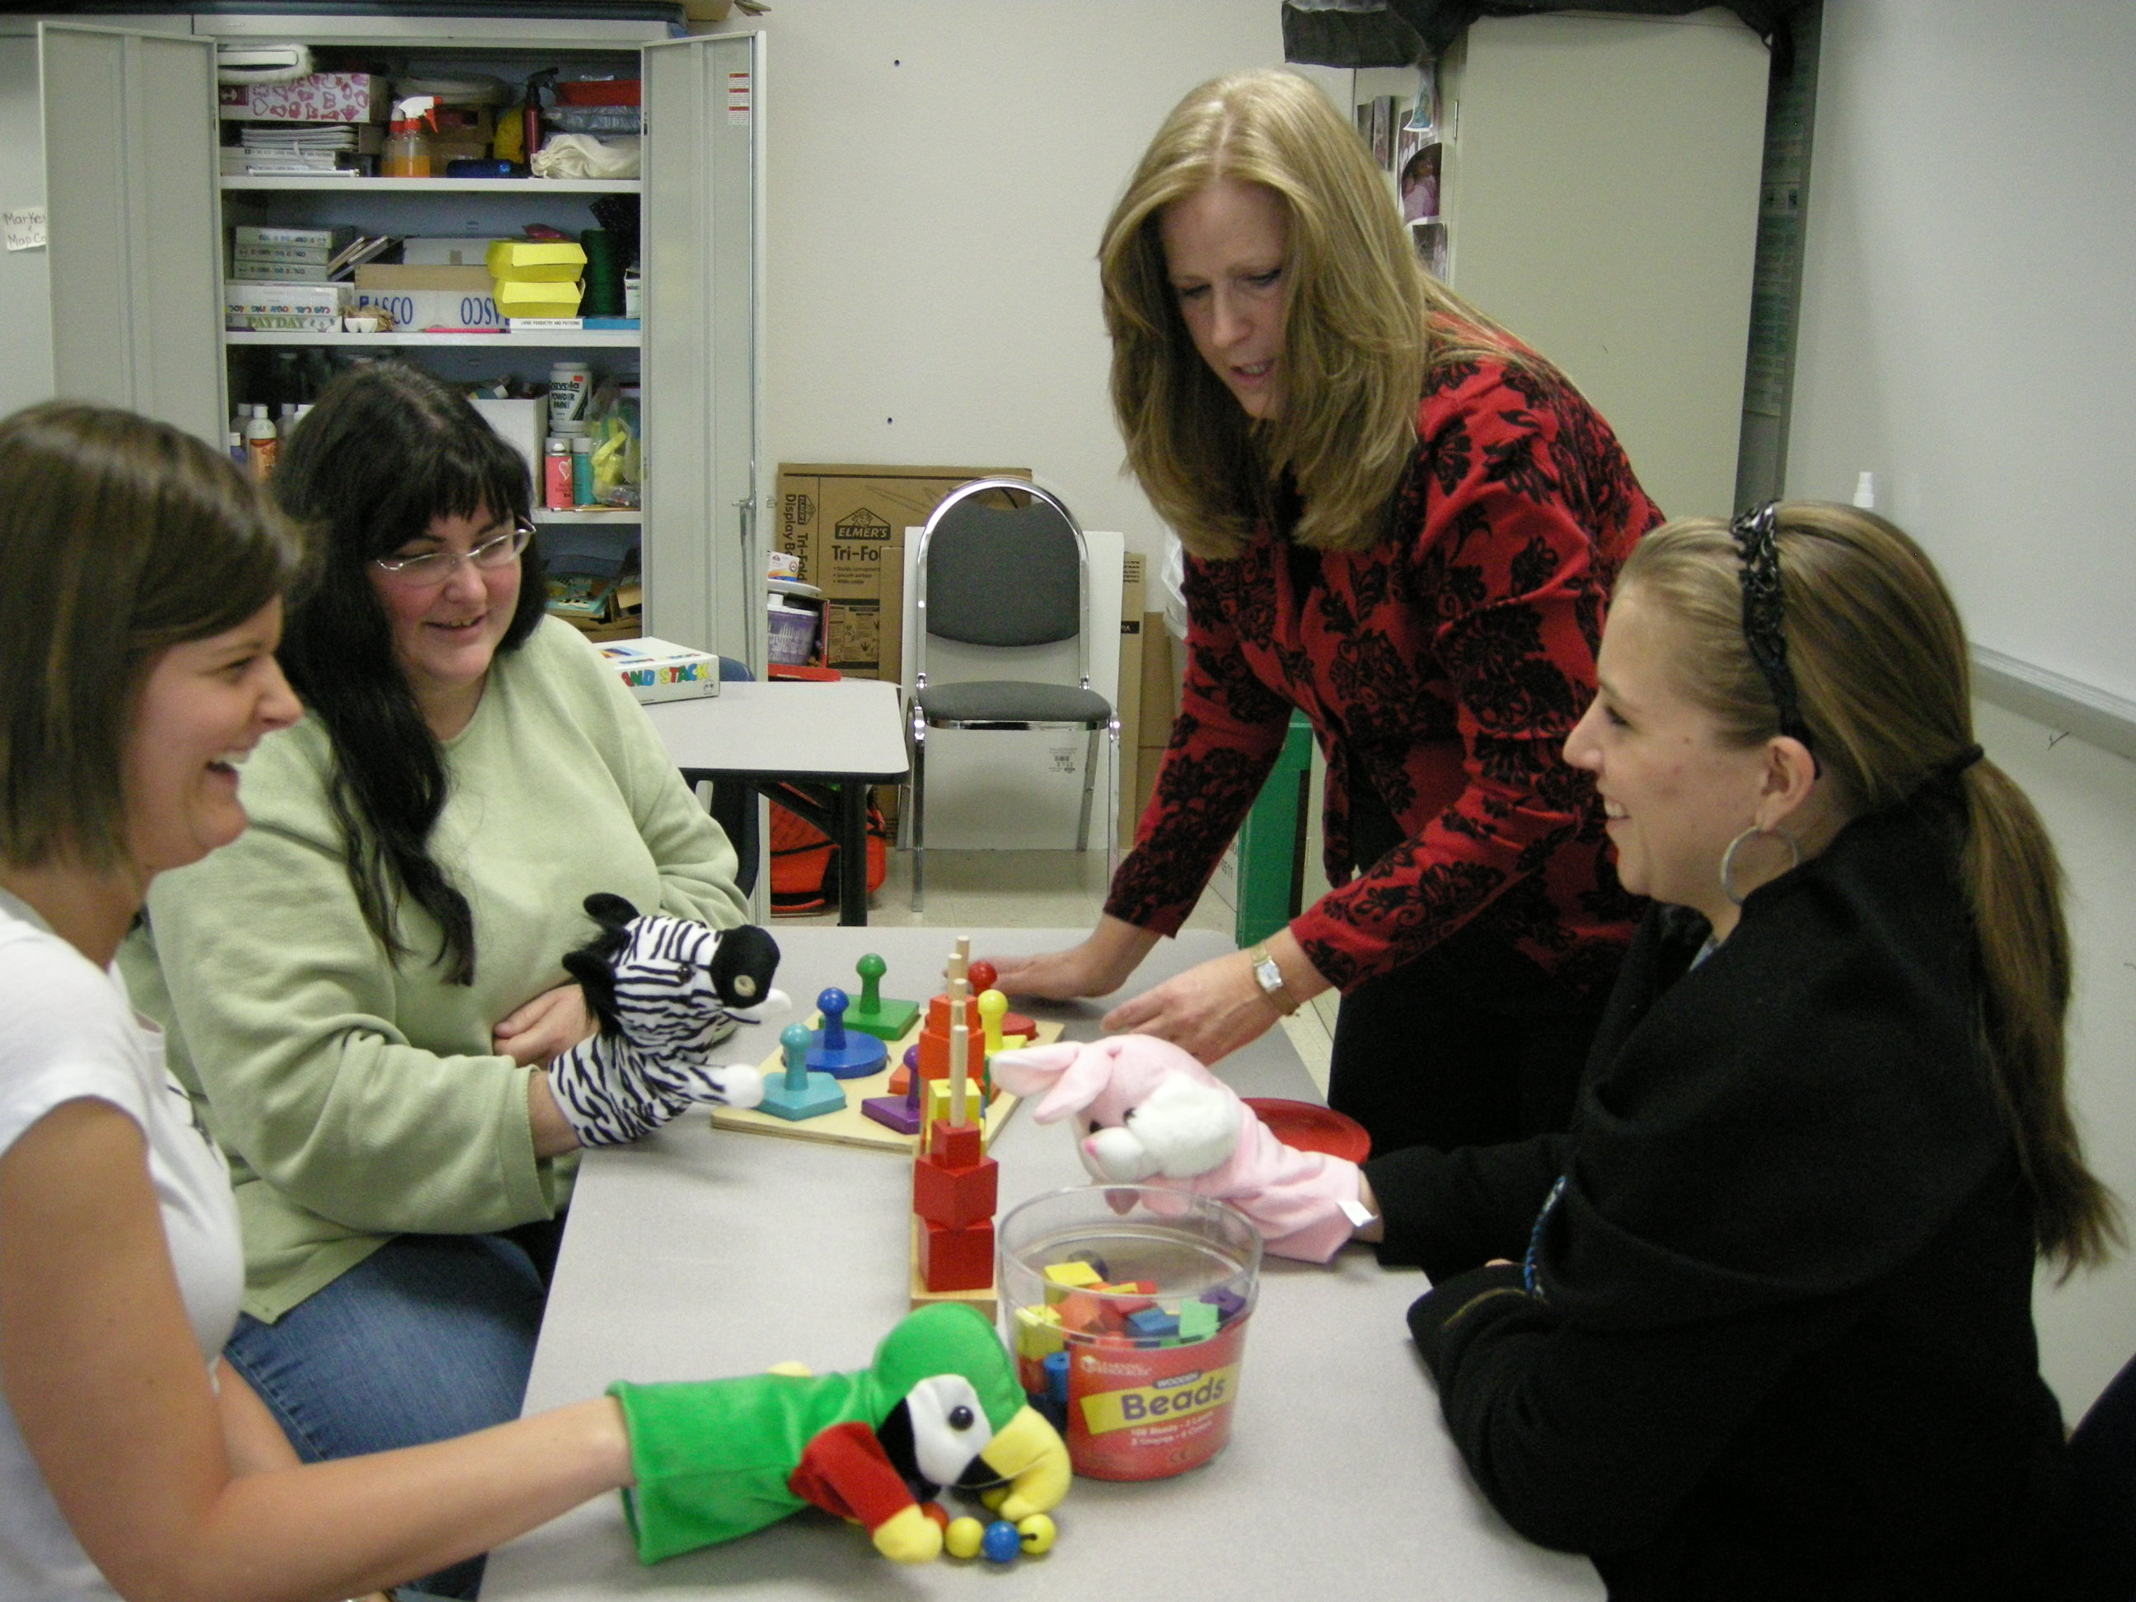
My classroom is not defined or limited by walls or technology, but rather it expands to exceed boundaries limited only by the imagination of the participants.
—Sandra Hartnitt, Weatherford College (TX)

Slide 52
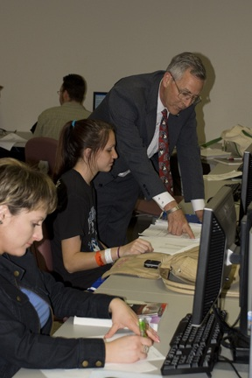
I’m inspired and motivated by student learning. When I ask the class questions and I don’t get answers voluntarily, I ask each person in turn. A few days of that usually loosens them up enough to volunteer answers.
—Jim Messinger, Weatherford College (TX)

Slide 53
As a nurse educator, my role allows me to form a unique and evolving relationship with students. I know that this educational process will profoundly change the lives of my students for the better. These students, as my peers, will profoundly change the lives of their patients. What a blessing!
—Jo Ellen Welborn, Weatherford College (TX)

Slide 54
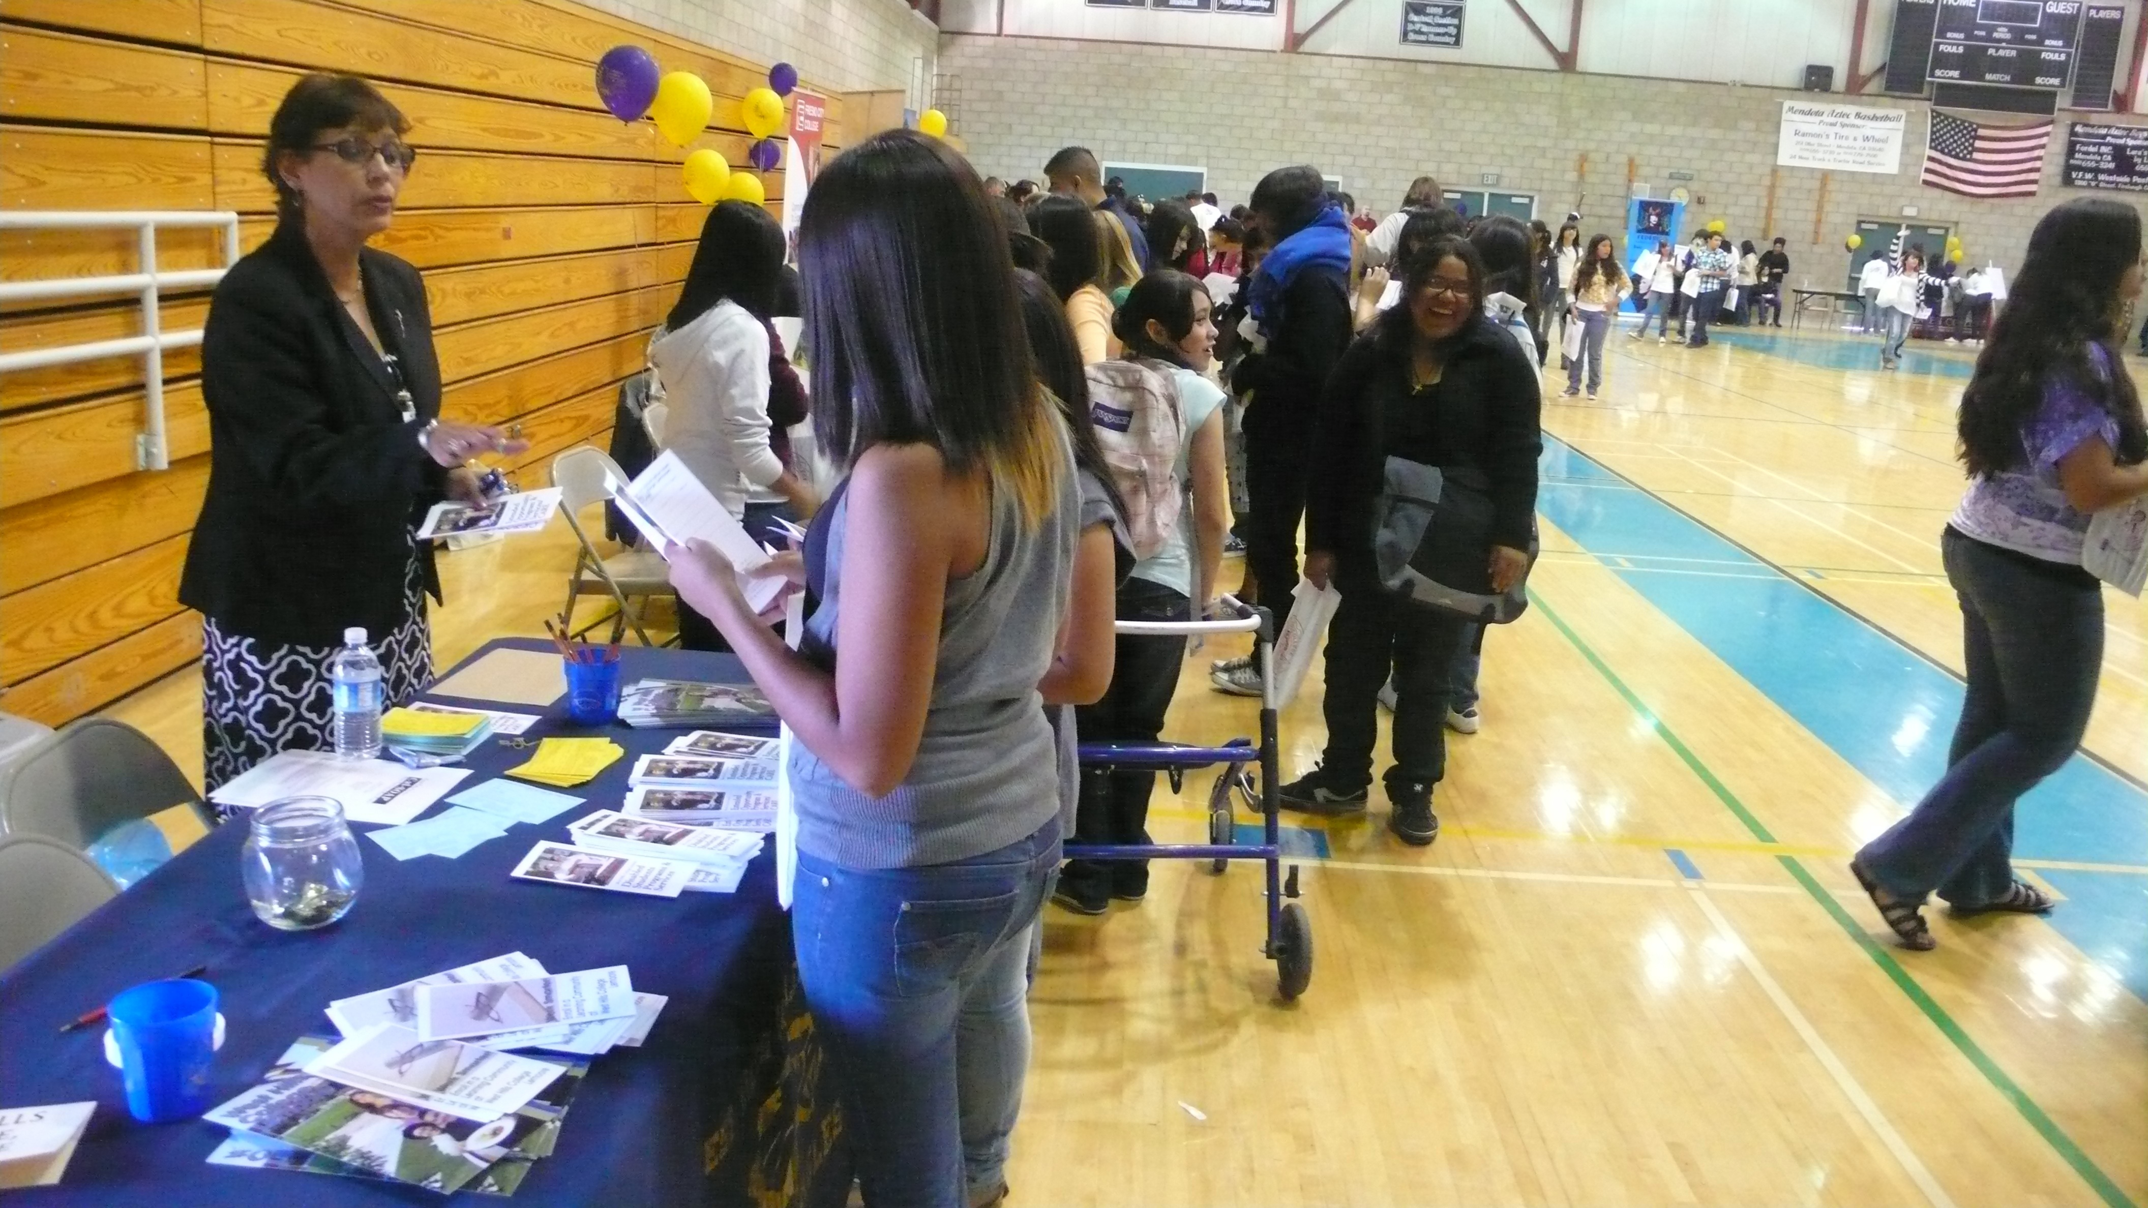
As a counselor, giving high school students vital information is very important. That is why I enjoy doing outreach to our feeder schools and talking with future students or helping students choose a college of their choice.
—Linda Amaya-Guenon, West Hills Community College (CA)

Slide 55
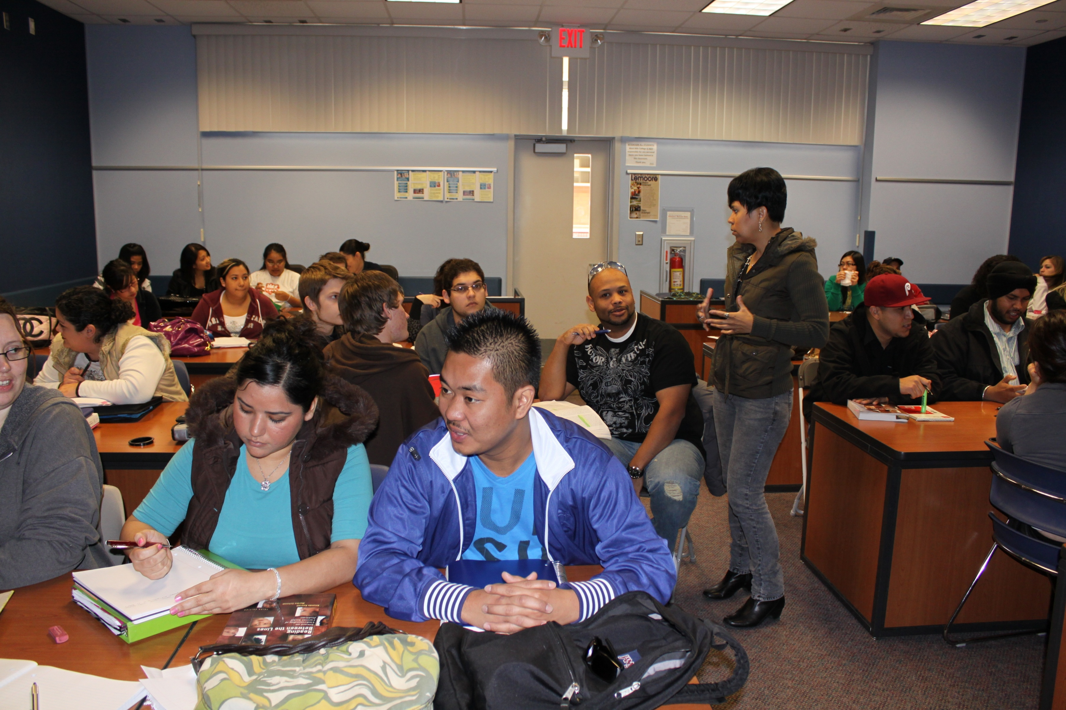
Inspiration comes from my students, their desire to learn, achieve, and believe. Those facing many obstacles are the ones that inspire me most. They come to me expecting a vessel of knowledge with patience and wisdom. In these moments, I am humbled and reminded to be my best for them.
—Vera Kennedy, West Hills Community College (CA)

Slide 56
In studio art classes, students often experience frustration with new materials, techniques, or concepts. When this situation arises, I remind them that frustration can often translate to being on the verge of making a breakthrough. If one can face the frustration, rather than retreat from it, the possibility of learning something new will occur.
—Michael McDowell, West Hills Community College (CA)

Slide 57
My motivation is student engagement in class and the world. I have had students tell me that the course was the most interesting that they have ever taken and they will pay more attention to politics. That is the greatest reward for my teaching.
—Kevin Wilds, West Hills Community College (CA)

Slide 58
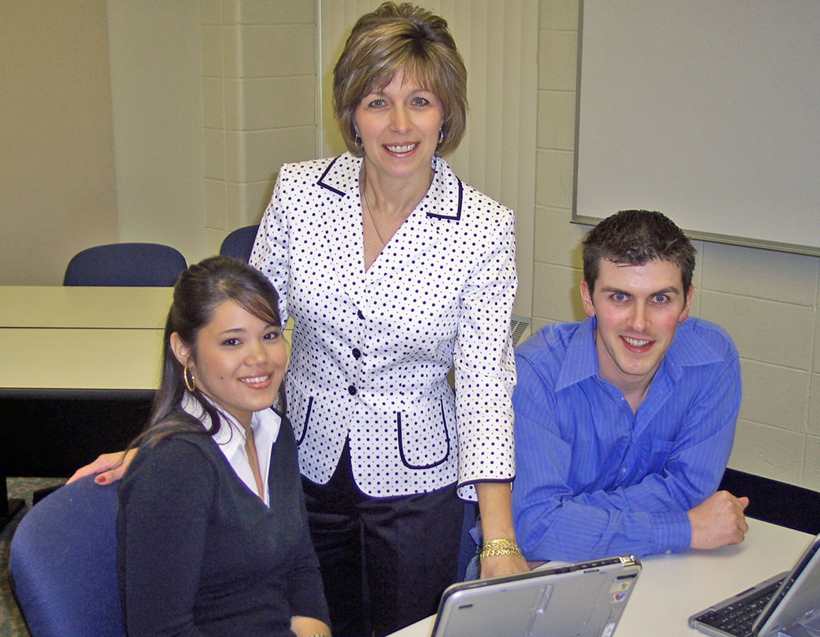
—Cynthia Gissy, West Virginia University at Parkersburg

Slide 59
Teaching the art of nursing is sharing the gifts of knowledge, wisdom, and experience with those courageous enough to want to learn. It is in turn a gift for the nurse educator to know that by imparting such knowledge brings great joy and comfort in knowing that students will be spreading the warmth and healing to those in need. I was inspired by my mother, a nurse, and wonderful mentors through my career. May I make them proud as I teach with the passion and joy they instilled in me. May every patient feel the healing touch of a caring nurse!
—Katherine Dowdle, Westchester Community College (NY)

Slide 60
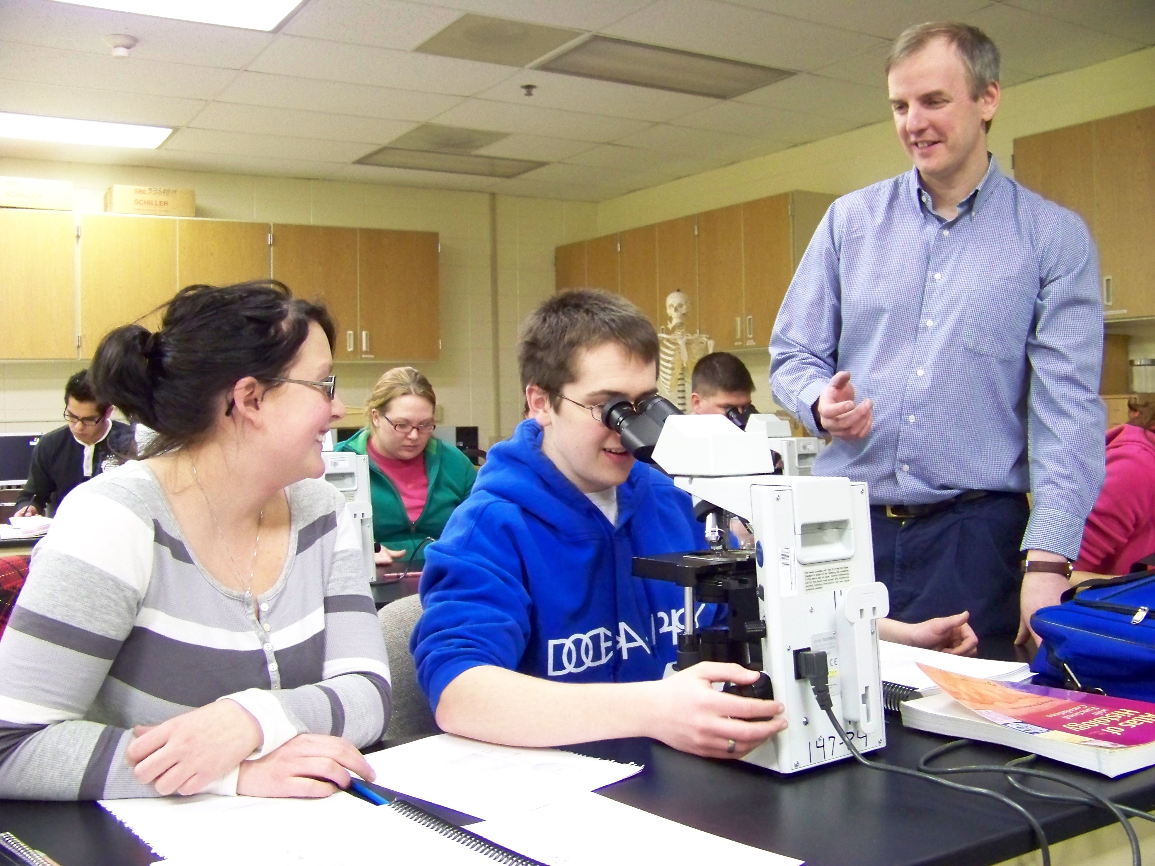
As a science instructor, I am always trying to find ways to make my classes interesting for my students as well as for myself. Humorous anecdotes and analogies help students remember key terms and concepts, and create a pleasant classroom environment.
—Greg Romig, Western Iowa Tech Community College

Slide 61
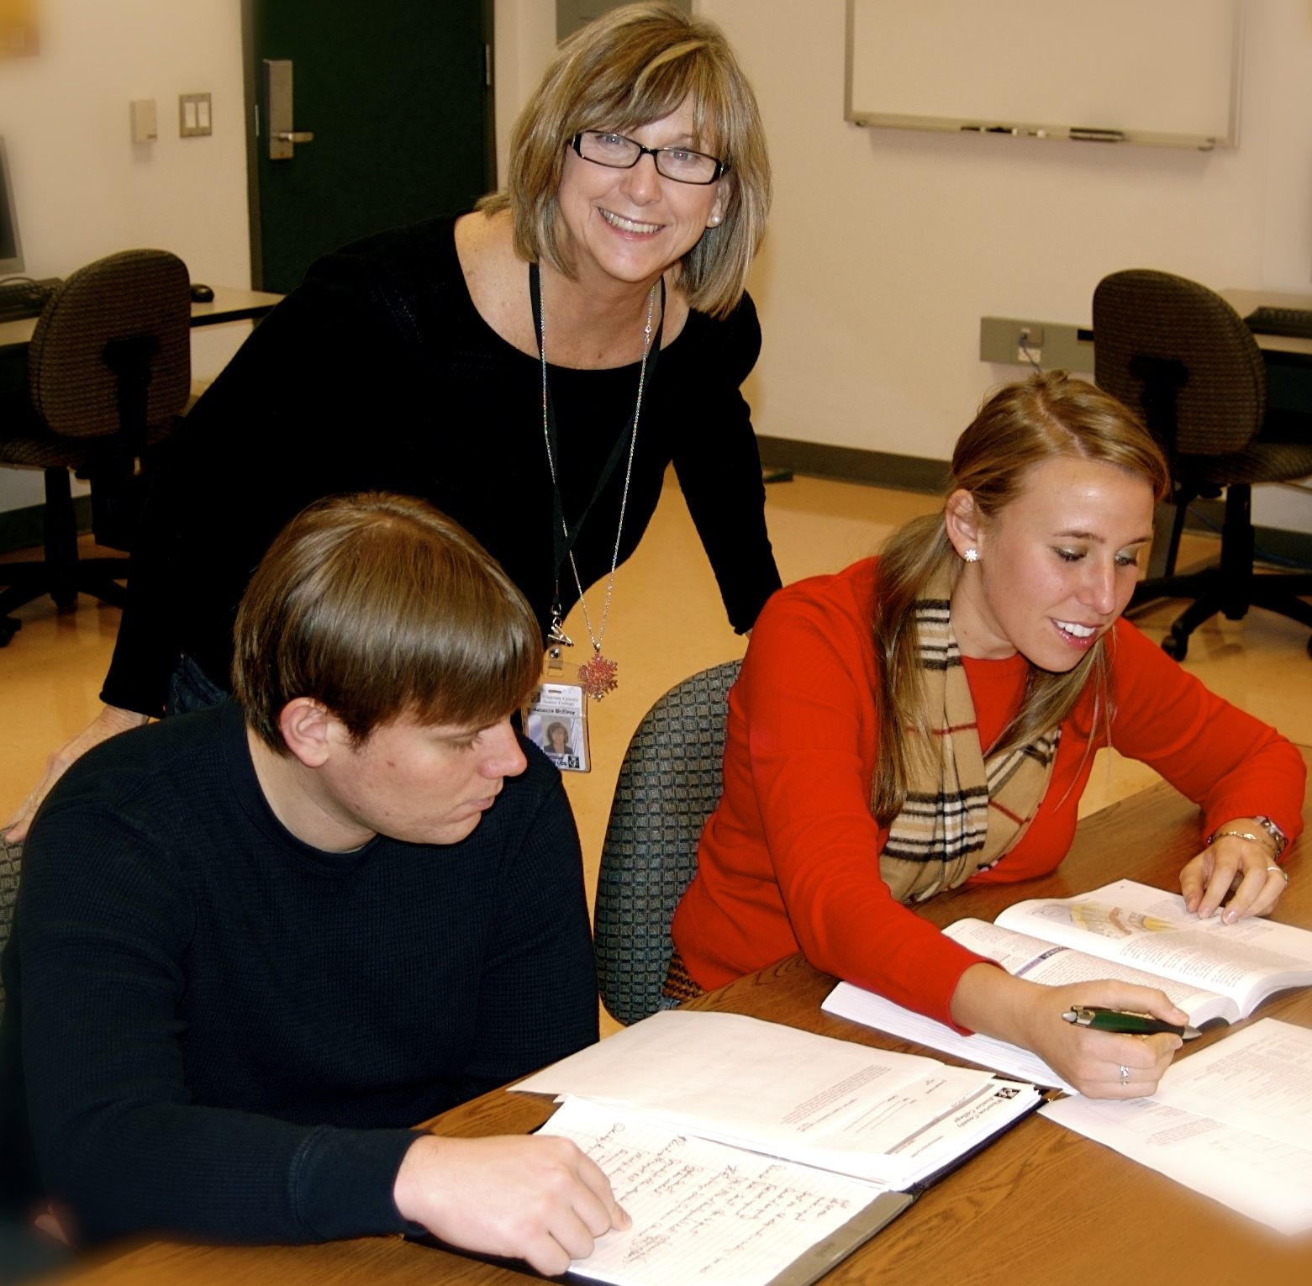
My work as a college instructor can be summed up in three words, which also apply to my students: competence, relevance, and persistence.
—Rebecca McElroy, Wharton County Junior College (TX)

Slide 62
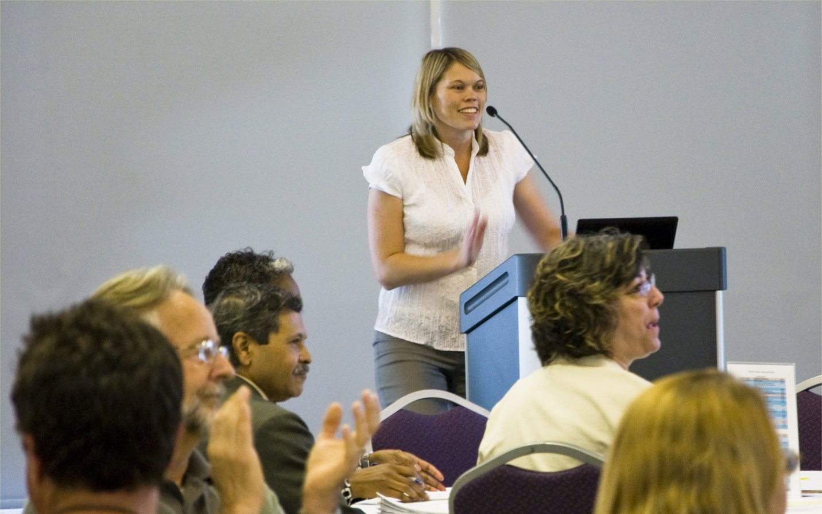
Why be silver when you can be gold? That is the mantra I take along with me as I assist faculty in designing and developing curricula and course materials that utilize instructional technologies. Do not use technology for the sake of technology. Our students today know how to use technology, but they do not know how to learn with it. That is where I come in.
—Stacey Hilton, Yavapai Community College (AZ)

Slide 63
Enthusiasm! No better word can sum up a great teacher’s gift to a student. If you have passion for your subject, it will show, and the students will feel it. Share your enthusiasm through your teaching!
—Janie Sigmon, York Technical College (SC)

Slide 64
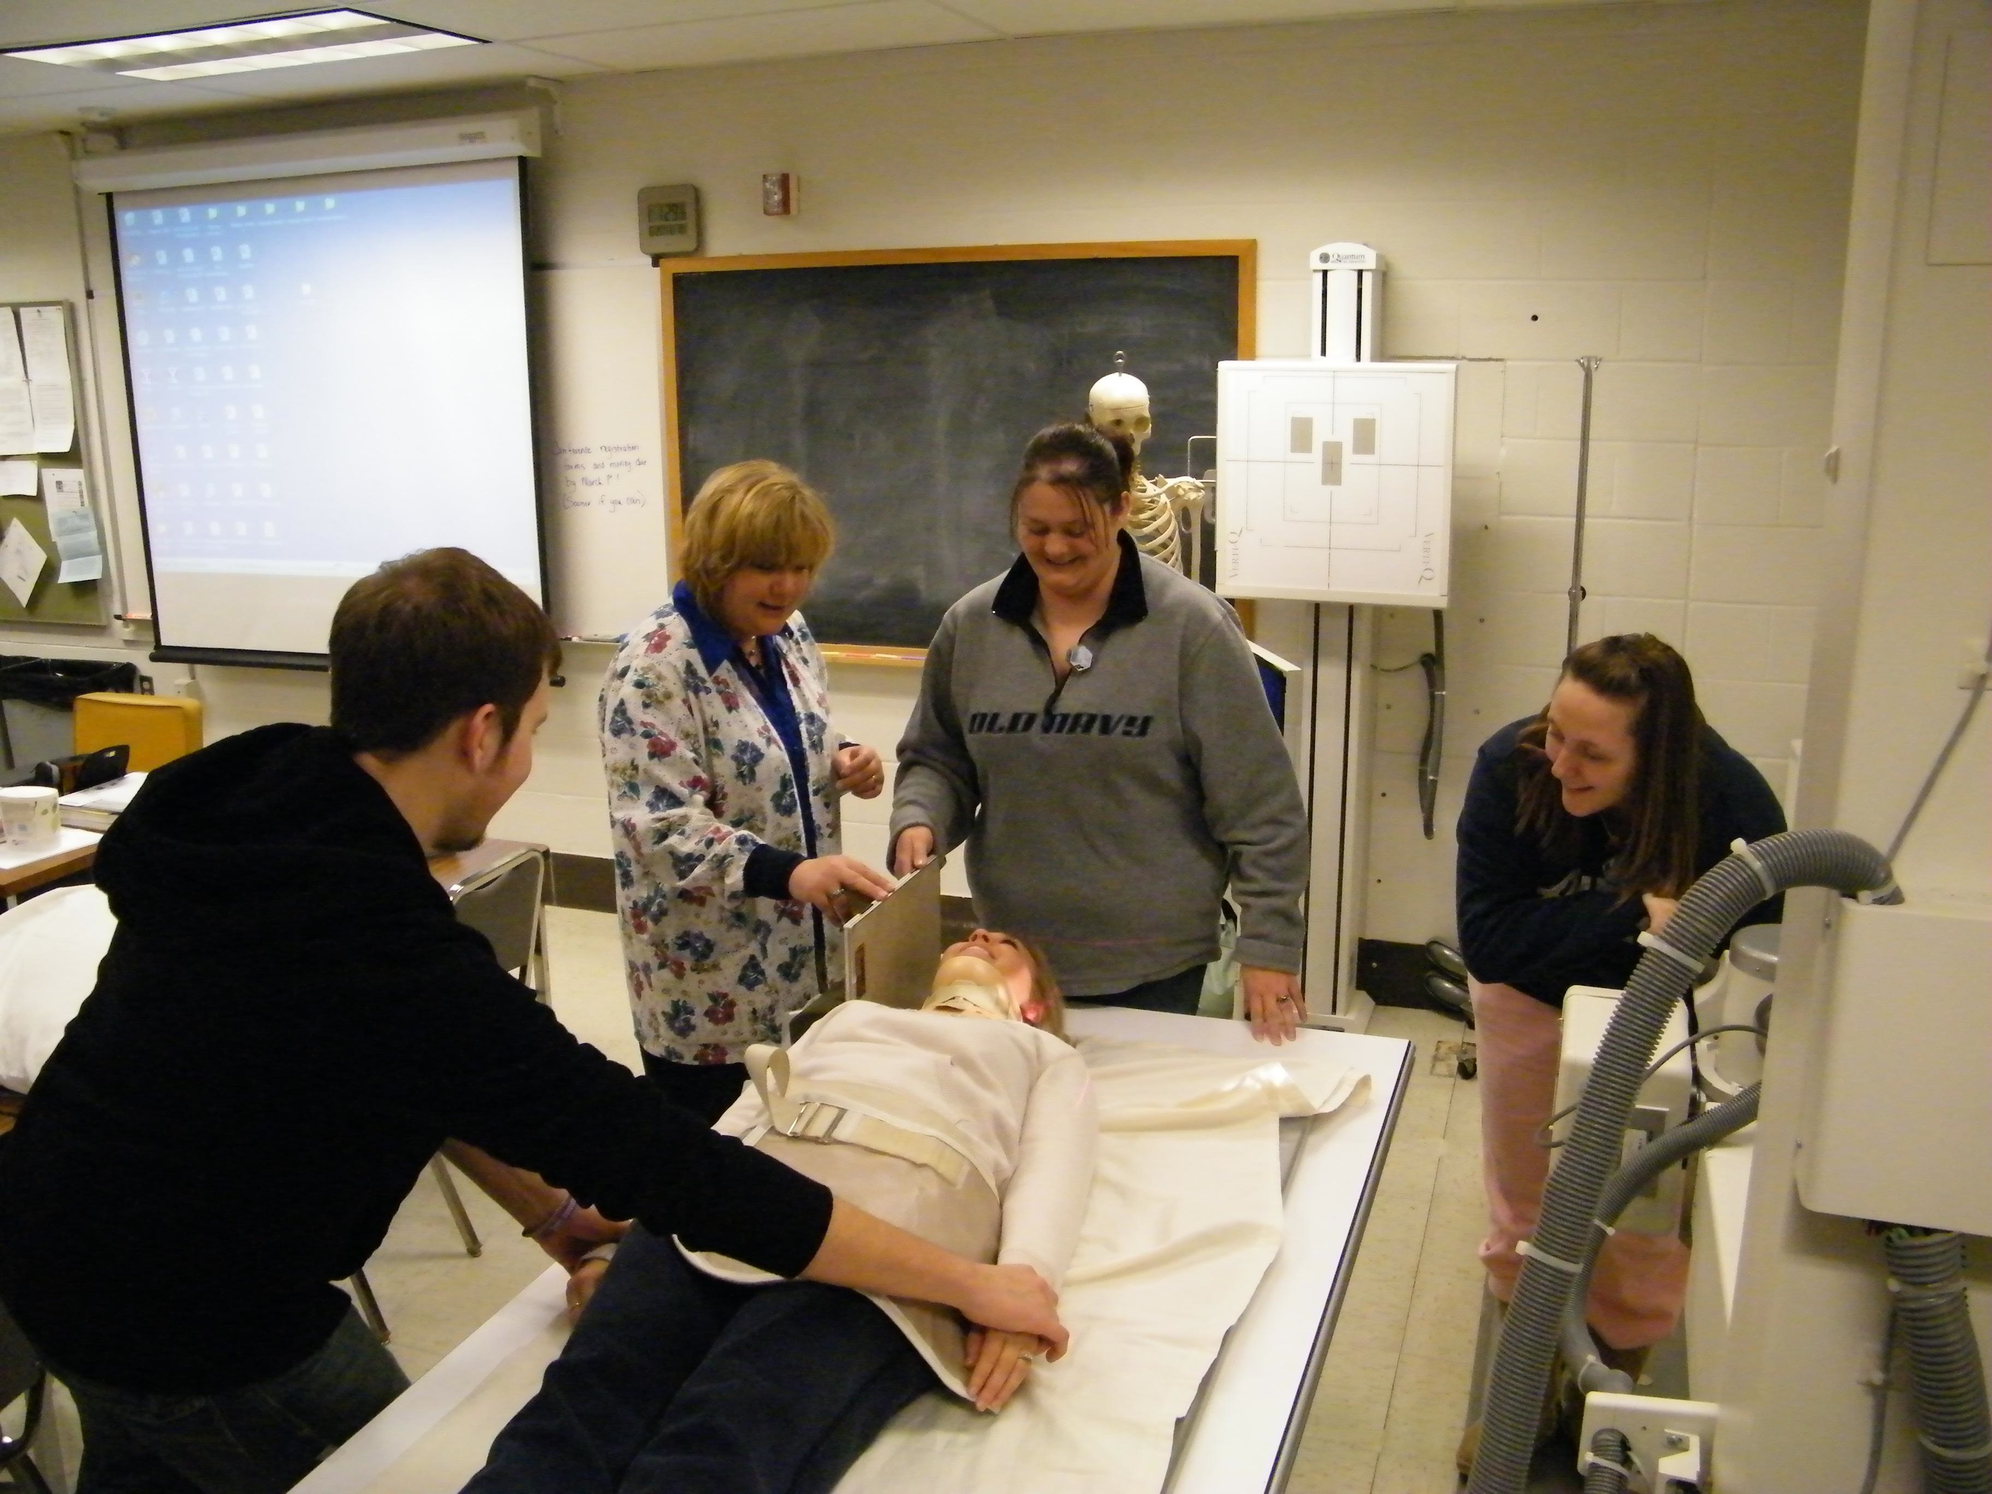
The most important aspect we can instill in our students is the love of learning. The continuance of the educational process, regardless of its formality, will provide the basis for lifelong learning and critical thinking. It is rewarding to see students graduate and become compassionate, competent healthcare professionals.
—Tricia Leggett, Zane State College (OH)

