Slide 1
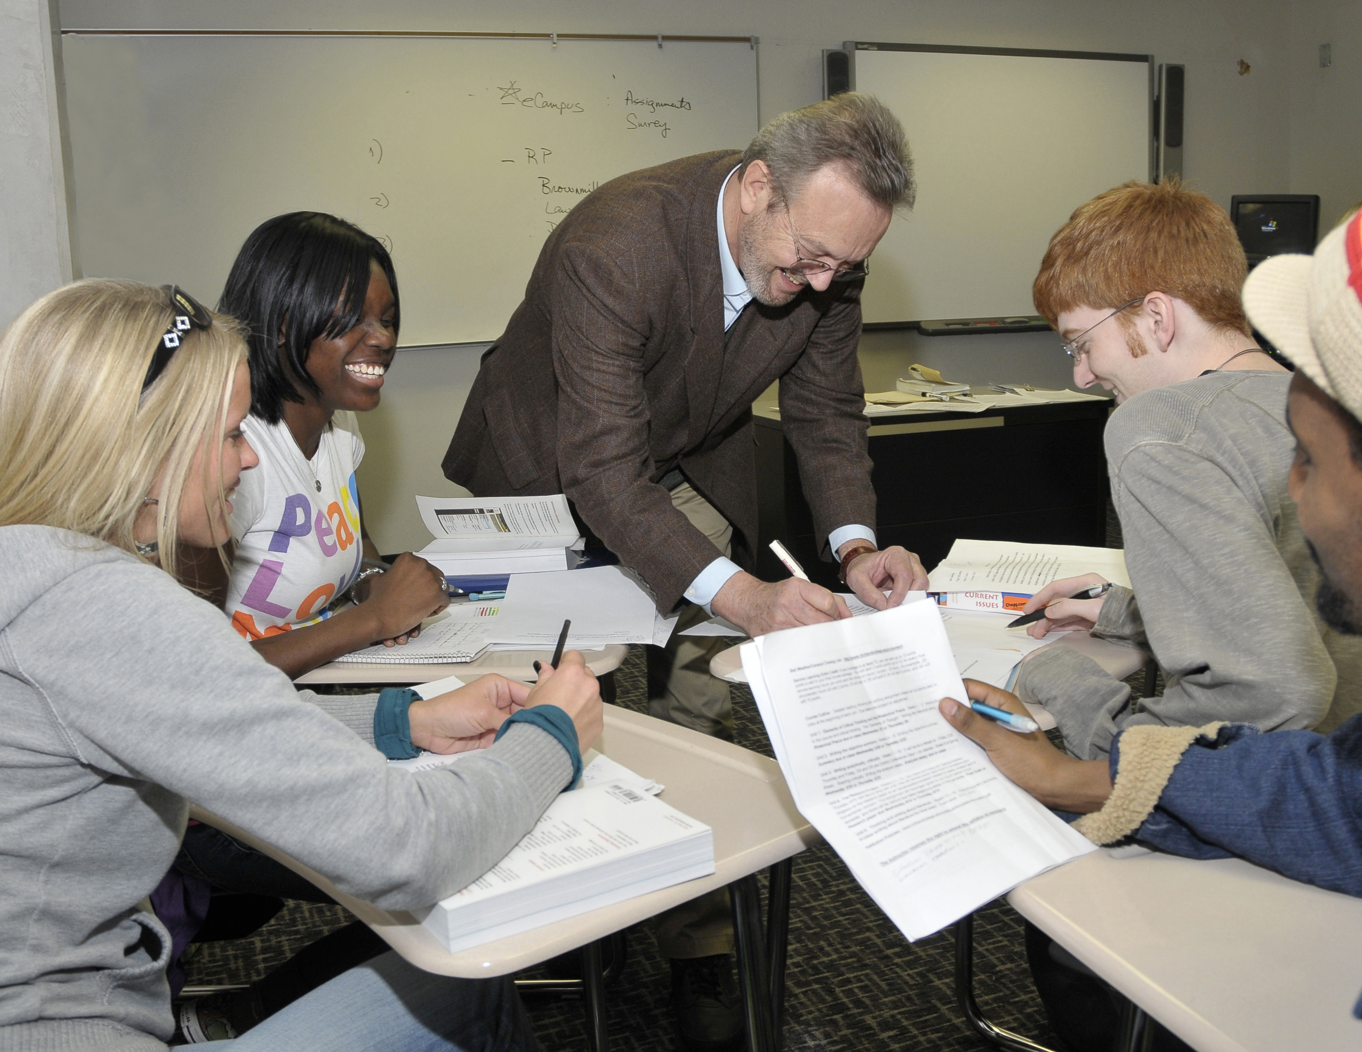
I try to speak a language of enthusiasm, calling on students to engage matters of deep moral concern critically and compassionately: human rights and social, economic, and environmental justice.
—Randy Conine, Richland College (TX)

Slide 2
One must remember: students are people who make decisions based on their situations. We may not always agree with their choices, but it is our responsibility to provide them with the tools necessary to make the best choices they can—not only inside the classroom but also in their lives.
—Steven Fowler, Rose State College (OK)

Slide 3
I believe that students are the most important part of the teaching equation. It is up to me as a teacher to reach out and touch them. This can be facilitated by personally involving them. Each student is different, so this must be done differently for each student.
—Robert Young, Salt Lake Community College (UT)

Slide 4
A good instructor will empower students with the knowledge needed to succeed in the academic and professional world. The apex of empowerment is when students go beyond textbooks and use their acquired skills to solve problems in the community and at work.
—Robert Gonzalez, San Antonio College (TX)

Slide 5
I always teach from life experiences—the students’ as well as mine—and weave together research and best practices in meaningful ways.
—Ana O'Connor, San Antonio College (TX)

Slide 6
My teaching goal is to help students get to the point where they no longer need me. They can THINK on their own.
—Teanna Staggs, San Antonio College (TX)

Slide 7
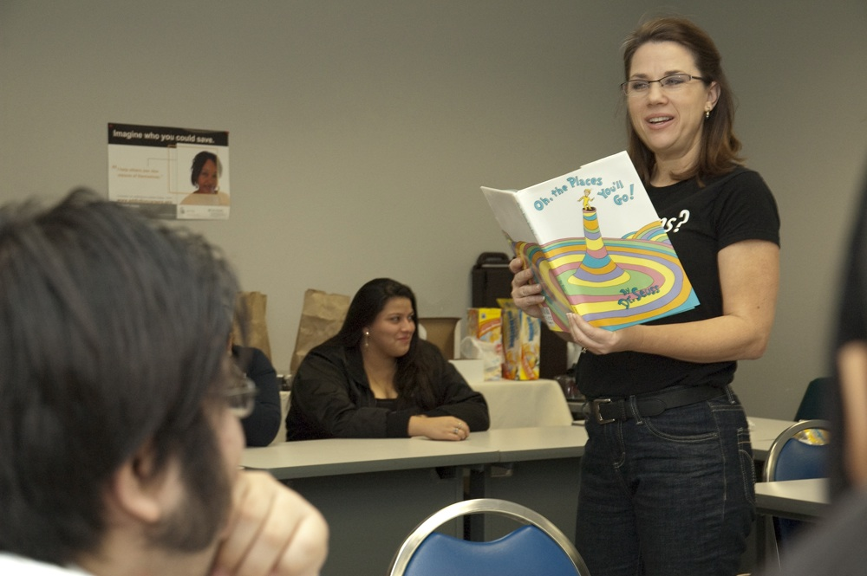
Each student who learns to believe in himself/herself, obtains the skills to be a successful student, and completes a degree, will permanently improve his or her family tree.
—Melissa Sutherland-Hunt, San Antonio College (TX)

Slide 8
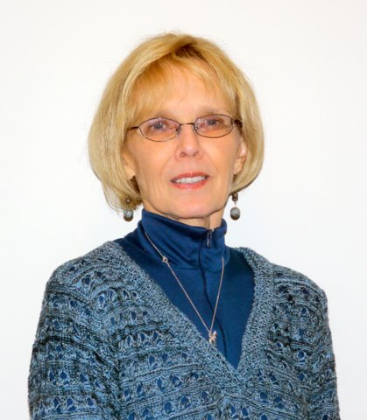
“I was called to be a teacher!” I heard these words from a keynote speaker at a NISOD Conference in 1987. The speaker told how he had this insight that he was meant to be a teacher—it was a calling, which indicated the importance of the teaching profession. He stated his feelings about our profession so eloquently that I was moved to tears, along with others in the audience. I knew just how he felt, for I too feel a calling. I know I am in exactly the right job for me, not just teaching, but teaching in a two-year college.
—Ann Cartwright, San Jacinto College District (TX)

Slide 9
Being in customer service has given me the opportunity to interact with people who are struggling with the frustrations of the computer age. It is a great feeling knowing the people I teach display what I have strived to achieve in my own work ethic.
—Larry Holley, San Jacinto College District (TX)

Slide 10
I always encourage my students to dream BIG. I tell them that with an education and dedicated efforts, they can do or be anything. I never interject negative reality into their hopes and aspirations.
—Kelly Mizell, San Jacinto College District (TX)

Slide 11
Teaching is an everyday part of life. Each new day brings questions, answers, and solutions to the daily task at hand. Therefore, the quest for excellence is expected in everything we do whether we are a student or an instructor.
—Sean Perrodin, San Jacinto College District (TX)

Slide 12
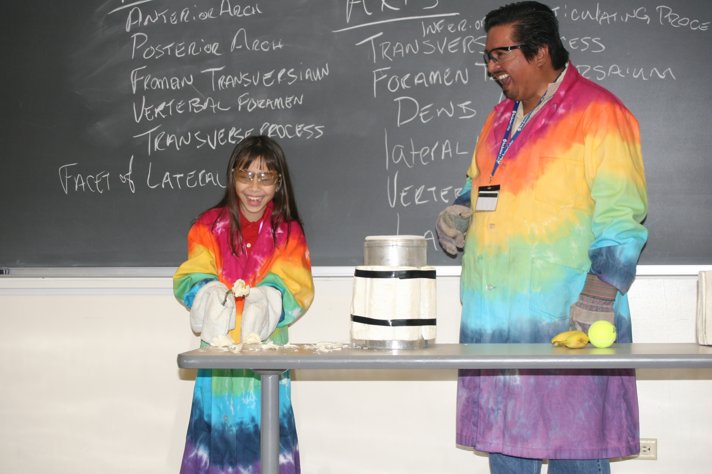
D.H. Lawrence wrote: "Every generation must lend its knowledge to the next, else all is lost." Education is the only way to ensure quality of life, equality, self-assurance, and hope for a future.
—Ruben Ramirez, San Jacinto College District (TX)

Slide 13
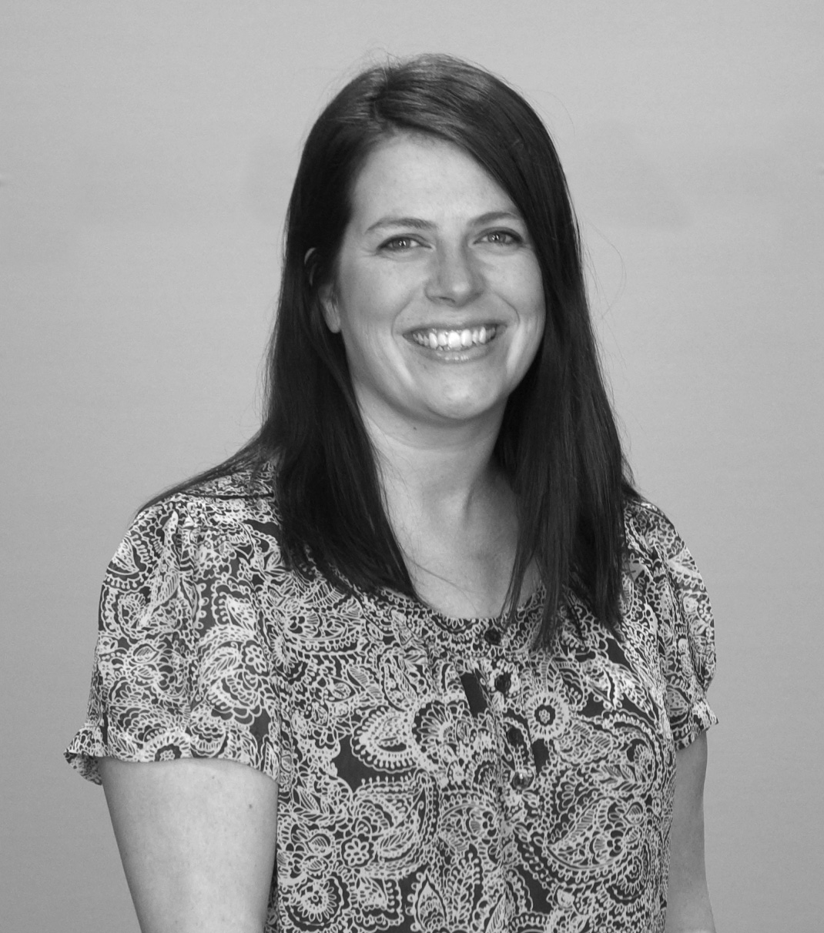
Appealing to all learning styles is an art. Teaching is taking part in perfecting this art.
—Holly Austin, Schoolcraft College (MI)

Slide 14
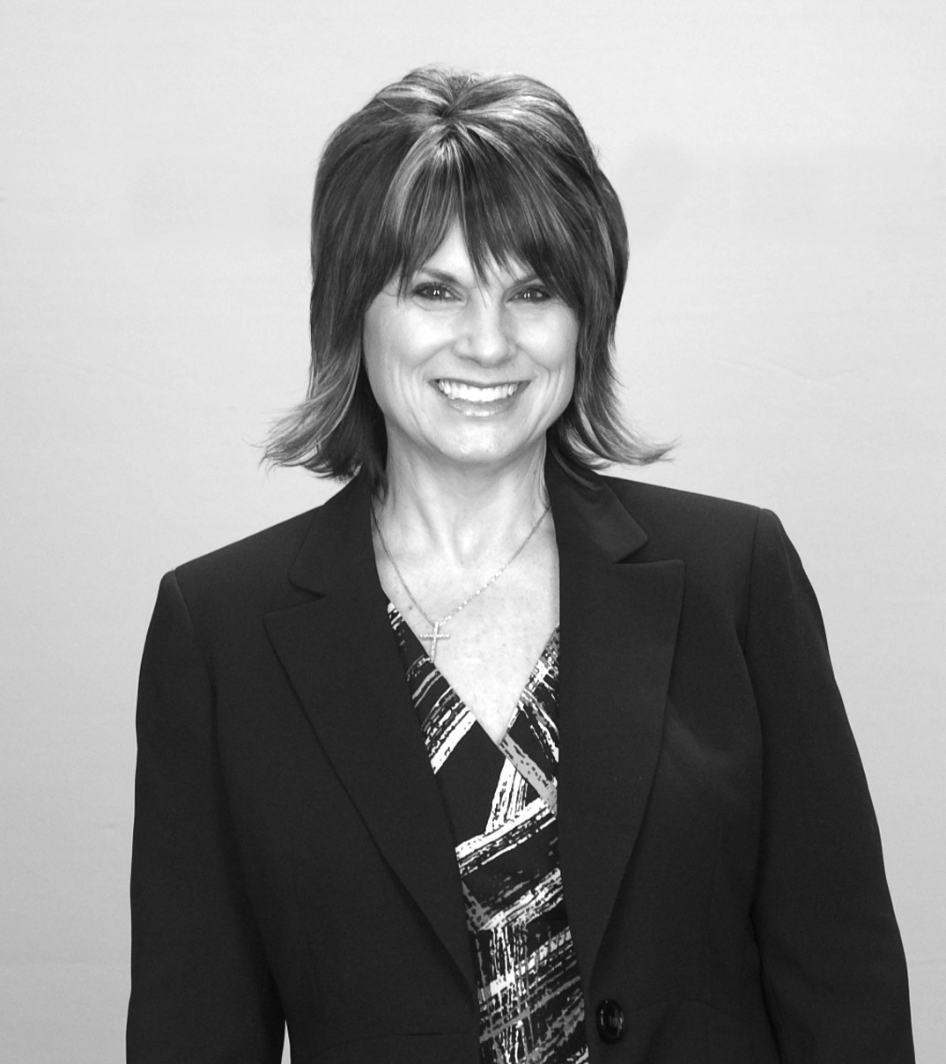
Be a lifelong learner and keep up with changes in technology and your discipline. Use current events to tie theory to the "real world.” Allow others to see your human side. Be available and show personal interest in students. Let the passion for your work shine in all you do!
—Jody Scheller, Schoolcraft College (MI)

Slide 15
I am amazed how time works. Ten extra minutes with a student can translate to a lifetime of change.
—Andy Gullen, Selkirk College (British Columbia)

Slide 16
What inspires me? What motivates me? It is really very simple—the students and staff with whom I work. Their successes, whether great or small, renew my belief and excitement in the power of learning. These accomplishments, which empower them to move forward and become effective in what they do, are truly inspirational.
—Corrine Major, Selkirk College (British Columbia)

Slide 17
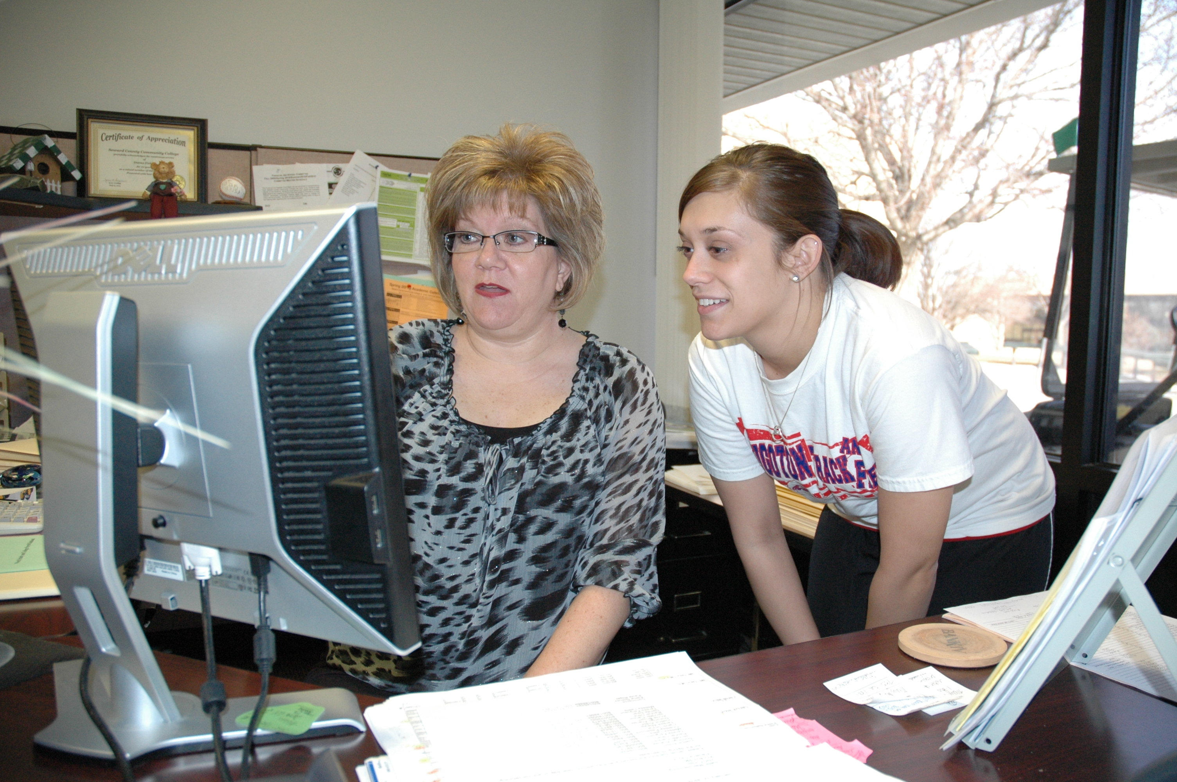
Students can be overwhelmed by the entire college process. I am there to deflect a portion of their anxiety. As Financial Aid Director, I do not teach student in a classroom setting; rather, I teach students responsibility through Financial Aid counseling, keeping in mind their difficulties and challenges.
—Donna Fisher, Seward County Community College (KS)

Slide 18
I believe that each day when I get up and come to work I have the opportunity to make a difference in someone’s life. Sometimes we forget that going the extra mile for a student can mean the difference in whether that student is a success or a failure. In my 30+ years of working in student services, I feel that I have given that little bit extra which may have helped many students be successful.
—Loretta Jones, Shelton State Community College (AL)

Slide 19
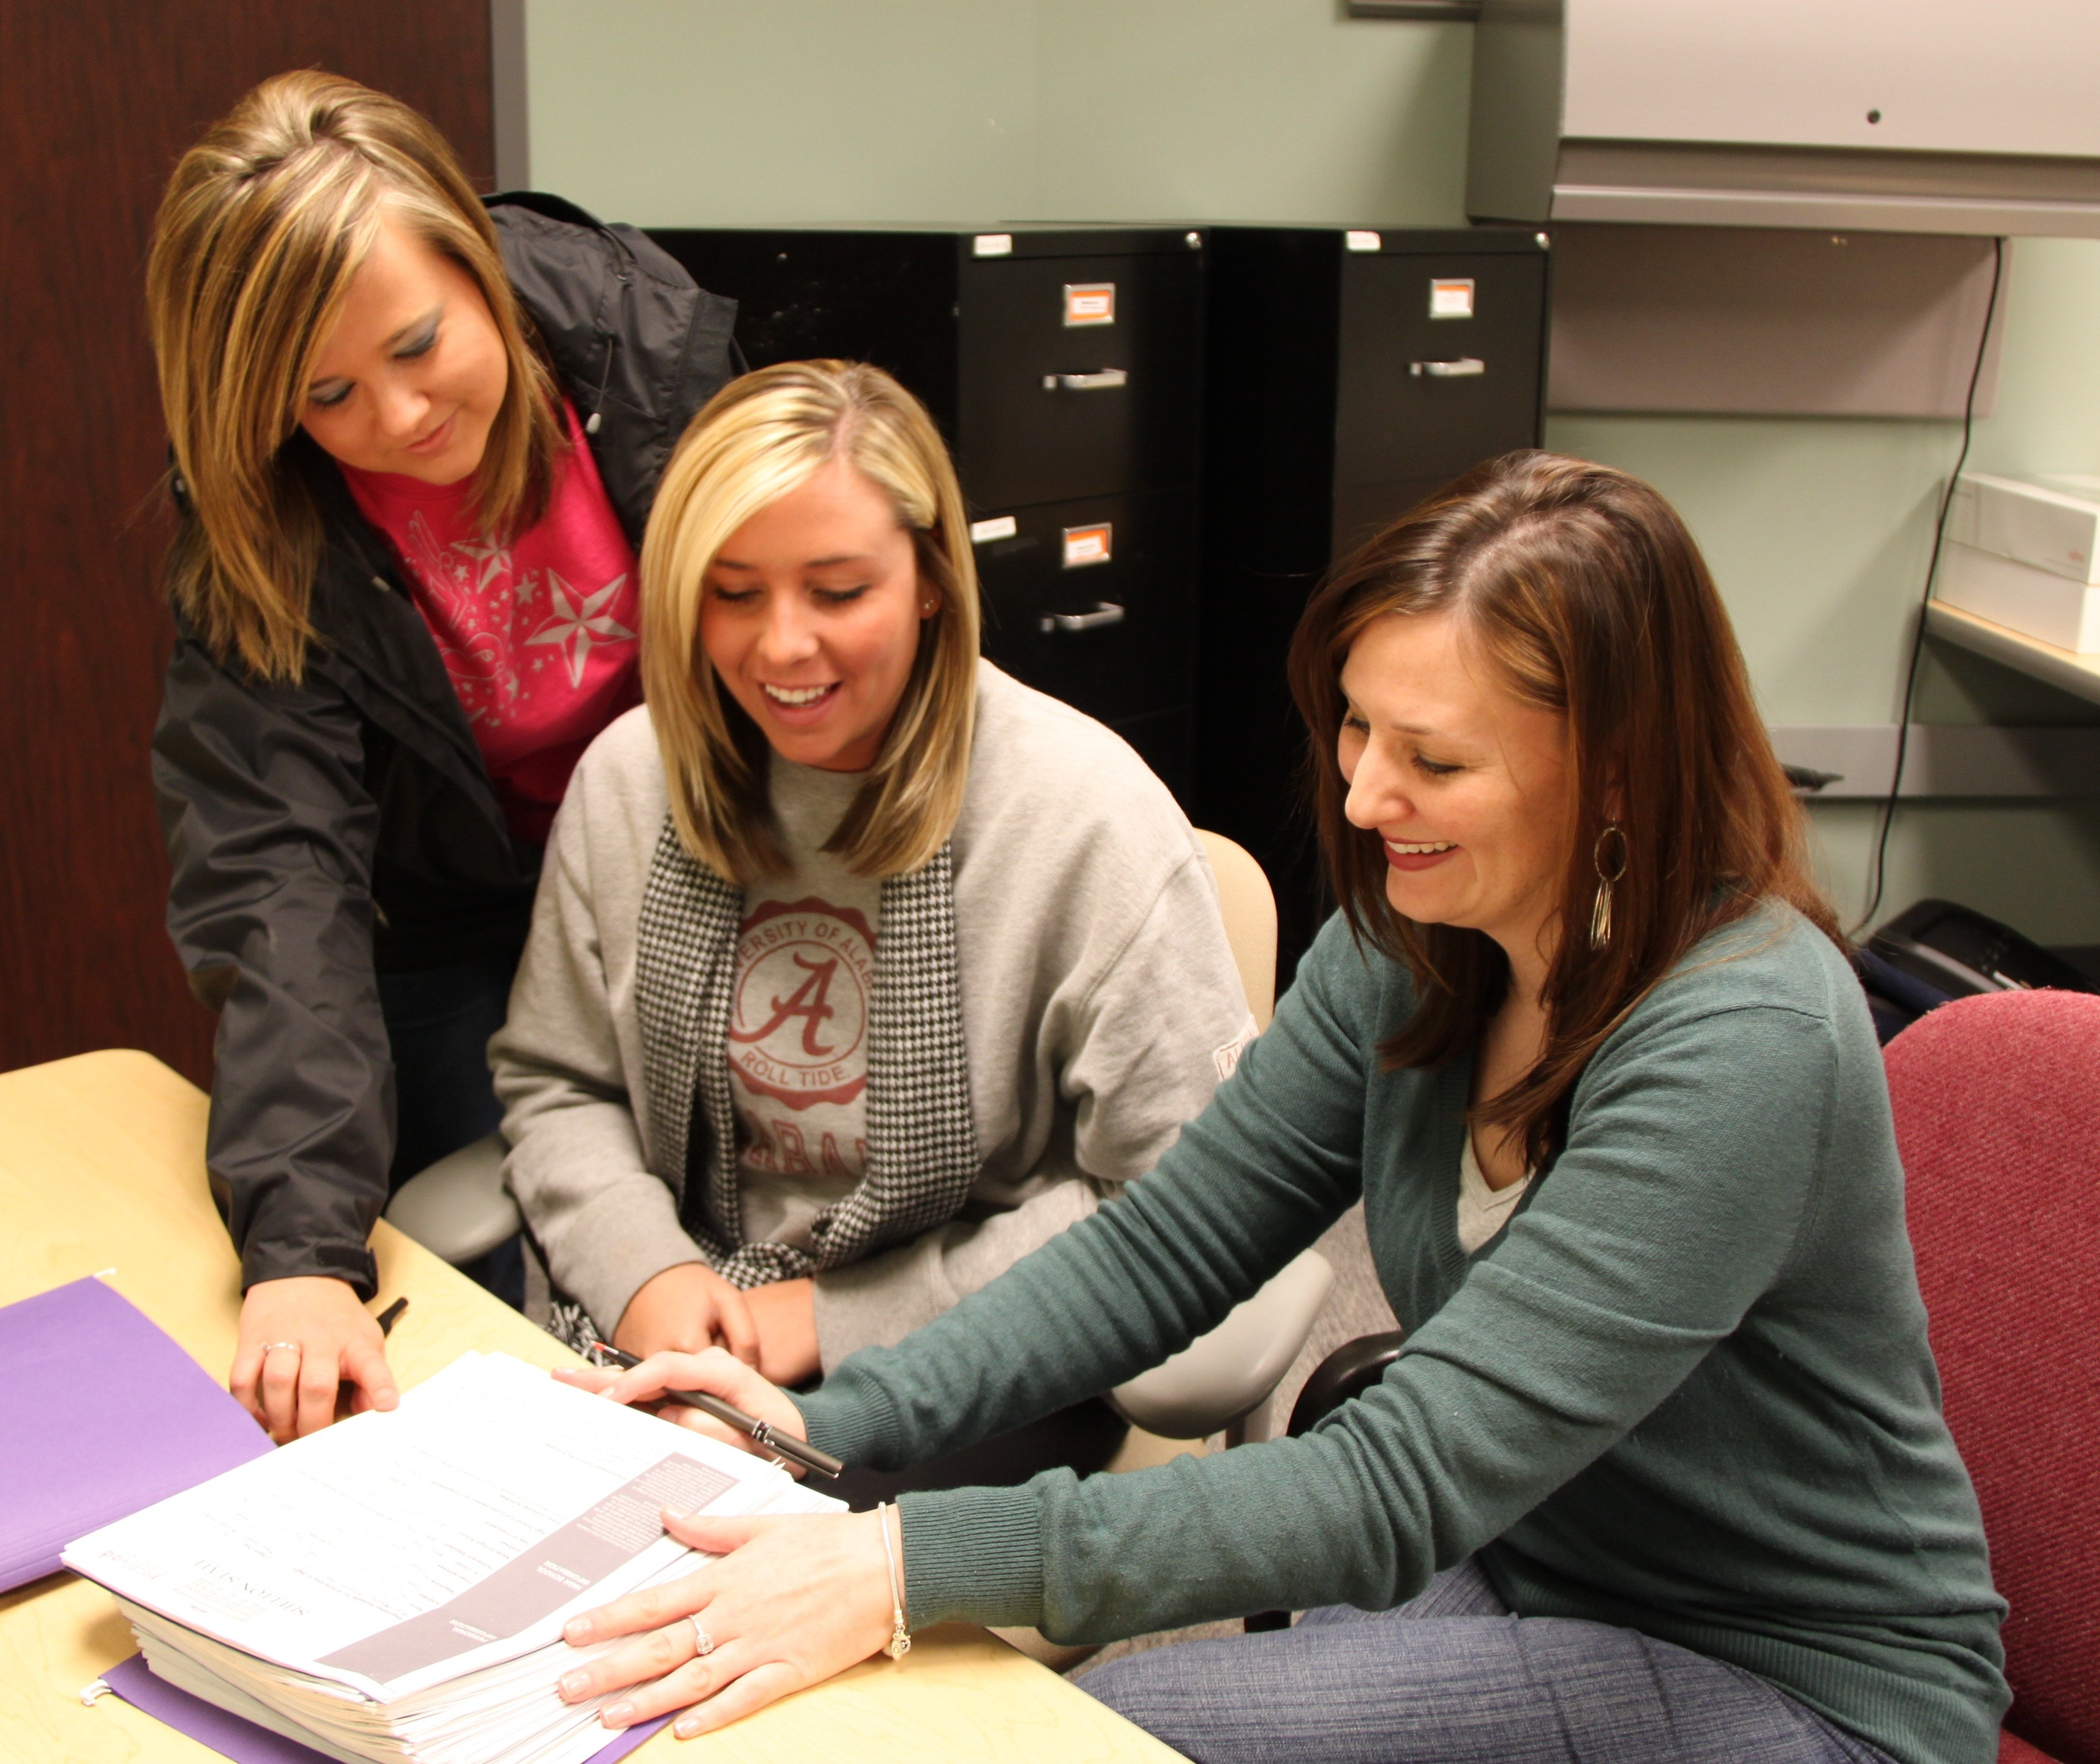
Being a part of the Information Technology Services team allows me to be a catalyst between our students and a world of limitless possibilities.
—Johnna McCracken, Shelton State Community College (AL)

Slide 20
As an educator, I lead an exploratory sightseeing tour through an ever-changing landscape—making sure to point out the highlights, but giving the freedom for the tour party to explore different paths and uncover gems. The value is in the journey.
—Scott Hadley, Sheridan College (Ontario)

Slide 21
The positive reaction of project clients to the quality of work by students in our program has been surpassed only by employers regarding our graduates. Students, my faculty colleagues, and I continue to be driven by these reactions.
—Steve Tywonek, Sheridan College (Ontario)

Slide 22
My students are what motivate and inspire me. Seeing the challenges that today’s students face, I feel truly blessed and inspired to help them achieve the success they are so desperately seeking. Being able to help them on their journey, and then having the opportunity to see them receive their diploma is what keeps me going.
—Dennis Brode, Sinclair Community College (OH)

Slide 23
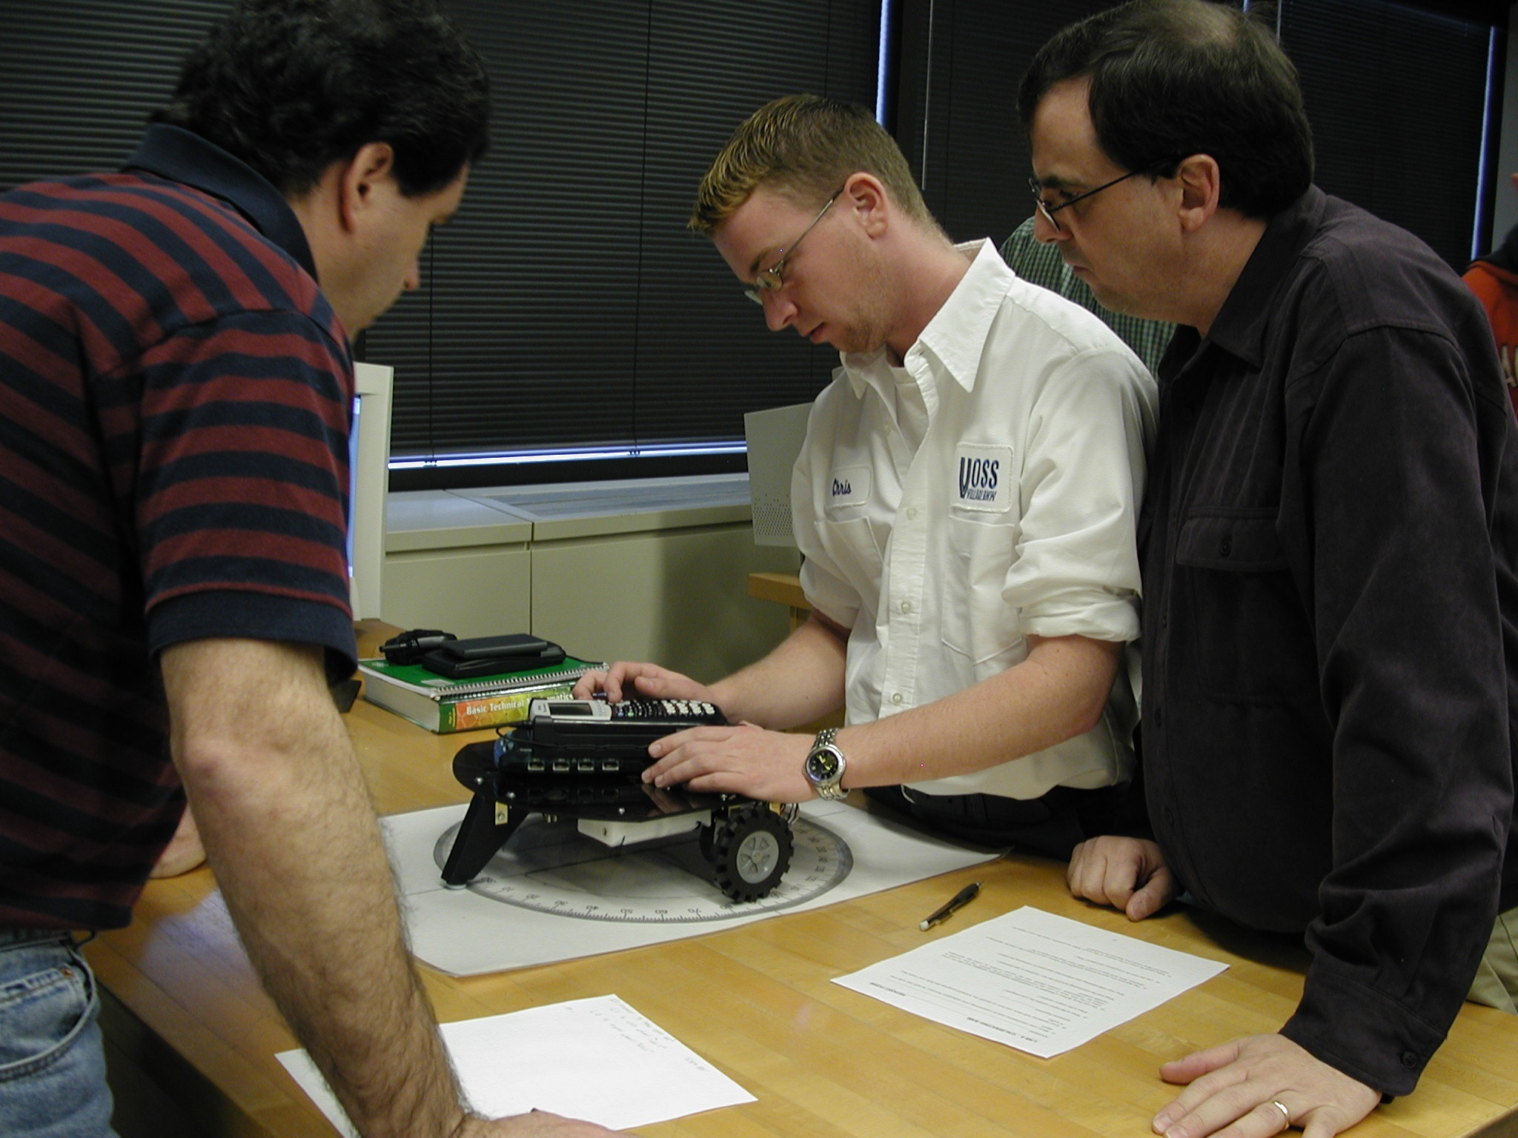
I teach math by incorporating rigorous hands-on group activities that motivate students to learn and to have a deeper understanding of important concepts. I find it rewarding to help students build confidence as they strive to learn material that is often considered complicated and intimidating.
—Robert Chaney, Sinclair Community College (OH)

Slide 24
While actively challenging my students to approach course assignments in a critical and creative manner, I provide them with consistent feedback regarding their work. In turn, I utilize student feedback to assess teaching strategy effectiveness and adjust my teaching practices/course content appropriately to facilitate student learning and engagement better.
—Kelly Joslin, Sinclair Community College (OH)

Slide 25
Every single person begins communicating the moment they are born. As we grow and learn, so too do our communication skills. As a teacher of communication, I expose students to new theories, model communication styles, teach them to be critical thinkers, and encourage personal growth. This is the most rewarding career imaginable.
—Robert Leonard, Sinclair Community College (OH)

Slide 26
The need to capture and retain the interest of students is paramount in their success in education. There are so many outside influences. We continually need to break through the noise with innovation and provide a reason for continued learning through applications
—Thomas Singer, Sinclair Community College (OH)

Slide 27
Every Respiratory Therapy student must graduate with the ability to think critically in emergency situations. I challenge my students to achieve the standard that when a patient is relying on them, they must have no greater satisfaction than to vindicate his expectation.
—Beth Zickefoose, Sinclair Community College (OH)

Slide 28
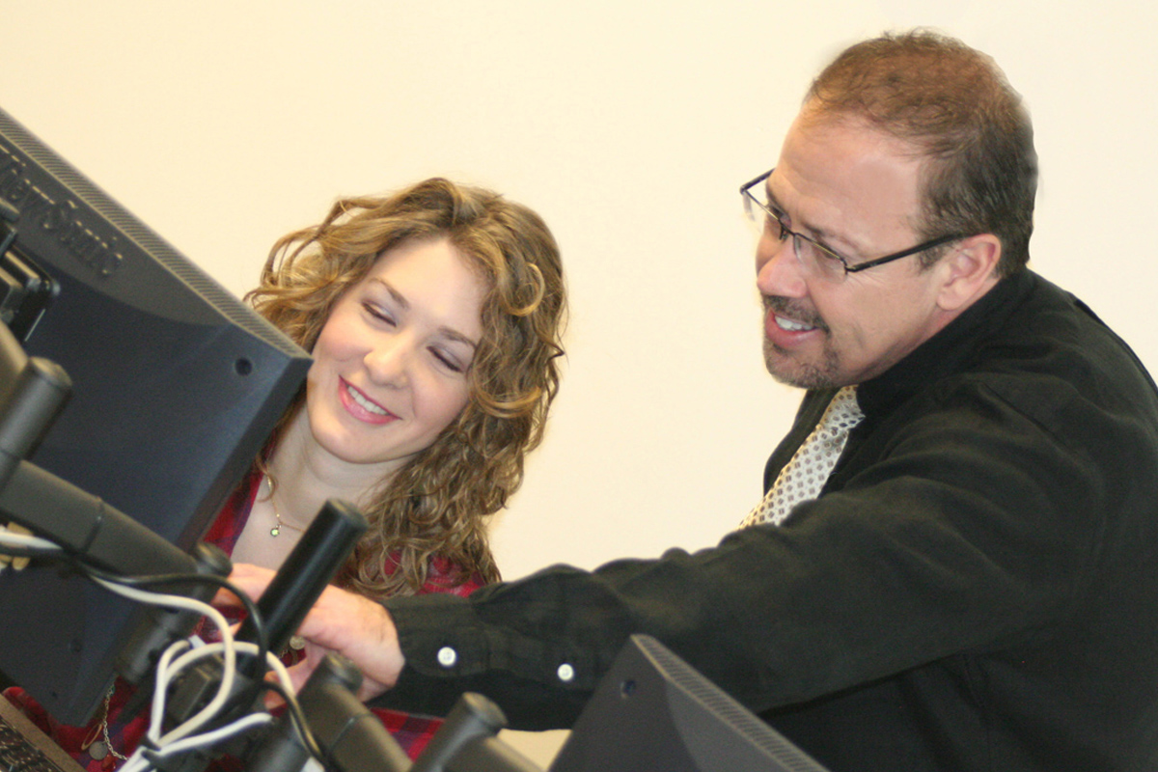
My motivation to teach is driven by the thought that I have a chance to make a positive difference in the lives of my students. A student will always remember how you, as an instructor, made them feel. I want that to be a positive memory to go along with their success. It is truly a blessing to be in a position to be an influential figure in the lives of so many people.
—John Haney, Snead State Community College (AL)

Slide 29
I enjoy teaching as much as learning. After teaching first grade for 16 years, I know what is required of quality teachers academically, physically, and emotionally. It is rewarding to see students who are nervous and scared at the beginning of their academic career become confident and skilled educators.
—Mary Pat Cook, South Arkansas Community College

Slide 30
In graduate school, I had a teacher who said “Play is the highest form of learning.” This made a huge impact in my thoughts about teaching and learning. Even when discussing serious subjects, I try to engage my students’ sense of play by engaging their imagination while stimulating their intellect.
—Amy MacPherson, South Mountain Community College (AZ)

Slide 31
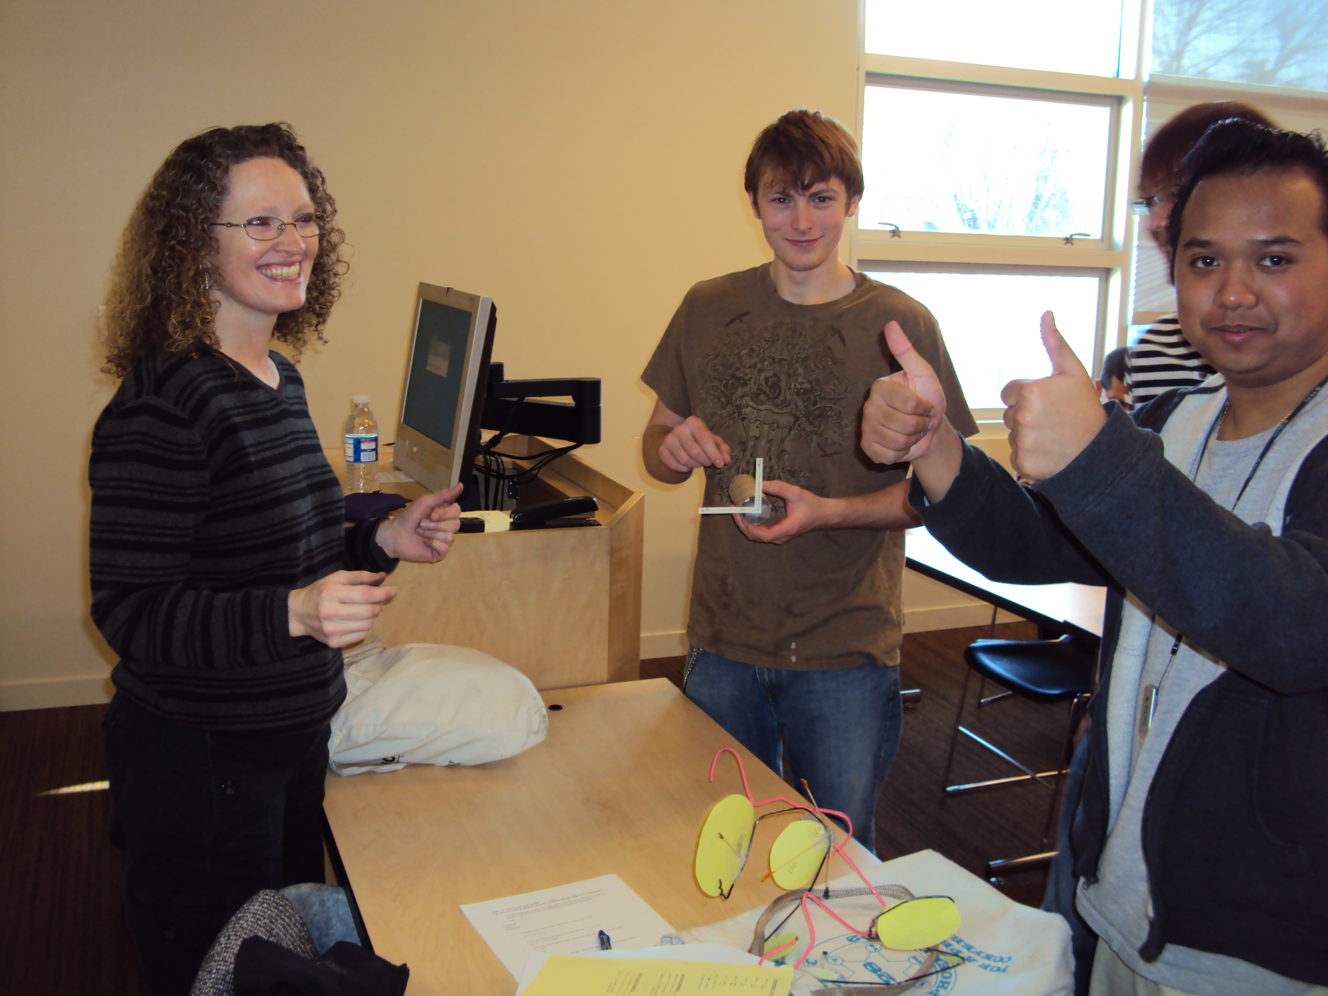
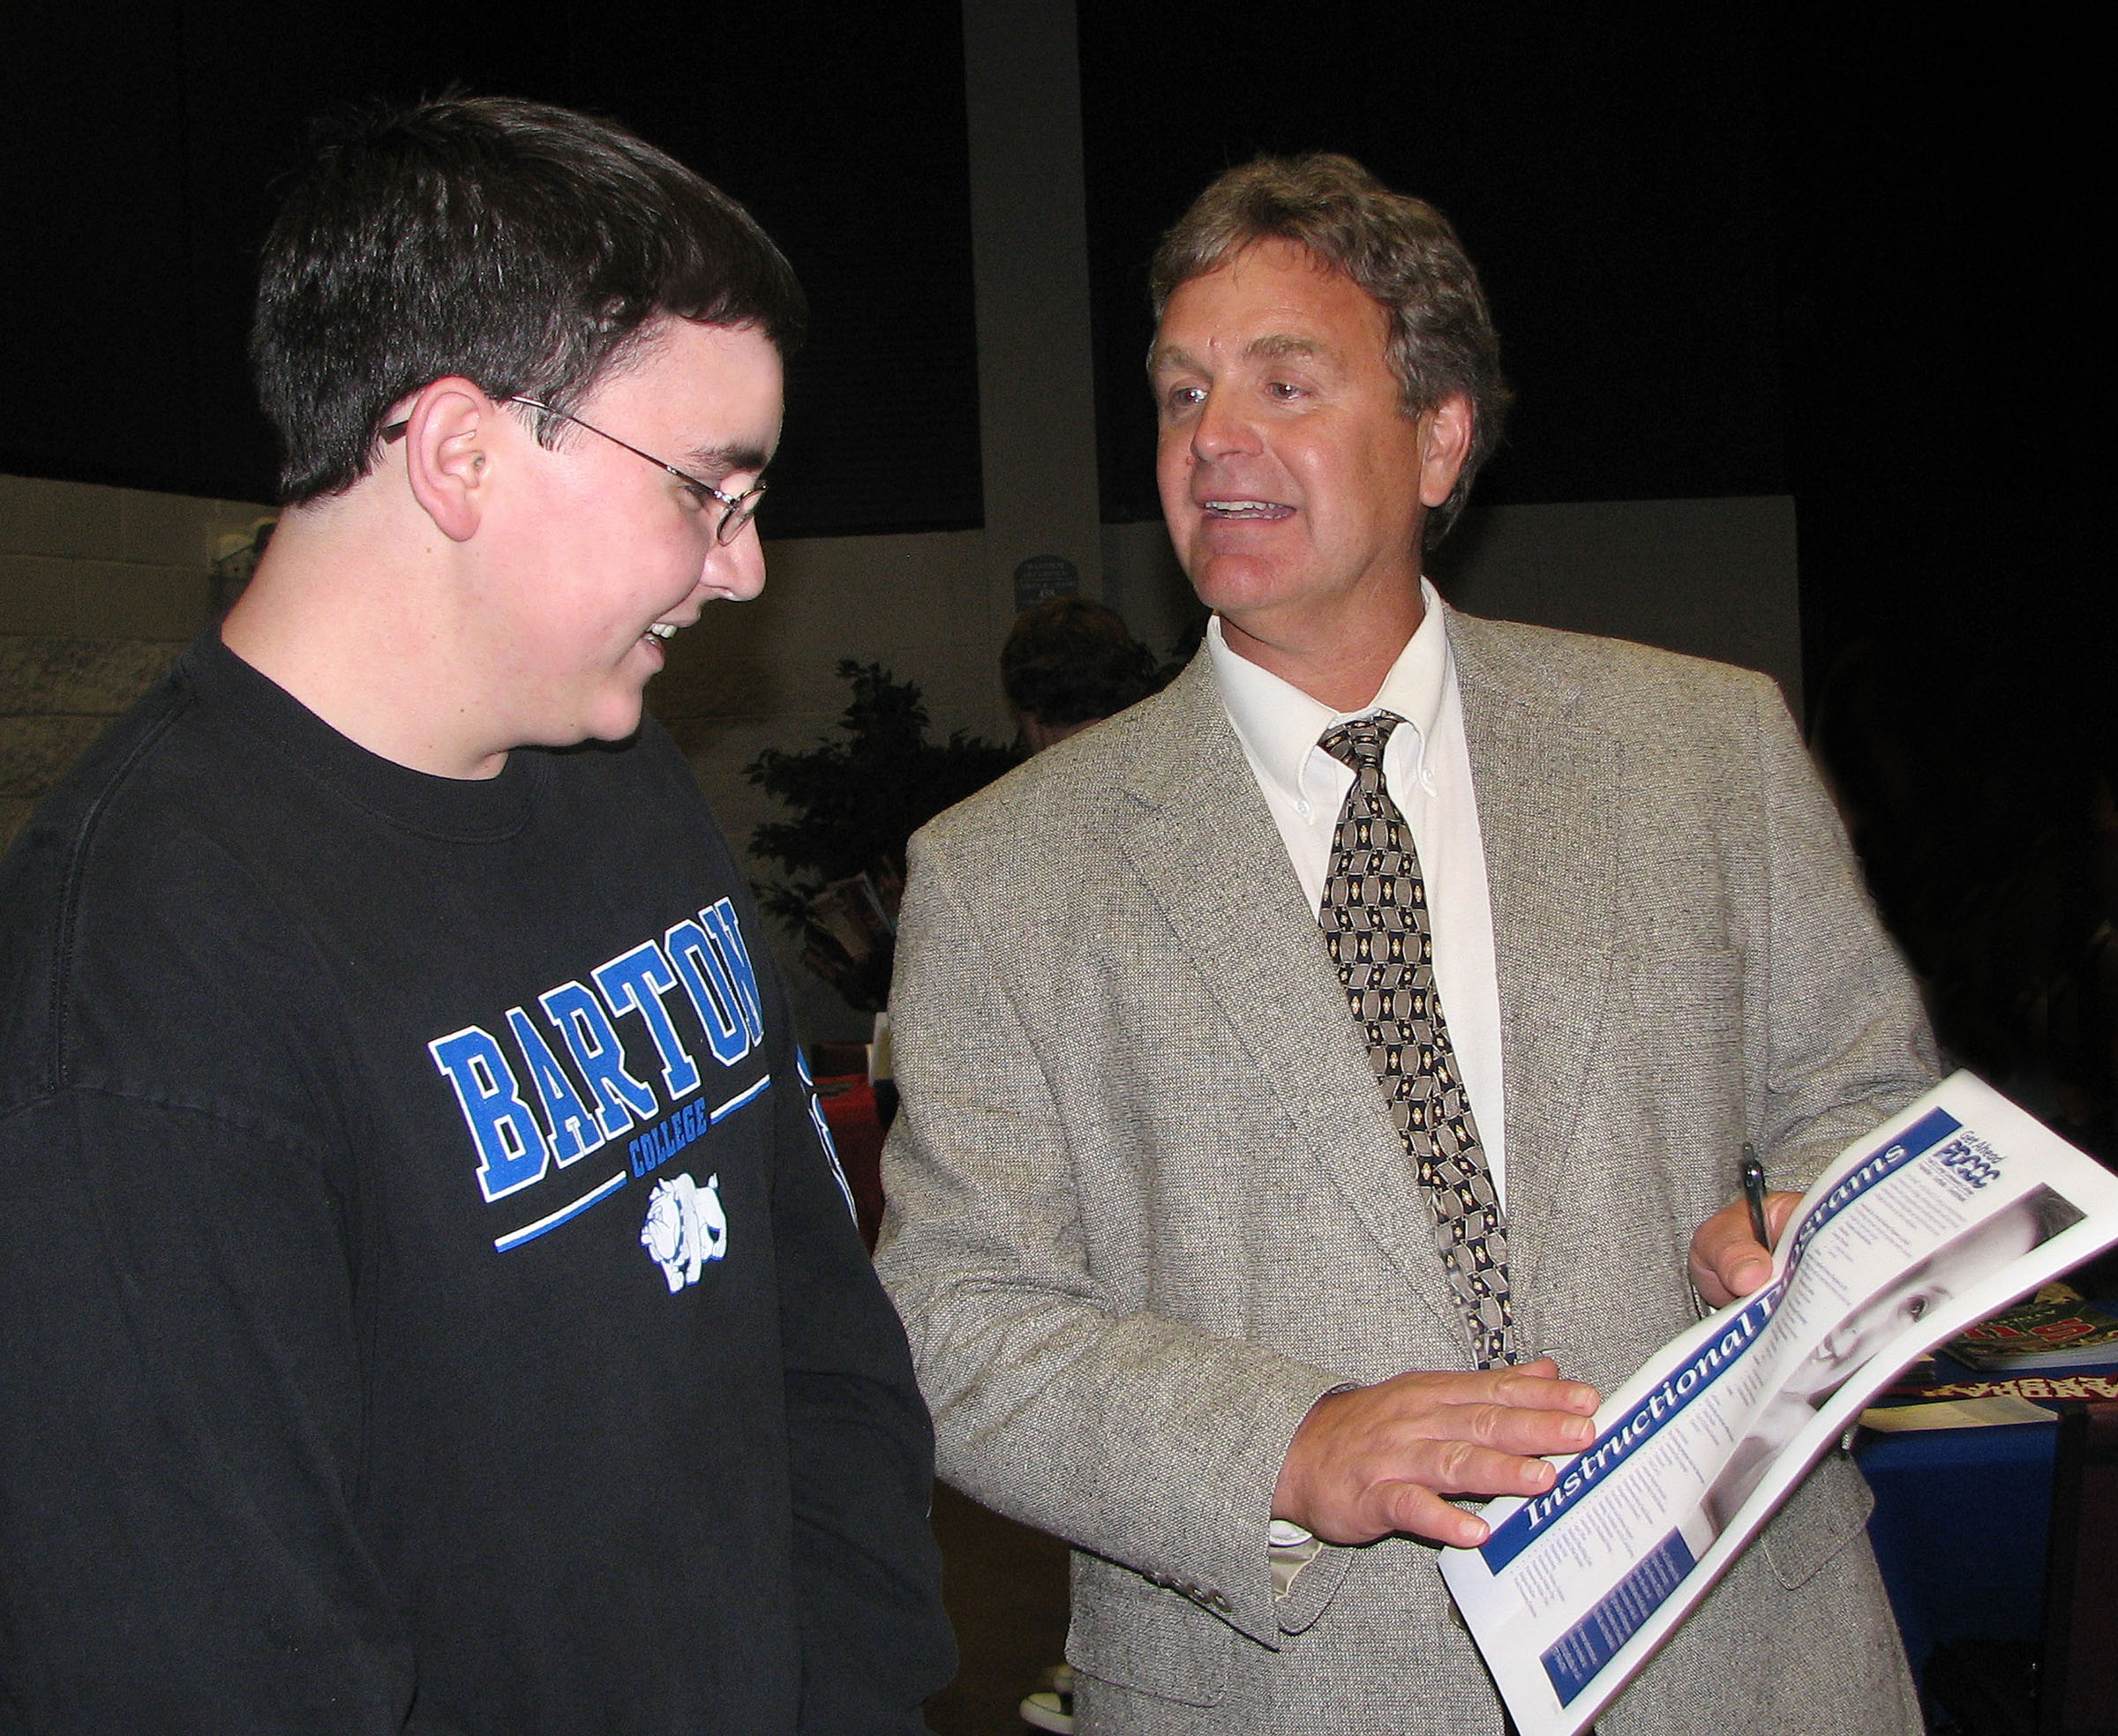
Math inspires me every day. I see it in everything I do. Students inspire me with their desire to learn and their fascination with the subject. When I talk in class about math in the real world and in everything they do, they listen, and that motivates me.
—Heidi Lyman, South Seattle Community College (WA)

Slide 32
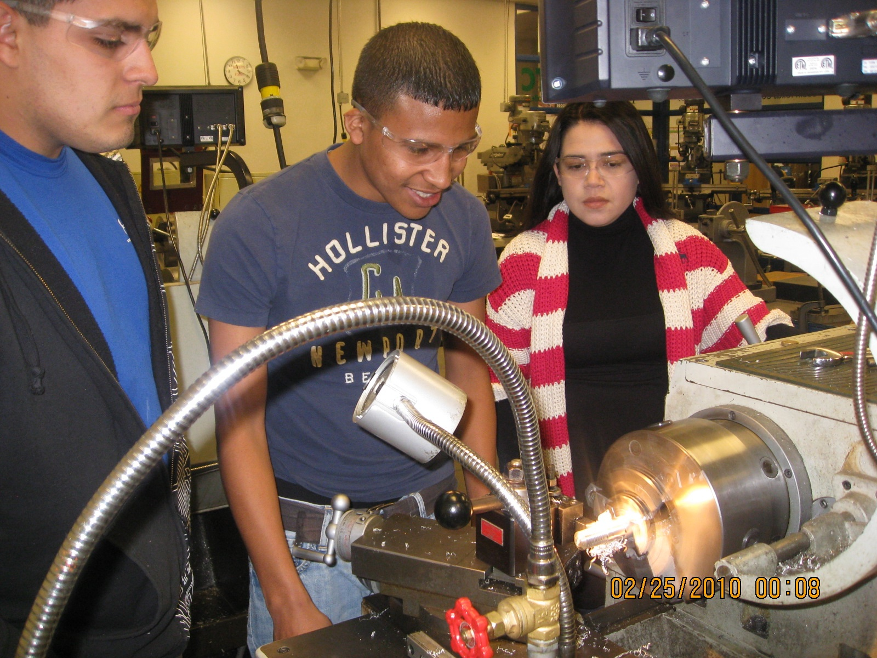
Students ranging from 15 to 60 years old are part of my classes, and it is amazing what listening to them and giving a little time can do. But much more rewarding is seeing them finish their projects and the skills they have acquired.
—Esmeralda Adame, South Texas College

Slide 33
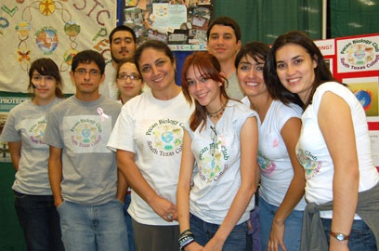
The magical moments of discovering the truth for oneself are high points on the lifelong journey of learning. As an educator, I thrive on seeing these epiphanies in the eyes of my students. In this journey we inspire each other as we question, plumb, and reorganize the truth.
—Mehrzad Mahmoudian-Geller, South Texas College

Slide 34
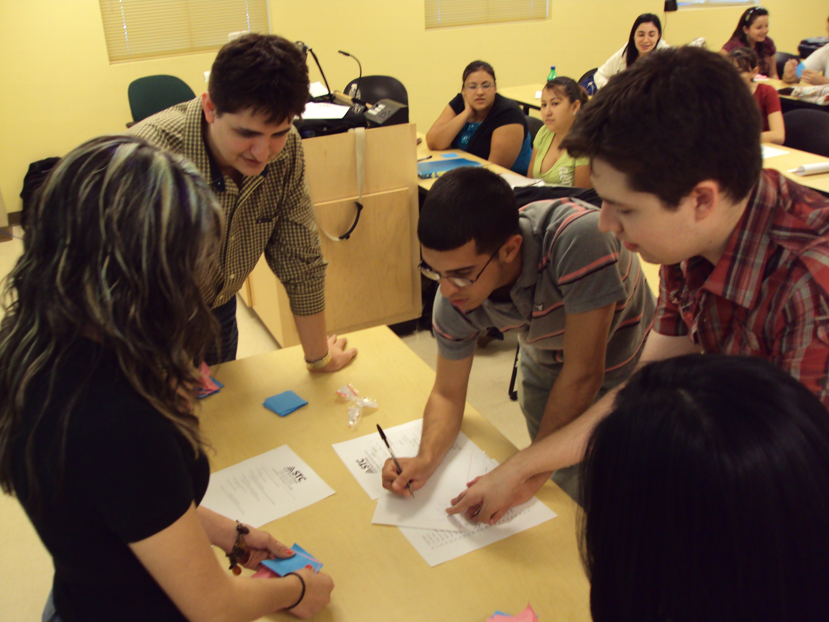
In the movie “Spiderman” someone said that with great power comes great responsibility. I might not be a superhero, yet every day I am honored with the opportunity to inspire and make a difference. Our students’ futures are figuratively in our hands, and we do not even need a colorful costume or a superpower.
—W. Eli Sarabia, South Texas College

Slide 35
It is such a fascinating journey being in education. Over the years, I've helped kindergarteners navigate the intricacies of tying a bow on a sneaker and 50-something, back-in-school folks learn to navigate the Internet. It is a privilege and a joy to do this kind of work.
—Caren Smith, South Texas College

Slide 36
I think learning is a lifelong process. If I can instill that thought and give my students the tools it takes to continue the learning process, I believe , they will mature to be productive citizens.
—Robbie Lindhorst, Southeastern Illinois College

Slide 37
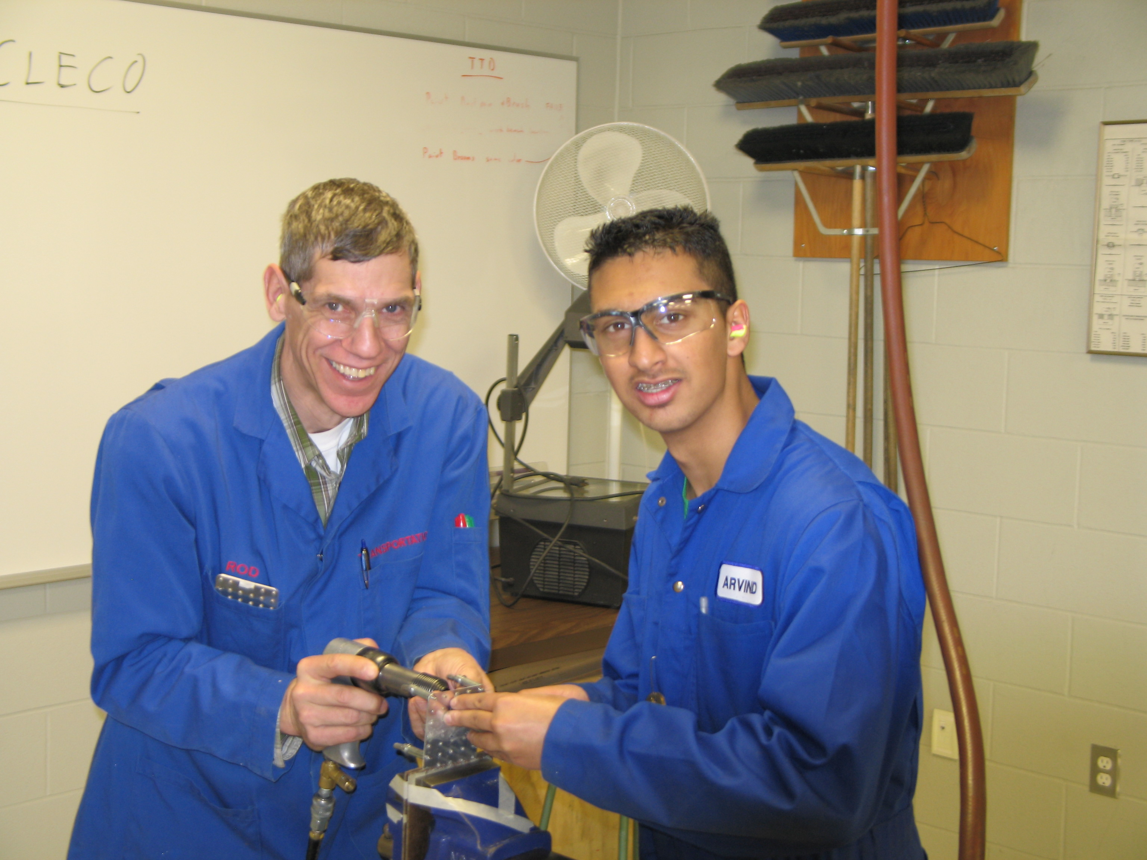
Stimulating a person’s curiosity and feeding their desire to know the why and how is a better motivator than you-need-to-know-this-because-it-is-on-the-exam fear of failure. A career in aviation is a lifelong learning process, and college is only the beginning. This is why helping a student learn how to learn is so important.
—Rod Deneve, Southern Alberta Institute of Technology

Slide 38
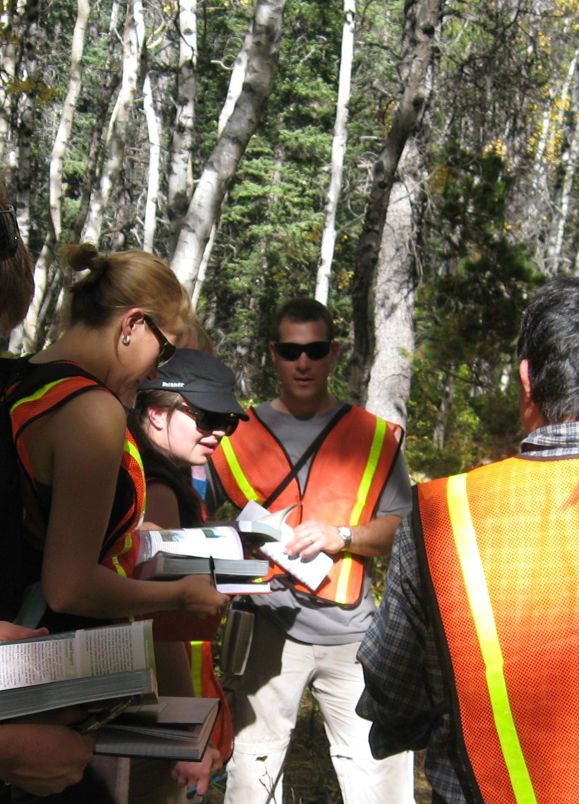
I learned early on to respect students, have high expectations, facilitate learning by helping them apply their knowledge, and never lecture for more than 20 minutes.
—Colin Pattison, Southern Alberta Institute of Technology

Slide 39
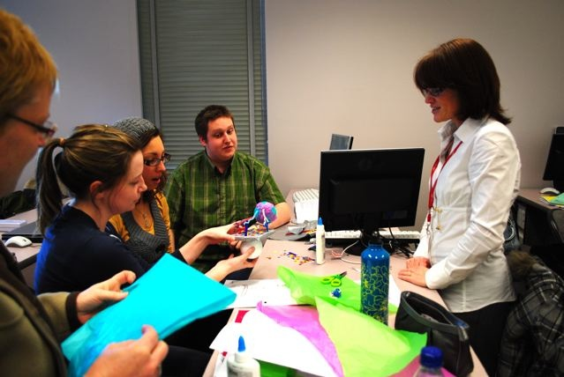
The Proster Theory definition of learning is the extraction, from confusion, of meaningful patterns. That is really my goal, to ensure that the students are exposed to material in such ways that they can find patterns within the material and, together with information they may already know or with experiences that they have had, begin to really learn!
—Donnell Wolff, Southern Alberta Institute of Technology

Slide 40
My greatest hope is to foster a love of learning mathematics in students at all levels by giving them numerous opportunities to do mathematics. I respect students as individuals with varying goals, abilities, and learning styles and consider myself a partner in the pursuit of their goals.
—Florence Chambers, Southern Maine Community College

Slide 41
Learning inspires me. Presenting information in a fun and unique way is a challenge—and I really enjoy preparing for class. I am motivated by new technologies and methodology that focuses on student learning. My success is driven by the students who really grasp the concepts.
—Rachel Guthrie, Southern Maine Community College

Slide 42
A teacher’s success is measured by his/her students’ successes. Credentials do not make teachers; students do.
—Loretta Beavers, Southwest Virginia Community College

Slide 43
I have the privilege of making a difference in people’s lives. For many, they are the first generation in their family to attend college. Students are diverse in background and have opportunities to better their lives by what they accomplish here. It is very rewarding to be a part of that.
—Alice Brown, Southwest Virginia Community College

Slide 44
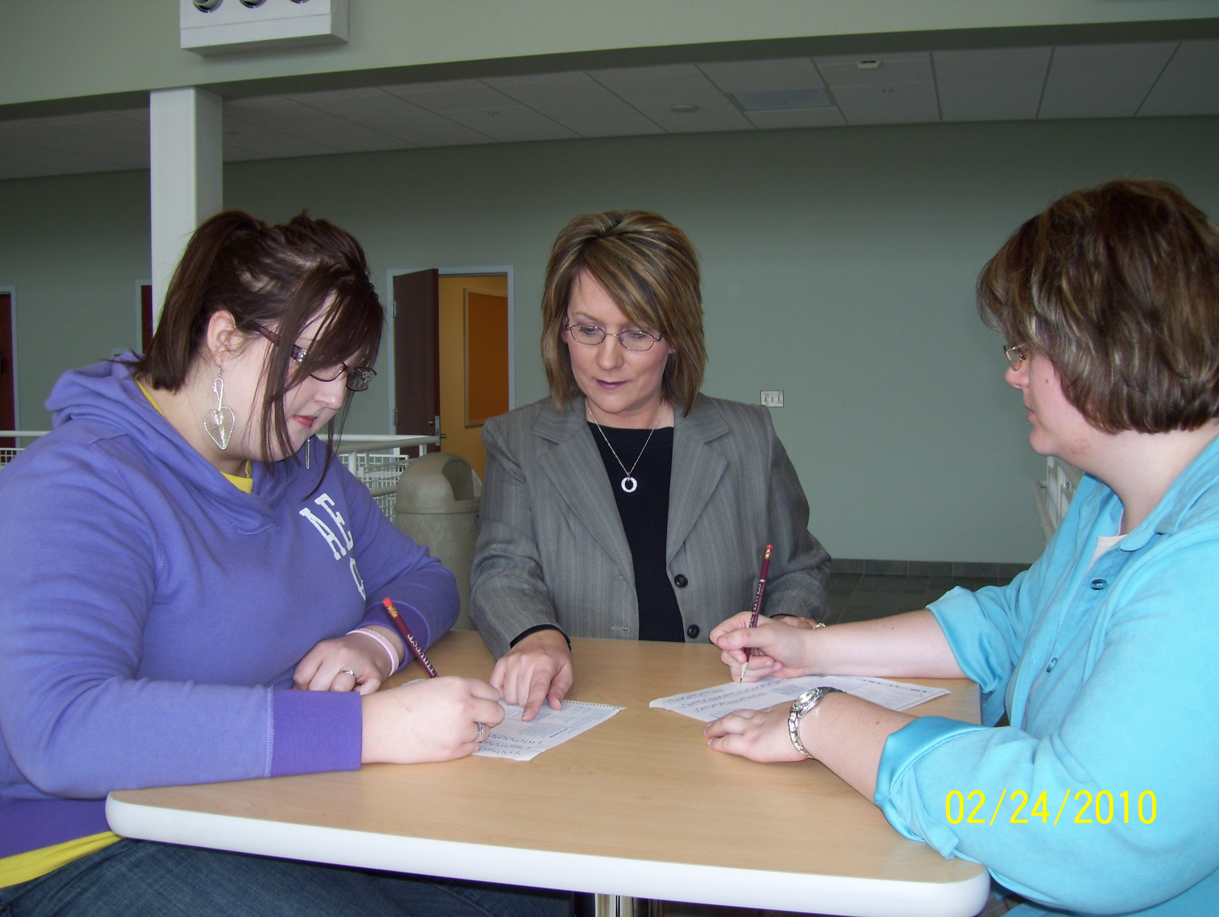
My inspiration comes from visits or calls from students thanking me for my time and efforts. Their desire to update me with their successes makes me realize that maybe I did make a difference in their lives. To be able to engage and connect with students is what puts true meaning into education!
—Dionne Cook, Southwest Virginia Community College

Slide 45
Assisting students with disabilities has been humbling and rewarding. Learning should challenge the mind and the spirit. Only when our students have achieved success have we earned the title of teacher.
—Stephanie Davis, Southwest Virginia Community College

Slide 46
Teaching is a passion. Every student must be personally engaged in the process. Students must be challenged in all aspects of their chosen profession; not limited to “nut and bolts” of trade, but peer and surrounding relationships. Each person teaches one’s self, which requires a personal commitment. Being the teacher is actually being a motivator and problem solver.
—Larry Hughes, Southwest Virginia Community College

Slide 47
A little levity in the classroom opens the door to academic endeavors; it then becomes my job to usher students in.
—Tom King, Southwest Virginia Community College

Slide 48
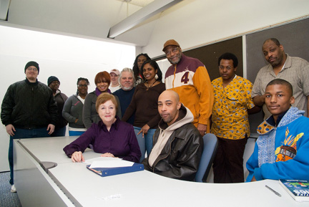
They are Tim, Marilyn, Walter, Binky—students waiting to open the door into their own imaginations, waiting to turn ideas into the written word. When they move on, sometimes to become English teachers themselves, I hurry back into the classroom hopeful there will be more of them, waiting to inspire me to teach.
—Karen Malouf-Ostlund, St. Louis Community College (MO)

Slide 49
I see myself as a guide dog, helping first-generation college students find their way in the world through education.
—Ellen McCloskey, St. Louis Community College (MO)

Slide 50
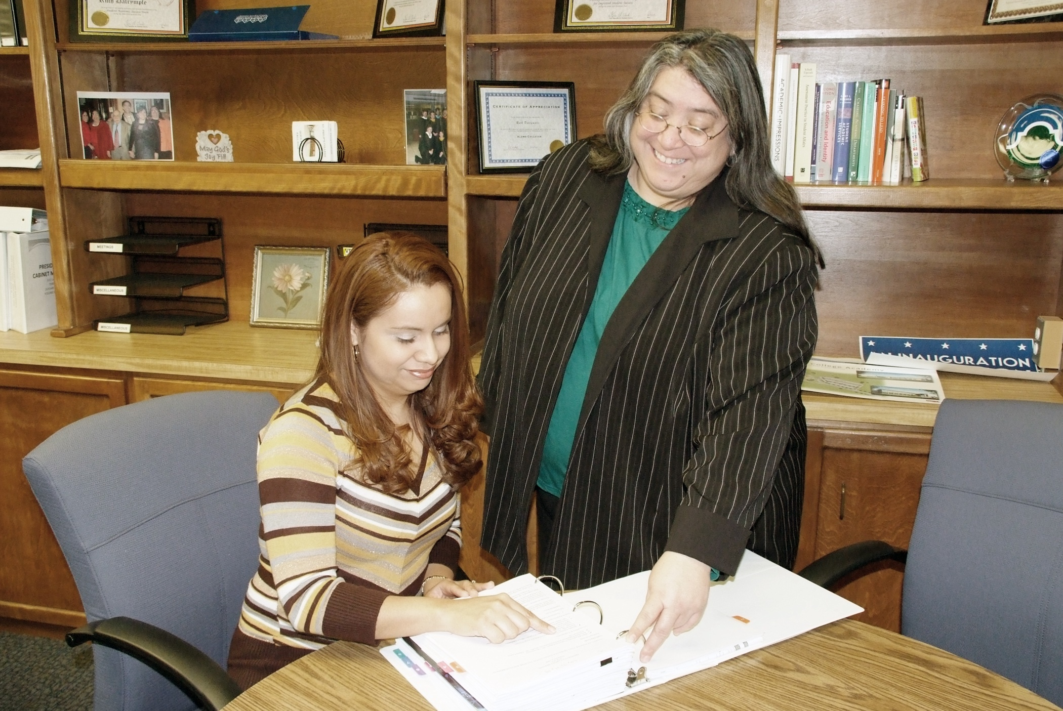
I try to take to heart the idea that the stresses of my day do not need to become someone else’s.
—Ruth Dalrymple, St. Philip's College (TX)

Slide 51
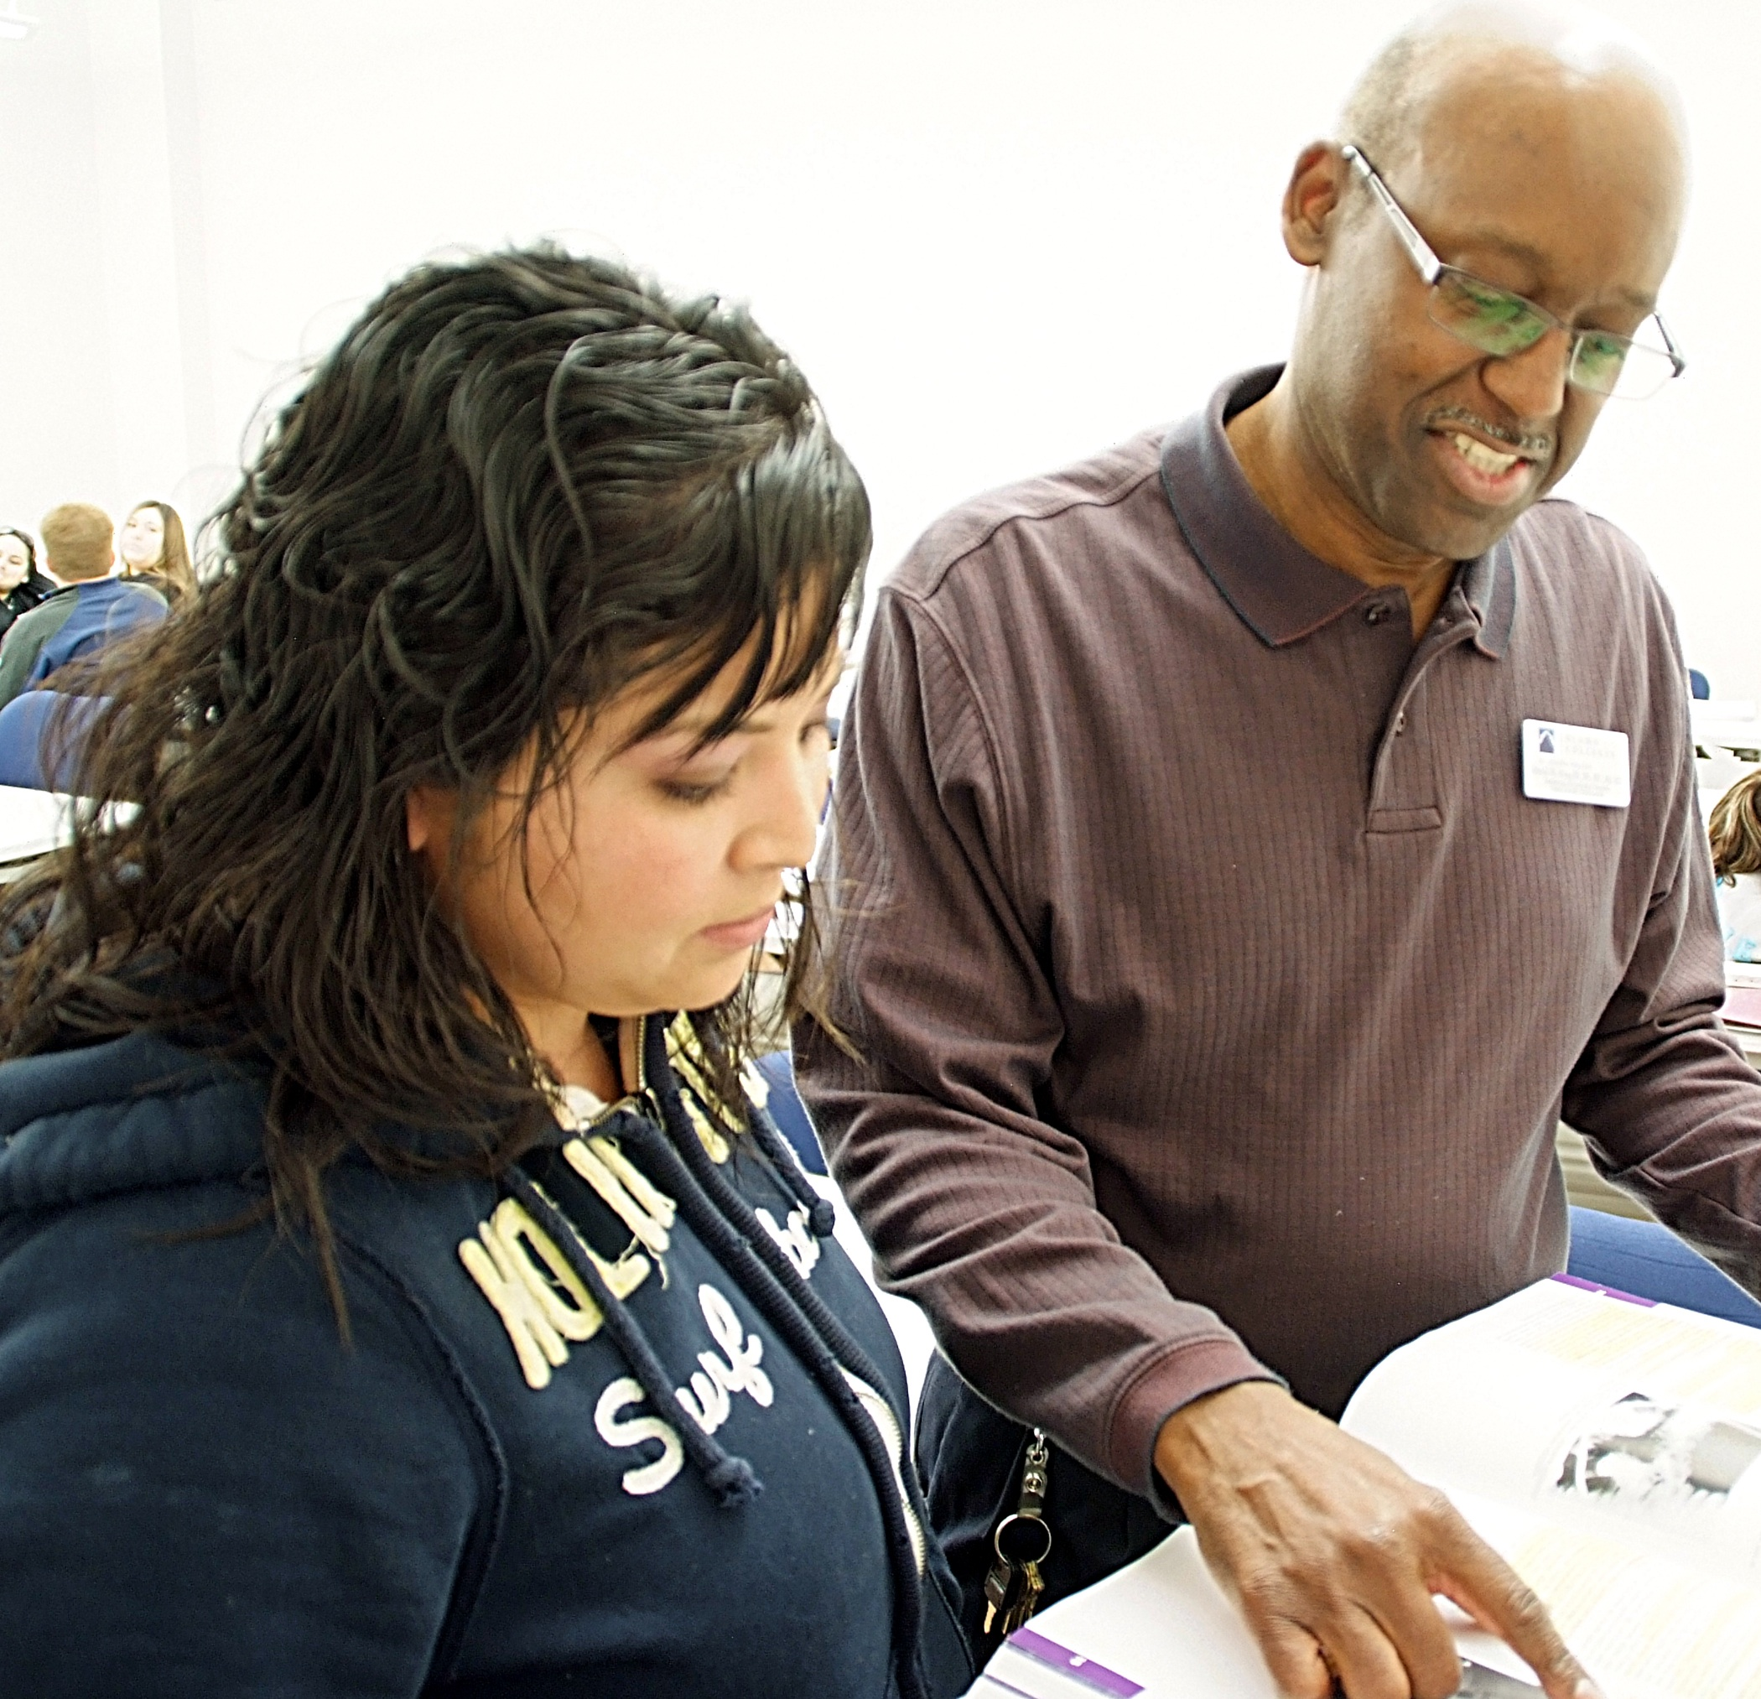
Teachers should employ education, knowledge, work experience, and enthusiasm for teaching to inspire and motivate their students to develop a hunger for learning and acquire the wisdom, knowledge, and understanding needed to master the course material presented during class sessions.
—David King III, St. Philip's College (TX)

Slide 52
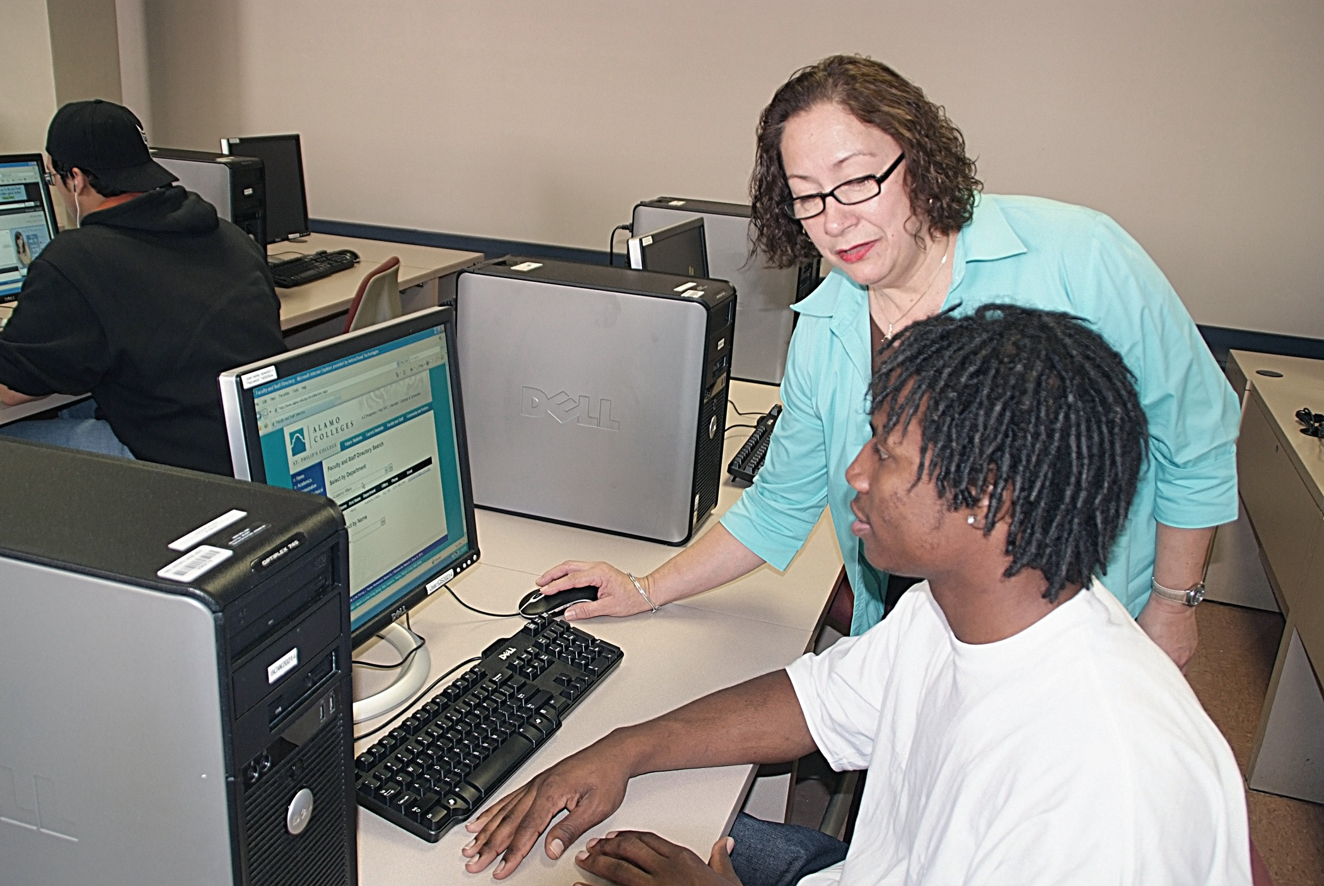
Advising is my passion because as a former student at St. Philip’s College the faculty and staff made a great impact in my life. Today, I take time with each student, be attentive, patient, and a good listener. I pray that my efforts help my students excel in their educational pursuits and assist them in achieving their education regardless of the obstacles that could hinder them from successfully graduating and continuing with their education and careers.
—Sylvia Vargas-Esquivel, St. Philip's College (TX)

Slide 53
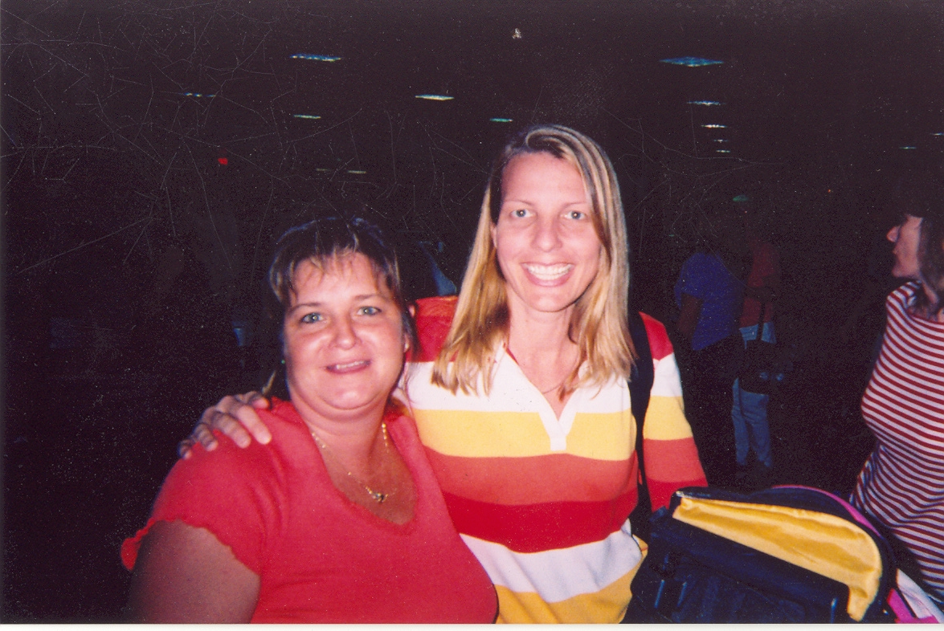
Opportunity inspires me!!! Lives are changed everyday from the opportunity that the attainment of higher education affords. I enjoy teaching and mentoring students. I love the idea that adults can recreate themselves and pursue a field for which they are passionate.
—Sheri Chejlyk, State College of Florida, Manatee-Sarasota

Slide 54
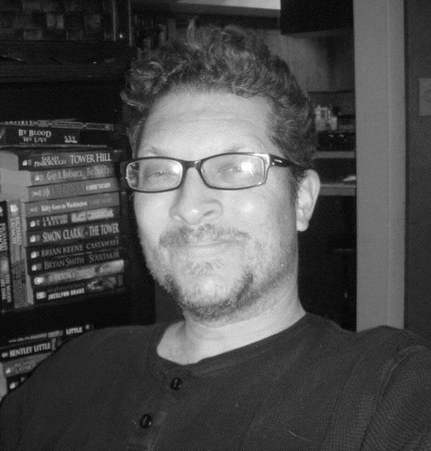
My father taught mathematics, and I remember how he seemed to infect students with his own enthusiasm for numbers and equations. For him, these numbers and equations amounted to stories that he would tell them on a daily basis. Ironically, I developed my passion for English by watching him transform mathematics into a narrative that captured his students’ imaginations.
—Douglas Ford, State College of Florida, Manatee-Sarasota

