Slide 1
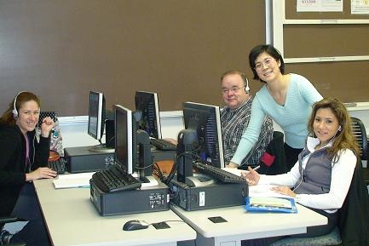
Everyone is born to learn, and learning is a life-long journey. When a person is motivated and has mastered some basic learning skills, including critical thinking, reading and writing skills, he/she can learn. As an instructor, my job is to motivate students and teach them all these learning skills.
—Jianyu Zheng, Naugatuck Valley Community College (CT)

Slide 2
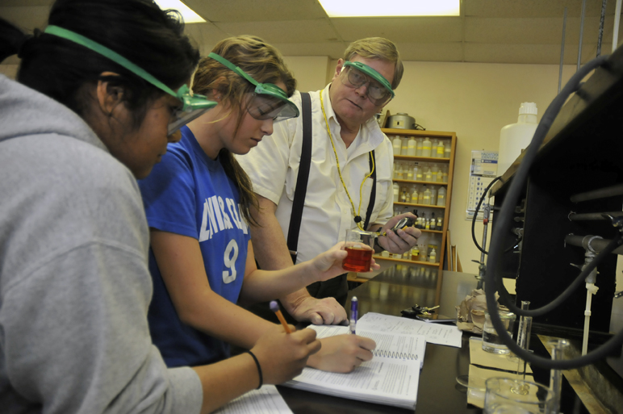
As my demonstration cart rolls into their classroom, my chemistry students wonder “what will see today?” They observe chemicals changing color, exploding, or catching fire, and they are entertained. In that “teachable moment,” education meets entertainment. It’s a great way to get students involved. It’s fun for me, too!
—Tom Hammargren, Navarro College (TX)

Slide 3
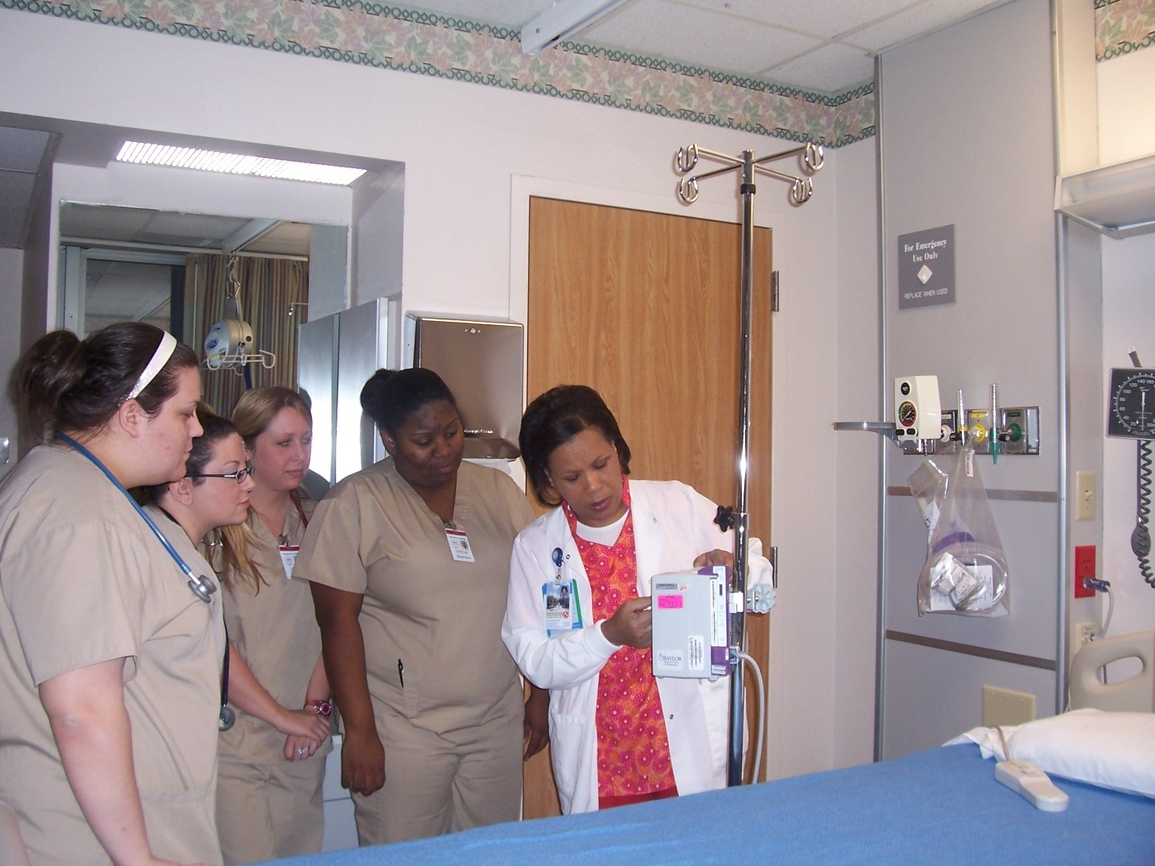
A former nursing student's thank-you card, given to me at his graduation, is what has kept me inspired and has kept me teaching nursing students. I keep my students' cards and notes to remind me of my contribution to my students, and to the nursing profession.
—Delores Price, Navarro College (TX)

Slide 4
Mathematics has a bad rep, it needs to be taken off the ivory tower of academia and put back in the toy box. Mathematics should be fun, humorous, and invigorating. It’s not an impersonal discipline. Laughing, talking, listening to peers explain how they see the problem, that’s “doing the math.”
—Shyla McGill, New Mexico Junior College

Slide 5
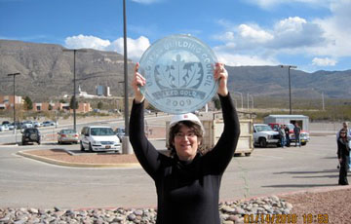
It is a wonderful feeling to wake up every day and be excited about going to work. I have always said I have the best job on campus. I get to participate in solving the smallest of problems to participating in the planning, designing, and construction of major projects. It is forever changing, forever challenging, and forever satisfying.
—Nancy Montgomery, New Mexico State University–Alamogordo

Slide 6
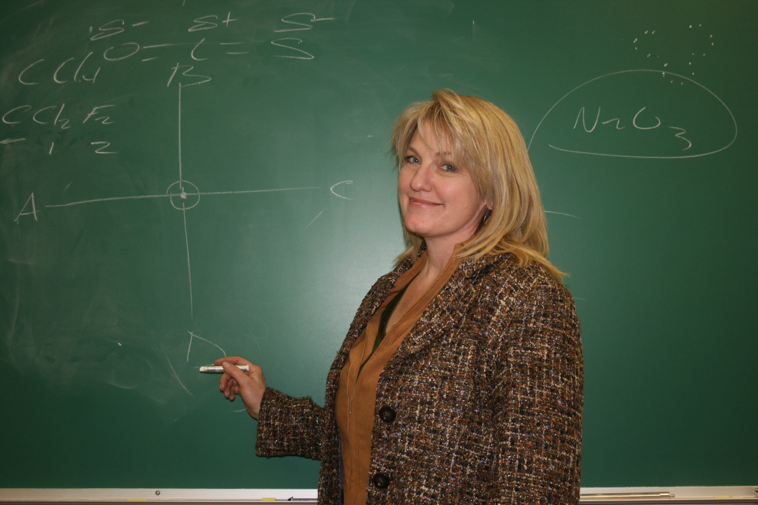
When I see a student at the store and she gives me the sister chromatid hand signal she learned in class two years earlier, it inspires me—I know I have helped someone enjoy learning about science.
—Jennifer Smith, New Mexico State University-Alamogordo

Slide 7
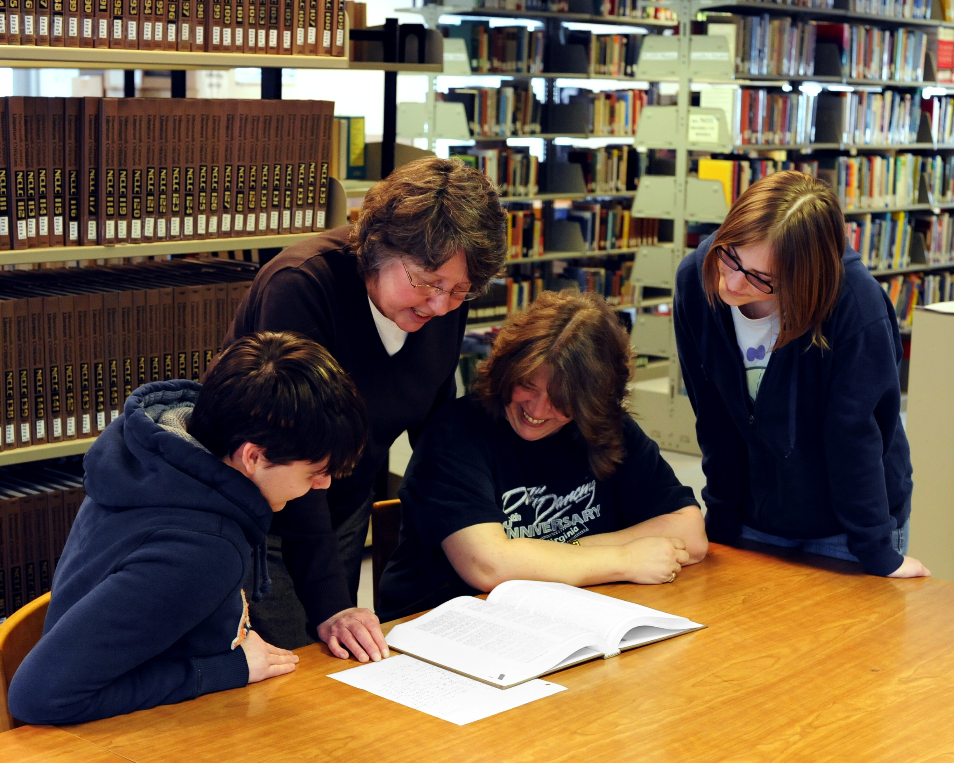
I am inspired by watching students engage in introspection, gain self-awareness, grow in self-knowledge. After one especially meaningful class discussion, a student declared, "It's just like being in church but without the guilt and the collection plate."
—Judith Stennett, New River Community and Technical College (WV)

Slide 8
In my more than 30 years of teaching, I have tried many strategies that "guaranteed" student engagement. The only no-fail one I have found is letting students know how much I care about their success.
—Wilma Finney, North Arkansas College

Slide 9
My favorite time each year is our graduation finale when faculty members form a walk-through. As graduates walk through the line to the applause of their instructors, the smiles on their faces reflecting the pride in our hearts are priceless!
—Paula Melton, North Arkansas College

Slide 10
I do not believe that people are born to be teachers; we educators learn many of the skills of teaching by trial and error. For me, teaching is the essential work of helping students grasp new sociological ideas and guiding them towards an understanding of how these new ideas can translate into careers such as nurses and police officers.
—Linda Ostrand, North Hennepin Community College (MN)

Slide 11
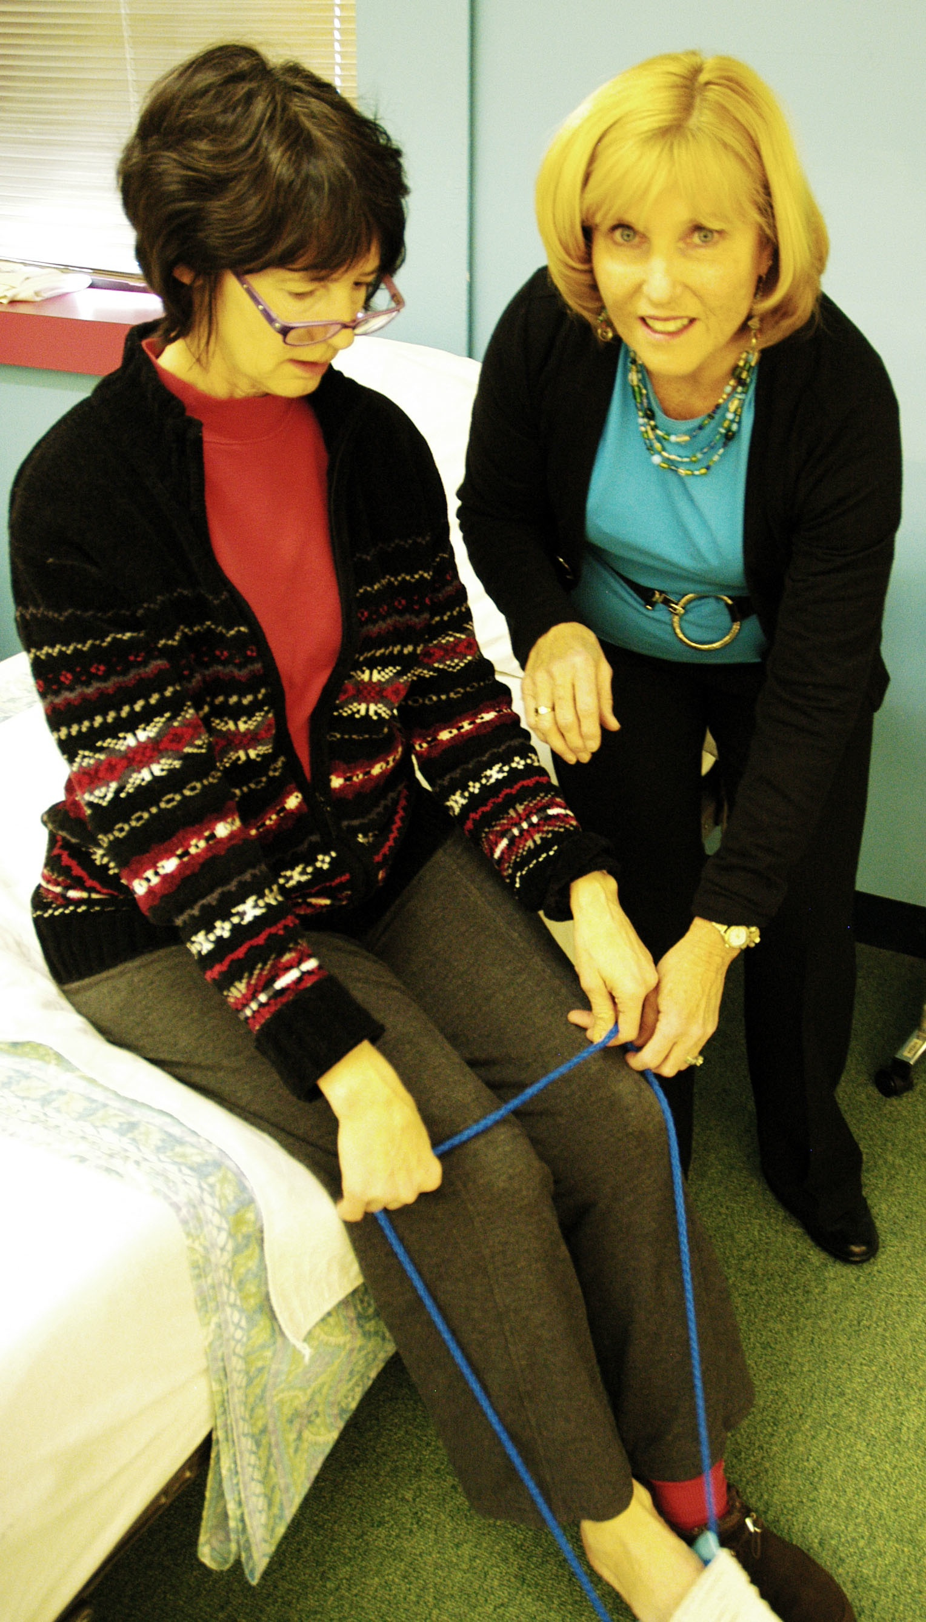
I begin semesters with keen awareness of an enormous responsibility but privileged with the amazing opportunity to have a positive impact on both students and the clients they will serve as occupational therapy practitioners. Semesters end with pride and accomplishment as students and teacher together demonstrate personal and professional growth. —Ruth DeLisio, North Shore Community College (MA)

Slide 12
It may sound a bit cliché, but my excitement and motivation for teaching comes directly from my students. Witnessing those “ah-ha” moments, watching as students make connections from theory to practice, and instilling a zest for lifelong learning are what keep me coming back for more! —Kathryn Gallo, North Shore Community College (MA)

Slide 13
I have long felt the goal of education should be to build the desire and ability to embrace life-long learning. A successful education should allow people to continuously exercise their curiosity about all the things that surround us and the plethora of ideas that attack our brain. —James Robinson, North Shore Community College (MA)

Slide 14
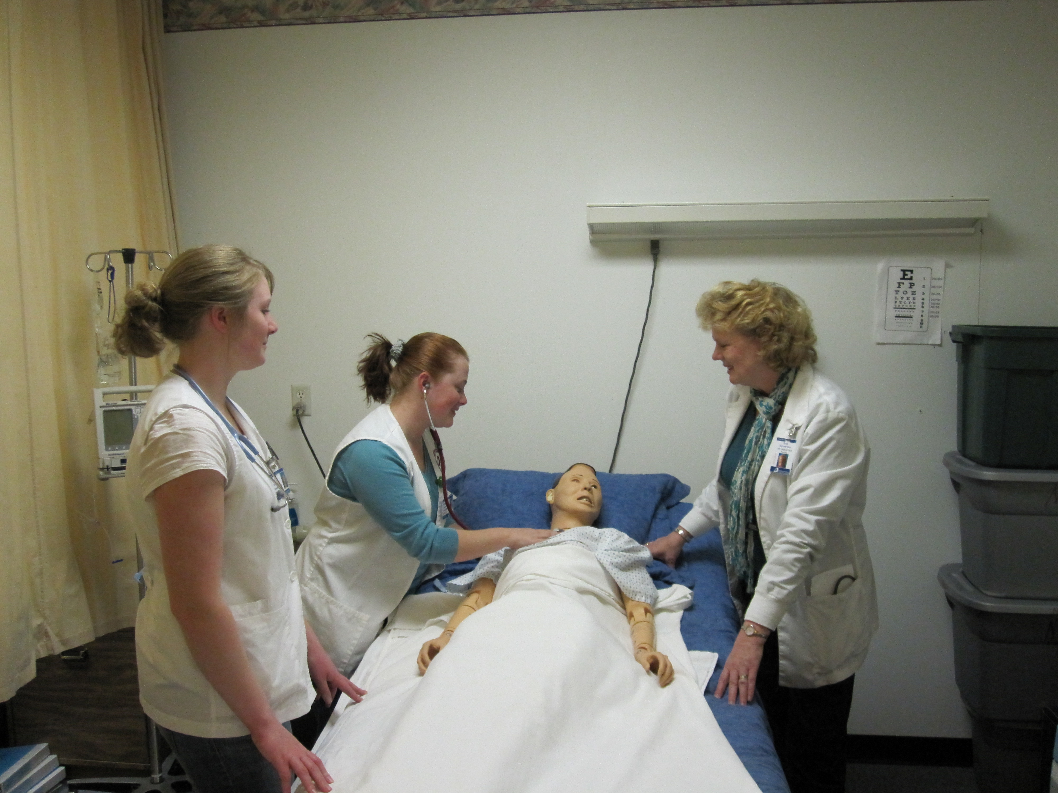
I am inspired by my students who are achieving their goal of becoming the best nurses they can be. I see them transforming from beginning students into confident professionals. I strive to make their classroom and clinical experiences interesting and challenging so they are inspired and prepared to touch lives and care for generations of people who need them.
—Susan Schneider, Northeast Iowa Community College

Slide 15
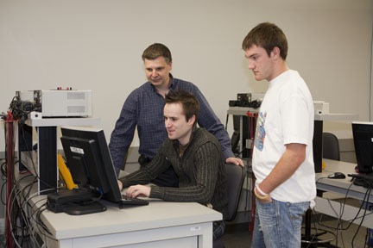
Encouraging cooperation among students is vital to student success. I strive to create a classroom environment conducive to the learning process. By laying down simple ground rules which ask for respect and tolerance, I create an atmosphere where students are able to share their knowledge and skills freely with their classmates.
—Aaron Boser, Northern Alberta Institute of Technology

Slide 16
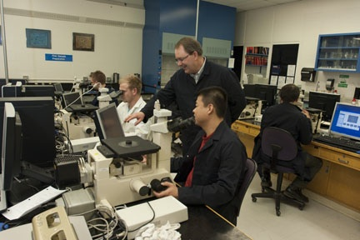
As an instructor, I have the privilege and the opportunity to encourage student learning and growth, inspire student success, and further my own knowledge each day. What a truly rewarding career!
—Andrew Brown, Northern Alberta Institute of Technology

Slide 17
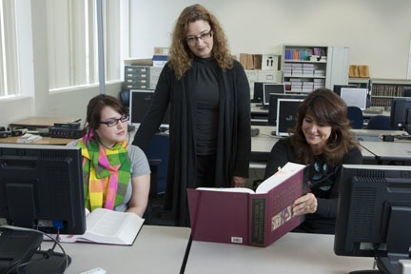
My instructional philosophy includes maintaining open lines of communication, delivering continuous encouragement, and providing support and frequent feedback. My students’ outstanding work ethics, diverse talents, sharing of knowledge, and mutual support are my daily inspiration to achieve and maintain a personal level of excellence.
—Loralie Euverman, Northern Alberta Institute of Technology

Slide 18
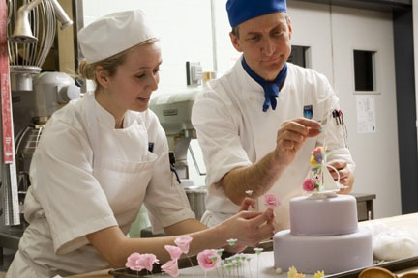
My students and I enjoy a professional working relationship, but we also have fun and enjoy the camaraderie and friendship. In the bakery lab where we work as a team, I encourage cooperative learning. In theory class, I pair students who need additional assistance with those who excel, to the benefit of both.
—Clayton Folkers, Northern Alberta Institute of Technology

Slide 19
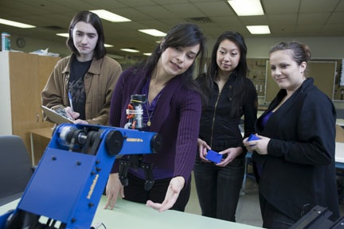
Knowing that my classroom performance plants the seeds of knowledge and new experiences gives me great satisfaction. Being a part of a student’s journey to success is my everyday inspiration.
—Daniela Ivkovic, Northern Alberta Institute of Technology

Slide 20
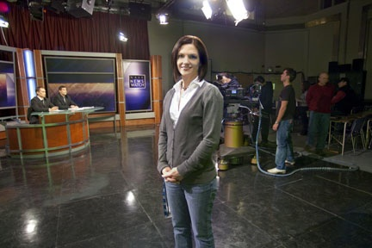
My students give me an incredible gift each semester—the gift of trust that I will equip them with the skills and the knowledge needed to embark on their careers.
—Jeannette LaBrie-Cable, Northern Alberta Institute of Technology

Slide 21
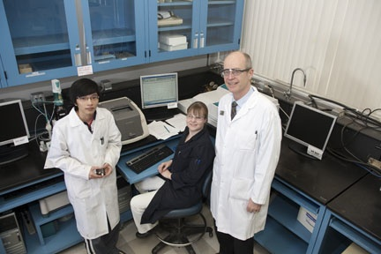
Students treated with respect enjoy being in class. Students who enjoy being in class, learn more.
—Chris Meintzer, Northern Alberta Institute of Technology

Slide 22
Passion is the fuel of heartfelt teaching and true learning. My students are passionate to be on the path out of poverty and into a life of fulfillment. Passion is contagious!
—Jane Thiefels, Northern Essex Community College (MA)

Slide 23
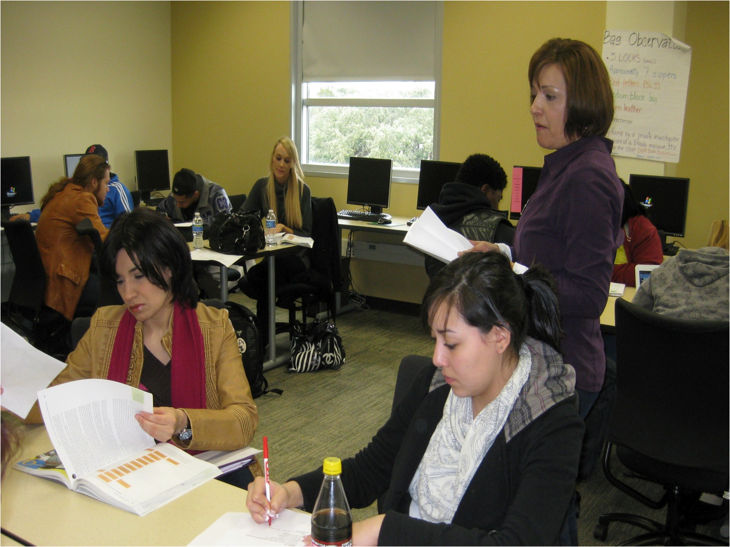
Working with students as an educator, I have grown along with them. They share their knowledge and experience with me, and I teach them in ways they want to learn.
—Elsa O’Campo, Northwest Vista College (TX)

Slide 24
Teaching is helping your students realize how much power they really possess—artistic, political, financial, and mental. In the end, you have helped them find the freedom to create, invent, solve, imagine, remember, and forget without you, all on their own.
—Refugio "Ito" Romo, Northwest Vista College (TX)

Slide 25
What motivates my teaching is a fundamental fascination with the universe. Everywhere I look, especially where life is involved, there is layer after layer of sense and intricacy and interplay. Teaching gives me a chance to continue to learn and to share the process of learning. How cool is that!
—Courtney Dodd, Oklahoma City Community College

Slide 26
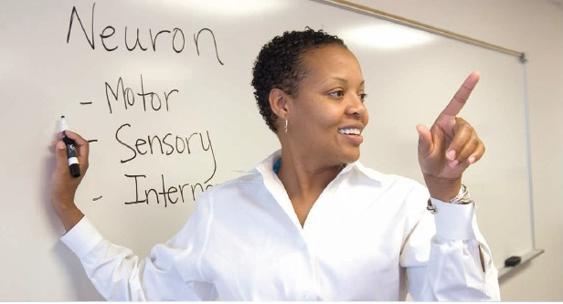
We are role models, we are cheerleaders, and we set the stage for our students to believe in themselves.
—Stephanie Hayes, Oklahoma City Community College

Slide 27
To learn and never be filled is wisdom. To teach and never be weary is love.
—Dan Johnson, Oklahoma State University–Oklahoma City

Slide 28
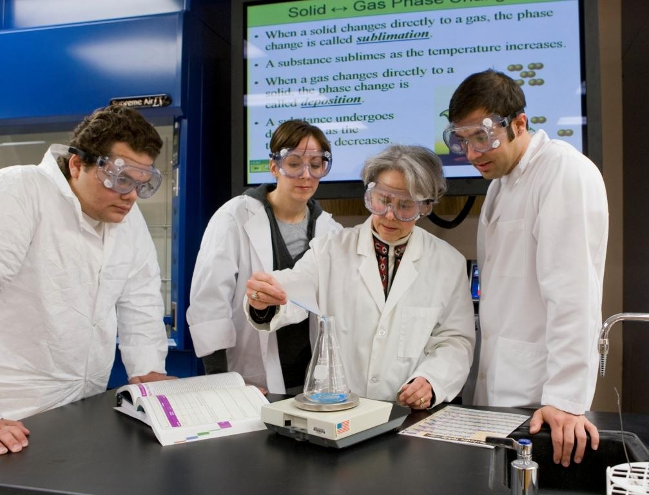
Each student comes into my classroom with a different educational goal and level of knowledge. My goal is not only to impart the knowledge they need to succeed, but also give them confidence in themselves as students and their educational pursuits.
—Becky Osmond, Oklahoma State University–Oklahoma City

Slide 29
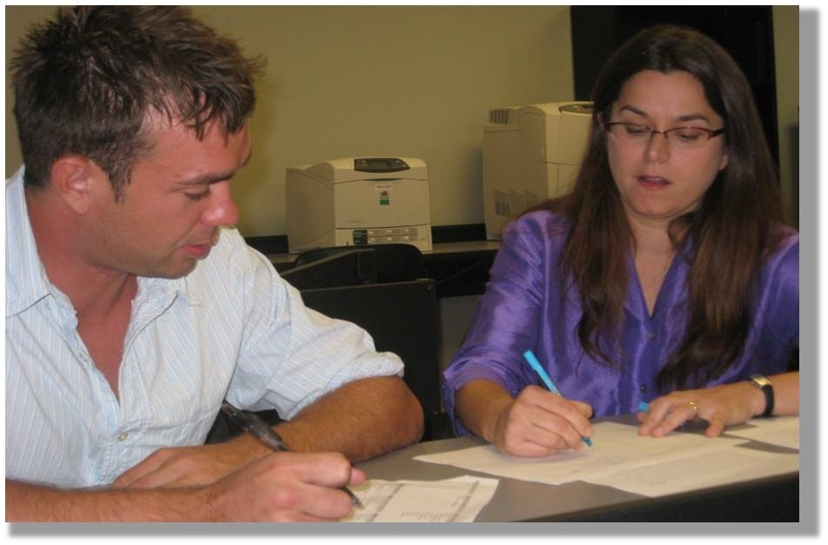
Create an environment where students make contributions, where classrooms become communities, where students share in exploration and inquiry.
—Barrie Talbott, Ozarks Technical Community College (MO)

Slide 30
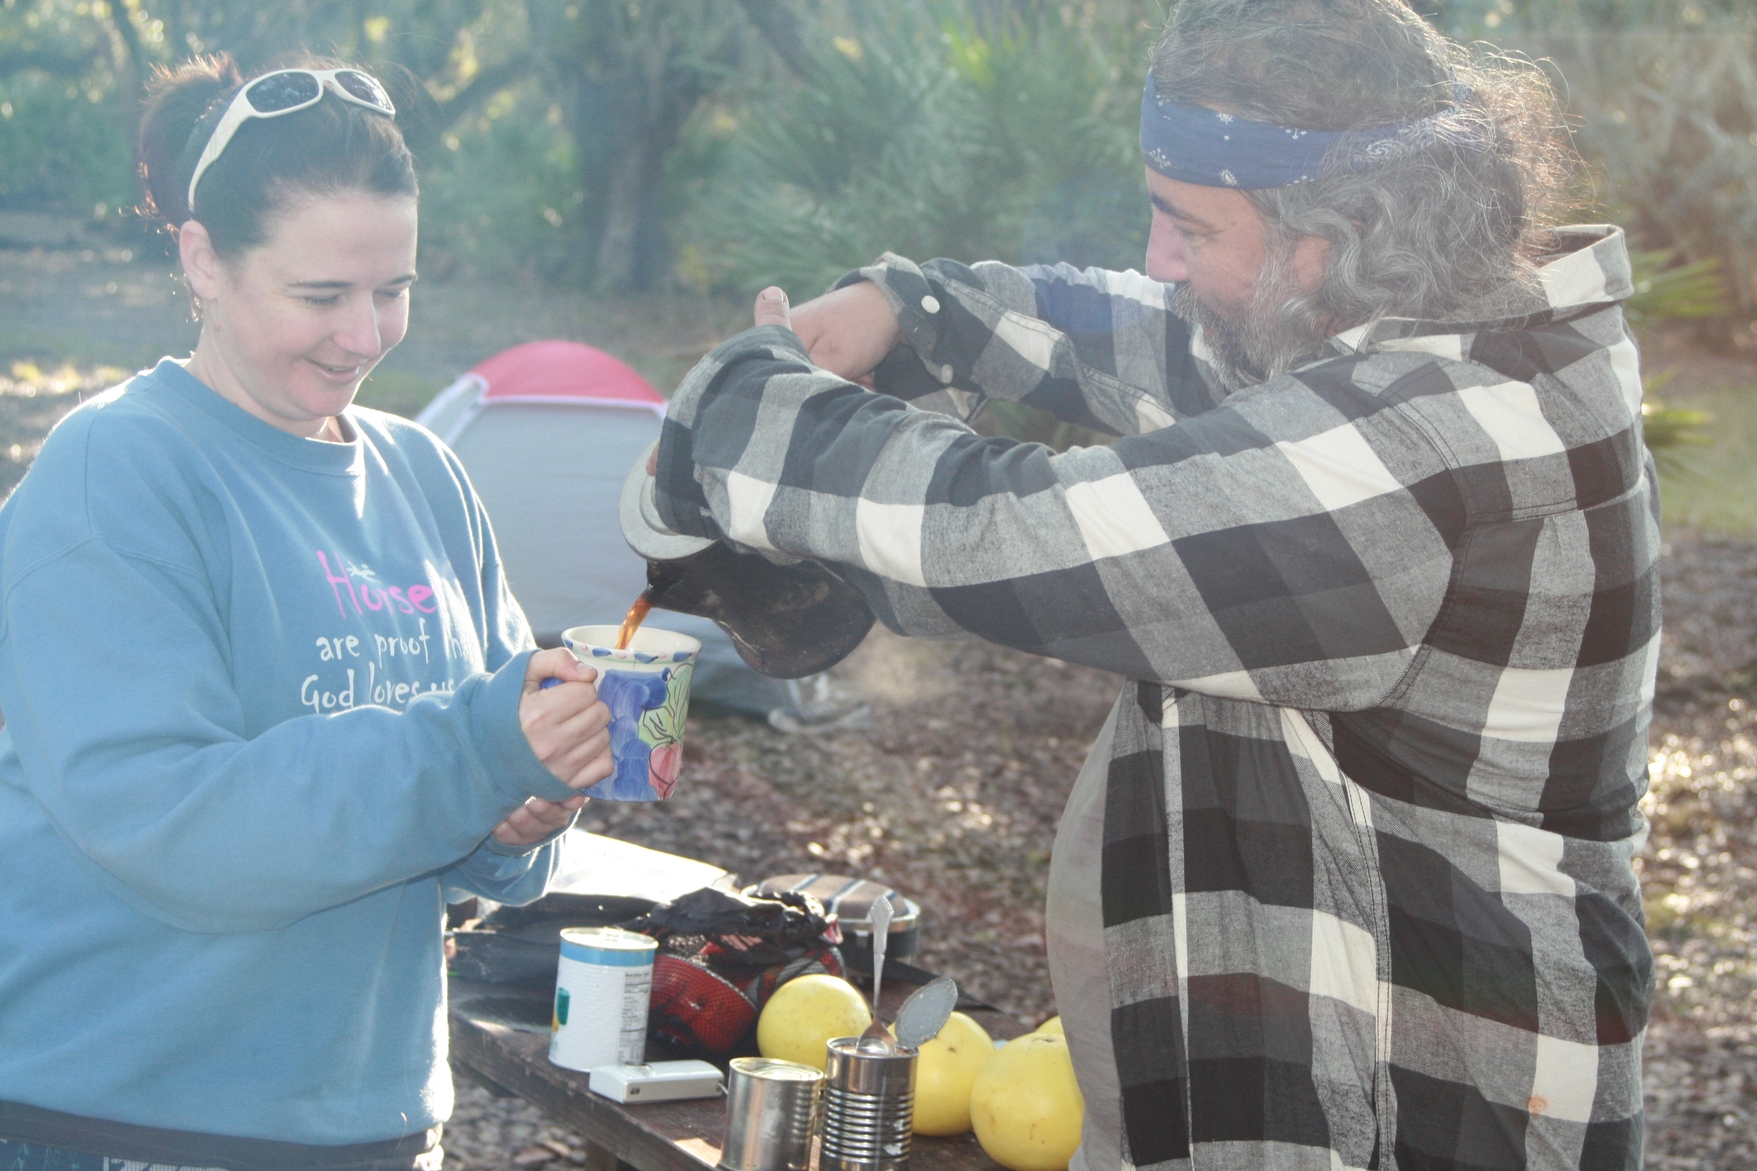
Popeye said, "I am what I am, and that's all that I am." Be real with your students, practice what you preach to them, and earn their respect by showing them that you live and love the subject that you teach.
—Steve Brahlek, Palm Beach Community College (FL)

Slide 31
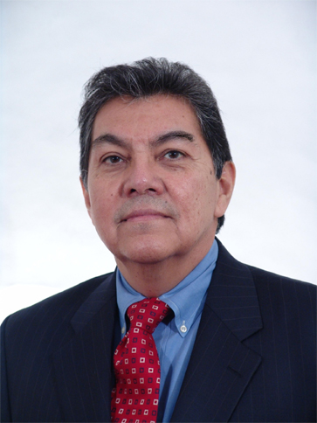
Teaching is both a calling and an art that readily assumes the giver in the position of the doer, directing, staging, and transforming responses into that grand dialectics called learning. I enjoy watching students make connections to everyday life when they read literature and respond to poetry, especially when we link Sophocles’ Antigone to the misogynistic rhythms of rapper Eminem. Or when students probe deeply into the metaphoric power of Edna St. Vincent Millay or analyze subterranean literary allusions in Gabriel Garcia Marquez or Junot Diaz.
—Rafael Castillo, Palo Alto College (TX)

Slide 32
Every semester, every class, I try to meet students where they are—disciplined, confused, lazy, eager, technologically inclined or not. Wherever they are is where we go as a class to learn. I am fortunate to draw from the world’s menu of media and embark on web or video excursions on a whim or at a student’s suggestion.
—Gregory Pasztor, Palo Alto College (TX)

Slide 33
Nothing is more inspiring than to see a student grasp the concept of whatever they undertake. When that task is unknown and within a few tries can be done with ease, it is much like how a flower starts as a tiny bud and grows into a beautiful flower.
—Linda Vickery, Panola College (TX)

Slide 34
Teaching in surgical technology is unique in that I see the education process in the classroom but I also see students realize their dreams and better their lives with an exciting new career as they develop from novice practitioners in surgery to working independently. I’m grateful to share their proudest moments!
—Carolyn Ragsdale, Parkland College (IL)

Slide 35
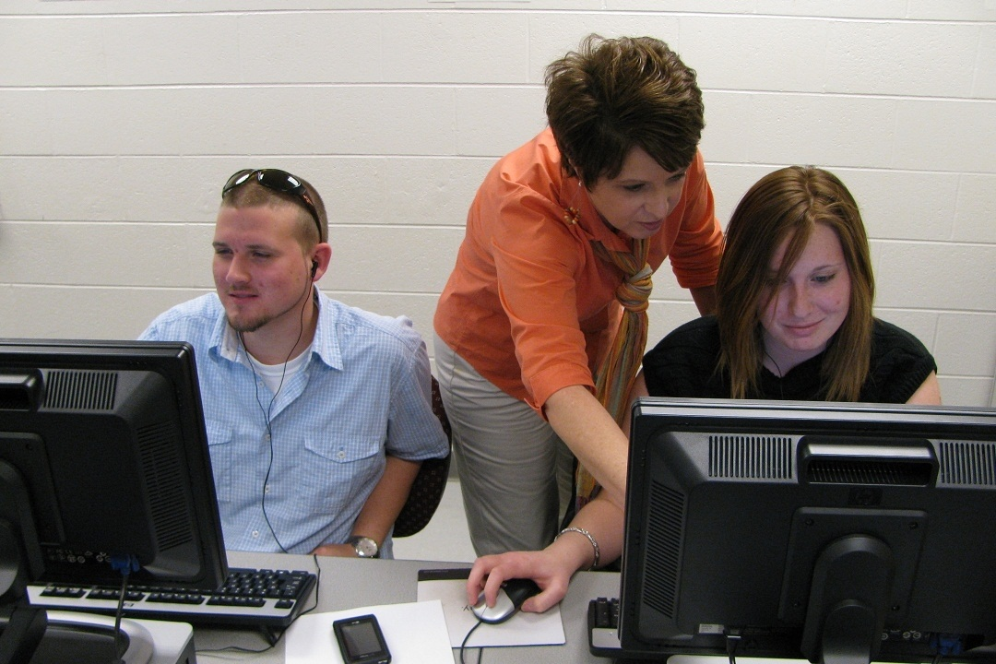
Communication yields success. When we consistently communicate with students, we forge relationships and those relationships yield success.
—Renee Felts, Paul D. Camp Community College (VA)

Slide 36
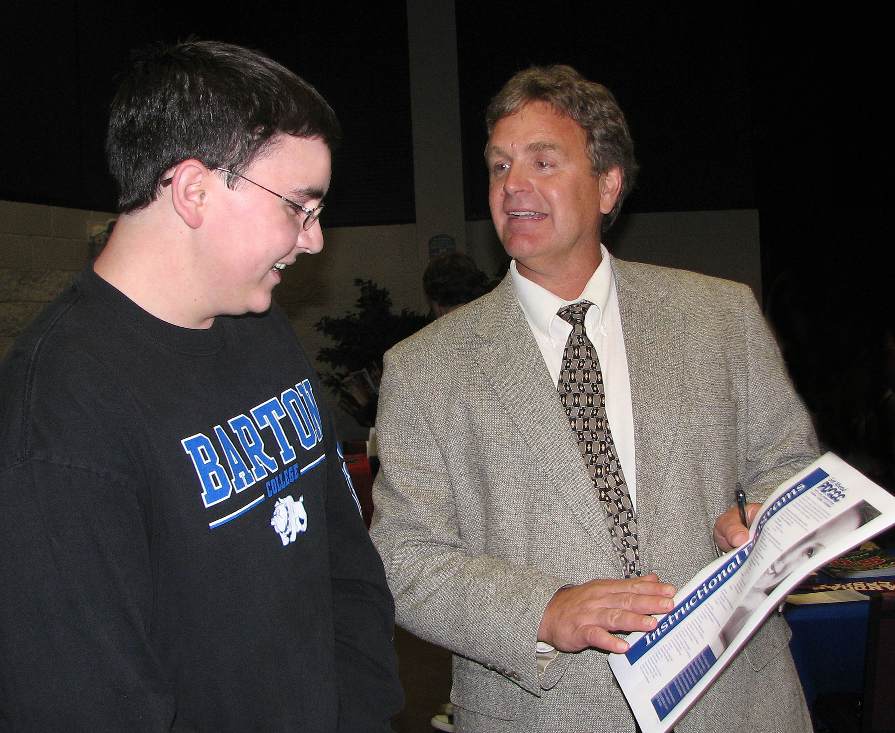
You must first capture their attention because students often arrive with the expectation of boredom. Look for ways to engage them. My favorite strategy is having students present information in front of class because this challenges them to do their best and they enjoy learning from their peers.
—Alan Harris, Paul D. Camp Community College (VA)

Slide 37
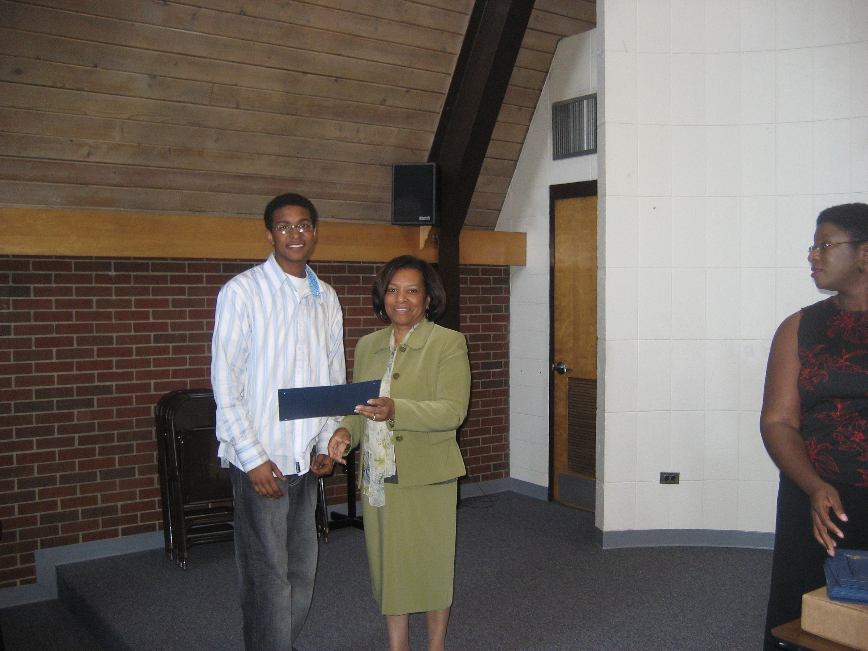
As an educator I am inspired by my students’ accomplishment—seeing a smile, hearing a sigh of relief, realizing that achievement is possible, and attaining a goal! Their achievements are my inspiration.
—Rosalyn Tillman, Pellissippi State Community College (TN)

Slide 38
To teach is to learn, and to learn is to teach. As long as I teach, I will always be a student. I employ all resources available to me to promote understanding and lifelong learning. Connecting concepts to familiar objects and being mobile enhances learning/understanding and help students focus.
—Caroll Hobbs, Pensacola Junior College (FL)

Slide 39
After more than 30 years of teaching at the college level, I have learned more from the students than they have learned from me. A formal education should be an exchange of ideas. Learning is a two-way process.
—Bobby Roberson, Pensacola Junior College (FL)

Slide 40
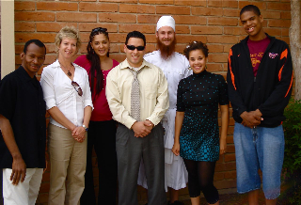
Teaching and I once personified a May-December romance. I, naive and willing, was swept away by its historical significance, its well-seasoned charms. Two decades later, we now dance well together. I still frequently defer to its power, but my students may say I have taught it something small in return.
—Liz O'Brien, Phoenix College (AZ)

Slide 41
Community and teamwork doesn't just happen by breathing the same air and standing on the same carpet as your co-workers. It happens by making friends, with conversation and communication, by helping someone out when they ask, even when your plate might already be full.
—Brian Martin, Pierce College District (WA)

Slide 42
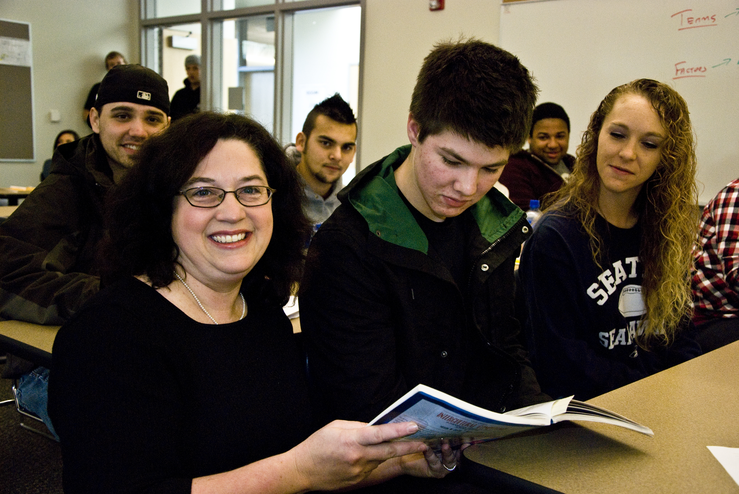
Students are passionate about what interests them. Engaging that passion means applying classroom theory to real-life issues. Our interpersonal communication unit became fascinating to the young men in class once they learned how video gaming was affecting their abilities to establish quality relationships with others in daily life.
—Nikki Poppen-Eagan, Pierce College District (WA)

Slide 43
Teaching to me is more than my vocation, it's truly my avocation. I strive to inspire my students to look within their hearts and find a career path for which they are passionate. And my students know I walk the walk, for teaching at a community college is my passion.
—Donald King, Pitt Community College (NC)

Slide 44
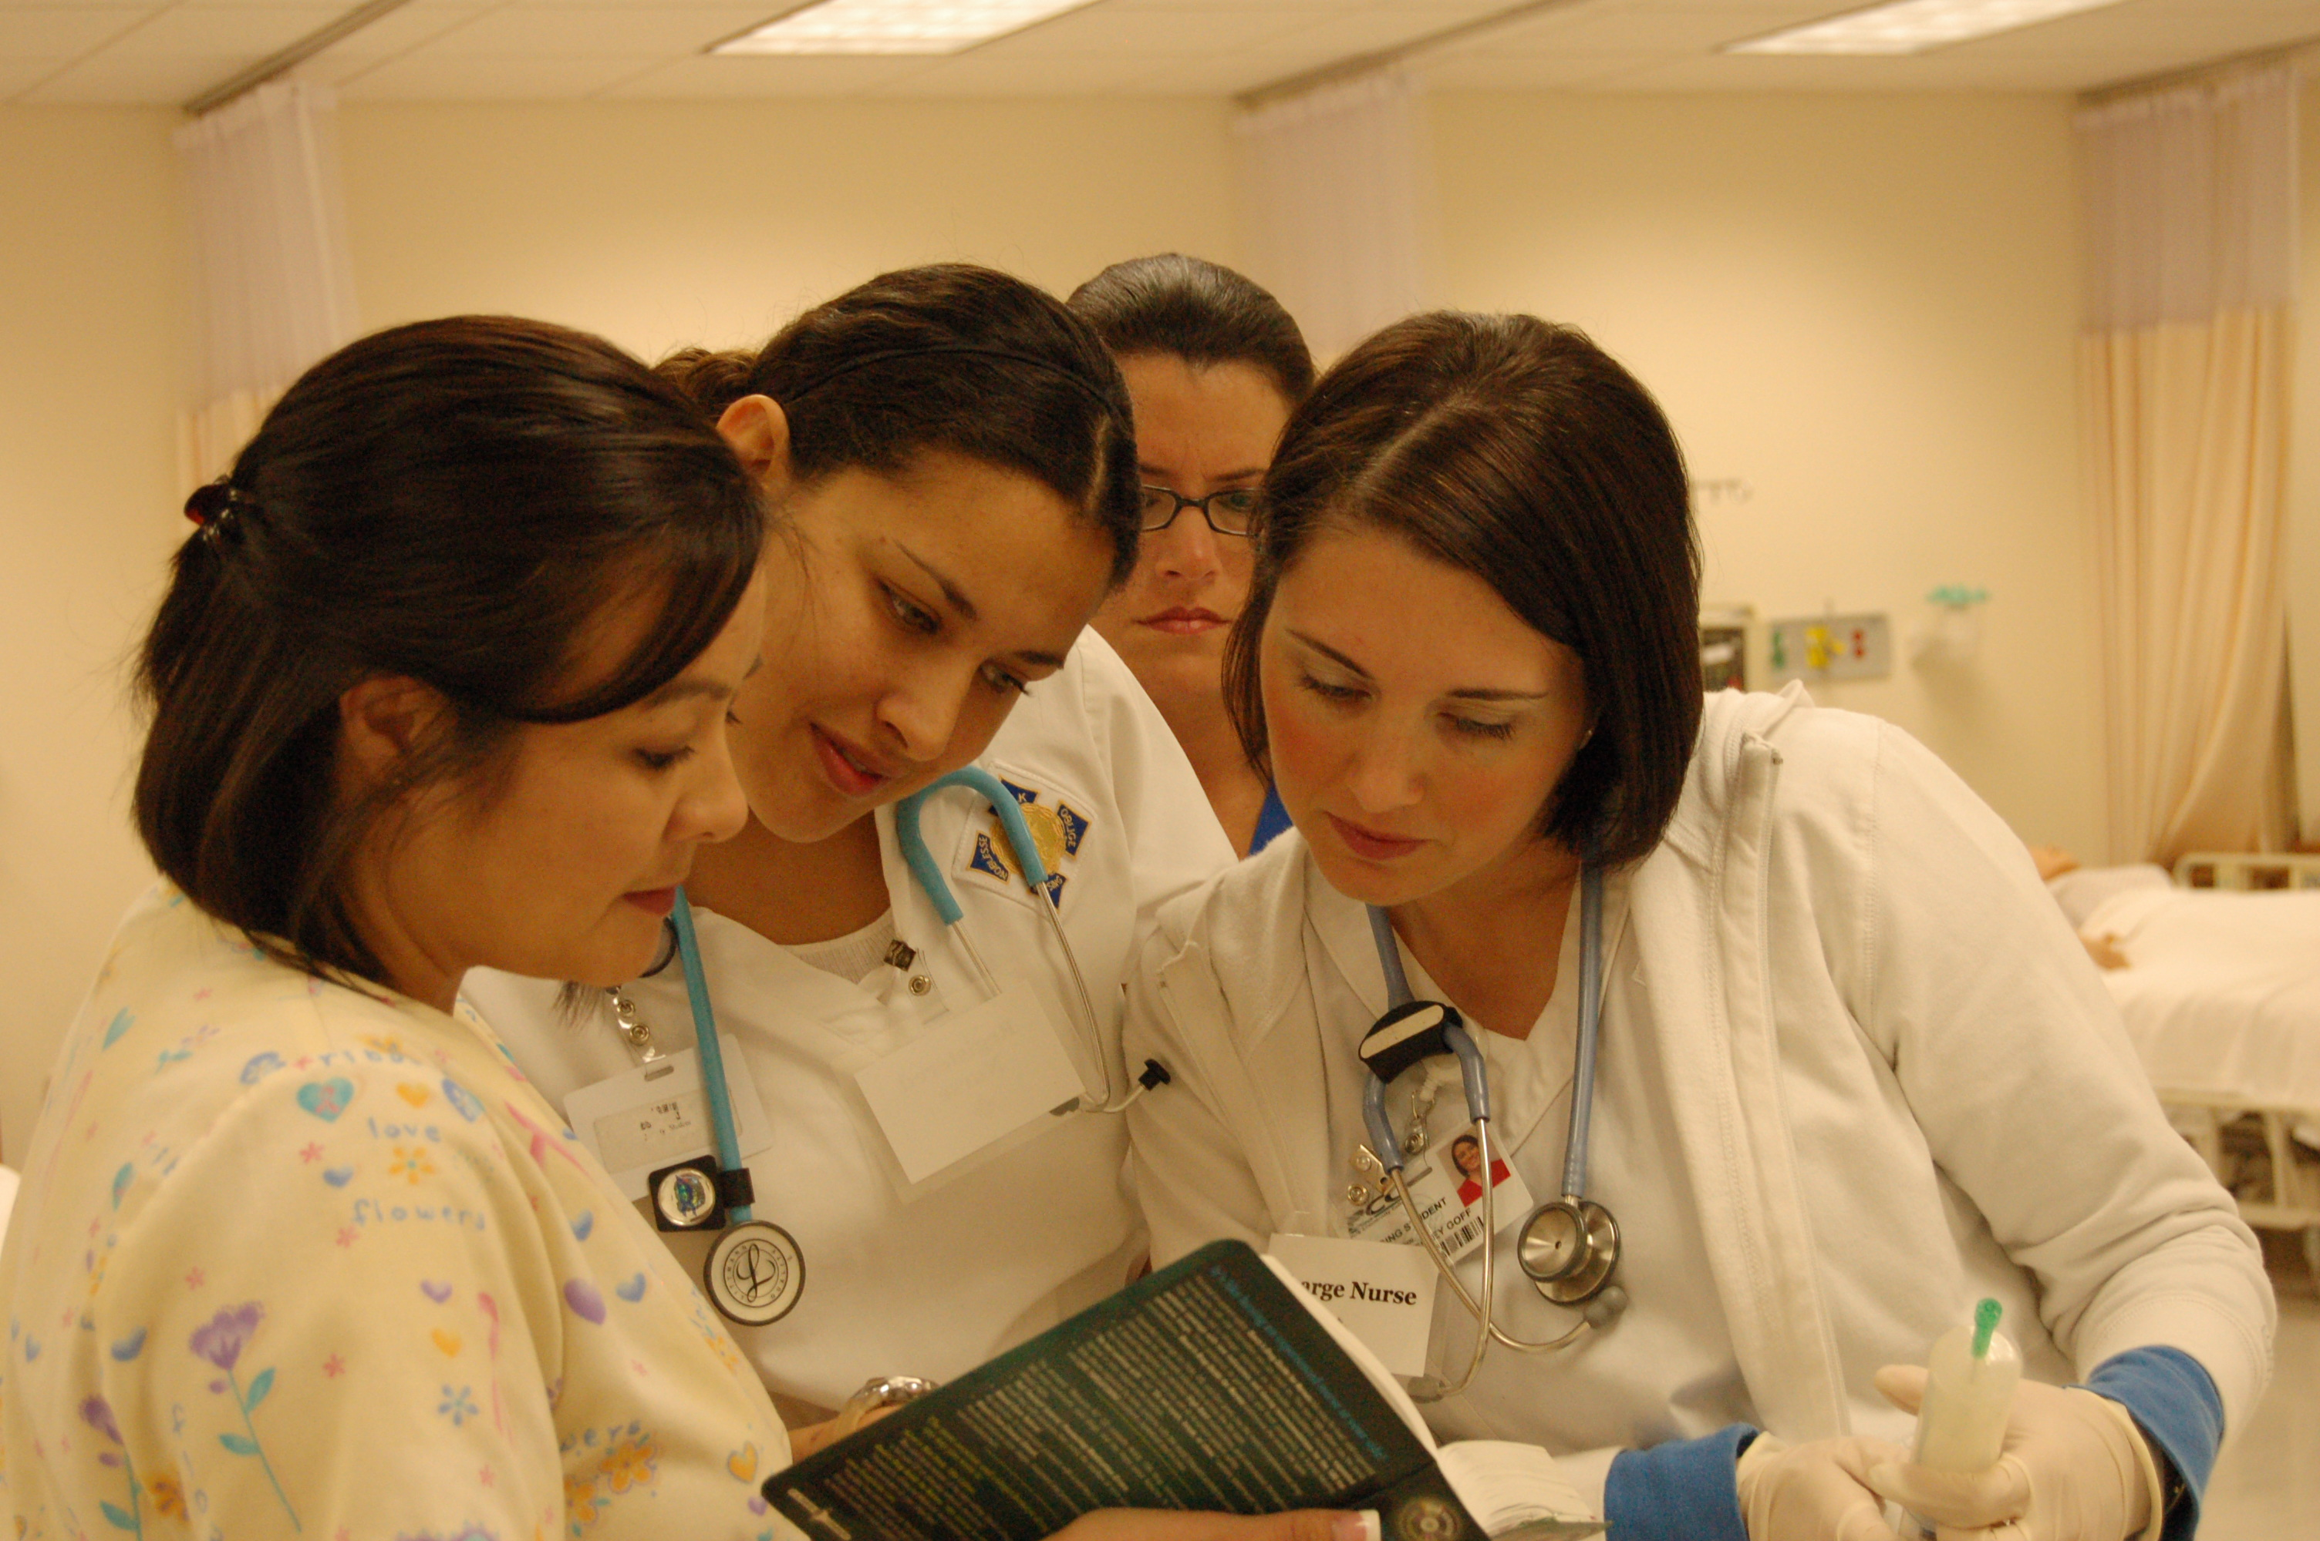
—Cheryl Conley, Polk State College (FL)

Slide 45
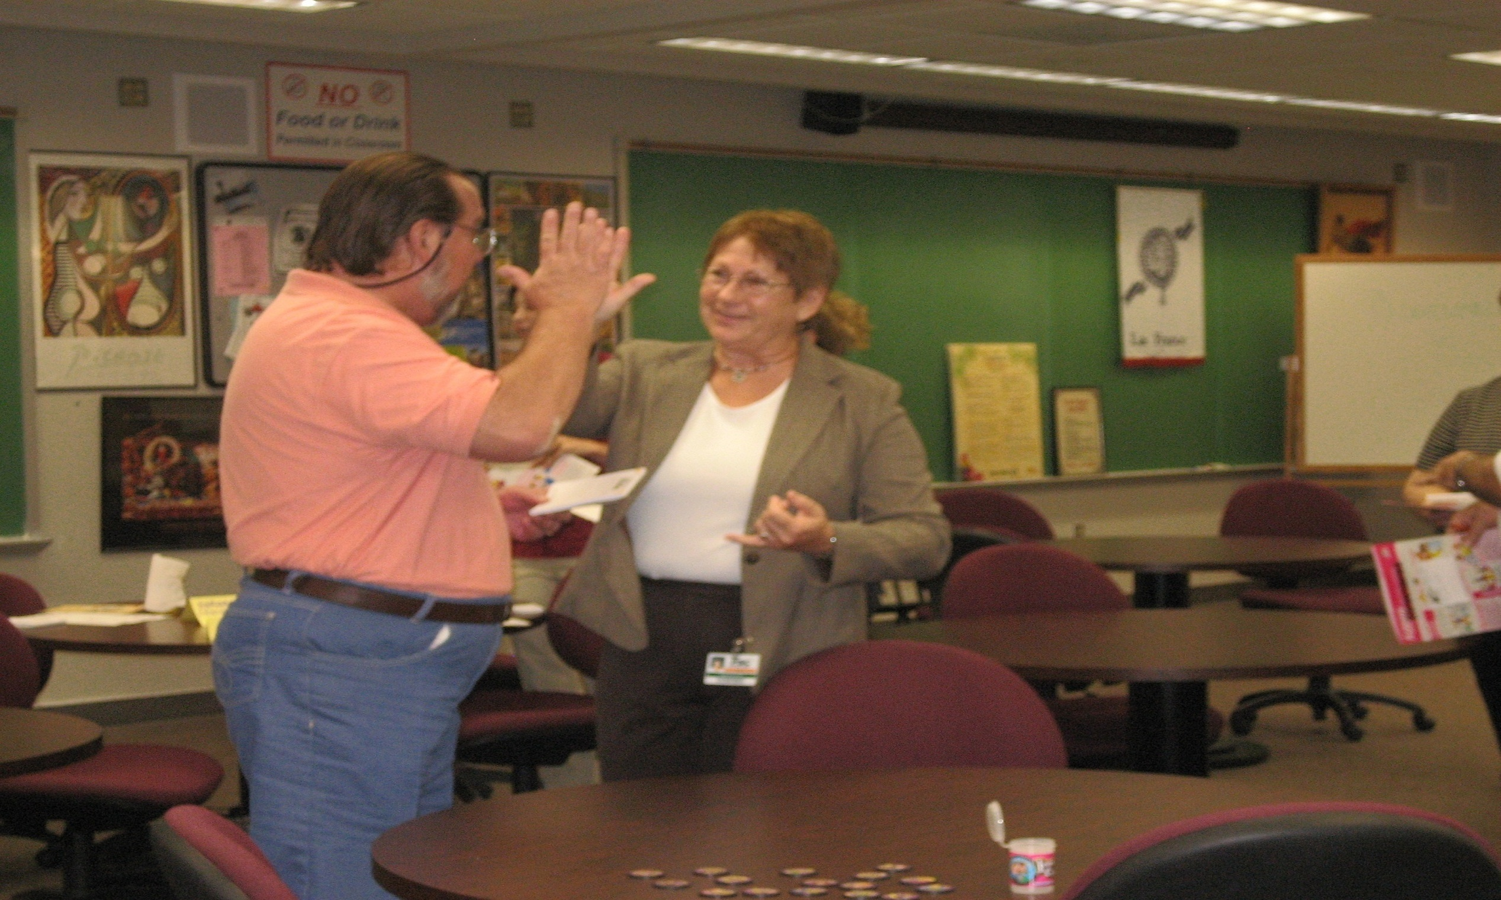
Education is ever changing. I must empower future educators to embrace teaching as an opportunity to inspire, stimulate, and promote lifelong learning by actively engaging students in the learning process. They deserve a challenging environment free to share ideas and take risks in preparation for the global world.
—Rebecca Pugh, Polk State College (FL)

Slide 46
Semester after semester I marvel at the courage of my students as they overcome seemingly insurmountable obstacles to make the college journey. The roadmap I provide is encouragement! I often wonder if my students learn from me as much as I from them?
—Brenda Aycock, Pulaski Technical College (AR)

Slide 47
Experience teaches instructors how better to understand the learning process for them and their students, that it is a lifelong journey, and that there are no shortcuts.
—Nicki Feldman, Pulaski Technical College (AR)

Slide 48
Advising is just another term for active listening.
—Larry Lewallen, Pulaski Technical College (AR)

