Slide 1
The experiences that students have within an academic advising area often will determine whether the students decide to stay and complete a program. I always make an extra effort to reach out and establish positive bonds with our students because I know just how important those meaningful connections are for student retention and success.
—Linda Williams, Lake City Community College (FL)

Slide 2
I enjoy teaching because of the challenges it presents. To be able to reach that student who appears to be unreachable and give him/her skills and hope for the future is very rewarding. It always inspires and motivates me to give my best in the classroom.
—George Bertin, Lamar Institute of Technology (TX)

Slide 3
Writing drives me, motivates me, and frustrates me. I love it. I hate it.
—Rita Gordon, Lamar Institute of Technology (TX)

Slide 4
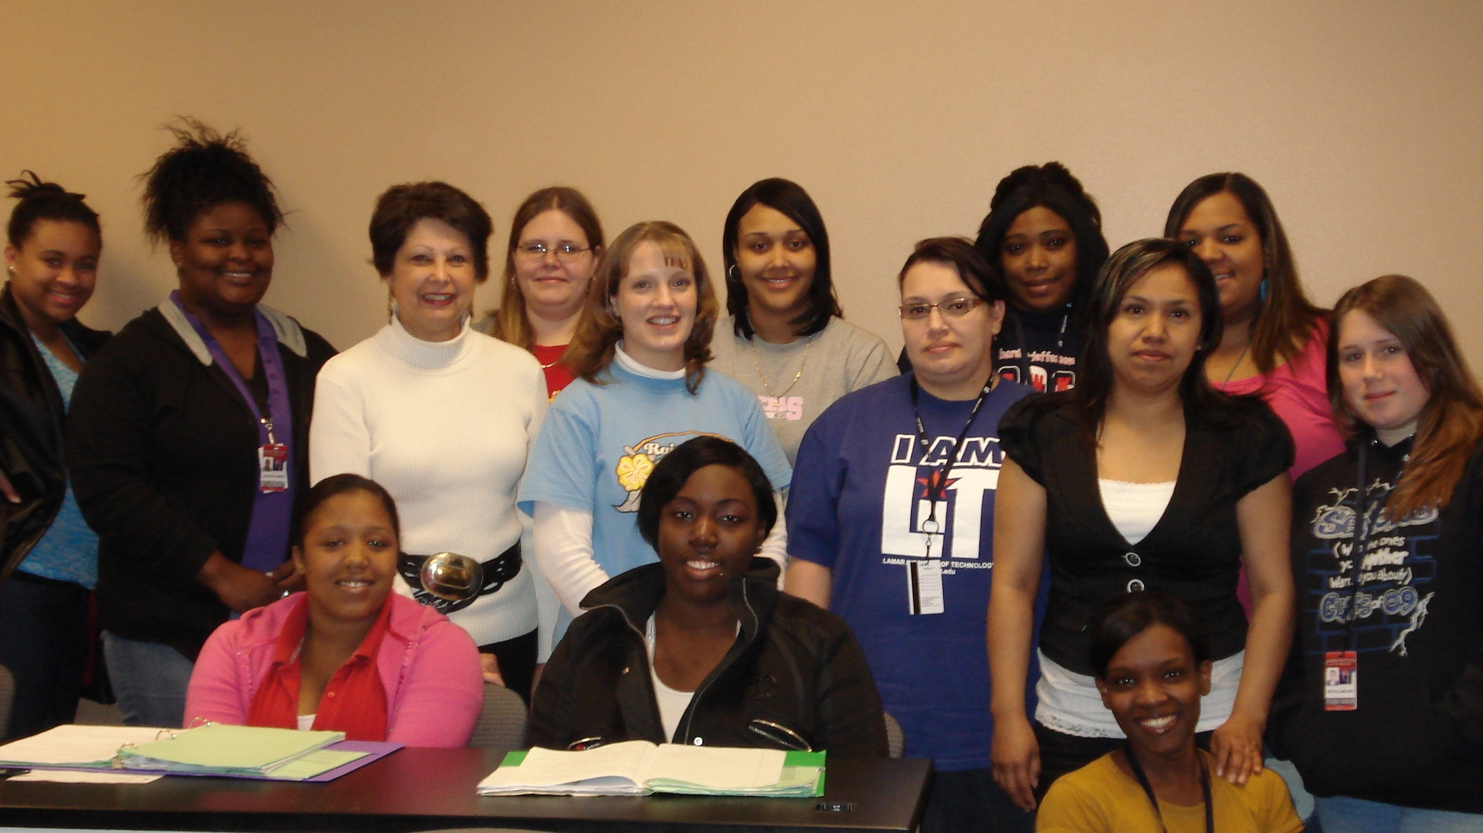
It is always a delight to see students learn and mature from one semester to the next. Taking their child development education into the workplace and impacting the lives of the young children they teach is continually an inspiration for me.
—Gail Williams, Lamar Institute of Technology (TX)

Slide 5
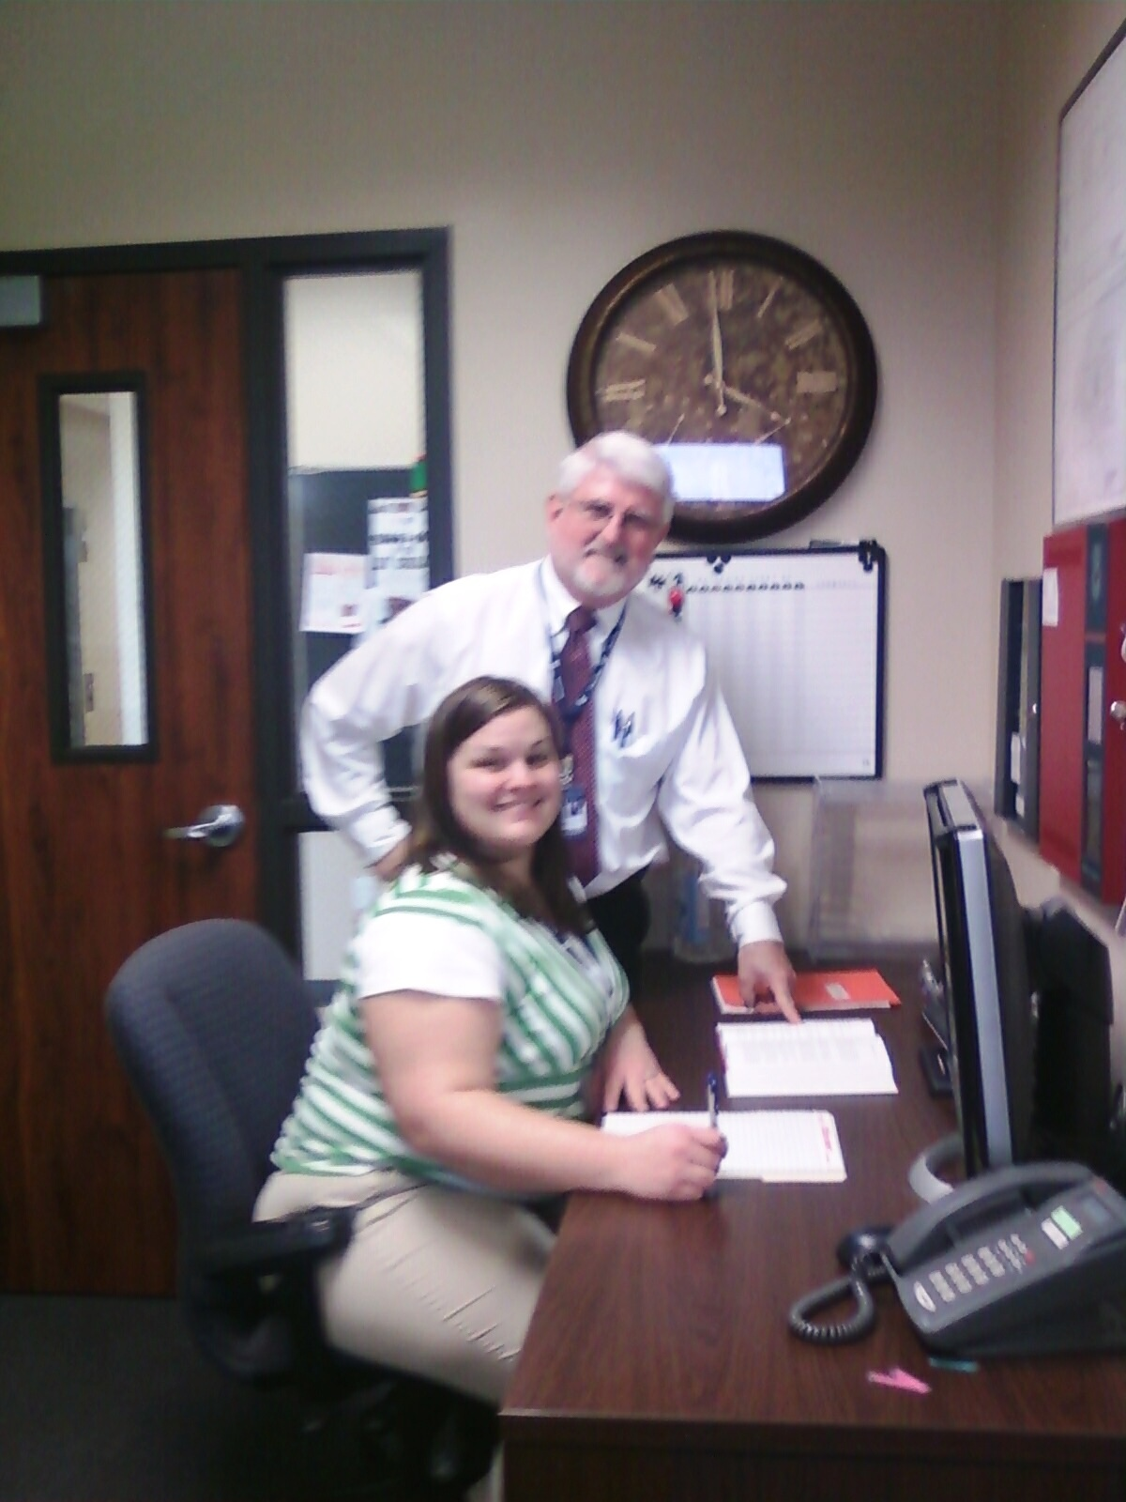
—Sam Williams, Lamar Institute of Technology (TX)

Slide 6
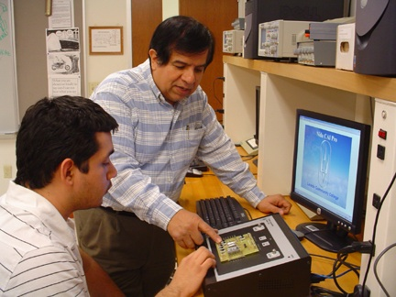
—Antonio Lozano, Laredo Community College (TX)

Slide 7
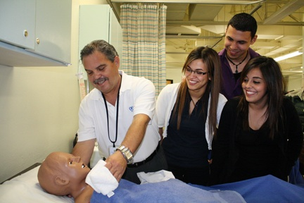
—Arturo Navarro, Laredo Community College (TX)

Slide 8
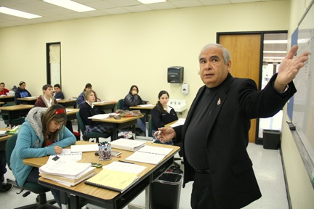
My experience in teaching economics at Laredo Community College for the past 35 years has challenged me to present my students the complex nature of economic theory by incorporating the problem- solving approach to current economic issues that plague the world in which we live. Such economic experiences, whether good or bad, make us better informed citizens.
—Manuel Rios, Laredo Community College (TX)

Slide 9
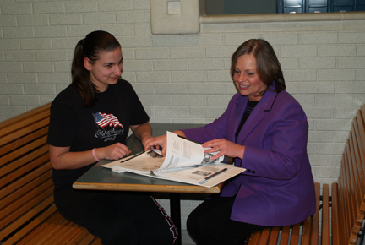
It isn’t what inspires and motivates me as much as it is who. What a blessing and an honor to have a part, however large or small, in a student’s life, each one having a story to share, expectations to realize, and a future for which to prepare.
—Virginia "Ginny" Mihalik, Lehigh Carbon Community College (PA)

Slide 10
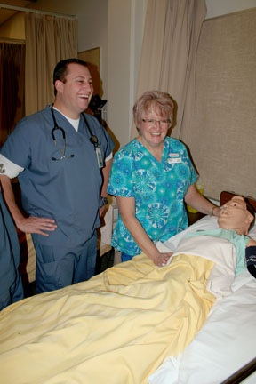
I work every day with students who will become caring, competent and confident registered nurses. Nothing brings more satisfaction than seeing the excitement in a student’s eyes when he or she grasps an important concept, performs a complex skill, or connects in relationship with a client. What a joy!
—Jacalynne Glover, Lethbridge College (Alberta)

Slide 11
Teaching and learning is something I like to share with students. We are all learners and benefit from each others’ knowledge and experiences. The diversity of learners and learning styles motivates me daily. —Cheryll Oakes, Lethbridge College (Alberta)

Slide 12
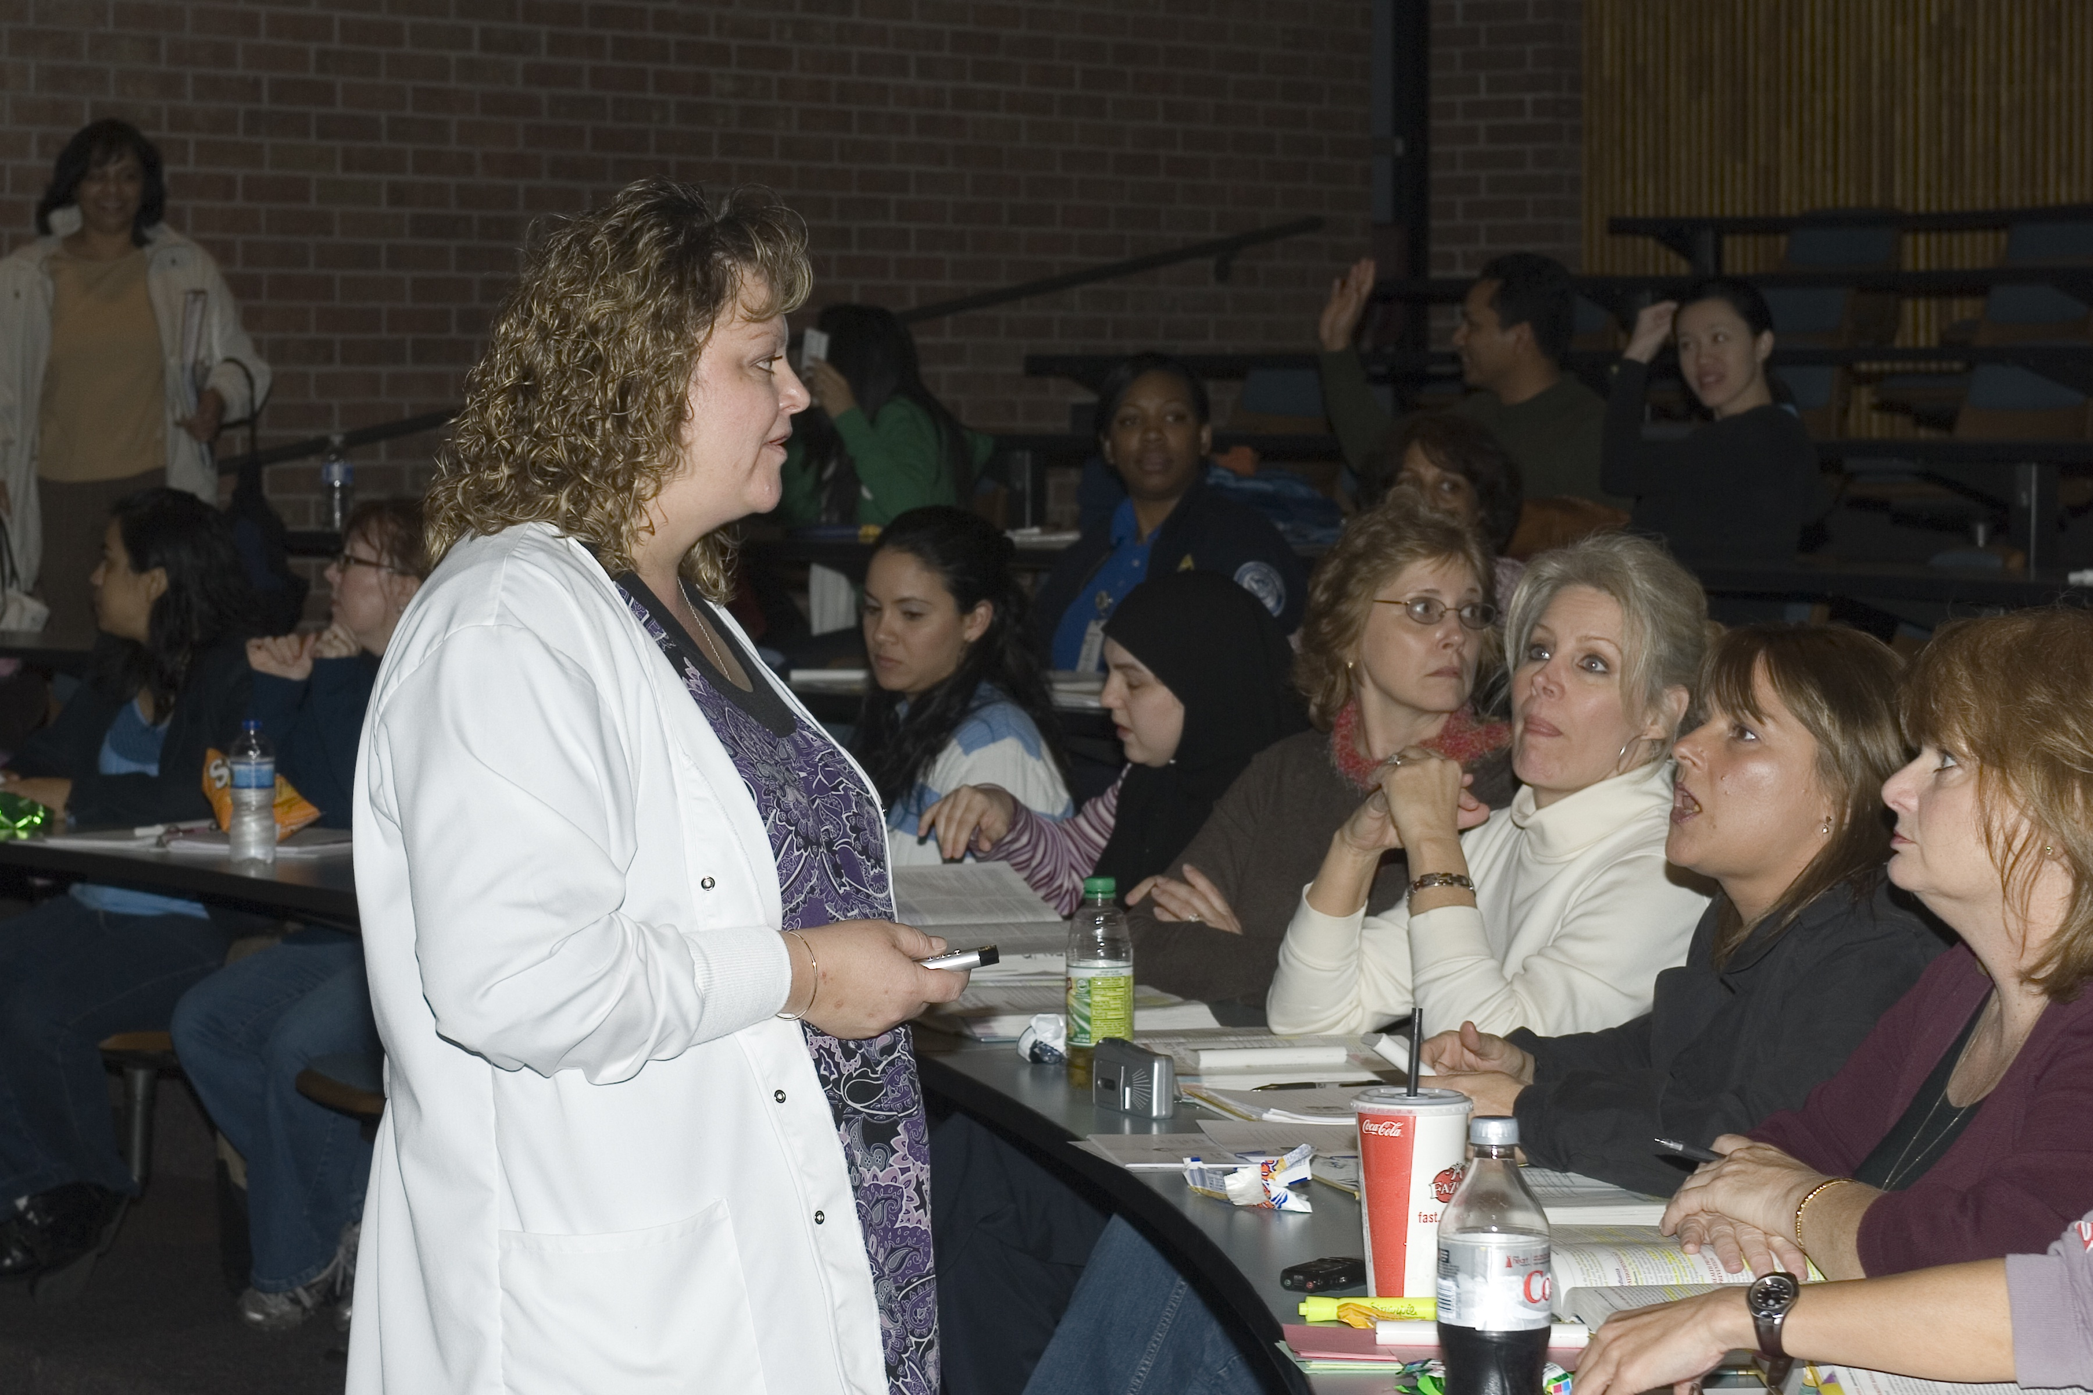
Every day I get to help teach my students how to impact another person's life. Small victories are what I thrive on, especially those of the student who has to struggle a little more than others. My advice to new educators is always do what is in the best interest of your student, and you will always be able to sleep at night.
—Nickie Loftin, Lone Star College–Kingwood (TX)

Slide 13
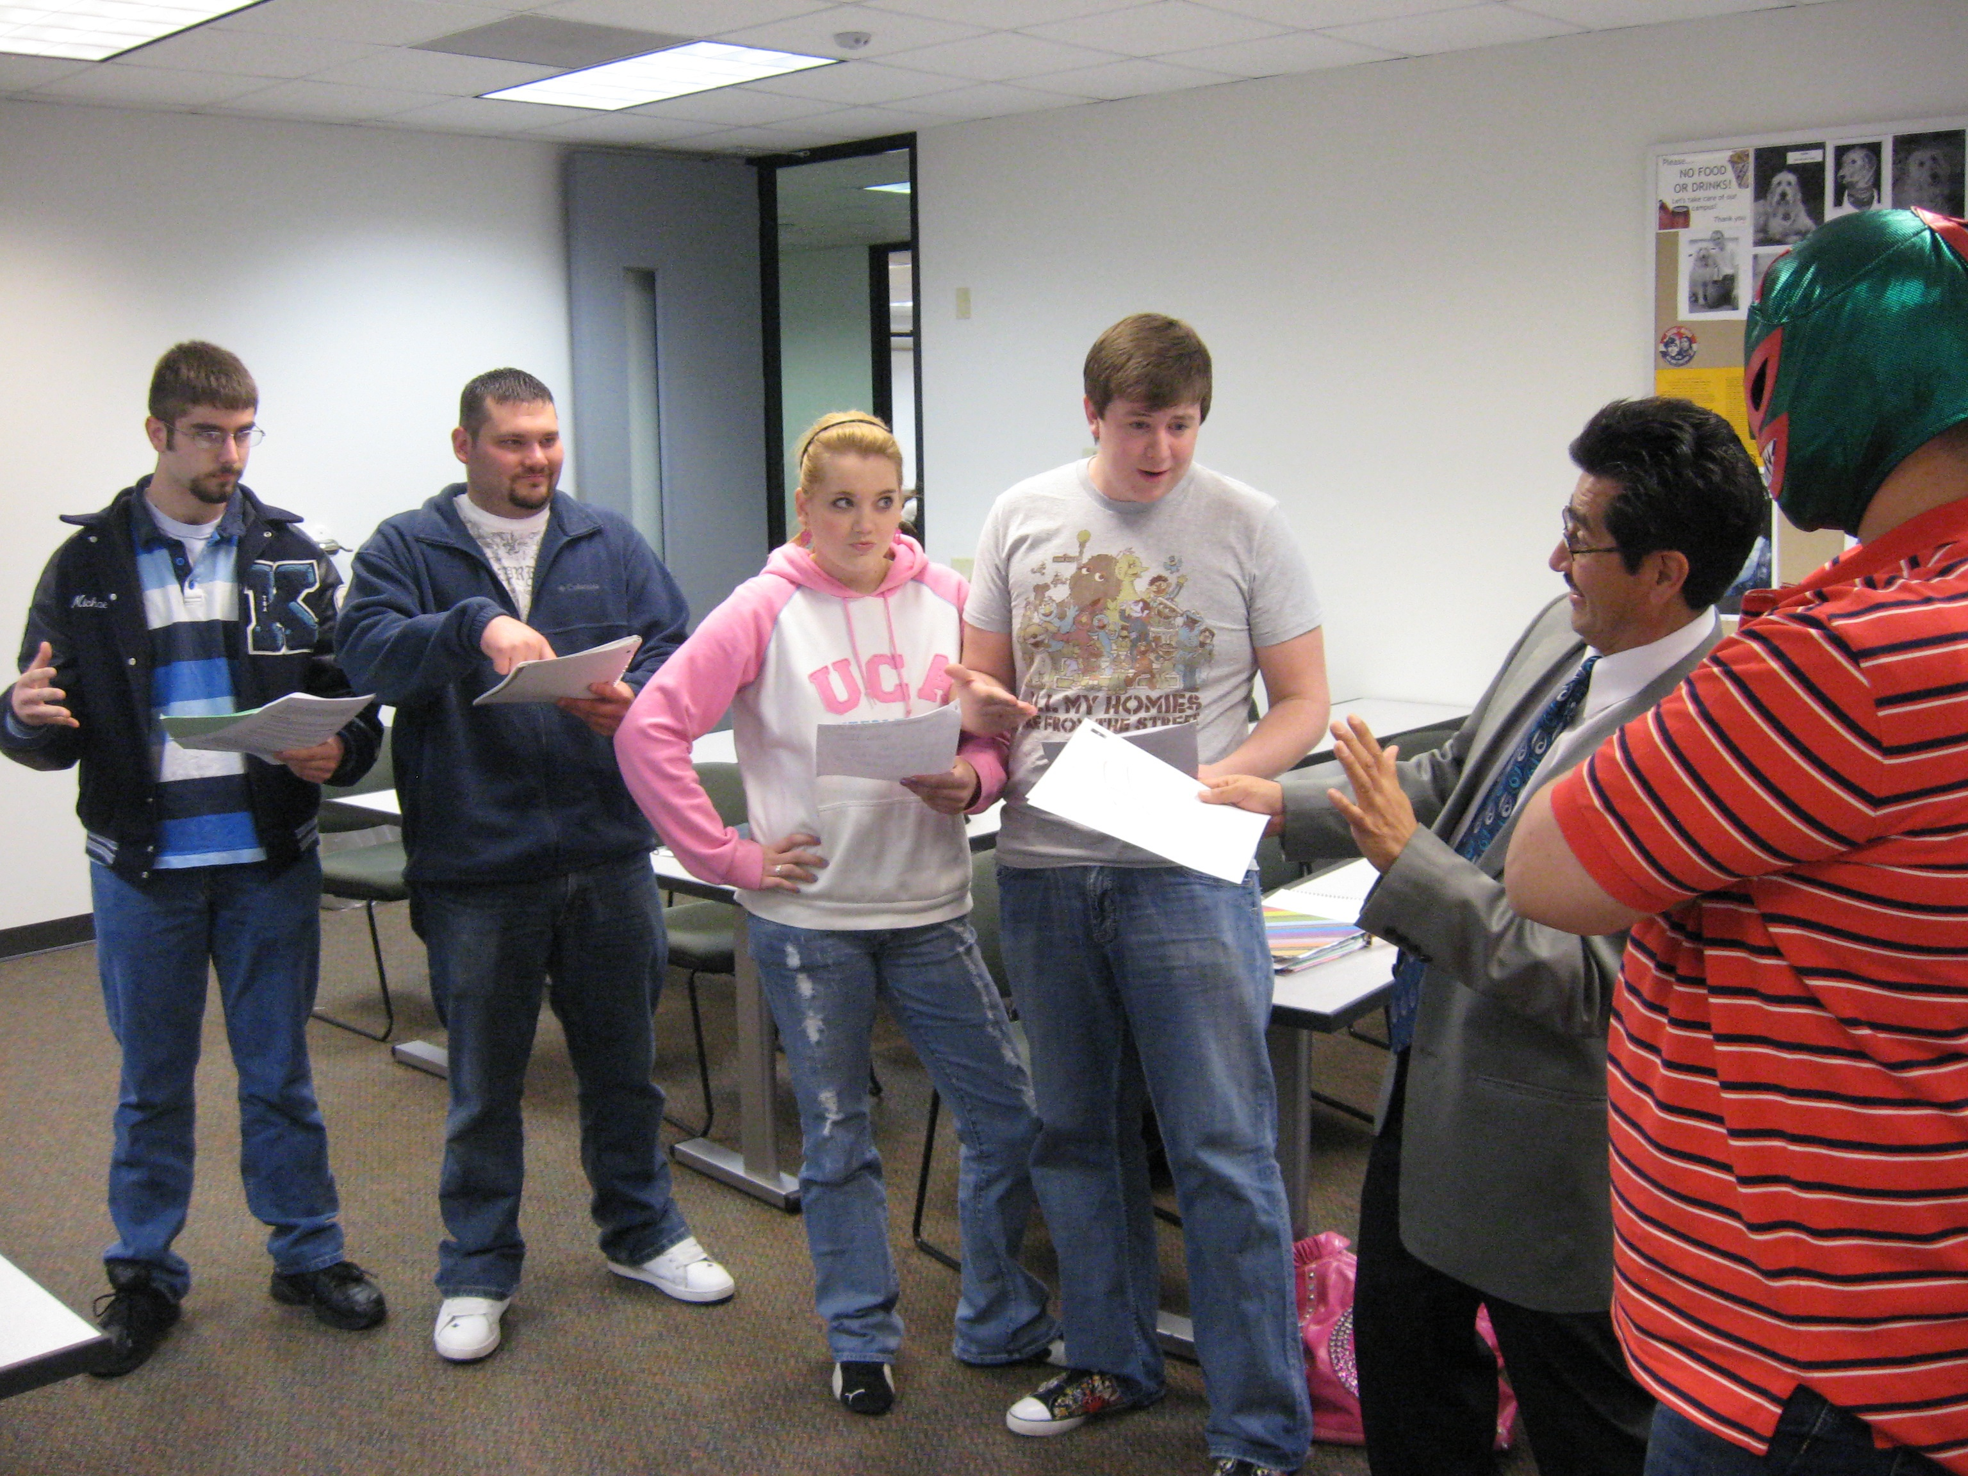
As a community college graduate and a former nontraditional student, I can identify with living a life of quiet desperation. I am reminded of my stewardship for each new crop of surrogates who permit me a participatory role in their lives.
—Raúl Reyes, Lone Star College–Kingwood (TX)

Slide 14
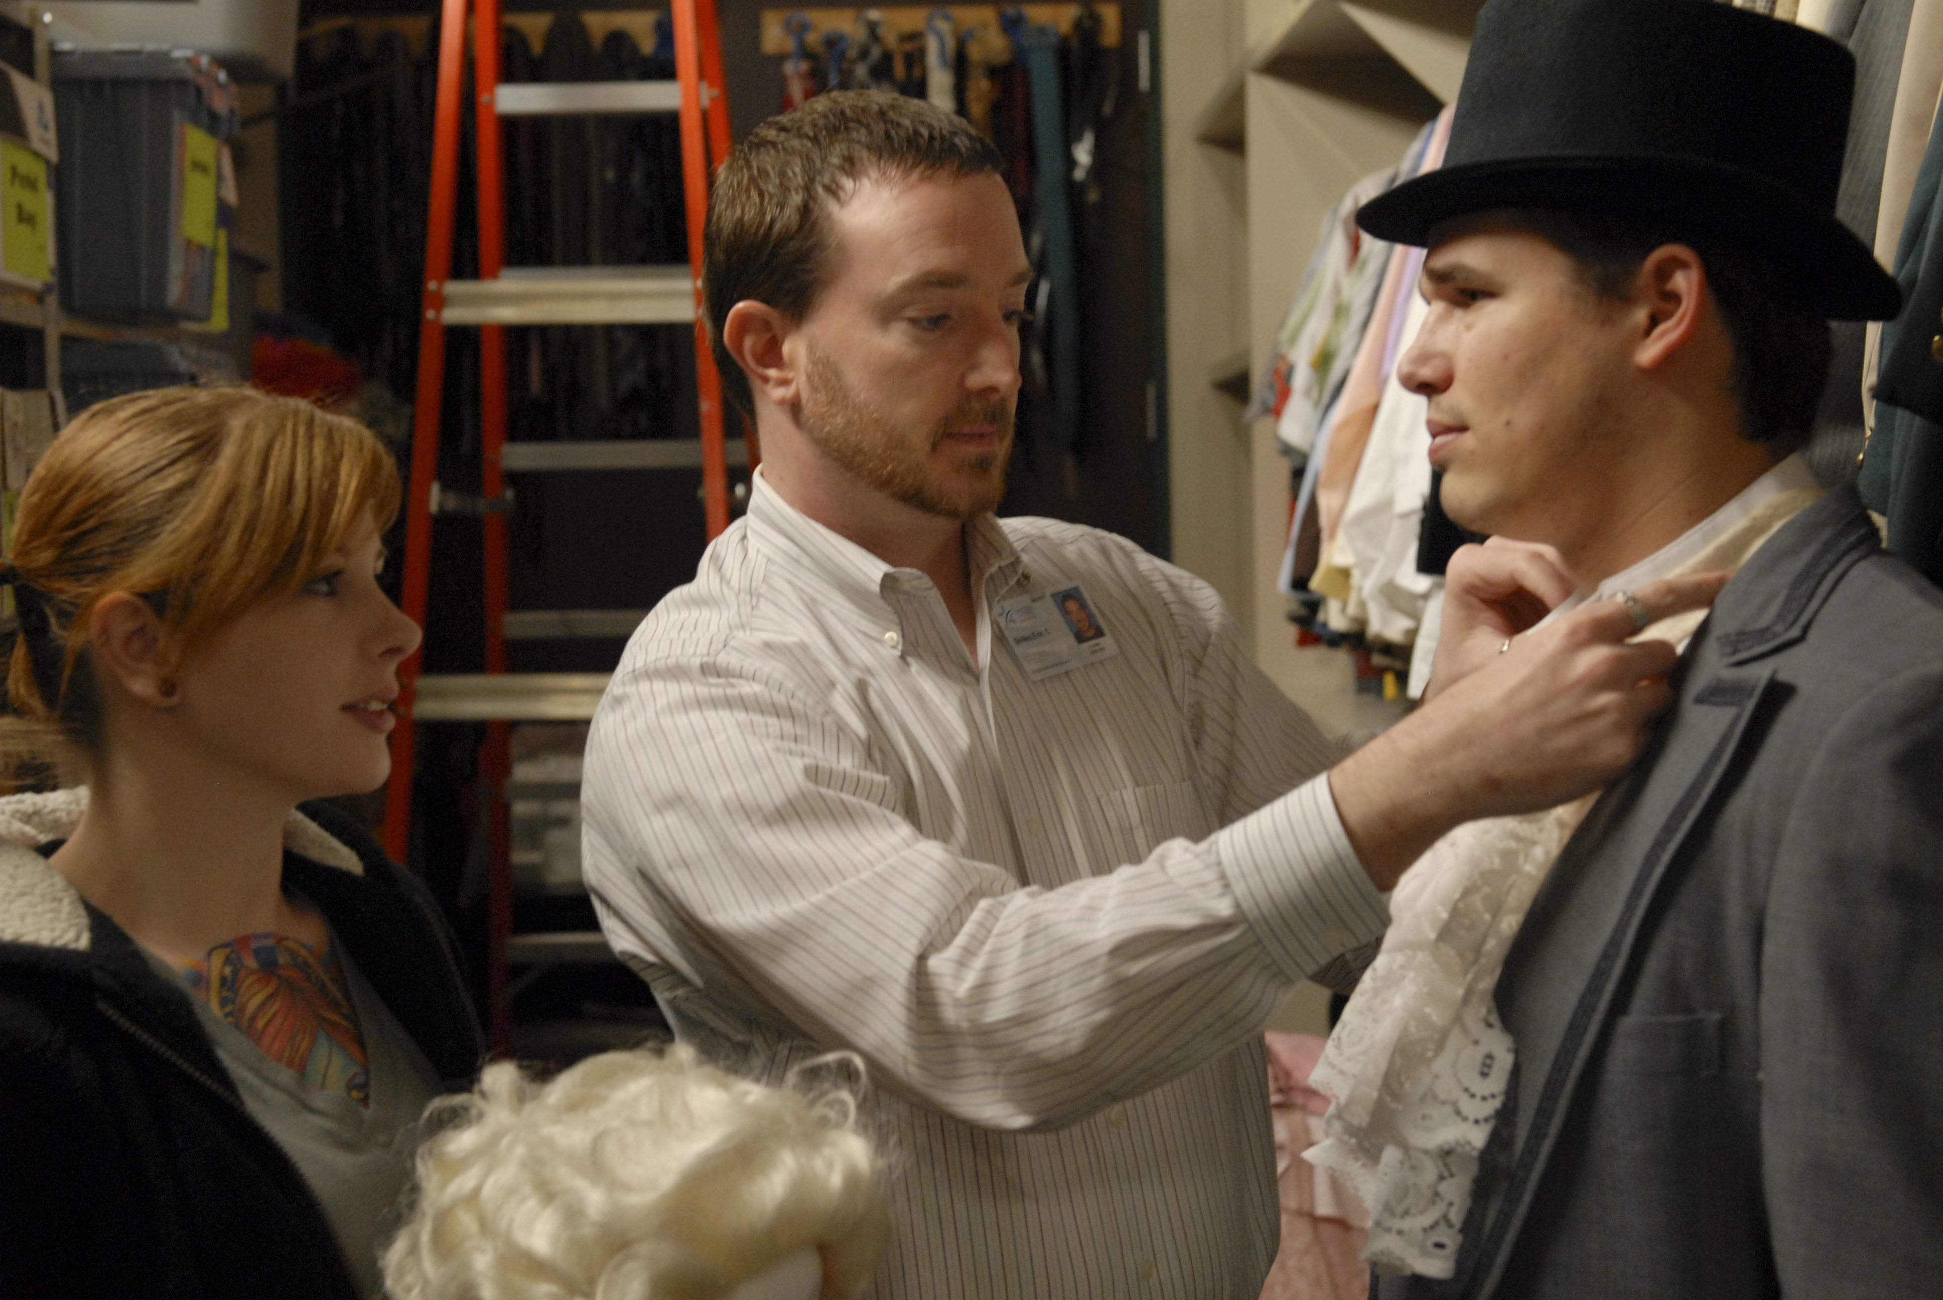
Theatre reinvents itself with every new production, and the same can be said of the theatre classroom. Every group of students is a new ensemble working together toward a goal. It is this exploration among creative individuals that renews me and drives me forward.
—Eric Skiles, Lone Star College–Kingwood (TX)

Slide 15
Plutarch said, “The mind is not a vessel to be filled, but a fire to be kindled.” Teaching is the kindling of the intellectual spark of curiosity, igniting transformation, inspiring metamorphosis, and uplifting the spirit. A teacher’s objective is to light the mind’s fire, challenging it to think logically and insightfully, stimulating and sustaining intellectual growth.
—Paullett Golden, Lone Star College–Montgomery (TX)

Slide 16
Teach less, BETTER. We have a tendency to rush through the material. Instead, work on a few important concepts one or two a class. Support each concept with some facts, some activities, and some homework. This is more fun for you and the students, and they learn better.
—Larry Loomis-Price, Lone Star College–Montgomery (TX)

Slide 17
A sense of community and a safe, friendly, accepting classroom are invaluable. Confident students become eager to learn and reluctant to leave the classroom each day.
—Gwen Charvis, Lone Star College–North Harris (TX)

Slide 18
Whatever you learn, teach to someone else. Knowledge is useless without teaching and practice.
—Megan Franks, Lone Star College–North Harris (TX)

Slide 19
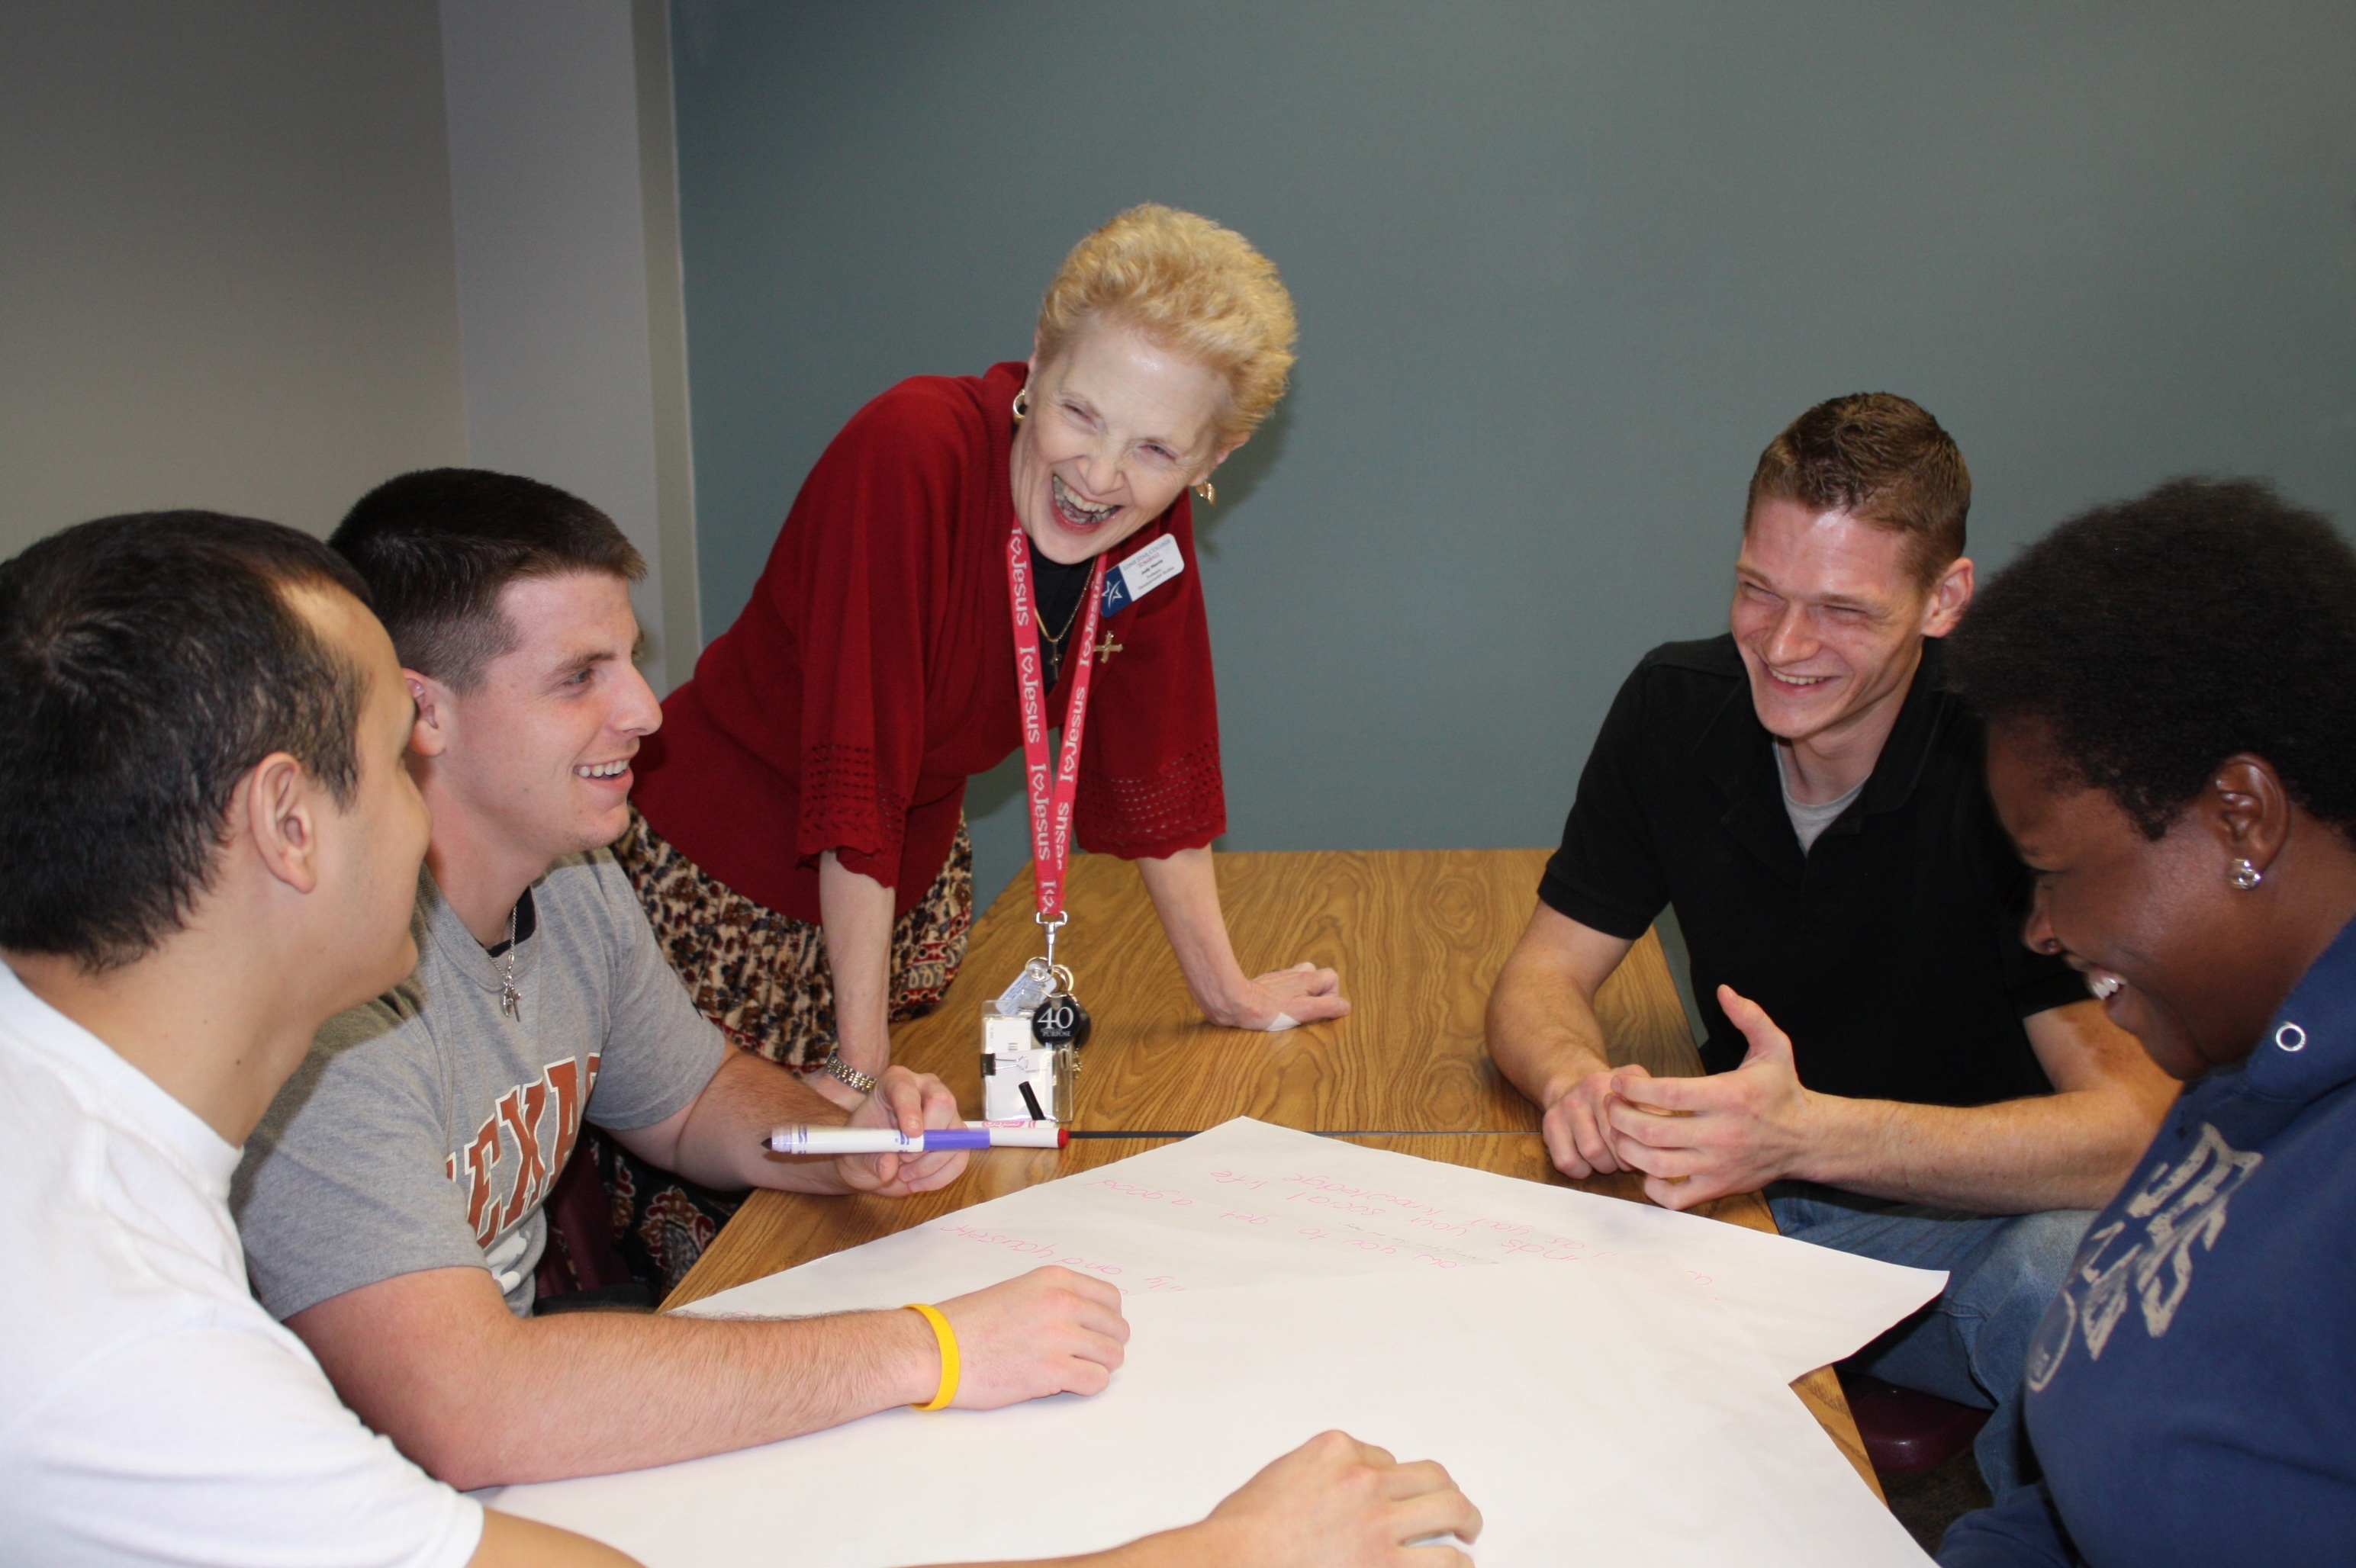
Having a direct, personal impact, one-on-one contact with students, and building relationships is huge. Our classes are small enough to engender identities and personalities, allowing us the joy of getting to know students and appreciate their success. My heart is the students and helping each one achieve his/her best goals.
—Judy Harris, Lone Star College–Tomball (TX)

Slide 20
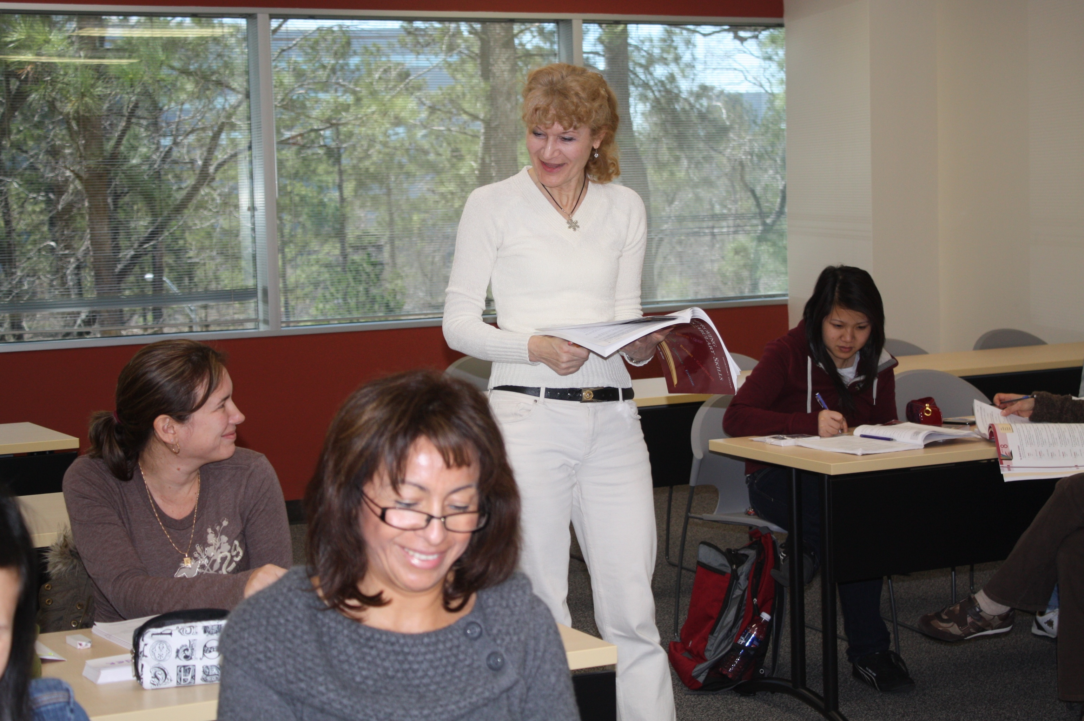
Our primary responsibility as professors is to our students. That should form our goals, the choice of teaching methods and materials, and our whole approach to teaching. To be an educator in the 21st century is to provide constant motivation for the students to engage in learning and thinking.
—Irina Nizova, Lone Star College–Tomball (TX)

Slide 21
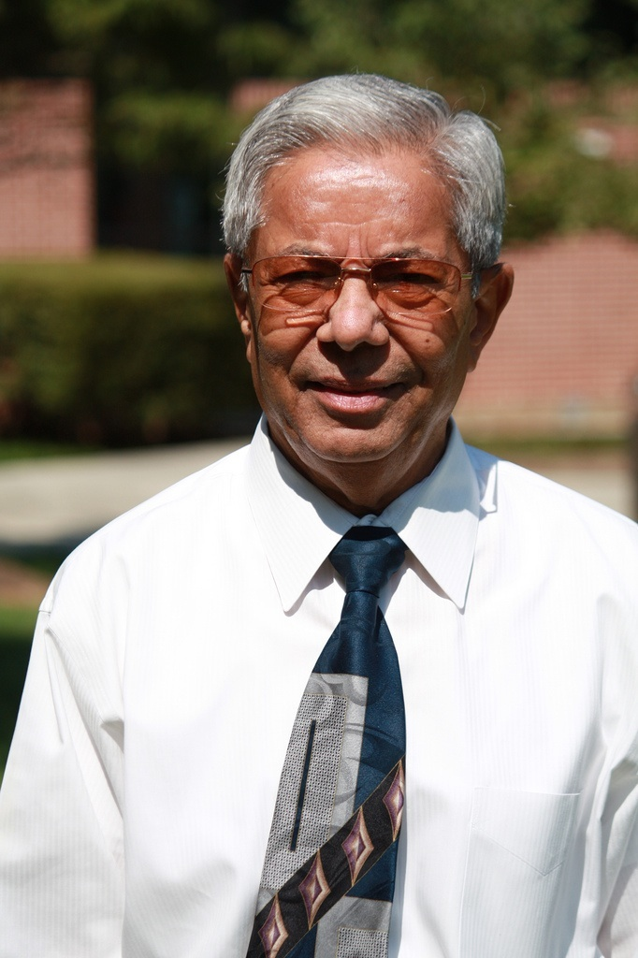
As a teacher, I consider every student a scholar, and my job is to wake up their sleeping minds to learn math or physics by using three important factors: concentration, continuity, and confidence. Also, I help them to create a positive attitude toward the subject by using the fact that “if you like your friend, he/she will like you.” I remind them that with math and physics , every step is generated automatically if you go step by step continuously. When I use the above strategy, my students do not have any problem succeeding.
—V.C. Patel, Lone Star College–Tomball (TX)

Slide 22
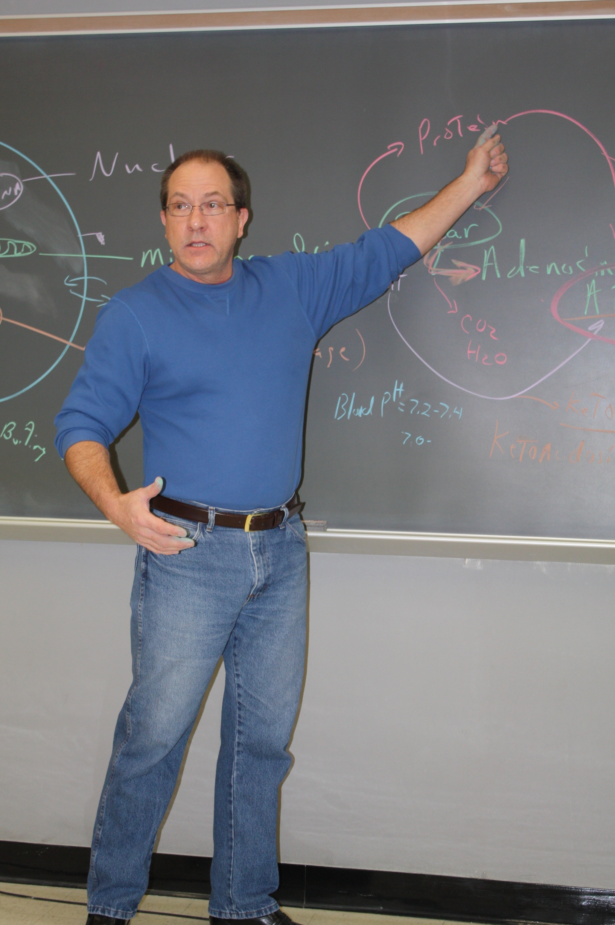
I find students in biology respond with an inherent vigorousness of intellect to what is not known as opposed to the more common approach of covering what is known in the sciences. By focusing on what is not understood in the life sciences, students begin to embrace what is known and where current research should be looking next.
—William Simcik, Lone Star College–Tomball (TX)

Slide 23
Ralph Waldo Emerson said: “No matter what your work, let it be your own. No matter what your occupation, let what you are doing be organic. Let it be in your bones.” As a counselor, I am inspired each day by students eager to create their future. I am honored to help them discover their talents and find a career that is “in their bones.”
—Laurene Grimes, Lorain County Community College (OH)

Slide 24
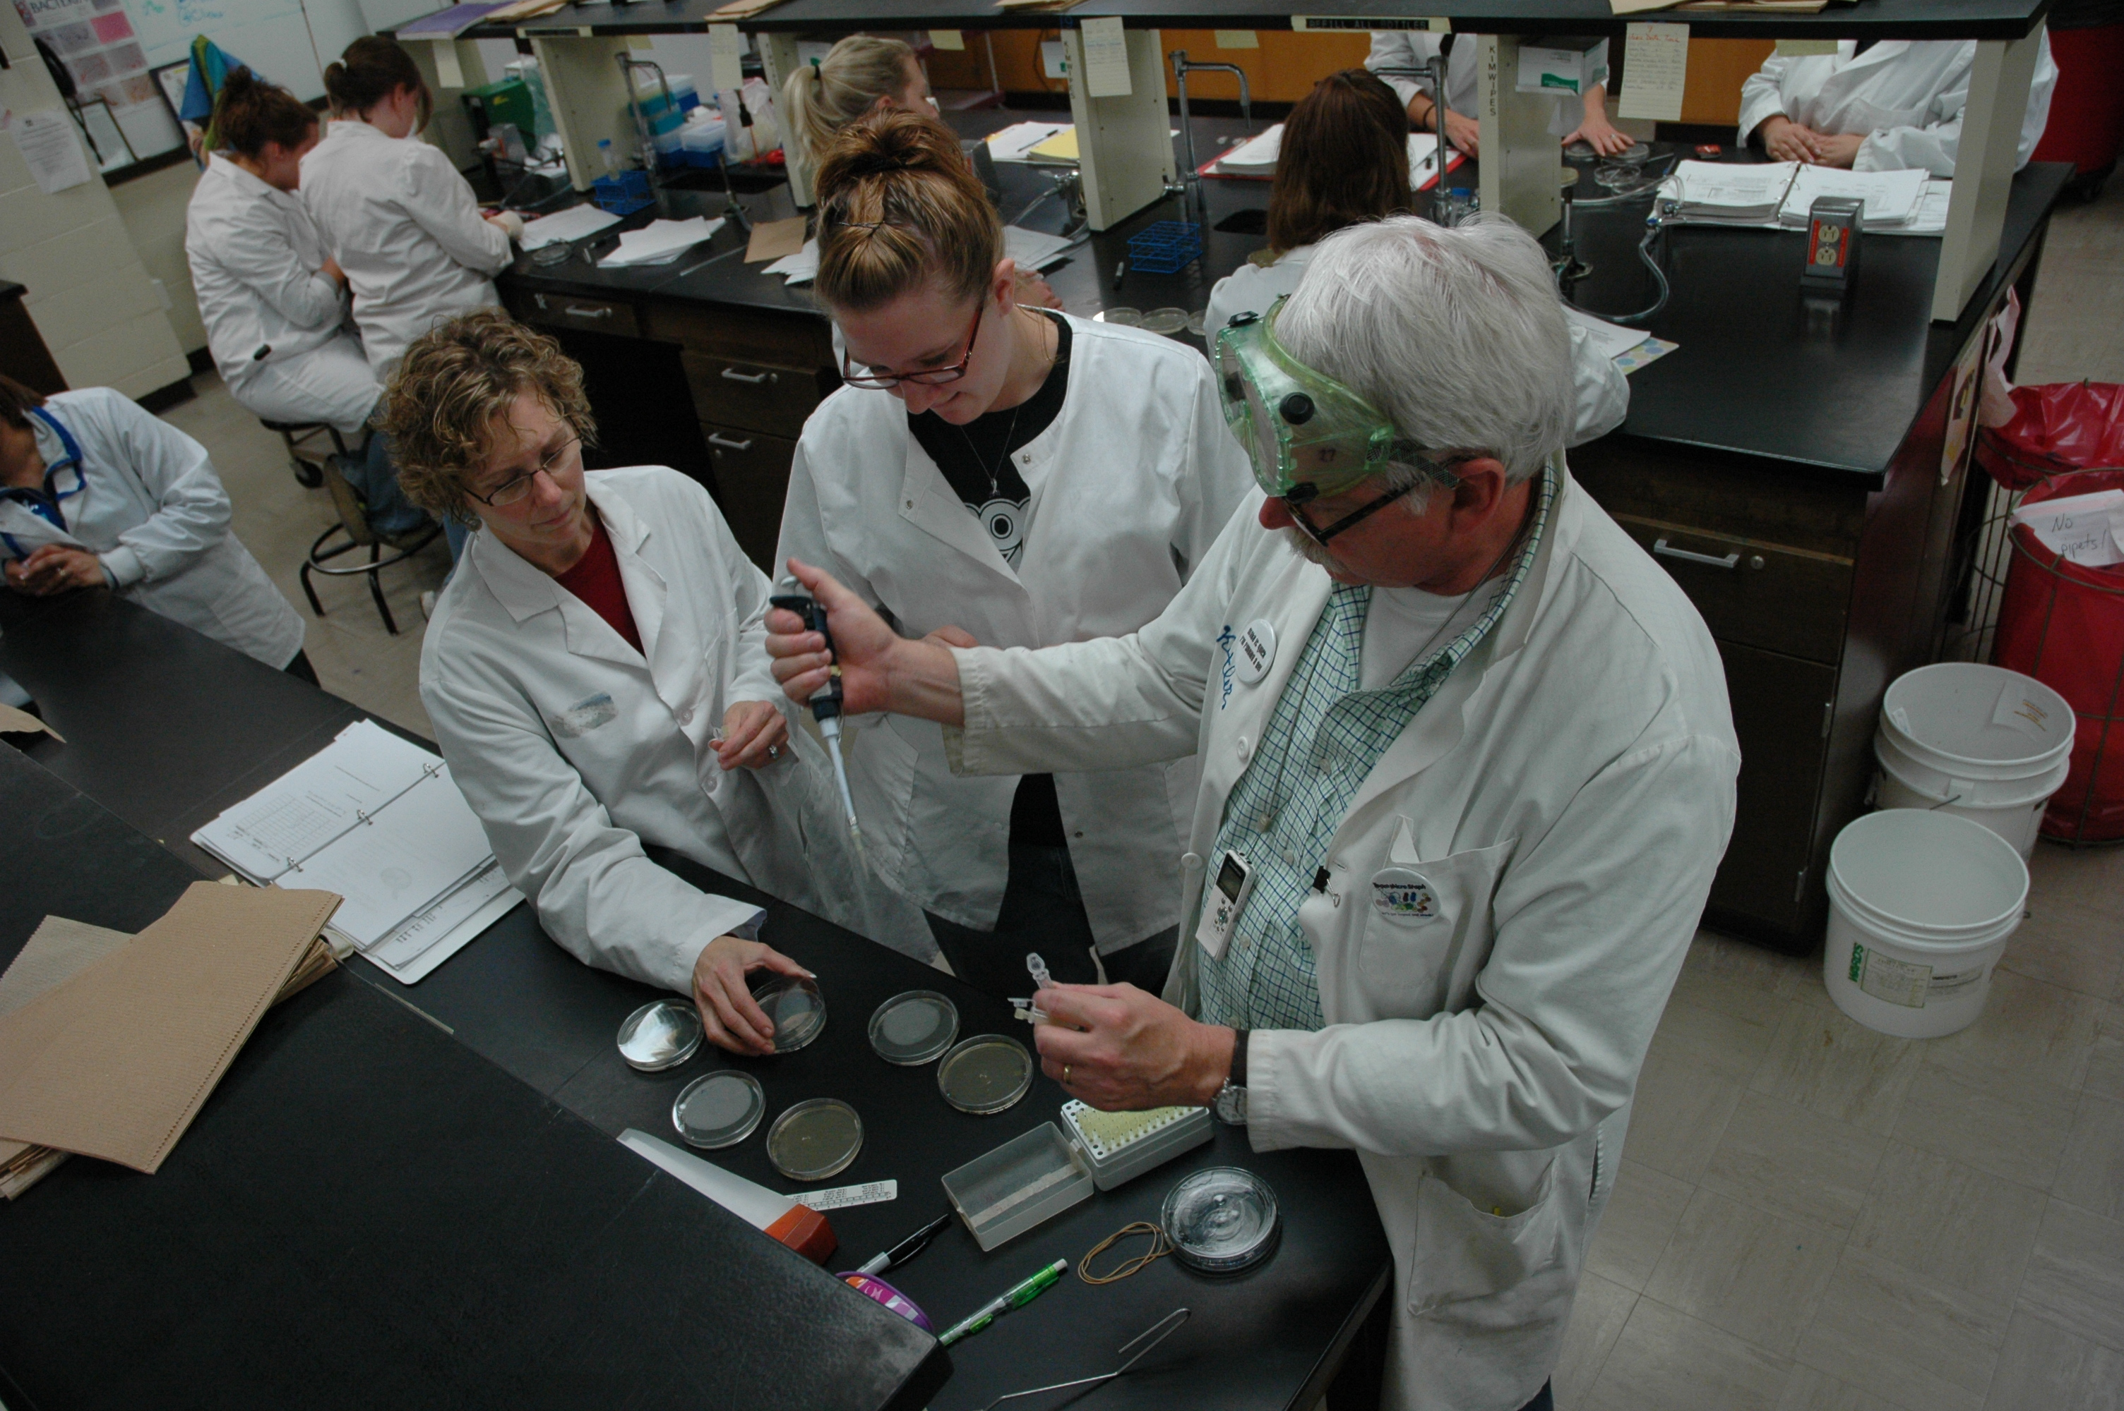
I’ve had two careers in my life—research and teaching. In research, you are discovering new things everyday, and that’s a pretty big high. In teaching, somebody else is discovering, and you’re getting a chance to see that through someone else's eyes. Either way, discovery is a wonderful way of life.
—Harry Kestler, Lorain County Community College (OH)

Slide 25
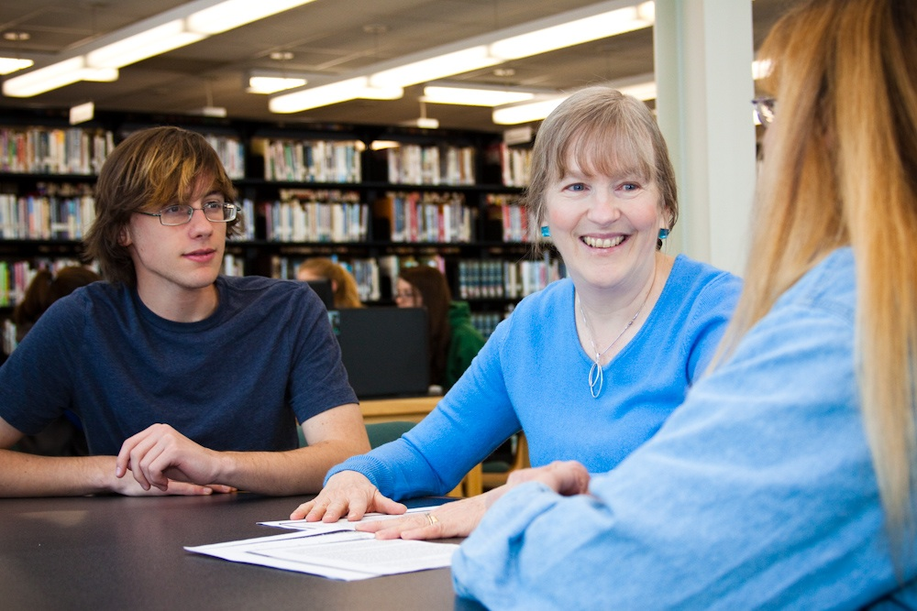
What provides inspiration for me in my work is knowing programs I develop and courses I teach will affect my students by helping them earn a living for themselves and their families. Students will face obstacles in their environment, but they must determine which ones they can take on with appropriate strategies.
—Lesley Casula, Lord Fairfax Community College (VA)

Slide 26
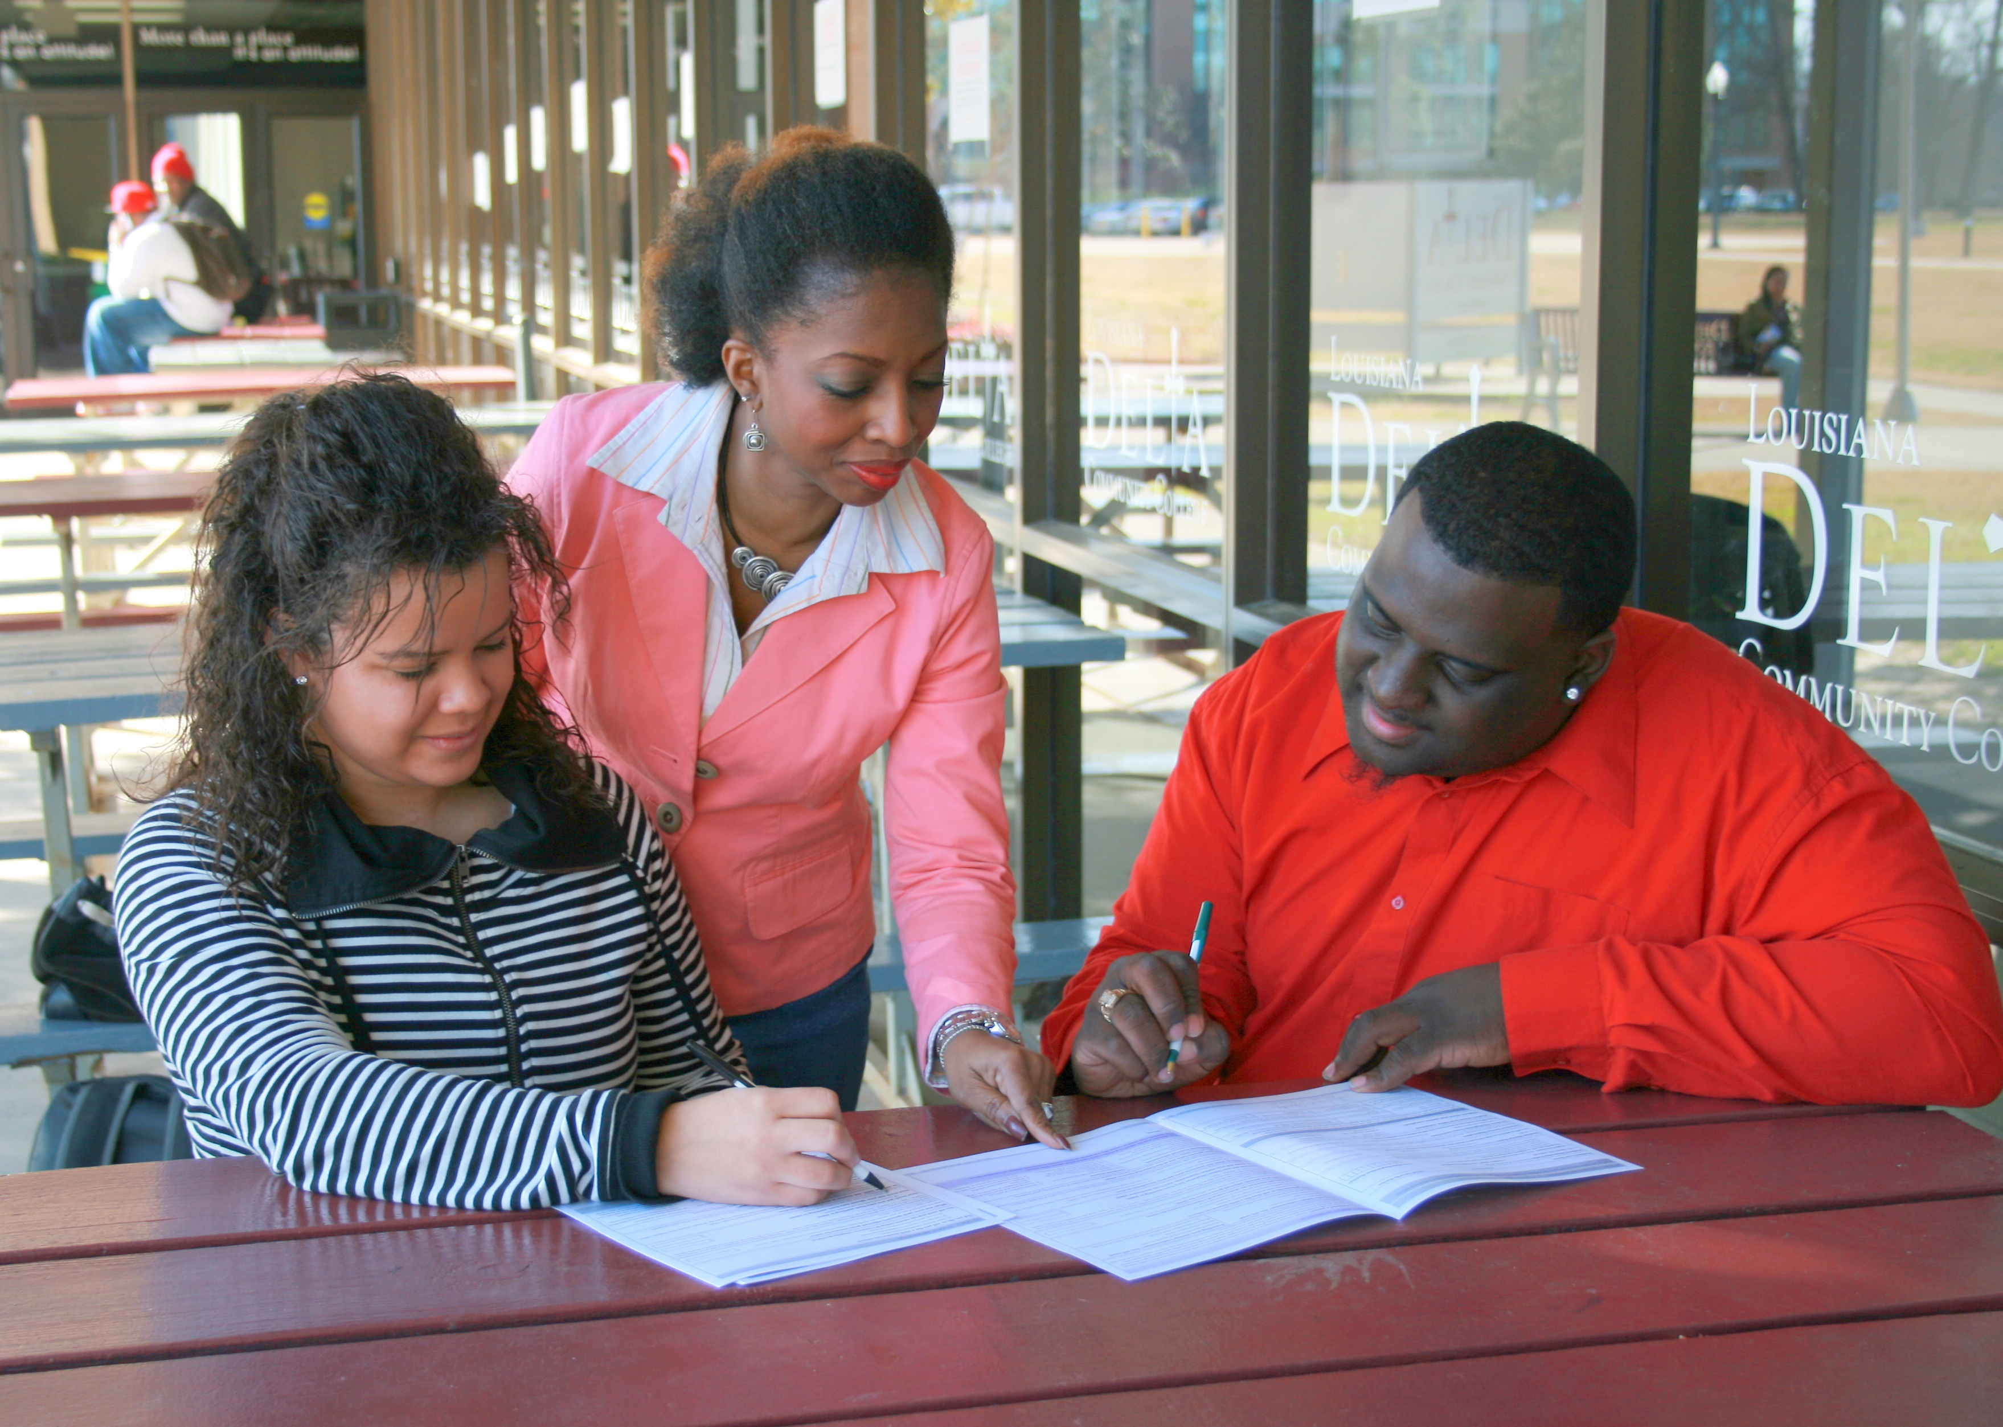
I have been blessed through my years of work to touch the lives of many students and help them realize their potential. Having been a first-generation college student, I see myself in many of my students. I want students to have a better quality of life and to understand the importance of having an education.
—Alvina Thomas, Louisiana Delta Community College

Slide 27
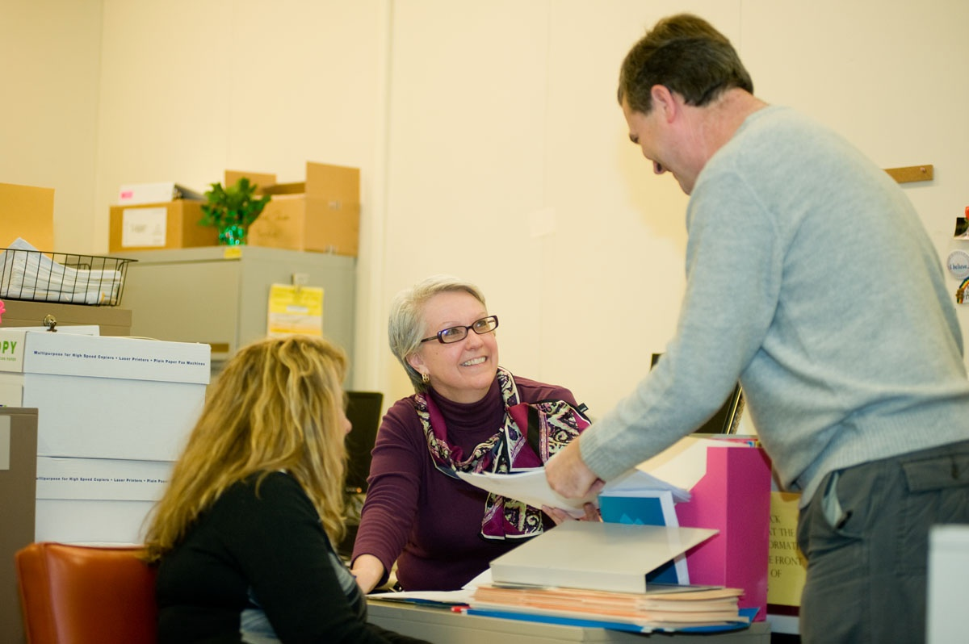
Sharing my knowledge and work skills and seeing people grow from this knowledge inspires me in my work. I am motivated by helping students and co-workers and watching them thrive.
—Barbara Choma, Luzerne County Community College (PA)

Slide 28
By providing students with the technology they need to succeed both in and out of the classroom, we can have a positive impact on their future. I believe it’s important to improve our technology constantly at the college so we can continue to serve our students.
—Don Nelson, Luzerne County Community College (PA)

Slide 29
I am inspired by the thought that education is not simply a forum to impress views, beliefs, or opinions. Rather, true education analyzes all perspectives. It examines conflicting positions, enabling students to think critically, synthesize information, and ultimately formulate their own opinion.
—Lisa Richter, Macomb Community College (MI)

Slide 30
My teaching goals include indoctrinating students into the community of learners; instructing with vivid examples, demonstrations, and metaphors; instigating curious, imaginative, critical, skeptical, reflective, and integrative thinking; and inspiring students with a desire to learn and use their knowledge in their lives and world, to take action, and to reach their own goals.
—Chris Dyszelski, Madison Area Technical College (WI)

Slide 31
I want students to connect with the material, with each other, and with me by framing a structure for learning. As an online teacher, I have learned that great teaching is about helping students construct their own paths to achievement and getting out of their way when necessary.
—Martha Schwer, Madison Area Technical College (WI)

Slide 32
By setting high standards, we are given the unique opportunity to watch our students thrive. The belief and knowledge that they CAN succeed is a gift like no other. Each day I learn life lessons from my students. I feel privileged to be a part of their lives!
—Joan Alegi-Feeney, Massachusetts Bay Community College

Slide 33
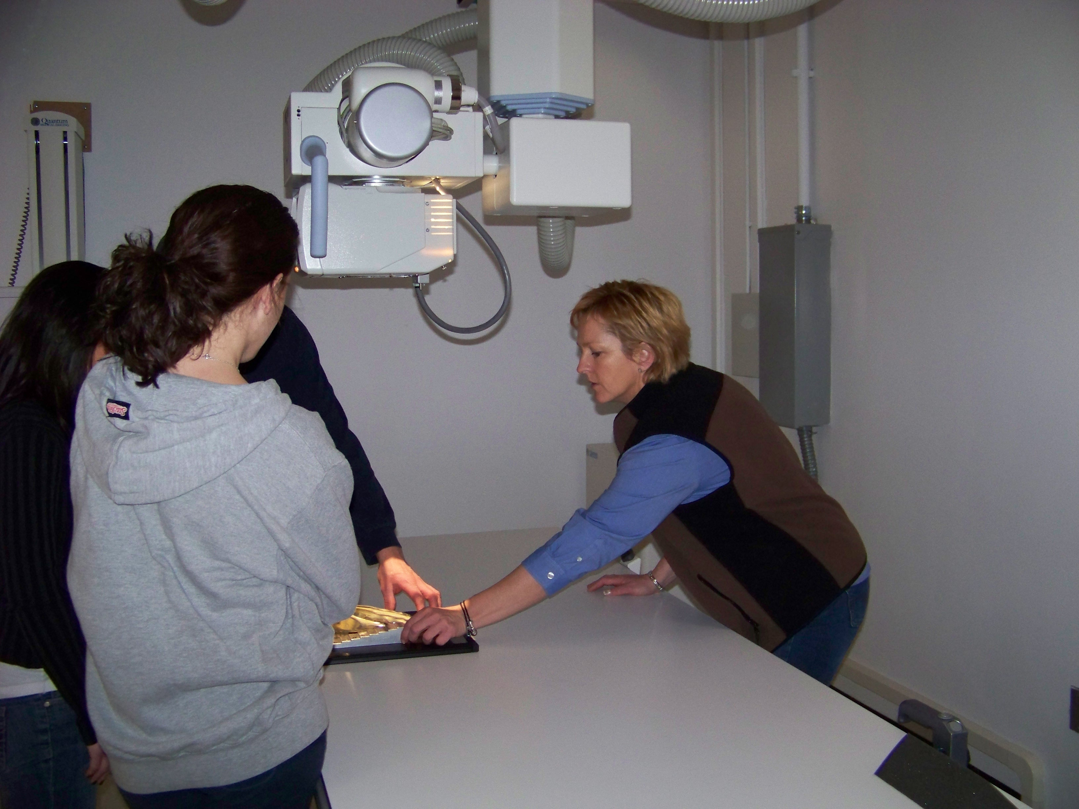
John Wooden said, “You can't live a perfect day without doing something for someone who will never be able to repay you.” Appreciate what an opportunity and privilege it is to live in service to others. In service, we learn about each other. The lives from which you come have shaped the gift of your uniqueness. Once embraced, your uniqueness will become the very strength that shapes your success. Seek to help each other, teach each other, and learn from each other. Now you’re ready.
—Karen Dow, Massachusetts Bay Community College

Slide 34
As a writing teacher for the last 20 years, I have been privileged to read about every topic and issue under the sun. And every semester, I always marvel at what my students bring to the page—what they say and how they say it. Their potential is staggering, and my reward is constant.
—Nina Keery, Massachusetts Bay Community College

Slide 35
We are apprentices. Teaching is being; its true nature requires us to always be learners. It is a journey toward that elusive practice of freedom.
—Mohammed Zefzaf, Massachusetts Bay Community College

Slide 36
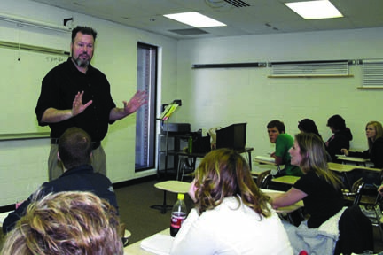
—Todd Culp, McHenry County College (IL)

Slide 37
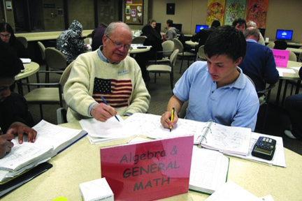
—Robert Reass, McHenry County College (IL)

Slide 38
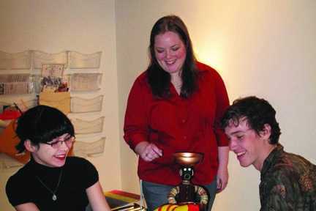
—Sarah Ruthven, McHenry County College (IL)

Slide 39
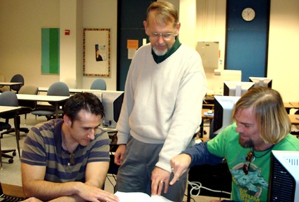
I do not see myself as the "expert" but rather as someone with experience who can help students connect with material and make it their own.
—Fred Hills, McLennan Community College (TX)

Slide 40
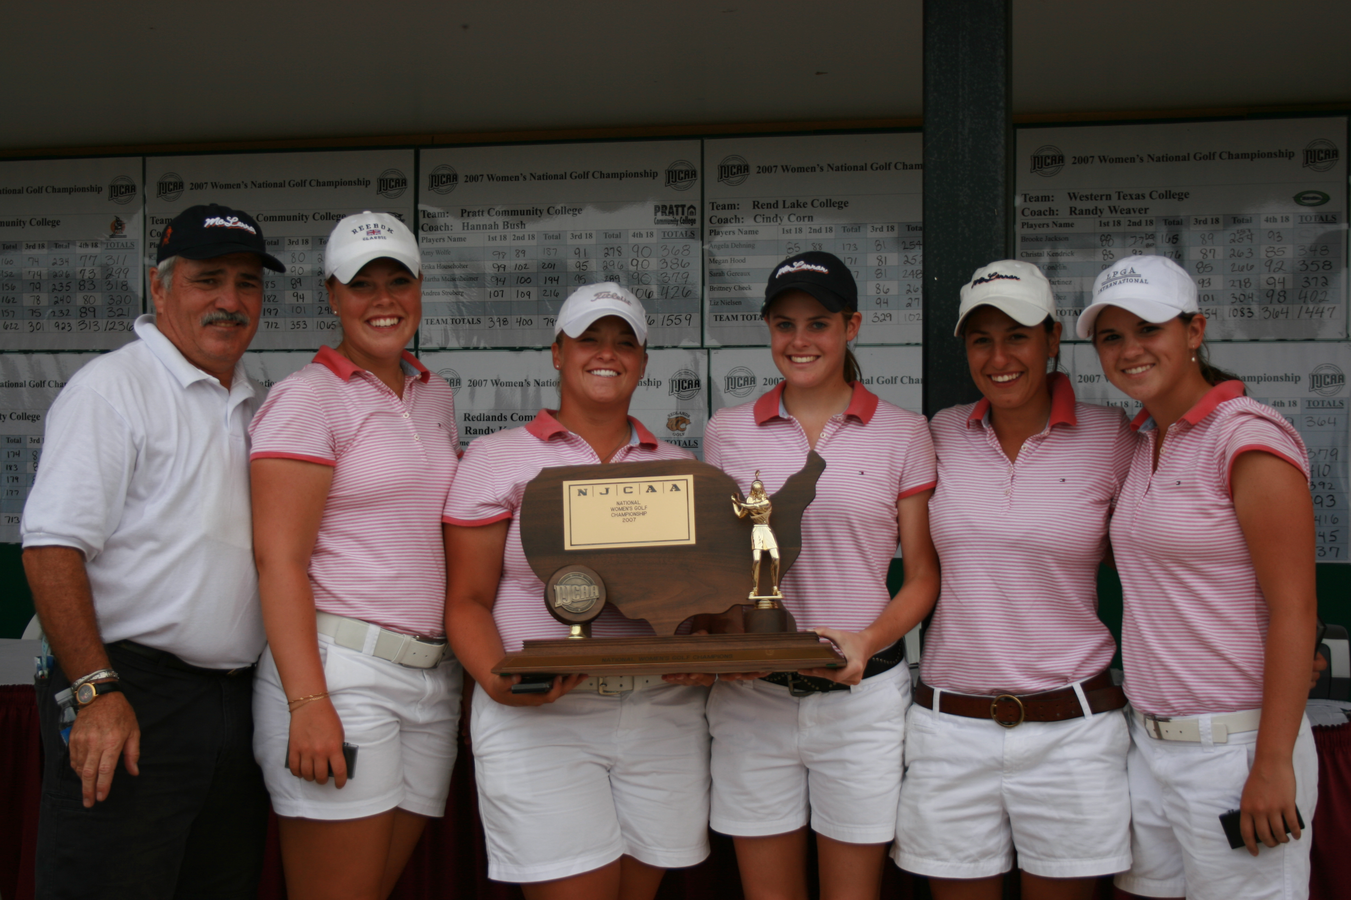
I'm a teacher who coaches. I try to prepare my economics students for tests like I prepare my team for golf tournaments. I tell/demonstrate/show the students what we are doing and why. Then I try to help them make better decisions on tests and with real-world situations.
—Stan Mitchell, McLennan Community College (TX)

Slide 41
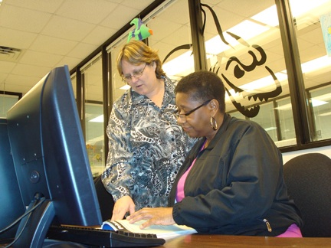
What inspires and motivates me about teaching is knowing that each day I have another opportunity to help students have one of those ah-ha moments...when the light suddenly comes on as he/she struggles to overcome a learning objective. No matter how trivial or enormous it may actually be. The smile tells it all.
—Catherine Prause, McLennan Community College (TX)

Slide 42
After 30 years of working in the transportation industry, I was fortunate to be hired to design and implement a CDL training program for the college. I now enjoy giving others the opportunity to enter into an occupation that was rewarding to me. My philosophy is simple. I was good at what I did, and I make every effort to give as much knowledge, experience, and technique to students so they can one day be better than me. Teaching has been a wonderful learning, challenging, and motivating experience for me.
—Rick Sandvig, Metropolitan Community College (NE)

Slide 43
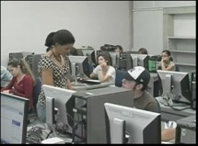
I am in the business of selling hope to students.
—Alina Coronel, Miami Dade College (FL)

Slide 44
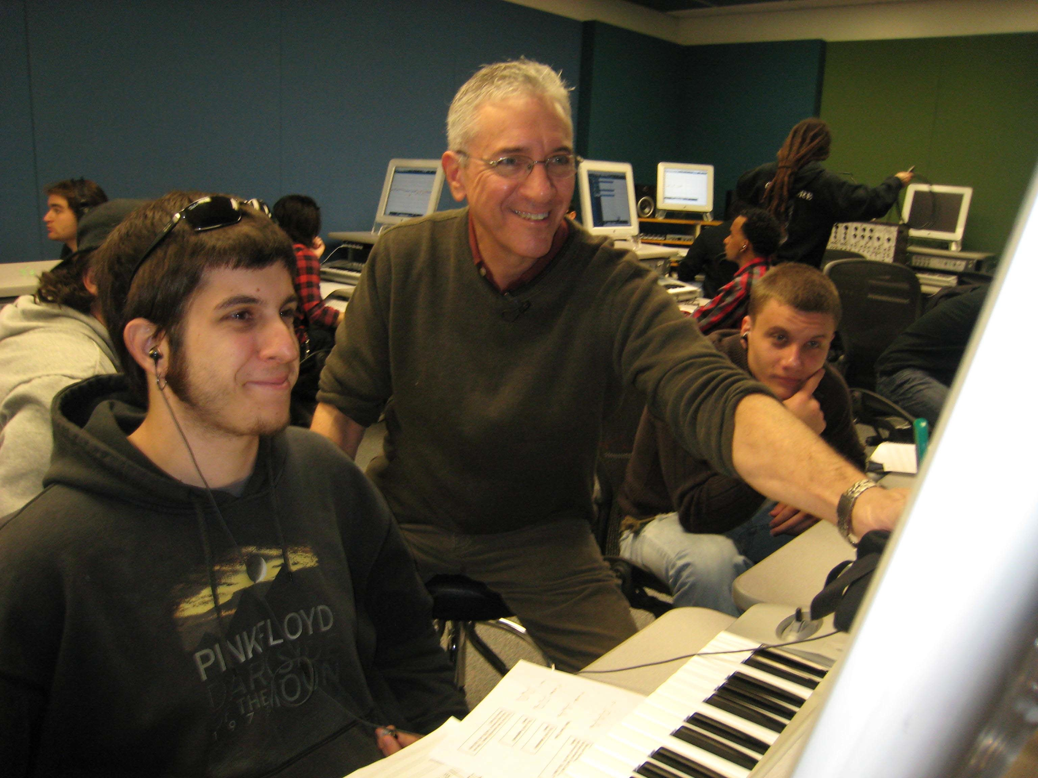
Students in arts technology classes ought to have resources in labs that exceed what's available to them at home. Providing this motivates and inspires students and reinforces the value of the good things that can be found at a college when one chooses to explore it. State-of-the-art is my goal!
—Richard Rose, Miami Dade College (FL)

Slide 45
Online courses are not a necessary evil or a repository for on-campus coursework files, but rather they are an opportunity to re-imagine our students’ learning experiences. I aim to improve online teaching to achieve and exceed the levels of interactivity and student engagement possible in a brick-and-mortar class.
—Jessie Allen, Mid-Plains Community College (NE)

Slide 46
Exceeding expectations is more rewarding than meeting expectations—that’s what I want my students to realize. By pushing them to explore how smart they really are, and challenging them to learn how to learn, I help my students grow and develop self-confidence, so they can realize their potential.
—John Femia, Middlesex Community College (MA)

Slide 47
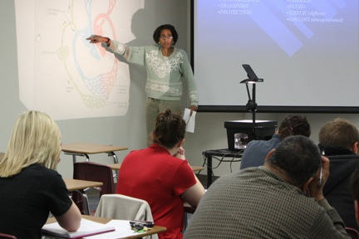
I find teaching can be as contradictory as the flavors of sweet and sour shrimp; frustrating yet rewarding, time consuming yet engrossing, repetitive yet new! I love to teach because at the end of the day, it’s the students, with their desire to learn, who inspire me to teach.
—Claudia Hinds, Midland College (TX)

Slide 48
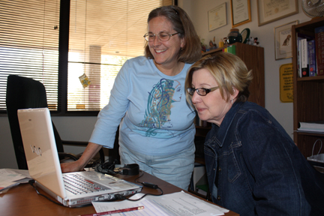
My motto is “your success is my success.” I do not want to be an "instructor." I want to be a teacher. The teacher works with the student to develop the learning process. It is said that teaching is an art. One of my goals in teaching is to develop the love of learning.
—Valerie Steiner, Midland College (TX)

Slide 49
This is the information age, and knowledge is the currency of the realm. Using technology to locate, evaluate, and effectively utilize knowledge is the key to success in today’s world. Mathematics is the perfect place to teach information literacy. So that is why I incorporate technology into mathematics.
—Doug Culler, Midlands Technical College (SC)

Slide 50
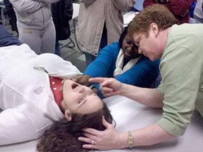
To be able to share my love of teaching with my passion for radiology is a true blessing! I model the compassion I want students to have with each patient we x-ray. They learn the responsibility of their knowledge; I feel a part of me will live on in them forever. Now that is impact!
—Mildred Massey, Midlands Technical College (SC)

Slide 51
I believe in participatory leadership.
—Diana Stithem, Mohave County Community College (AZ)

Slide 52
I aim for a pedagogy that looks and feels as if it has been hatched out of the minds of the students themselves. In his “Essay on Criticism,” Alexander Pope said that there is a kind of art that conceals that it is art. Well, there is also a kind of teaching that conceals that it is teaching.
—William Dunning, Monroe Community College (NY)

Slide 53
The greatest source of my motivation comes from my love of mathematics and my desire to share it with others. I embrace each opportunity to teach my students mathematics and to help them develop an appreciation for it. I often learn as much from them as they do from me.
—Steven Kilner, Monroe Community College (NY)

Slide 54
Staying motivated is easy when you love what you do!! As an educator, each day I have an opportunity to serve as a role model, to challenge, support, and inspire students. Two messages I share with them are, "don’t be a prisoner to fear, your past or your future” and "find reasons to succeed rather than excuses to fail—we live in America, truly the land of opportunity.”
—Sherry Tshibangu, Monroe Community College (NY)

Slide 55
At the beginning of the semester, I see people hesitantly give tentative answers to my questions about the reading. At the end of the semester, with a little luck, I see confident people clamor to engage their peers in conversations about texts and ideas. That’s rewarding.
—Jana Carter, Montana State University–Great Falls College of Technology

Slide 56
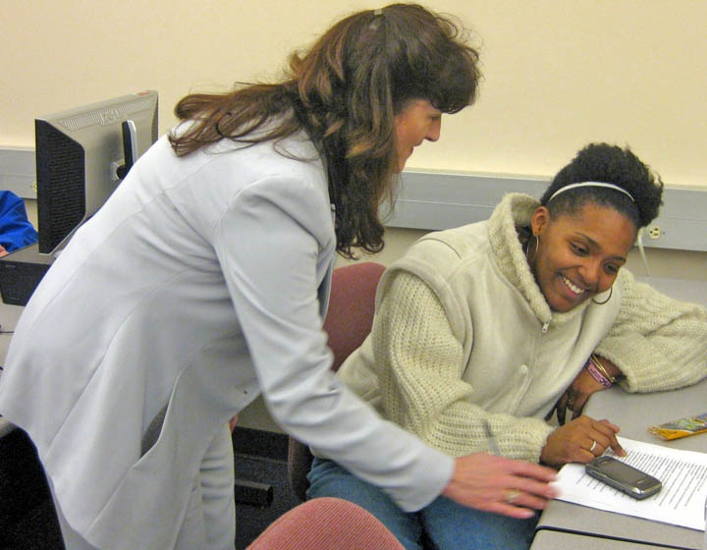
A prime motivator in teaching should be to challenge students to reach beyond their comfort zones and to explore the options available to them. Challenge yourself to search out more information and learn from your student and your peers. Each day offers us a new chance to move forward and embrace the challenges of life.
—Teri Dwyer, Montana State University–Great Falls College of Technology

Slide 57
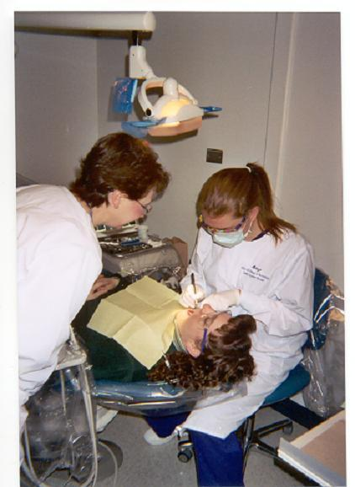
Teaching is wonderful, it allows me to learn continually right along side the students. Students challenge you to be your best by looking to you as a role model. There are moments of frustration and heartache, but seeing students succeed in the end makes it all worth it!
—Kimberly Woloszyn, Montana State University–Great Falls College of Technology

Slide 58
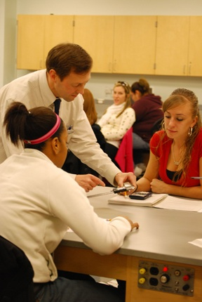
What motivates me when I am teaching is that education is a life-long pursuit regardless of age. My students range from those straight out of high school to senior citizens, but all have one common thread: the pursuit of knowledge to improve the quality of their lives.
—Craig Casey, Morton College (IL)

Slide 59
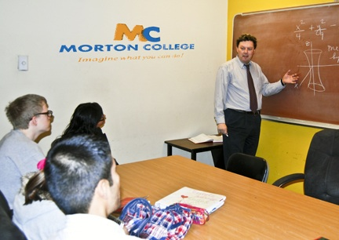
Many students find math difficult. I try to make it enjoyable. Learning new things that are practical and interesting is rewarding and is beneficial both now and in the future. I try to make learning new and useful.
—Robert Casey, Morton College (IL)

Slide 60
In the classroom, concepts are introduced. Outside the classroom, concepts are learned. I believe learning, like life, is experiential. I facilitate new, sometimes life-changing experiences for my students by sending them out into the world to discover art for themselves.
—James Behan, Mountain View College (TX)

Slide 61
You are not climbing a mountain. You ARE the mountain. In other words, do not be afraid of falling. Be confident in the immensity of your potential. I try to remove my students’ fears so that they take delight in what they already know. The learning process remains mysterious. That is just fine with me.
—Martin Guerra, Mountain View College (TX)

Slide 62
Focusing on the possibilities ignites my creativity; producing in a team environment makes work enjoyable.
—Christa Jones, Mountain View College (TX)

Slide 63
I became a librarian to learn something new every day. I teach at a community college to be inspired by someone new every day.
—Anna Johnson, Mt. Hood Community College (OR)

