Slide 1
We aren't all given the same gifts. If I can help a student identify and develop their talent to their best ability, even if that ability is a "C" compared to another's "A," I feel rewarded. It is a privilege to help those achieve what they didn't think possible.
—Madelyn Danner, Harford Community College (MD)

Slide 2
Educating nurses gives me the opportunity to instill enthusiasm for the profession and excellence in practice. By my example as a teacher and a nurse, I am presented this challenge with each new nursing class. It is extremely satisfying to watch a student emerge into a professional nurse.
—Katherine Leonard, Harrisburg Area Community College (PA)

Slide 3
There is no one person more responsible for student success than the other. It is only through creating an atmosphere of open communication among all instructors that student achievement can be maximized. We must listen to our students and to one another.
—Elizabeth Holmes, Harford Community College (MD)

Slide 4
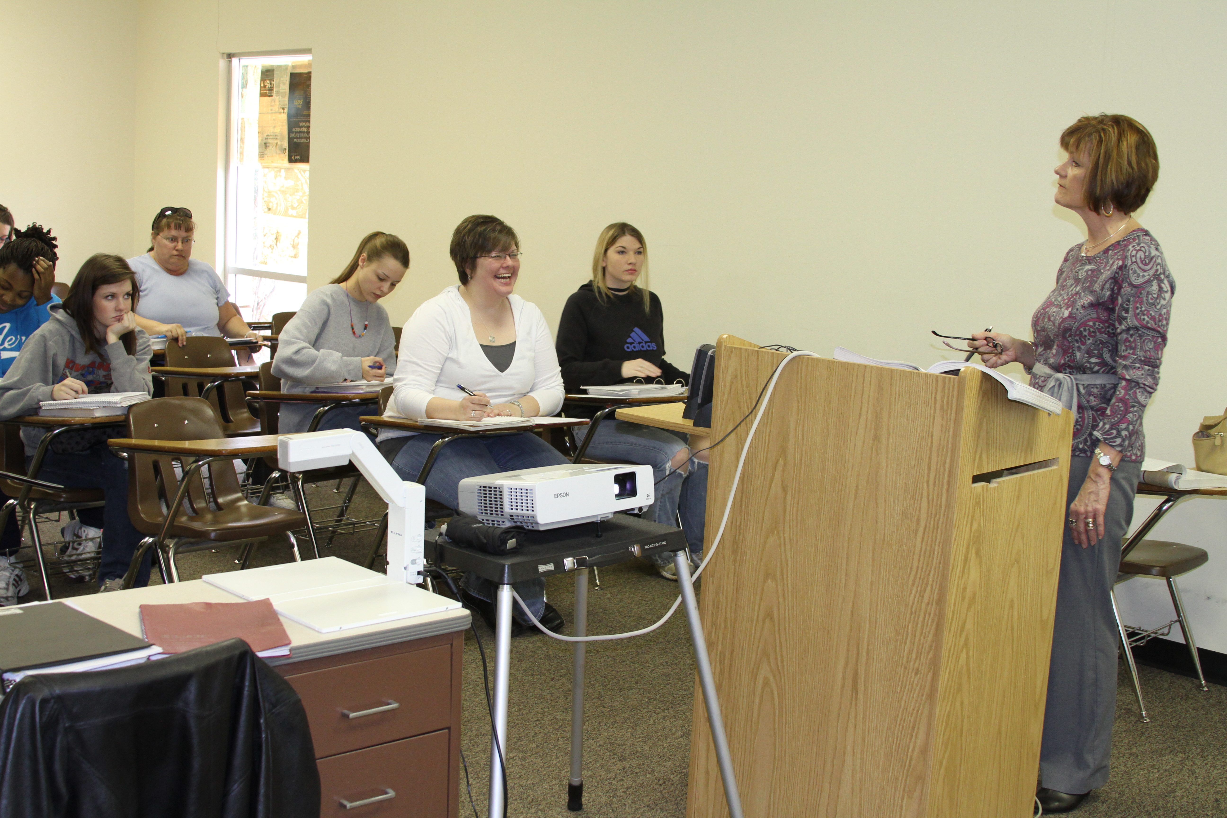
A college education is the most efficient means of improving oneself, creating a higher standard of living, and collecting the knowledge to make good decisions. Students are worthy of the teacher's time, attention, assistance, and accessibility. Teaching is a place where the student becomes a stakeholder in education.
—Pam Boehm, Hill College (TX)

Slide 5
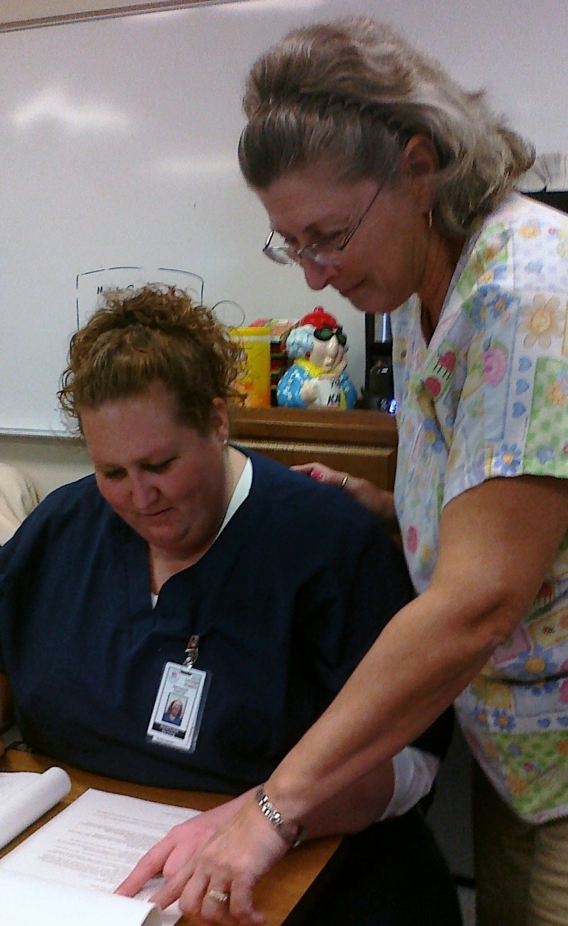
I teach nursing students, watching them come into the program like rose buds, tight and timid. They graduate as full-bloomed roses.
—Sherry Bright, Hill College (TX)

Slide 6
I love to watch students realize math is not something to fear or dread, but something they can understand and embrace as a tool to use throughout their lives.
—Patricia Hillyard, Hill College (TX)

Slide 7
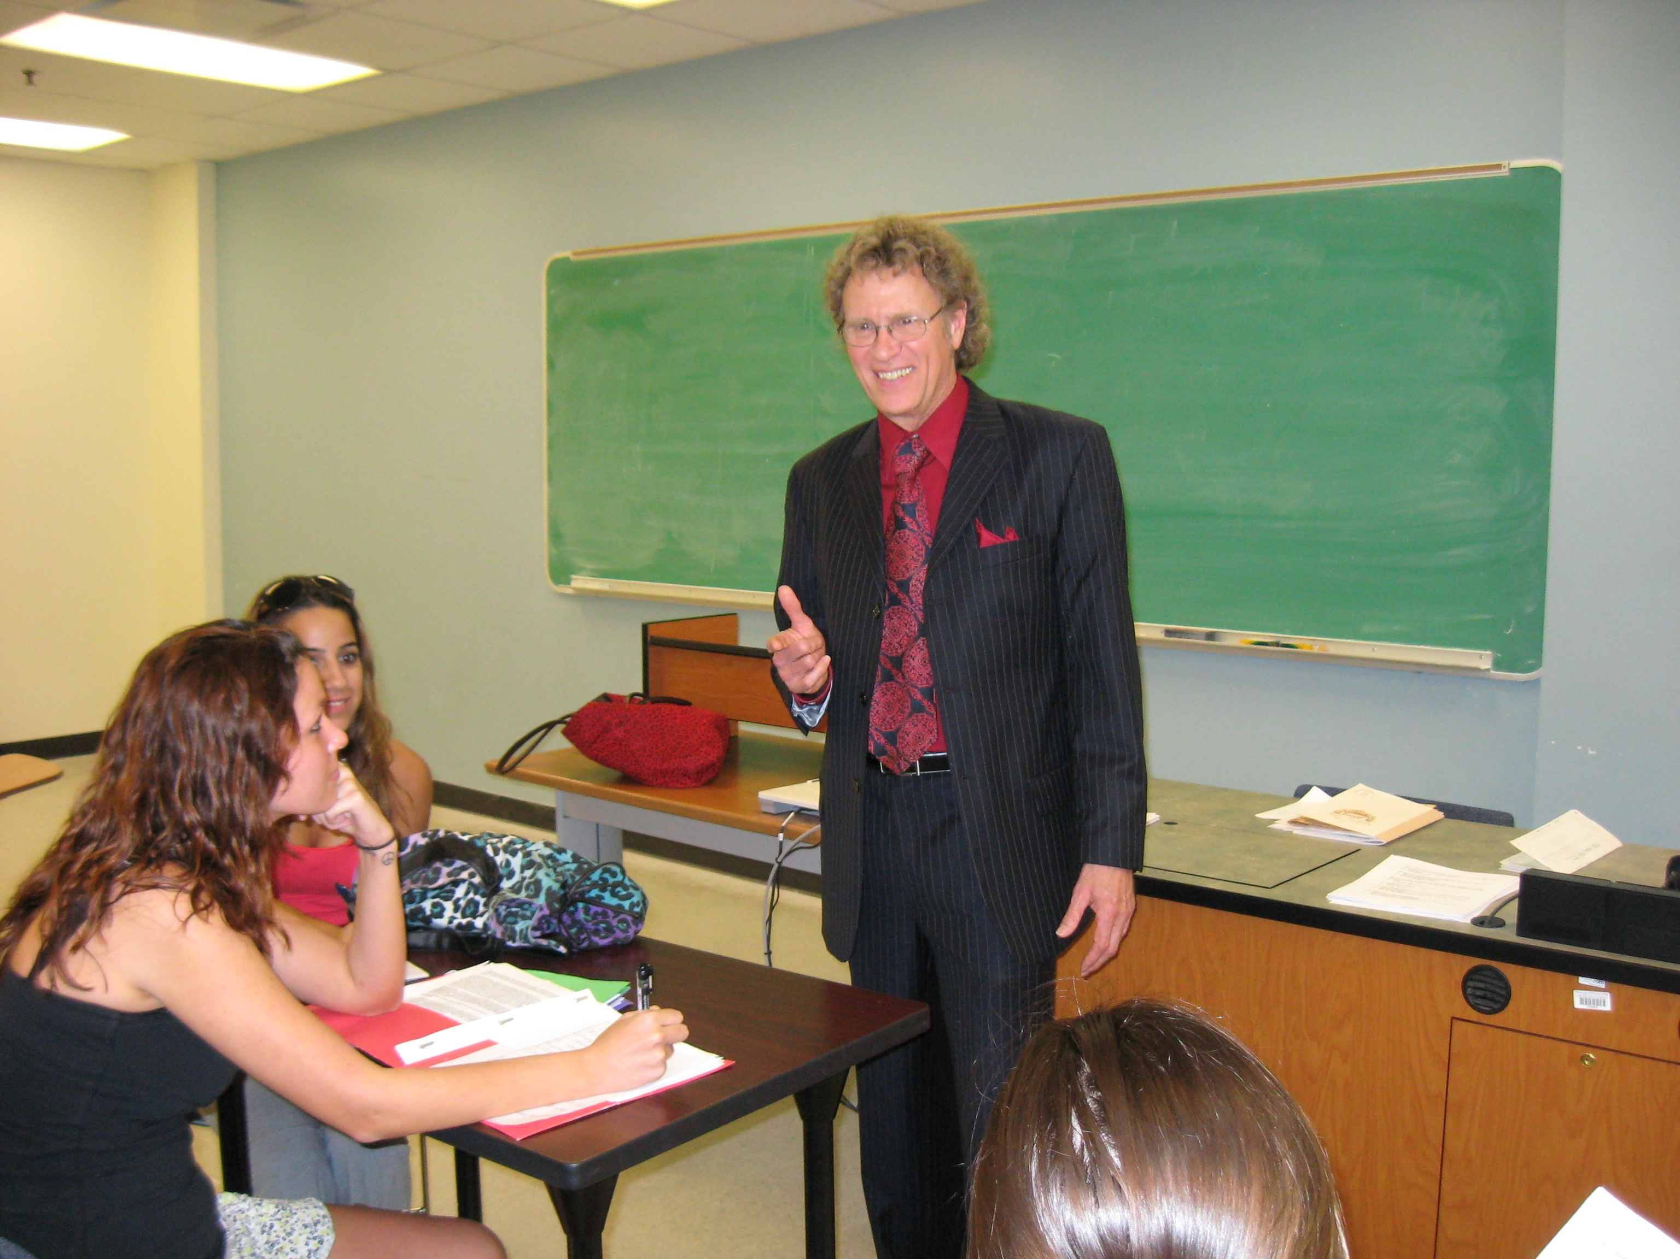
Make a difference in students' lives now, and they will make a difference in the future.
—Walt Ellis, Hillsborough Community College (FL)

Slide 8
I live by the philosophy that "people may forget what you say and do, but they will never forget how you make them feel." As a mathematics professor and college administrator, I have always achieved success by empowering others through empathy, encouragement, and positivity.
—Craig Hardesty, Hillsborough Community College (FL)

Slide 9
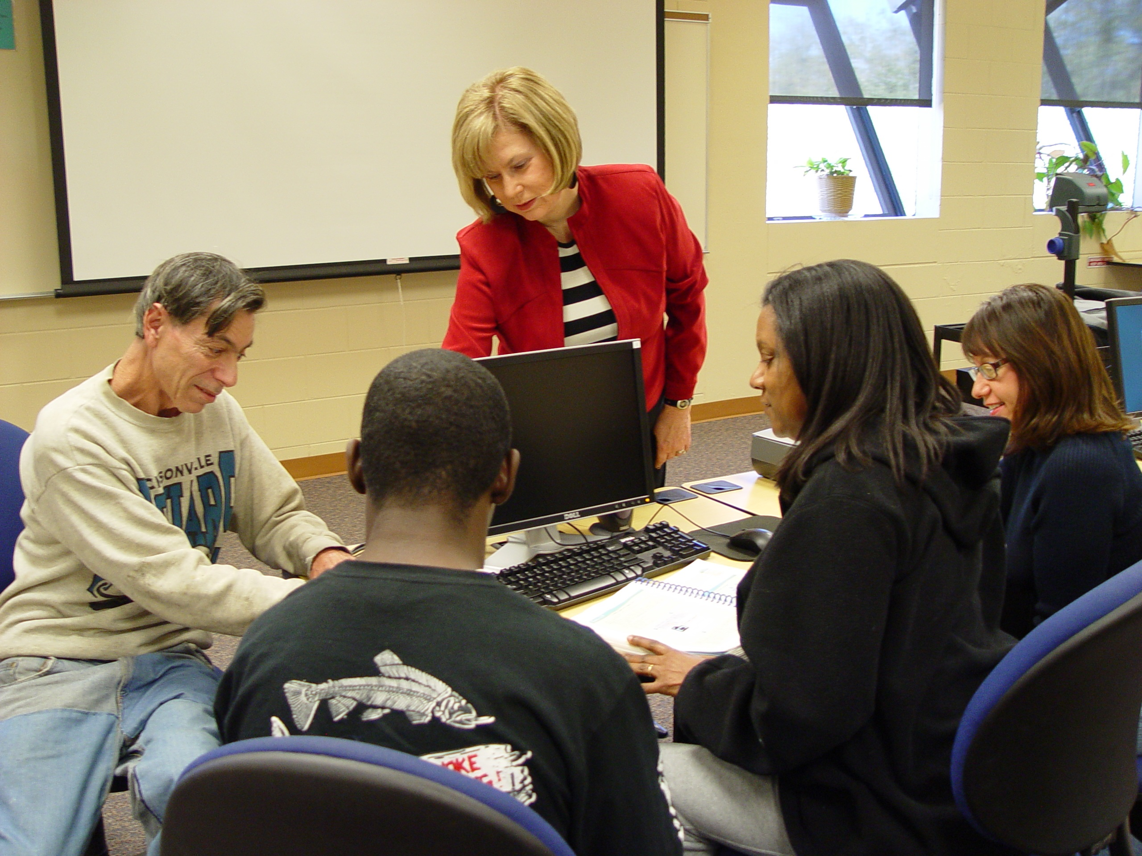
My challenge as a teacher over the last 40 years has been to meet student expectations and prepare them for the next learning experience in their life journey.
—Linda Prescott, Hillsborough Community College (FL)

Slide 10
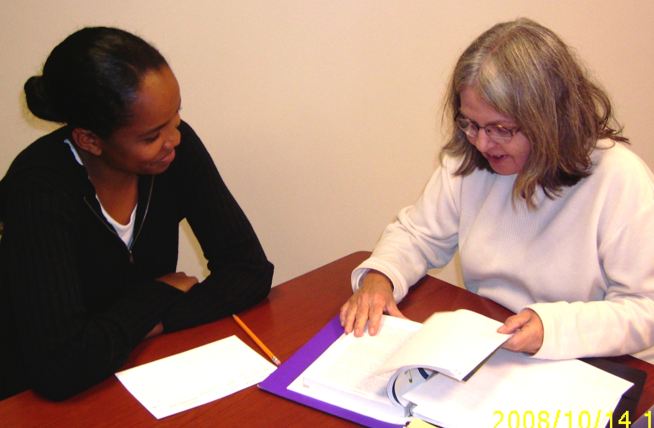
Working with a team of dedicated tutors in our new Learning Commons is exhilarating as we guide students one-on-one through so many disciplines from algebra to poetry analysis. The rooms are filled with the electricity of personal interactions, academic hard work, and dynamic intellectual growth. Everybody learns.
—Marcella Sherman, Hillsborough Community College (FL)

Slide 11
I tell my students: Never forget that persistence, discipline, determination, and study win the day. You can do this!
—Robbe Hallmark, Houston Community College (TX)

Slide 12
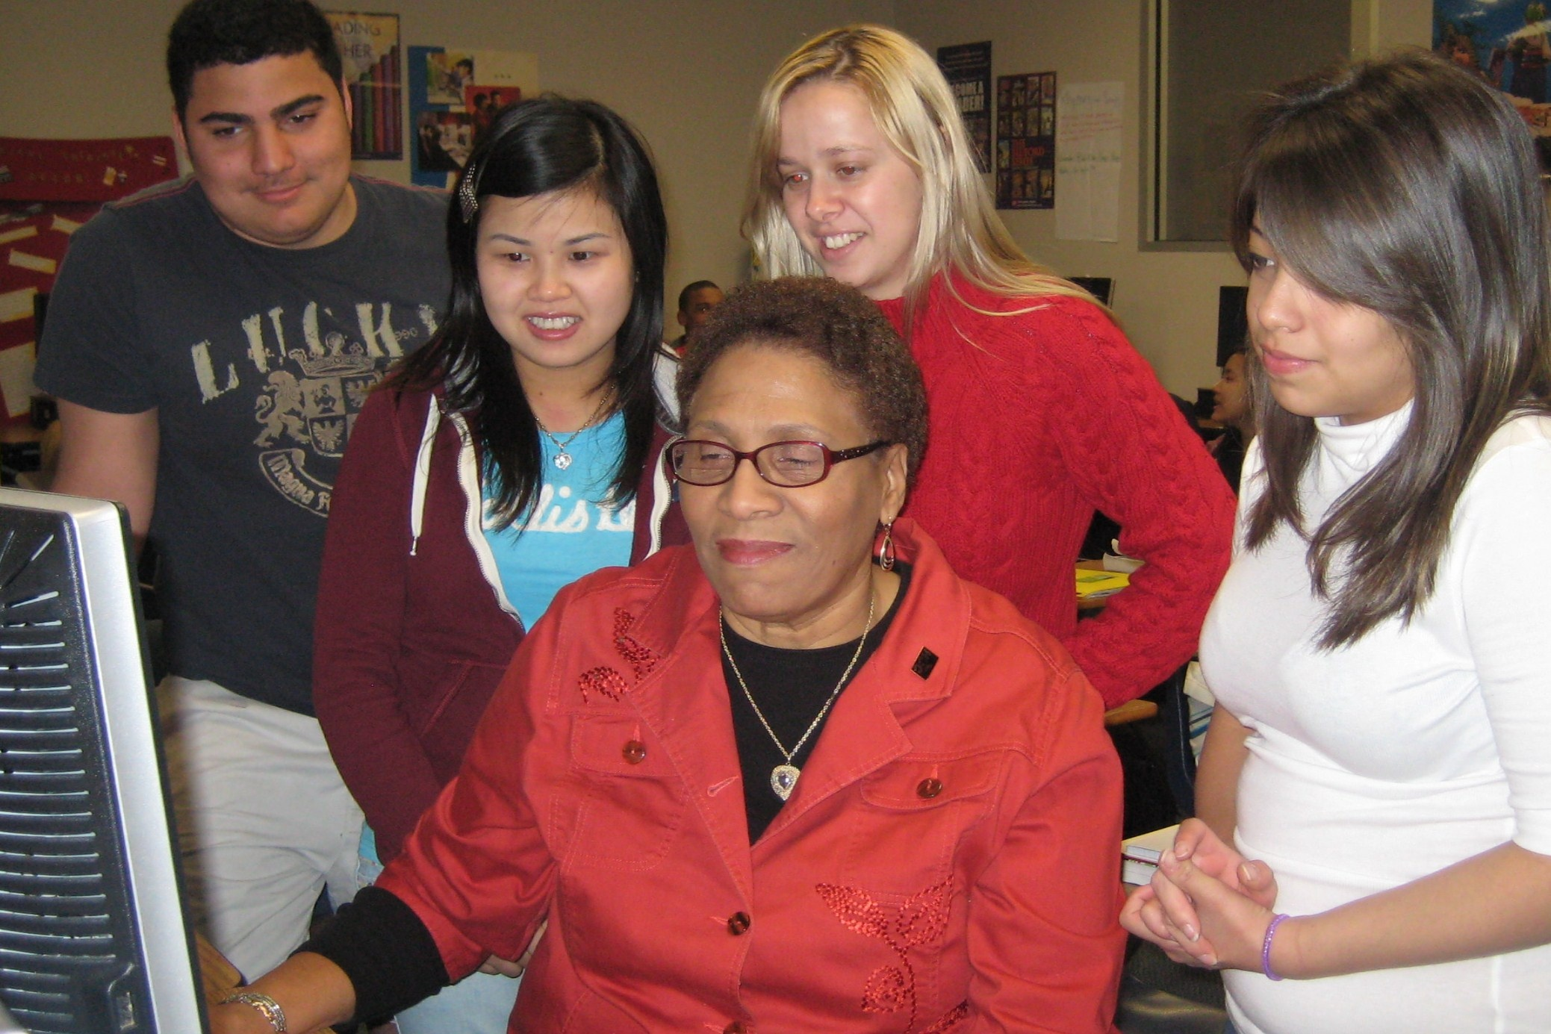
My belief is that for students to become lifelong learners, they must develop a passion for learning. I am driven to be a facilitator who is committed to excellence, establishes high academic standards, and inspires students in the hopes of making a significant and positive impact in their lives as well as their role in an ever-changing society.
—Montez Hines, Houston Community College (TX)

Slide 13
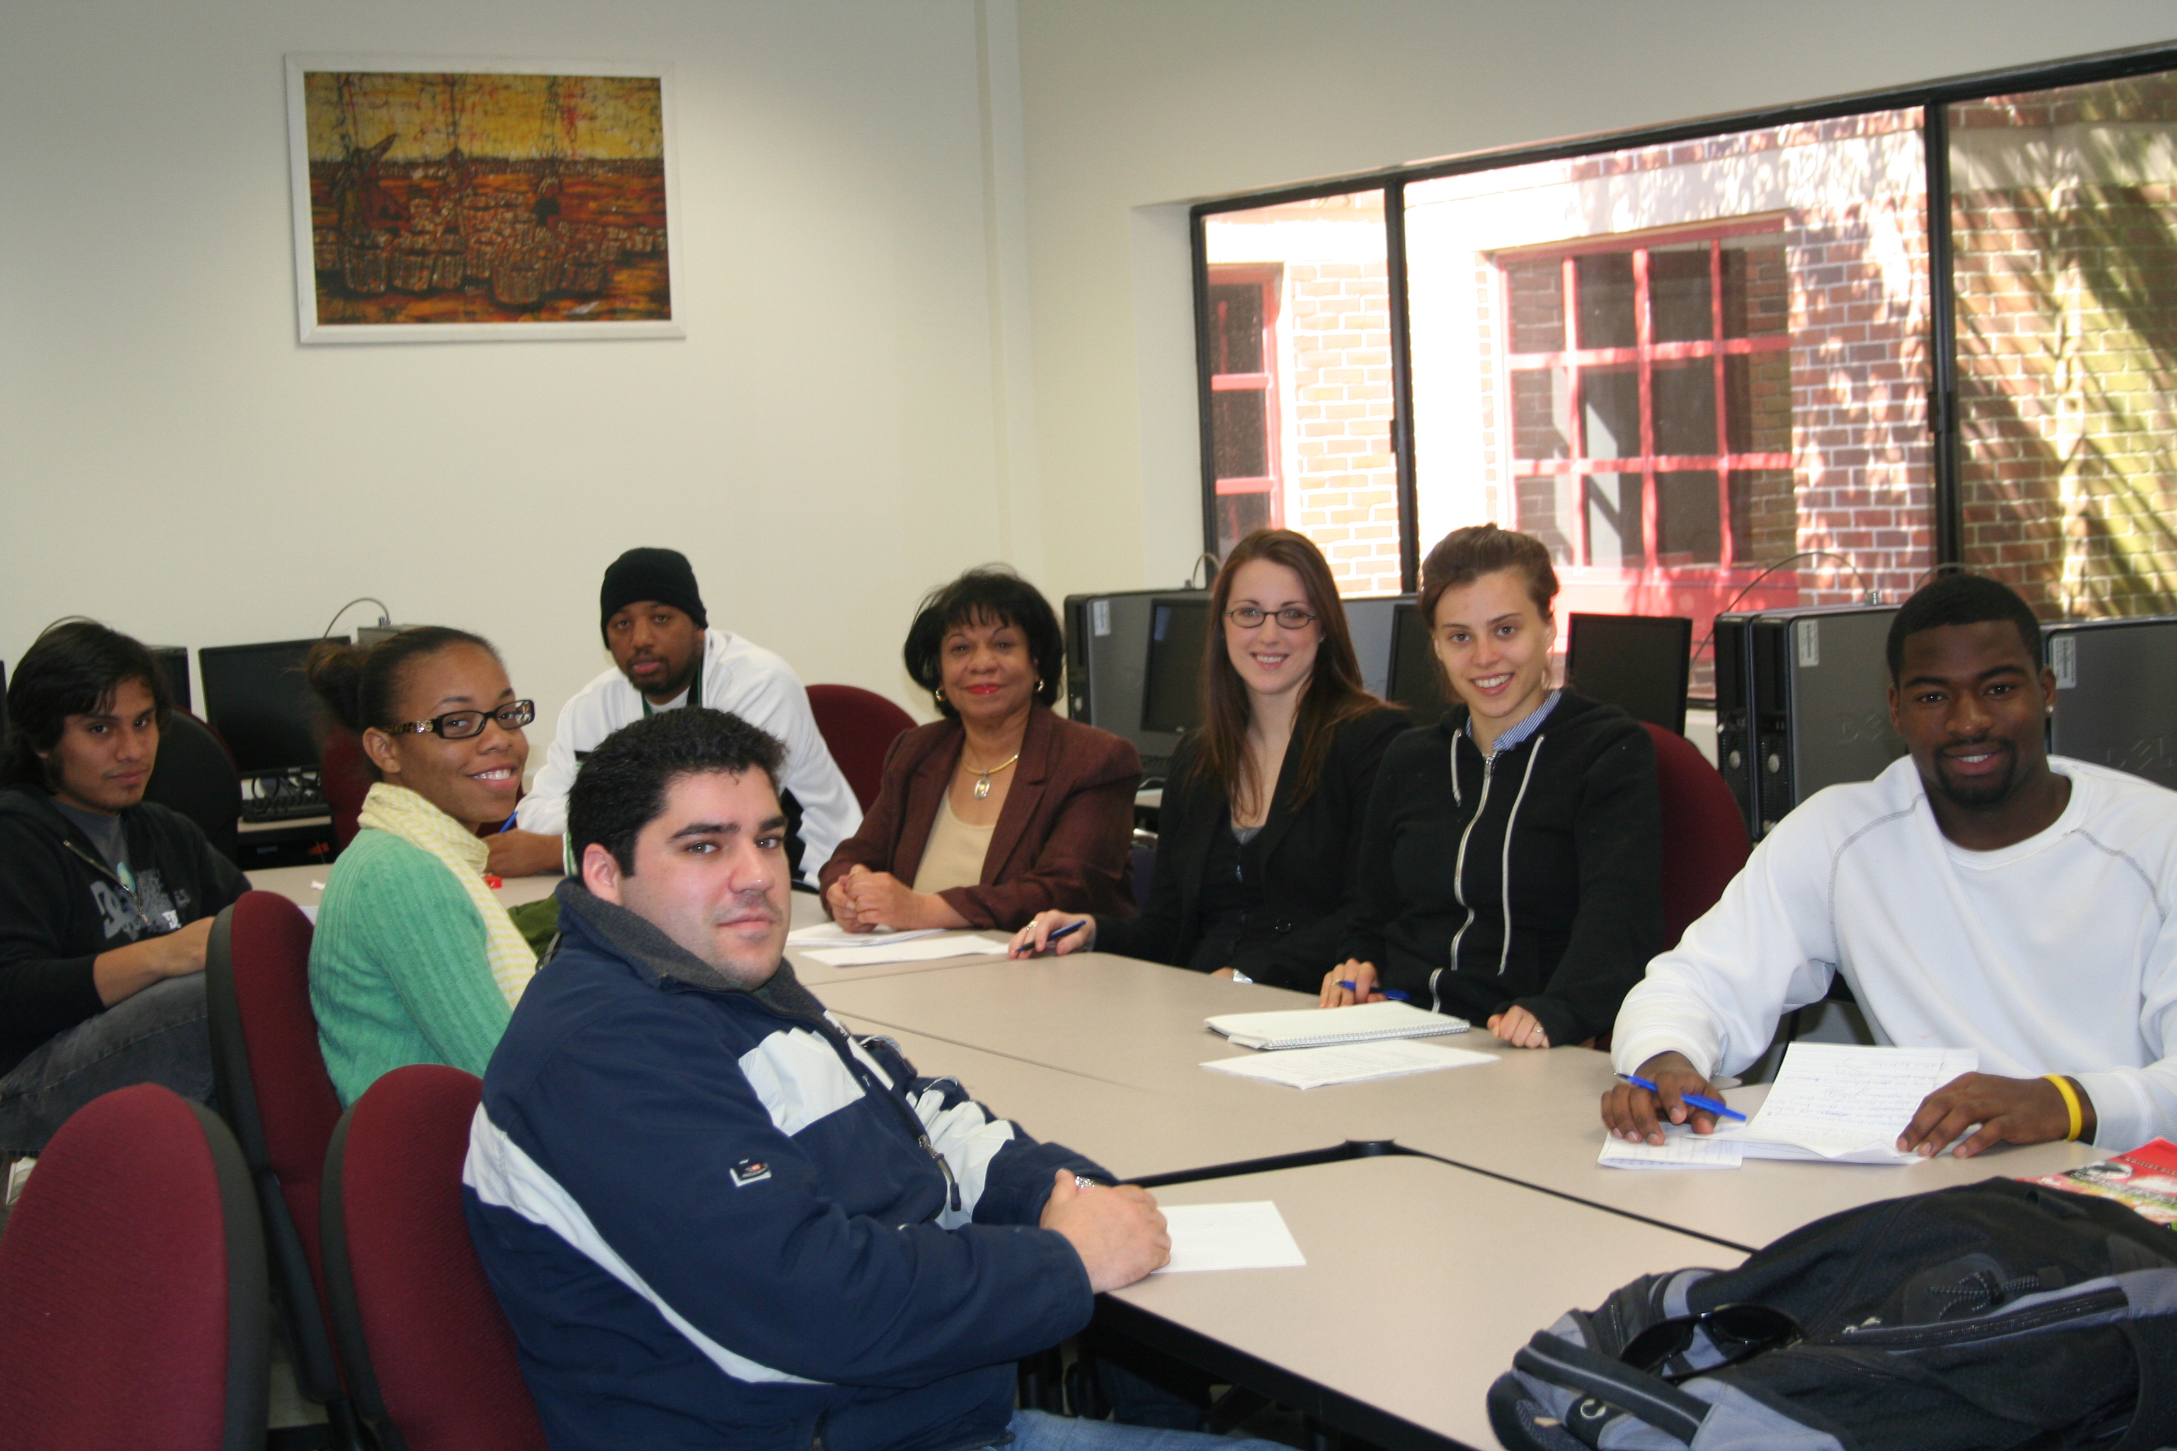
Making a difference in the lives of my students is the greatest motivating factor in my role as a teacher. I hope to create a student-centered environment that nurtures the development of my sociology students in terms of their skills, talents, and abilities. I hope that my students will be enlightened by the course, engaged in applying what they have learned to everyday life events, and empowered to improve the quality of their lives and communities.
—Patricia Johnson, Houston Community College (TX)

Slide 14
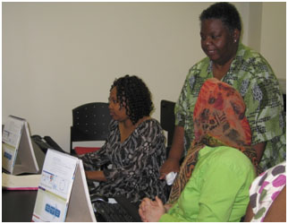
Using an active learning environment allows students to become actively involved in their learning process by connecting prior knowledge and new content to which they're exposed. Teaching in Business Technology provides me with an opportunity to use this environment to touch and change the lives of students by providing knowledge and content.
—Rhonda Johnson, Houston Community College (TX)

Slide 15
Goethe said, “Treat people as if they are what they ought to be and you help them to become what they are capable of being.” We are most effective when showing students how to overcome difficulties and supporting them during the effort.
—Robin Raborn, Houston Community College (TX)

Slide 16
The knowledge and skills that students acquire in my classes help to form the foundations for their careers and can positively impact their personal and professional lives forever. This fact brings much gratification and motivates me to learn more, in order to teach more—as I also learn from them.
—Louis Smith, Houston Community College (TX)

Slide 17
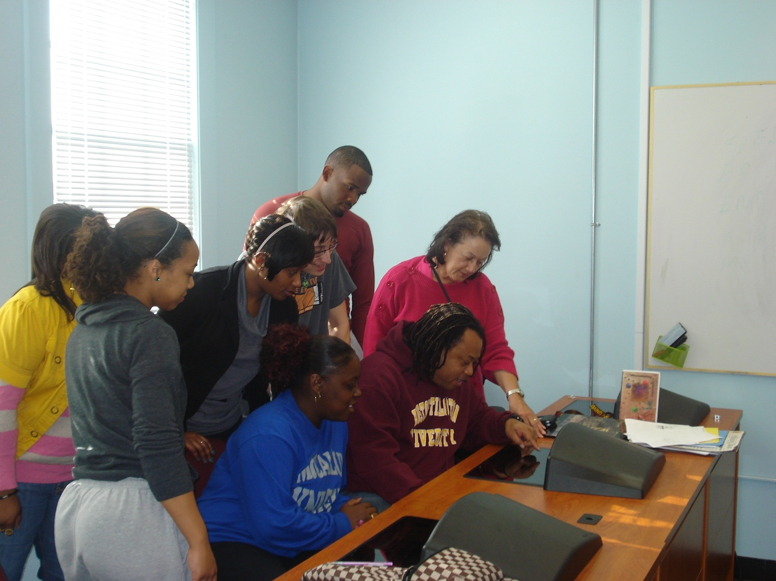
As a teacher and educator for more than 40 years, I can truly say that I am inspired by the scope of the influence of our work. When I see former students who are delighted to see me, I have to wonder how they are able to recognize me after so many years. This profession keeps me young at heart and in spirit.
—Deanna Mercer, Huston-Tillotson University (TX)

Slide 18
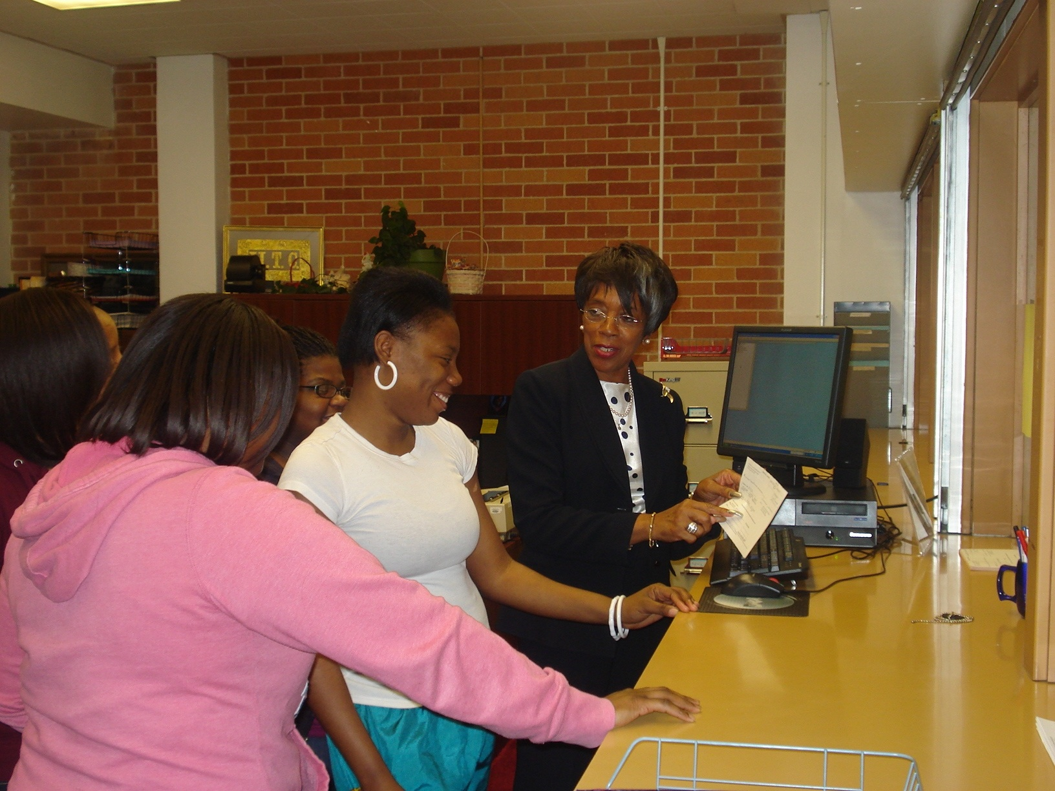
Miss no opportunity to teach is the premise upon which I operate. I am inspired, knowing that I can help students by making them aware of what it takes to be successful. Many students arrive on campus not understanding the "freshman to graduate" process. Enter the Registrar!
—Earnestine Strickland, Huston-Tillotson University (TX)

Slide 19
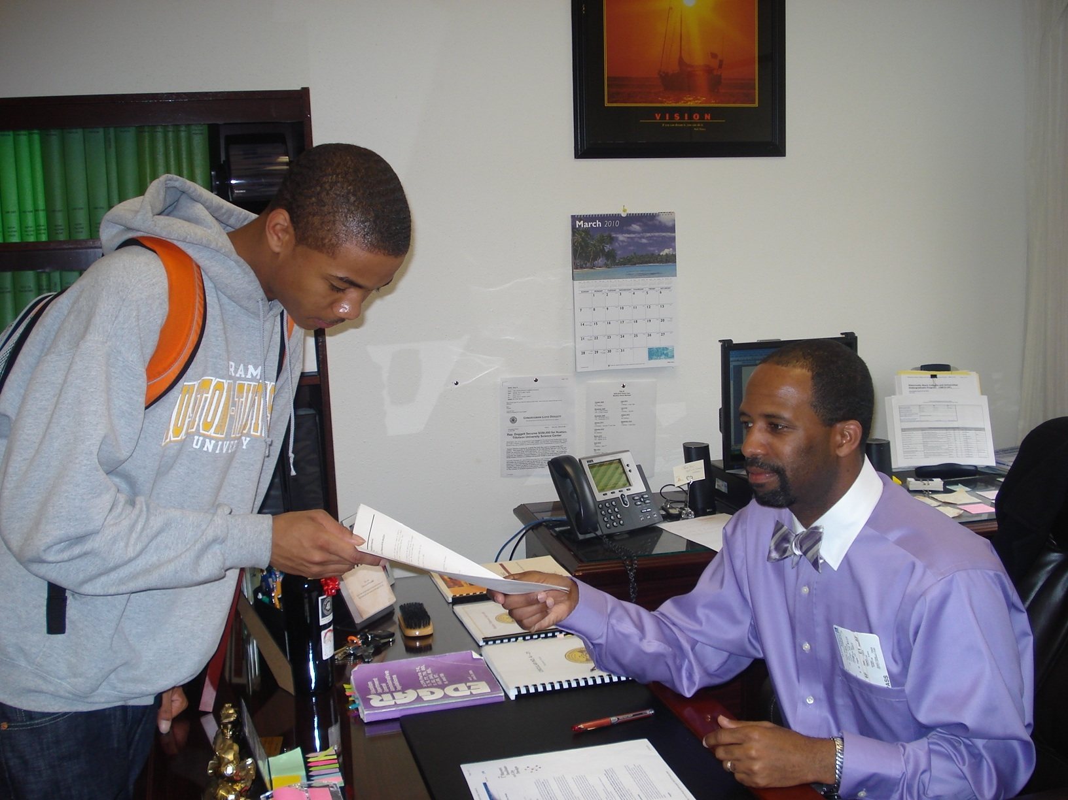
As educators we have a moral and ethical obligation to provide learning and professional growth opportunities for our students, staff, and faculty. In doing so, we will create a society of more productive citizens.
—Hillary Williams, Huston-Tillotson University (TX)

Slide 20
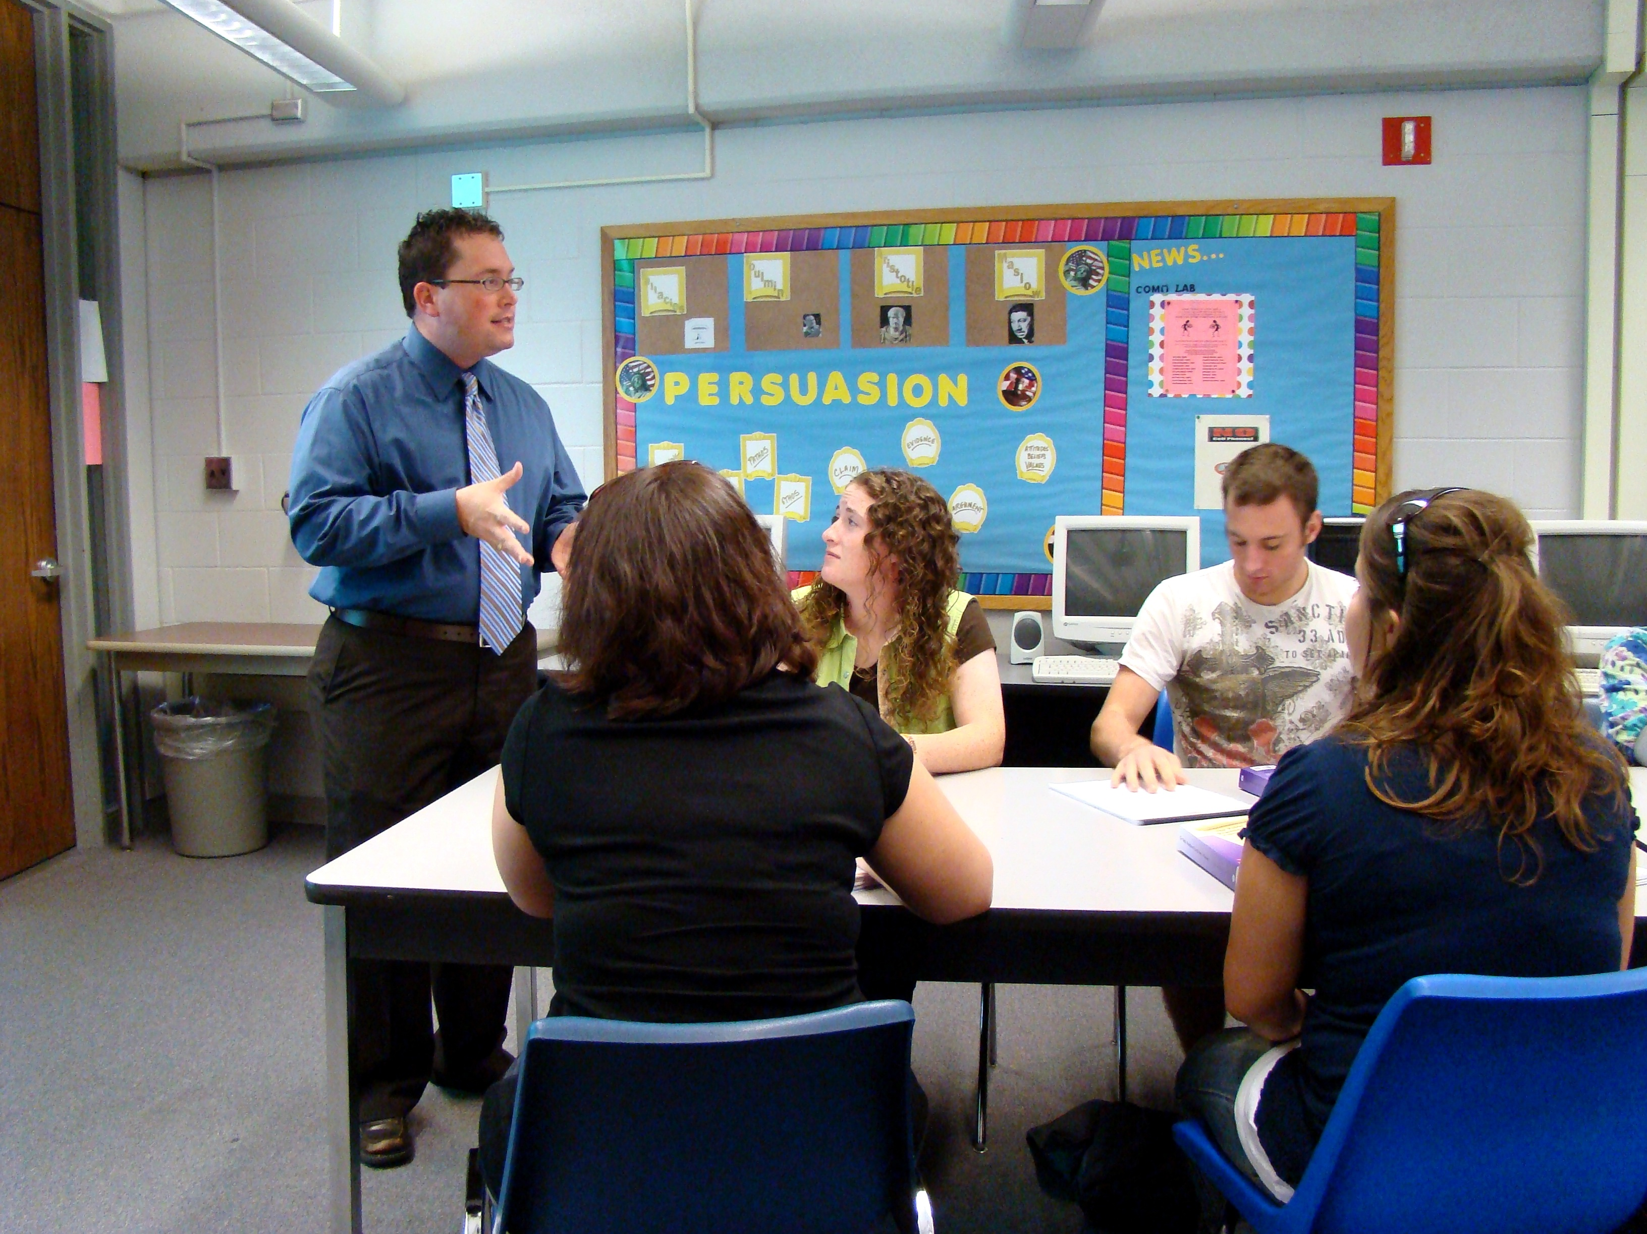
Teaching is a way of investing in our culture. If we do it carefully, we just might contribute to something big.
—Brent Goken, Illinois Central College

Slide 21
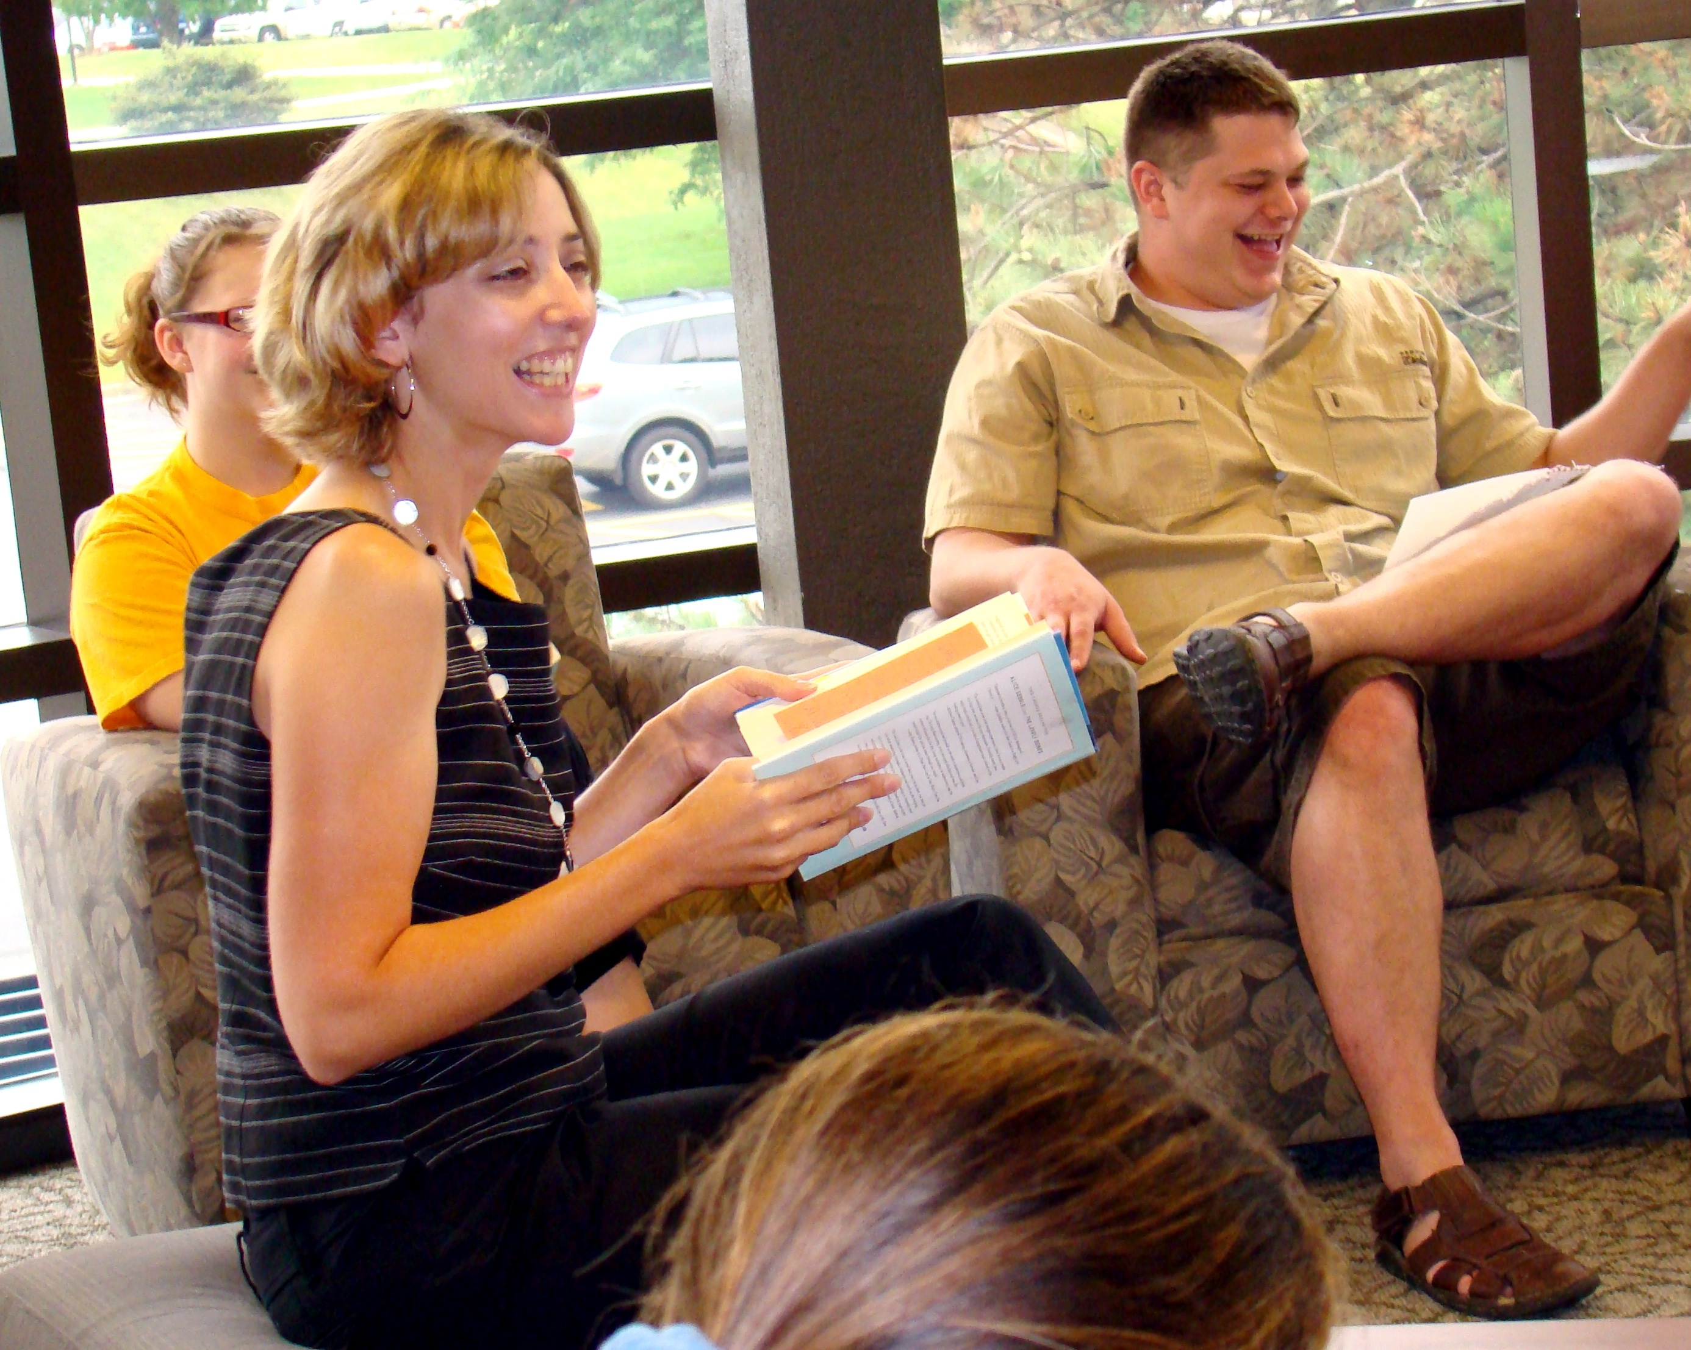
Relationships are crucial to student success. Teachers must connect with students in order to inspire and encourage. Students must connect with each other to foster a supportive learning community. With time, each class becomes a family, full of shared trials and triumphs. The semester ends, but the relationships continue. This is community college at its best.
—Sarah Parlier, Illinois Central College

Slide 22
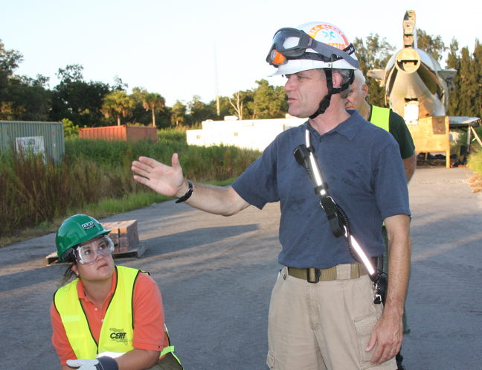
My privilege is to create exciting active-learning environments that challenge my students and myself to explore new concepts and new ideas. To witness students come alive, working with their new knowledge and skills and realizing their potential is the joy of being a teacher.
—Paul Forage, Indian River State College (FL)

Slide 23
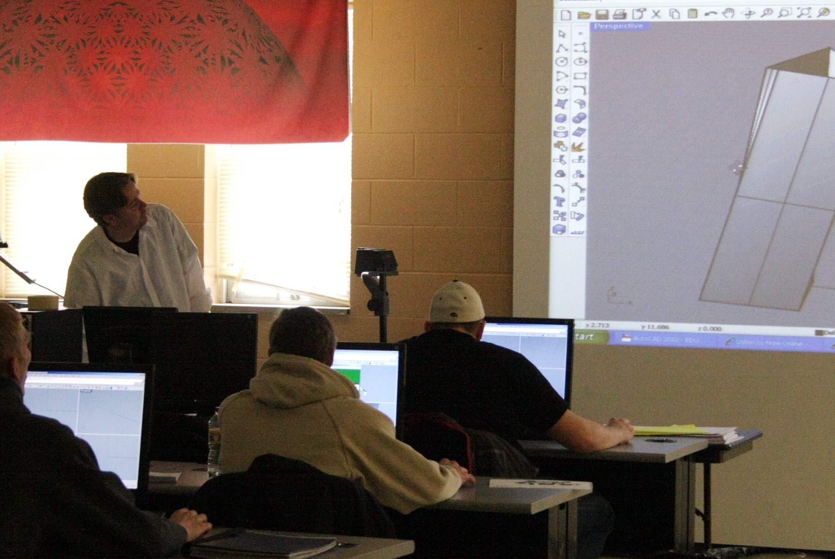
I left industry to become a teacher. My career has been a journey of discovering what teaching really is and what it is not. Everyday becomes another lesson in which I am the student. Through it all, I have found that teaching is about one human soul taking time to engage, encourage, and challenge another human soul to grow.
—Neil Peterson, Iowa Central Community College

Slide 24
I was blessed to have teachers who believed in me. They didn't just teach content. They motivated and challenged me to be my best, to think critically, and to open my mind to new possibilities. They inspired me, and above all, they cared. That is the legacy I hope to pass on to my students, as well.
—Amy Simpson, Iowa Central Community College

Slide 25
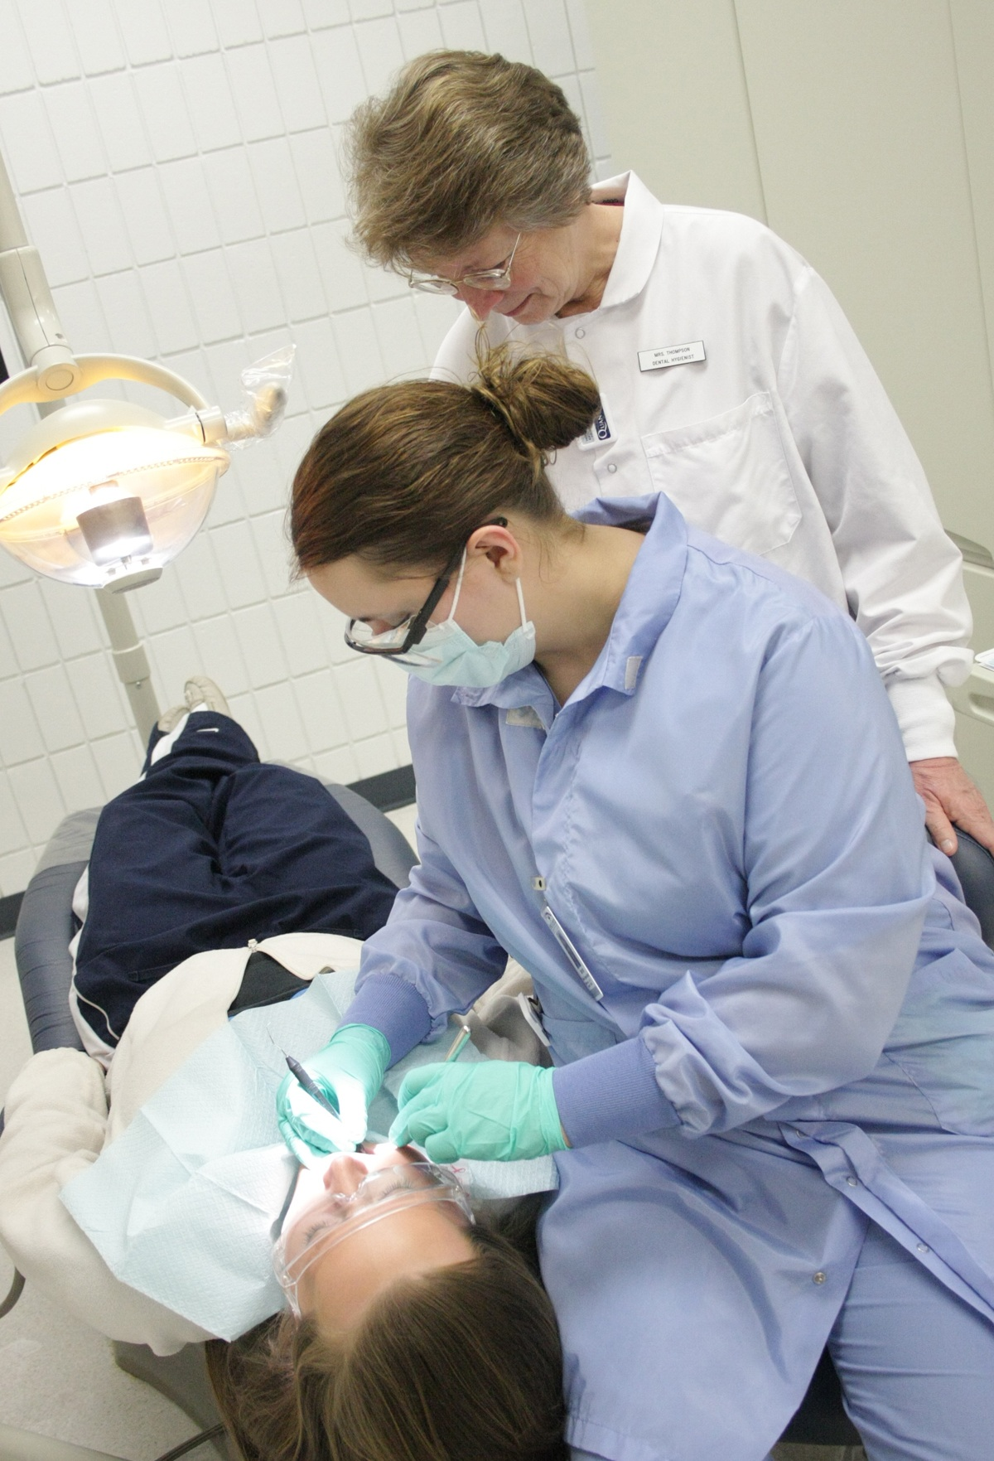
Successful teaching, like dentistry, is the result of teamwork. Together we work toward a common goal, a quality education for our students.
—Mary Thompson, Iowa Central Community College

Slide 26
Most of my students are majoring in a health-related field. This makes teaching these students easy and exciting because they are highly motivated and see the relevance of these topics to their field of study. That is how I approach teaching, to make the subject matter relevant, interesting, and understandable for my students. Focusing on my students, their goals and learning needs, always comes first. Community college students are very diverse and bring a multitude of experiences and strengths to the classroom. Does the educational experience get any better than this? (I say no!)
—Tamara Donney, Iowa Western Community College

Slide 27
Teaching provides the opportunity to go to work each day and do something I truly enjoy. Each semester begins with a new group of students, a new set of challenges, and every class represents an endless array of possibilities for both myself and my students in our quest for knowledge.
—Chuck Smith, Iowa Western Community College

Slide 28
While climbing the corporate ladder a number of years ago, I agreed to teach a college course. Little did I know that I would discover my true passion.
—Laura Pannell, Itawamba Community College (MS)

Slide 29
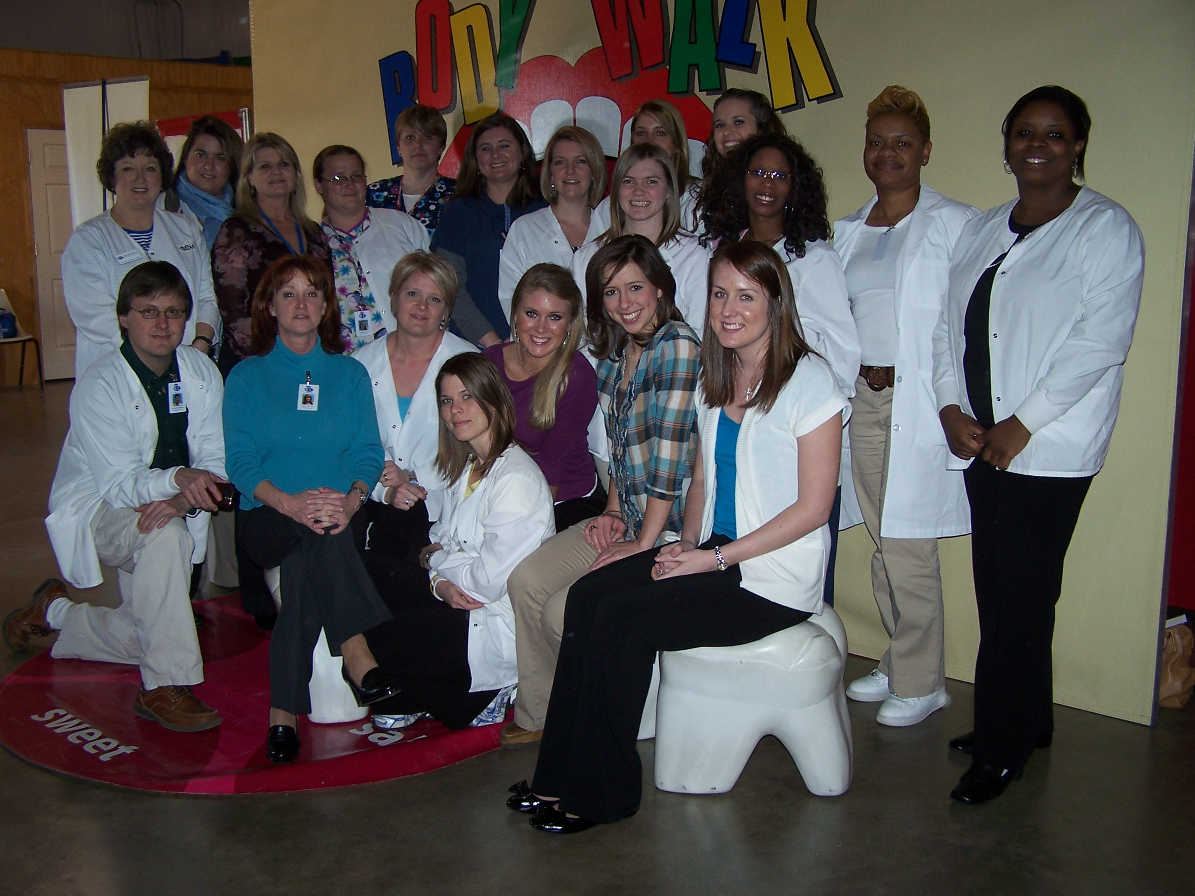
Ida V. Moffett once said that a good nurse is caring in her heart, well educated, and skillful with her hands. I graduated in May 2009, from the Ida V. Moffett School of Nursing at Samford University, in Birmingham (AL), with a Doctor of Nursing Practice, at the age of 53. You never get too old to learn!
—Donna Williams, Itawamba Community College (MS)

Slide 30
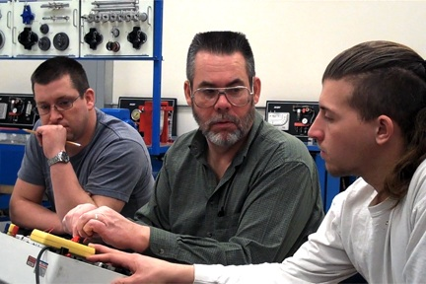
One of my favorite sayings describes how I see my work: "I am a professional that decided to become a teacher, not a teacher trying to be a professional.” I live by this.
—Charles Jones, Ivy Tech Community College–Wabash Valley (IN)

Slide 31
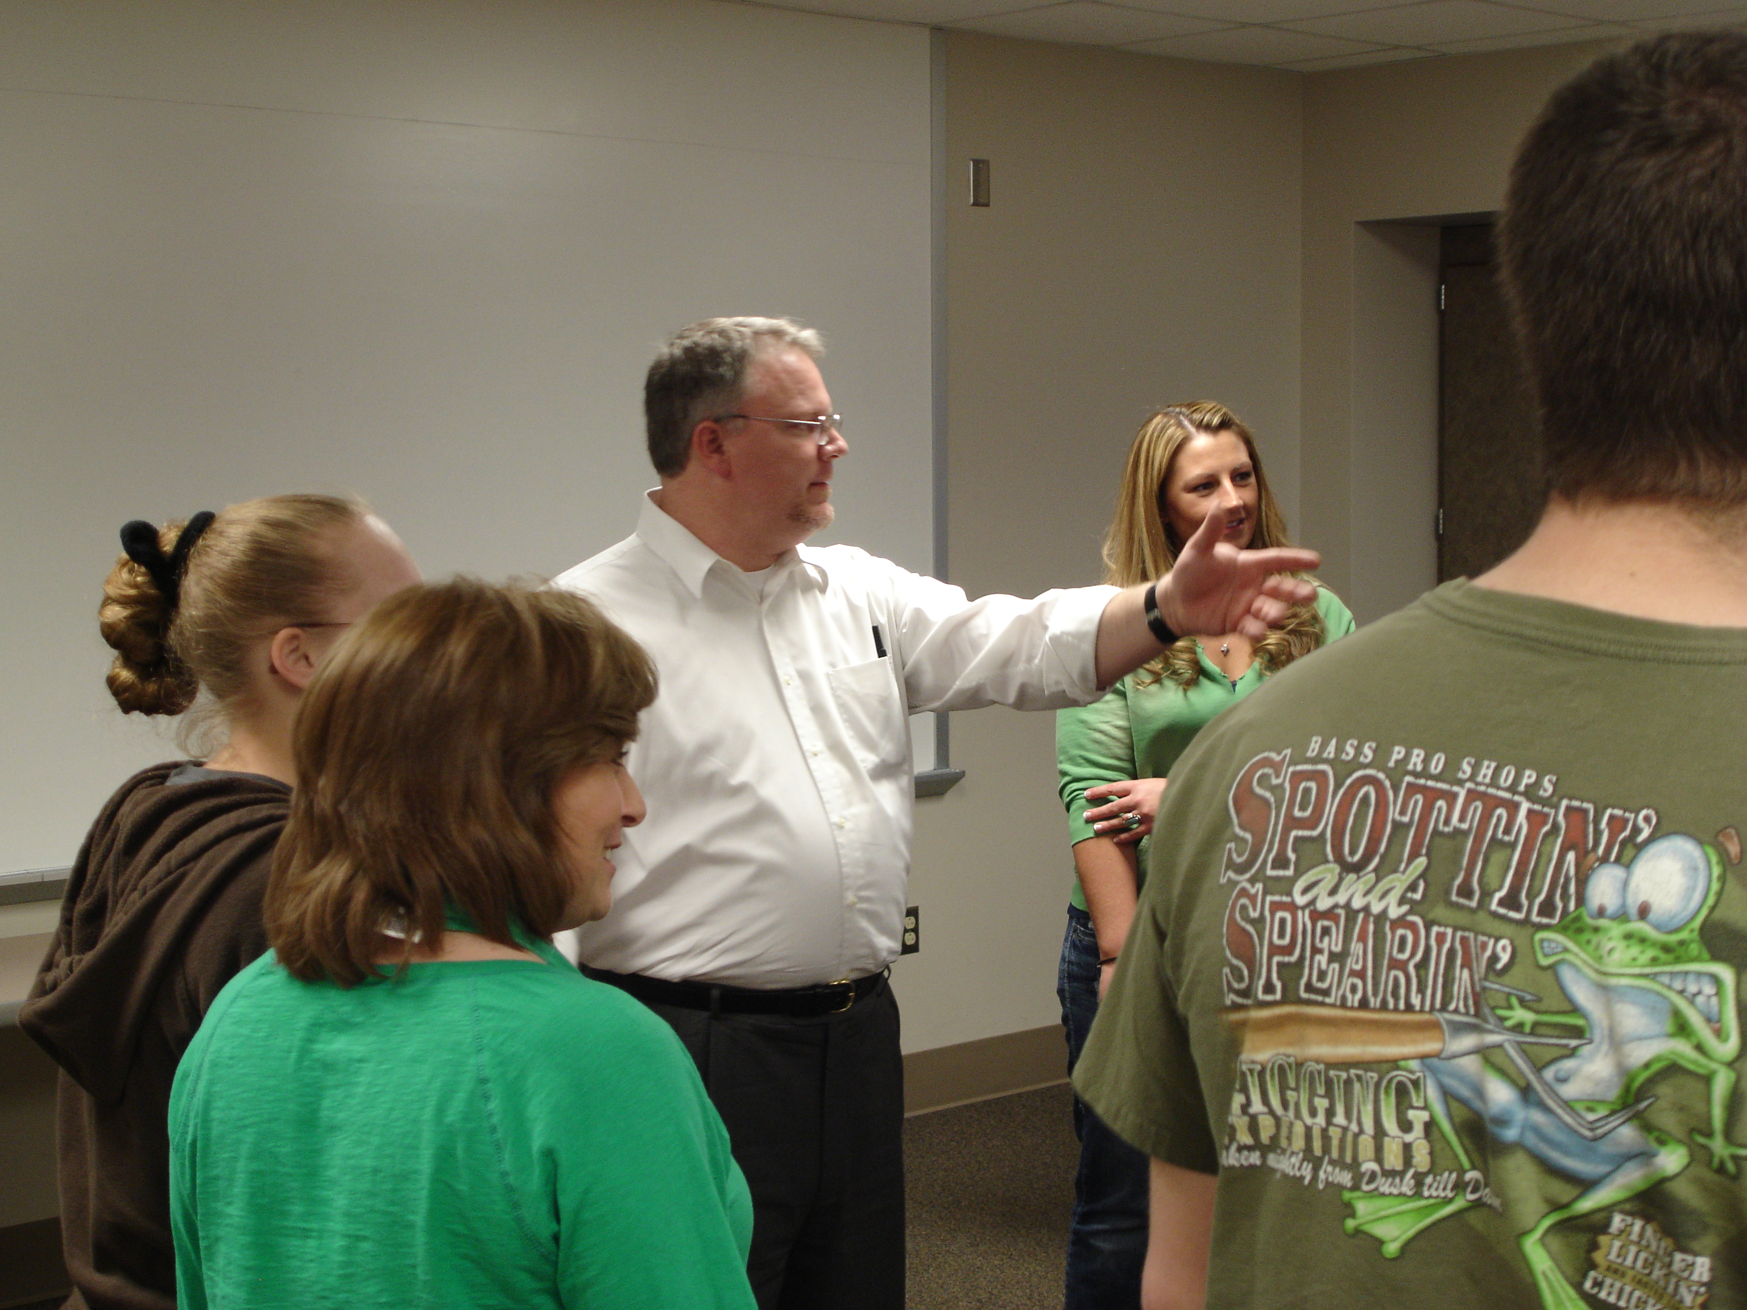
Sidney Smith, a 19th century British cleric once said, “The real object of education is to give… resources that will endure as long as life endures; habits that time will ameliorate, not destroy; occupations that will render sickness tolerable, solitude pleasant, age venerable, life more dignified and useful, and death less terrible.”
—James Boldman, III, Ivy Tech Community College/Southwest (IN)

Slide 32
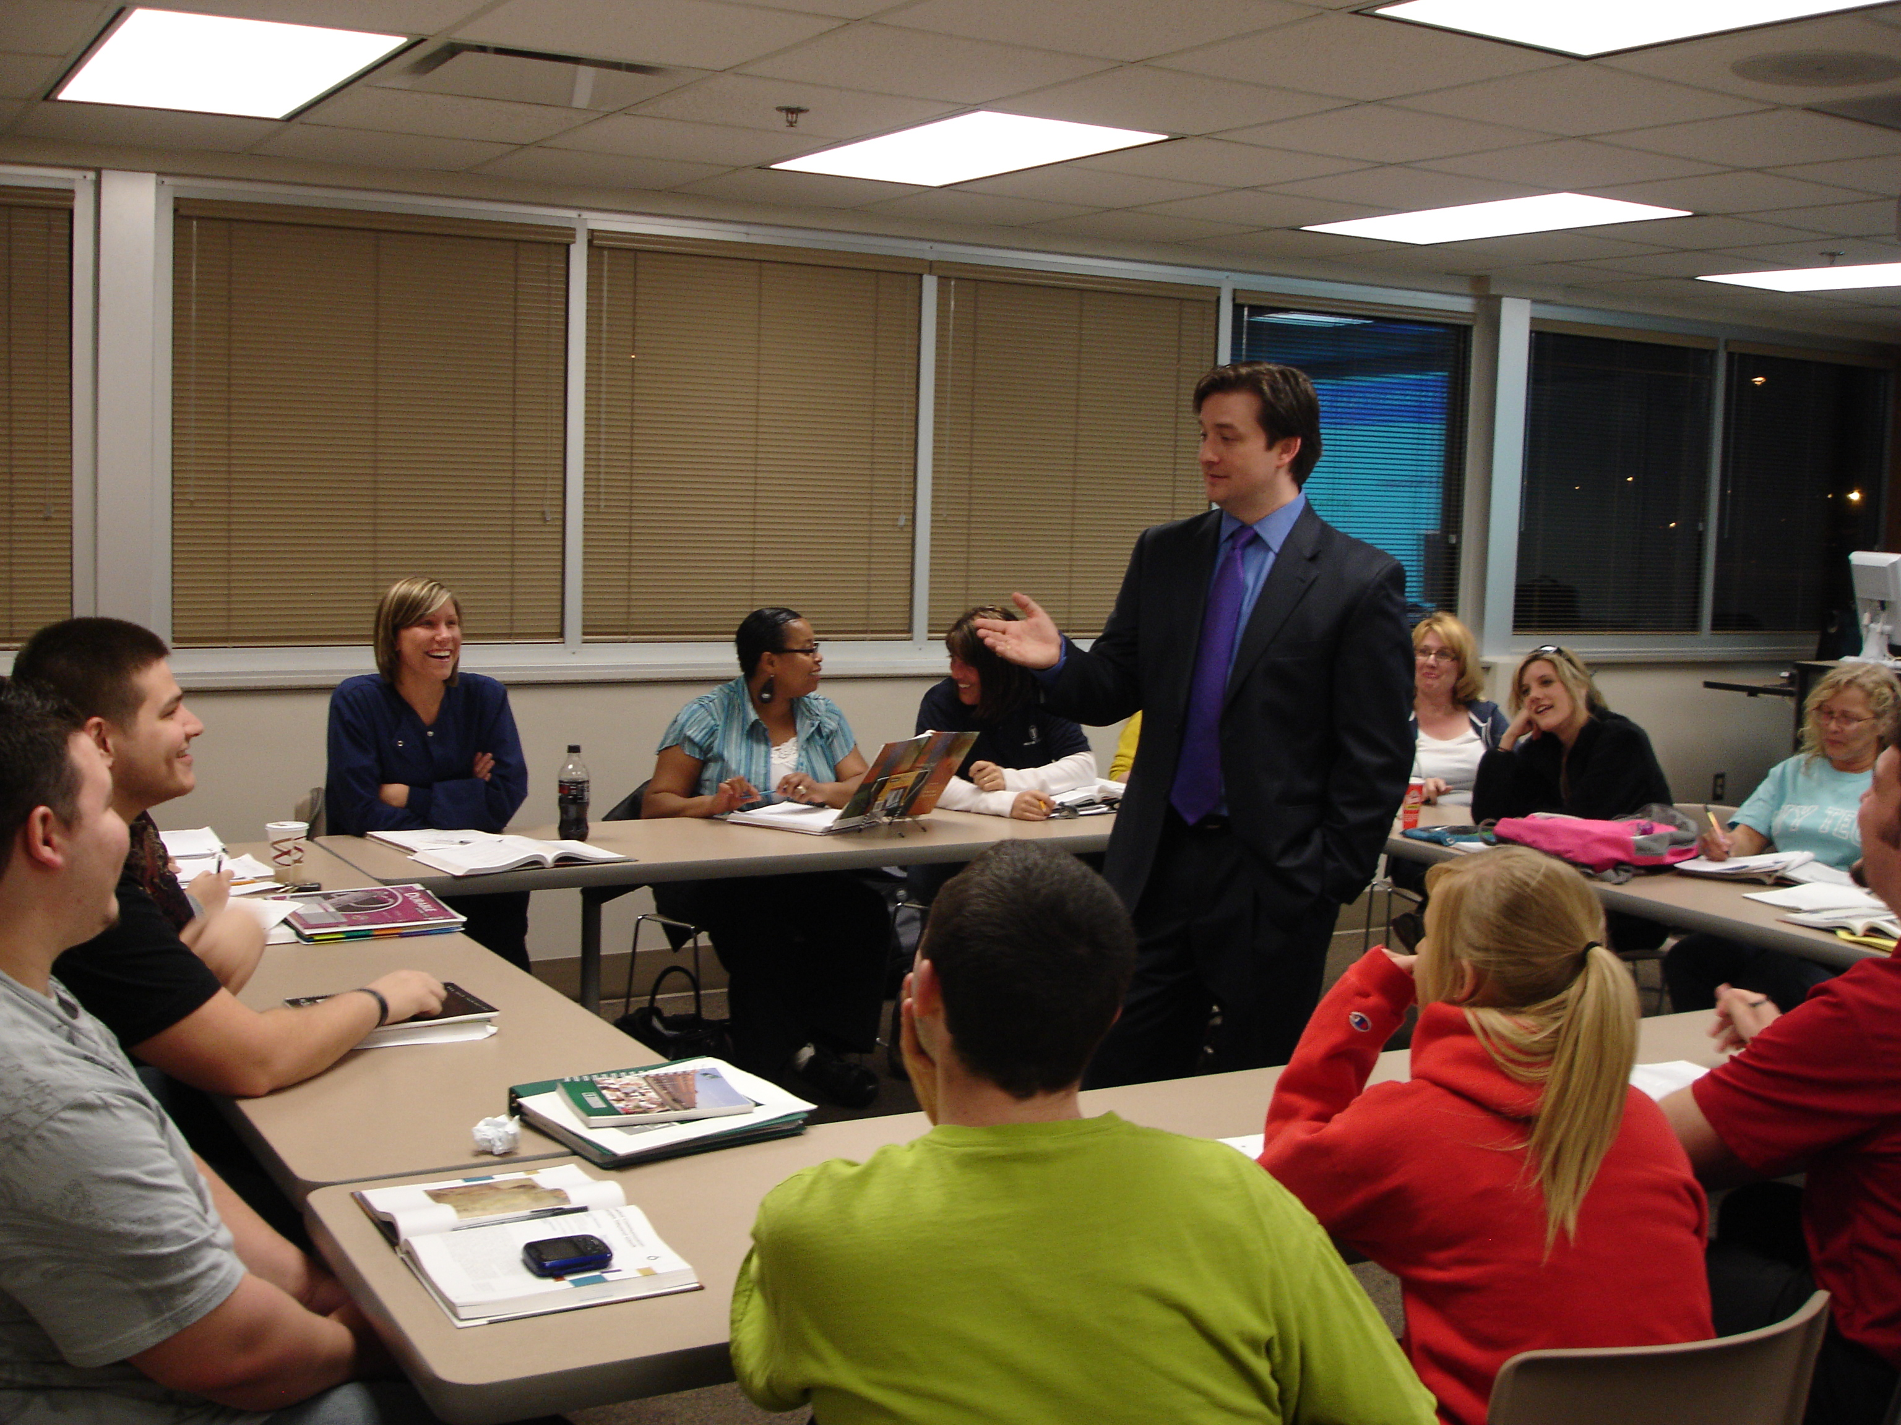
I’m inspired by students who have the courage to enter a learning environment with a willingness to grow. The partnership that is created becomes a powerful force that expands beyond perceived limitations and ignites the world with hope. It is through these noble efforts that a life is made better, and a world is changed.
—Scott O'Daniel, Ivy Tech Community College/Southwest (IN)

Slide 33
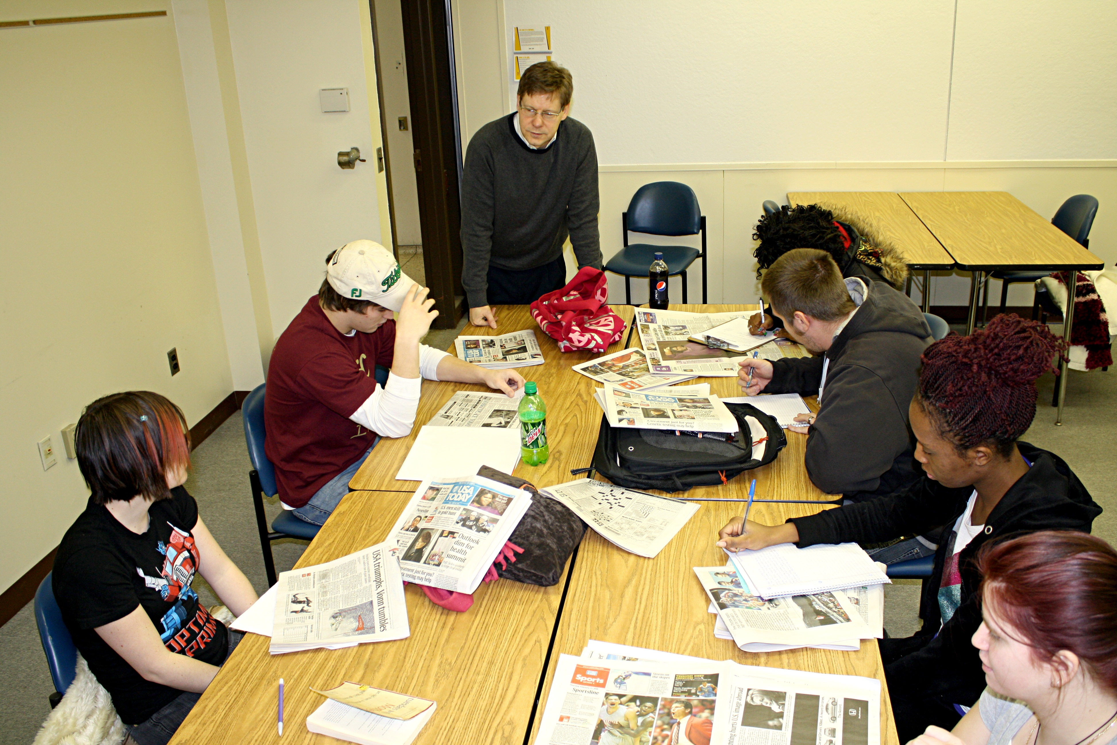
How students perceive themselves is critical. Many come to college burdened by skill gaps and self-doubt. An instructor who recognizes strengths and warmly mentors students toward excellence can open hearts and spark determination to live up to the expectations of those who believe in him.
—Ted Miller, Jackson Community College (MI)

Slide 34
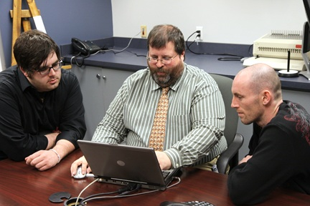
Professional development gives faculty the opportunity to be the extraordinary teachers and educators they always dreamed of being. Your colleagues will notice; more importantly, so will your students.
—Tom Bell, John A. Logan College (IL)

Slide 35
One of the greatest duties I have as a faculty developer in a community college is to make sure adjunct faculty are integrated into the learning culture of the college. For many students, adjuncts are the face of the institution, and it is crucial that they receive the training, support, and respect afforded other faculty.
—Rick Burkett, John A. Logan College (IL)

Slide 36
Teaching is learning new things all the time and learning is inspiring and fun. What more could a person possibly ask for! Students and colleagues motivate me by their curiosity and their wonderful questions and observations. Words of wisdom? Stay fresh by always searching for new ways of teaching.
—Perry Knop, John A. Logan College (IL)

Slide 37
I have learned that you cannot go into serving others with a preconceived objective. The best approach is to learn the needs and expectations of those you are serving and adapt to meet them.
—Phillip Lane, John A. Logan College (IL)

Slide 38
It’s easy to help the enthusiastic student, but you have to be willing to do a little extra to assist those less forthcoming. Surveying student needs and wants is only a slight inconvenience, especially considering the return on investment.
—Steve McLaughlin, John A. Logan College (IL)

Slide 39
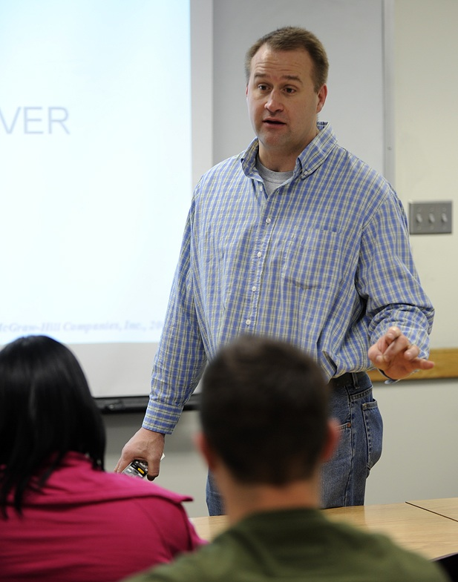
Sharing in another’s life journey defines my teaching experience. While I recognize that sharing my experience and insight has value for students, I am constantly reminded that it also has immeasurable worth for me.
—David Krug, Johnson County Community College (KS)

Slide 40
I am fortunate to teach students preparing to work in one of the best, most rewarding industries. Food is the common thread that binds cultures, races, genders and individuals, as we gather around food for every special occasion. Working in this industry makes us a special part of people’s lives.
—Michael McGreal, Joliet Junior College (IL)

Slide 41
I feel extremely fortunate to do what I love everyday, interacting with students and teaching them to love the profession of nursing. As I watch them struggle to balance school, work, family, and other commitments, I am inspired. I am blessed because I learn from them as they do me.
—Lauren Bates, Kentucky Community and Technical College System

Slide 42
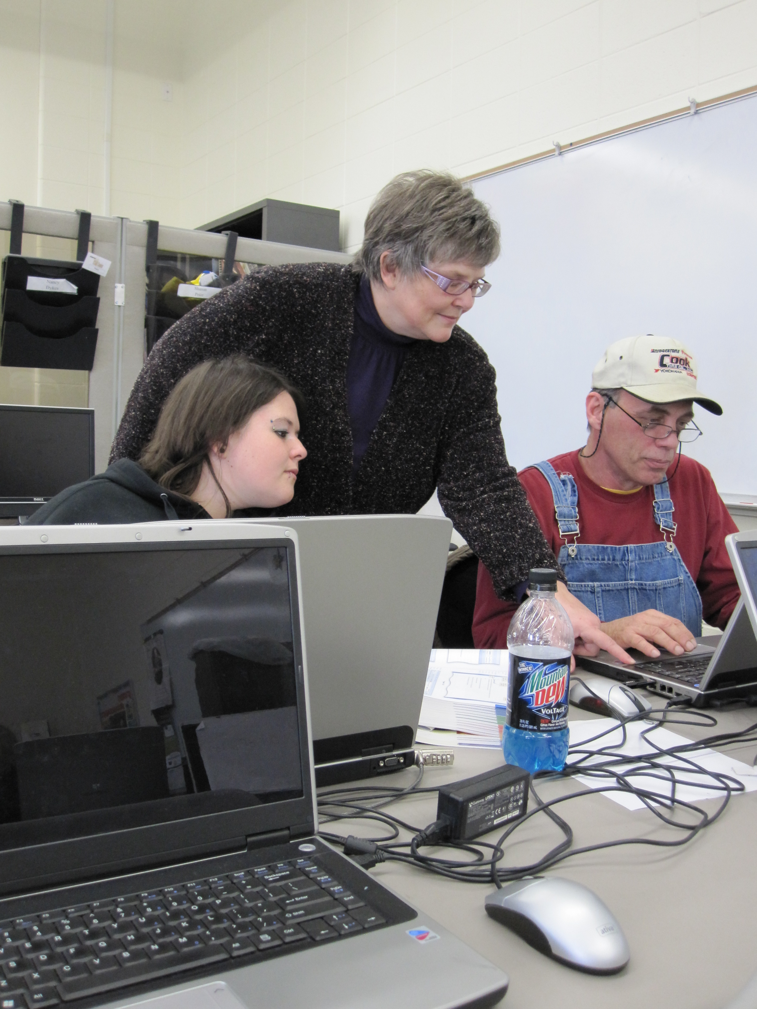
According to Alvin Toffler, "The illiterate of the 21st century will not be those who cannot read and write, but those who cannot learn, unlearn, and relearn." It is imperative that educators critically examine and re-examine pedagogic strategies to meet the needs of students in a technology-driven society.
—Kim Cleberg, Kentucky Community and Technical College System

Slide 43
I am inspired daily working for an organization that strives to be the best in providing an education to its students to help transform their lives. I am pleased when I read the success stories of our students and know that I was a small part of that success.
—Janet Covington, Kentucky Community and Technical College System

Slide 44
I encourage students to take responsibility for their education, recognize their strengths and weaknesses, and become better learners in the process. Encourage students to learn, not just to listen.
—Kim DeVaughn, Kentucky Community and Technical College System

Slide 45
Great teaching has everything to do with building relationships. You cannot impact students without making a strong bond with them.
—Kevin Felton, Kentucky Community and Technical College System

Slide 46
I was taught early on in life to take pride in my work and to do a good job regardless of the circumstance. With this guiding life principle, I know inherently that doing my job and doing it well reflects positively on me and my organization.
—Wendell Followell, Kentucky Community and Technical College System

Slide 47
I love my job working with future nurses. We have a diverse group of students from many different backgrounds. I get to know these students as they first apply to our program, and they are so nervous and anxious. Two years later, I watch them graduate as confident professionals.
—Kay Hawkins, Kentucky Community and Technical College System

Slide 48
I encourage students to see themselves beyond the challenges of life, to pursue their educational goals, to fulfill their life’s dreams. I have been there and done that.
—Lorna Hollowell, Kentucky Community and Technical College System

Slide 49
My paramount goal is growing an interest in science. While stimulating cognitive activity in both prepared and less-prepared learners, I strive to develop an environment that respects experimentation and knowledge. A satisfaction arises from having students with both mind and face illuminated by an appreciation for learning.
—Charles Howes, Kentucky Community and Technical College System

Slide 50
“Education is Not the Filling of a Pail, but the Lighting of a Fire," wrote Yeats. To light the fire, I create meaningful, collaborative activities to engage the students in mathematics and statistics. Through these contextual activities, I also hope to deepen student understanding and increase memory of the concept.
—Kathy Mowers, Kentucky Community and Technical College System

Slide 51
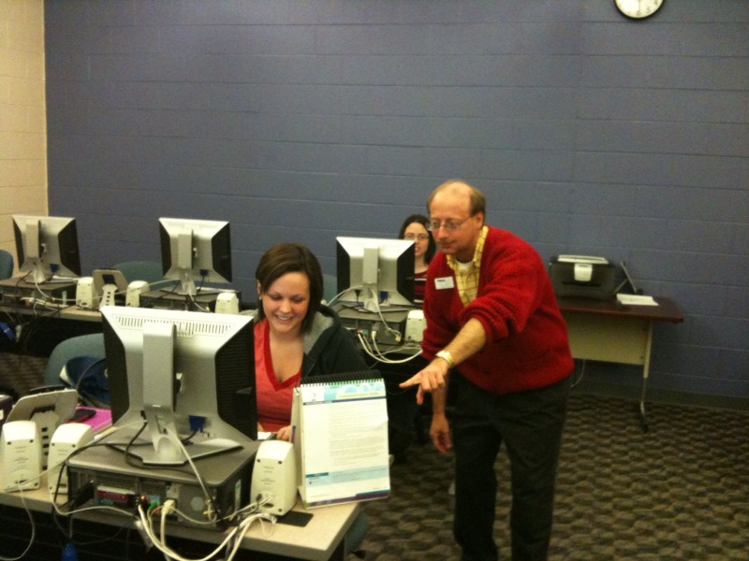
As a facilitator of learning, I embrace the four pillars of education as set forth by the United Nations Educational, Scientific, and Cultural Organization (UNESCO). These four pillars of education include Learning to Know, Learning to Do, Learning to Live Together, and Learning to Be.
—Clovis Perry Jr., Kentucky Community and Technical College System

Slide 52
We should always have great customer service with each student. Just because we have answered the same question all day, it is the first time this student has asked.
—Lisa Phillips, Kentucky Community and Technical College System

Slide 53
Technology is just a tool. It requires the user in order to be of any benefit and to have any value or purpose.
—Ruby Rodgers, Kentucky Community and Technical College System

Slide 54
It is inspiring to see students suddenly gain the insight on how to solve a problem, academically or personally, and to see them persevere to receive their GED and/or degree. The successes of the students and staff have been what has motivated me to continue to be an educator. My main strategy in helping others to help themselves is to encourage them to have a Can Do attitude. I tell my students and staff to SMILE, set manageable goals, accept constructive help, and stay the course until you reach your main goal in education and in life.
—Omar Rogers, Kentucky Community and Technical College System

Slide 55
Since I am in a field that is continually advancing, I must keep current and inform my students of recent developments. I strongly believe that in order to prepare students for their career in the healthcare field, teachers must expose them to the latest trends in technology.
—Lori Slaughter, Kentucky Community and Technical College System

Slide 56
What motivates me is helping people to locate the information they need to achieve their goals, instill the love of life-long learning, and facilitate the discovery of new ideas. It is a joy to watch students embrace their education, overcome obstacles, face new challenges, and rejoice in their accomplishments.
—Sandra Smallwood, Kentucky Community and Technical College System

Slide 57
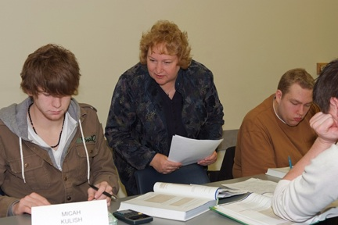
I view accounting as my profession, but teaching is my vocation.
—Linda Abernathy, Kirkwood Community College (IA)

Slide 58
As I strive to improve my teaching, decisions are guided by how classroom experiences will assist students to develop learning skills such as problem solving, critical thinking and self-assessment. By keeping students as my first priority, I am able to design activities that challenge them to think, and also enhance their ability to learn throughout their career.
—Melissa Carnahan, Kirkwood Community College (IA)

Slide 59
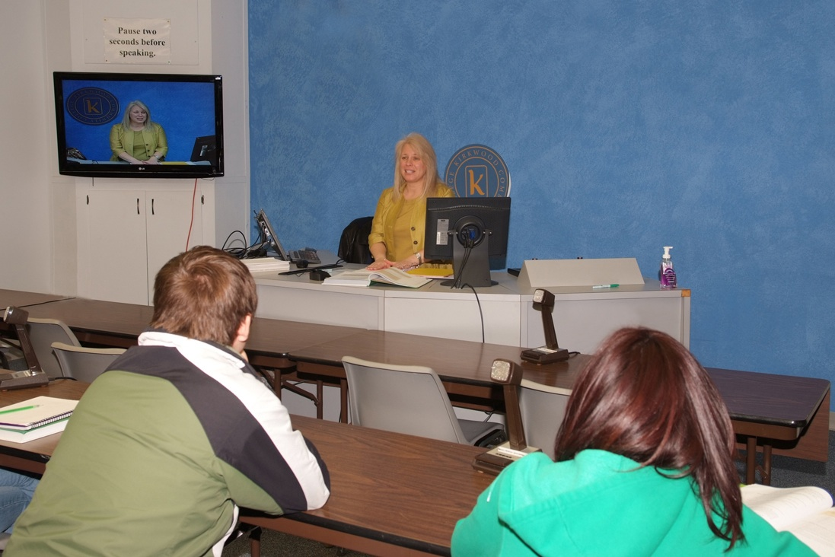
I’m so proud to call myself a teacher! I get energy from being in a classroom, and I think that the enthusiasm for the subject matter is contagious, as well. As Confucius said, “Choose a job you love, and you will never have to work a day in your life.”
—Heidi Hansel, Kirkwood Community College (IA)

Slide 60
I help people understand the science they might use in their next class, their career, or while sitting in a doctor’s office later in life. That’s good, but I also encourage them, and help them see a way forward to a better life than they thought possible. That’s great.
—Lynne Zeman, Kirkwood Community College (IA)

