Slide 1
Just before class, I get a rush. These are performances. Am I up for it? Then the rush kicks in. Why did 1938 audiences believe in Martians? Silence, then: Because they believed the radio wouldn’t lie to them about something so important. A wonderful moment, and I get feedback for the next performance. Why wouldn’t I love teaching?
—Douglas Carr, El Paso Community College (TX)

Slide 2
I am so inspired daily by the students that I have the privilege to teach. Many of them overcome obstacles to pursue their education while in the program. They all have such high hopes and dreams of becoming health care professionals and skilled members of the dental team. Their enthusiasm is contagious, their passion strong. This motivates me to play a part in seeing their dreams become reality.
—Sharon Dickinson, El Paso Community College (TX)

Slide 3
I believe that by coming to work everyday and asking my students to open their minds and hearts to literature, even if they have not enjoyed it in the past, I can help them to find something that appeals to their humanity. I believe that reading and studying literature makes us more responsible members of the human race.
—Grace Haddox, El Paso Community College (TX)

Slide 4
I do not settle for mediocrity in hopes that my students will not just learn theory, but put theory into practice.
—Cristina Sharp, El Paso Community College (TX)

Slide 5
To help a student reach his/her goals, to help a family see a different future, and to shape a community one student at a time are reasons I feel that being a part of a community college is the best way to touch the future!
—Lydia Tena, El Paso Community College (TX)

Slide 6
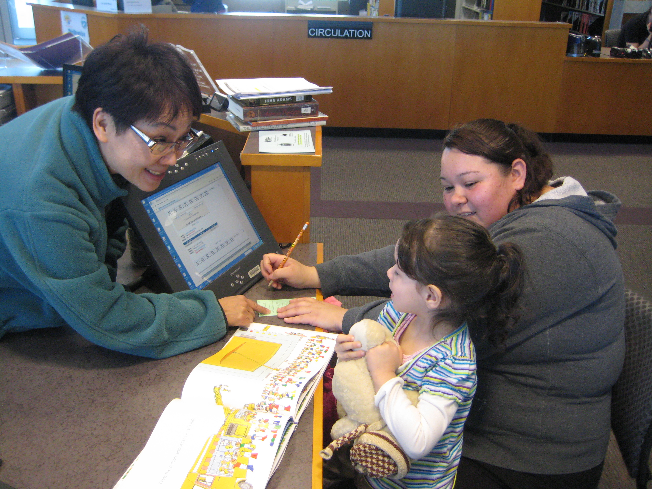
When community college libraries form partnerships with public libraries, students’ entire families can be served. Learning is enhanced when parents and children learn side by side.
—Monica Wong, El Paso Community College (TX)

Slide 7
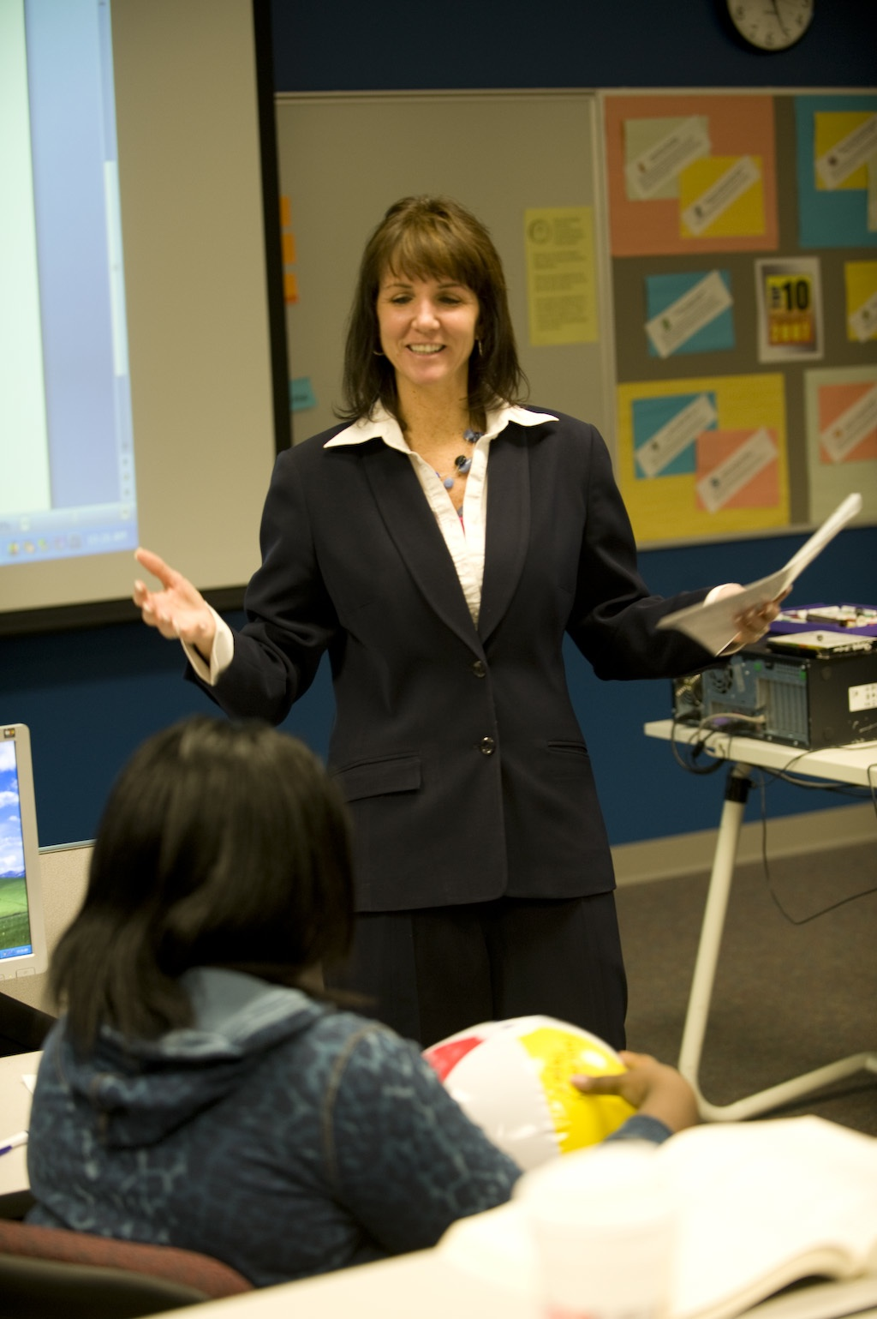
Success starts in my classroom by creating an environment that is open to asking questions, taking risks, and working together!
—Heidi Eaton, Elgin Community College (IL)

Slide 8
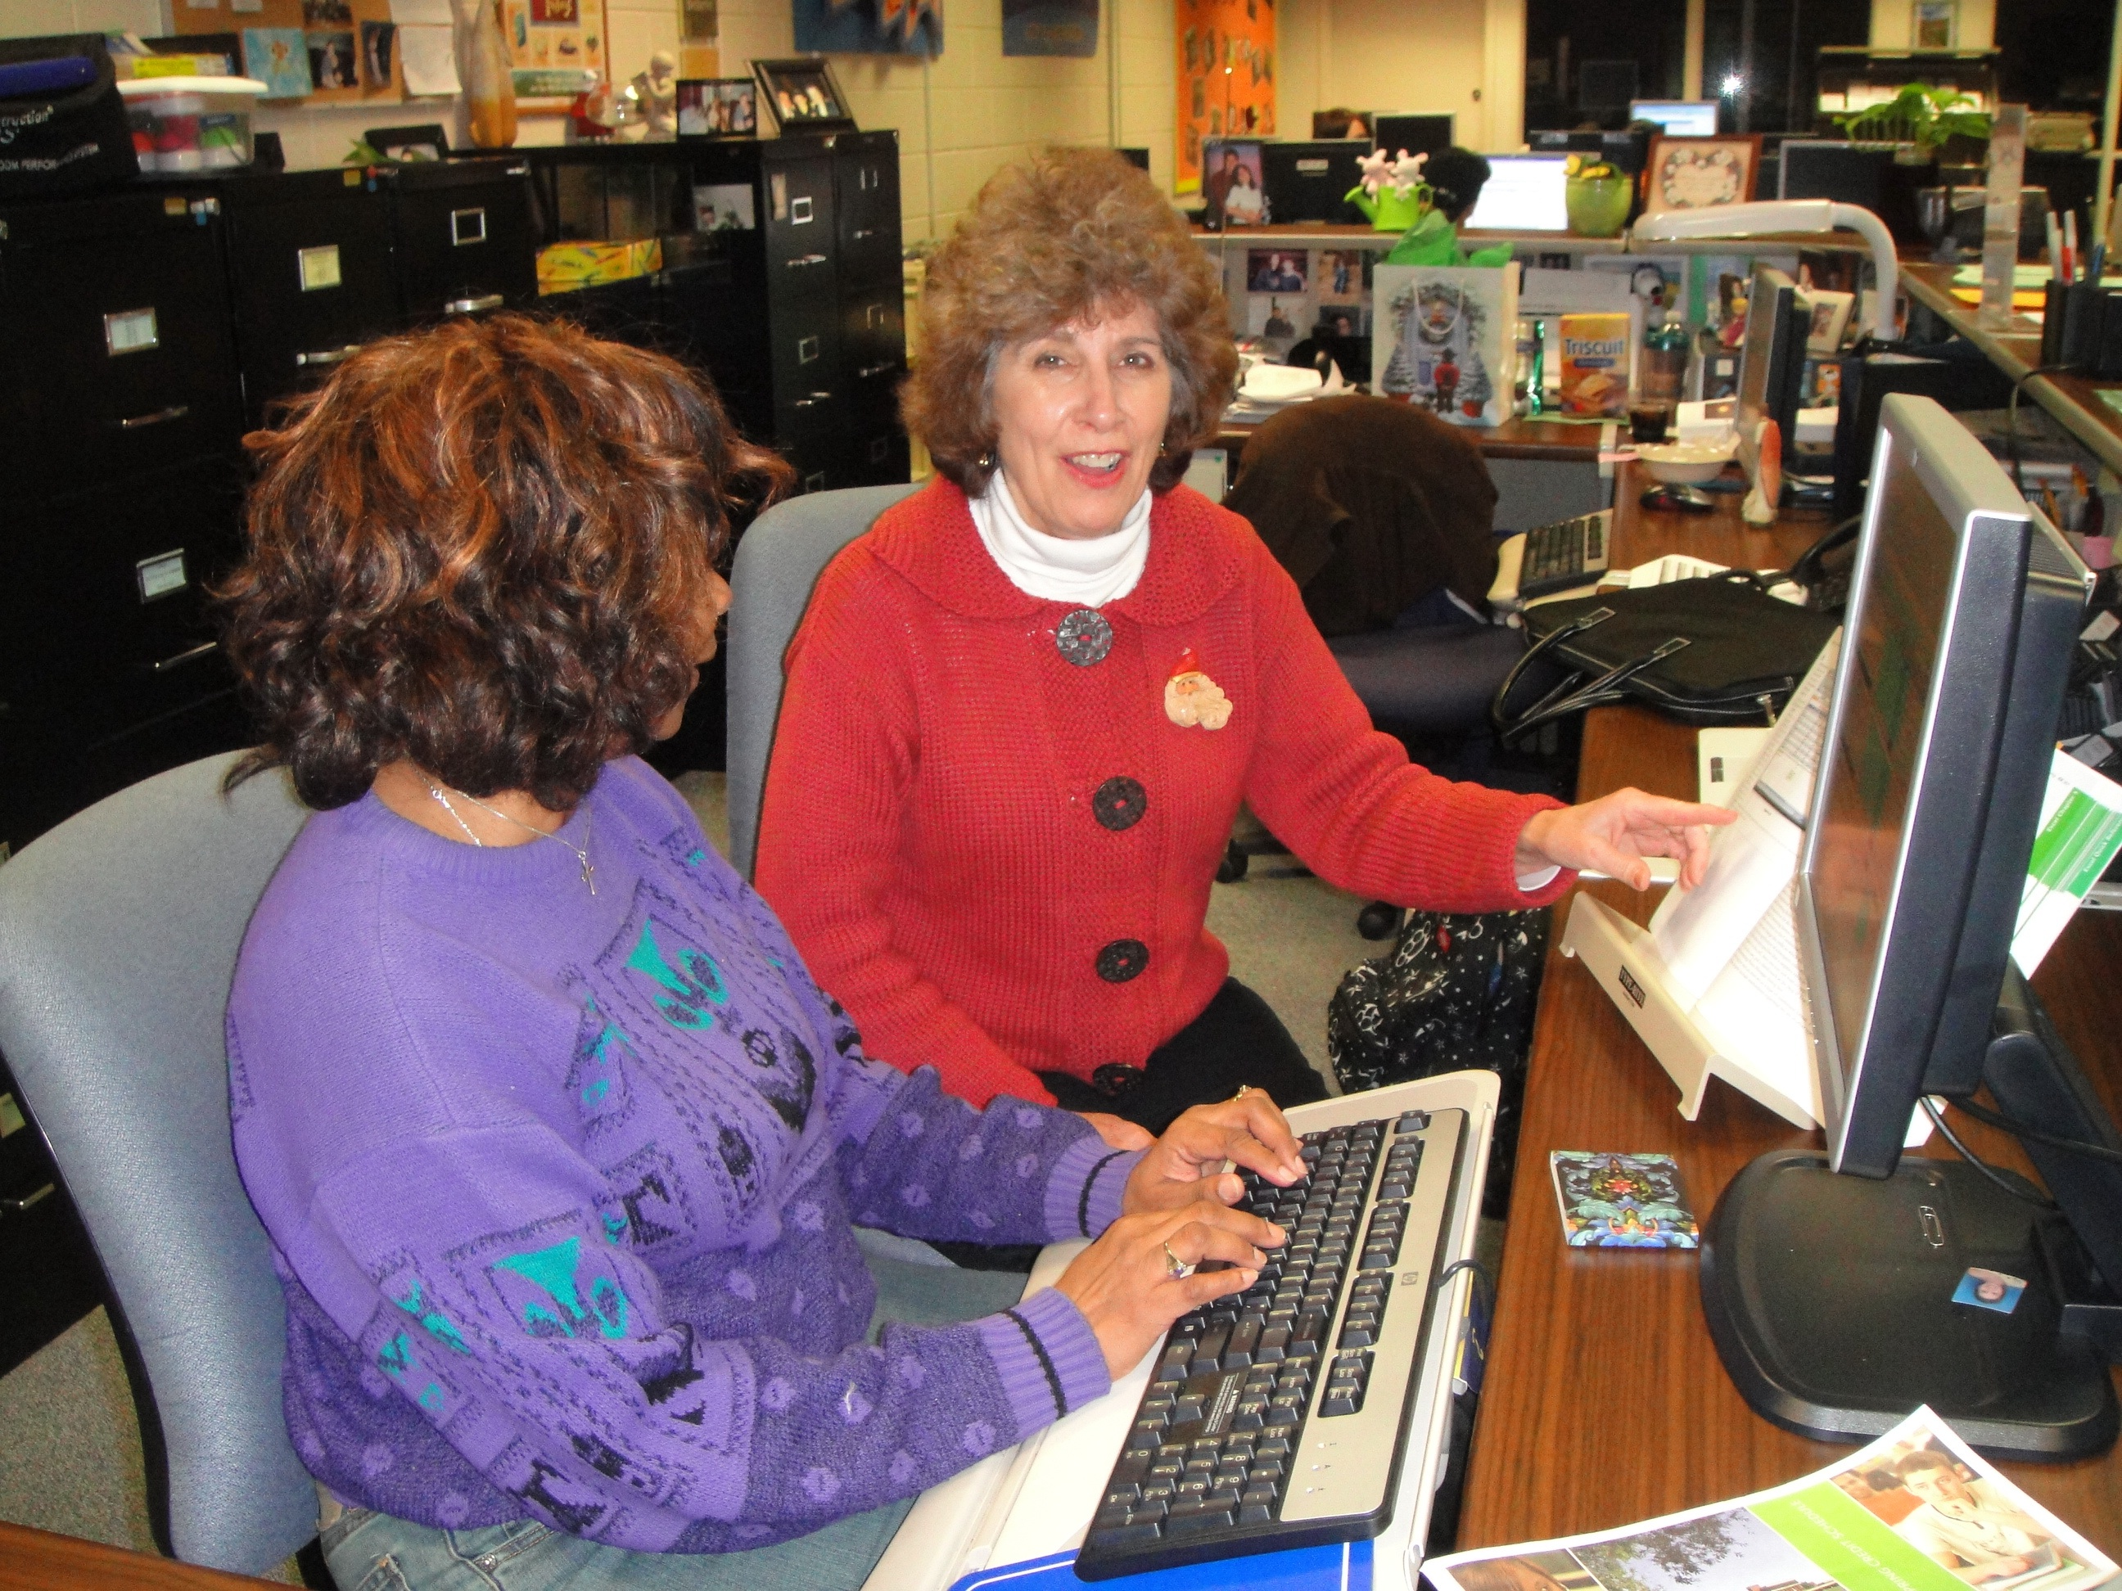
In a college methods class, I had a professor say: “If you can’t admire the picture, admire the frame.” Forty years later I still use that philosophy in teaching—every student is valuable.
—Crystal Kerwin, Elgin Community College (IL)

Slide 9
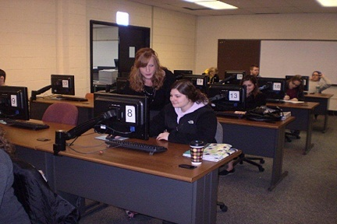
Inspiring students to enjoy learning is an important objective that should not be overlooked.
—Dianna Cichocki, Erie Community College (NY)

Slide 10
As a teacher, I am never complacent in my obligation as a role model.
—Christine Lamanna, Erie Community College (NY)

Slide 11
The purpose of education is to stimulate creativity and passion. This is my mantra and my goal. Each day before I teach, I recommit myself to achieving it.
—Marie Schmitz, Erie Community College (NY)

Slide 12
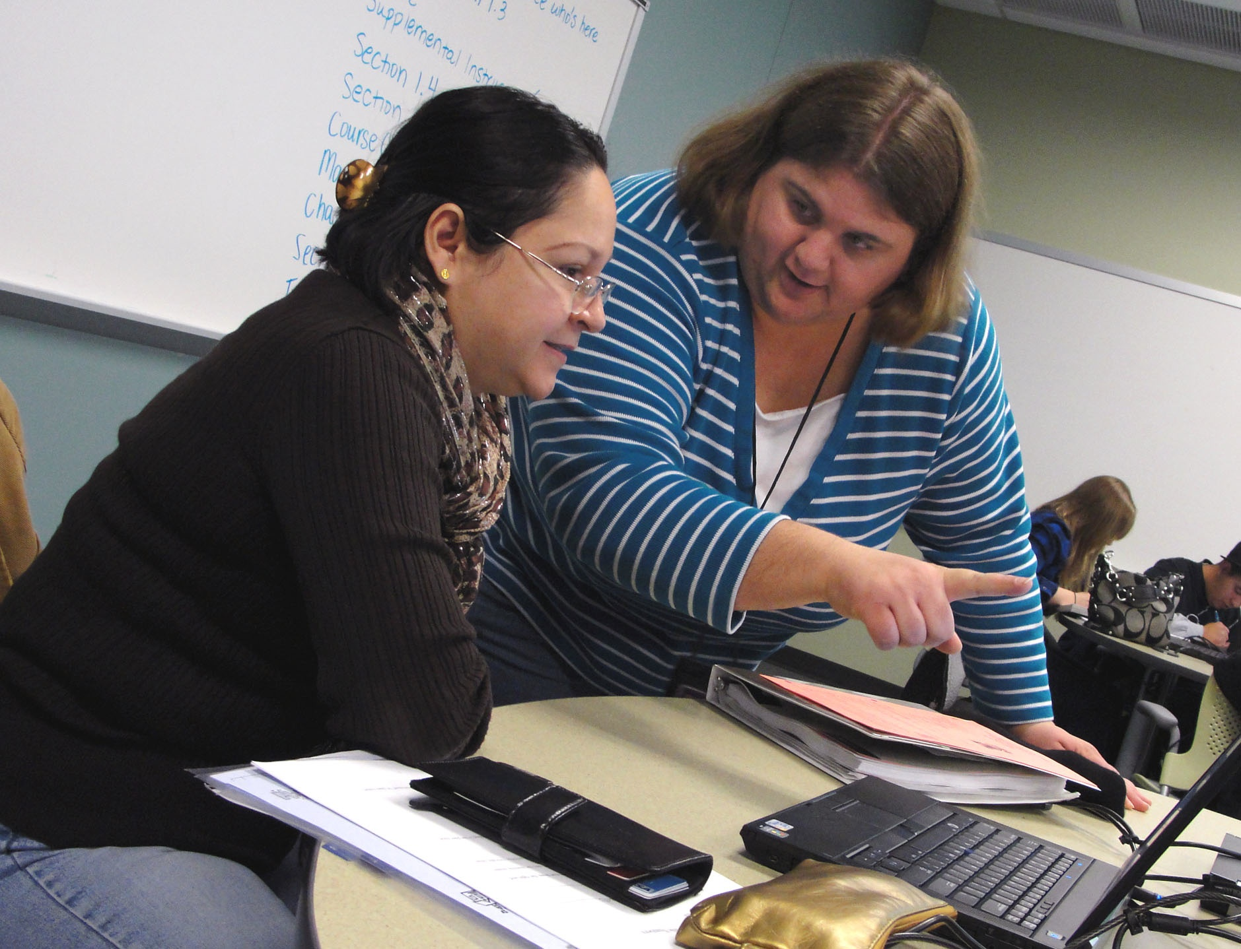
As a mathematics instructor, my goal is not only to inspire student interest in and appreciation for mathematics, but to also show students that I care about them, their success, and their education and career goals.
—Michelle Breaux, Estrella Mountain Community College (AZ)

Slide 13
I'm from Missouri, the Show Me State. I actually grew up in New Hampshire, but I learned how to be a chef and teacher through several mentors who "showed" me what was expected. I use this same process with my students, showing them what is expected, setting the bar, and challenging them to reach it.
—Steve Griffiths, Estrella Mountain Community College (AZ)

Slide 14
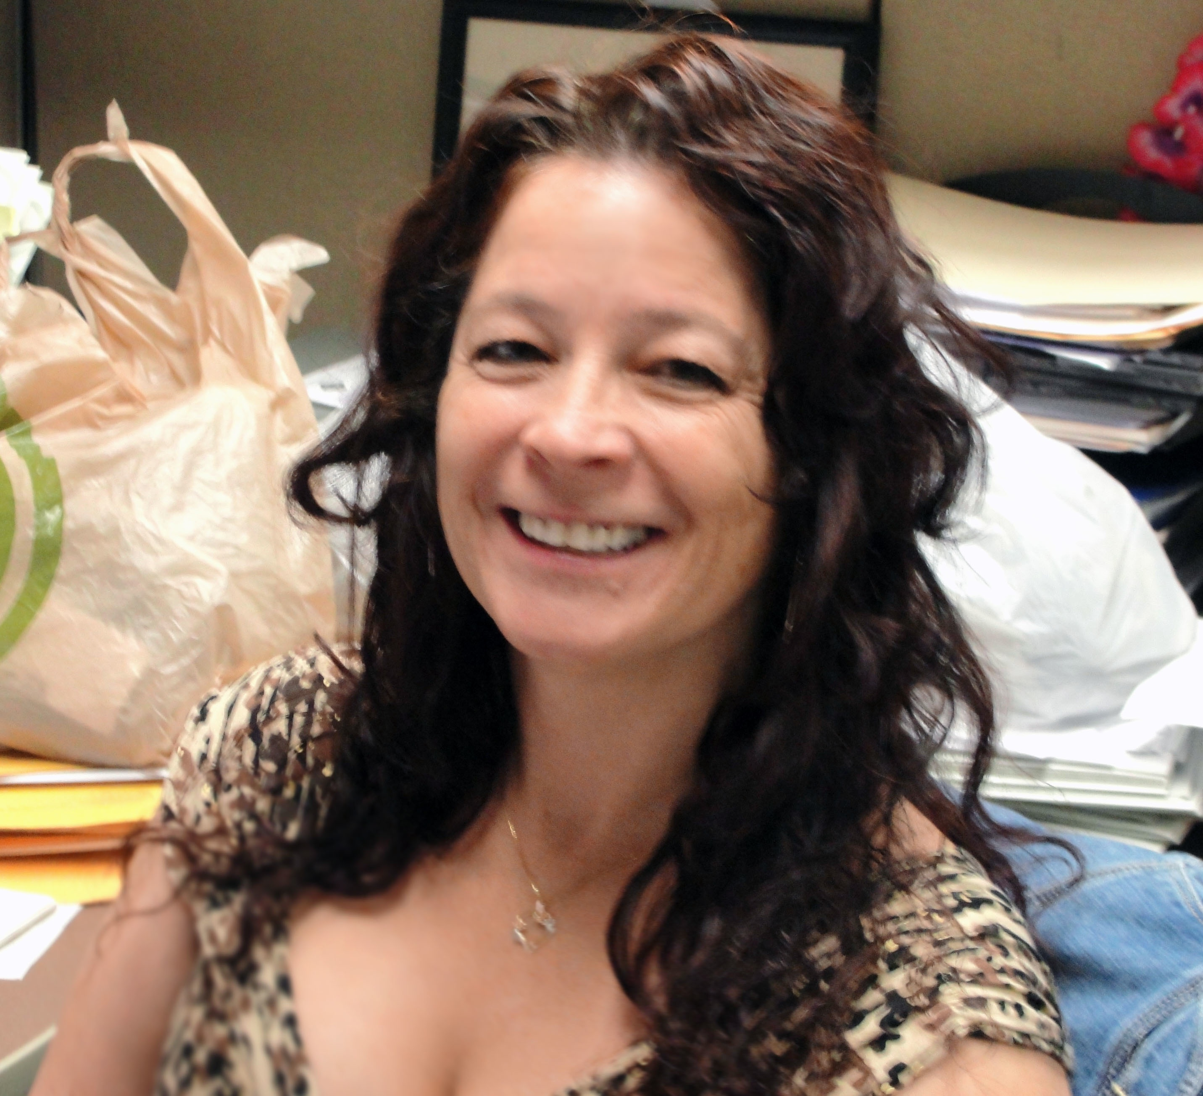
Publius Syrus said “Anyone can hold the helm when the sea is calm.” My passion to help others meet their needs in a complex learning environment is my motivation for serving students and faculty.
—Linda Keyes, Estrella Mountain Community College (AZ)

Slide 15
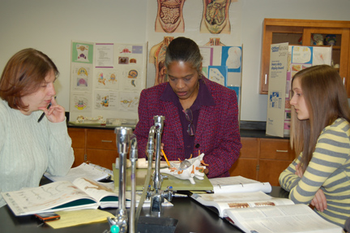
Acknowledgment that information is understood and received motivates, inspires, and stimulates further instruction. Active participation, carefully listening, asking questions, and completely answering them enhances learning. Use of various available resources and teaching methods promotes mental development.
—Linda Randall, Forsyth Technical Community College (NC)

Slide 16
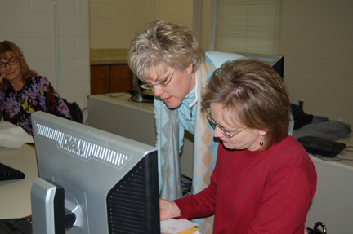
I promote a climate based on care and trust to help students set challenging and achievable goals. Teaching is a commitment to the subject matter, transmitted with enthusiasm.
—Elizabeth Sprinkle, Forsyth Technical Community College (NC)

Slide 17
Teaching excellence is the commitment to students on a day-to-day basis—staying after hours to allow them to complete an assignment, patiently answering questions, and teaching them accountability for their work. It is providing them access to the tools they need to succeed.
—William Fell, Gateway Technical College (WI)

Slide 18
Wisconsin Technical College System’s slogan is: We are futuremakers. We are changing the future every moment. I am an agent of change. I change the future one moment and one student at a time.
—Valerie Hennen, Gateway Technical College (WI)

Slide 19
Teaching presents daily opportunities. On a good day, I inspire students to stretch their horizons. I cause them to believe in themselves. I challenge them. I infuse them with enthusiasm. I give them confidence. I awaken their imagination. I let them see beyond today, and help them want to go there.
—Dale Reich, Gateway Technical College (WI)

Slide 20
Co-curricular activities can support and enhance learning in face-to-face and online classrooms. I always assign or encourage students to participate in outside projects that support what they are doing in class. I believe that getting involved in outside classroom events can boost retention.
—Janet Hollier, Georgia Perimeter College

Slide 21
Teaching is only meaningful when it results in student learning that lasts!
—Martin Okafor, Georgia Perimeter College

Slide 22
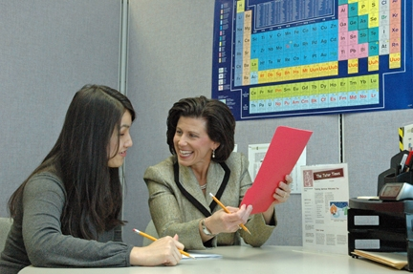
It is extremely rewarding work, collaborating with our tutors. I look to their delightful personalities, talents, insights, and creativity to give me energy.
—Ann Lyons, Germanna Community College (VA)

Slide 23
I avoided teaching online for years because I thought it was not appropriate for teaching mathematics. After being forced to take the plunge, I grew to love teaching math online. It sparked my creativity and led to big improvements in my traditional classes. What a surprise!
—Delois McCormick, Germanna Community College (VA)

Slide 24
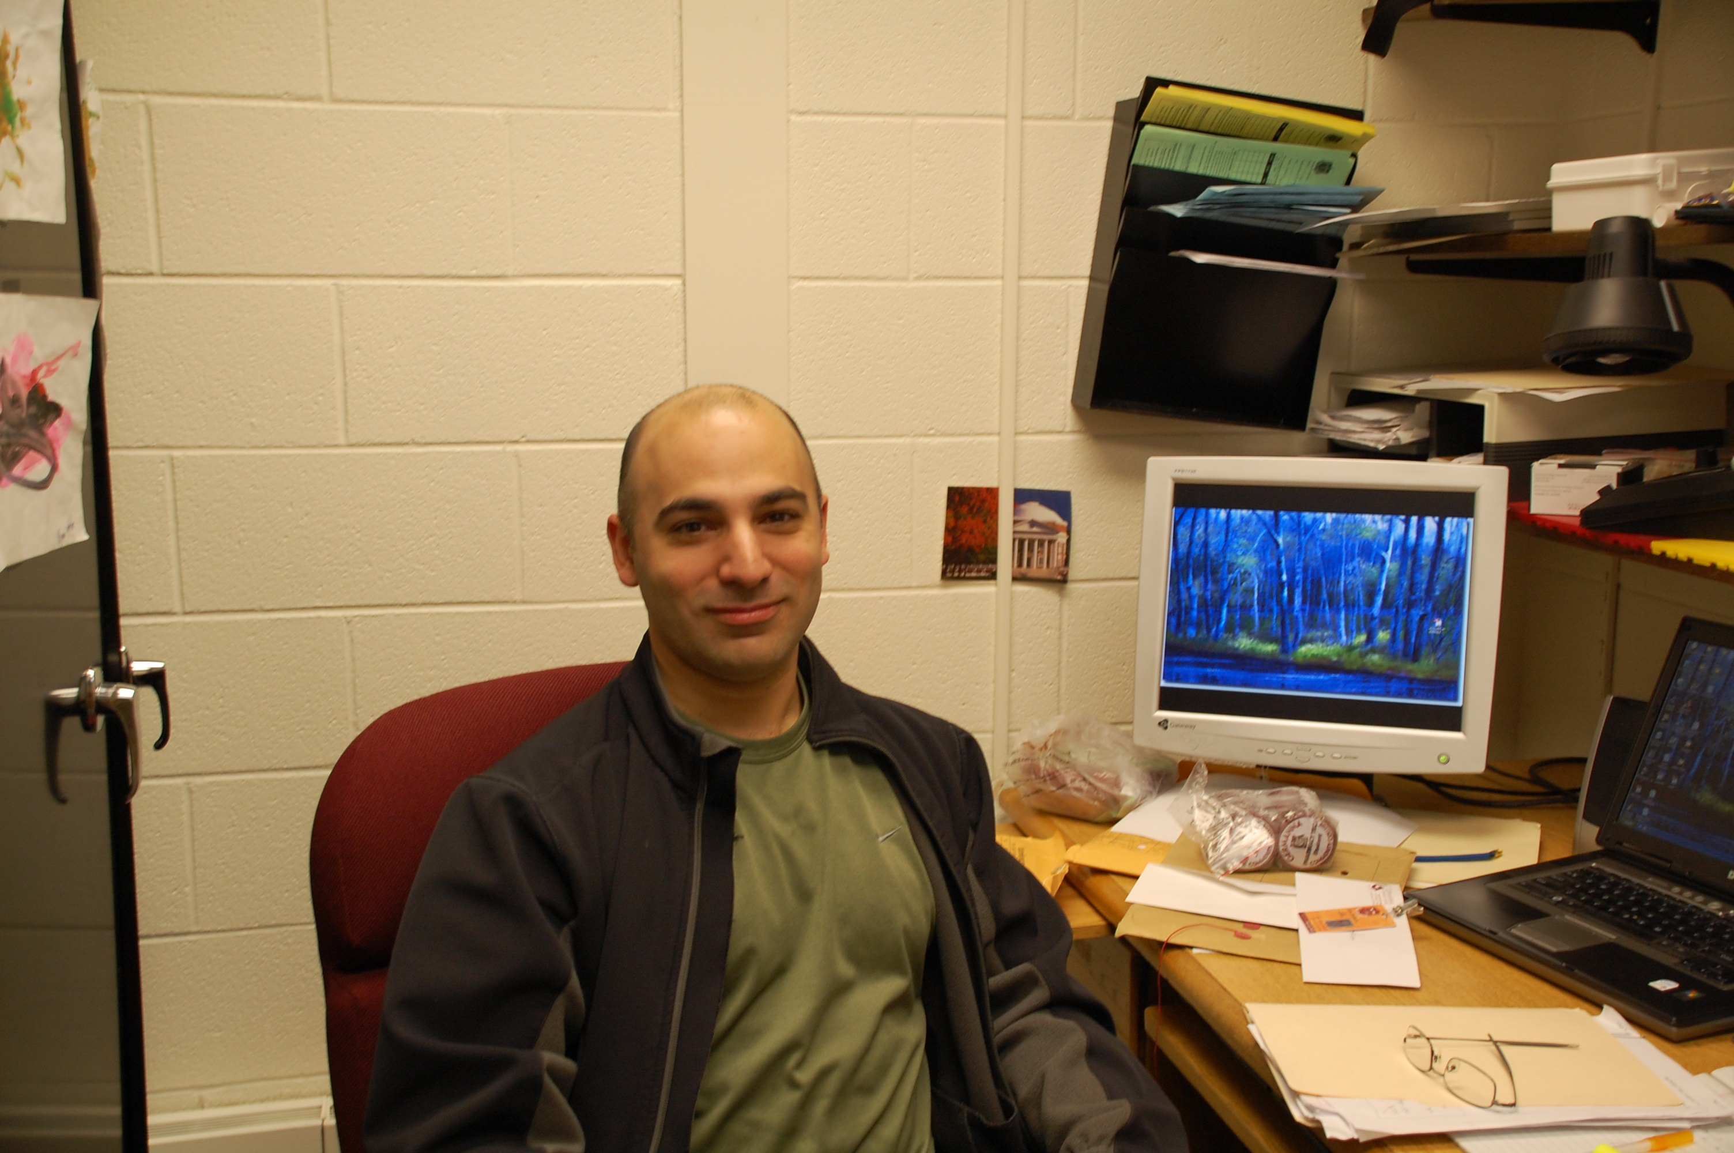
My goal is to provide an atmosphere where effective teaching and learning of both knowledge and skills can take place, having a lasting impact on the lives of both students and me. I encourage students to develop both personal and professional goals and motivate them to reach these goals.
—John Stroffolino, Germanna Community College (VA)

Slide 25
I love what I do as an instructor; I enjoy working with students and try to the best of my ability give them the skills and tools they need to continue to learn for the rest of their life.
—John Doneth, Grand Rapids Community College (MI)

Slide 26
What I try to do is to remember life as a student, emulate the behaviors of instructors I loved, and remind myself that I, like many students, needed to want to learn before I would engage my brain. So I suppose my mantra would be “inspire, then teach."
—Tom Kaechele, Grand Rapids Community College (MI)

Slide 27
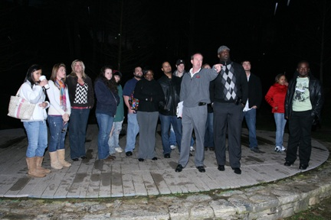
I want to be a better teacher. This is important work. Dialog before Pedagogue.
—Martin Flynn, Greenville Technical College (SC)

Slide 28
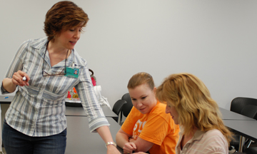
For me excellent teaching is about passion, fun, and expecting excellence, not perfection from my students and myself. I have been inspired by their willingness to hold onto and pursue their dreams despite difficult circumstances. It is truly an honor and privilege to be a teacher. I feel very grateful.
—Beth Ashworth, Guilford Technical Community College (NC)

Slide 29
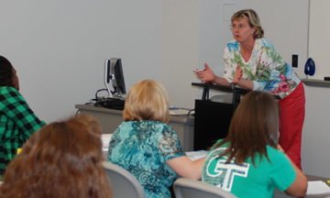
The questions of my students continually inspire new ways of thinking and teaching. I often feel that I learn as much from them as they do from me. Seeking to understand how the students learn best instead of teaching in a manner that is easier or more convenient for me is my focus.
—Michele Garrett, Guilford Technical Community College (NC)

Slide 30
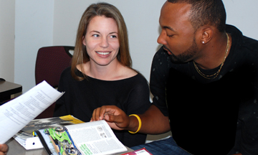
—Kristi Short, Guilford Technical Community College (NC)

Slide 31
Students inspire and motivate me! Most of my students have family responsibilities, work full-time, and attend school all to make a better life for themselves. Their dedication and determination is truly inspiring.
—Wendy Payne, Gulf Coast Community College (FL)

