Slide 1
Information literacy is vital to health science professionals. My goal is to foster lifelong intellectual curiosity, to encourage perpetual continuing education, and to inspire a dedication to using critical thinking and research skills to inform and support evidence-based practice in students’ professional lives.
—Brenda Collins, Cape Cod Community College (MA)

Slide 2
While teaching and working with students, I always try to provide a value-added learning experience through “learning by doing.” I provide the student with the opportunity to participate and learn through brining real-world business projects to the classroom.
—Gary Donnelly, Casper College (WY)

Slide 3
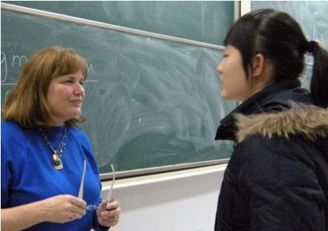
As I continue my teaching journey of 33 years, I reflect on my changed methodologies, philosophies, and pedagogies. However, some important constants remain: clear expectations, enthusiasm, humor, smiles, laughter, empathy, and approachability. I find great wisdom in the words of Lily Tomlin’s character Edith Ann: “I like a teacher who gives you something to take home to think about besides homework.”
—Debra Foster, Central Arizona College

Slide 4
Teaching is my passion, and my desire is to be an effective and motivational instructor. I welcome every opportunity to apply my skills and knowledge of course curriculum and instructional methods to my instruction. I strive to continue to refine and develop my teaching, and to be involved in the development of course curriculum, assessment, and the goals of the college.
—Mary Kieser, Central Arizona College

Slide 5
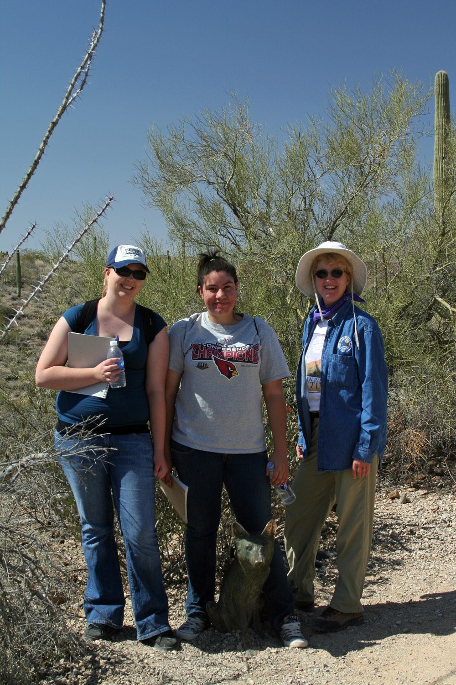
Taking students outside to do field research motivates them! In partnership with the Nature Conservancy, my biology and environmental science students perform water-quality monitoring and ecological studies. "When do we go again?" and "This rocks!" and "Science is FUN!" are popular evaluations for the project. I love my job!
—Beth Krueger, Central Arizona College

Slide 6
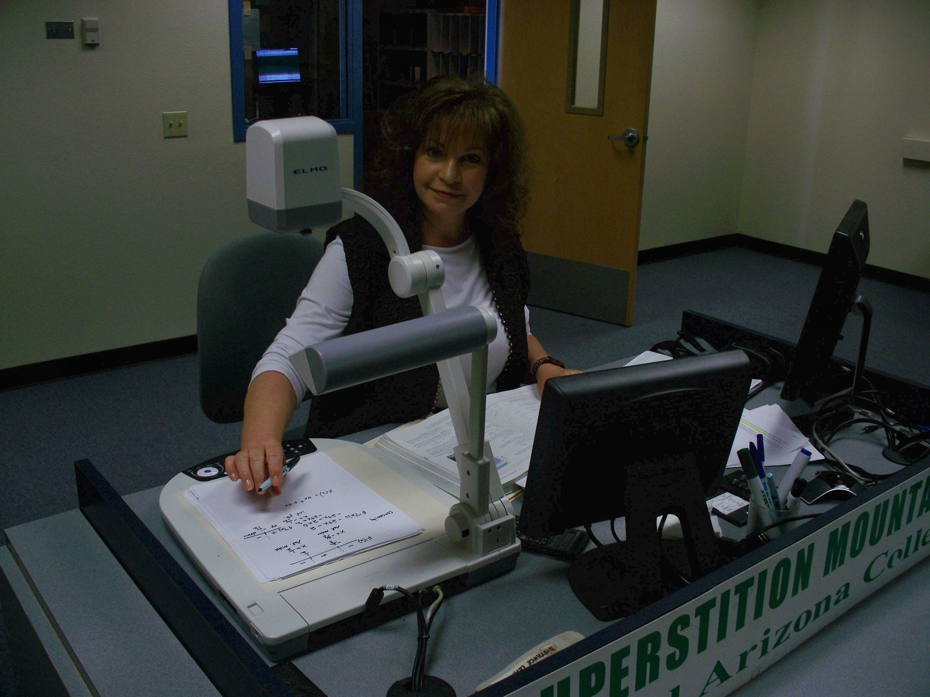
My ultimate goal is to help every student experience success and appreciate math for its beauty and usefulness.
—Deborah Primm, Central Arizona College

Slide 7
The unique opportunity of teaching agriculture allows us to teach chemistry, marketing, and common sense. We are so blessed with natural resources in this country, and we are helping people fish for a lifetime instead of eating for a day.
—Robert Randall, Central Arizona College

Slide 8
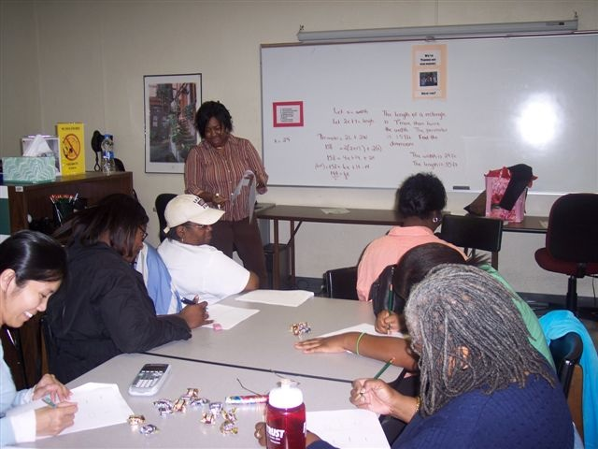
Alex Haley wrote, "When you see a turtle on a fence post, you know that he had help.” Without intervention, the top of the fence post would have been impossible to reach. Teachers are the world's greatest helpers. Today, I teach from that fence post.
—Sonya (Rudy) Johnson, Central Piedmont Community College (NC)

Slide 9
At the front line to students and faculty, I find that a smile and a level head help me to meet their needs. A calm manner and good knowledge of processes and procedures makes the front office an ideal place for the students and the faculty.
—Inge Olsen, Cerro Coso Community College (CA)

Slide 10
While my students may not remember the specific lectures I taught them, they do remember my passion for biology. They remember that I made science fun and applicable to their lives. I have the most amazing job in the world; I get a chance to touch the future.
—Scarlet Estlack, Clarendon College (TX)

Slide 11
Find a cause that MEANS something to you, and volunteer your time. You will meet new people, learn about needs in your own community, be re-energized, and show your students how important it is to “Make a Difference.”
—Susan Webb-Curtis, Cleveland State Community College (TN)

Slide 12
I teach acting at Clovis Community College and unlike the university level where students are looking for a career, my students come to the class for many different reasons. My job is to discover what their goals are and then to build on their strengths and give them the tools to move on in their chosen vocations.
—Christy Mendoza, Clovis Community College (NM)

Slide 13
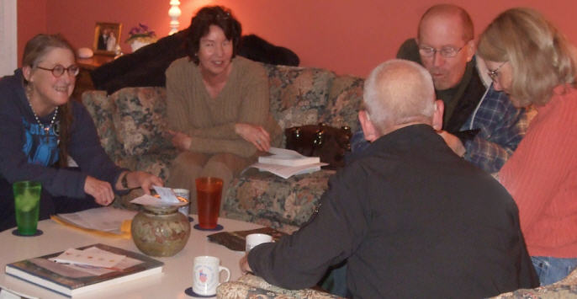
To have been selected for excellence in teaching means to me that my efforts to encourage and to incite, to enlighten and to excite, have been noticed. But more than that, it means to me that it is the LEARNABLE MOMENT that has counted. I have always believed that teaching and learning are a harmonious pair, a yang and a yin, a recto and a verso, neither able to survive in health without the other and both nourishing the same goal, that of understanding.
—Katherine Watson, Coastline Community College (CA)

Slide 14
Albert Einstein said, “Education is what remains after one has forgotten what one has learned in school.” I believe that making connections between content and applying this knowledge to real-life situations makes a great impact on student learning.
—Tasneem Ashraf, Cochise College (AZ)

Slide 15
My students inspire and challenge me. I work for them; they pay my salary. I love this job!
—Randy Fox, Cochise College (AZ)

Slide 16
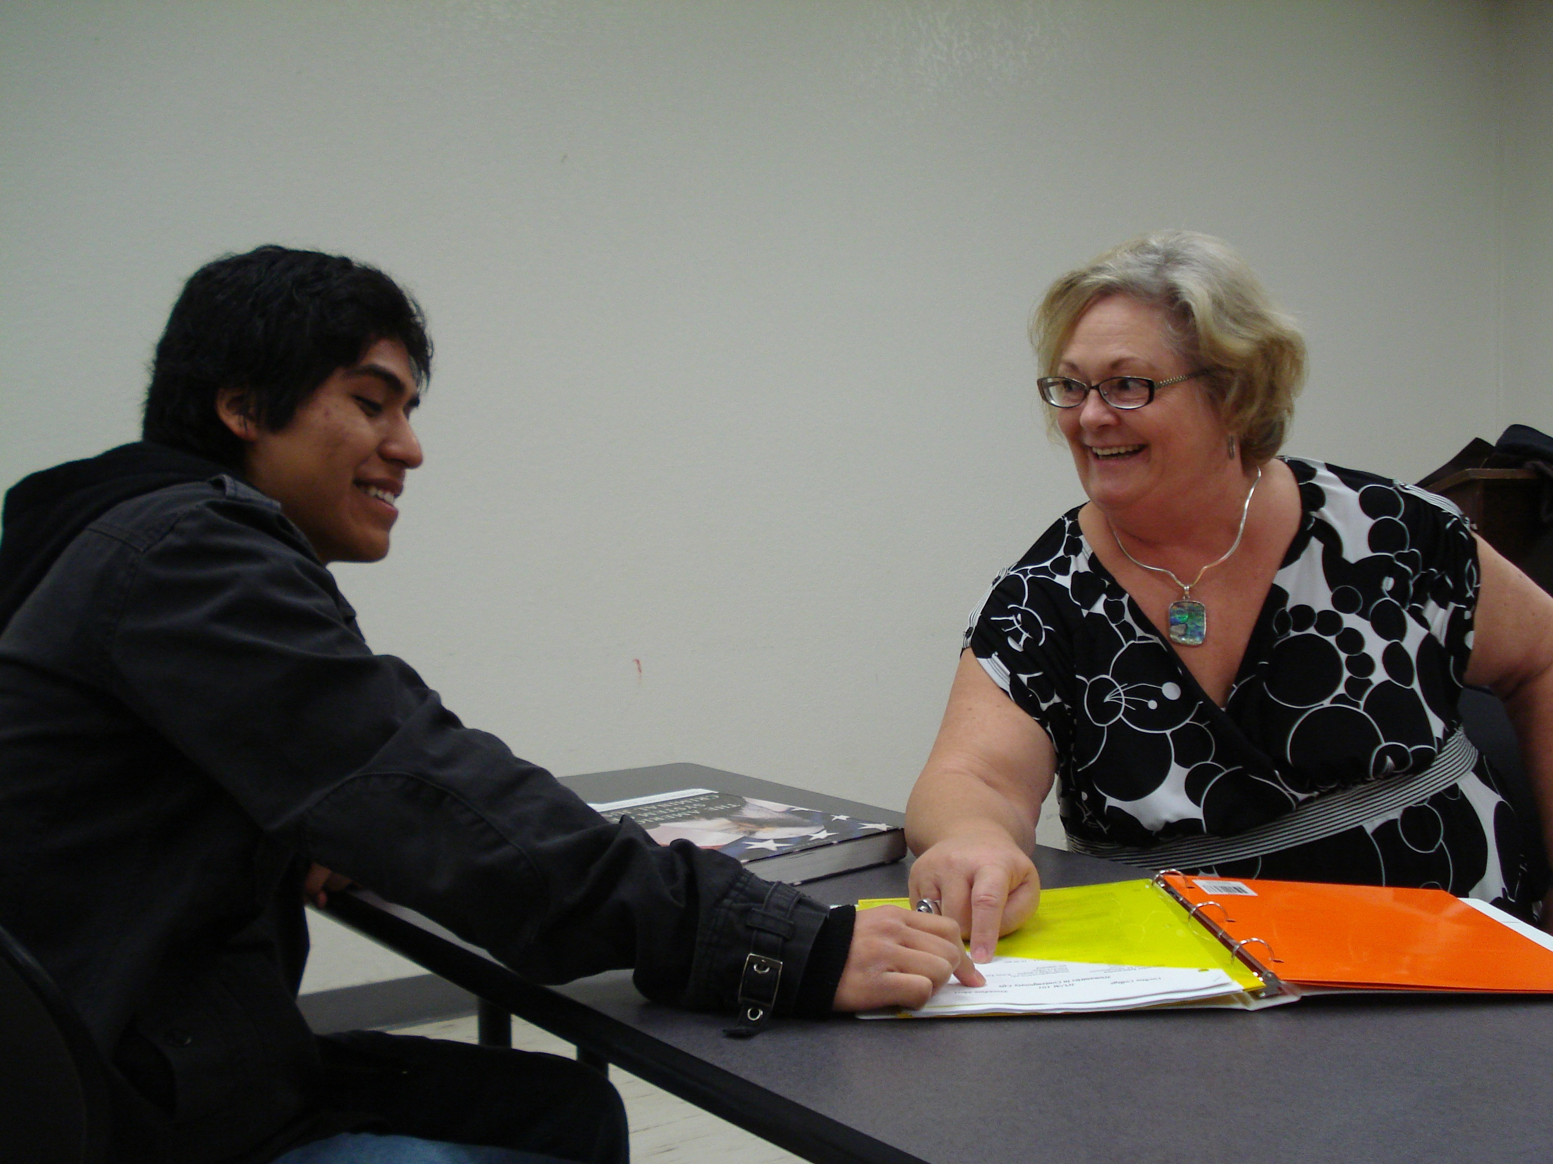
I love what I teach, and I believe that I am sharing my passion rather than teaching a subject. I actively involve my students in the process of discovery by showing them the path and providing them the tools to travel down the path.
—Gail Shaughnessey, Cochise College (AZ)

Slide 17
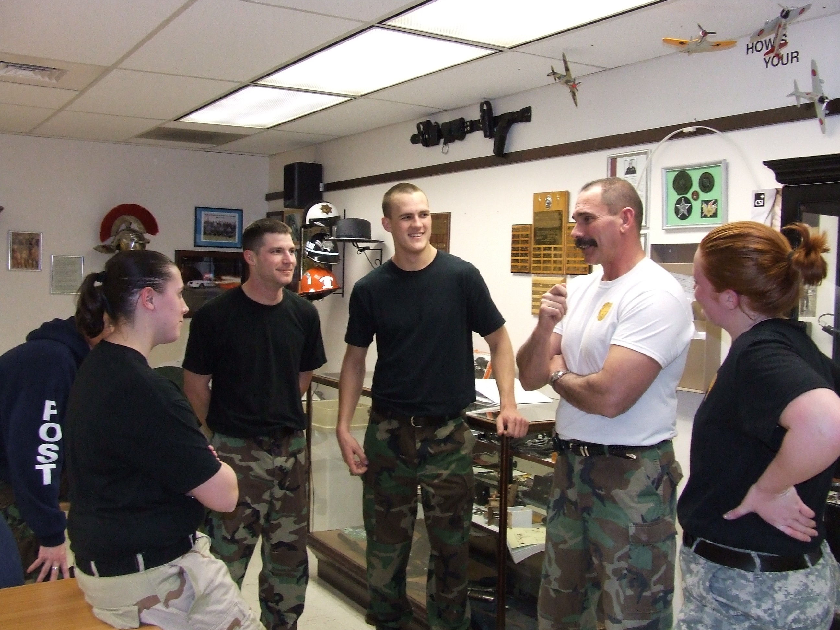
I have always considered the opportunity to instruct an honor and a privilege. To serve the students enrolled at the College of Southern Idaho is one way that I can also serve my community. I understand the importance of the great responsibility that comes with educating our students, and I cherish it. I am energized by the learning that I see take place and it only furthers my commitment to, and my belief in, our motto here within the Law Enforcement Program, Ethics, Honor, and Duty .
—R Reid, College of Southern Idaho

Slide 18
I work my hardest to become the best student in the classes that I teach. When I stop learning, it is time to stop teaching.
—Mark Wasden, College of Southern Idaho

Slide 19
Don’t let technology scare you. Students today enjoy learning through interaction, whether it is in a face-to-face lab room where they extract DNA or a virtual lab where they transcribe DNA in a simulation and extract DNA in their kitchen. Provide a rich learning environment and your students will thrive!
—Ronda Jacobs, College of Southern Maryland

Slide 20
It is more than disturbing that our nation accepts that it is OK to say, “I can’t do math.” Every math educator should take this embarrassment personally and accept the responsibility to eliminate it. The old ways have brought us to this point. The next move falls upon us.
—Tom Seremet, College of Southern Maryland

Slide 21
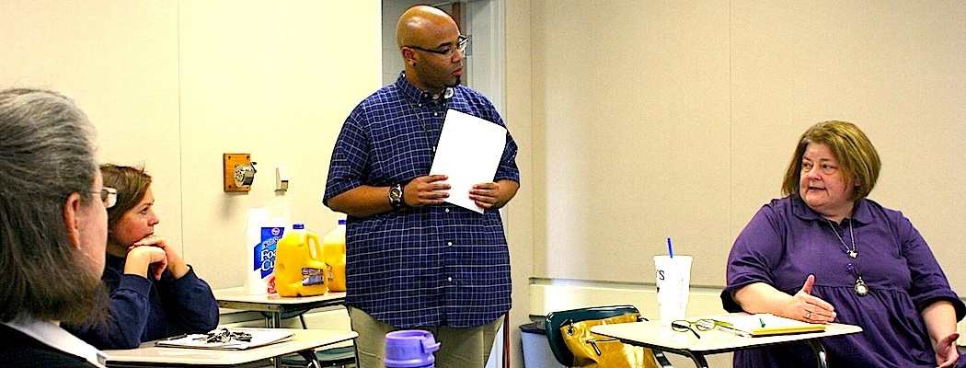
Teaching is about exploring knowledge. T.S. Eliot said: “We shall not cease from exploration, and the end of all our exploring will be to arrive where we started and know the place for the first time.” I learn from my students as much as they learn from me, and together we explore the full depths of knowledge. Together we succeed!
—De'Marcus Jackson, Columbia State Community College (TN)

Slide 22
I strive always to be conscious of the great responsibility inherited with each student I serve.
—Michael Sztapka, Columbia State Community College (TN)

Slide 23
Make each minute fruitful. Teach each student in the class rather than teaching the entire class.
—Sudha Kolathuparambil, Columbus State Community College (OH)

Slide 24
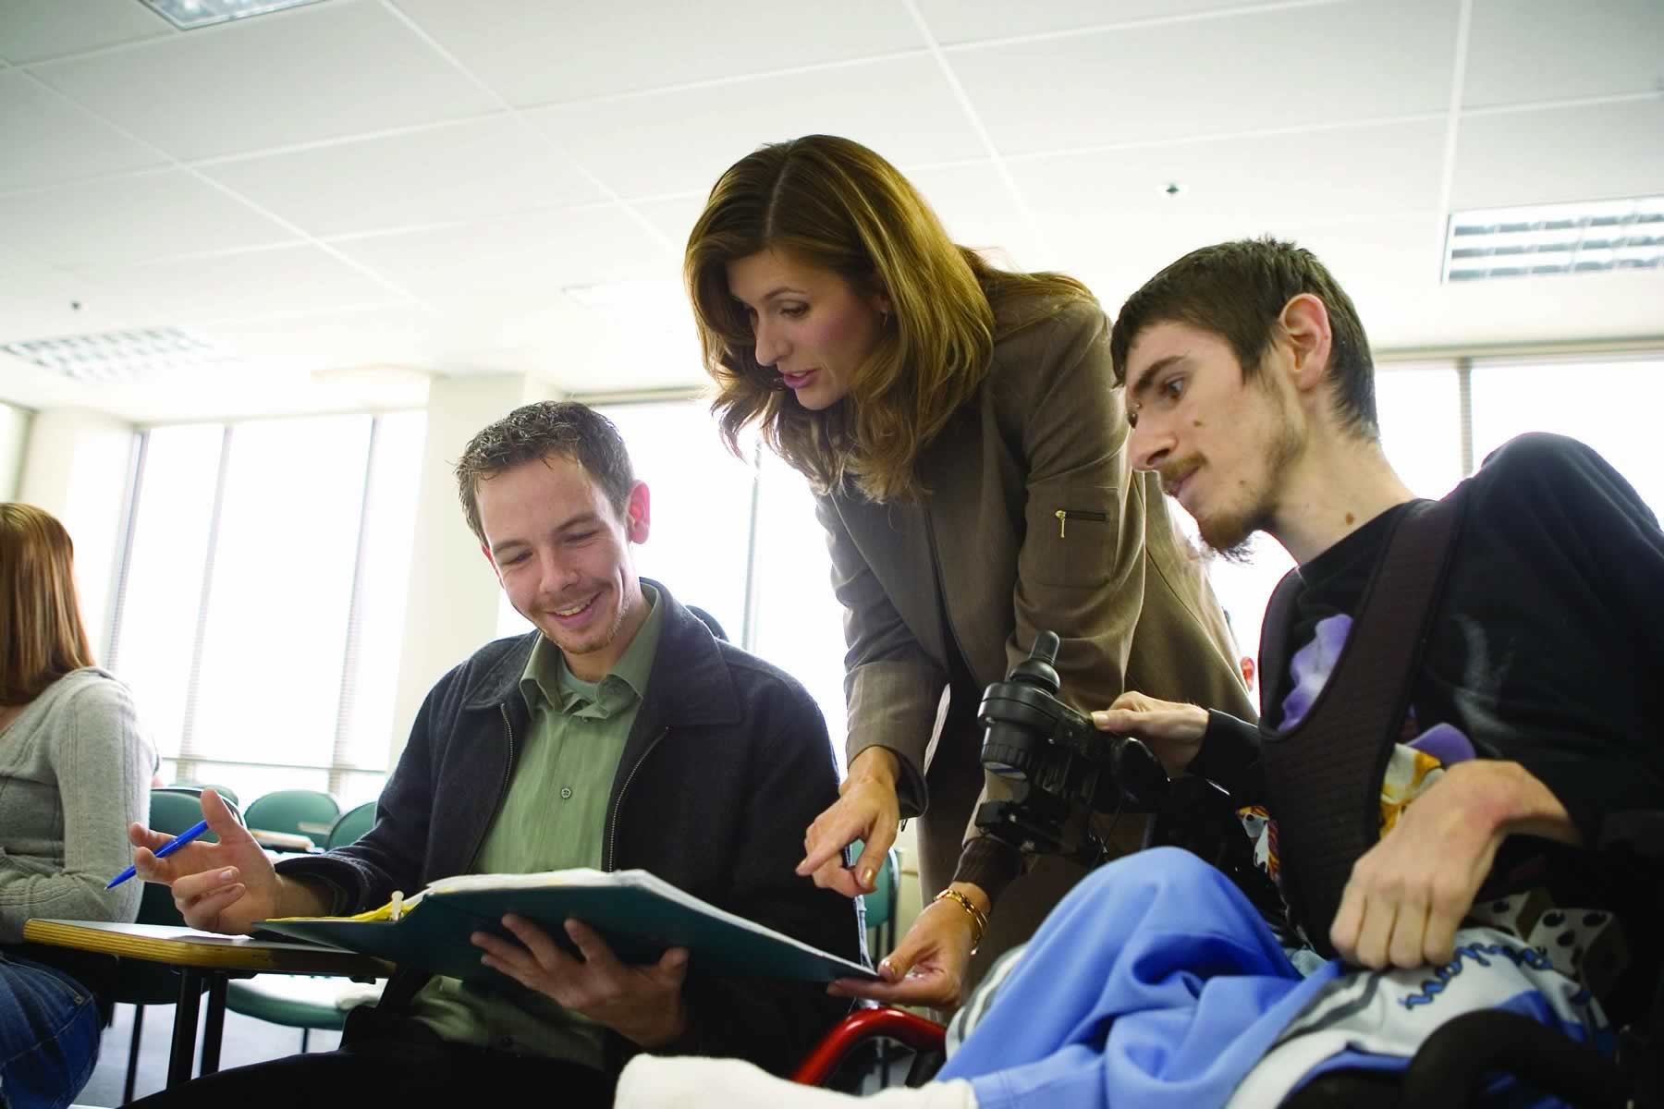
My job is to meet students’ learning needs rather than expecting them to meet my teaching style.
—Bonnie Ordonez, Community College of Allegheny County (PA)

Slide 25
It is ironic that I ask students to avoid overused expressions because the slogan that drives me is Nike’s “Go for it.” Not only do I encourage students with the phrase, I apply it to my own teaching: searching, updating, questioning, trying new strategies—all to reach students.
—Kathleen Beauchene, Community College of Rhode Island

Slide 26
It is the determination and diligence of our students that makes them successful learners and compels me to offer them every opportunity for success. It is my obligation to provide current and comprehensive material in a way that students can understand it, remember it, and use it.
—Sharon Perkins, Community College of Rhode Island

Slide 27
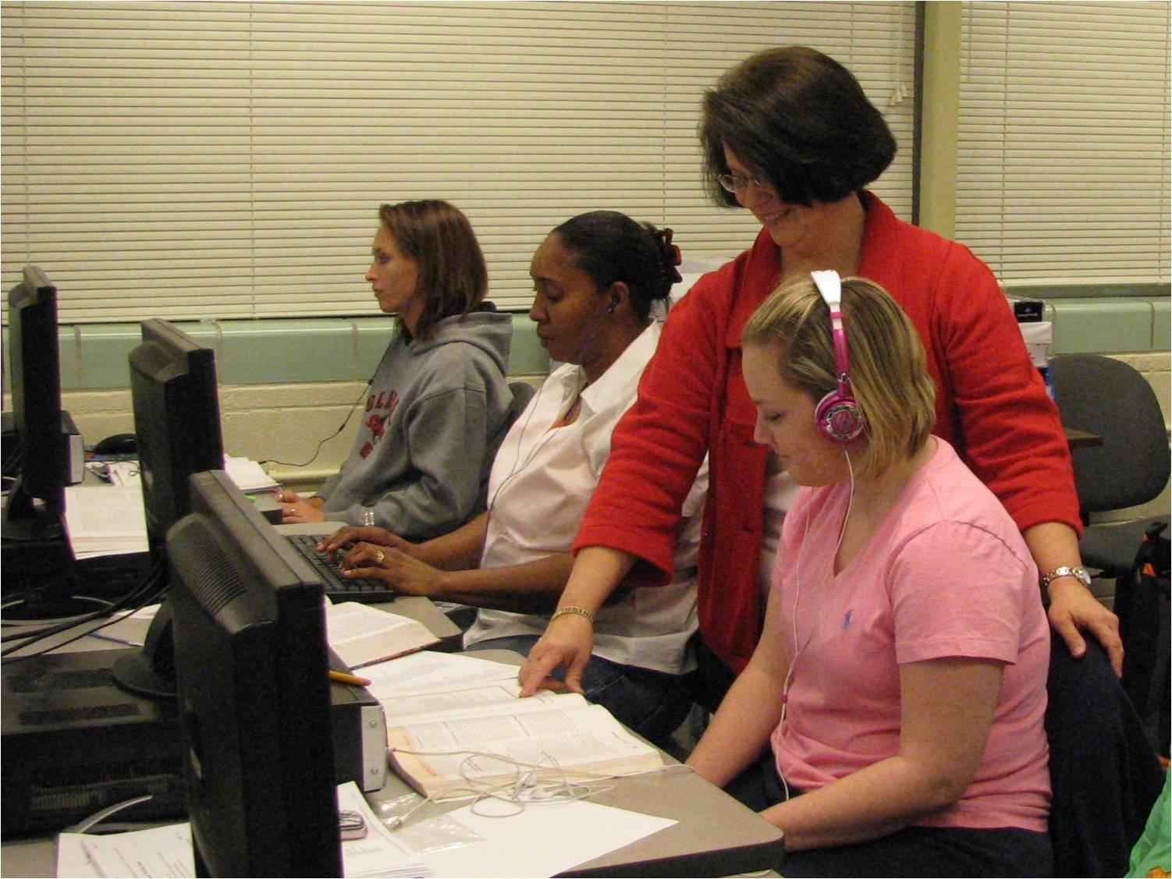
My role reaches beyond the classroom. Most of my students are nontraditional, and obtaining an education is sometimes difficult with the added duties of taking care of families and working part-time jobs. Therefore, I must have genuine concern for their education to encourage them to pursue learning for a lifetime.
—Angela Garrett, Copiah-Lincoln Community College (MS)

Slide 28
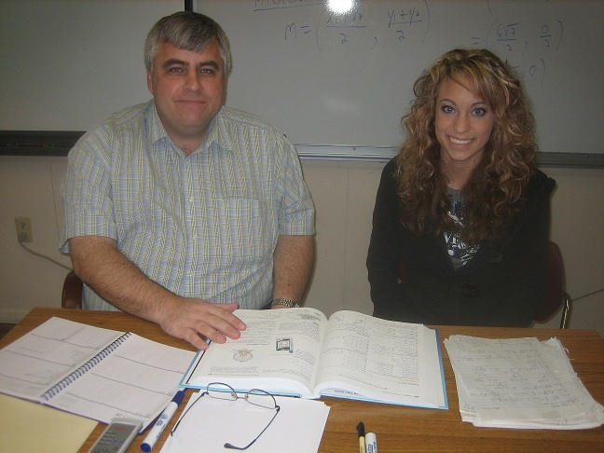
Our goal for our students should be 100% comprehension of the material, 100% retention (material and enrollment), and 100% satisfaction. Anything less is unacceptable.
—David Hays, Cowley County Community College (KS)

Slide 29
I feel it is my duty to provide a learning environment for student success. I enjoy learning how to become a more effective teacher through pedagogy and technology. I prepare students to become great thinkers.
—Greg Nichols, Cowley County Community College (KS)

Slide 30
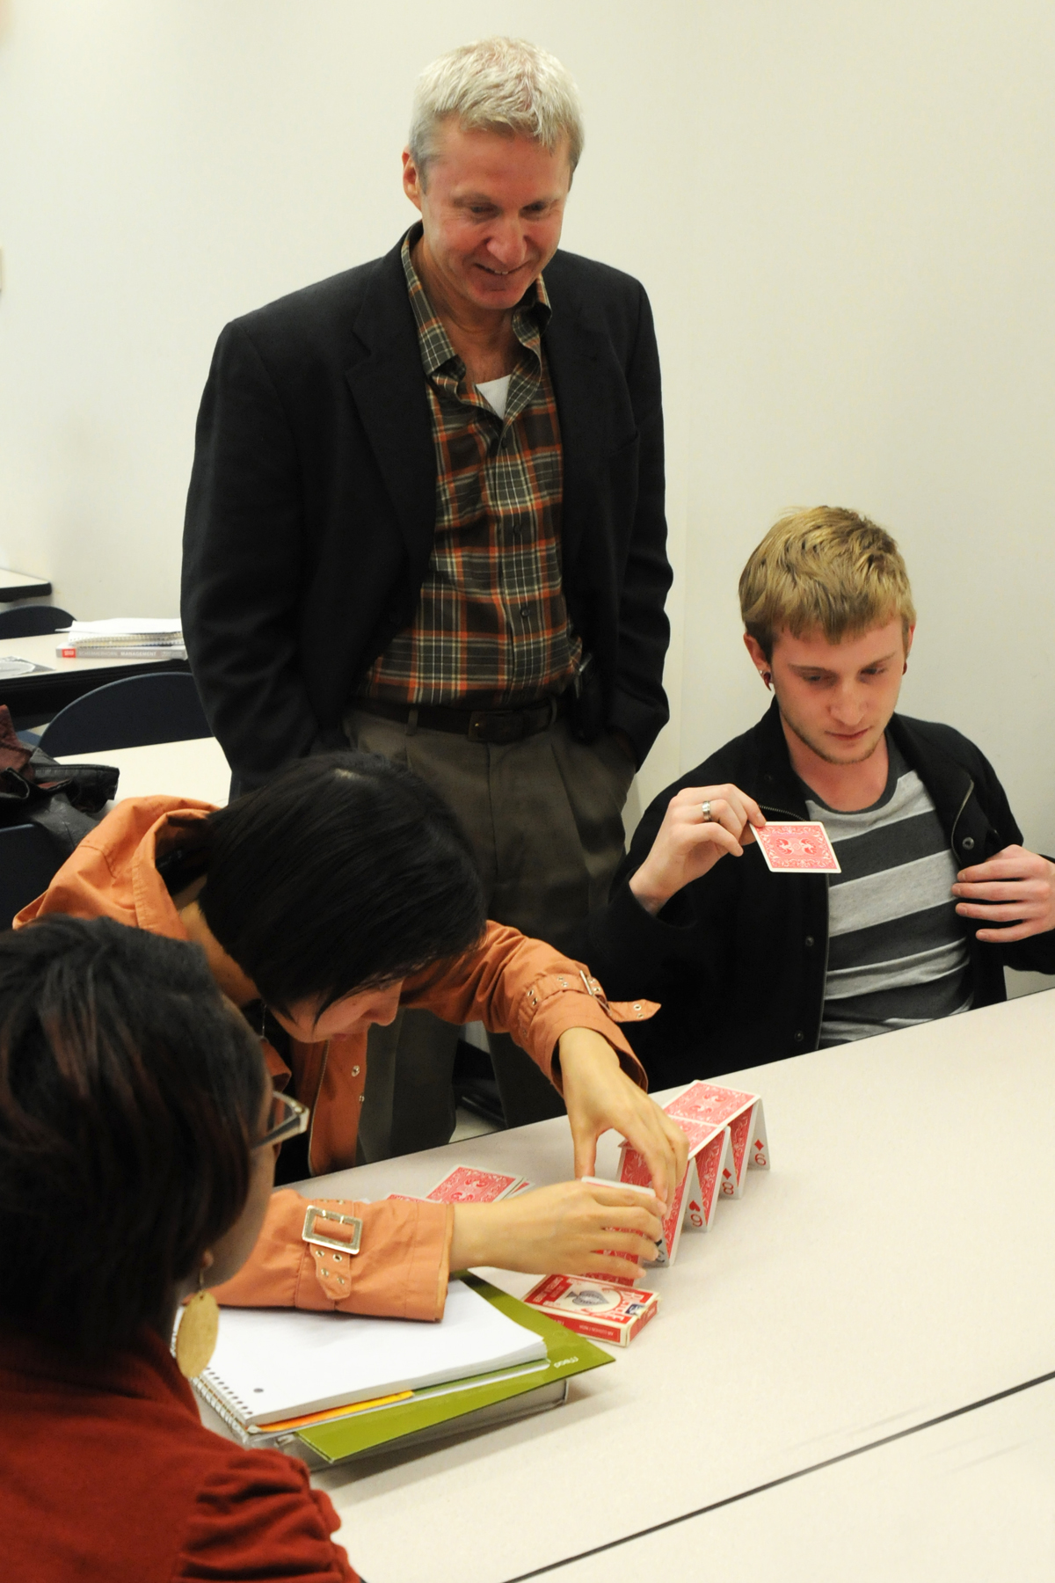
I am continually inspired by our students, many of whom overcome tremendous odds and adversity to seek the opportunities for growth and success that we are so privileged to offer.
—Andrew Bajda, Cuyahoga Community College (OH)

Slide 31
In the laboratory, students and I are engaged in dialog using the “language of chemistry”; therefore, reinforcing concepts that we have discussed during the lecture/discussion periods. I highlight links to resources matching students’ career interests. Throughout the semester I present articles written about or by contemporary scientists with matching careers.
—Ormond Brathwaite, Cuyahoga Community College (OH)

Slide 32
Let your students see what interests and excites you. It may be the spark that ignites their passion for learning. Take topics from your field and make connections with the real world. Your students will be able to apply your examples to their lives.
—Paul Rokicky, Cuyahoga Community College (OH)

Slide 33
Before succumbing to pancreatic cancer in May 2009, Robert Parelli, in a graduation speech to his students the year before, stated that the character traits necessary to sustain a person through a 35-year career in medical radiography such as mine are hard work, intelligence, compassion, and a strong sense of ethics.
—Robert Parelli, Cypress College (CA)

Slide 34
As an Instructional Developer, I work closely with faculty and staff here at Darton College. I’m motivated by faculty who wish to make their online courses the very best that they can be. It’s very gratifying for me to be a part of our student’s educational success.
—Tracy Cosper, Darton College (GA)

Slide 35
The process of writing itself is what gives me joy. I love to see my students begin with just an idea and turn it into something amazing—not just something that fulfills the assignment, but something they are proud to call their own and have others read.
—Elizabeth Gassel, Darton College (GA)

Slide 36
For many students, attending college is a once-in-a-lifetime opportunity. I would not dare cut corners; I find the time and the energy to create enriching experiences.
—Matt Huntanar, Davidson County Community College (NC)

Slide 37
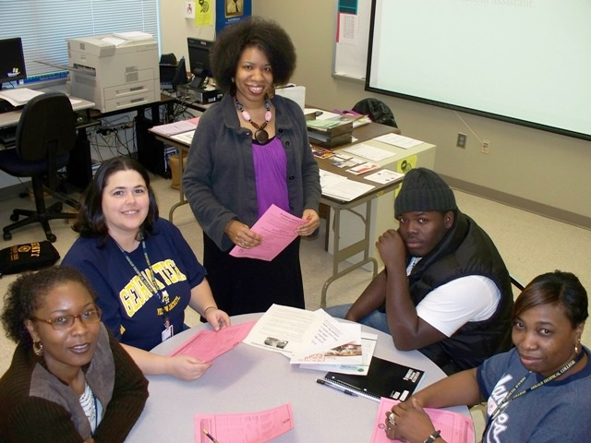
I still remember what it was like to be a student—the excitement, the curiosity, the fear, the positive experiences, and the “not-so-positive” experiences. Remembering those feelings shape the way I assist students. I want to be part of their positive experiences. My advice to others: Remember and Empathize.
—Angela Cummings, DeKalb Technical College (GA)

Slide 38
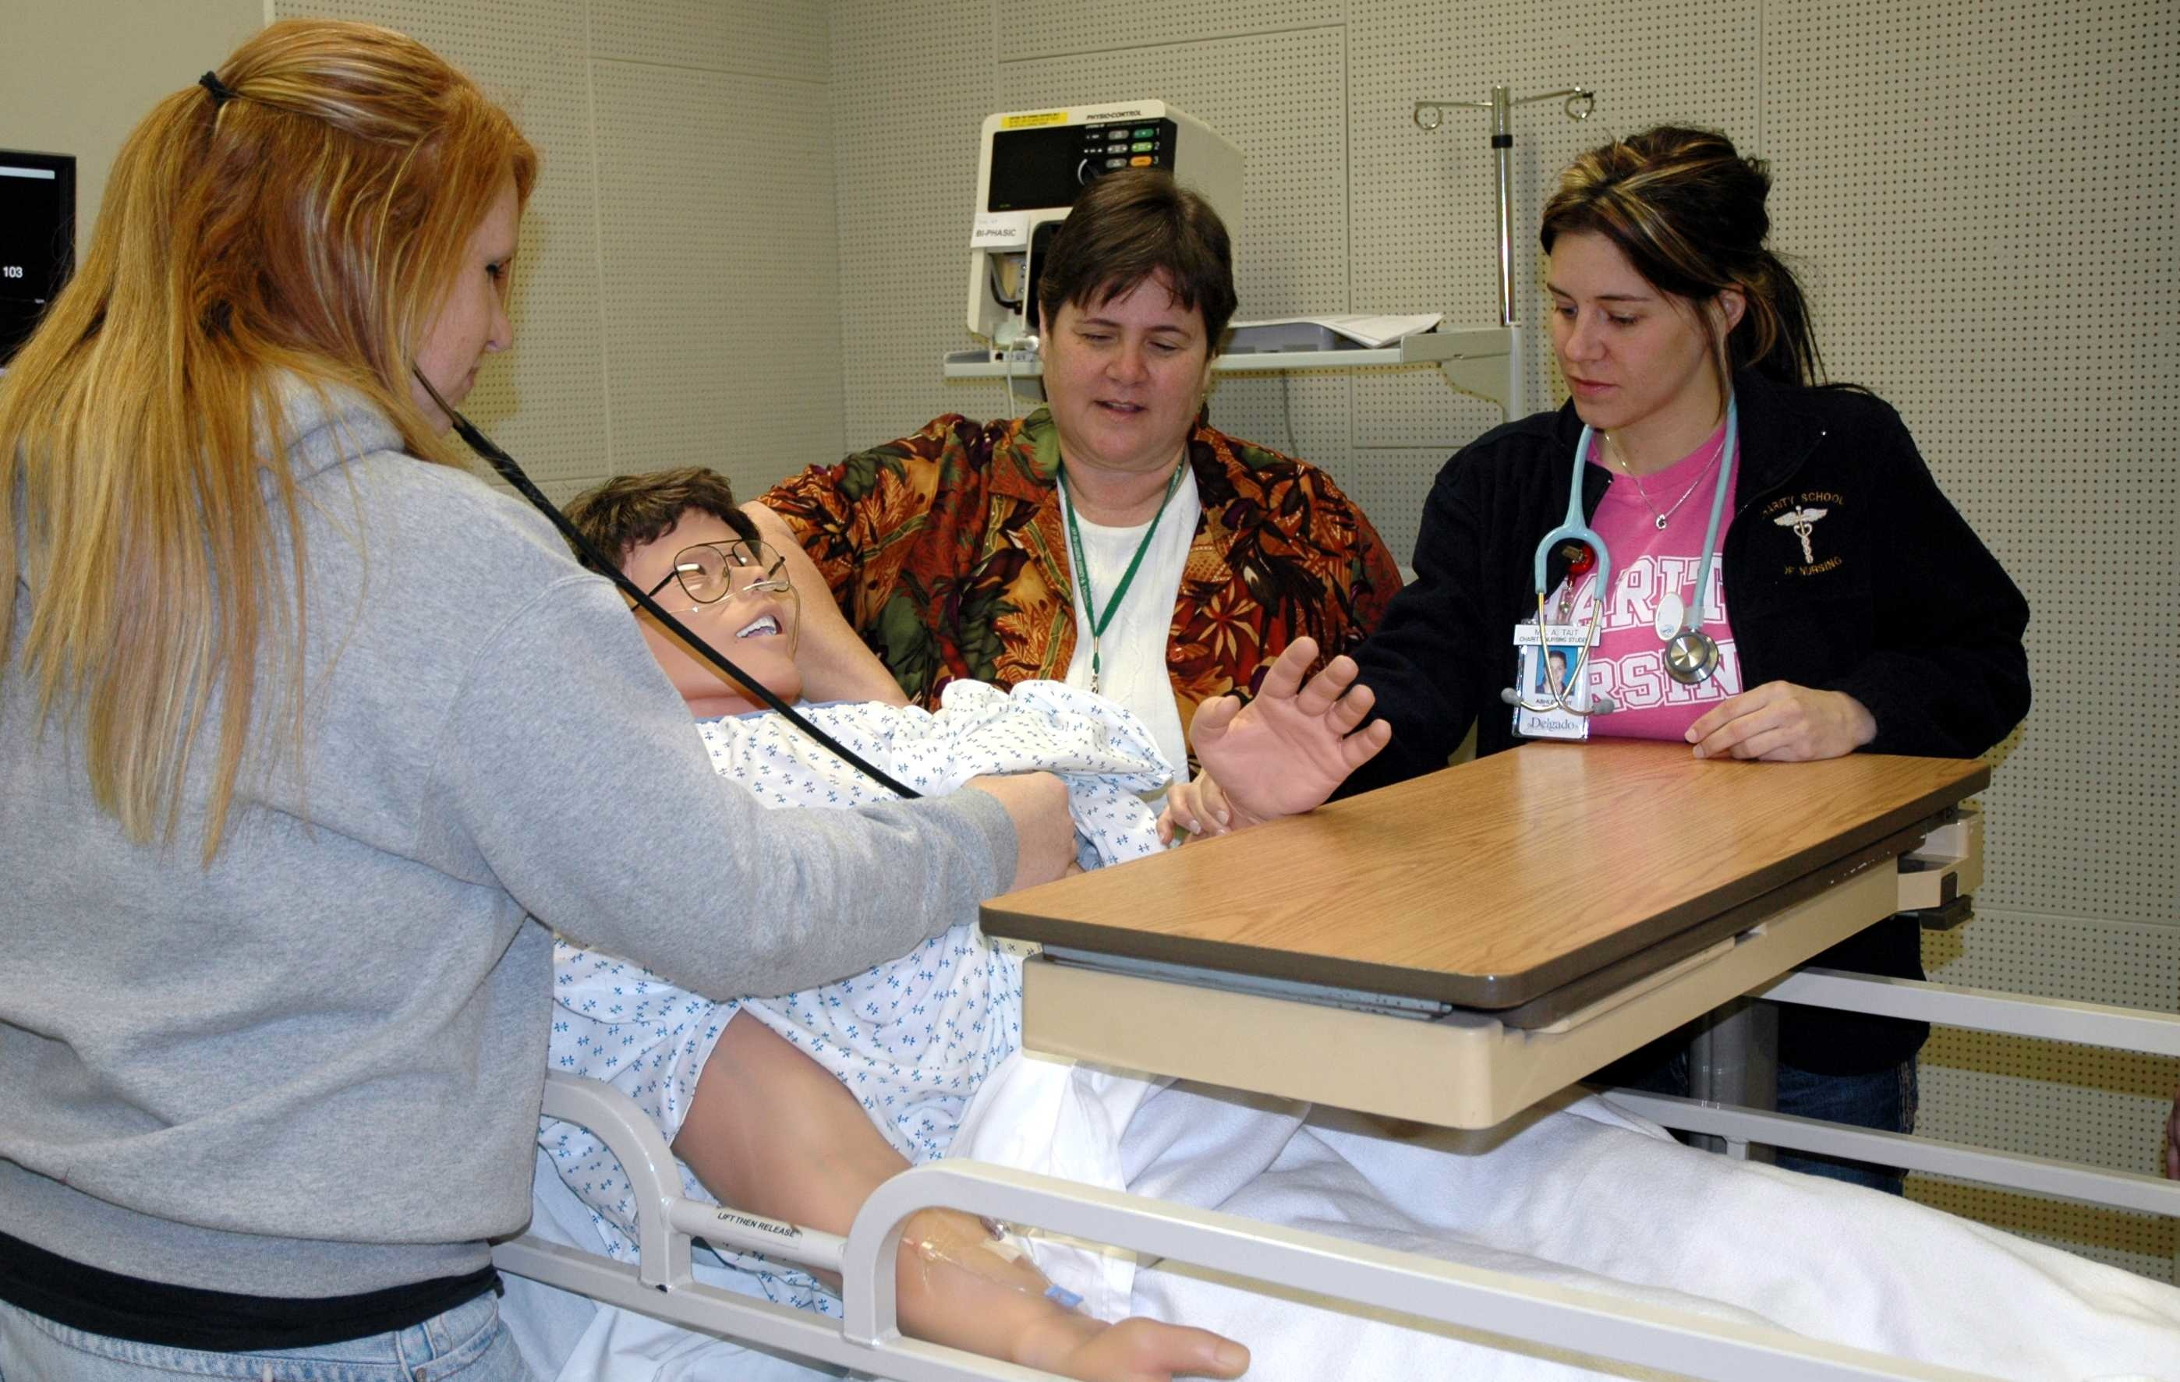
My two professional passions are nursing and teaching. My students motivate me. I feel that I have been given the gift of being a teacher, and I try to use this gift to the best of my ability. To watch students grow and learn during the semester is priceless. I feel so proud when I see my students graduate and reach their goal of becoming a Registered Nurse. I am honored to have assisted with their growth and achievement.
—Patricia Smart, Delgado Community College (LA)

Slide 39
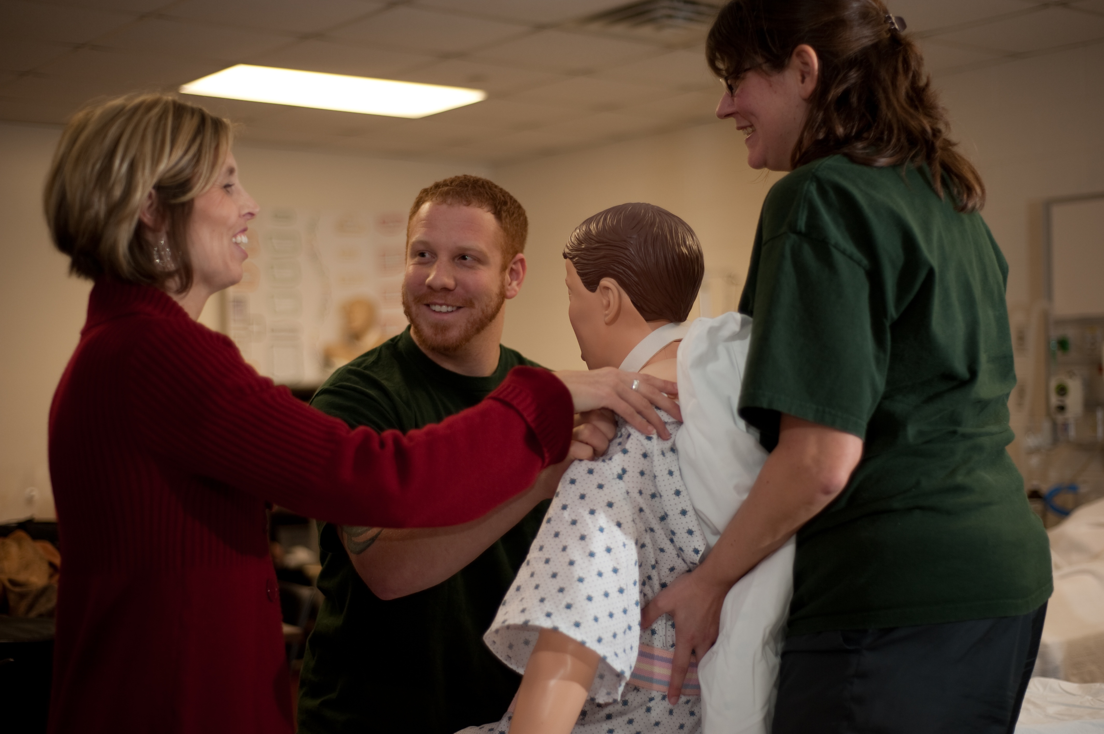
My teaching success comes from stimulating all areas of the brain using activities that get students "working" with the information they are trying to learn. I make my students move, feel, see, draw, touch, experience, eat, color, draw, manipulate Playdoh, jump, exercise, describe, talk, demonstrate, teach others, hypothesize, test, reflect, and retest. We have fun, which helps with memory, but by "doing," they are able to experience the information.
—Jamie Duley, Delta College (MI)

