Slide 1
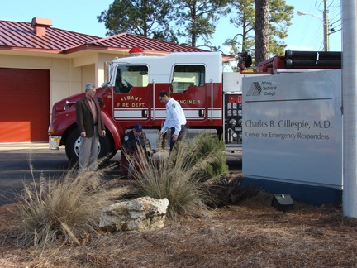
Workforce development is the primary objective of the Technical College System of Georgia. I instruct fire science courses, to fire departments, and have introduced what we’ve termed: On the job training, a different approach. Providing continuing education, as well as a career development pathway for fire personnel, is a rewarding experience.
—Don Laye, Albany Technical College (GA)

Slide 2
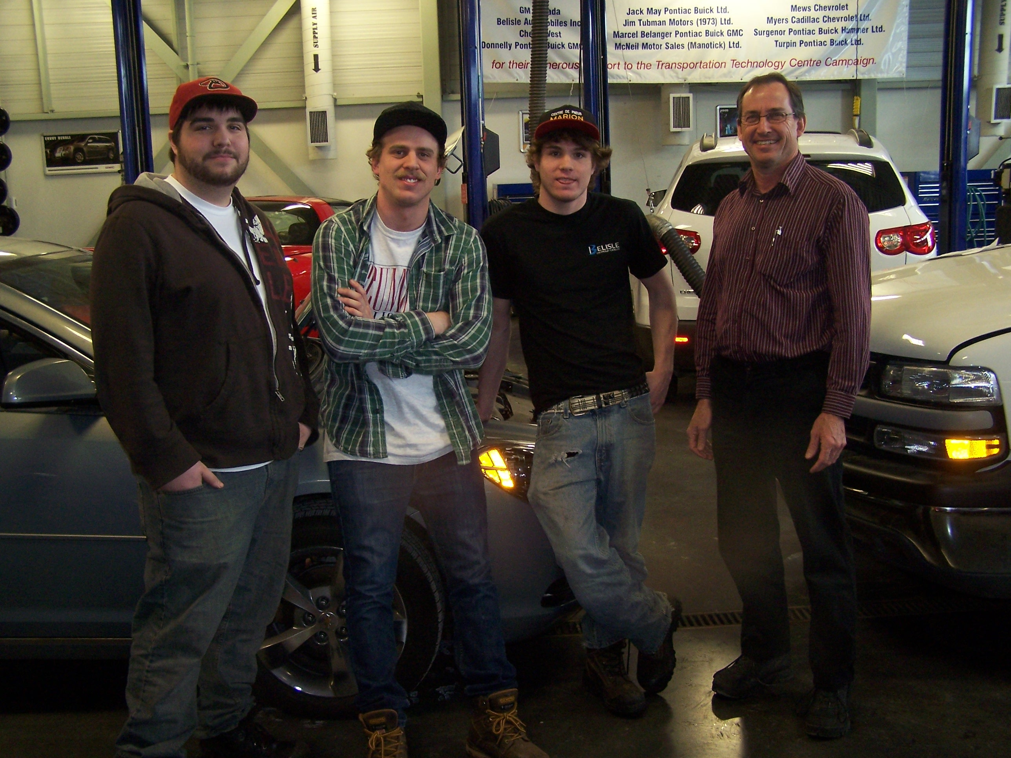
The greatest reward in teaching for me would have to be watching the look in a students eyes perform a certain task successfully, and knowing only a short time ago the same student had minimal, and in some cases, no technical or practical skills around the motor vehicle. Awesome sight!
—Roger Davey, Algonquin College (Ontario)

Slide 3
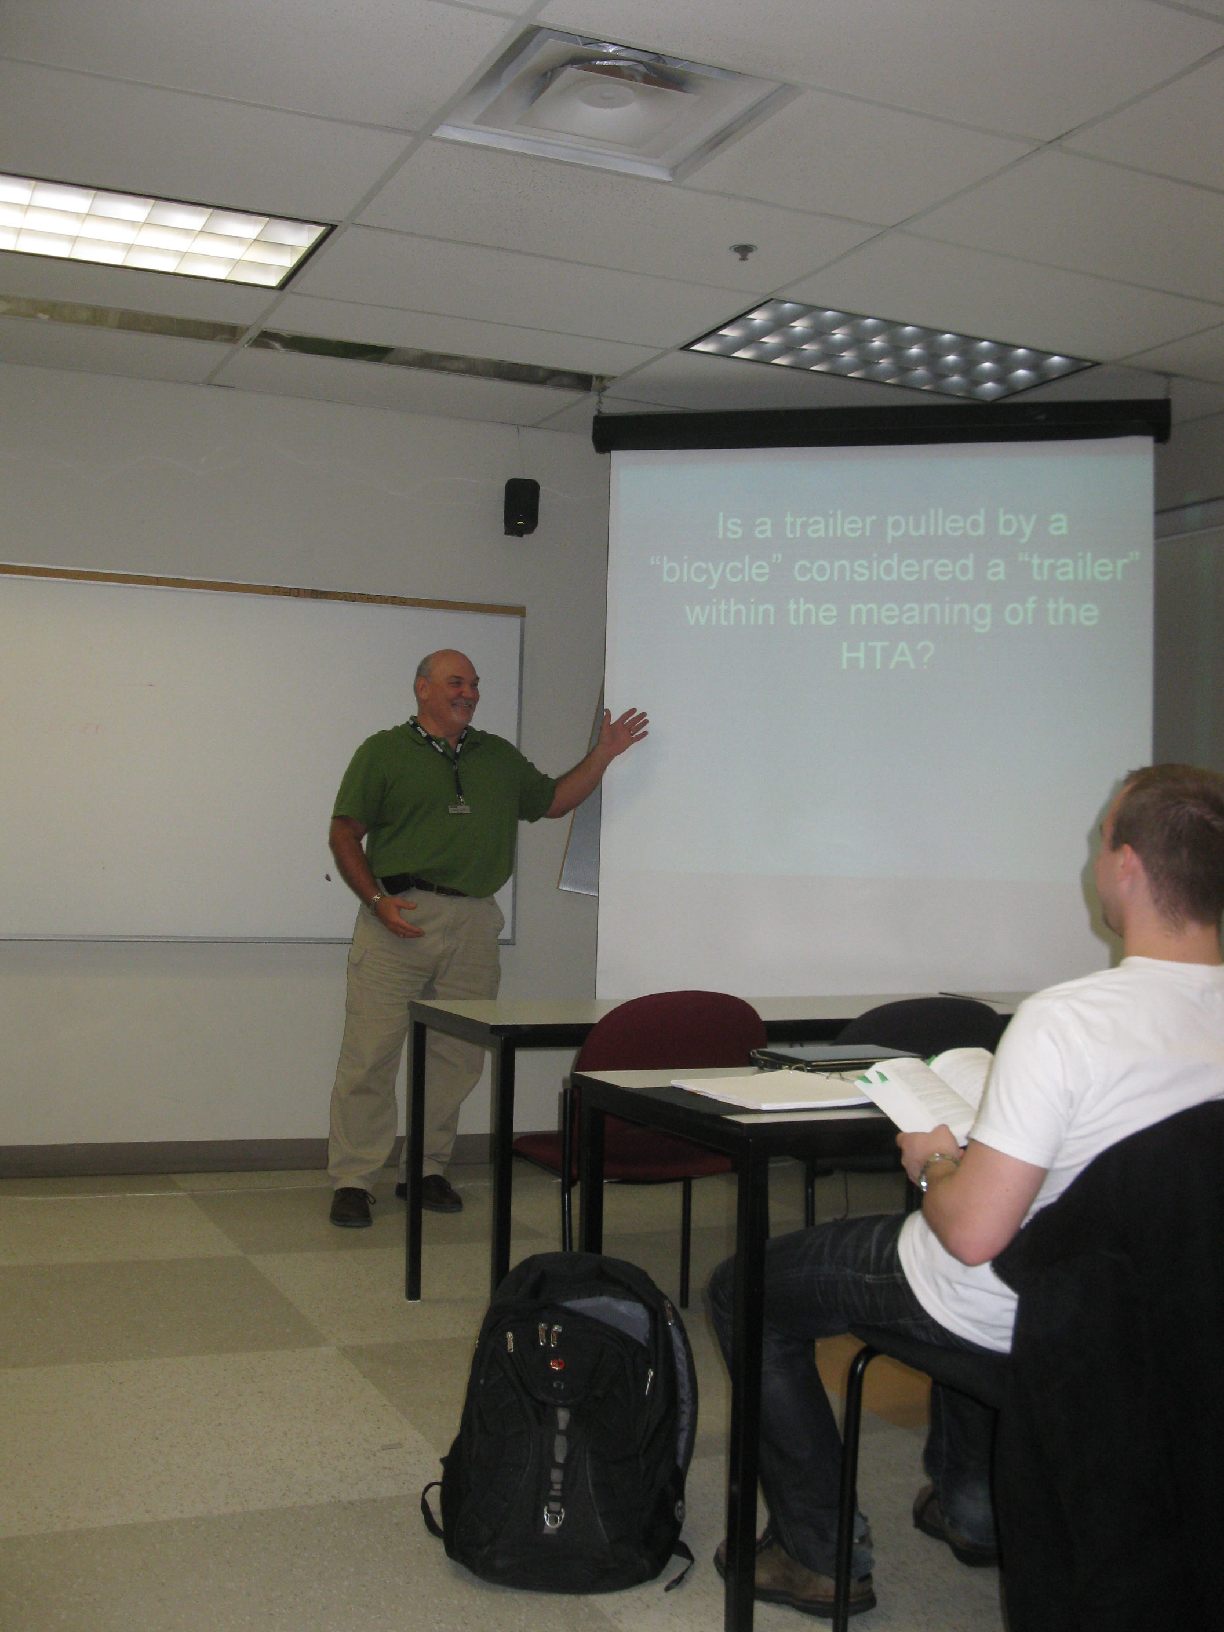
The success of my students is my success.
—Brian Duffy, Algonquin College (Ontario)

Slide 4
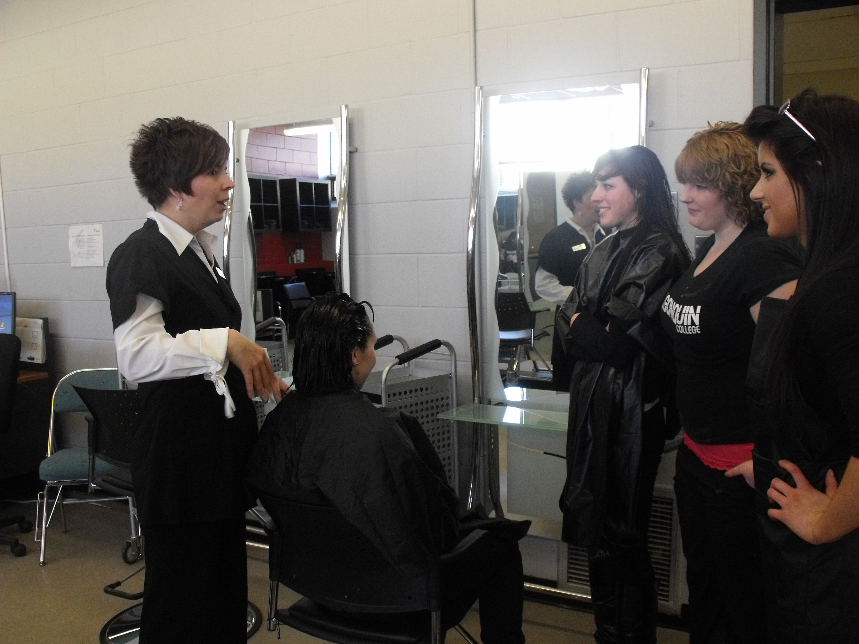
Teaching for me is an innovative way to improve the knowledge of others while simultaneously improving my own.
—Tara Ettinger, Algonquin College (Ontario)

Slide 5
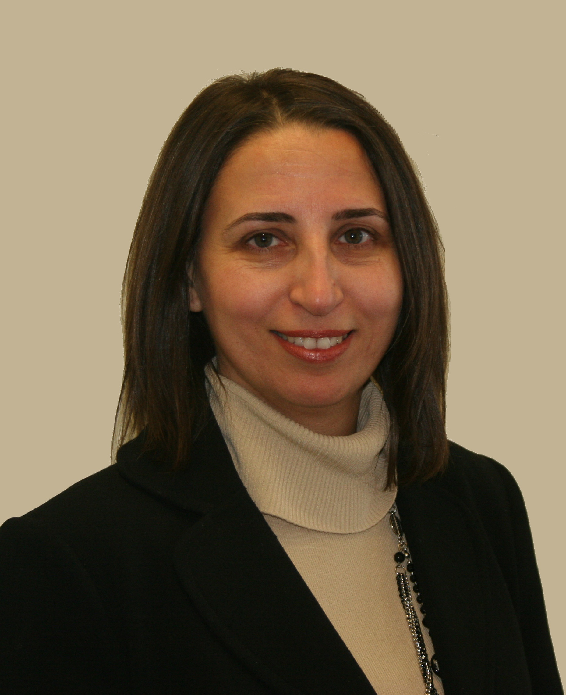
What inspires me is to help students develop their analytical skills and critical thinking. I encourage them to identify available paths and persevere in finding solutions. My aim is to help them acquire skills which will stay with them and change the way they view and approach challenges in life.
—Nelly Faycal, Algonquin College (Ontario)

Slide 6
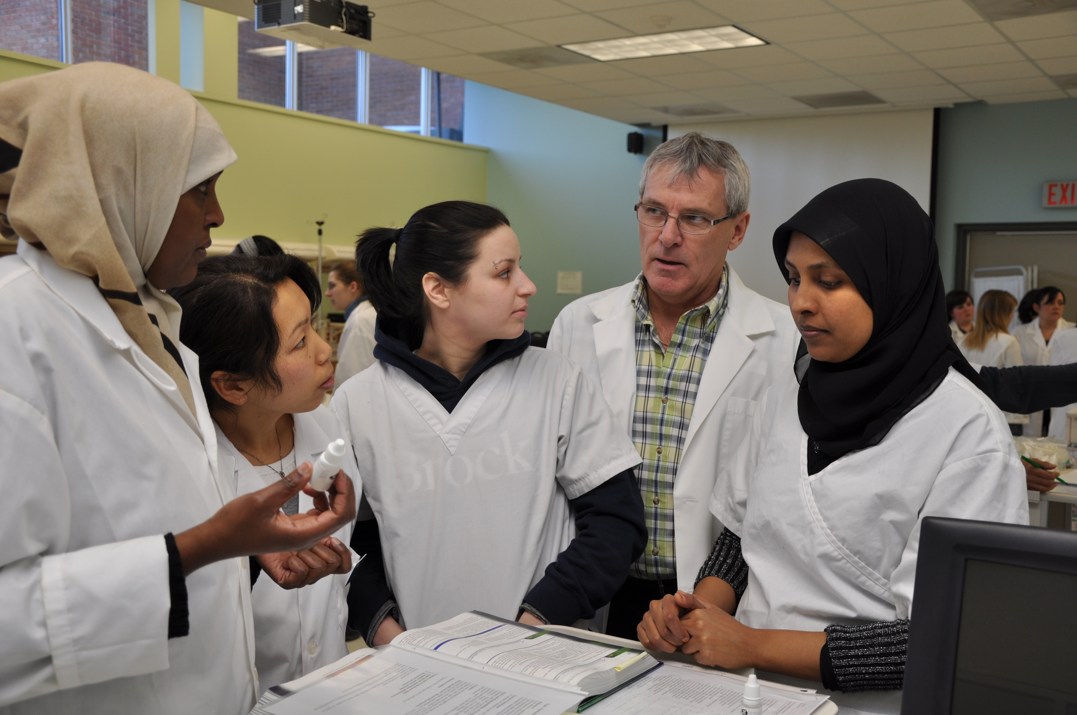
One of my nursing students gave me a plaque which states: To have knowledge is good. To teach and share knowledge is a gift. I believe that the word gift should be changed to privilege. For me, there is no greater reward than watching our graduates; the nurses of tomorrow receive their diplomas.
—Carl Gray, Algonquin College (Ontario)

Slide 7
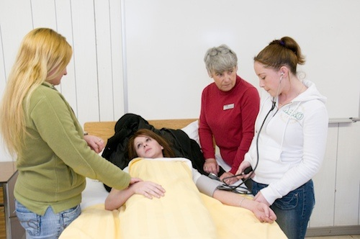
I am inspired to strive for excellence in my teaching by my students, many of whom are returning to school after many years. These students are determined to create a better life for themselves and their families. I see the sacrifices they have made to attempt this goal and I feel compelled to offer them the tools to succeed. My emphasis is on the need of the adult learning to see the link between the theories they are learning and how they will use this knowledge in their career.
—Kathleen Hamilton, Algonquin College (Ontario)

Slide 8
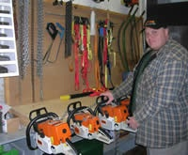
Passing forestry knowledge on to new students is by far the most satisfying aspect of my career as a professor. Providing them with the thorough knowledge that I have attained in the natural resource field gives me a feeling of extreme gratification. The students are tomorrows forestry technicians, and I know that I was part of their development.
—Chris Ryan, Algonquin College (Ontario)

Slide 9
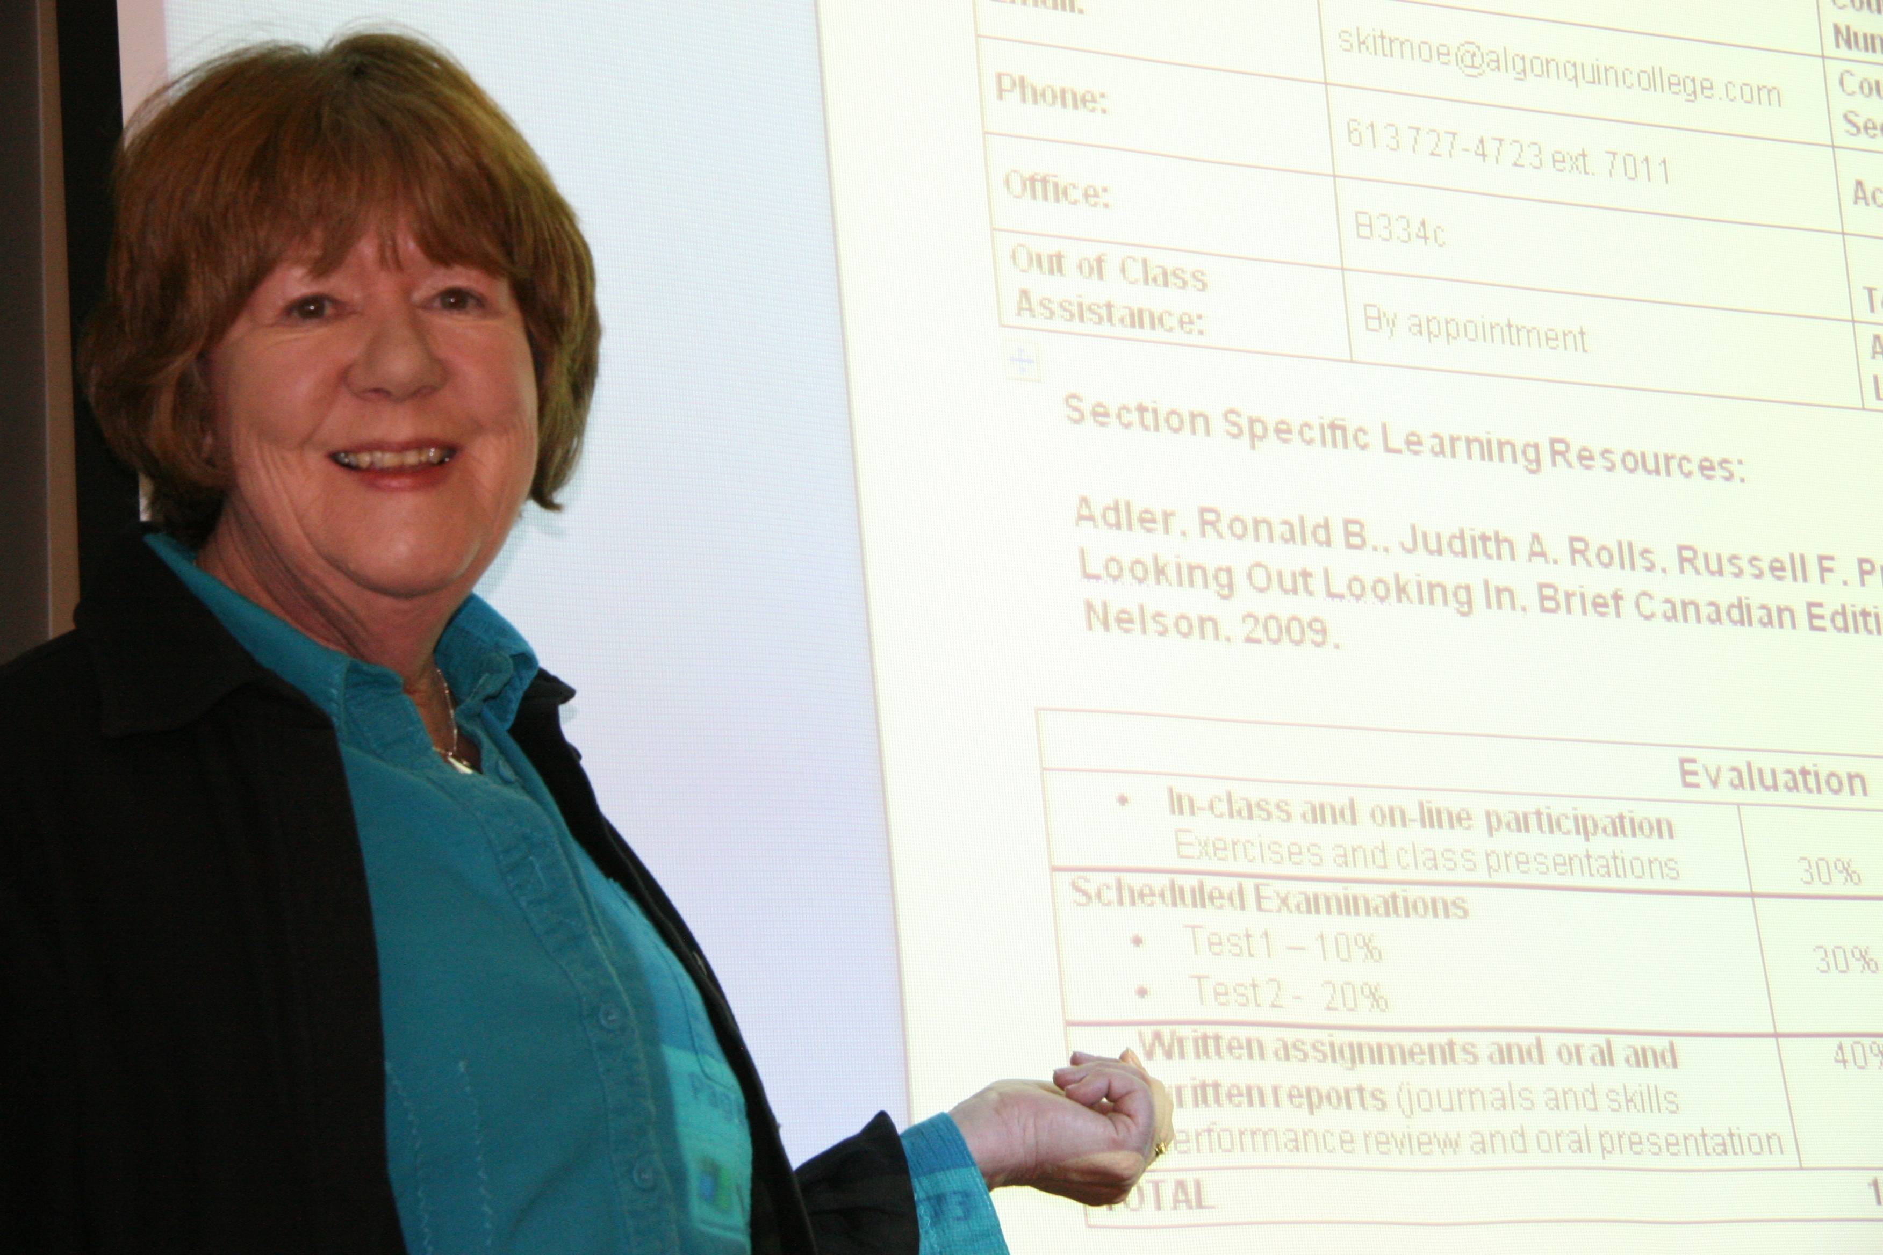
As one student cheerfully greeting me remarked, “You see, what you have taught us works; now I have the confidence to reach out to others.”
—Elizabeth Skitmore, Algonquin College (Ontario)

Slide 10
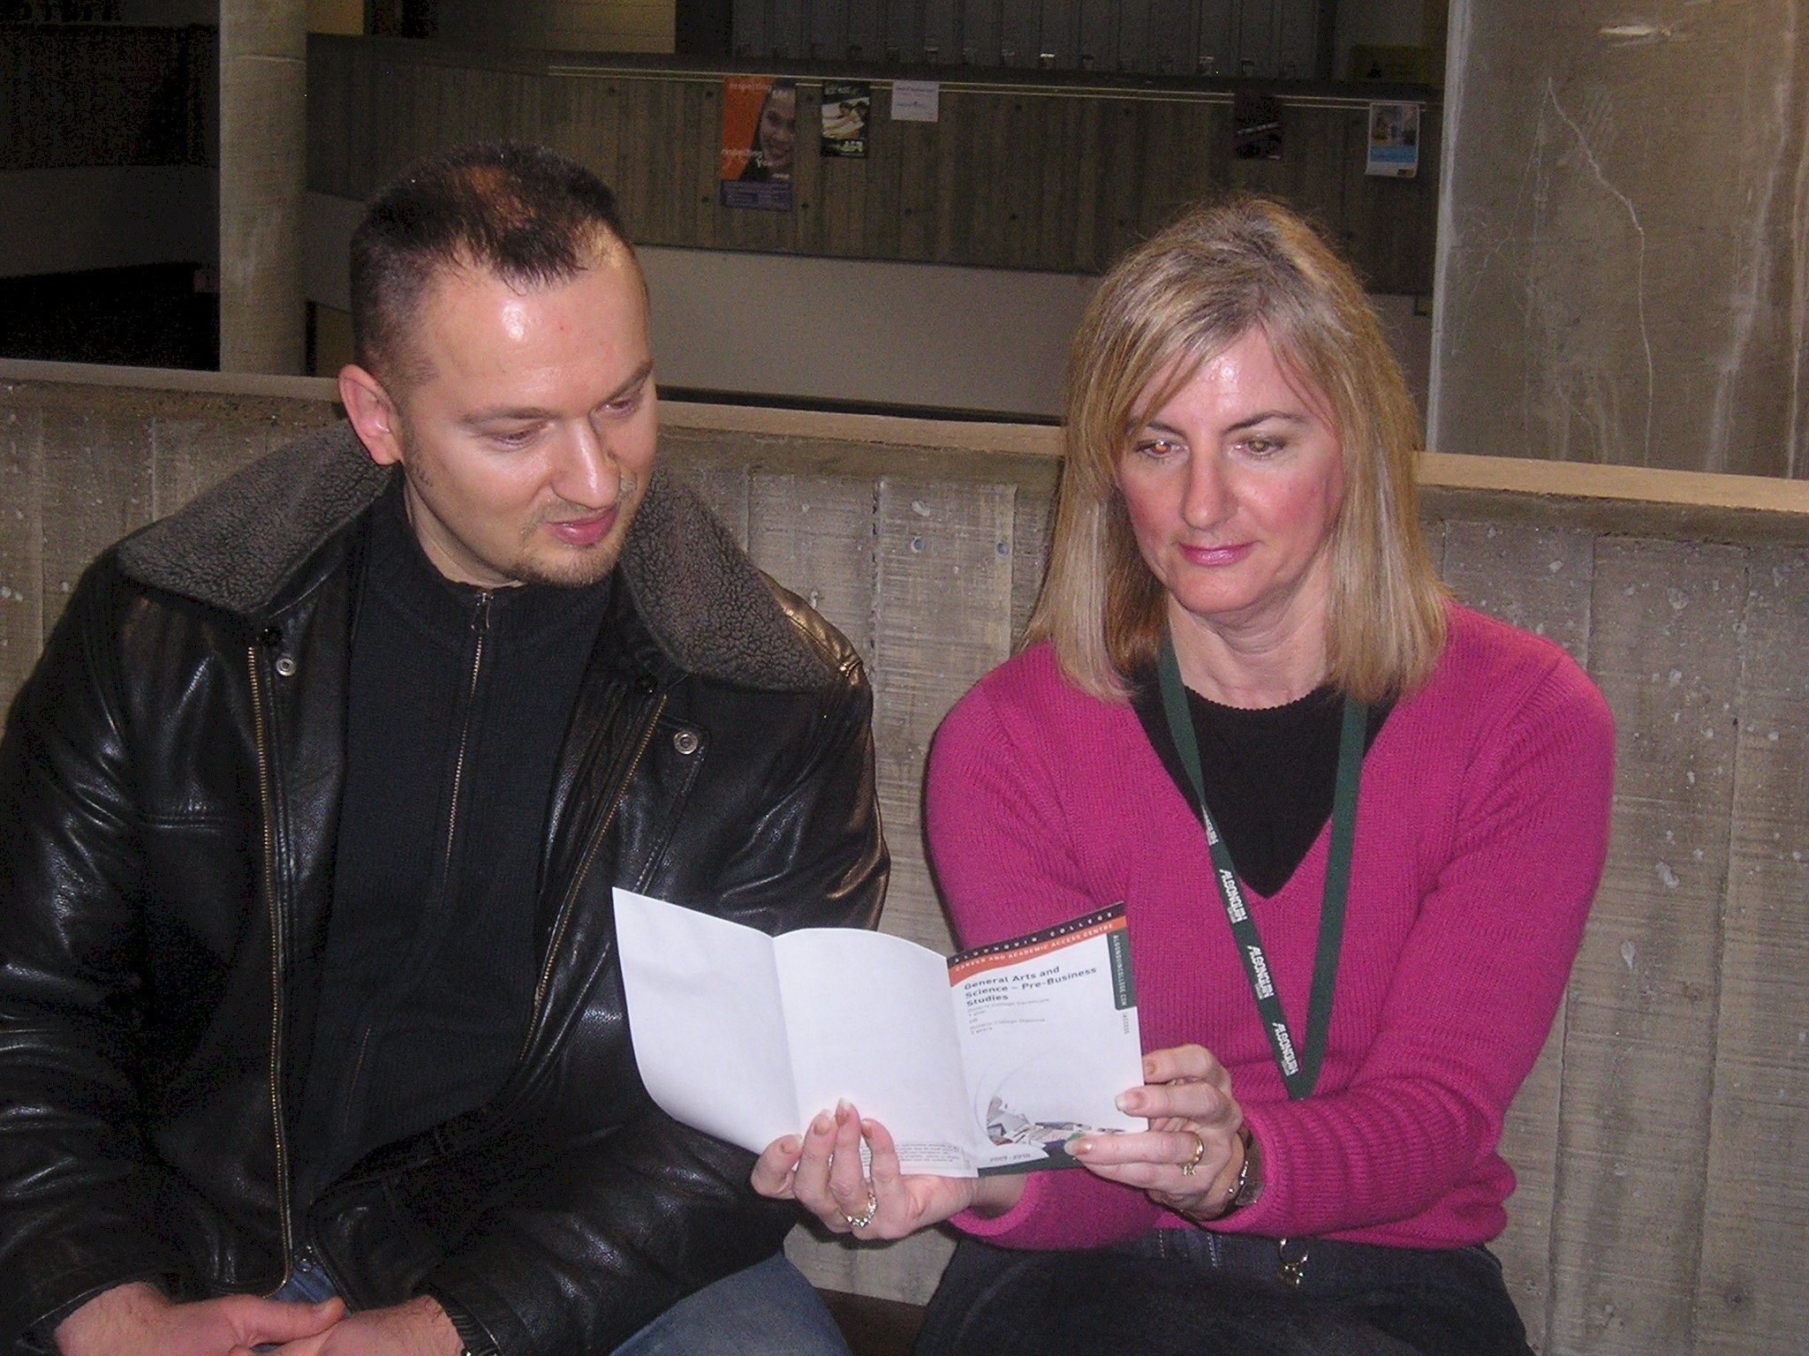
My personal belief in lifelong learning gives me the motivation I need to provide the best possible service to our students. My wonderful manager and co-workers provide me with inspiration; and in turn I believe I inspire others.
—Kit Wolski, Algonquin College (Ontario)

Slide 11
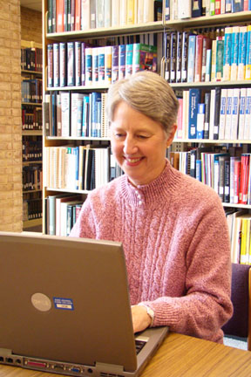
Being present for a student who needs assistance is essential and rewarding. Enabling students to learn how to find answers to their questions, not just now but for the rest of their lives, is a thrilling experience.
—Vicki Cone, Anne Arundel Community College (MD)

Slide 12
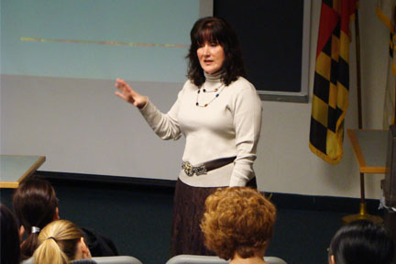
As a nursing professor, I get to see my former students working as nurses. When I see them mature in the role and grow as professionals, I know I have had a hand in that. This motivates and inspires me to continue to educate the next group of new RN's.
—Myra Dennis, Anne Arundel Community College (MD)

Slide 13
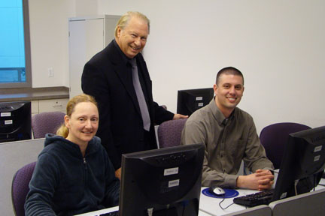
When a student discovers the error in an incorrectly configured computer network, the sense of pride and accomplishment is radiant! This is my inspiration and motivation.
—Paul Derdul, Anne Arundel Community College (MD)

Slide 14
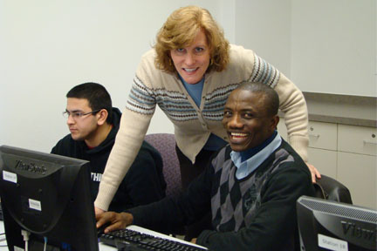
I enjoy finding ways to get my students excited about technology and I take a personal interest in them by meeting with them individually. This fosters a positive learning environment and allows me to capitalize on the opportunity to make the course relevant to them.
—Cheryl Heemstra, Anne Arundel Community College (MD)

Slide 15
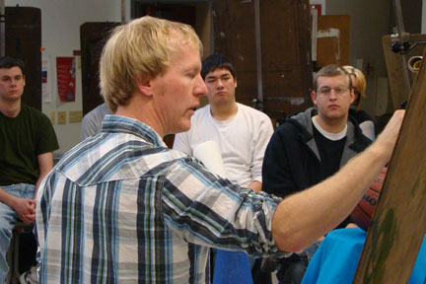
My classes in art are places of action and visual discovery. We are all participants in culture; by practicing the visual arts anyone can be a producer of culture, not just a consumer of culture. We are responsible for the world we see and make.
—Christopher Mona, Anne Arundel Community College (MD)

Slide 16
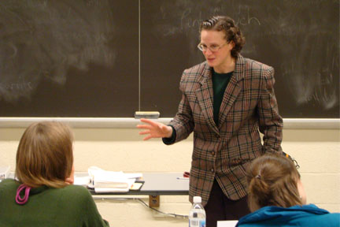
Getting students, who do not want to be in literature class, to leave saying, “Yea, poetry!” makes it all worthwhile for me.
—Jessica Rabin, Anne Arundel Community College (MD)

Slide 17
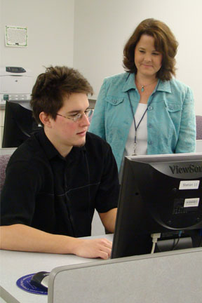
My strategy to helping students succeed is walking them through the problem. Encouraging students not to give up and to critically think through the problem is the key to learning the curriculum. The look of students excitement when they passed the industry certification, make my working with students all worthwhile.
—Kelly Sell, Anne Arundel Community College (MD)

Slide 18
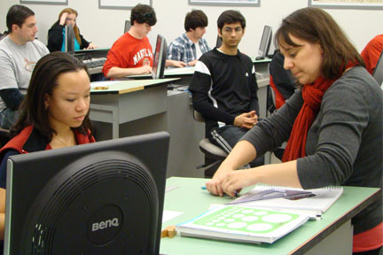
From the analysis ethics case studies pertaining to student academic integrity issues to reflecting on why tree trunks are round in statics, to using licorice ropes to demonstrate elastic properties of materials, I bring in real-world examples to help students relate to concepts and think about them beyond the textbook.
—Elizabeth Wyler, Anne Arundel Community College (MD)

Slide 19
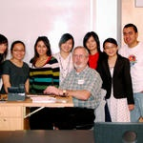
I do not go to work each day: I teach. I challenge my students to be better than they can imagine. I challenge them to live what they learn in the classroom, to experience their classroom theory by applying their newfound knowledge in real-life situations. I test the boundaries of their lives, and ask them to reach for more. I challenge them to be a success.
—David Godley, Arizona Western College

Slide 20
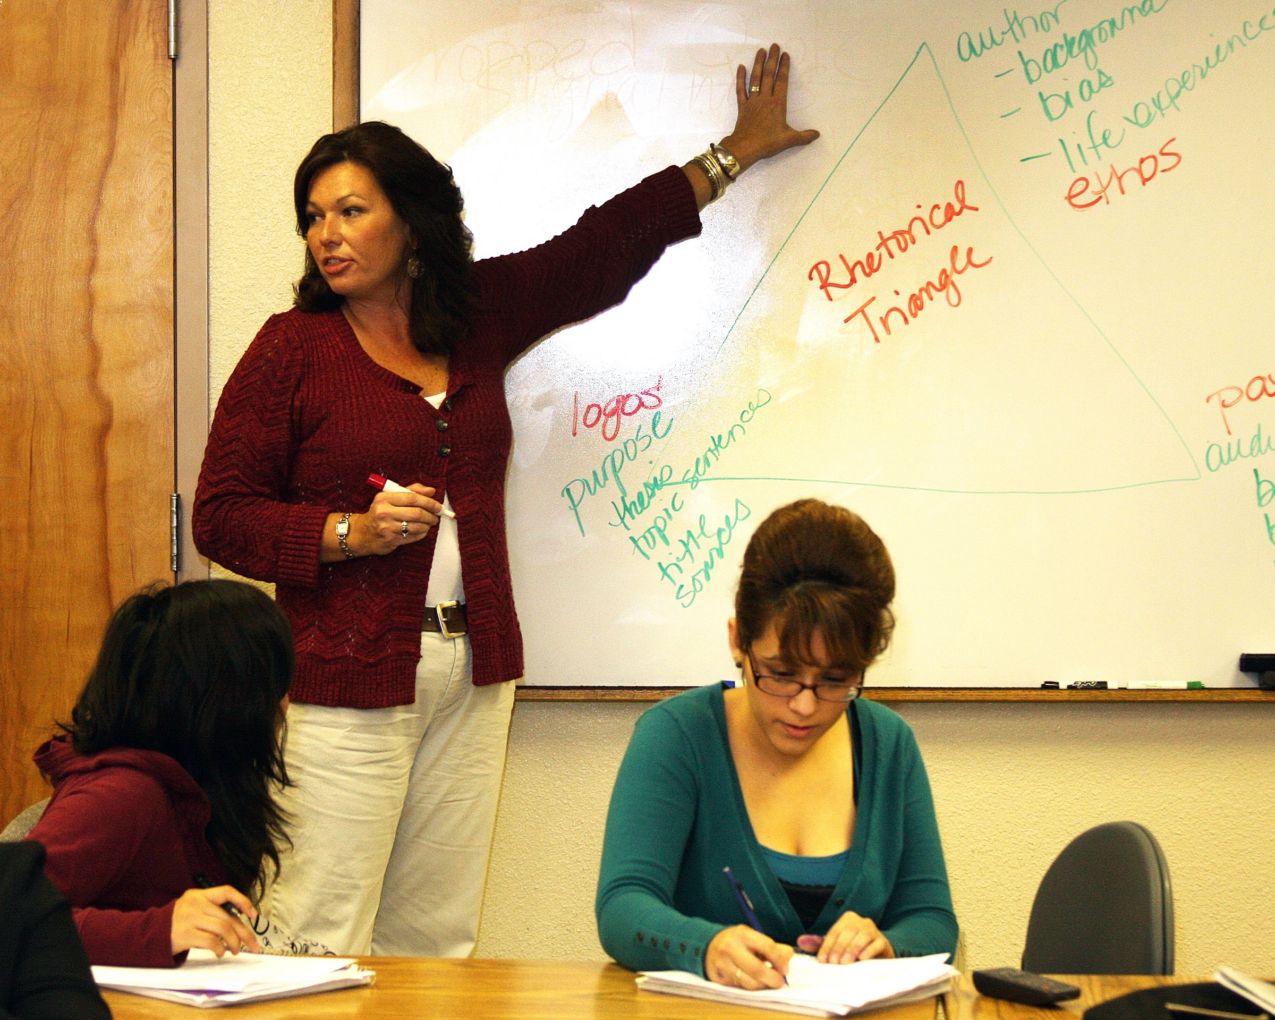
Teaching is my passion. Nothing is more exciting to me than working with students and seeing them engage and develop their curiosity. We are fortunate at the community college to encounter students with varied backgrounds who are in our classrooms because they want to reach their potential. What an incredible opportunity!
—Ellen Riek, Arizona Western College

Slide 21
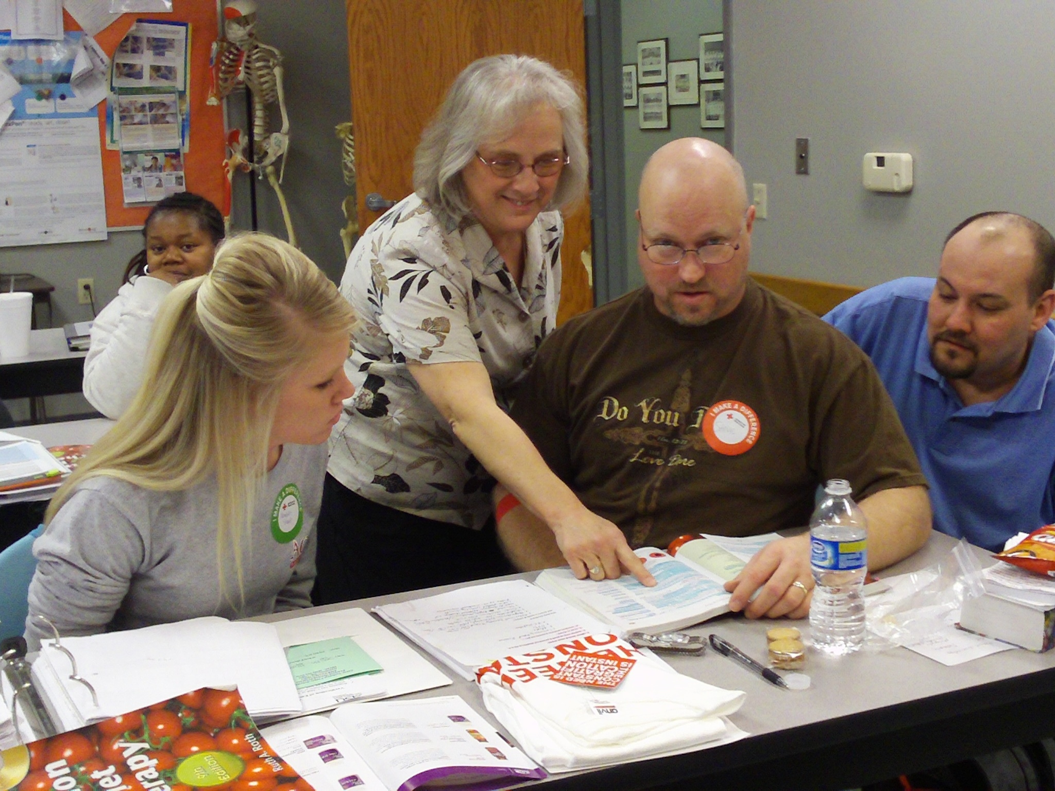
Seeing a student grow in knowledge & performance is the best evaluation I can receive as a teacher. My focus and desire is to encourage students to be the best they can be, creating a desire to have pride in what they pursue, regardless of the path they choose.
—Daphene Heern, Arkansas State University-Newport

Slide 22
I see myself as a facilitator. Some days I facilitate snow removal, some days it is a department budget, but every day is a little different. I enjoy helping secure equipment and materials that assist faculty and sharing their success stories.
—Linda Sharp, Arkansas State University-Newport

Slide 23
When I teach I think about my students; how I inspire them and praise them. My goal is that they will ultimately leave the educational environment and enter society as a contributing member. If I can reach a few of them, even one, and help them become better or more confident, then I have done my job and for that my satisfaction lies and is the reason I teach.
—Robin McCart-Brown, Ashford University (AZ)

Slide 24
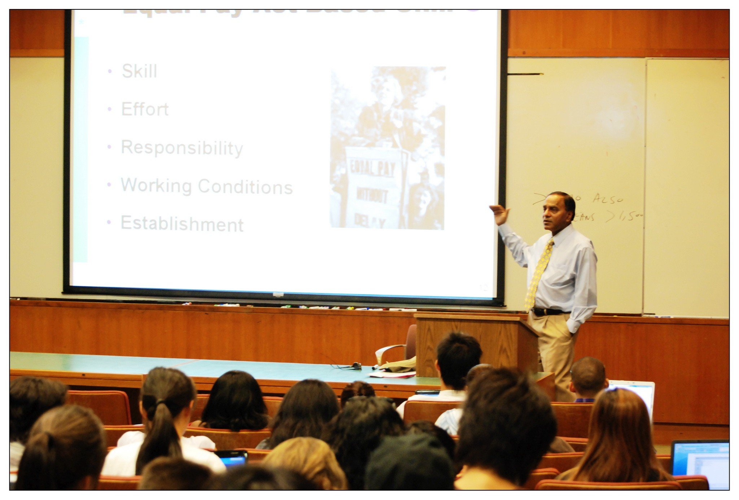
I find teaching enjoyable, and it gives me opportunity to make a positive impact in people’s lives. I have found working adults are both motivated and committed to achieving excellence in higher education. They inspire me, and I am energized by their commitment to learning.
—Raj Singh, Ashford University (CA)

Slide 25
Just being average or settling for mediocrity was difficult for me; my mother always told me to be the best in what I do. I believe that all students who have decided that learning is a lifelong process have an extraordinary opportunity to do something great.
—Michael Williams, Ashford University (AZ)

Slide 26
I encourage my students to take risk! I tell them they learn more from their mistakes then they do from their successes. Successes feel better, but in the end, we learn from what we did not get quite right the first time. As the great artist Henri Matisse said “Creativity takes courage.”
—Wendy Fosterwelsh, Ashland Community and Technical College (KY)

Slide 27
I have the wonderful opportunity to be a part of the educational arena; there's nothing quite like education! It gives hope and offers the opportunity to change your circumstances. I am inspired by seeing lives transformed.
—Ina Braxton, Atlanta Technical College (GA)

Slide 28
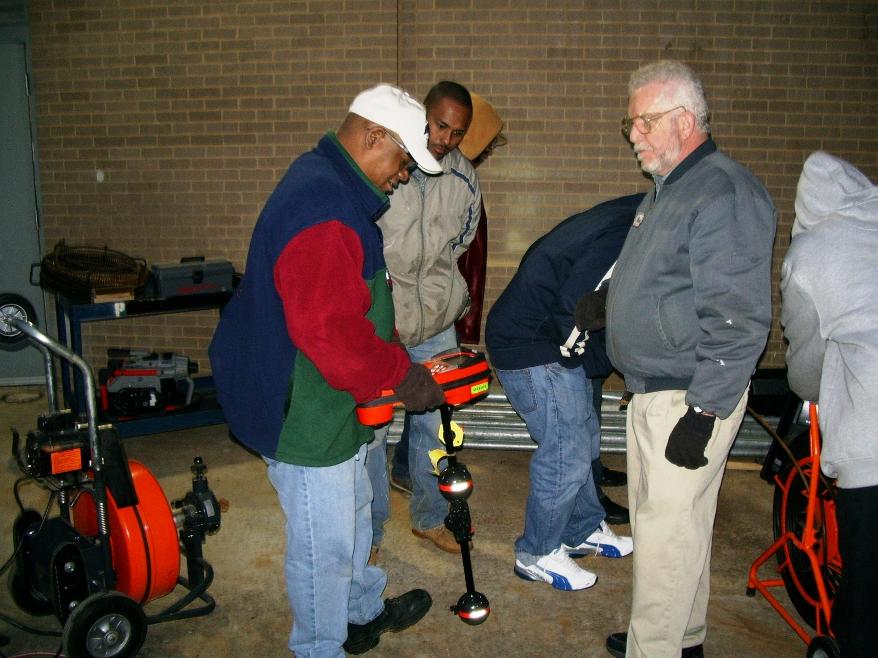
My students all want to improve their standing in life. My goal is help them get a solid foundation in the plumbing skills and knowledge. Then I aim to open as many doors, windows, skylights, portals to continued training and learning as I am able. I provide multiple resources from the latest tools to news stories to Internet searches to enable all of this.
—Kenneth Swain, Atlanta Technical College (GA)

Slide 29
Being an educator requires content knowledge, skill, patience, generosity, and empathy. Every time I see a student question, connect, and grow as a result of our readings, assignments, and discussions, I am reminded that we make a difference.
—Jennifer Beck, Austin Community College (TX)

Slide 30
I engage students, using innovative activities to ensure learning is occurring. Students become active learners by moving around the classroom, participating in student-driven learning activities, and role-playing. Each student has something to contribute that enhances the course experience.
—Richard Espinosa, Austin Community College (TX)

Slide 31
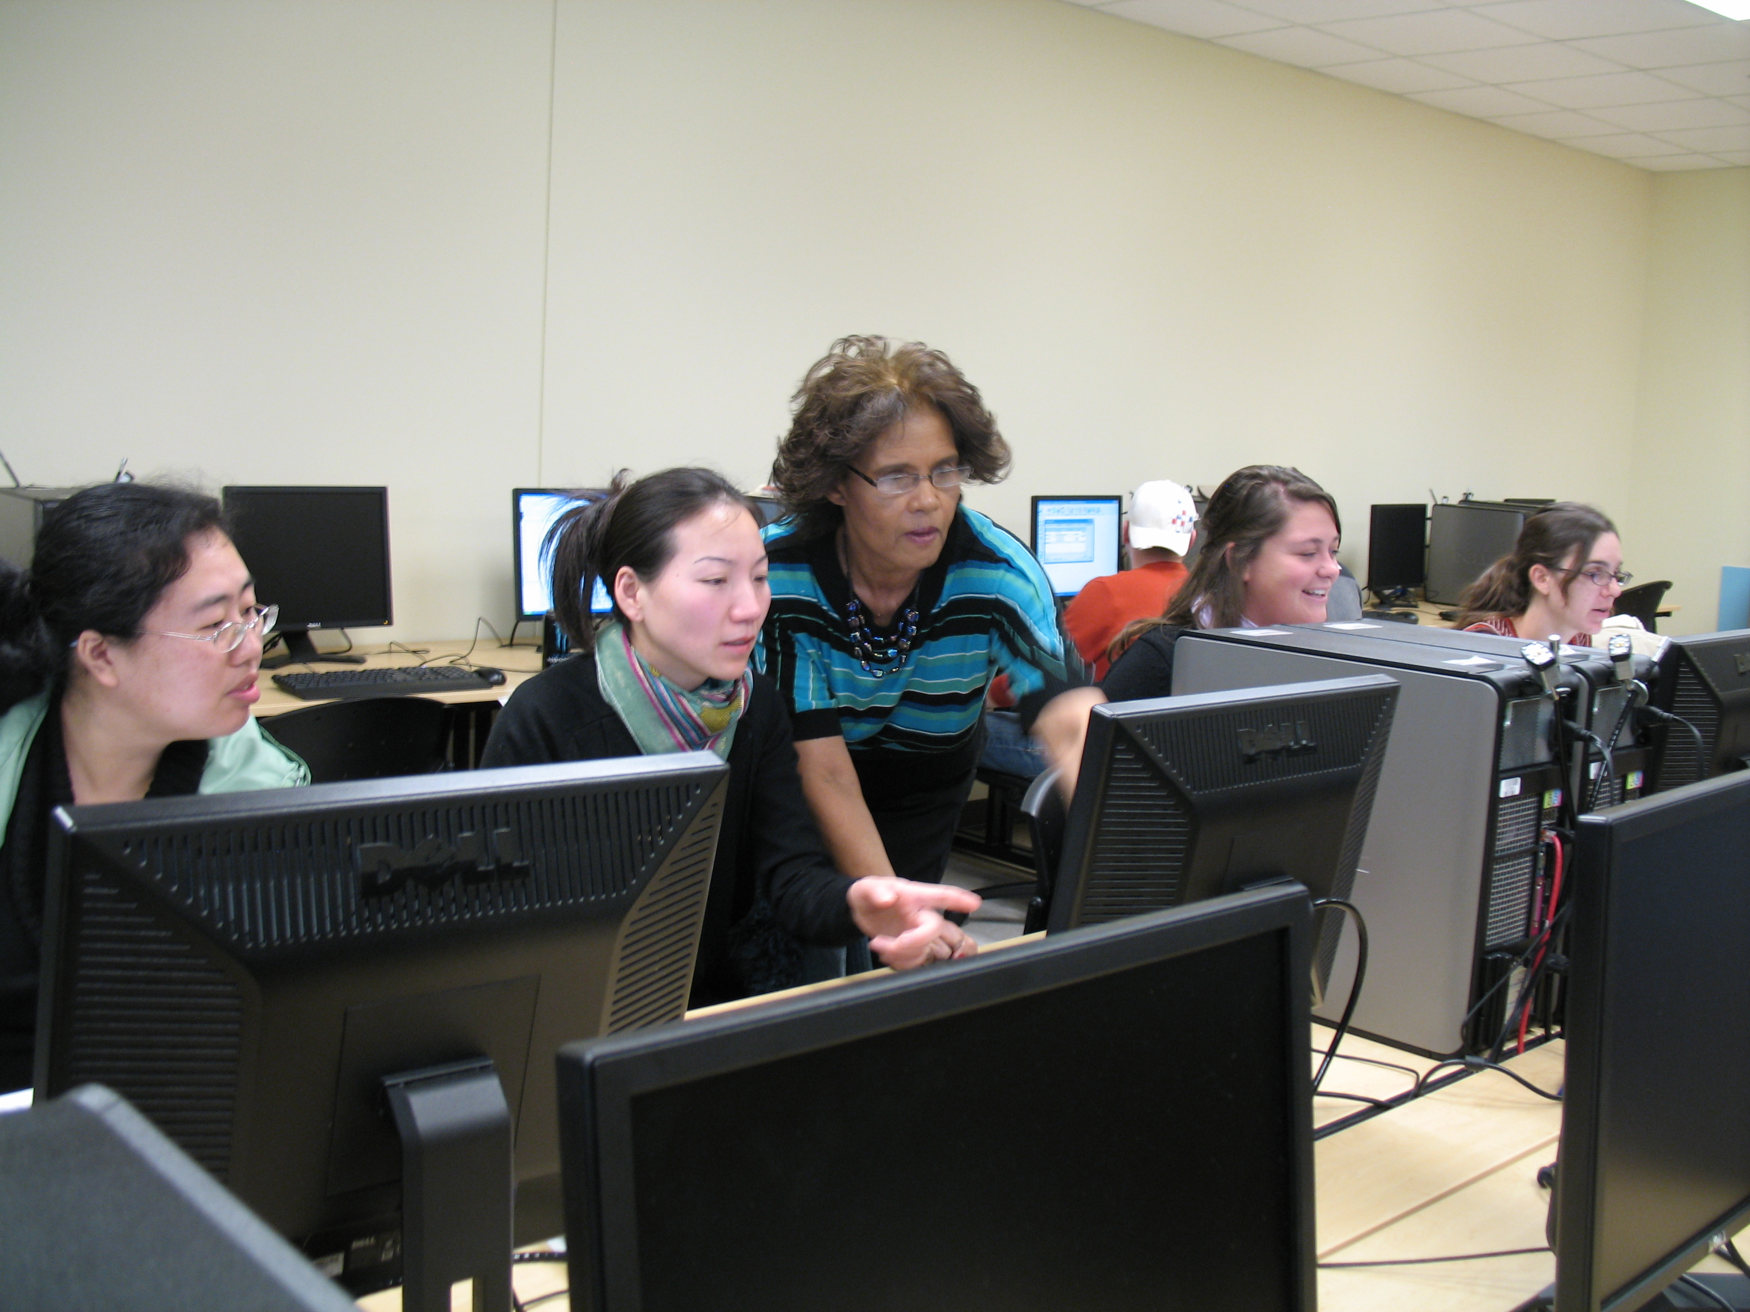
Life is a teacher. Pay attention! This encourages me to live life on purpose. Life-long learning encourages us to be the change we want to see.
—Norma Jacobs, Austin Community College (TX)

Slide 32
I tell my students that accounting is the language of business, but education is the key to success. I urge them to use the gifts they have, work hard, and take responsibility for their future. What they learn today will be stepping stones for tomorrow.
—Tracie Nobles, Austin Community College (TX)

Slide 33
There is not a day that goes by that I do not learn something from my students. Hopefully, the process is reciprocal.
—Stanley Pushkarsky, Austin Community College (TX)

Slide 34
If John Dewey was correct about learning being the ongoing recollection of experience, then we should strive as teachers to make each class day a fresh, new experience for our students. Finding new ways to deliver information is also what keeps me motivated. That is what I love about the teaching life.
—Russell Wittrup, Austin Community College (TX)

Slide 35
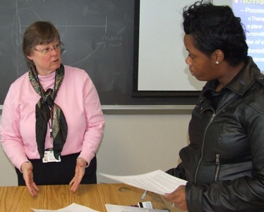
Not only do we need to see students as diamonds in the rough, we must also hold a mirror in front of them so that they too can see their brilliance.
—Karen Shallenberger, Baltimore City Community College (MD)

Slide 36
“To whom much is given, much is required,” is a scripture I live by. It makes me accountable for the knowledge and resources given to my students. Each has an amazing story to tell about struggles and determination. It is from that I am inspired to teach!
—Sheila Duplechain, Baton Rouge Community College (LA)

Slide 37
When I see my PTEC students graduate and obtain a high-paying job in industry, I feel a great sense of accomplishment. I am blessed to have the opportunity to help educate and train these students.
—Bernis Graham, Baton Rouge Community College (LA)

Slide 38
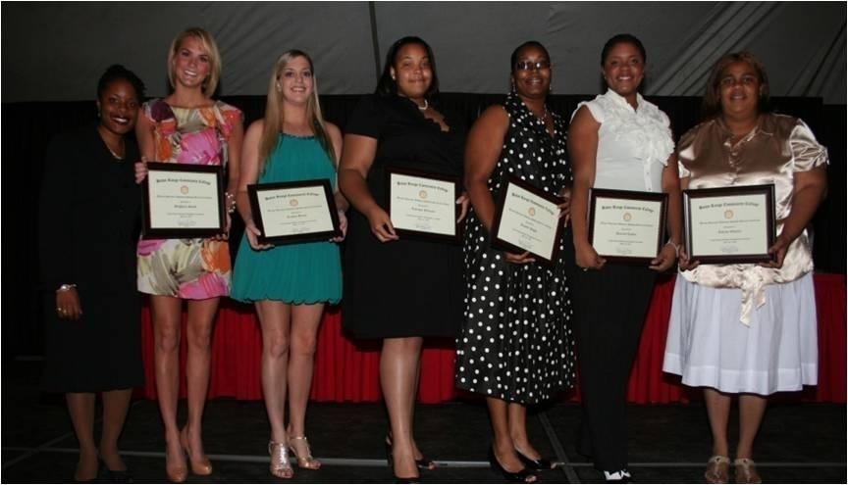
I always tell students: Do not get frustrated when there are obstacles in your life. Just remember that these hindrances serve as the price of admission to the dream.
—Bea Gyimah, Baton Rouge Community College (LA)

Slide 39
Drawing from real-life situations, regional and geographic interests helps me make psychology an applied subject and “come alive” for students. Mature and traditional students come with life experiences. Taking the subject out of the textbook and drawing upon human experiences allows me to touch both groups.
—Quinton Sherlock, Bermuda College

Slide 40
I love to work around machines, but I am very sensitive to the human factor. I view the employees as clients. To put it in a nutshell, I work by this principle: “Every man considereth his goats, sheep.” I don’t minimize what’s important to the client. It’s the human factor that’s important.
—Eugene Wainwright, Bermuda College

Slide 41
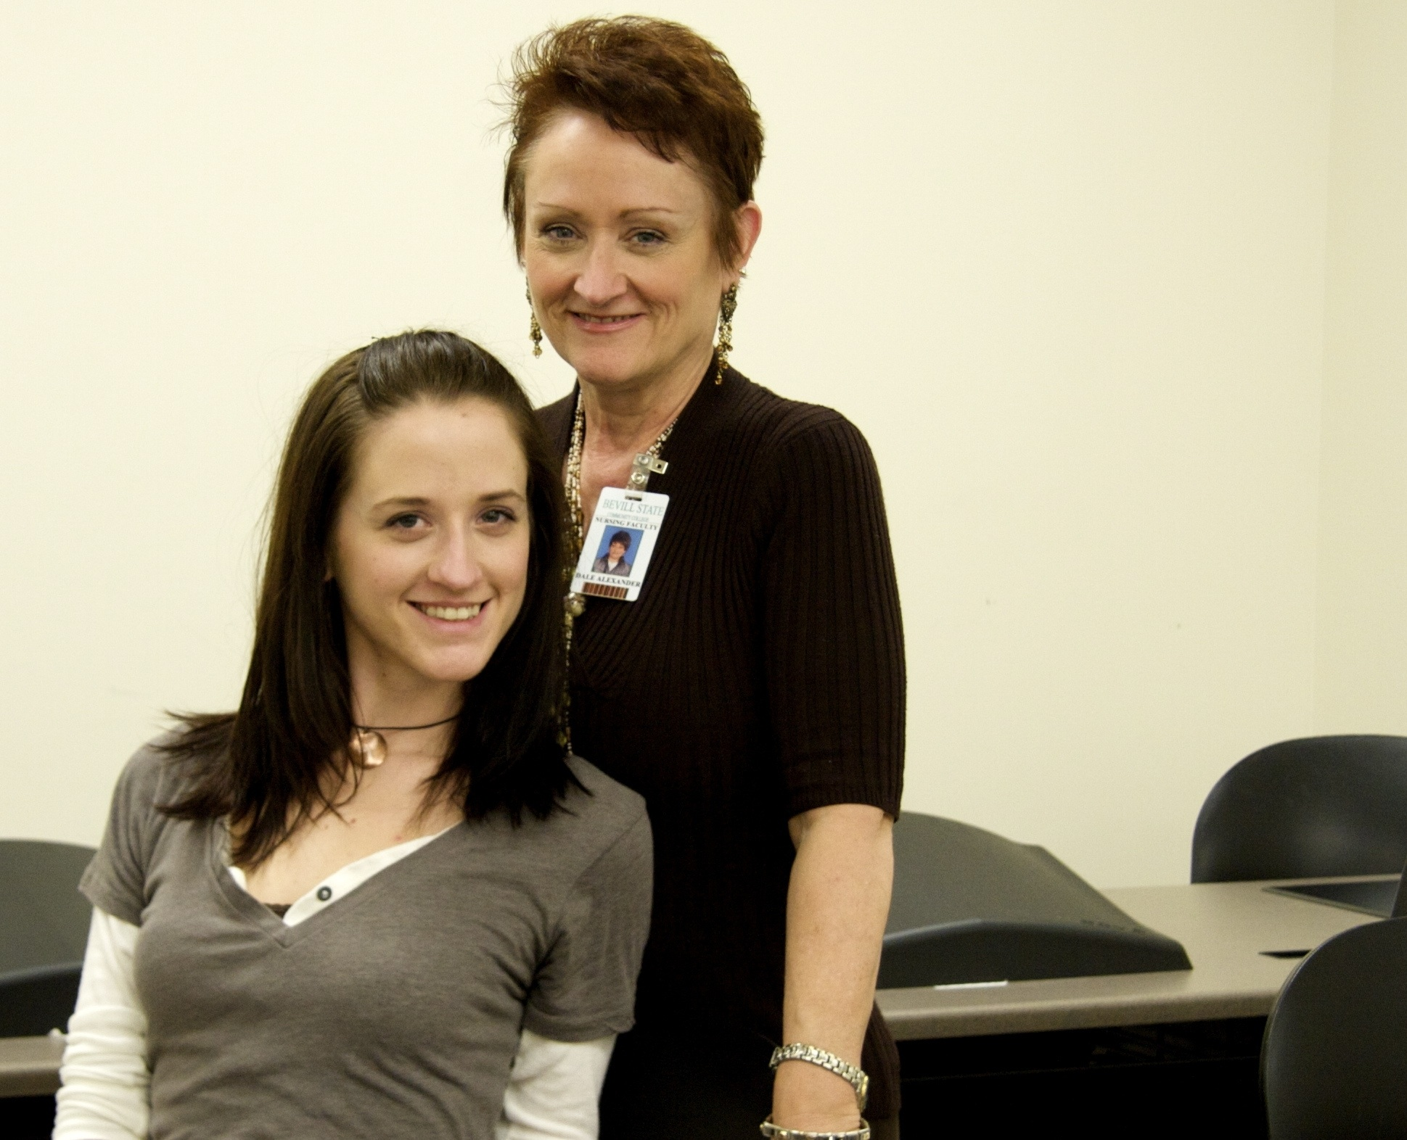
As a nursing educator I promote health and illness prevention through education, and am an advocate for others and a change agent for the good of humanity. I am committed to building and bridging human possibilities.
—Dale Alexander, Bevill State Community College (AL)

Slide 42
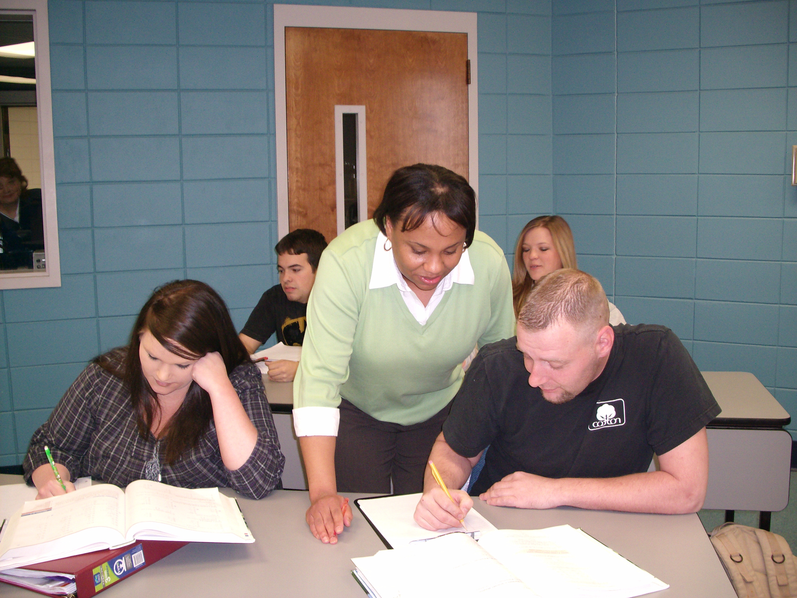
As a teacher of mathematics, my goal is to help students realize that mathematics is pretty straightforward. I understand the adversities and struggles with which my students deal; nevertheless, they have dreams of making a better life for themselves and their families. This motivates and inspires me to go the extra mile to expand their horizons in mathematics.
—Zonja Coleman, Bevill State Community College (AL)

Slide 43
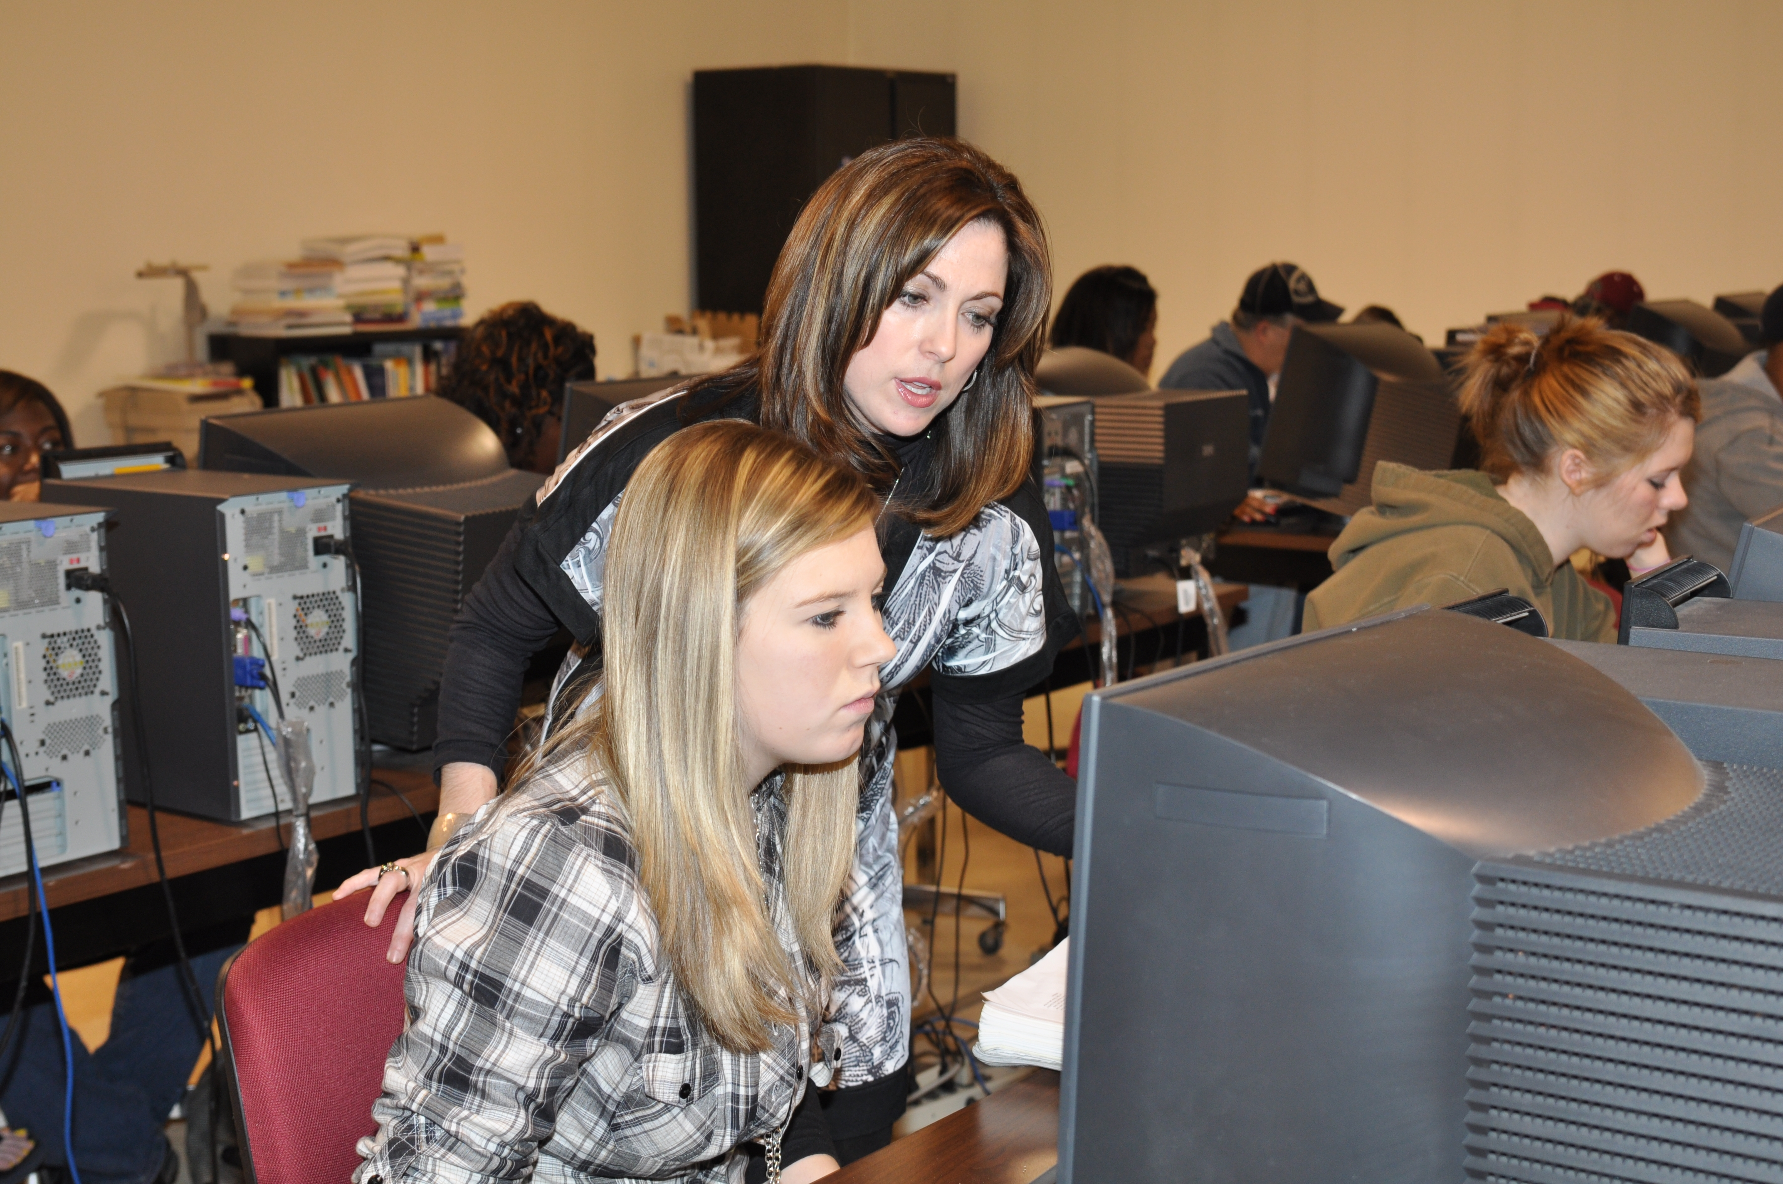
Teaching computer science courses provides me with the opportunity to be exposed to changing technologies frequently . As a result, I find that I am constantly changing my pedagogical methods to adjust to these changes. Positive changes like these inspire me to find ways to become a better instructor.
—Kristie Ramsey, Bevill State Community College (AL)

Slide 44
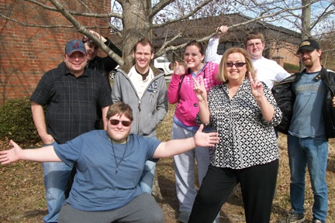
My first career choice was teaching, but then my life took a different turn. Funny though how I was led right back to it. It amazes me that after 27 years, I still love what I do. Teaching is not for everyone, but how fortunate you are if it is for you!
—Rebecca Vanzant, Bevill State Community College (AL)

Slide 45
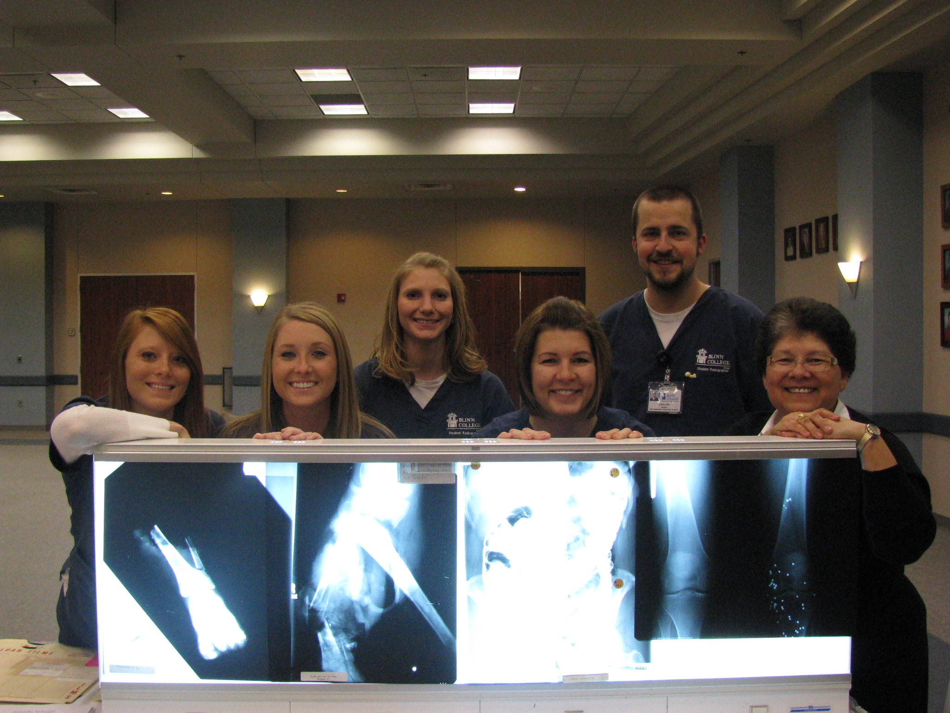
As instructors and leaders, we must also be students—intellectually motivated, creative, and driven by new knowledge.
—M. Elia Flores, Blinn College (TX)

Slide 46
Albert Einstein said, "Not everything that counts can be counted, and not everything that can be counted counts.” Teaching falls into this category without a doubt. The moments that make me sit back and realize I'm in the profession I was made for, fall into the uncounted category. It’s not all about grades. It’s about seeing the "light" come on for a struggling student or a student coming back and telling you about the impact you had in his/her life. That is what teaching is all about.
—Andrew Harrington, Blinn College (TX)

Slide 47
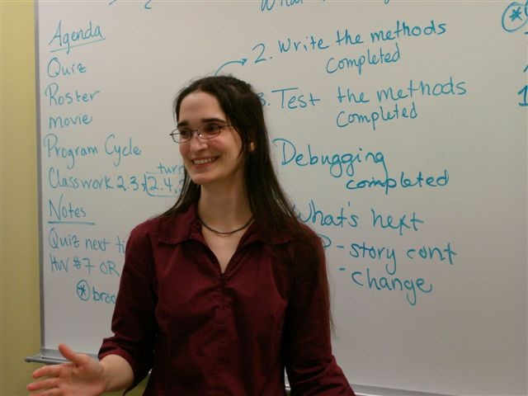
My students inspire me to apply what I already know in new, more creative ways. I am driven to be a better teacher from my students’ passions and am proud to say that I learn as much from my students as they learn from me.
—Laura Goadrich, Bossier Parish Community College (LA)

Slide 48
My experience with science or inquiry-based instruction has been to engage students so that they are “building” knowledge while in the process of asking and answering questions. My greatest joy is seeing the "light bulb" moment happen in a student's face when they finally make the connection.
—Roishene Johnson, Bossier Parish Community College (LA)

Slide 49
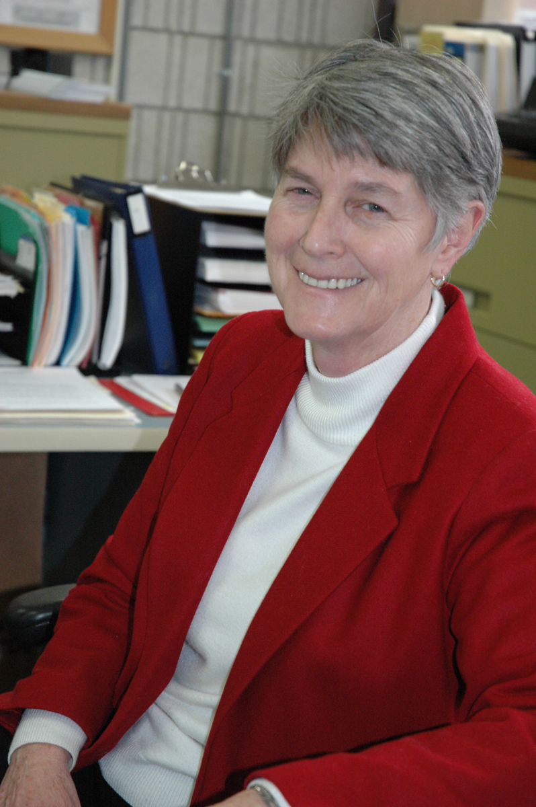
To make students feel comfortable and help them to find their way through the college maze is to treat them as we would want to be treated.
—Donna Durand, Bristol Community College (MA)

Slide 50
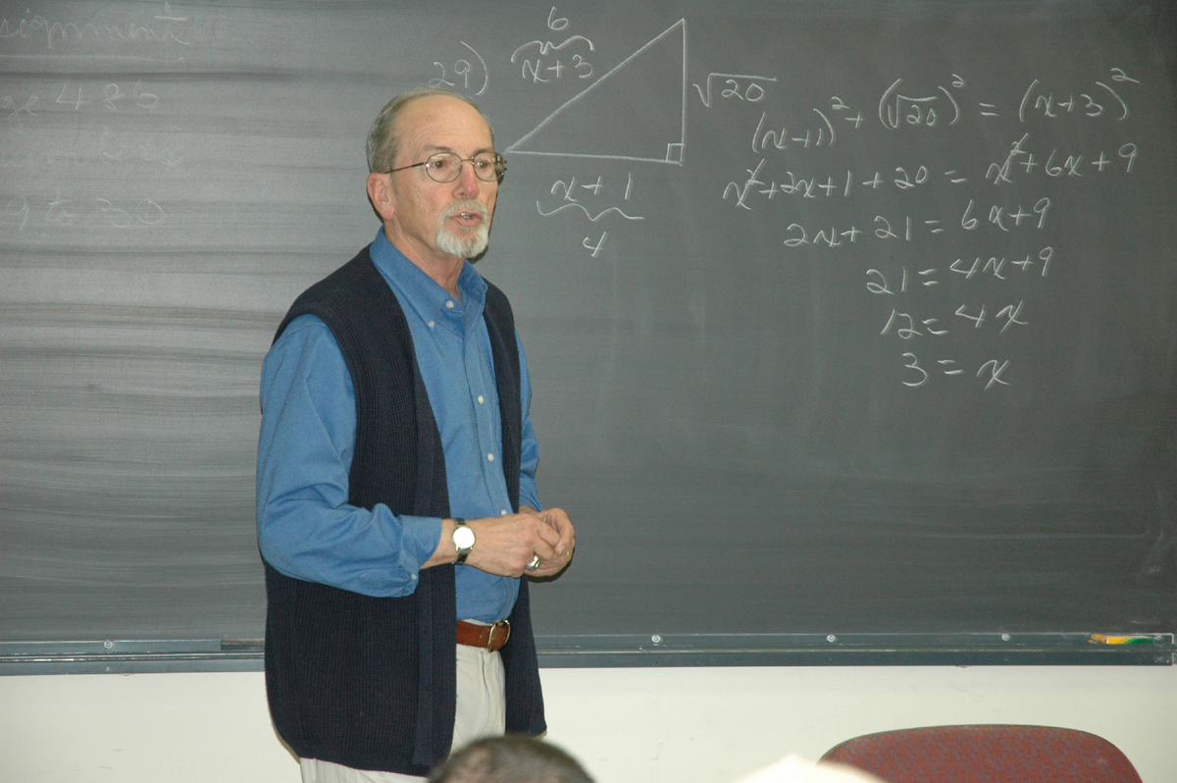
I am motivated daily by the subject that I teach. The joy of sharing the wonderful world of mathematics (where terms are well defined and answers are for sure) with students has excited me for 49 years. Have you ever wondered why division by zero does not exist and is not unique?
—Albert Roy, Bristol Community College (MA)

Slide 51
The teachers I most admire overflow with intelligence, character, charisma, compassion, and an overwhelming passion for teaching and learning. Those are the characteristics I try to exude as I connect with my students and plant seeds in hopes they’ll thrive prosperously.
—Mirella Baker Bemmel, Broward College (FL)

Slide 52
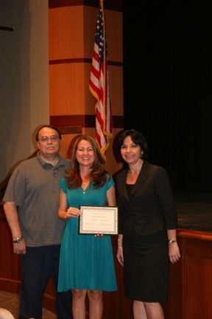
As a teacher, I believe it is my role to help my students prepare to be the best they can be, as members of society, but also as members of the profession for which they are also preparing in my classroom.
—Patrick Ellingham, Broward College (FL)

Slide 53
My grandmother’s words, “What you become is important; however, helping others on their journey is equally important” are my daily inspirations.
—Janice Stubbs, Broward College (FL)

