Slide 1
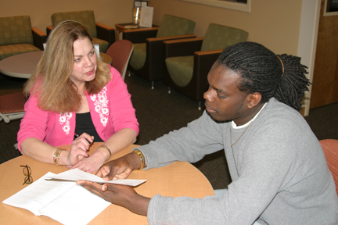
Meri Culp
Tallahassee Community College
Teaching English and Humanities is about connections: bringing literature alive through linking universal themes to students' life experiences, discovering the hand-in-hand walk of analysis and creativity, opening the door to commonalities in student writing/reading communities. When students see this synthesis between life and literature, evaluation and imagination, linear and circular expression, I sit back and smile, believing they will carry these ways of thinking, reading, and writing into the beyond-the-classroom world.

Slide 2
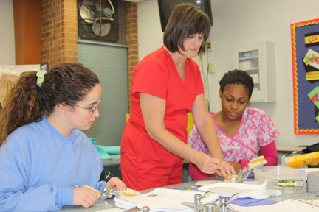
Michele Edwards
Tallahassee Community College
I like adding energy to ideas in order to enhance learning and commitment.

Slide 3
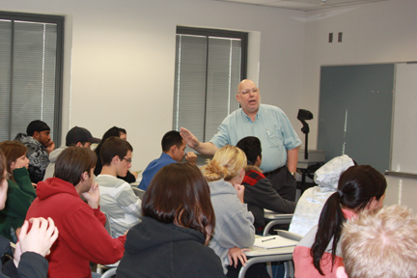
Mark Goldman
Tallahassee Community College
My goal as an educator is to expose the student to as many new ideas as possible as I challenge them to explore the past and the present. If one brings an open mind to the classroom, the possibilities are limitless.

Slide 4
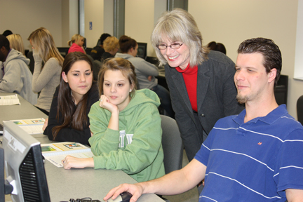
Connie Jenks
Tallahassee Community College
My classroom strategy? Exhibiting a sense of humor!

Slide 5
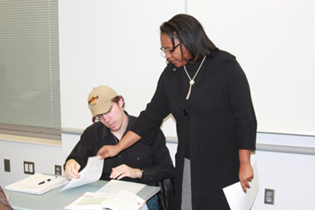
Sharisse Turner
Tallahassee Community College
The question I ask myself is whose life benefits from my life? I receive my answer every spring during commencement exercises when I see former students march across the stage to receive their diplomas. To watch these students beam with pride in their accomplishments gives me unspeakable joy! That I have in some small way played a role in assisting students in their academic pursuits is a reward that cannot be matched by any dollar amount.

Slide 6
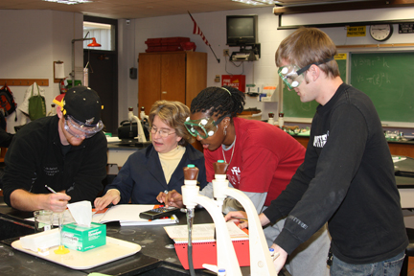
Joi Walker
Tallahassee Community College
My advice for having a fulfilling teaching career is never stop looking for new ways to reach more students. Listen to the students, and learn from them. When a student fails, ask yourself why.

Slide 7
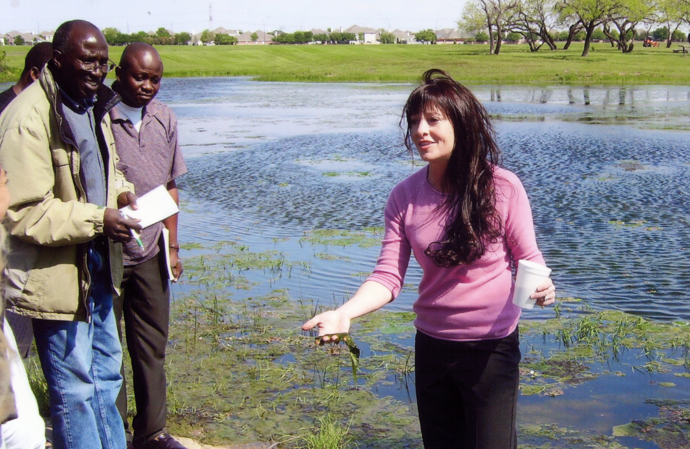
Elizabeth Carrington
Tarrant County Community College

Slide 8
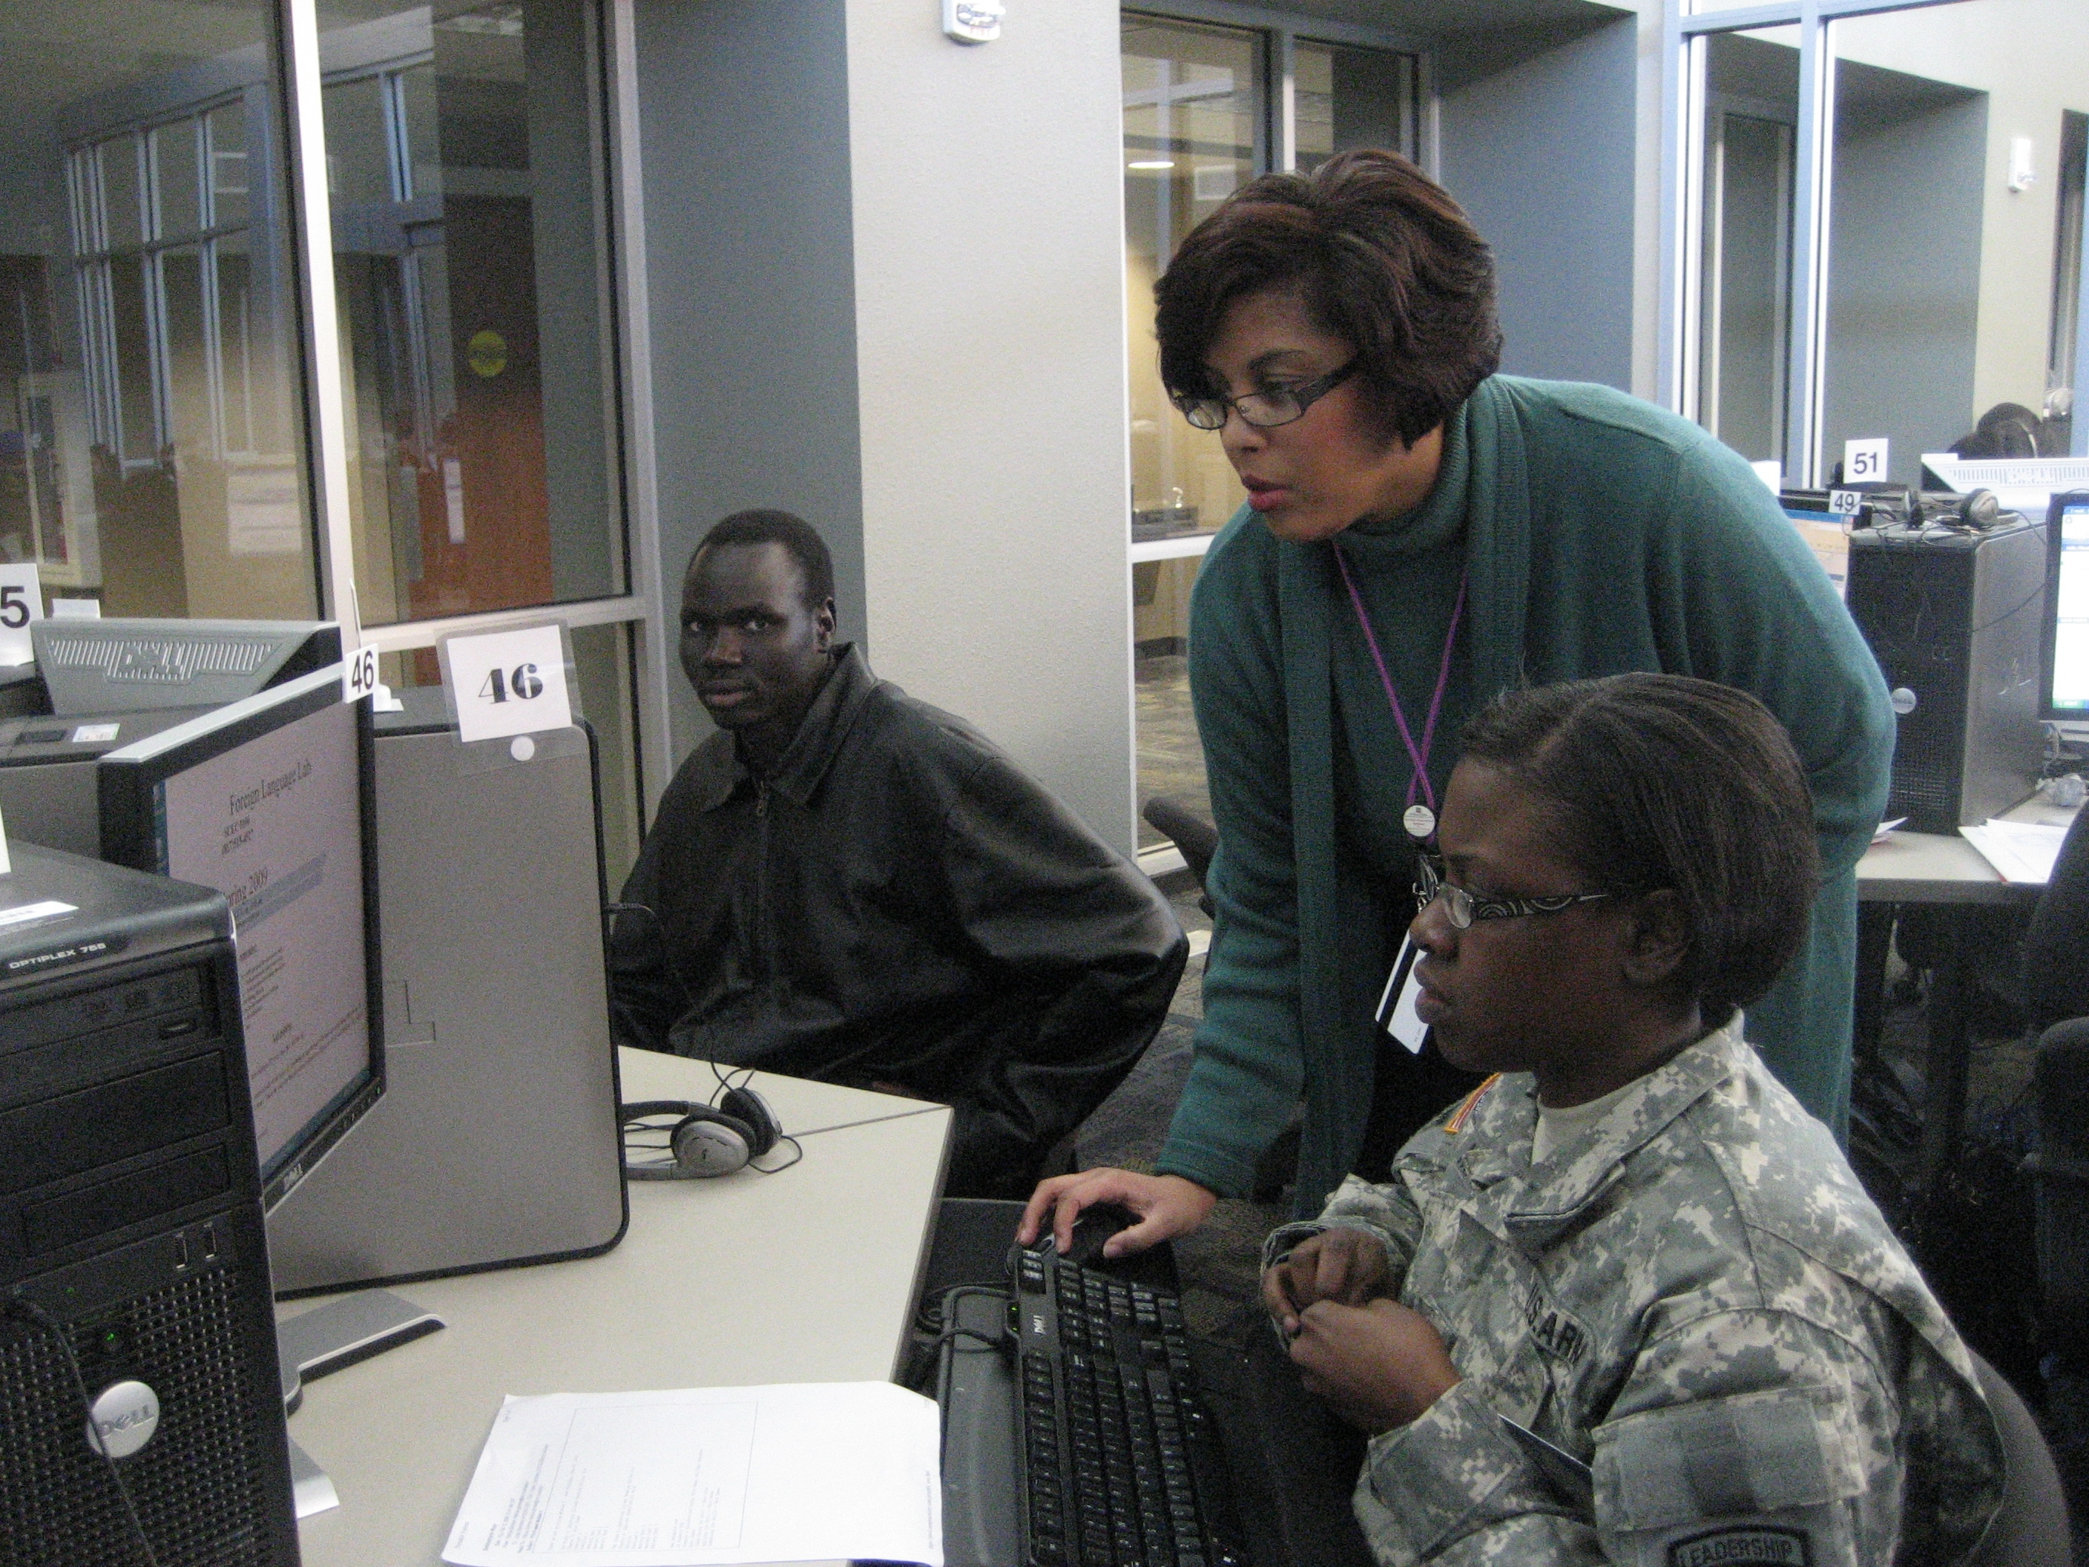
Felicia Grimes
Tarrant County College District
It is an exhilarating experience to follow my students’ path to success. Their success is ultimately my success. My motivation comes from having the opportunity to cultivate their potential, allowing them to believe in themselves.

Slide 9
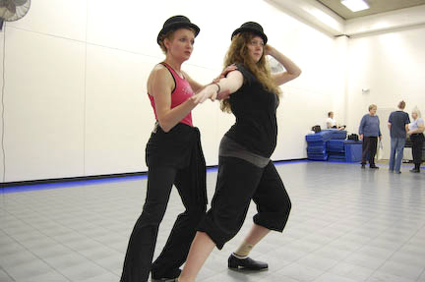
Linda Quinn
Tarrant County Community College

Slide 10
Jenni Campbell
Technical College of the Lowcountry
Every day I have the opportunity to act as a facilitator of student success. In this role, it is essential to recognize that each student defines success differently. The chance to play a part in that success, no matter how large or small, motivates me.

Slide 11
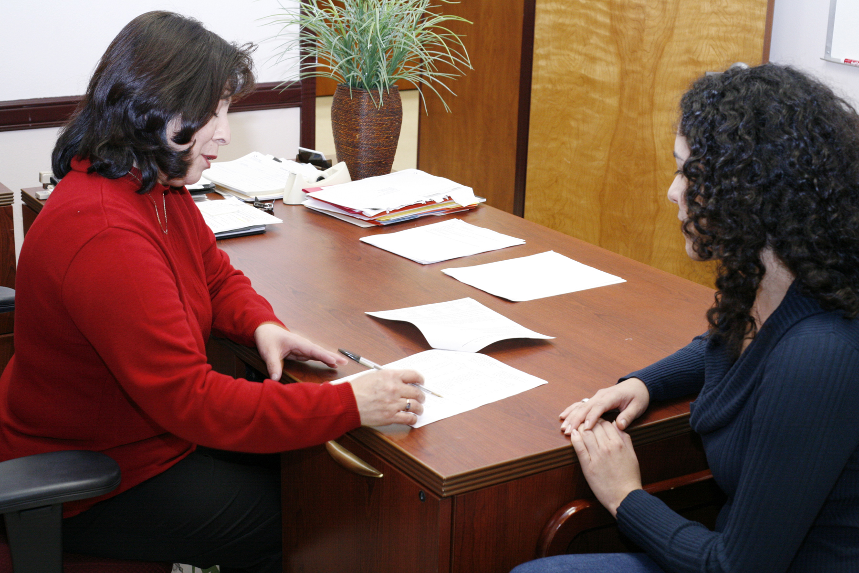
Paula Arredondo
Texas State Technical College System

Slide 12
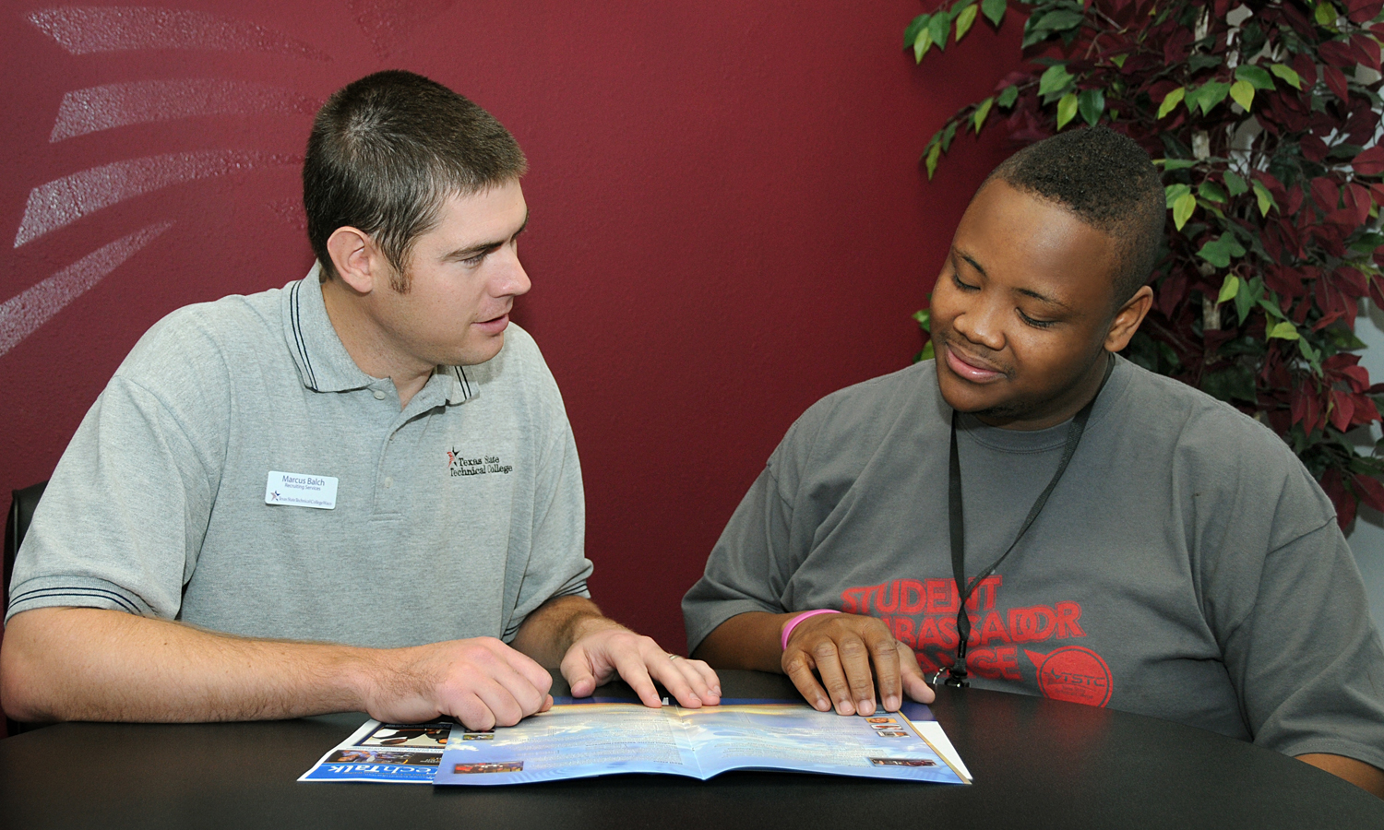
Marcus Balch
Texas State Technical College System

Slide 13
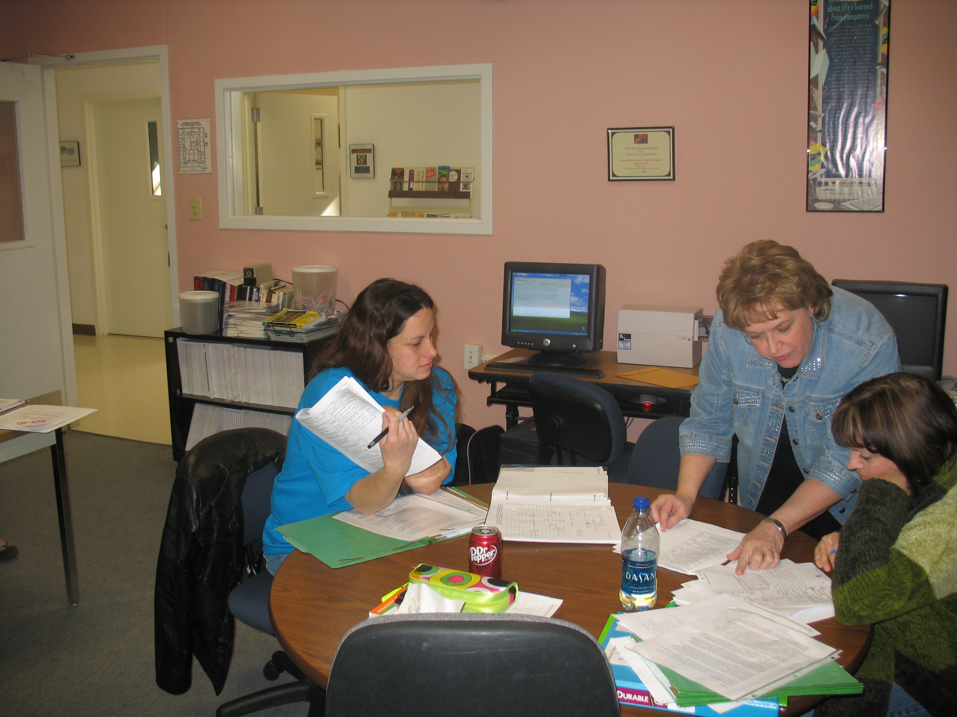
Patty Bundick
Texas State Technical College System

Slide 14
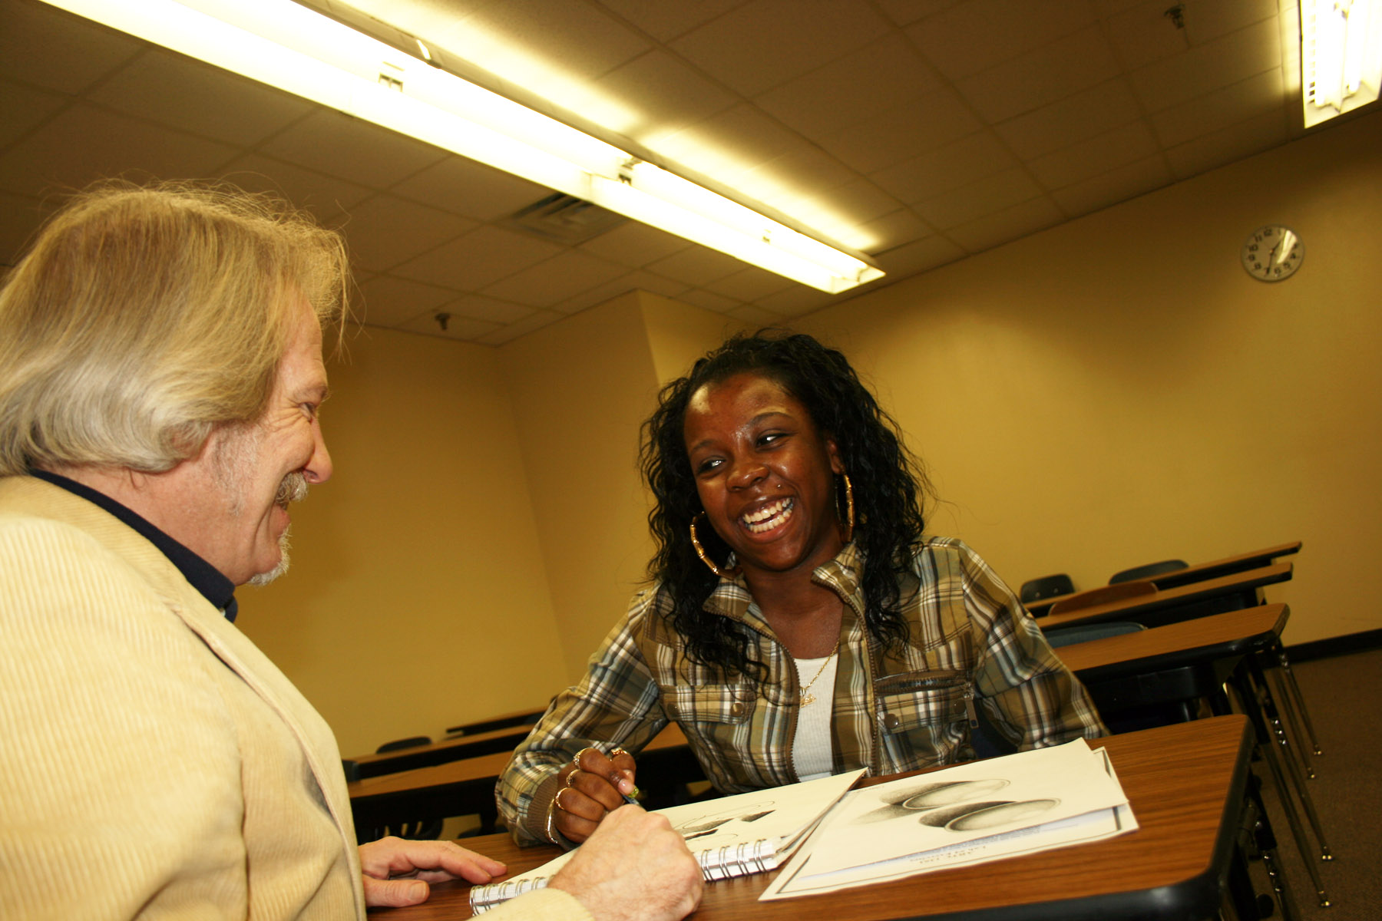
Jeff Ermoian
Texas State Technical College System

Slide 15
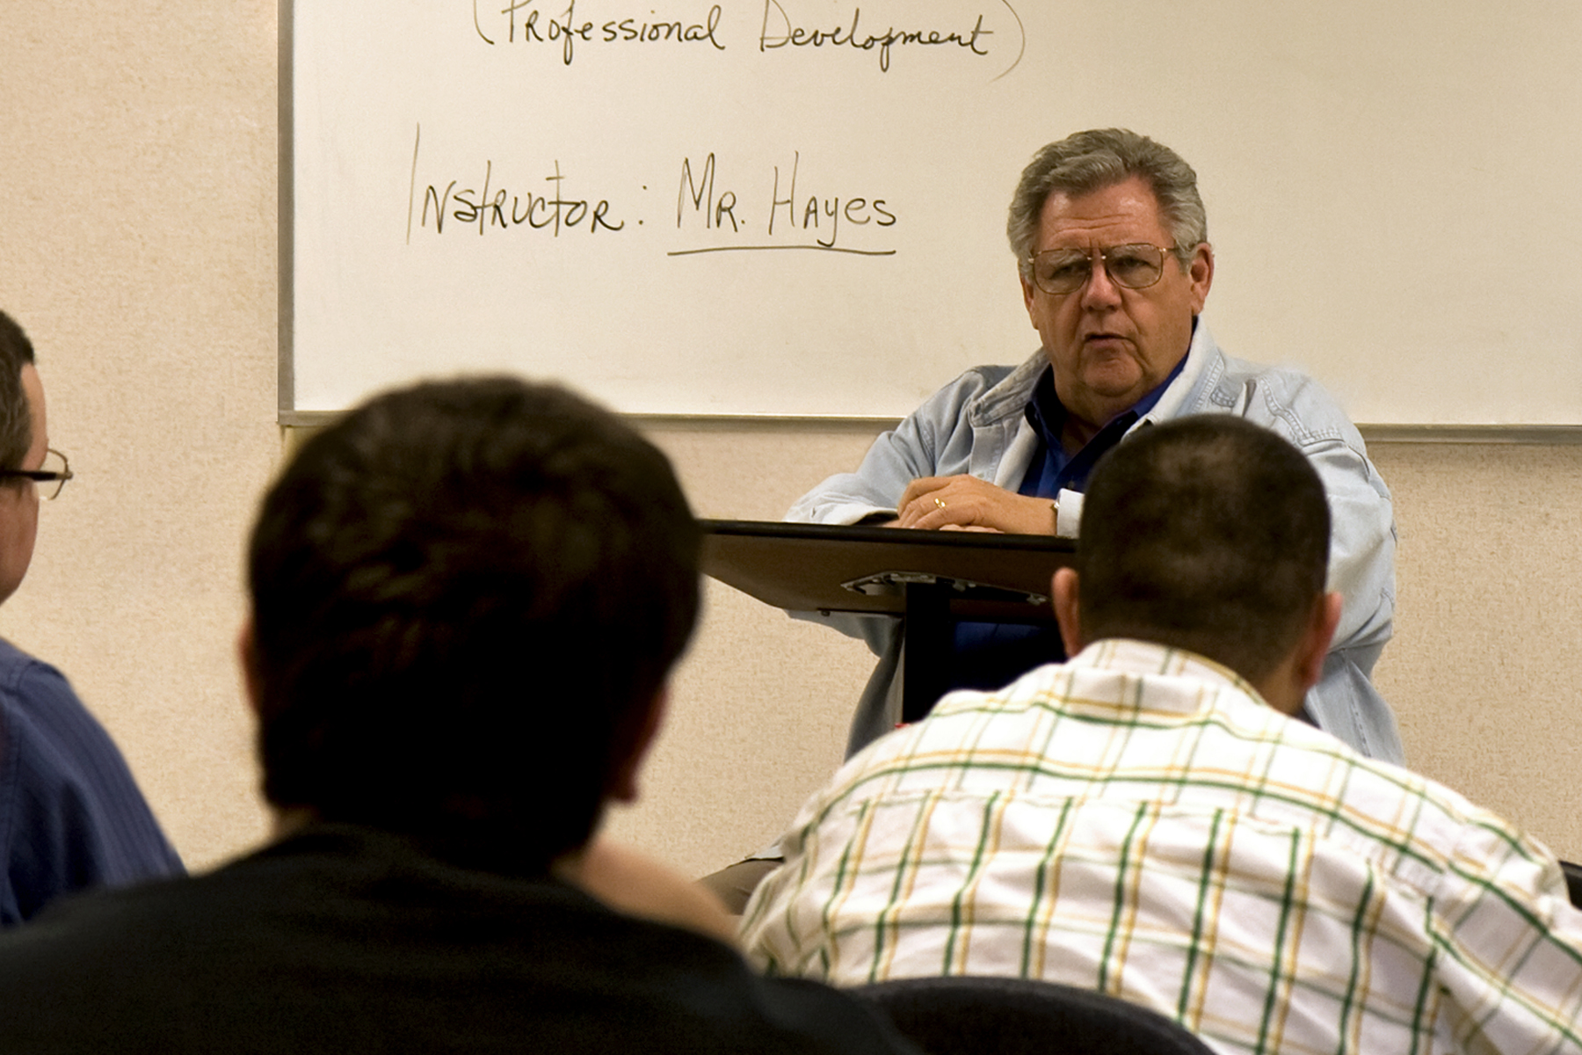
Dennis Hayes
Texas State Technical College System

Slide 16
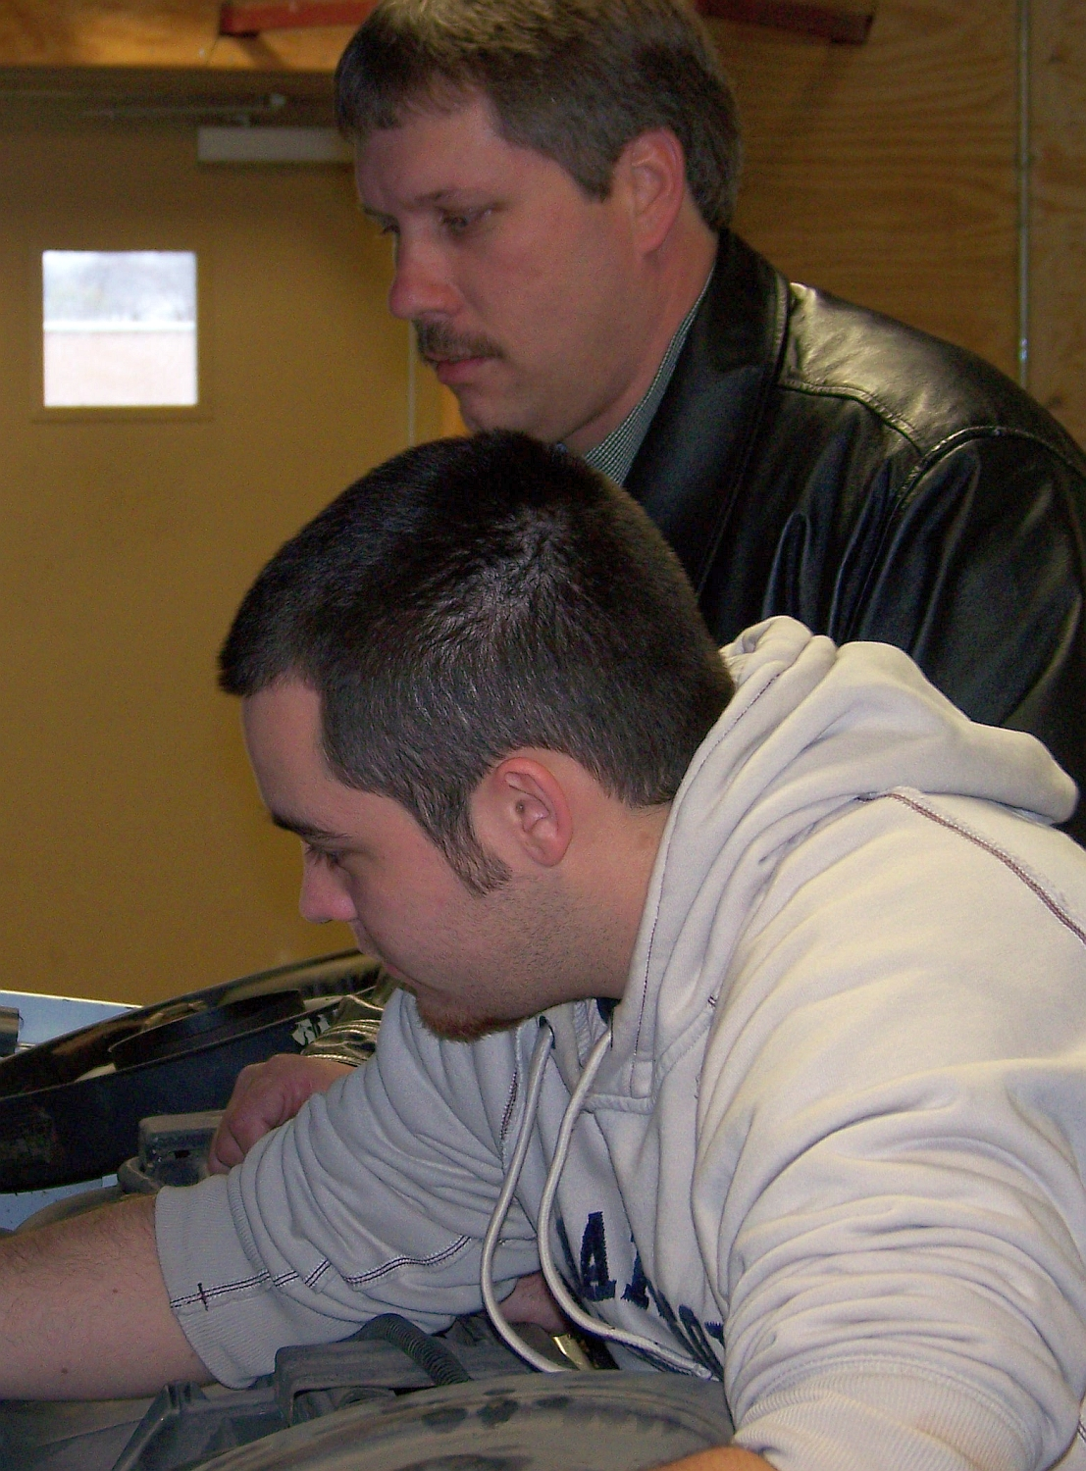
Selby Holder
Texas State Technical College System

Slide 17
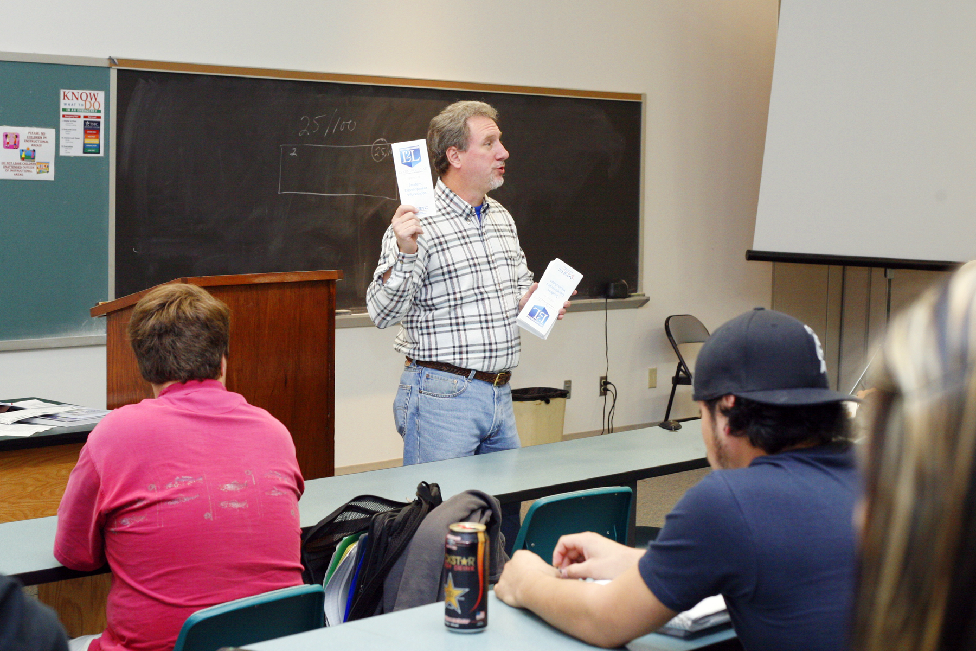
Richard Kirk
Texas State Technical College System

Slide 18
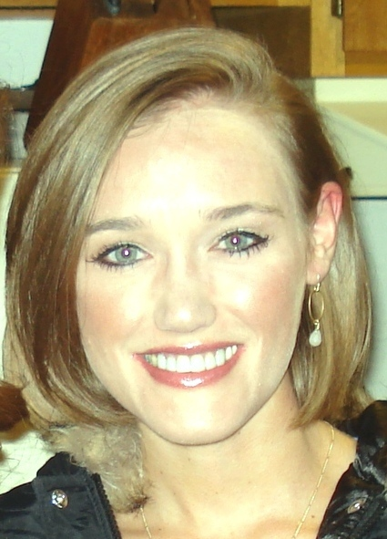
Braid Sharp-Blanks
Texas State Technical College System

Slide 19
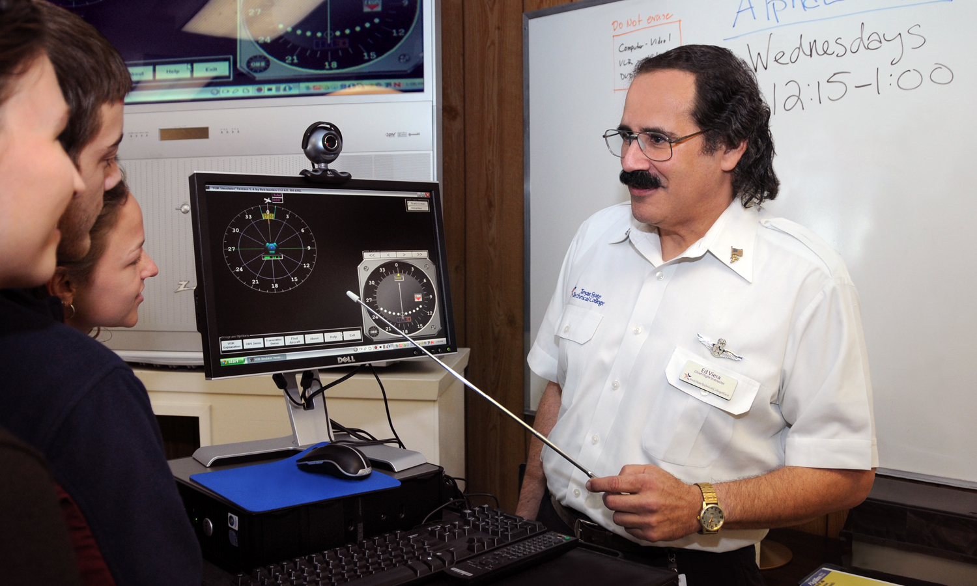
Ed Viera
Texas State Technical College System

Slide 20
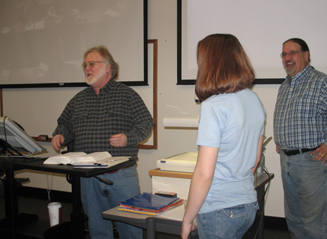
Phillip Mahaffey
Treasure Valley Community College
Writing on the page, the words whisper. Lean closer. Someone will cross the mountains. Someone will lose her heart. Someone will stop one step before the edge. The next page waits for you.

Slide 21
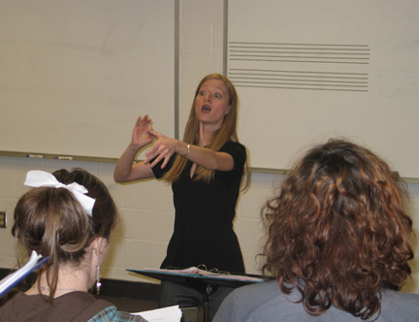
Rebecca Replogle
Treasure Valley Community College
As a teacher and musician, I always look for ways to grow and improve; and I work daily to instill in my students that desire to constantly be going for more, rather than settling for good enough. I also attempt to give students brief mental breaks during class by telling personal stories that relate to the lesson or concept, or otherwise impart some general life lesson which can be tied to what we were learning. This seems to help the students understand that I am perhaps more like them than they first imagined and helps them see how skills and ideals necessary in the classroom can be applied in all areas of life.

Slide 22
Renee Wright
Triton College
Before I became a teacher I used to think teaching was hard. Now I understand that learning is harder. So as a teacher I try to develop ways to help my students learn effectively and provide opportunities for them to think critically about topics that are broader than just what goes on in the classroom.

Slide 23
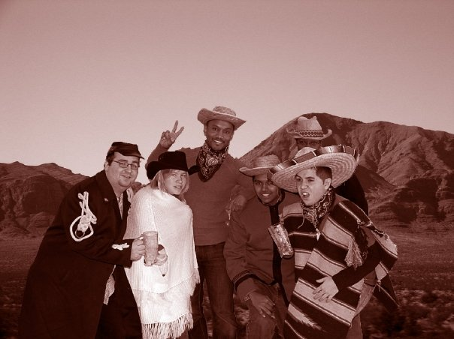
Quincy Martin III
Triton College
Listen more, talk less. Don’t sit back and watch; jump in and actively participate. Don’t make decisions for students; make decisions with students. Have passion about what you do; and always, always, always be a person of integrity.

Slide 24
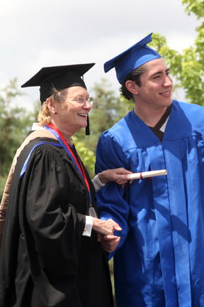
Delores Sanford
Truckee Meadows Community College
Just being a part of a team working to ensure success for every student is personally energizing and rewarding. Love what you do. If you don’t love what you do, are excited about each day, you are in the wrong job, wrong field.

Slide 25
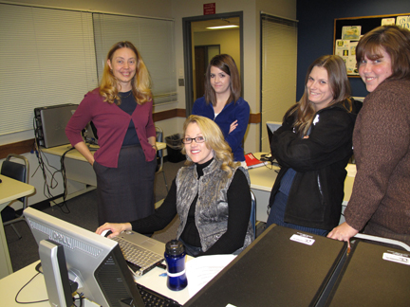
Julie Luscomb
Tulsa Community College

Slide 26
Lynn Gray
Tyler Junior College
When I left medical research to teach full-time, a research colleague told me that I was, perhaps, going to do something even more important. I am convinced that my colleague was right as I watch a health care professional, who once sat in my classroom, care for someone I love.

Slide 27
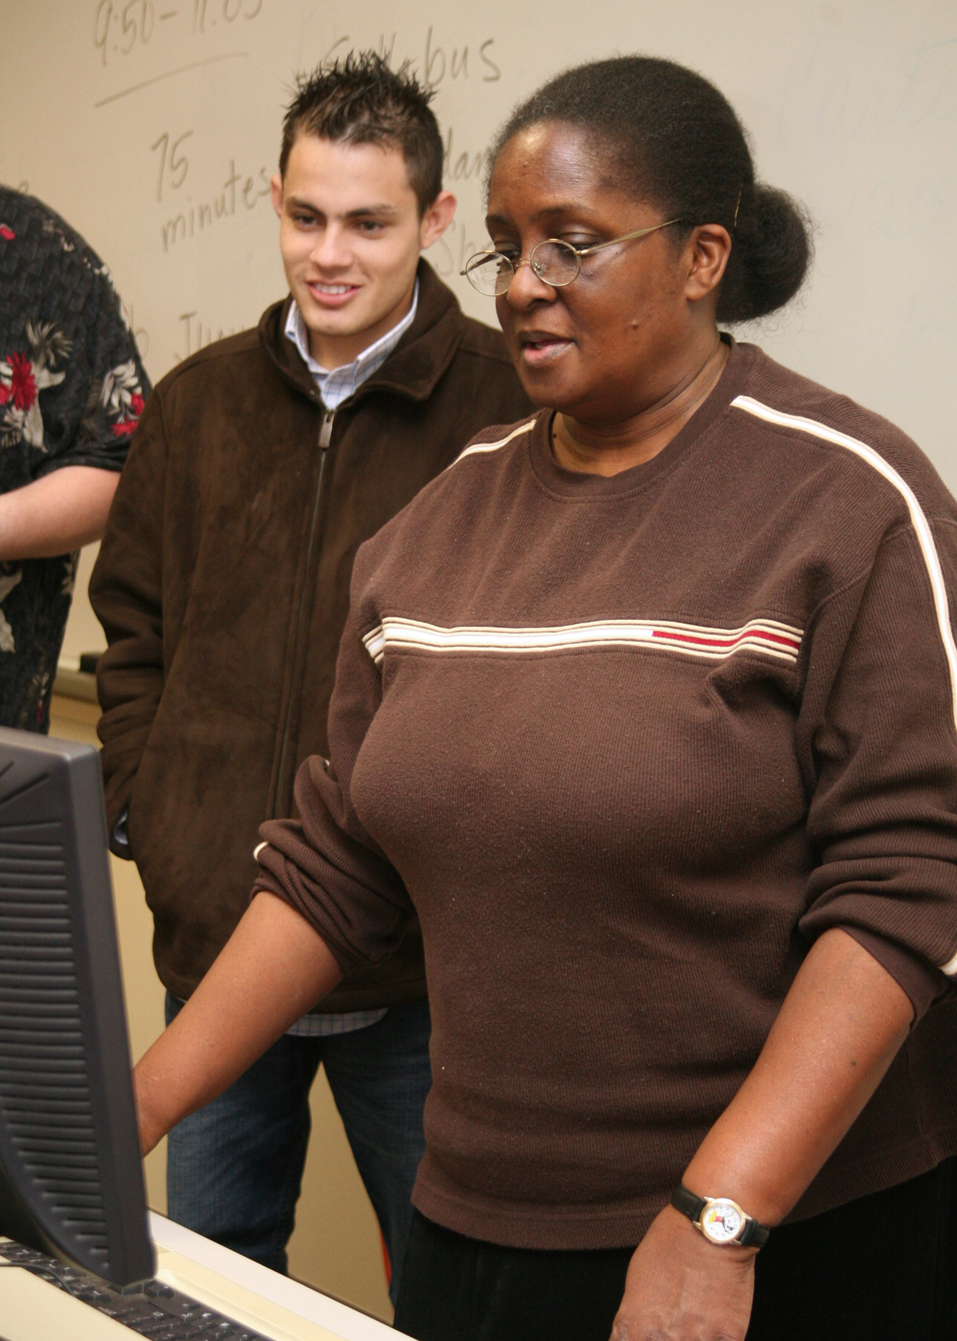
Lee Nell Hill
Tyler Junior College

Slide 28
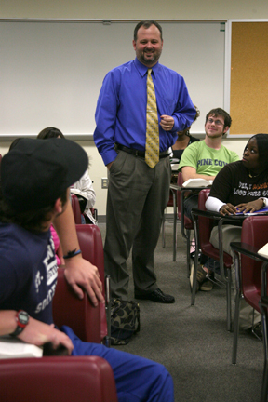
Jim Richey
Tyler Junior College

Slide 29
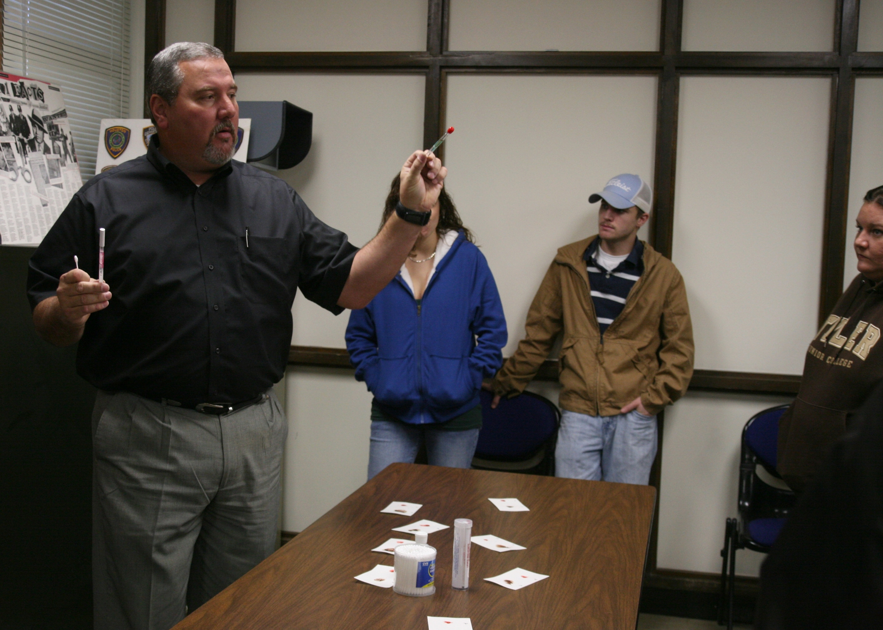
Jason Waller
Tyler Junior College

Slide 30
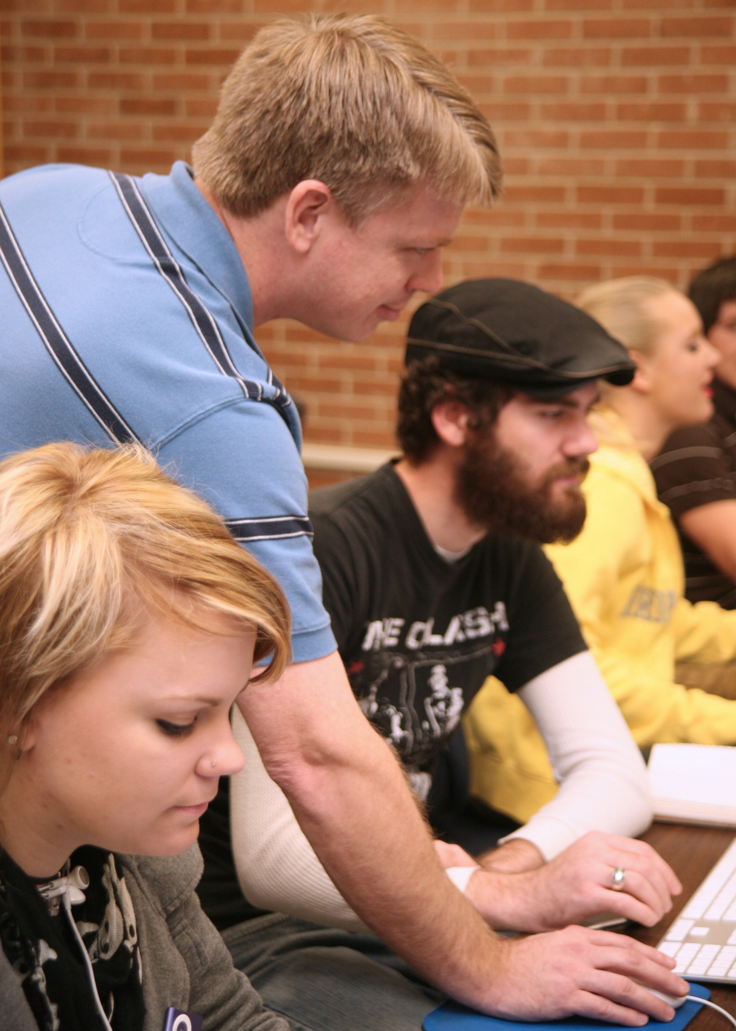
Torrey Wylie
Tyler Junior College

Slide 31
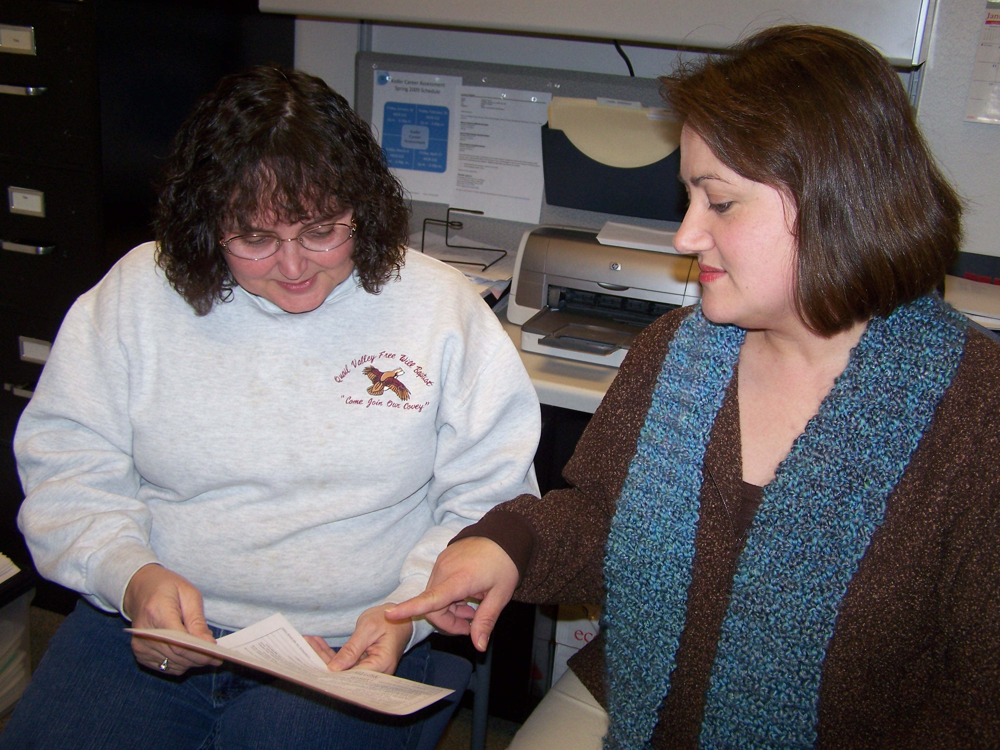
Louise Hughes
University of Arkansas Community College at Batesville
We all have an effect on those we meet—we can choose to make it a positive one.

Slide 32
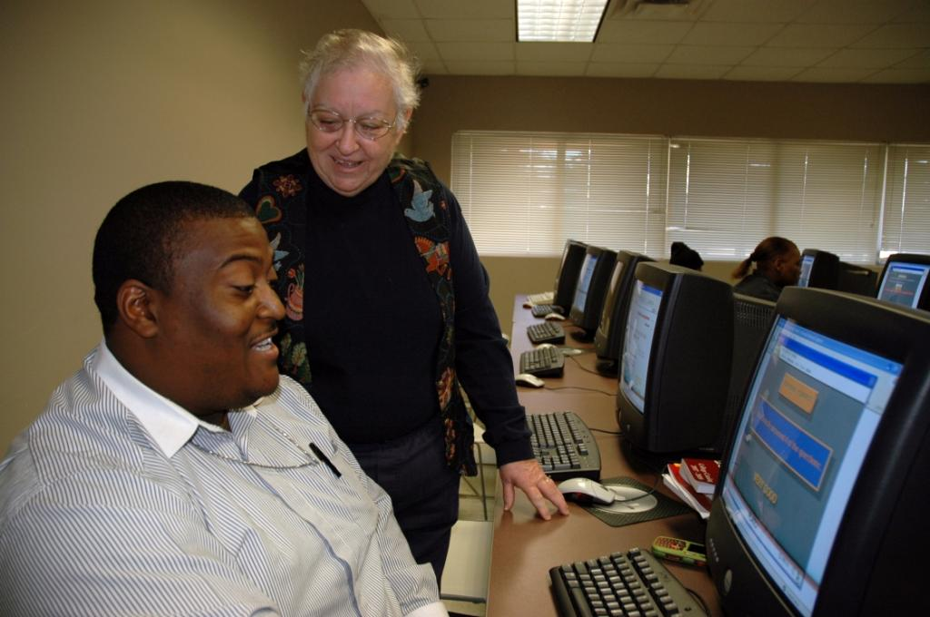
Martha Funderburk
University of Arkansas Community College at Hope
If students can learn to believe in themselves, they can achieve their goals. I am rewarded each year at graduation by seeing these students receive their diplomas.

Slide 33
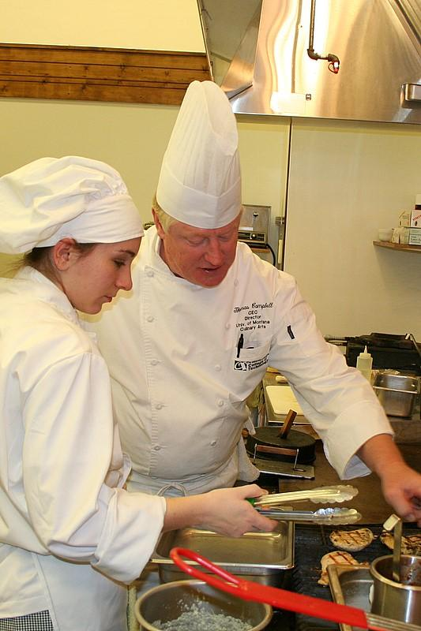
Chef Tom Campbell
University of Montana College of Technology

Slide 34
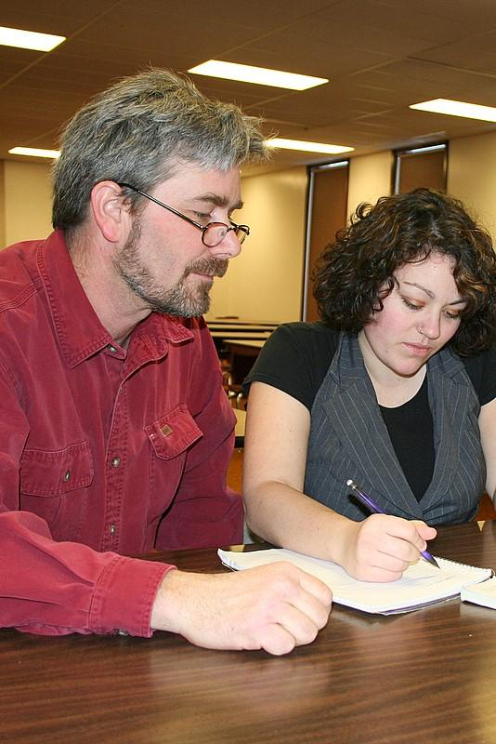
Josef Crepeau
The University of Montana College of Technology
Your understanding of mathematical concepts is no measure of your worth as a human being, but your willingness to devote time and effort to expanding your understanding of mathematical concepts is a measure of your integrity as a student.

Slide 35
Deborah Fillmore
The University of Montana College of Technology
Educators in the 21st century must encourage students to become guardians of their knowledge. Escalating costs, teamed with the downward spiral of state support, have resulted in a very real crisis for our students. This is particularly true in rural areas where all programs may not be available. Today’s educator needs to not only be prepared, but to embrace the demanding needs and challenges involved in alternative delivery methods to make education available to all students, regardless of financial resources or geographical location.

Slide 36
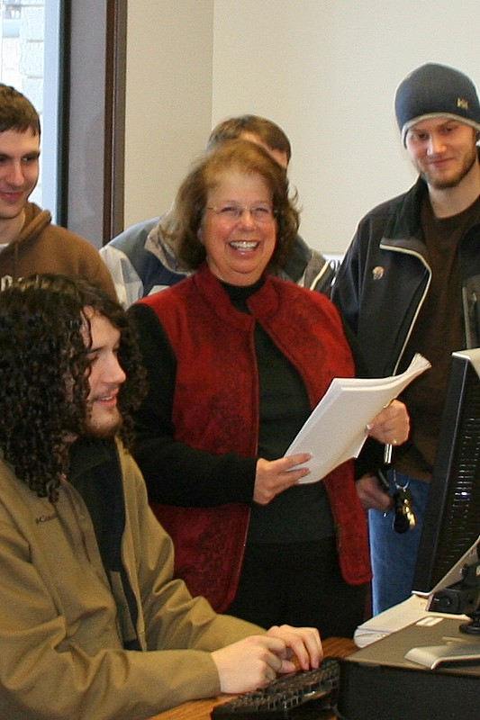
Penny Jakes
The University of Montana College of Technology
Lifelong learning is my mantra. I stay connected to the community, see difficult situations as opportunities, continually upgrade/develop new courses, and treasure the little successes each day.

Slide 37
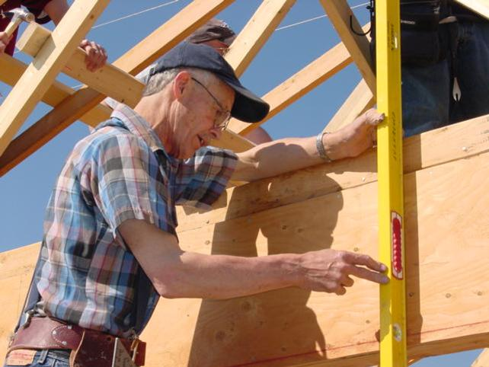
David Neu
The University of Montana College of Technology
My greatest inspiration in teaching my students carpentry comes when I observe them falling in love with the trade, gaining a special pride in their role as builders of civilization. I am humbled then to think that my own love for carpentry is perhaps what has inspired them.

Slide 38
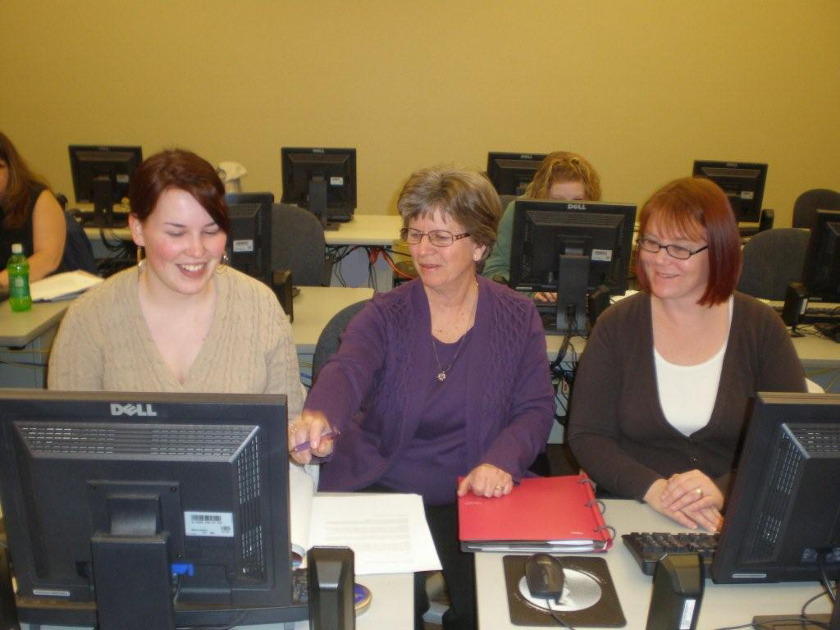
Joan Schneider
The University of Montana College of Technology

Slide 39
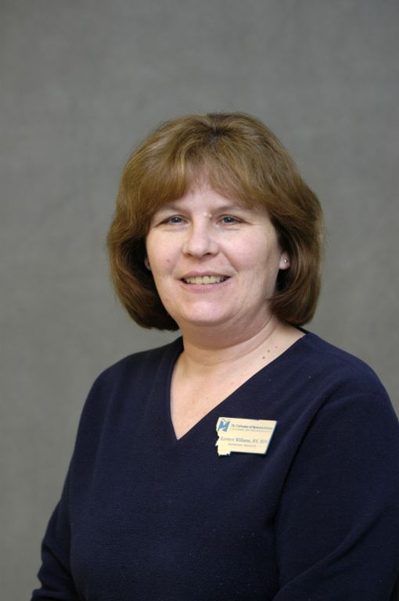
Karmen Williams
The University of Montana College of Technology

Slide 40
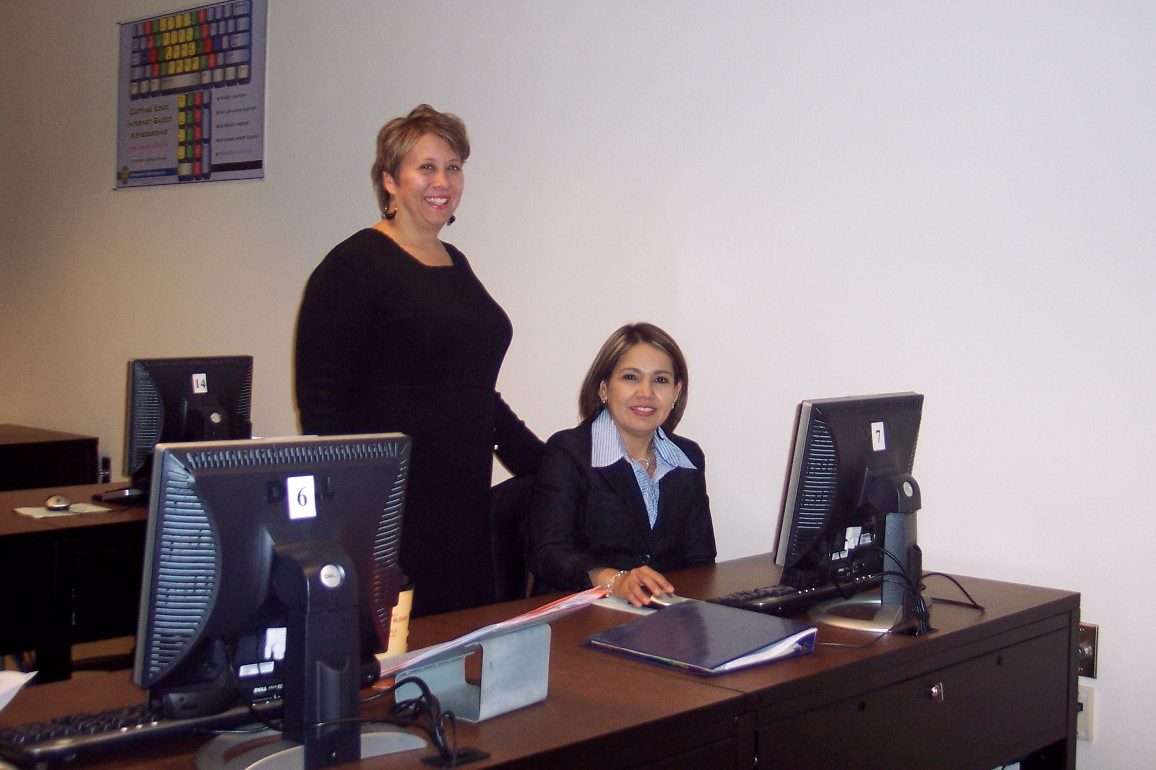
Karen Betancourt
The University of Texas at Brownsville
My nontraditional students inspire me. Most of my students are full-time employees, full-time dads or moms, volunteers, and eager full-time students. Now those are inspirations!

Slide 41
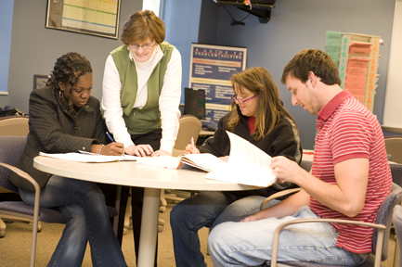
Priscilla Gray
Valencia Community College
No matter what age, students enter college with a multitude of learning obstacles, sometimes self-imposed. Balancing work, family, and education can be challenging. My role is to help break down those barriers through positive reinforcement, genuine concern for their success, and praise for their achievements.

Slide 42
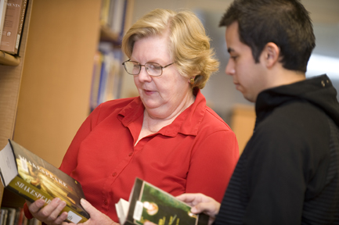
Linda Hidek
Valencia Community College

Slide 43
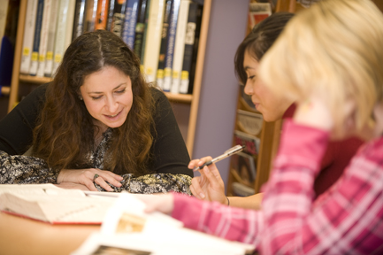
Ilyse Kusnetz
Valencia Community College
I’m inspired by the stories students tell, humbled by the obstacles they’ve encountered and overcome, and honored to play a part in their journey of self-discovery as they explore the richness and diversity of their own voices. And whenever I see a student realize with wonder, pride, and excitement that she or he is a vital part of the greater collective of literary and cultural voices, it still gives me shivers.

Slide 44
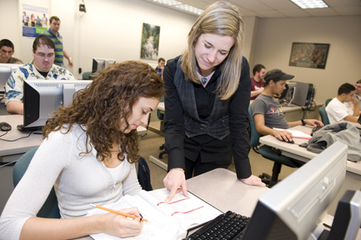
Lisa Macon
Valencia Community College
I am inspired and motivated by the success of my students, many of whom have exciting, challenging careers in the computer industry. Keeping in touch with them helps me stay up-to-date on the latest technologies I should be teaching current students. Always learn from your students!

Slide 45
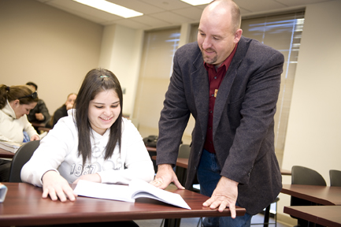
James May
Valencia Community College
Good teaching in not about sharing what we know; it is about inspiring others to know. It is about sparking curiosity, instilling a hunger for discovery, and conveying the desire to replace “I don’t know” with “Let’s find out!”

Slide 46
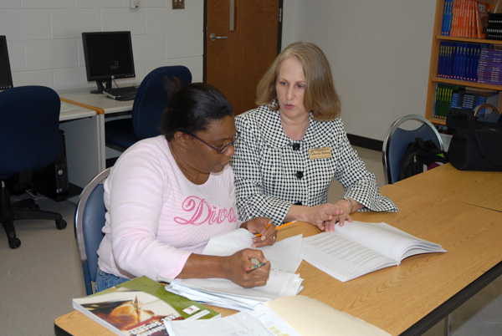
Cathy Barham
Vance-Granville Community College

Slide 47
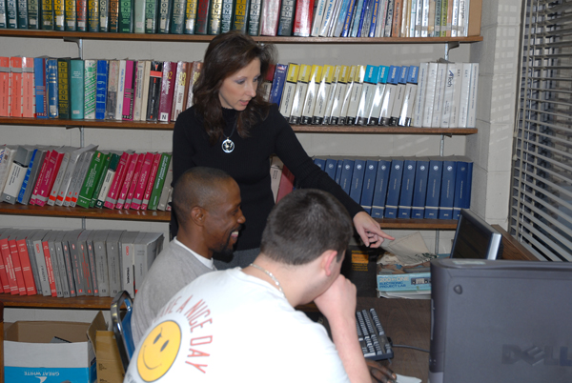
Betty Jo Ellis
Vance-Granville Community College

Slide 48
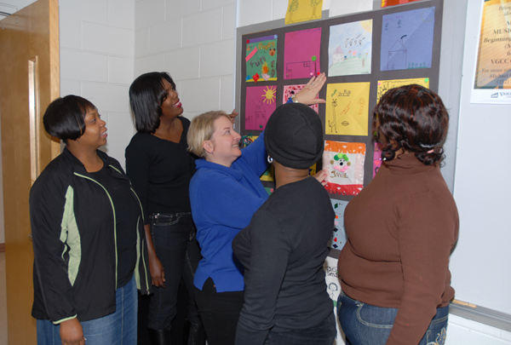
Jennifer Johnson
Vance-Granville Community College

Slide 49
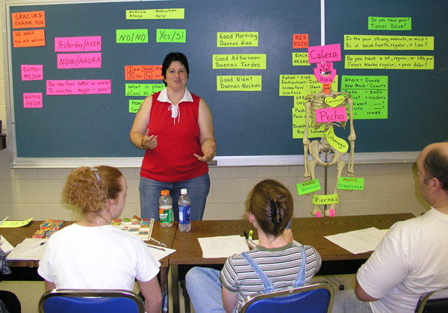
Maria Orsini
Vance-Granville Community College

Slide 50
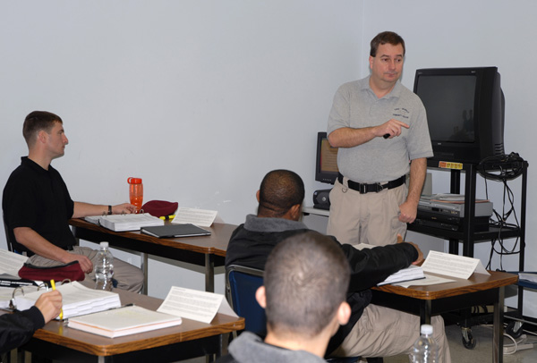
Tony Pendergrass
Vance-Granville Community College

Slide 51
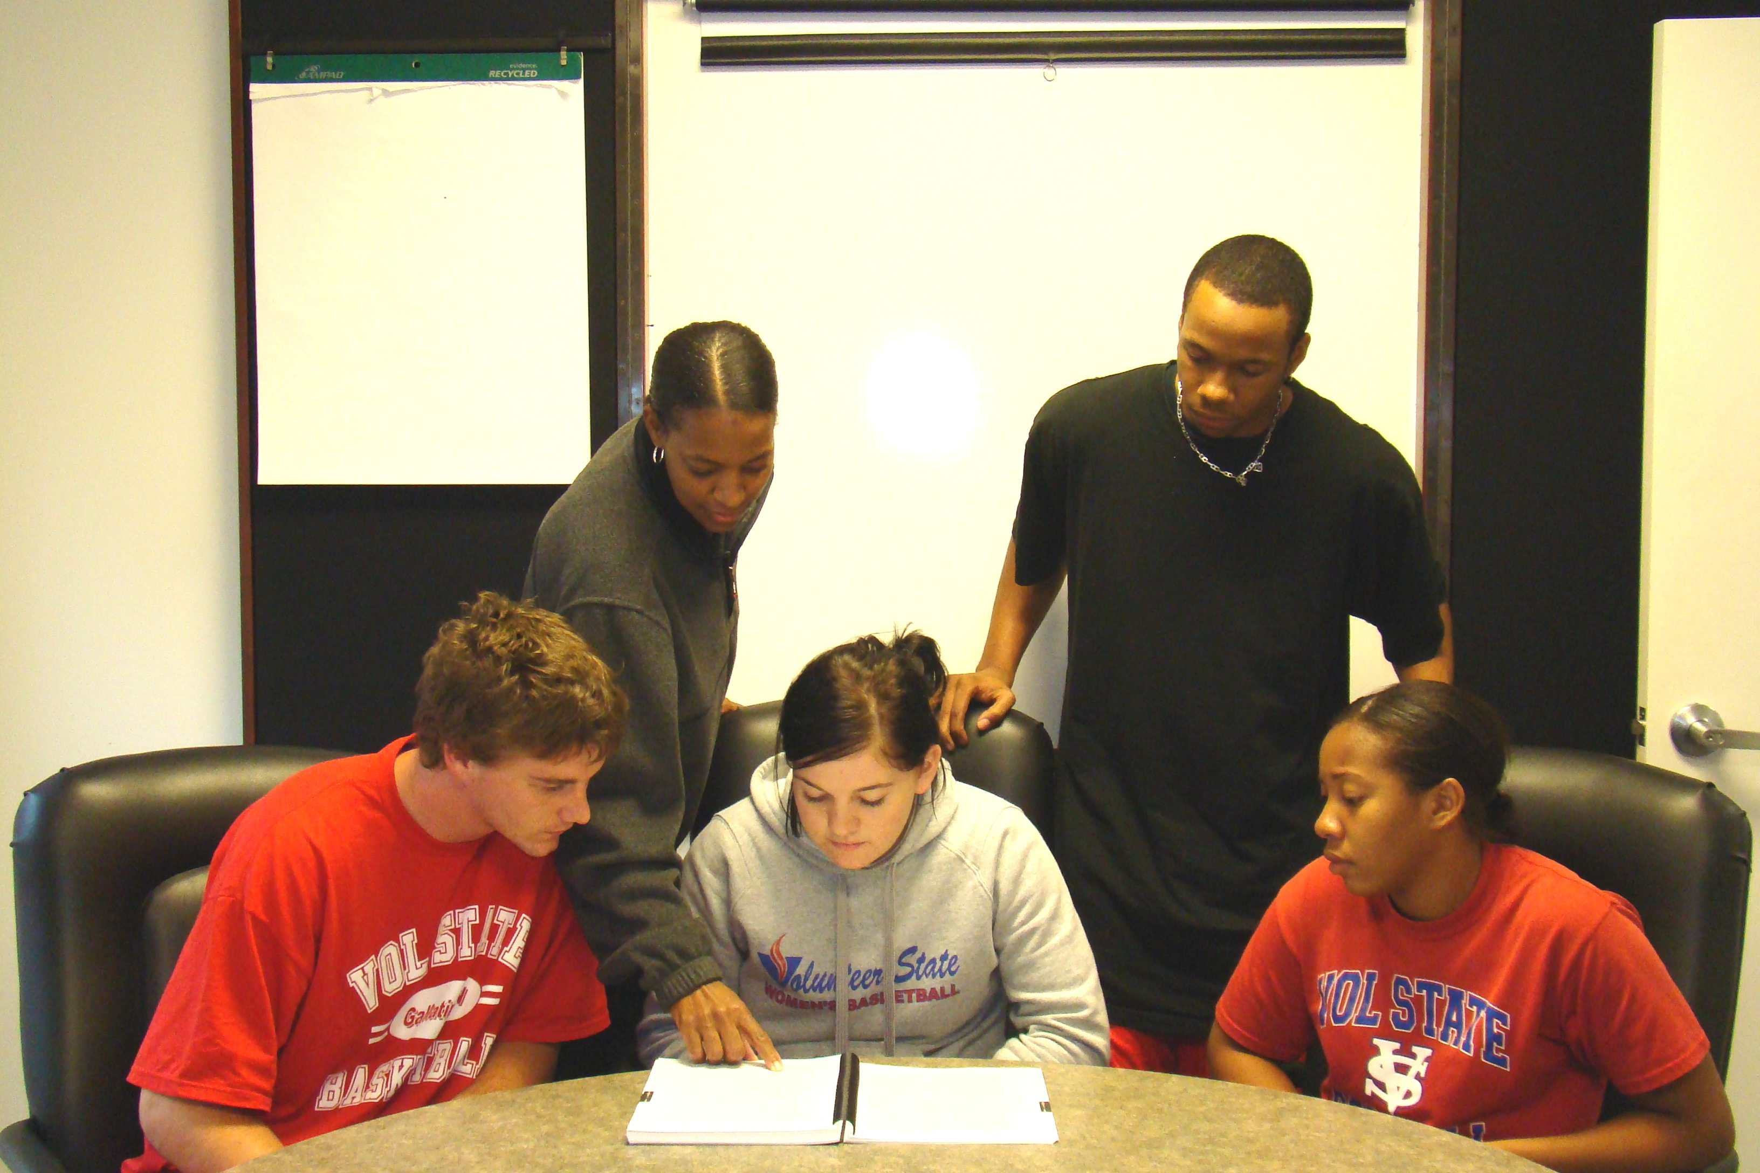
Erica Malone
Volunteer State Community College

Slide 52
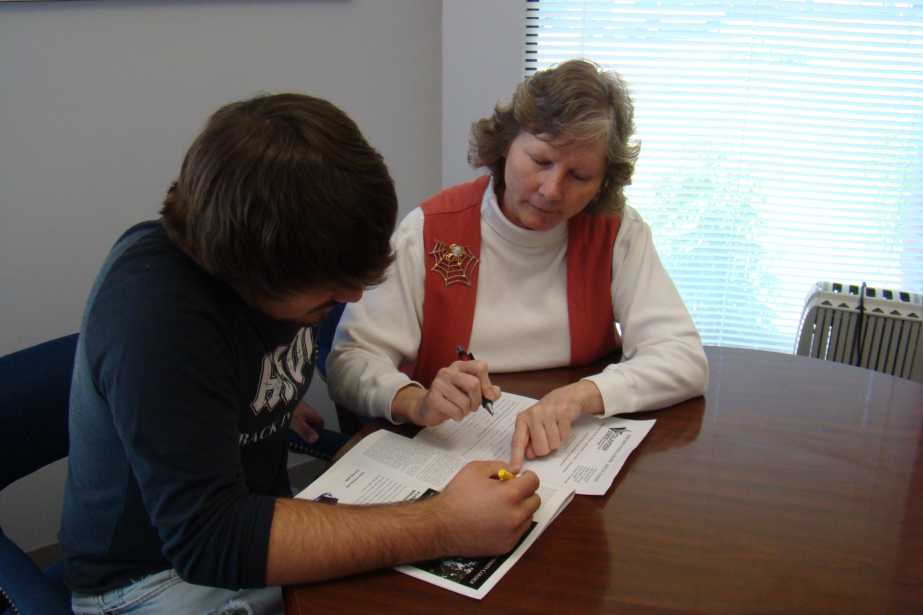
Brenda Martin
Volunteer State Community College

Slide 53
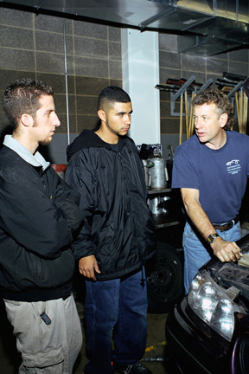
James Armitage
Waubonsee Community College
Great educators understand the distinction between teaching what they feel is important and ensuring students are given the opportunity to learn what they need to know. Additionally, the challenge of learning stems from a belief that each student is unique while knowledge remains a constant.

Slide 54
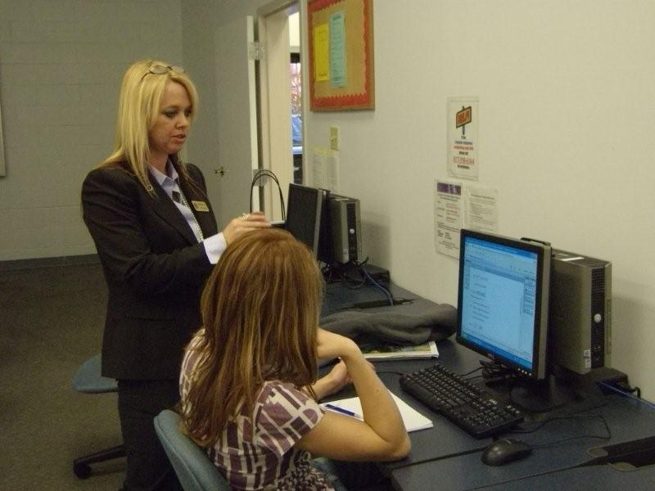
Rebecca Weaver
Weatherford College
Answering questions in a concise and respectful manner is key to establishing a positive student-teacher relationship. Insuring that students are not spectators, but rather people with the requirement to participate in their own learning experience, allows them to develop a confidence that encourages their ability to become functional as mathematical thinkers.

Slide 55

Clint Cowden
West Hills College
I feel like a proud parent when students are doing well.

Slide 56

Marty Ennes
West Hills College
My inspiration comes from seeing students' eyes sparkle as they successfully deliver a speech, offer an opinion or answer, and believe they are worth listening to. Students sustain and renew my energy. When I walk into the classroom, I am energized by the possibilities each student offers.

Slide 57

Scott Wilson
West Hills College
I'm inspired by the fact that, for many of my students, attending college is the first self-initiated step they've taken in their education. When I see a student who gets a spark of interest or insight in a topic, it renews my energy for a long time.

Slide 58

Randy Simmons
West Kentucky Community and Technical College
What motivates me as a professor of art is my lifelong dedication to the process. As a serious artist, studio time is crucial. Bringing this passion and energy to my classroom environment is motivational for my students and reflected back to me through their efforts in class and homework projects. With a positive attitude and high energy level from me in the classroom, the artist in each student is obtainable, and student success always exceeds expectations.

Slide 59
Kathy Herrington
West Virginia Northern Community College
These students strive for excellence and do their best for me, and I am compelled to strive for excellence as well; they deserve nothing less. I am also renewed when I receive feedback from a student, perhaps who left my classroom years before, who remembers me and writes to express their gratitude and appreciation for what they believe I did for them, or because I believed in and encouraged them. This is what makes me love being a teacher.

Slide 60

Marilyn Love
West Virginia University at Parkersburg

Slide 61
Phil McClung
West Virginia University at Parkersburg
Investigate new practices and teaching methods. Shift away from memory and recall. Move toward synthesizing. Encourage students to become designers, as well as users, and to share knowledge with others. Encourage teamwork. Attend learning conferences. Try out new methods of teaching, use focused interaction, photos essays, multiple intelligences techniques, or any other innovations that match your teaching style. Create an interactive and sensory environment.

Slide 62

Catherine Mutz
West Virginia University at Parkersburg
I often feel like a Sherpa guide for students on their journey as they realize their potential and pursue their dreams. It is an honor and privilege to be part of their journey.

Slide 63

Rhonda Briggs
Western Iowa Tech Community College
My motivation to teach is the desire to honor teachers that inspired me—to be like those teachers who were more storytellers than instructors, to pass that spark to my students, and to pass on a sense of curiosity and willingness to see the world through a new lens.

Slide 64

Beatrice Houston
Western Iowa Tech Community College

Slide 65

John Jorstad
Western Iowa Tech Community College

Slide 66

Gary Powell
Western Iowa Tech Community College
You can lead a horse to water, but you cannot make him drink. But if you feed the horse some salt, it will want to drink. My goal: Feed students some salt.

Slide 67
Mary Hunt
Western Iowa Tech Community College
My key motivation is student success. I feel good when my students have success in the classroom and in the workplace, and know that I played a small part in their success. Food for my soul is “I learned that in your class” or “you touched my life.”

Slide 68

Rebecca McElroy
Wharton County Junior College
I want to reach the students who sit in the back of the room, as well as those who sit in the front.

Slide 69
Wayne Stephens
Wharton County Junior College
I am motivated, inspired and re-energized when an employer tells you that a graduate is raising the benchmark for all the Process Technicians in their plant. Those are the words that make all the hours spent in preparing lessons and directing the program worth it!

Slide 70
Kevin Dees
Wharton County Junior College
I am motivated by being allowed to discuss our natural world and its wonders each day with my students. Though they may not all be as enamored by the living world as I am, I can use biology as an important mechanism for developing a diversity of critical skills.

Slide 71
Gennie Fuemmeler
Yavapai College
Deep within every student lay hopes and dreams. Sometimes they're well articulated, sometimes not. But the dreams all exist. I teach my students with those hopes and dreams uppermost in my mind. My work is focused on building their ability to think and strengthening their drive to learn.

Slide 72

Lee Mickelson
Yavapai Community College

Slide 73

Martha MacDonald
York Technical College
An old woman's saying, “Your grandmother learned me how to read” showed me teaching comes from the heart. I engage students by encouraging conversations in class, listening, and using different activities to help every student.

Slide 74
Peg Earhart
Zane State College
It's been said that lasting change only comes in relationships. This is very true in teaching. Connecting with the students as partners in learning creates the motivation to learn. The desire drives the process. Without it, there's only sharing information. Teachers aren't as much the fuel in the tank, as they are the ignition.

