Slide 1
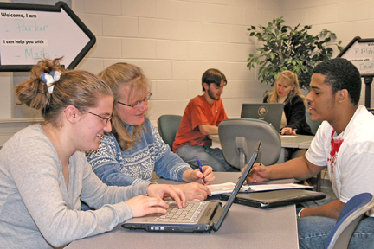
Patricia Parker Rappahannock Community College
Teaching is cherishing every moment: when learning is filled with life and emotion, when expectations are set and goals are achieved, when questions are asked and answers are challenged. No two days are ever the same, but each one has the potential of truly taking your breath away.

Slide 2
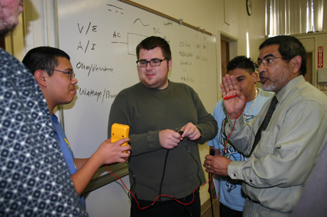
David Atencio Reedley College

Slide 3
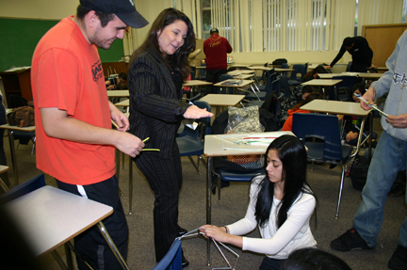
Linda Carvalho Cooley Reedley College
I try hard to make the experience of taking a speech class as painless as possible. When students give their speeches, I'm not always sure if it is confidence or empowerment; but there is a moment when they have a sparkle in their eyes. That's when I know I've done my job.

Slide 4
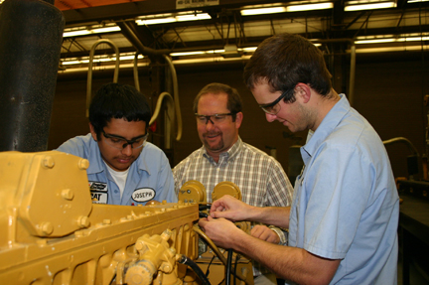
David Clark Reedley College
Don’t forget the human element! We are teaching real, live, complex individuals. Are they ready to learn? Look at their eyes and facial expressions. Do they comprehend what you have taught them? Teach, check for understanding, and repeat!

Slide 5
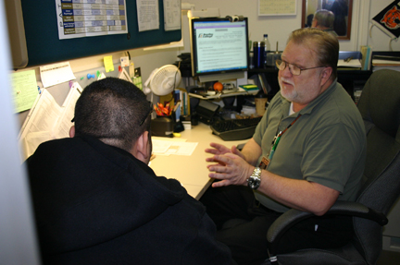
Steven Jones Reedley College

Slide 6
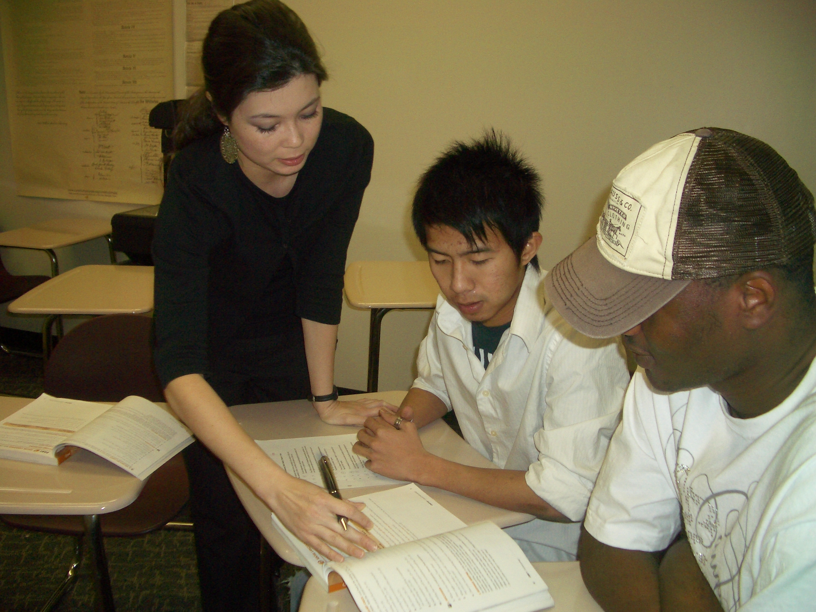
Anna Gann Richland College
My students inspire me. Most of my students have immigrated to the United States for a better life, and their determination and perseverance are inspiring. I strive to be the best teacher I can be so that my students continue to build the tools they need to succeed in their future endeavors. I would advise others to meet students where they are, and point them in the direction of their potential.

Slide 7
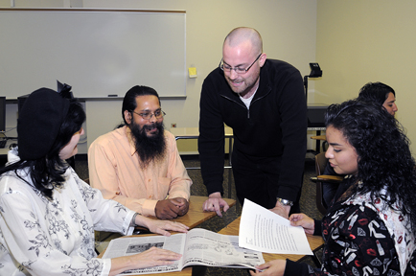
Matt Hinckley Richland College

Slide 8
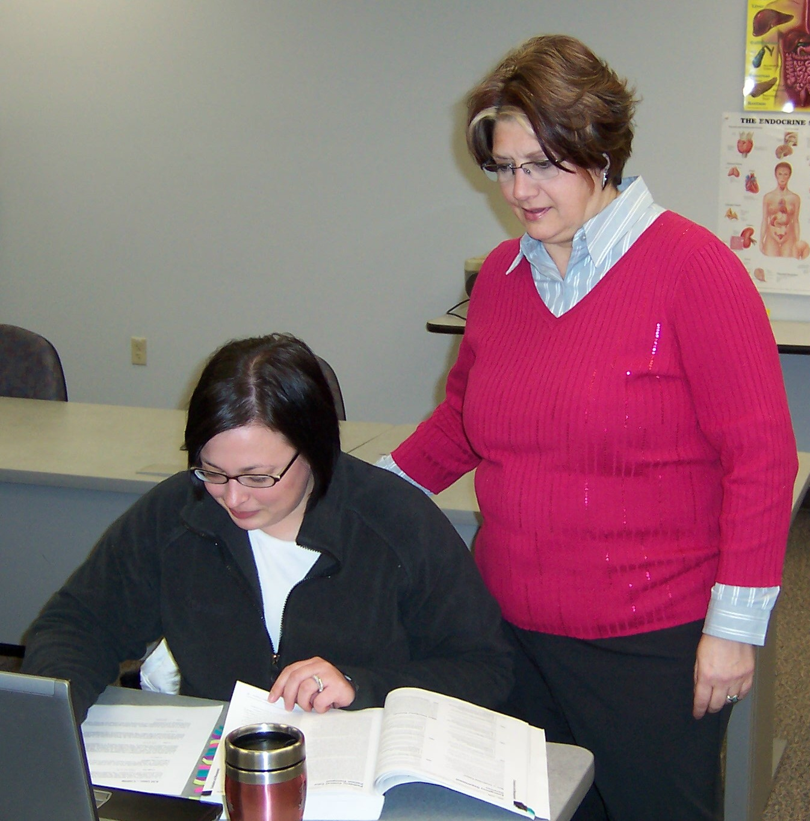
Sheryl Barton Riverland Community College
I help students achieve personal growth and a successful future. I am committed to maintaining an active teaching and learning environment while modeling excellence, including a strong work ethic, passion for one’s discipline, and a desire to see others achieve their educational and career goals.

Slide 9
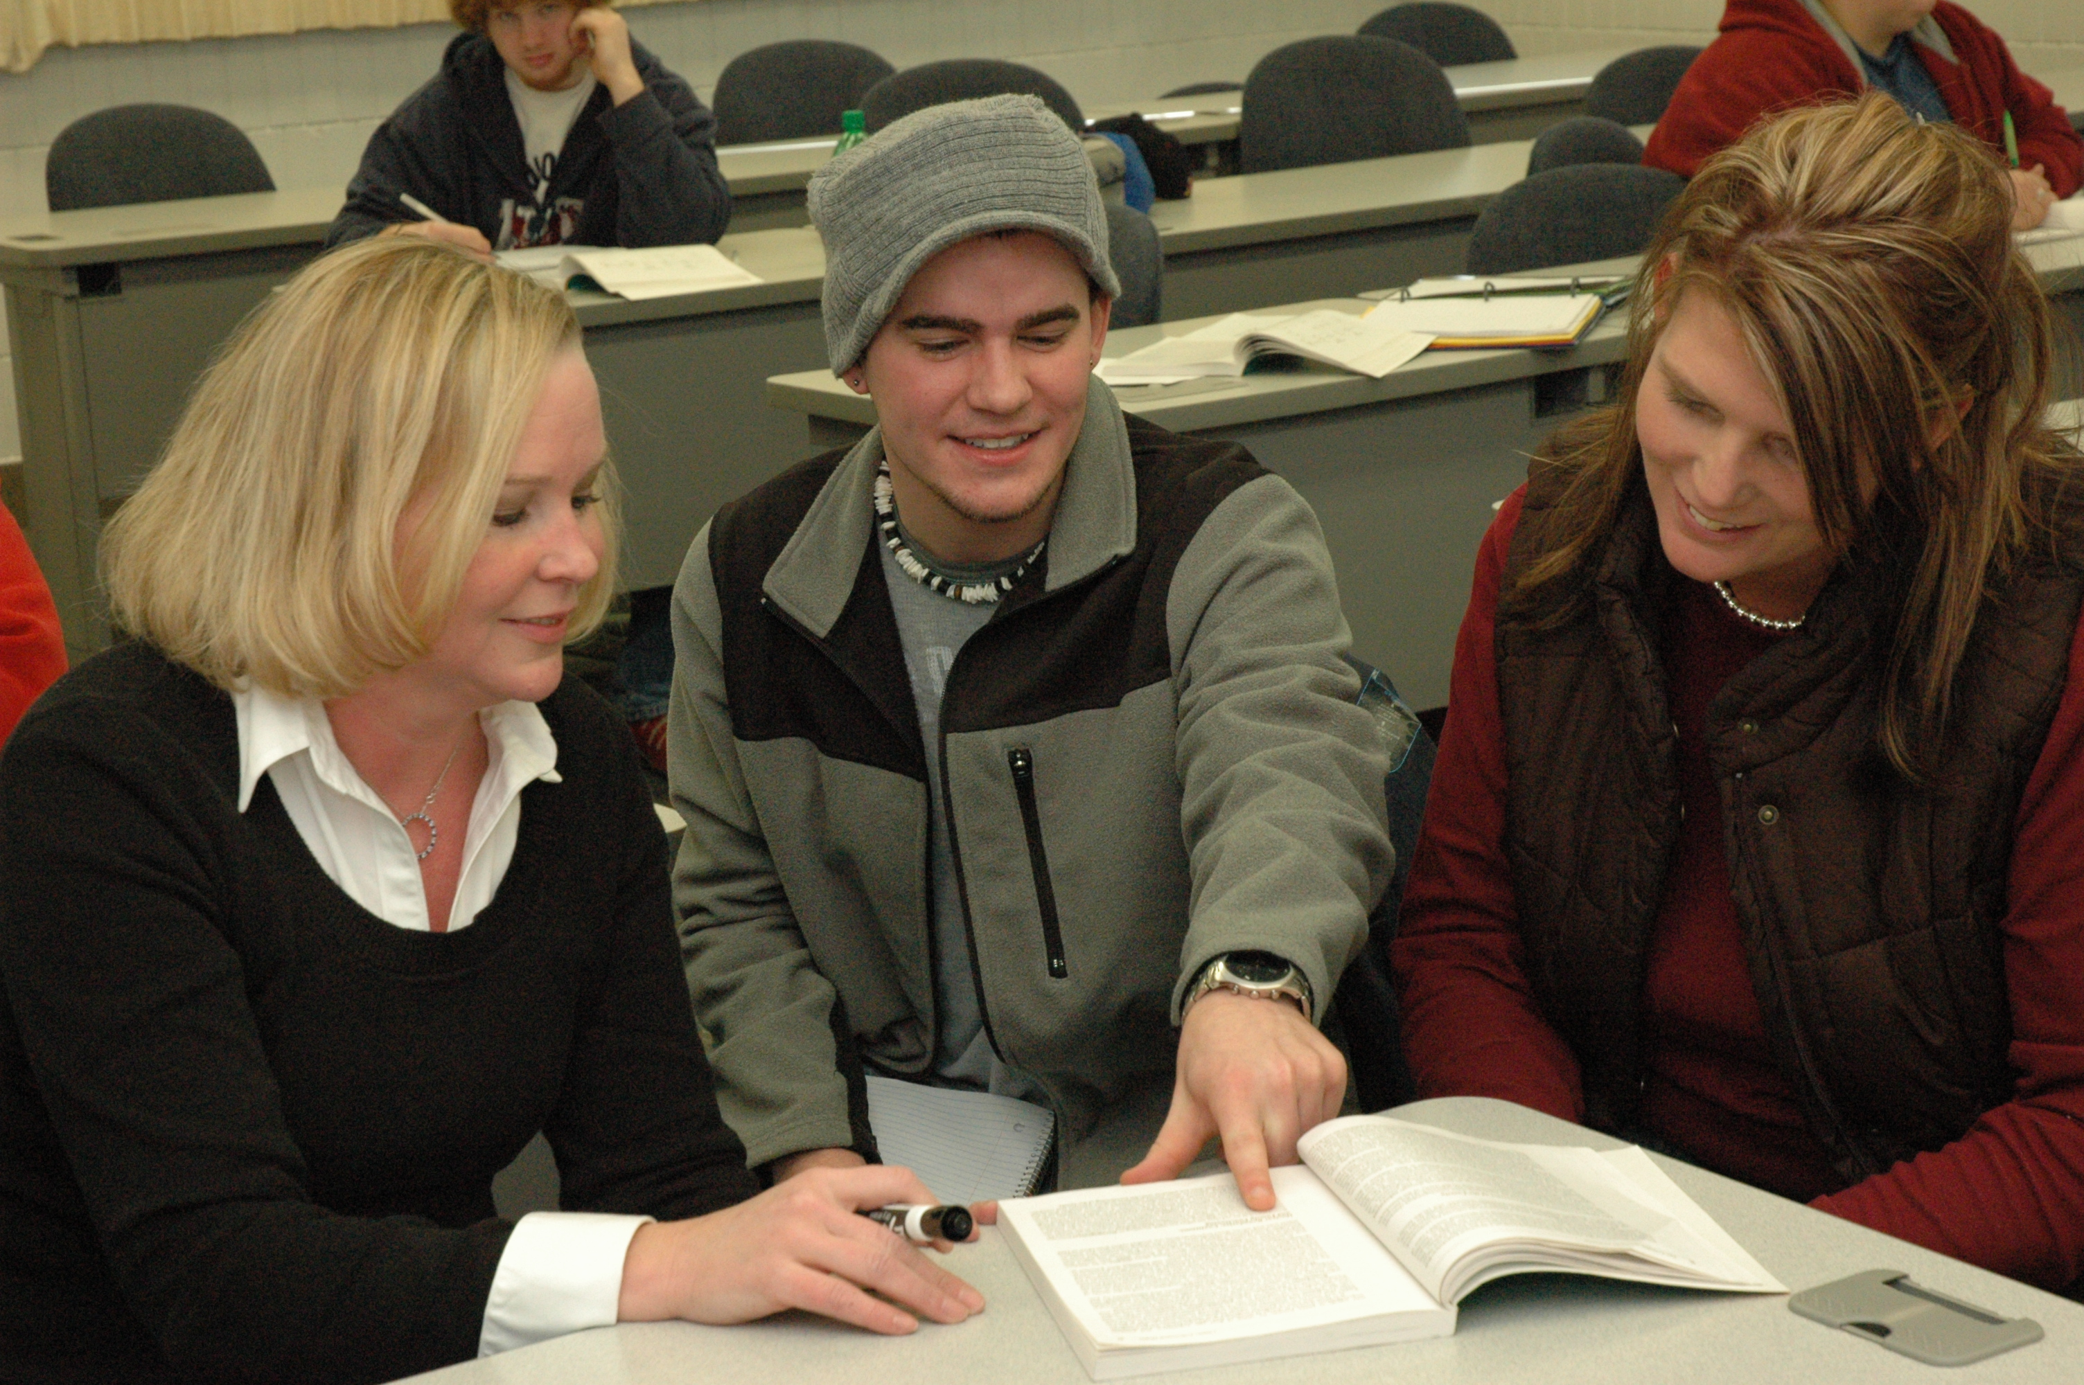
Suzette Overby Riverland Community College

Slide 10
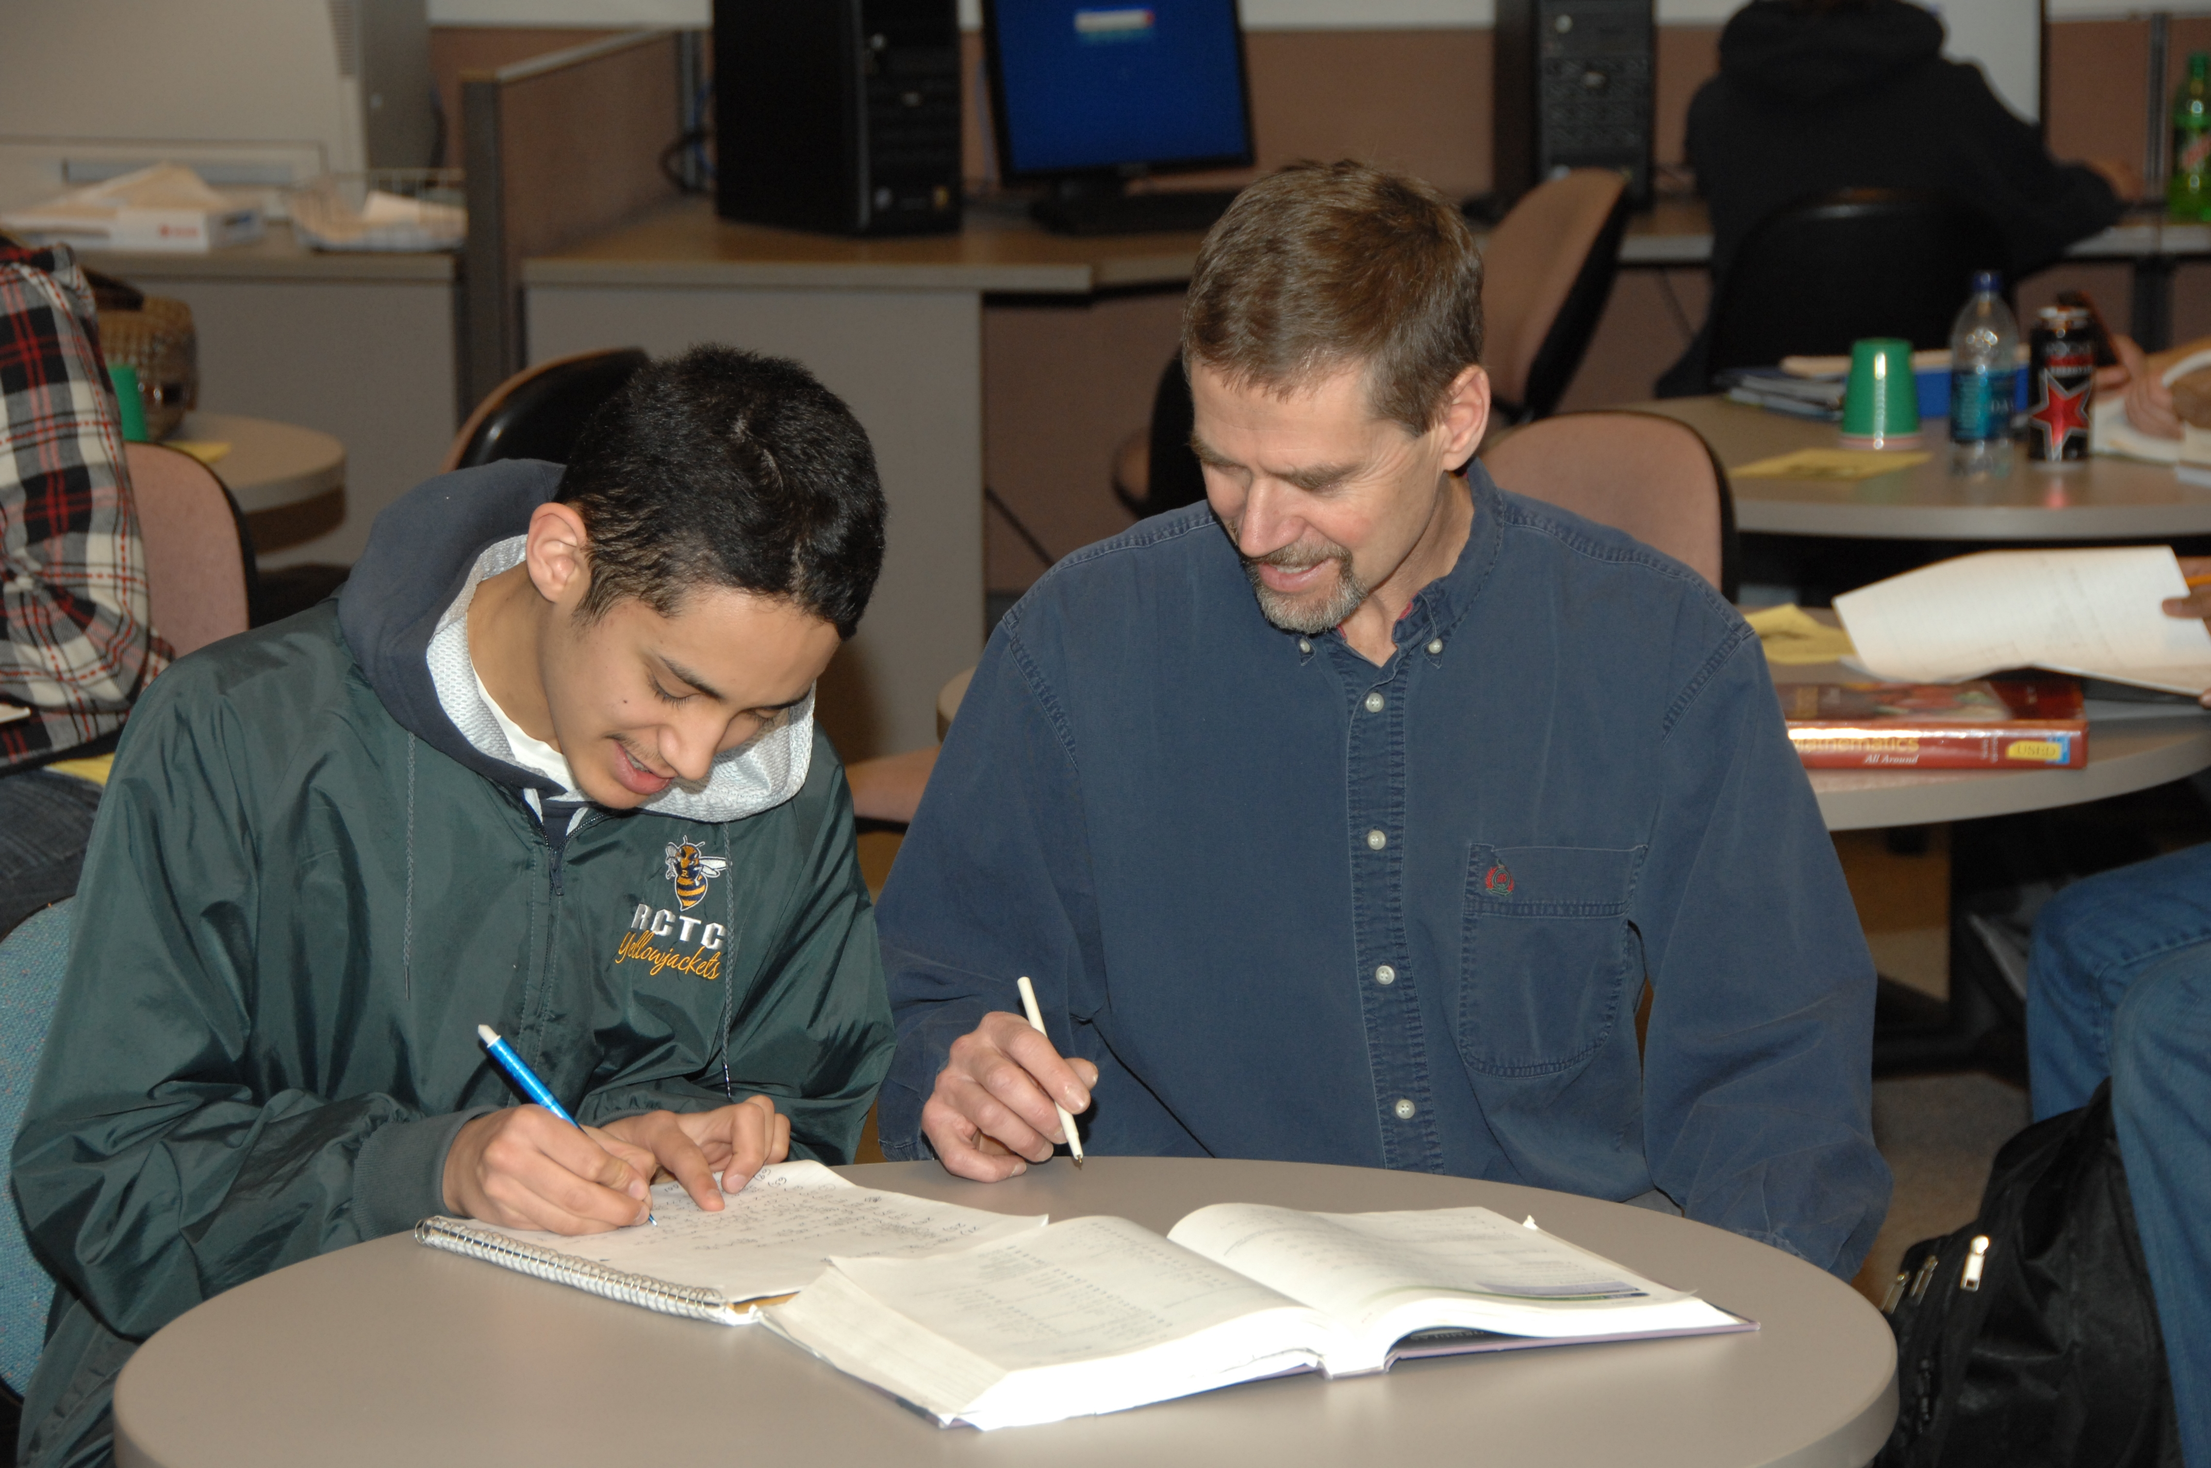
Don Baldus Rochester Community and Technical College
Doctors, engineers, teachers, lawyers, programmers, and nurses are in my classroom, all seeking a better life for themselves and those they serve. I impact their decisions, their values, their priorities, their thirst for truth, and their contributions to society. A part of me lives on in them.

Slide 11
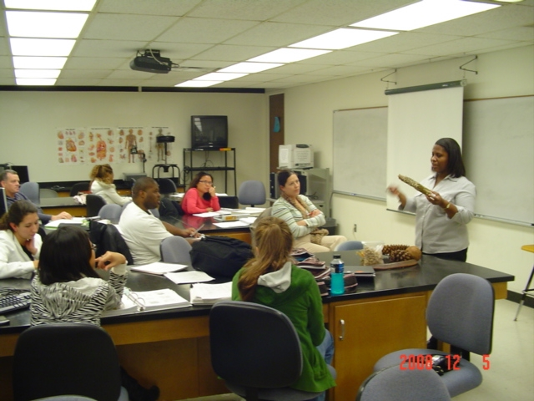
Adjoa Ahedor Rose State Community College

Slide 12
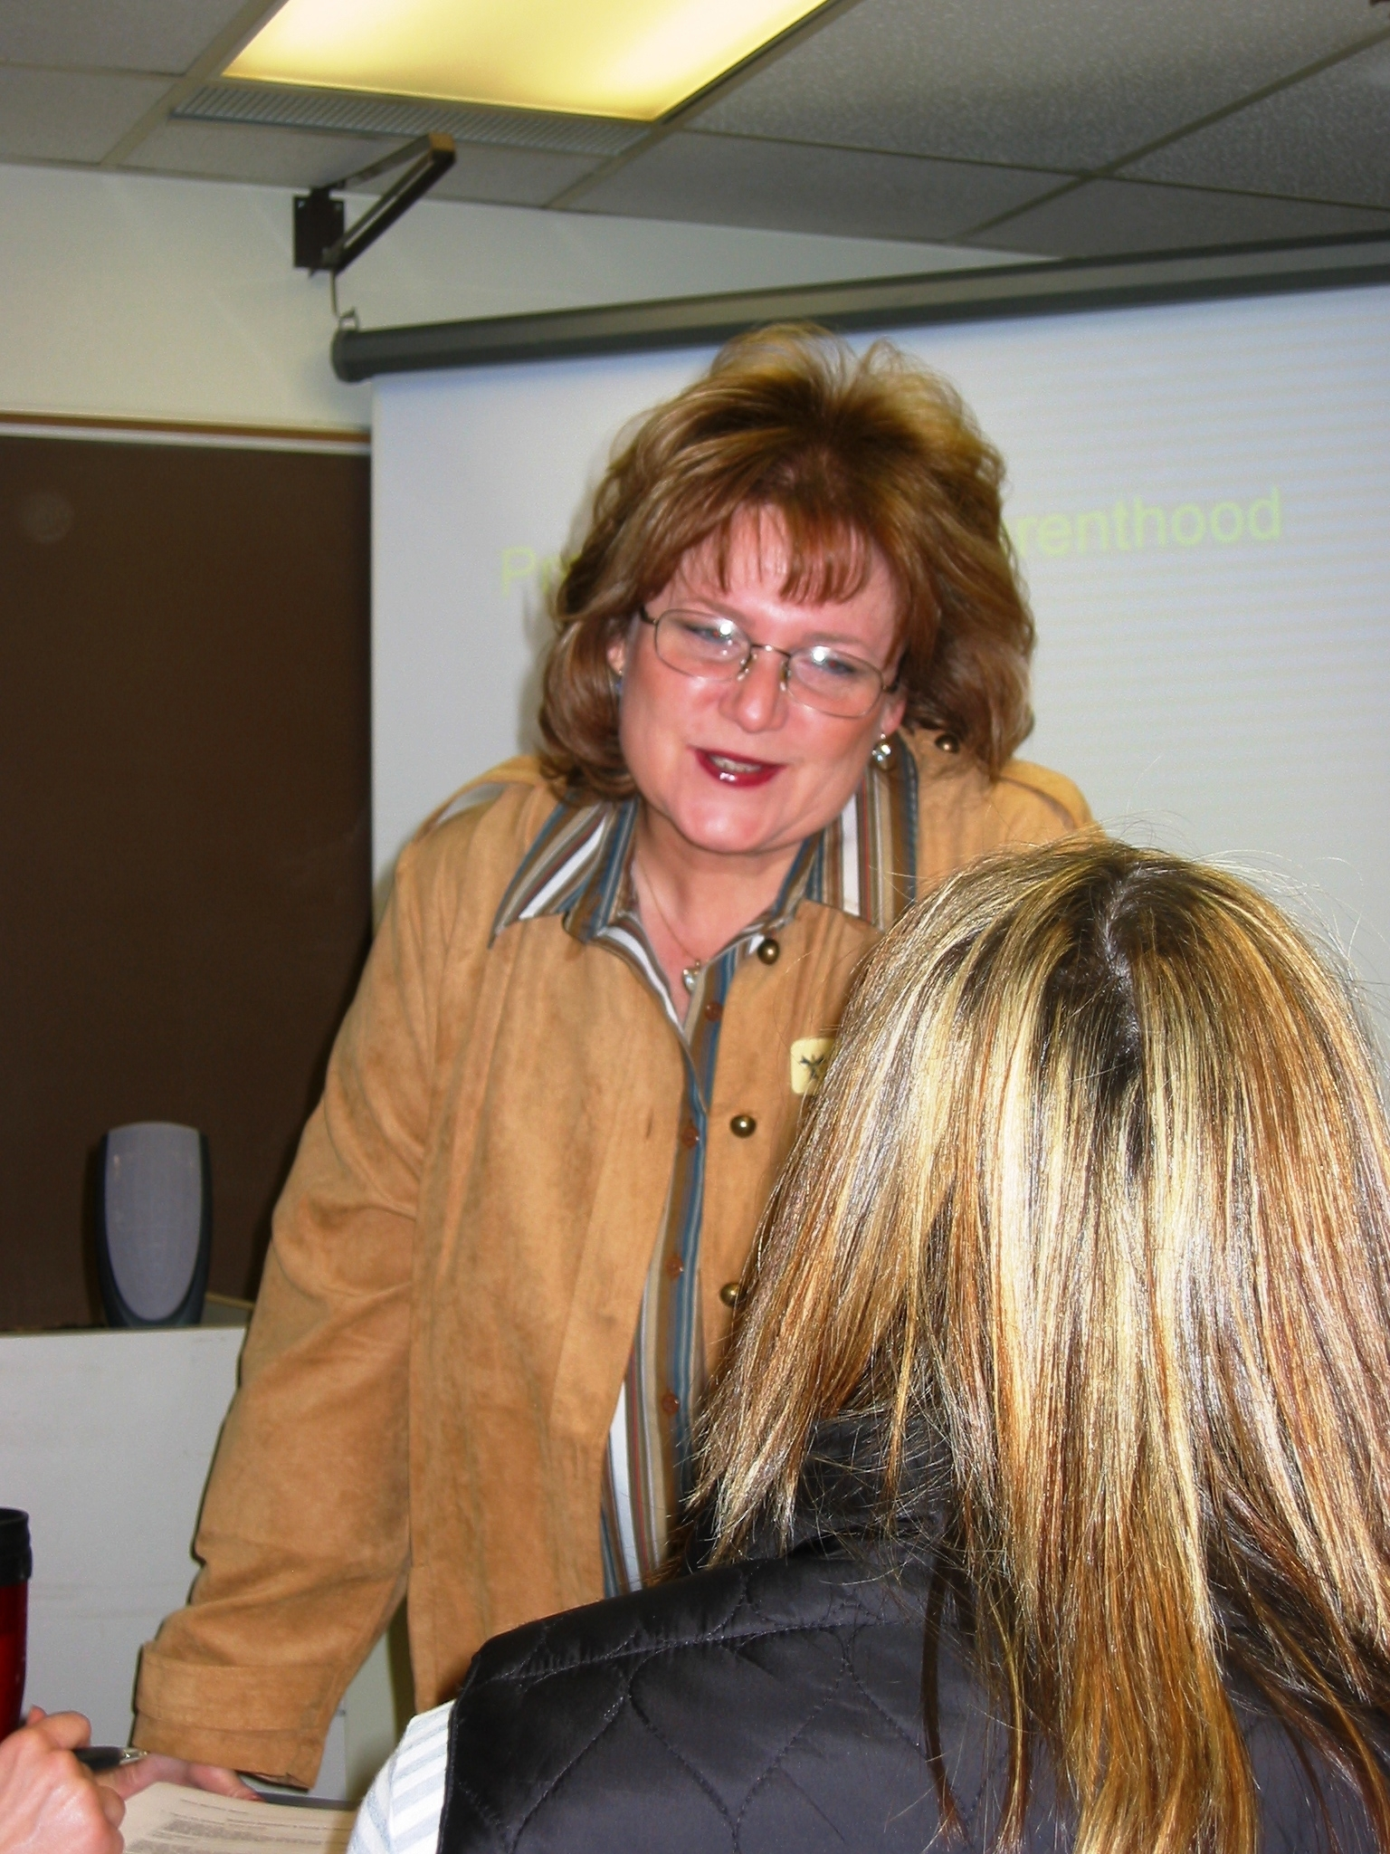
Sally Boyster Rose State College
I came to higher education later in life and was surprised to learn just how rewarding education can be. Each semester a new class comes to me; a group of new faces who are eager to learn what I have to give. I also rejoice with them when they teach me a thing or two. Teaching future nurses is an empowering experience—I am giving back everything I learned as a nurse to the next generation. I can tell my stories and watch my students grow.

Slide 13
Stacie Mayes Rose State College
I have always had a deep-rooted need to right the wrongs of the world. The best way to do that is to create the best accountants I can, help them be the best they can, and show them how to right the wrongs in their little corner of the world. Little by little, this world will become a better place.

Slide 14
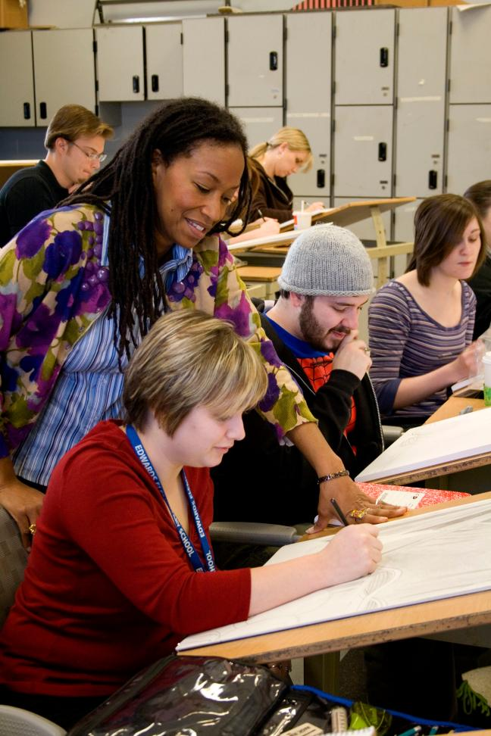
Suzanne Thomas Rose State College
My most favorite thing to tell a student is “Go out on a limb; don’t worry; I’ll pull you back before you fall.”

Slide 15
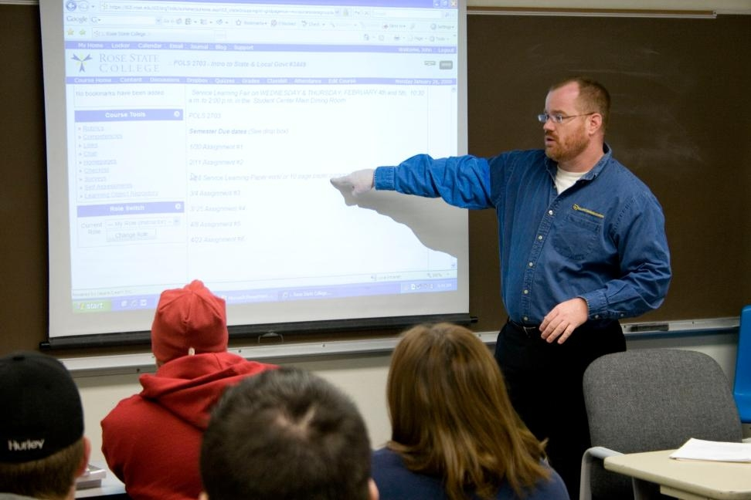
John Wood Rose State College

Slide 16
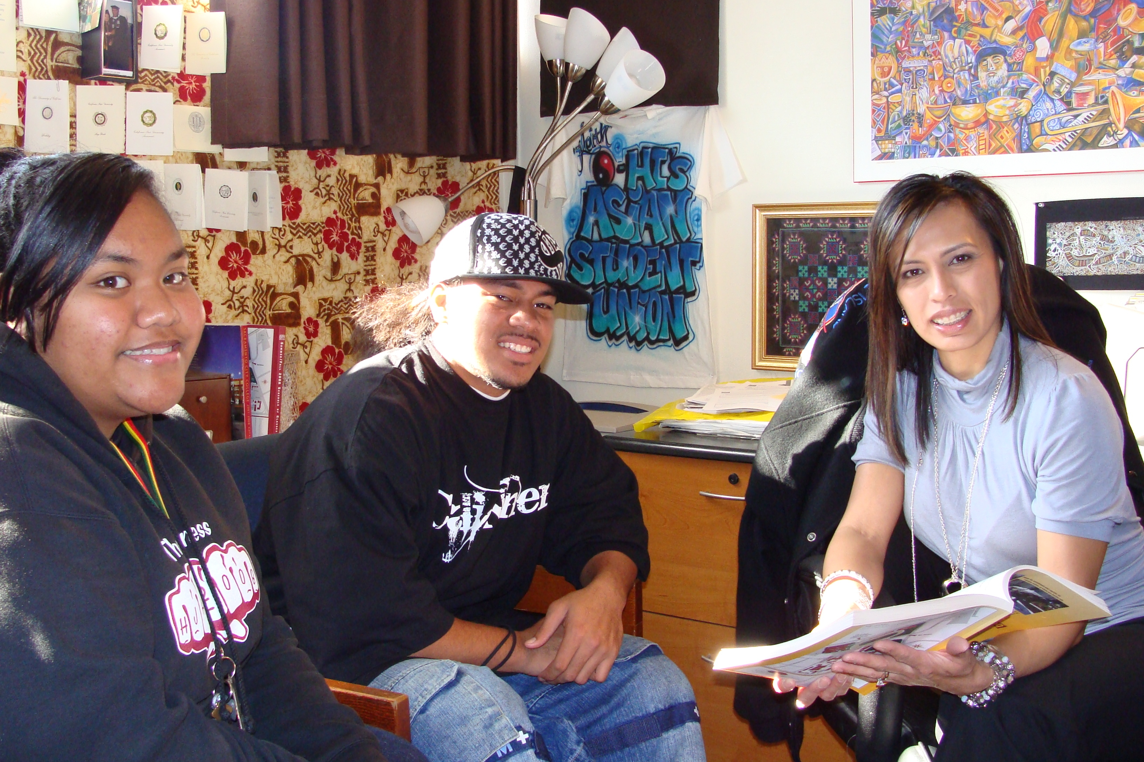
Marcia James Sacramento City College
I am often amazed by students’ ability to juggle work, school, and family life. Their dedication to learn and achieve their educational goals inspires me, and knowing that I have helped them get there is a wonderful feeling.

Slide 17
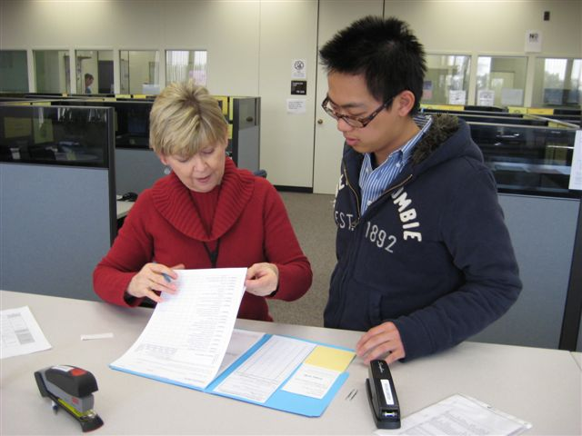
Marie Larson Sacramento City College
Listening to students inspires me. When I’ve earned enough trust that students reveal their inner fears and ambitions, not only to me but to themselves, I know I’ve reached them. Sharing laughter and tears, we develop relationships that allow me to push students harder to surprise themselves as real learners.

Slide 18
Lisa Gunderson Sacramento City College
Always bring your passion into the classroom. Students will see it, feel it, and be inspired by it. My father said never to forget that you are not teaching a subject, but rather teaching human beings.

Slide 19
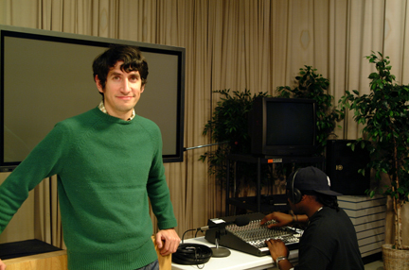
Alexander Adan Sacramento City College
I believe in leading by my own positive example, earning the respect and trust of others, and committing myself to excellence. Experiences in my life and on campus have challenged me to always strive for my personal best and made me a firm believer in making the impossible, possible.

Slide 20
Mary Ann Robinson Sacramento City College Library
At Sacramento City College, we are encouraged to step up and participate in shaping college culture and direction through committees, initiatives, volunteer activities, and more. Then there are the talented and dedicated colleagues who make the process work and the students whose hope and dedication are an inspiration. I am grateful to have landed on such fertile ground.

Slide 21
Maura Cavanagh Dick Salem Community College
Engage curiosity! Once you open the door of curiosity for your students, information and experiences can flow back and forth from teacher to learner. Learning becomes natural and individualized, and teaching becomes dynamic and rewarding!

Slide 22
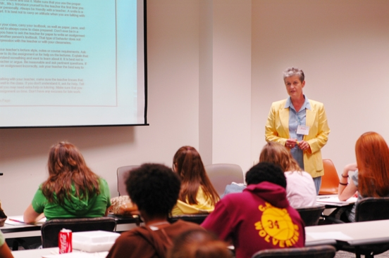
Pamela Campbell San Jacinto College

Slide 23
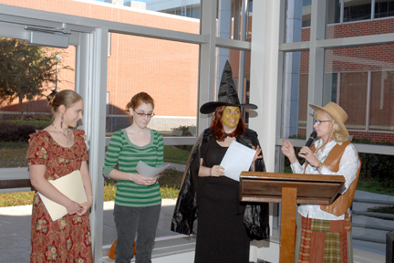
Sherrin Frances San Jacinto College
My highest priority is to inspire students to make connections, both intellectual and creative, between English and their other interests. Whether discussing the importance of paragraph development or the tone of a literary piece, I strive to convey the nature of language as integral to our understanding of the world.

Slide 24
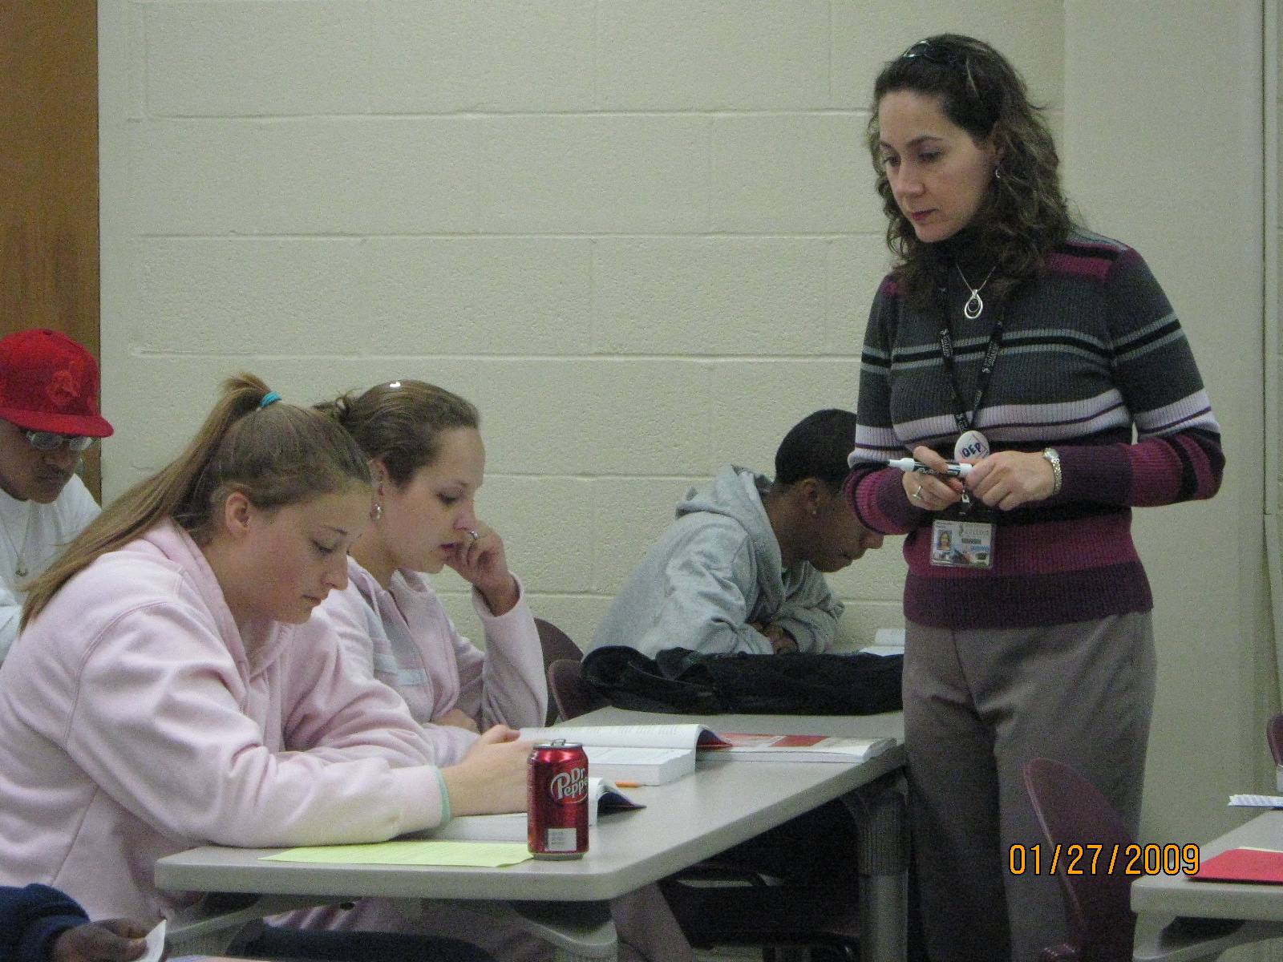
Myrna Gonzalez San Jacinto College
The idea that through education each of my students can make a positive difference in our nation, in society, in the community, and in their own lives, inspires me every day to work hard and to teach with excellence. My goal is to spark their desire to learn and to be successful.

Slide 25
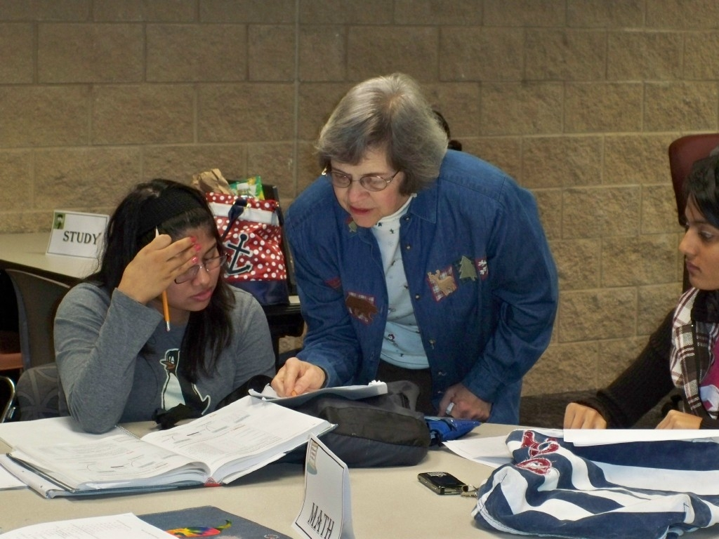
Sandra McCurdy San Jacinto College
When students grasp a concept and believe themselves capable of understanding mathematics, perhaps for the first time, I am excited and inspired to read and learn about facilitating this development. The focus for excellence in teaching is not a list of things to do, but rather the teacher to become.

Slide 26
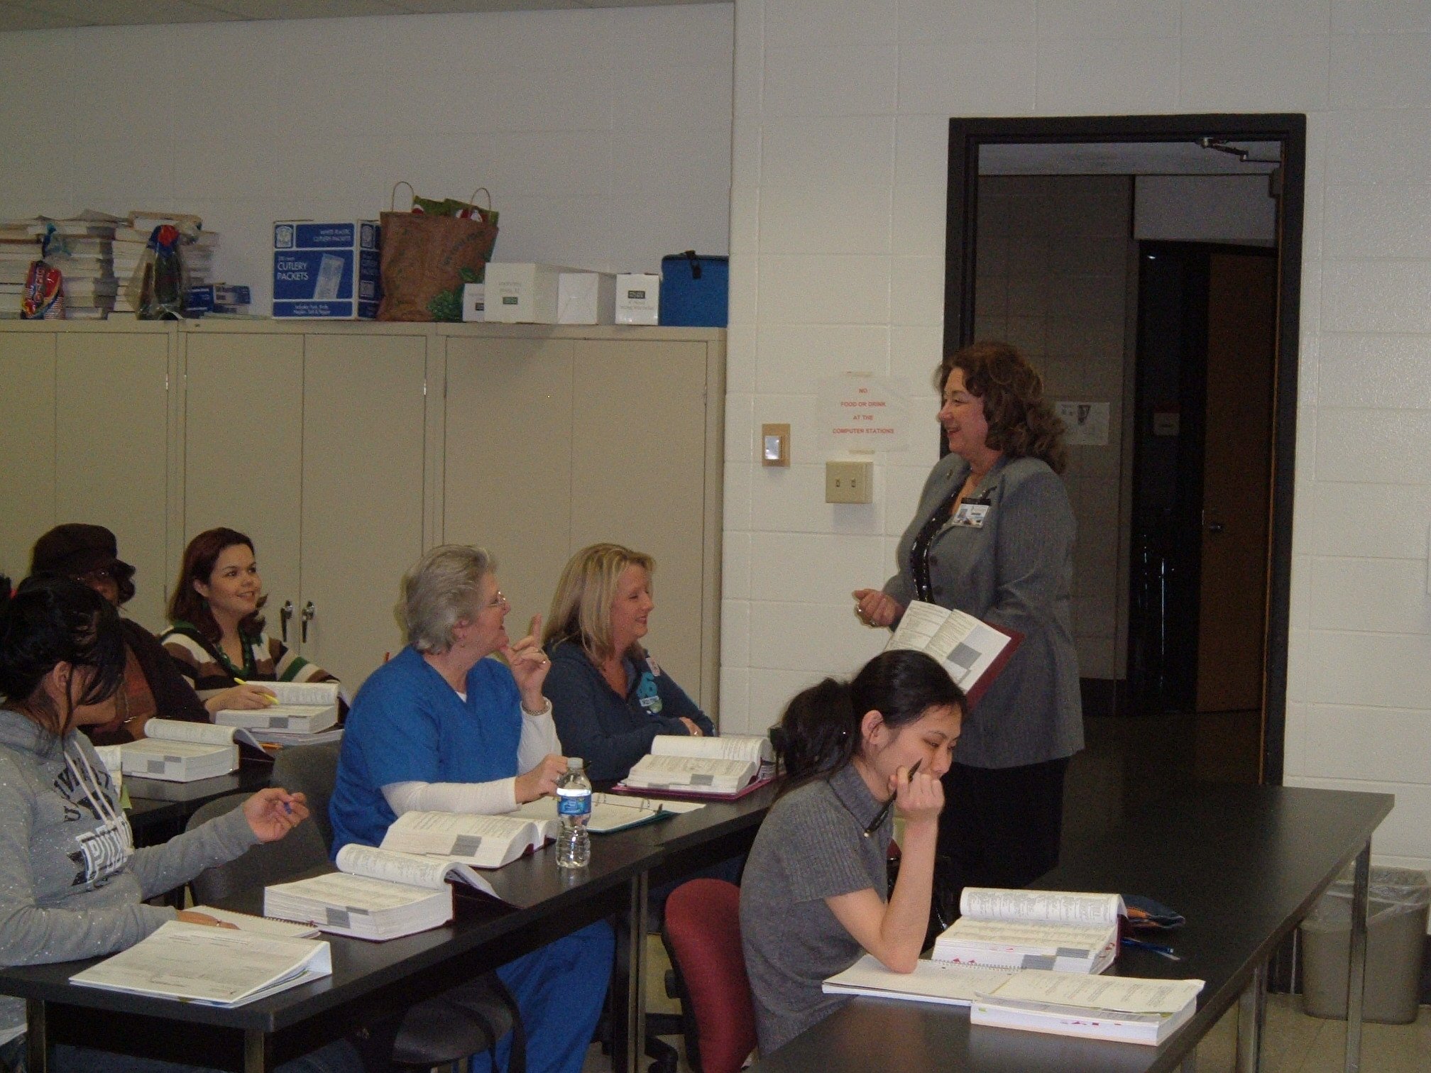
Della Moon San Jacinto College
After working in the healthcare industry for more than 30 years, I have finally found a job that inspires me to come to work every day. To be able to take a student from not knowing anything about our discipline, to seeing that light come on with understanding, is tremendously gratifying. And to see that light continue to burn brightly as that student continues to absorb information is even more gratifying. We hopefully assist students in achieving that dream of completing their degrees, walking that stage at graduation, and ultimately passing the national certification exam. To see we have been an influence in their success motivates us to continue to meet the challenges that each new group of students presents to us. We do make a difference in others’ lives. I must admit I cry at each and every graduation I attend.

Slide 27
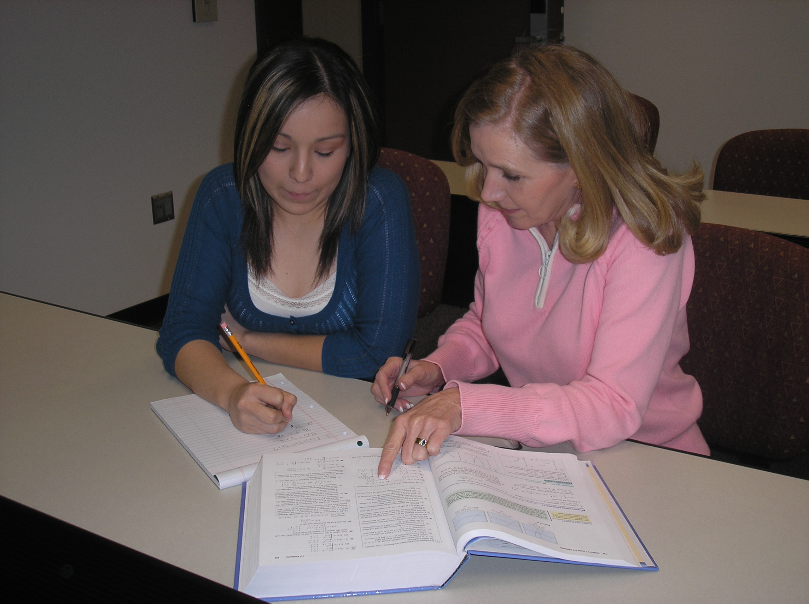
Martha Robertson San Jacinto College
Teaching, I have an opportunity to share an old truth: Success comes to people who are willing to work as hard as they must to accomplish their goals. I try to erase the notion that natural intelligence, luck, and an ability to manipulate the system are the elements that lead to successful outcomes. The joy of seeing students buy-in to this idea keeps me invested.

Slide 28
Linda Wilborne San Jacinto College South
I have worked with many wonderful people during my 20-plus years at San Jacinto College. I enjoy serving the community with a smile or a word of encouragement. If nothing else, I’m always a friendly face where sometimes none can be found.

Slide 29
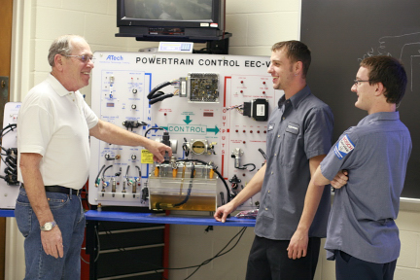
Mario Schwarz Santa Fe College
Visiting local auto repair shops and seeing former students using the skills I taught them inspires me to continually strive to be the best teacher I can be.

Slide 30
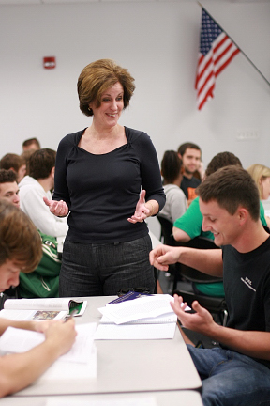
Rebecca McKee Santa Fe College
Primarily, I rely on an interactive/dialogical approach that facilitates information management, encourages critical thinking, promotes technology, strengthens communication, and stimulates creativity. I believe that my interactive/dialogical approach in the classroom activates students’ imaginations, and fosters their ability to make connections, challenge assumptions, and envision possibilities.

Slide 31
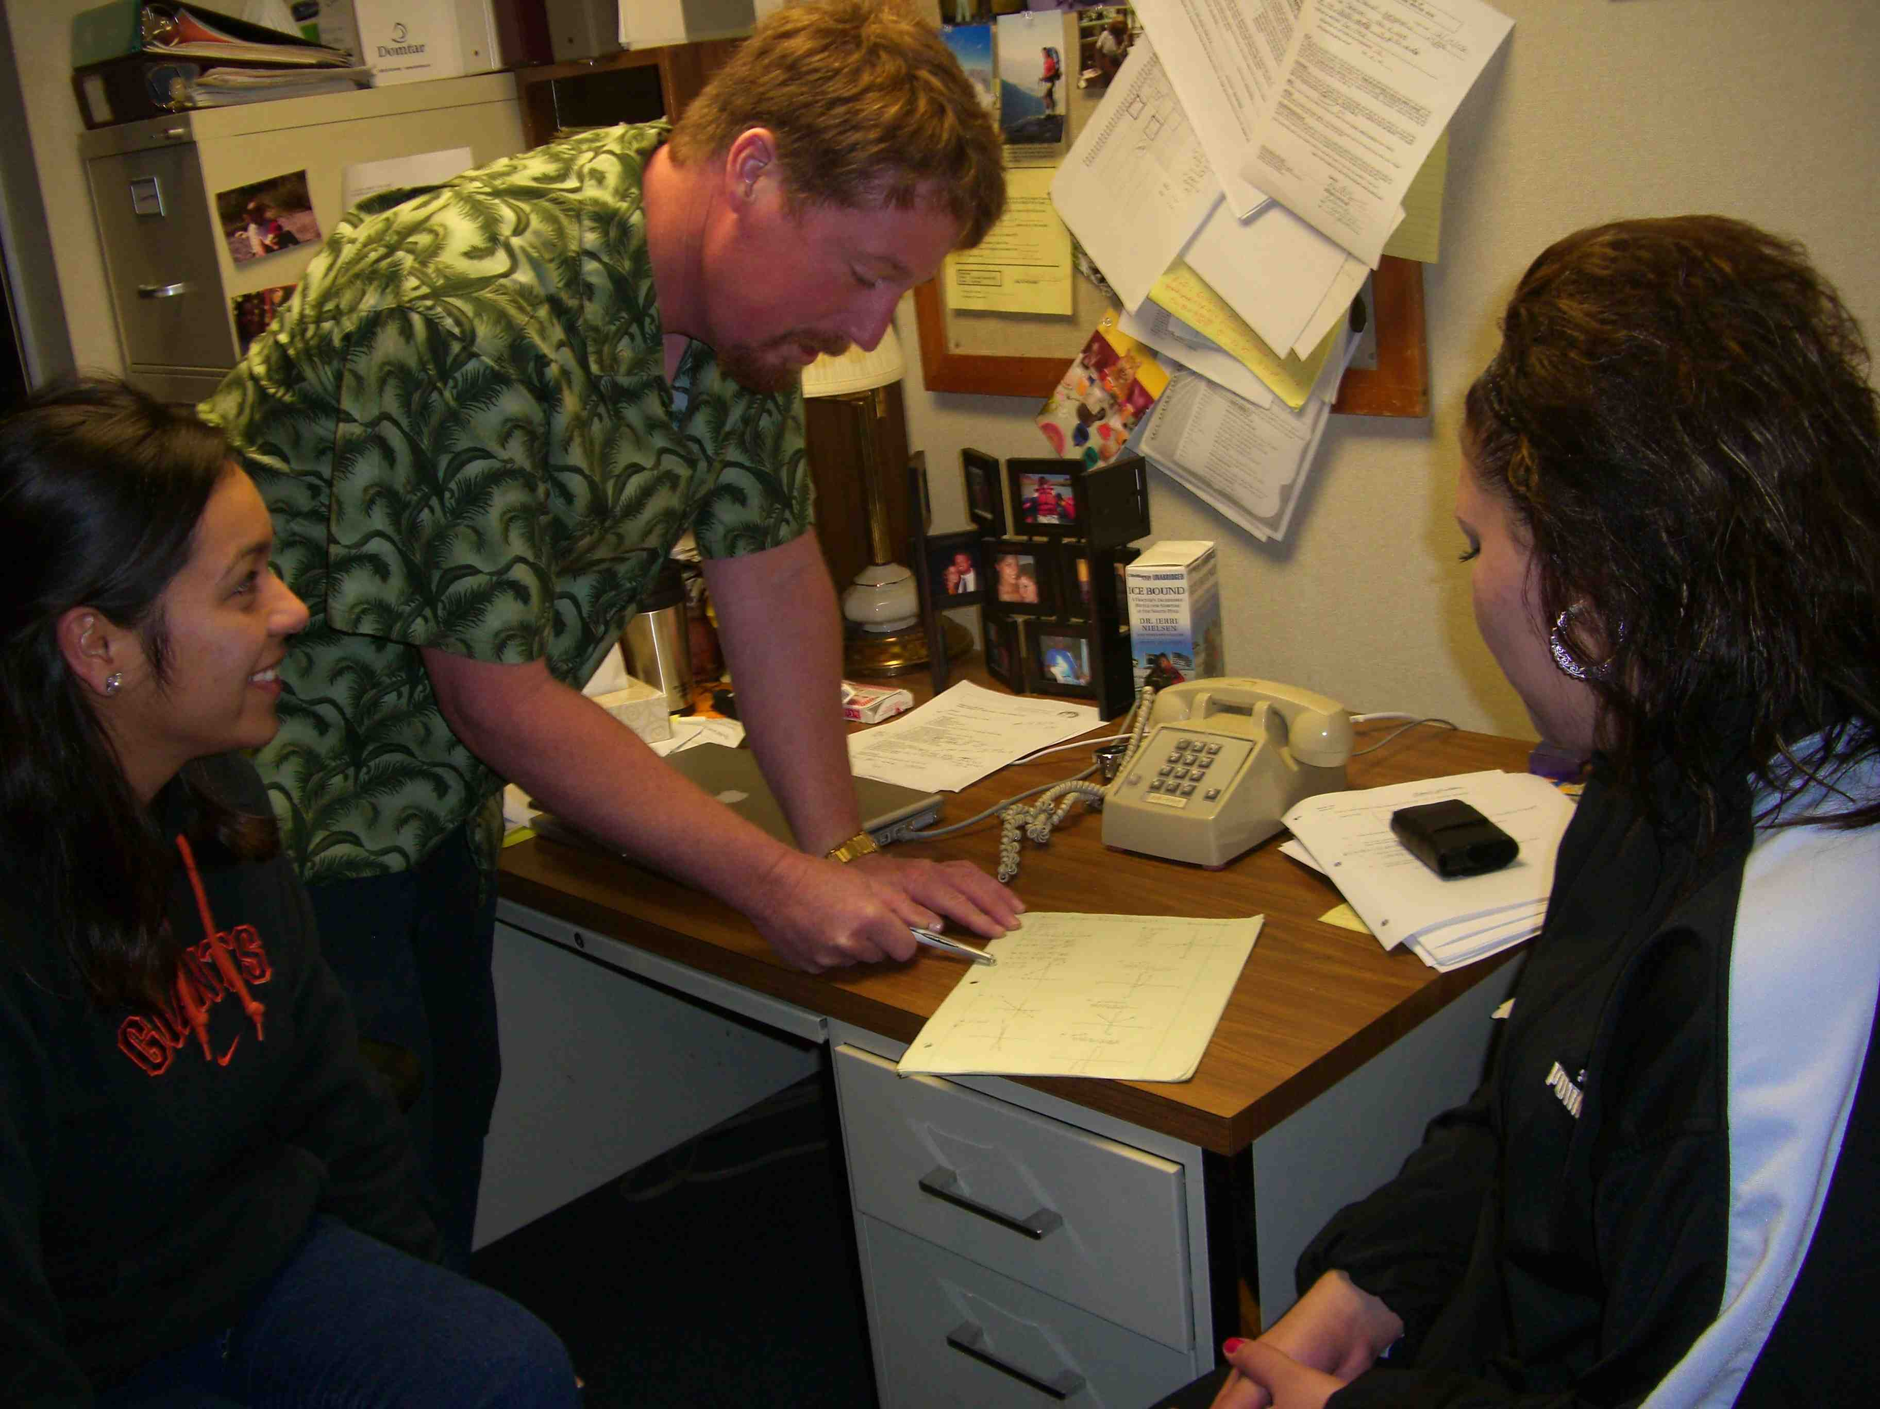
Daniel Munton Santa Rosa Junior College
I am humbled by my students' stories. When I listen to them tell me about their lives, about the obstacles they are overcoming in order to earn an education, I cannot help but be amazed and inspired to work hard myself. Their efforts motivate me to do my best for them.

Slide 32
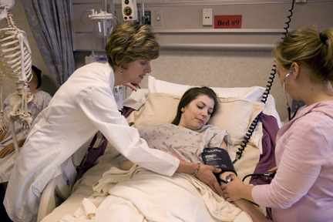
Cynthia Sheppard Schoolcraft College
As a nurse, I utilize a holistic approach to promote maximal wellness of the patient's mind, body, and spirit. As an educator, I utilize a similar philosophy to foster student achievement and success. I strive to nurture a student’s mind, body, and spirit through a relationship that embraces passion, respect, and flexibility.

Slide 33
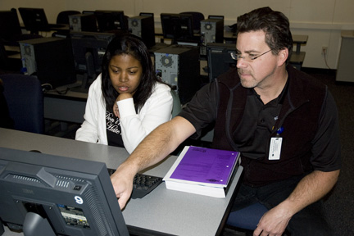
Tim Ellis Schoolcraft College

Slide 34
Larry McHenry Selkirk College
I teach for that unexpected call, card, email, or letter that comes right out of the blue, saying thanks; for those occasions when you see a parent or a former student and they treat you as if you are someone special. Sometimes I’m prone to cynicism, but my students always pull me back and give me hope. I teach to learn, and I learn something new everyday. I teach because it teaches me humility. Teaching is still a job that makes you feel good about yourself, the world, and your place in it.

Slide 35
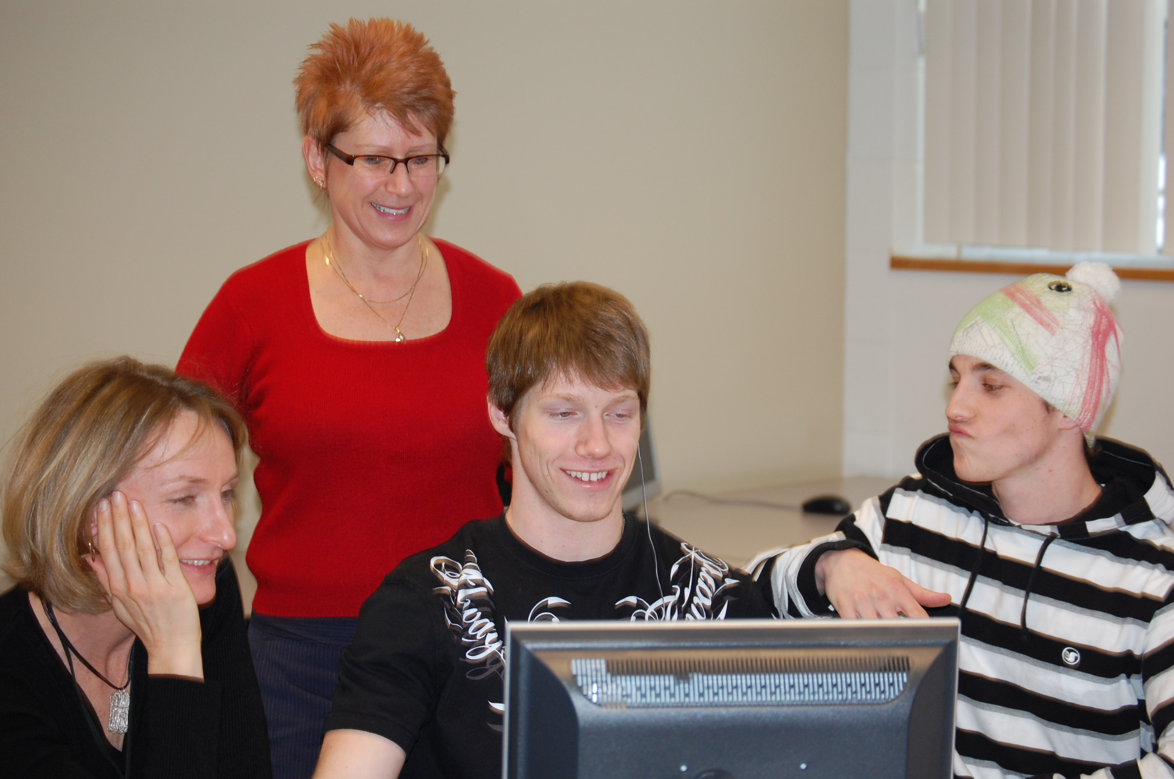
Bernadette McMullin Selkirk College

Slide 36
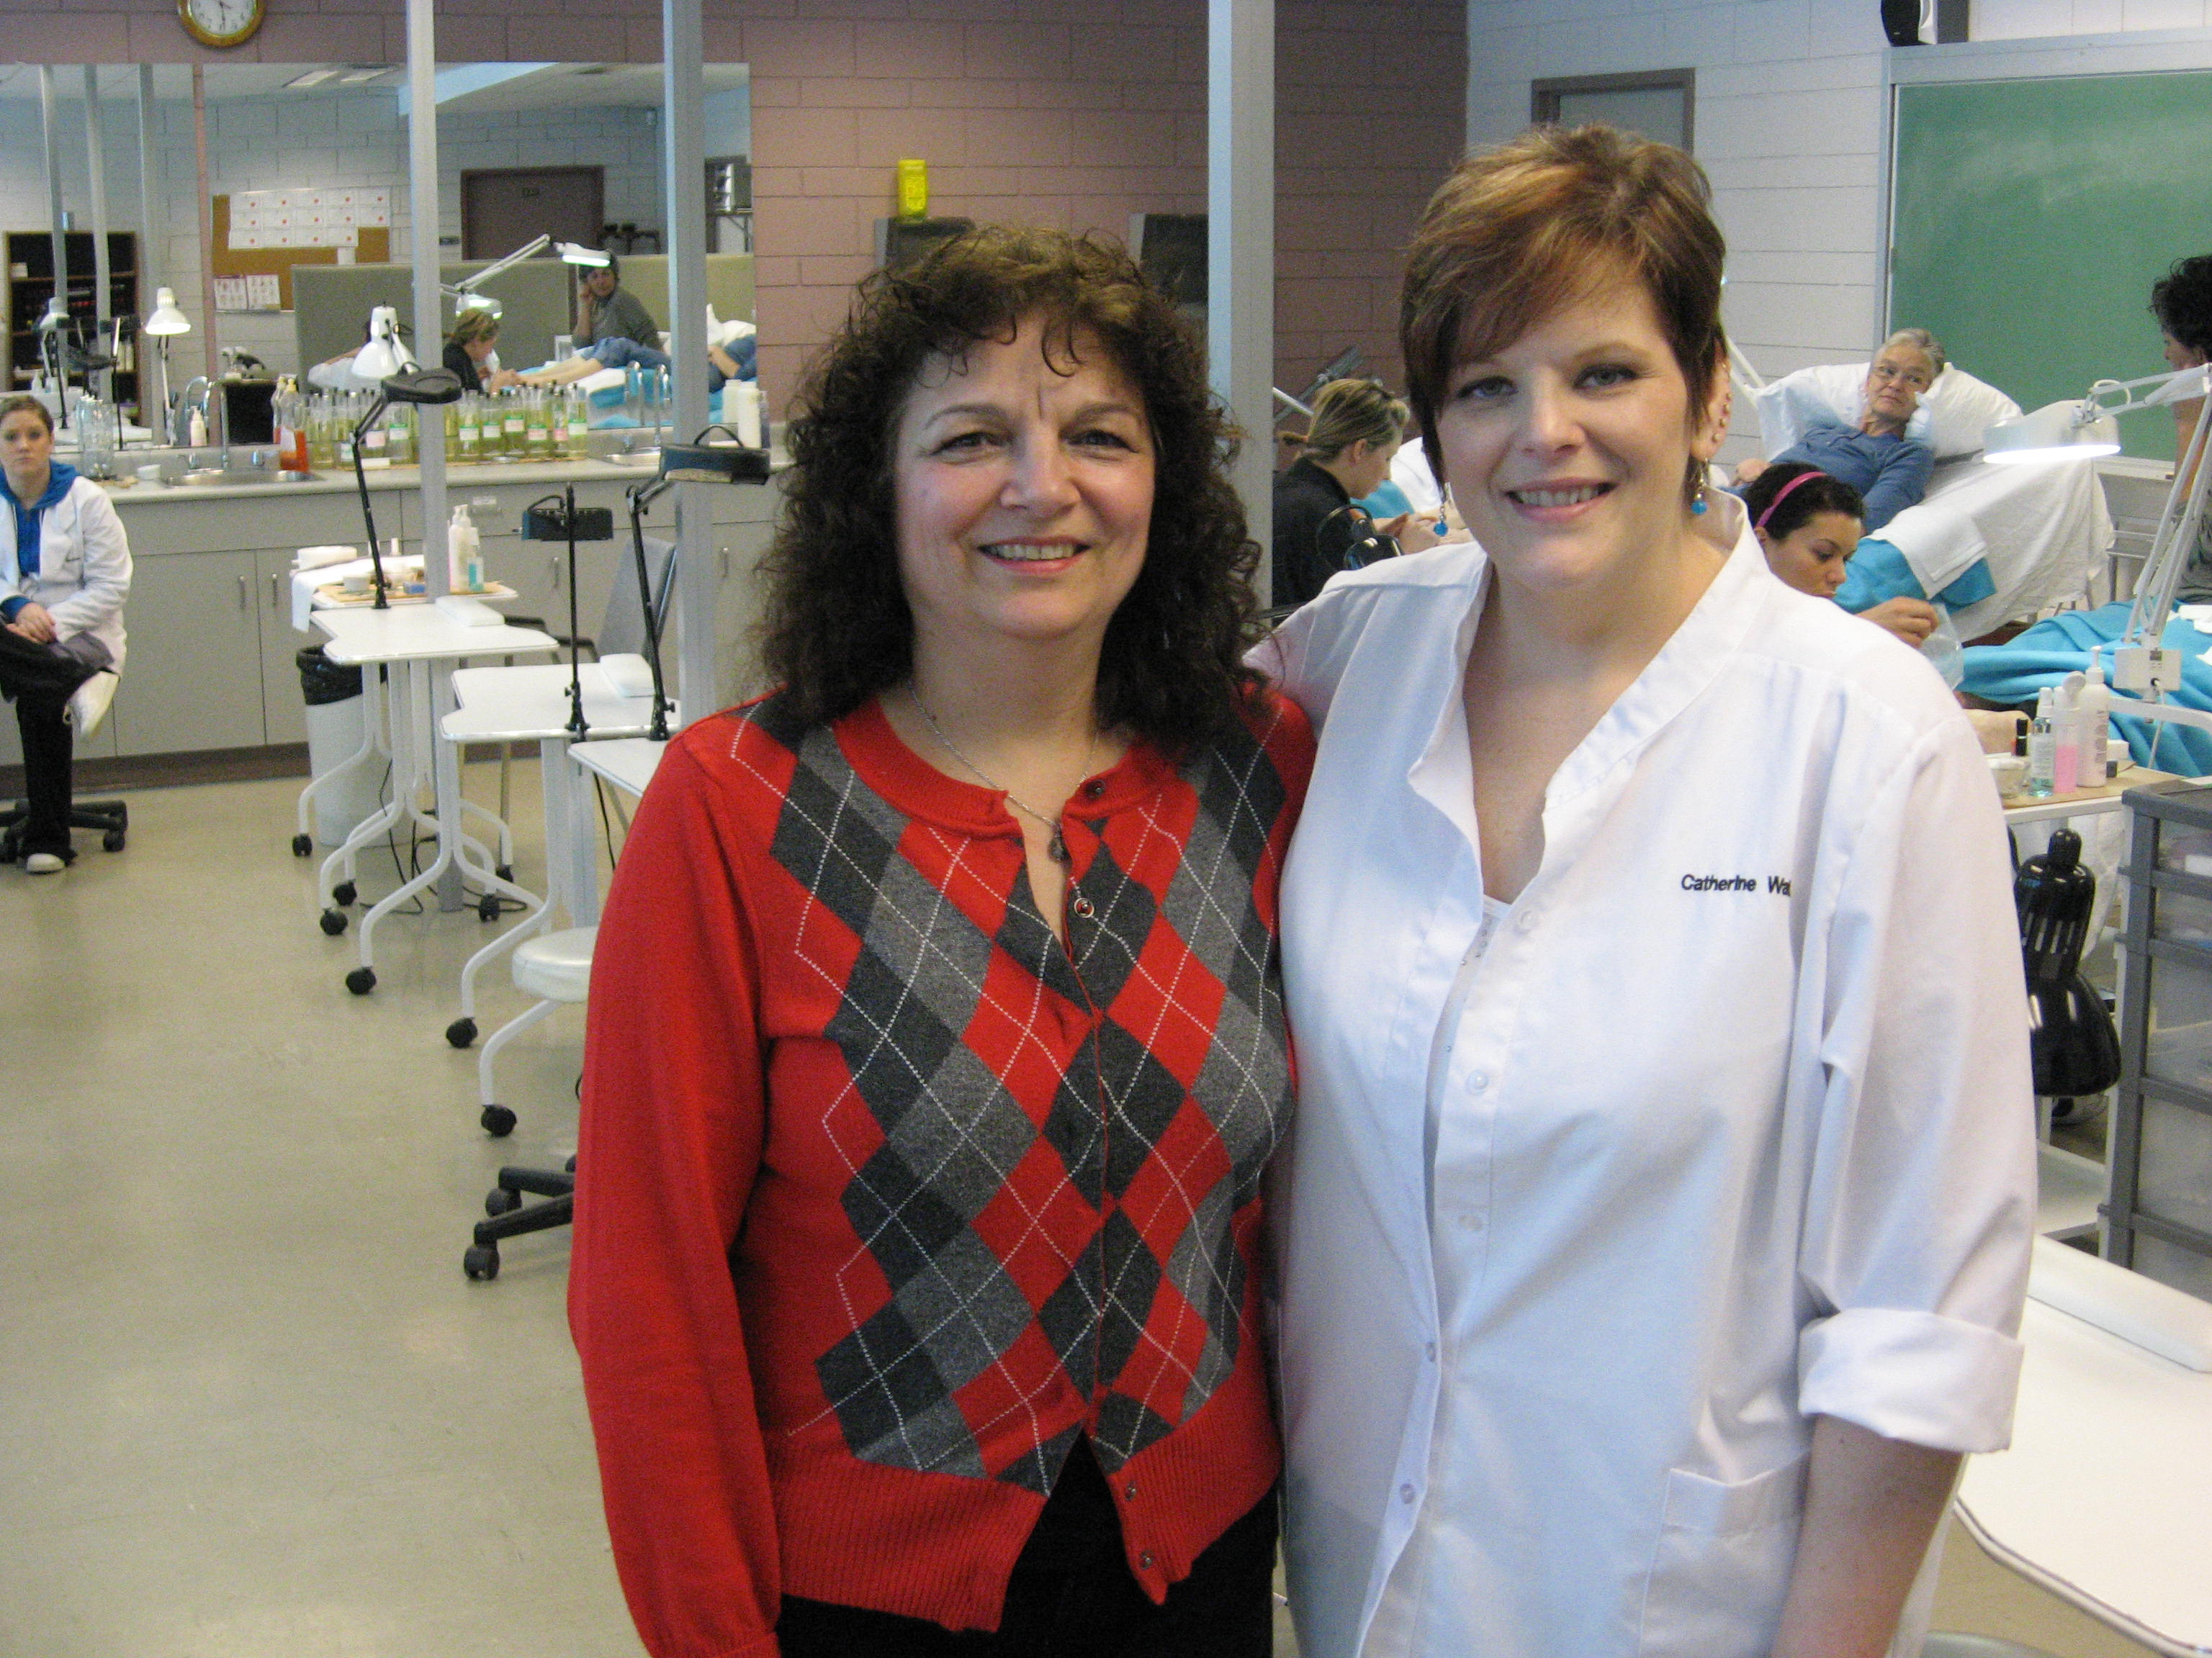
Carol Zubick Selkirk College
A well-supported, positive learning environment for students is what I can contribute to their success, and that is why I am here.

Slide 37
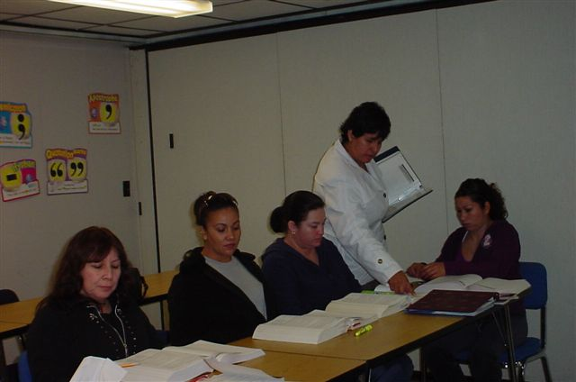
Sonia Hernandez Seward County Community College
Being an instructor isn’t a job to me but instead, it’s my passion. I count it as an honor and privilege to put the effort in teaching my students. It is indeed a pleasure. I thank God for giving me an opportunity such as this to help all students. I love what I do and wouldn’t change my profession for anything.

Slide 38
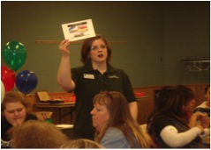
Rhonda Kinser Seward County Community College
I am driven by my compassion for students. They are the reason I strive to make Student Support Services the best it can be. Their stories of personal courage inspire me to provide the tools needed for their academic success. Many of our students are the children of immigrants. Seeing them excel on the college level is particularly rewarding. Knowing that I and my staff are making a difference in the future of our students makes it worth all the time and hard work.

Slide 39
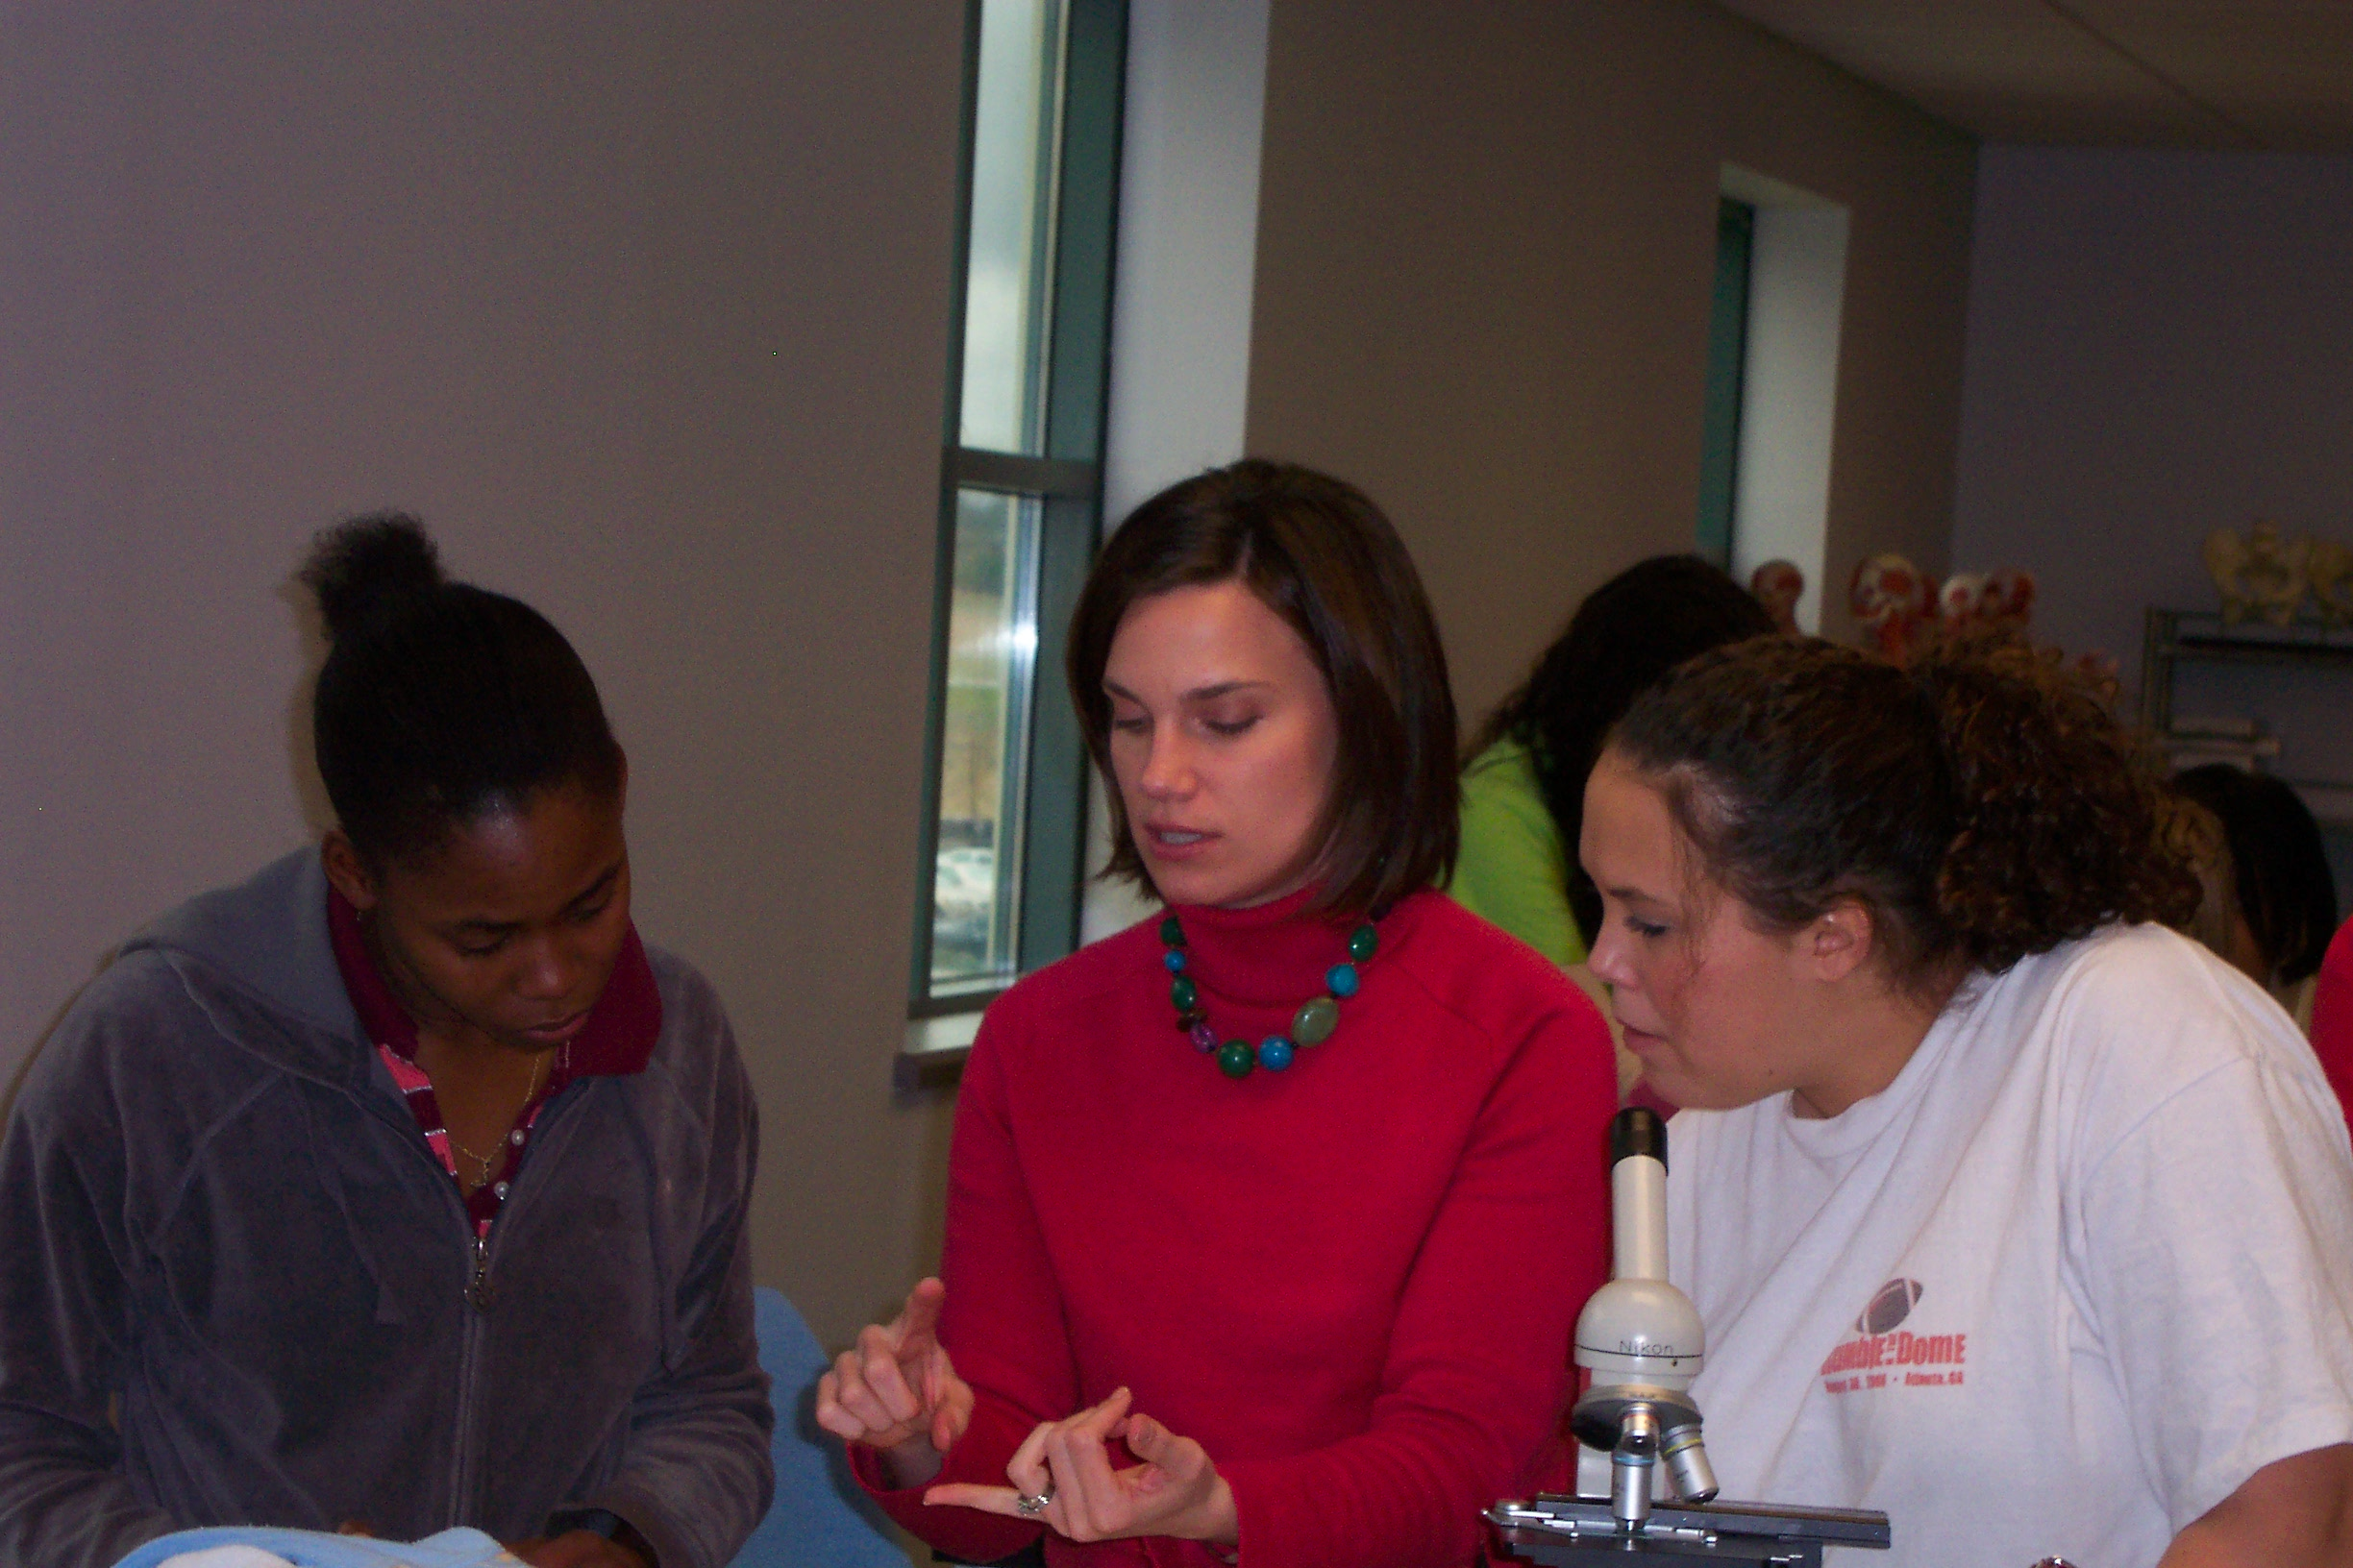
Sarah Pugh Shelton State Community College

Slide 40
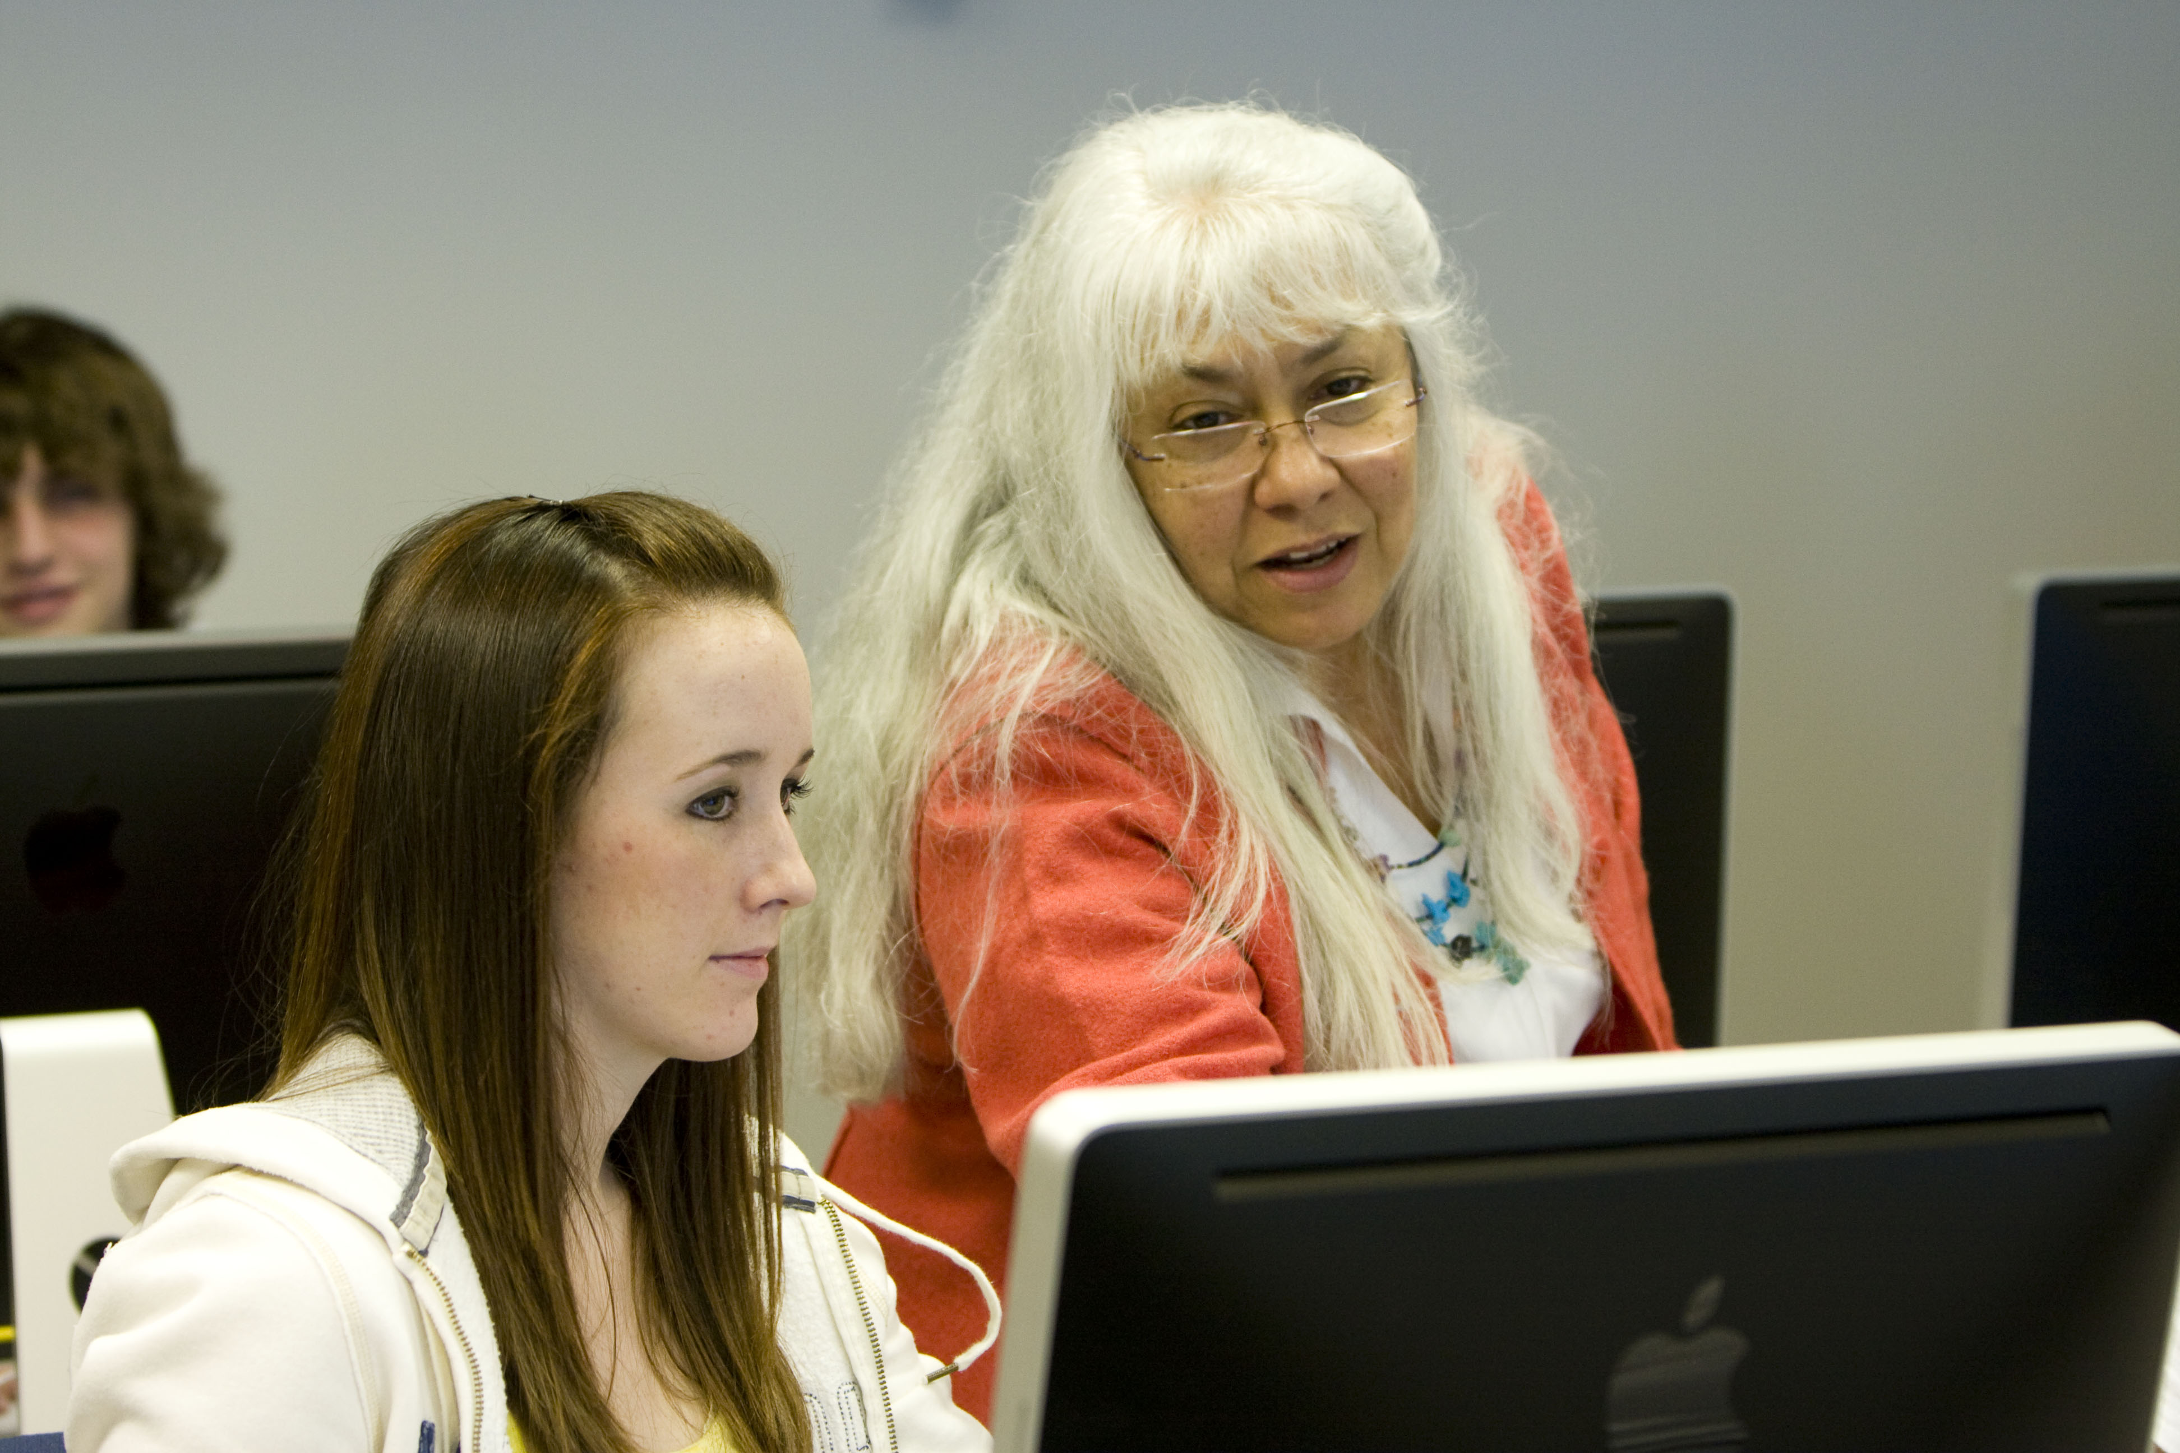
Mercedes Aguirre Batty Sheridan College
How can I create the magic that inspires and excites my students? This is my self-imposed discontent. It is not the classroom or the technology that teaches purposeful content for human communication. It is the people that make it work. Reading, learning, and incorporating technology to enhance my students' learning sustain and renew my energy to continue teaching.

Slide 41
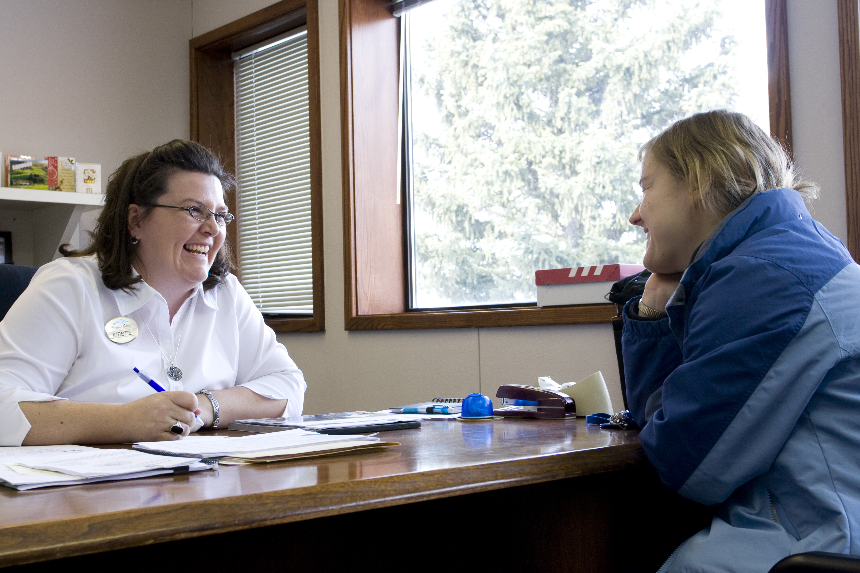
Kirstie Auzqui Sheridan College
In my office, I have a quote that reads: “It is good to have an end to journey towards, but it is the journey that matters in the end” (author unknown). And I live by the impression this quote offers. My inspirations come from the people who represent the Cinderella stories and the underdogs. I believe everyone becomes a champion by doing the little things that matter most. The rewards that I receive are simple: the students who learn who they are for the first time, the students who are victorious by reaching their goal, and the students/colleagues who have their first “aha” moment.

Slide 42
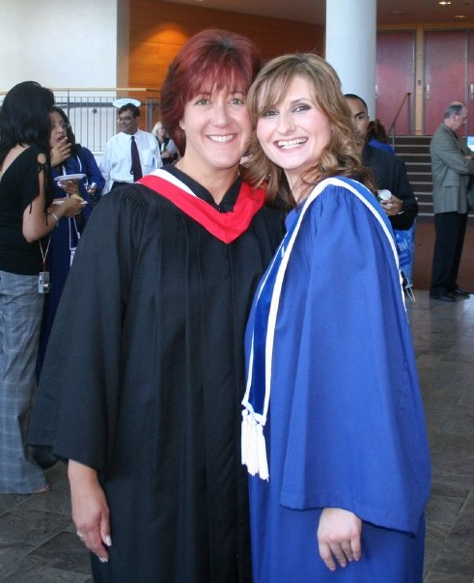
Peggy Barnwell Sheridan College
I am very grateful for the teaching opportunities I have been given. When I see students succeed beyond their wildest dreams, regardless of how that success is defined, I feel an intense sense of pride. Helping students learn and work towards greater personal fulfillment is a true privilege.

Slide 43
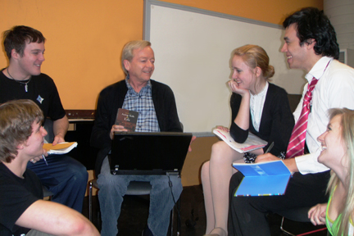
Ron Cameron-Lewis Sheridan College
My students’ success is my greatest motivation. After 36 years teaching acting, using generous humor, and sharing my passion, I look back at the many students I have taught and am delighted to see that many enjoy lead roles on stages in Toronto, Stratford Festival, Broadway, Las Vegas, and London’s West End; entertain on cruise ships; and star in television series. They inspire me further.

Slide 44
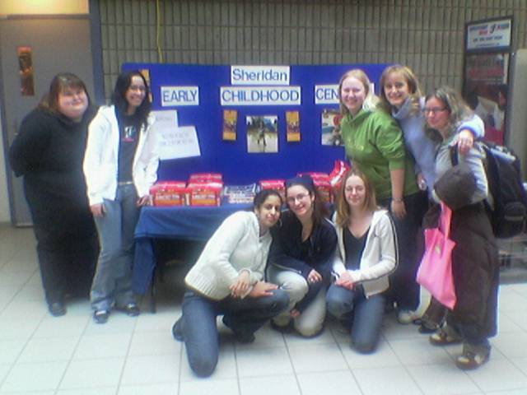
Cathy Coulthard Sheridan College
‘One generation plants the seed, another gets the shade’—Chinese Proverb. I have been given a great gift—the opportunity to spend time with future Early Childhood Educators while they are in their formative years. I am always in awe of, and inspired by my students. It is my complete pleasure to come to work every day.

Slide 45
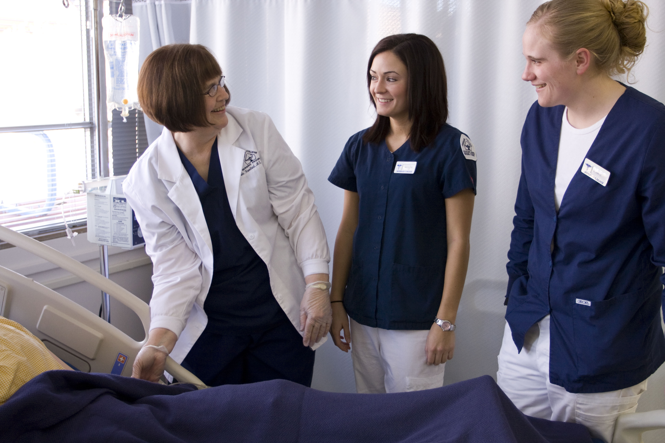
Carole Hoveland Sheridan College

Slide 46
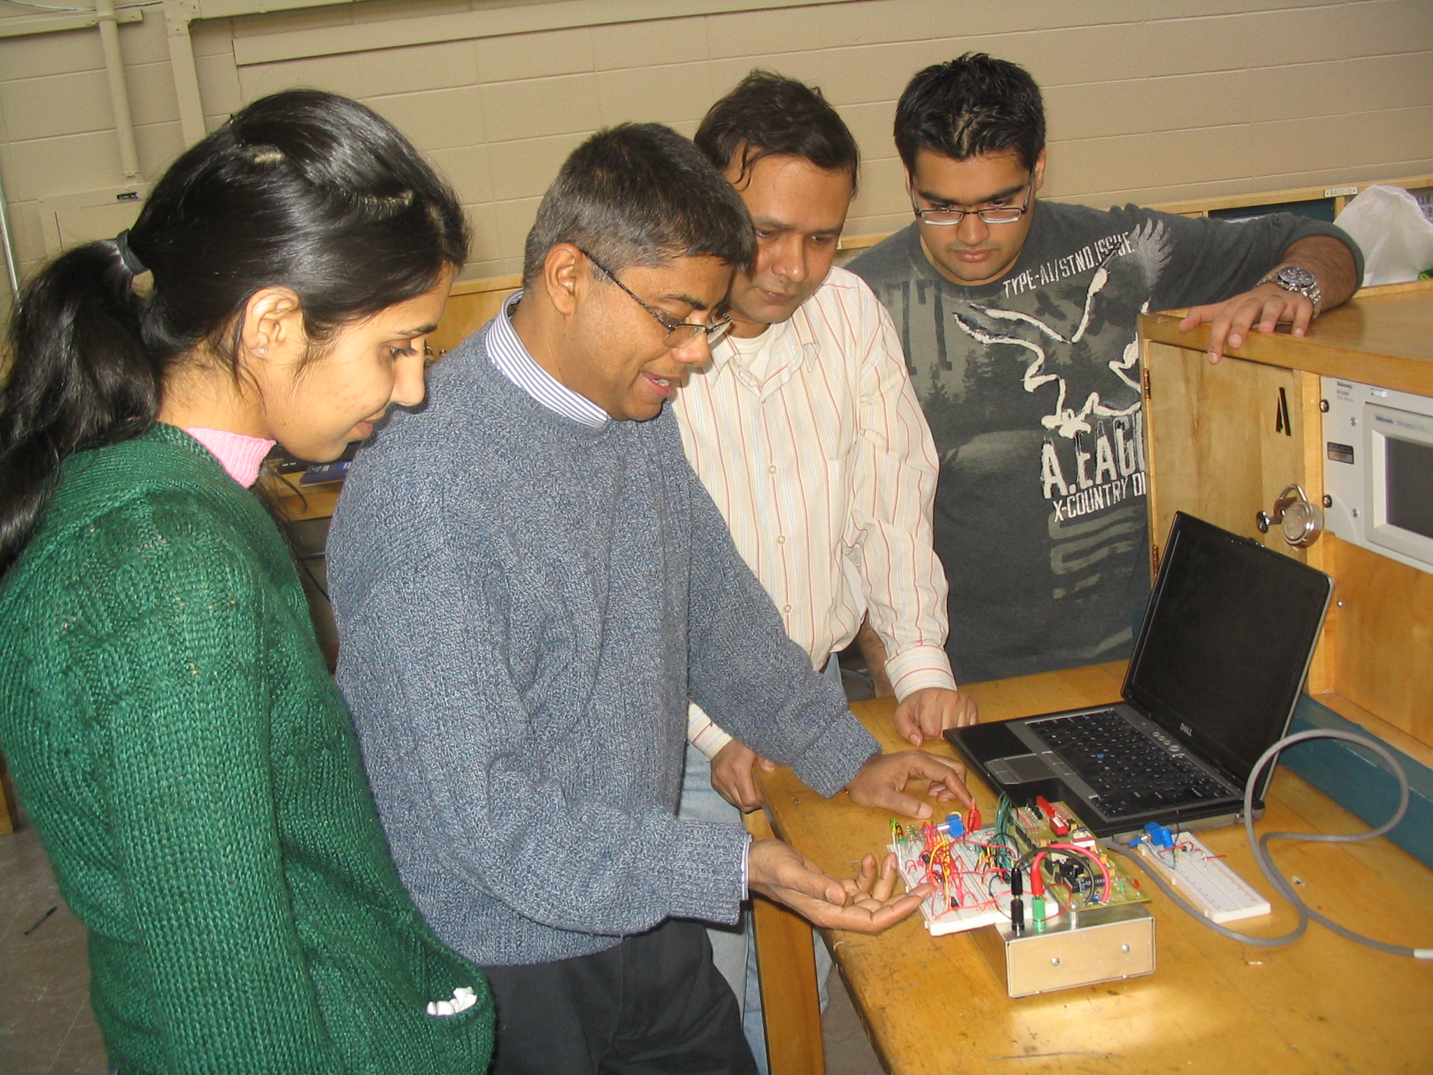
Nazrul Khan Sheridan College
I teach because I'm making change in someone's life.

Slide 47
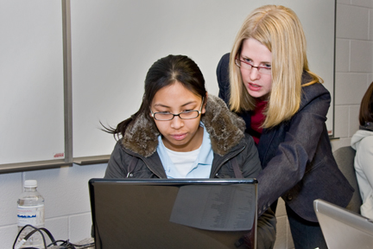
Miranda McVeigh Sheridan College
As educators, we have the privilege of sharing our knowledge and passion with energetic students. By creating an open, engaging, and enthusiastic learning environment, we experience a journey of discovery together. I am inspired by the students desire and commitment to learning and enjoy watching as they achieve their goals.

Slide 48
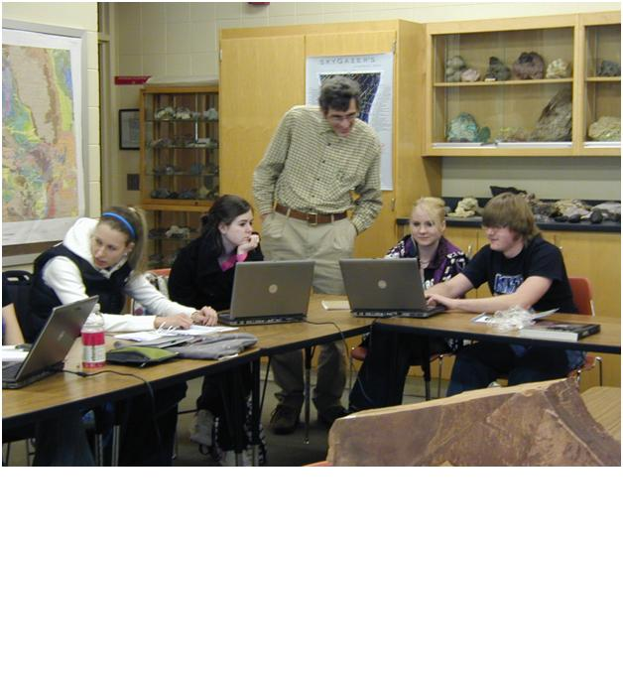
Ray Oltion Sheridan College
Taking challenging classes as a student has improved my teaching. I understand the pressures students endure. The advice I offer to students as an instructor comes from my direct experience as a student.

Slide 49
Phillip Stubbs Sheridan College
In the pursuit of knowledge and understanding, there can be no more rewarding career than helping someone else succeed. My students are as much my teachers/mentors as I am theirs.

Slide 50
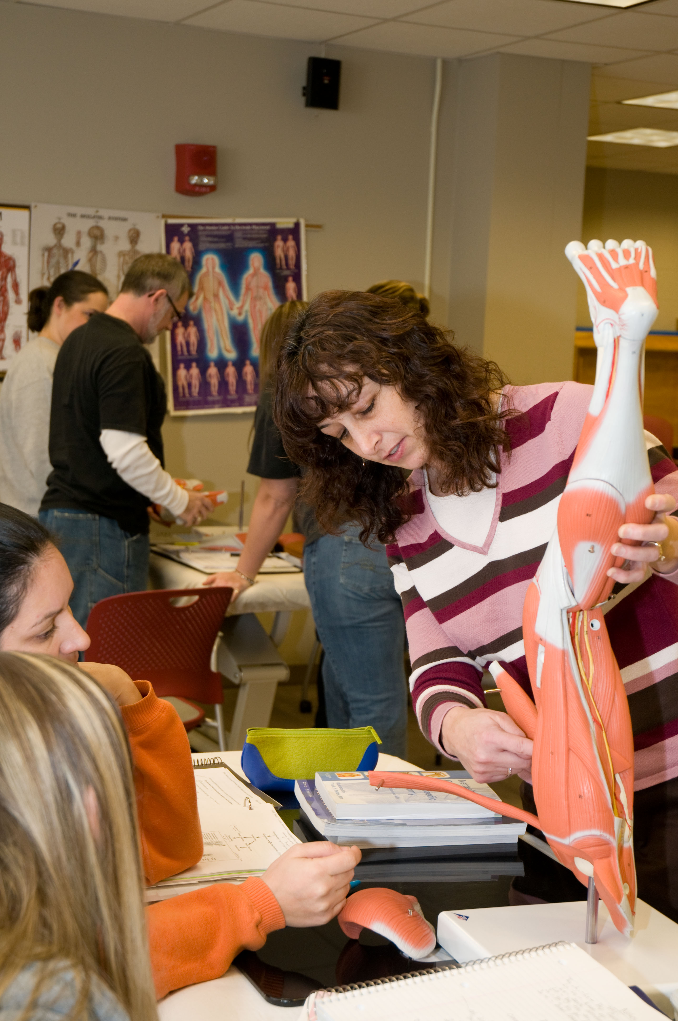
Debra Belcher Sinclair Community College
Displaced factory workers, high school dropouts, middle-age housewives, single mothers—these are the faces of my students who inspire me. In my classroom, I am as often the student as the teacher. My students teach me about perseverance and resilience, inspire me to give my best. For all that my students have taught me, I am grateful.

Slide 51
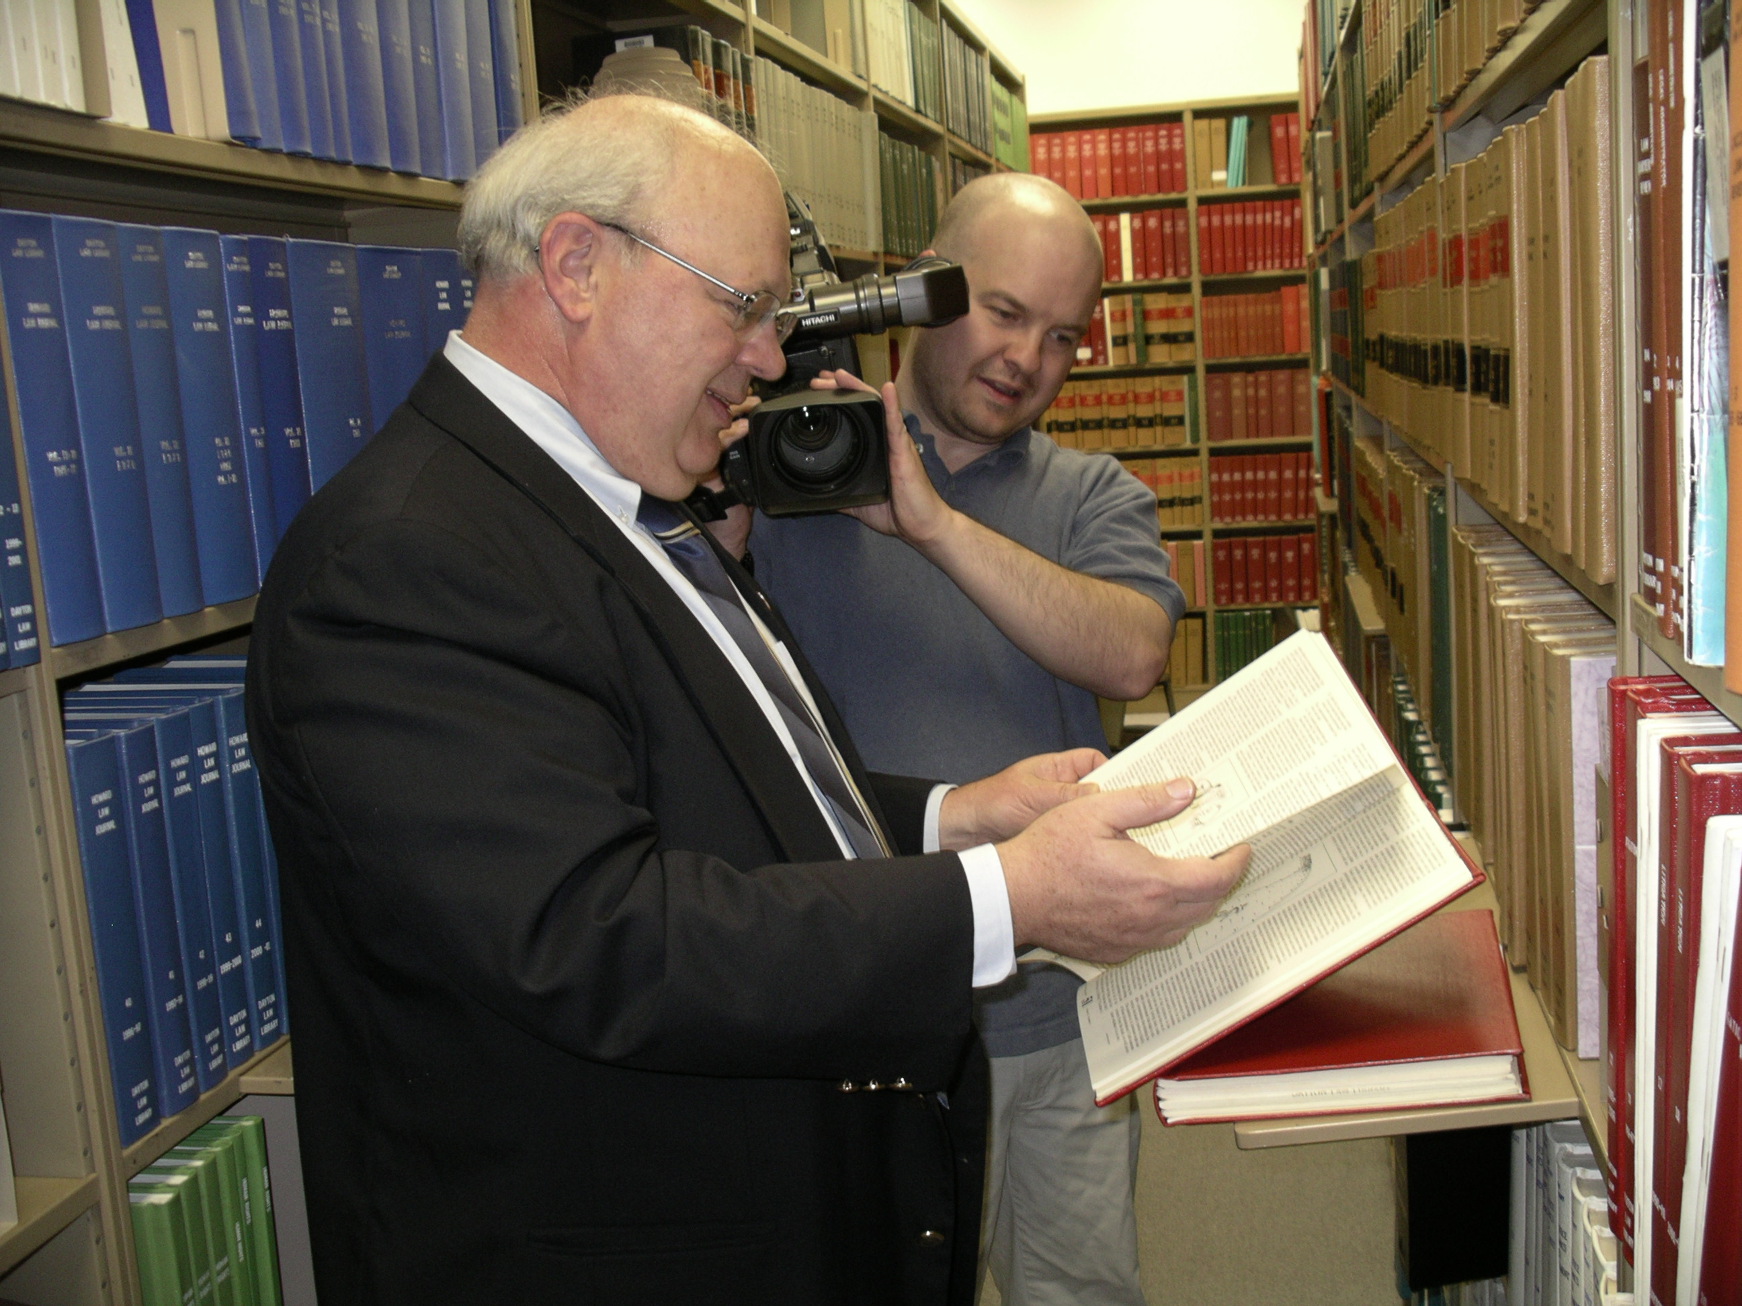
Mike Brigner Sinclair Community College

Slide 52
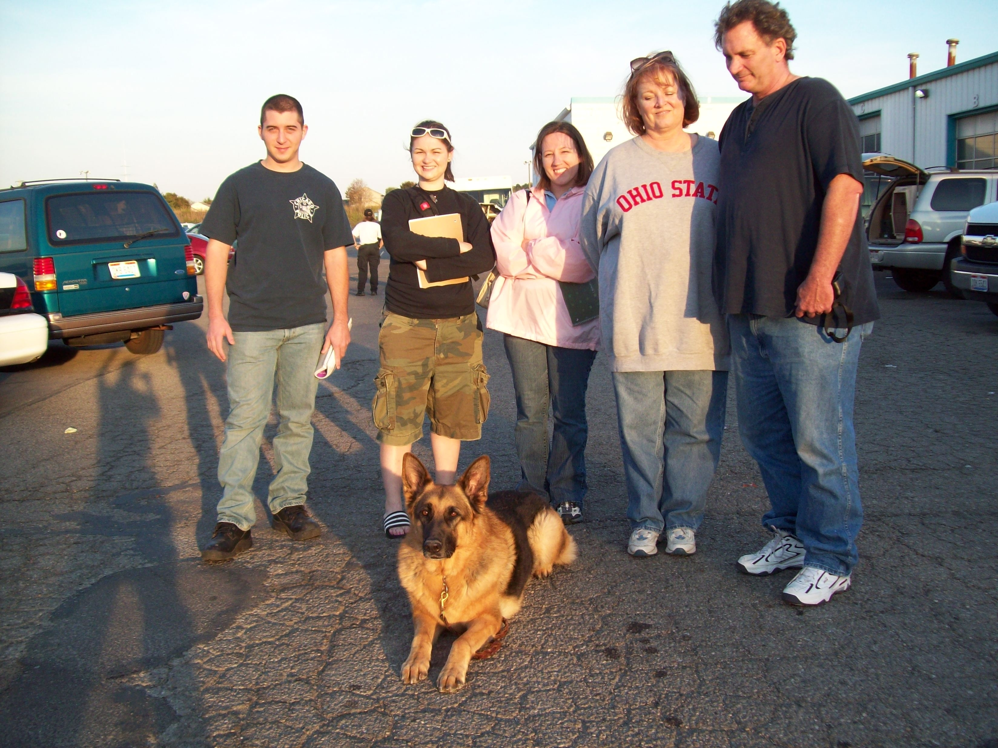
Pamela Chambers Sinclair Community College
It is my responsibility to display enthusiasm, leadership, and professionalism while providing diverse and alternative learning methodologies. This engenders a holistic learning environment that empowers students to turn dreams into achievable goals.

Slide 53
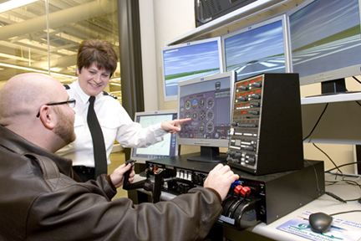
Donna Hanshew Sinclair Community College
It is my students who inspire and motivate me daily because they are so enthusiastic about flying, especially after their first flight. That experience is my reward! I have found that when you find a job you love, you'll never have to work a day in your life!

Slide 54
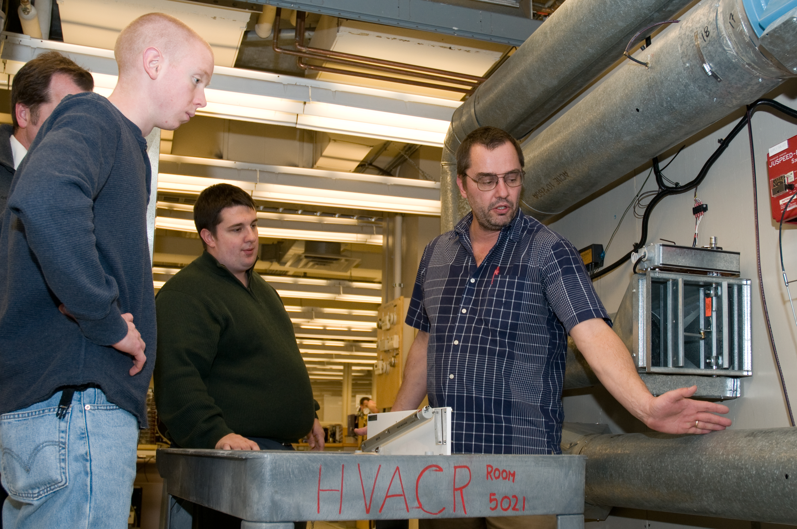
Russell Marcks Sinclair Community College
To know I’ve had input preparing someone for an entry-level position on a viable career path and educating him or her in the methods and procedures to remain current is an absolute thrill. Getting paid for doing so is just a bonus. Oops, don’t tell my bosses I said that last part!

Slide 55
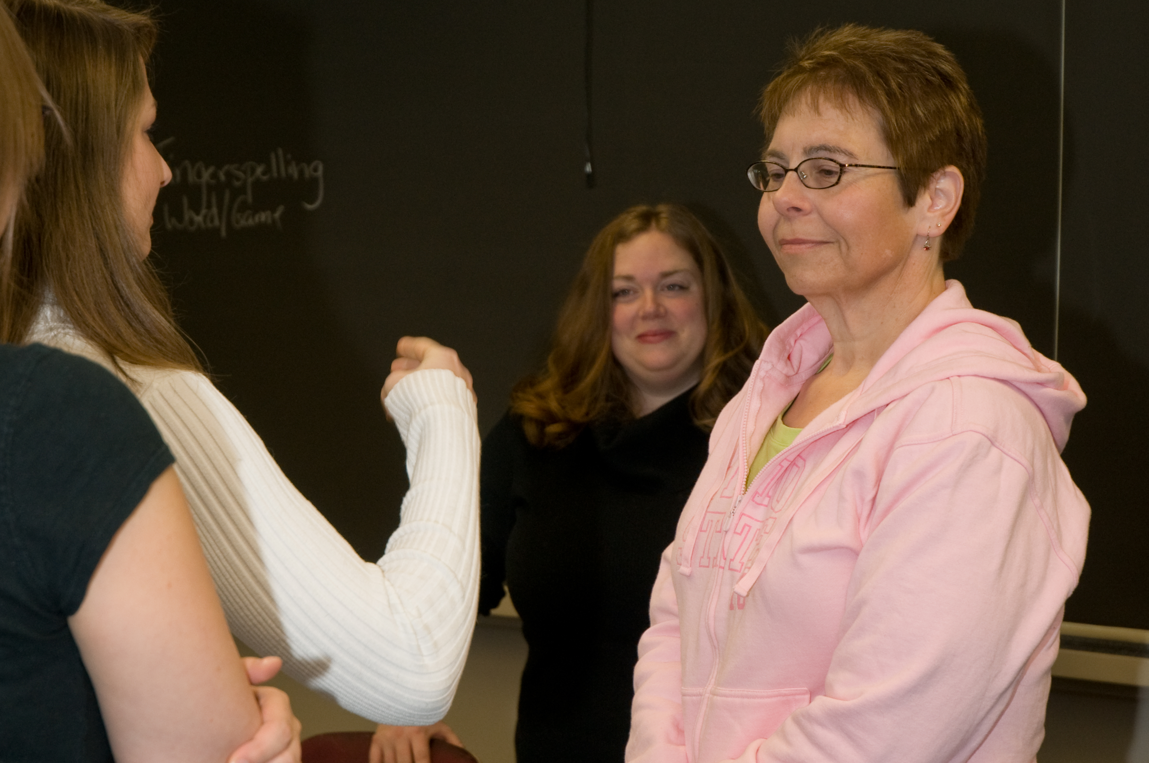
Jessica Minor Sinclair Community College
I feel it’s necessary for students to serve the community, through service learning. Most students have the desire to learn, but its not until you say ‘go ahead, show me’ that they internalize their experiences.

Slide 56
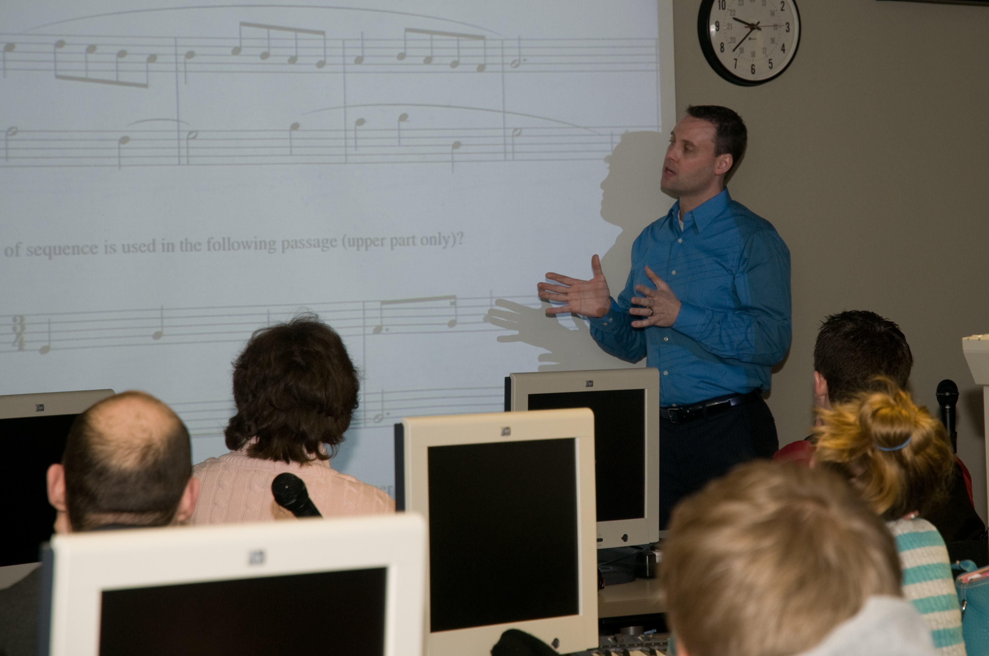
John Parcell Sinclair Community College

Slide 57
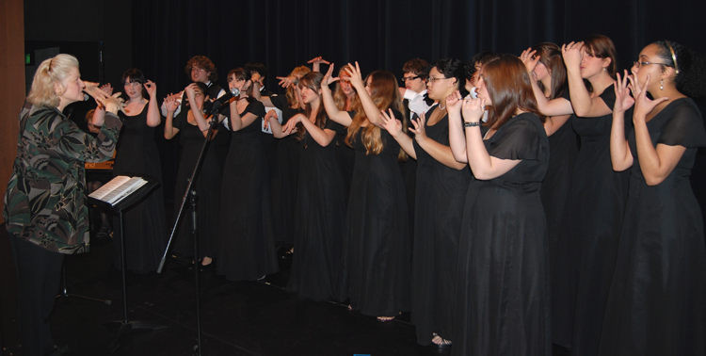
Diane Johnson Skagit Valley College

Slide 58

Mark Freshwater Snead State Community College

Slide 59

Susie Humphries Snead State Community College

Slide 60
Betty Peterson Somerset Community College
What inspires my teaching are those exciting moments when students come to realize that literature informs, enriches, and even changes our lives, and that there is an interconnectedness among all disciplines, all philosophies, and all humanity.

Slide 61

David Cazalet Jr. Somerset Community College

Slide 62

Deborah L. Gaskin-Richardson Somerset Community College

Slide 63

Donna Hendricks South Arkansas Community College

Slide 64

Holly Gilman South Seattle Community College
Two ideas motivate my work in the classroom—the stuff that goes on in college should get all of us thinking about what we think about and how we think about it; and I believe in serious fun.

Slide 65

Brian Hughes South Seattle Community College

Slide 66

Brad Altemeyer South Texas College

Slide 67

David Lung South Texas College
Love your students, and don't be afraid to tell them so. Students will always look for the easy way out. Make sure there isn't one.

Slide 68

Olga Rosales South Texas College

Slide 69

Astor Simpson Southeast Kentucky Community and Technical College

Slide 70

Meridith Comeau Southern Maine Community College
Learning is like running a marathon. Teaching is all the support that the marathon runner gets before, after, and during the race. A teacher should encourage, support, make demands, provide resources, set goals, and more. But the one thing a teacher can’t do is run the race for the learner.

Slide 71

Mary Hart Southern Maine Community College

Slide 72
Gregory Hanscom Southern Maine Community College
The state of Maine, a newcomer to community colleges, implemented its system in 2003. The promise of greater access to higher education is happening before our eyes. To be 'on deck' as a fundamental social transformation occurs, one that gives people greater hope and opportunity, is a challenging, rewarding, and exciting opportunity.

Slide 73

Terri Petnov Southern Maine Community College
To children, the moon's sole purpose is a source of companionship and reassurance that the world revolves around them. Piaget would say this egocentric view illustrates the power of logical thinking that children use to make sense of the world. As an educator, I search for examples to show students the relationship between theoretical concepts and the daily actions of young children. I seek to do this with passion, engagement, and creativity.

Slide 74

Devonye Brown Southern University at Shreveport
Learning is neither confined to four walls nor hallowed halls. My key strategy is to use creativity to develop teachable moments outside of the classroom.

Slide 75

Wanda Lewis Southern University at Shreveport

Slide 76

Laura Brown Southwest Virginia Community College
The look of appreciation in their eyes when I have imparted some information, which has made the college experience less intimidating, is what inspires me to counsel and teach. They now have a hope that completing a degree is an achievable goal; their future is going to be brighter.

Slide 77

Sherri Dawson Southwest Virginia Community College

Slide 78

James Dye Southwest Virginia Community College

Slide 79

Amanda Ellis Southwest Virginia Community College
I feel blessed to have a job that I am passionate about. Investing in students is one of the best investments one can make in today’s market—you are guaranteed a yield.

Slide 80

Brian Hale Southwest Virginia Community College
I love the moment when a student’s unawareness or frustration is replaced with understanding. You have the power to change someone’s life for the good or bad, and neither you nor your student may realize it until much later.

Slide 81

Warren Harris Southwest Virginia Community College
I have good class days and bad ones. The good days usually occur when I have a clear goal but do not attempt to accomplish too much, allowing me to model for the students a cheerful and relaxed approach to the material at hand.

Slide 82

Lanna Lumpkins Southwest Virginia Community College
Imagination is the preview of life's coming attractions. I encourage students to mentally create the picture of their ambitions and set the ride in motion. There is no time like the present.

Slide 83

Terry Morris Southwest Virginia Community College
I love and enjoy my work because I have the opportunity to talk about my favorite subject—chemistry. I achieve success because I relate chemistry to the real world of the student with examples that stimulate the student's thinking.

Slide 84

Sandra Corona Southwestern Community College

Slide 85

Callie Daniels St. Charles Community College
Having the opportunity to learn and improve each semester, right along with my students, inspires me the most. My strategy for success is to live intelligently in all aspects of life. Feed the mind, body, and spirit; and remember to have some fun and laugh each day. My best words of wisdom: Do the right thing for every student, every time. It's that simple.

Slide 86

Russell Murray St. Louis Community College - Meramec
What excites me in teaching is when the level of understanding of the student is at the point where they are using math to analyze real-world data.

Slide 87

Jody Martin de Camilo St. Louis Community College - Meramec
Passion for teaching is expressed from the simple description of the color of the oceans to the complexity of rainforest, biodiversity to fetal development. Inspiration comes from understanding, laughter, and interactions with students.

Slide 88

Scott Barlowe Stanly Community College

Slide 89

Anthony Balzano Sussex County Community College

