Slide 1
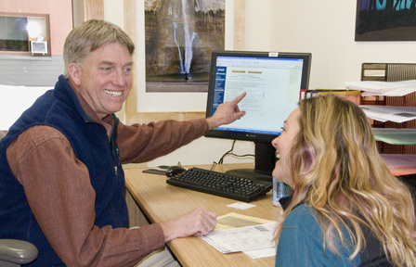
Peter Dixon
Lake Tahoe Community College

Slide 2
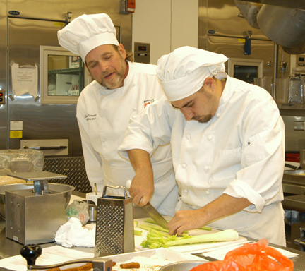
Stephen Fernald
Lake Tahoe Community College

Slide 3
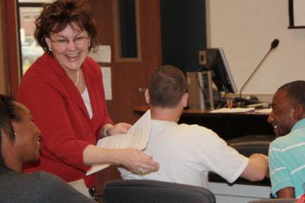
Mary Lyn Brown
Lamar Institute of Technology
I have been blessed to know many amazing students whose stories have become our legacy of hope because of the life-changing opportunities they found here.

Slide 4
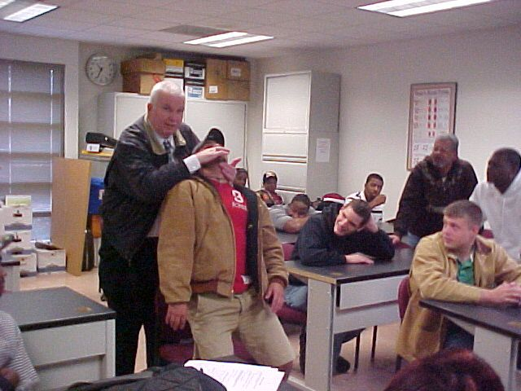
James Doane
Lamar Institute of Technology
One of my most rewarding experiences as an educator is helping students identify their career goals. Advisement sessions help students set goals. Once a teacher knows the desires of his students, his presentations must crystallize their thought processes. And putting theory into practice helps inspire students for exciting careers.

Slide 5
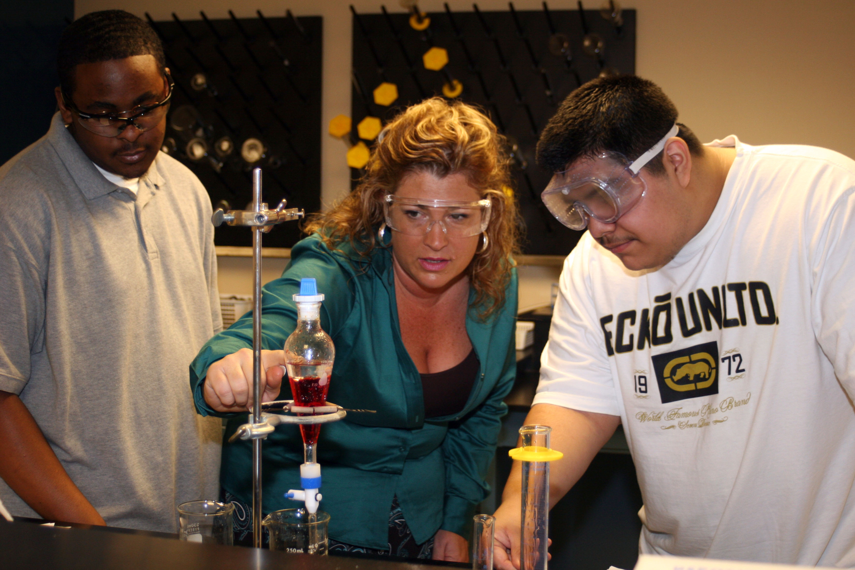
Vicki Rowlett
Lamar Institute of Technology
Will Rogers said, “Never miss a good chance to shut up.” Excellent instructors add and listen to that. We often don’t listen to what our students are asking; instead we assume we know. In order to best help our students understand a concept or a process, we must first listen.

Slide 6
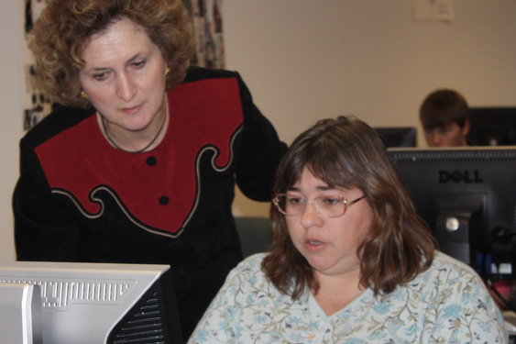
Marsha Steffek
Lamar Institute of Technology
I credit my parents for instilling in me a strong work ethic and the belief in the importance of education. My parents believed that education held the key to success. This philosophy has stayed with me throughout my life and has become the driving force in my educational career. My goal in teaching is to help students develop up-to-date skills that will put them to work in today's marketplace and open the doors of opportunity.

Slide 7
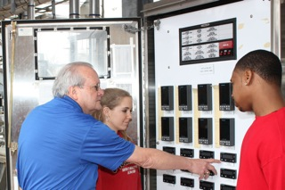
Walter Tucker
Lamar Institute of Technology

Slide 8
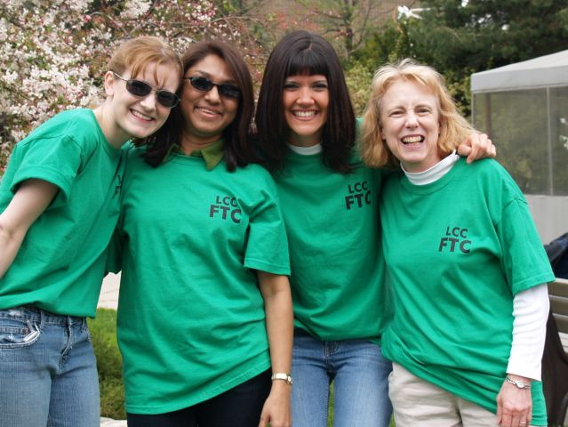
Mary Brown
Lansing Community College
Every day is a new opportunity to set high expectations and work together on achieving them. Respect, challenge, and celebrate successes!

Slide 9
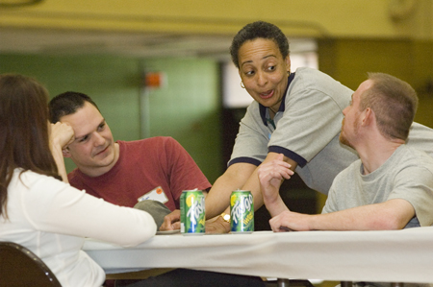
Toni Glasscoe
Lansing Community College
I am inspired by the evidence that proves many students will be successful because of the role I play in their lives. My motivation comes from knowing that students want us to care, but they don’t want to let on that they want us to care. Keep caring!

Slide 10
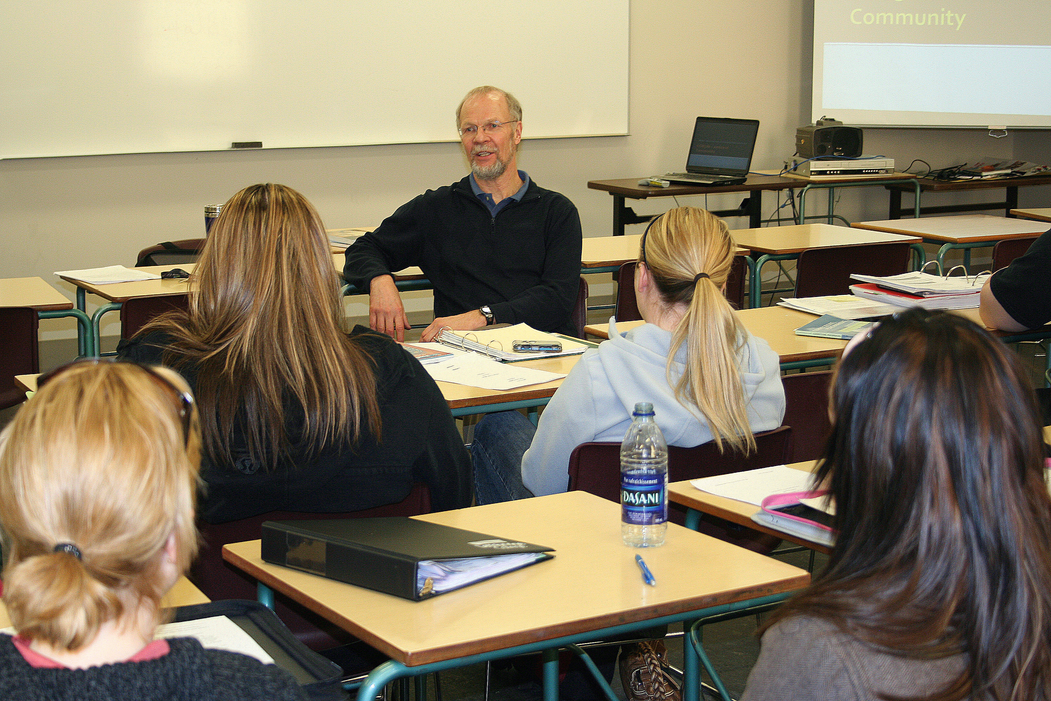
Ian Hepher
Lethbridge College

Slide 11
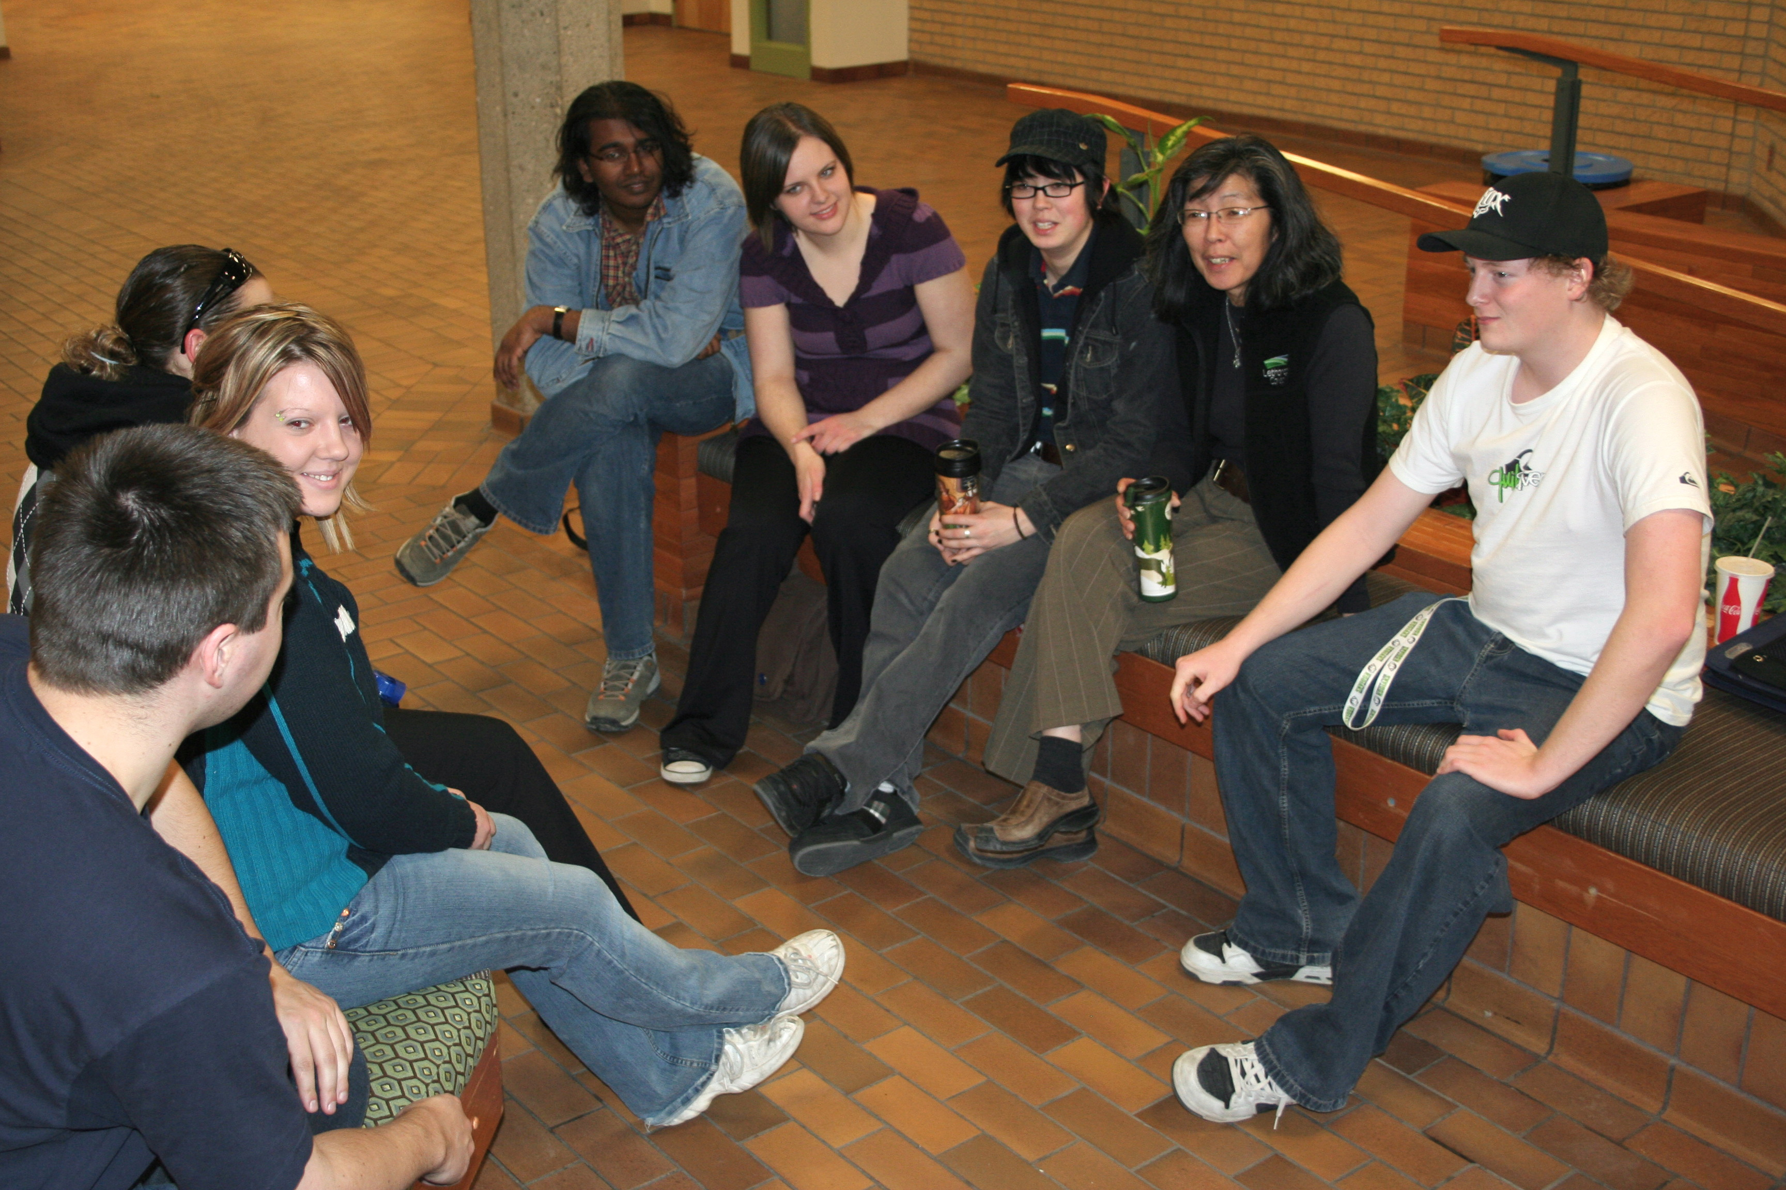
Cathy Takeda
Lethbridge College
Great leadership is not a solo performance; it is fueled by an entire orchestra of motivated people who believe in each other and who work and play together for the betterment of the students, the programs, and the institution. Really, it’s quite exhilarating and contagious!

Slide 12
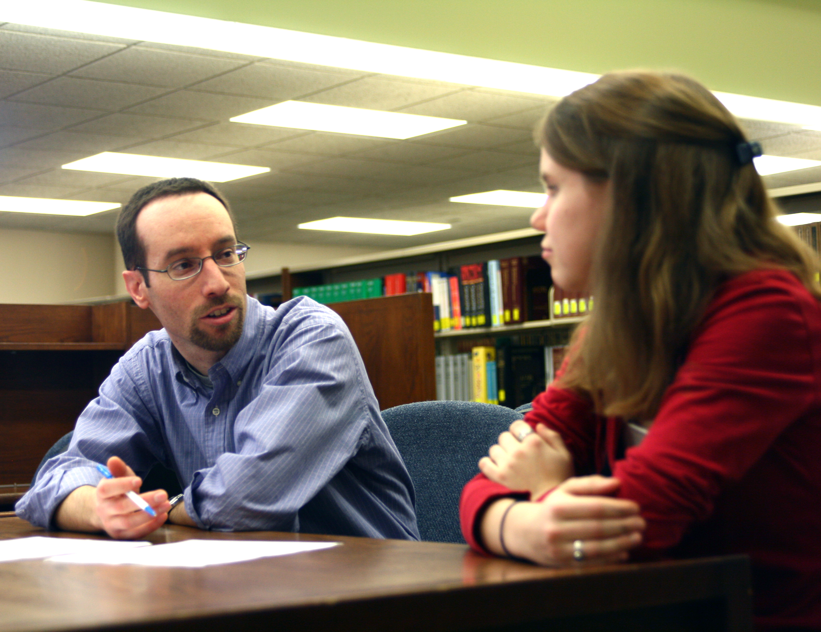
Jason Dockter
Lincoln Land Community College

Slide 13
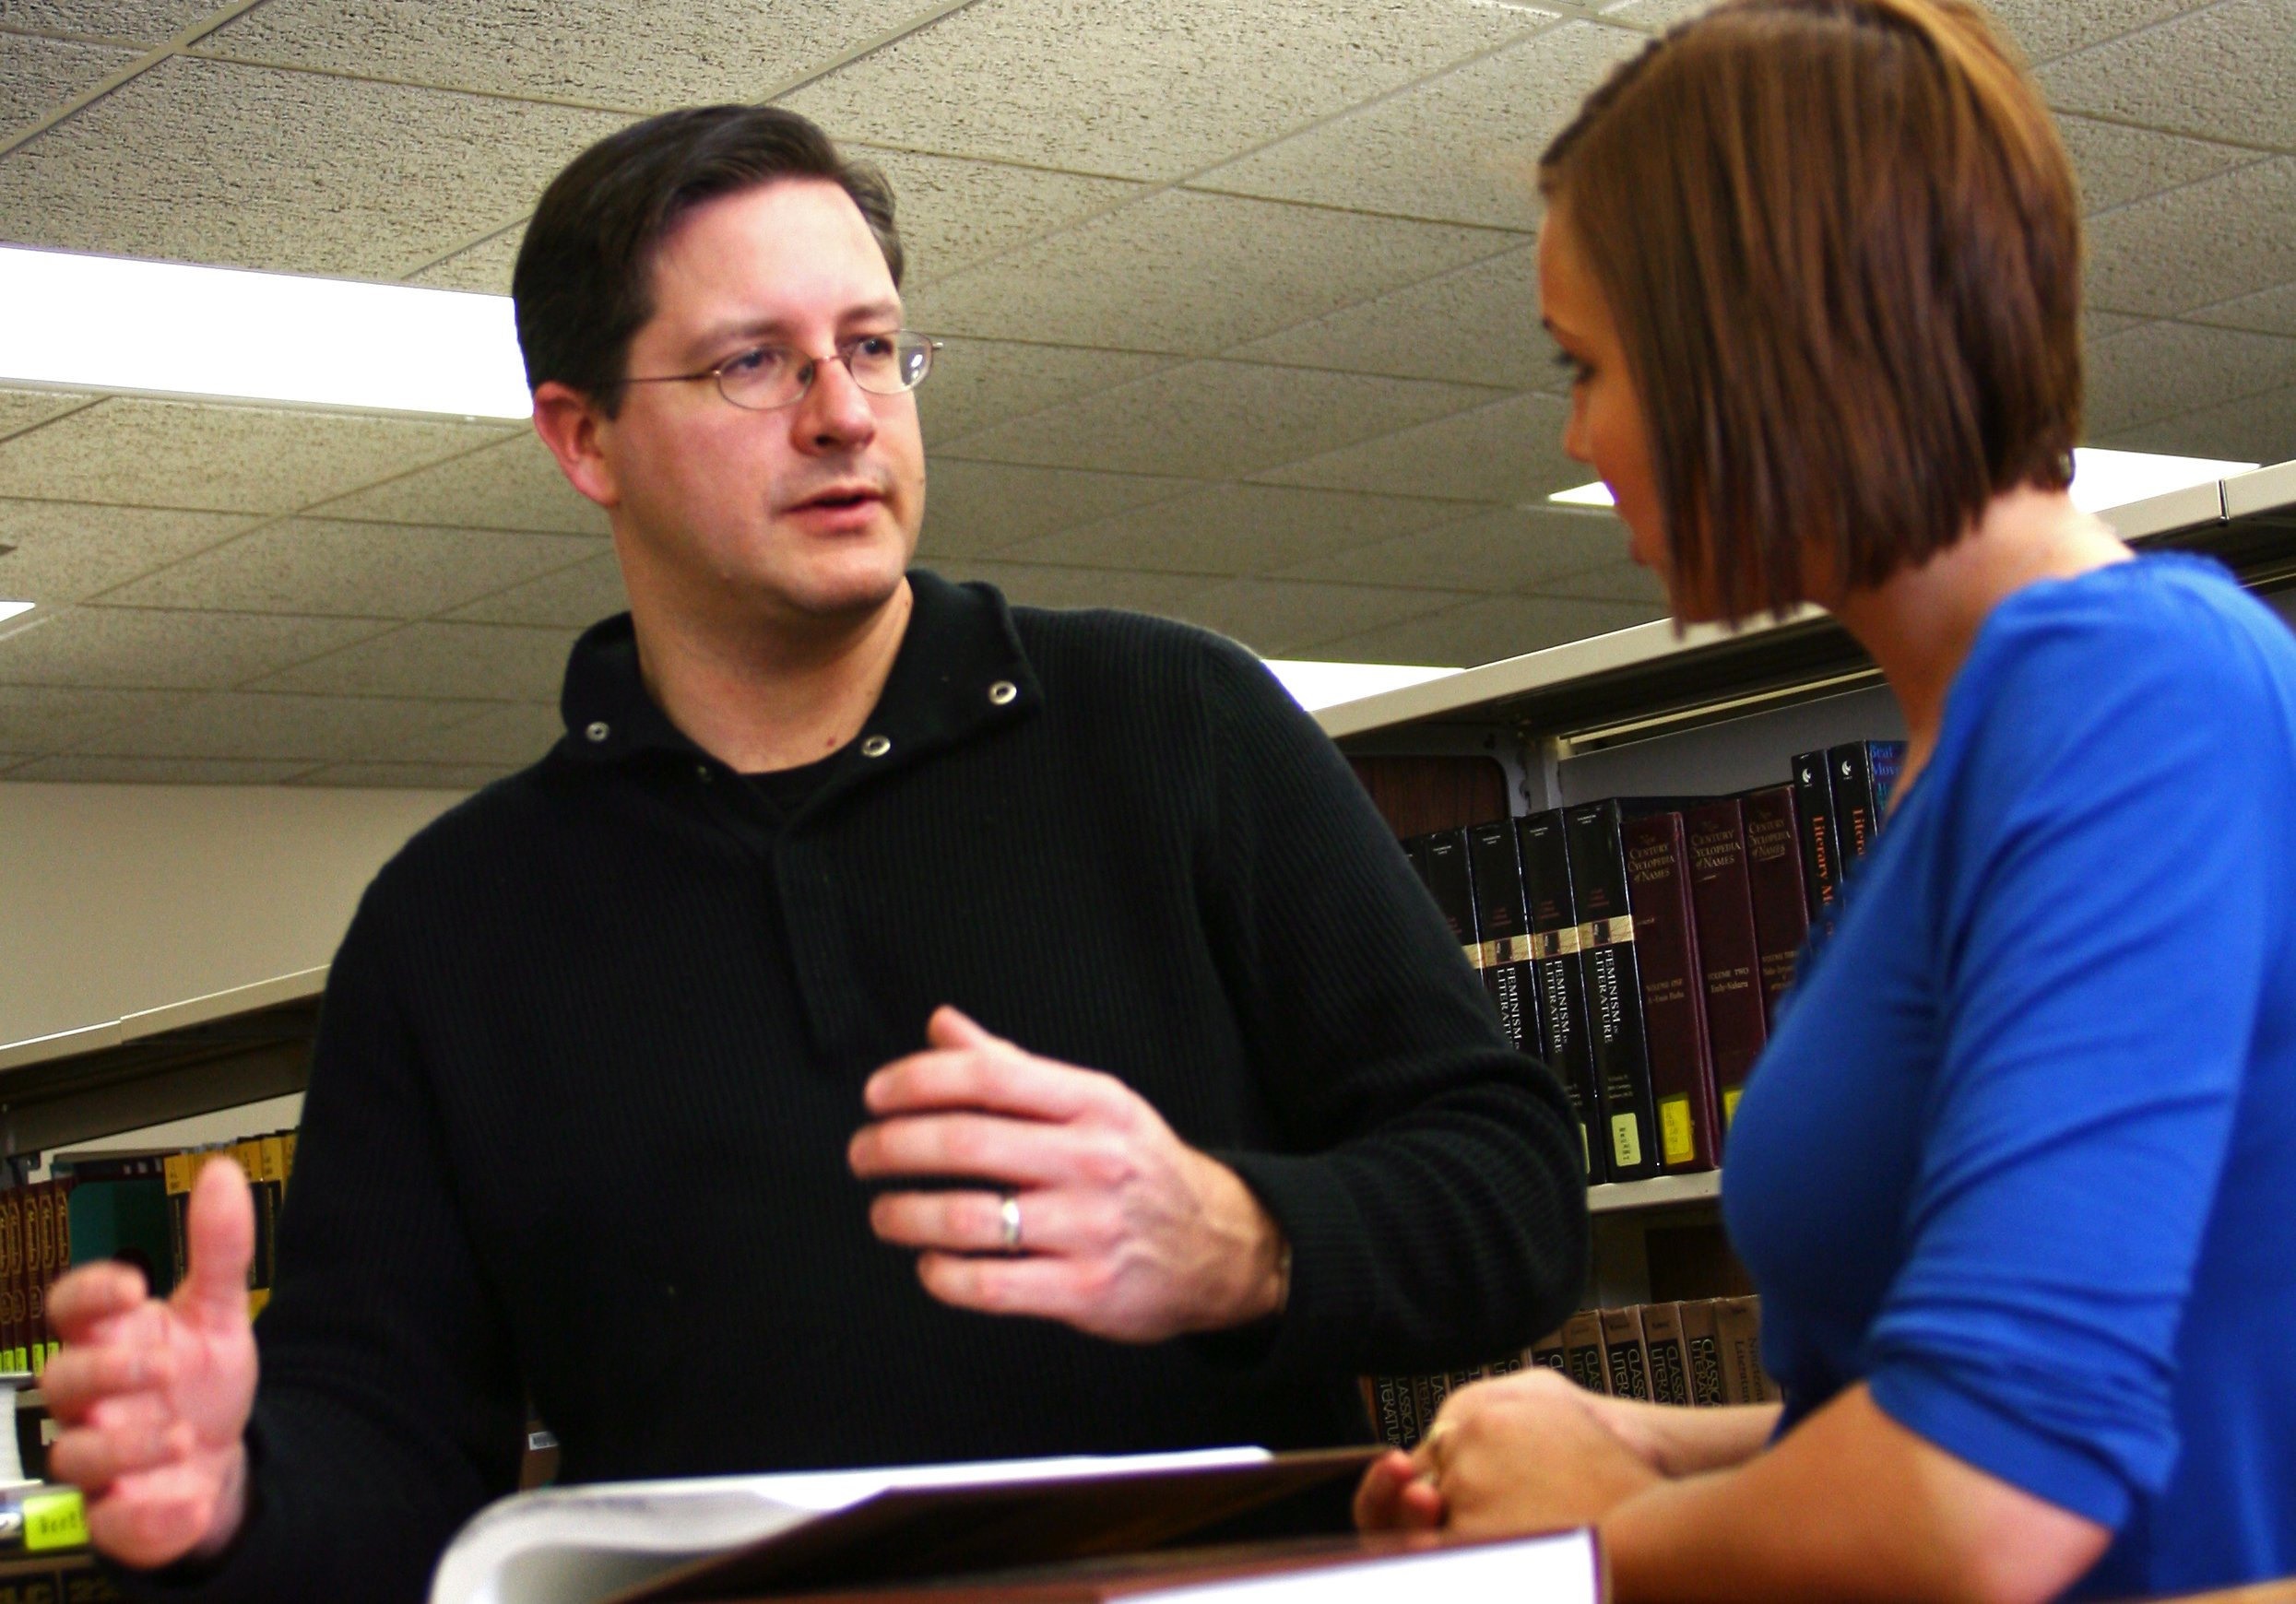
Ryan Roberts
Lincoln Land Community College
I enjoy those quiet moments of recognition in a student's eyes when information transforms into meaning and understanding. I believe strongly in my students' pursuit of self-improvement and strive to keep in mind an old saying I came across years ago: “Success lies in the ability to change minds.”

Slide 14
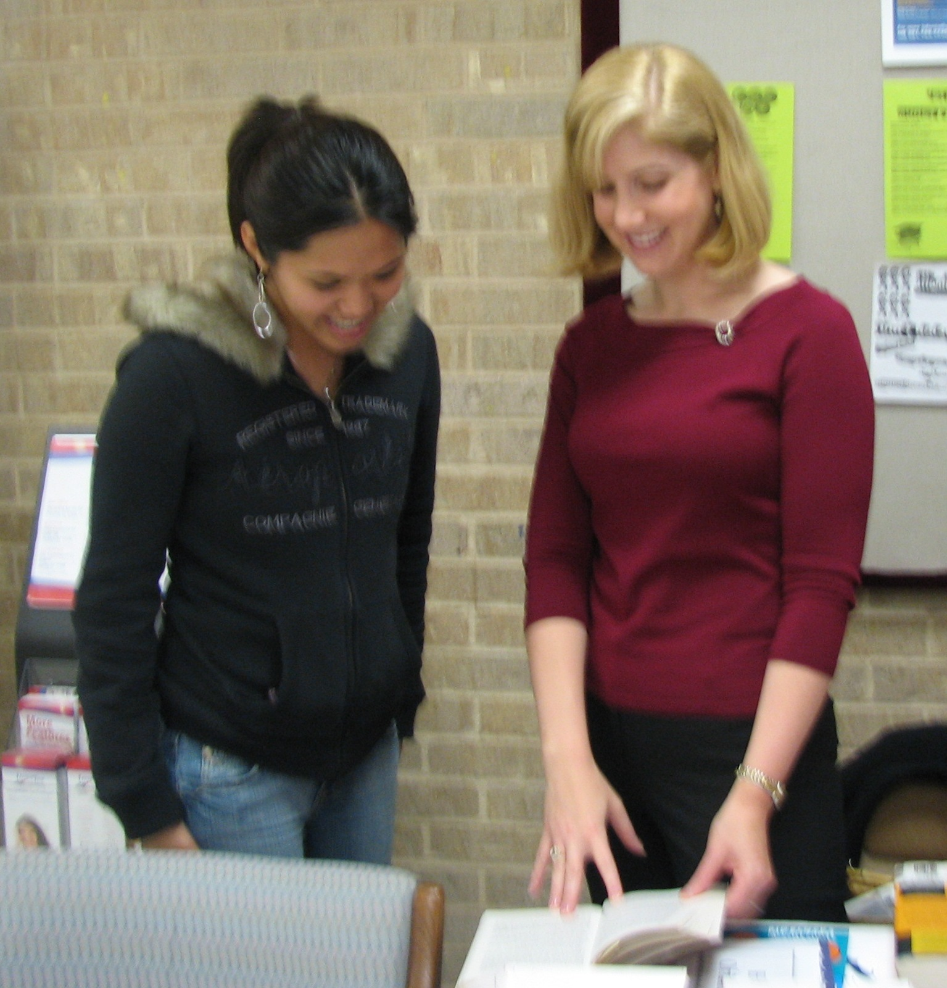
Shae Adkins
Lone Star College

Slide 15
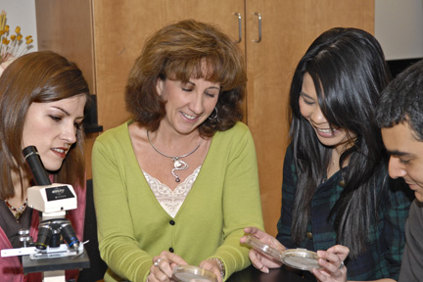
Betsy Morgan
Lone Star College

Slide 16
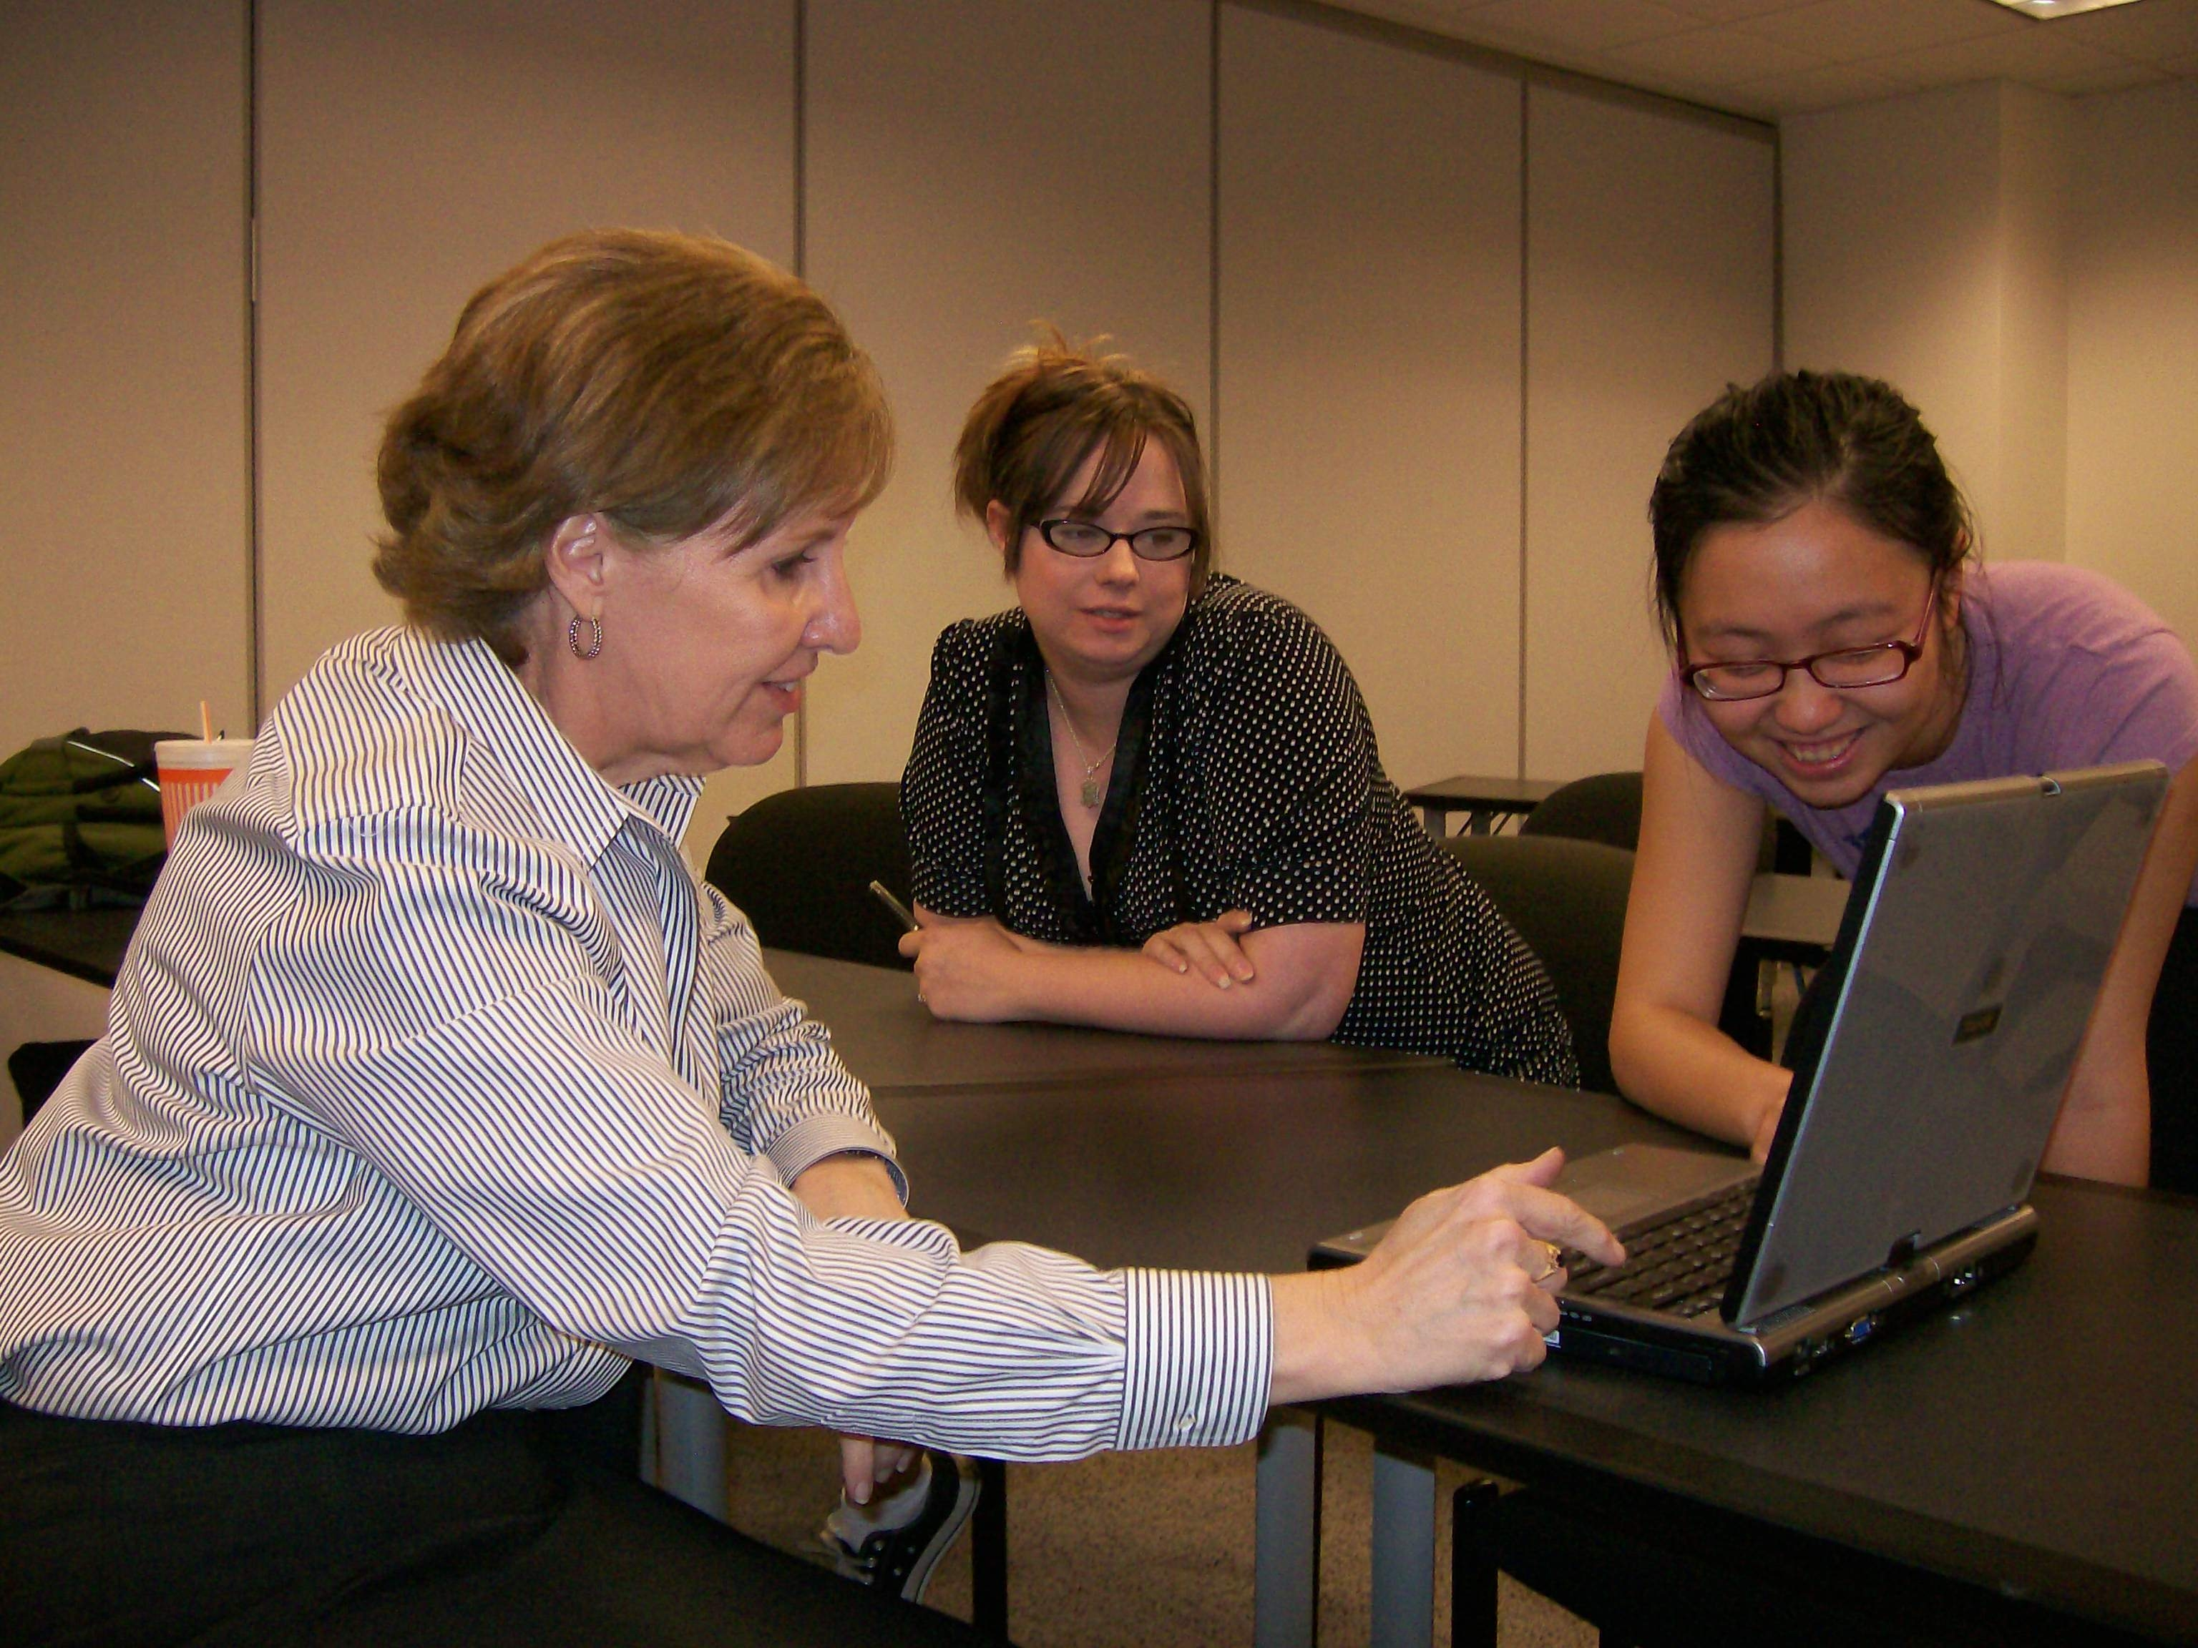
Esther Robinson
Lone Star College System - CyFair

Slide 17
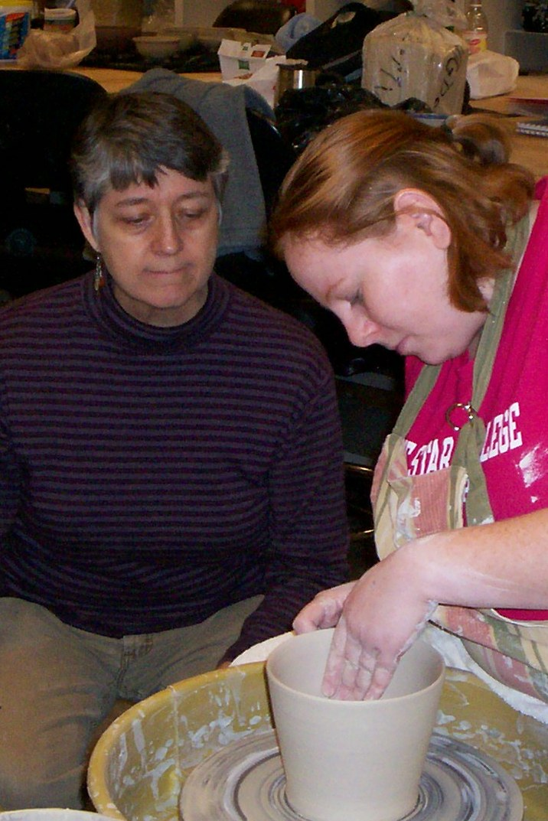
Suzanne Shield-Polk
Lone Star College System - Cy-Fair
When I stop to think about the influence we educators exert on those we teach, I am awestruck. It is a privilege and a responsibility to be involved in students’ lives.

Slide 18
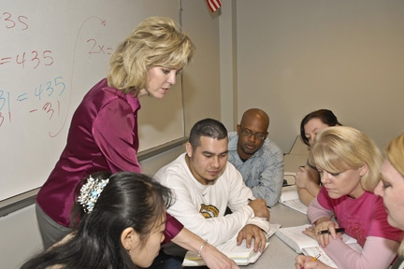
Stephanie Doyen
Lone Star College System - Kingwood

Slide 19
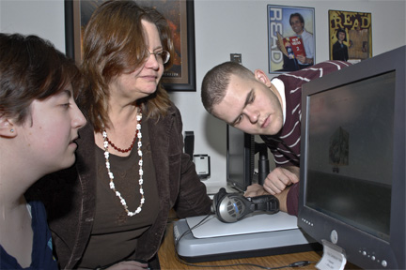
Jimmi Rushing
Lone Star College System - Kingwood
Every day is a new opportunity to help someone else along their path to success—working one-on-one with a student on a research paper, teaching a class, collaborating with another faculty member to create a successful library experience for a class or passively creating an assignment guide, developing a video tutorial, or selecting resources; it all comes down to that. Being even a small part of someone’s journey is an honor and a responsibility. Even the briefest contact may be critical in getting to the next step. I may have heard a question many times over; but for the student, it is always the first time. Each and every graduation is one of my favorite days in the year; I am reminded why I love being a part of this college and renew my commitment to the students who choose us.

Slide 20
Deborah Cox
Lone Star College - Montgomery
As a reference librarian and an English teacher, I attempt to live by the motto: Everyone is special.

Slide 21
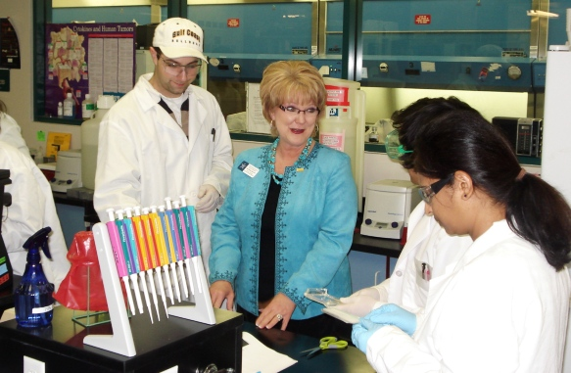
Sue Jan Herber
Lone Star College System - Montgomery
Woodrow Wilson’s observation captures the essence of my purpose: ‘You are not here merely to make a living. You are here to enrich the world, and you impoverish yourself if you forget your errand.’ My purpose focuses on helping people thrive. I see the potential in others and am able to help an individual progress, stretch, and grow. My passion is helping others succeed by coaching, mentoring, teaching, and counseling.

Slide 22
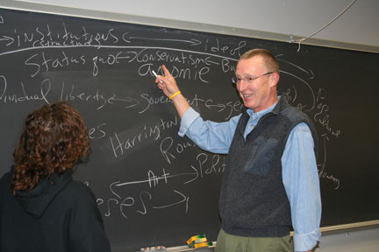
David Birch
Lone Star College System - Tomball
I guess I've bought into Jerry Garcia's comment: ‘Stuff that's hidden and murky and ambiguous is scary because you don't know what it does.’ To me, education is about providing practice in the exploration of the ambiguous so we're not afraid of ‘things that go bump in the night.'

Slide 23
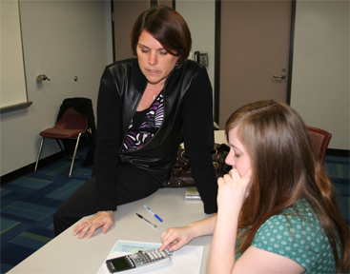
Melinda Coleman
Lone Star College System - Tomball

Slide 24
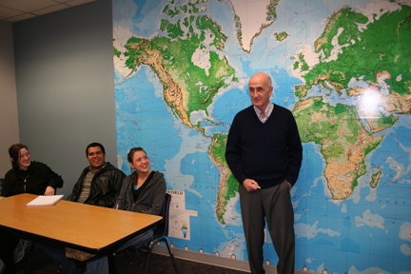
Tom Lovell
Lone Star College System - Tomball
I enjoy the exhilaration when I know I've connected with my young—and sometimes, not so young—charges. Those looks combining curiosity with what—for many of them—is a new-found discovery of the personal joys and insights into the human condition that history affords is worth putting up with all the downsides that beset the profession!

Slide 25
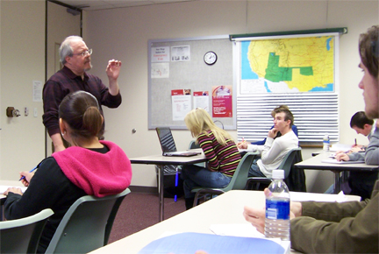
Thomas Rogers
Lone Star College System - Tomball
History need not be a boring study of the names of long-dead people in a book that students were made to read, nor a dull exercise in memorization of dates and irrelevant facts. My goal in teaching is to show how history has brought us to where we are and make it alive and relevant to students.

Slide 26
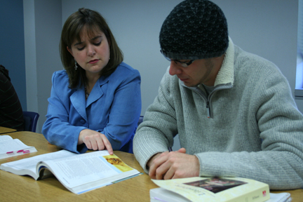
Kathy Sanchez
Lone Star College System - Tomball

Slide 27
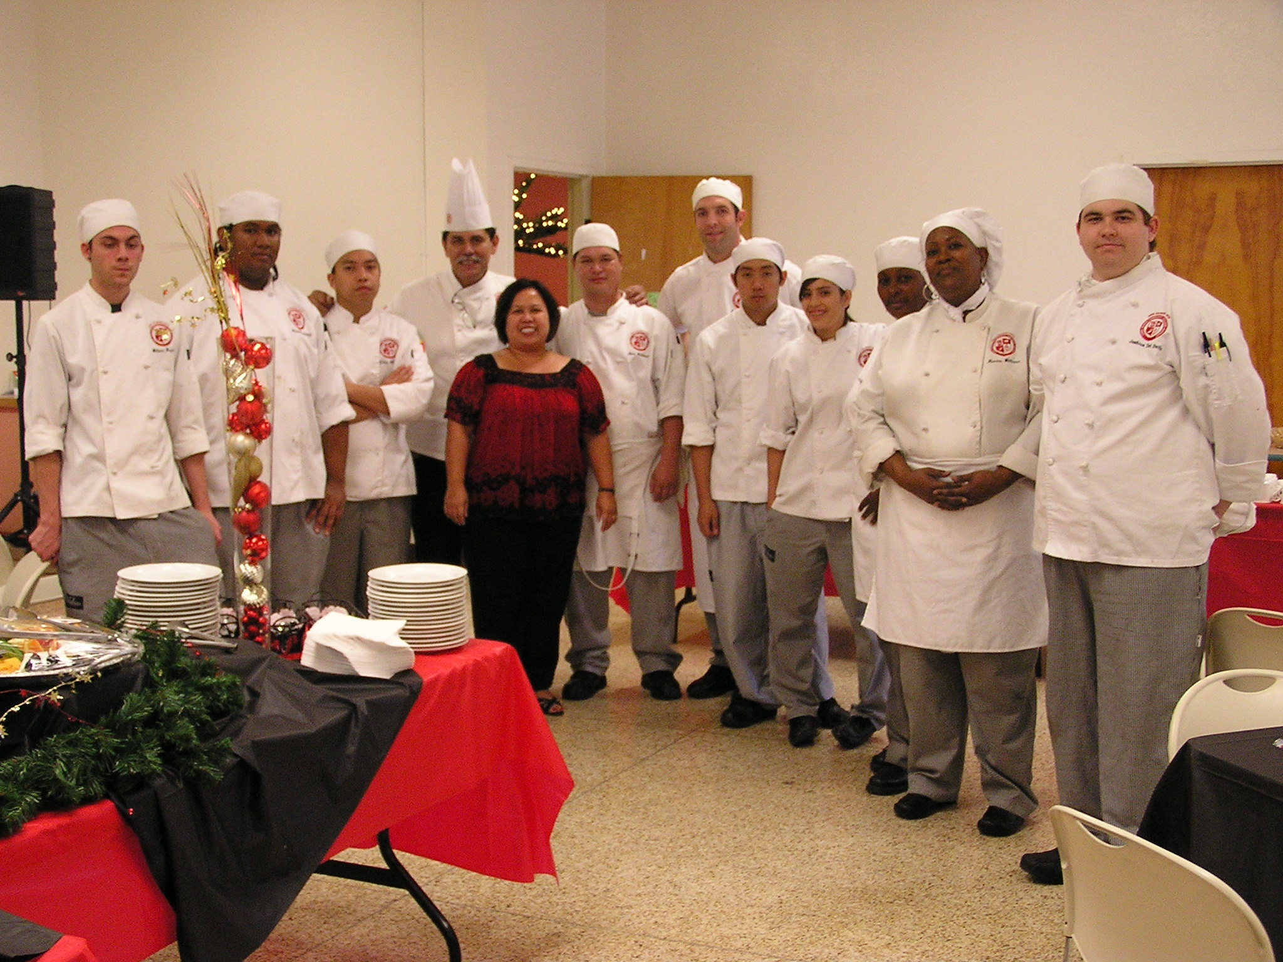
Maria Narvaez
Long Beach City College
Success is collaborative. It requires effort on one’s part and support from others. One must cultivate good relationships, create meaningful work, seek out new learning experiences, and have a goal.

Slide 28
Aimee Dickinson
Lorain County Community College
Students’ feedback makes me glow from the inside out. When students share news stories related to course content or I witness their community involvement, it illustrates they are engaged both inside and outside the classroom. I realize I’m the catalyst facilitating their journey on becoming independent and lifelong learners.

Slide 29
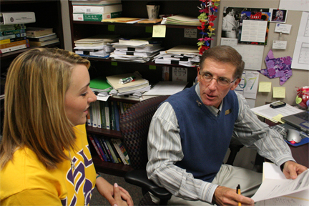
Joe Lane
Louisiana Delta Community College

Slide 30
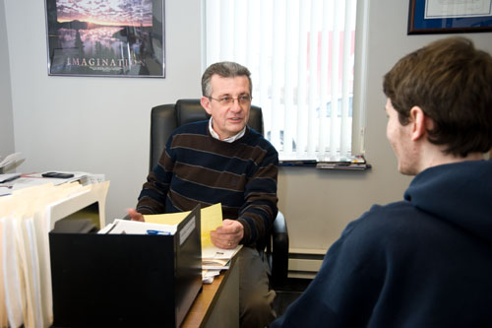
William Barrett
Luzerne County Community College

Slide 31
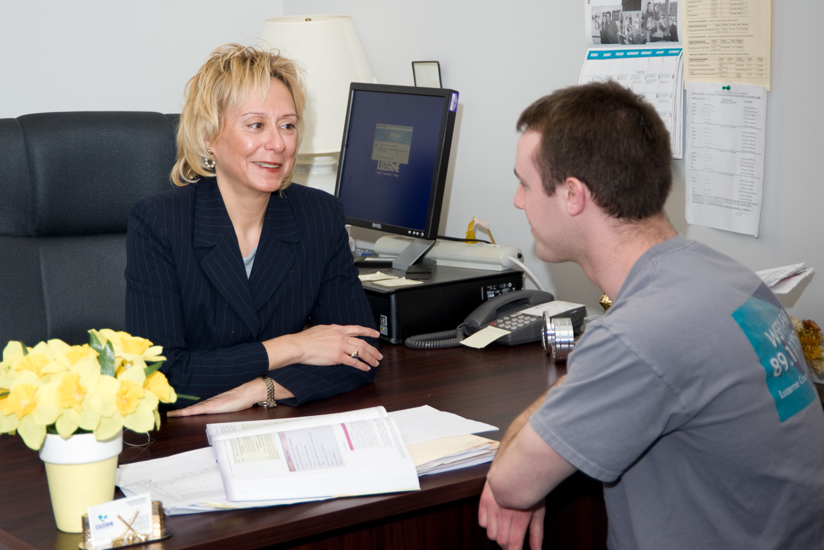
Maryann Kovalewski
Luzerne County Community College
Students must believe in themselves to develop the confidence they need to become successful, productive members of our global society. To accomplish this, we must teach them to focus on what they can rather than on what they can’t do. Can-do students can reach out to help others.

Slide 32
Mary Alstead
Macomb College
Performance evaluations are an integral part of my process. They allow me to evaluate if students can perform a procedure and tell me what they are doing and why, at the same time.

Slide 33
Christopher Donnelly
Macomb College
Learning is best accomplished through individual discovery rather than from acceptance of a given result. When one discovers an idea on his own, it becomes his and stays with him. My duty is to promote this discovery by replacing the fear of failure with an attitude of determination and perseverance.

Slide 34
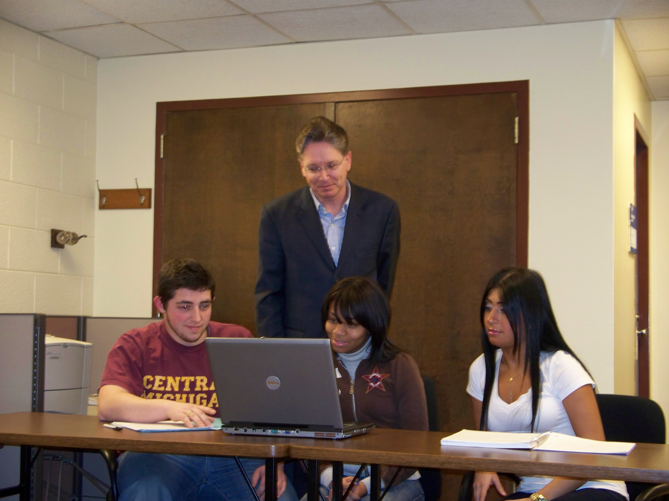
Randy Gerber
Macomb Community College

Slide 35
Joseph Nazione
Macomb College
My teaching philosophy is simple. To provide a learning environment where the student is comfortable and gains self-confidence. Teaching and leading students to think through problems systematically and use tools to solve them, ultimately leads to academic and vocational success.

Slide 36
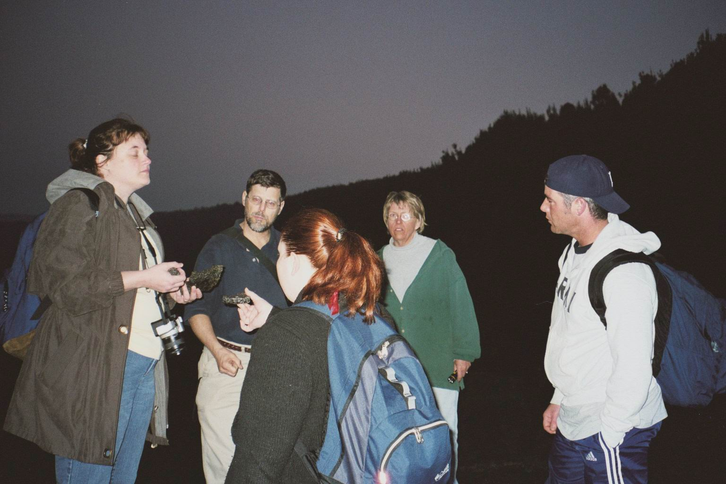
Joseph Sarnecki
Macomb Community College
I am guided by the idea that students must be given a chance to succeed. Most students learn from traditional means. Getting the message to our more diverse students is the challenge. Individual contact is my solution: private chats before class, help during laboratory sessions, talking to struggling students, and asking those who come in late if there is a problem. I learn from every class.

Slide 37
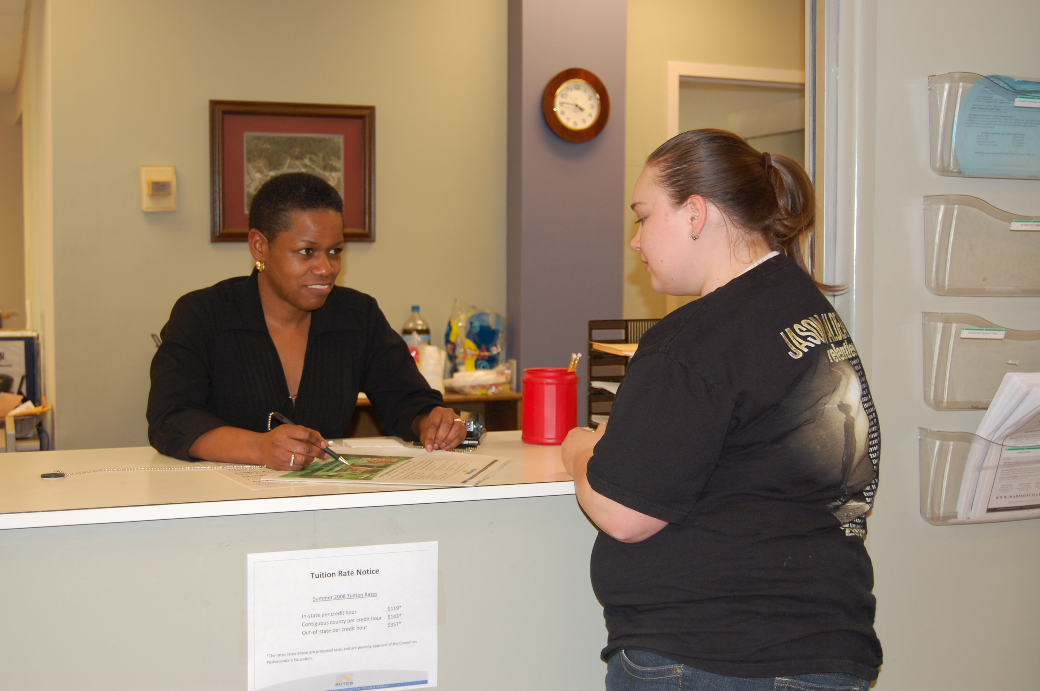
Katrina Scott
Madisonville Community College

Slide 38
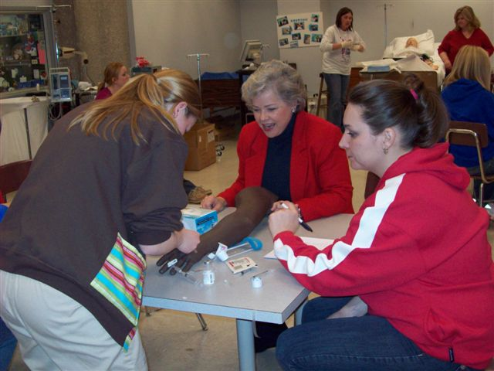
Linda Thomas
Madisonville Community College
As we continue to modify our methods of instruction to incorporate advanced technology, I am amazed at the senior faculty who are embracing the newer methods and are actually enjoying themselves in the process.

Slide 39
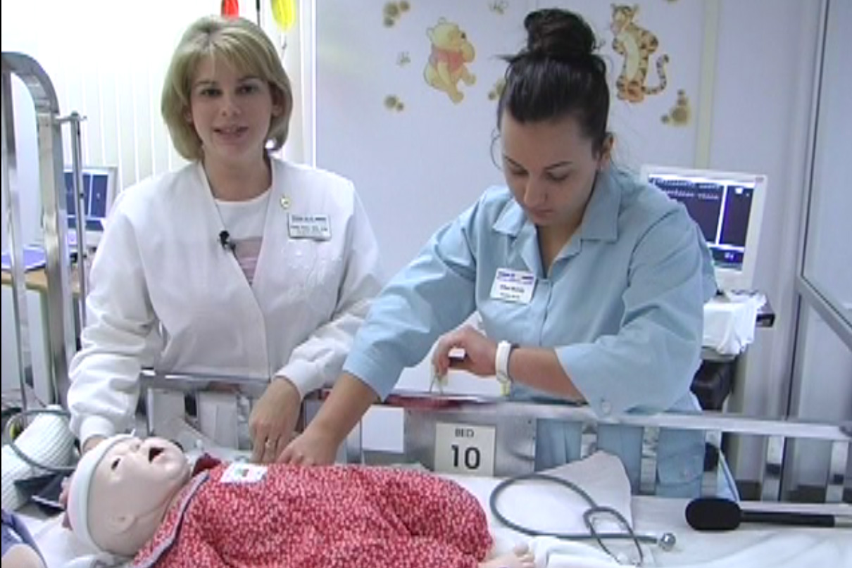
Kendra Barber
Manatee Community College
I’m fortunate that my work combines my two passions: teaching and nursing. I’m inspired everyday as I see young, timid, and unsure nursing students evolve into confident, competent, and professional nursing graduates. It’s a privilege to be a part of that transformation.

Slide 40
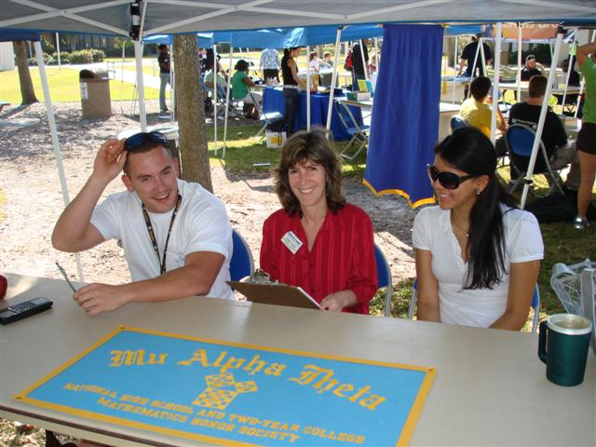
Kathy Fields
Manatee Community College

Slide 41
Orland Fernandes
Mass Bay Community College
My strategies can be coined in three simple words—listen, learn, and apply. The key to success lies in the patient listening to one’s students.

Slide 42
Barbara Campbell
Maysville Community and Technical College
One of my favorite sayings is ‘Work like you don't need the money, love like you've never been hurt, and dance like nobody's watching.’ I enjoy what I do and get to work with great people. Every day is different, we are encouraged to be creative and progressive, and we get a lot of support in our work. Who couldn't be motivated in that environment?

Slide 43
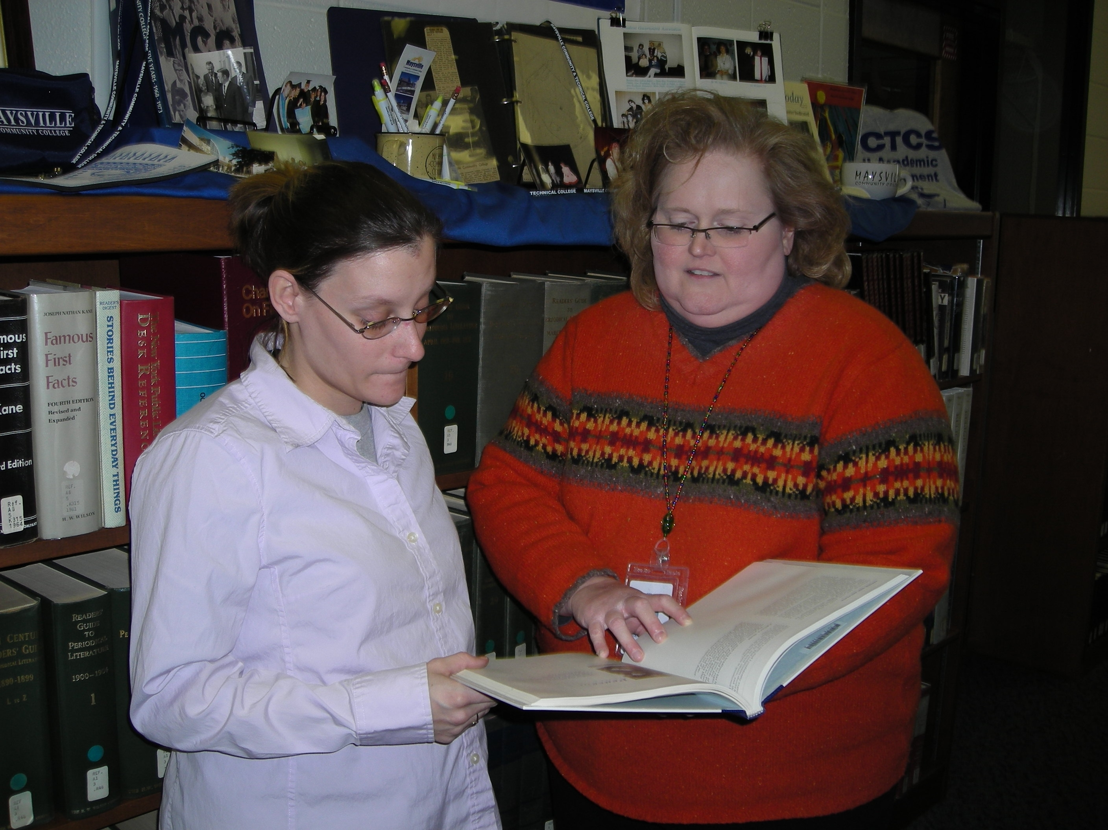
Margo Hamm
Maysville Community and Technical College

Slide 44
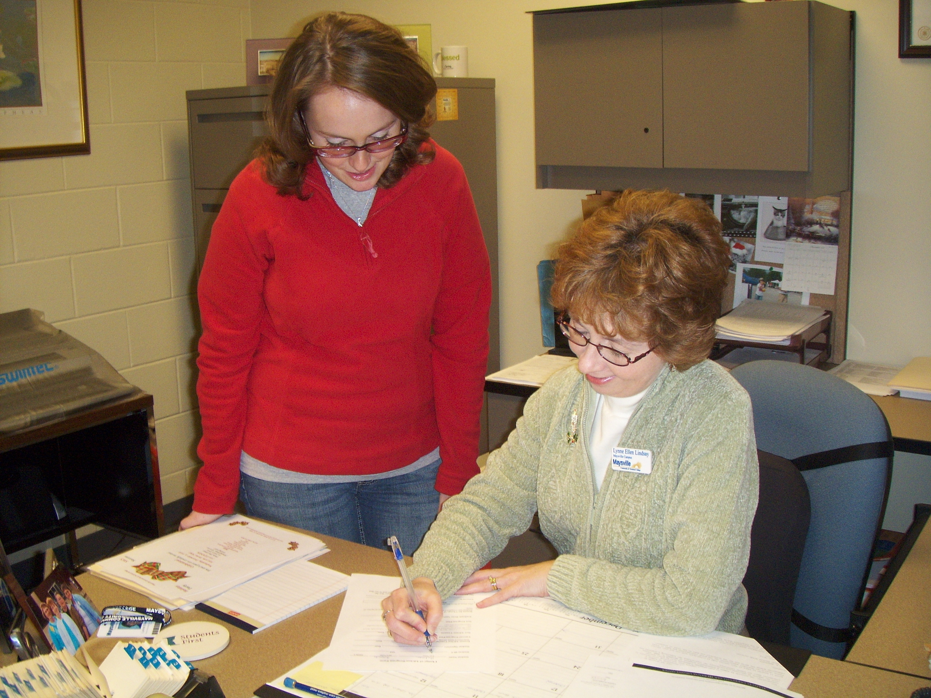
Lynne Lindsay
Maysville Community & Technical College
It is gratifying to witness the metamorphosis of a timid first-semester student into a confident, self-assured graduate. This reminds me that we make a difference in people's lives.

Slide 45
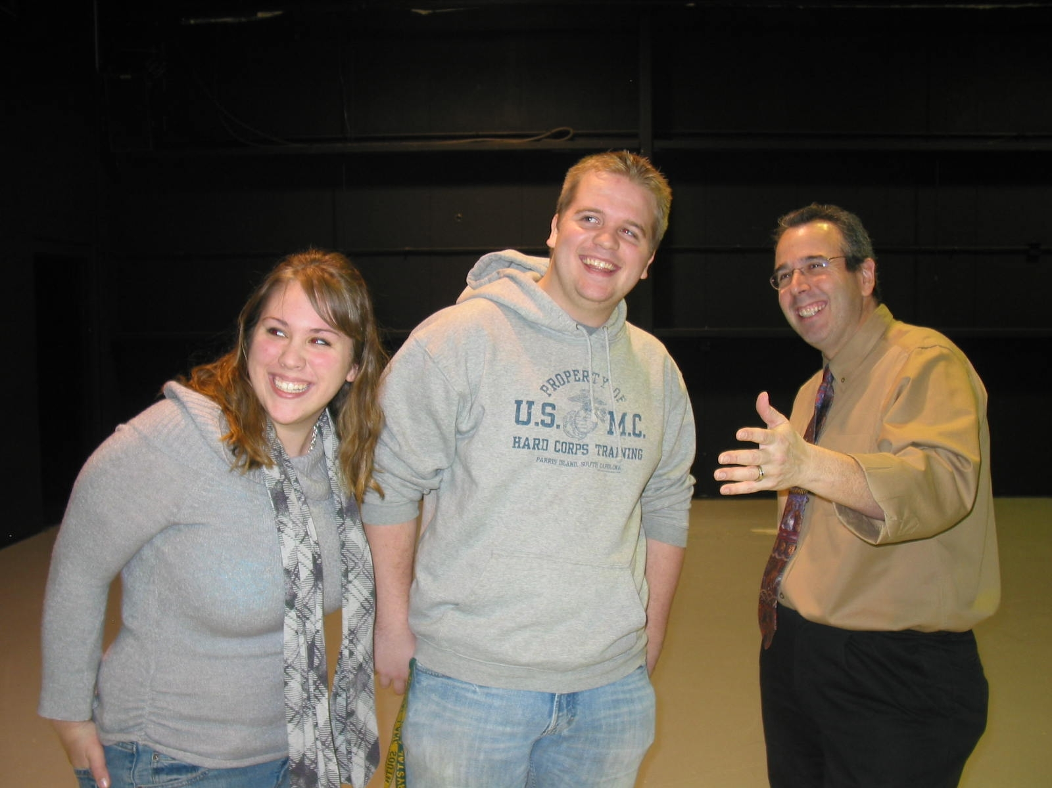
Jay Geller
McHenry County College

Slide 46
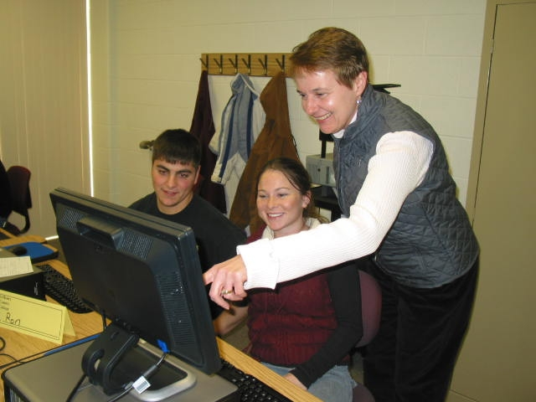
Sandra Vitale
McHenry County College

Slide 47
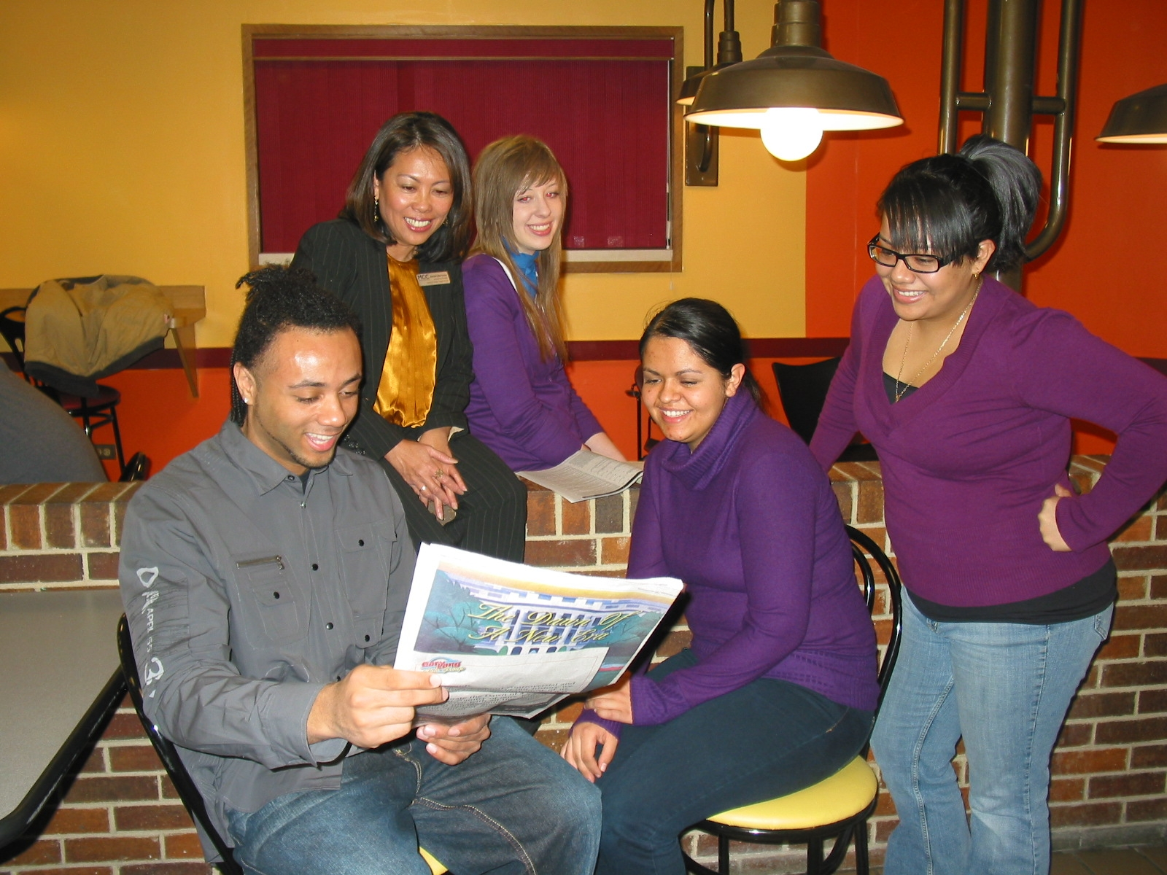
Normah Salleh-Barone
McHenry County College

Slide 48
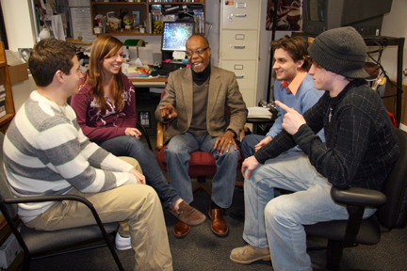
Alvyn Haywood
Mercer County Community College
I am inspired by the joy of teaching the art of life-long learning—motivated by ten two-letter words: “If it is to be, it is up to me” and driven by the strategy: “Learning, like life, is supposed to be fun.”

Slide 49
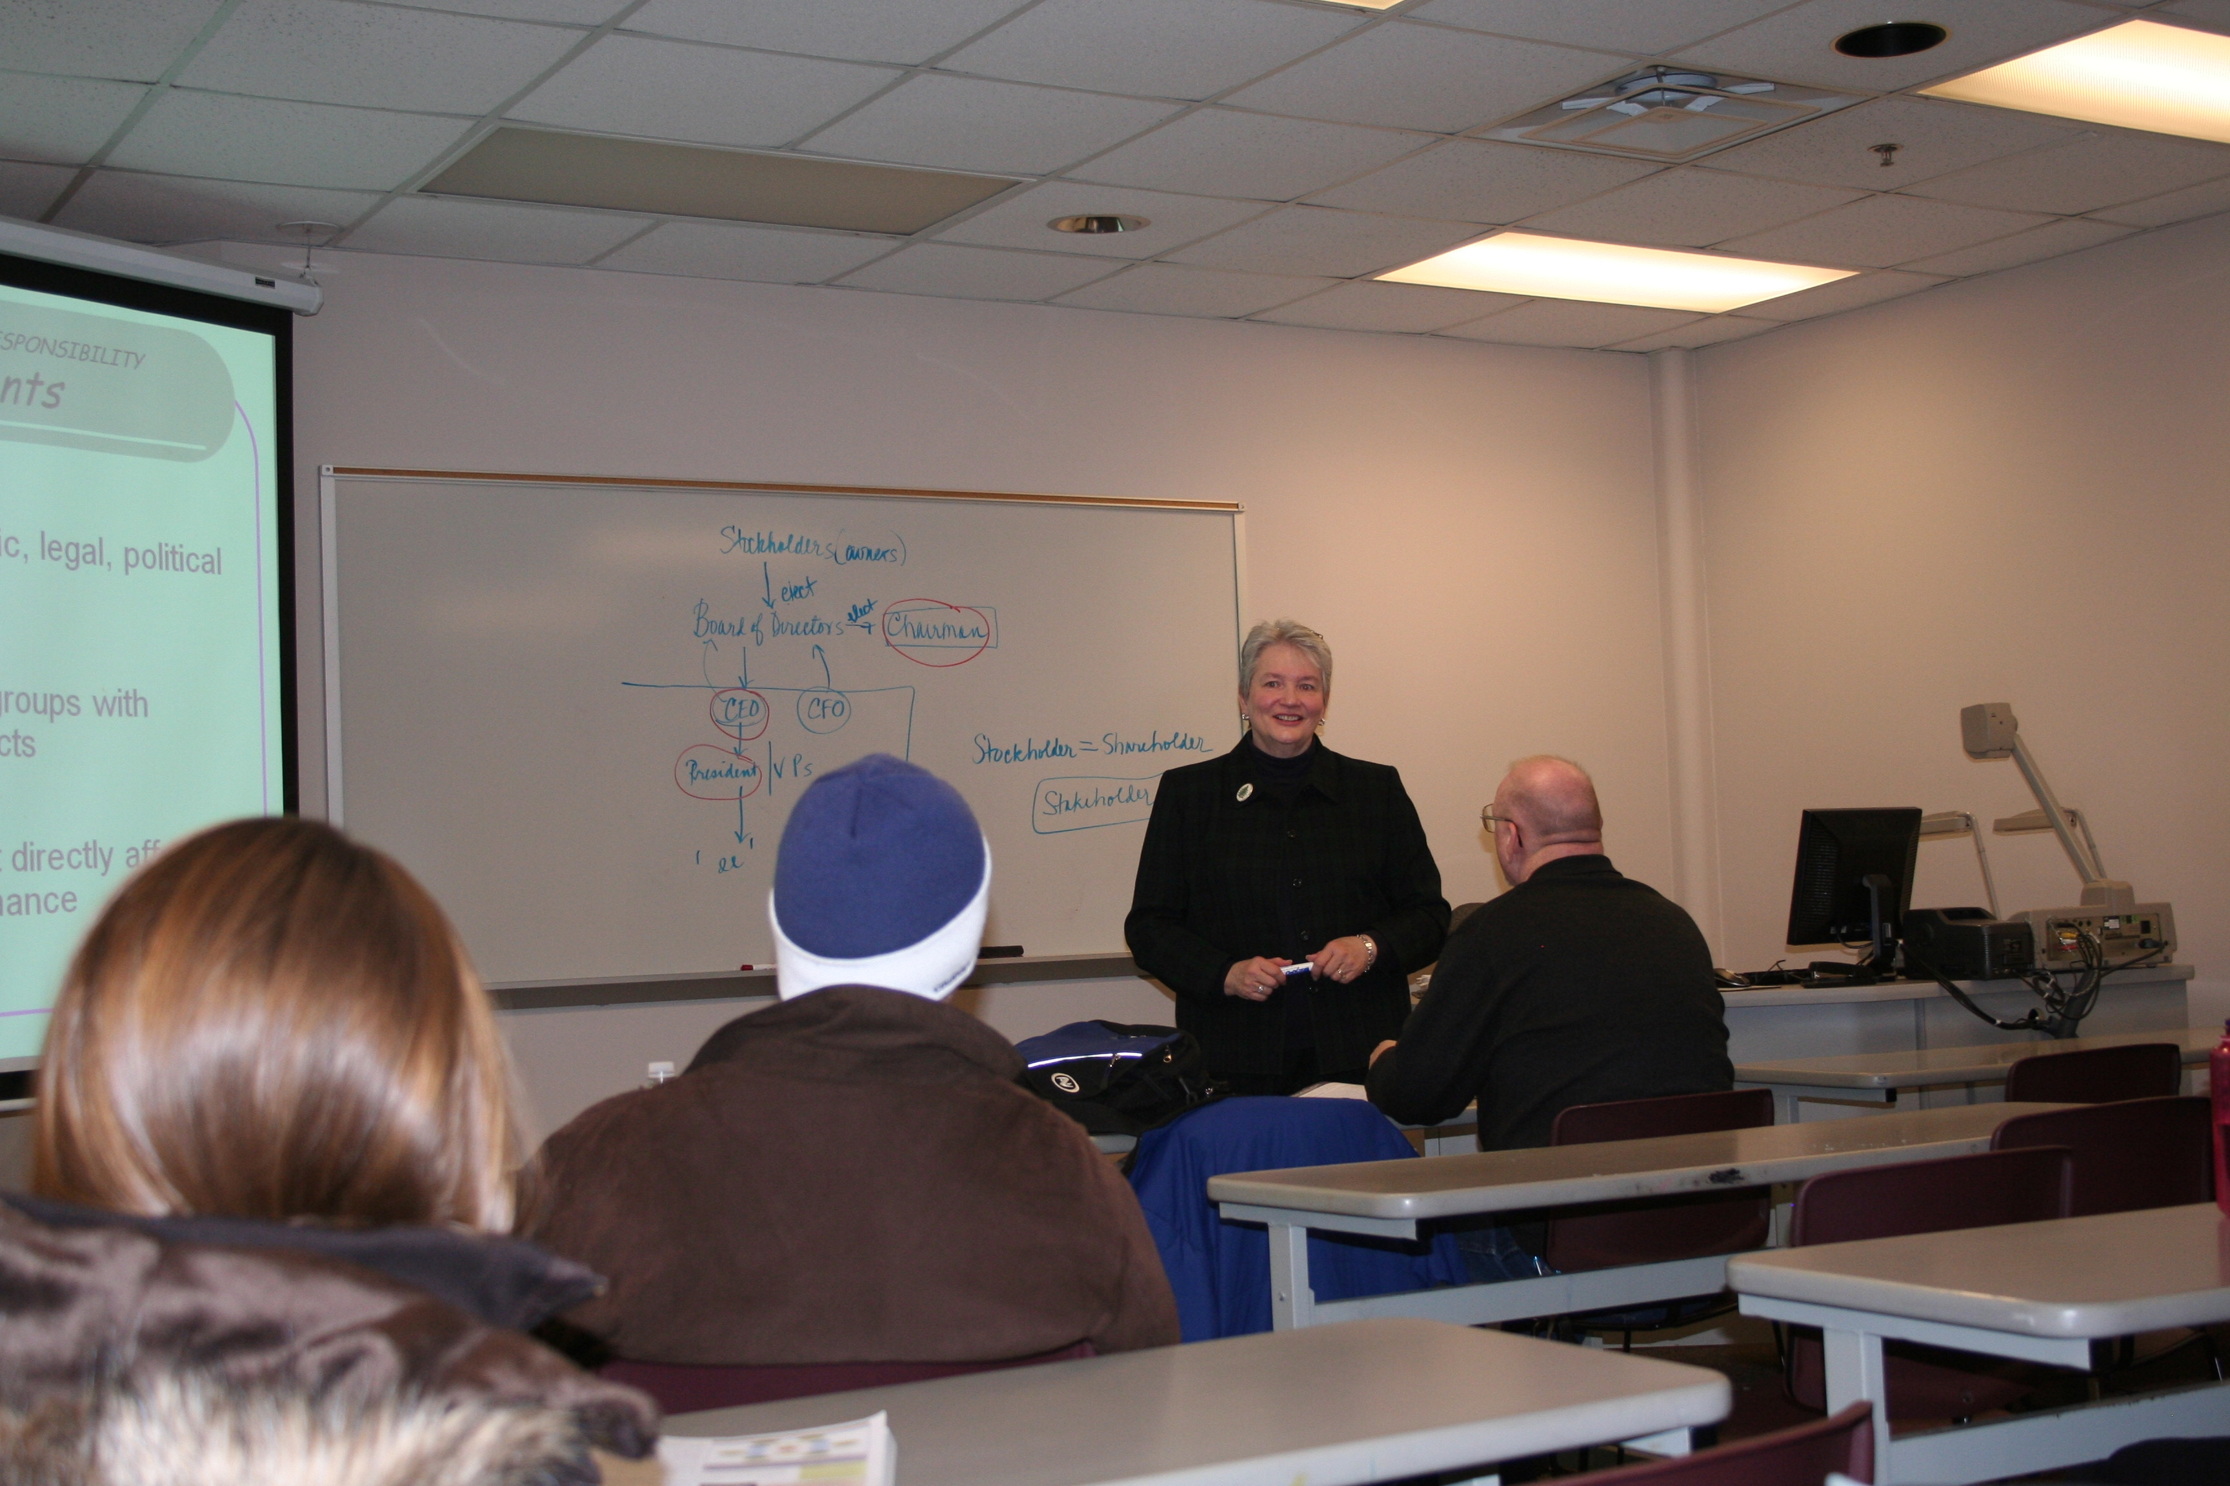
Peg Johnson
Metropolitan Community College

Slide 50
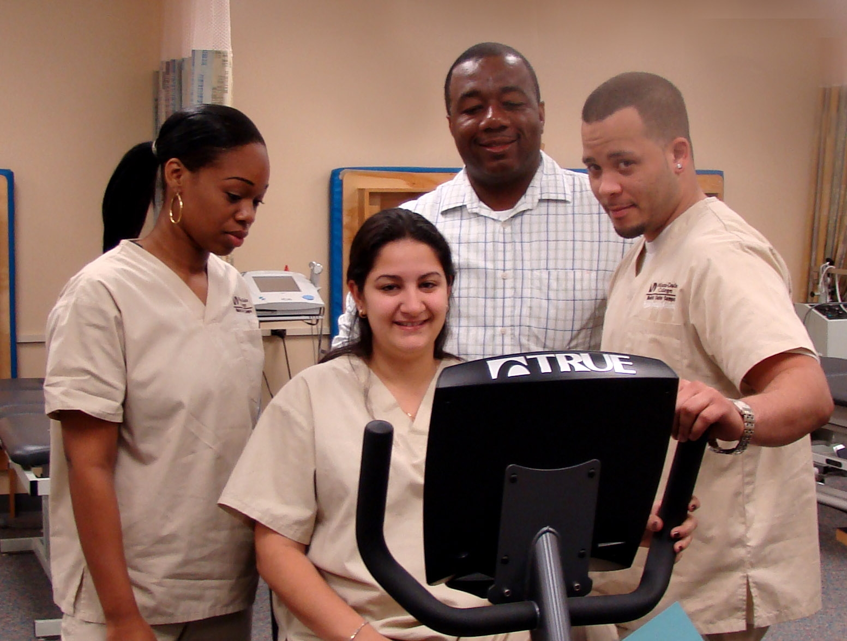
Kenneth Lee
Miami Dade College
I believe that an educator's true goal should be to challenge students and at the same time encourage them to be all that they can be.

Slide 51
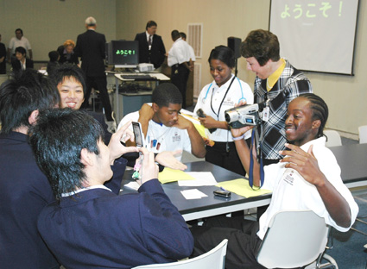
Linda Graham
Mid-South Community College
Working with students and watching each step of achievement toward success is a real power boost! Working with creative, dedicated professionals who work tirelessly to help our students is the other.

Slide 52
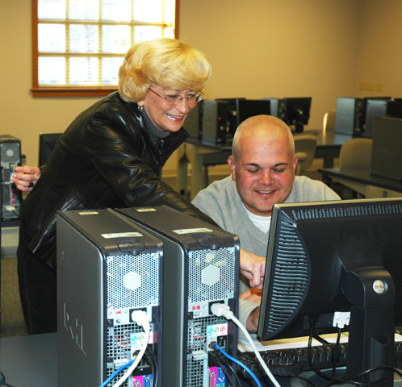
Reita Gorman
Mid-South Community College
Nothing thrills me more than watching students climb to levels of learning and understanding that exceed any expectations they ever held. I have found no greater honor in life than the service of teaching and no greater motivator than the students themselves.

Slide 53
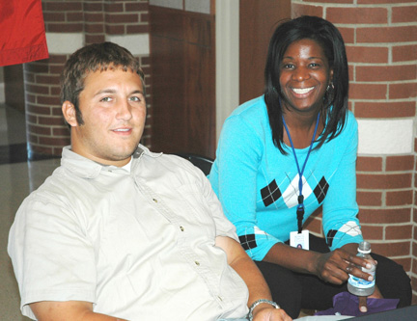
Miles Trenia
Mid-South Community College

Slide 54
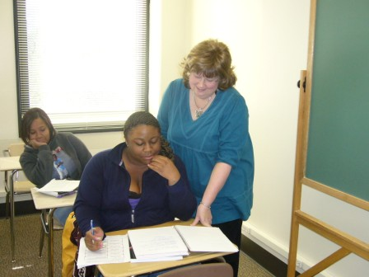
Gwendolyne Bunch
Midlands Technical College

Slide 55
Dixie Fjeld
Minnesota State Community and Technical College
It motivates me when students take ownership and responsibility in their own learning to become lifelong learners and when they realize this is only the beginning!

Slide 56
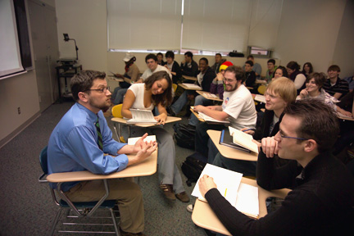
Matthew Hachee
Monroe Community College
More than anything else, staying current and active in my discipline helps reinvigorate my teaching and restore my sense that I am doing exactly what I should be doing. Certainly meeting new students each semester gives me a necessary charge, but having new ideas, arguments, and material to bring to them each semester helps keep my teaching fresh and helps me to model a sense of wonder.

Slide 57
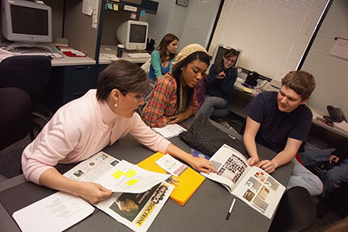
Lori Moses
Monroe Community College

Slide 58
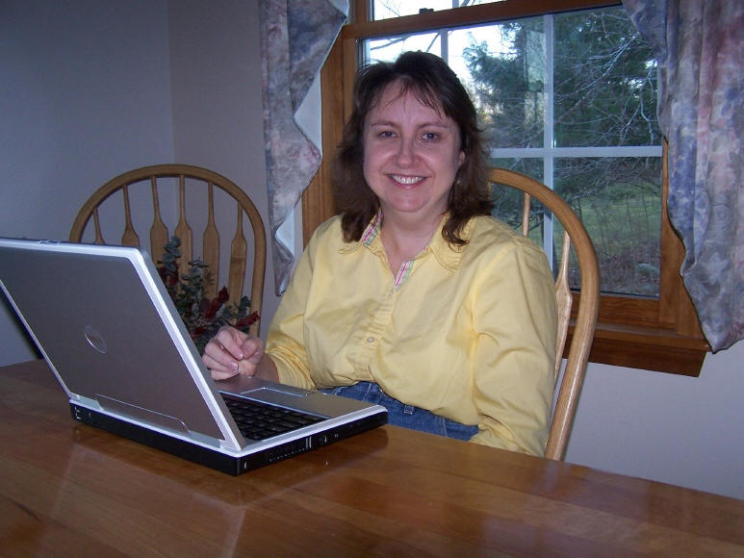
Lynn Ward
Montana State University

Slide 59

J.C. Malitzke
Moraine Valley Community College
Be prepared. Be a leader. Be enthusiastic and have a passion for what you do. Be the guide in the learning process. Be patient and show respect to your students. Understand generational diversity. Establish classroom goals. Bring true life experiences into the classroom. Try to develop the student as a whole. Instill the importance of lifelong learning. Enjoy what you do. Show that you care.

Slide 60

Susie Compton
Motlow State Community College

Slide 61

Janice Harder
Motlow State Community College

Slide 62

Billy Hix
Motlow State Community College

Slide 63
Auksuole Rubavichute
Mountain View College
It gives me a great pleasure to witness how, day-by-day, students grow into knowledgeable and responsible men and women, dedicated to the good of their communities. I am very thankful for an opportunity to touch their lives and be a part of this beautiful transformation process.

