Slide 1
David Hines
H. Lavity Stoutt Community College
I obtain enormous satisfaction in passing on my experience and knowledge for the benefit of improving students’ chances of meaningful employment. Seeing my students gain confidence and personal development further fuels my motivation and enthusiasm. Patience and empathy for my students are keys to success.

Slide 2
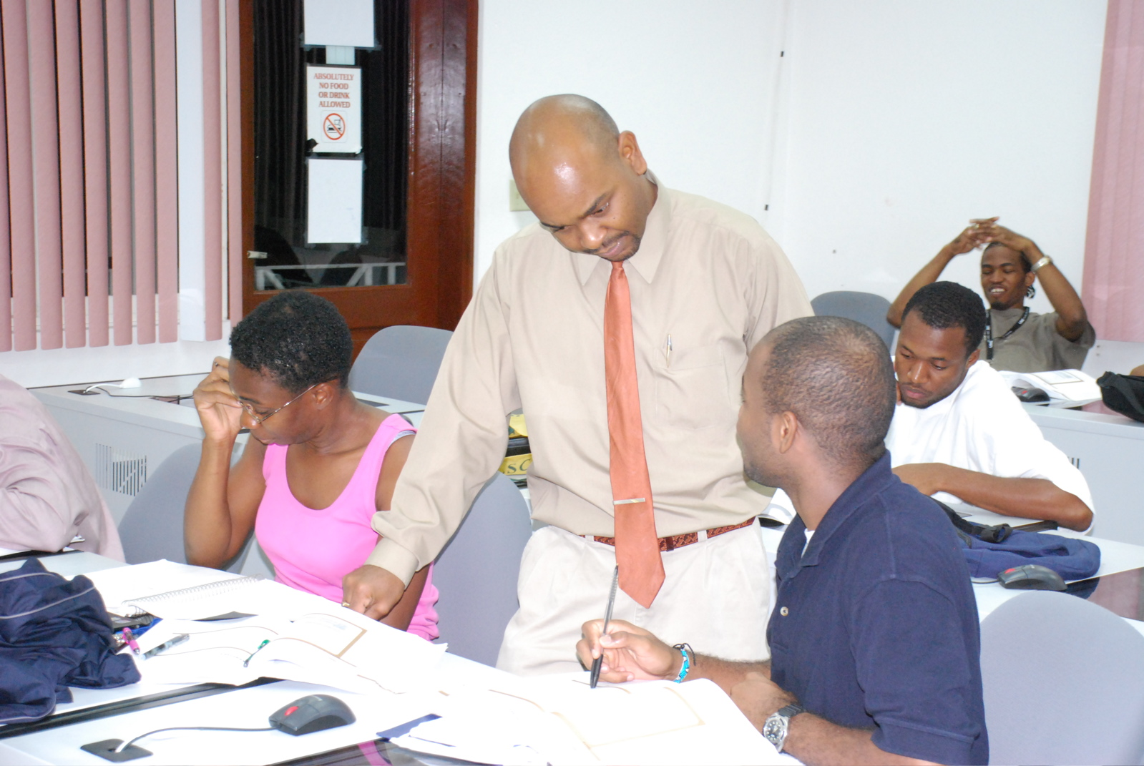
Fidel Captain
H. Lavity Stoutt Community College
Teaching is more about learning than about teaching. Once you get students interested in learning, teaching becomes more about them learning rather than about you teaching them.

Slide 3
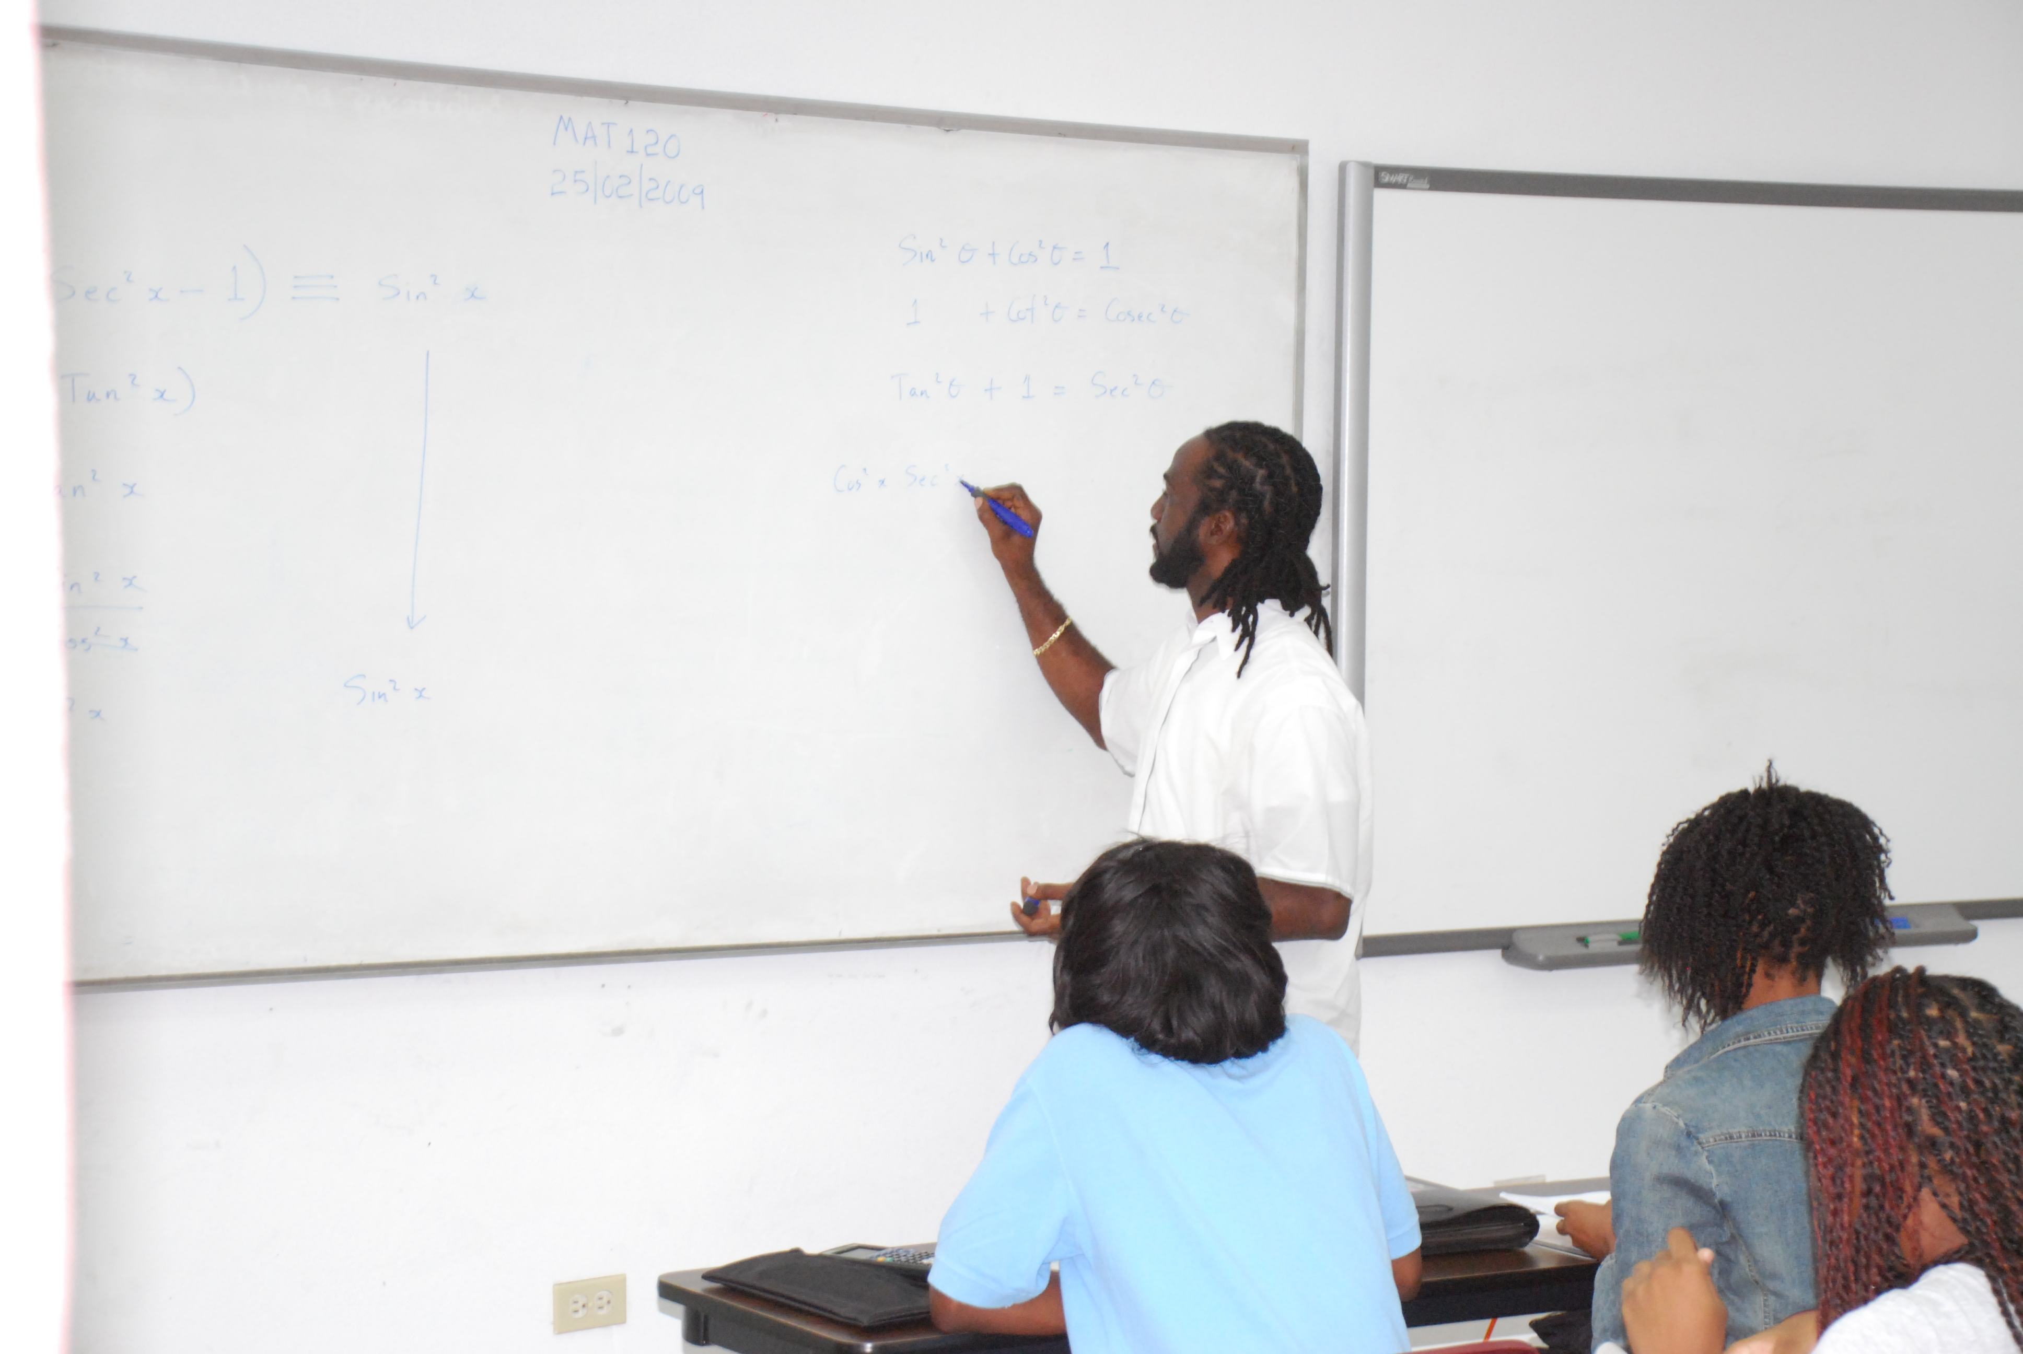
Earle Henry
H. Lavity Stoutt Community College

Slide 4
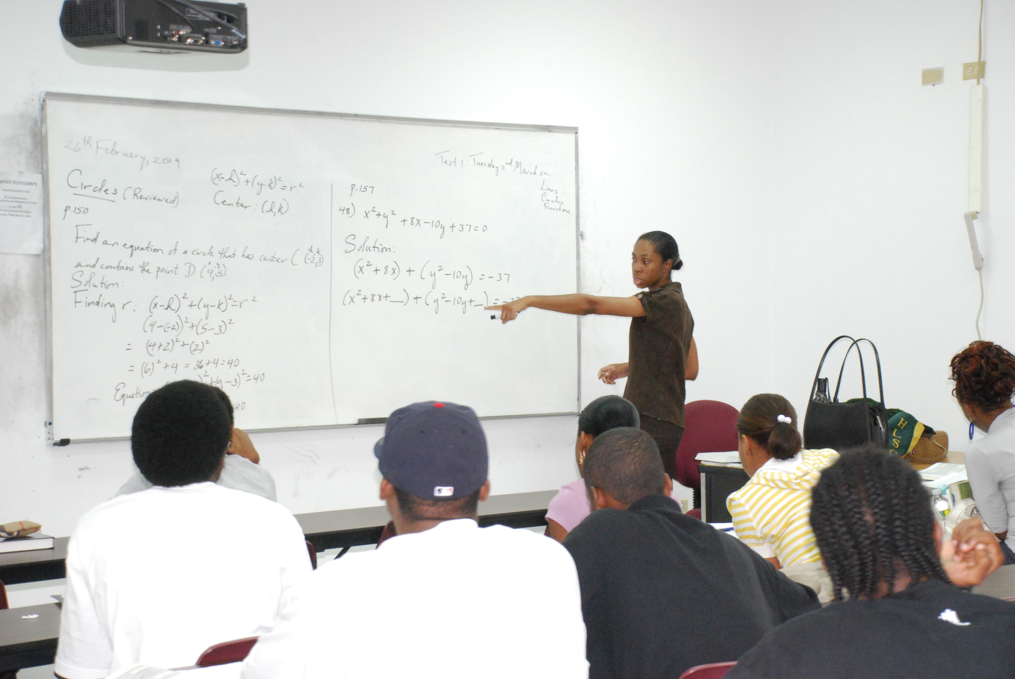
Lucille Skelton
H. Lavity Stoutt Community College

Slide 5
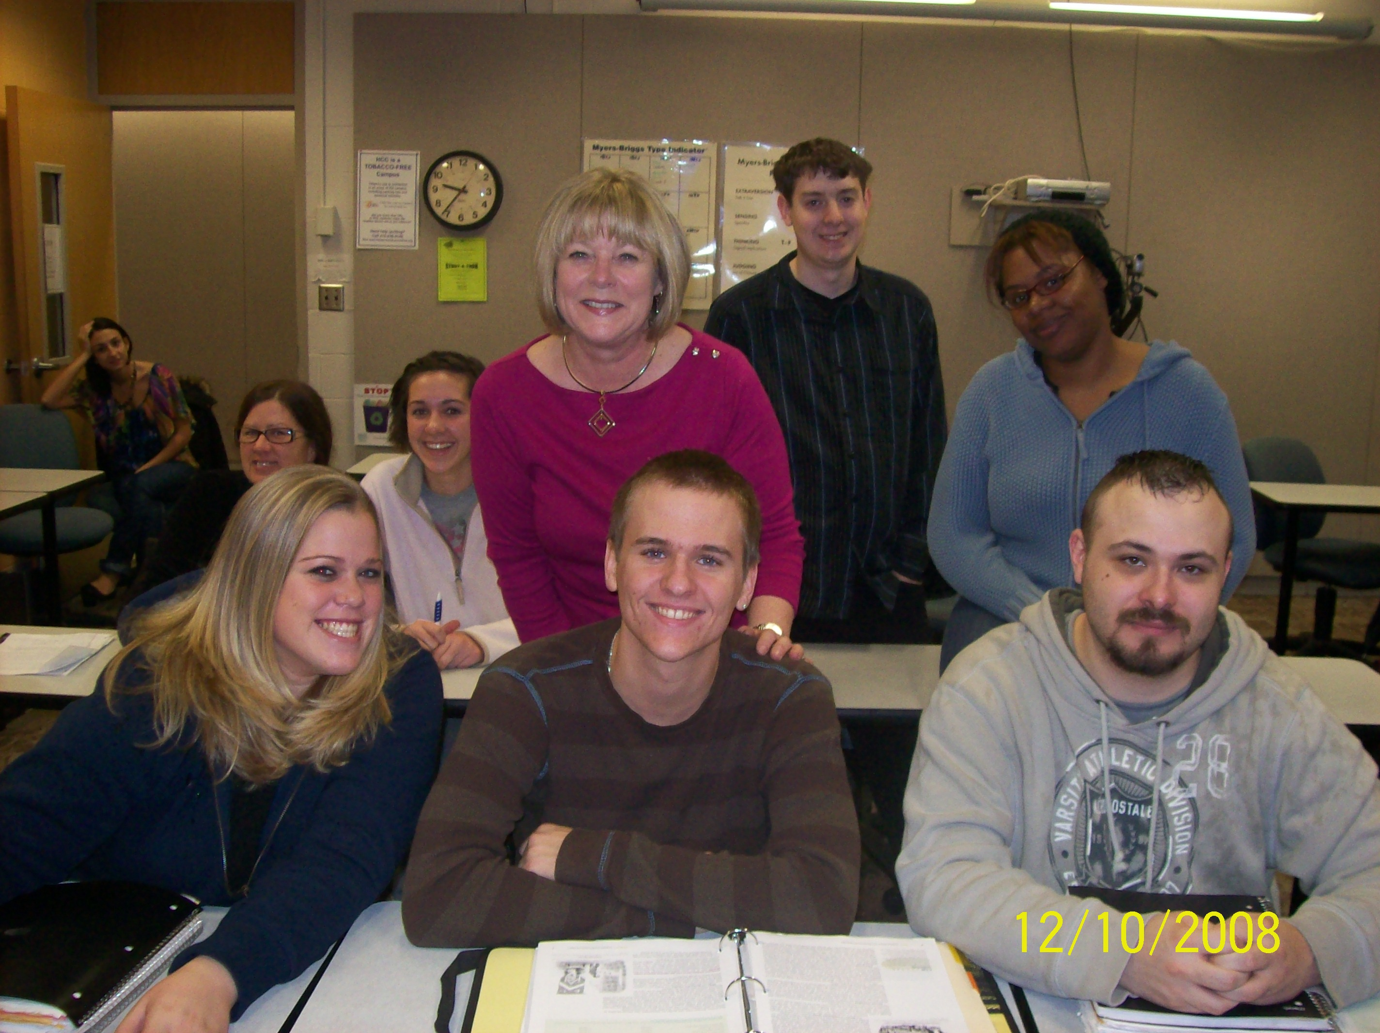
Linda Heil
Harford Community College

Slide 6
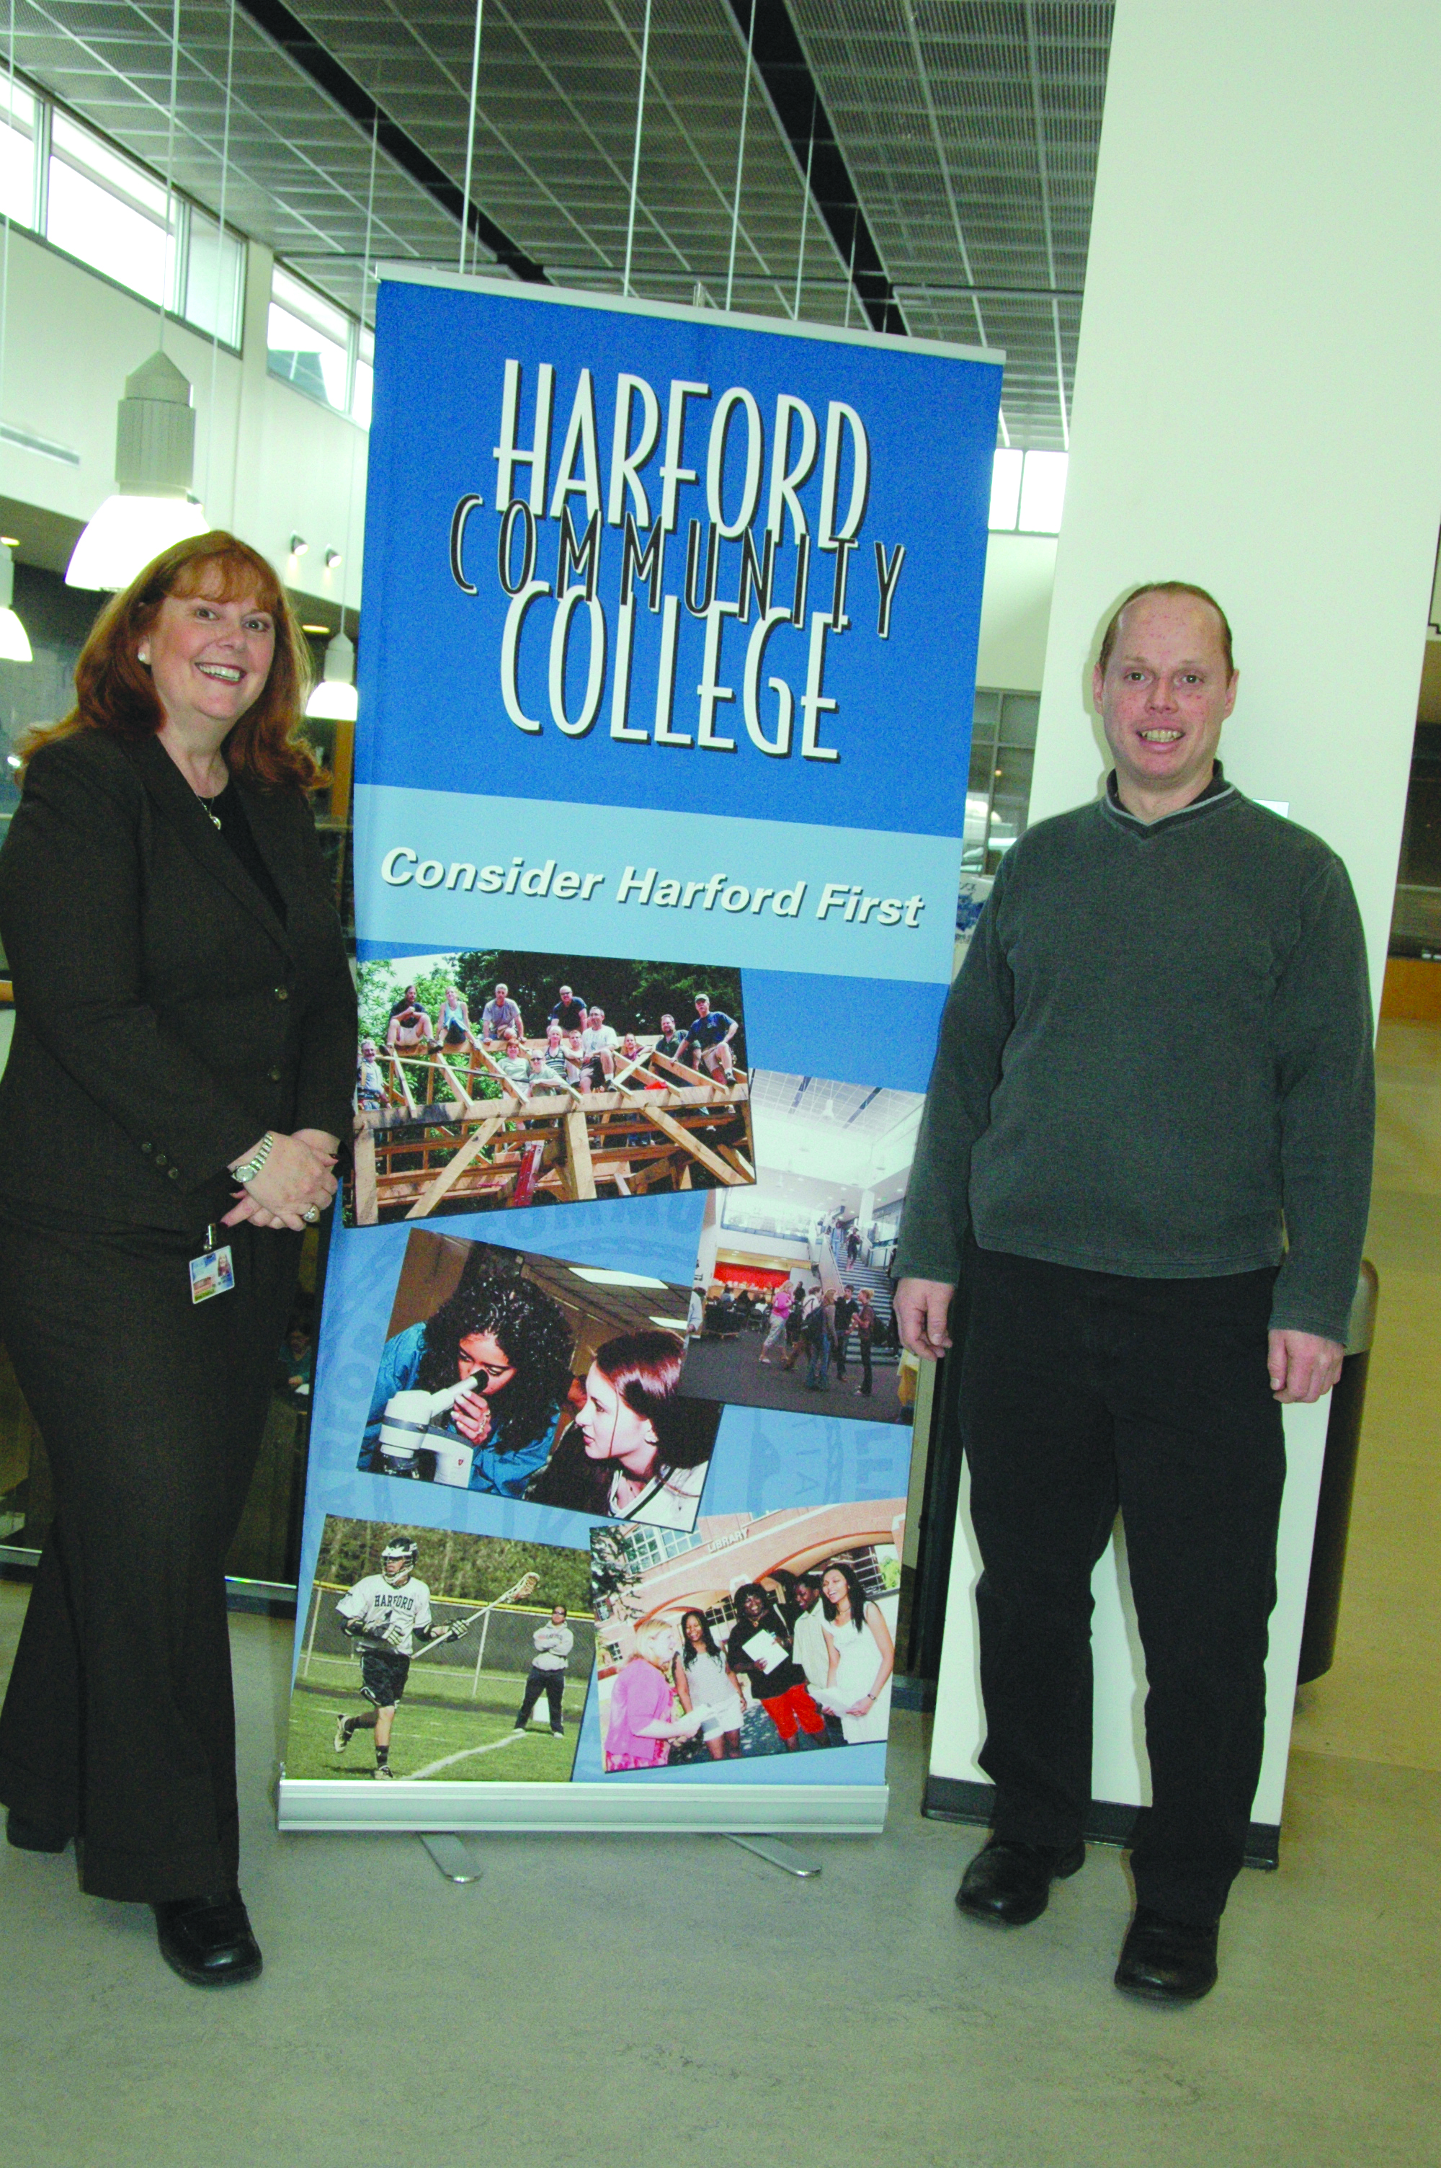
Bonnie Sulzbach
Harford Community College

Slide 7
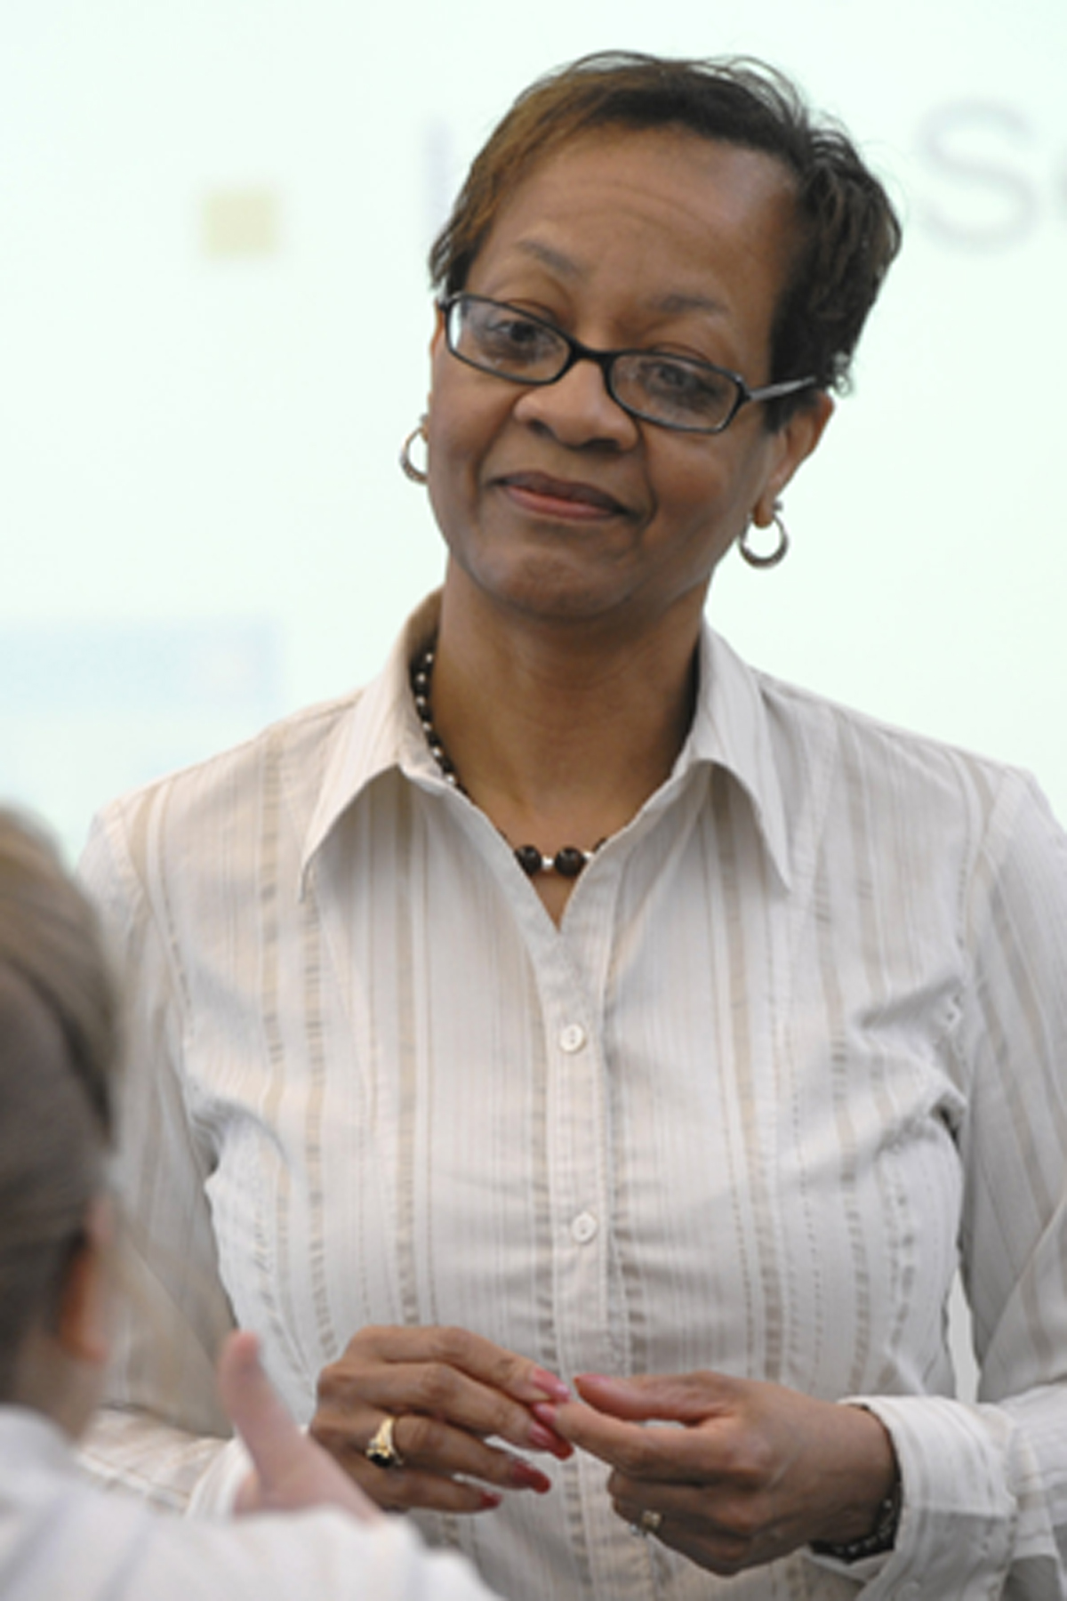
Virginia Mickens
Harrisburg Area Community College

Slide 8
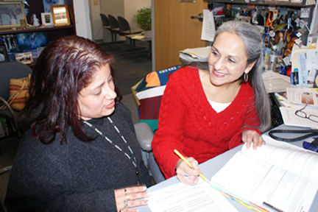
Irma Alicia Villarreal
Harrisburg Area Community College
I strive to teach all students not to settle for anything less than what they really want.

Slide 9
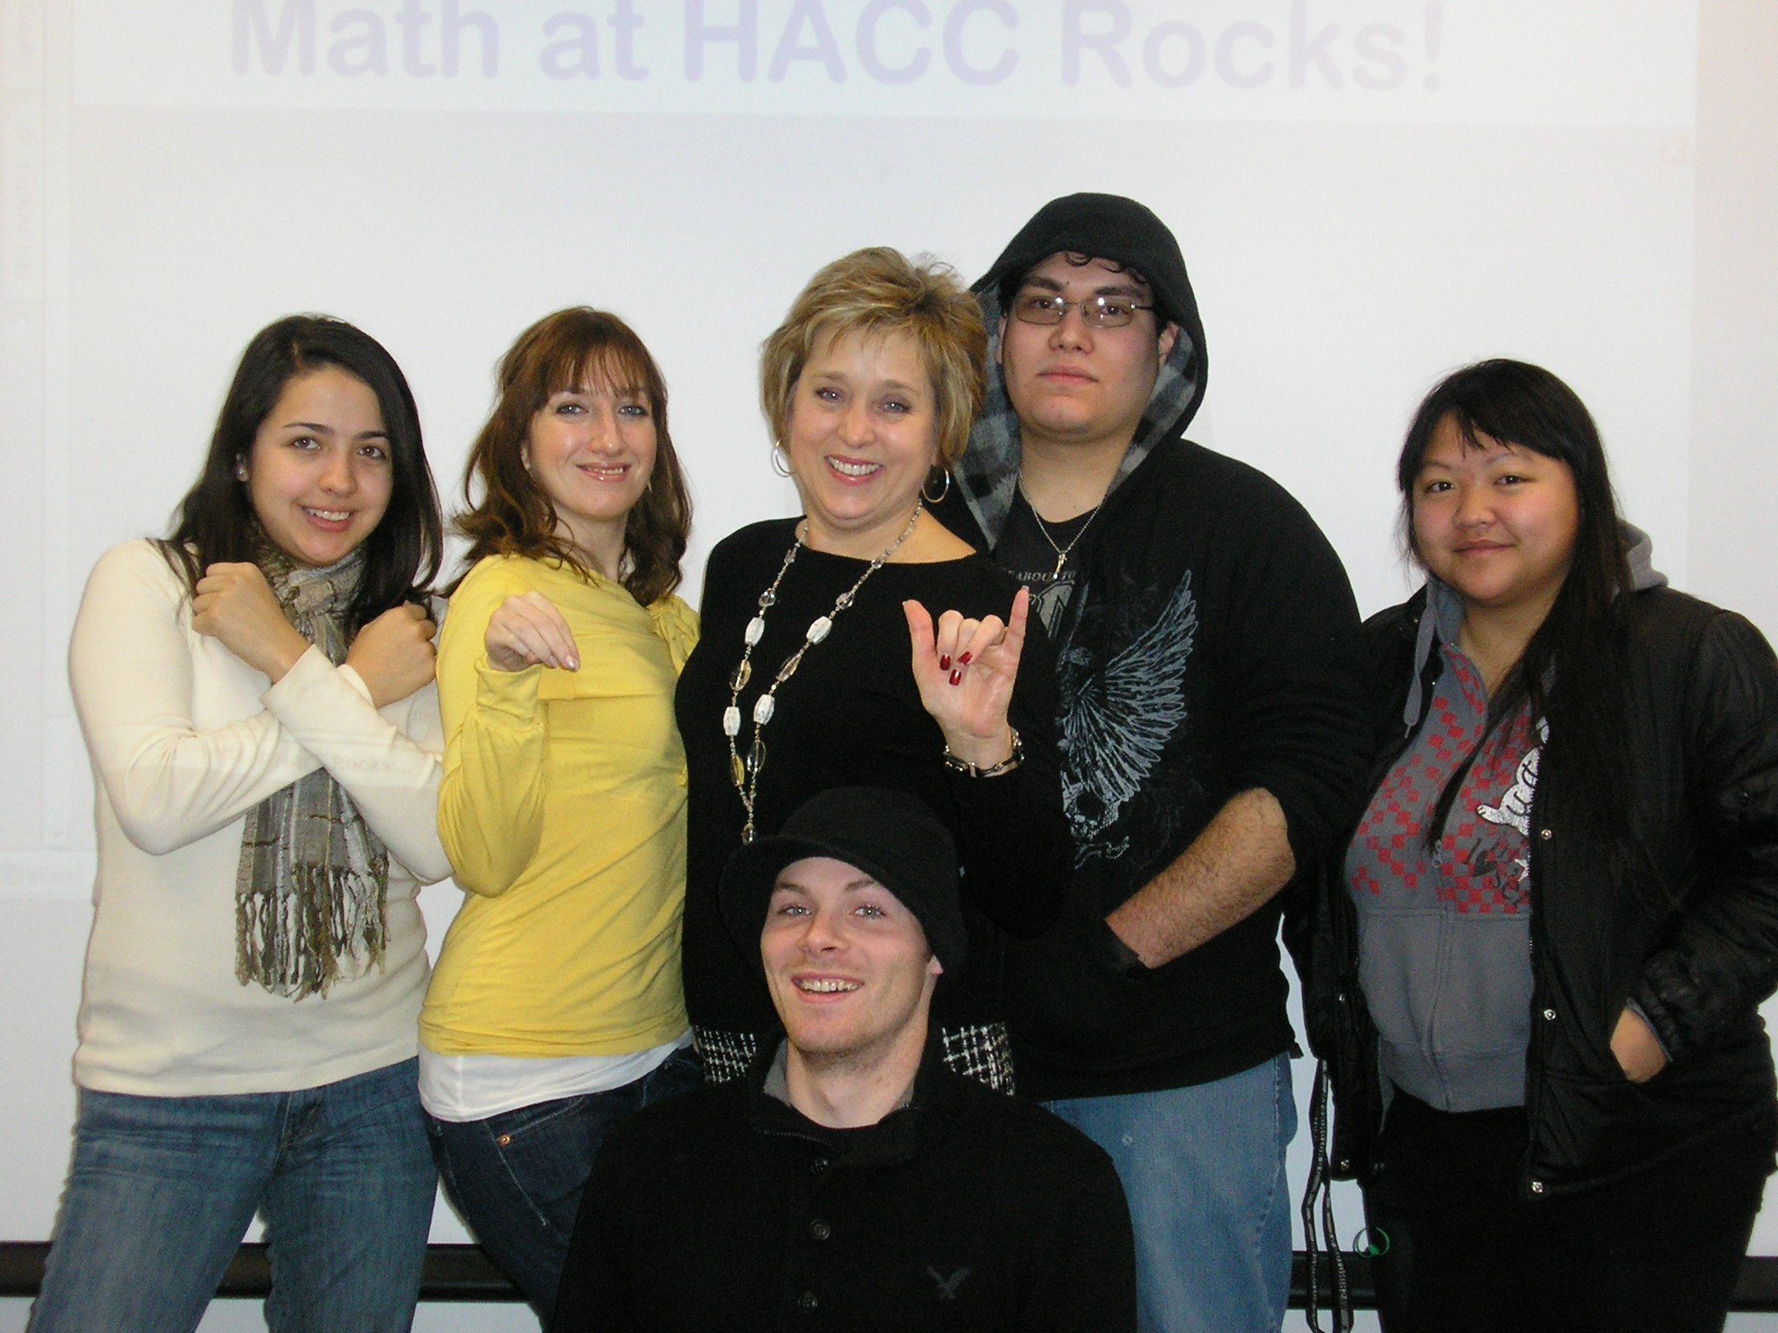
Pamela Watkins
Harrisburg Area Community College
My teaching philosophy has always been: Meet them where they are, but don’t leave them there. I use a variety of techniques and technologies to create an environment that stimulates each student. To promote critical thinking, I encourage students to ask at least one really good question every day.

Slide 10
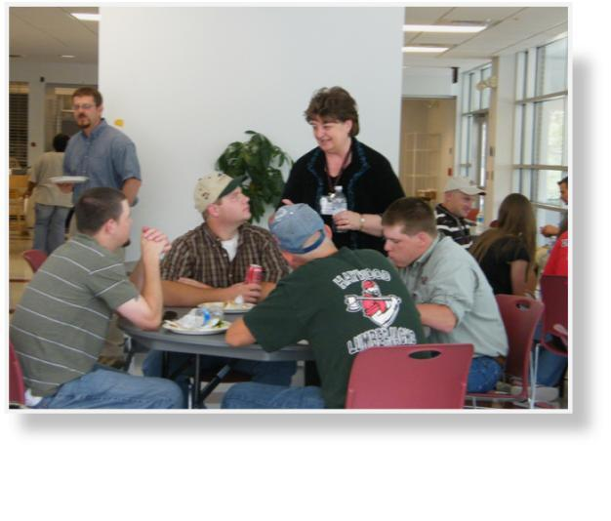
Janice Gilliam
Haywood Community College
The implementation of the community college opened the door for thousands of students to higher education. As student development administrator, it is my job to facilitate that process. As Jack Welch stated in Winning, “We have to make it easier for people to do business with us.”

Slide 11
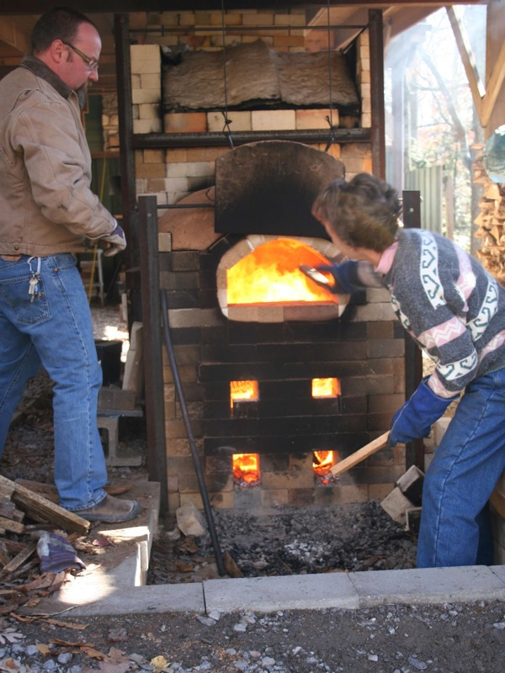
Stephen Lloyd
Haywood Community College

Slide 12
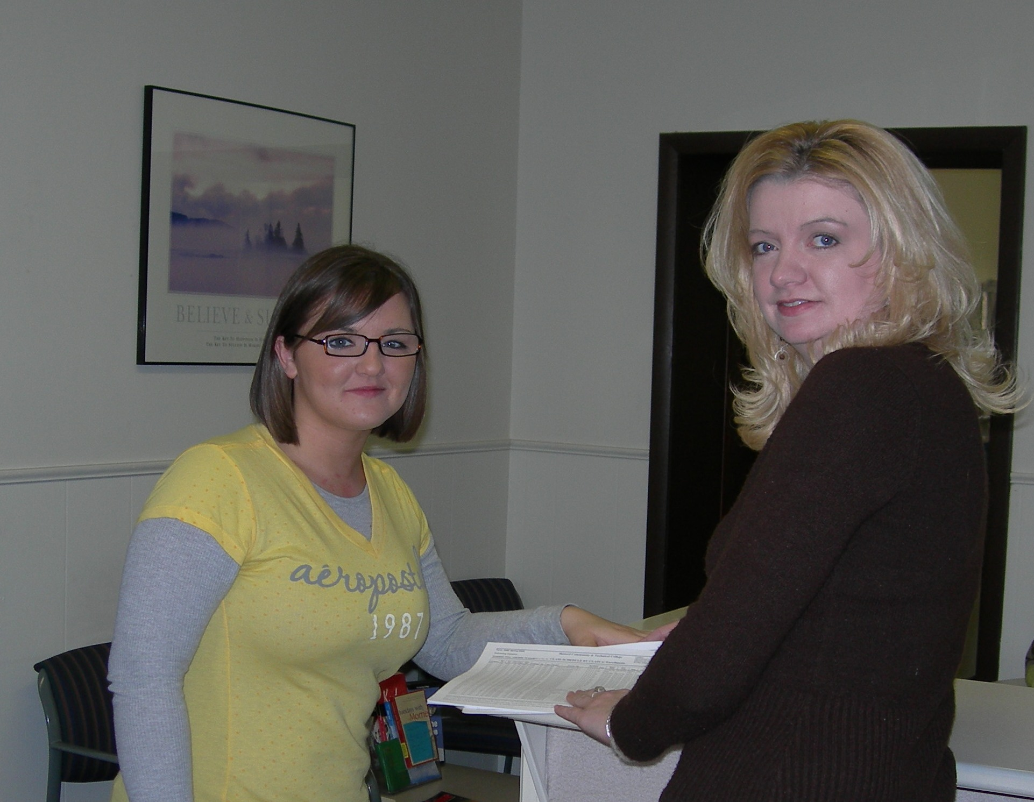
Glenna Fletcher
Hazard Community and Technical College
I am known as the go-to person. I try to help anyone who needs me.

Slide 13
Paul Currie
Hazard Community and Technical College
Teaching is an art, not a science. It is fluid and changing. To improve, the teacher must evolve with it.

Slide 14
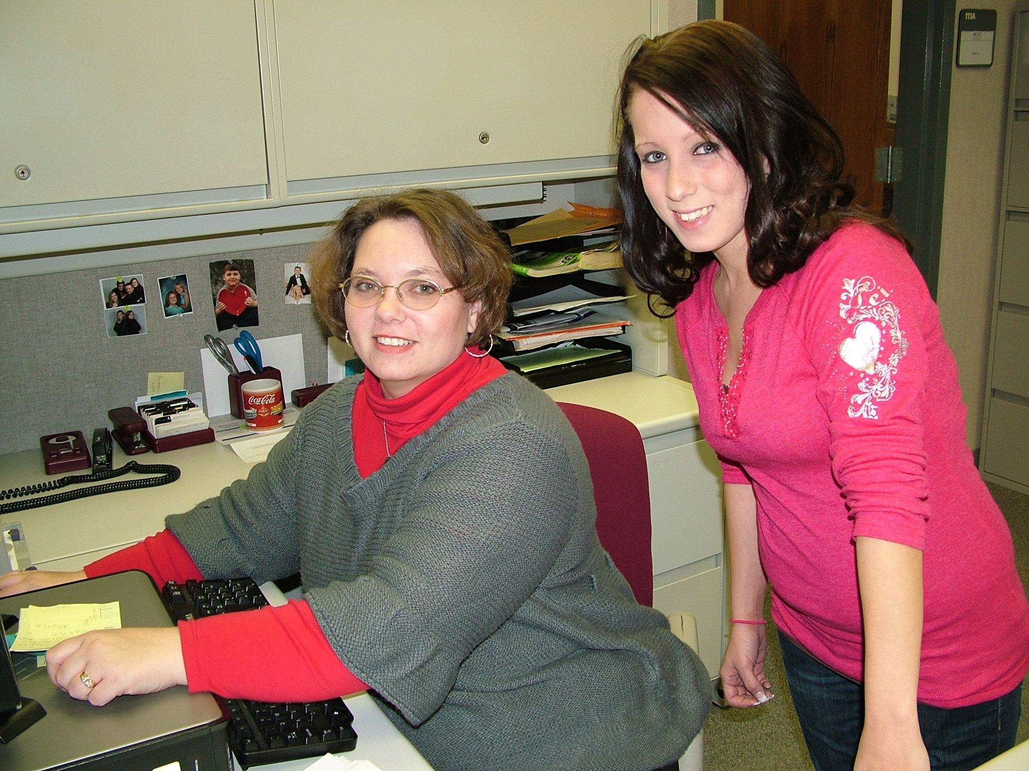
Myla Barrett
Hazard Community & Technical College

Slide 15

Terry Conley
Hazard Community & Technical College
Better to go out looking for trouble before trouble comes looking for you. If something needs attention, try to fix it before it becomes a major issue.

Slide 16
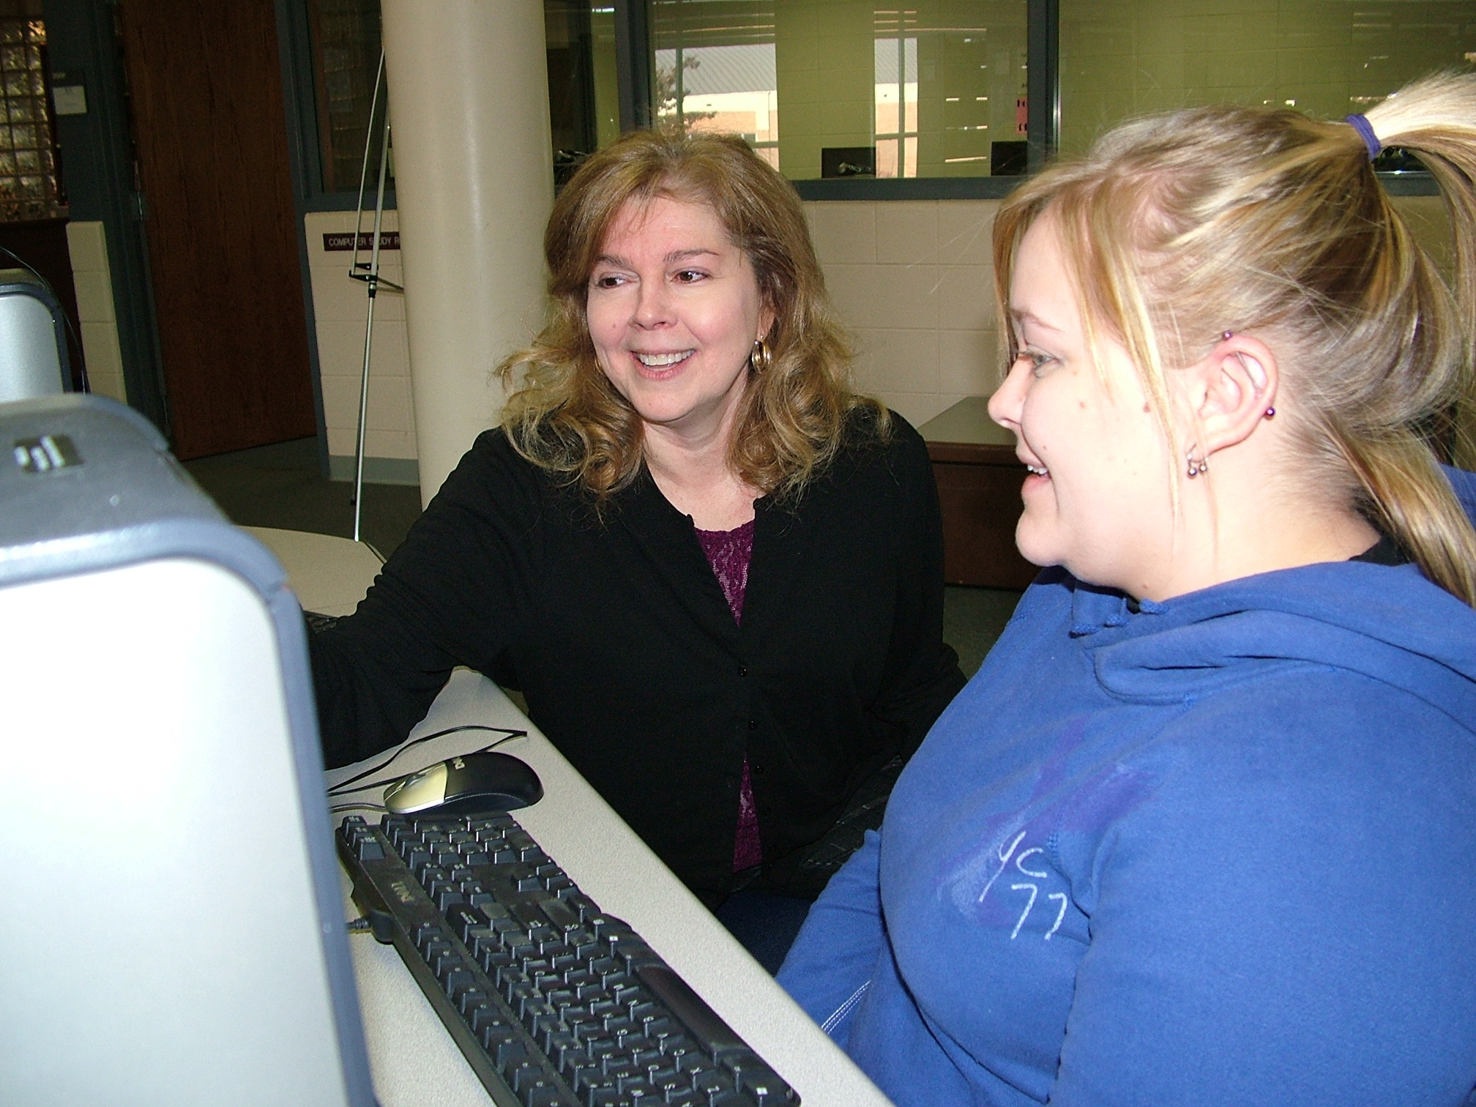
Judy Johnson
Hazard Community & Technical College
I am most inspired when I hear from a student that he or she will be graduating soon. I enjoy reflecting on qualities of the student that likely contributed to their success. It is these individuals who drive me to work harder. To observe an enthusiastic learner triumphantly reaching for a better opportunity is one of life's great gifts, and it is my self-improvement strategy.

Slide 17
Mary Johnston
Henderson Community College
While pursuing my education, I was a nontraditional student on financial aid. My experience allows me to understand the needs and obstacles of our students. Financing their education is a major concern for the majority of our students. I receive my joy and satisfaction from guiding them through the financial aid process that will permit them to finance their dreams of an education and a satisfying career.

Slide 18
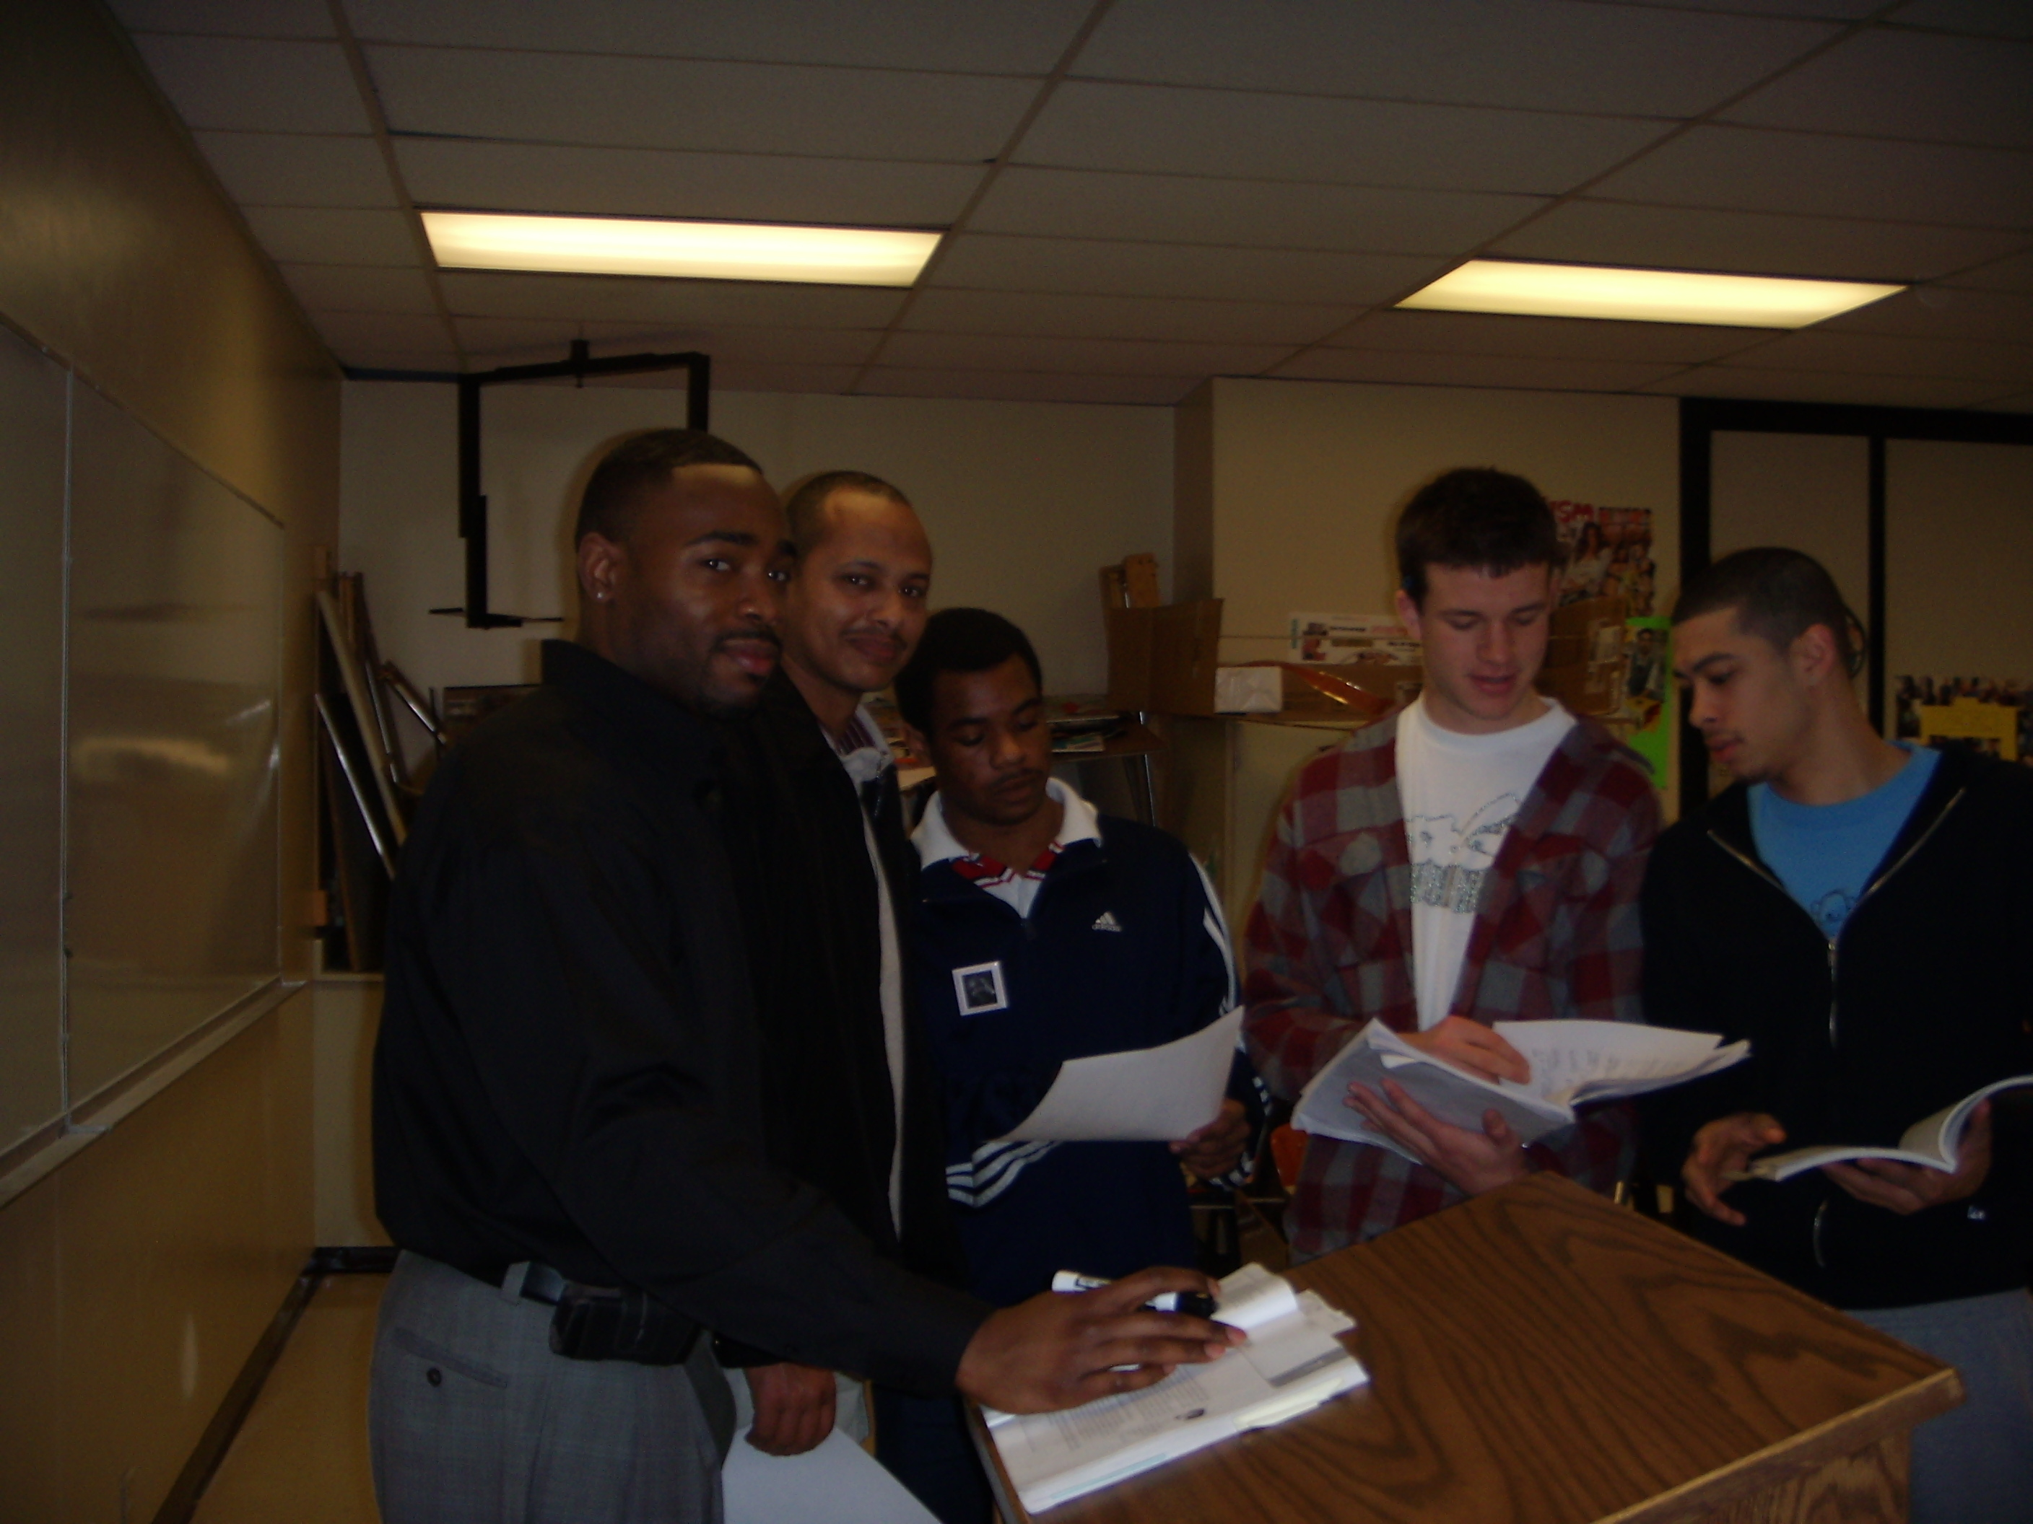
Darryl Brice
Highline Community College
In his Nobel Prize acceptance speech, Martin Luther King Jr. said, ‘I believe that what self-centered men have torn down, men other-centered can build up.’ I try to be other-centered in my work with students, and I encourage students to approach life from this other-centered point of view.

Slide 19
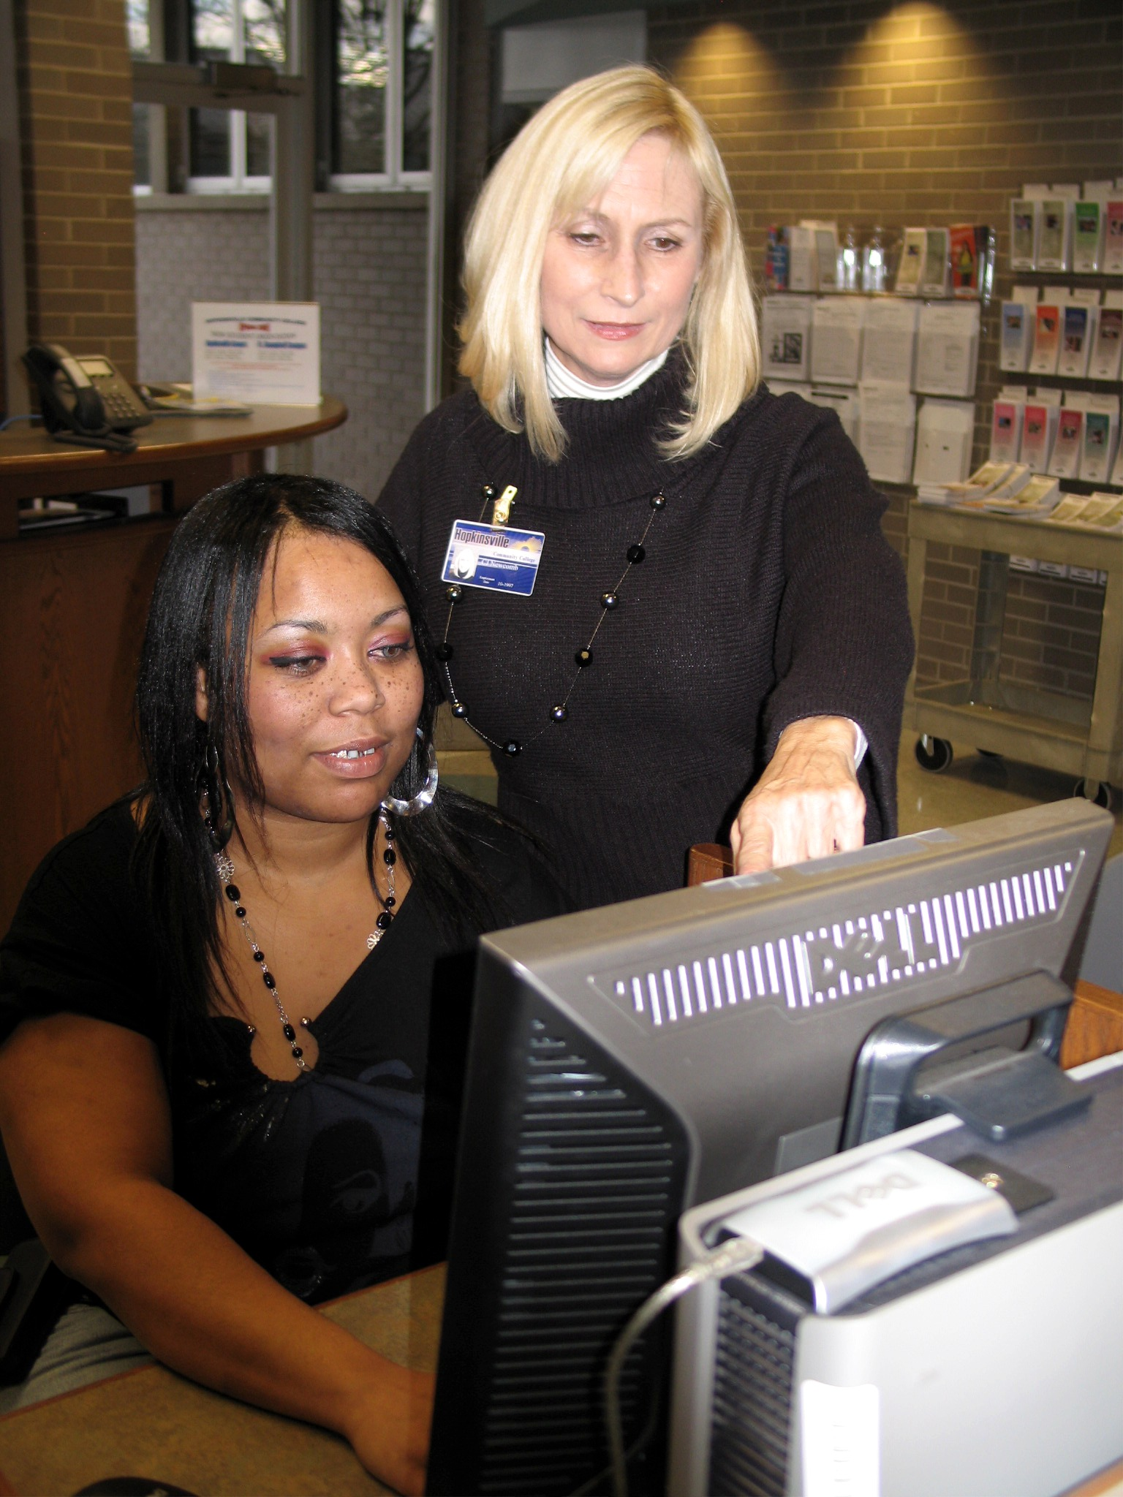
Carol Newcomb
Hopkinsville Community College

Slide 20
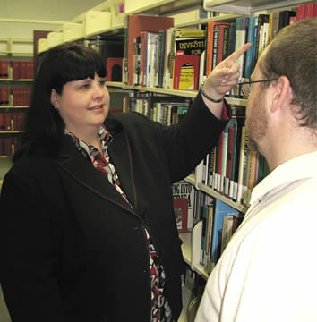
Ann Nichols
Hopkinsville Community College

Slide 21
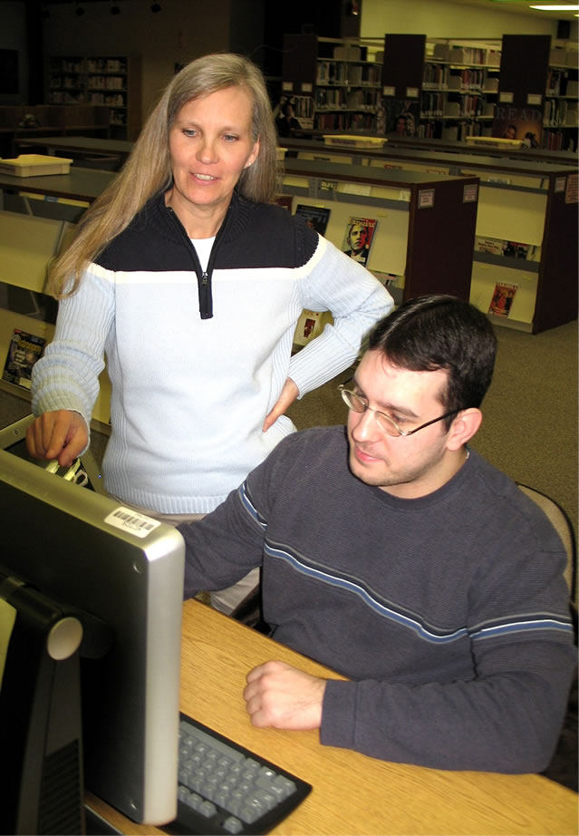
Kathy Saleeba
Hopkinsville Community College
The technology-rich environment of higher education can be quite daunting for many students. It is rewarding to see a students demeanor change from frustration to elation as we solve a technology challenge together. I’m able to teach people essential skills outside a formal classroom, and that’s just cool!

Slide 22
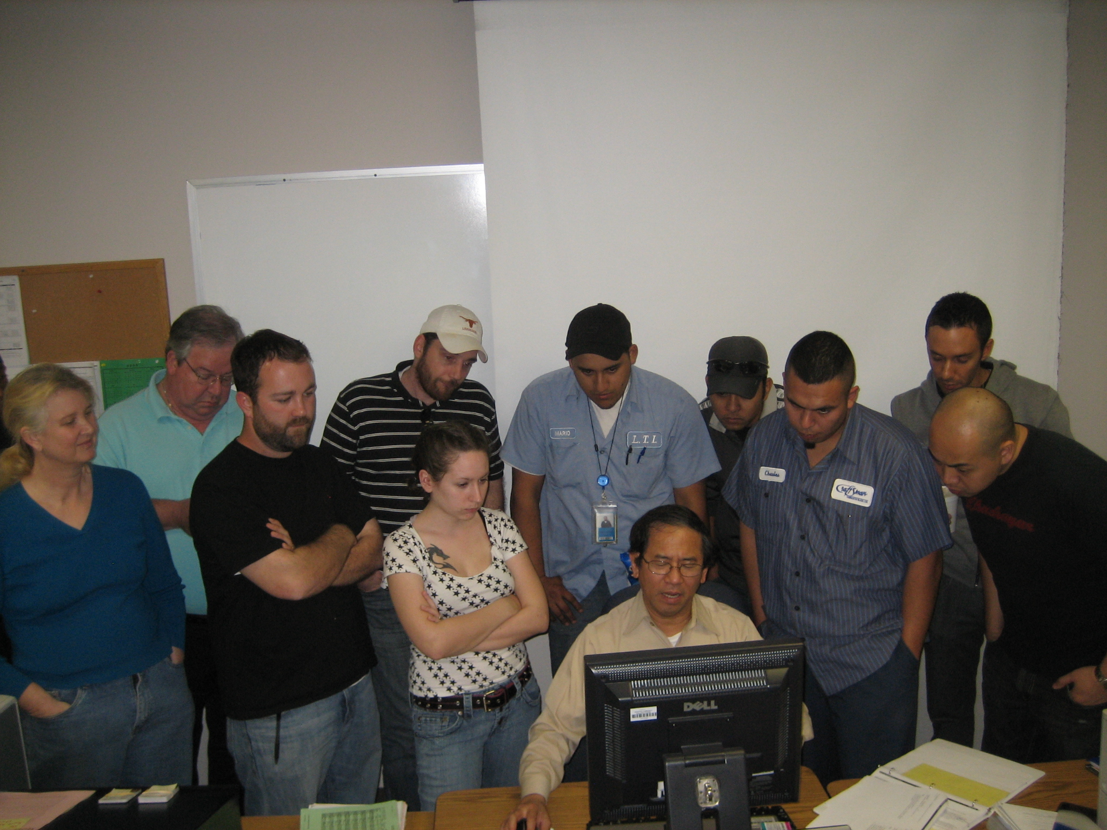
Ha Francis
Houston Community College

Slide 23
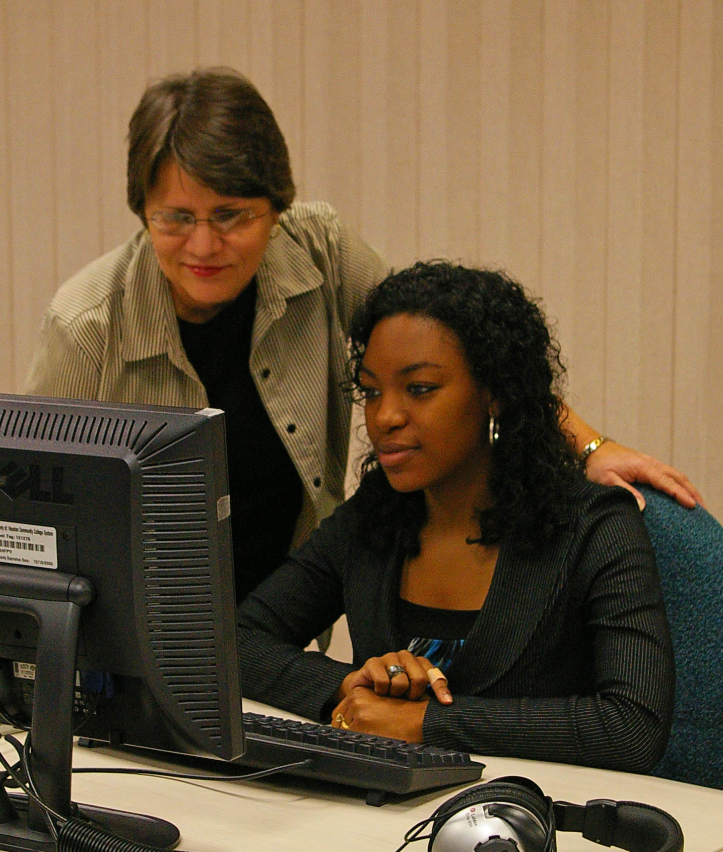
Paulette Heidbreder
Houston Community College
Whenever students whine that school is too hard, I think of Lasundra. While in my class, Lasundra, a grandmother, faced life-threatening health problems. Her minister and doctor warned she’d die if she didn’t quit college. She insisted she’d die if she did. Two years later I was privileged to attend her graduation. Teachers inspire; so can students.

Slide 24
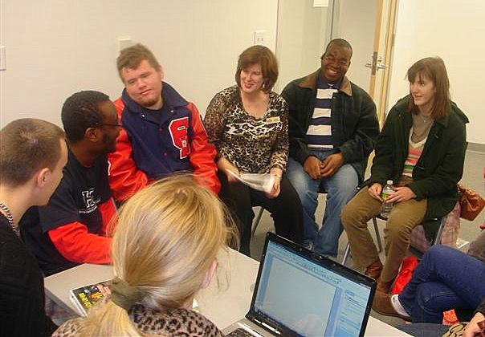
Sue Moraska
Houston Community College
I see my role as facilitator—to inspire students to learn by creating a warm, fun, and collaborative environment where each student feels valued. Teaching students how to learn is just as important as the content itself.

Slide 25
Michelle Muhammad
Houston Community College
My mother said: ‘I do not care what you decide to do, I just want you to be the best at what you do.’ Along with these words and the fact that I love and respect the human body, nothing gives me more happiness than to teach someone how to care for and repair it properly.

Slide 26
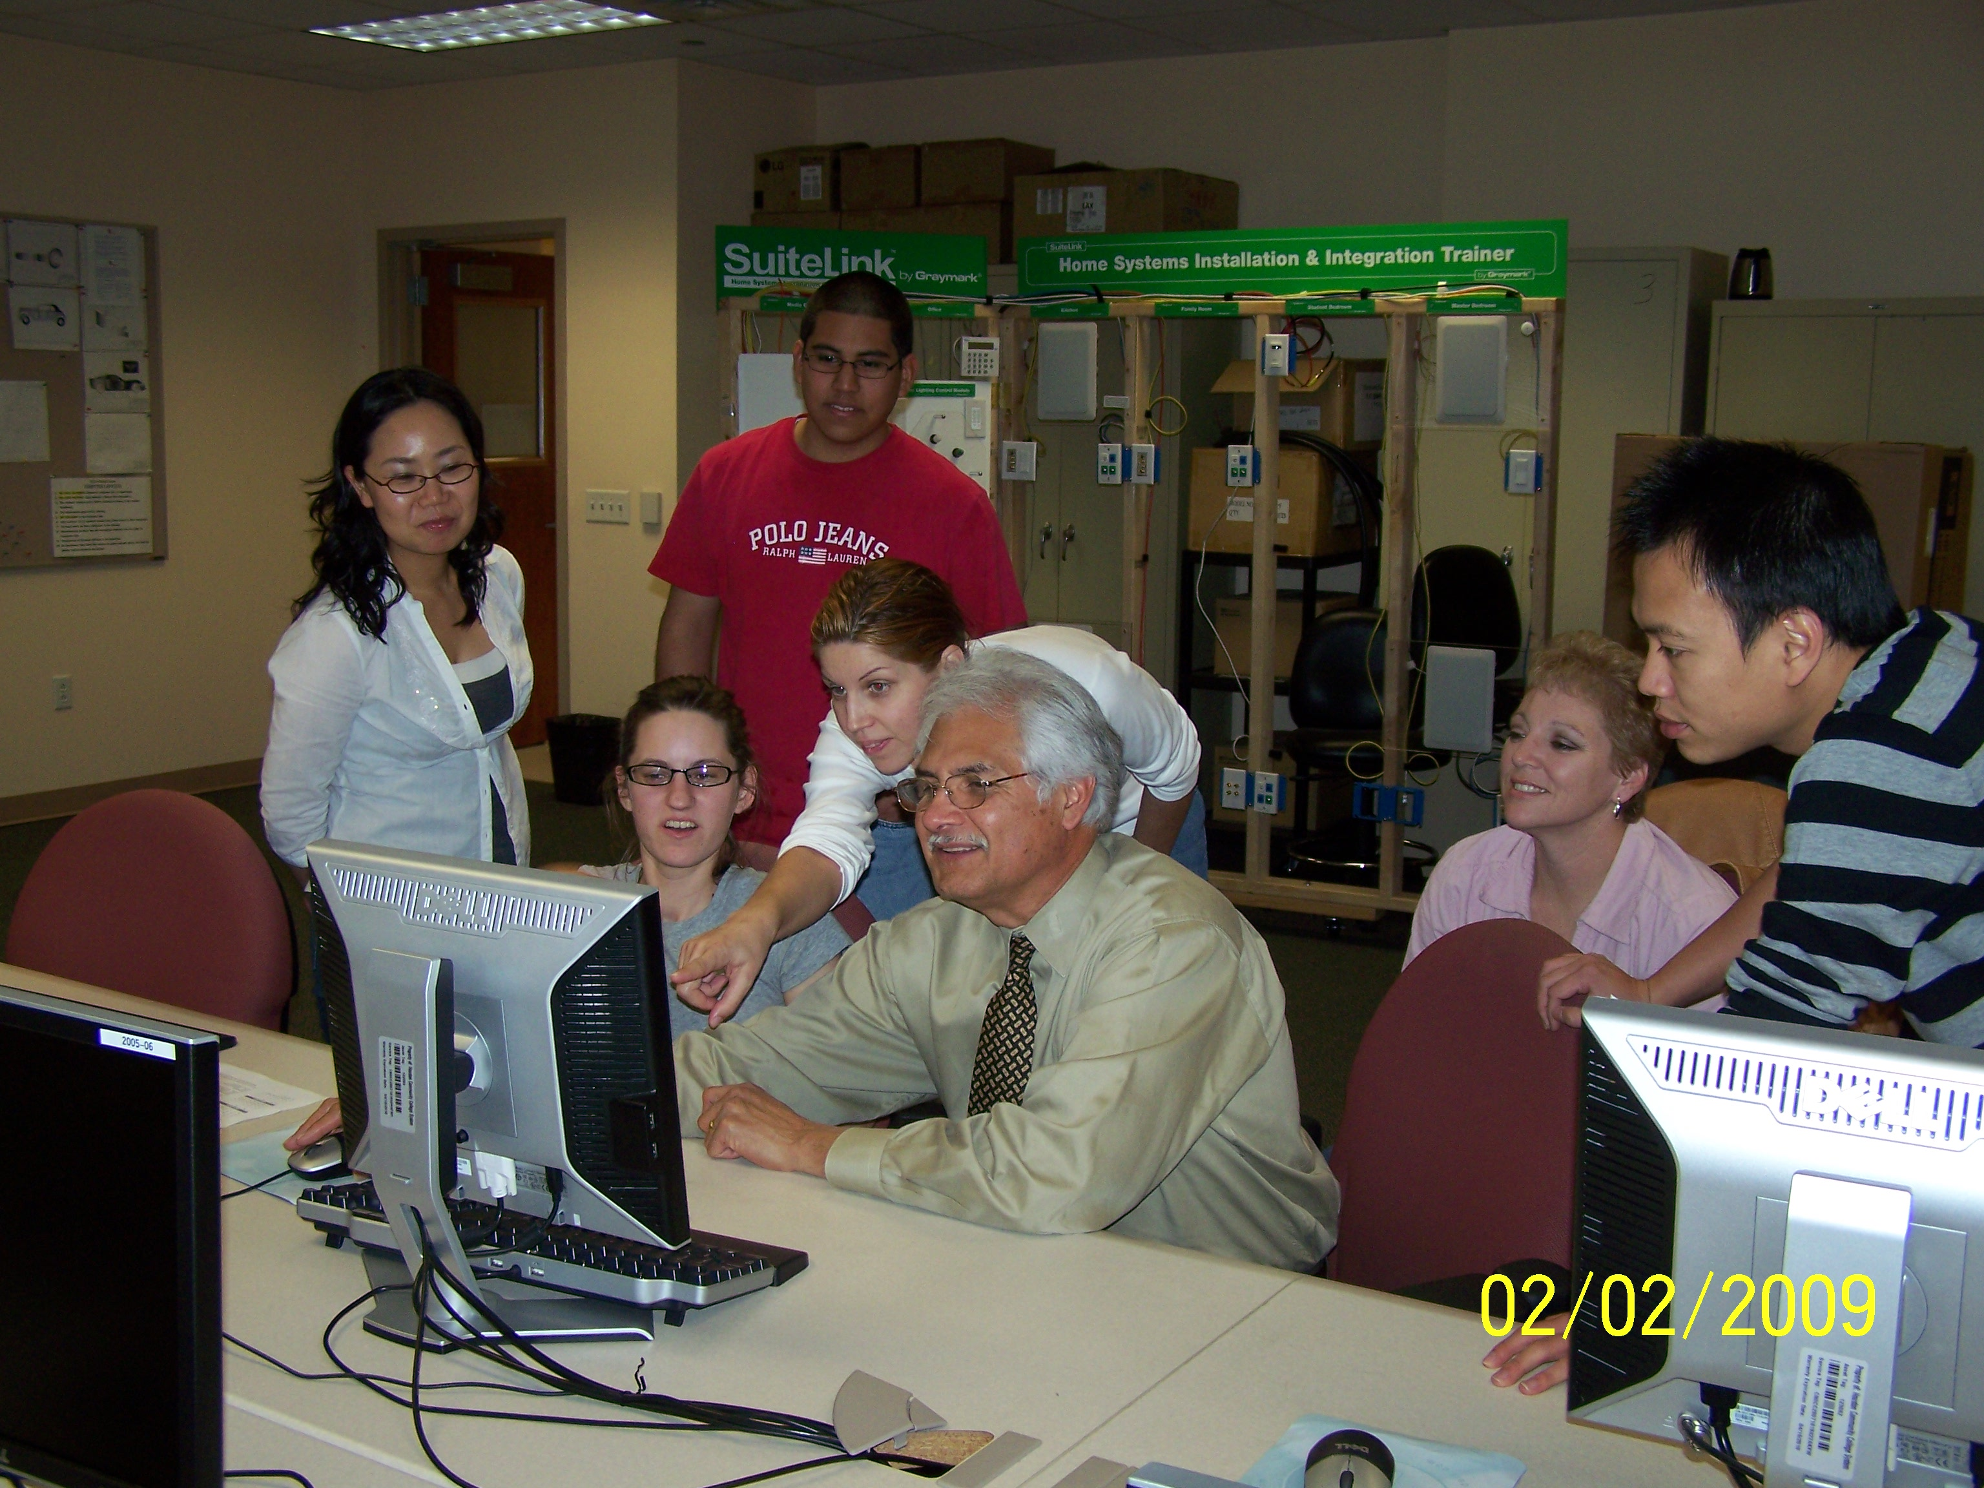
Frank Ortiz
Houston Community College

Slide 27
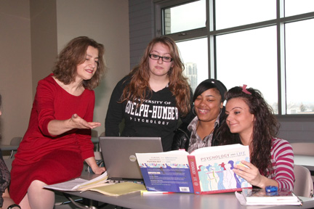
Rena Borovilos
Humber College
If I attribute my success to anyone, it's my students. They motivate and inspire me. In the words of Ben Sweetland: ‘We cannot hold a torch to light another's path without brightening our own.’

Slide 28
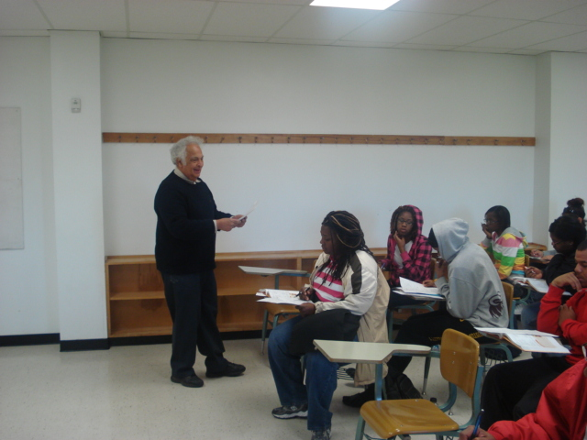
Horacio Pena
Huston-Tillotson University

Slide 29
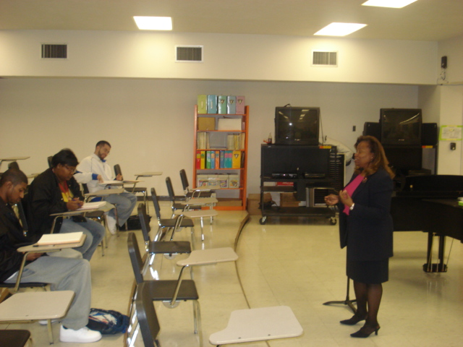
Gloria Quinlan
Huston-Tillotson University

Slide 30
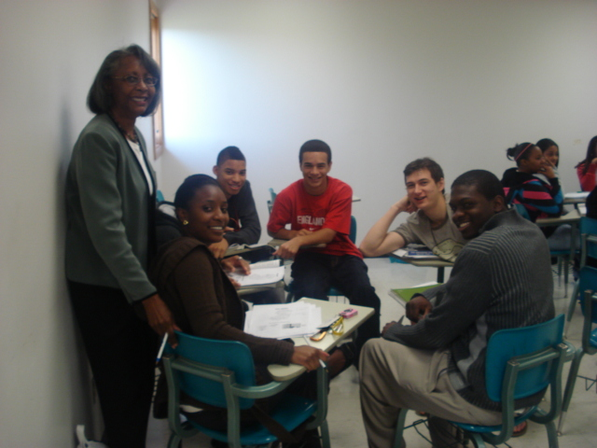
Janice Sumler-Edmond
Huston-Tillotson University

Slide 31
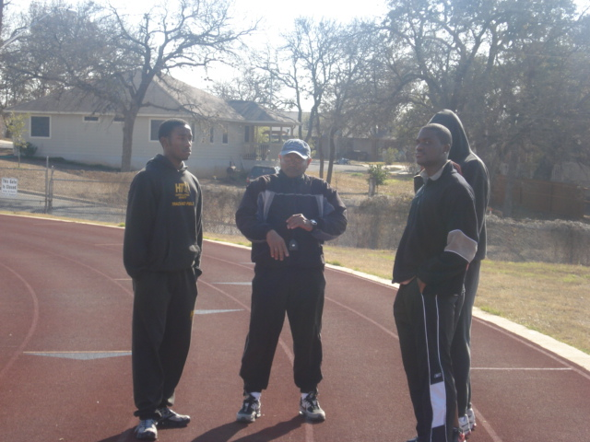
Howard Ware
Huston-Tillotson University
I push athletes to realize that they're capable of achieving more than what they are doing.

Slide 32
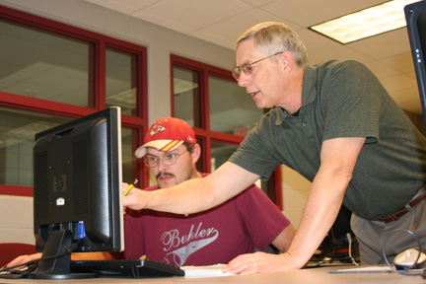
Vince Puyear
Hutchinson Community College
As a teacher educator, I strive for teaching excellence because I believe that if I provide a classroom environment which models learning engagement, exemplifies the value of relationships, and supports the development of a learning community, my students have the potential to affect positively the lives of their own students using these same techniques.

Slide 33
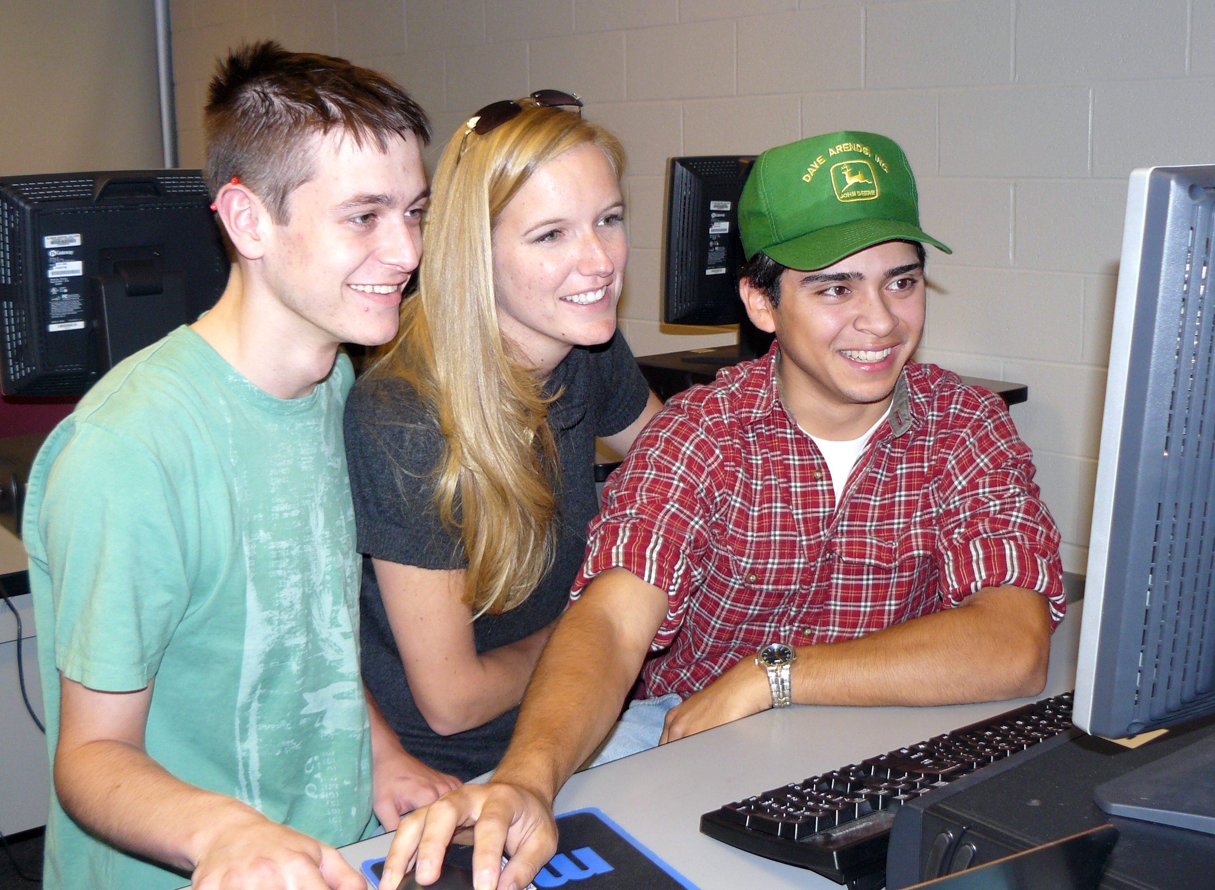
Elizabeth Baldridge
Illinois Central College

Slide 34
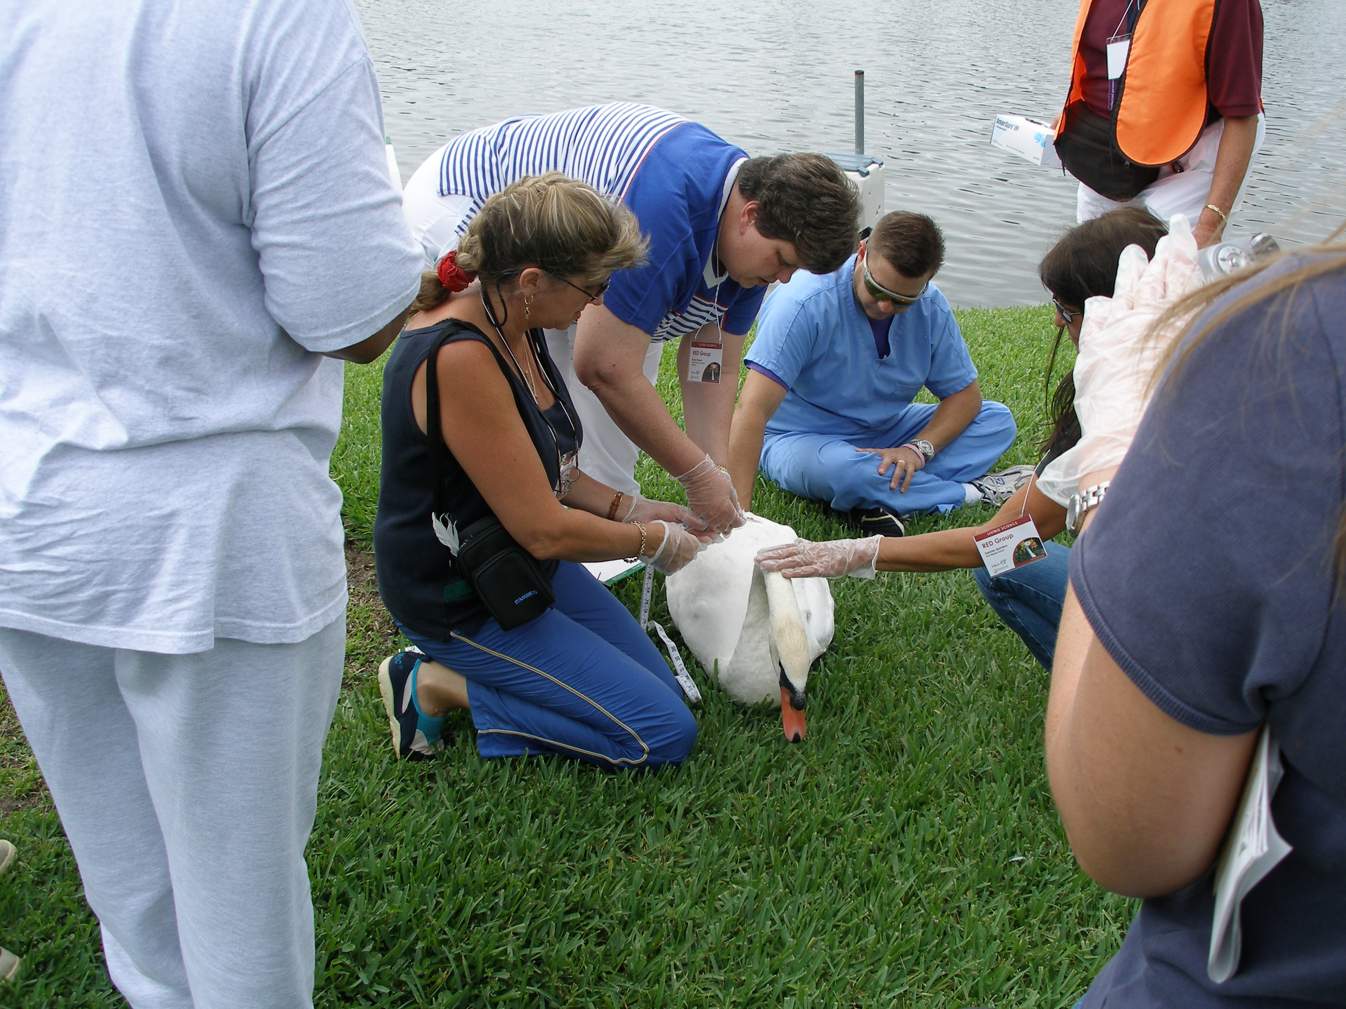
Sherry Bowen
Indian River State College

Slide 35
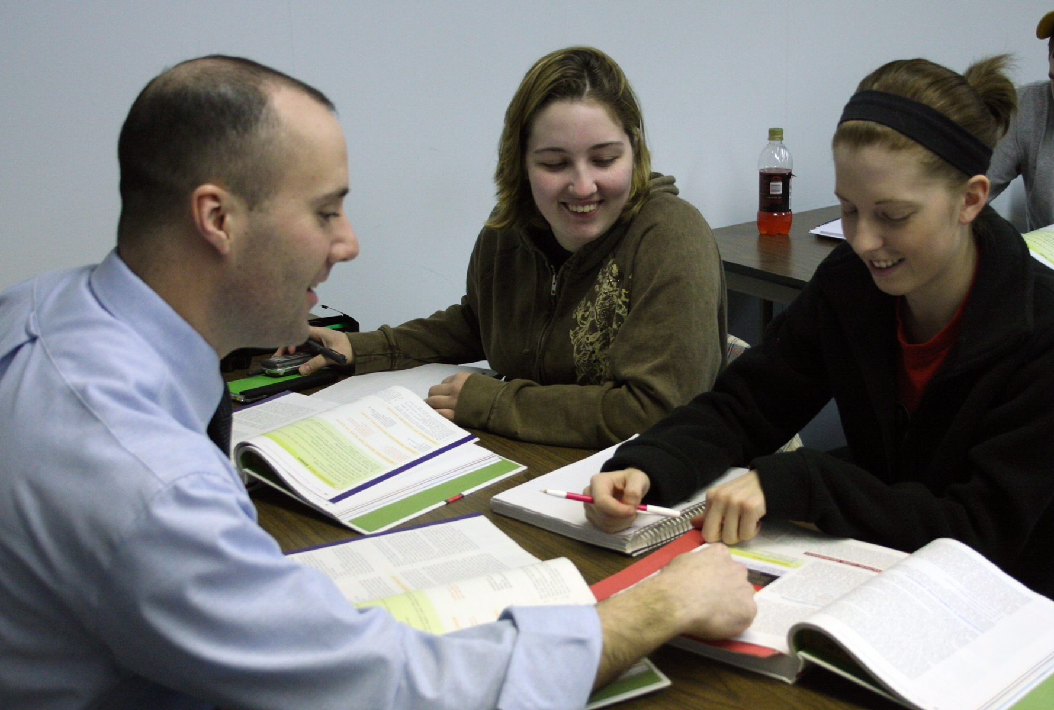
David Barwin
Iowa Central Community College
I am inspired and motivated to be the best instructor I can be; I believe the better I am, the better the students will be. Leading the students through a positive learning experience in the college environment and getting them engaged is my strategy for success.

Slide 36
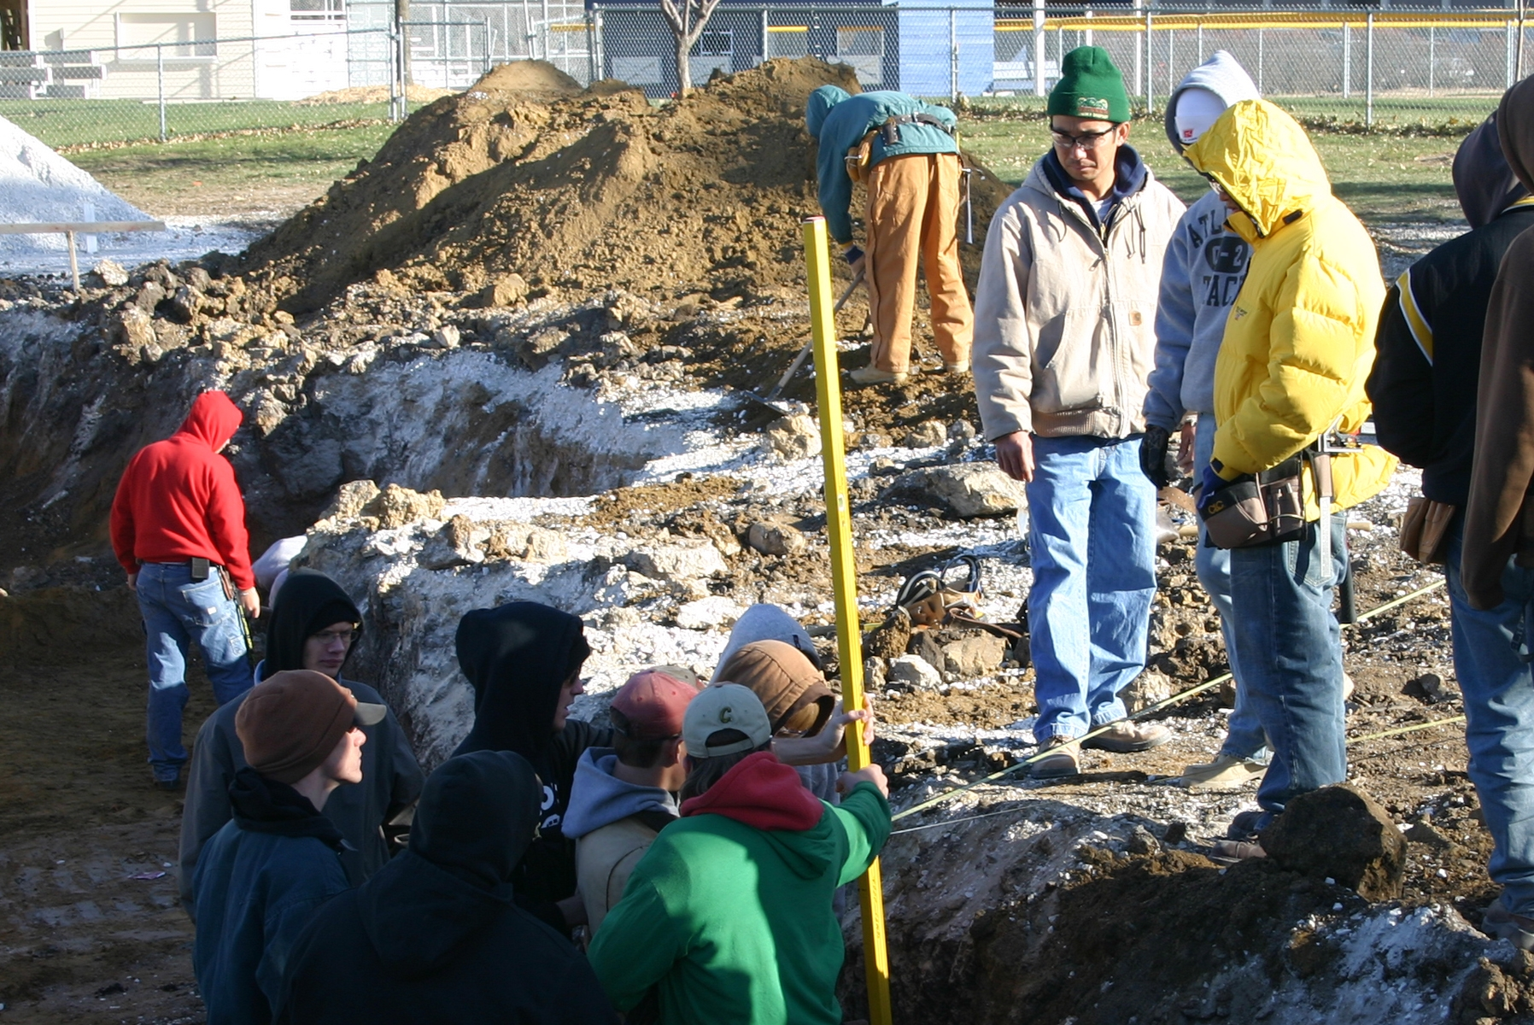
Sone Chounthirath
Iowa Central Community College
Given the chance to be in America, I like to demonstrate to the students what its possible to achieve through hard work and dedication to your work. I push my students to take full advantage of the opportunities they have available to them and to do their best.

Slide 37
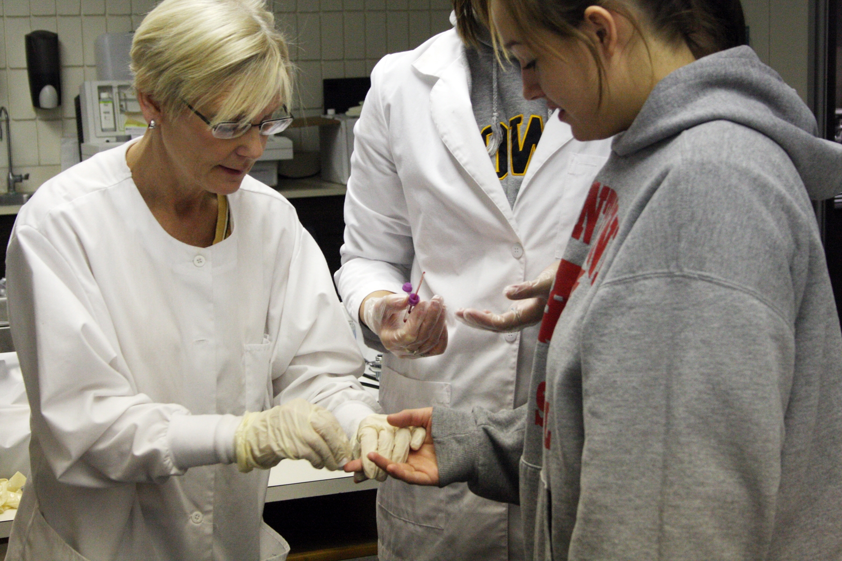
Kate Stuart
Iowa Central Community College

Slide 38
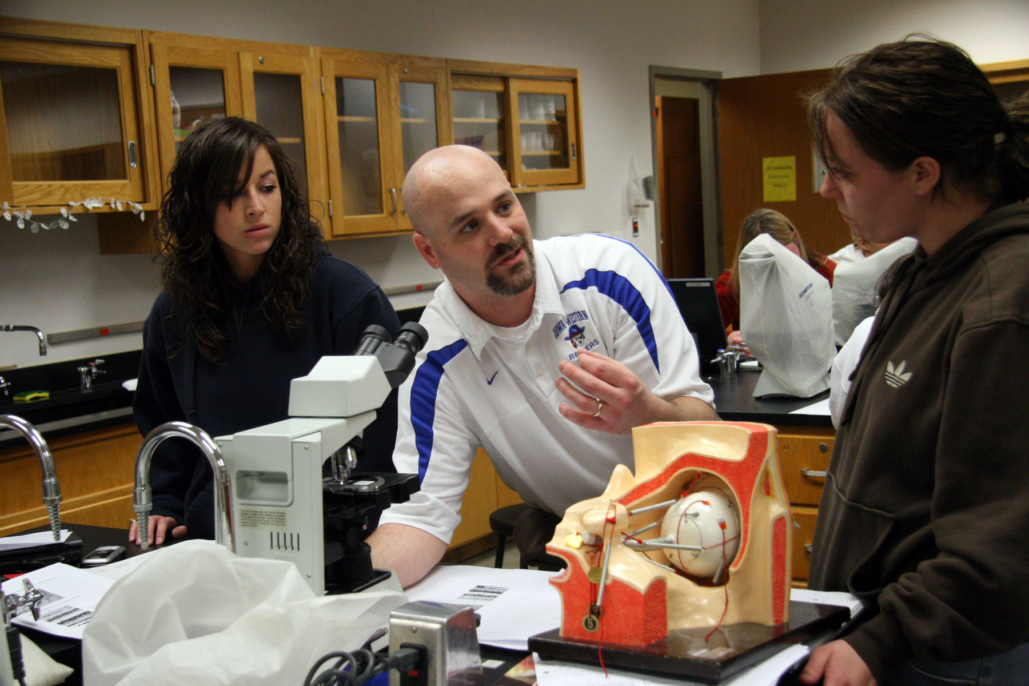
Brian Berthelsen
Iowa Western Community College
As a teacher educator, I strive for teaching excellence because I believe that if I provide a classroom environment which models learning engagement, exemplifies the value of relationships, and supports the development of a learning community, my students have the potential to affect positively the lives of their own students using these same techniques.

Slide 39
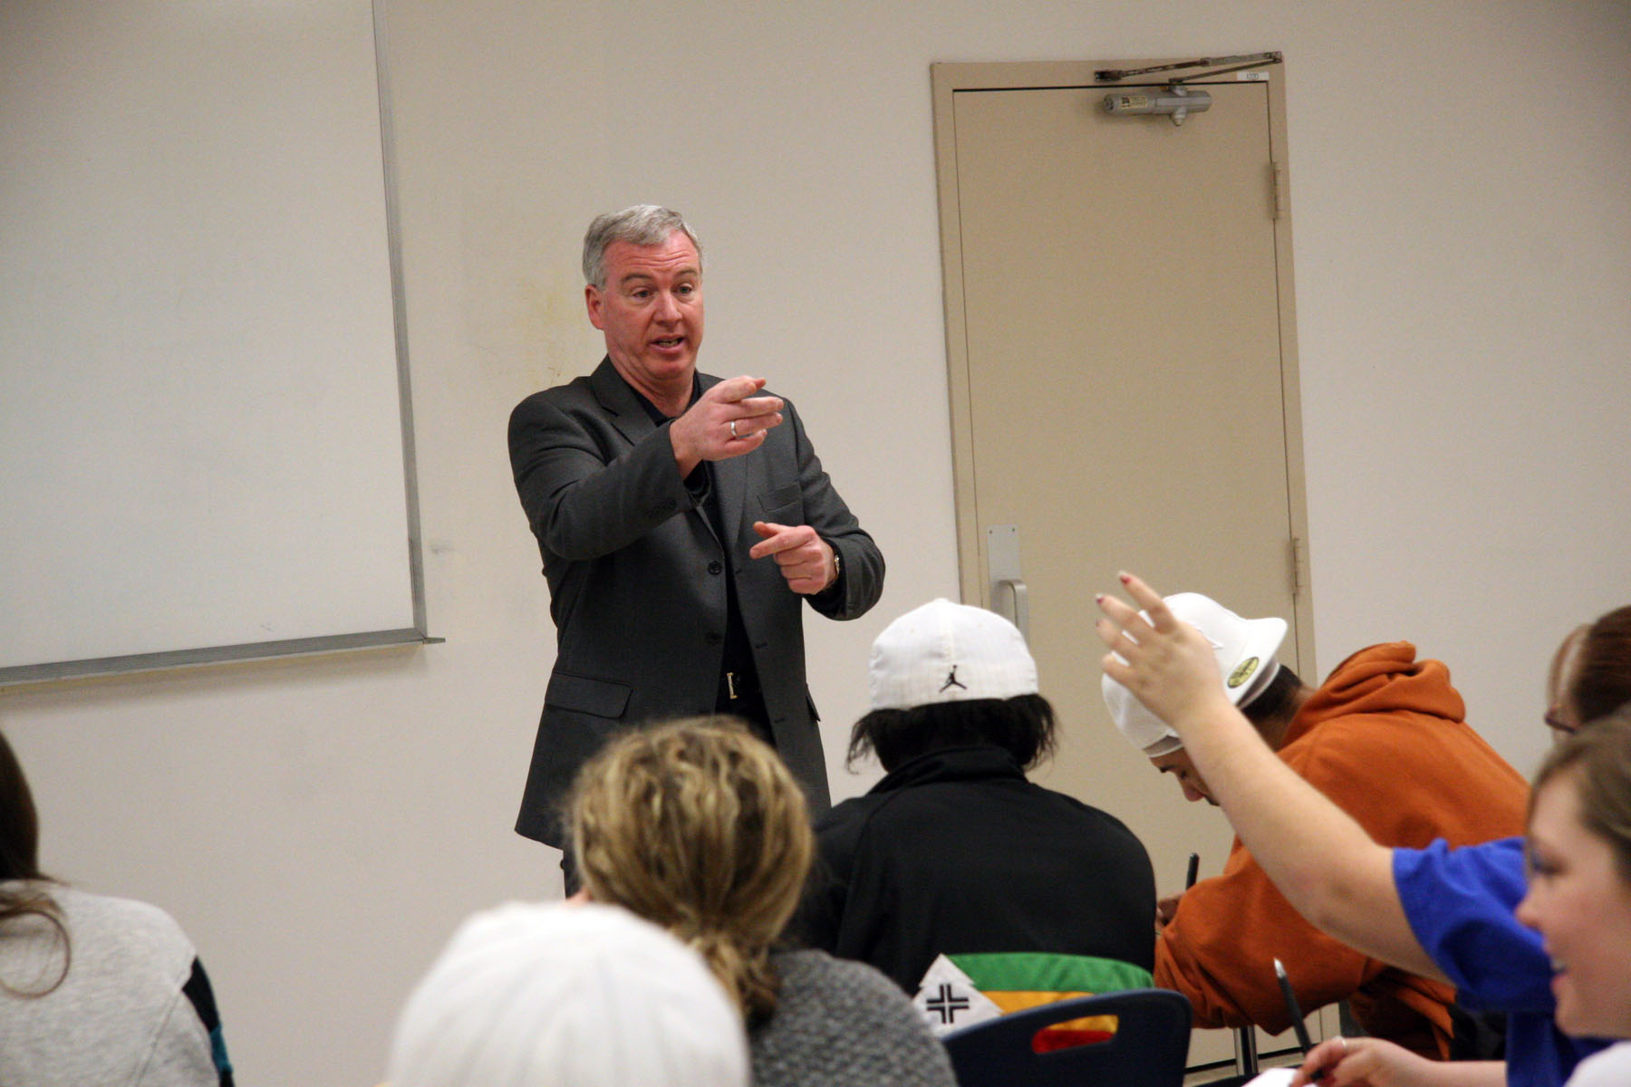
James Davey
Iowa Western Community College
I strive to bring to the classroom all that I have experienced in my past careers and my personal life. I believe in effectively communicating with enthusiasm, passion, and conviction.

Slide 40
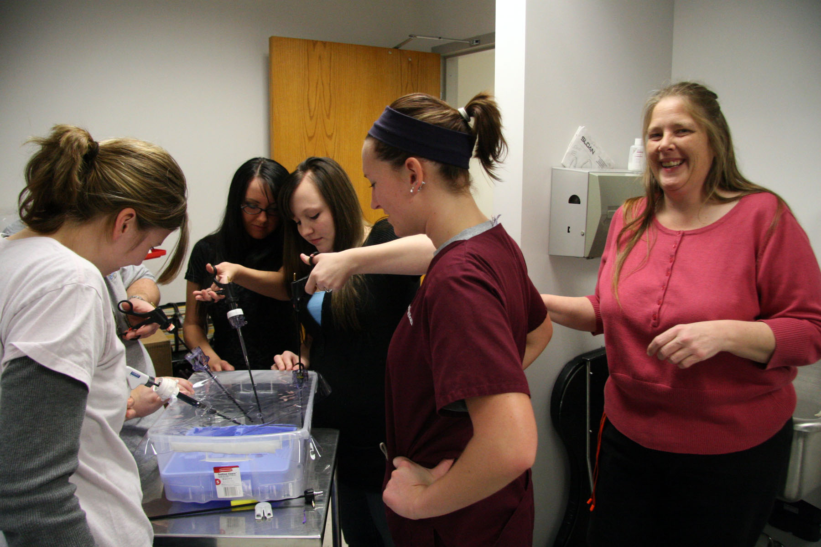
Toni Steward
Iowa Western Community College
I'm delighted to share my expertise and shape the practitioners of tomorrow, and I'm excited to learn all that the students can teach me.

Slide 41
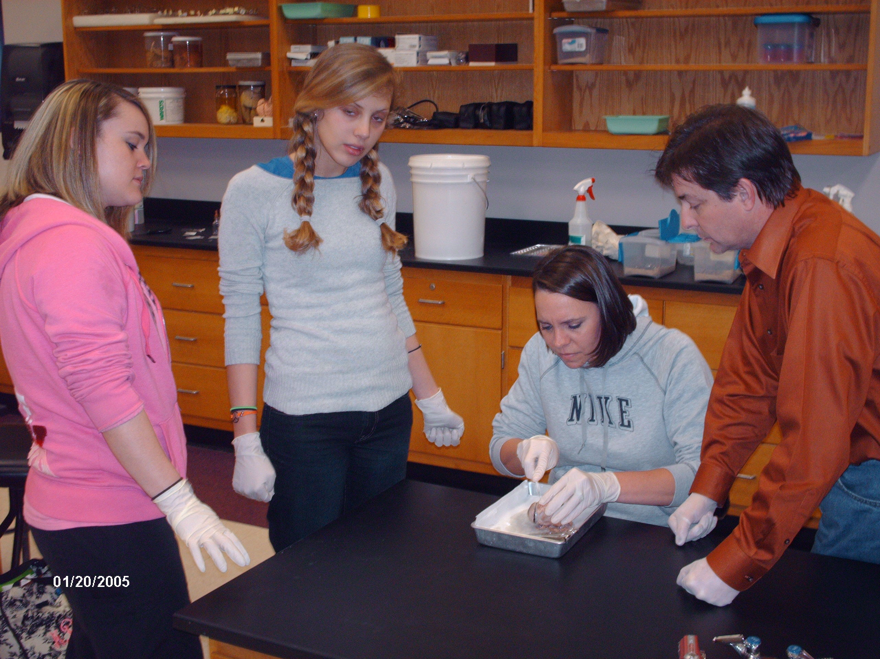
Creig Sherrer
Itawamba Community College
In our competitive society, it is important for students not only to receive a solid education, but to learn from someone who is aware of and sensitive to their individual needs. My desire is that I can be that someone.

Slide 42
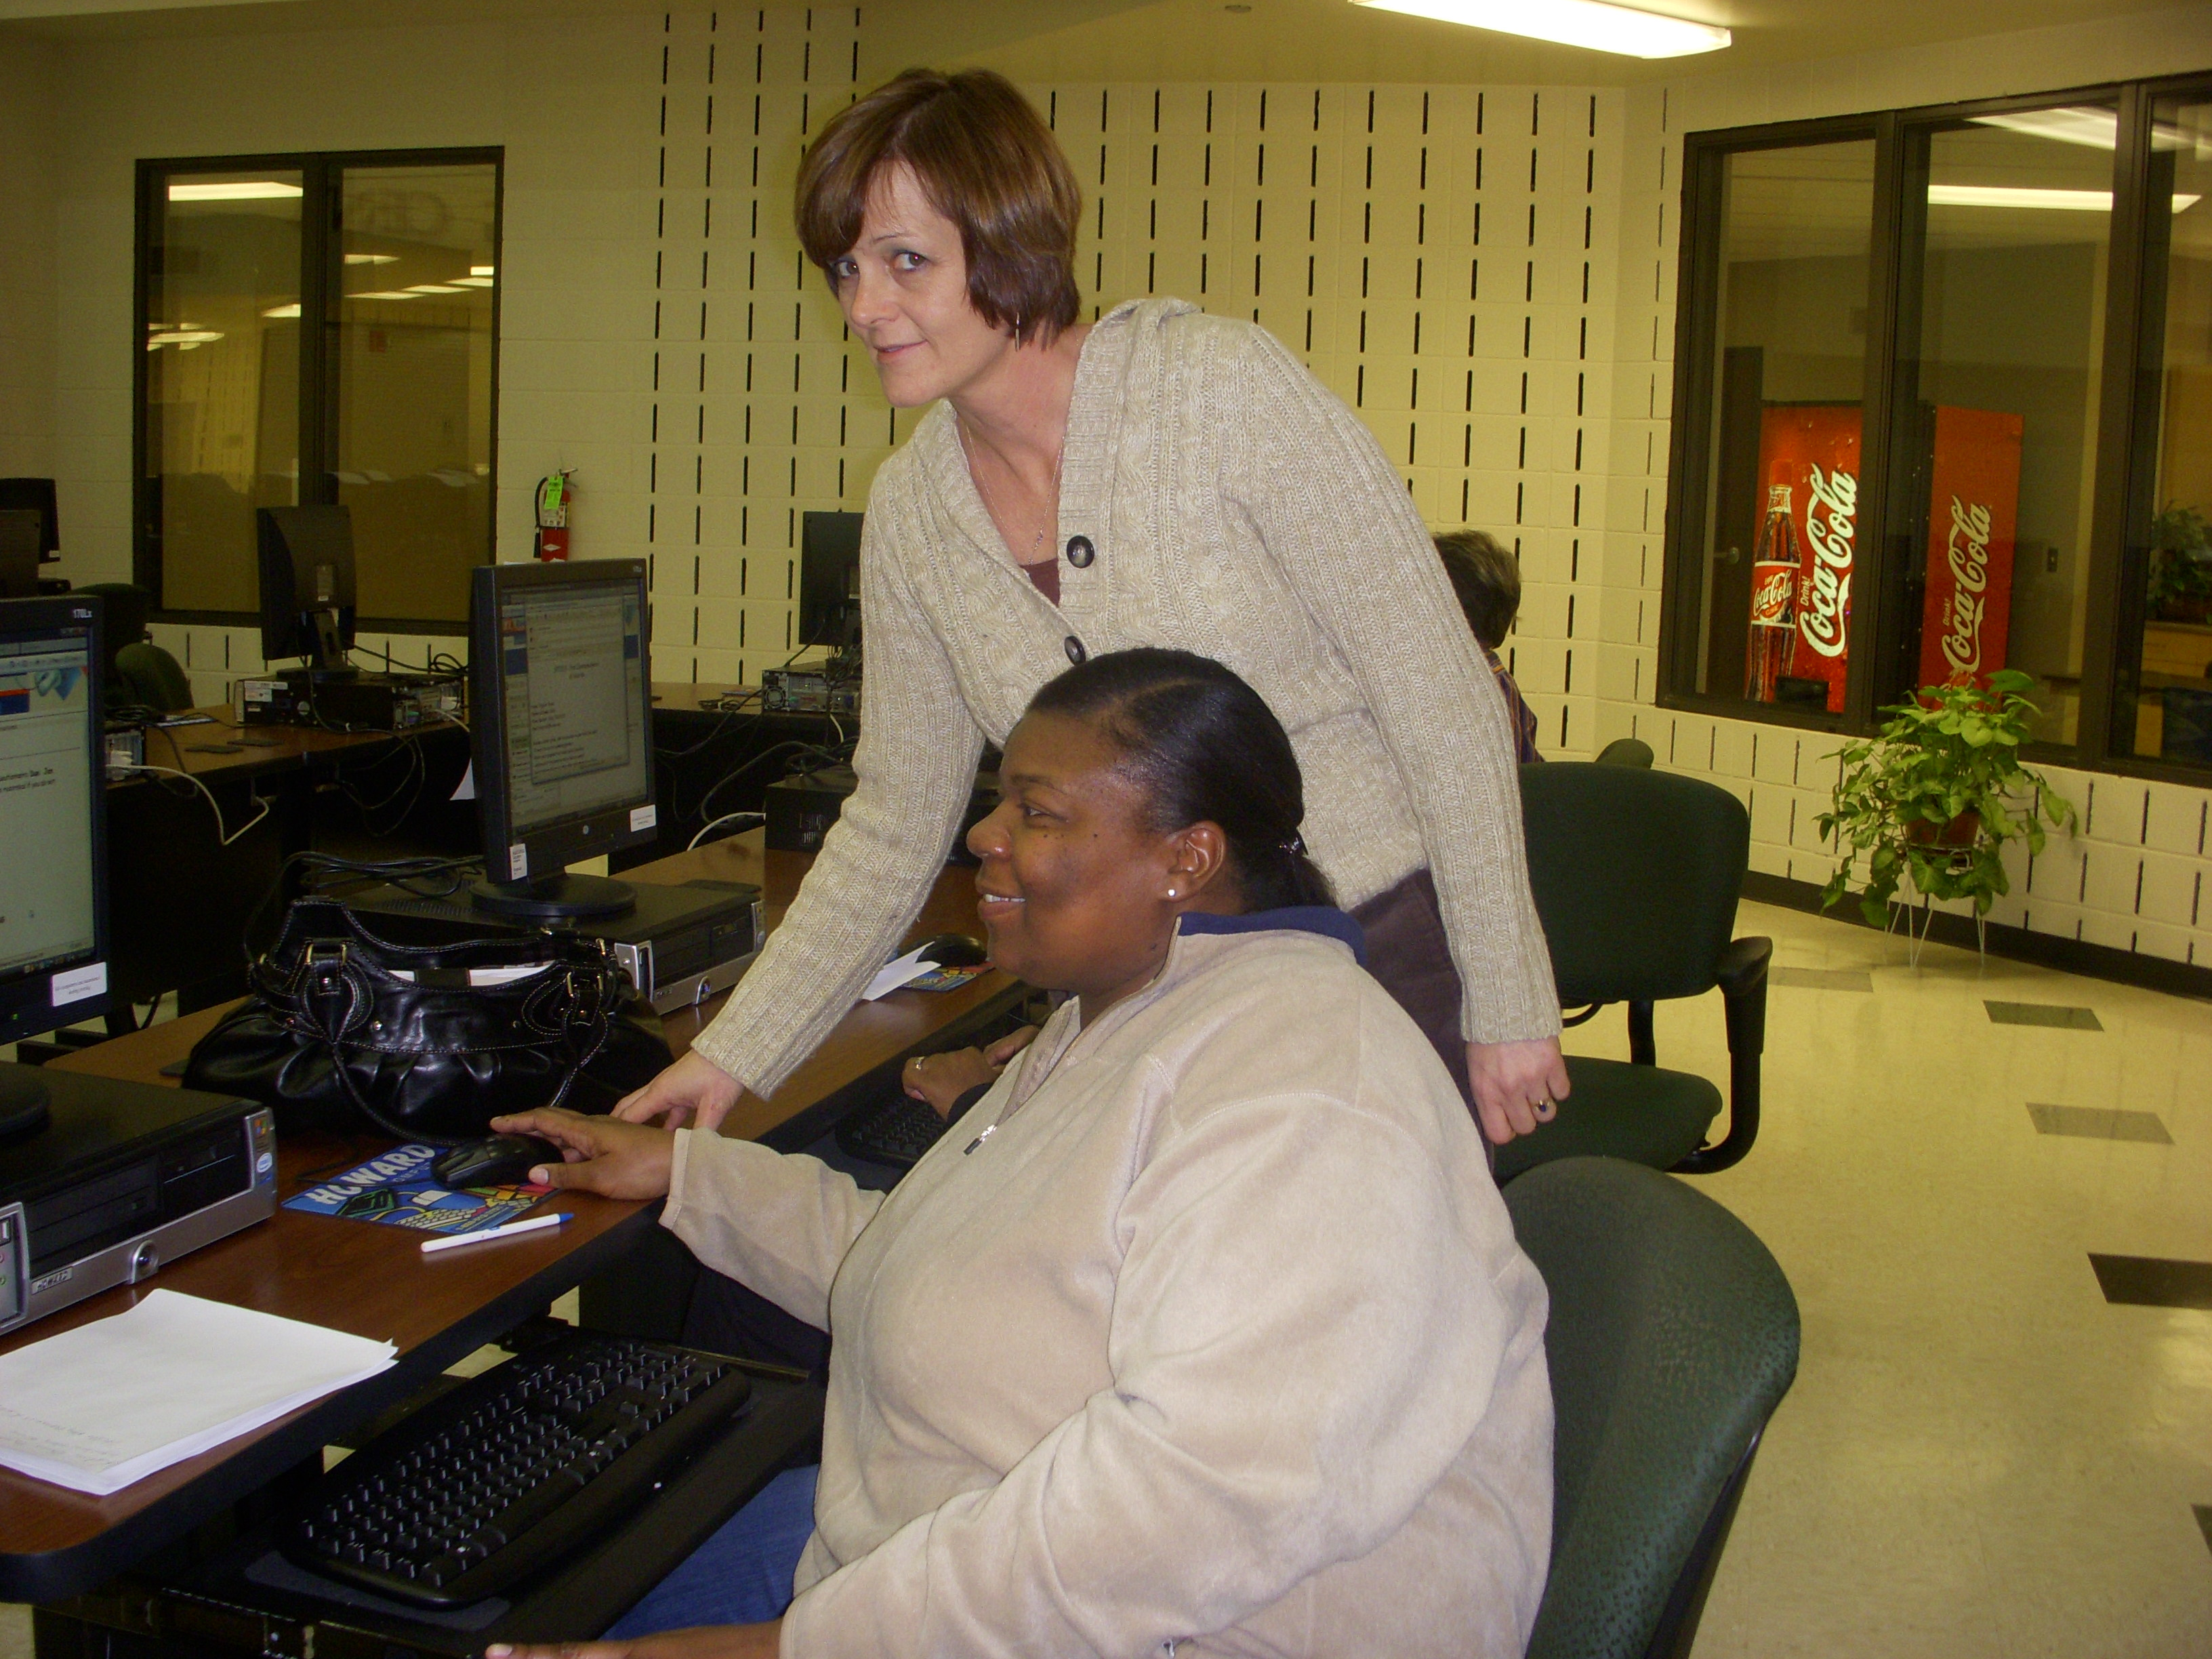
Wanda Sullivan
Itawamba Community College
In our first class meetings, I discuss with my students their motivation for returning to school. Listening to my non-traditional students discuss the hardships they have encountered to receive an education always inspires me and everyone else in the classroom. After these discussions, we are all focused on the same goal—acquiring knowledge that will ensure them a better future.

Slide 43
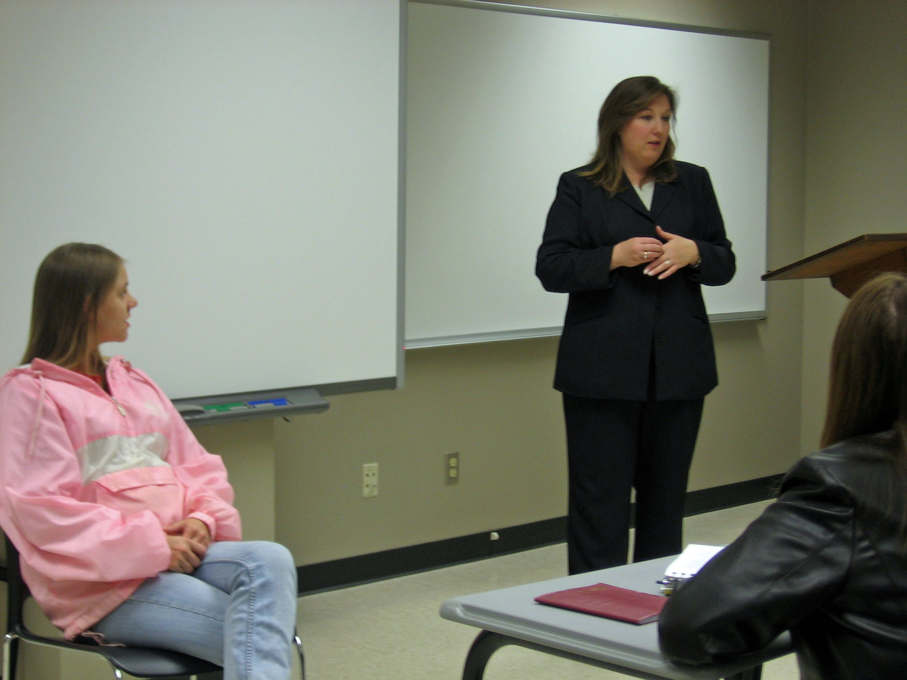
Michelle Sumerel
Itawamba Community College
Watching nontraditional students beat the odds inspires me to find new ways to communicate and teach. Never give up on students. Each one is worthy of our time, patience, and effort in helping them find who they are capable of being.

Slide 44
Ann Aull
Ivy Tech Community College
I am excited to see students turn into teachers and teachers turn into advocates for families with young children.

Slide 45
Ann Heiny
Ivy Tech Community College
I teach more than my subject matter; I teach life. Seeing students grow from I can't, I won't, into I can, I will, I did, is tremendously inspiring.

Slide 46
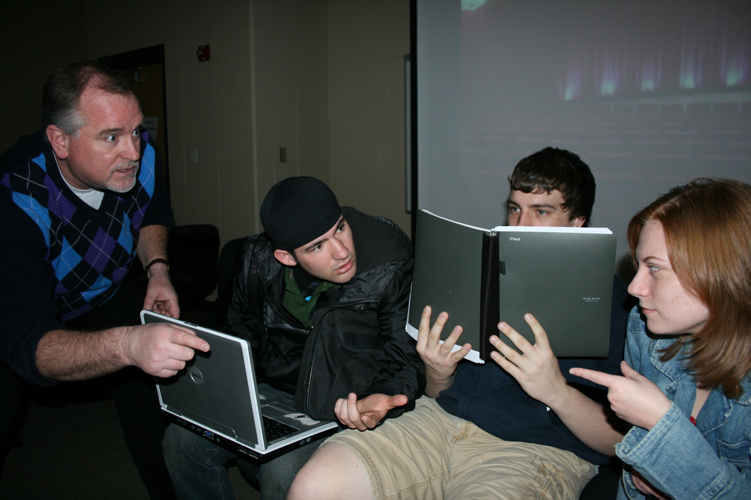
Bryan Kirby
Ivy Tech Community College
I love ignorance. Ignorance is a blank canvas, a barren stage, an empty page. A blank canvas stimulates the imagination of the artist. A barren stage stirs the creative juices of the actor. An empty page summons the voice of the author. I provide a brush for the artist, a script for the actor, and a pen for the author. I am a teacher. I love ignorance.

Slide 47
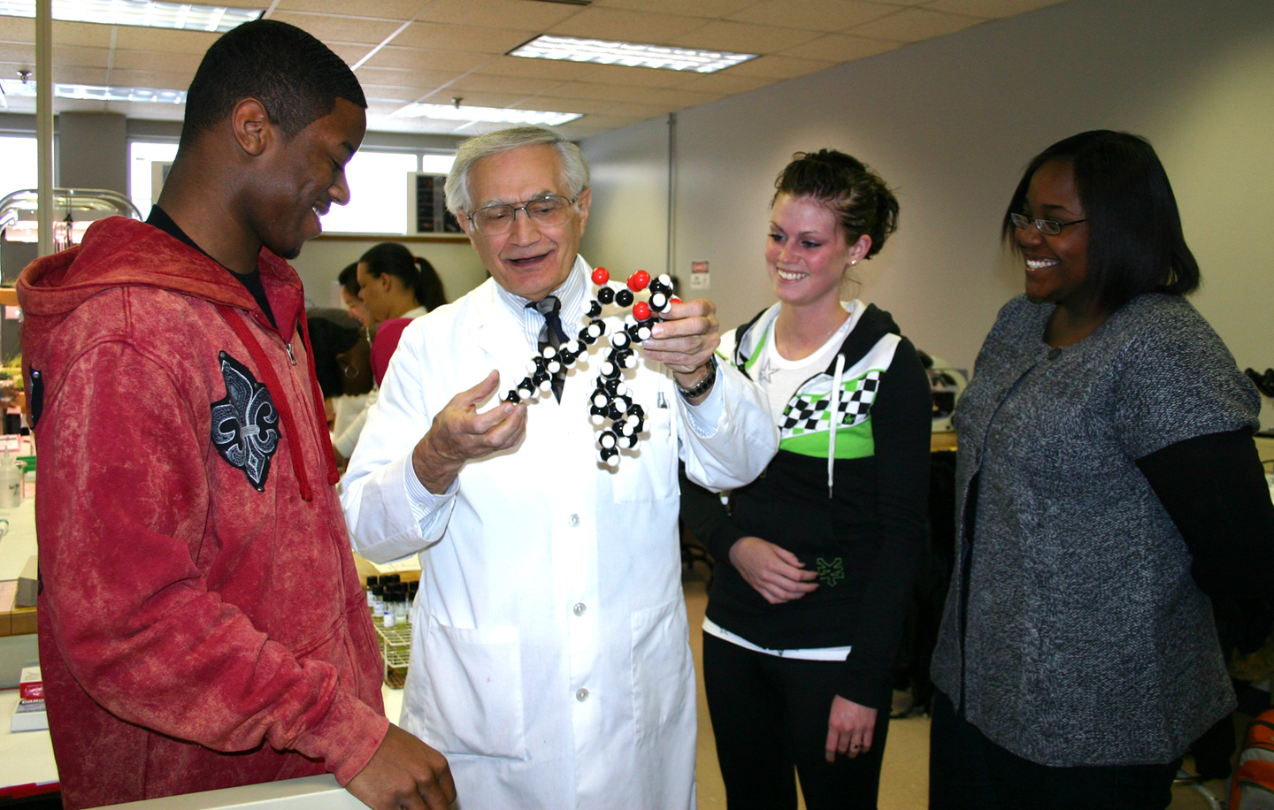
Al Rubenstein
Ivy Tech Community College

Slide 48
Paula Hopper
Jackson Community College
As a nurse, I have the opportunity to make a difference in my patients’ lives. As a teacher, I hope to make a difference in my students’ lives. One of my greatest rewards is seeing students find joy in making a difference in their patients’ lives.

Slide 49
Christopher Graney
Jefferson Community & Technical College
I like to be able to teach from the ground up, to teach not just 'here is what we know' but also 'here is how we know it and why we got to where we are.’

Slide 50
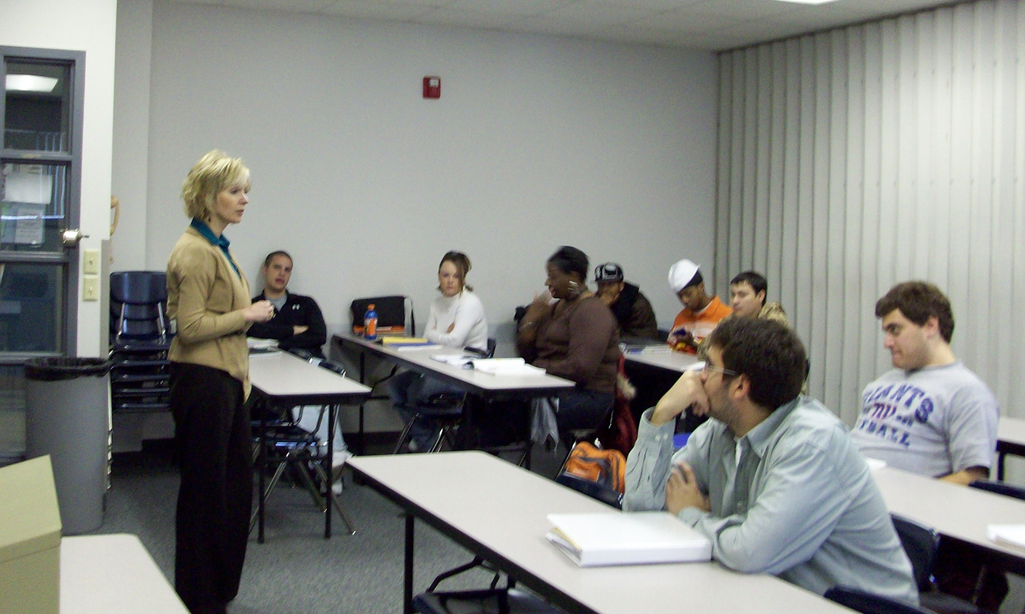
Denise Crews
John A. Logan College

Slide 51
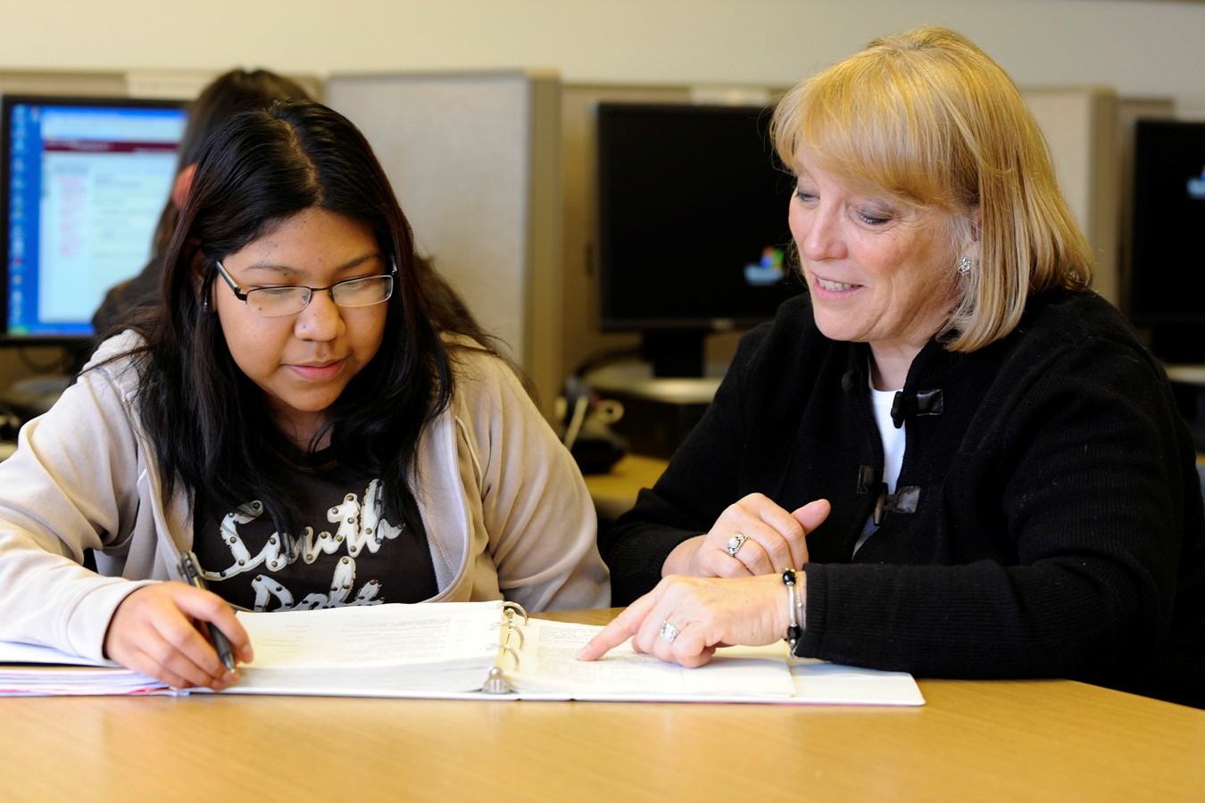
Charis Sawyer
Johnson County Community College
Mother Theresa said: ‘We can do no great things, only small things in a great manner.’ It's the small things that pave the way to student success.

Slide 52
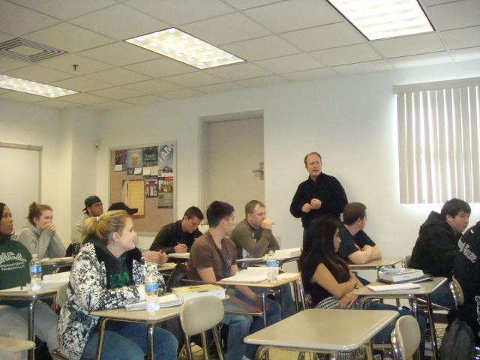
Terrence O’Neil
Joliet Junior College
Some of my students enter with limited resources. I see myself a couple of decades ago, living the circumstances of many of these individuals. It is a privilege to help them achieve their goals and overcome obstacles. I never tire of that.

Slide 53
Kay Crossley
Kansas City Community College
Words of wisdom: Set your standards high and work to that level. Emulate the performance standard of someone you respect.

Slide 54
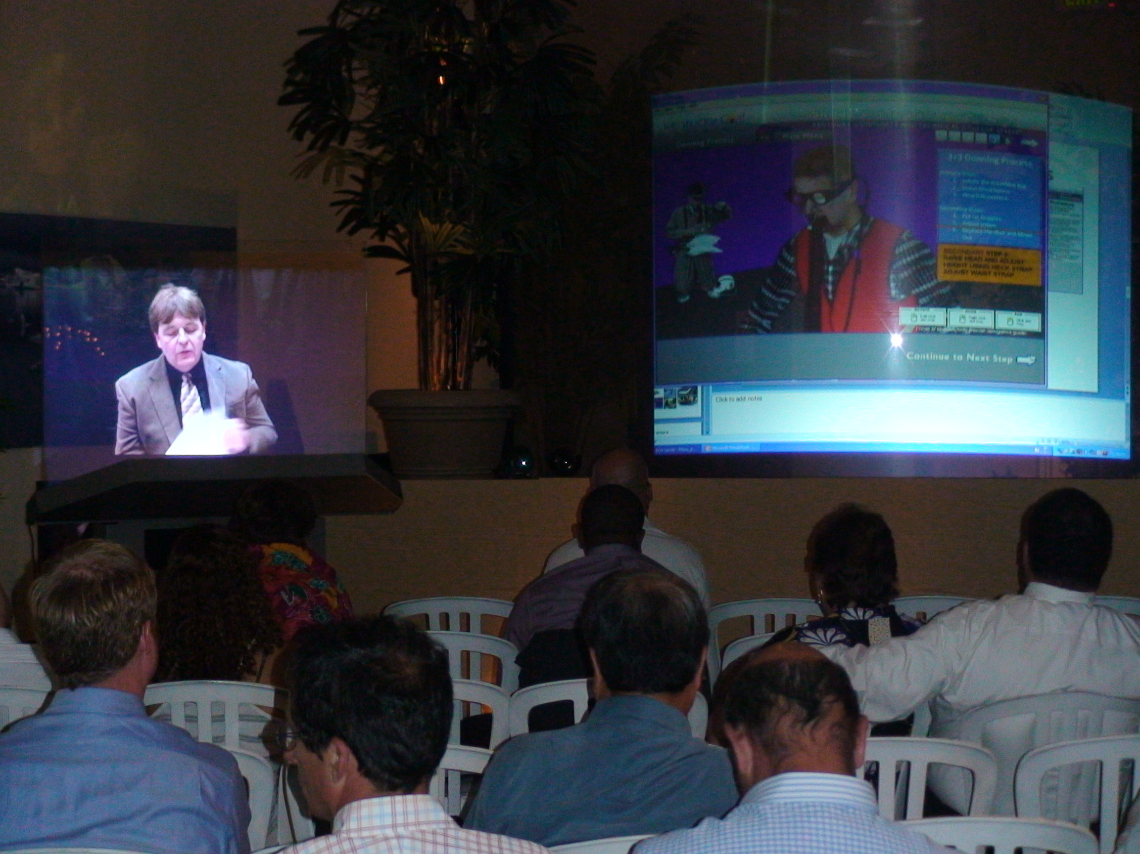
Jamie Justice
Kentucky Community and Technical College System
You must be true to yourself in all things—enthusiastic, positive, and passionate. Then everything else takes care of itself.

Slide 55
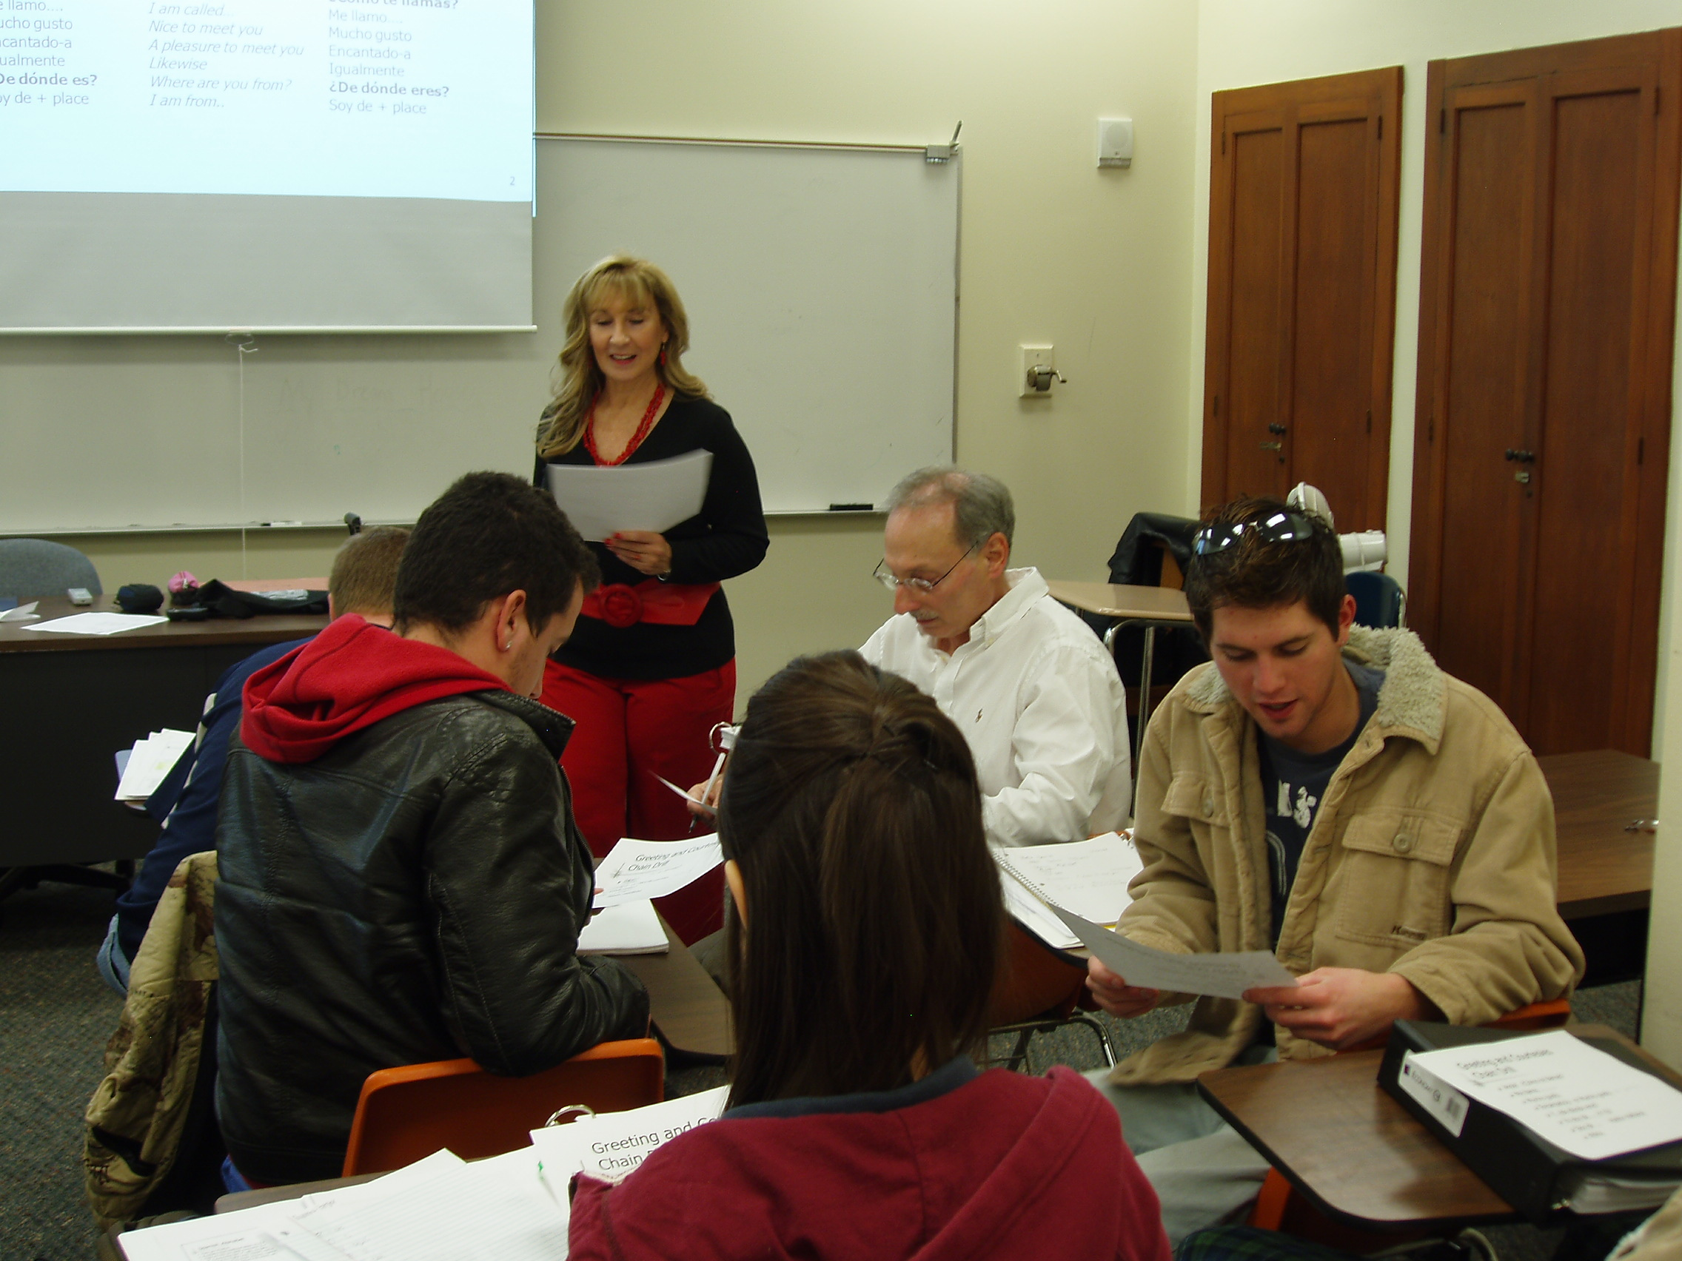
Margarita Talavera Hoferer
Kilgore College
Teaching is the source of my energy and youthful outlook on life. It’s about humor and entertaining. My students feed my enthusiasm and joy. My passion transfers to them.

Slide 56
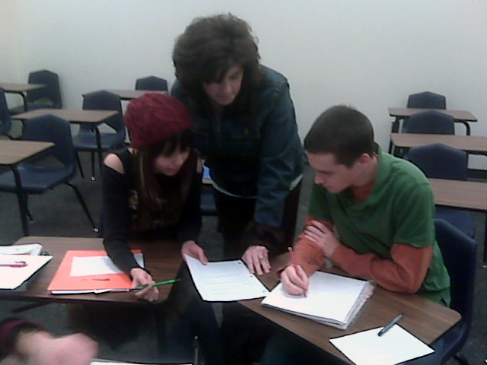
Lori Truman
Kilgore College

Slide 57
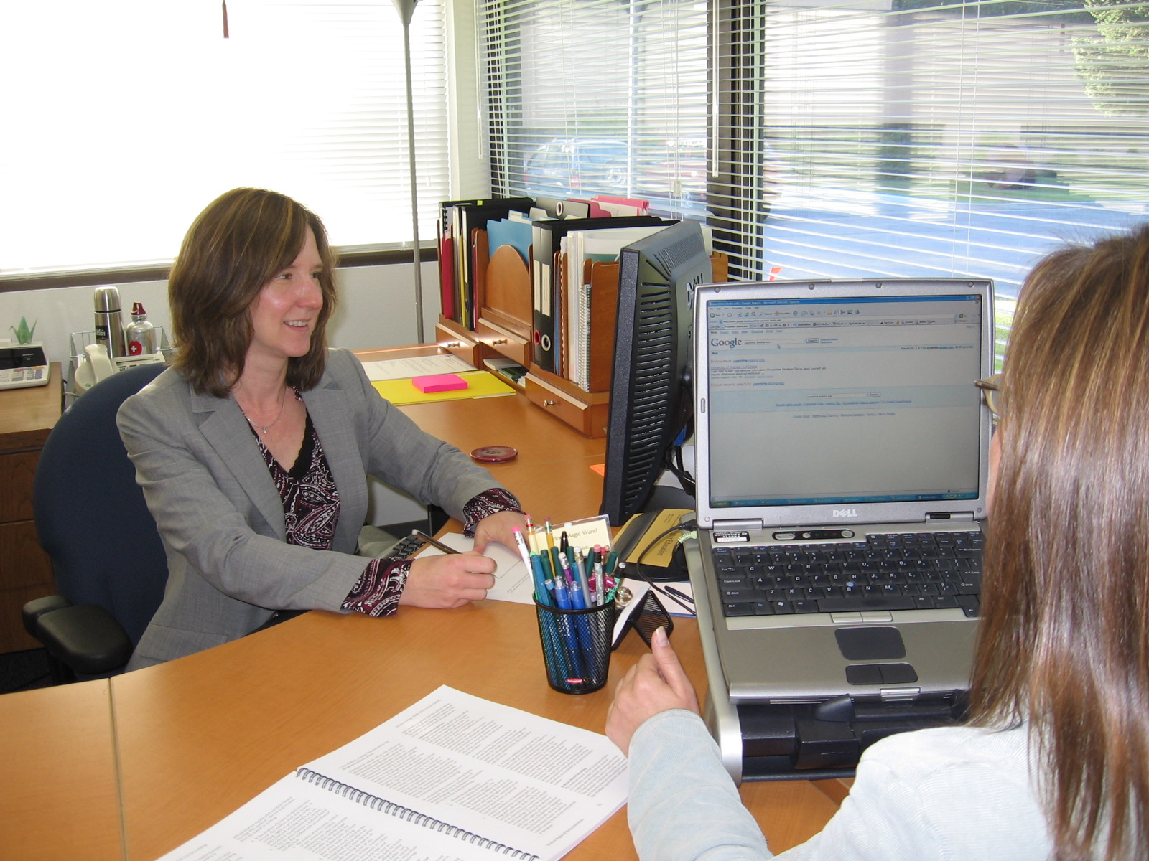
Barbara Brown
Kodiak College
I am honored to guide, support, and encourage students as they bravely create their dreams!

Slide 58
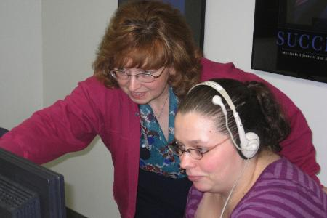
Debbi Canavan
Kodiak College

Slide 59
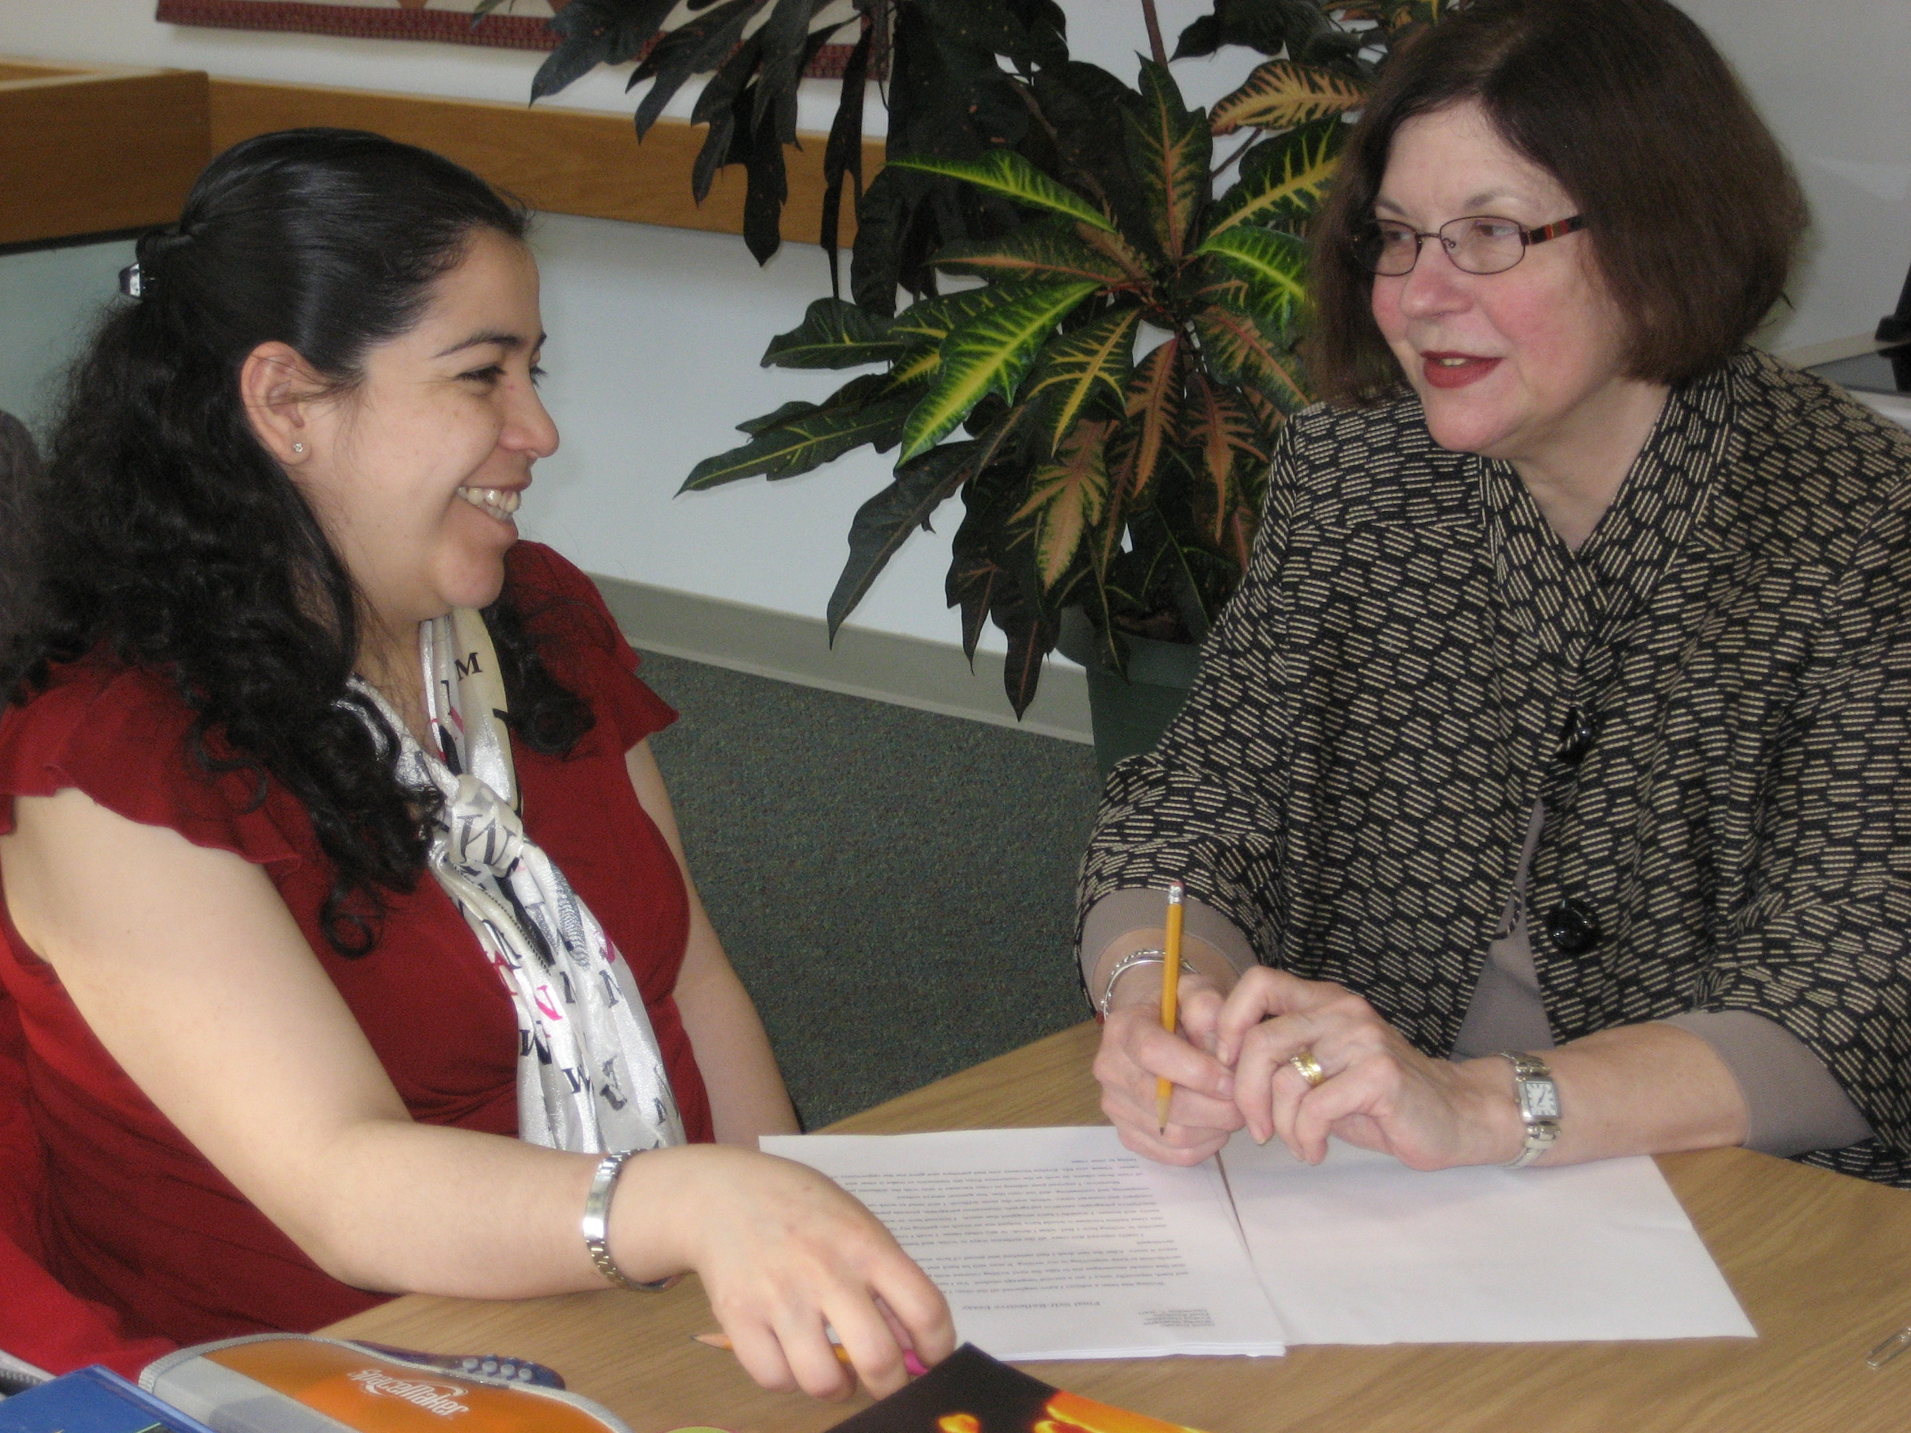
Evelyn Davidson
Kodiak College

Slide 60
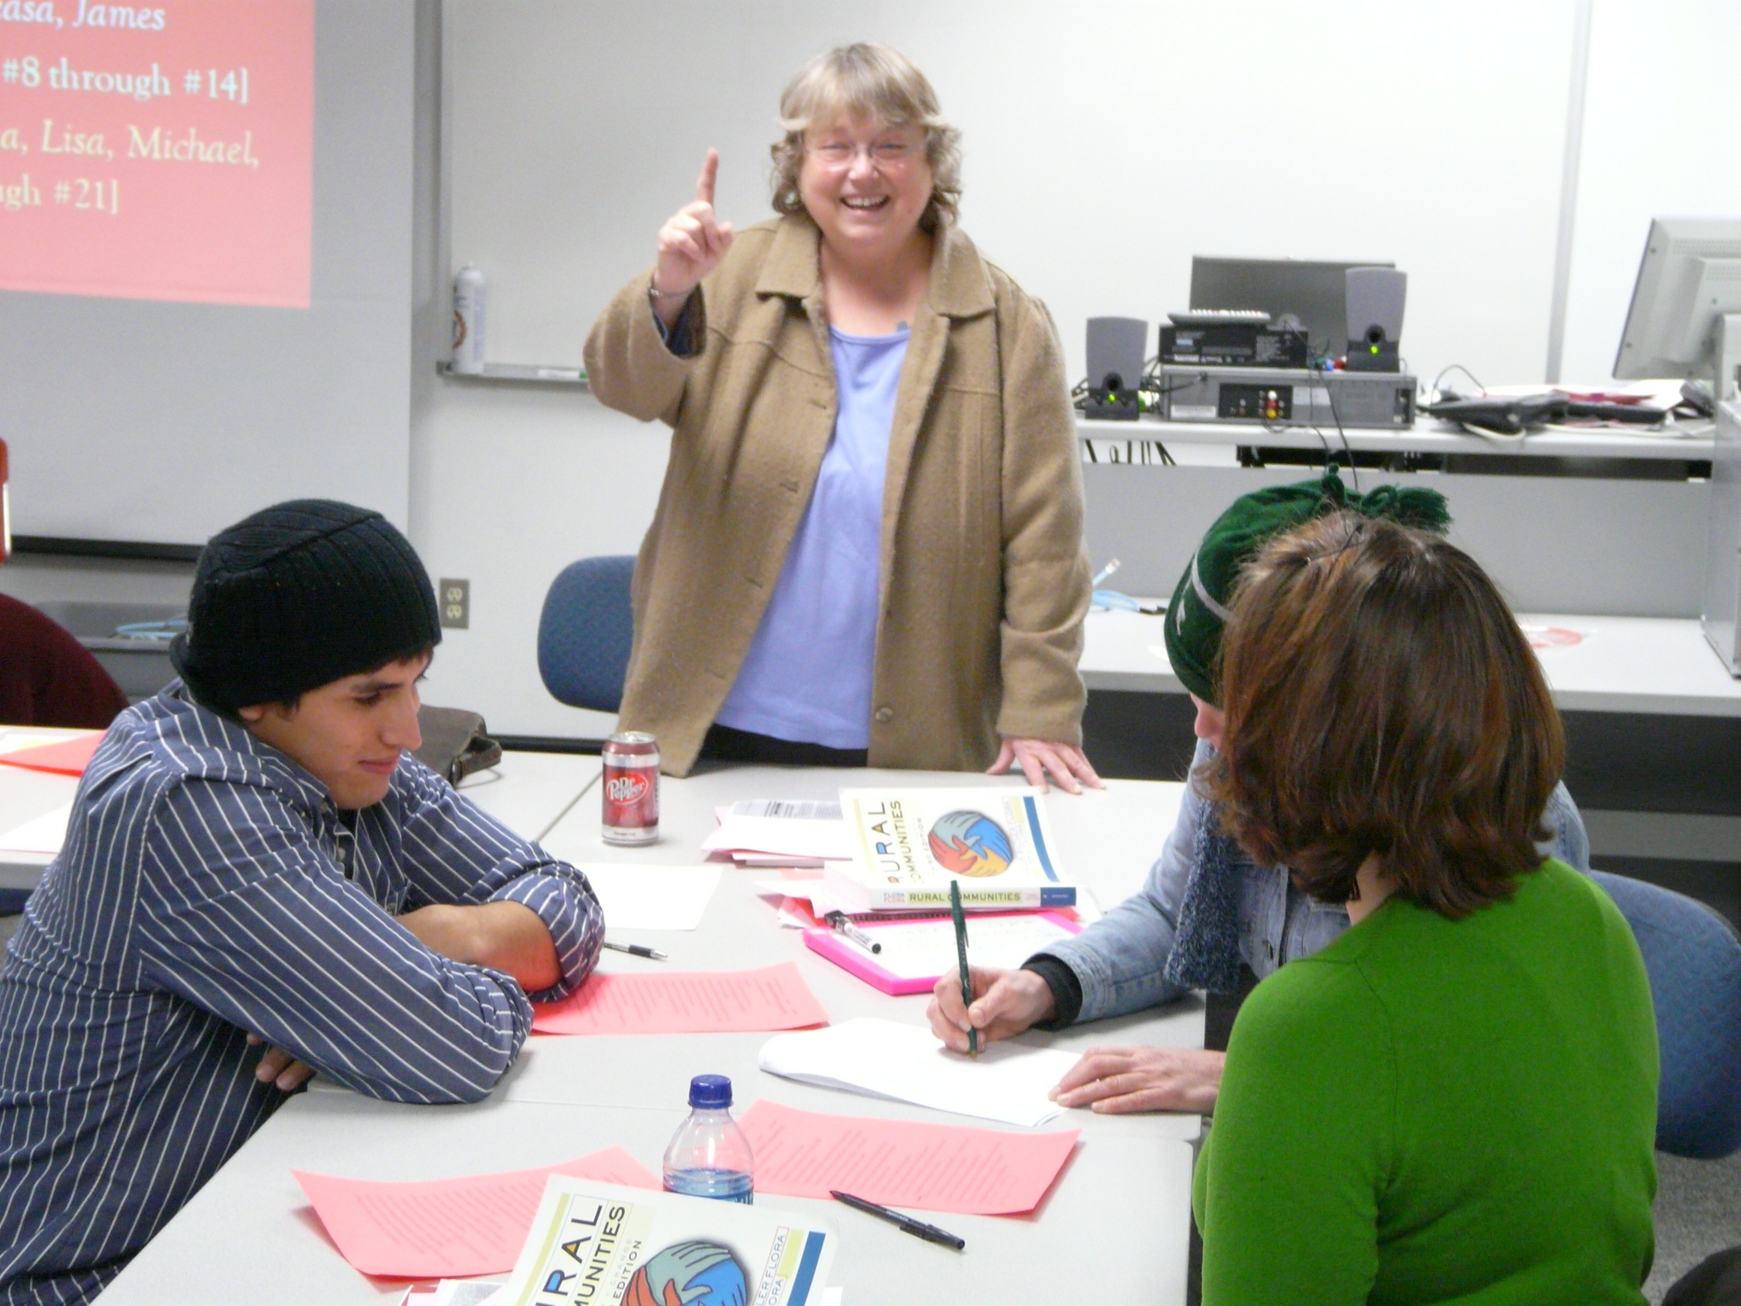
Thia Falcone
Kodiak College
Teachers teach the way they learn. Get out of your seat, move around, touch things, build things, make a skit; anything in the room is a prop. Go on a scavenger hunt to collect status symbols or examples of the normal curve. Interview elders, talk to kids, tell your story, do service somewhere, and make a difference. Be proud of who you are, always. All classes are get-up-and-do, not sit-and-stew.

