Slide 1
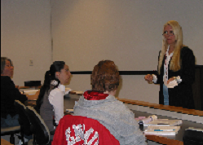
Joan Arnold
Eastern New Mexico University Roswell

Slide 2
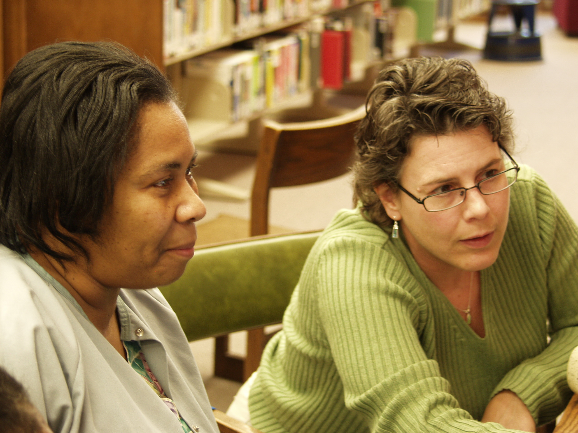
Kim Grewe
Eastern Shore Community College
I am inspired by the determination and passion that our students have for their educational goals. When students write about their experiences from learning in our classes, I can see the doors of true knowledge opening—and I am delighted, because I know that they are stepping into an adventure of a lifetime.

Slide 3
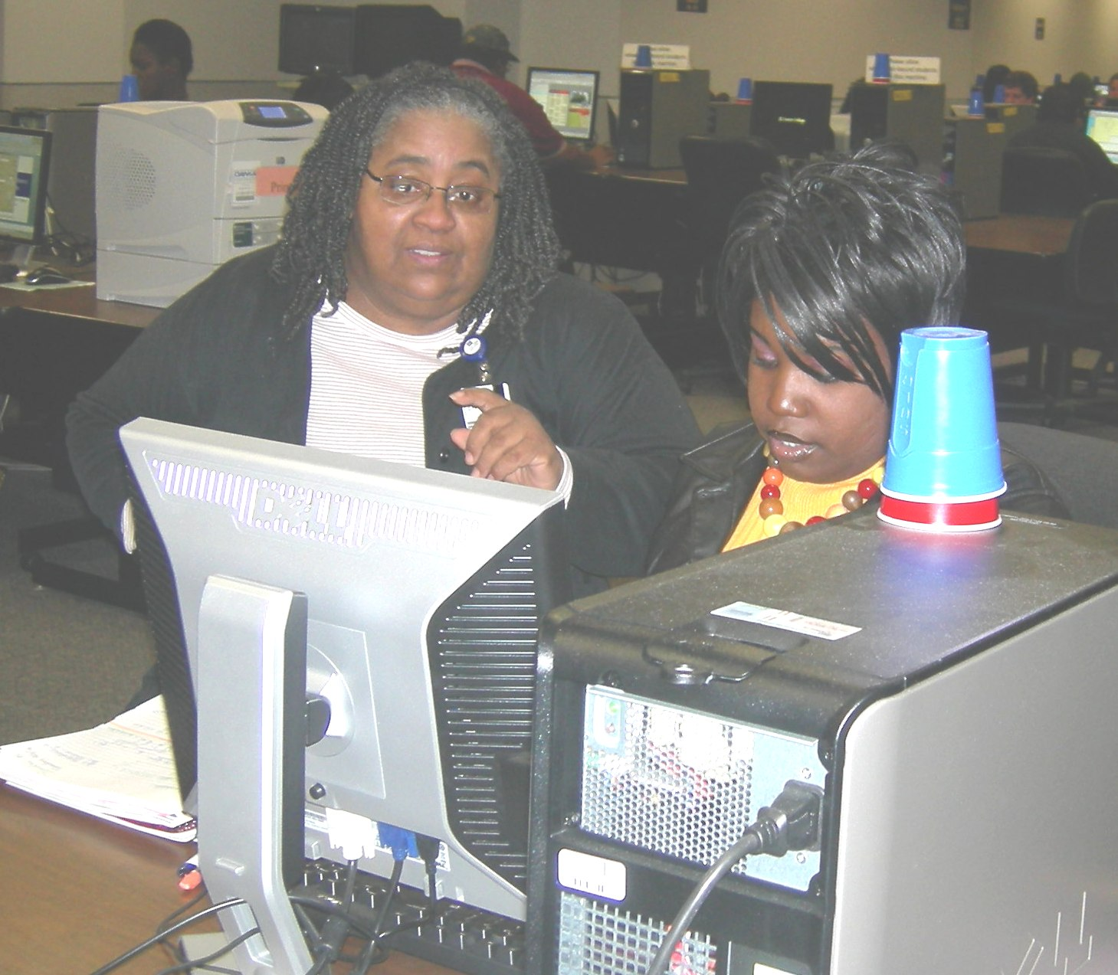
Ramona Williams
El Centro College

Slide 4
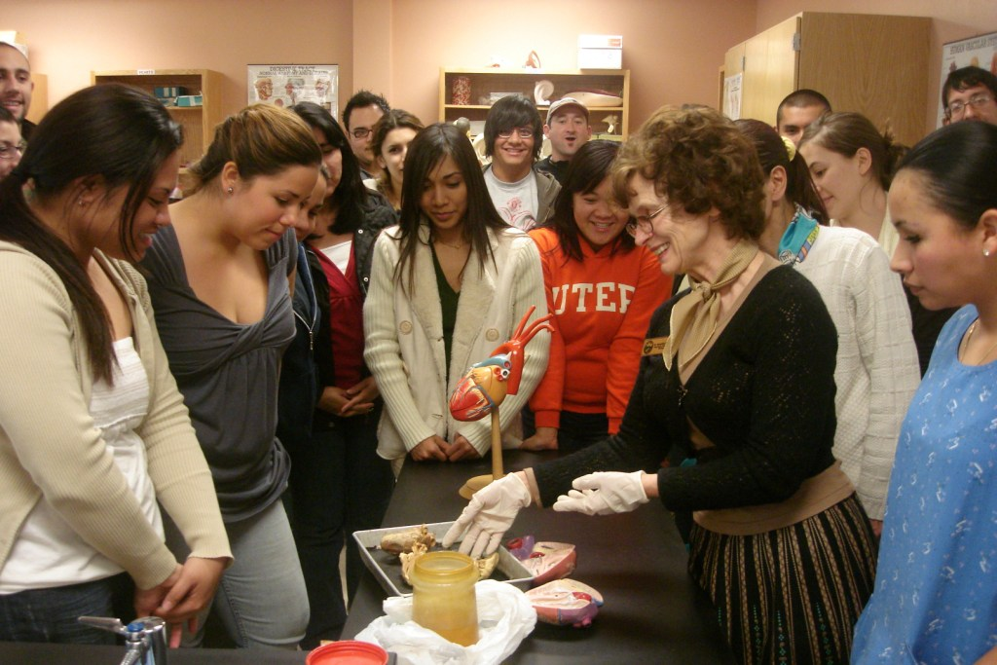
Roswitha Saenz
El Paso Community College
My most successful teaching tool derives from the greatest master teacher of all times. Linking known situations and self-evident metaphors to new principles has facilitated my students’ analysis, synthesis, and evaluation of complex scientific concepts. If the salt loses its saltiness, can bacterial plasmolysis still occur?

Slide 5
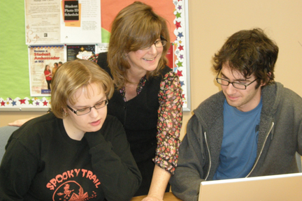
Alison Douglas
Elgin Community College
Throwing stones from the water’s edge, which stones ripple will reach the shore? My interactions with students cast ripples in their lives and in the lives of others they touch. Infinite waves, for good or ill. My choice.

Slide 6
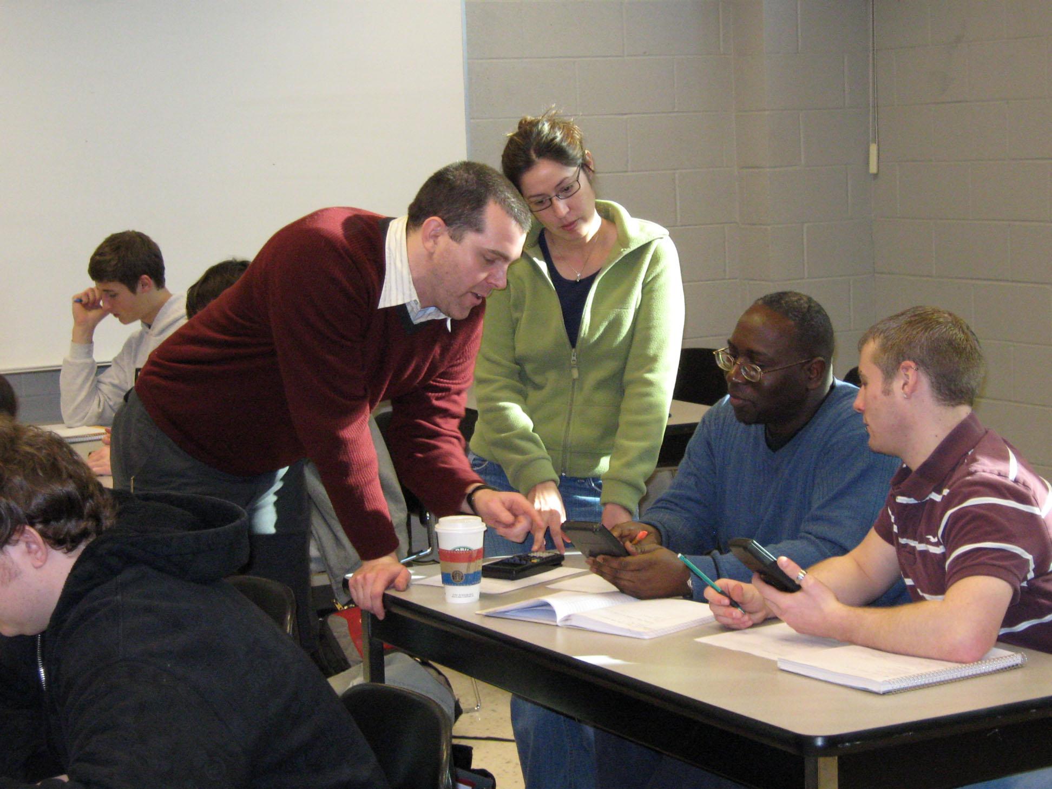
Dan Kernler
Elgin Community College

Slide 7
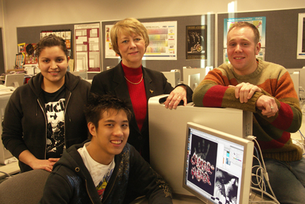
Connie Orbeta
Elgin Community College

Slide 8
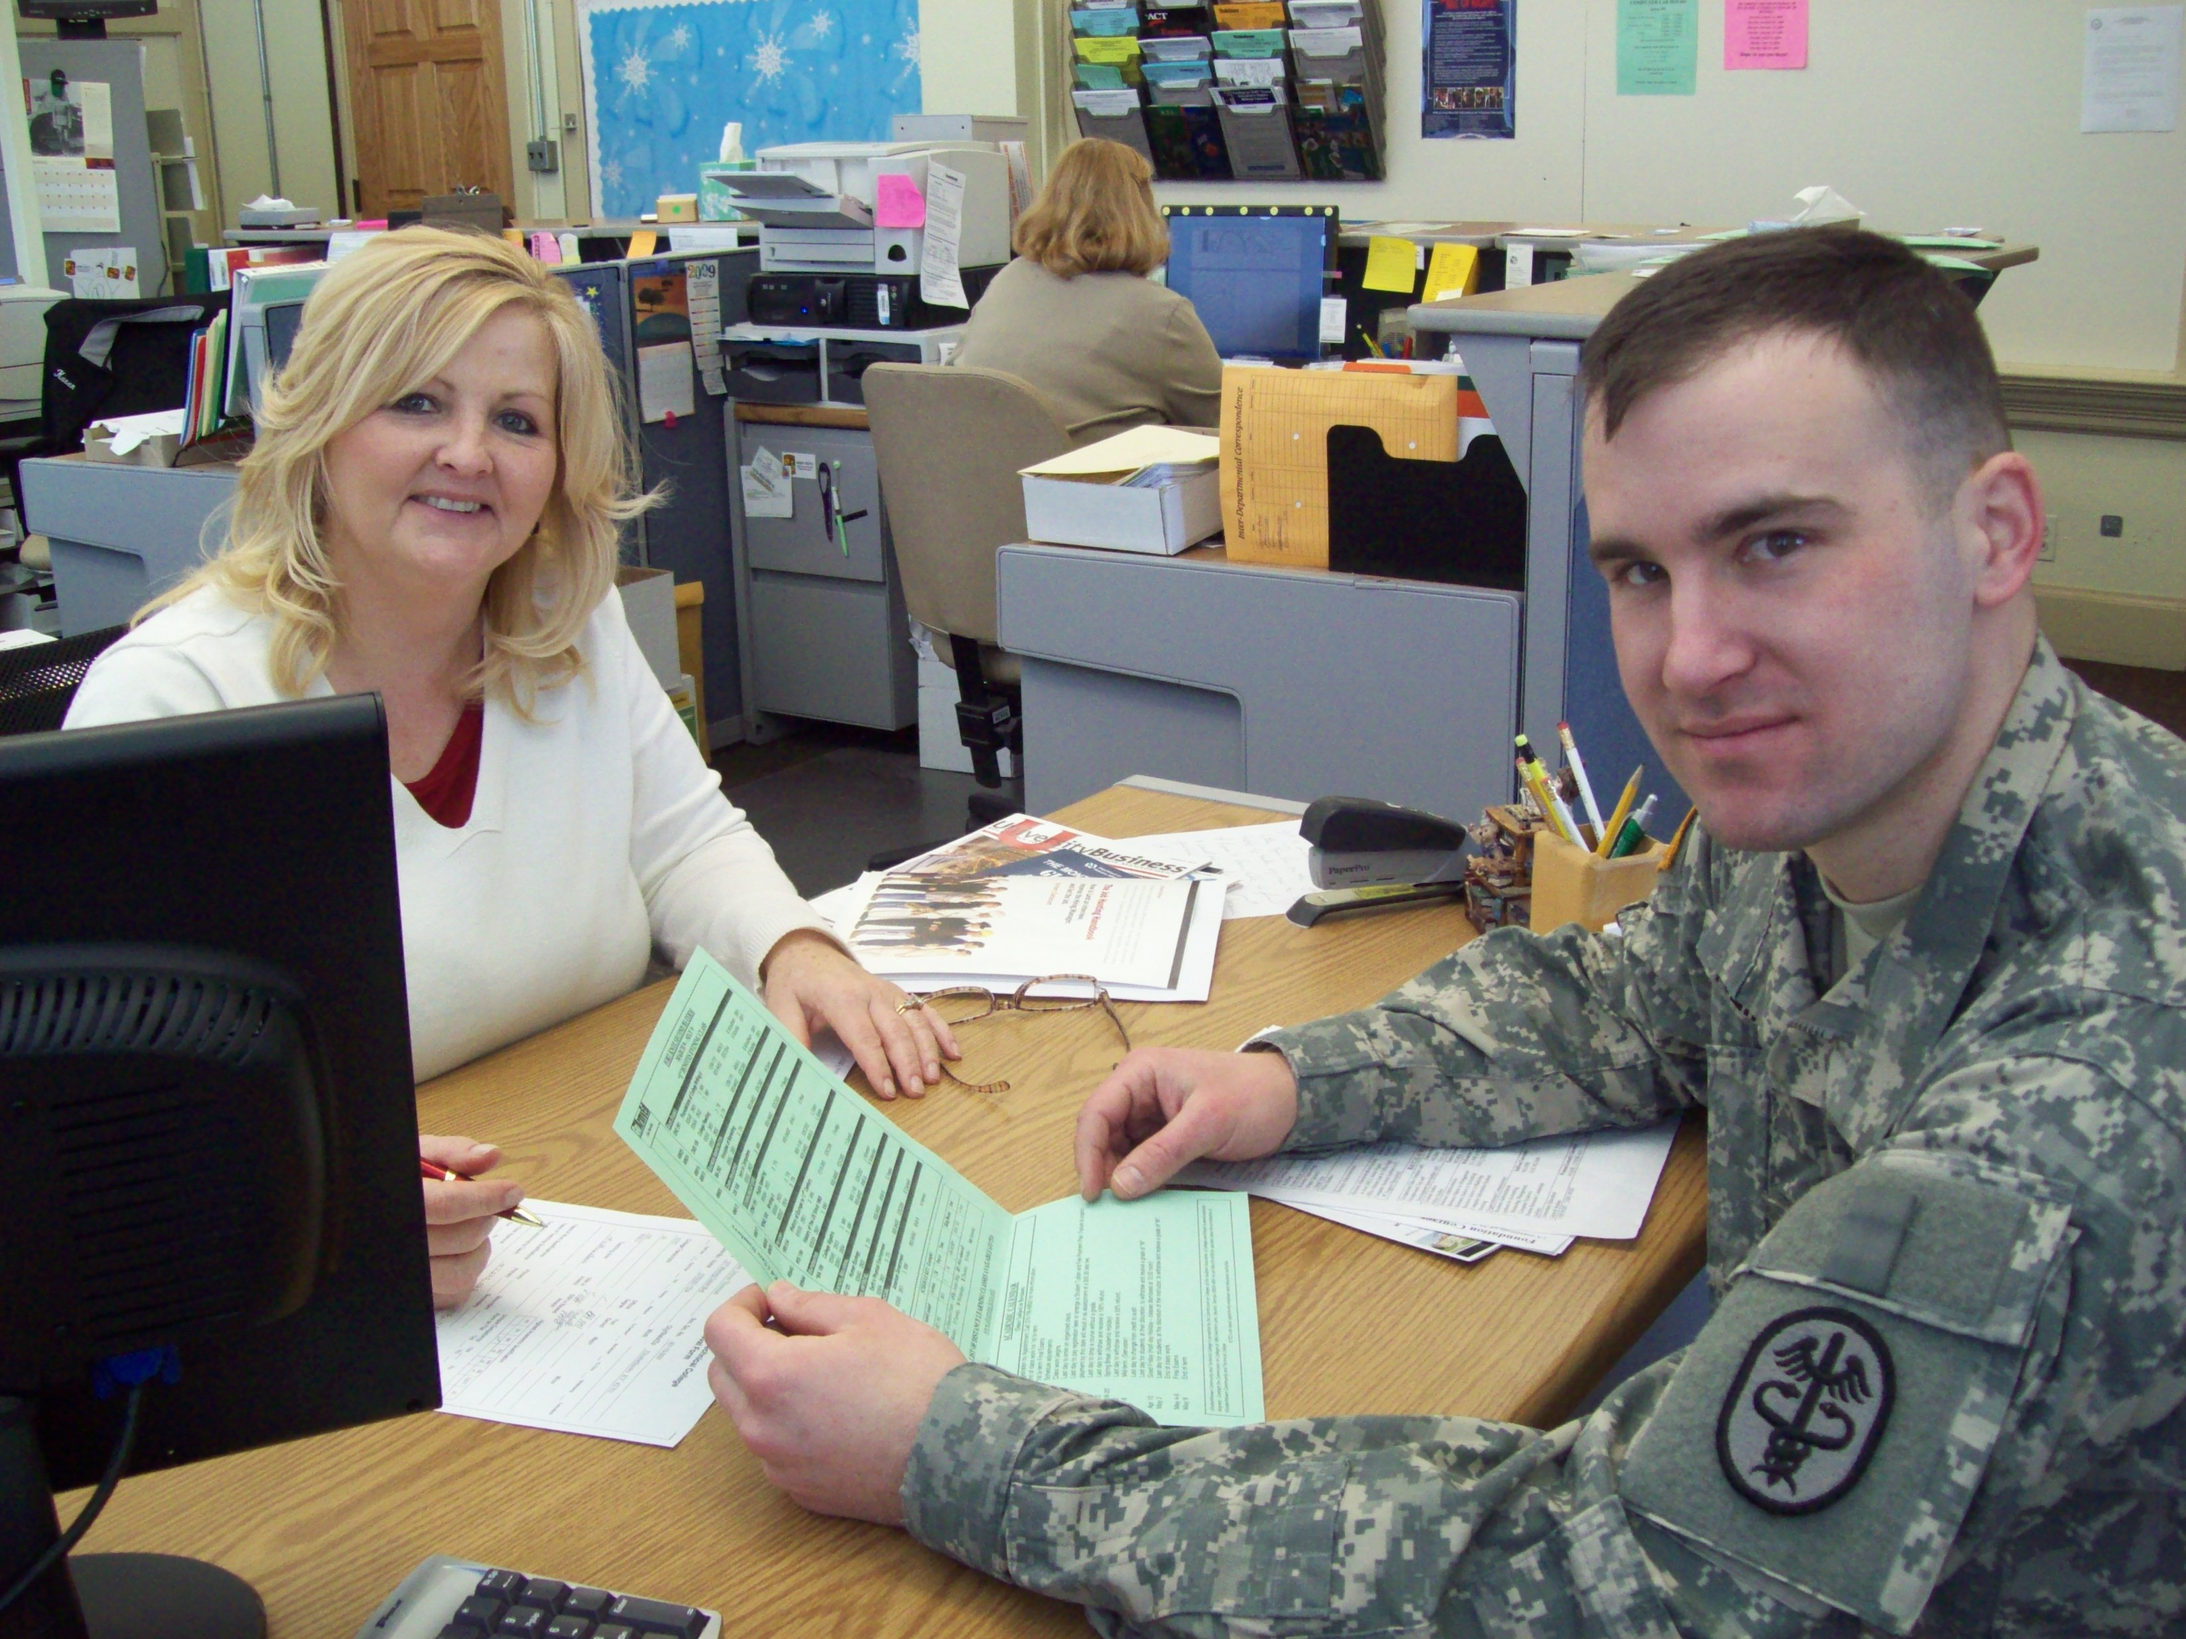
Mary Flowers
Elizabethtown Community & Technical College
I serve those who serve us. Helping our soldiers and family members achieve their educational goals fuels my motivation. Touching their lives and providing them with inspiration is the most meaningful part of my work. Together, we achieve the dream!

Slide 9
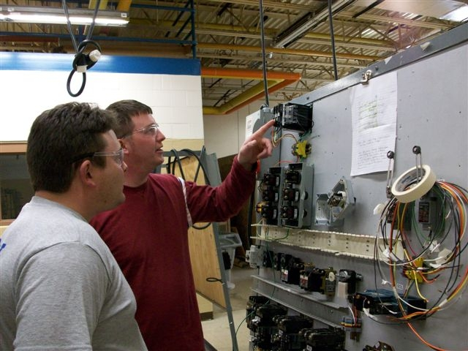
Jeffrey Rivera
Elizabethtown Community and Technical College
Teaching is not about demonstrating what one knows or delivering information. Great teaching encourages self-reflection, enhances curiosity, and makes students want to participate in the subject matter—shaping their own education.

Slide 10
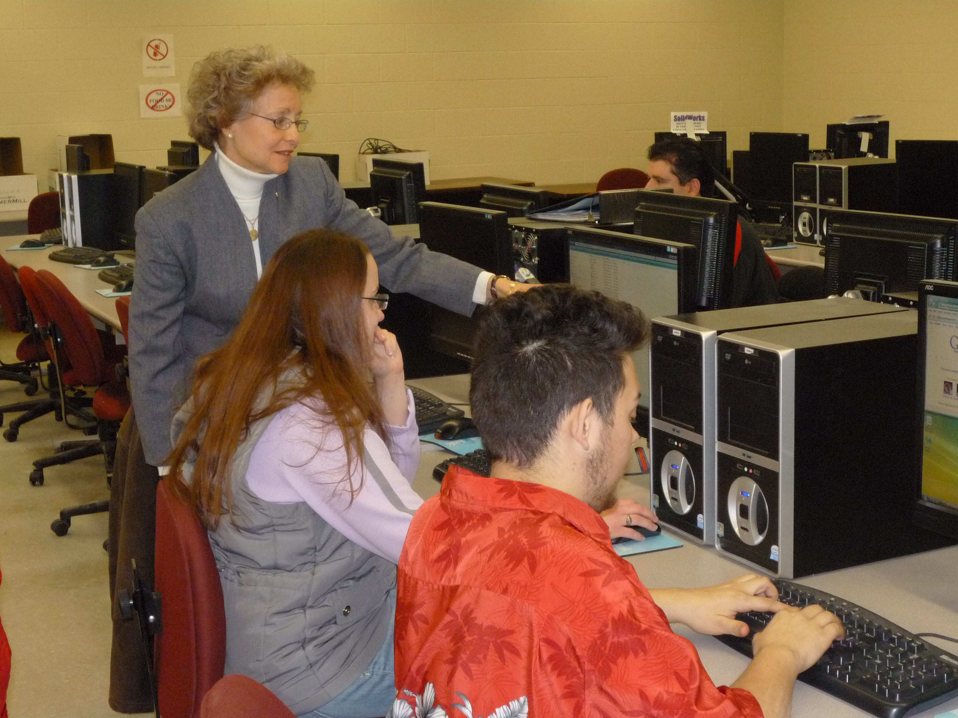
Susan Theeman
Erie Community College

Slide 11
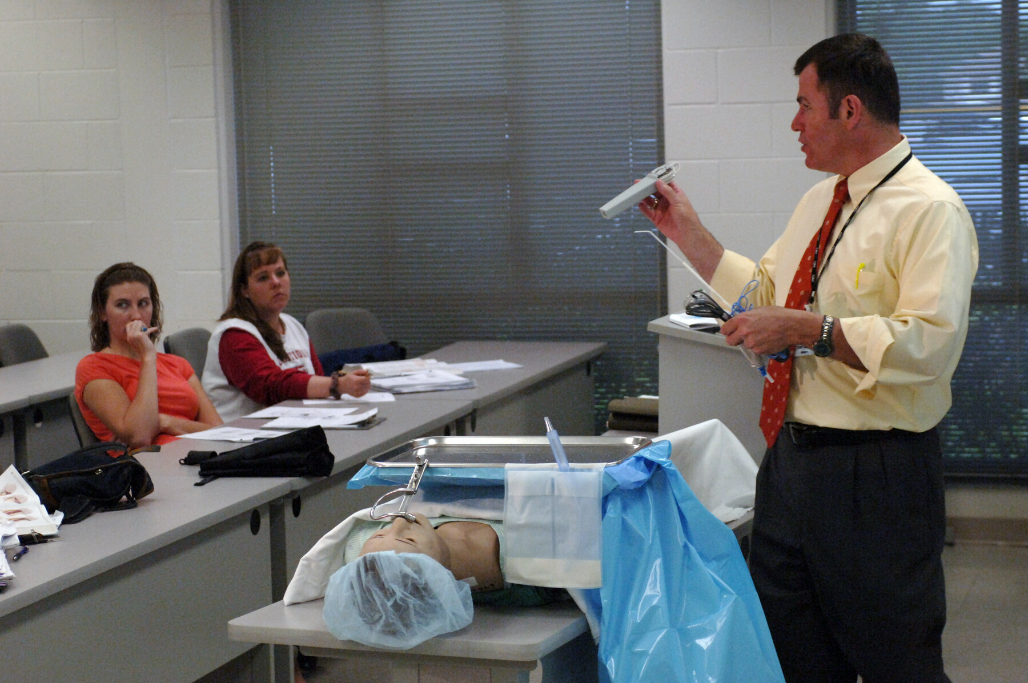
Terry Herring
Fayetteville Technical Community College

Slide 12
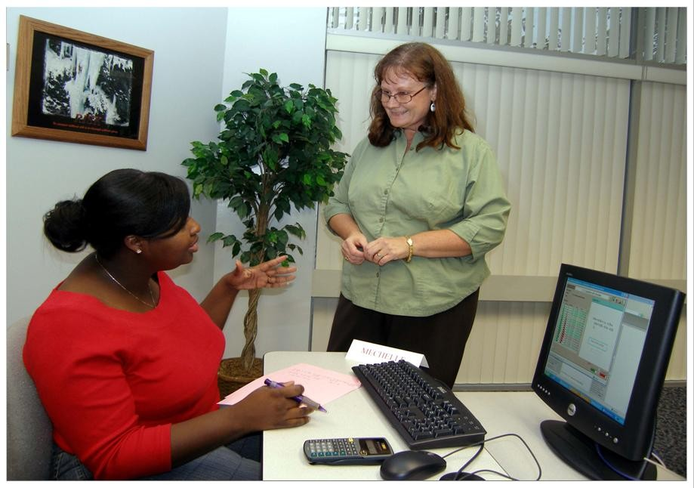
Donna Martin
Florida Community College at Jacksonville

Slide 13
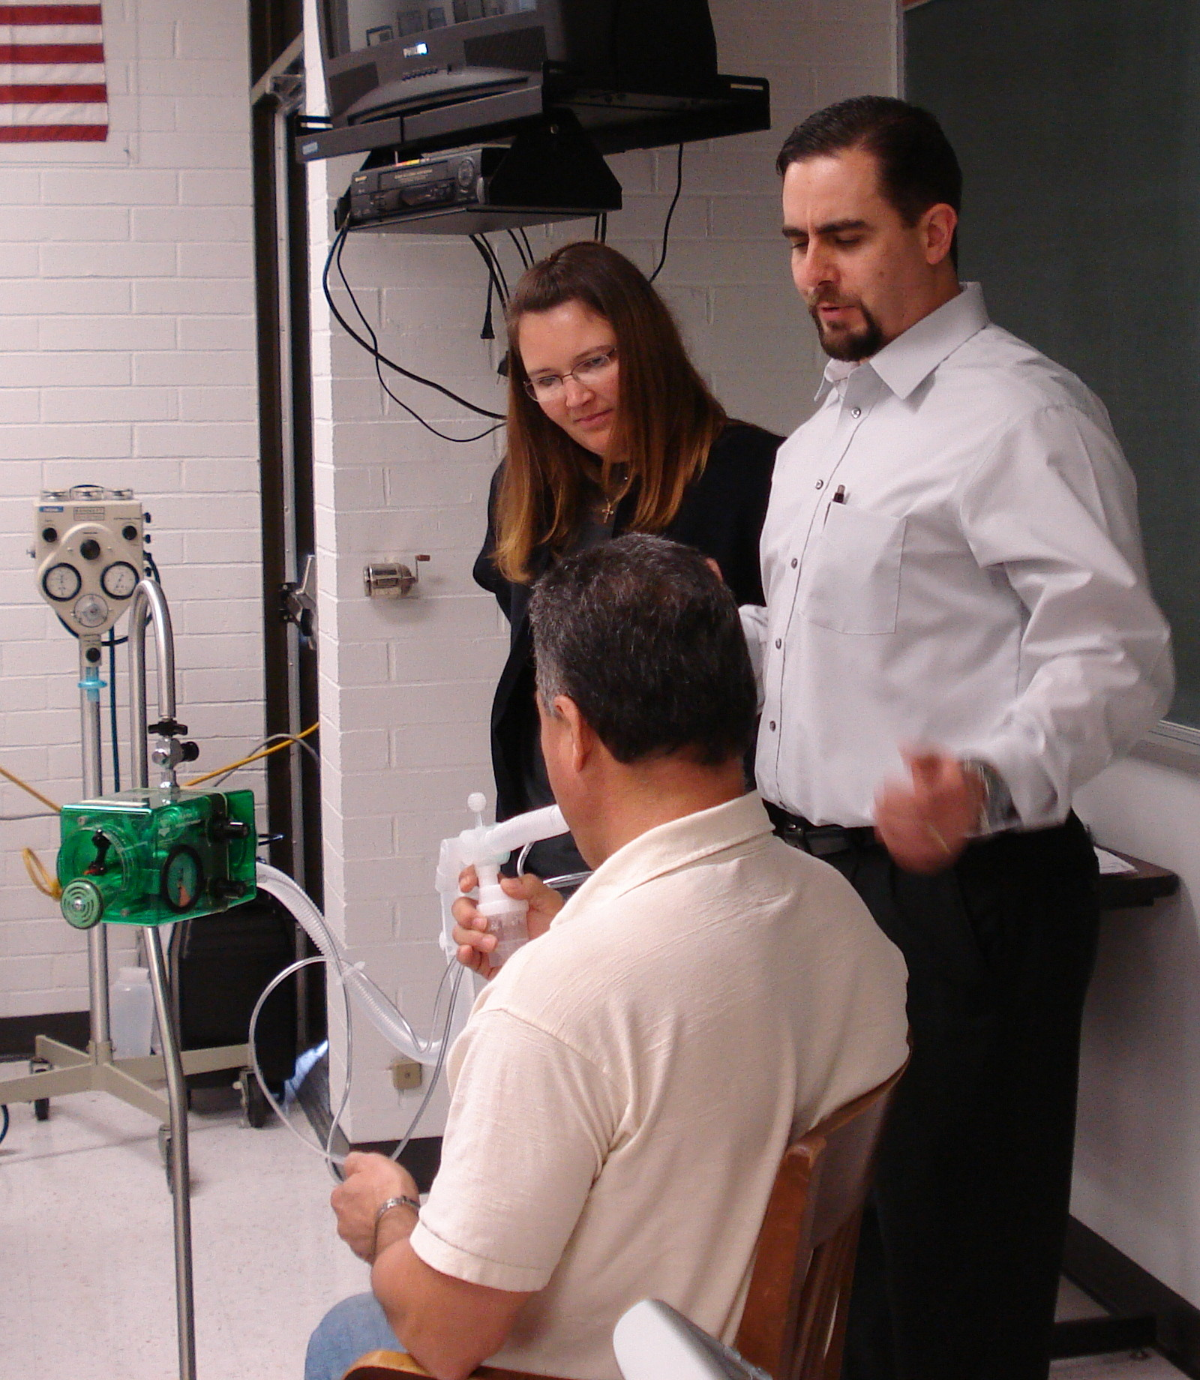
John Salazar
Florida Community College at Jacksonville

Slide 14
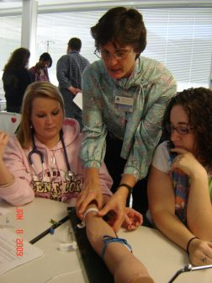
Susan Schultz
Florida Community College at Jacksonville

Slide 15
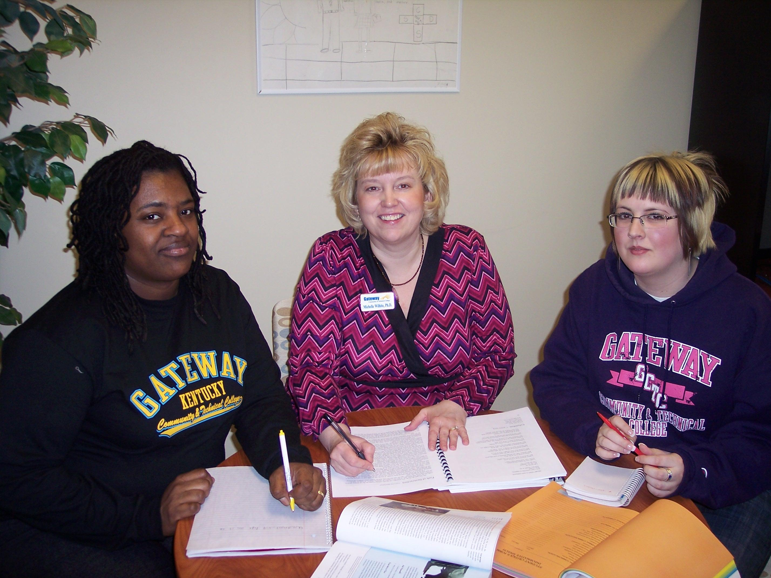
Michelle Deeley-Wilhite
Gateway Community and Technical College

Slide 16
Patricia Goodman
Gateway Community and Technical College
What inspires and motivates me each day are the endless possibilities that fill our hallways and classrooms. I use the gifts I have been given to look for opportunities to change lives. As a first-generation college graduate, I am blessed that someone took the time to believe in my possibilities.

Slide 17
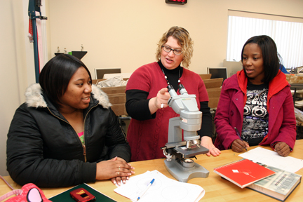
Sue Hanneman
Gateway Technical College
I strive for excellence because I feel that quality teaching gives my students the best chance at success. Students inspire me with their personal stories and individual paths to learning. I find renewed energy in finding a creative way to approach a subject. When students respond to new activities, it encourages me to seek more alternative ways to teach. Working at a community college is exciting because I am always challenged to learn new things, try a new delivery method, and keep things fresh.

Slide 18
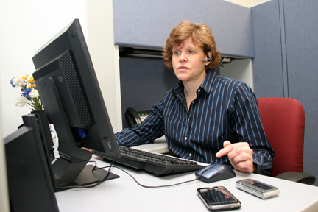
Meg Hunter
Gateway Technical College
Brick walls are there for a reason. It gives us the opportunity to show how badly you want something (Randy Pausch, The Last Lecture). The most exciting thing about teaching at a technical college is finding teachable moments to help students make their way over the wall.

Slide 19
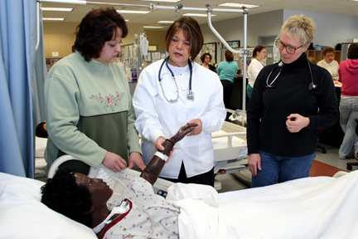
Diane Skewes
Gateway Technical College
I am inspired by my students. As they transform their dreams into becoming wise and skilled professional nurses, I am buoyed by their success. My enthusiasm is sustained as they step off the stage and into the profession of nursing with confidence that they will make a difference.

Slide 20
Anne Heale
Genesee Community College
Students enter community college with trepidation, immaturity, and few realistic goals. Being part of the process that allows them to leave as independent adults, with a more defined path for their life, always leaves me enthusiastic for meeting the next freshman class.

Slide 21
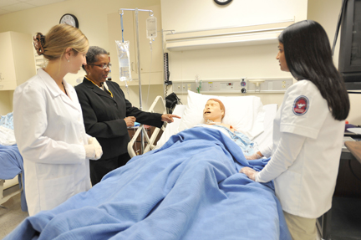
Brenda Cherry
Georgia Perimeter College

Slide 22
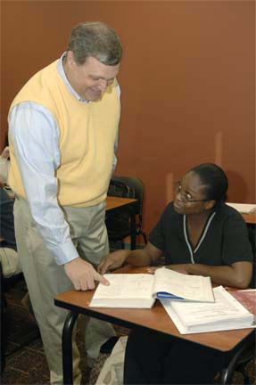
Todd Hendricks
Georgia Perimeter College

Slide 23
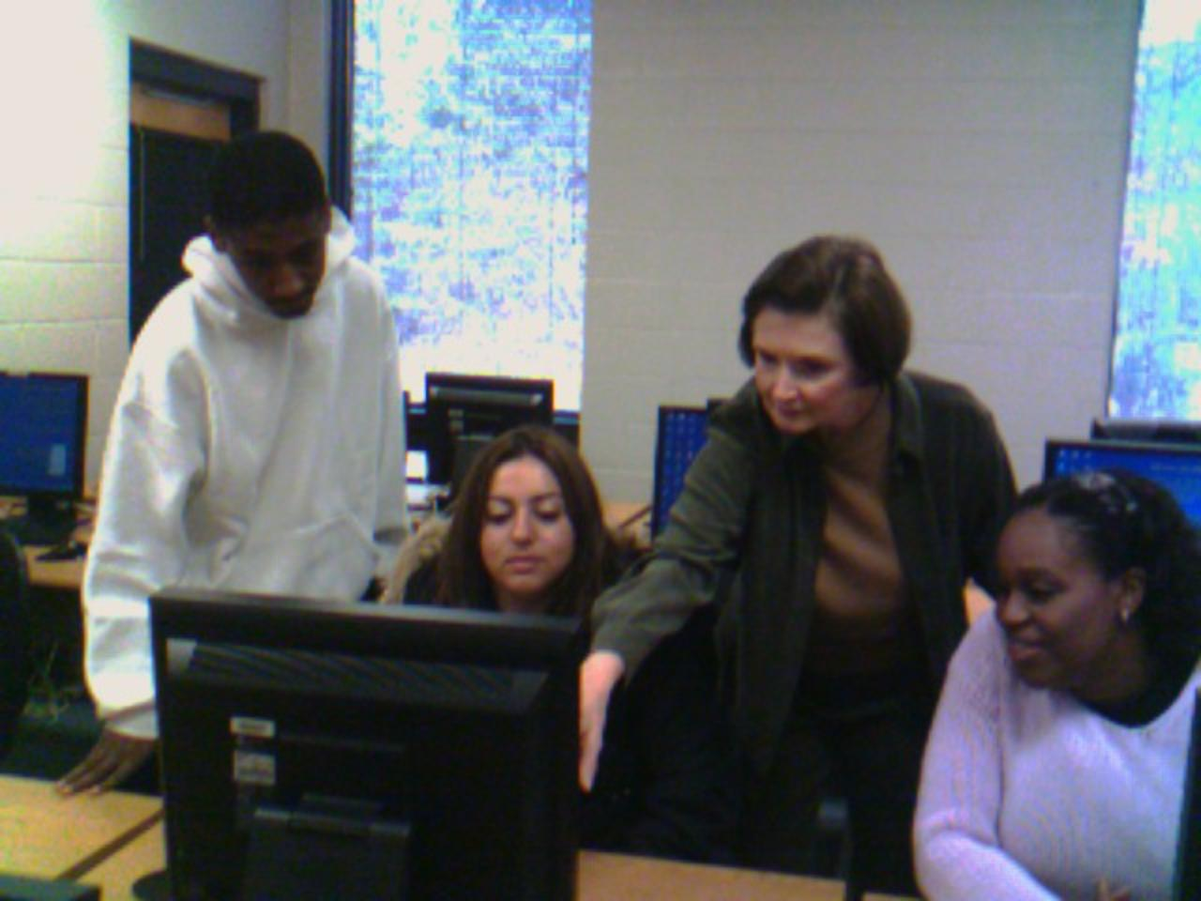
Sandra Matthews
Georgia Perimeter College

Slide 24
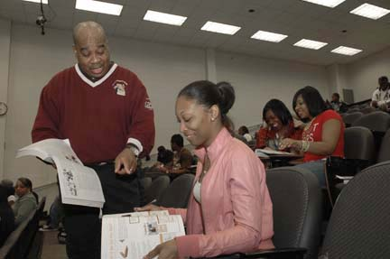
Newburn Reynolds
Georgia Perimeter College

Slide 25
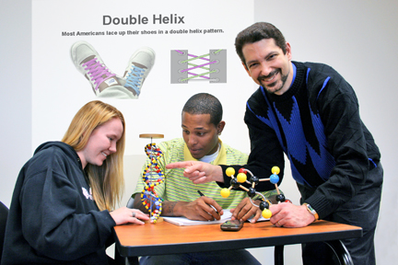
Mike Sakuta
Georgia Perimeter College

Slide 26
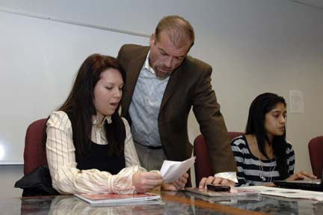
Kim Sisson
Georgia Perimeter College

Slide 27
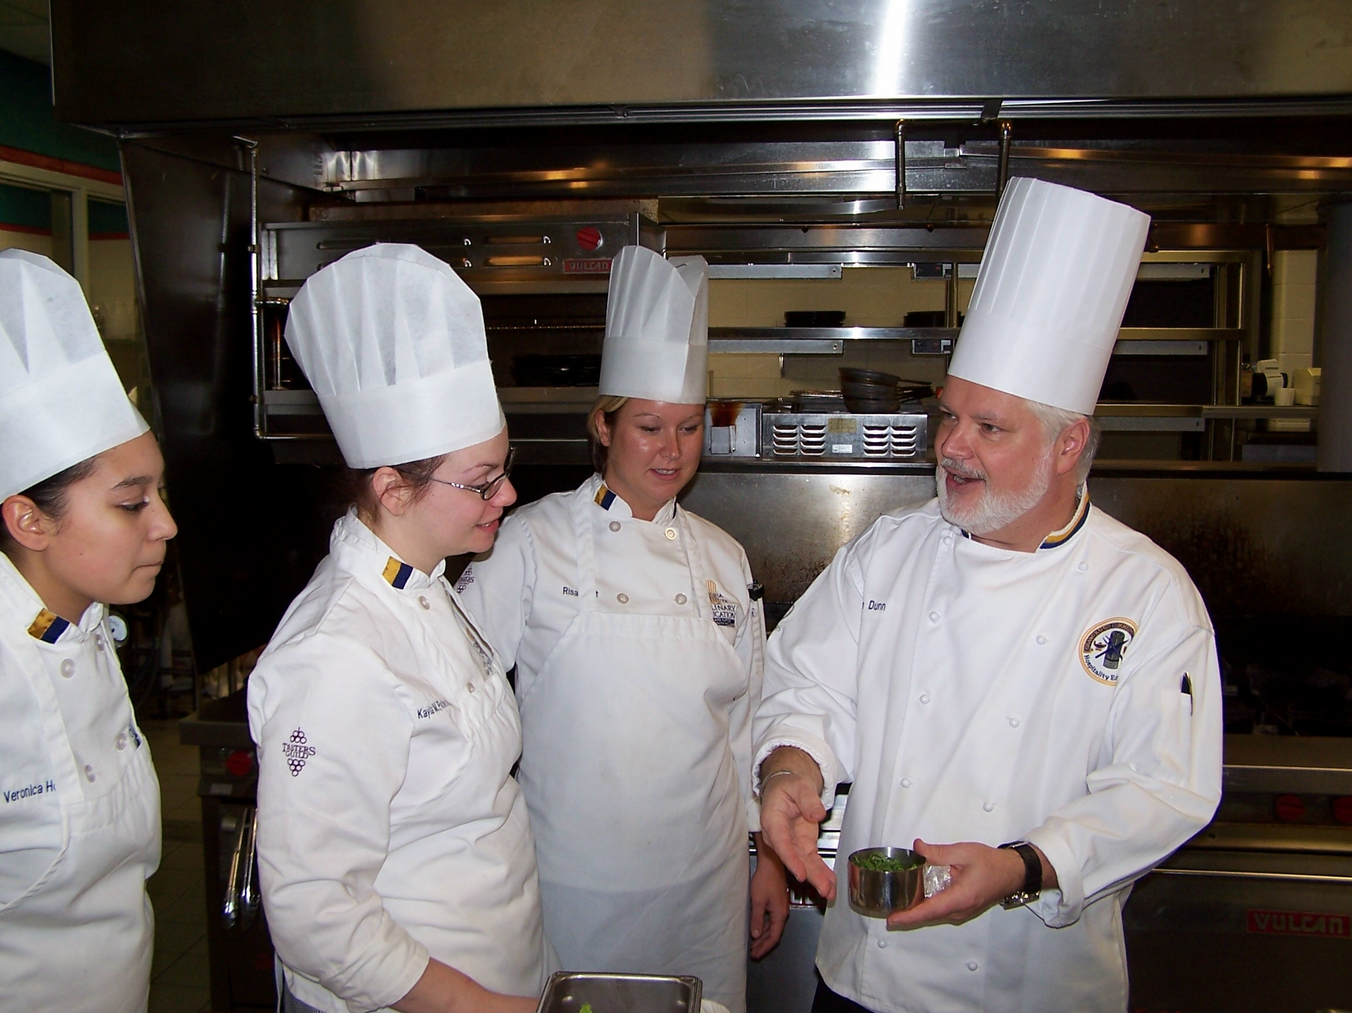
Kevin Dunn
Grand Rapids Community College
I am inspired by the moment when I can see a student truly get it—knowing it’s not only for the moment, but for the rest of their careers.

Slide 28
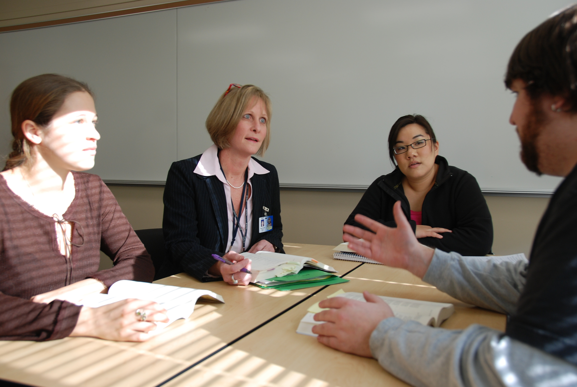
Susan Mowers
Grand Rapids Community College
Inspiration arrives in flashes—an entire class writing furiously, believing in the capacity to be writers; and an email saying, “I wanted you to know I’m in grad school now, thanks.” But motivation to achieve these inspired moments arrives daily in the form of every student who enters my classroom.

Slide 29
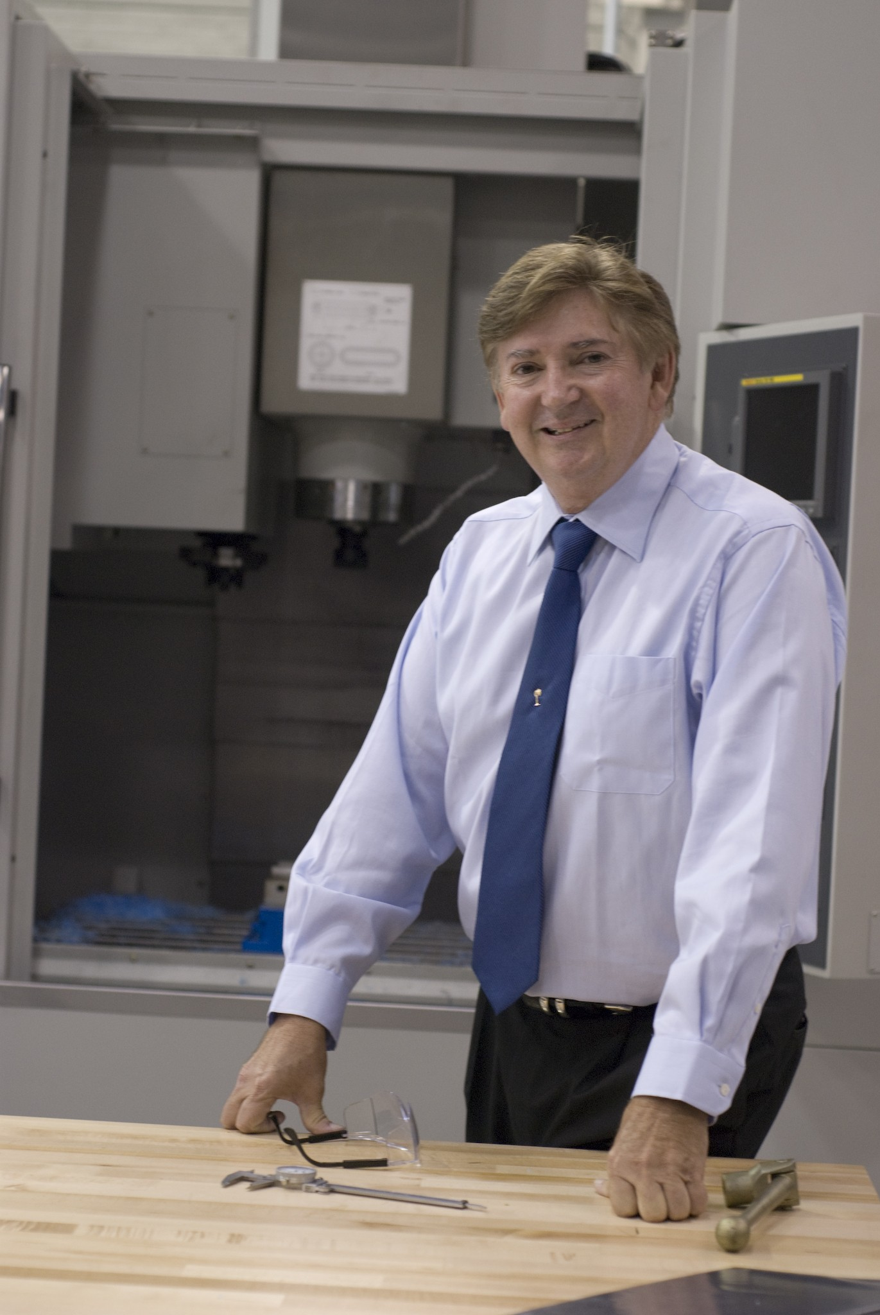
Charles Wilson
Greenville Technical College

Slide 30
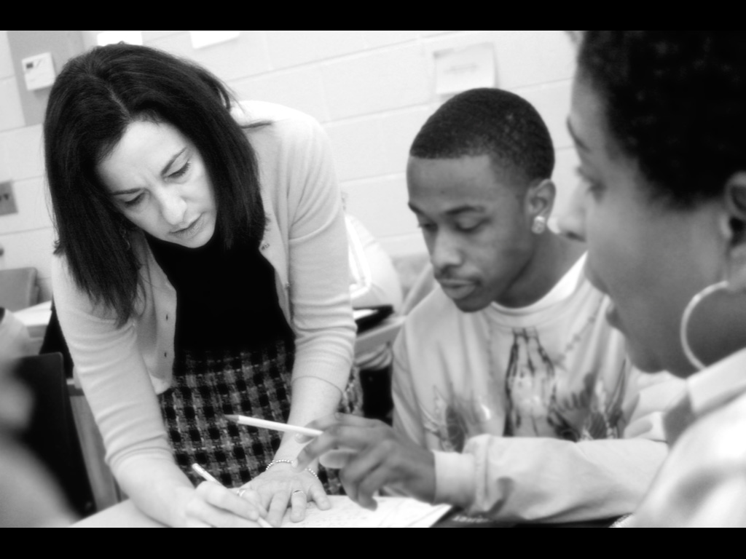
Susan Baritta
Guilford Technical Community College

Slide 31
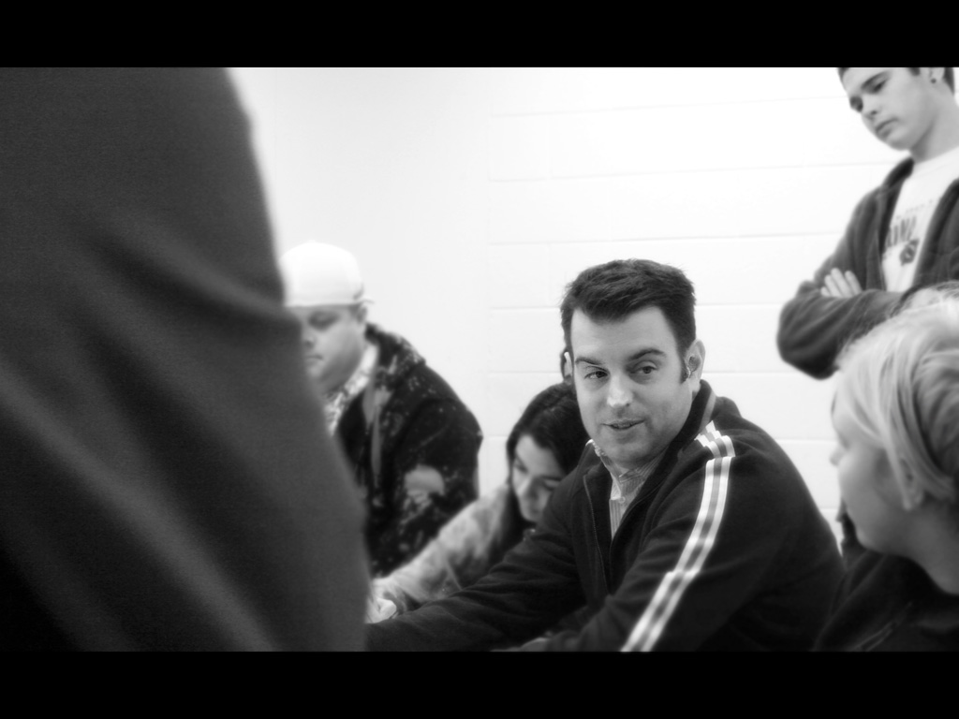
Michaeal Lawson
Guilford Technical Community College

Slide 32
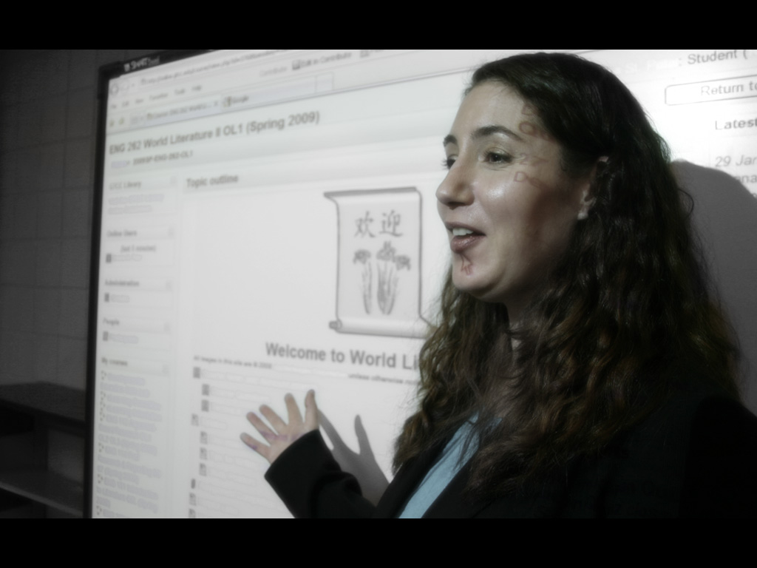
Deanna St. Peter
Guilford Technical Community College
Many of my students are older adults, returning to the classroom after many years. I find their stories inspirational and heartbreaking. My classes are one of their baby steps toward a better life for themselves and their families, and my calling is to provide them with the tools they need. Thus, my students inspire me and motivate me to do my best.

Slide 33
Julia Carlson
Guilford Technical Community College
I figure that if you're going to do something, do it well, or keep at it until you do. Learning and knowledge are the spices in the meal of life.

Slide 34
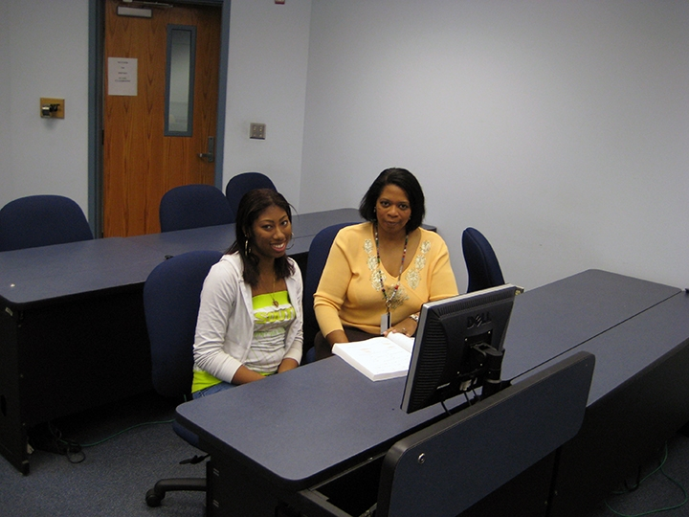
Patrice Adams
Gulf Coast Community College

Slide 35
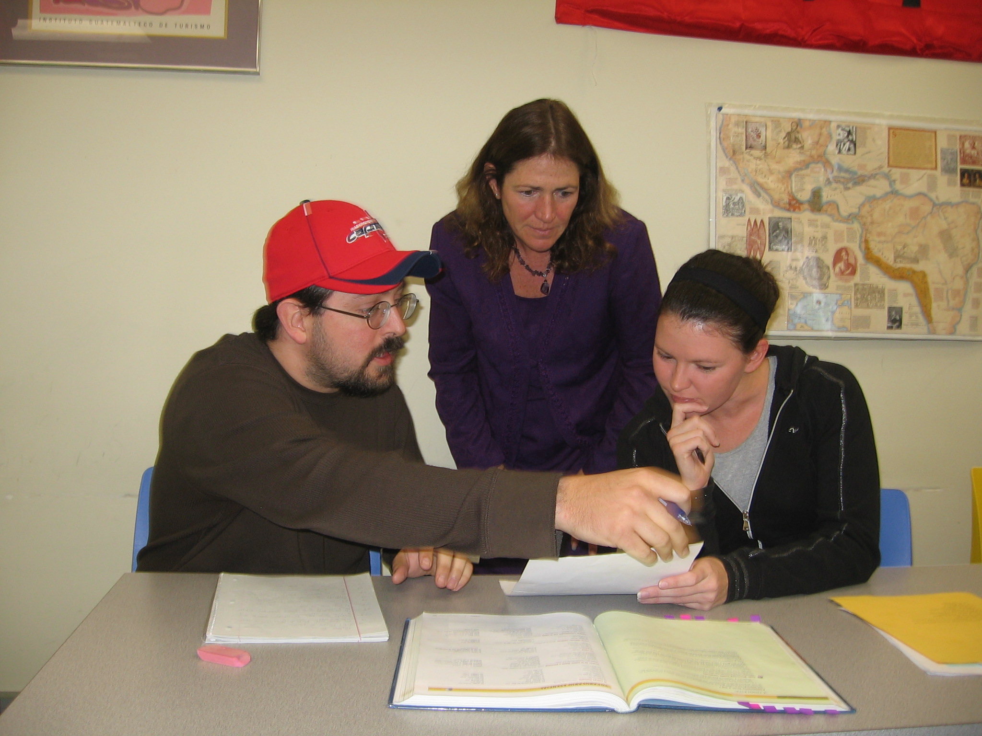
Carolyn Dunlap
Gulf Coast Community College
I am most inspired when I feel I am the person responsible for igniting moments of clarity of understanding in my students.

Slide 36
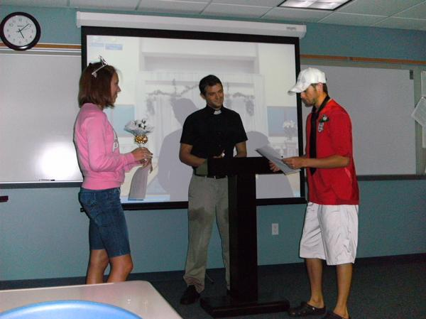
Wes Keene
Gulf Coast Community College

Slide 37
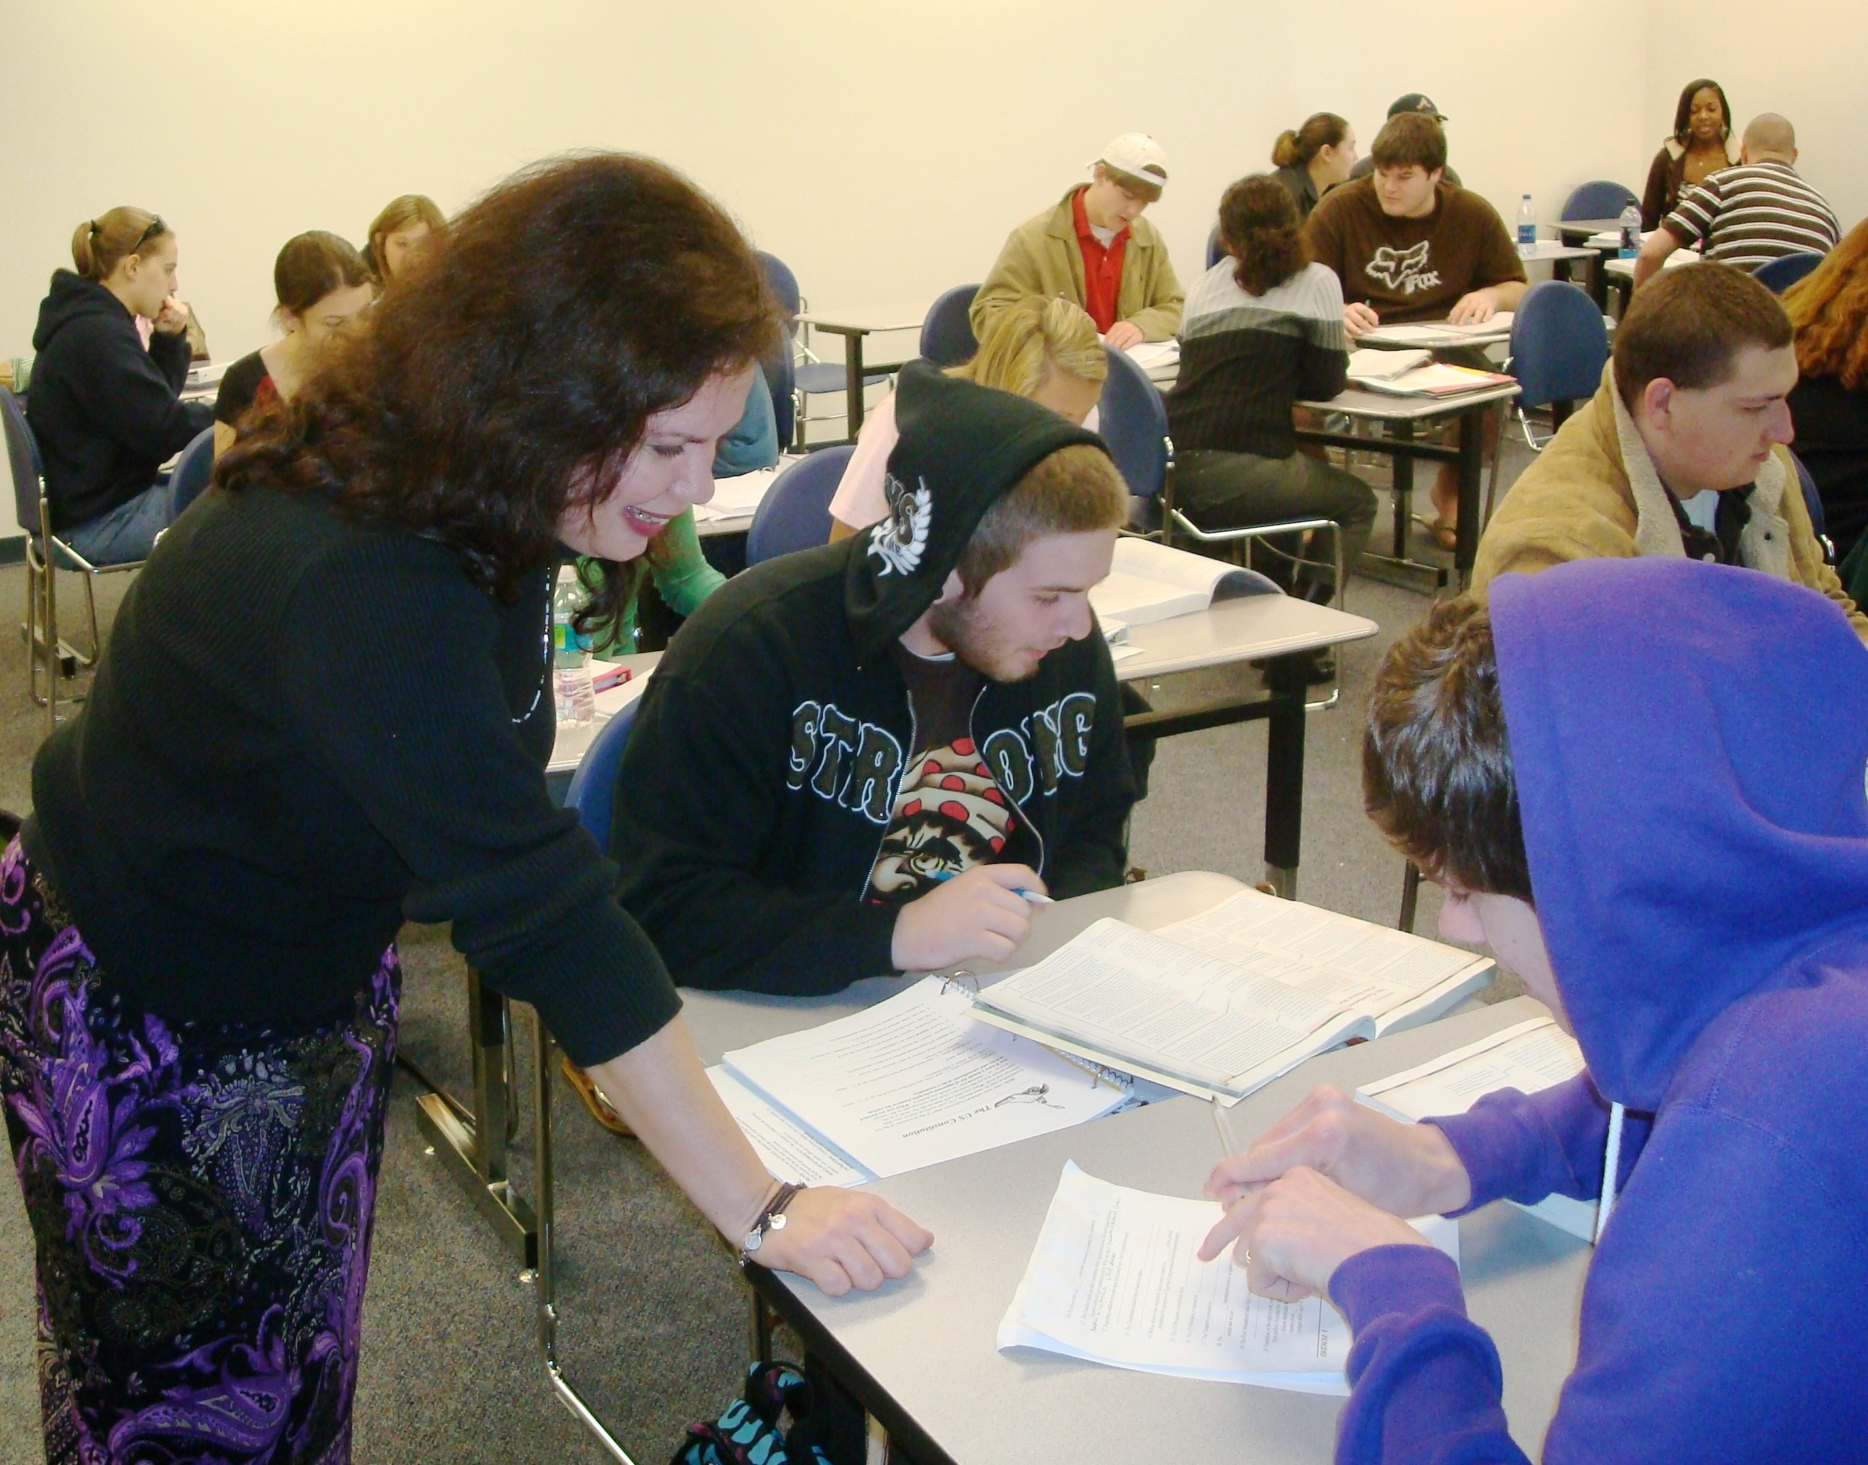
Elizabeth Trentanelli
Gulf Coast Community College

