Slide 1
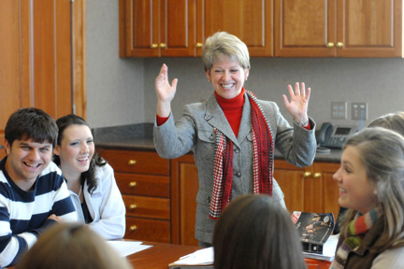
Mary Yarbrough
Calhoun Community College

Slide 2
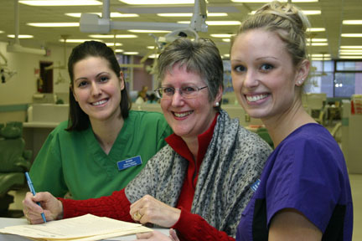
Heather Bos
Camosun College
I am inspired with the journey I share, communicating with the students before their arrival and during their residence, hearing their dreams, and, in a small way, helping them succeed. It is delightful when our alumni continue to connect and share wonderful experiences.

Slide 3
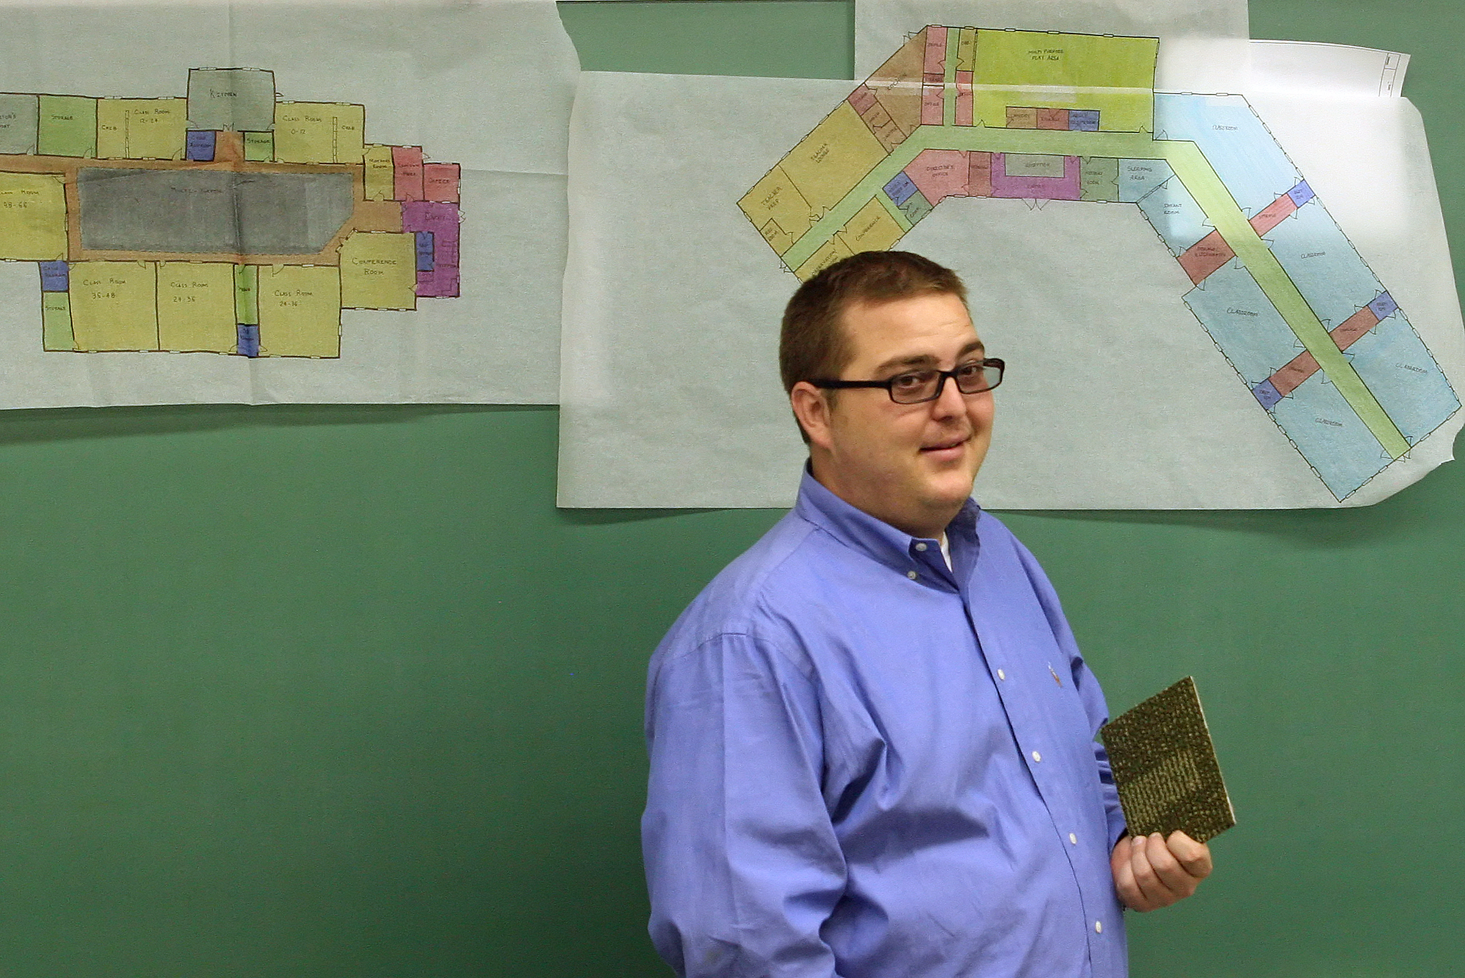
Jason Eggemeyer
Casper College
I am always excited to hear updates from students after graduation. I am most excited when I hear they are happy in their life. That is excellence!

Slide 4
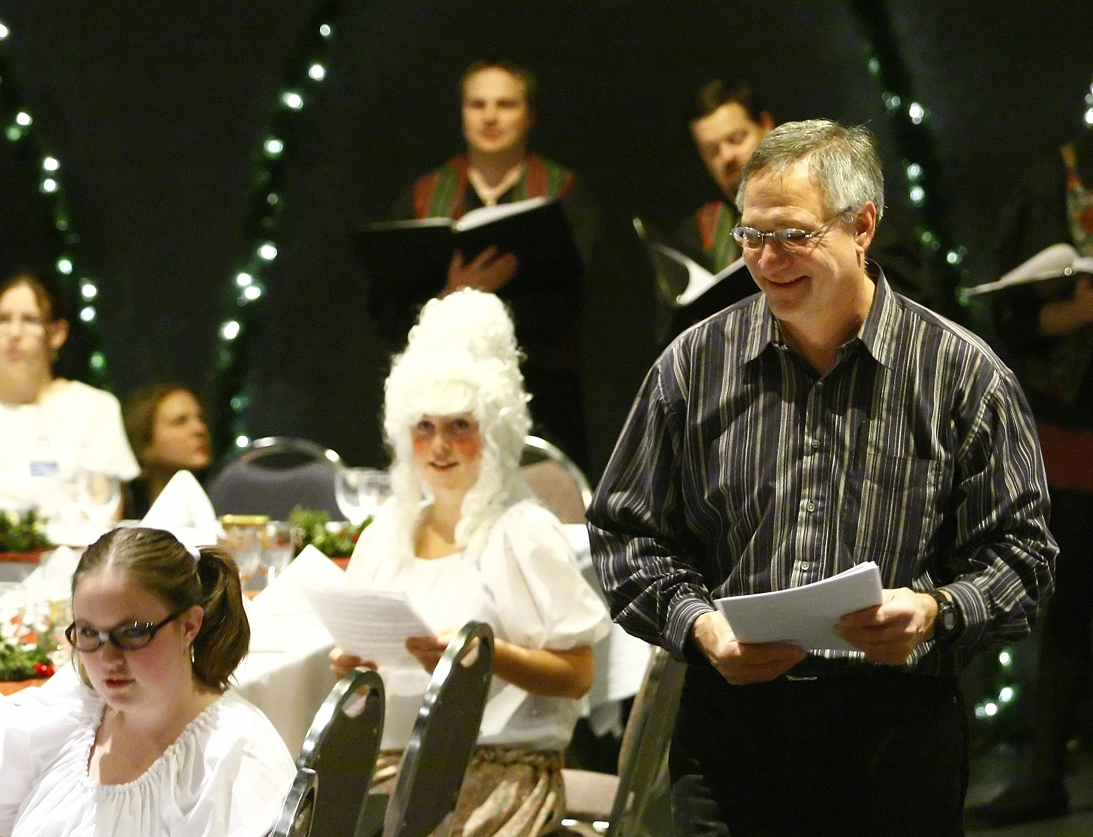
Pat Patton
Casper College

Slide 5
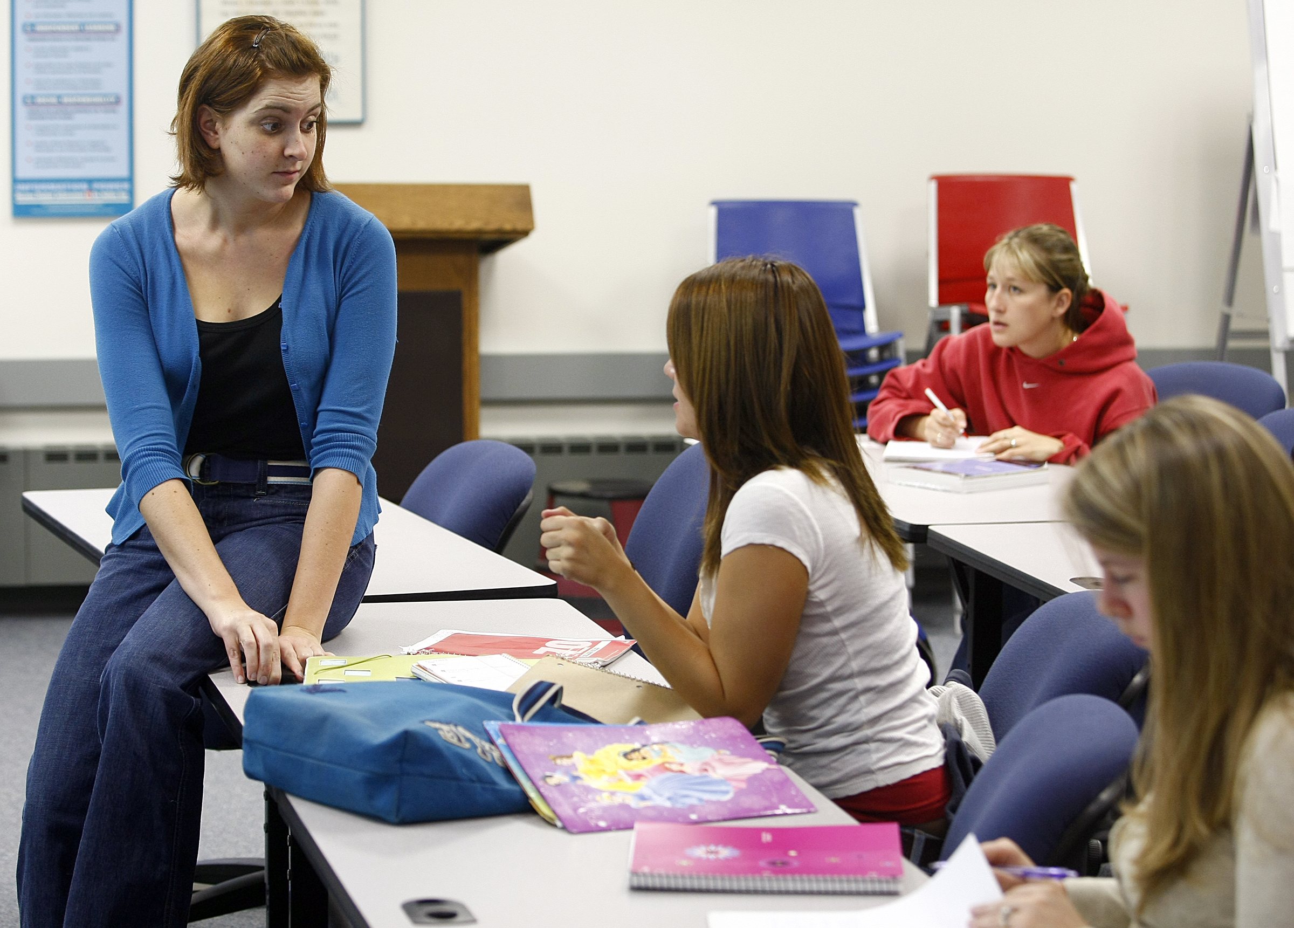
Melanie Young
Casper College
What really excites and inspires me is thinking about my students as not only students at a community college but as parents, consumers, citizens, activists, employees, and members of my community. When I see them as part of something beyond just the college, I know that learning how to communicate effectively and make informed choices will not only improve their lives but also the lives of those around them. If they can clearly articulate their experiences and beliefs, then politicians, employers, community members, family members, and fellow citizens can hear their often overlooked voices.

Slide 6
Garrett Hurt
Central Arizona College
When a graduate from our program comes to visit three years later to say thank you and tell us his success story it makes sense as to why I am a teacher. Every fall I look forward to that new crop of students who want to become productive American workers.

Slide 7
Valerie Jensen
Central Arizona College
I am inspired by people, especially young people, who find happiness by seeking to better themselves, their relationships, our community, and the world. When I inevitably feel the weight of the world lowering upon my shoulders, I replace it with the weight of a backpack and wander around the woods for a couple of days. When I return home and remove the backpack, the weight mysteriously has disappeared.

Slide 8
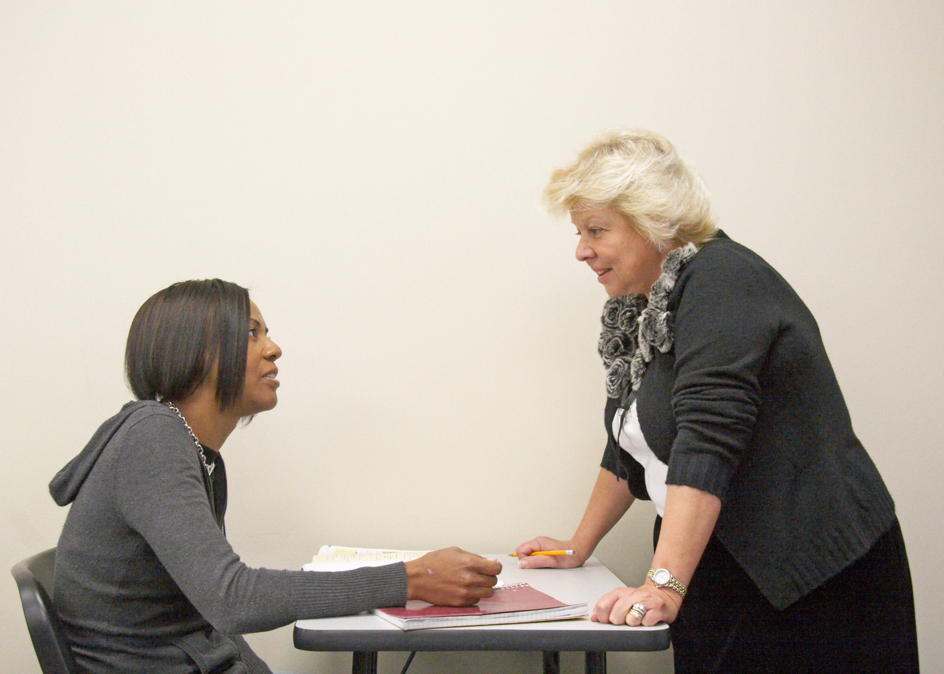
Sylvia Nikopoulos
Central Piedmont Community College

Slide 9
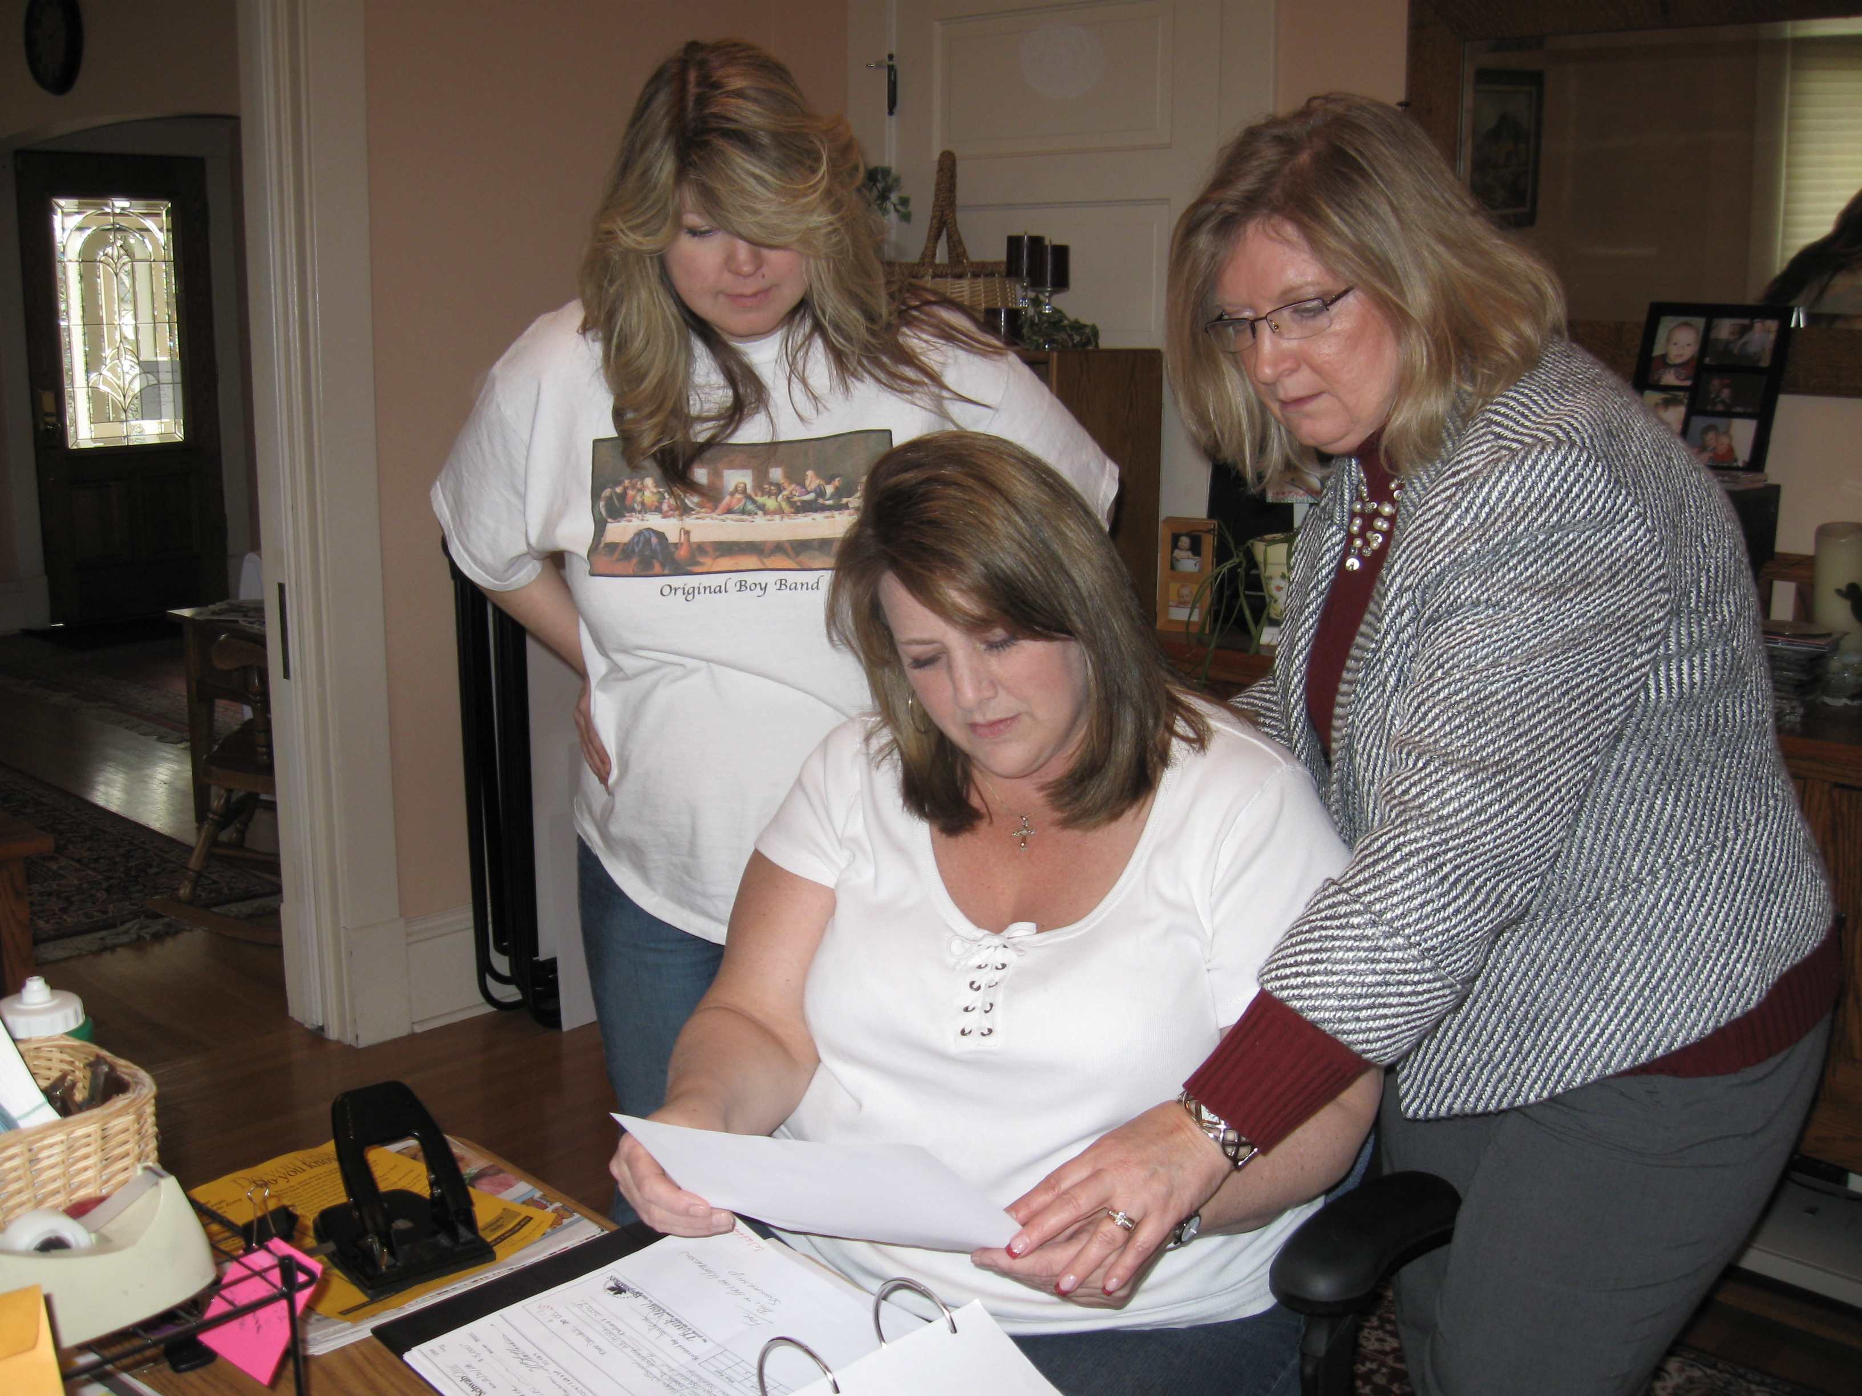
Julie Johnson
Centralia College
It gives me great pleasure to meet with donors and share how students have overcome various obstacles and how thankful they are for the assistance to help them realize their educational dreams. We truly are investing in our future, and that investment returns to us a hundredfold.

Slide 10
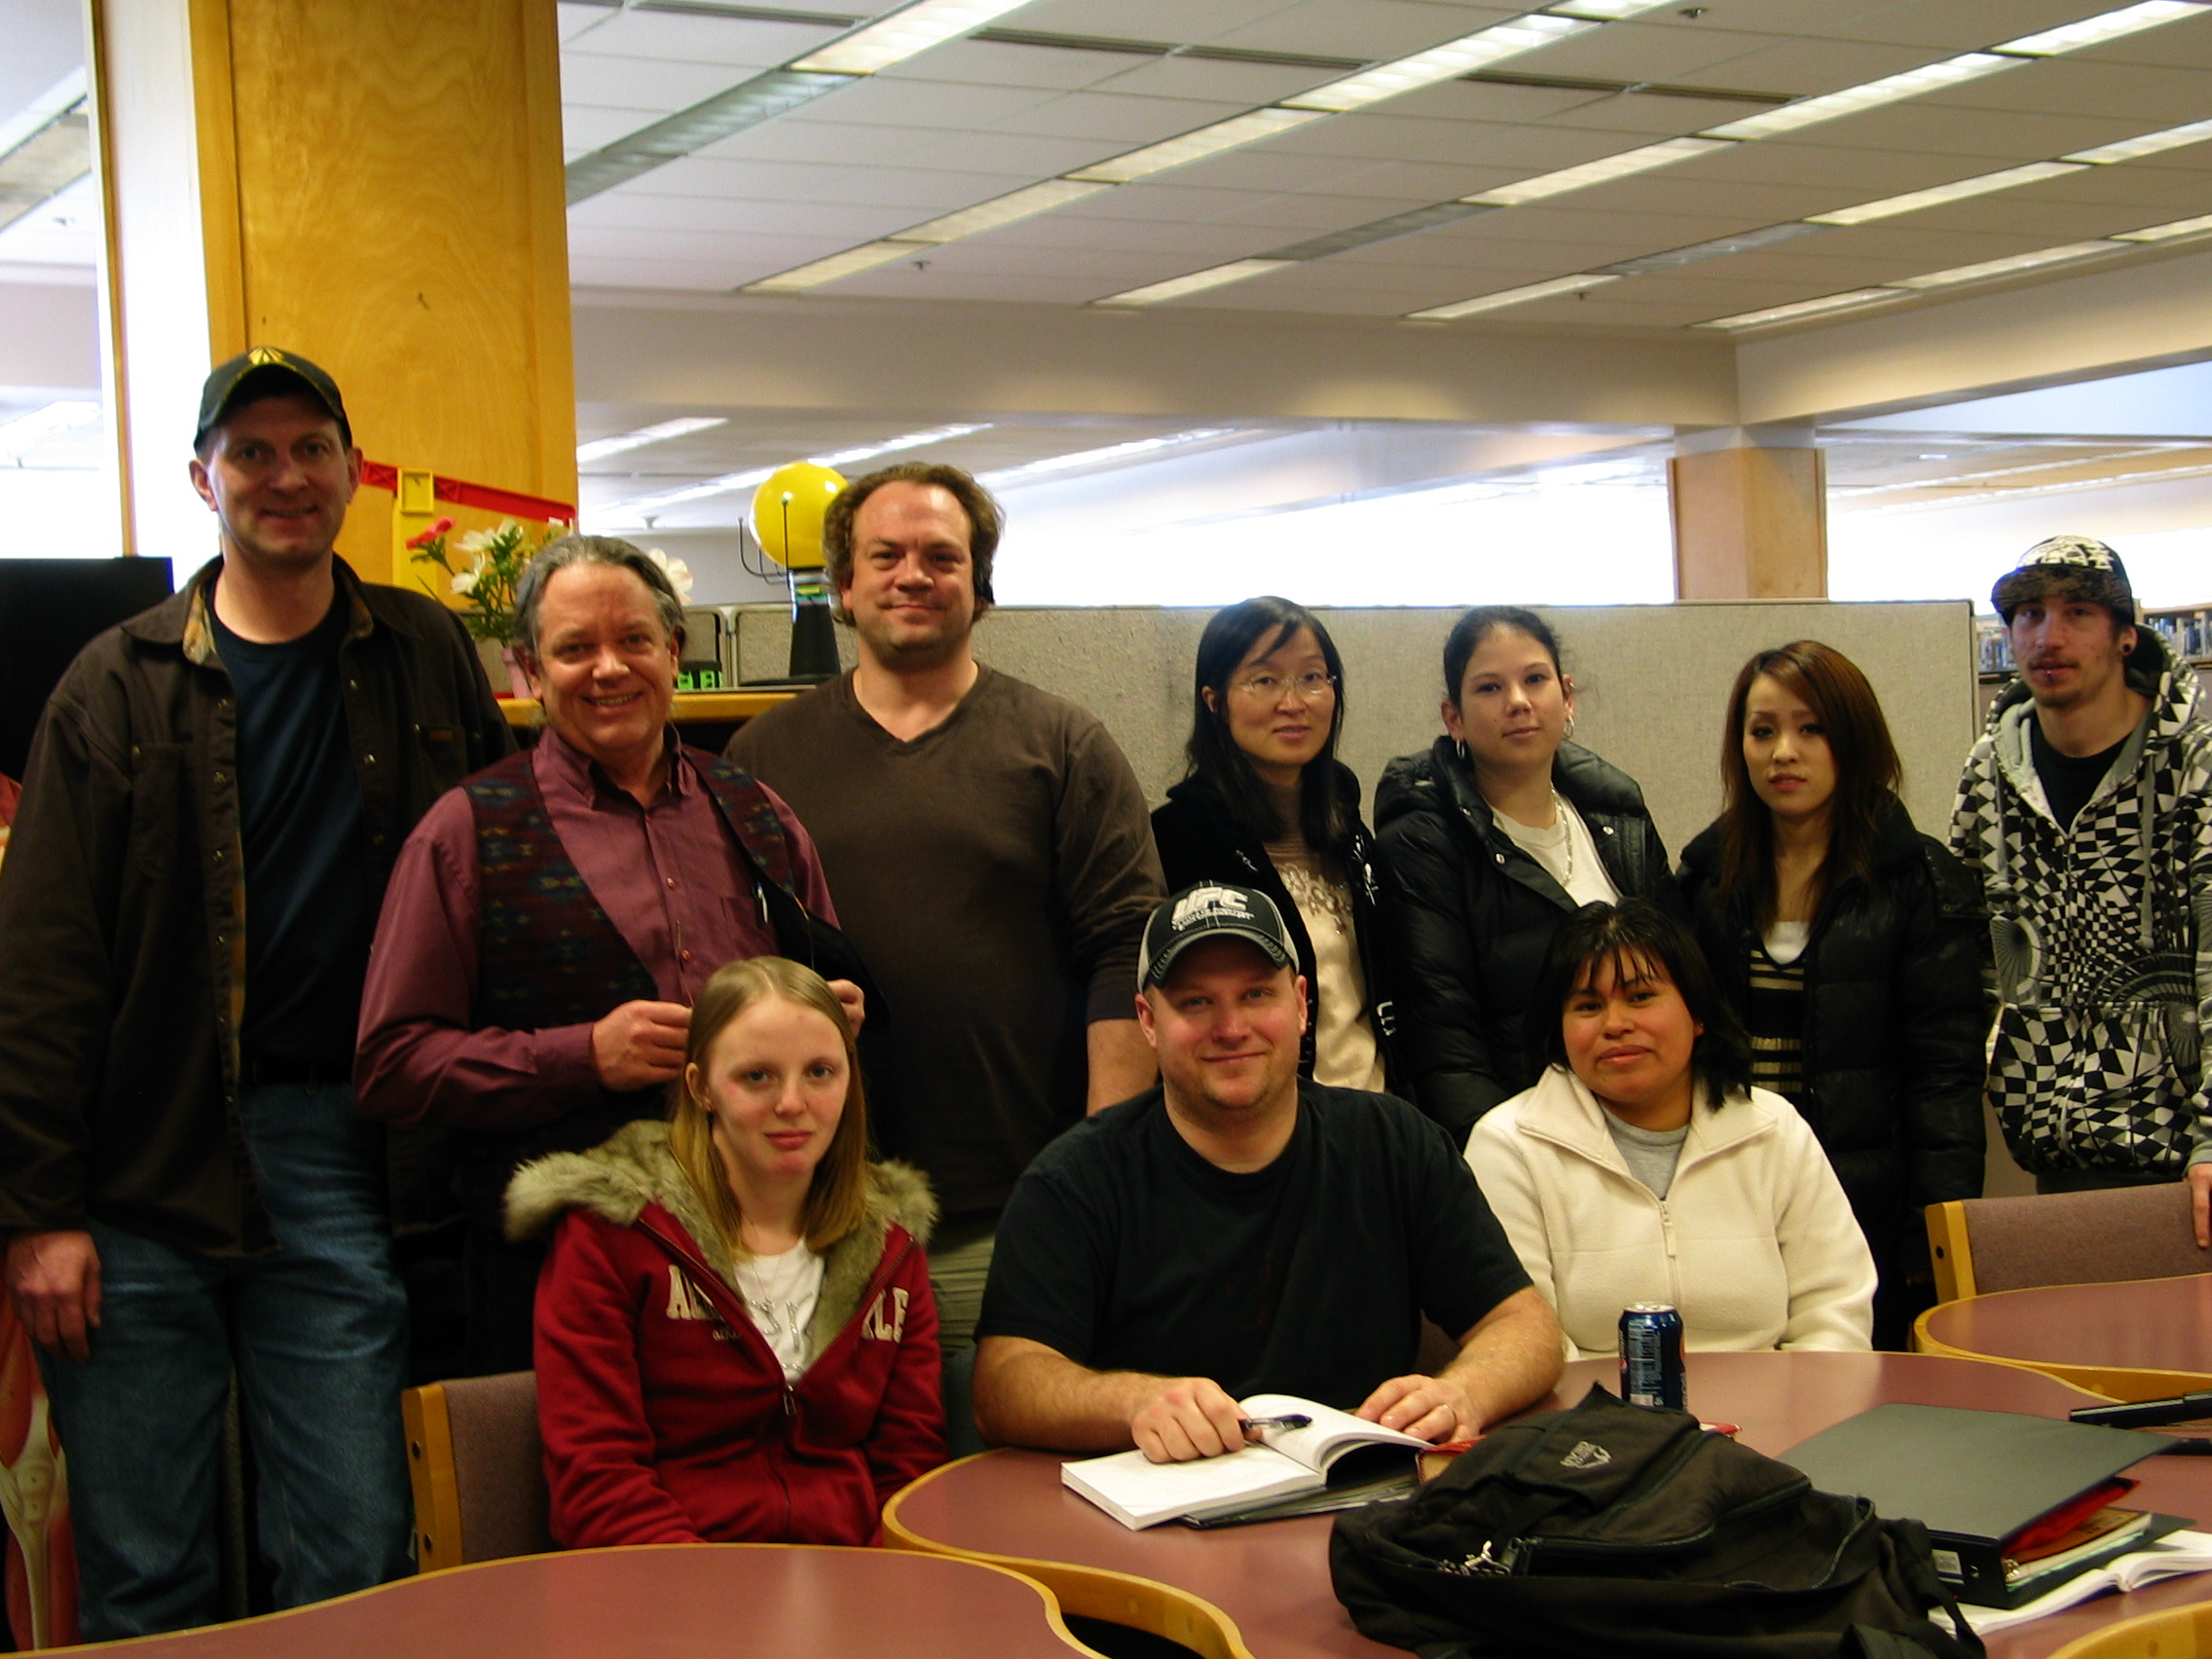
Randy Johnson
Centralia College
I choose to work with under-prepared students, to re-open the door to education as a way to grow. It’s tough on them, and tough on me, but together we often triumph. We share life, hopes, dreams, troubles, and the work of being human.

Slide 11
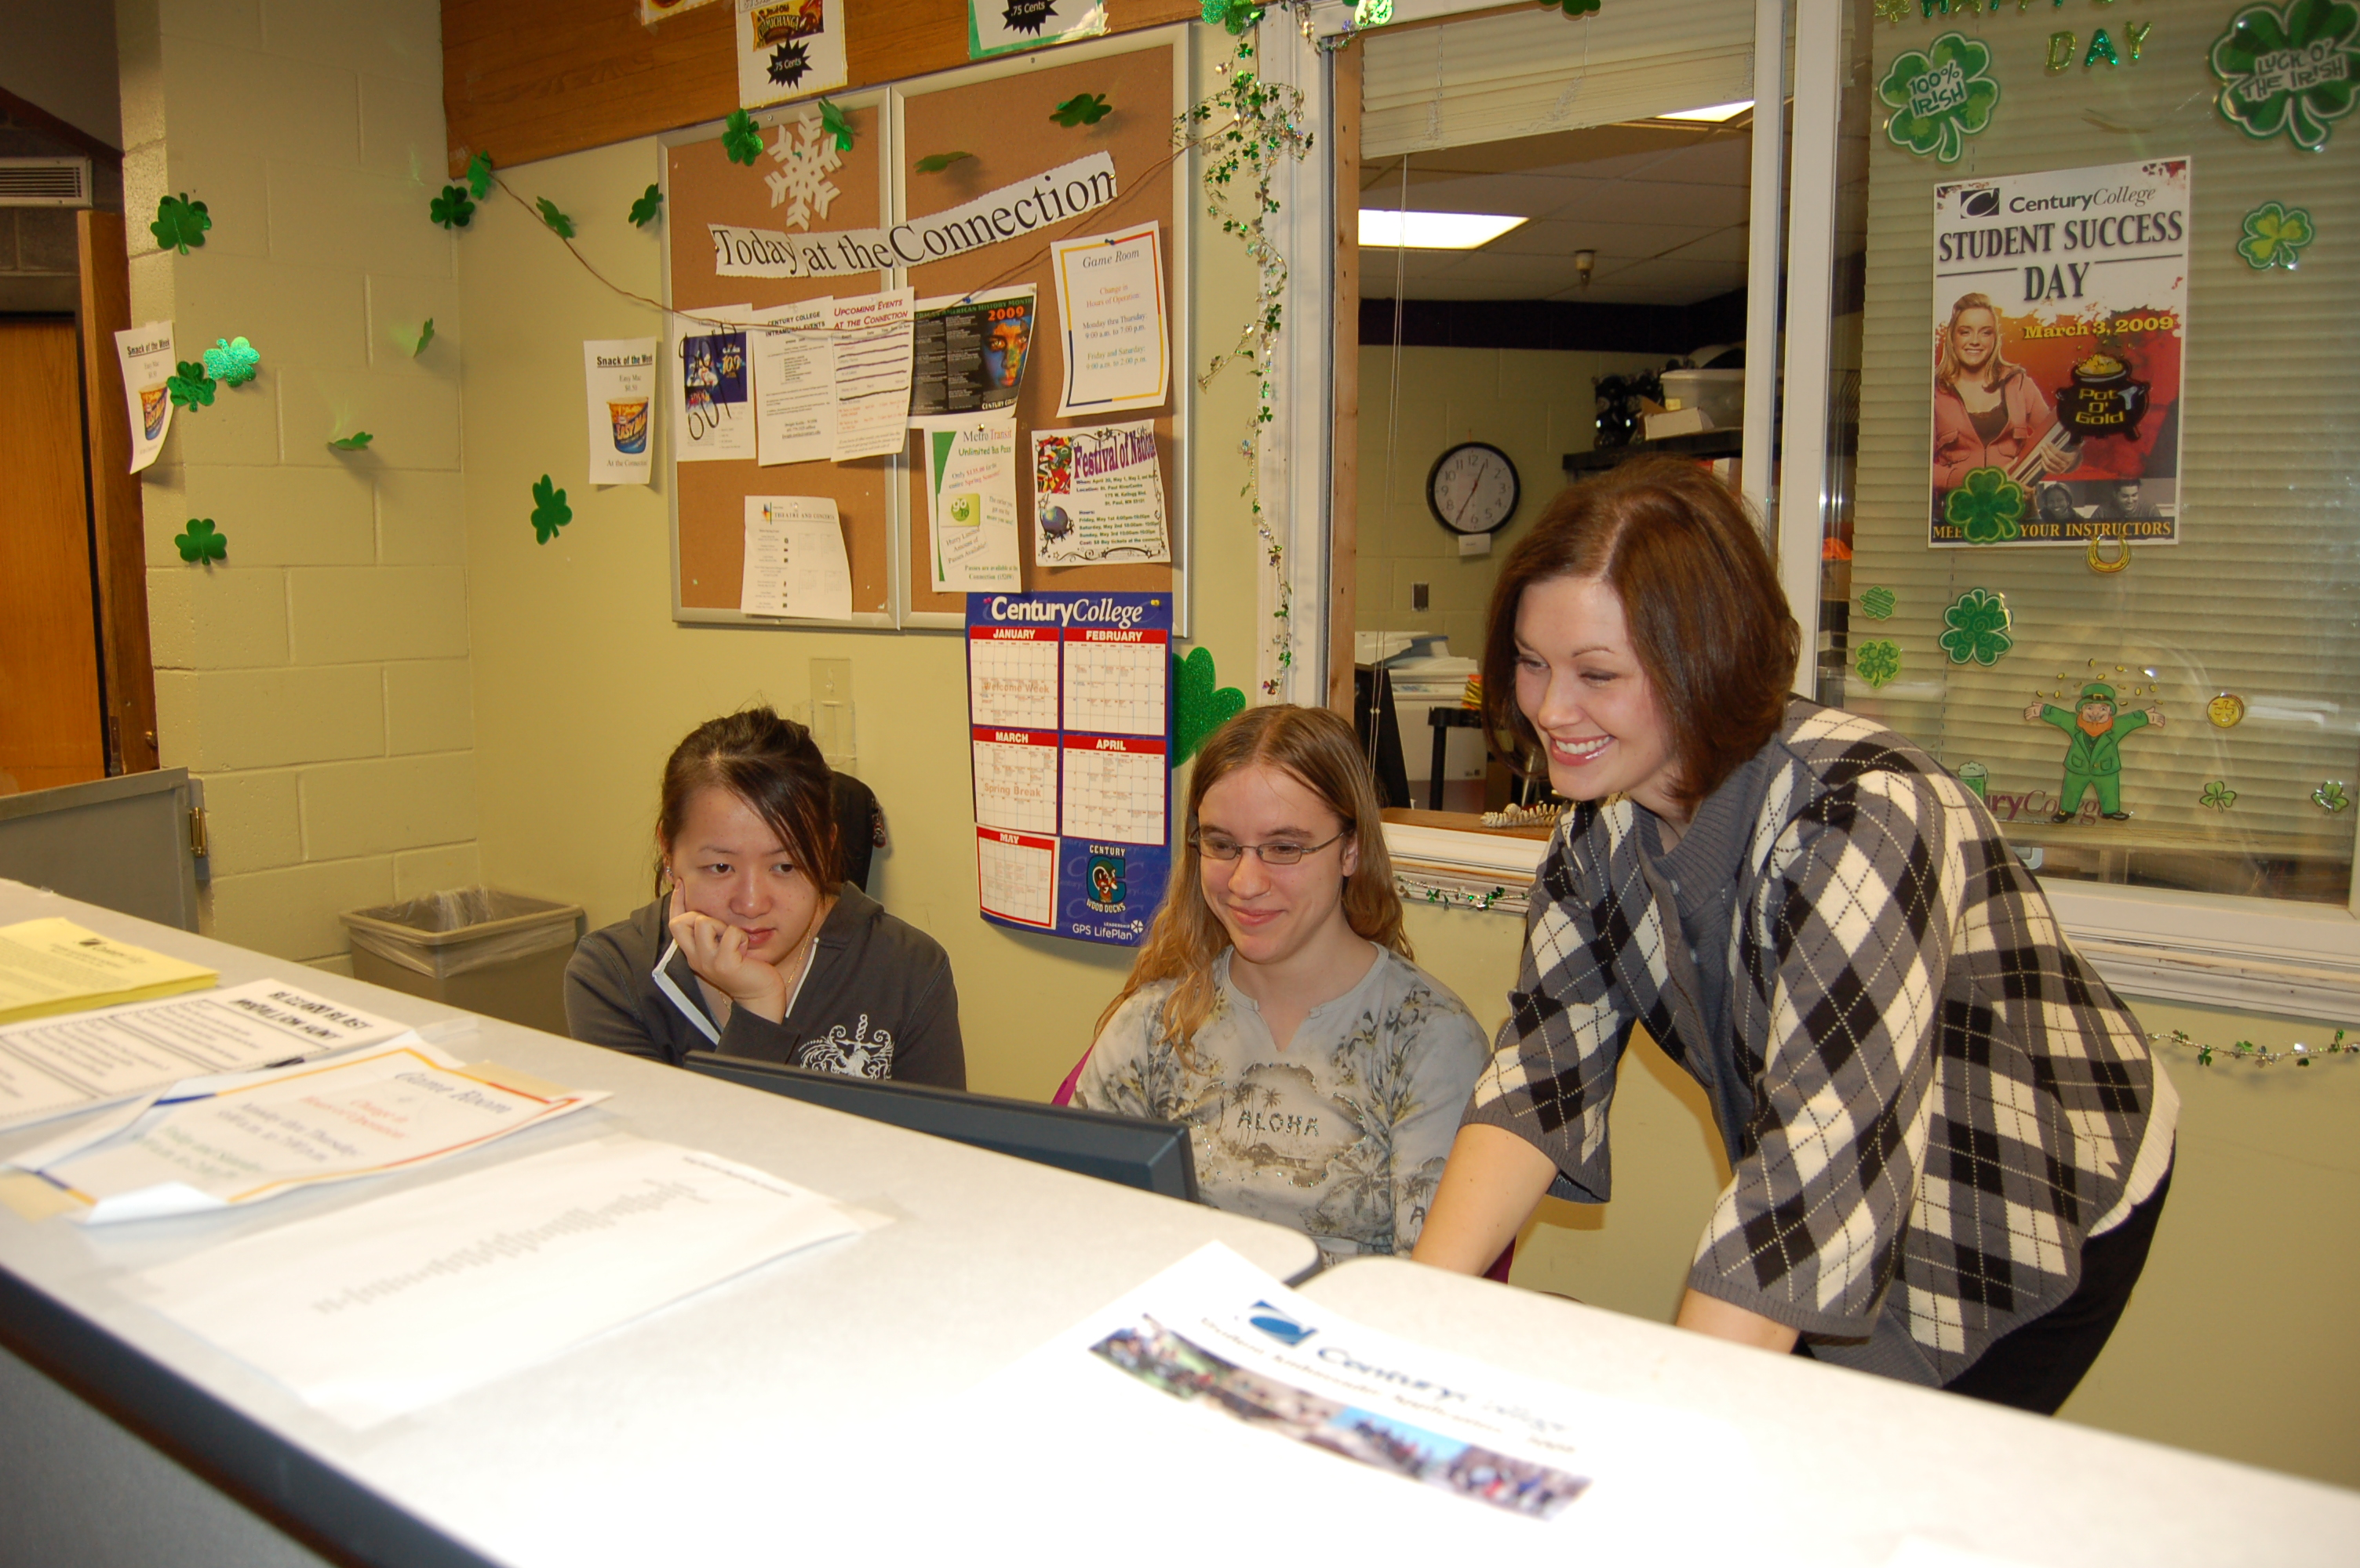
Katie Svoboda
Century College

Slide 12
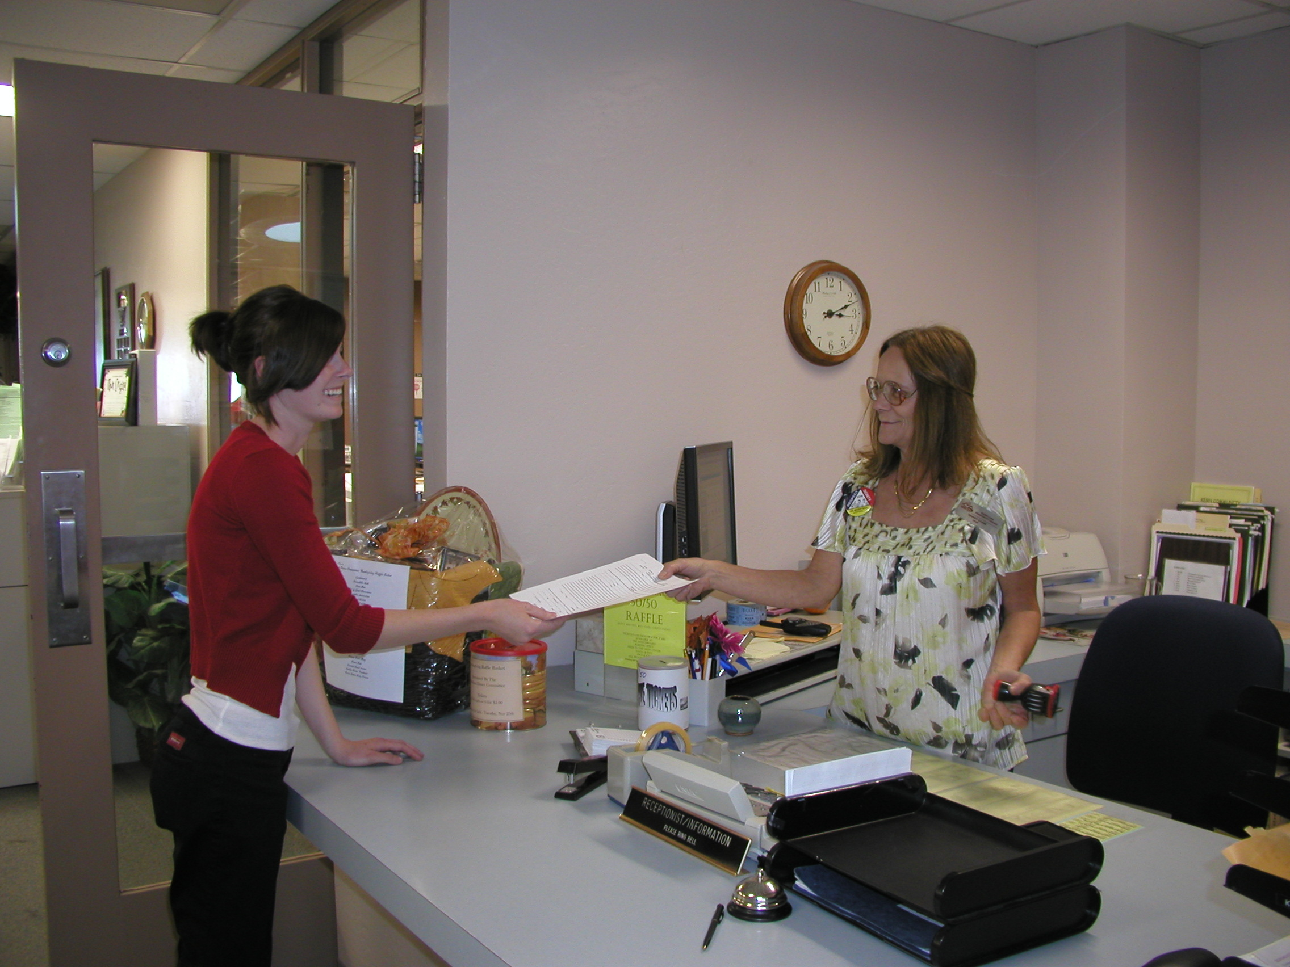
Candy Caine
Cerro Coso Community College

Slide 13
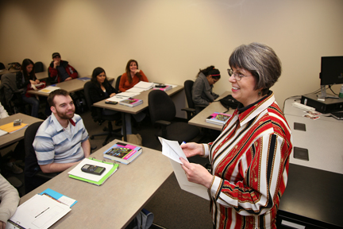
Barbara Thompson
Chattahoochee Technical College

Slide 14
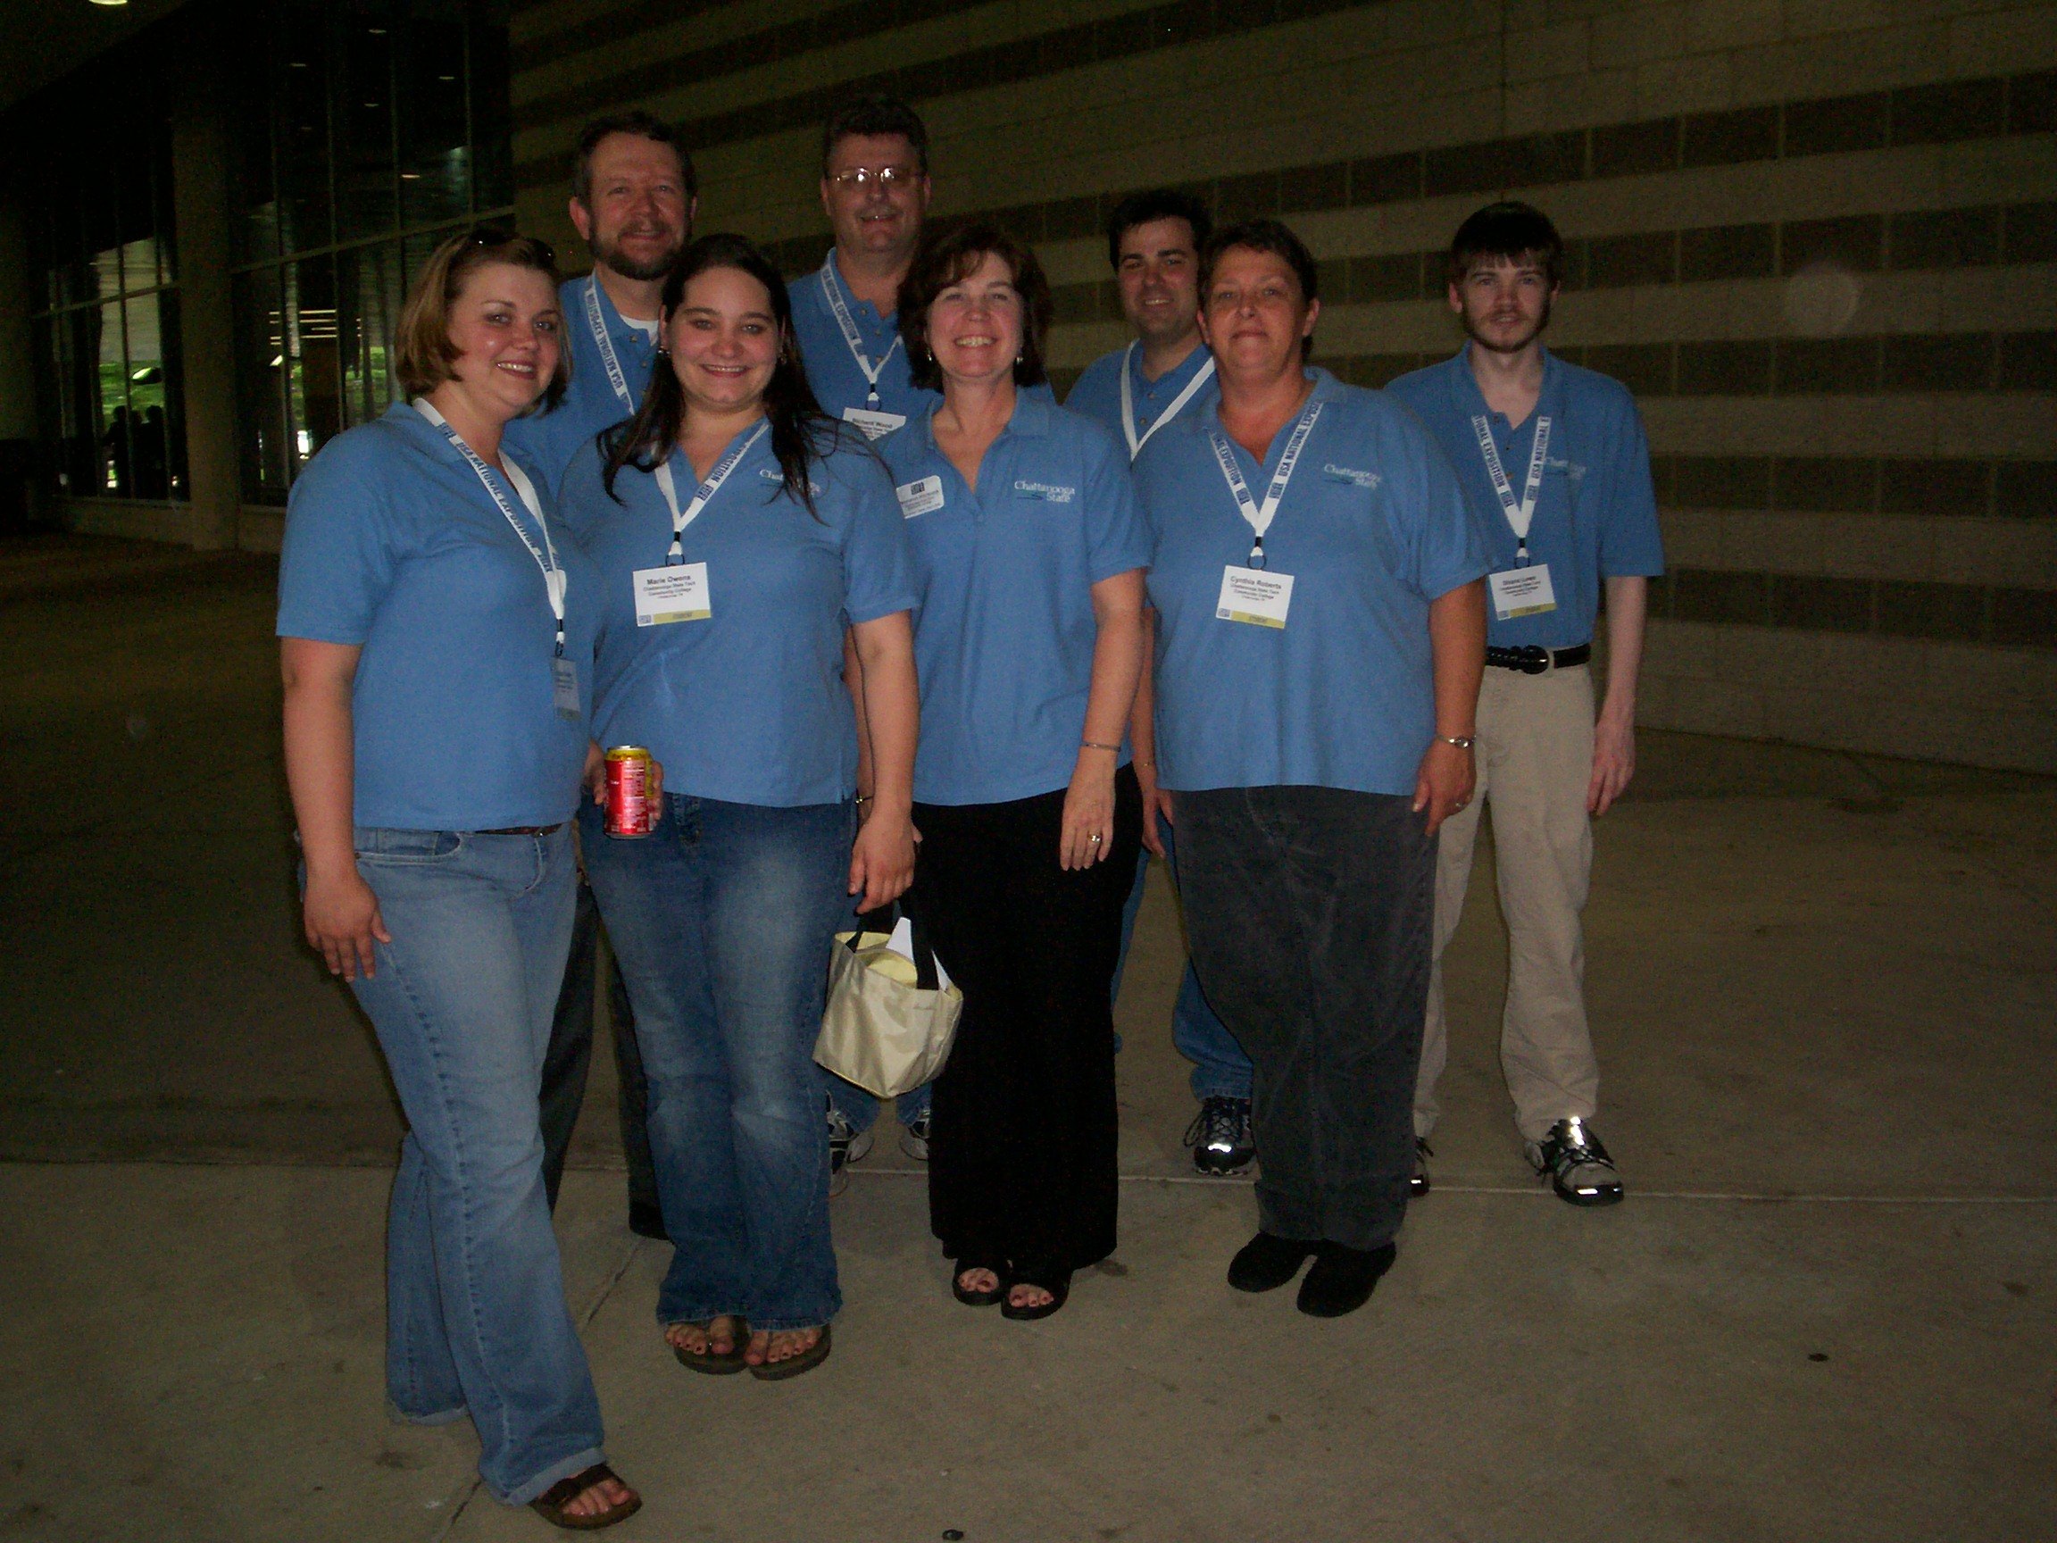
Connie Hitchcock
Chattanooga State Technical Community College

Slide 15
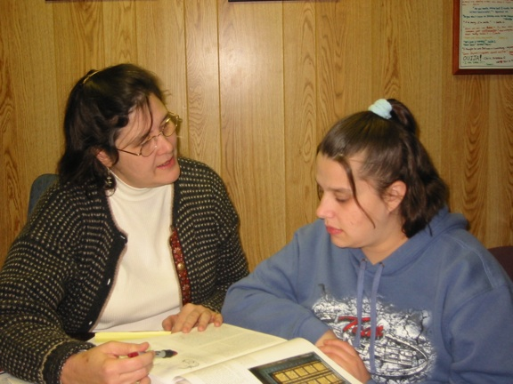
Andrea Sanders
Chattanooga State Technical Community College
To succeed as a teacher, you must genuinely enjoy, trust, and care about your students. If you don’t, you might as well go back to the house.

Slide 16
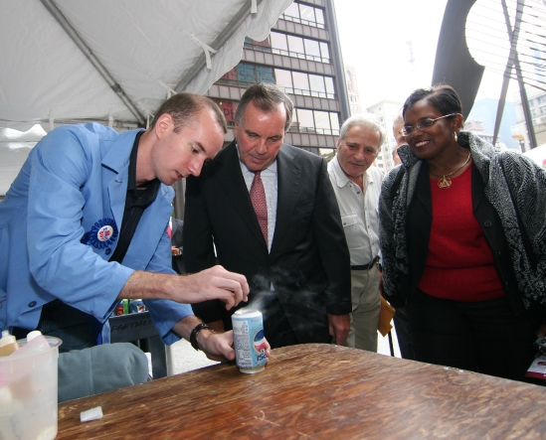
Michael Davis
City College of Chicago

Slide 17
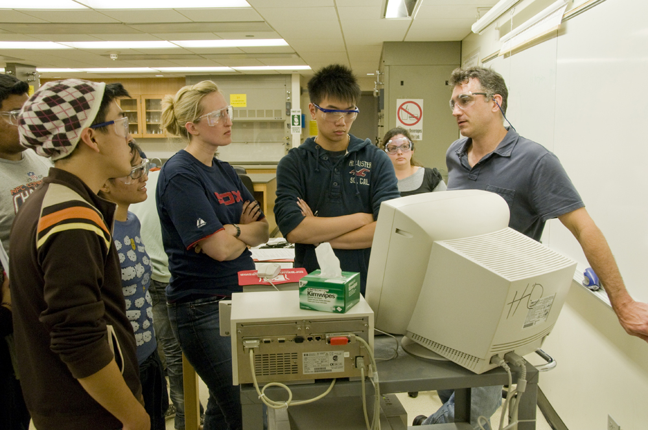
Tom Higgins
City College of Chicago

Slide 18
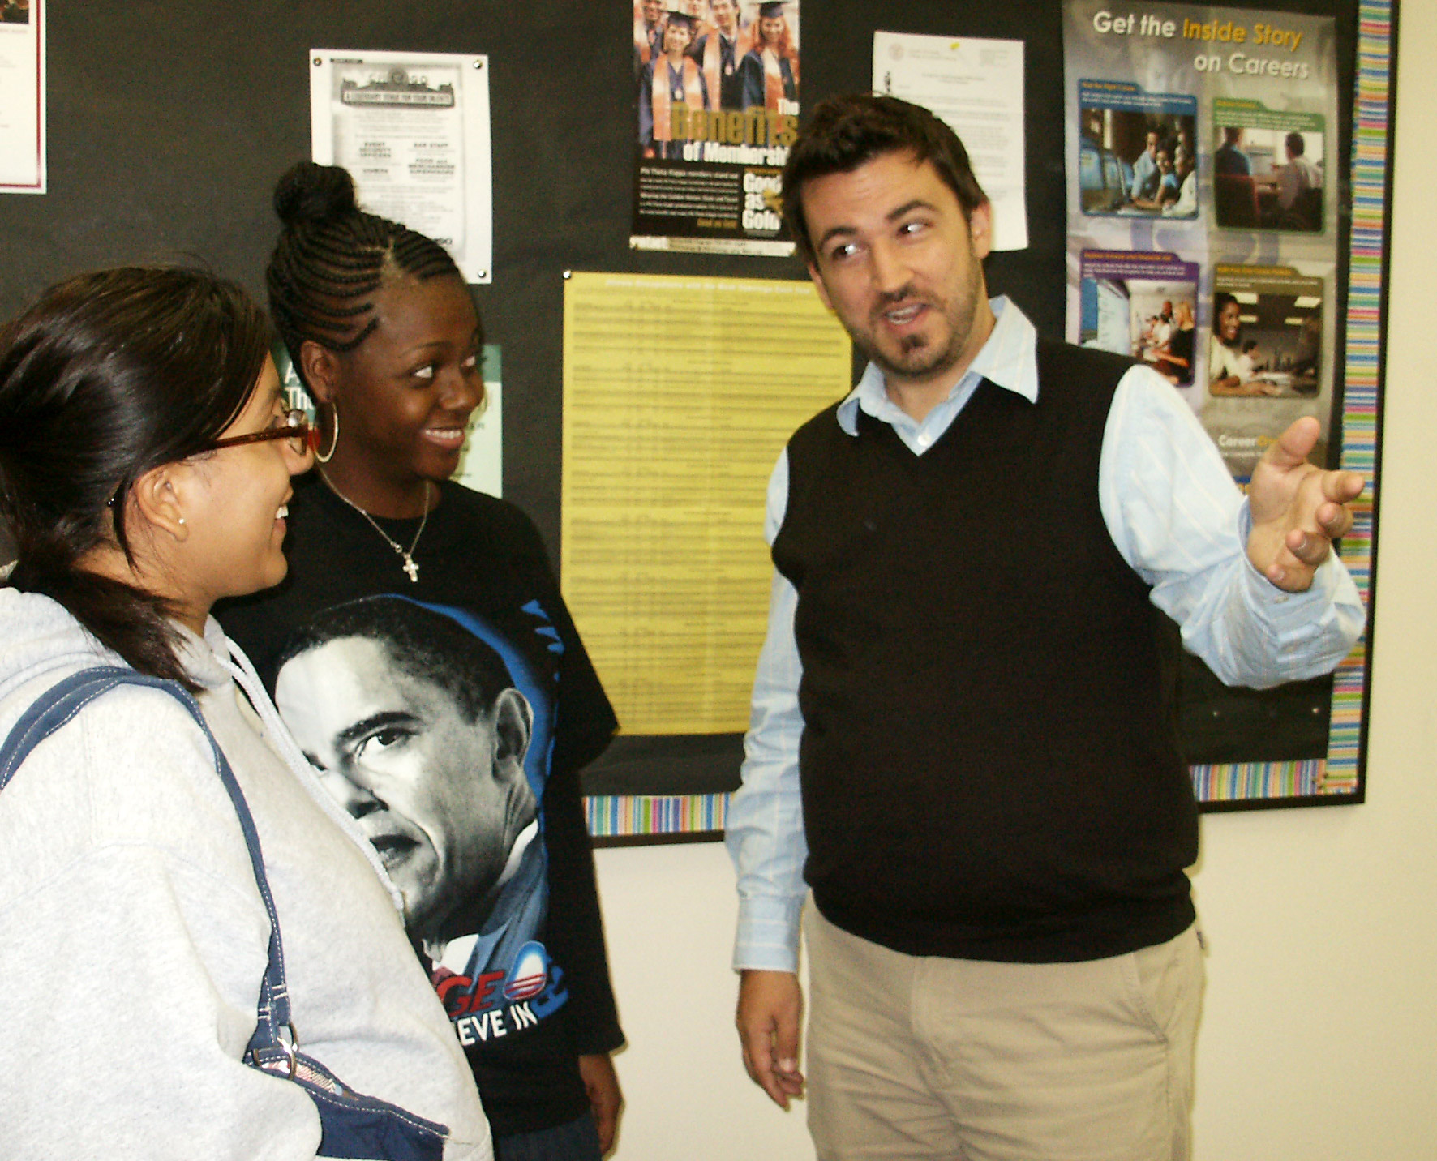
Frank Reynolds
City College of Chicago

Slide 19
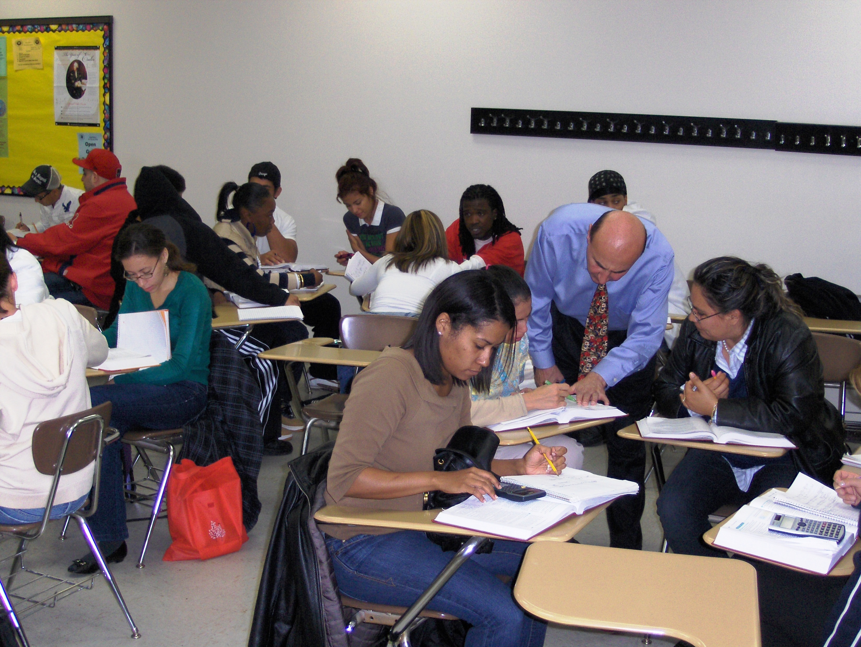
Vali Siadat
City College of Chicago

Slide 20
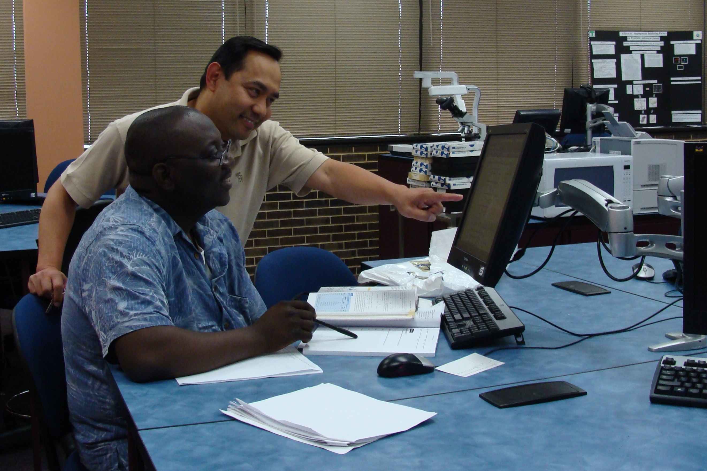
Raymund Torralba
City College of Chicago

Slide 21
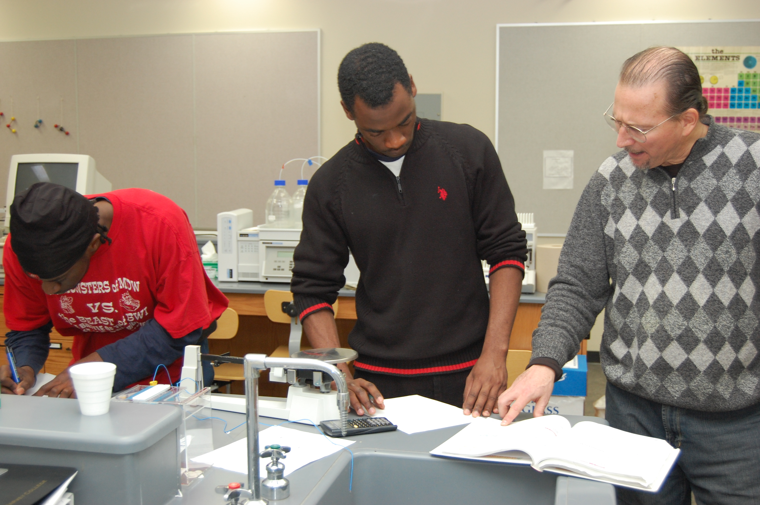
David Zoller
City College of Chicago

Slide 22
Christopher Bays
Clark State Community College
When my students argue vociferously, yet reasonably, against one of my claims, I know that I have succeeded in making them better students and citizens. They are, after all, the voice of our future.

Slide 23
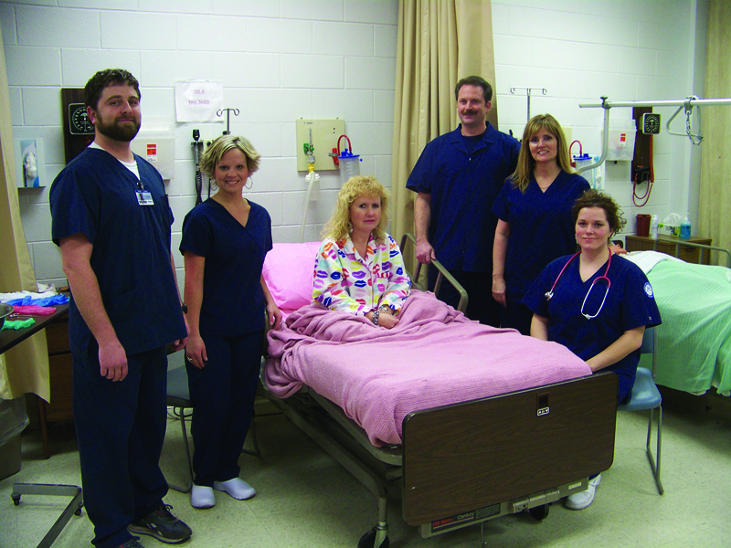
Joyce Brock
Cleveland State Community College

Slide 24
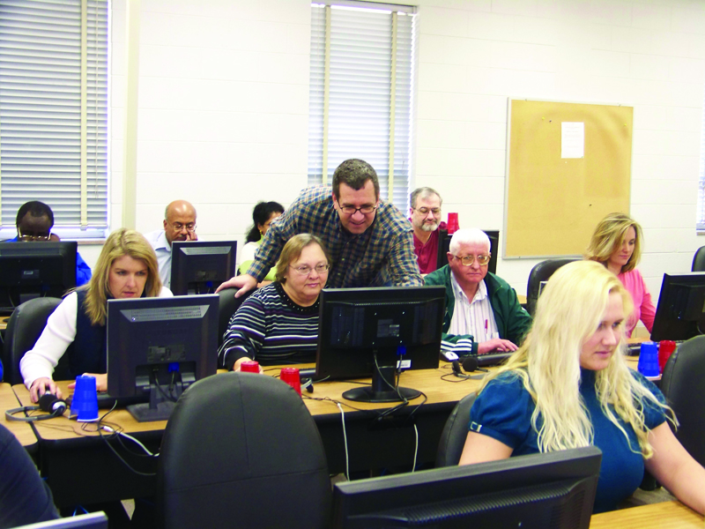
John Squires
Cleveland State Community College

Slide 25
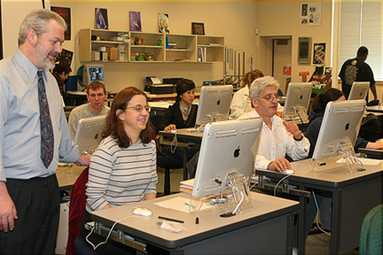
John Moyer
Clover Park Technical College

Slide 26
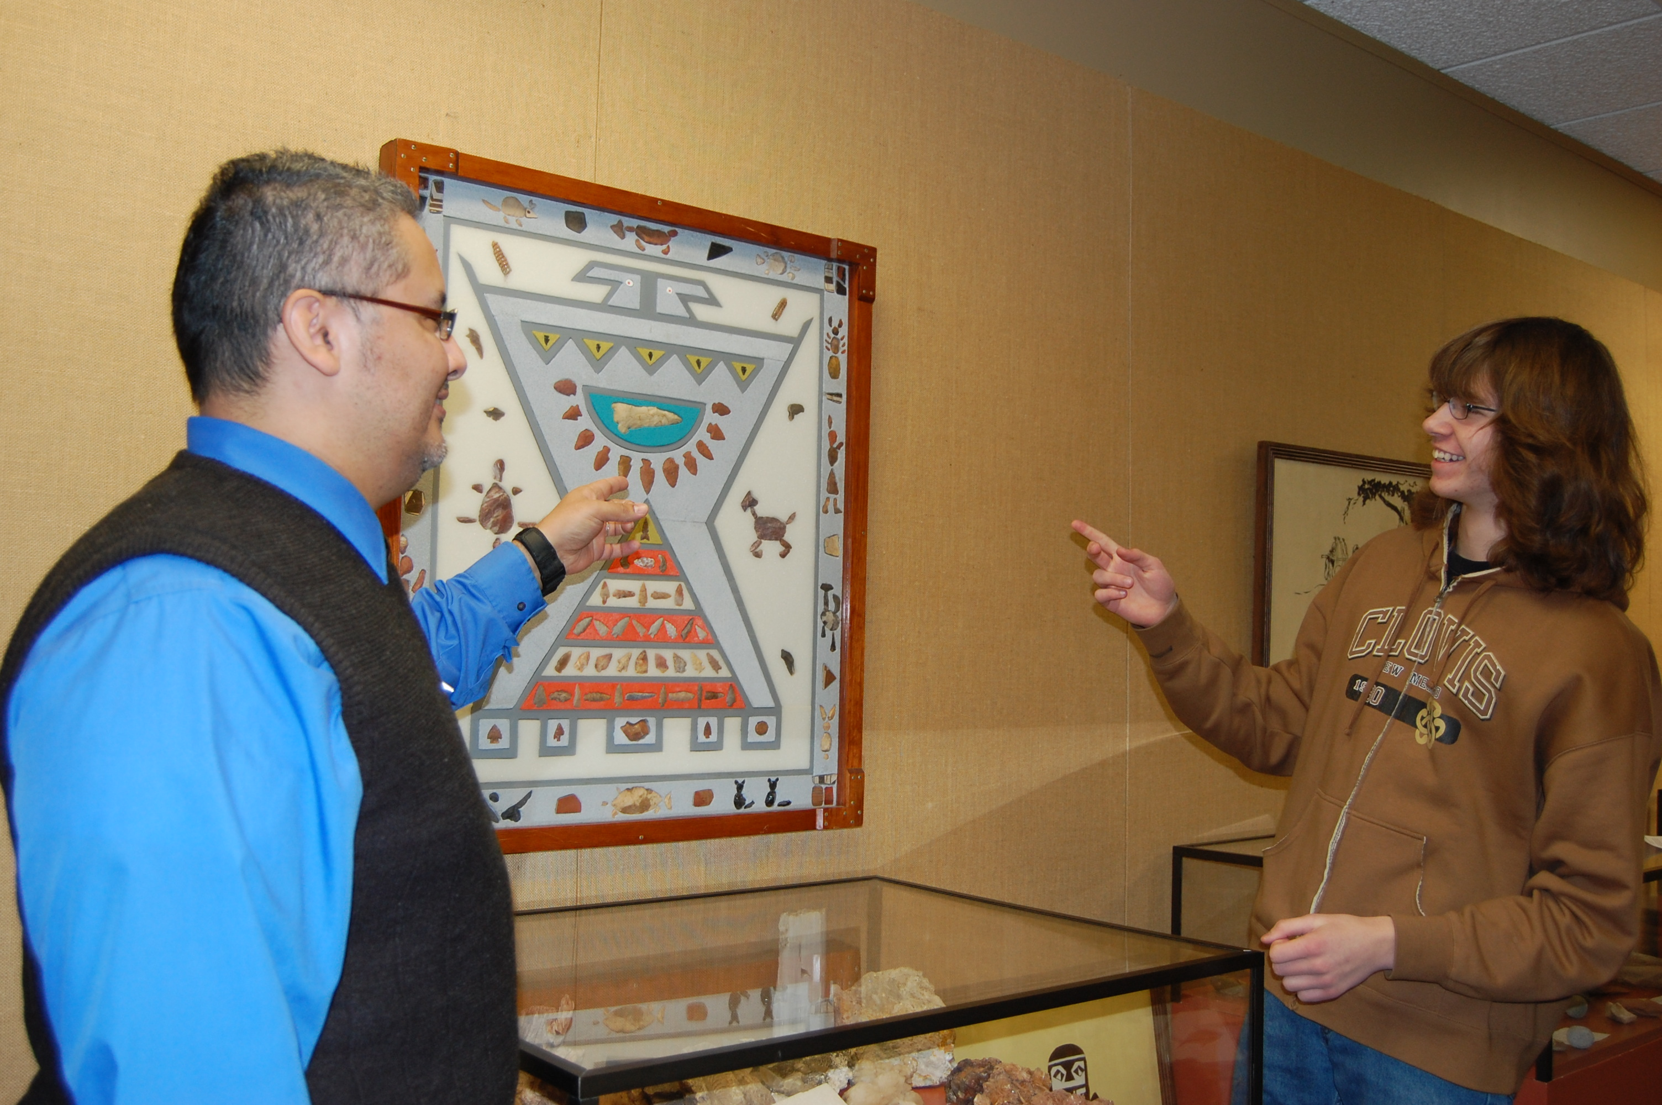
Ricardo Arredondo
Clovis Community College
Sometimes the most difficult teaching technique is letting students discover the answers themselves. If we give students only knowledge and deny them the stressful, problem-solving experiences, then they will be the poorer for it.

Slide 27
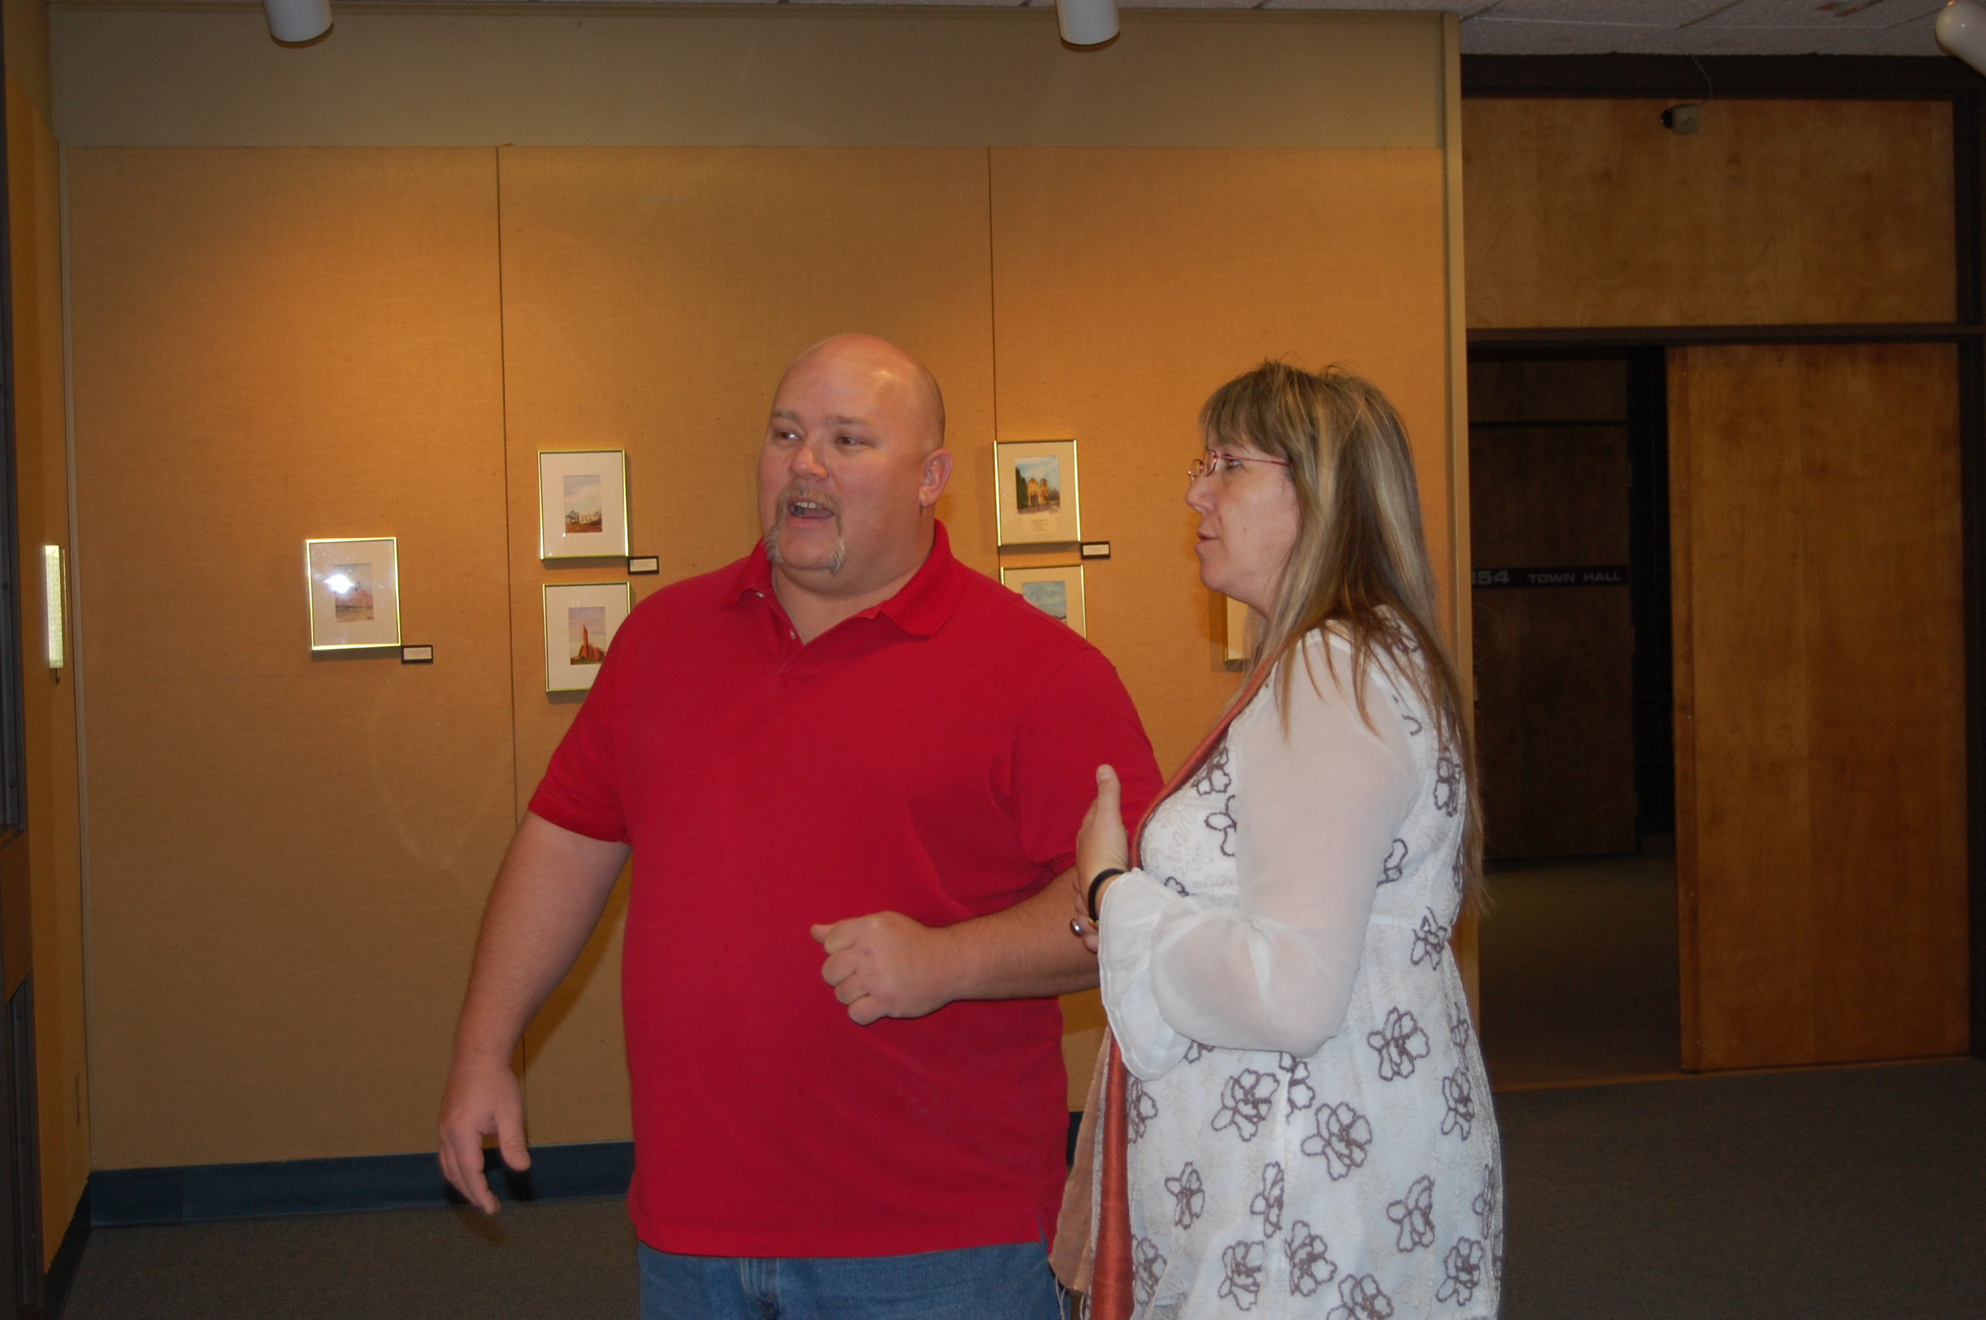
Janett Johnson
Clovis Community College
Life and education are interwoven. One cannot exist without the other. Instructors and students weave both fabrics together and create colorful tapestry that inspires, touches, and changes the world for the better.

Slide 28
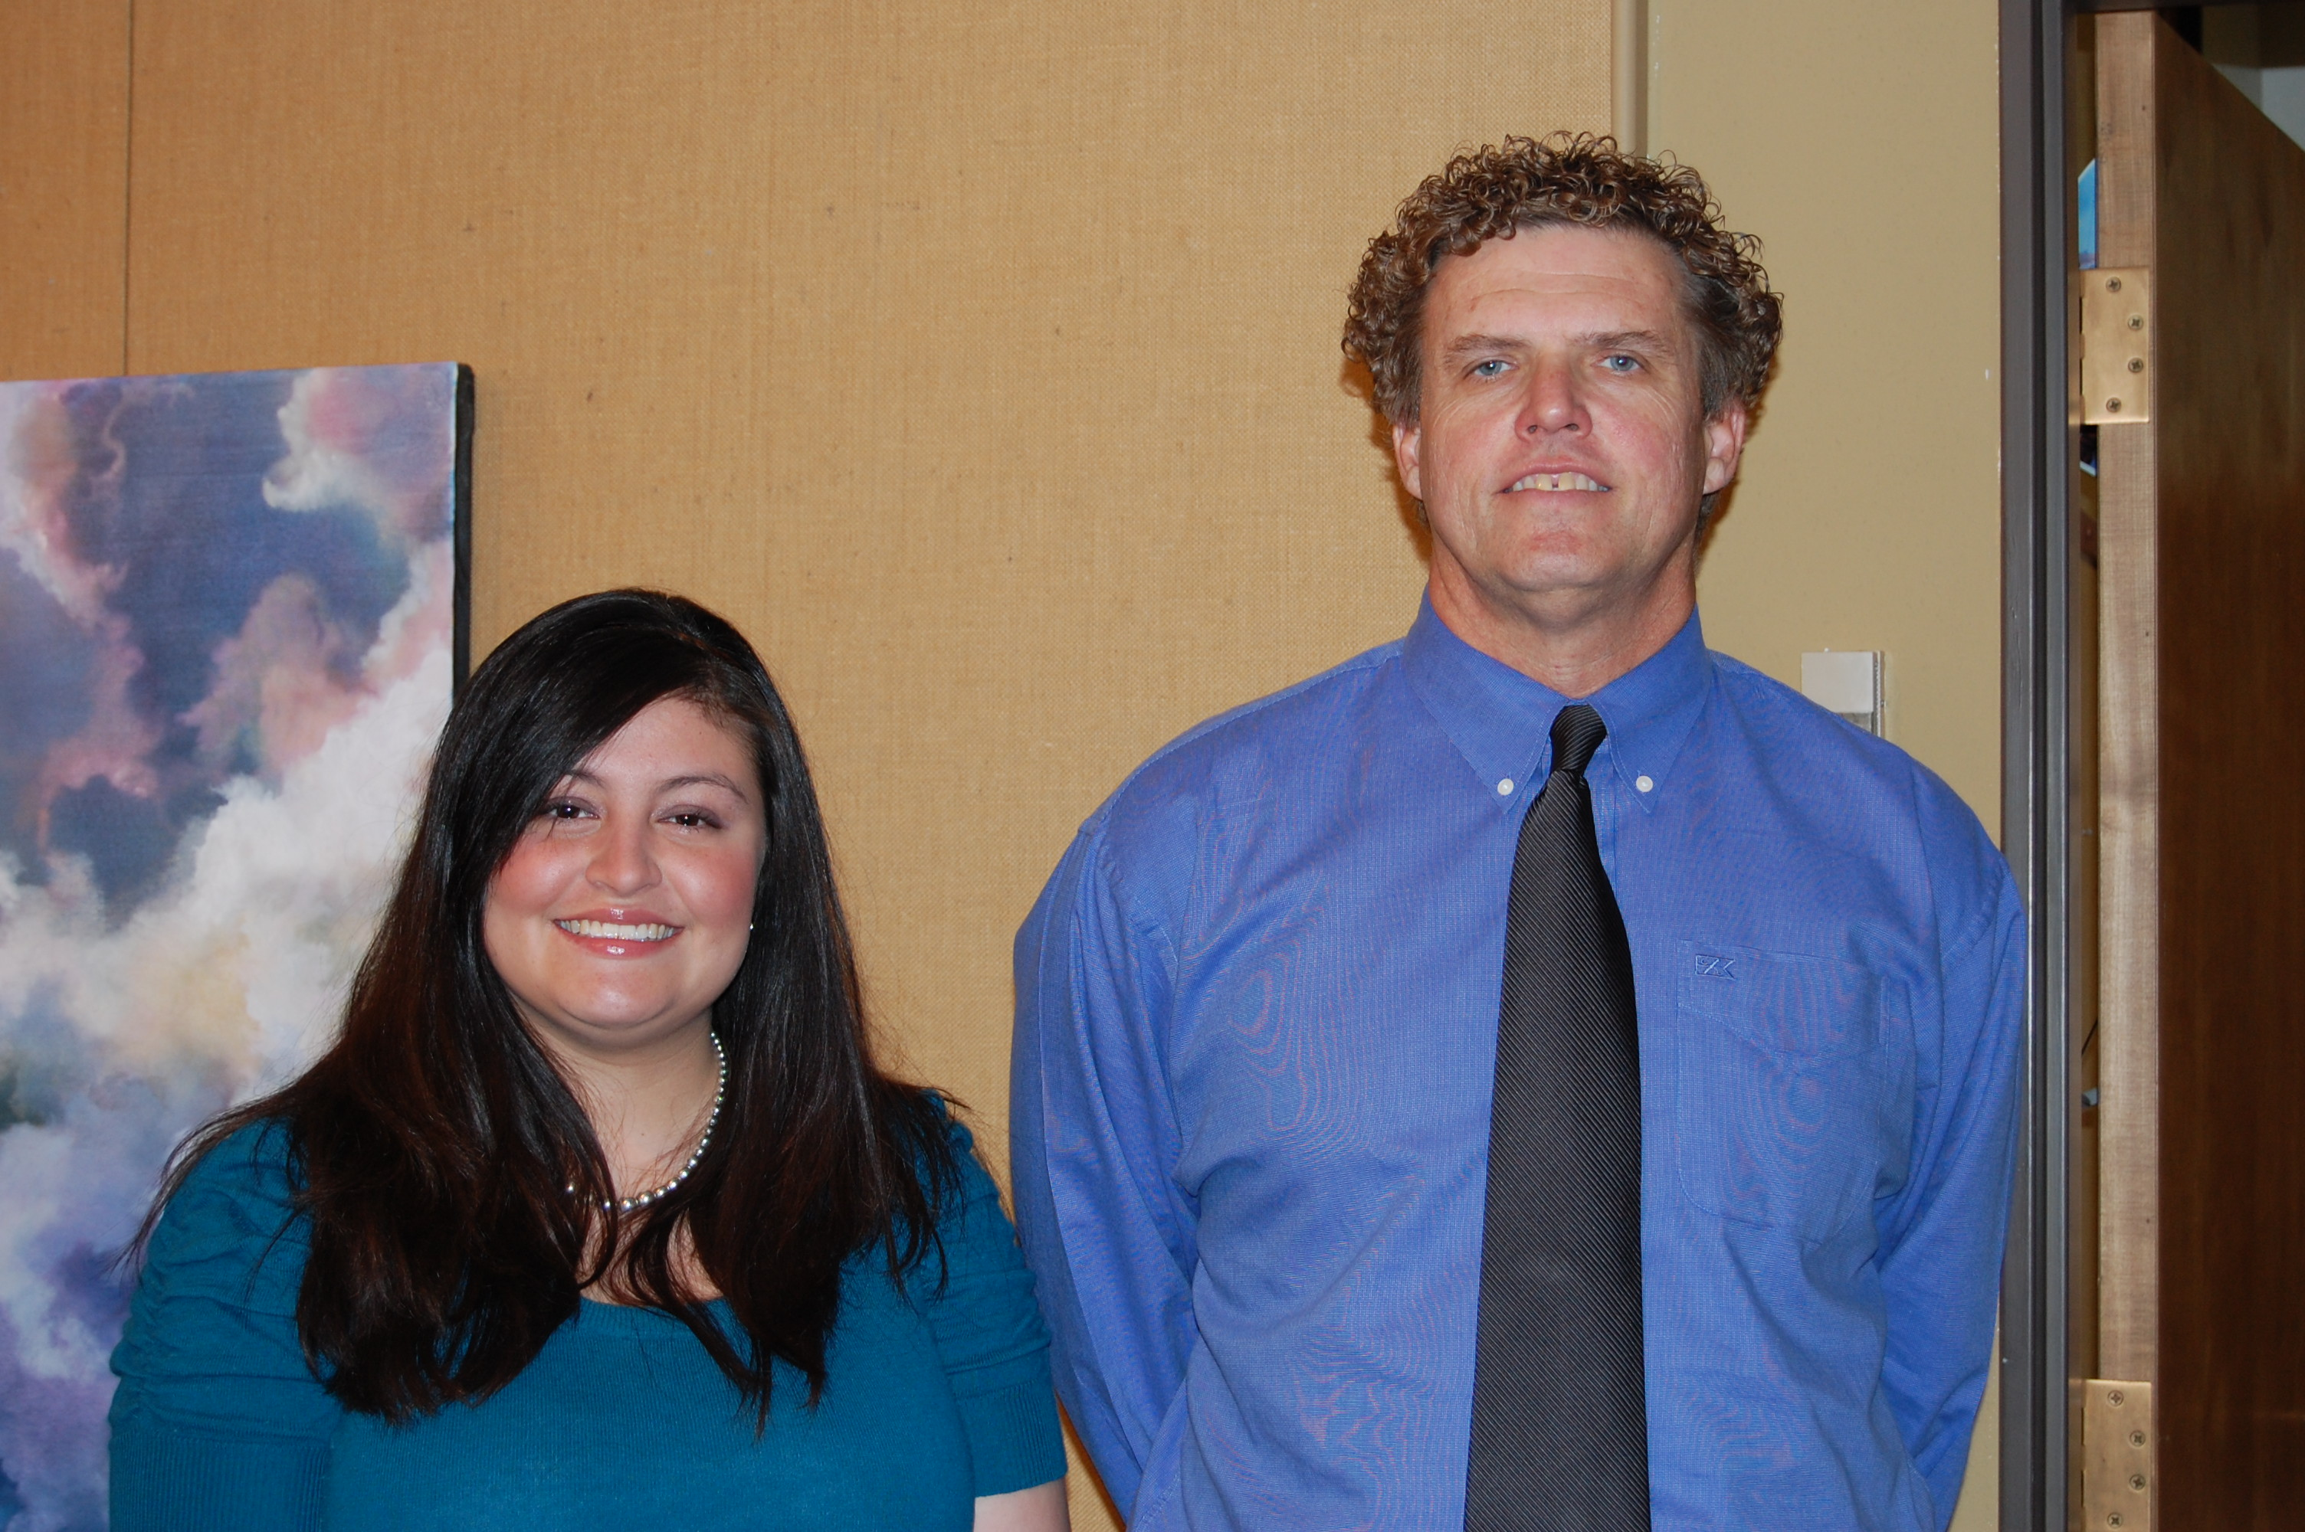
Michael Powers
Clovis Community College

Slide 29
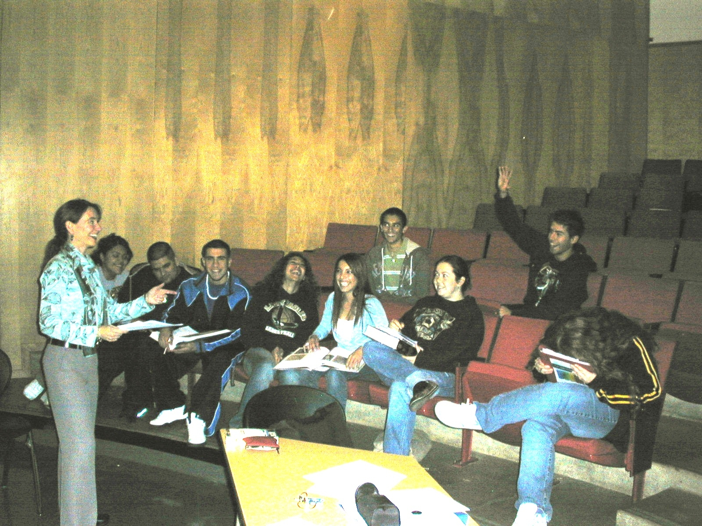
Macaela Cashman
Cochise College

Slide 30
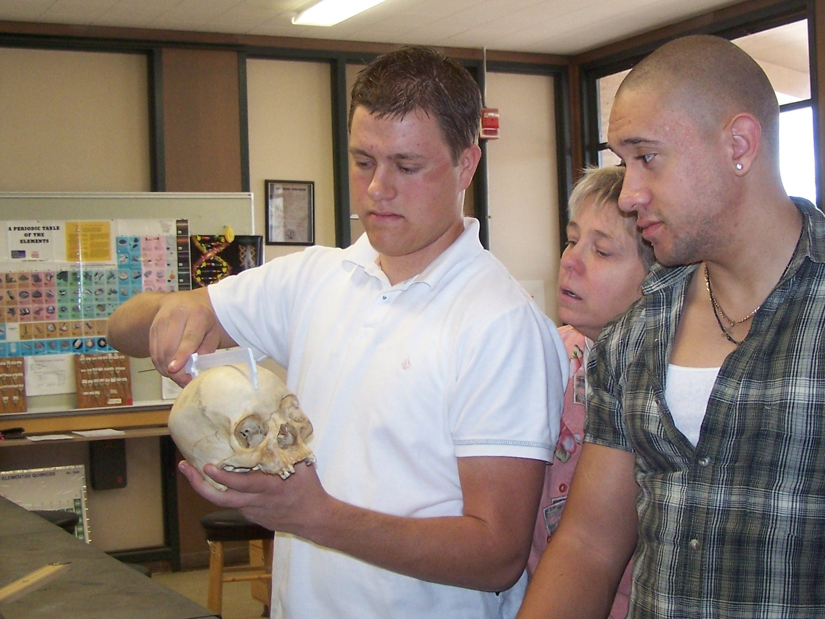
Janeen Crockett
Cochise College
Each time I review material, I discover some new wonder. It never seems the same to me, so I always seek new ways to share. The students feed off my enthusiasm; and before long, they are excited about learning. I am renewed each time I see that desire within them.

Slide 31
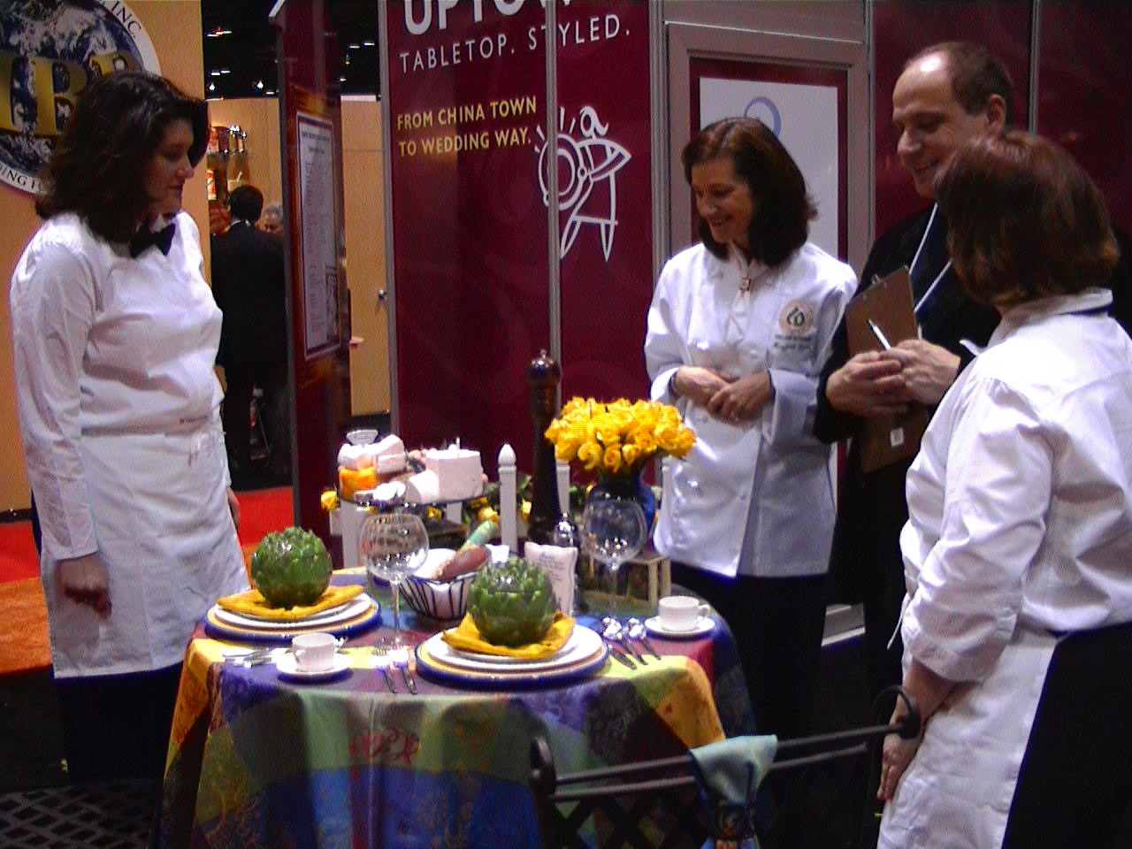
Mary Beth Leone
College of Dupage
It would be easy to teach to faceless students, but I know that students who connect to their teachers are often more successful.

Slide 32
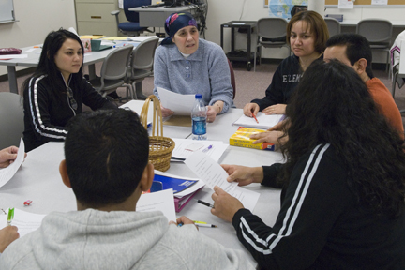
Suzanne Leibman
College of Lake County
Respect for learners is the foundation of good teaching. Respect for learners results in customized, interactive, collaborative teaching to a reflective learning community. In the words of a recent student: “Because you believe [in] us, and you tell us always we can do, we get courage to do.”

Slide 33
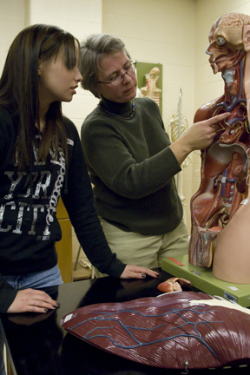
Elisabeth Martin
College of Lake County
Teaching at a community college is first and foremost about helping students change their lives and ultimately their families’ lives. This excites me. I rejuvenate by spending time with friends and exploring things out of my comfort zone such as playing the piano, glass blowing, and dog sledding.

Slide 34
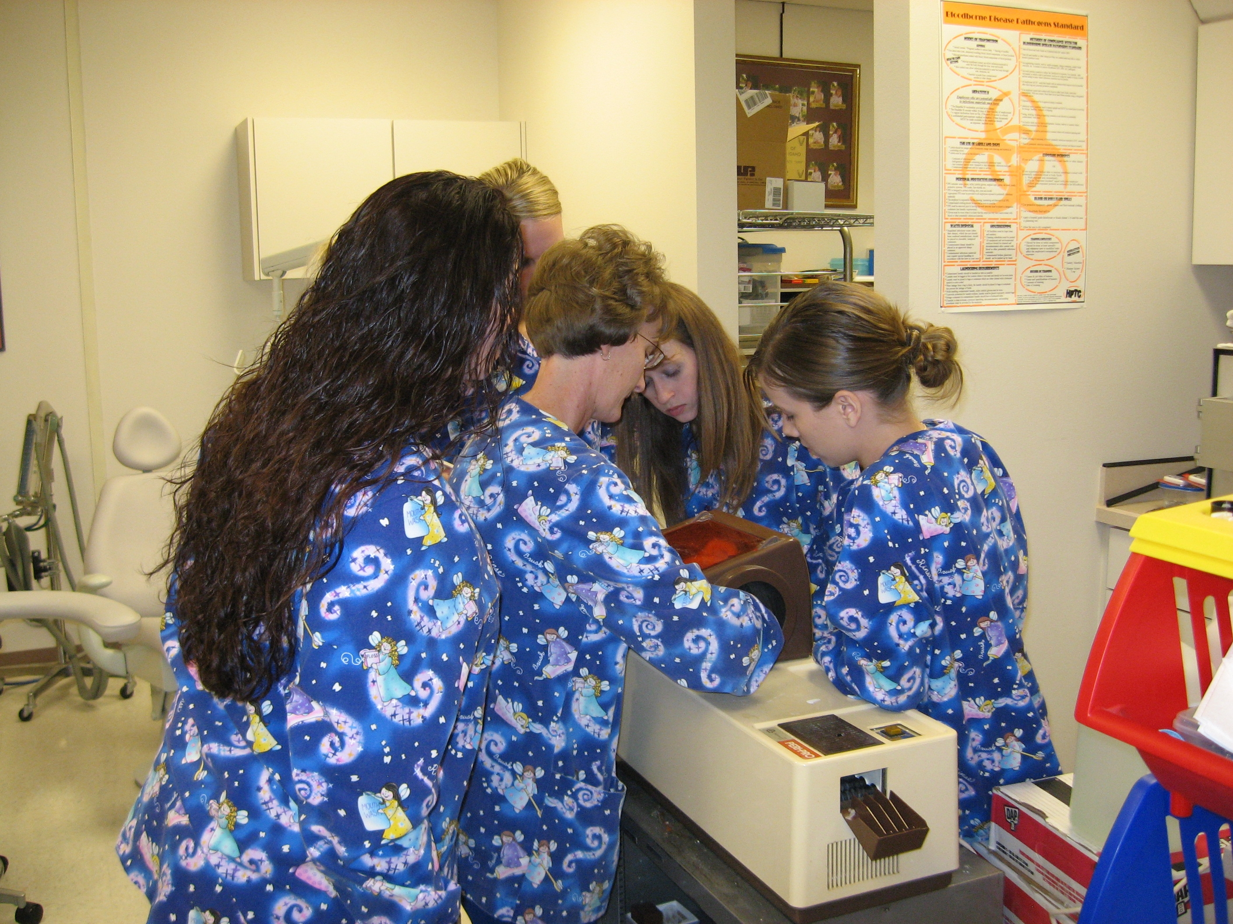
Tonja Bowcut
College of Southern Idaho
The philosophy that has helped me the most is that learning is a lifelong process and I can learn as much from my students as they learn from me. If I become a part of the team and we all work together, we all learn more.

Slide 35
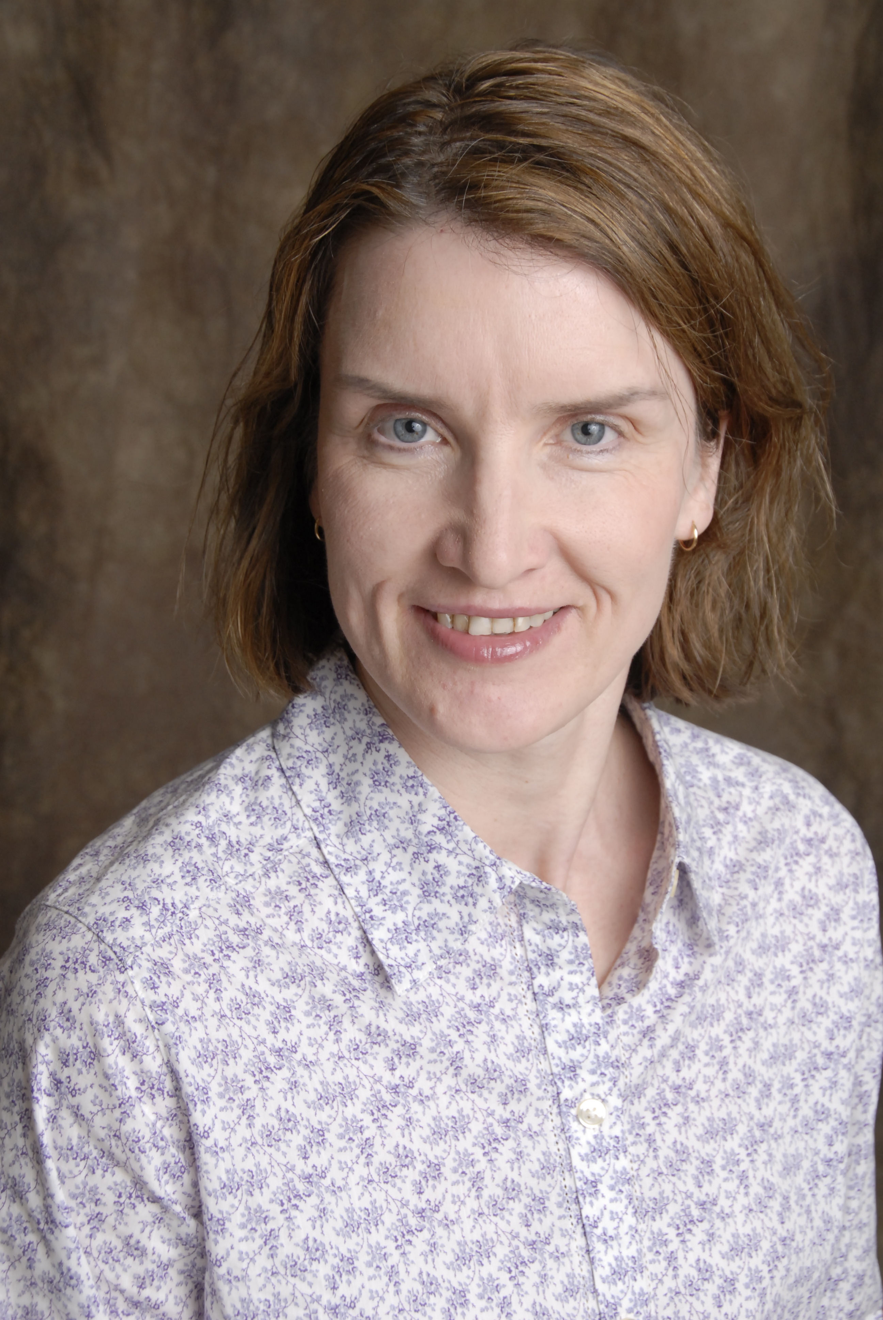
Edith Carron
College of Southern Maryland

Slide 36
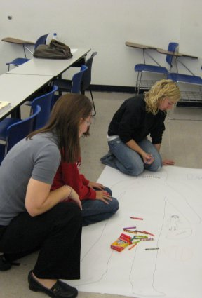
Mary Lewis
Columbus State Community College

Slide 37
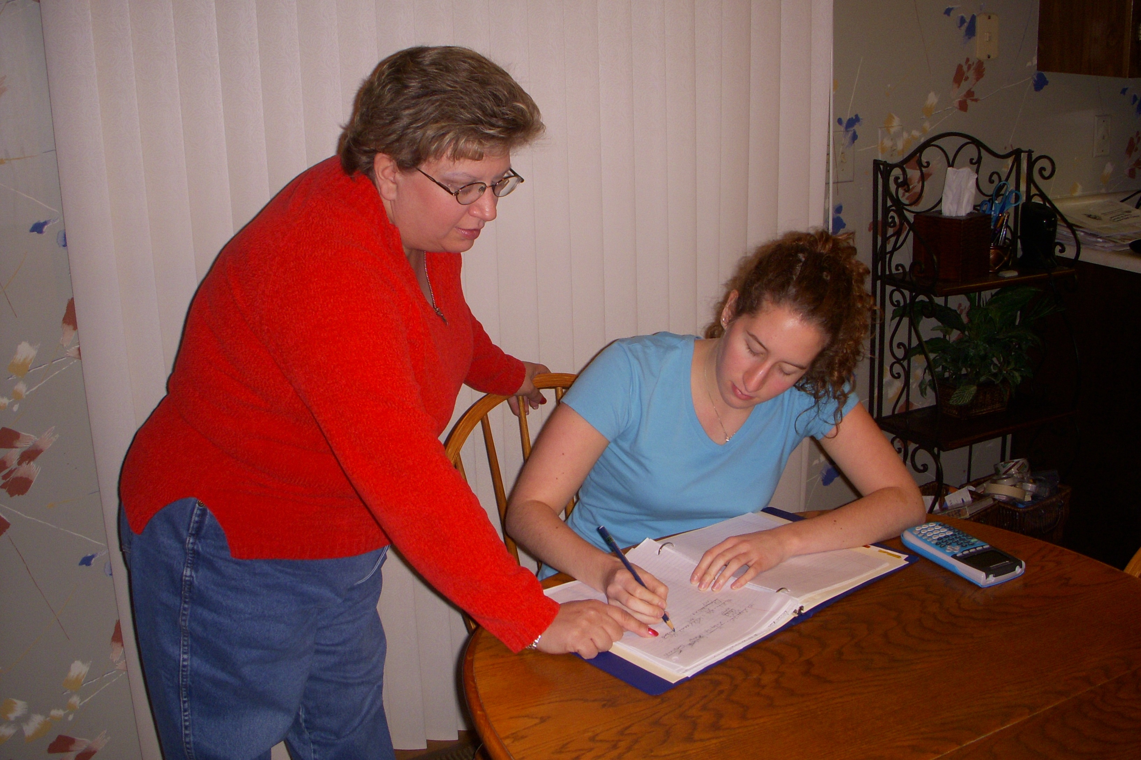
Susan Rosh
Columbus State Community College

Slide 38
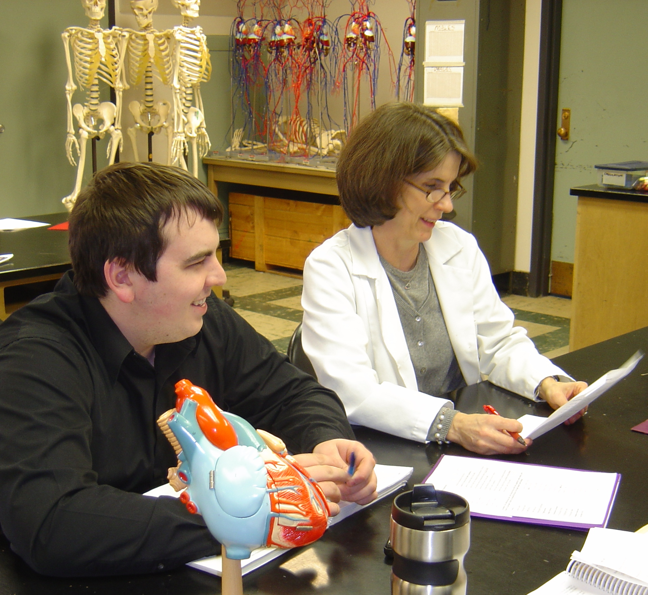
Maura Stevenson
Community College of Alleghany County
Being at an urban community college, I draw energy from the diverse student population we serve. Watching a housewife from an affluent suburban neighborhood become a study partner with a single mother on welfare makes one realize that the work we do as educators is truly important.

Slide 39
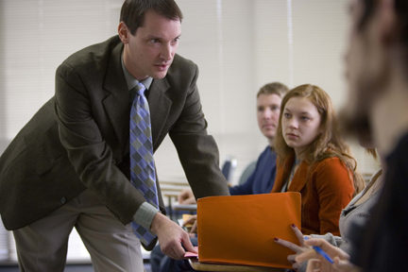
Stephen Wells
Community College of Allegheny County
If I can lead my students to engage with the world ideas rather than to memorize the ideas of others, then I have succeeded.

Slide 40
Jacquelin Black
Community College of Beaver County
I believe the main inspiration in my work comes from knowing that I am fulfilling my life’s calling. Helping to educate others, who will in turn provide better care for our youngest, gives me a feeling of hope and achievement.

Slide 41
C.V. Smith III
Community College of Beaver County
Teaching history is an art, since most students arrive with the expectation that it is a catalog of names and dates that have no relevance. History is FUN! The secret is making historical figures human by creating vibrant word pictures of their foibles, successes, and failures. If students can laugh about monarchs and magnates and popes, they learn better and faster.

Slide 42
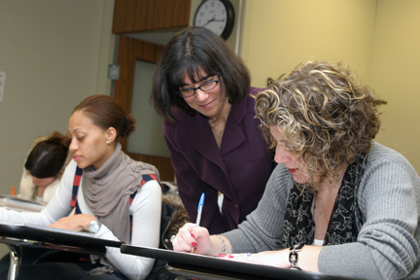
Jeanne Mullaney
Community College of Rhode Island
This is a very exciting time to be in education because we now know more than ever about how people learn and we can use that information to refine and perfect our teaching and assessment methods.

Slide 43
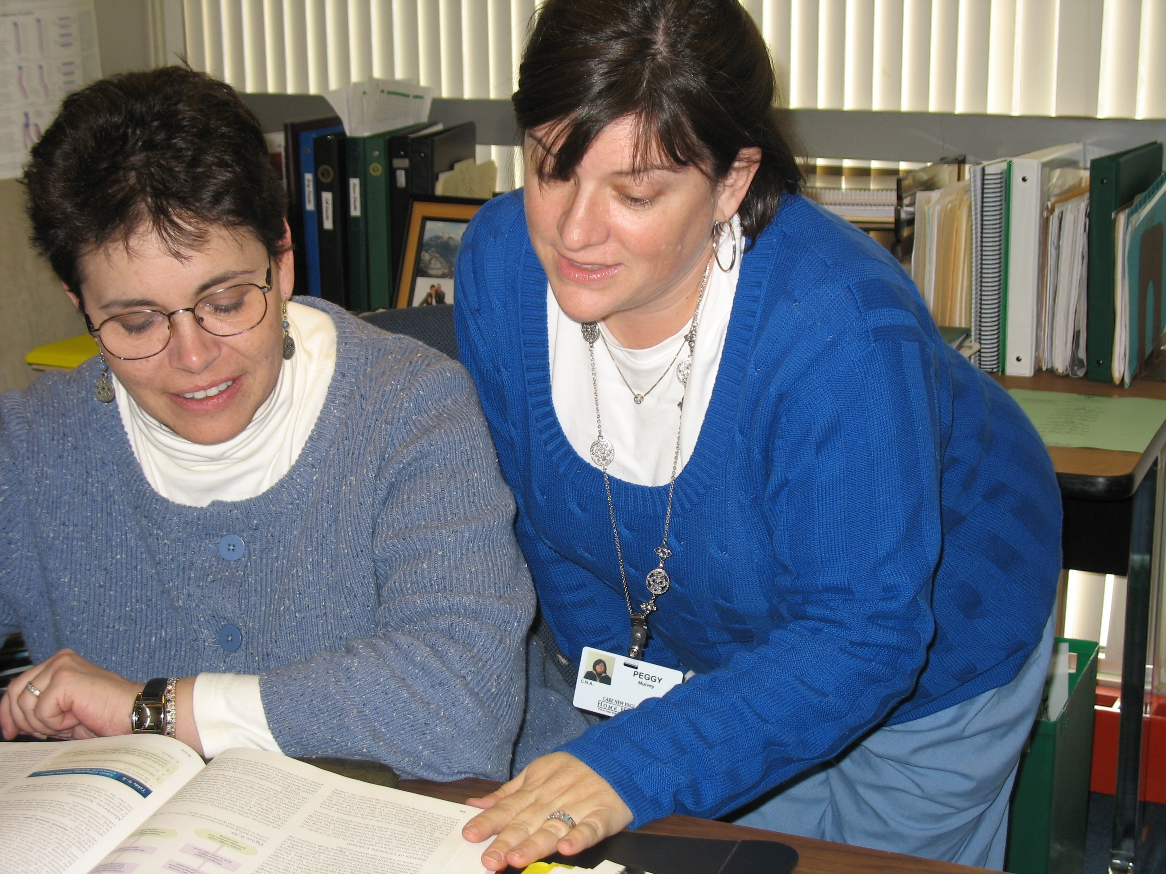
Denise Yordy
Community College of Rhode Island

Slide 44
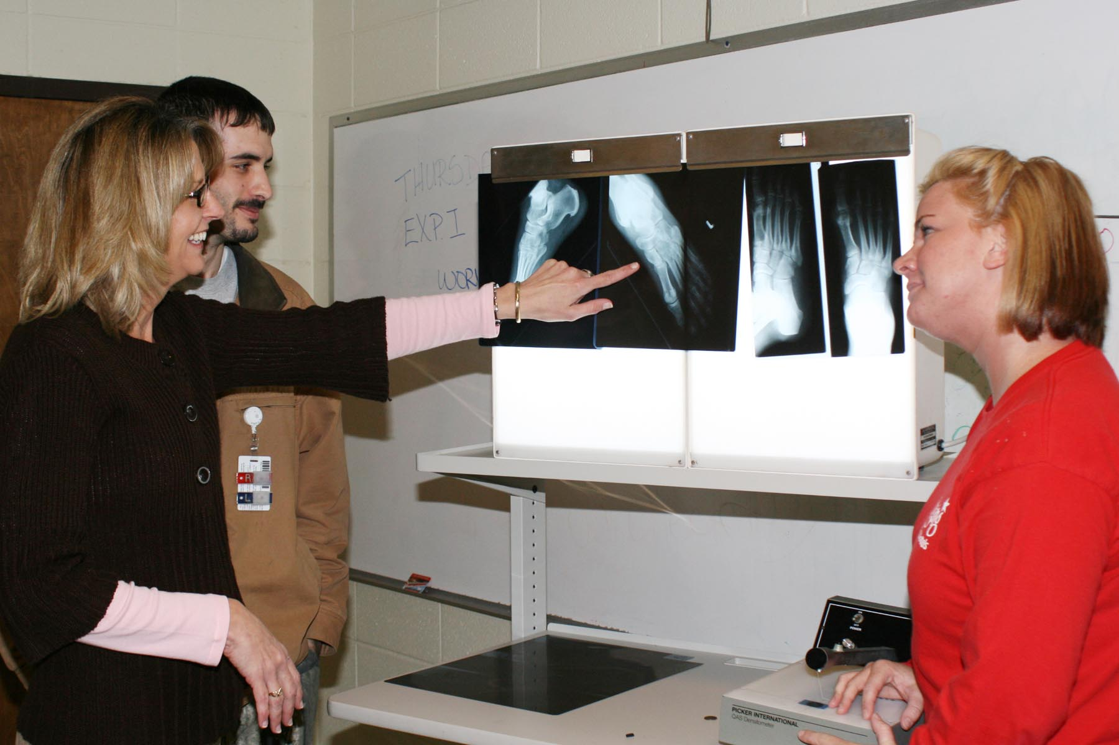
Julie Gaudin
Copiah-Lincoln Community College
I love to learn and still get excited from teaching. Every single day is as different as my students are from each other.

Slide 45
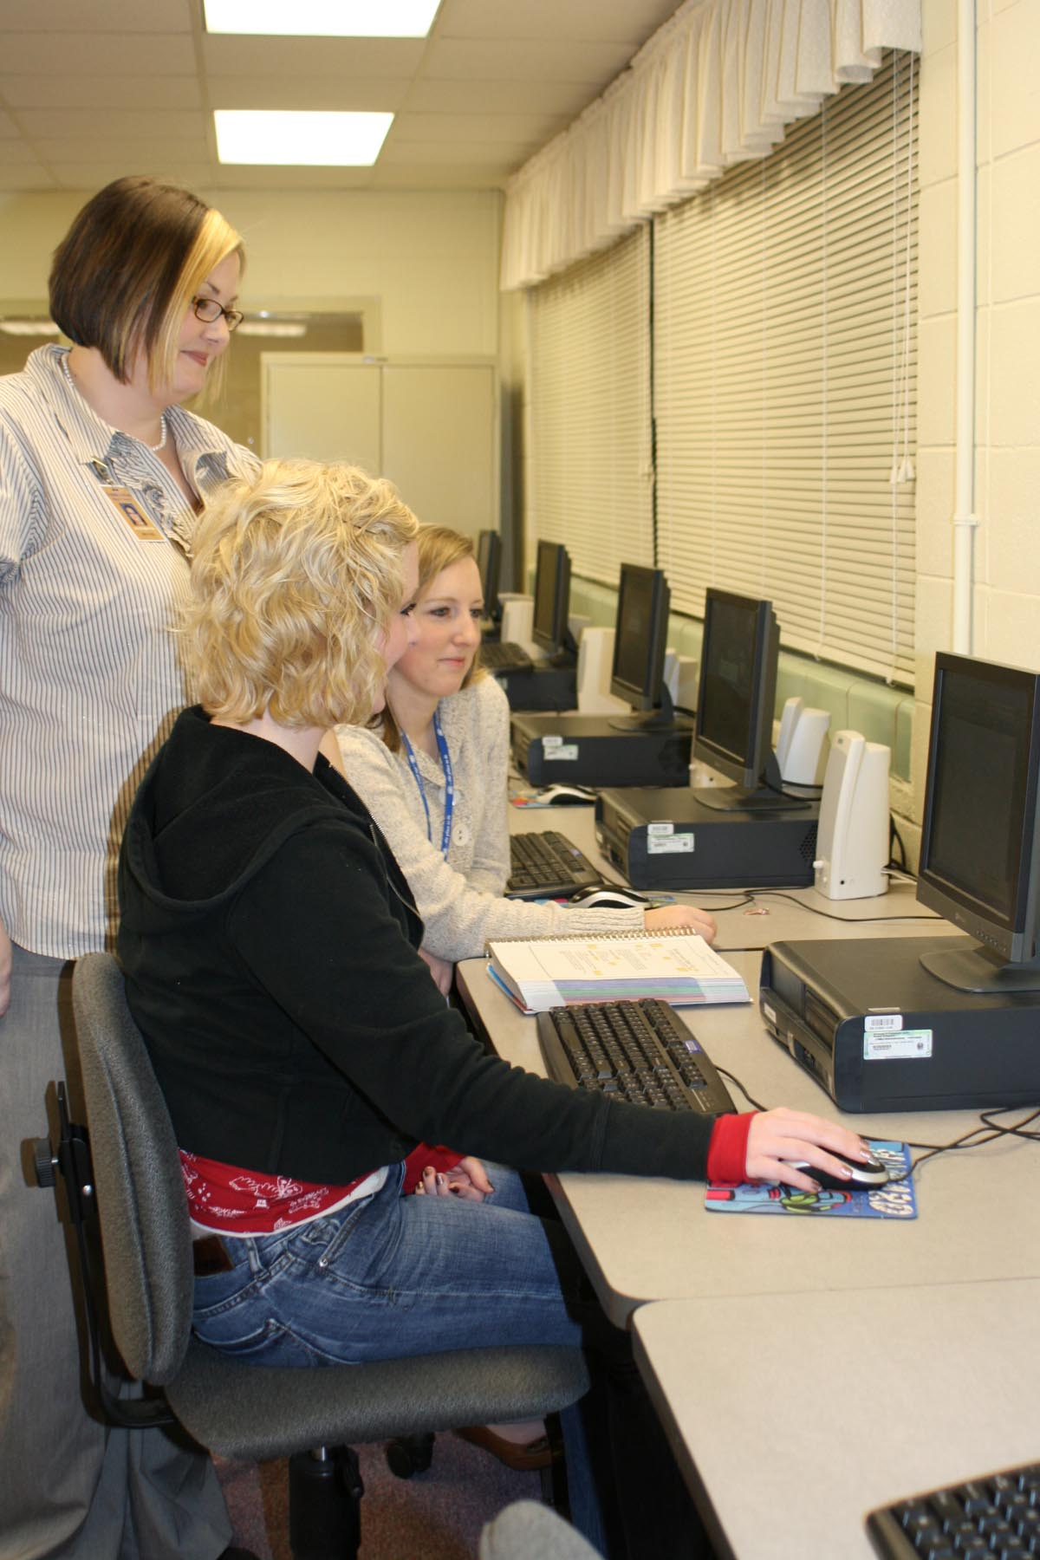
Jackie Martin
Copiah-Lincoln Community College
The optimism and determination that many of my students bring to class and the life obstacles they have overcome to better themselves motivate me.

Slide 46
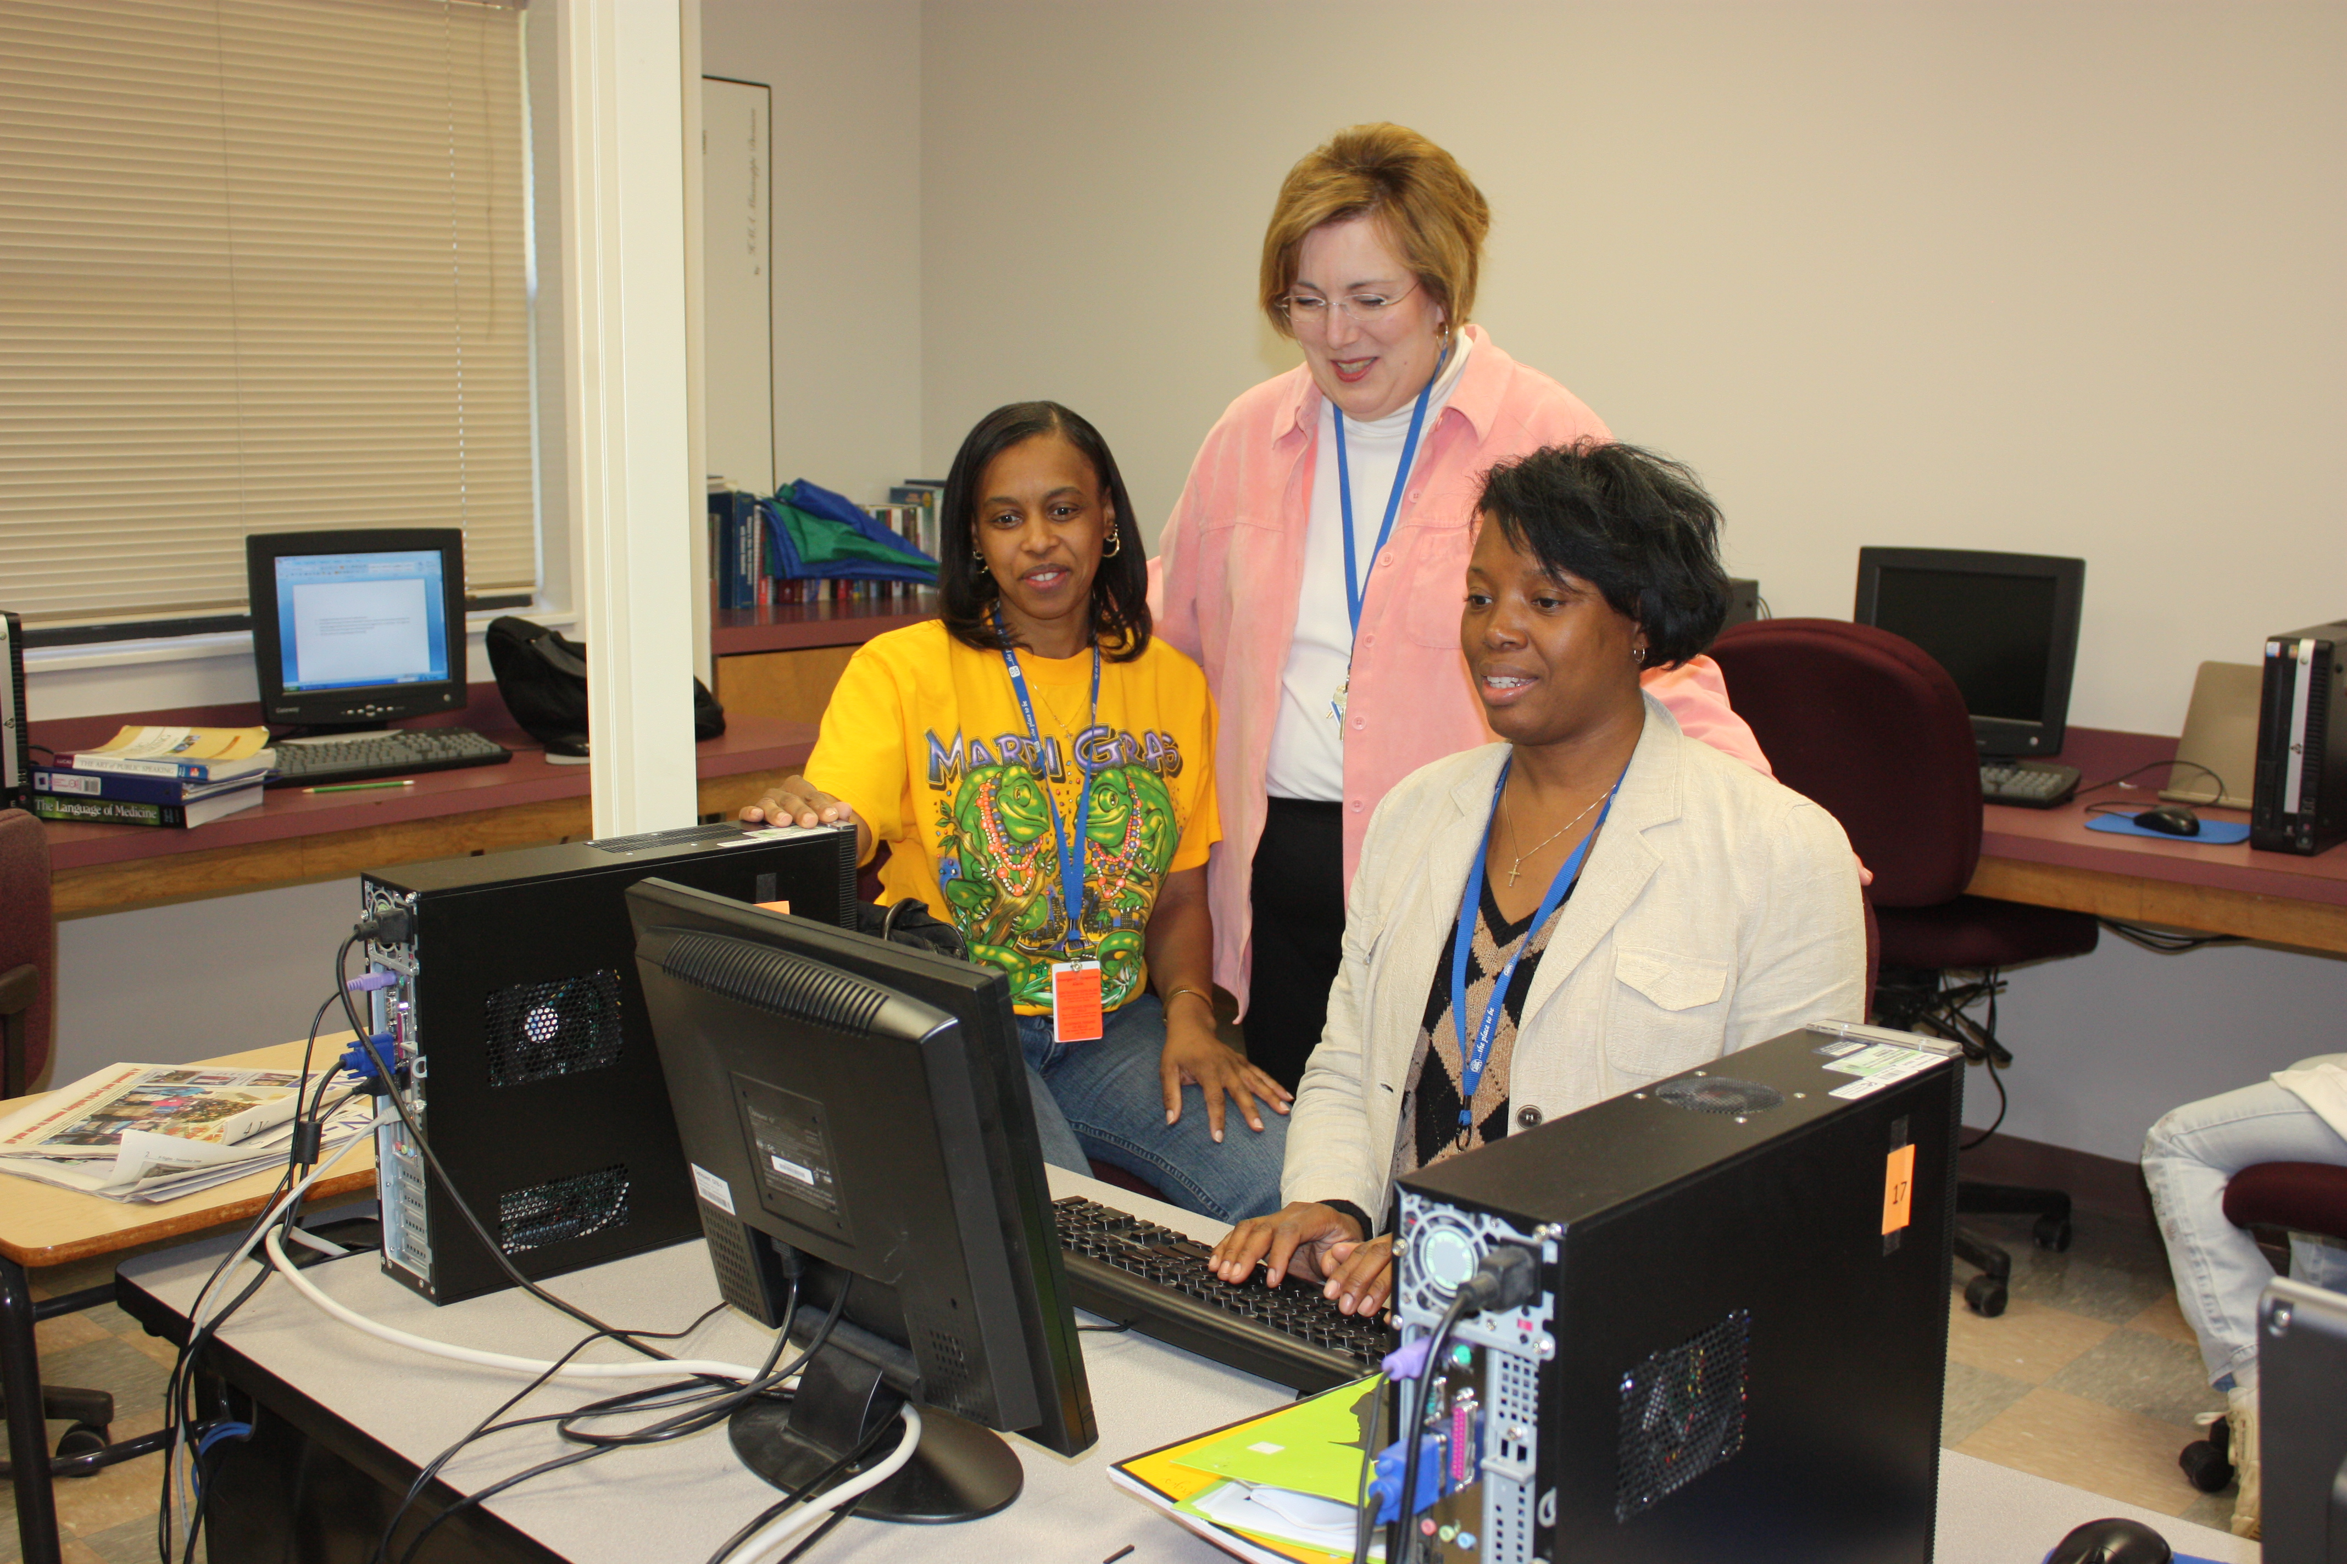
Terry Stutzman
Copiah-Lincoln Community College
I am inspired by the fact that many of my students are overcoming significant challenges to advance their knowledge and skills. I am motivated to help them become highly qualified job seekers. I expect their best efforts, and they deserve mine.

Slide 47
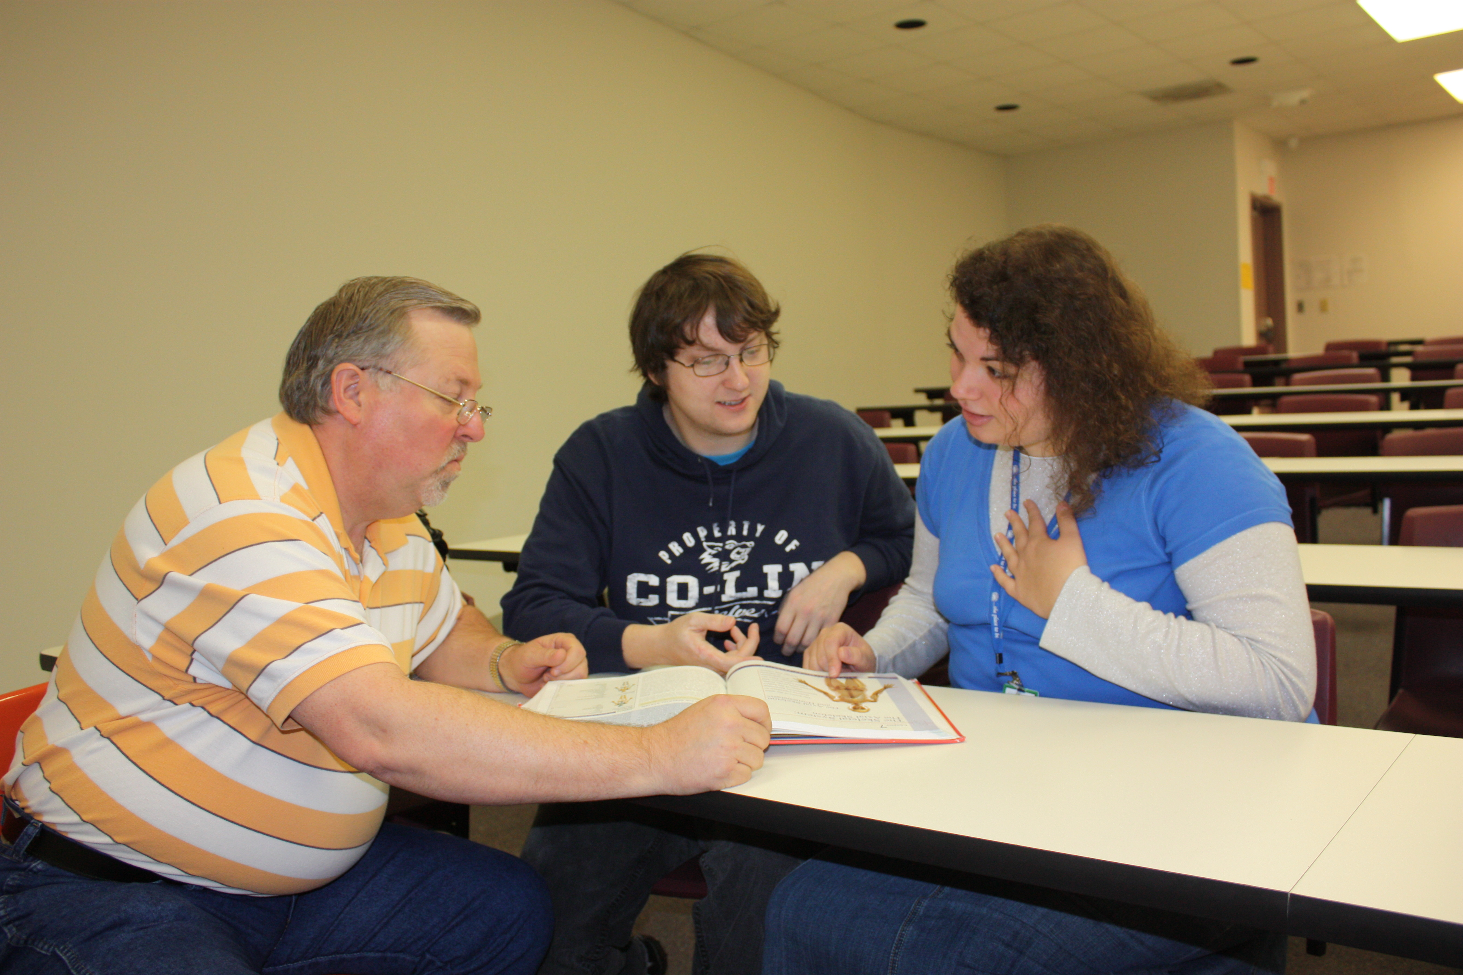
Joe Swoveland
Copiah-Lincoln Community College
I feel fortunate that my background as a clinical practitioner lends an added sense of realism to the theories I teach in class. My greatest reward is when former students call or stop by to discuss their first job in the mental health field—then, I know I have made a difference.

Slide 48
Marybeth Buechner
Cosumnes River College
The best compliment I ever received from a student was that the world looks different than it did before my class. We have succeeded when they look at a tree, lake, or person and see more than they saw before, know more than they knew before, and care more than they cared before.

Slide 49
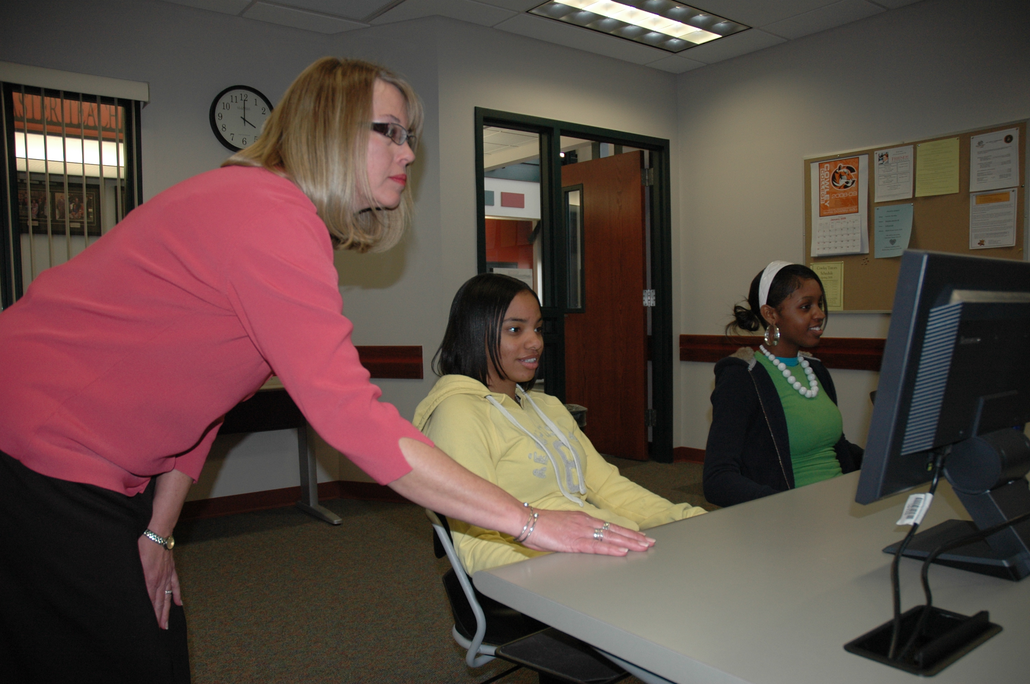
Rae Dale
Cowley County Community College

Slide 50
Jafar Hashemi
Cowley County Community College
My inspiration comes from students' smiles, enthusiasm, and success. I use a variety of teaching techniques, creativity, and humor to keep students engaged and understanding complex physics concepts and problems—from high-tech equipment to film clips from “Saturday Night Live.”

Slide 51
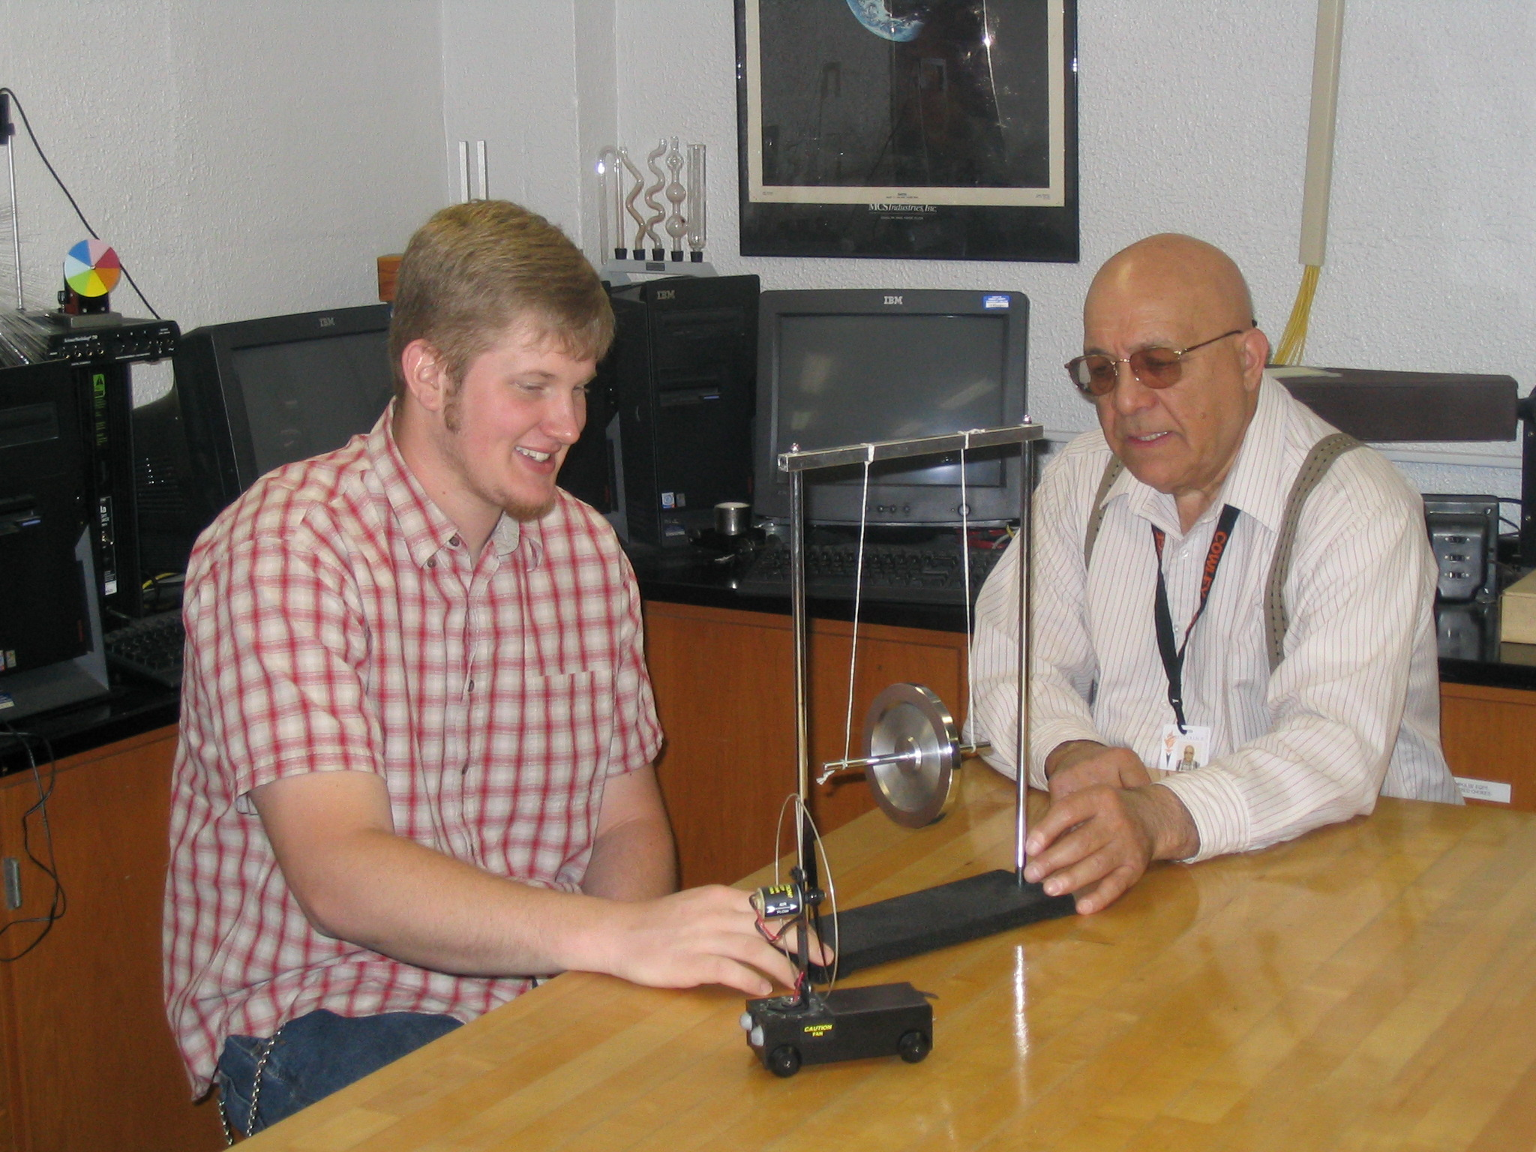
Rama Peroo
Cowley County Community College

Slide 52
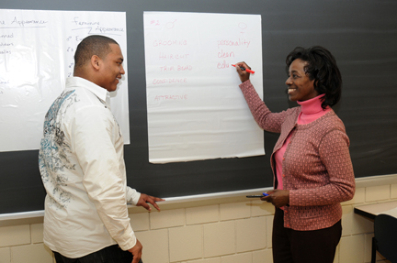
Valerie Brown
Cuyahoga Community College
I am motivated and inspired in my teaching by my students enthusiasm, determination to succeed, resilience, and wealth-of-life experiences. To facilitate the development of a classroom community, virtual or real, I incorporate contemporary events, discussion groups, and service-learning opportunities, all vital to me as a sociologist.

Slide 53
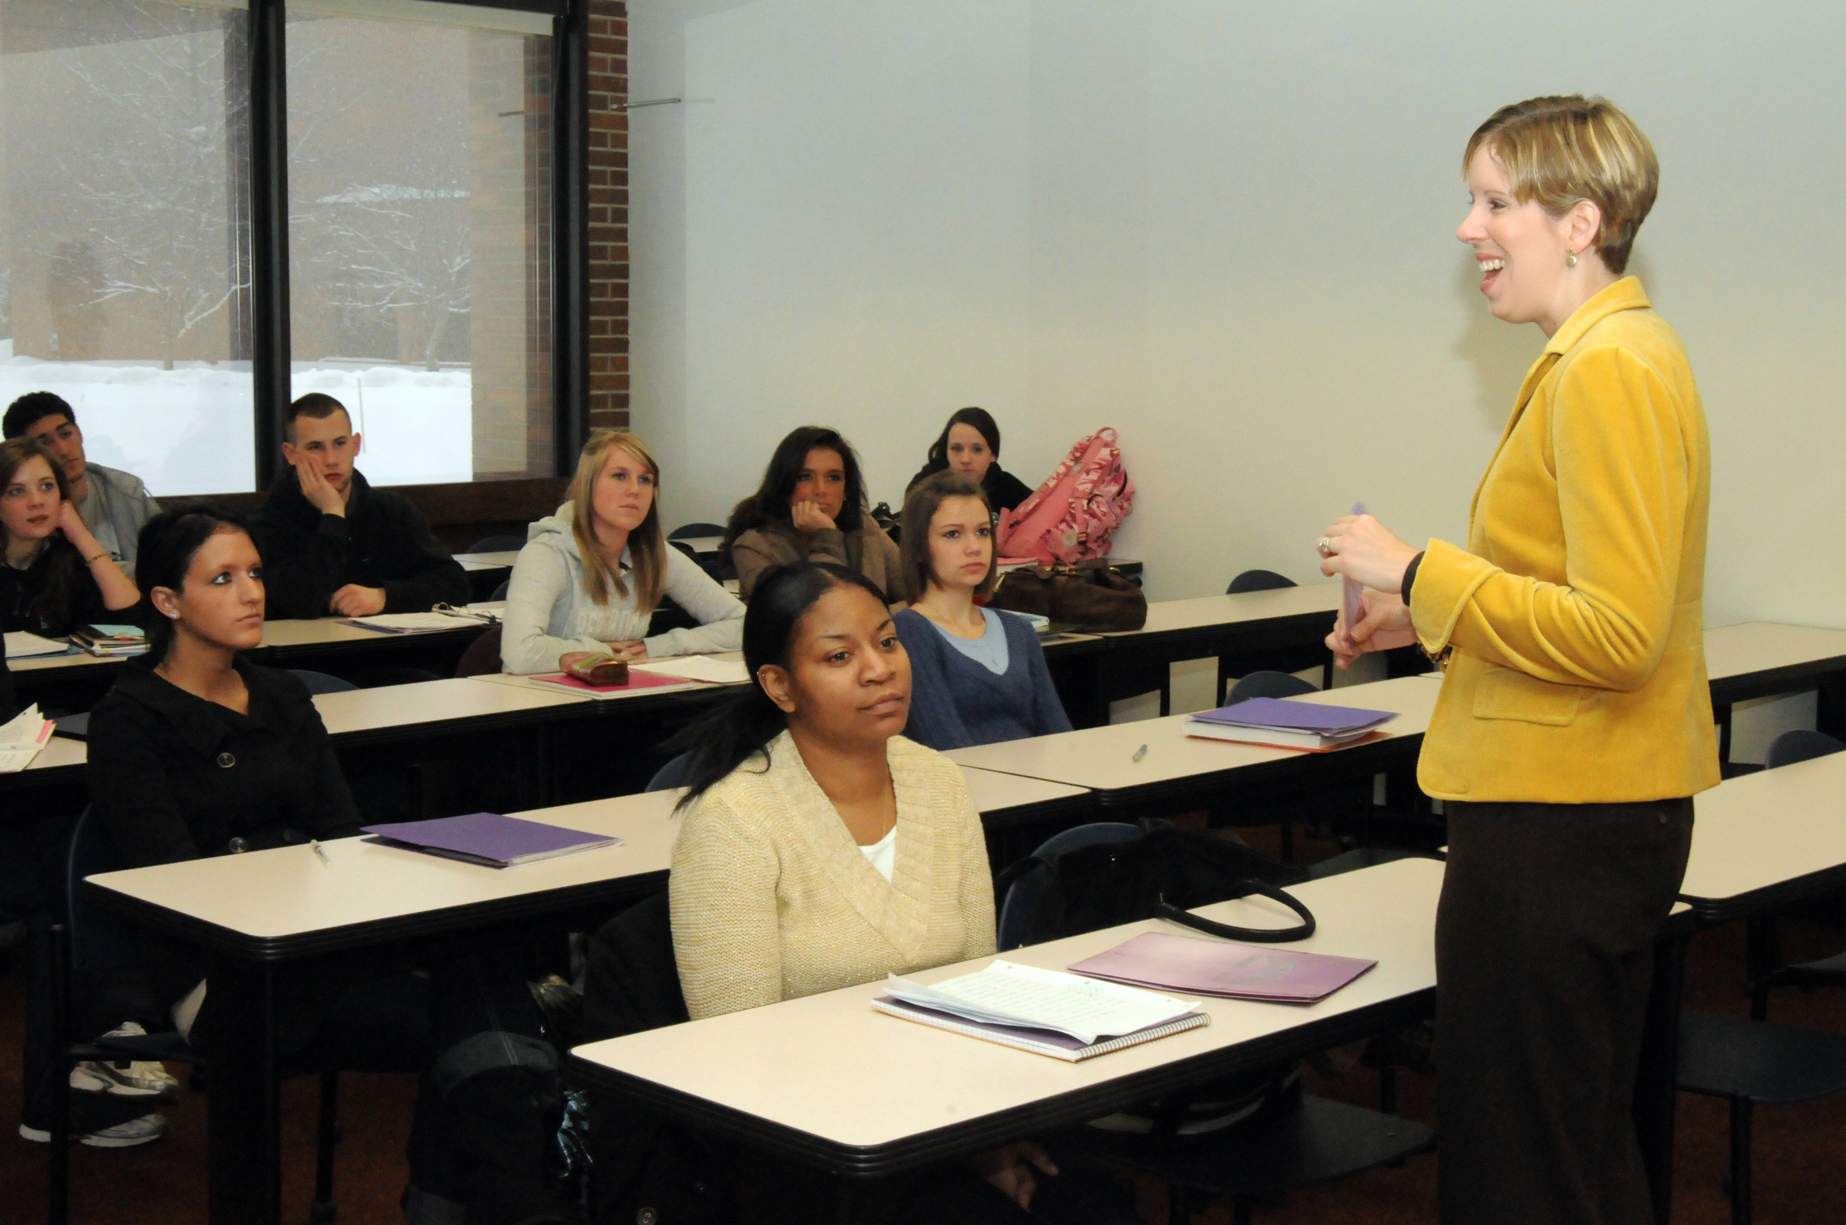
Melissa Paliwoda
Cuyahoga Community College
My students are responsible for making me a better teacher. Just as I challenge them to approach the world in an intelligent, open-minded, more perceptive way, they challenge me to connect what they learn in the classroom with their daily lives. It's that personal relevance that makes learning worthwhile.

Slide 54
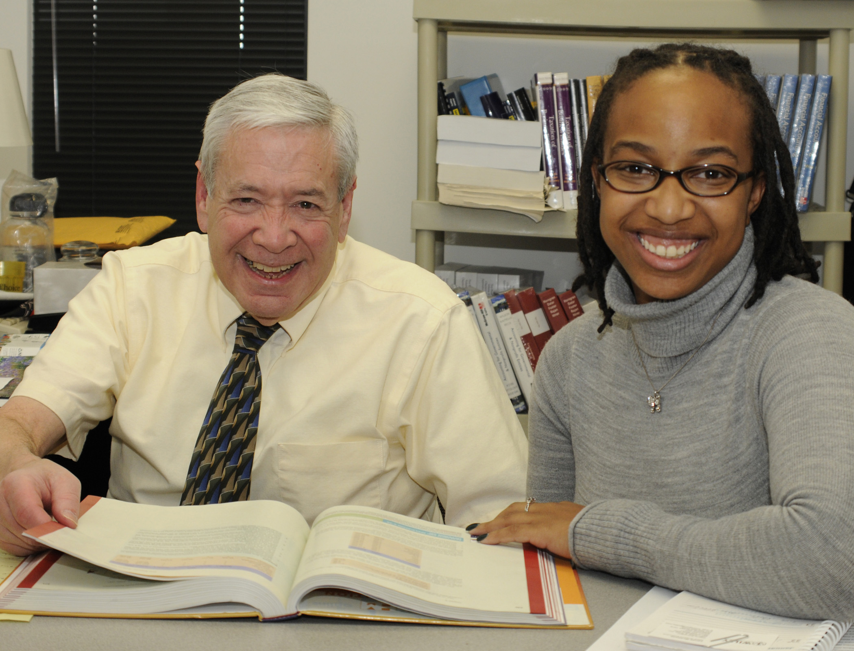
Lawrence Roman
Cuyahoga Community College

Slide 55
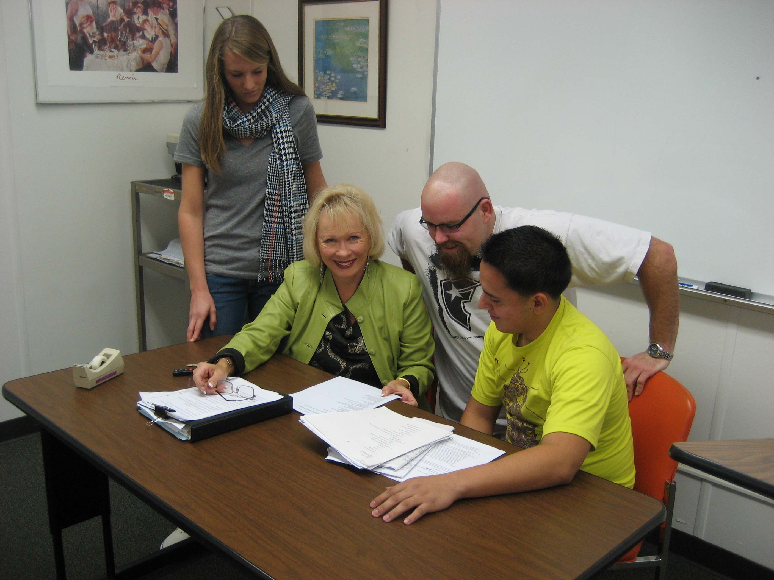
Donna Friess
Cypress College

Slide 56
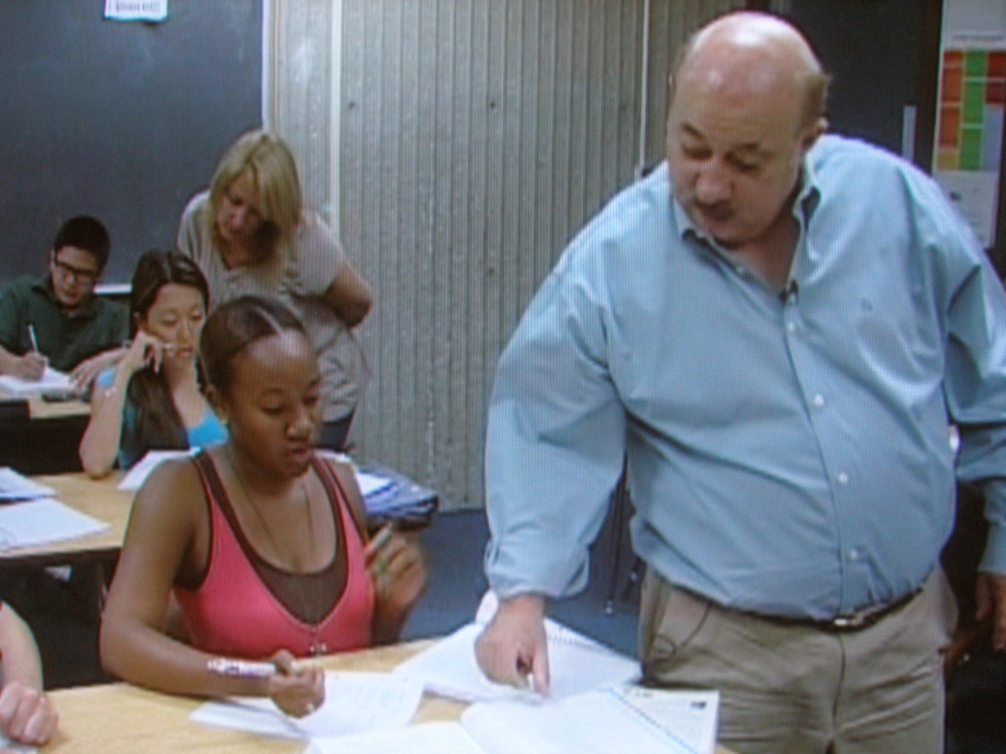
David Petrie
Cypress College

Slide 57
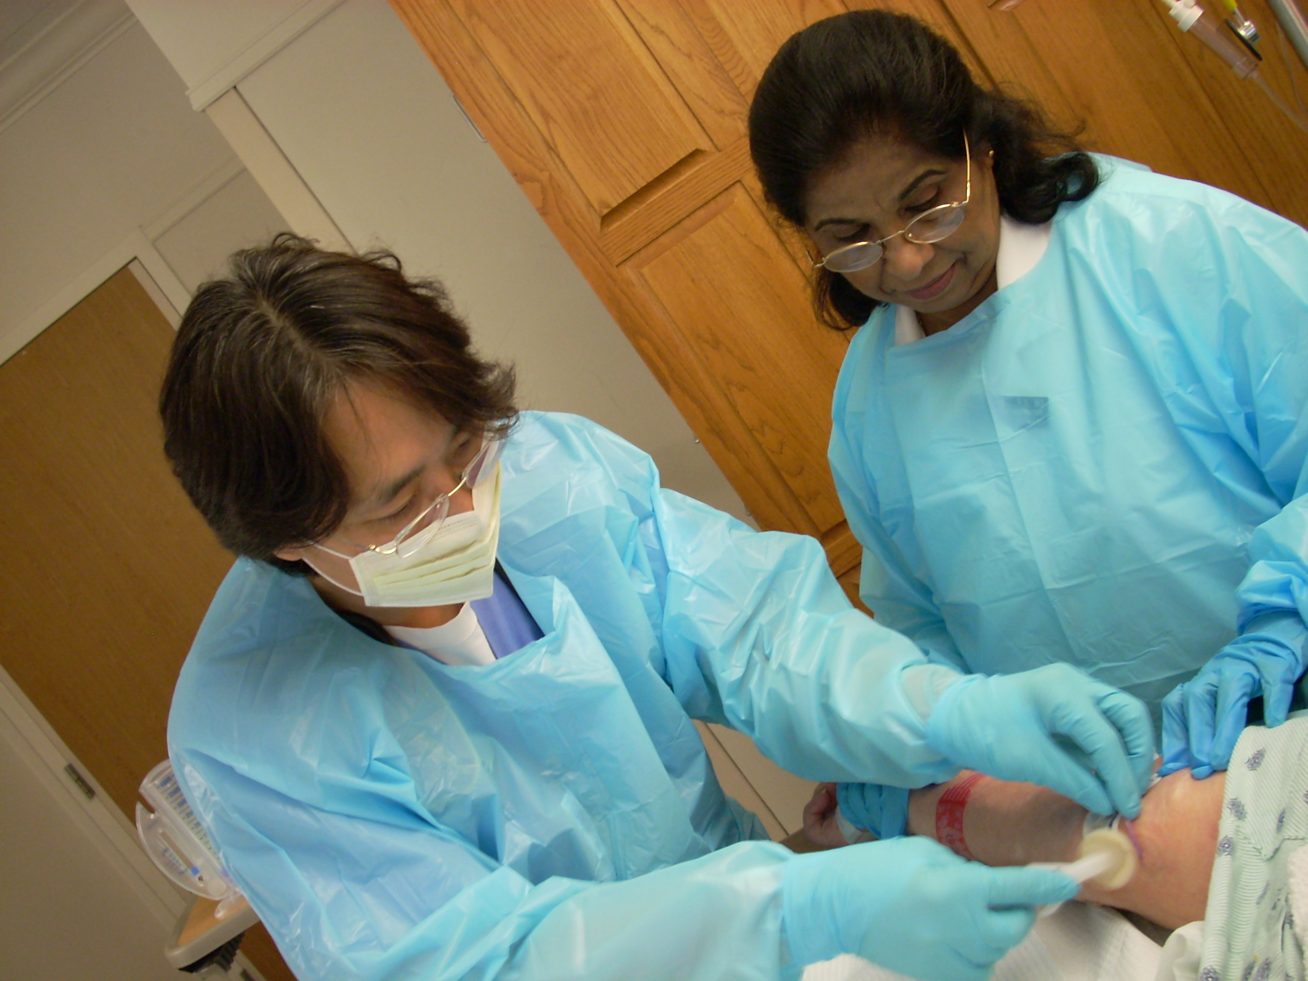
Anna Paul
Dallas County Community College District

Slide 58

Auksuole Rubavichute
Dallas County Community College District

Slide 59

Kerri Johnson
Darton College
I like to think of my role as the gatekeeper to my profession. For me, there is nothing more satisfying than opening the gate and welcoming each graduate into a field of endless rewards and opportunities.

Slide 60

Wendy Kennedy
Darton College

Slide 61

Beth Tison
Darton College

Slide 62

Suzanne LaVenture
Davidson County Community College
What inspires me to excellence is the knowledge that education can change people's lives and that these changed lives have a ripple effect in the community and in the world. I am energized by witnessing the powerful impact of a broadened mind.

Slide 63

Beverly Thomas
DeKalb Technical College
You have to love what you teach. I have a huge desire to see my program succeed and criminal justice gain a more professional standing in our country. I strive to make each of my students an example of excellence and will do whatever it takes to achieve that end.

Slide 64

Arnold Taylor
DeKalb Technical College

Slide 65

Scottie Walls
Delta College
If you educate with enthusiasm, they can learn with laughter.

Slide 66

Roman Edger
Dona Ana Community College

Slide 67

Nina Javaher
Dona Ana Community College
Teaching is my passion, and I don’t look at it as my occupation. Every second of teaching is a priceless learning experience for me, and I am honored to be called a teacher!

Slide 68

Susan Osborne
Dyersburg State Community College

