Slide 1
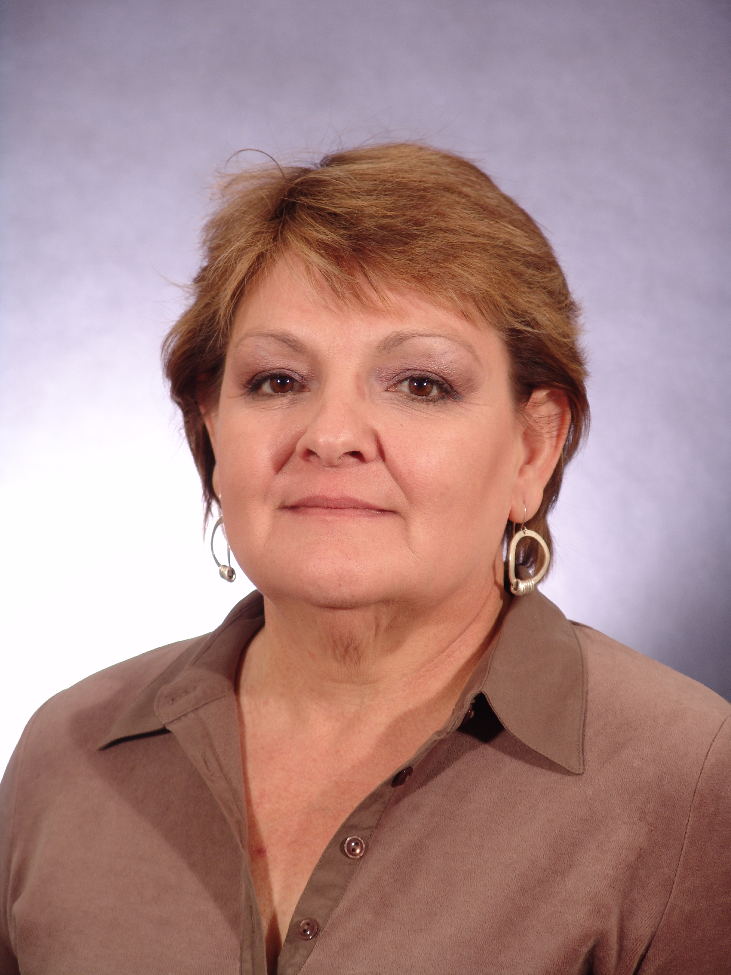
Nancy Hall
Alamo Community College District – Palo Alto College
Challenging and uncertain circumstances require people to strive for excellence. I believe community is enhanced by recognizing student potential, facilitating their synergy, and imparting a desire for academic excellence.

Slide 2
Diane Nystedt
Alamo Community College District - Palo Alto College
My students inspire me every day. I learn from them as they face their fears with grace and perseverance, grateful for a second chance at education. Their eagerness to build their own strong futures affirms my motivation to help them succeed.

Slide 3
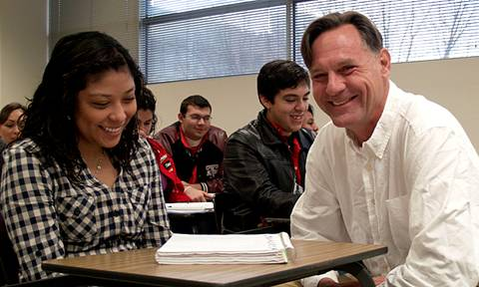
Michael Berrier
Alamo Community College – San Antonio College

Slide 4
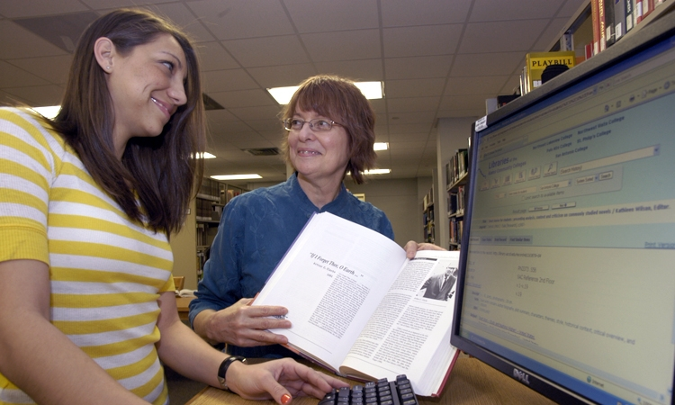
Susan Myers
Alamo Community College – San Antonio College

Slide 5
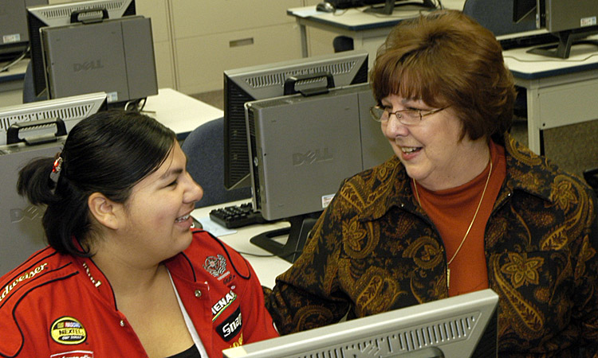
Jan Starnes
Alamo Community College – San Antonio College

Slide 6
Allison Joubert
Alamo Community College District
I read somewhere that people may not remember exactly what you did or what you said, but they will always remember how you made them feel. I want those that I assist, whether they be faculty, staff, students, or visitors, to feel, at that moment, they are my priority.

Slide 7
Benjamin Kraft
Alamo Community College District
Helping students find their life goals and how to achieve them is what motivates me. Many people have mentored me, and I feel a strong sense of responsibility to do the same for others. My ultimate message to students: ‘Let your dreams be your only boundaries.’

Slide 8
Maria Belanger
Algonquin College
For all students, learning involves a major transformation. It’s exciting to be part of this process and, where possible, to enable it. Its a pleasure to watch students grow and become more self-confident. My vision is to help mold the type of person I would want to hire.

Slide 9
Jamie Bramburger
Algonquin College
There is nothing more powerful in a rural community than the impact of a community college. The college drives economic development, provides a skilled labour force, and builds partnerships that support regional prosperity.

Slide 10
Dan Brigham
Algonquin College
Acknowledge responsibility when there is misunderstanding, and focus on developing methods to reach individuals. Educators must earn respect along with their students.

Slide 11
Don Crockford
Algonquin College
There is no job that is more frustrating and more rewarding than teaching—frustrating when the best laid plans go astray and rewarding when the idea that would never work in a million years turns into the best class you’ve ever taught. It's the tension between the possibility of failure and the hope for success that makes teaching inspiring.

Slide 12
Debbie Dufresne
Algonquin College
It is important to care about students as individuals, not just as a group; to care about how they are succeeding in other courses, not just in our own; to care about how they are coping out of classroom, not just during the two or three hours that we, as teachers, are with them in the classroom.

Slide 13
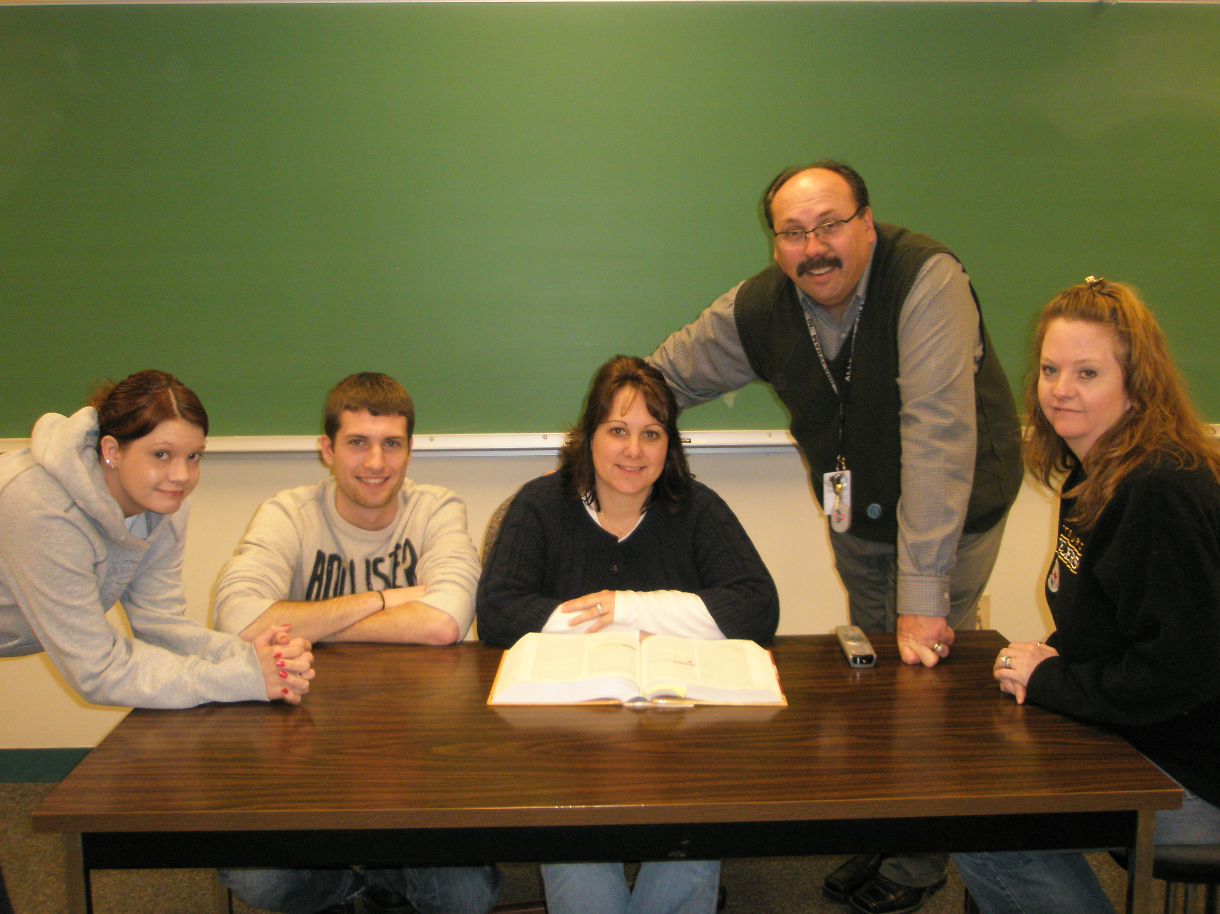
William Rocks
Allegany College of Maryland
My students motivate me. I am inspired by their personal and professional growth. I embrace the teaching philosophy of Parker Palmer where good teaching comes in a myriad of forms, but good teachers share one trait: They truly are present in the classroom, deeply engaged with their students and their subject.

Slide 14
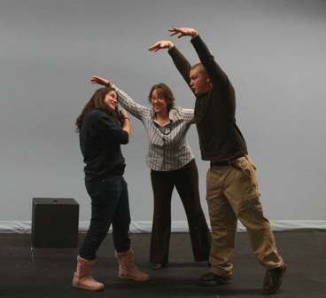
Terri Piazza
Allen County Community College
My students inspire me to strive for excellence both from myself and from them. They know that I have high expectations and that I will guide them to achievement. Their willingness to try inspires me to prepare instruction that is timely, challenging, and relevant.

Slide 15
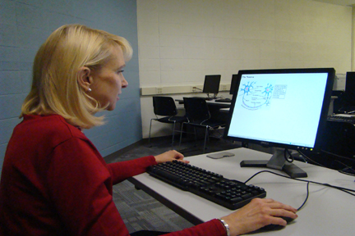
Joan Doolittle
Anne Arundel Community College

Slide 16
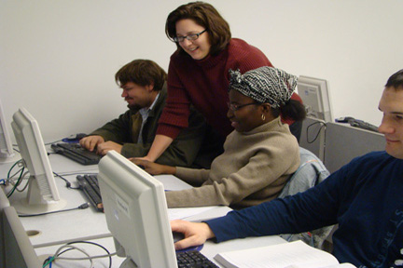
Krysten Hall
Anne Arundel Community College

Slide 17
Jan Starnes
Alamo Community College District – San Antonio College
What could be more stimulating and rewarding than helping people change their lives?!

Slide 18
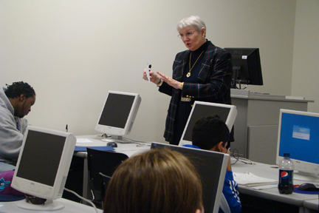
Martha Linksz
Anne Arundel Community College
Incorporate your own student experience in your teaching. Emulate those who most profoundly impacted you in a positive way.

Slide 19
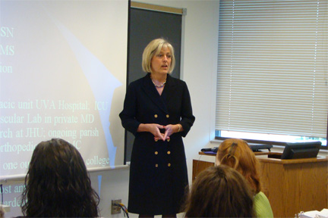
Marion Schilder
Anne Arundel Community College

Slide 20
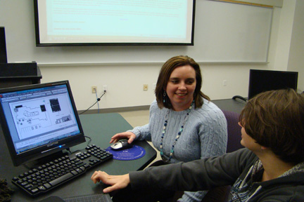
Brandi Shepard
Anne Arundel Community College

Slide 21
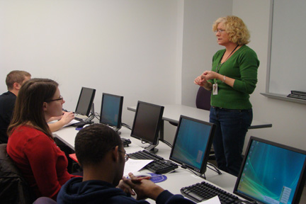
Kasia Taylor
Anne Arundel Community College

Slide 22
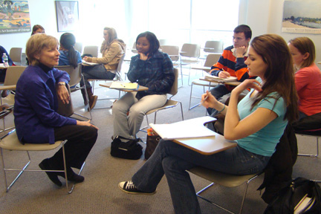
Jill Voran
Anne Arundel Community College
Fueled by intellectual curiosity, interaction with colleagues, and interest in students, I search for new ways of putting successive generations of students in contact with subject matter and encouraging them to ask seminal questions.

Slide 23
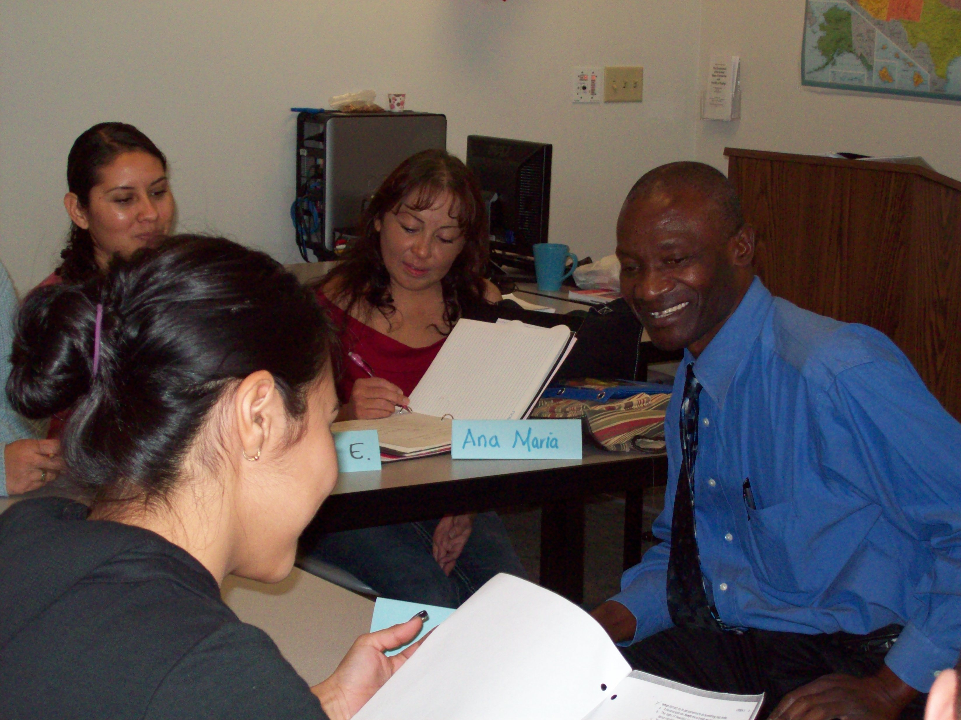
Mizaba Abedi
Arizona Western College

Slide 24
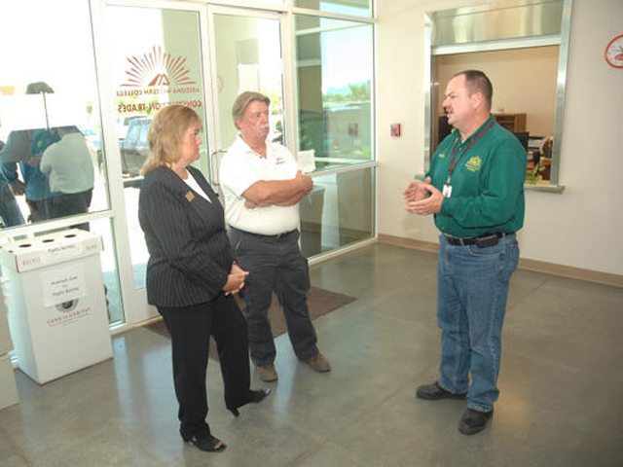
Lee Altman Sr.
Arizona Western College
I treat my students as customers. I am selling them knowledge. I am honored they choose my classes, and I try very hard to give them their dollars’ worth and then some. When they succeed, I am successful, and I did my job.

Slide 25
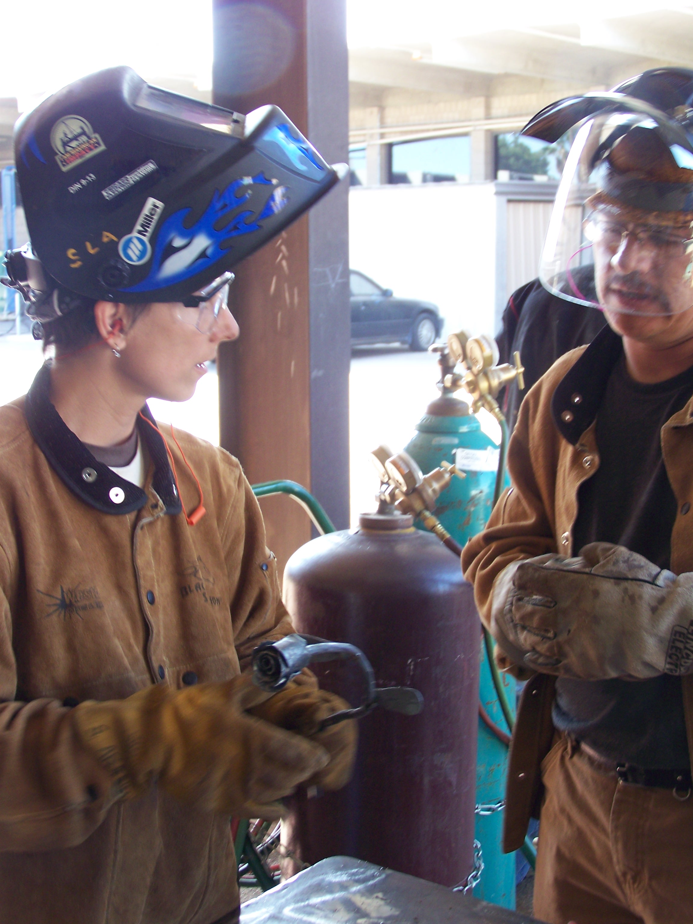
Shanen Aranmor
Arizona Western College
My passion for learning has inspired me to pursue somewhat unrelated degrees. Whether I am outdoors calming a nervous rock climbing student, forge welding in the blacksmithing lab, or serving as life coach for holistic wellness classes, I am grateful for the opportunity to share ah-ha moments with my students.

Slide 26
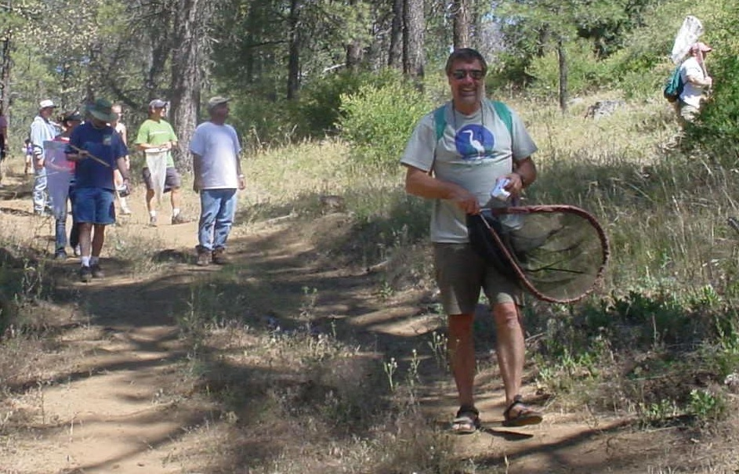
Ian Watkinson
Arizona Western College

Slide 27
Eszter Barra-Johnson
Ashford University
I would like to share my favorite quote: “If you think you know all the answers, then you have not yet been asked all the questions.”

Slide 28
Ronald Bolender
Ashford University
I facilitate intellectual, professional, and personal development. While I desire students’ comradeship, it is more important to enrich their lives by active facilitation that sometimes requires I challenge them in uncomfortable ways. I must do this in order to teach with integrity.

Slide 29
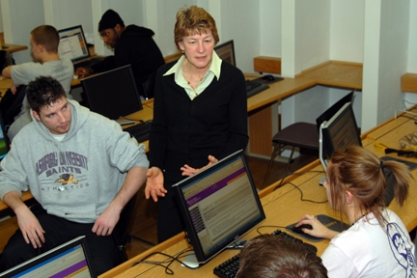
Mary Cornilsen
Ashford University

Slide 30
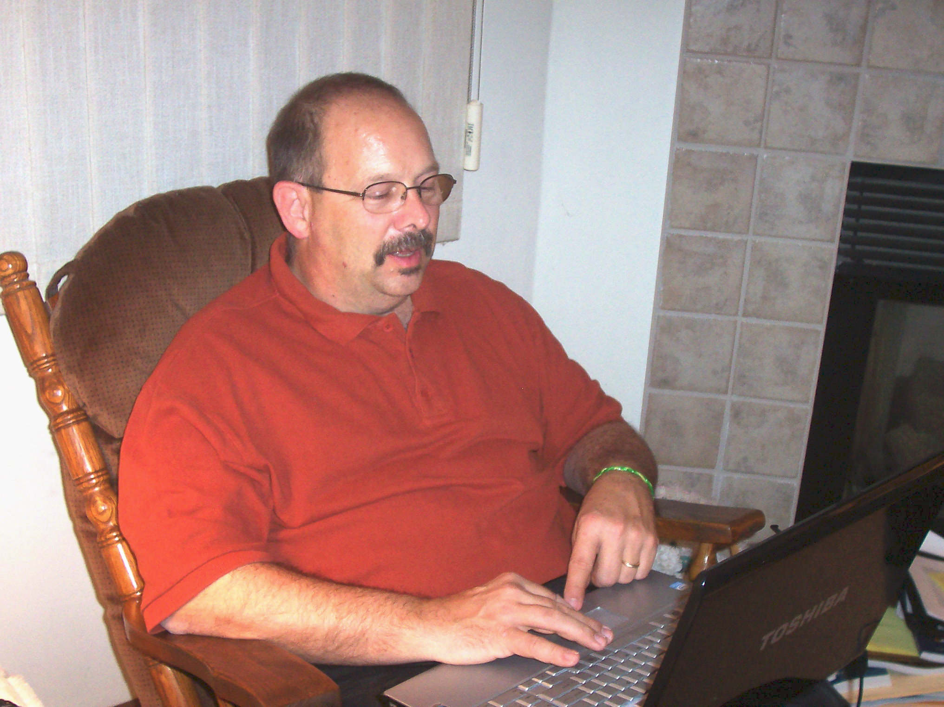
Daniel French
Ashford University
Teaching has been my passion for 32 years. I am driven to utilize the methods and strategies that enable students to learn. Within the online learning environment, my words convey the message of learning and the extent of my love for providing that opportunity.

Slide 31
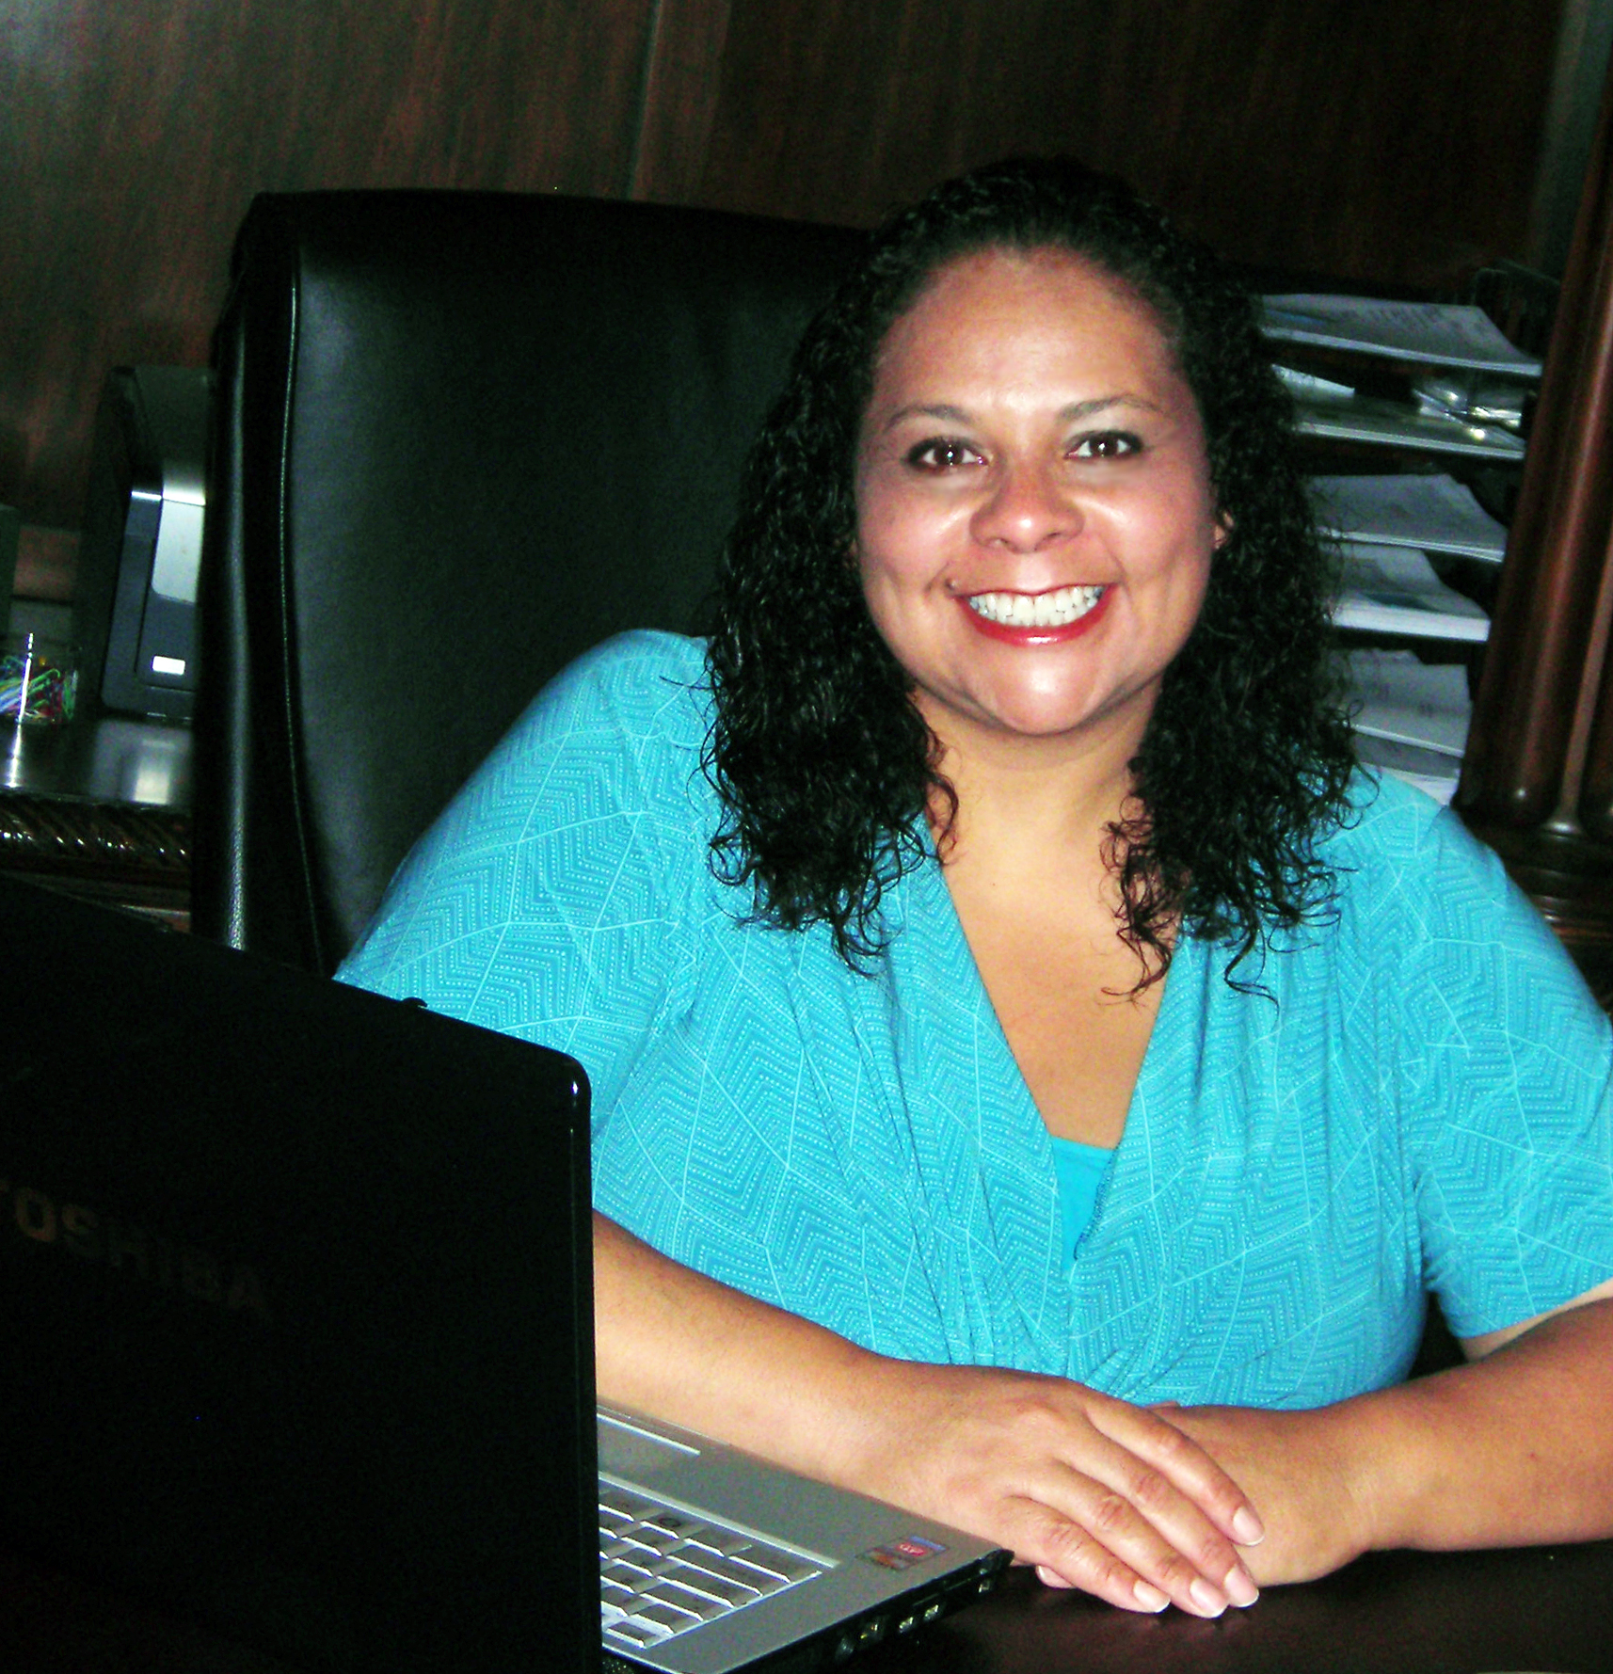
Ann Hopson
Ashford University

Slide 32
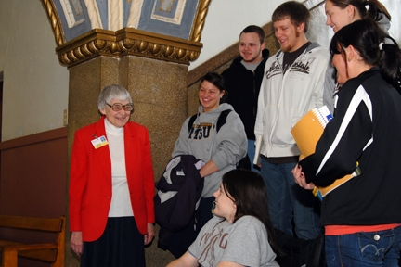
William McCue
Ashford University
I am task-oriented and a people-builder.

Slide 33
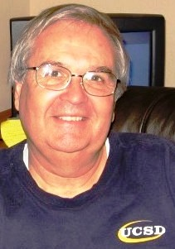
Timothy Serey
Ashford University
I teach to inspire my students and help them be the person they have always wanted to be. Those of us who come to teach also come to learn. My students inspire me and have helped me find passion and a sense of purpose in my life.

Slide 34
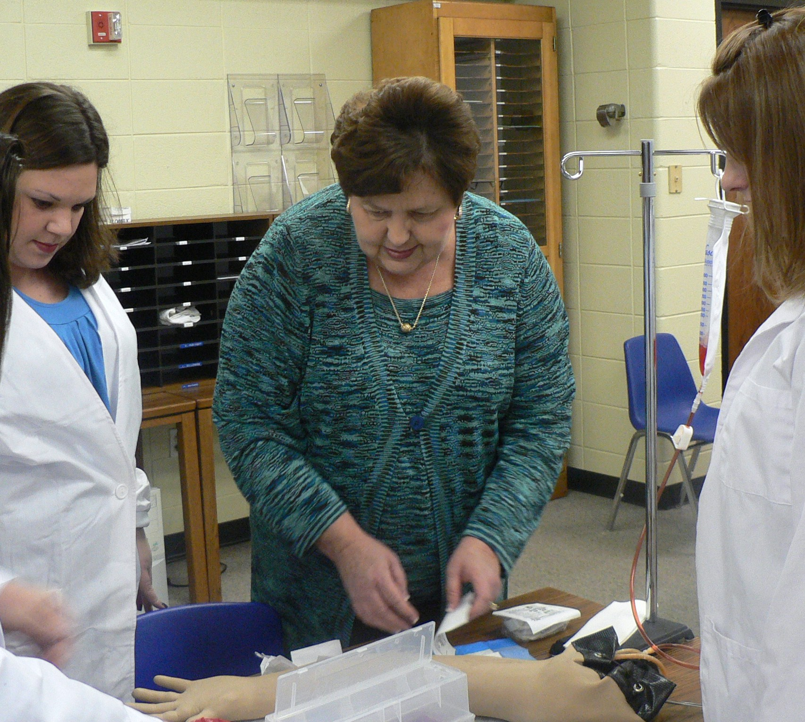
Jennifer Carroll
Ashford University

Slide 35
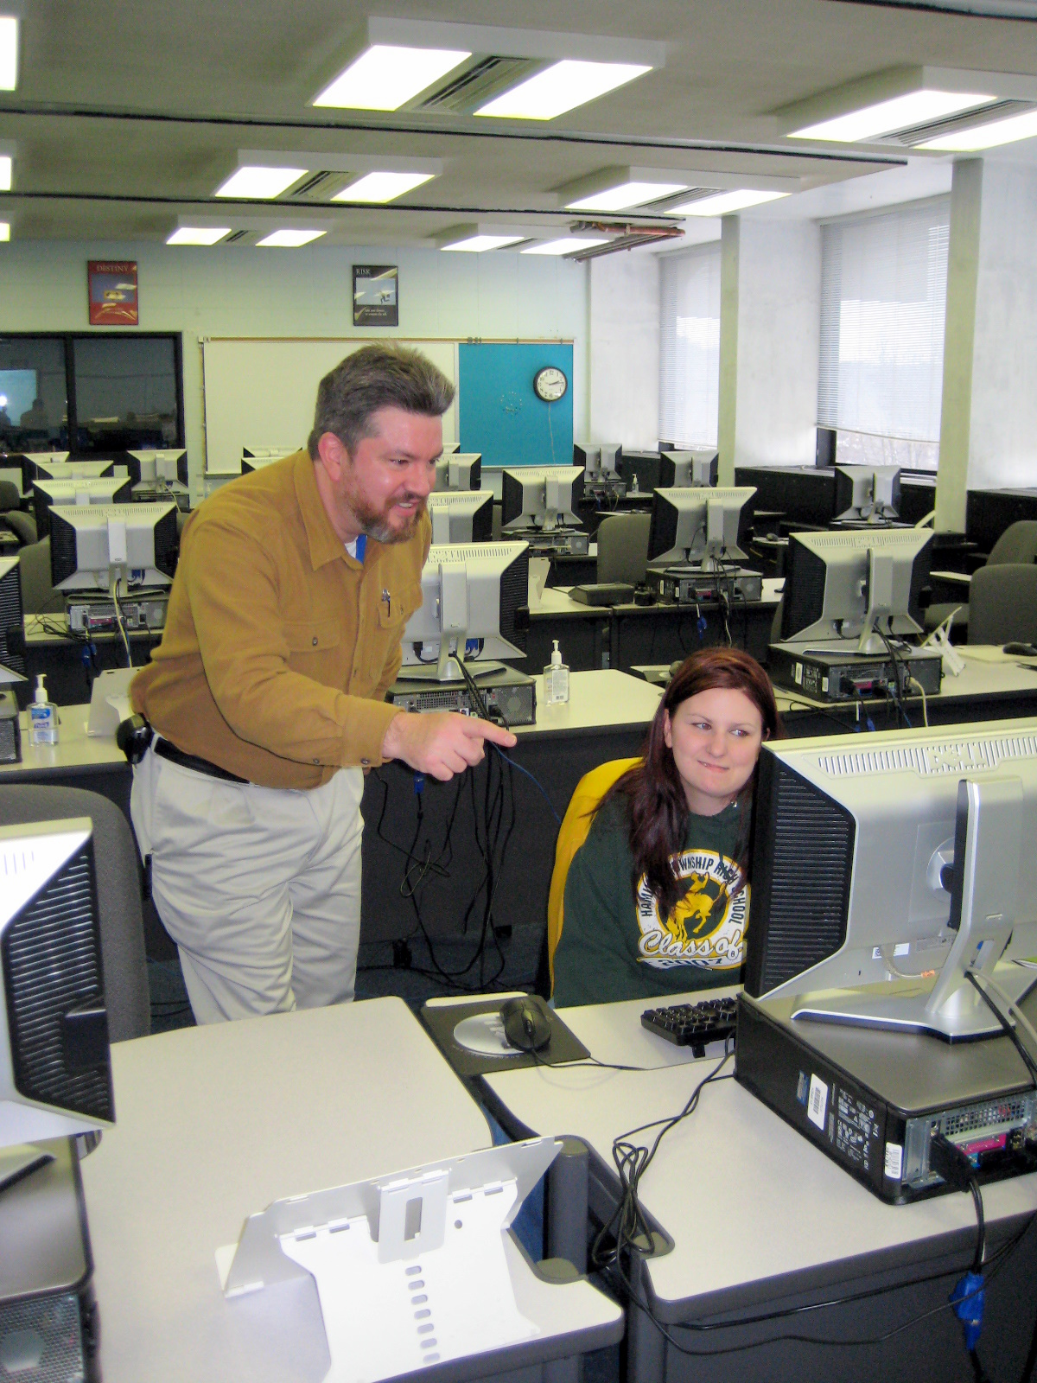
David Childress
Ashland Community and Technical College
I want to provide a relaxed learning atmosphere where the only dumb question is the one unasked. I use the three Ps—Praise, Patience, Practice.

Slide 36
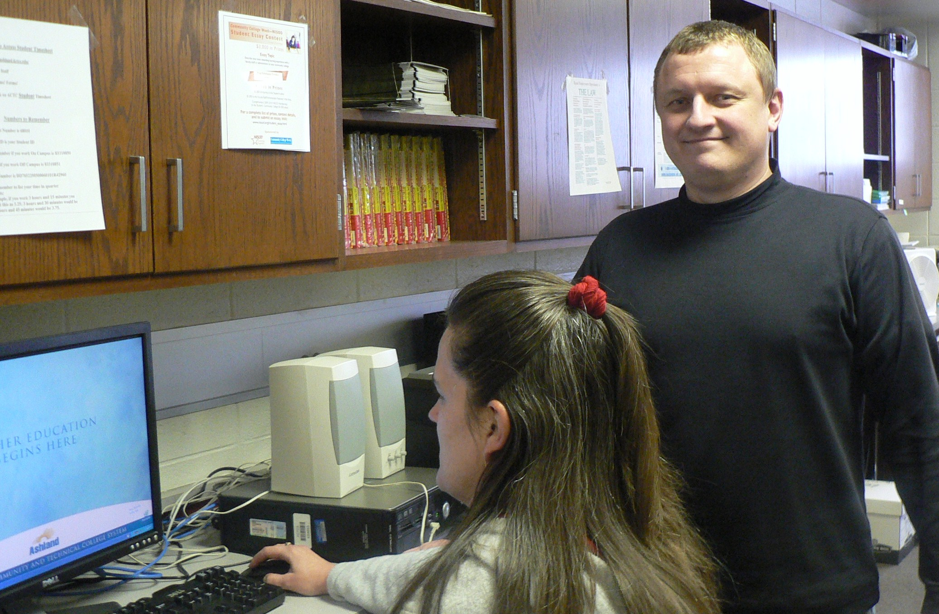
Jack Johnson
Ashford University

Slide 37
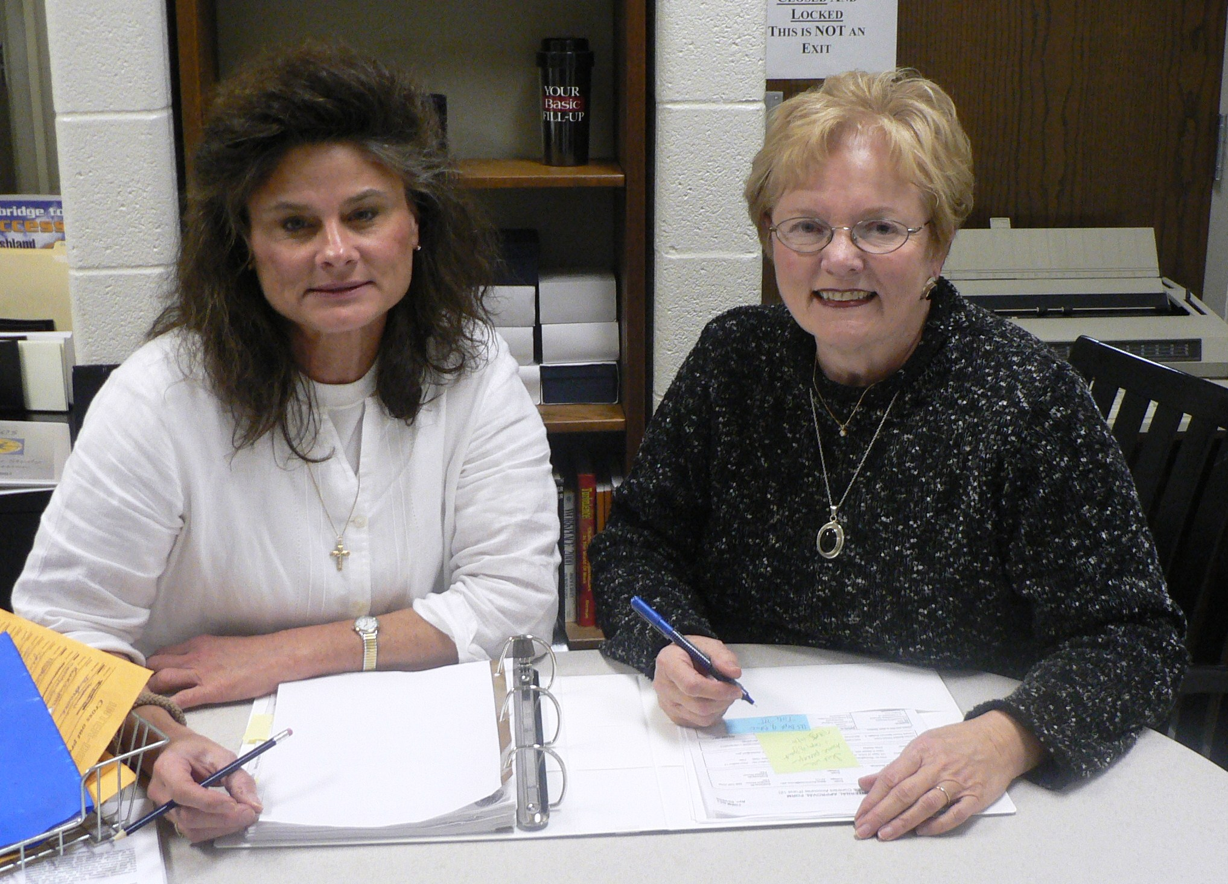
Louise Shytle
Ashland Community & Technical College
Opportunities to serve individuals, organizations, and the community motivate me. It is a good feeling to know others are counting on what you do.

Slide 38
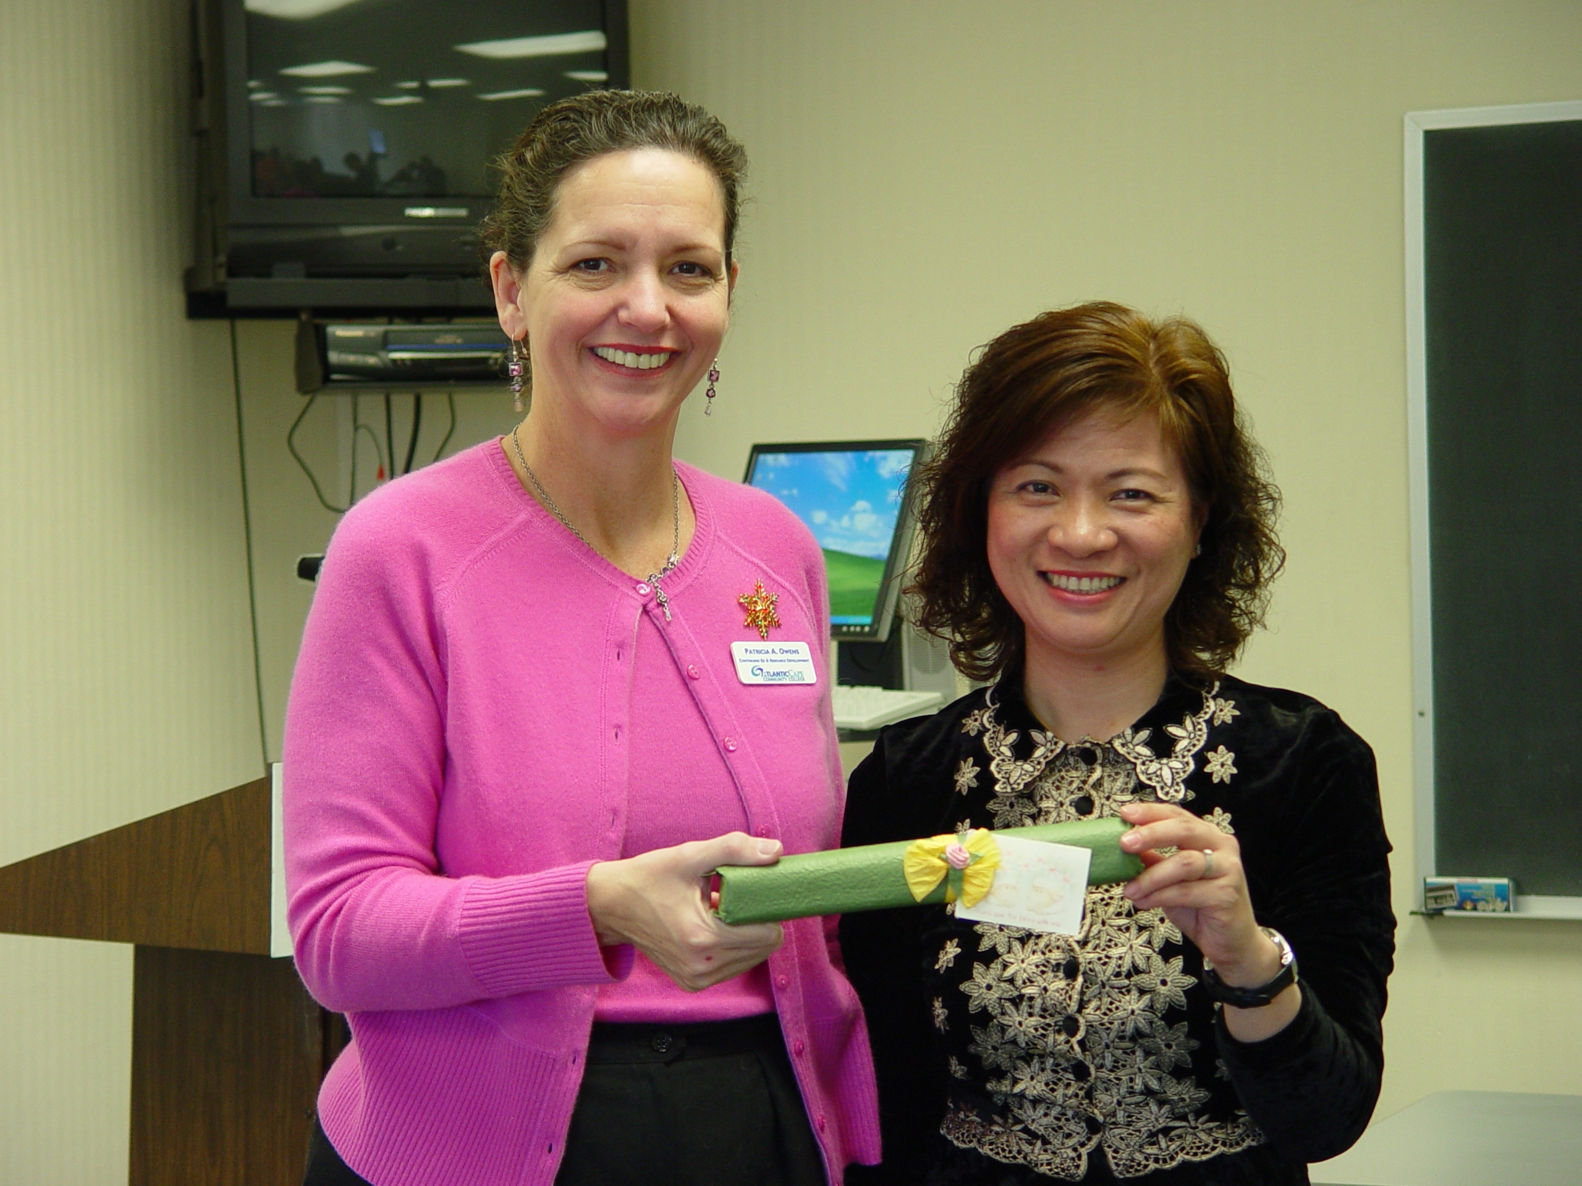
Patricia Gentile
Atlantic Cape Community College

Slide 39
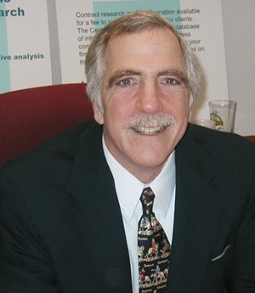
Richard Perniciaro
Atlantic Cape Community College
Effective planning is a combination of data-driven decision-making and vision. The data tell you where you have been and where you are going, if nothing changes. Vision is where you want to go. Good planning is connecting the two.

Slide 40
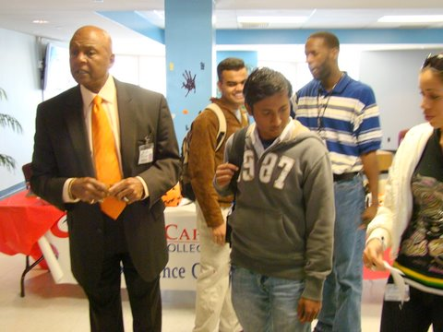
Bobby Royal, Sr.
Atlantic Cape Community College
My inspiration and motivation in my work is deeply rooted in my childhood memories of poverty, segregation, and discrimination. But I had mentors who encouraged me and would not let me give up. I owe so very much to those unsung heroes of my past. I try to repay their kindness each and every day through my work.

Slide 41
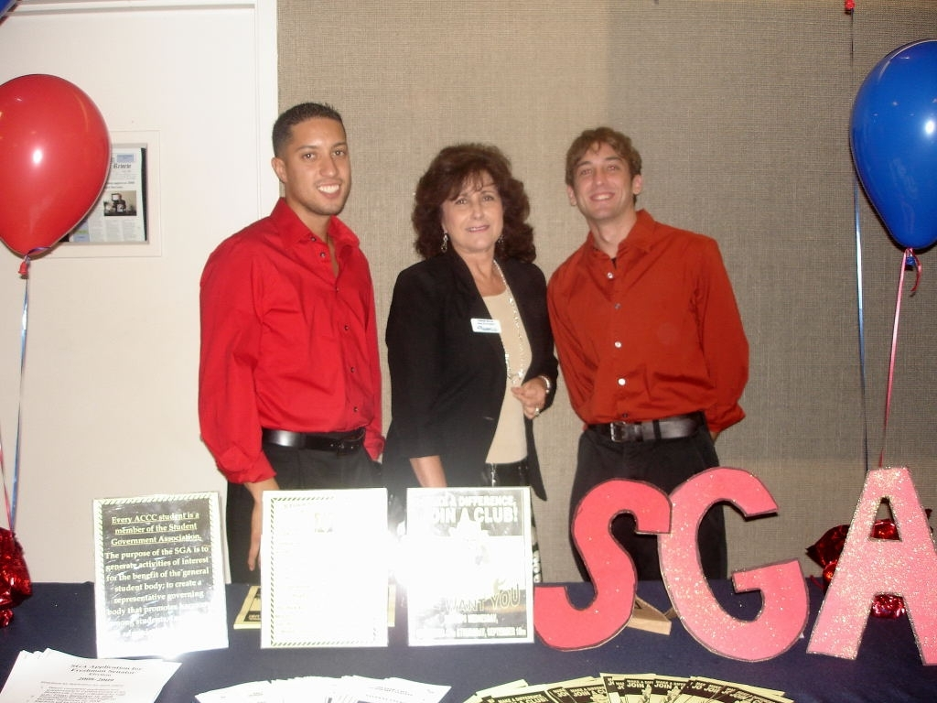
Carmen Royal
Atlantic Cape Community College
My motto has been to instill in students a sense of community and the value in becoming a responsible citizen of the world. I continue to affirm my commitment to my profession by holding myself to the highest standards of accountability.

Slide 42
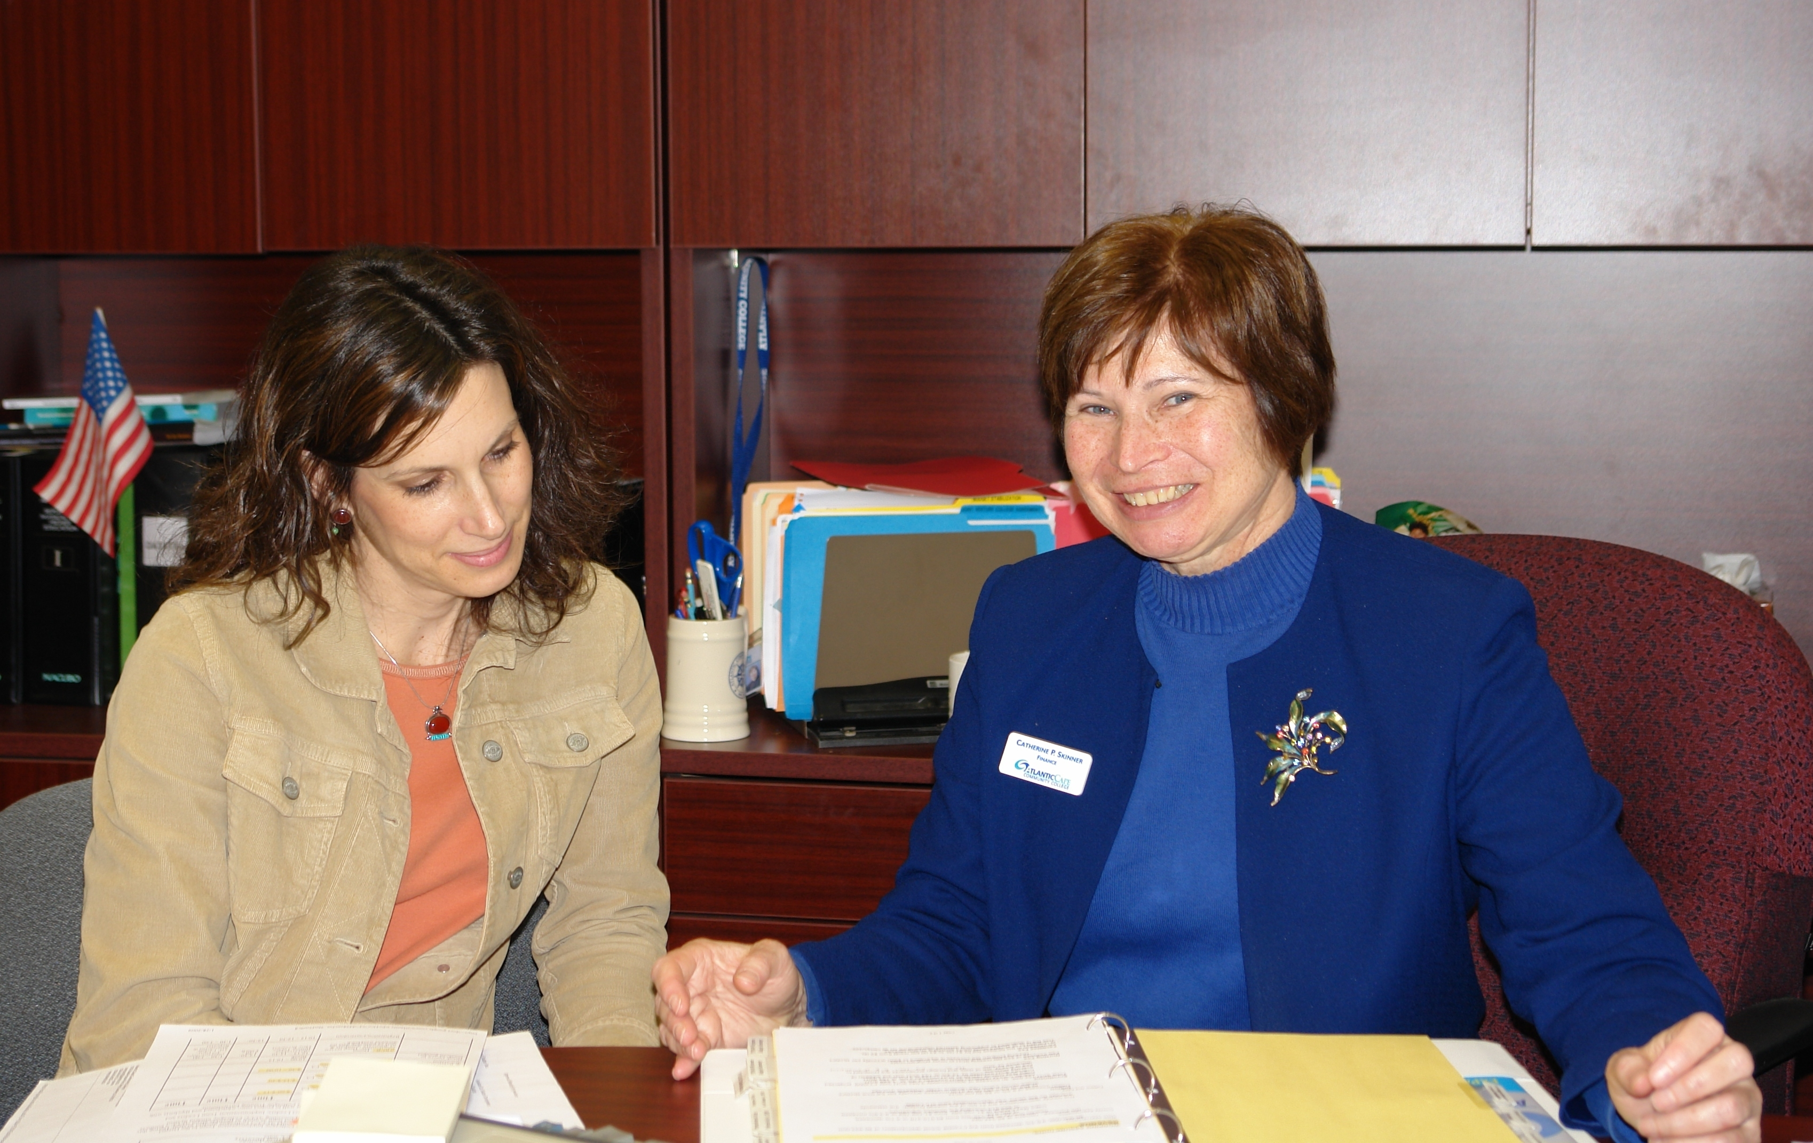
Catherine Skinner
Atlantic Cape Community College

Slide 43
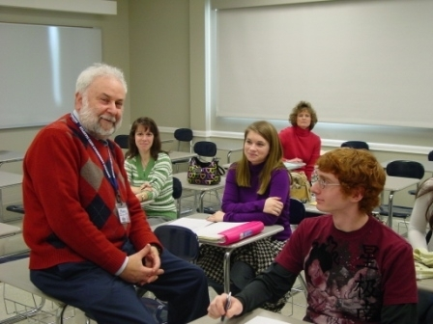
Art Wexler
Atlantic Cape Community College

Slide 44
Gail Bayeta
Austin Community College
Every day that I work with students, I am reminded that I have the best job in the world. I'm always amazed at how much creativity and talent they have, and am humbled to share in the process of helping them learn, discover, and grow into designers.

Slide 45
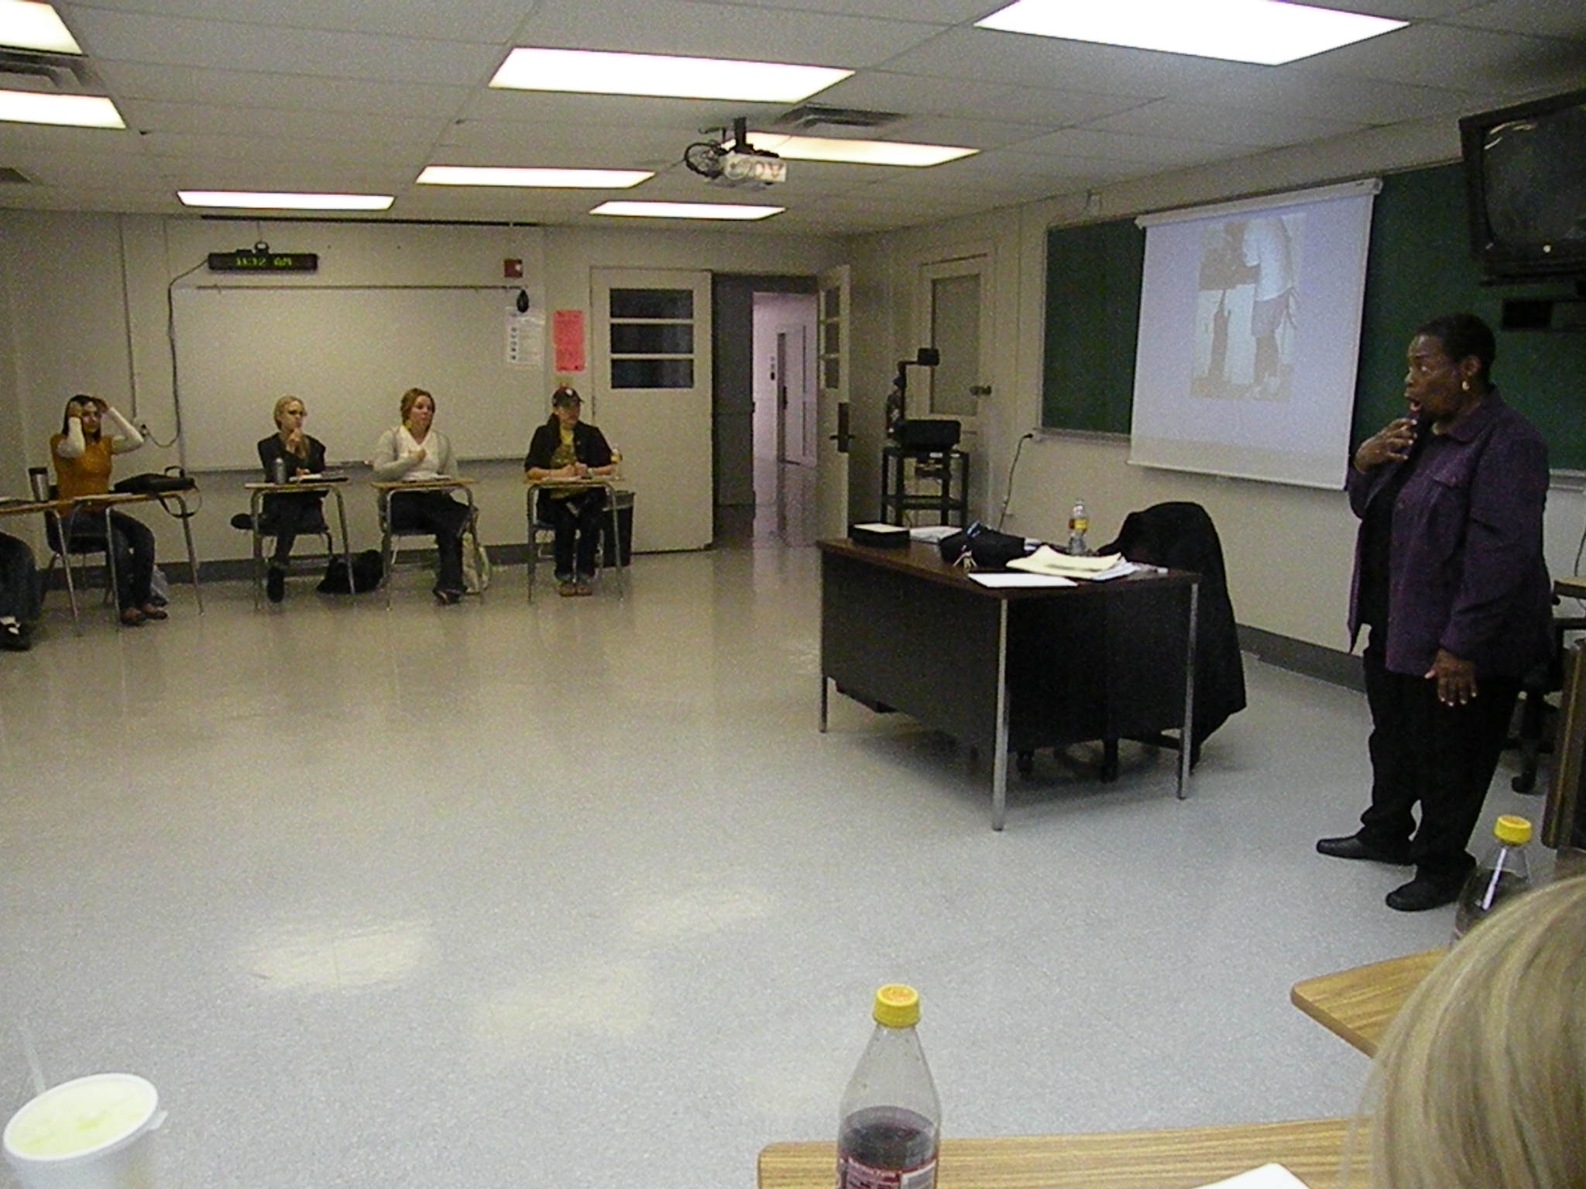
Nathie Marbury
Austin Community College

Slide 46
Betty LaFace
Bainbridge College
As a teacher with interests in cultural studies, I engage students in writing topics that attempt to stress differences and similarities among societies, and which discourage tendencies to brand one nation or social group as superior or inferior to another. I want students to gain knowledge of and respect for societies in lands nearly half a world away from Bainbridge, Georgia.

Slide 47
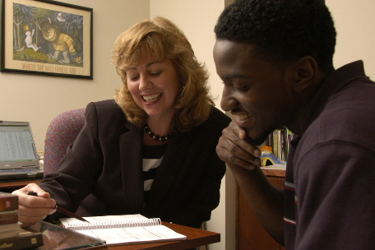
Tonya Strickland
Bainbridge College
Learning is profoundly social. We learn as we share and are comfortable in that sharing. If we don’t allow students to feel okay about making mistakes, they won't risk significant learning. To create nonthreatening classrooms, I use lots of humor, and I participate with great enthusiasm in our classroom activities.

Slide 48
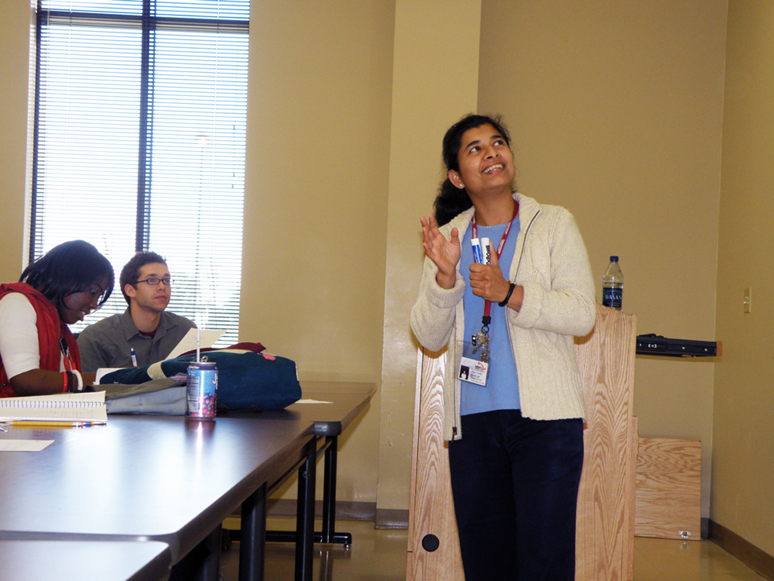
Nisha Aroskar
Baton Rouge Community College
My class is a dialogue with students. I like to ask questions and get students thinking on their own. I love to show how economics is just using common sense. It is exciting to see their reactions, nods, and smiles with the Eureka moments. I simply enjoy teaching.

Slide 49
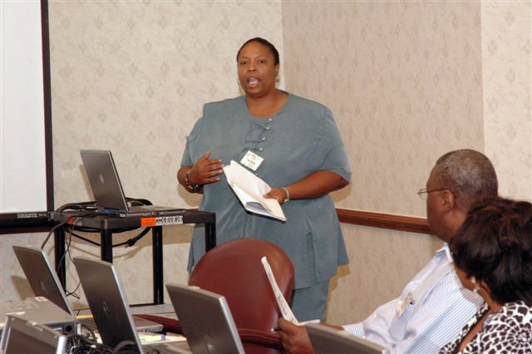
Linda Batiste Paul
Baton Rouge Community College
I get to prove to students that they are capable of learning the material. Usually when they come to an accounting class they are mystified about the subject and assume that it will be to hard to learn, like learning Algebra. I enjoy proving them wrong.

Slide 50
Sharon Davidson
Baton Rouge Community College
My experience in education has faithfully taught me that learning is a conversation; the potential of that inevitable change is what most inspires me. When my students gain genuine interest in our subject and the skills and the desire to present it to me through their eyes, the teach me. I feel most like a teacher when I am again the student.

Slide 51
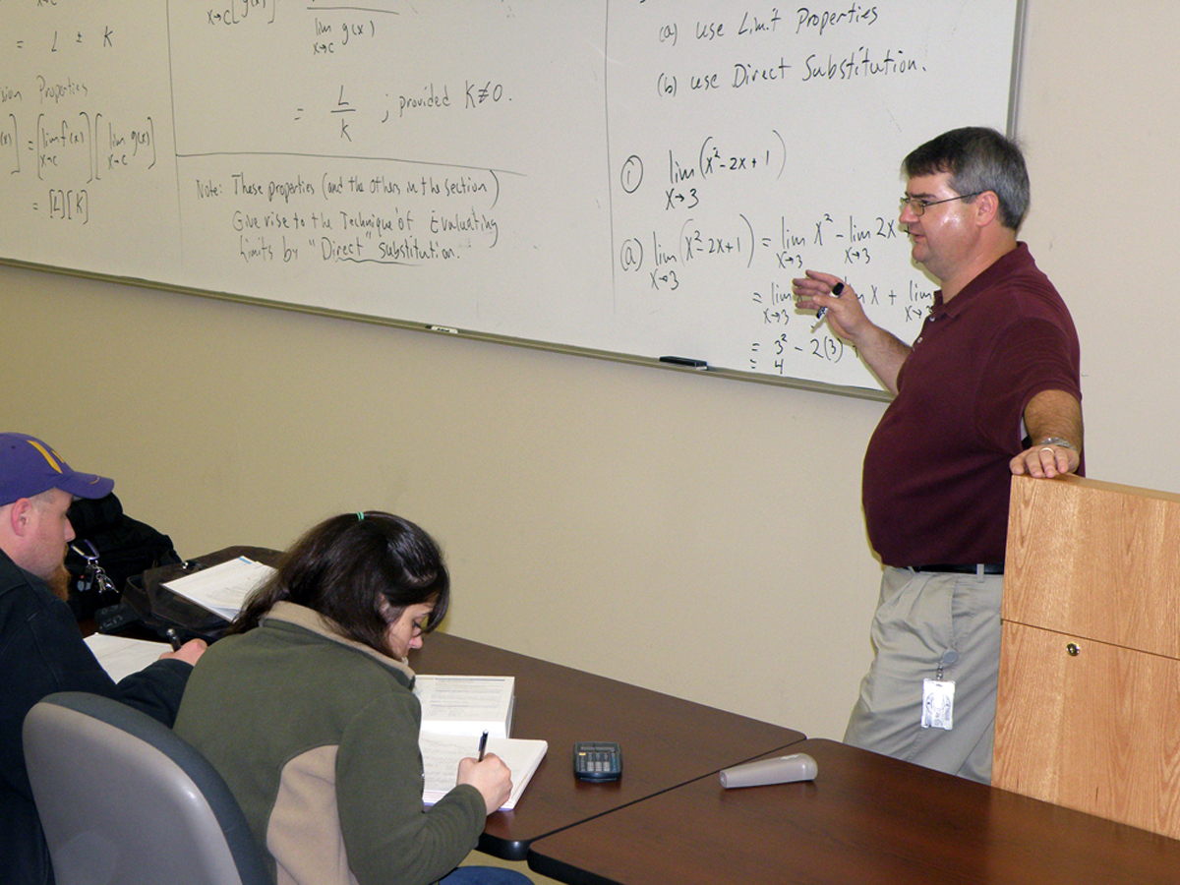
William Forrest
Baton Rouge Community College
I set high standards, and expect my students to rise to meet them. I often have some unhappy campers as a result, but nothing is more rewarding than when a former student returns to say ‘Thank you preparing me for that difficult road ahead.’

Slide 52
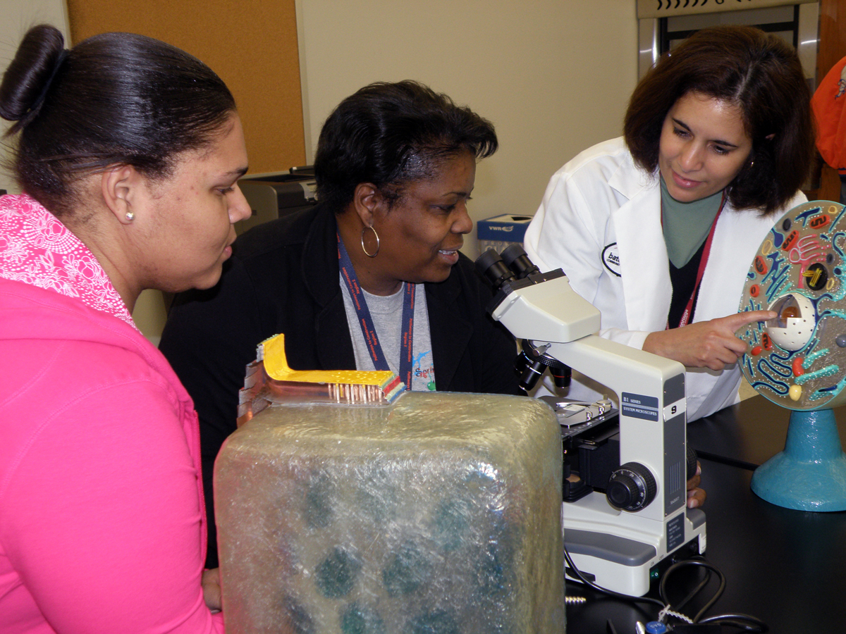
Sandra Guzman
Baton Rouge Community College

Slide 53
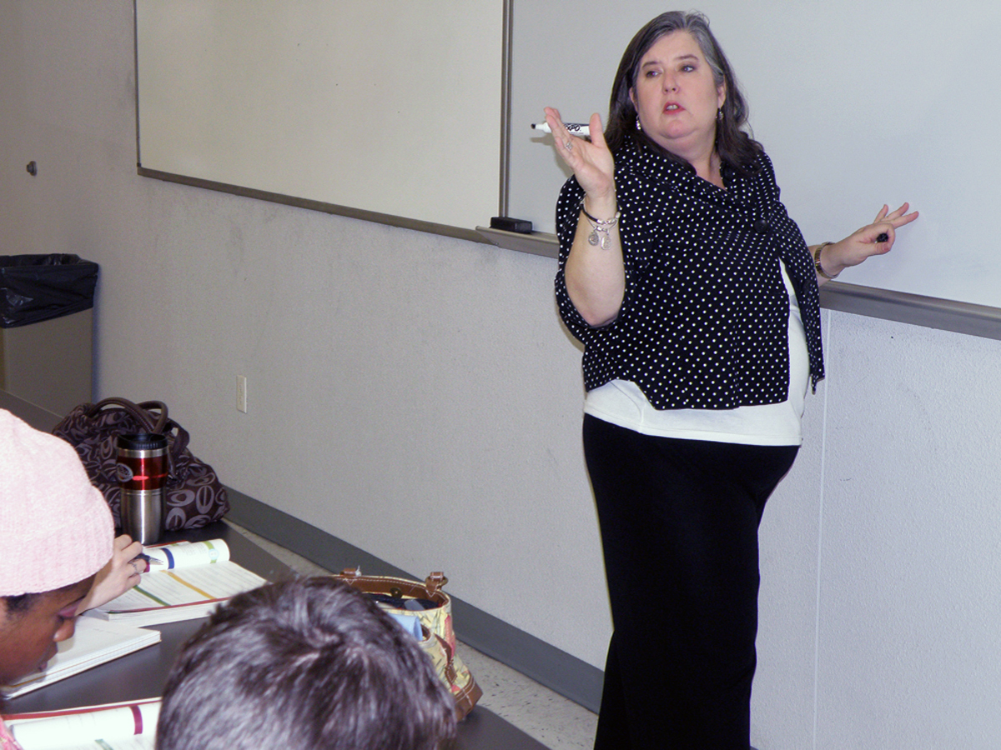
Susan Neely
Baton Rouge Community College

Slide 54
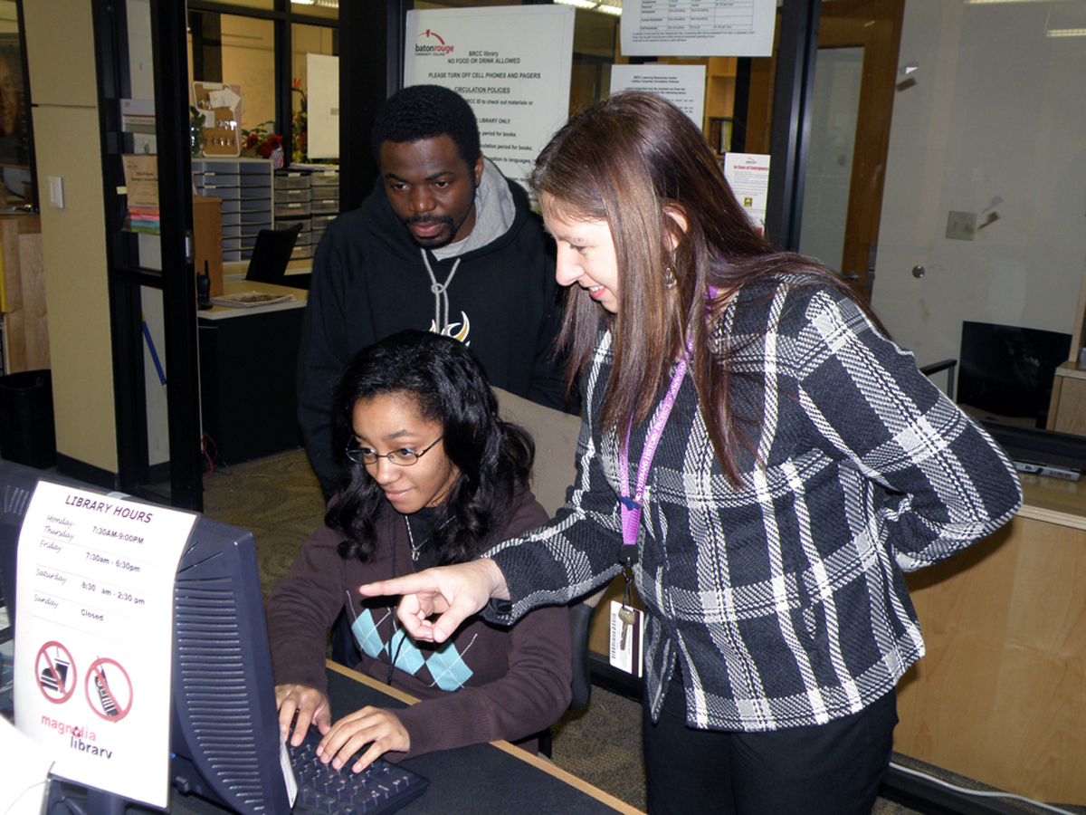
Amy Reese
Baton Rouge Community College
Getting students to grasp elusive concepts moves me towards excellence. Textbooks don’t reach all students. Using a variety of available media keeps things fresh. Sometimes media will make them laugh or make them look at me like I’m from another planet. When they do, I know I’ve hit upon something that sticks.

Slide 55
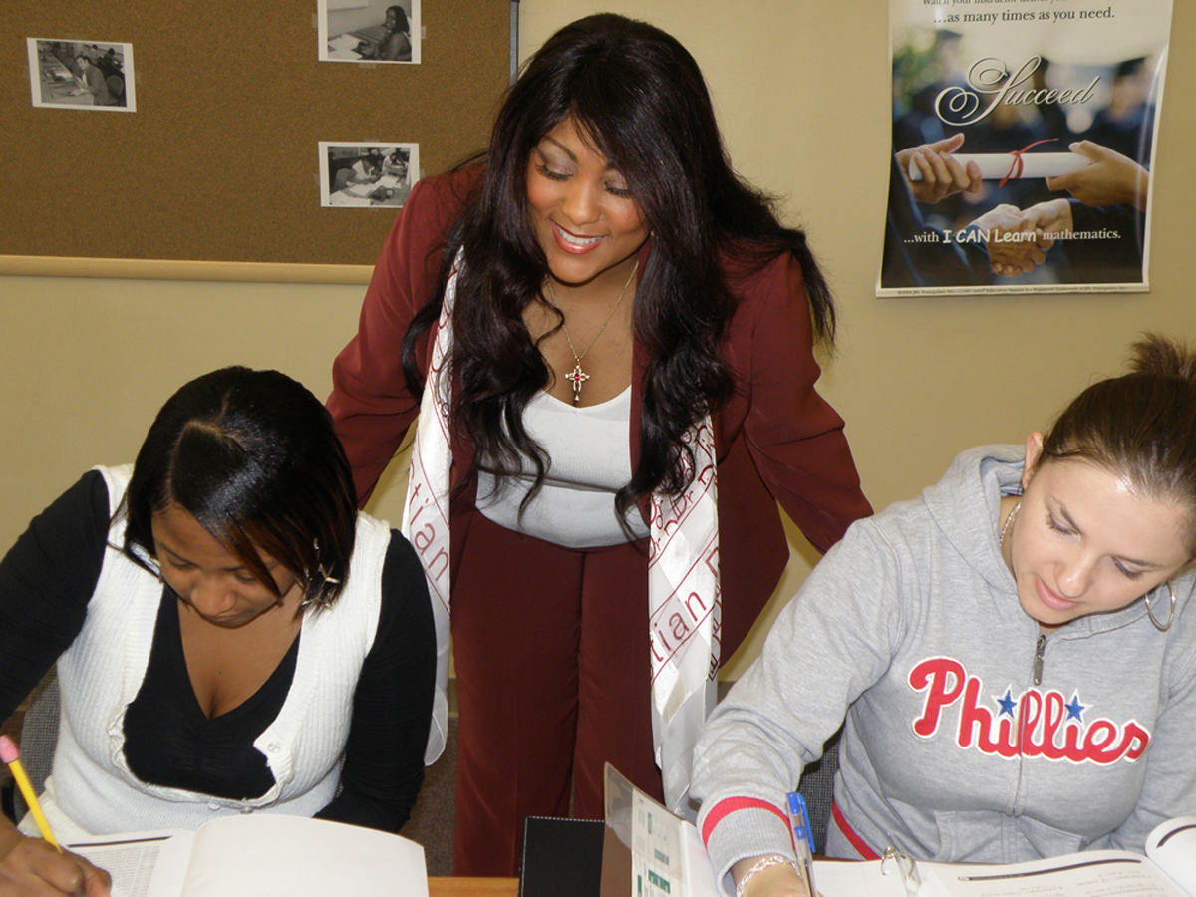
Sandra Stokes
Baton Rouge Community College
I believe that all students can learn given the right environment, circumstances, and nurturing. My passion is helping students in developmental mathematics, because, they don’t believe that they can learn mathematics. I can relate to them. I once was one of them. I get excited when I see students have a change of heart about mathematics and start to learn.

Slide 56
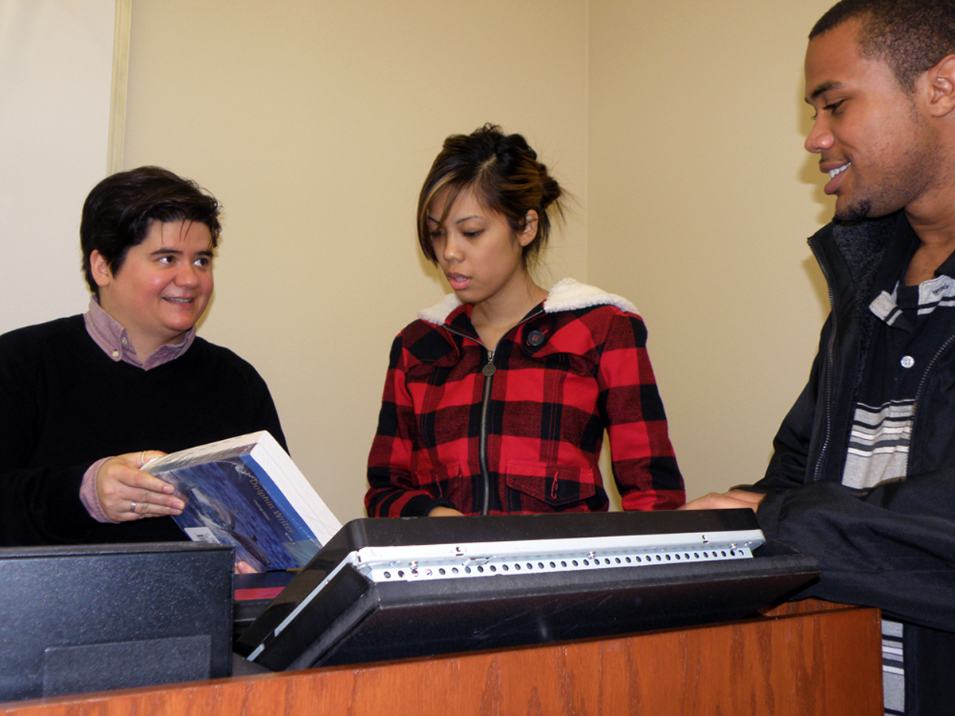
Laci Talley
Baton Rouge Community College
If I can inspire lifelong learning, I have done my job as a teacher. I want my students to dig deeper and to question everything. Each day, I set this ambitious goal for myself as well as for my students: I challenge us all to learn.

Slide 57
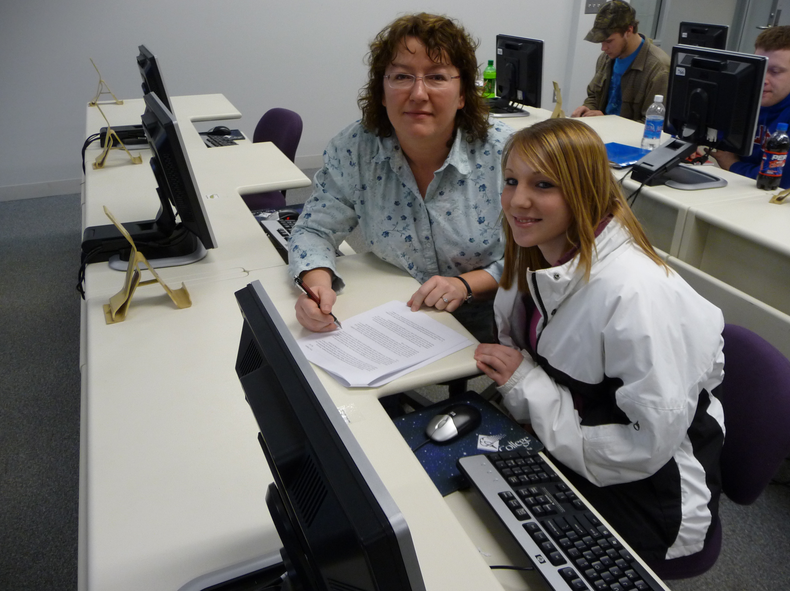
Jennifer McCann
Bay de Noc Community College
What inspires and motivates me the most about teaching is the potential I see in the students I am fortunate enough to assist. When a student is motivated to learn, I am motivated to teach. I believe my ultimate responsibility is not to relay information, but rather to provide my students with the tools that will allow them to decipher information in a way that is palatable for them.

Slide 58
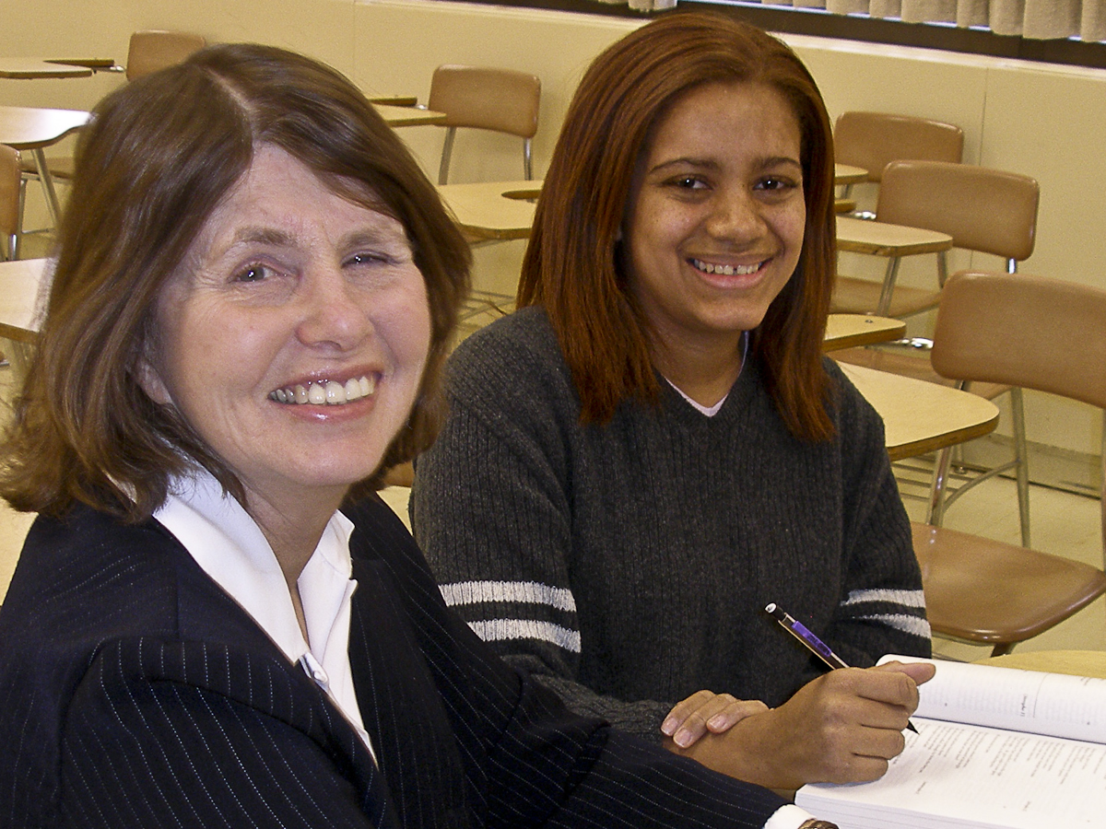
Dorothy Altman
Bergen Community College

Slide 59
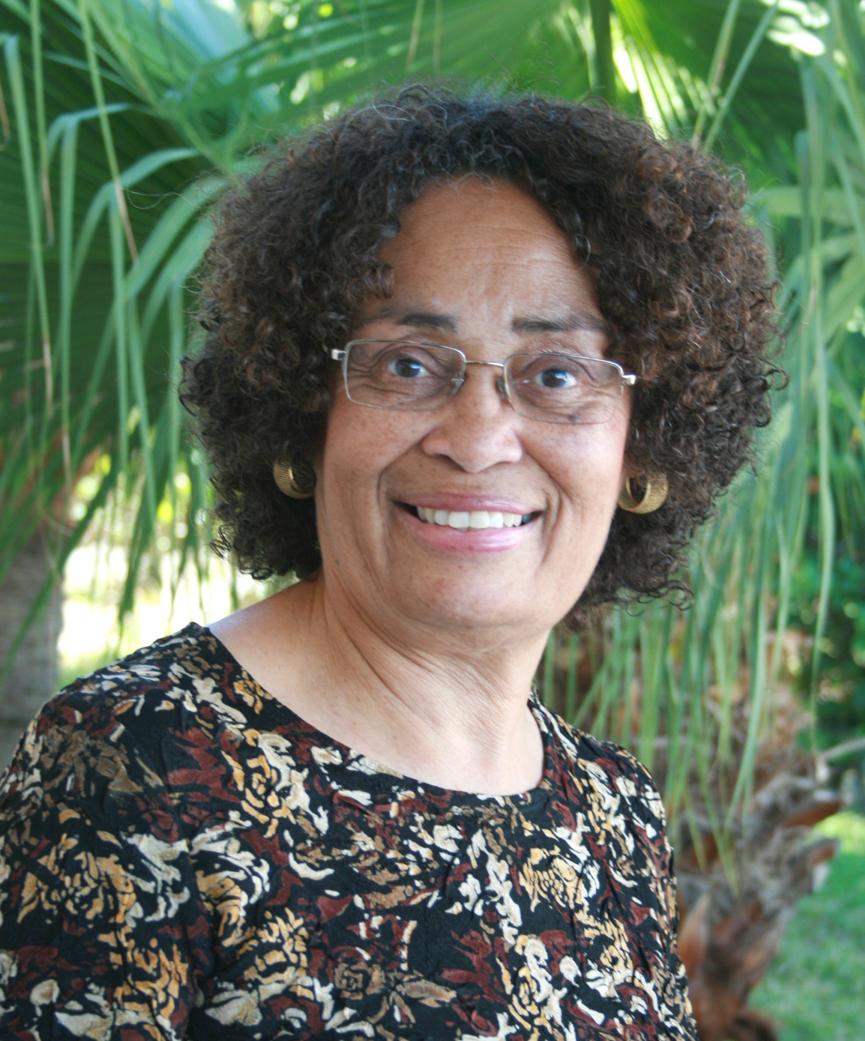
Jolene Bean
Bermuda College

Slide 60
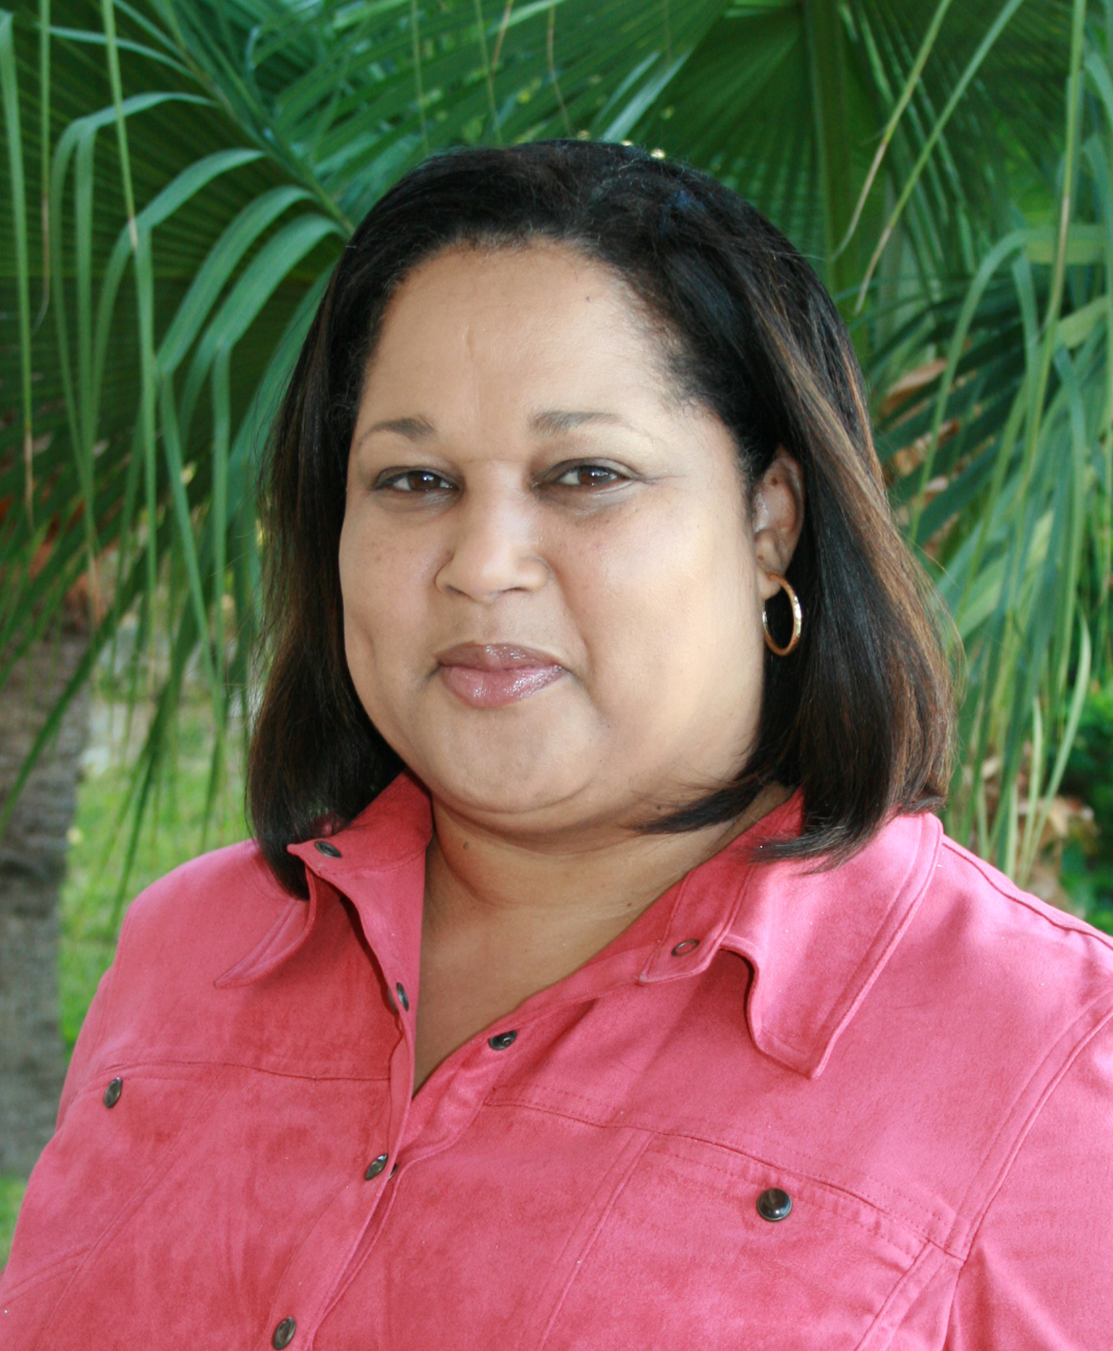
Robin Ingham
Bermuda College

Slide 61
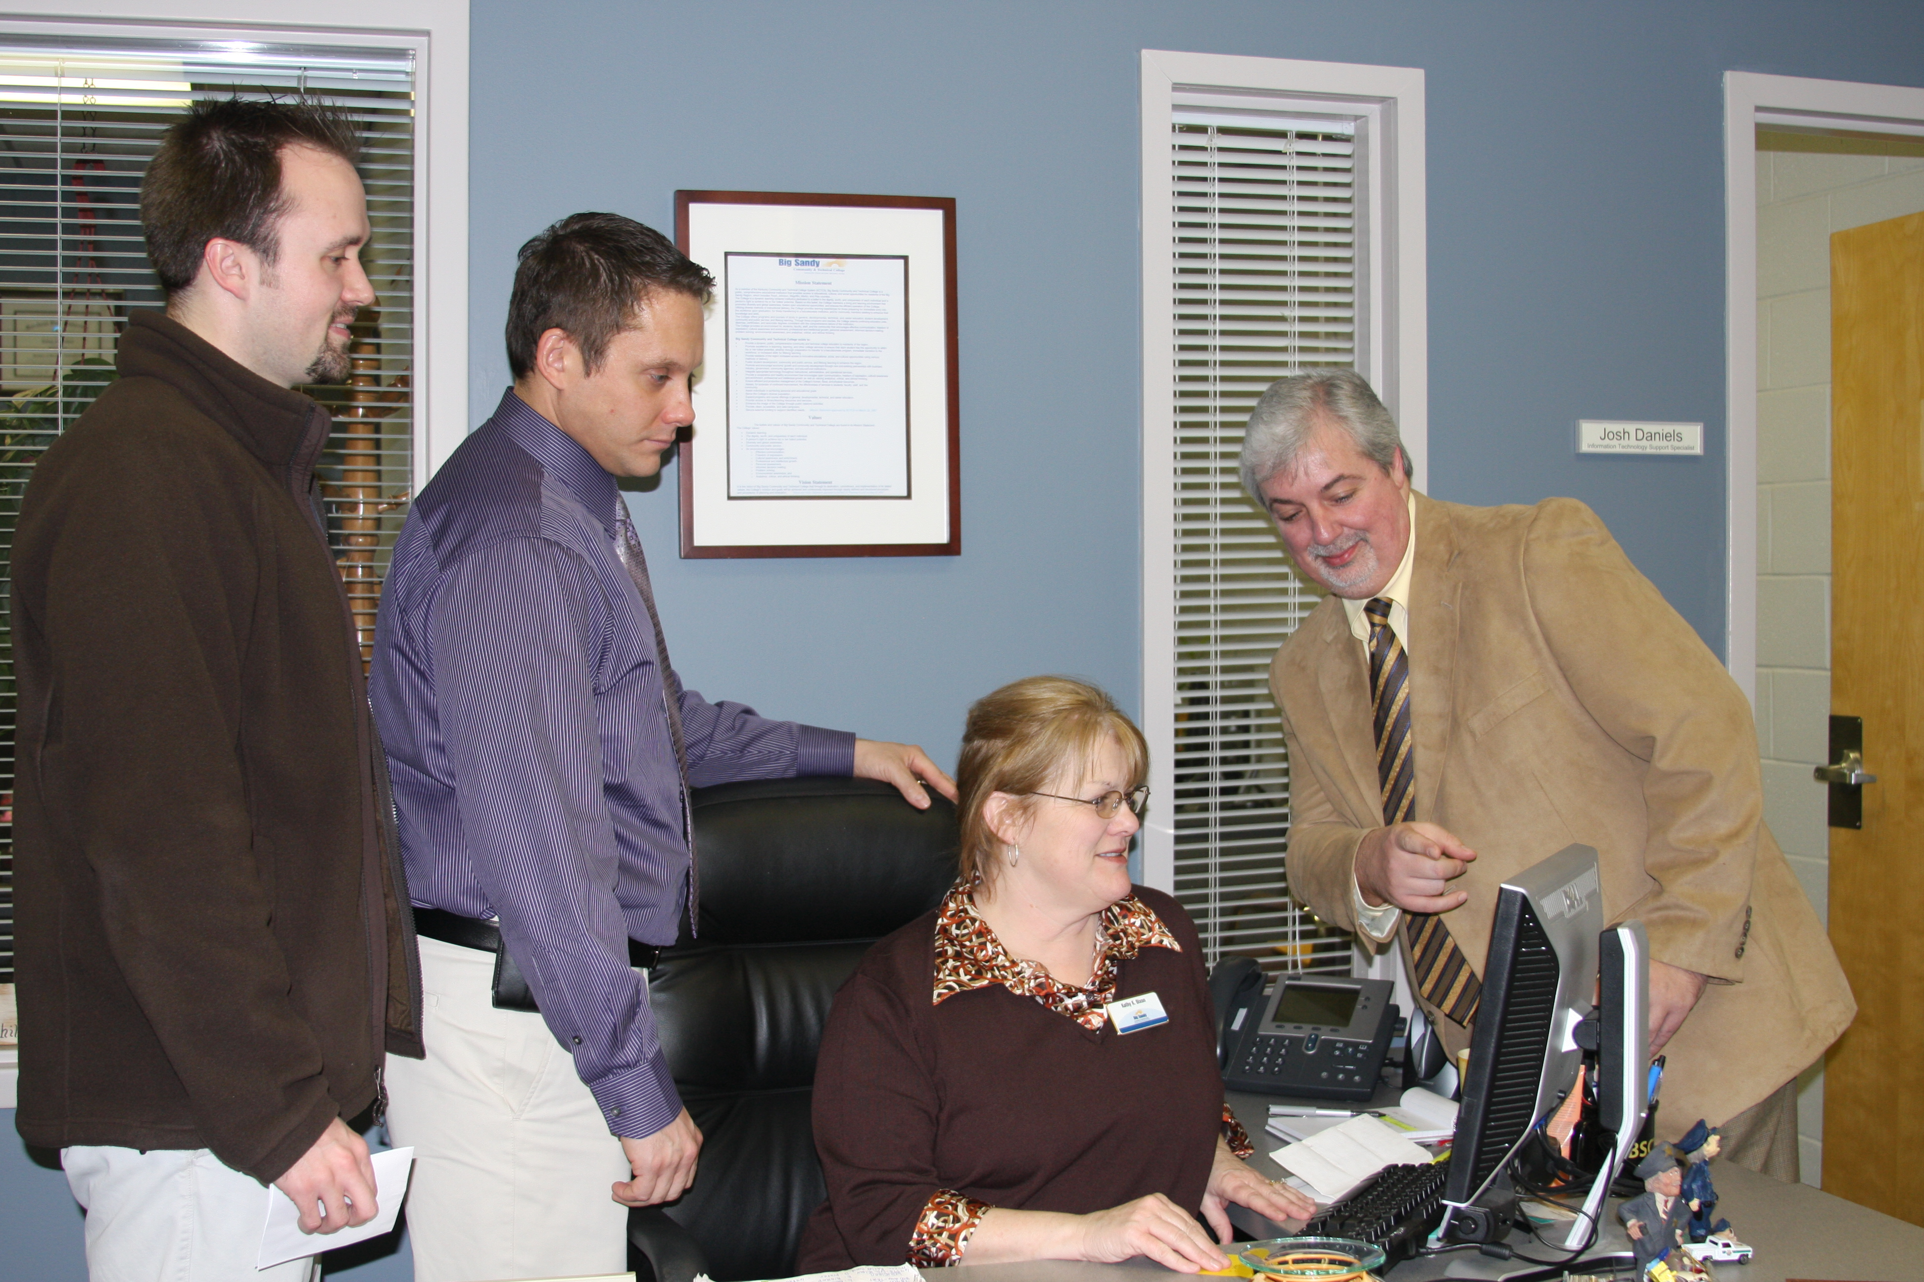
Jackie Cecil
Big Sandy Community & Technical College

Slide 62
Dan Bell
Big Sandy Community & Technical College
That which inspires me to strive for excellence is the intrinsic satisfaction I get when I have done my best. Whatever it might be, I always approach a situation with the expectation of gaining something from it. Generally, I have found that by being willing to serve, I benefit others.

Slide 63
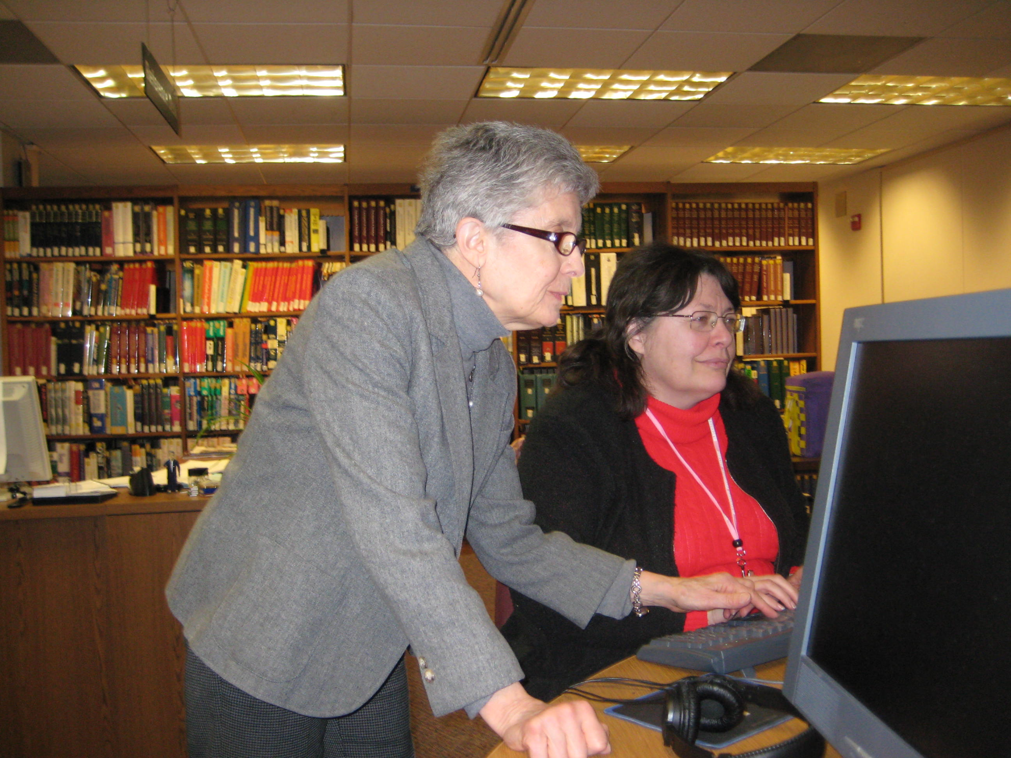
Janet White
Blackhawk Technical College
As an academic librarian I help students at their point of need, assisting them in gathering information, learning the technology necessary to find it, and coping with information overload. These lifelong skills are essential for success and sometimes needed just to survive.

Slide 64
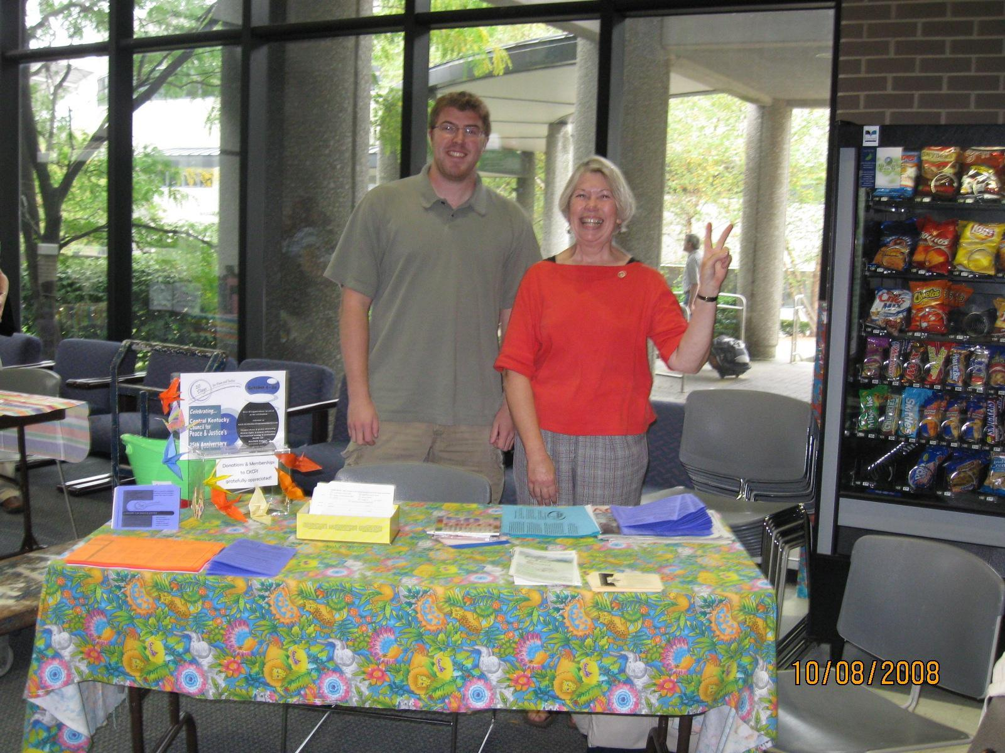
Rebecca Glasscock
Bluegrass Community and Technical College
I am motivated by a sense of urgency. Life on this planet is in greater jeopardy than we are willing to acknowledge. As teachers, we have to do more than provide information. We must be catalysts—reconnecting communities, learning self-reliance, valuing global cultures, honoring our earth, and practicing what we believe.

Slide 65
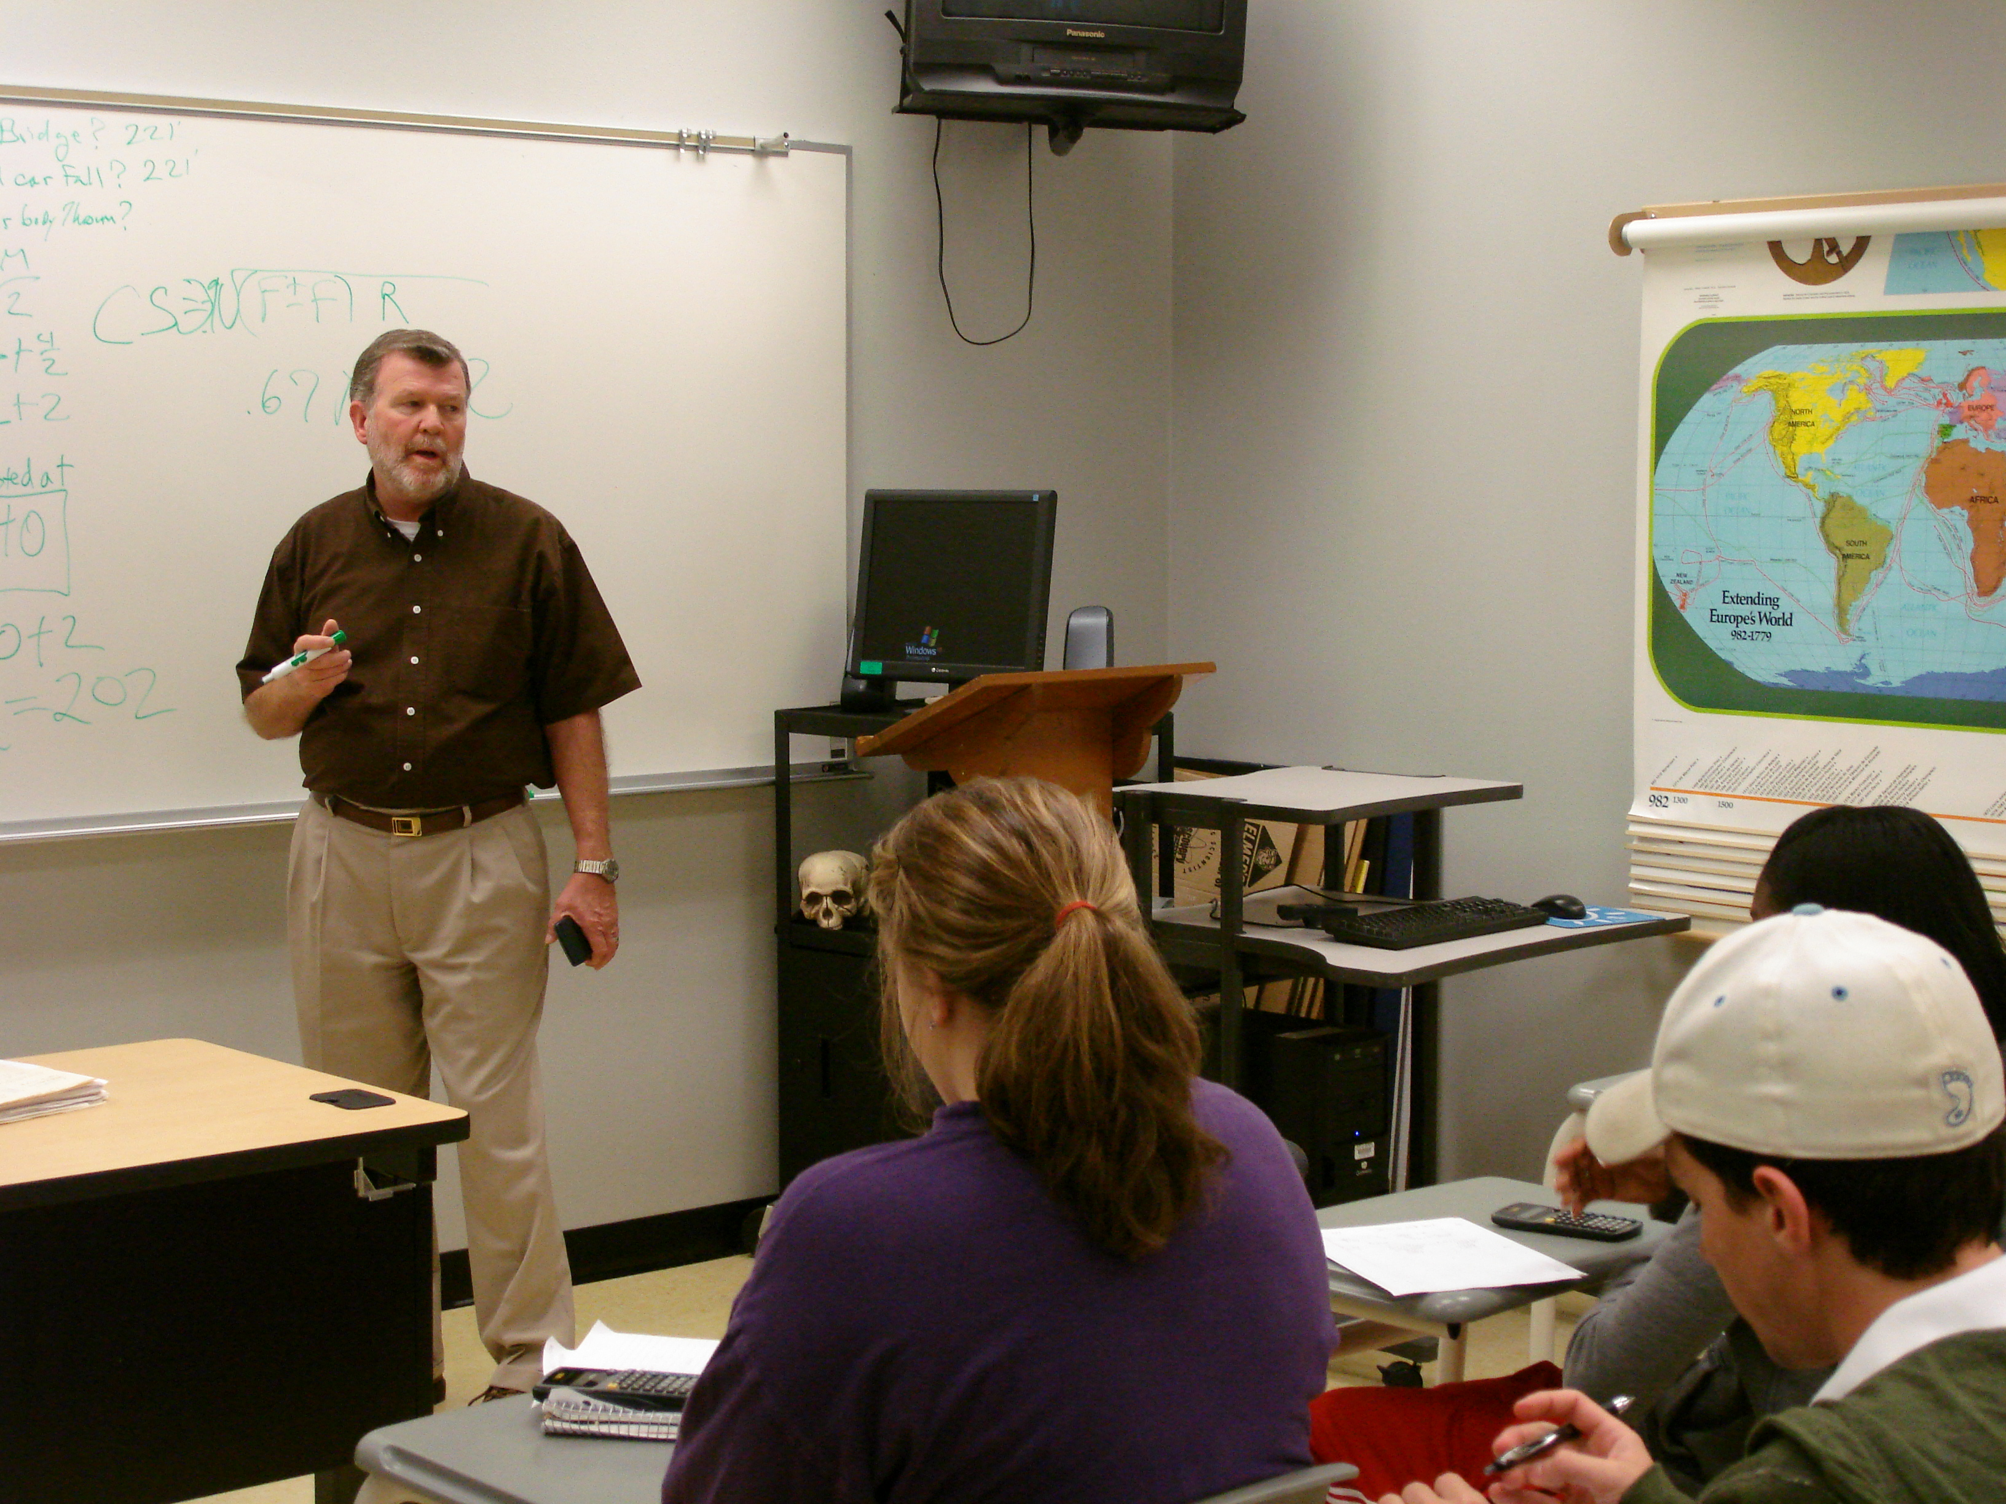
Dan Cain
Bossier Parish Community College

Slide 66

Darrell Chitty
Bossier Parish Community College

Slide 67

Jennifer McMullen
Bossier Parish Community College

Slide 68

Kerry McNamara
Bossier Parish Community College

Slide 69

Peggy Beasley
Bowling Green Technical College

Slide 70

Lisa Hunt
Bowling Green Technical College

Slide 71

Donna Martin
Bowling Green Technical College

Slide 72

Alisa Petrovich
Brazosport College

Slide 73
Robert Koohy
Bristol Community College
Smiles and tears, both reflecting accomplishments, are what motivate me. An evening student, having succeeded in passing my accounting 11 course, hesitated in shaking my hand when I praised him, and instead put his hands on my shoulders and said, “You have no idea what you have done for me.” That was his smiles; that was my tears, both reflecting accomplishments. BCC, my Camelot.

Slide 74

Hildaci Murray
Brookhaven College

Slide 75

Sean Devaney
Broward College

Slide 76

Mitzi Fulwood
Broward College

Slide 77

Glenn Patterson
Broward College

Slide 78

Judith Graham
Bunker Hill Community College
I see many non-traditional students doing great things as they pursue their education and career goals. It’s wonderful to be rewarded by your colleagues; but when a student comes into your office and says “thank you,” that is the biggest reward.

