Slide 1
JANE NAPIER Midlands Technical Community College

Slide 2
KARLA NARDI National Park Community College
Sharing my experience enables me to help my students find their passion as well as grow through education and real-world experience. In turn, my success is rooted in and measured by their success.

Slide 3
BRANDY NAUGHTON Harford Community College
Innovation is the strategy that helps me to achieve success. I continually seek opportunities to develop, implement, and improve programs to help students. I am inspired by the faculty and staff who helped me in college; their example and the opportunity to help others motivate my work in student development.

Slide 4
CORA NEWCOMB Technical College of the Lowcountry
‘Teach so that students can learn’ are words that ring out as I develop the curriculum, create the syllabus, plan the classroom activities, or prepare an online class.

Slide 5
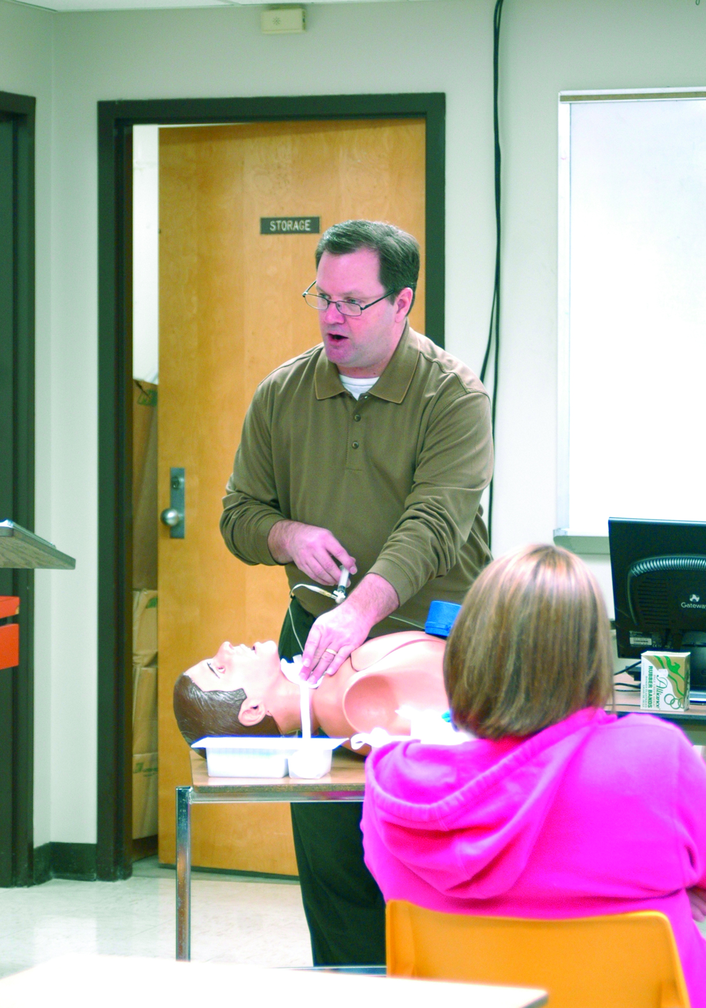
JAMES NEWELL Itawamba Community College

Slide 6
DONNA NEWMAN Baton Rouge Community College
As an instructor in today’s technological world, the incorporation of technology in a math course is required. The use of technology, such as graphing calculators, automated response devices, computer-based learning, the internet, and PowerPoint, brings the real world of technology into mathematics courses to help build math skills and confidence in students from various educational backgrounds and disabilities.

Slide 7
KATHLEEN NICKLAUS Polk Community College
For Dr. Kathleen Nicklaus, effective education requires active student involvement, innovative scholarship, positive reinforcement, and advanced critical thinking. Activities for her literature and mythology classes include reports, creative projects, lectures, dramatic performance, guest speakers, debates, and cultural events, along with traditional book work, formal research papers, and thorough testing methods.

Slide 8
DAVID NIPPOLDT Reedley College
My students are at the center of everything I do as an instructor. The more I know my students and understand what they are experiencing as learners, the better I am able to teach in ways that lead to their success.

Slide 9
JERRY NISSEN Iowa Western Community College
What drives me is helping that ‘C’ average student with an internal passion for the profession, but not academics, move from school to a successful career. Being part of that transition keeps this former ‘C’ average student motivated to work harder, learn more, and communicate better.

Slide 10
JO ANNE NUGENT Humber College
What motivates me the most in my teaching is attending graduation and meeting the families of the graduates. Many of my students are the first of their family to attend post secondary school. Their families are so proud of them when they get their diploma! This energizes me to return to the classroom and use every instructional technique I can find to support the students to be successful.

Slide 11
NELSON NUNEZ-RODRIGUEZ Hostos Community College
Teaching with passion and love is always a fulfilling journey.

Slide 12
MARIE OLIVAREZ South Texas College
I am truly honored to work with such an outstanding group of students at South Texas College. I have found a passion in assisting them build a solid academic foundation to achieve academic excellence. It is very rewarding to know you are empowering their lives and changing their futures.

Slide 13
VIRGINIA OLSON Anne Arundel Community College
I’m privileged to bring alive the traditions of a centuries-old trade and develop students’ lifelong respect for the knowledge and traditions of the baker. Baking is skill, science, and art.

Slide 14
FEMI ONABAJO Austin Community College

Slide 15
TAMRA ORTGIES-YOUNG Georgia Perimeter College
I begin with the goal of inspiring my students to make a lifestyle change, much in the same way a physical education instructor hopes that their students will continue to exercise after the course is completed. It is my fervent wish that my students be transformed into informed, caring, and active citizens once they leave my classroom. Sparking this civic transformation in my students while enhancing their skills and confidence brings great energy and joy to my teaching experience.

Slide 16
DIANE OSBAHR Iowa Western Community College
Students come here to make their future better. My motivation comes from helping create a positive learning environment and providing quality teaching for our students, ensuring that brighter future.

Slide 17
SUSAN OSBORNE Dyersburg State Community College
Listen to your students, listen to your colleagues, and learn from others.

Slide 18
KEITH OVERBAUGH Northwestern Michigan College
I am honored to help so many people that are hoping to make a better life for themselves and their family. Many are under incredible pressure to balance school, family, and work. All I can do is make the ‘school’ part as low impact as possible, ‘Get to the point’, and do it in a fashion that reaches the most people in the fewest words.

Slide 19
JAMES OVERBY Southside Virginia Community College
It is wonderfully gratifying to know that I make a significant contribution towards a brighter future for disadvantaged students by bringing them to a level of competence and confidence so that they can succeed in obtaining a college degree.

Slide 20
MARK PADDISON Humber Institute of Technology and Advanced Learning
I provide a safe and positive learning environment. I give them clear assignments with fair deadlines. I am their teacher; not their friend. Firm but fair with a smile. I try to use humor whenever possible.

Slide 21
VERA PALMER Halifax Community College
I derive great pleasure in serving as a mentor and helping others grow and prosper under my tutelage. This involves stressing and exemplifying the importance of high standards, while supporting the team concept and celebrating team successes or providing encouragement for a student who is studying for a GED exam.

Slide 22
SUE PARTON Southwestern Indian Polytechnic Institute
Being the daughter of a music teacher and a Native storyteller, I was destined to teach. My basic mathematics students motivate me the most, especially those who believe that Native people’s survival today, comes through education. My teaching methods are varied, adapting to new students each term.

Slide 23
KATIE PAULSON Southwestern Oregon Community College
I challenge myself never to be satisfied with my knowledge and abilities. I am constantly seeking and expanding my knowledge of teaching strategies, adult learning theory, and best practices to increase my effectiveness. I believe that every person has strengths and abilities and as an instructor it is my job to find these in my students and use them to help them be successful inside and outside the classroom.

Slide 24
RUTH PENQUE Navarro College
Each semester, I reread a letter to a young teacher (me) from her aunt, a master teacher. The letter is dated August 21, 1979. Aunt Estelle counseled: ‘The primary purpose of education is not to make a good living . . . it is to make a good life.’

Slide 25
B. DEAN PERSHALL Southwestern Indian Polytechnic Institute
My personal excitement and humor capture students’ attention and illustrate application.

Slide 26
PATRICIA PFEIFFER Wayne Community College
I teach students who have hopes and dreams for their futures. What better profession could there be?

Slide 27
VAN PIERCY Lone Star College – Tomball
A faculty member in a community college should serve the students, the college, and the community by innovating in the classroom and winning the students over to the joys of learning; serve the college with energy and distinction; and work to provide a top-notch, affordable education for community members.

Slide 28
SOPHIA PIERROUTSAKOS St. Louis Community College at Meramec
Collaborate with students, help them find their own awareness and power, see them discover more choices in all aspects of their lives, use passion to spark student curiosity and internal motivation to discover, try, and grow.

Slide 29
RACHEL PLAKSA Lehigh Carbon Community College
I have a job where I want to come to work every day. The real challenge is to make the students want to come to class every day! My approach is to create an atmosphere with high expectations and academic standards, where students can still have fun learning and feel comfortable asking questions.

Slide 30
LYDIA POWELL Vance-Granville Community College

Slide 31
JAMES PREER Ivy Tech Community College – Central Indiana
I have a job where I want to come to work every day. The real challenge is to make the students want to come to class every day! My approach is to create an atmosphere with high expectations and academic standards, where students can still have fun learning and feel comfortable asking questions.

Slide 32
NAIMA PRINCE Santa Fe Community College
Enthusiasm is contagious, and I am passing it on to my students! In addition to projecting my voice and making exaggerated gestures, I season my lectures with funny jokes, emotional stories, and outrageous examples. Students get excited about the class and consequently enjoy learning.

Slide 33
KIM QUERI Rose State College
As a teacher in the field of health and recreation, I have been given the unique opportunity to empower students to reach their potential, in the classroom and in everyday life activities. My goal is to provide students the knowledge and tools needed to live a healthy lifestyle now and throughout their lifetime.

Slide 34
SHANA RABLAH Selkirk College
What inspires and motivates me? The ESL students—their dreams, hopes and passions—and, in a small way, helping to fulfill their potential. I find motivation in building connections between the classroom and the ‘real’ world and am fortunate to work in a supportive environment that encourages creativity and new ideas.

Slide 35
DEBORAH RAFFIN Estrella Mountain Community College
I am inspired by my students’ enthusiasm towards becoming classroom teachers. High expectations, cooperation, dedication, and a willingness to learn are strategies that enable me to be successful. I convey these guiding principles to my students and take pride in their assimilation. Learning is the best part of teaching.

Slide 36
MARIO RAMSAY Algonquin College
I am inspired by my students who have gone out into the industry and come back to the college for a visit. Their stories and enthusiasm are wonderful, and the fact that our program has made a difference in their lives is so rewarding. My strategy is simple, I am disciplined, I am strict but fair, and I want to see a student succeed. My words of wisdom: Make it right.

Slide 37
MICHELLE RANDALL Schoolcraft College
A great teacher is part scholar, part cheerleader, and part friend. I love the energy that is generated by students learning new ideas. Every time I enter the classroom it is a privilege; it is an opportunity to transform a life and ignite a passion for learning.

Slide 38
JANET RANGEL Palo Alto College
The students I work with and the struggles that many of them have to overcome are what inspire and motivate me to be the best teacher possible. As teachers, we have to remember that we were once students and we all face challenges.

Slide 39
MARY RAWLS Midlands Technical College
Mother Teresa shaped my teaching and learning philosophy; she said: ‘There is no greater happiness than to give yourself to others.’ I am to serve, nurture, and give all I have so that students can be successful and in a position to make that difference in the lives that they will serve.

Slide 40
PAMELA RAY St. Phillip’s College
My students display and demonstrate a high level of commitment to higher education. I believe all students enter higher education with diverse ‘gifts’ and desire to explore new opportunities. At times students must overcome personal blocks but they keep me motivated through their strong incentive to succeed. A strategy the helps my success is ‘faith’. My faith helps me to posses and maintains a positive attitude towards all students. It also helps me to always be genuine in dealing with others.

Slide 41
LUCIE REFSLAND New River Community and Technical College
All students deserve a teacher who is passionate about his/her subject, engages students in their own learning, understands educational pedagogy, and loves people. I hope to be such a teacher.

Slide 42
BARBARA REGAN Bossier Parish Community College

Slide 43
PAMELA REID Copiah-Lincoln Community College
As I reflect on my career as an instructor, I have to conclude that the most necessary trait of an educator is flexibility. Technology, environment, and student nature create new challenges in the classroom that require adaptation, commitment, and, above all, a happy and healthy interest in lifelong learning.

Slide 44
ANDY REYES Bunker Hill Community College
My inspiration as an ESL teacher comes from my students who take their education very seriously. I try to keep my classes active and creative and a lot of fun. I see ESL classes as a forum to bring people from all walks of life together. My mission is to promote multiculturalism and global understanding. My students and I are ambassadors of goodwill and peace to each other and to the larger community.

Slide 45
YOLANDA REYNA Palo Alto College
As educators we are not successful because of our own personal achievements, but for the effect our efforts have had on the lives of others. I am inspired by those who struggle, face obstacles, and still persevere. My motivation is that in spite of personal challenges, persistence allows me to grow; and in the end, I discover a new self. Education is the ticket that will get you anywhere you want to go in life.

Slide 46
GARDNER REYNOLDS South Texas College
My primary objective with students is to make learning interesting and enjoyable, otherwise learning is merely dry and ineffective. I think technology needs to be balanced with eyeball-to-eyeball human interaction. And I never let myself forget that any one of my students may be one greater than myself.

Slide 47
BOB RICE Sinclair Community College
As an educator, I believe that each student possesses unique experiences and expectations, and it is my responsibility to exude enthusiasm, leadership, and professionalism by providing diverse and alternative learning strategies that embrace a holistic learning environment that empowers students to turn dreams into achievable goals.

Slide 48
SHELLEY RINEHART San Jacinto College South
I want to share the overwhelming sense of personal accomplishment I felt upon walking across the stage for my Bachelors degree! That feeling is what inspires me to strive for excellence and go the extra mile for my students. Watching them reach that milestone and seeing the growth they have experienced keeps me excited about student success.

Slide 49
STACEY ROBBINS Olive-Harvey College
Success is a collaborative effort. It must be measured in fractions of the whole and then as the whole itself. Success is only as rewarding as the successes of those around us—students, colleagues, supervisors, and then ourselves. Help someone else with success, and you will find your own.

Slide 50
GARY ROBINSON Murray State College
When I invest in students, I imagine the people they will affect in their career. What I say and do today reaches beyond the classroom. The effort I put into students is an example of the level of effort they should put forth with the patients they will serve.

Slide 51
SUELLEN ROBINSON North Shore Community College
I ‘came home’ to community college. The diversity of the students, the potential to impact their lives in ways that reach beyond our objectives and the fun of teaching the gamut from arithmetic through calculus make this the best job in the world.

Slide 52
JOEL ROGERS West Hills College Lemoore
I strive to give my students the skills necessary to succeed in the professional world. I knew I was doing something right when a former student emailed me and said they earned an "A" on their first pathophysiology exam in nursing school! What a feeling!

Slide 53
KRISTIN ROSS Camosun College
As is the key in human services for which we are preparing graduates, I believe an engaging relationship is essential to provide a context for learning and change. I endeavor to guide and challenge learners, to model a supportive relationship that facilitates their personal growth and encourages evidence-based practice.

Slide 54
SHERI ROWLAND Tallahassee Community College
What inspires me is the realization that I have the opportunity every day to make a difference in someone's life, so I make a choice to serve and to never lose sight of the importance of a smile, a kind word, or a friendly touch. Small things can make lasting differences!

Slide 55
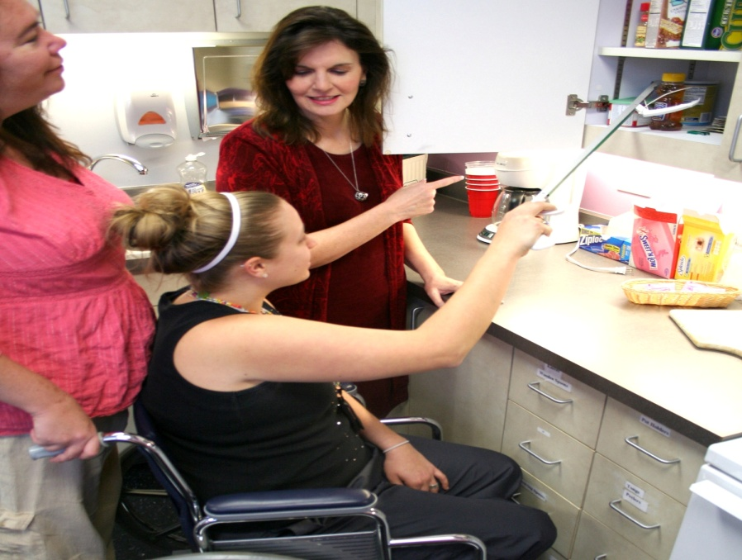
TERRA RUPPERT Lonestar College – Tomball
I am inspired by the profound impact that a college education has on the personal lives of my students, the lives of their families, and the patients they ultimately treat. Through teaching, my small contribution can change hundreds of lives.

Slide 56
GENE SAGER Sheridan College
Philosophy of Education - Education is the art of awaking a passion within a student, nurturing that passion to create a sprit of self-investigation, cutting the dependency between student and teacher, and allowing the student the freedom to discover truth through self-expression.

Slide 57
BILLIE SANDERS Sinclair Community College
Being an educator is a privilege. The process that goes into teaching is what inspires me. My goal is to empower my students to embrace success and realize they can do anything. I often share with them a famous quote, ‘Success is a journey, not a destination.’

Slide 58
KAREN SANDERS Piedmont Community College
The tremendous potential locked inside students inspires and motivates me. As a developmental mathematics instructor, I have the opportunity to reinforce years of negativity or break those bonds, improving someone’s mathematical confidence. My desire is to arouse an appreciation of the beauty and practicality of mathematics.

Slide 59
HEATHER SAYRE Brookhaven College

Slide 60
MARY SCARBOROUGH Tyler Junior College
Motivation is driven by my students. They know the difficulty of the course, their responsibility in achieving success, and my willingness to engage and help them along the way. From ‘light bulb’ moments in the classroom to contact through the years, I am thrilled to be part of their learning journey.

Slide 61
KENNETH SCHABER Lake Michigan College
Lake Michigan College Art Instructor Kenneth Schaber taught students in several area schools and judged art competitions throughout Michigan. Schaber received several Professional Development Awards included an opportunity to work with artists in Caracas. A recognized Michigan artist, Schaber provides a nurturing, creative atmosphere for his students.

Slide 62
EDWIN SCHOWE Ivy Tech Community College
I am motivated by helping students meet their educational and career goals. By continually giving them positive reinforcement students will stay on course and receive their degrees. I get a wonderful feeling watching my students walk across the stage to receive their diplomas at graduation.

Slide 63
WARD SCOTT Santa Fe Community College

Slide 64
RUSSELL SELF Trinity Valley Community College
I feel the best preparation we can give to our students is a appreciation of the limitless possibilities learning can bring.

Slide 65
JAMES SEYMOUR JR. Lone Star College – CyFair
I counter history’s boring image with relevant and engaging materials so that students consider historical topics from divergent viewpoints.

Slide 66
JACQUE SHACKELFORD Tyler Junior College

Slide 67
LISA SHAW Miami Dade College

Slide 68
EILEEN SHEA Bristol Community College
I am continually impressed by our students’ discipline, determination, and academic abilities. Their success is even more impressive when you take into consideration the obstacles that many of our students face on a daily basis. It has been my good fortune to share in their success.

Slide 69
SARAH SHEPARD West Hills College Coalinga
It’s an awesome feeling to be surrounded by people who are dedicated to creating the life they want! I strive to empower my students, develop confidence and esteem, and foster an attitude of caring for and commitment to the world around them.

Slide 70
ELISE SHEPPARD Lone Star College – CyFair
What inspires and motivates me as Teen Librarian is my belief that all 12 - 18 year olds are impressionable. I view my encounters with teens as an opportunity to teach, mentor and encourage them. I feel confident that learning will lead to knowledge, and knowledge will favorably affect teens’ behavior.

Slide 71
GLENDA SILVERII Copiah-Lincoln Community College
One of the satisfying dynamics of teaching is that when I give, I receive. Studying and preparing for the same classes that I have been teaching for years does not seem like too much sacrifice when I am able to witness, firsthand, the variety of student epiphanies that come with being an educator.

Slide 72
ELAINE SIMMONS Barton County Community College
The community college mission drives me to ensure that everyone has the opportunity to benefit from its learning services. This is achieved through partnerships, customer service, planning, and implementation. As a working agent in this system, I dedicate myself to endless energy, passion, and doing what’s right—not what is easy.

Slide 73
JANE SIMONS Lone Star College – Tomball

Slide 74
LYNN SITTON Tyler Junior College
I am a teacher because it is my calling. I cannot say that I am an exemplary teacher because I think there are many who ‘teach’ better than I. My true gifts are encouraging and providing a supportive climate for my students to learn. I truly believe each one of my students can be successful!

Slide 75
HOLLY SMITH Lake City Community College
Ultimately, I think that what makes me a good teacher is acknowledging that I am flawed and that I will fail. This allows me to acknowledge the mistakes that I make and to grow from them. Teaching is, after all, a career in life-long learning.

Slide 76
MELINDA SMITH Tulsa Community College
Reveal your Heart -Demonstrate Authenticity and Generosity Review Instructions -For me, it’s the Holy Bible Emulate a great Leader -For me, it’s Jesus Christ Lead with Integrity -Integrity builds Trust Overcome Obstacles -Success creates ‘Character-Building Opportunities’

Slide 77
JAMIN SNARR Northwest Arkansas Community College
I have the privilege of having a job doing what I enjoy most. I enjoy teaching and working on the ambulance as a paramedic/mentor. It is very gratifying to watch my graduates working in the field of Para medicine and excelling as health care professionals.

Slide 78
KEN SNELL Sheridan Institute
Ideas are precious things. Artists give form to ideas, making invisible concepts, visible. Their skillful unveiling also reveals the art of teaching. The art of learning becomes visible when students re-arrange existing thought structures to accommodate new ideas. This process enriches us all. What could be more important than this?

Slide 79
LINDA SOLIS St. Philip’s College
It is my job to make sure that students make informed choices about their future to increase their chances for success.

Slide 80
KENNETH SOWDEN West Hills Community College
Although I've been teaching the same subject for 14 years, I have never tired of trying to impart a love of learning to my students. I have always known that a majority of my students will never come to enjoy mathematics as much as I do. However, if I can stoke their intellectual curiosity and create at least a respect for acquiring knowledge, in whatever field, then I know that I have done my job.

Slide 81
SUZANNE SPOOR Anne Arundel Community College
Whenever I begin to lose energy in my teaching, I visit the classes of my colleagues. Seeing them perform their art as they encourage, coax, incite, motivate, cajole and provoke their students to learn is a work of beauty that inspires me.

Slide 82
TERESA SQUIZZERO Community College of Rhode Island
My work is important to me because students who come to the community college are looking to education as a way to better their lives, and I view my role as the key to making their goal a reality.

Slide 83
CATHERINE STABLEIN College of DuPage

Slide 84
GAIL STAPLES Cochise College
My hope is to teach students how to find appropriate, authoritative information to fulfill their personal, educational, and career needs.

Slide 85
TRINA STATON Iowa Central Community College
Teaching at a community college has its challenges as well as its rewards. Every student is unique with different qualities. Given the opportunity, every student has potential. I cherish moments when the students’ facial expressions demonstrate understanding of the material and their confidence grows right before your eyes.

Slide 86
CARLA STEIN Western Nebraska Community College

Slide 87
STEVEN STEINMAN American Intercontinental University
It’s my duty to as a visual arts educator to push the boundaries of creativity of each student into the future using skills based upon each individual’s unique talents. To this end I encourage multiple expressions in a multi-discipline environment and I recognize the diversity of activities that constitute art. A good visual education balances the fundamentals with learning how each body of knowledge and skills is not just an end in itself, but is part of a vast network of interrelated thoughts and actions.

Slide 88
MARK STEVENS Davidson County Community College
One of the most rewarding experiences life has to offer is the opportunity to reach out and touch another individual, in a positive manner, introducing the concept that there is indeed a thrill associated with learning. The thrill evolves into excitement when one realizes that learning is a gift that should be cherished, experienced, and enjoyed for a lifetime.

Slide 89
JESSI STEVENSON Itawamba Community College
As a product of the community college, myself I find that I am inspired most by the experience I had as a student. As a result I always strive to motivate my students to enjoy their college experience, learn as much as they can in and out of the classroom, and become model citizens as they look back to the experiences that shaped their life while pursuing their education.

Slide 90
DIANA STINSON Southwest Virginia Community College
I am inspired by my students who successfully complete their educational goals. In 2001, two of my students planned to continue their studies in the pharmaceutical field. Recently, I was happy to learn they are now pharmacist and are employed by Wal-Mart and Food City Pharmacies.

Slide 91
GEORGE STOCKTON San Jacinto College South
One of the keys to successful teaching is the ability to take the focus off of oneself and place it firmly on the students. I can't make them successful, but I can inspire and support them, increasing the odds that they will succeed.

Slide 92
SHAUN STOKES Halifax Community College
Strategically, what drives me is my ability to empathize with my students. Wisdom passed on would be ‘potential is not what you have done, it is what you are yet able to do.’

Slide 93
SHARON STOWERS Harford Community College
My students and I deconstruct social problems to reveal their many complex layers. Through applied activities, I engage students in powerful and positive learning experiences that help them transform their lives and meet their goals.

Slide 94
ELLA STRONG Hazard Community and Technical College

Slide 95
JOSLYN SULLEN Panola College
The students continue to motivate and fuel my desire to find innovative ways of teaching. I try to instill in students a life-long commitment to learning and to inspire critical-thinking, dedication and pride in the nursing profession. I use videocast, podcast, games and a variety of multimedia to simplify critical concepts.

Slide 96
TIMOTHY SULLIVAN Cedar Valley College
Challenging students to think about themselves and their connection to the world around them is a constant in my classes. I frequently provoke debate with deliberately controversial statements or questions. I feel obligated to teach not so much what to think as how to think.

Slide 97
K. SUNDARAM Lake Michigan College
Lake Michigan College Philosophy Instructor Dr. K. Sundaram, a Senior Fellow at Harvard University, was instrumental in revitalizing humanities teaching. Dr. Sundaram presented numerous papers and was selected for publication in internationally recognized journals. He created the website for the Introduction to the Arts Course and directed the Honors Program.

Slide 98
SAM SUNG South Texas College
Teaching is not only a content delivery. You need to understand your students’ background and weakness, so that you know how to teach them right. Many of our students are working almost full-time, they also have family need to care, and at the same time they probably take several courses. So, it is very important to encourage them to keep up with the class schedule, and be flexible in cases.

Slide 99
SUSIE DORIS SWENSON Community College of Rhode Island
My goals in teaching music are to help students realize and live to their individual potentials. Humor, word pictures, real situations are used in class to instill concepts. They laugh, and they also remember! Class mottos are: ‘Require it of yourself,’ and ‘Success comes before work only in the dictionary!’

