Slide 1
TERESITA LAMPE Georgia Perimeter College

Slide 2
CURTIS LANDRUM Tarrant County College
I enjoy the challenge of imparting knowledge and skills to those who are our future. One strategy used is to focus on the desired outcome with each lesson, and adjust instructional media as necessary to assure comprehension of the material. If this is missing, students may not reach their full potential.

Slide 3
FRANCIS LANZER Anne Arundel Community College
I believe that students learn best when they become part of the process. In fact, at times, THEY become the process. Role-playing the character and functioning of inanimate tools or components cause these objects to come alive. Thus, the students can internalize that experience and the knowledge that flows forth.

Slide 4
JEANINE LARSEN Iowa Western Community College
For over 30 years I have worked in Student Services, having an impact on students’ learning ‘out of the classroom.’ While many of these learning opportunities are not viewed as parts of their college education, they are truly life lessons.

Slide 5
RONA LEBER Bossier Parish Community College

Slide 6
LISA LEE Coastline Community College
I have been told, ‘When you have a dream, all the people in the world will conspire to make your dream come true.’ Teaching is a passion with flexible styles and methods for all students who want to learn, regardless of where they started, but aiming them towards personal success.

Slide 7
ROBERT LEE Blackhawk Technical College
My teaching philosophy is really quite simple. Since the courses in my program are demanding, I try to make the classroom a place not only to learn but to have as much fun as possible. I encourage students to work in groups so that they may learn from each other, as well as from textbooks. I take great pleasure in watching students from very diverse backgrounds become more than classmates, forming friendships that last long after graduation.

Slide 8
ANDREW LENARD Darton College
It is an honor and pleasure when students and colleagues contact me for a technology solution to make an idea happen. Their challenge is my motivation.

Slide 9
JENNIFER LESURE Ivy Tech Community College
I previously worked in Corporate America for over 20 years. The worst days in teaching are by far better than the best days in Corporate America. I was once told ‘If you find a job you love, you will never work another day in your life.’ I feel I have found such a job. Teaching students is something I love. Having a love for something is motivation within itself.

Slide 10
CAROL S. LEWIS Three Rivers Community College
Almost every community college professor shares one goal, regardless of subject area, student population, or location: If we can help our students learn how to think critically, then they can do almost anything they choose.

Slide 11
KATHY LEWIS Luzerne County Community College
When describing laboratory work I am apt to talk too fast and gesture wildly with my hands. I've been known to end descriptions of current research both laughing and crying. When interacting with my students, time slows, and deadlines recede. With a spark of interest, a 'what if' possibility flashing through normally guarded eyes, I start to smile. A quietly shared intention of taking more chemistry courses, of considering careers in science, I forget the paperwork waiting on my desk. A glimpse of new confidence, a curious mind sharpened. I am renewed and inspired.

Slide 12
KEN LEWIS Vance-Granville Community College

Slide 13
MARJORIE LEWIS Cypress College
I am inspired by the challenge and joy of serving others, both students and colleagues, helping them to achieve their dreams. As an aspiring servant leader, I hope I am an example to others in providing leadership characterized by deep compassion, integrity, and love.

Slide 14
TRIESHA LIGHT Tarrant County College – South Campus
The world can be changed by focusing on ‘one student at a time.’ Learning is fun and engaging in my classroom because I use nontraditional methods. As Erick Erickson said: ‘I am what survives of me.’

Slide 15
ROBIN LOWE Itawamba Community College
At the age of four, I knew teaching was what I wanted to do with my life. It is, after all, in my blood. Ever since I was a child, I would go to work with my mom and watch her teach. I loved it! After 33 years of teaching and a multitude of awards, my mother retired from Itawamba Community College. Because of her influence and inspiration, I am a teacher at the very institution where she taught and where I grew up. In addition to my inspiring mother, my students inspire and challenge me to be the very best teacher I can be.

Slide 16
SANDRA LOWERY Chattanooga State Technical Community College
My inspiration comes from that glimmer of awareness/understanding/thinking in a student's eyes. Two quotes reflect the guiding principles of my teaching: "The doors of wisdom are never shut" (Ben Franklin) and "Treat people as if they were what they ought to be and you help them to become what they are capable of being" (Goethe).

Slide 17
SCOTT LUKAS Lake Tahoe Community College
Teaching is a form of empowerment. When we teach students, we pass on wisdom—the wisdom to look deep inside themselves, challenge themselves and others, and develop new forms of understanding of the world that challenge the commonsense realities of the media and consumer society. Education, as Paulo Freire said, is the practice of freedom.

Slide 18
BARBARA LYNN Wharton County Junior College
I have enjoyed learning from a very early age. Any success I have accomplished as an educator must be attributed to my former teachers' ability to inspire me with their zeal for learning. I have a simple philosophy of instruction which involves incorporating the best practices of my former teachers into my classes and avoiding those practices I did not find effective or enjoyable when I was a student.

Slide 19
GEOFF MACE Algonquin College
Coming to work everyday in a supportive and caring environment of eager students, fellow professors, support staff, and managers is what excites and inspires me. Knowing that students are able to translate what they do in classroom into rewarding careers provides a constant motivation for me to provide the best and most current courses and program.

Slide 20
LEAH MACPHERSON Middlesex Community College
I love to watch my students learn, reach where no one has reached before, and help them reach their potential. My students are in a demanding program. Many of them have children, work many hours, and have been challenged by education. In the beginning, they often have low-self esteem and anxiety about being successful. I watch as they begin to realize they can complete their education and reach their dream. This confidence is amazing to see after their long struggles.

Slide 21
ROBERT MACRAE Selkirk College
My motivation is a dream I share with my students for global environmental justice. All humanity deserves equal rights to safe air, water, land, and food, regardless of race, religion, or other factors. Environmental justice is intimately tied to social justice. Striving for both builds a culture of global peace.

Slide 22
ANGIE MACRI Pulaski Technical College
Educators balance reality with optimism. English composition at a community college changed my father’s life, my life, and the lives of his students and their families. When I look at my students at Pulaski Technical College, I see my father. When I think of their children, I think of myself.

Slide 23
JOHN MAGILL Iowa Western Community College
My motivation comes from observing students take a concept, internalize it, and solve a more complex problem. The fun is developing activities to facilitate that process. I believe that education opens doors of opportunity and windows of vision to our everyday world.

Slide 24
MARY MALASKA Oklahoma State University – Oklahoma City
The students are my motivation. They ‘keep me on my toes’ by their questions and ever-changing ideas. I strive to remain current in the information I present and be as approachable as possible. I utilize humor, costume, and music to set the stage for class.

Slide 25
CHRISTINE MANGINO Hostos Community College
I love teaching and developing our department and program. I always keep in mind what is best for our students to learn. I am very aware that we are preparing future teachers, who will one day teach our children and grandchildren, and so we want them to be the best they can be.

Slide 26
BETSY MARIERE Bunker Hill Community College
I witness a formerly homeless Korean woman receive her nursing pin; I know persistence. I honor the Spanish New Year's tradition by stuffing 12 grapes in my mouth; I experience true humility. I listen to a Latino student tell how he placed first in a Japanese speech contest during his study abroad program; I understand multiple intelligences.

Slide 27
JUANITA MARQUEZ El Centro College
Striving for excellence is inspired by a framework in which I am committed to embracing with an open heart. My framework consists of Purpose, Passion, Caring, Citizenship, Respect, and Responsibility. Purpose is my vision in life which is to teach, learn, and be productive. Passion and Caring come from my heart which enjoys life and having fun. Citizenship is to make contributions to my community. Respect is to value diversity. Responsibility is to be a reliable team member. Trust and support renew my energy.

Slide 28
GUINISE MARSHALL Oklahoma State University – Oklahoma City
I openly explore and explode racial, social, sexual, and socio-economic stereotypes, misconceptions, and prejudices that all too often interfere with effective law enforcement. The process is accomplished with a balance of humor, candor, and honesty. The result is a competent and compassionate servant of the law.

Slide 29
KAREN MARSHALL Montgomery College
Karen Benn Marshall has been teaching biology at the post-secondary level for over fifteen years. She is currently a full professor and chair of the department of biology at the Takoma Park/Silver Spring Campus of Montgomery College in Takoma Park, Maryland.

Slide 30
DEBRA MATCHINSKY North Hennepin Community College

Slide 31
JO MATSON Century College
It is important to document success to demonstrate that higher learning institutions continuously improve in the areas of student learning and retention. How do we know what works well and when to duplicate or enhance practice without supporting documentation? Data collection, assessment and informed decision-making must be college-wide endeavors.

Slide 32
MARCELLA MAZZARELLI Massachusetts Bay Community College
I am always astonished by the wonderful potential of the students and the prospects of engaging in learning with them. Our role as faculty is to help tap into this intellectual potential and encourage and support students.

Slide 33
THERESA MCCHESNEY Johnson County Community College
When I started teaching 18 years ago, a peer evaluator suggested that I call students by name when they responded to questions. Since then, I make it a point to talk to every student every day. I want them to know that their presence in class is noticed and appreciated.

Slide 34
DAVID MCCLENDON Tyler Junior College
Building a relationship with students is a necessary precondition for creating the trust you must have to explore the ideas your students are not ready to explore, but must anyway. Having that trust with your students will give you some of the best friendships you will have in your career.

Slide 35
HEATHER MCCORMICK Tyler Junior College
I can make or break students’ days through my words and/or my actions. I strive to be a positive influence on their lives.

Slide 36
LINDA MCCUNE Greenville Technical College
Teaching art with passion for me means being absorbed by art making in my studio. Over-preparation is the key to produce comfort, high energy, and captivation in the classroom. I never cease to be awed, amazed, and genuinely concerned for students' tenacity, resourcefulness, and appetite for art.

Slide 37
DIANE MCCUTCHEON Algonquin College
I feel privileged to support the faculty and staff who are making a difference in the lives of students and communities.

Slide 38
JESSIE MCDONALD South Seattle Community College
I teach professional/technical courses and have taught a wide range of subjects over the last 20 years. For me, it is all about the students—helping them move toward their goals and dreams. My role is small, but I try to make it significant.

Slide 39
LINDA MCEWAN Elgin Community College

Slide 40
WILLIAM MCGOVERN Sussex Community College

Slide 41
DEBRA MCINTOSH Texas State Technical College – Marshall

Slide 42
MICHAEL MCKEE Lake City Community College
My inspiration comes from being a part of our student’s progress through college. I help develop advertising materials that encourages them to attend our smaller classes and one on one instruction. My support continues through constant student contact. The process ends with recognition of their success at graduation and in college publications.

Slide 43
LEE MCKINLEY George Perimeter College
Share your knowledge with your colleagues! Collectively, we all strive to provide our students with the best possible educational experiences!

Slide 44
SHERRY MCLAUGHLIN Macomb Community College
How does one change the world? The answer is, one doesn’t. But one can teach in such a way as to inspire and then watch the inspiration of many make the change. In that sense, the opportunity to teach is perhaps one of life’s greatest rewards.

Slide 45
DAVID MCMAHON Kirkwood Community College
I almost despair of "teaching" anything to anybody. Teaching success is proportional to learning success. My advice is to be aware of the world around you and be interested in the people that come your way.

Slide 46
MARY MCNARON Gulf Coast Community College
It is the personal growth of each member of the graduating class as they evolve into a performing team of professionals that motivates me. Even the ones who never reach the optimal plateau do evolve. Hope springs eternal.

Slide 47
NEVADA MCPHERSON Nunez Community College

Slide 48
ROBIN MCQUEEN Camosun College
I try to remove status barriers between students and me. This strategy creates openness and allows the inclusion of all learners. My words of wisdom would be ‘get excited about the subject’—as excitement is contagious.

Slide 49
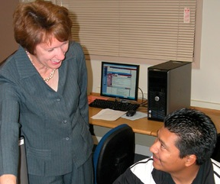
CHRIS MCVEAN Cochise College

Slide 50
PETER MEGGISON Massasoit Community College

Slide 51
CATHY MEIER Southwestern Oregon Community College
In the past, our educational system reflected the statement ‘when teachers speak, people learn.’ I believe that students need to be a bigger part of the picture.

Slide 52
RENEE’ MENKENS Southwestern Oregon Community College
The essence of the faculty role is twofold: 1) Respect students and engage them in the learning process. 2) Design learning activities with a focus on creating meaningful work that involves students as individuals and in groups to attain knowledge, apply concepts, and utilize critical thinking to solve real-world problems.

Slide 53
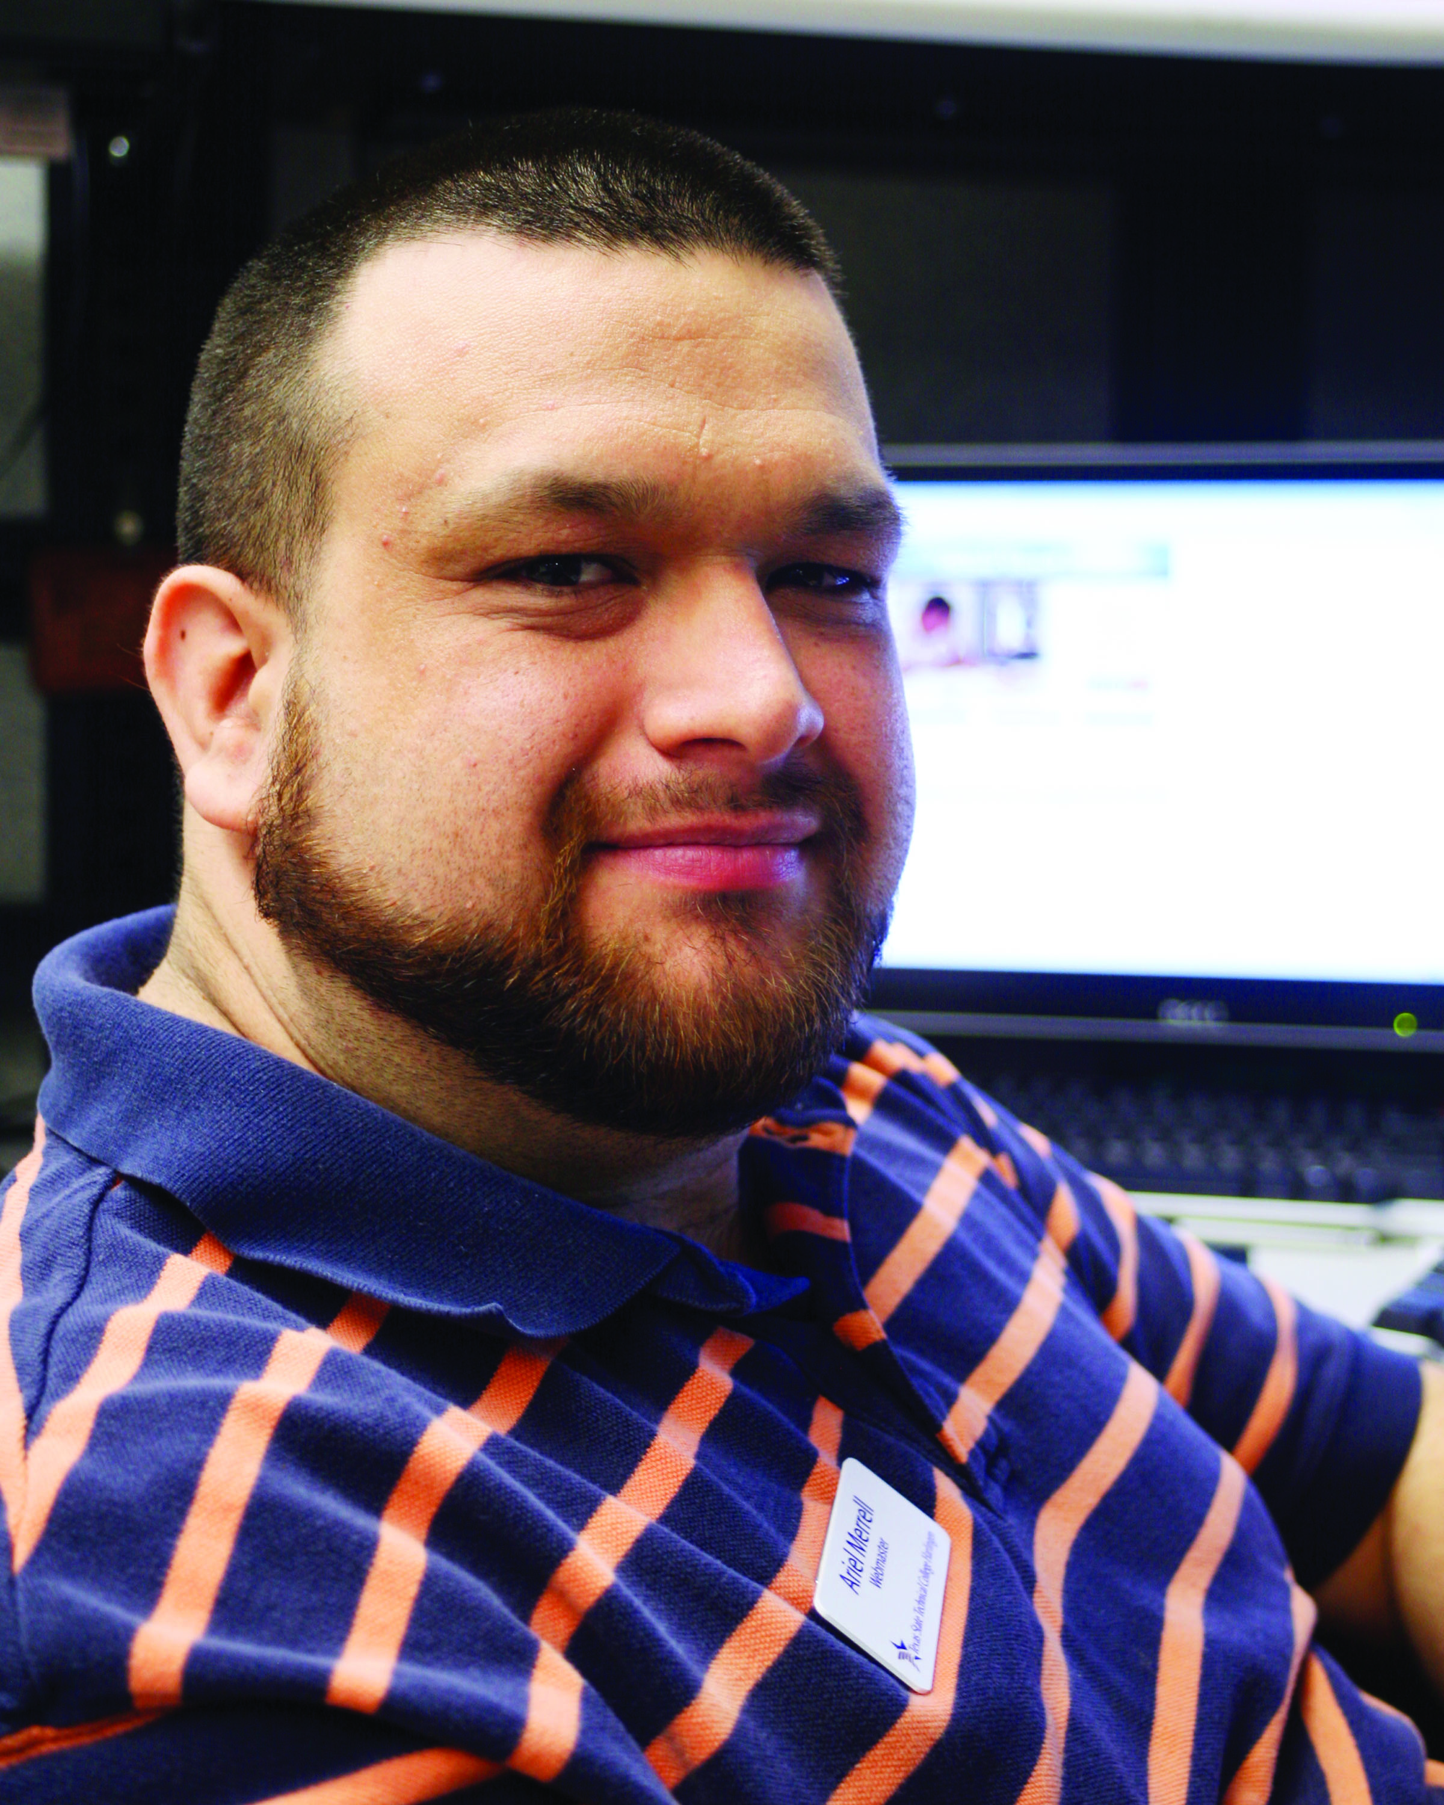
ARIEL MERRELL Texas State Technical College – Harlingen

Slide 54
LES MEYER Ivy Tech Community College
Learning occurs in school and continues for life. Since teachers have such little time in each class, it's important that in addition to teaching the subject, we also motivate and inspire students to do their best so they desire to continue learning for a lifetime.

Slide 55
JOANNA MICHELICH Cochise College
Nothing inspires me more than hearing from students: how much they learned from excellent instructors, how much they valued the extra effort or intervention of a caring staff member, or how much they have grown because of their interaction with other students, faculty, and staff.

Slide 56
JANICE MILLER Long Beach City College
I have been very lucky to have had great mentors and worked at a college where the students come first. I know that each and every contact with a student is important. We can lend a hand, help them grow, and guide them to success.

Slide 57
LORRAINE MILLER Eastern New Mexico University – Roswell
My students motivate me to find the best way to deliver instruction. My discipline (computer applications) provides motivation to try the ‘latest and greatest’ software, gadgets, and technology, to develop and deliver instruction. My adjunct faculty also motivates me to stay current and open to new teaching methods and ideas.

Slide 58
NICKI MONAHAN George Brown College
Here are a few words of wisdom from my teaching years: find the joy in your life, and bring it into the classroom with you. Always be prepared, but leave room for spontaneity—getting off track if it’s worth the detour. And never teach the same class twice!

Slide 59
BRENDA MONTEMAYOR Texas State Technical College – Waco

Slide 60
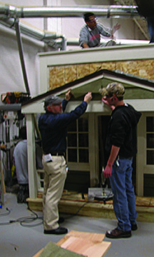
MARK MONTGOMERY Waukesha County Technical College
WCTC Carpentry students remodel and construct residences for local charitable, non-profit agencies. This year's project will be used as a group home for people confined to wheelchairs. The real-life lab work emphasizes WCTC Critical Life Skills such as Teamwork, Problem-Solving, Citizenship, and Social Responsibility.

Slide 61
STACY MOONEYHAN Arkansas State University – Newport
I believe that great teachers are passionate learners. Education is not about me, the teacher; rather, it is about students and learning. I inspire students to maintain a positive outlook, view learning as an adventure, set high standards, and be emphatically determined.

Slide 62
NORMA MOORE Laredo Community College
A teacher is the conductor of an orchestra. The teacher reaches out with encouragement, enticement, and challenges so that each student will develop the unique potential and abilities each possesses. In so doing, the teacher, like the conductor, has an end result that is truly amazing.

Slide 63
ANGEL MORALES Hostos Community College
I encourage creative thinking by providing a climate in which students can try and fail, not afraid to take risks and explore. Working ‘in role’ has provided them with ‘safety’ in the classroom, so that they are not afraid to make mistakes.

Slide 64
JOAN MORAN Guilford Technical Community College

Slide 65
SARA MORELLO Baton Rouge Community College
I strive to make students understand that learning is not a passive activity and that they must be empowered to take an active part in their own learning. They are in control of their education. I am just a guide.

Slide 66
SARA MORRIS MidPlains Community College
The greatest motivation is the one students provide when they have the "Ah-hah!" moment. When material becomes clear to students you share their sense of accomplishment. A teacher could not ask for more positive feedback.

Slide 67
JANE MORRISON Middlesex Community College
I love what I do. My role as an instructor in the Diagnostic Medical Sonography Program and as a registered diagnostic medical sonographer has provided me with the tools and experience necessary for teaching. My students’ learning requires not only the implementation of scientific knowledge and practical application, but also the need to develop empathy and skills as effective communicators. It is my sincere hope that these qualities will expand beyond the classroom and follow them in their work in the health care environment.

Slide 68
LORI MORROW Rose State College
As a community college graduate, I appreciate the personal atmosphere of two-year colleges. I teach to help others achieve dreams. Most students attend college to earn that degree and get their dream job; as a pragmatist, I show them how learning in my classroom will help them outside of school.

Slide 69
DAVID MORSE Long Beach City College
My motivation is my students and their success. I teach because I am able to help individuals who have often been failed by their previous education. Watching those students grow educationally and personally and knowing that I played a role in advancing their lives is all the inspiration I need.

Slide 70
EDWIN E. MOYE Piedmont Community College
My teaching philosophy centers on teaching film and video in a manner that replicates the way I learned the industry as a professional so that our students will be ready to meet the demands and challenges of a rewarding industry upon completion of the Film and Video Production Technology program at Piedmont Community College.

Slide 71
SIMA MPOFU Olds College
I incorporate stories, and that always helps bring the subject to life—students seem to respond to that.

Slide 72
ROSEMARIE MUNOZ San Jacinto College North
I was a 4th grader with many learning differences, speech impediments, and failing at every attempt to learn. Yet, my teacher had an impact in my future. He believed that I could succeed, and I ‘learned’ that I could! My highest calling is to help students learn and believe in themselves. My reward is the excitement a student gleams, while I transmit affirmation and heartfelt commitment to the individual learner. It is true, ‘VISION is not seeing things as they are, but as they will be!’ Viva la VISION!

Slide 73
PATRICK MURPHY Algonquin College
My interaction with students is the source of my inspiration as an educator. I am exhilarated by their enthusiasm and excitement for the heritage carpentry trade. I have taught timber framing every fall semester for the last 10 years, and I am as excited on each ‘raising day’ as if it were my first.

Slide 74
ZAKARIA MUSALLAM Macomb Community College
God did not create dummies. I specialize in making students realize their God-given talents. This is what motivates me. My love for mathematics, work ethic, humor, persistence, continuous repetition, and never giving up on my students leads to helping them reach their potential. Hard work equals success and happiness.

Slide 75
ROBIN MUSSELMAN Lehigh Carbon Community College
Teaching and learning are my passions, and I am motivated by my students to find innovative and creative ways to motivate them to learn. I am very fortunate to teach psychology because psychology has a natural link to everything that students do and think!

Slide 76
CHRISTINE MYERS-BAKER Tulsa Community College
I see my students as intelligent young adults who are in school to improve their lives. I am here to guide them to a broader, more global perspective of the world in which they live; help them to see cause-and-effect relationships; show them why cultural differences exist and celebrating that diversity.

Slide 77
SHELBY MYERS-VERHAGE Kirkwood Community College
From my first teaching experience in a middle school, I learned the value of collaborating with different perspectives. As a writing instructor, I watch a student’s life experience unfold and how that enhances their educational journey. It is through these classroom collaborations that we begin to understand the wider world.

