Slide 1
DAVID GAER Laramie County Community College
I am most inspired by students who genuinely want to learn. Watching them grow and develop not only as students, but as productive world citizens, are my goals.

Slide 2
EDDYE GALLAGHER Tarrant County College – Northeast Campus
I teach because I enjoy helping others. I also want to pay back my mentors by helping my students achieve and believe in themselves. I want to share my love and enthusiasm for writing with others. When I convince non-writers that they can write, I feel successful and renewed.

Slide 3
DONNA GALVAN Macomb Community College
‘Never give up on students, and they will find success,’ describes my strategy and the wisdom I pass on.

Slide 4
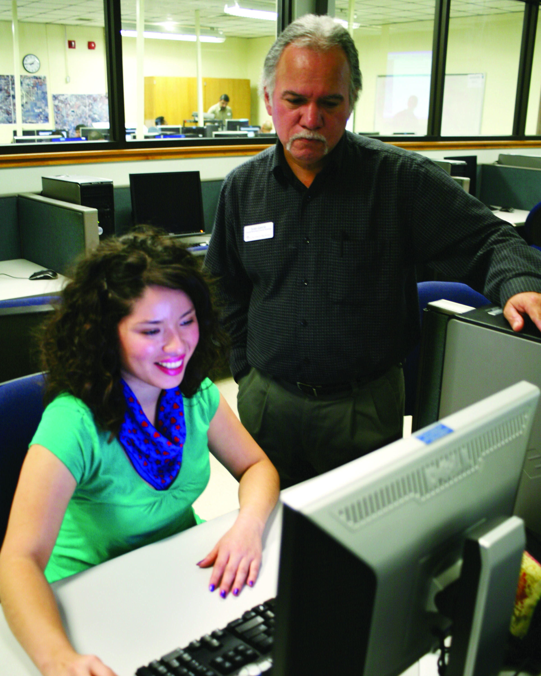
JUAN GARCIA Texas State Technical College – Harlingen

Slide 5
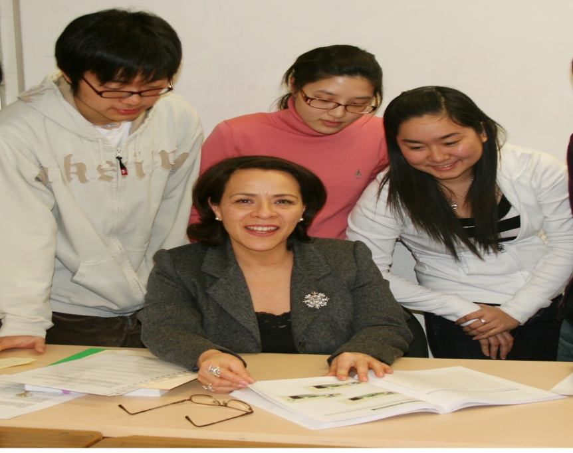
SILVIA GARCIA Algonquin College
It is gratifying and inspiring to see students take ownership of their learning. Whenever I succeed in transmitting my enthusiasm and love for what I am teaching, I have drawn my students into the learning environment; they are engaged.

Slide 6
ALICE GARDNER Anne Arundel Community College
My motivation comes from believing I can make a difference in a student’s life.

Slide 7
KATHARINE GARDUNO Santa Fe Community College
I try to base my decisions on whether or not they will help students succeed.

Slide 8
CARMEN GASKINS Bowling Green Technical College
As I continue to grow, I will continue to teach ‘Don’t Quit’.

Slide 9
NORMA GATICA Cuyahoga Community College
Teaching becomes a truly exciting and rewarding experience when we realize that we cannot force students to learn but we can motivate them to feel the need for learning.

Slide 10
HENRY GAUS Lamar Institute of Technical

Slide 11
KATHLEEN GAZZOLA Community College of Rhode Island

Slide 12
GENA GESING Northeast Iowa Community College
The opportunity to create a dynamic new program with potential to impact the entire community inspires us to expand our current successes. Under the guidance of visionary leadership, we appreciate the independence to address career and education programming needs through new strategies. Partnerships are critical to our continued success.

Slide 13
KATHRYN GODSHALK Cypress College
I am truly grateful for the opportunity I have to share the gift of learning with my students. I hope to model the necessary skills they need to achieve success. My greatest motivation is derived from helping students to reach their potential to pursue the meaningful lives they dream of.

Slide 14
JOE GONZALEZ San Antonio College
Humor and laughter are some of my best inspirational tools in the classroom. Laughter seems to be a universal language. No matter our first language, we all laugh the same. The challenge of combining and presenting all the language elements of reading, writing, listening, and speaking, and keeping the humor alive, stimulates me. It is especially gratifying when students tell me they have used their new learned language skills at work and at home.

Slide 15
ARNOLD GONZALEZ South Texas College
Working with a great team of professionals is my inspiration every single day.

Slide 16
MEGAN GRAHAM Casper College
What is the most useful advice that I have to offer? Relax...Students are more creative and productive when they feel it’s OK not to know all the answers.

Slide 17
JONATHAN P. GRAY Piedmont Community College
In my 23 years of teaching for Piedmont Community College, I have discovered that most students respond well if given respect from the beginning, patience when asking questions, and humor as time goes on.

Slide 18
PATRICK GRECO Sinclair Community College
Make sure that you both enjoy and know your field, your pedagogy, your students, and yourself.

Slide 19
EDWARD N. GRIFFIN Piedmont Community College
Pride in the finished product, if it bears your name or not, is the feeling of a job well done.

Slide 20
LAURENE GRIFFIN Ivy Tech Community College
Teaching and learning are as vital to our mind and body as is air. It requires a good teacher to be a good student.

Slide 21
RONALD GRIMMETTE Malcolm X College
My motivation is driven by loving the profession that I teach people.

Slide 22
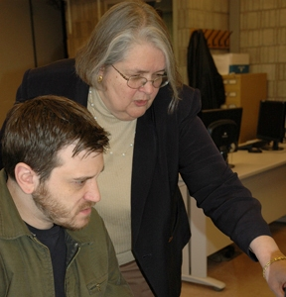
PRISCILLA GROCER Bristol Community College

Slide 23
MARGARET GUERRERA Naugatuck Community College
My inspiration and motivation come from students and my community. I was born, raised, and live in the community in which I teach. To know that I am giving back and contributing to building a stronger community keeps me energized to provide the best possible educational experiences for my students.

Slide 24
KASSANDRA GUGAT Western Iowa Tech Community College
My inspiration to teach is revitalized each time I step into a classroom.

Slide 25
ANGELA GUM Lincoln Land Community College
My grandpa and grandma both earned college degrees in the early 1900’s to become teachers, and I knew at a very young age that a degree was truly special. They instilled high expectations, respect for humanity and especially for teachers, and a profound and passionate love of learning in me. My desire to live in a socially just world, as well as my quest to be just like my grandpa, excites and inspires and drives me to strive for excellence.

Slide 26
HEATHER GUNN Lethbridge College
Every student inspires me in some way. I often learn something new about myself by interacting with students, looking at old situations through new eyes. I share my experiences and knowledge with those who have chosen to go where I have been.

Slide 27
JUAN GUZMAN Lake City Community College
One of the most important goals of my life is to give the best of me to my students.

Slide 28
ELBERT HAGANS Hazard Community and Technical College
I am inspired and motivated by the gift of life and the opportunity to help others. I wake up in the morning prepared to face new challenges. My goals are to become a better person, a better friend, and a better citizen.

Slide 29
DAVID HALL Baton Rouge Community College
In guidance or teaching, there are several truths. ’One, understand the goals, Two, learn so you can guide. Three, have a clear, logical plan. Four, assess and determine if goals were met!’ If not, what strategy may lead to achievement? ‘NEVER keep doing what works poorly or not at all.’

Slide 30
ALLEN HAMILTON St. Philip’s College
For eons history meant stories shared around the campfire. History and storytelling are forever linked. I tell the stories of my country and my people: stories of war and of peace, of times of despair and times of rising above, of darkest hours and finest hours. I teach History.

Slide 31
KIM HAMMETT Stanly Community College
Students’ words, ‘I am scared to death to start college’ motivate me beyond words. The first thing I tell them is, ‘You will be one of my top students.’ Thus begins the self-esteem-building aspect of my work—my biggest motivation.

Slide 32
PAMELA HANSEN South Florida Community College
My younger colleagues inspire me to learn new methods and stay on top of the latest technology.

Slide 33
WILLIAM HANNA Massasoit Community College

Slide 34
CURTIS HARRELL NorthWest Arkansas Community College
I believe every student is capable of success. What inspires me is helping students find their avenues to success. Be it a well-crafted lesson, quick and helpful feedback on an essay, or something as simple as an encouraging smile, I enjoy helping them on their paths.

Slide 35
CHRIS HARRINGTON Southwestern Indian Polytechnic Institute
I wanted to make a difference in the life of Natives. Not only my own tribe-the Comanches, but all Natives. After 10 years practicing as an Indian Law attorney, I thought the best way to make a difference was teaching. The next generation holds the key to preserving tribal sovereignty, and I hope I can help in that preservation.

Slide 36
JENNIFER HARRIS North Shore Community College
Nothing thrills me more than watching students not only enjoy and respect knowledge, but create new knowledge.

Slide 37
TOSCA HARRIS Neosho County Community College
Watching students learn and grow as individuals while they mature in their thinking is always an adventure. The most exciting challenge is to find the approach that works best for each class to allow every student the opportunity to excel.

Slide 38
LINDA HARRIS-YOUNG Motlow State Community College
What excites me as a community college professor?—when the majority of students make an A on the first microbiology exam, when lecture attendance is 99%;,when former students return and say I made a difference in their lives, and when a student takes all the science classes I teach.

Slide 39
GINA HART Iowa Western Community College
When we share a vision and work together to see it implemented, that motivates me to want to do more to help students.

Slide 40
HADLEY HARTMAN Santa Fe Community College

Slide 41
JERRY HAVILL Bay College
I’m most inspired by the growth that I observe in people over time, not only as students, but also as human beings. I use the tenets of ‘active learning’ as a strategy for success. To be uniquely successful, one needs to have high expectations and a good sense of humor.

Slide 42
ESKINE HAWKINS Georgia Perimeter College

Slide 43
DENNIS HAY Arkansas Northeastern College
During my teaching career, I have had students at many different levels, and most of them exhibit pride in their performances. Their feelings of accomplishment and fulfillment inspire me to be a teacher of excellence.

Slide 44
JOHN HEATHCOTE Reedley College
I am inspired by seeing students grow in confidence, in critical thinking ability, in curiosity, and in the goals that they set for themselves.

Slide 45
LISA HEBL Kirkwood Community College
Being a part of students’ journey of self-discovery and their desire to make a difference in the lives of the people they touch is what inspires me.

Slide 46
FLOR HENDERSON Hostos Community College
My motivation is educating students in a multicultural society and molding their minds for the challenges of the 21st century. I instill in them the importance of an open and critical mind and make them aware of the opportunities that are ahead of them.

Slide 47
MARY HESTER Barton County Community College
Students are changing their lives by sheer determination; they persevere to have a future for themselves and their families.

Slide 48
STEVEN HEULETT Haywood Community College
Education is the most powerful mechanism for helping people improve their lives. As a teacher, I am inspired by students who rise to meet the challenge of a rigorous academic program. As an administrator, I am motivated to provide opportunities and resources to instructors.

Slide 49
MARKO HILGERSOM Lethbridge College
Plain and simple, I love my job. I get paid to work alongside people I genuinely like, I get to watch students evolve and succeed, and I get to discuss philosophy, politics, and religion openly.

Slide 50
RONALD HITCHCOCK Northwest College
Teaching is about engaging students. It's about demystifying the difficult, reducing frustration and gaining empowerment, and bringing student imagination and creativity to bear.

Slide 51
ELAINE HOBBS Cuyahoga Community College
Engaging students in the classroom to reach their full potential is exhilarating! Empowering them with confidence and seeing them strive for excellence rather than mediocrity increases my passion for teaching. As educators, it is not what we have, but how we use what we have to engage and inspire our students to become successful.

Slide 52
BARBARA HOCKABOUT Northland Pioneer College
The increasing number of disenfranchised Americans and students in my classes inspire me to promote unfettered inquiry in an attempt to debunk disempowering and prevailing myths in our culture. The most effective strategy to encourage learning and empowerment is through a student-centered, project-based curriculum; it's time to revisit humanist approaches.

Slide 53
JULIE HOESEL Iowa Central Community College
Amanda Vick Lethco said that a teacher’s goal should be ‘to arrange for [the students’] success.’ This ‘arranging’ is my motivation: a mentally challenging and exciting task. Knowing my students, growing in my discipline, and creating connections between them leads to my greatest reward: seeing my students succeed.

Slide 54
SANDY HOLBROOK Southeast Kentucky Community and Technical College
If I touch one student and make that student find something within that inspires him/her to do and be more than they ever thought possible, then I have made a significant contribution. I received a plaque from some students with this quote: ‘To touch the soul of another human being is to walk on holy ground.’ To this, they added, ‘Never doubt you have touched many souls.’ This meant so much to me because it came from those I serve.

Slide 55
WILMA H. HOOD Central Piedmont Community College
What inspires and motivates me is the awesome task of transforming a mind devoid of the art and science of nursing into a mind able to astutely assess, plan, and implement for positive outcomes of health.

Slide 56
ROSS HORROCKS American Intercontinental University
To provide the student-artist and student-designer with a solid foundation of materials use, skills, and procedures in addressing technical and formal concerns, while developing the tools to explore ideas, self-question, find independence and identity, and to “see” the inter-relatedness of things, art and non-art, thereby growing ideas (content) to express.

Slide 57
KIMBERLY HUBBARD Lone Star College – Cy-Fair
I create an environment that not only gives students an academic understanding of Information Technology but also a workforce perspective and hands-on skills that are crucial to their success. My teaching approach prepares students for a career in a competitive industry and ensures they are prepared to meet that competition.

Slide 58
MARCI HUFFMAN Davidson County Community College
The main inspiration that renews my outlook and drives me is constantly looking for ways to remove boundaries for education. My personal motto is remove time, distance, and location restraints, and teach students to receive an education how, when, and where they want it.

Slide 59
SUSAN HUNT-BRADFORD St. Louis Community College – Meramec

Slide 60
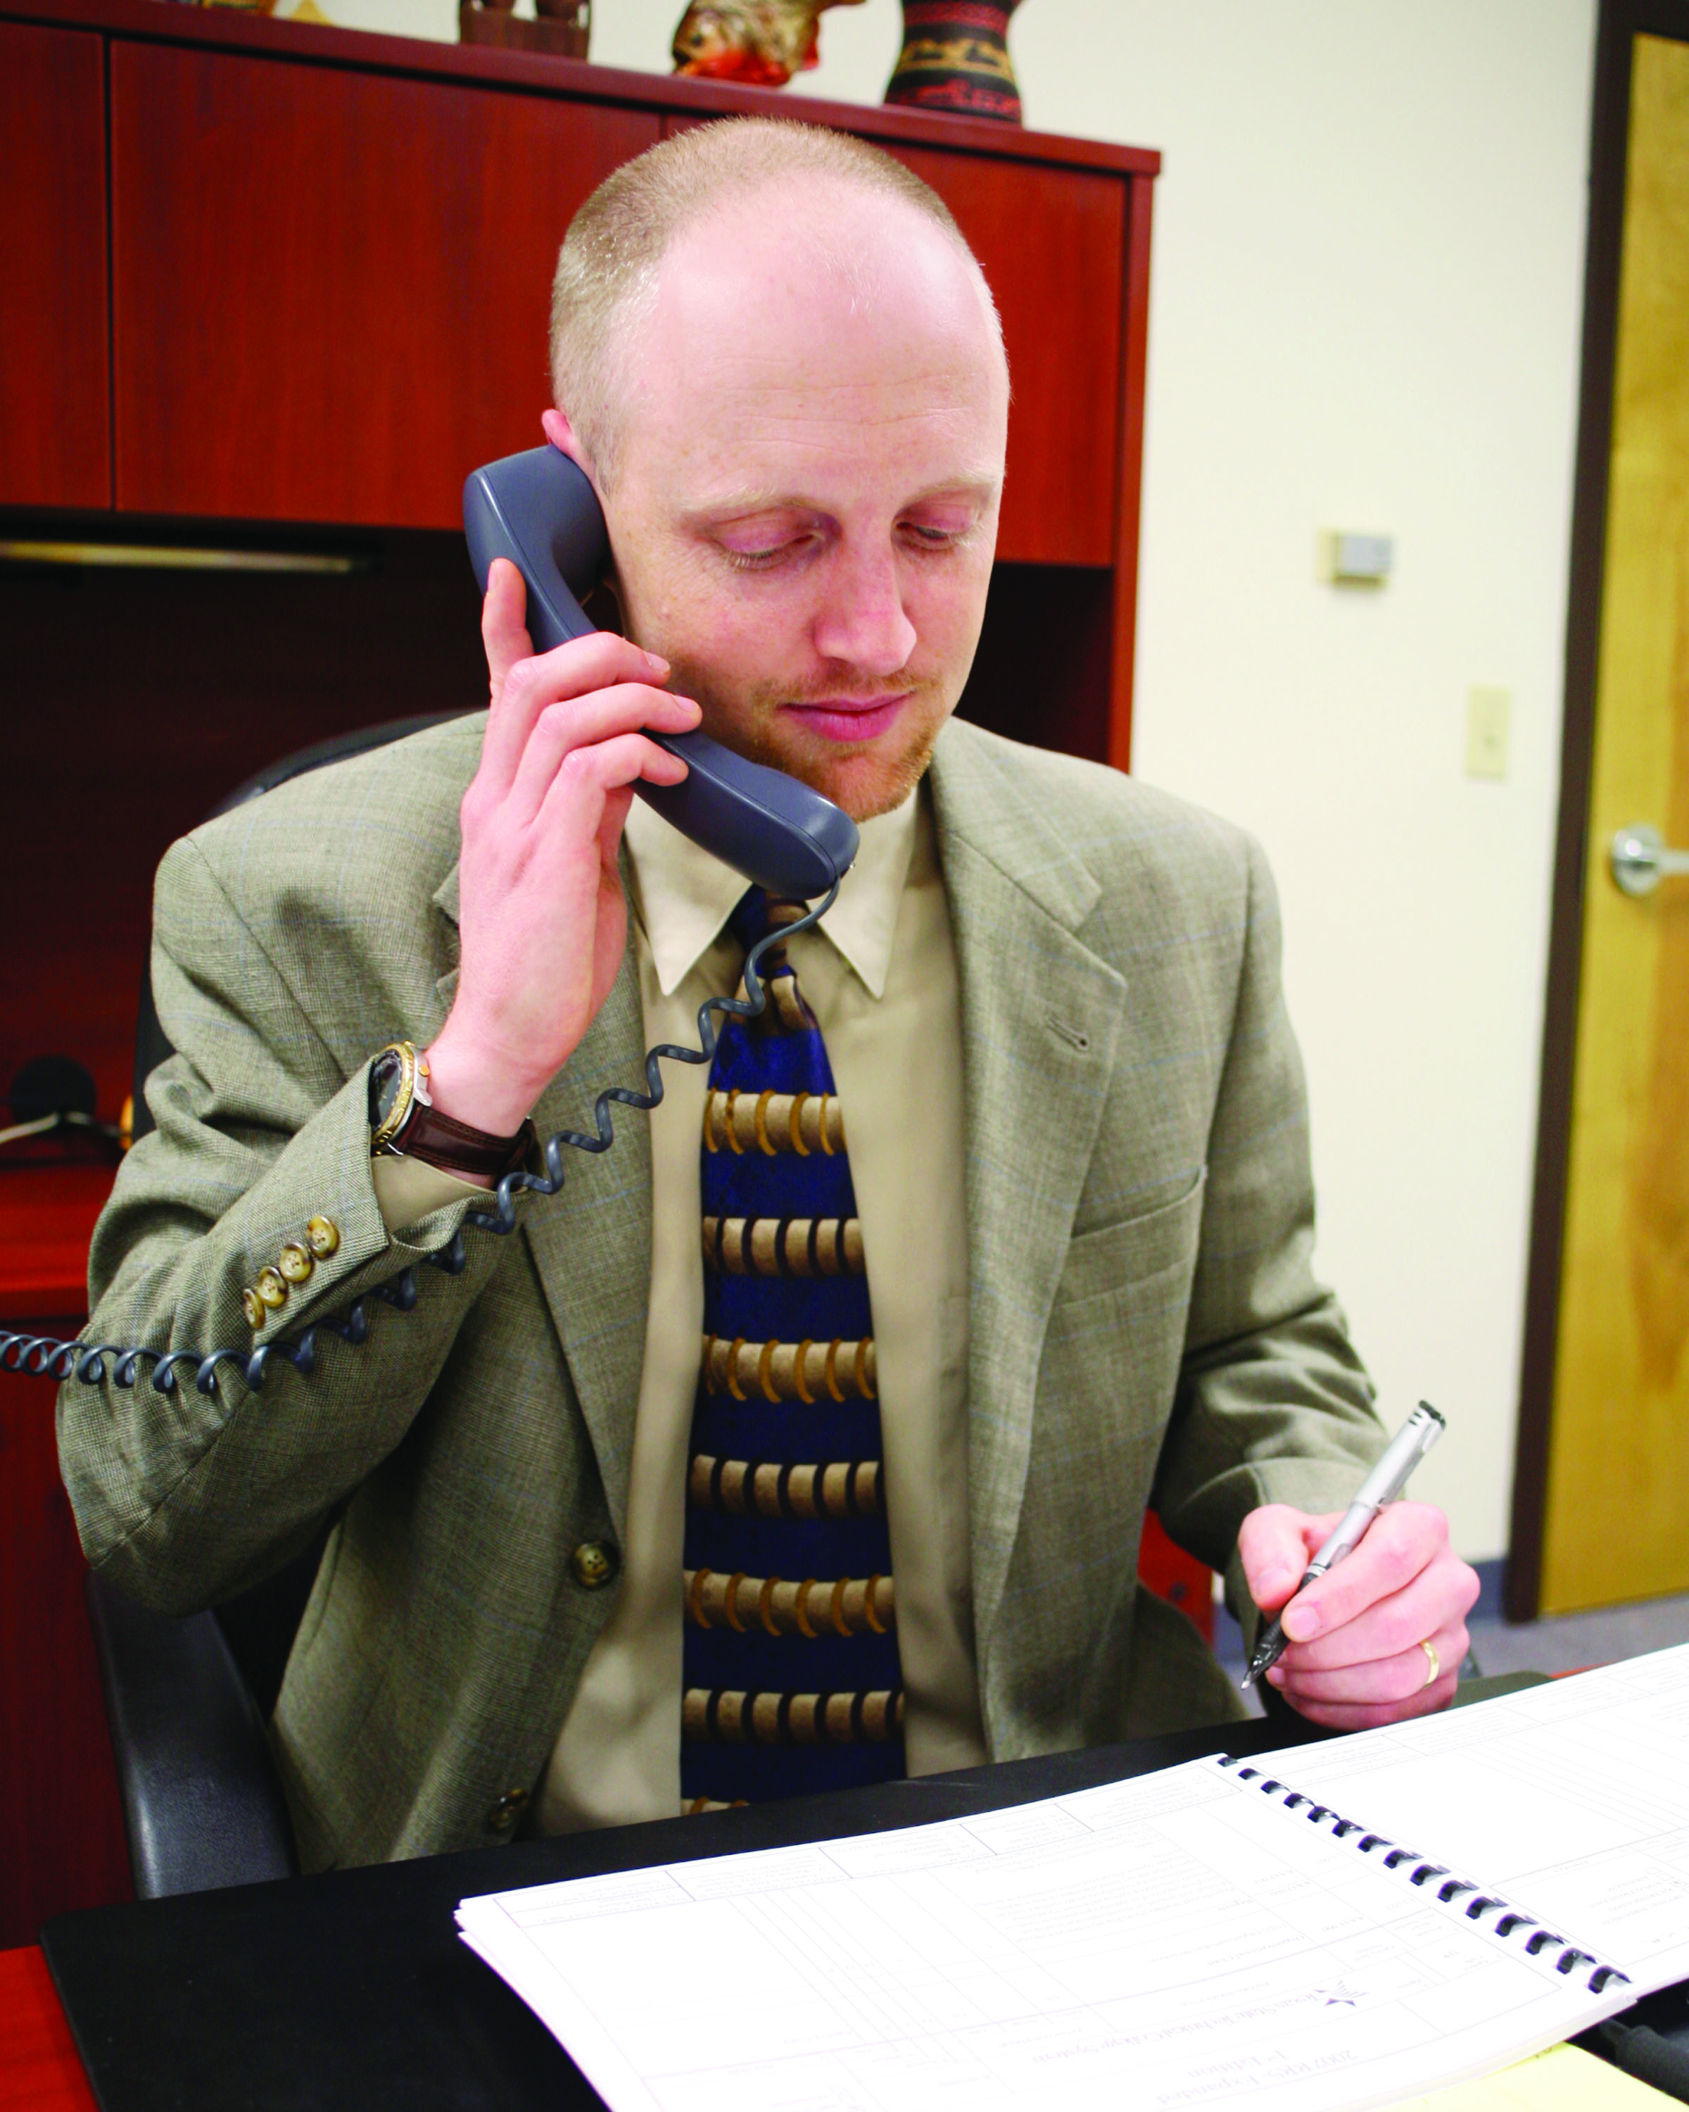
ADAM HUTCHISON Texas State Technical College – Harlingen

Slide 61
BERTHA IBARRA PARLE North Harris College
My French and Spanish courses are the starting point of a journey. If students get involved in the target language and culture, they can bridge cultural differences in their community and better understand other worldviews. I bring the world into the classroom through music, visuals, and visitors. We go into the city for performances and presentations. It is a journey toward becoming a citizen of the world.

Slide 62
LISA INGRAM West Virginia Northern Community College
Many of my students are attending college looking for a ‘second chance.’ I am thankful for the opportunities that I have been afforded in my career and the chance to help them achieve their goals.

Slide 63
JANALEE ISAACSON Johnson County Community College
It is a joy to come alongside a student as s/he embarks on a lifelong journey of discovery; in a never-ending quest to become the best s/he can be.

Slide 64
CHARLOTTE JACKSON San Jacinto College North
I feel to be a success in life I need to do whatever it takes to show others that I care. Working at San Jac has allowed me opportunities to put a face on compassion to those who might not have been shown it before.

Slide 65
RICKEY JACKSON Northland Pioneer College
We are placed on this planet to have a positive impact. Motivating people to accomplish goals they did not believe were possible keeps me in this profession.

Slide 66
BLANCA JIMENEZ South Mountain Community College
What motivates me in my work is the opportunity to show my students by example that if they persevere in their studies they will succeed. Perseverance and commitment are some of the strategies that drive my success. This is the reason why I tell my students: ‘Don’t Ever Give up.’

Slide 67
BETTY JOHNSON St. Philip’s College
Things that inspire me in my work are being able to serve and help others. I'm motivated by sharing my knowledge, skills and experiences with others. Words of wisdom—always strive to be the best in whatever capacity you may be serving in.

Slide 68
DANIEL JOHNSON Cerro Coso Community College
Arthur C. Clarke observed: ‘Any sufficiently advanced technology is indistinguishable from magic.’ My inspiration is to seek and communicate how technology can make our lives magical. I’ve never used a teaching/learning tool that was too good to make better.

Slide 69
DEANNA JOHNSON Austin Community College
Education is the foundation for every goal achieved in life. Serving as the bridge between my students and their aspirations motivates me to make every learning experience worthwhile. As educators we have the privilege of not only being inspired by our students but also guiding them to limitless opportunities.

Slide 70
PATRICIA JOHNSON Brookhaven College

Slide 71
CHRISTA JONES Mountain View College
I am inspired by our professors and colleagues who demonstrate excellence and genuine concern for our students. Strategies for success include perseverance, teamwork and life-long learning; and remember to never, ever give up.

Slide 72
CRYSTAL JONES Southside Virginia Community College
Being an effective teacher requires patience, dedication, flexibility, and caring. My greatest reward from teaching is seeing the growth and success of my students.

Slide 73
JACQUELINE JONES Baton Rouge Community College
Imparting knowledge gives me the unique role of empowering my students. By embracing my own education, I engage students in classroom discussion that is personal, stimulating, and relevant.

Slide 74
ROBIN JONES Clovis Community College
My motivation is to provide graduates of our program with choices.

Slide 75
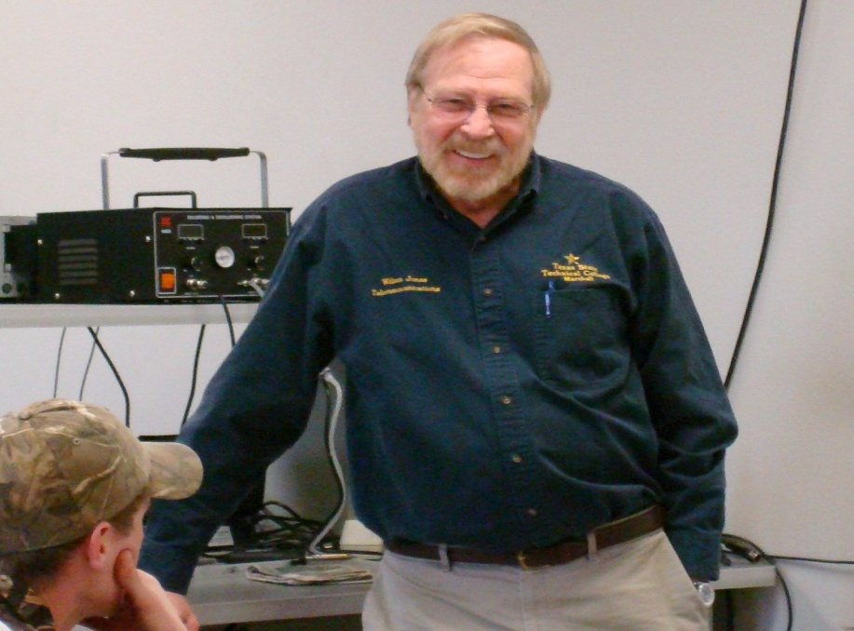
WILSON JONES Texas State Technical College – Marshall

Slide 76
KIM JORDAN Guilford Technical Community College
My work is important to me because I get to show people every day that I care about them and want them to succeed.

Slide 77
TIM KAAR Elgin Community College

Slide 78
HARMIT KAUR Sinclair Community College
As an educator I take part in imparting education—a wealth no one can steal. I believe being educated uplifts individuals, which in turn uplifts families, communities, and societies. Working as an educator, I am an itsy-bitsy part of that process.

Slide 79
ED KAVANAUGH Schoolcraft College
What keeps me going is how much fun I have at my job! I keep the atmosphere light and enjoyable for the students. My career summary:
There was a teacher from S’craft Who taught math so much he went daft. He reached the apathetic masses In algebra and calculus classes And when he was done, he just laughed

Slide 80
DON KEARNEY Iowa Western Community College
My greatest sense of accomplishment comes from making classroom visits of inspiring new faculty members and thinking, ‘This was a great hire!’

Slide 81
SHONA KEARNEY George Brown College
I anticipate that wonderful moment when, after many doubts, a student will suddenly discover that all the techniques which took so much effort to acquire have suddenly become skills, allowing the confident expression of their own artistic vision. I knew it would happen, and now they know it, too.

Slide 82
TARA KEETER Halifax Community College
Creating opportunity for others to succeed is my inspiration and motivation. As a first-generation college graduate, I know firsthand the obstacles that a non-traditional student population must overcome in their higher education experience. The community college has been the driving force behind my success and leadership accomplishments.

Slide 83
DEBORAH KEITH Northland Pioneer College
The desire to pass along my knowledge and experience is what inspired me to pursue education. Helping patients has been special, but facilitating nursing students in achieving their goals has been enlightening. I’m proud of both my careers—nursing and education, tremendously demanding and both so rewarding.

Slide 84
CAROL KELLER San Antonio College
I teach history because I have a passion for learning that I want students to share. I want them to be excited about history, to think about history in new and different ways, and to understand and use the past to live effectively in the present.

Slide 85
LEO KELLY Vance-Granville Community College

Slide 86
DIDIER KENNEL Sheridan College
Anyone can teach.
However, a teacher who wants to inspire their students also needs passion - passion for the subject and passion for teaching. Without passion, you will never reach your students and challenge them to reach beyond their expectations.

Slide 87
KENNETH KERR Frederick Community College
Teaching at a community college has to be one of the best jobs in the world. Everyday, I get to interact with intelligent and committed colleagues, to be with students and discuss the important issues of our time, and to know my work matters.

Slide 88
KATHLEEN A. KERSEY Piedmont Community College
When working with students, instructors must be flexible and consistent. If one approach doesn’t work, try 15 others! Provide structure, and treat students the same—no favorites. Be fair, and treat students like people. However, always remember that they will hustle you if you let them. Run a tight ship!

Slide 89
ANITA KESS Camosun College
I am inspired by the contagious excitement students bring. They want so much to be successful. I just try to accept them for who they are right now, but also convince, remind, or reassure them that they have the brains, guts, and drive to become better versions of themselves.

Slide 90
MOHSEN KHANI Sinclair Community College
I have been teaching geography for 11 years and during this time the geography department has grown tremendously by offering new courses in GIS, Middle East, and Cartography. I am also the co-advisor for the Global Awareness and Actions Club and have led international student trips to Mexico and Guatemala.

Slide 91
DAVE KIESIG College of Southern Idaho
As educators we endeavor to help students discover within themselves their own individual interests, strengths and weaknesses. As teachers we then strive to provide students with as many resources and 'discovery' opportunities as possible in order to prepare them to go forth and serve humanity with knowledge, skills and confidence.

Slide 92
ROBERT KING Georgia Perimeter College

Slide 93
HELEN KINGKADE Midlands Technical College
"Fighting Fire with Fire“ Students sit, implacable, earbuds firmly implanted, almost disdainful.
Others, restless, shift in their chairs. Teachers, light a fire! A spark shoots across the room, then another; The vacuum fills with power, energy, and light.

Slide 94
SALLY KODZIS Massachusetts Bay Community College
The students are my inspiration; they bring an enthusiasm for learning, a determination to reach for their goal, an appreciation for whatever instruction they receive, and a genuine compassion and empathy for the patients in their care. I advise them that the nursing profession entails lifelong learning and to consider personal satisfaction as a factor in their job search.

Slide 95
NANCY KOLAKOWSKY Paradise Valley Community College
Knowledge of mathematics empowers individuals. This inspires me to share not only my knowledge of mathematics, but also my sense of the power and beauty of mathematics. It motivates me to nurture my students' interest in mathematics, develop their appreciation of mathematics, and support their efforts to learn mathematics.

Slide 96
BRIAN KRON West Hills College Lemoore
Seeing students succeed when they thought they would fail is where I find my motivation. Helping a confident student has rewards of its own, but watching students gain self-esteem to believe they can reach goals they previously thought were unattainable is the truly rewarding experience.

Slide 97
BRENDA KRUMM Neosho County Community College
I work in the world of outreach and workforce development at a small community college in Kansas. I love all of the multi-tasking, unrelated assignments, and variety of activities. The days fly by! I’ve always said that if the day comes that I’m not excited to go to work, it is time to change careers. That day is a long way off.

Slide 98
BROOKS KYLER EBERLEIN Waukesha County Technical College
Teaching is innovative, challenging, and rewarding. I teach traditional and nontraditional interior design students who bring a gamut of creativity and skill levels. Innovation fosters a safe and creative learning environment. Challenge is meeting the learning styles of the students. Reward is watching the process and each student’s ultimate success.

