Slide 1
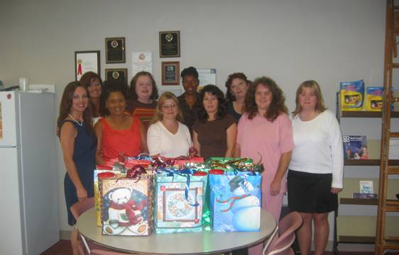
MARY D’AOUST
Gulf Coast Community College
My students inspire me because many times they have lost everything they hold dear. They come to me out of desperation, in spite of their fear. Now that’s brave.

Slide 2
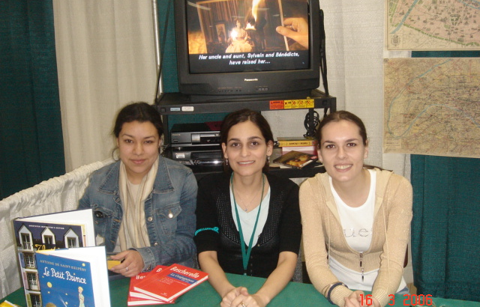
MARYAM DAMGHANI
City Colleges of Chicago – Truman College
As a child, language fascinated me, opening the door to new worlds. This sense of wonder and excitement is what I try to convey to my students.

Slide 3
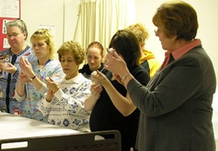
KAREN DAVIDSON
Community College of Beaver County
I have taught nursing for 30 years and am still motivated by the excitement I see on the faces of students on their first day of class. Many have had the dream of being a nurse for many years and are able to see that dream come true. I am there to help make it happen.

Slide 4
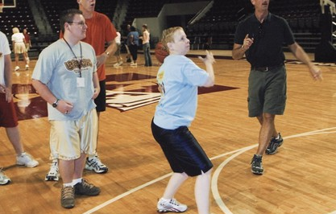
DIANNE DAVIS
West Virginia University – Parkersburg
My students motivate me with their passion for learning. They know that I am interested in them, will listen to them, and will help them succeed if they will allow it. It's true that they don't care how much you know until they know how much you care.

Slide 5
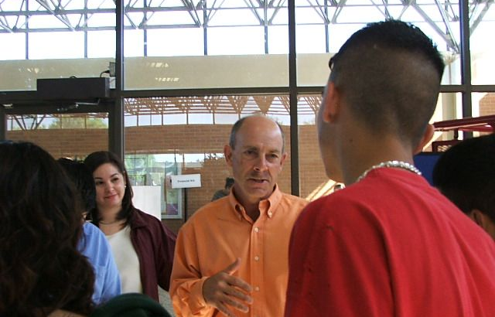
PHILLIP DAVIS
Del Mar College
Education is about affecting a long-term positive change in a learner's behavior. I view my role as a facilitator to assist and guide a learner through their journey of education. I am success if at the end at that journey the leaner has accomplished goals and dreams.

Slide 6
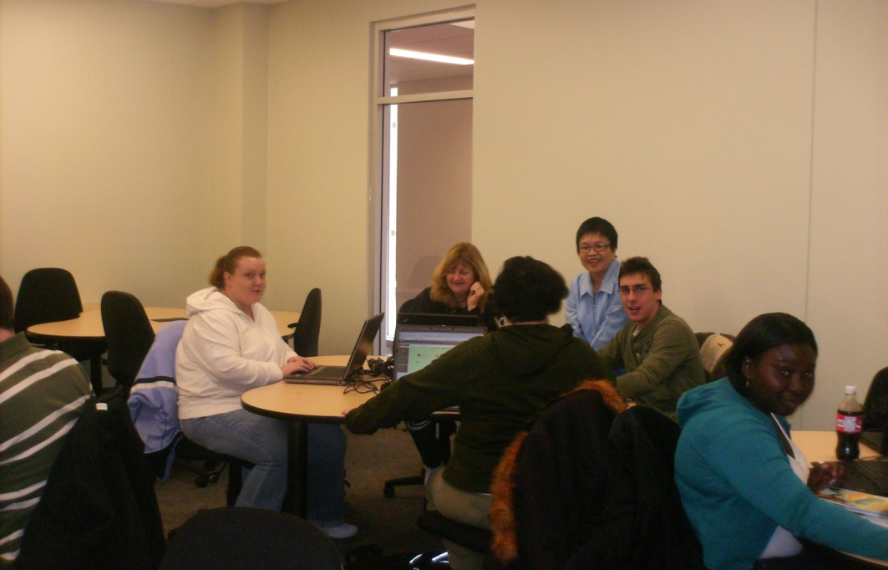
LOURDES DE LA CRUZ
Sheridan Institute of Technology and Advanced Learning
Living the learner experience when I teach a class of diverse students gives me a chance to reflect, review, redesign learning activities, and rejuvenate. When we solicit students’ feedback and listen to their voices, we weave connections with them, and their voices resonate in the way we teach.

Slide 7
ALFRED DE LA ROSA
Lamar Institute of Technology
Teaching mathematics is about giving students the tools necessary for them to succeed in life. By using techniques that build on what my students already know, I work toward teaching new concepts and eliminating math anxiety. This way, I am encouraging my students as well as guiding them toward success.

Slide 8
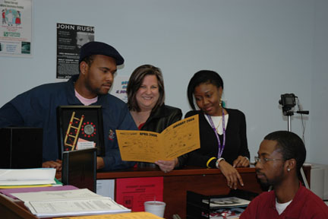
AMANDA DEKLE
Lake City Community College
Working as the Student Activities Coordinator/SGA Advisor gives me great joy. I enjoy working one on one with the students, inspiring them and encouraging them to become leaders in their homes, schools, and workplaces.

Slide 9
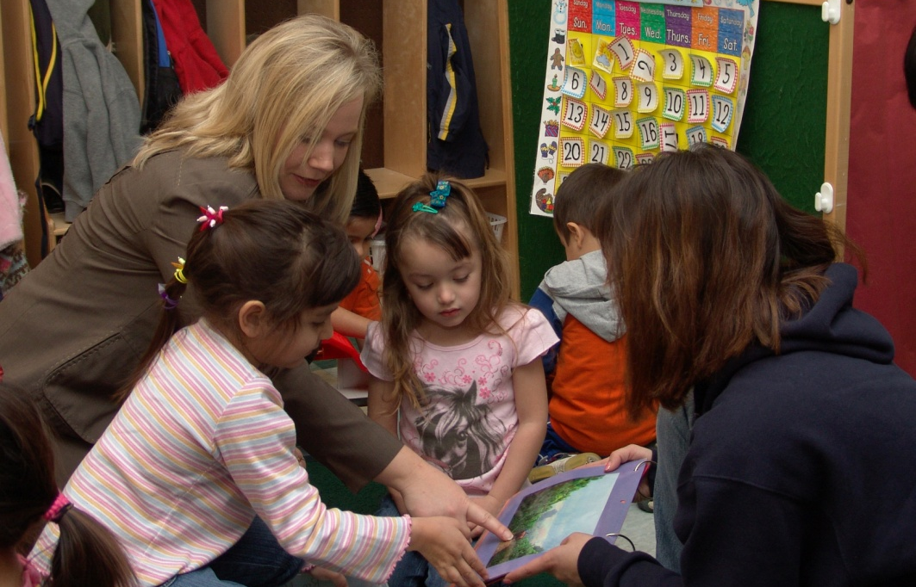
AMIE DELEON
Palo Alto College
I am inspired by a student’s freshness to old ideas. Plain and simple, my students motivate me to become a better teacher. A piece of wisdom that I would pass on is never to forget what it was like to be a student.

Slide 10
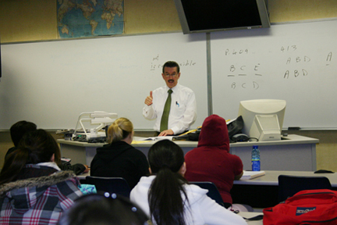
RUBEN DELGADO
Reedley College
I invite my students to learn and succeed. I build on their strengths and help them see any failures as opportunities to change and do better. They come to understand that learning and applying knowledge is the key to success in life. And when life gets hard, they must work harder.

Slide 11
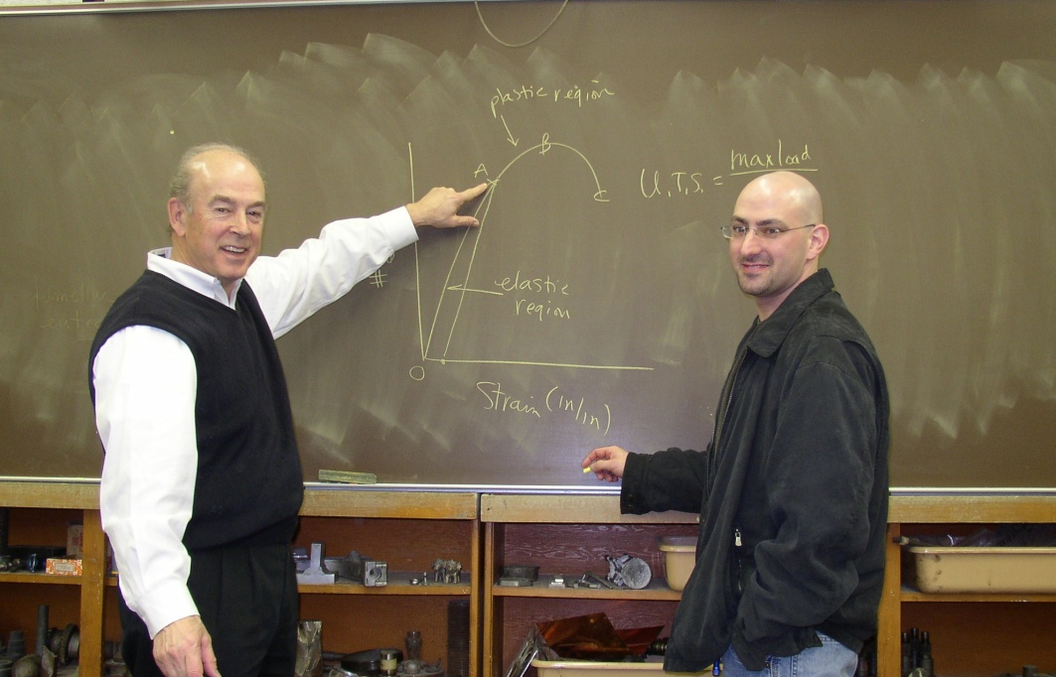
RONALD DEMERINO
Macomb Community College
Passion comes from within and drives one to present material that is both practical and relevant so that the student goes home knowing one more thing than he walked in the door knowing.

Slide 12
EDWIN DENNIS
Haywood Community College
I believe film and video production can only be taught in a hands-on environment. Students learn how to make movies by making movies. I strive to make a filmmaker of each student.

Slide 13
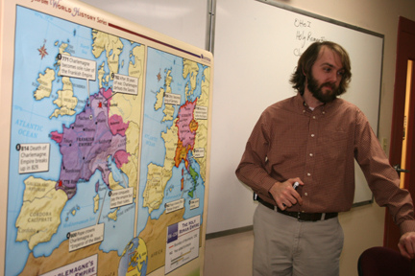
WADE DERDEN
Pulaski Technical College
Teaching is how I give back to the society that has given me so much. The classroom must be more—a place where students are comfortable and safe enough to explore their identity.

Slide 14
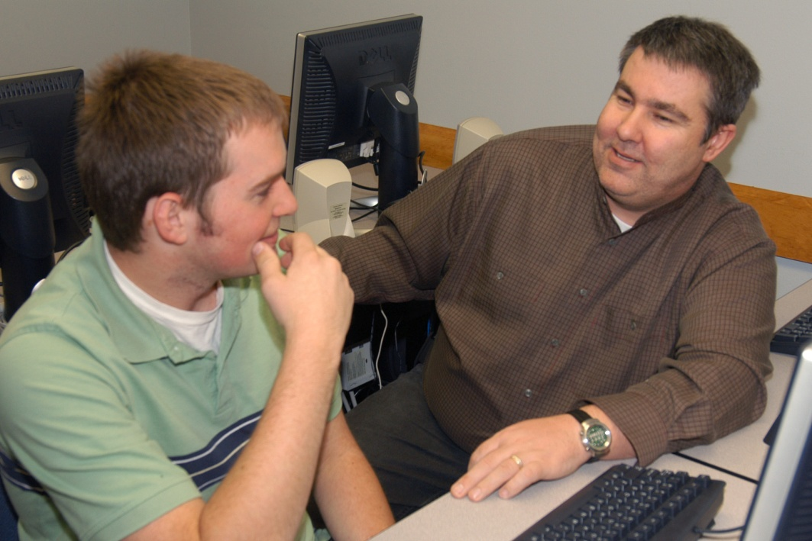
KEN DEWEY
Rose State College
I totally love teaching. Nothing thrills me more than when the light bulb comes on and the student actually understands the concepts.

Slide 15
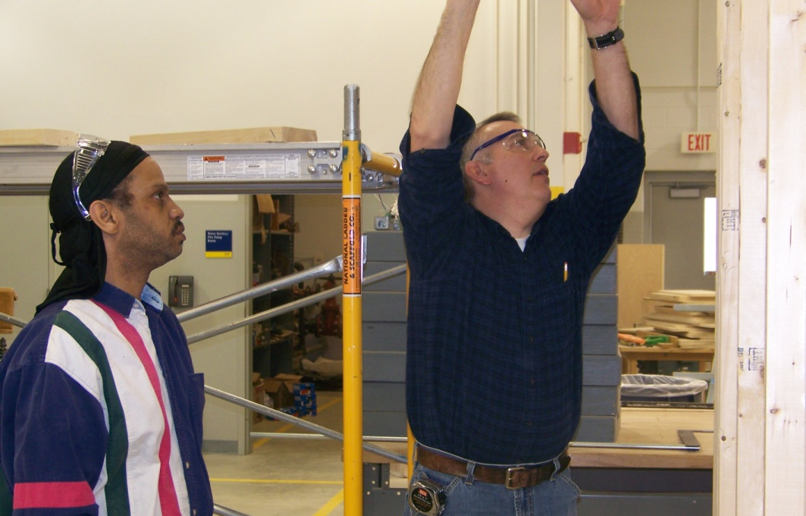
JOHN DOANE
Grand Rapids Community College
Reaching out and connecting with students has always brought me great satisfaction. Taking math, building principles, and teaching students how they work in real-life situations makes learning meaningful. Finding what I love in life and getting paid to do it has taken what most people call work and turned it into fun.

Slide 16
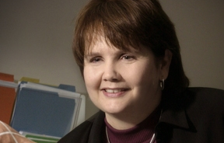
ROBIN DONALDSON
Tallahassee Community College
Family responsibilities, financial restrictions, and limited time are among the challenges that many of today’s students must overcome in their pursuit of learning. I am motivated and inspired by the sense of empowerment that my students feel after achieving their academic goals in spite of these challenges.

Slide 17
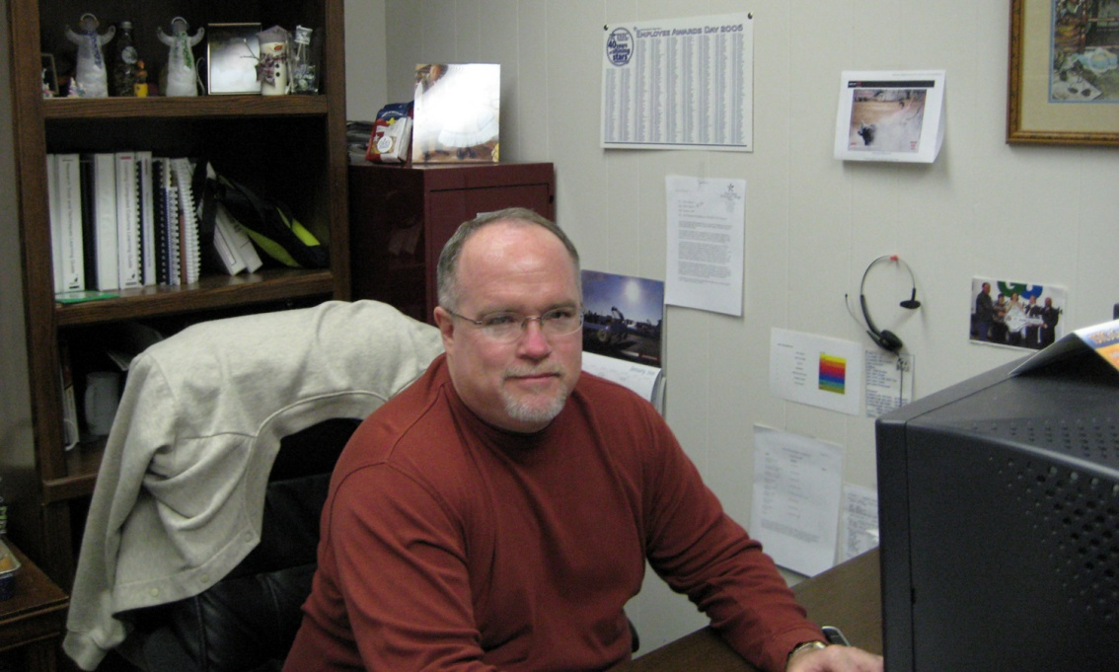
TED DONAVAN
Texas State Technical College – Waco

Slide 18
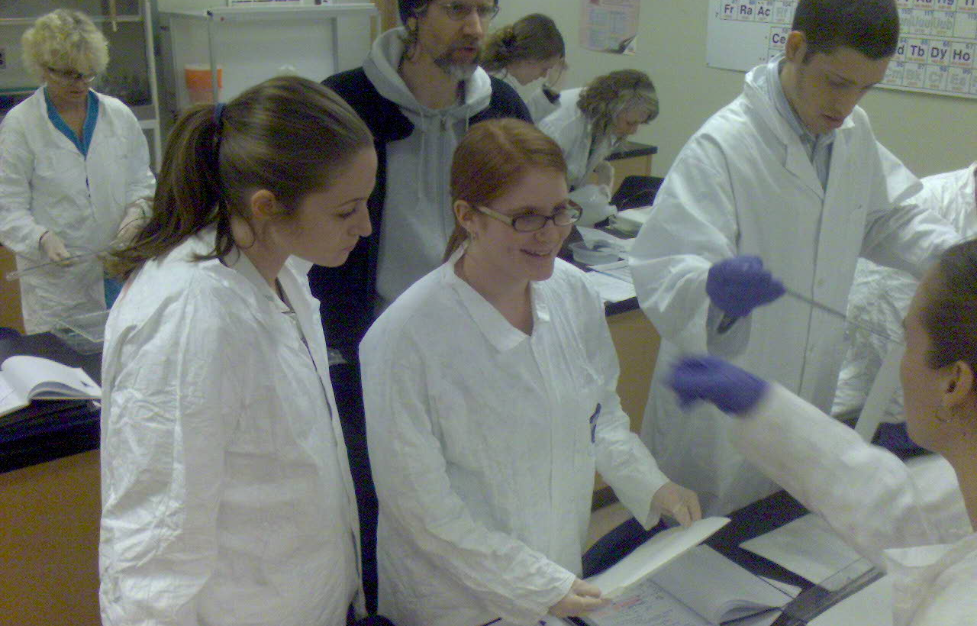
JAMIE DORAN
Camosun College
The manifestation of efforts to return, by several fold, the benefits gained in learning from students through their curiosity and forward-looking critical thinking is the foundation for a valued learning environment.

Slide 19
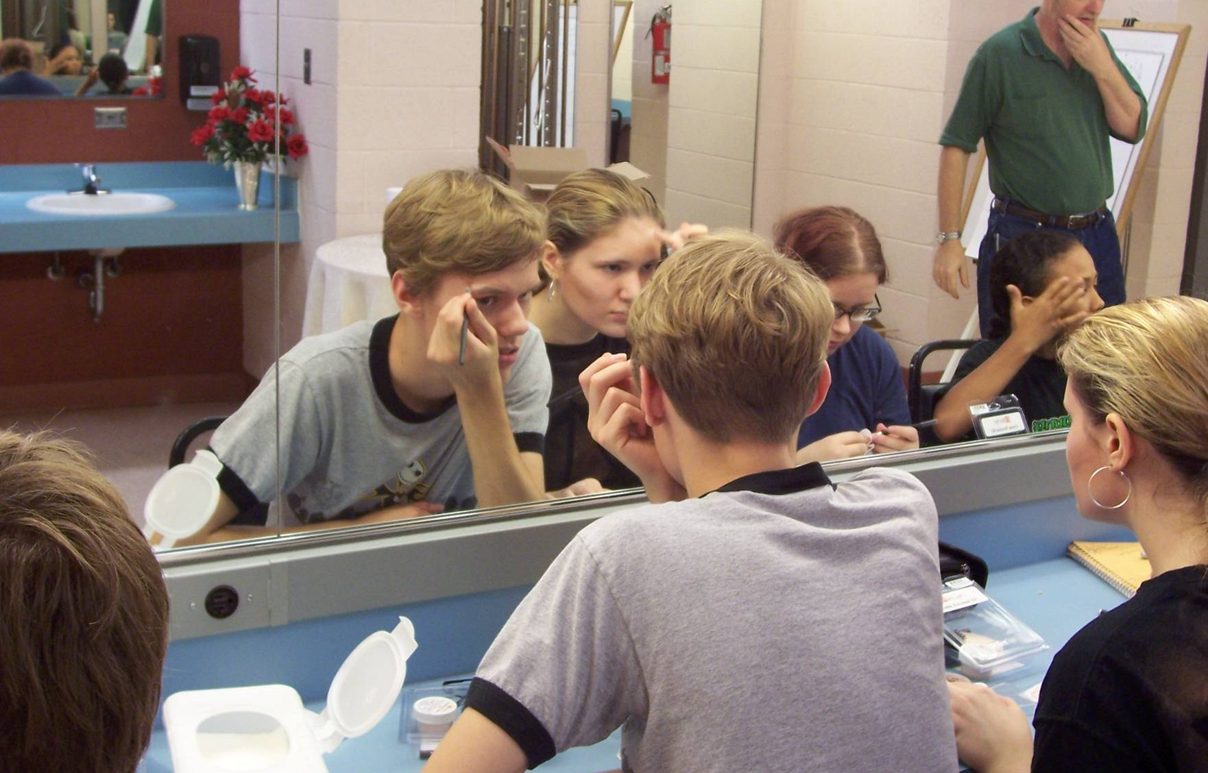
BRAD DOWNALL
Kentucky Community and Technical College System

Slide 20
RUTH DOYLE
Casper College
My goal is for each student to leave my class with ‘tools’ to use in future educational endeavors, in their personal lives, and in collaboration with others. Modeling democracy in my classroom also emulates the philosophy of service learning.

Slide 21
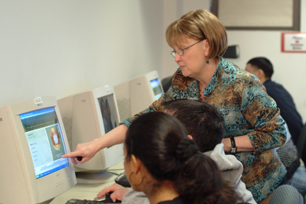
NITA DRESCHER
Brookhaven College

Slide 22
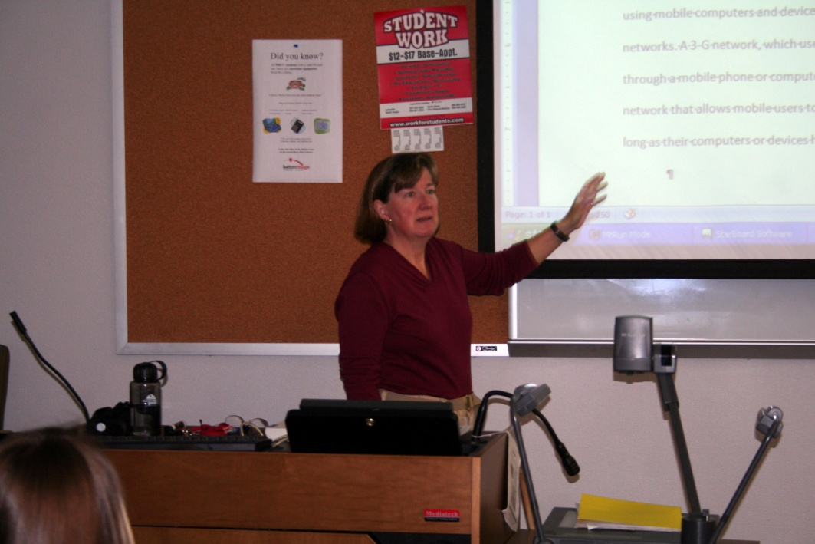
EVELYN DUBOIS
Baton Rouge Community College
As you monitor the class progress, consider the differences between the students taking that course now and the students who were in your class when you took the course. This can help single out new teaching strategies.

Slide 23
SARA DUCEY
Montgomery College
I am a champion of lifelong learning. I attend as many conferences, workshops, and continuing education opportunities as I can. When I teach, I tell my students about these experiences—where I went, what I learned, how it shapes my understanding of the topic. It makes my teaching and my life fresh.

Slide 24
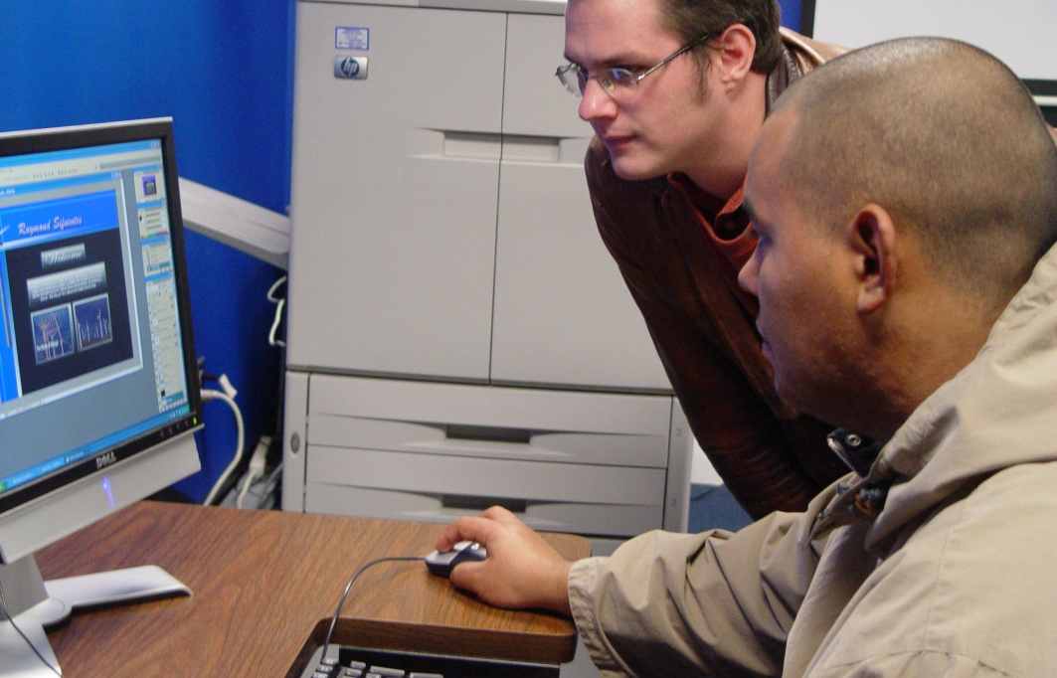
JOEL DUFFIELD
Community College

Slide 25
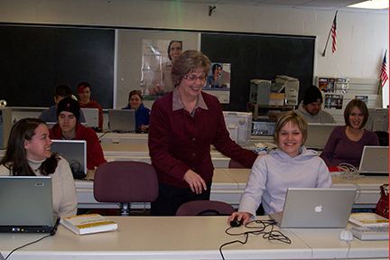
LYNN DURWARD
Minnesota State Community and
Technical College
My students are my inspiration. They persist in their education goals in spite of enormous obstacles.

Slide 26
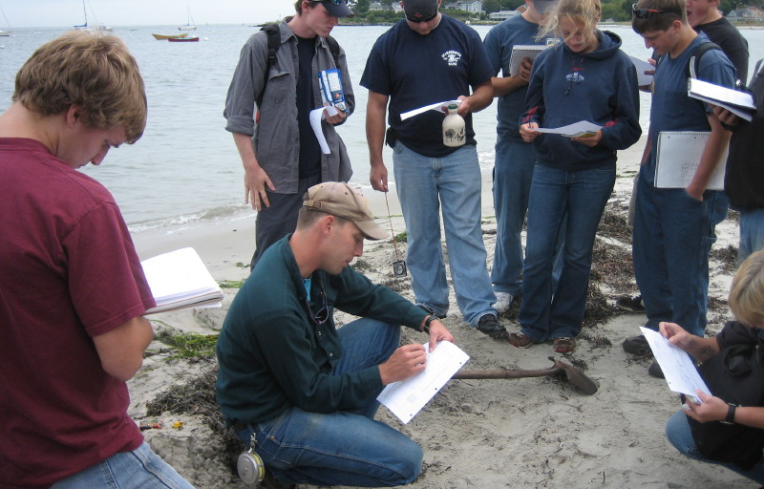
MATTHEW DUVENECK
Southern Maine Community College
Find passion in your teaching. If passion doesn’t come, make the content exciting; make the delivery exciting, or get out of the game. Inspire learning, not teaching. Read your notes before class.

Slide 27
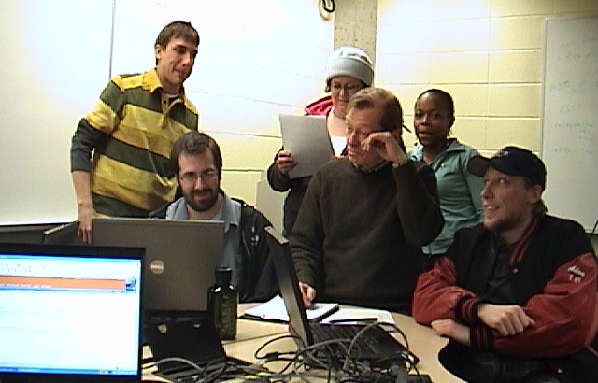
BRIAN DWYER
Community College

Slide 28
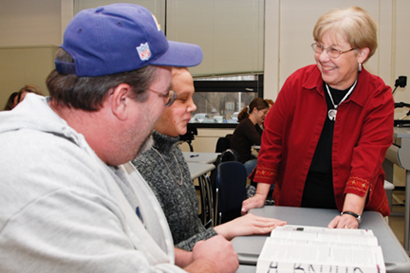
JOAN DWYER
Community College

Slide 29
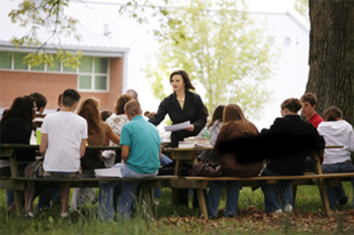
STACY EDDS-ELLIS
Owensboro Community College
I am motivated personally and professionally because I believe that education equals empowerment. I adhere to this philosophy in my personal life by being a life-long learner. In my professional life, I strive to provide educational opportunities that offer others empowerment.

Slide 30
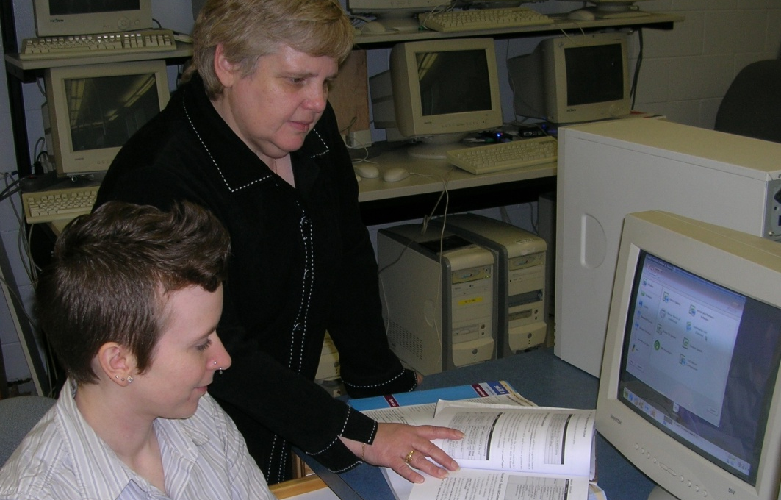
PAULINE EDMONDS
Algonquin College
Teaching is my dream job. Every day I learn something new from students. It’s truly a win-win situation!

Slide 31
HAYWARD EDWARDS
Casper College
My father always told me:
1. If you do not know what you are looking for, you will probably not find it.
2. If you do not know how to do something new, make it look like something you already know how to do.
3. If you are going to work for someone, WORK!!!
In class I try to get students to understand what we are trying to do and how this can be applied to other areas of life or other courses. I consistently relate new inspiration to something we have already learned or some previous knowledge that college students should possess. I tell students this course is their job. They need to be punctual, attentive, and I expect them to work as hard as I work at my job.

Slide 32
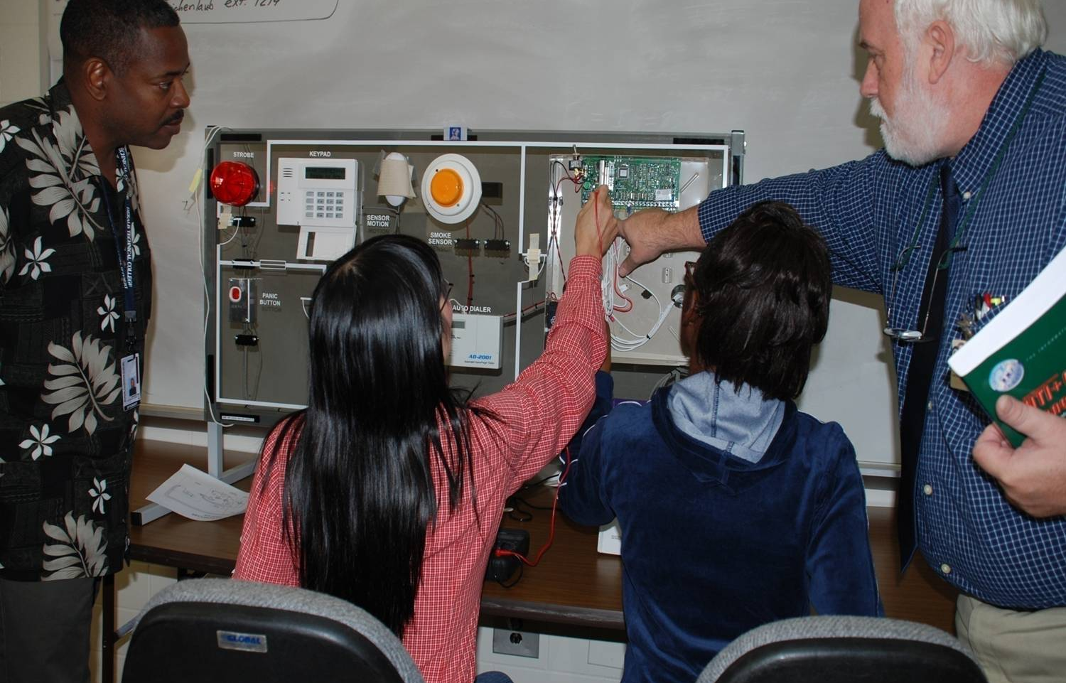
BRUCE EICHENLAUB
DeKalb Technical College
I consider it a sincere honor to assist students in their preparation for their careers. It is exciting to have students be successful and to share their job accomplishments, family events, and goals for their future. The joy of student success stories are what encourage me to continue to teach.

Slide 33
PATRICK ELLINGHAM
Broward Community College
The classroom may be a staging area where individual students are prepared to take a role in society. Whether that individual is one more cog in the wheel that grinds along, maintaining the status quo, or an agent for change, may well depend on what happens in that classroom.

Slide 34
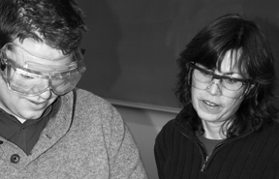
MARY JO ELLIOT
Northwestern Michigan College
I’m lucky in that there are exciting Chemistry demonstrations and engaging hands-on activities to illustrate concepts in chemistry, often serving double duty as great promoters of student critical thinking. The students appreciate my staying current with the technology available that allows increased student interaction, such as placing course materials online, use of animations to make abstract concepts more concrete, and finding reliable information on chemistry current events or chemistry videos that students can access from home.

Slide 35
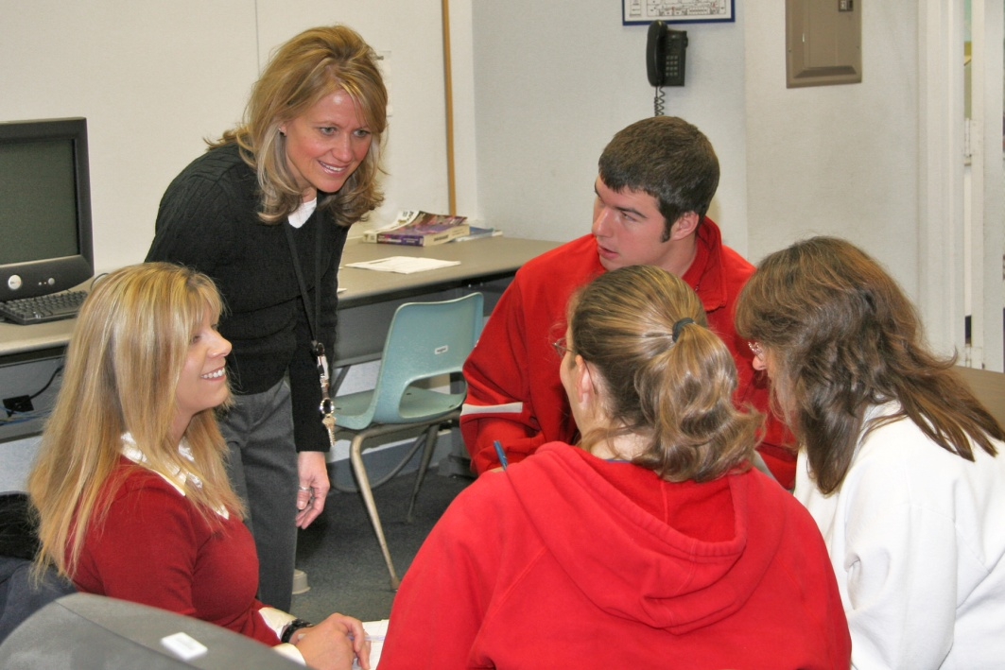
MARLENE EMMONS
Lincoln Land Community College
Witnessing the change education makes in people inspires me. Metaphorically, students will say, ‘I used to believe red was red, but now I understand that sangria is a shade of red.’

Slide 36
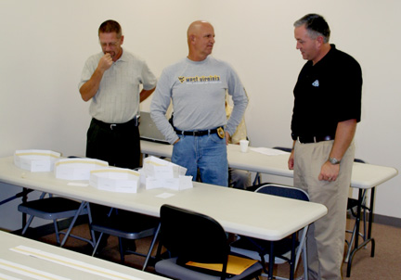
ROBERT ENGLAND
Mountain Empire Community College
What inspires and motivates me most is knowing I have been a good model and positive influence for students. By devoting myself fully, I have the pleasure of seeing them shape their vision, attitude, values, and educational choices.

Slide 37
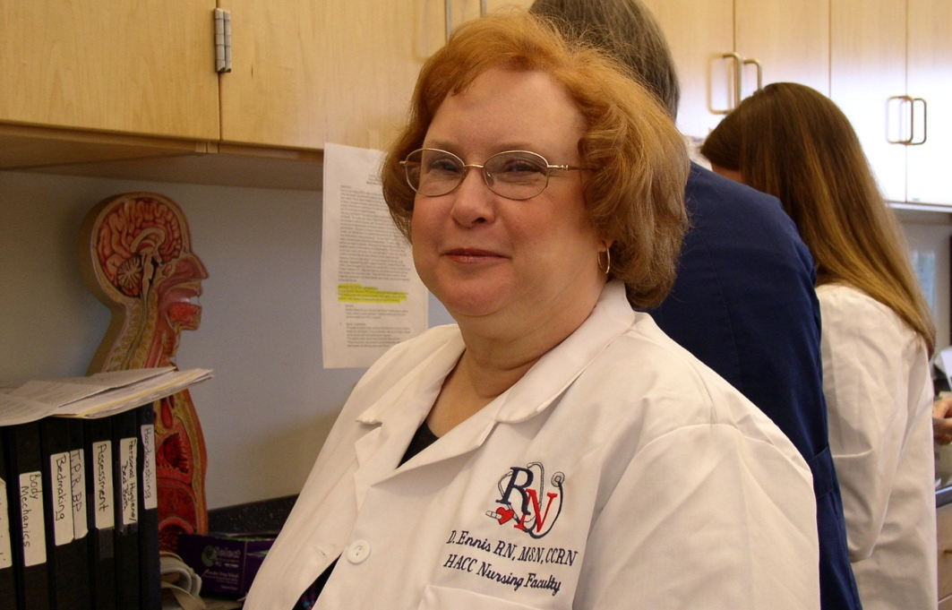
DEBORAH ENNIS
Harrisburg Area Community College
I am privileged to continue to work as a nurse in one of the local hospitals, and I work with many of our graduates. I am bolstered by their success. I feel proud to have had a small part in their success.

Slide 38
TINA ERDMAN
San Jacinto College
I am proud to be involved with an institution that helps to better people's lives.

Slide 39
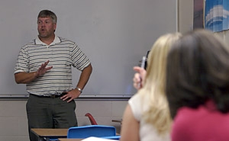
DAVID ERICKSON
Northwest College
A college campus is such a vibrant environment. It is so rewarding to see the personal growth that takes place there!

Slide 40
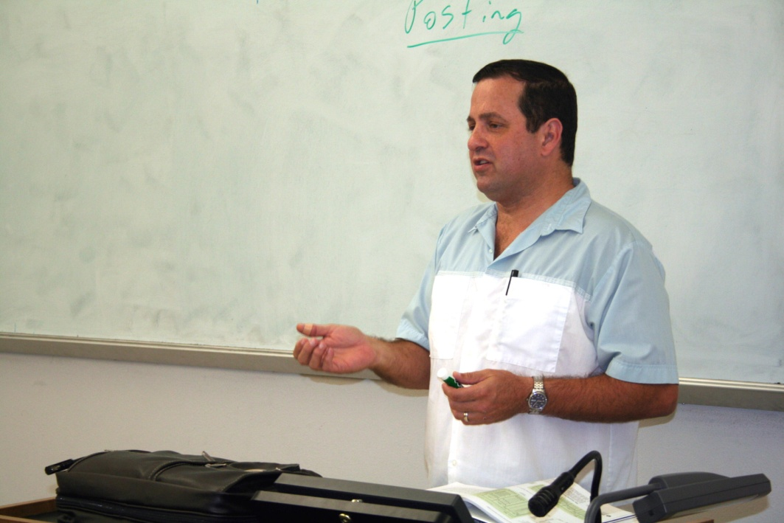
STEVEN ERNEST
Baton Rouge Community College
The things that inspire me the most are my desires to get students to ‘think’ and to educate them about accounting. Using accounting, my goal is to improve students’ problem solving abilities and to help them develop a learning style. My motivations are my family and school, BRCC.

Slide 41
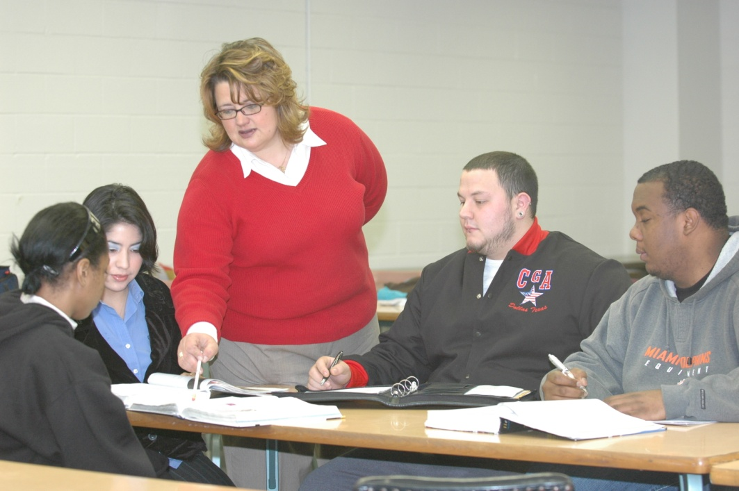
CHRISTINA ESQUIVEL
Navarro College
My work is guided by my hope that something I am doing will make another person's life better.

Slide 42
MARIE ETIENNE
Miami Dade College
What inspires and motivates me in my work is my passion for the nursing profession. One strategy that helps drive my success is developing projects that engage students in serving the un-served/under-served population locally/abroad. A career in health care is above and beyond an occupation; it is service to mankind!

Slide 43
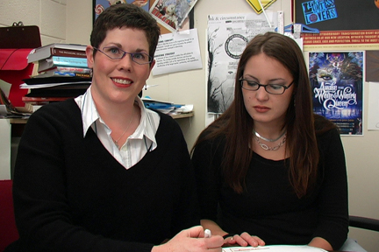
JULIE EVANS
Guilford Technical Community College

Slide 44
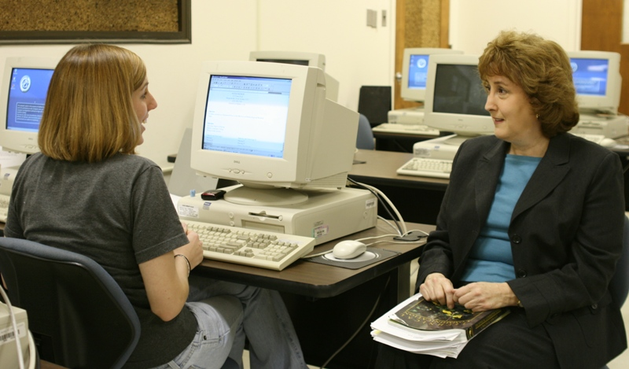
CATHY FARABOW
Halifax Community College
However much you love a method, be prepared to discard it. Change will regenerate you. Be motivated by student behavior. Live without the comfort of your methods.

Slide 45
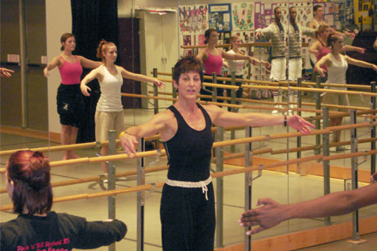
LYNDA FITZGERALD
Anne Arundel Community College
I know I'm in the right profession because my students inspire me daily! I'm excited by the look of accomplishment on their faces when they master a complex dance combination. My goal is to challenge my dancers without overwhelming them, making success possible with effort and determination.

Slide 46
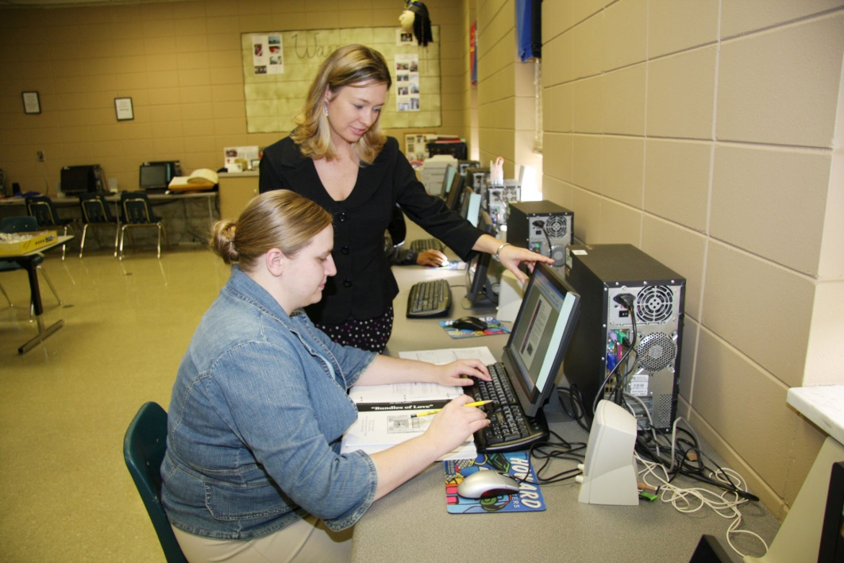
CHRISTY FERGUSON
Community College

Slide 47
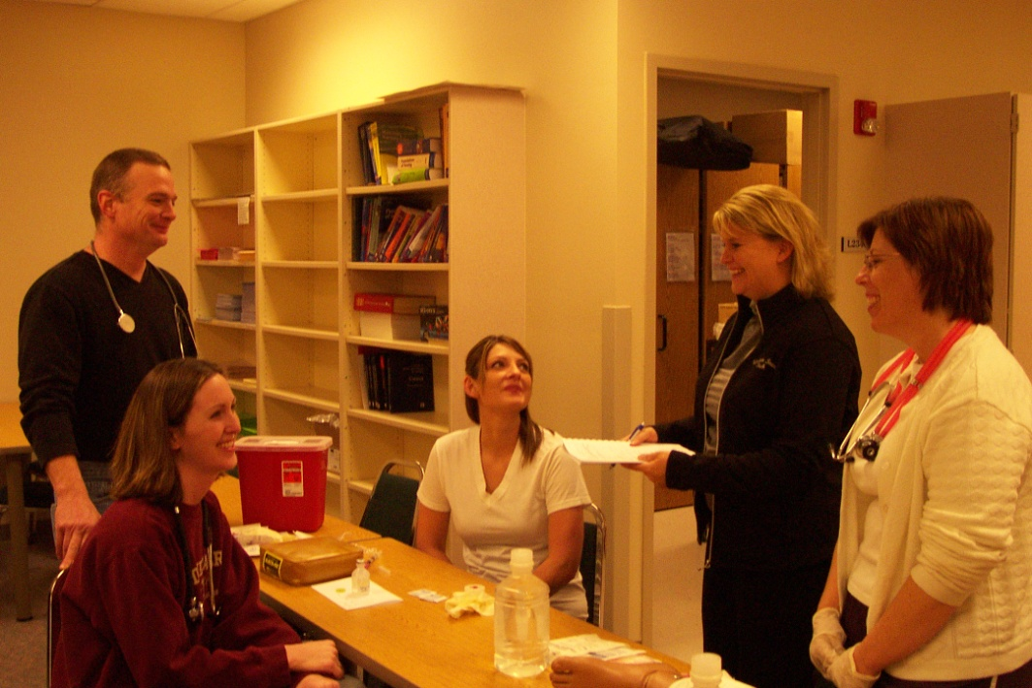
KELLI FLACK
Western Iowa Tech Community College
Excellence in my hybrid (online) classroom is accomplished by observing my students as they correlate theory and clinical. The students are provided the opportunity to promote critical thinking as they make a positive difference in the lives of the patients they care for. Renewing my energy is watching my students grow into the nursing role.

Slide 48
MARGARET FLEMMING
Austin Community College
I adhere to my teaching philosophy of expressing clear intentions, helping students integrate the material, and committing myself to high standards of integrity. Classes are dynamic, interactive, and fun.

Slide 49
JENNIFER FLINN
Ozarks Technical Community College
Developmental writing classes motivate me to create hands-on activities, and throughout the semester I ask for anonymous student feedback to determine which activities and teaching methods are working or need improvement.

Slide 50
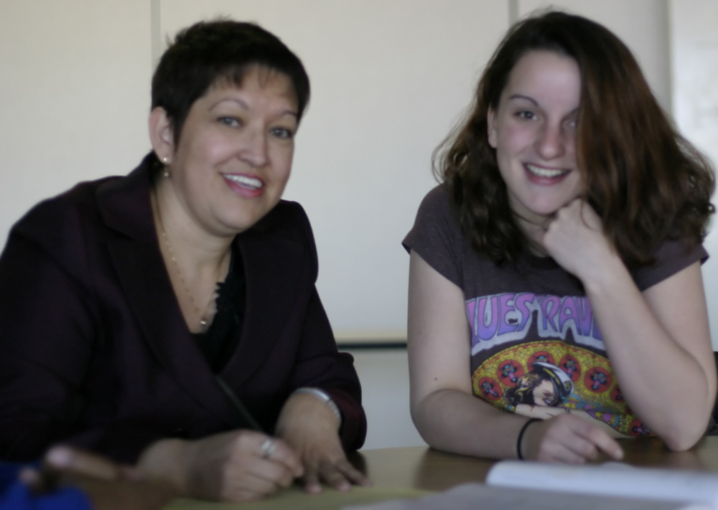
BLANCA FLOR JIMENEZ
South Mountain Community College

Slide 51
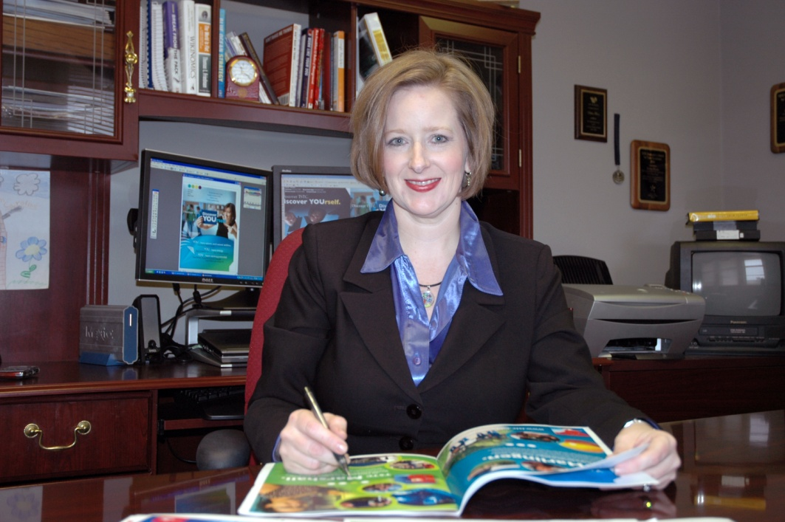
ELISKA FLORES
Texas State Technical College System

Slide 52
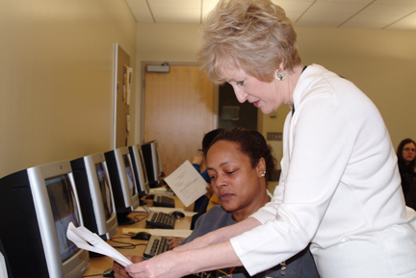
KAY FOREST
Kirkwood Community College
I strive to teach ‘real-world’ skills in my courses, and I’m inspired by the accomplishments of those who are eager to learn!

Slide 53
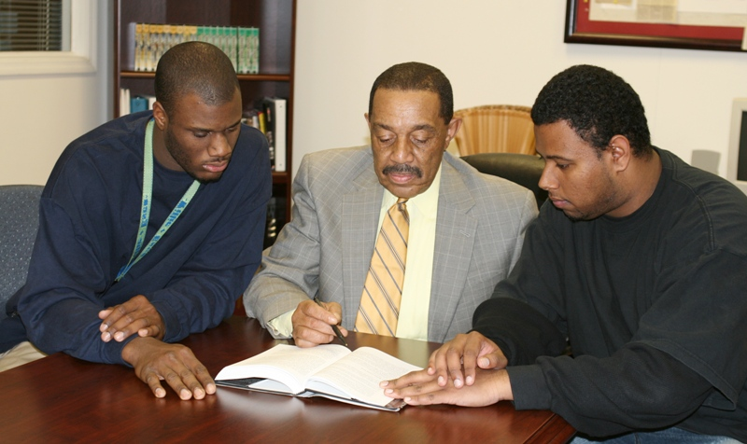
JOHN FORIEST
Halifax Community College
My passion for effecting positive changes in the lives of diverse groups of students inspires and motivates me. My knowledge of society's prevailing ills and workable solutions causes me to remain focused and persistent. To others, I would say, ‘Believe in and appreciate students while leading them to realistic goals.’

Slide 54
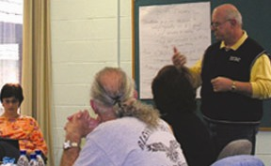
JOE FORRESTER
Community College of Beaver County
Graduation is always a great time. As I shake hands with the graduates, the looks on their faces say ‘Success.’ Whether the graduate is 20, 50 or 80, our focus on excellence has helped shape a dream into a reality. I can't imagine anything more special!

Slide 55
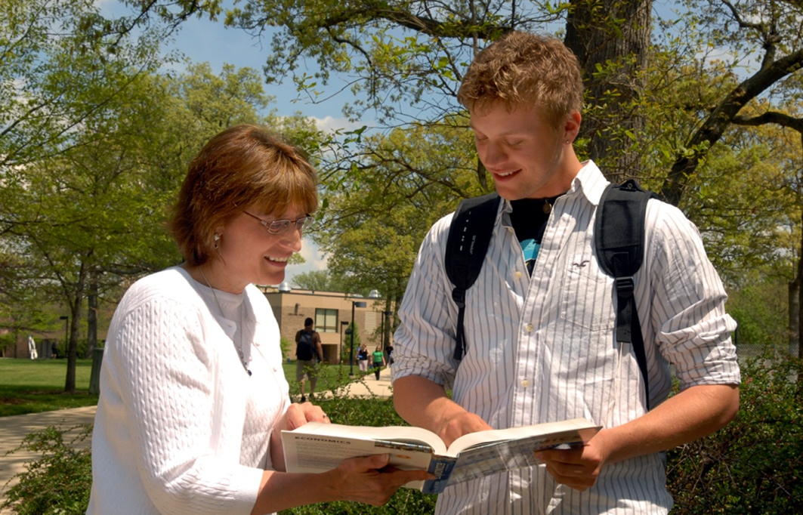
DIANE FORTIER
Waubonsee Community College
Personal reflection, from the practical to the philosophical, and consideration of all the facets of external incentive structures and internal inspirational factors resulted in one simple underlying motivation to continually strive to be the best teacher I can be—the desire to help others be the best they can be.

Slide 56
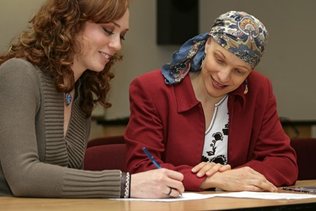
CATHY FROST
Camosun College
I’m privileged to teach at Camosun College. I’m motivated to do the best job I can because of students who face numerous life challenges but still strive to succeed. I’m inspired by my colleagues, who help each student attain his/her goals through compassion and innovation.

Slide 57
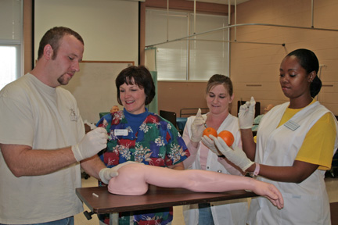
CATHERINE FRYE
Southeastern Community College
I hold high standards for my students in the clinical and classroom areas, and enjoy imparting these ideals to fledgling nurses. Nursing is a noble, respected profession, and to be involved in teaching people to become nurses is a high honor and privilege. One of my greatest rewards in teaching is to see the frightened and unsure student nurse blossom over two years into a confident, skilled practitioner of nursing.

Slide 58
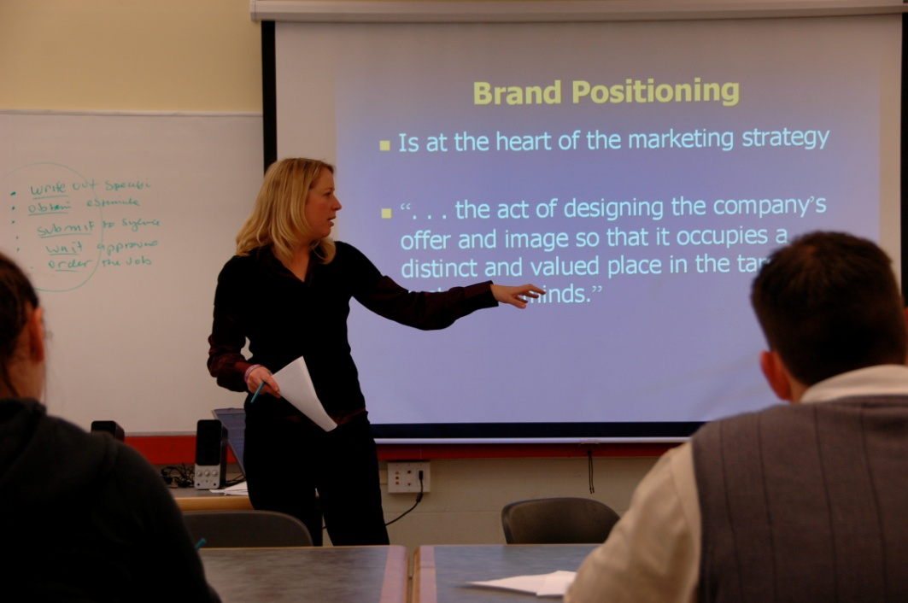
LORI FUTTERER
George Brown College
We all want to make a difference. My most inspiring moment as a teacher happened at graduation when one of my students commented that he would judge his career on whether he thought that I would be proud of him. I knew then that what I do matters.

