Slide 1
OMAR ADAWI Parkland College
I believe that students will want to learn more about a subject if they see how it applies to real-life situations. In my teaching I incorporate many application examples to help motivate the students to learn the material and show how it applies to their lives and future courses.

Slide 2
RENA ADKINS Roane State Community College
I have come to work for 17 years inspired by the opportunity to make a difference in a student's life. Having a positive attitude and treating others how we would like to be treated can help us make the most of this opportunity, which we are blessed with every day.

Slide 3
FRANCIS ADU-FEBIRI Camosun College
I delight in inspiring students and providing them with opportunities to transform knowledge into wisdom that benefits their learning, relationships, and community. My strategy is diversity in instructional methods, evaluation techniques and learning materials. The objective is to motivate students to develop critical thinking, analytical skills, passion for learning and ability to apply knowledge to identify and solve problems.

Slide 4
MACARENA AGUILAR Lone Star College-CyFair
What inspire me are my students who are motivated to come to learn English. I feel privileged to play a part in their success. Then my colleagues, especially those in the ESOL department at Lone Star College-CyFair, with whom we share a vision to strive for excellence and set high standards.

Slide 5
BRUCE AITKEN Algonquin College
Teaching is a passion, not an occupation.
We have committed ourselves to sharing not only our knowledge but our experience. I believe we should be helping our students surpass our own accomplishments. Watching the continuous growth of my students inspires and energizes me to continue to strive for excellence!

Slide 6
CHRISTINA ALEXANDER Southwestern Oregon Community College
‘You cannot not teach,’ especially in the classroom, Cultural and academic knowledge are both important, and our own experiences often provide powerful teaching and learning opportunities. It only takes one generation for knowledge to be lost; it’s important to nurture critical thinking about the national and global issues that face.

Slide 7
DEREK ALLEN Sinclair Community College
I teach because I’m passionate about making tremendous contributions to someone’s learning. Games help students learn, and for some strange reason retention and grades are higher in classes where games are played. I can’t see myself being in any other profession. I actually love what I do for a living.

Slide 8
TERESA ALLEY Southwest Virginia Community College
Leading and teaching for the community college librarian is synonymous with instilling lifetime learning in students. Learning how to gather and process information is a skill that enables students to continue to learn, grow, and succeed in whatever fields of study or occupations they pursue in their lifetimes.

Slide 9
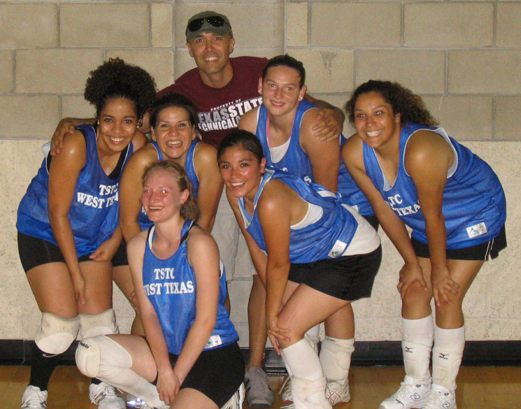
NICK ALVARADO
Texas State Technical College – West Texas

Slide 10
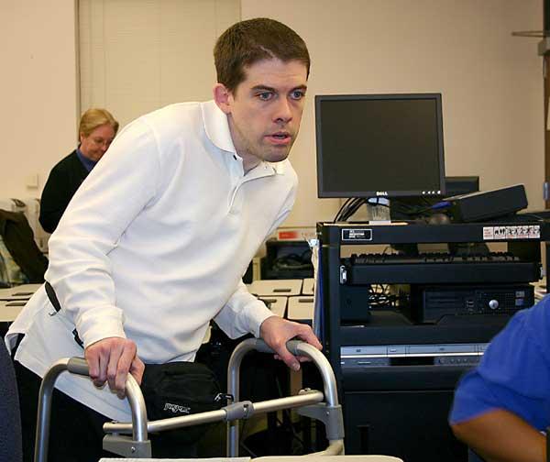
VANCE ANANIA Columbus State Community College
I really listen to students to get a full understanding of their situation. I explain policies and procedures in a clear and concise manner, making sure that they understand what is going on. I would want to be treated the same way if I were in their situation.

Slide 11
JOHN ANDERSON Polk Community College
Many musicians listen to their students' musical mistakes as well as their triumphs. Recently, however, a student thanked me for listening not only to her music, but also to her life. My greatest honor and calling is to be a musician who listens to music and to lives.

Slide 12
SAMANTHA ANDERSON ASU – Newport
Becoming a nursing instructor has motivated me to push myself and students to strive for the best. Knowing that I play a special part in creating wonderful nurses for our future is all the inspiration I could ever want or need.

Slide 13
MARK ANDRES Portland Community College
A piece of art can have all the ingredients of great art and still be mediocre. The latest pedagogy never guarantees education. Both artist and teacher must answer a similar challenge: to bring authenticity and playfulness to the moment. Only then is art or education possible.

Slide 14
MARIA ANDREWS St. Philip’s College
I love my job—the opportunity to work with multicultural and diverse students in registration, advising, and financial aid. With over 16 years of supervisory leadership in training college work-study students, we all are training the future leaders of America

Slide 15
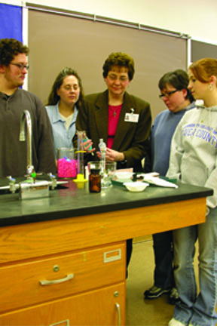
PATRICIA ANDREWS Community College of Beaver County
When I reflect on my last 20 years, I see that my teaching has been inspired and motivated by the teachings of the Bible. They remind me to treat my students with respect and equality, to have compassion on those with needs, and to provide opportunities for my students to learn and think critically, so they will be prepared for their future roles in society.

Slide 16
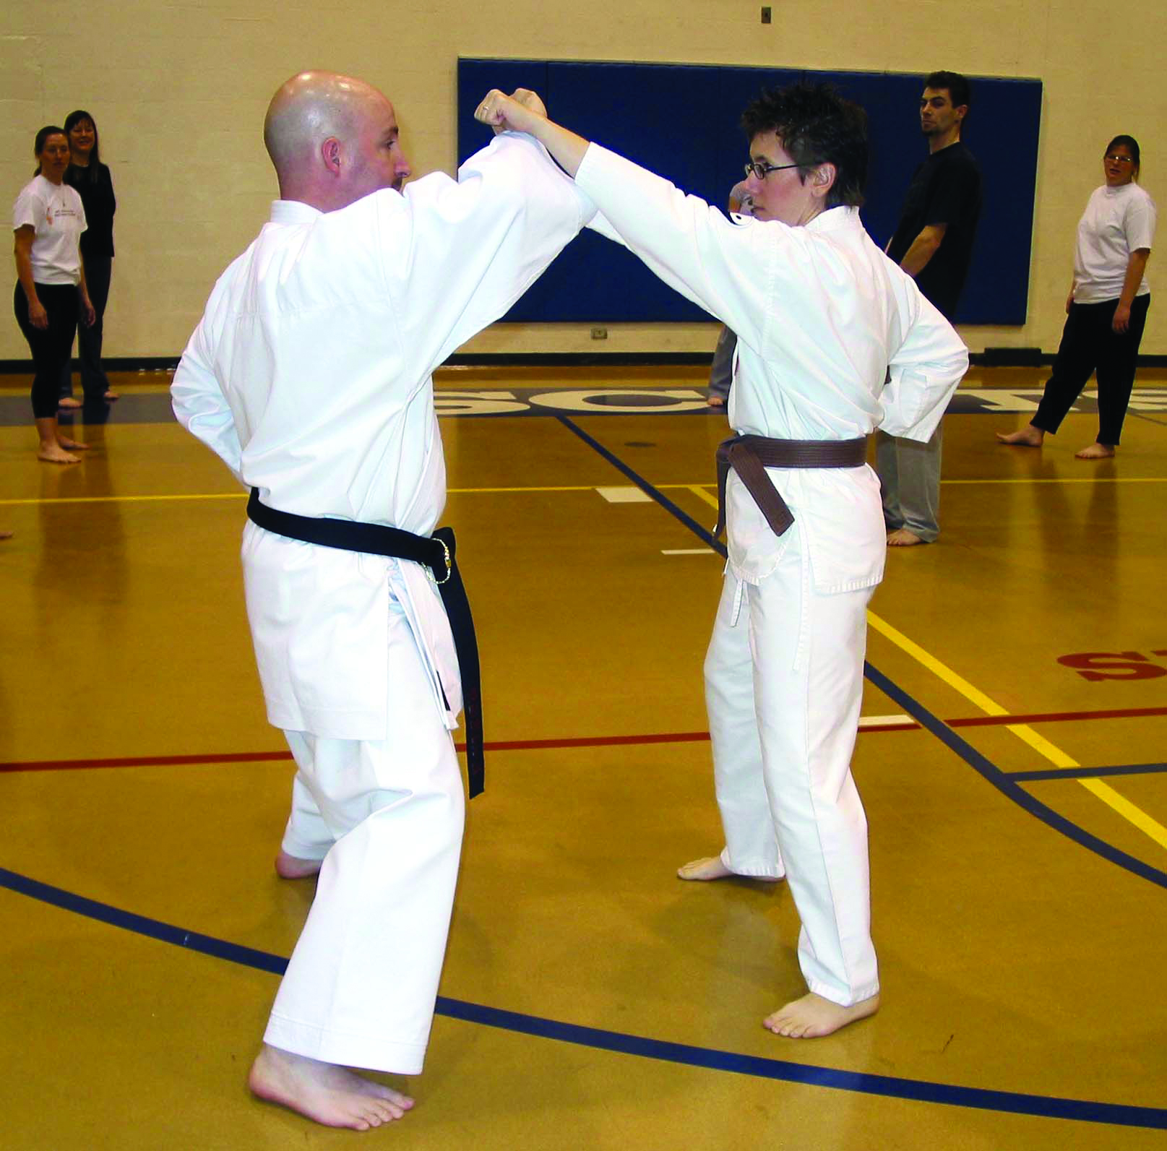
FRANK ARDITO McHenry County College
The extraordinary diversity and authentic open-door accessibility at the community college provides an inherent source of motivation. This educator urges his fellow scholars to continue to raise their professional expectations, as our student’s true potential is seldom realized.

Slide 17
BARBARA ARGUEDAS Santa Fe Community College
Our students, step by step, move into a world they never imagined was possible. My motivation and inspiration come from student possibilities.

Slide 18
BRUCE ARMBRUST Lake Tahoe Community College
I don’t consider myself a mathematics/physics teacher. My students learn these subjects, but I’m really giving them something else—how to use logic and critical thinking to use their intelligence and abilities to better our world.

Slide 19
LAURI ARNOLD Lamar Institute of Technology
What motivates me is that I have the pleasure of leading individuals through the process of discovering their future. It is a fantastic feeling to know that a student will leave your class on a daily basis knowing something that they did not know when they arrived.

Slide 20
MELANIE ARPAIO Sussex County Community College
I am inspired by my students, who teach me as much as I teach them. My goal is to instill a passion for knowledge that will carry them on to a future life doing what they love - which is what I get to do every day!

Slide 21
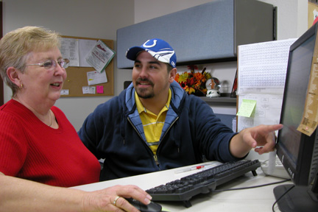
DARTLE ATHERTON
Cochise College

Slide 22
BOBBY AUSTIN Lenoir Community College
Each day, I watch my students grow in knowledge and abilities. I see lives change for the better and the pride they feel in becoming professionals. I am inspired by their willingness to learn and their commitment to their patients and each other. What better reward could anyone ask for?

Slide 23
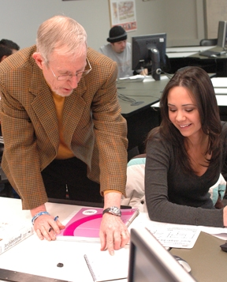
GARY AZBELL Macomb Community College
When in the classroom, everything I do that is directed towards the students is done as if I were a student trying to learn what is being taught. Being a student all my life, it is important that the instructor communicates with me. My most memorable professors gave me knowledge that could be used long after the course was completed.

Slide 24
CHRISTINA BAACK Tarrant County College-Southeast
‘You make science fun. If I’d known I was going to like Geology this much, I’d have taken it a long time ago.’ When I hear this from my students, I know I’ve accomplished my goal—to share my excitement, my enthusiasm, my passion for what I do.

Slide 25
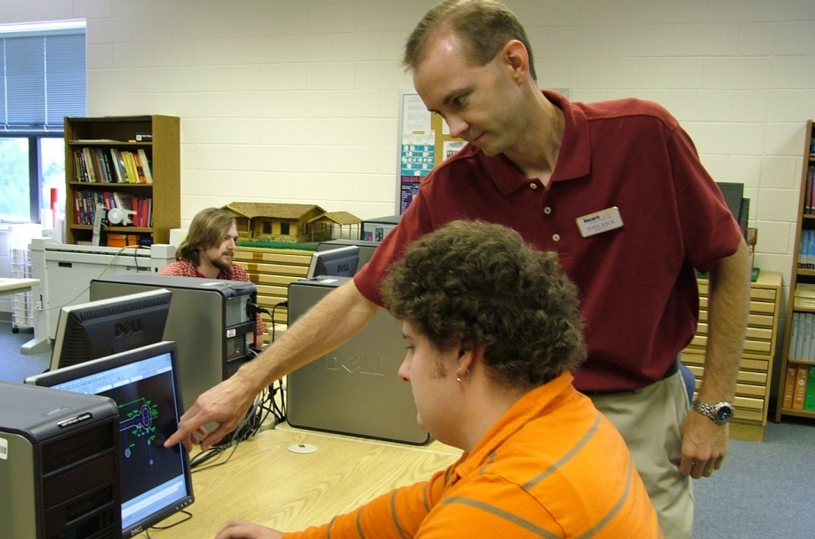
TONY BACK Hazard Community and Technical College
As a teacher, my primary inspiration is student success; therefore, I feel I can never know enough or do too much. For me, real success is delivered through the expressions on students’ faces, allowing me to see they truly understand the lesson. At that moment, I know I make a difference.

Slide 26
NANCY BAILEY University of Arkansas Community College at Hope
Education is about learning, discovering, and sharing the wonder of human possibilities. Being involved in education has provided me a number of opportunities to catch a glimpse of a student’s amazement when he or she peeks into the gifts inside and begins to understand ‘Yes, I can!’

Slide 27
SHARON BAIRD Roane State Community College
Students inspire and motivate me. For many of our students, we are the first step toward improving their lives. When students take that first step, they may face uncertainty, even fear. That's why, as educators, we must always remember the importance of compassion.

Slide 28
KINGKADE BALDWIN Midlands Technical College
"Fighting Fire with Fire”
Students sit, implacable, earbuds firmly implanted, almost disdainful. Others, restless, shift in their chairs. Teachers, light a fire! A spark shoots across the room, then another; The vacuum fills with power, energy, and light.

Slide 29
TAMARA BALLMAN McLennan Community College
Learning motivates me. And, helping someone else learn is even better. I ask the question, ‘WHY ARE YOU HERE?’ After giving students time to reflect, I hear ‘to get a better job’ or ‘to avoid getting a job at all!’ But most tell me about how they are here to change the world or their family history. When I read that one of my students will be the first person to graduate from college and how that will change his/her children's future, I know I want to be a part of that!

Slide 30
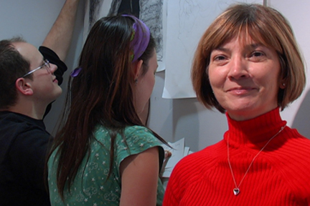
ROBBIN BAKER
Guilford Technical Community College

Slide 31
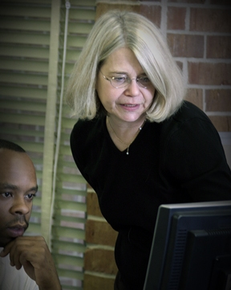
CHRISTINE BARRILLEAUX Tallahassee Community College
My students inspire me. Their stories, hopes, and dreams motivate me to give them my best. At the end of every semester, I think about how I can improve my course delivery, so when the next round of students comes through the open door, I’m just a little bit closer to giving students what they need to succeed.

Slide 32
PHILIP BARRONS Macomb Community College
I am reminded of the old adage, "You can lead a horse to water—", well you can finish it. My job is to see that my students are successful—not always a big drink, but at least I can make them thirsty.

Slide 33
BRENDA BARROW Lamar Institute of Technology
The highlight of my career as an educator comes when I observe former radiology students working as registered radiologic technologists, mentoring current radiology students in the clinical setting. I realize that I have been successful in positively impacting their lives as well as the quality of health care.

Slide 34
HANK BASKETT Clovis Community College
As a teacher, my inspiration and motivation came from the students. My personal success is measured by helping other people. My advice to students: Never let anyone take control of your ‘keyboard’.

Slide 35
ELVA M. BEACH Austin Community College
For every student in whom I inspire a thirst for reading and writing, there lives another person who has the power to communicate effectively via written word, and who will make intelligent and compassionate decisions concerning their life, their family’s lives and their community.

Slide 36
RONALD BEALER Norwalk Community College
Commitment to the NCC Vision and a particular aspect clarifies my objective—‘provide an environment in which students are empowered to achieve their highest potential.’ Multiple dimensions are embraced by this concept; they all lead to a life of productivity, contribution to family and community, and self-actualization.

Slide 37
JULIE BECK San Antonio College
As an artist and floral designer, I look to materials for my inspiration. My students are my inspiration. Each is as varied and unique as flowers; every student is looking for a place to share his/her beauty and talent. Seeing them bloom is pure joy.

Slide 38
SCOTT BENJAMIN Bunker Hill Community College
A struggling student exclaims, ‘Dude! I totally get it now!’ But even more rewarding when I listen to a student’s thoughts, and I find myself exclaiming, ‘Dude! I totally get it now!’

Slide 39
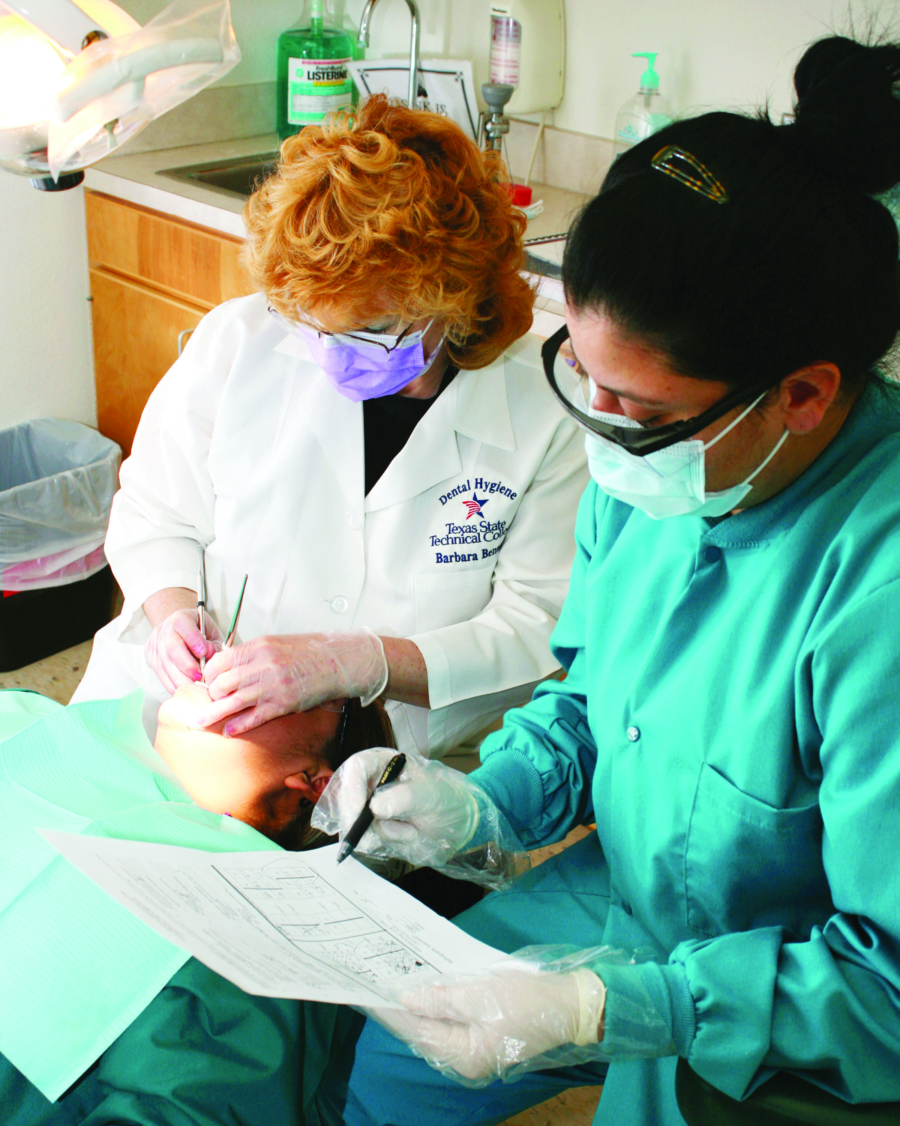
BARBARA BENNETT Texas State Technical College – Harlingen

Slide 40
JENNIFER BENNETT Camosun College
I am inspired by students who bring a rich world of experience and insight to the classroom. Truly, success is a collaboration of colleagues and learners. I recommend openness to new ways of teaching, in particular with innovative technologies and, most appreciably, an embracement of indigenous approaches to learning.

Slide 41
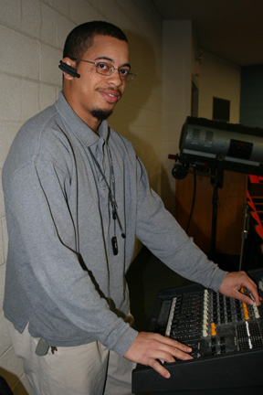
NESBY BERKLEY Southeastern Community College

Slide 42
SUSAN BERRY Elizabethtown Community and Technical College
I am inspired by students who bring a rich world of experience and insight to the classroom. Truly, success is a collaboration of colleagues and learners. I recommend openness to new ways of teaching, in particular with innovative technologies and, most appreciably, an embracement of indigenous approaches to learning.

Slide 43
CAROLE BERUBE Bristol Community College
Students inspire me to be the best teacher I can be—for them.

Slide 44
ANJALI BHATTACHARYYA College of DuPage

Slide 45
REBECCA BILBREY Ivy Tech Community College
Write out what you want students to say about you once they have moved on, attempting to describe the significance you had in their lives and their success. Teach based upon what you think you want them to say.

Slide 46
PAUL BISHOP Monroe Community College
Air goes in and out, blood goes round and round, if anything changes it’s a problem. I help students solve this problem. As an EMS Instructor and active paramedic, I am inspired when I work side by side with a former student to save a life or solve a problem.

Slide 47
DAVID BODARY Sinclair Community College
I am your expedition guide. I help you plan your trip, offer direction, help you see what others miss and support you along the way, but you must be responsible for each step. Your effort propels you, your eyes appreciate the view, your head will know the accomplishment, and your heart will feel fulfillment at the summit.

Slide 48
MICHAEL BOESTER Monroe Community College
As a community college graduate whose life was changed by a single instructor, I have an authentic understanding of the importance of my profession.

Slide 49
TANYA BOLER East Central Community College

Slide 50
JOHN BOLING College of Southern Idaho
Gee-whiz science is fun, interesting, and captivating for students, but it’s like giving a hungry man a fish. To really teach students to ‘fish’ takes a willingness to be available, recognize the questions that they’re asking between the lines, and guide them to finding their own answers.

Slide 51
JEFF BOOKOUT Arkansas State University-Newport
I teach technology courses. What really motivates me is seeing students’ face when it clicks for them and they get excited about a particular topic. Those moment’s are pivotal, and inspire students to go and do great things, and that’s what it is all about.

Slide 52
CHARLES BORDOGNA Bergen Community College

Slide 53
KAY BOSTON Bossier Parish Community College

Slide 54
NANCY BOUREY Camosun College
I strive to teach with open hands, to remember that what I teach I do not own. Open-handed teaching asks me to be courageous and remain vulnerable. It demands I be truthful. As Parker Palmer says so succinctly, ‘To teach is to create a space in which the community of truth is practiced.’ I want to create that space.

Slide 55
MIKE BOVE Southern Maine Community College
Teaching is learning. Each day my students give me messages about what works, what doesn't, and what I need to do to grow with them. The key is paying attention.

Slide 56
SUSAN BOWEN Darton College
As the Assistant Director of Admissions, I am involved in helping students reach their full potential. By encouraging and counseling them, I help them realize that an education is the path to making their dreams come true.

Slide 57
MICHAEL BOYD Illinois Central College
As a teacher, I am most inspired when I see students a few semesters or years after they complete my class, and they tell me that what I taught them in my classroom made a difference in their college education. This reminds me that what I teach today matters tomorrow.

Slide 58
AMANDA BOYLE Texas State Technical College – Marshall

Slide 59
ANN BRAGDON Houston Community College

Slide 60
DANA BRAMBLE Wharton County Junior College
I know that my students may not remember all of the content I taught them, but I hope they remember how I made them feel about themselves, their future, and their world.

Slide 61
MARIA BRANDT Monroe Community College
The boundaries between ‘outside’ and ‘inside’ the classroom must be fluid if meaningful learning is to take place. This means that we must invite our students to explore the relationship between their scholarship, themselves, and their worlds, that the classroom must be a site of revolution.

Slide 62
BRENDA BRANTLEY Bossier Parish Community College
What inspires me is seeing those students in the library for the first time and not knowing where to begin their research. The strategies I use to help drive my success is to keep an open mind that they are not where I am and to assist the students until their needs have been completely met. Words of wisdom: "We only have one life; live it to the fullest.”

Slide 63
LINDA BRENDER Macomb Community College
I emphasize a student’s reason for enrolling in college. As much as possible, I personalize my teaching.

Slide 64
GREGORY BRIDGEMAN Hopkinsville Community College
It is hard not to be inspired by students. Don’t say you care; show you care.

Slide 65
FREDA BRIGGS Butler Community College
What students need is to know is how passionate you are—that you are passionate about your discipline, about learning, but most of all, about them.

Slide 66
MORGAN BROADHEAD Kentucky Community and Technical College System

Slide 67
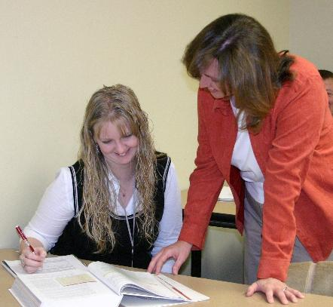
TRACY BROADWATER University of Arkansas Community College at Batesville
My motivation and inspiration are the students who are working so hard to enrich their lives through education. Seeing them gain confidence in their abilities and helping them accomplish their goals is rewarding beyond measure.

Slide 68
MADELINE BROGAN Lone Start College-North Harris
The ability to instill confidence in students and develop their self-esteem while teaching them motivates me to be a better teacher and a better person. My students teach me, and I hope I teach them how important it is to listen to people and to respect other's differences, skills, and contributions.

Slide 69
MARK BROOKS Bowling Green Technical College
As in every profession, to succeed you must draw from an impetus within yourself. I am also inspired by the students whose lives are changed by the education and training they receive at our college. True success and fulfillment comes from service to and for others.

Slide 70
BEN BROTEMARKLE Brevard Community College
While the tried-and-true lecture and Socratic dialogue style of teaching is still an important and effective classroom mainstay, successful programs must also strive to integrate new technologies and incorporate new teaching methodologies in classes to reach new generations of students who assimilate knowledge in a variety of ways.

Slide 71
JEANNIE BROWN Motlow State Community College

Slide 72
JUDGE BROWN Iowa Central Community College
Persistence is the key to success in teaching—where change is constant and things don’t always go as planned. If you love what you do, the job is less difficult.

Slide 73
KEVIN BROWN Texas State Technical College – West Texas

Slide 74
ROBYN BROWN Anne Arundel Community College
My inspiration for teaching is the privilege that teachers are given to inspire others—to excite students about a subject and perhaps even ignite a fire within them that has the potential to change their lives.

Slide 75
SUZANNE BROWN Northern Oklahoma College-Tonkawa
As educators, we work with tomorrow’s leaders. It inspires me to know that we interact daily with the future of the United States of America.

Slide 76
ELAINE BRYAN Georgia Perimeter College
I believe that there are several components to being a successful and effective professor. First, I believe that one must care about the student. If a professor trusts the notion that student wants to learn, the student will reciprocate with a sustained effort. Second, love of the material is essential. If a student recognizes a professor’s devotion to the topic, it will be embraced. Third, showmanship and clarity are vital. Finally, without passion and enthusiasm, the material fades, and the message is not delivered.

Slide 77
KAREN BUCKMAN Lone Star College-Montgomery
Energy and enthusiasm! If I could share words of wisdom with a new professor, I would say ‘get excited about the discipline. If you are energized and enthusiastic about what you are teaching, students will be excited to learn.’

Slide 78
GWENDOLYNE BUNCH Midlands Technical College
If given a chance, students can teach many of us about the willingness to persevere despite life's obstacles. We can only motivate students if we are motivated! The greatest title one can have is not "Doctor" but "Teacher.”

Slide 79
DAVID BURGETT McLennan Community College
You and your students are comrades-in-arms in the knowledge arena. If you are not learning from them, you’re not doing your job right.

Slide 80
MICHAEL BURKE Iowa Central Community College
The Administration at Iowa Central Community College enables me, as an Instructor, to be student centered. This, coupled with my past experience in the Criminal Justice Field, inspires and motivates me everyday. The one and only strategy I have is to keep it REAL.

Slide 81
DAVID BURLESON Community College
Working with our community’s diverse student population is my key motivator. It is especially satisfying, to work with first generation students who beam with enthusiasm, learning the rigors of college life while grasping and appreciating the power and thrill of knowledge. Connecting History to their lives is particularly rewarding.

Slide 82
HERBERT BURNS Forsyth Technical Community College
Passion and vision are the fuels that drive me. With passion and love for what you do and willingness to help others, vision releases the anchor to go where you have not been. These strengthen me to, enlighten, educate, enrich, engage, and empower students to their best.

Slide 83
ALAN BURRIS Murray State College
Model the behavior you want to see in your students—be involved with the students, the school, the community and your area of discipline. Prove you believe that what you are telling them is important and is, in fact, important.

Slide 84
DEBRA BURTOFT Tallahassee Community College
I am inspired and motivated by my students. It is a pleasure to see them grow and develop into dental healthcare professionals who will impact our community. Each student is special in their own way. I feel that it is important to embrace each student’s unique nature and find a way to help facilitate their education and personal growth.

Slide 85
GREGORY BUSCH West Virginia University – Parkersburg
My goal, as an educator and a sociologist, is to empower my students by instilling in them a sense of self-worth, while fostering respect for their own and global communities. It is inspirational and personally fulfilling as I observe the evolution of attitudes and the students’ minds begin to open to new ideas, peoples, and beliefs. In the end, through my students, I feel as though my work is making our shrinking planet a more peaceful place for everyone.

