Slide 1
“If we think it, believe it, we can make it happen. It is better to challenge our thinking, than stay within our comfort zone and keep with the status quo. Many people say “Think outside the box.” I say, “Move away from the box!” There are endless opportunities if we challenge ourselves to travel off the well-trodden path”
-Brenda Talley

Slide 2
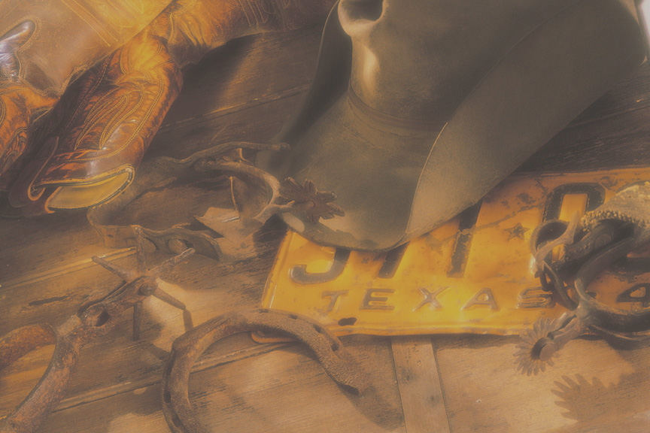
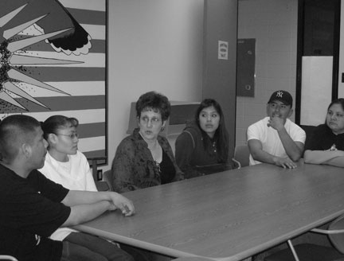

Slide 3
“The word, History, comes from the Greek “historia” meaning “learning through inquiry.” Working with primary sources in a collaborative, constructive environment, my students, as historians, quickly begin to realize the relevancy of historical issues and their responsibilities as global citizens to compassionately reach out and make a difference in their worlds”
-Dr. Cathy L. Briggs

Slide 4
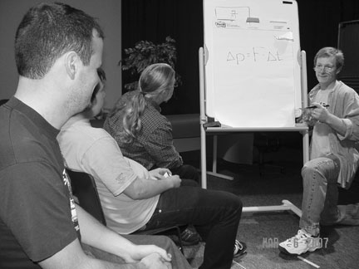

Slide 5
“It is all about the students. They are the inspiration and the joy”
-Silvino Ferreira

Slide 6
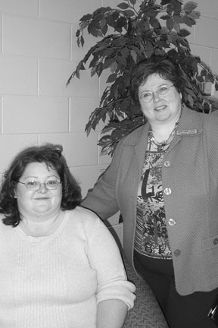

Slide 7
“I am motivated by the challenge of teaching and working with students who have to overcome many obstacles to seek an education. This has meant creating meaningful assignments and a classroom environment in which students can ask questions and take risks to learn new things”
-Farah Habib

Slide 8
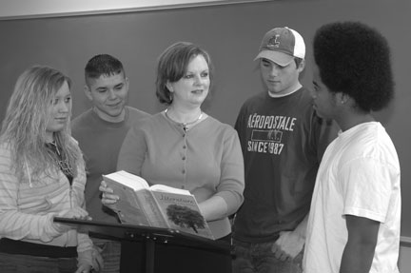

Slide 9
“Student success motivates me—a working mother who surpassed her expectations in basic writing or a second-year student from my first-year writing course who actively seeks out challenging courses that require writing. Success is a student who transforms from reticent to eager and thoughtful discussion participant”
-Jean-Paul Nadeau

Slide 10
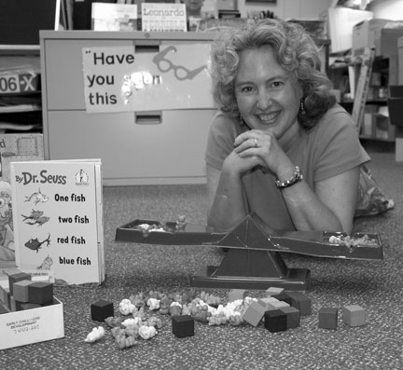

Slide 11
“In this era of tremendous change brought on by globalization, global warming, and impending fossil fuel depletion, community colleges have a vital role to play in developing sustainable communities. The need for forward-thinking education toward a post-carbon future, the importance of preparing students for a world faced with previously unknown challenges, and the satisfaction felt helping learners develop the knowledge and skills necessary to successfully face these changes keep me invigorated, inspired, and excited about teaching”
-Nancy Lee Wood

Slide 12
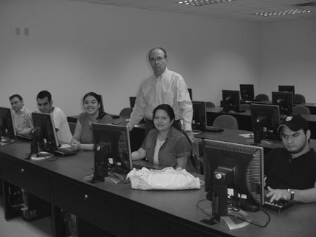

Slide 13
“Be flexible and creative in working with students, care about them as individuals. There is a temptation to pigeonhole everyone and to make decisions based on rules rather than on relationships. While rules are important, and should be followed, there are exceptions, and listening to students who need those exceptions often paves the way for a potential dropout to become a successful graduate”
-Brian Dopson

Slide 14
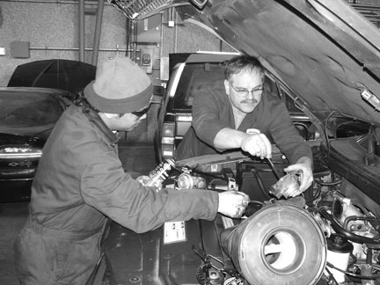

Slide 15
“I have been most successful in meeting the diverse needs of students when I have worked collaboratively with other faculty to create innovative learning strategies. I truly believe that every student can be successful”
-Dona C. Fletcher

Slide 16
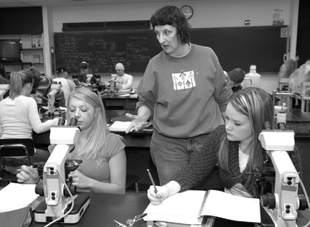

Slide 17
“To teach students, I must see them as people first. I understand the humanism they bring into our classroom and what they will ultimately bring into their classrooms as future teachers. It isn’t enough to lecture about social justice and equity in education; I have to practice it daily in context”
-Theresa Garfield

Slide 18
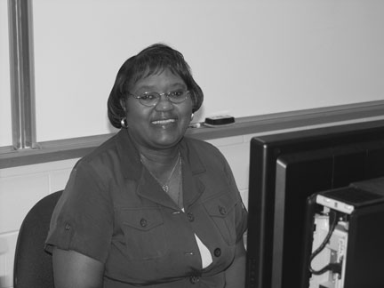

Slide 19
“We should not merely “profess”—we must inspire, as well. Even our most elementary courses should provide logical (and often visual) foundations, so that mathematical processes are intuitive and thought-provoking rather than abstract. Our passion should radiate throughout the classroom. When the path to competence is not only clearly marked but also fun to follow, it is well traveled”
-William Heierman

Slide 20
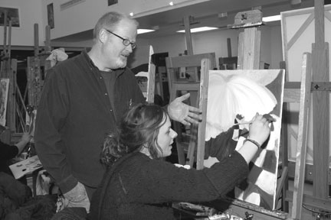

Slide 21
“The need to create something that contributes to the advancement of others motivates me. The presentation of a problem inspires me to find a solution. I see problems as opportunities and when I see the effects of my solutions, I'm inspired to work harder, to create more. Hustle as you wait. Work with your teammates; you can't win alone. However, don't be shy about playing your best game and making a goal whenever an opportunity arises. Be the best player on the team. It's only when every player has this attitude that the team wins”
-Farhad Javidi

Slide 22
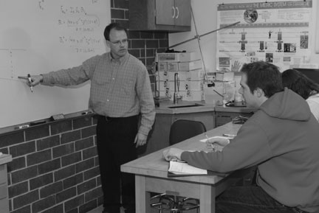

Slide 23
“I am a nursing instructor, and I always think of my students providing care for me, my children, and my family in the future. I want to feel confident that I prepared them to be safe and competent practitioners”
-Shiree Kennedy

Slide 24
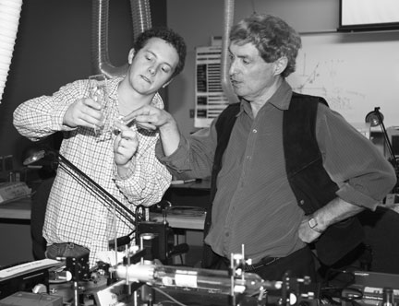

Slide 25
“Listen to students. When you stop listening, your passion for teaching is gone”
-Barbara Klomp

Slide 26
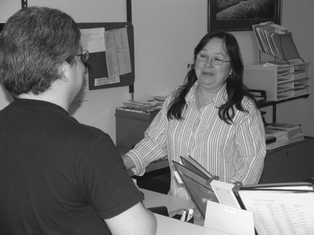

Slide 27
“Many things inspire a teacher, but nothing inspires more than a student’s heartfelt expression of gratitude. The compliments I’ve heard most often from students—though not always at the time they’re enrolled—is that I kept the standards high, expected nothing less than personal best, and cared for them”
-Norma Lawless

Slide 28
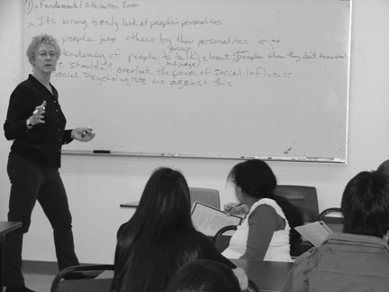

Slide 29
“I encourage life long learning. I tell students that when they feel comfortable with life is then when they must seek out new challenges”
-Tamar Lucas

Slide 30
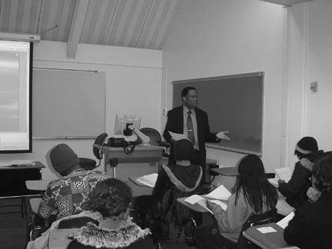

Slide 31
“Passion and compassion are watchwords for interactions with students. Passion comes from being excited about working with students whose success is important to a community’s economic future. Compassion stems from the recognition of our critical role in helping those students make informed decisions. An instructor’s commitment to excellence is contagious”
-Donald Morandini

Slide 32
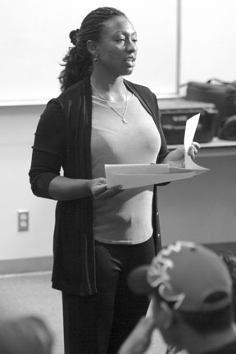

Slide 33
“My fifth-grade teacher had such a profound effect on me that I knew that I wanted to be a teacher. I tell my students at the beginning of each semester that math is my favorite subject. I usually hear groans from this remark, but by the end of the semester I hope they can say the same or at least like it better. To get to this level, they need to become more successful at it. If they agree to work with me—pay attention, do homework, ask questions, and attend class each day—they will be successful”
-Jeanne Pirie

Slide 34
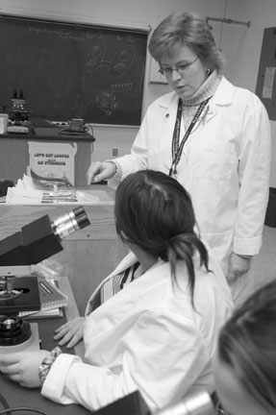

Slide 35
“It is my responsibility to foster a culture of teamwork, cooperation, and innovative thinking to provide students with the most enlightening experience possible”
-Amy Wright Perrin

Slide 36
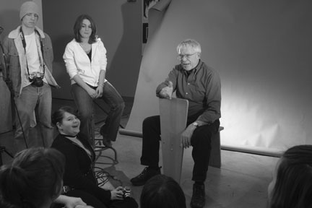

Slide 37
“I cannot think of a better occupation than to have fun teaching a subject as fascinating as psychology. Simply speculating about what makes others tick can be one of the most compelling activities in life.
I want students to leave my class with useful knowledge that will help them in their own lives—giving them practical solutions to real-life problems. I promote the idea that mistakes should not be viewed as signs of failure, but as learning experiences that help shape their behaviors towards success.”
-Lydia Powell

Slide 38
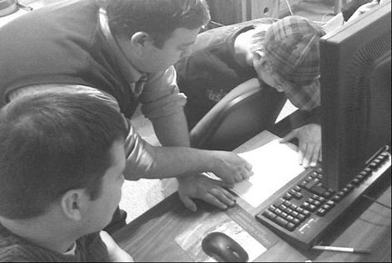

Slide 39
“The greatest joy and the very reason that have kept me teaching for last fourteen years have been the intellectual evolution and the mental transformation that I have been seeing in my students, and have seen it so vividly and noticeably. This evolution and transformation have been so notable, dramatic, and truly inspiring to me that has given me the greatest joy and fulfillment of my life”
-Francis Aryana Afghan

Slide 40
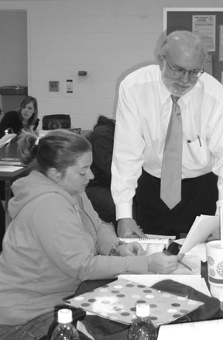

Slide 41
“My grandmother taught for two years, my mother for ten. Seeing two of my grandmother’s students at her 90th birthday party, and my mother’s students visiting her in her 90’s, I knew teaching could change lives for the better, including the teacher’s life. Through writing, reading, and talking, my students and I have raise each other’s awareness and improve our citizenship”
-Priscilla Bellairs

Slide 42
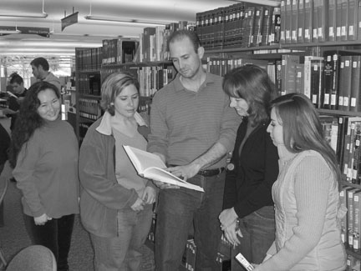

Slide 43
“Life is for learning. Learning requires mindfulness from both the teacher and the student. Mindfulness happens when we are fully engaged in our thinking, creative, and ready for something new, important and interesting to occur. Engagement happens when we experience the world openly, freshly and mindfully in the present moment”
-George Medelinskas

Slide 44
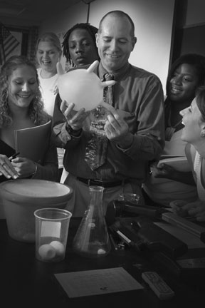

Slide 45
“For more than three decades I have had the honor and pleasure to be able to share the knowledge and wonders of the world with thousands of students. Geography allows me to explore—with students—all of the awesome aspects of our home, planet Earth. From weather and climate to volcanoes and earthquakes; languages and religions to music and stories, I love helping students discover the incredible power and beauty of our planet, the people who live here, everyday things and events, and how they are connected to the greater world”
-Robert (Bob) Hall

Slide 46
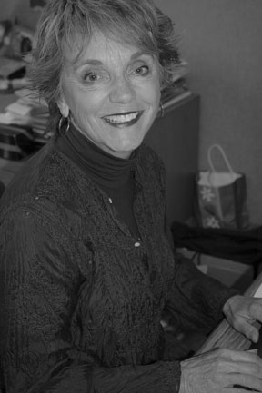

Slide 47
“Teaching inspired by blue collar, hard scrabble, born under a bad sign, second chance, bouncing back, leap of faith, tough, we shall overcome, fierce pride, don’t let the bastards keep you down, open some doors, flashes of brilliance, light some fuses, great leaps forward, justice, courage, and si se puede”
-Nathaniel Hong

Slide 48
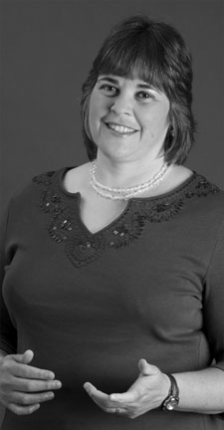

Slide 49
“I had wonderful mentors who taught me the true essence of commitment and the passion for teaching, and I am thankful for that. It is always delightful to receive a jubilant phone call inviting me to a college graduation or a call from a student reporting his/her progress in graduate school. And there are times when I simply receive a phone call from a student who says, “Thank you, for believing in me when I didn’t believe in myself.”
My strategy is to be prepared, treat students with dignity, be accessible, have an open-door policy, and reach out to students. My motto is I expect more from you rather than less. Do not cheat yourself when it comes to your education, do the best you can, you are investing in yourself and the future.”
-Dorothy Blackmon

Slide 50
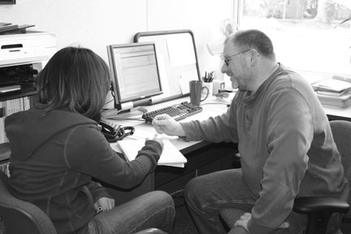

Slide 51
“Inspiration in the classroom is a two-way path. I am inspired by my students who consistently motivate me to develop and update, to elicit that spark of understanding and interest in a topic. I am driven by the responses of my students who despite enormous barriers continue to strive to obtain an education because they appreciate its value. As a veteran instructor the best strategy I have found for my success is to continuously reevaluate and reassess so that my approach to the material and the classroom remains fresh. We must avoid becoming stale—education is a living process.”
-Mary Hovanec

Slide 52
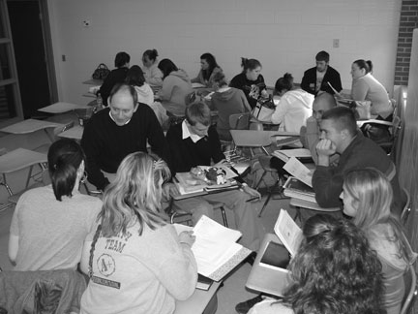

Slide 53
“I always had an interest in drawing and business , but it took a motivated art instructor and cooperative accounting teacher to encourage more career exploration. Through the seed of cooperation they planted in me 28 years ago, I start my own students on their own paths of exploration everyday.”
-David Brandstetter

Slide 54
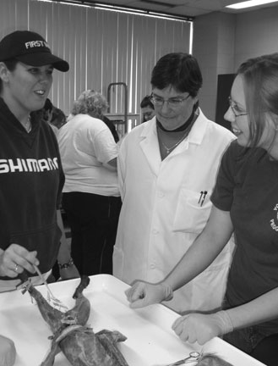

Slide 55
“Students who discover new worlds in a new language motivate me just as
those who develop a love for their own language and become lovers of
literature or poets themselves inspire me. Mutual respect and
appreciation carry the day in my classrooms, and I leave campus every day
richer, more interested, and even more interesting than when I arrived
because of what I have learned from my students”
-Sharon Ahern Fechter

Slide 56
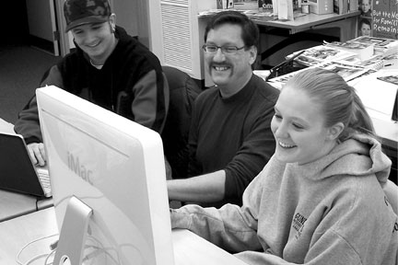

Slide 57
“Students inspire me by their eagerness to enhance their knowledge of the world around them. They demonstrate critical thinking through their open and respectful exchange of ideas. They value the opinions of their peers, while effectively communicating their own beliefs. Excellence occurs when they let me know they have registered to vote.”
-Mark Logas

Slide 58
“Believing in what you teach and teaching what you believe creates a powerful role model for our students.”
-Brenda Hurbanis

Slide 59
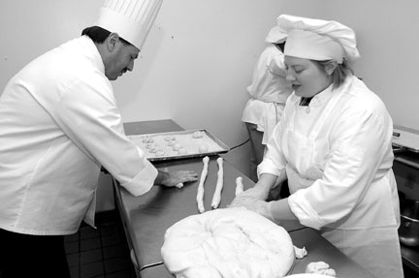

Slide 60
“My interest in teaching began in high school, and I’ve been enjoying it ever since. For me, the key word is “enjoy.” Not only do I love teaching others but I love to learn new things. I am constantly taking courses in different disciplines to increase my knowledge base. This helps me to become a better teacher.”
-Susanne Markowski

Slide 61
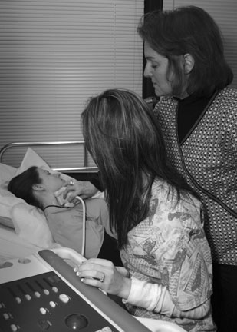

Slide 62
“Student success is “the engine that pulls the train.” This is at the core and the reason we do what we do.”
-Richard Niewerth

Slide 63
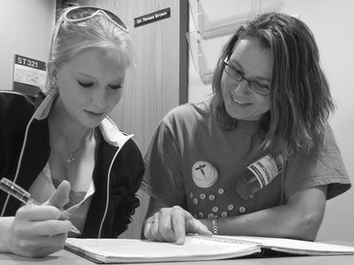

Slide 64
“To be an educator is to be an explorer. Sometimes you’re the scout; sometimes, the guide; other times, a follower. You help to point out destinations and how to create the maps to get there. However, you do not always choose the path that should be taken; that is often chosen by those you teach. The journey is often a difficult one, but therein lies the satisfaction.”
-Marilyn Trentham

Slide 65
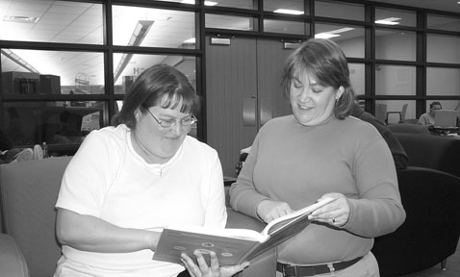

Slide 66
“I consider myself to be a "curious character," always analyzing how things function. This is lived out in the classroom. I hope that my enthusiasm is contagious in the sense that my students become passionate and curious about their world, especially since physics is a major part of everyday life!”
-Casey Durandet

Slide 67
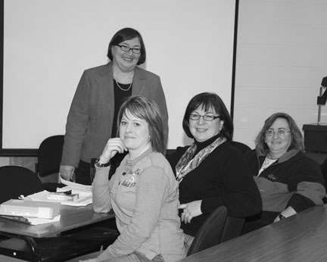

Slide 68
“I try to treat all students as adults capable of making decisions about their education. An attempt is made to create an environment that fosters participation in class and in the community; an environment where mistakes, made during honest attempts at success, are seen as valuable learning opportunities.”
-Michael R. Edwards

Slide 70
“ALWAYS err in favor of the student. Be a little understanding: Even if 50 students have told you the same story, give the 51st student the same wide-eyed look you gave the first. Be a little forgetful: When a student asks you the same question you just heard 30 seconds ago, forget you already answered it.”
-Joan Van Glabek

Slide 71
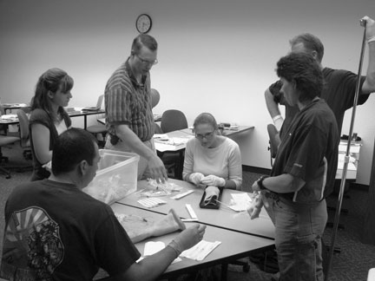

Slide 72
“I'm passionate about connecting students' lives with big ideas that really matter for their lives. As a class we stand in awe of the truth in a poem or reflect with trepidation on the challenge facing us in an idea. Students learn to see an issue in new ways, and they develop new perspectives: often they no longer think the way they once did. Truly this is life-changing, soul-enhancing, spirit-invigorating.”
-Deanna Louie

Slide 73
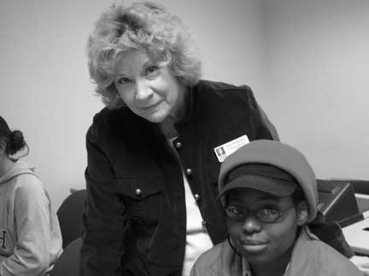

Slide 74
“It is necessary to invest in student interests as they relate not only to the classroom, but also to their dreams and future endeavors. Since I began teaching, I have made it a practice not only to learn the names of my students, but also to inquire about what motivates them.”
-Estelle DelPrincipe

Slide 75
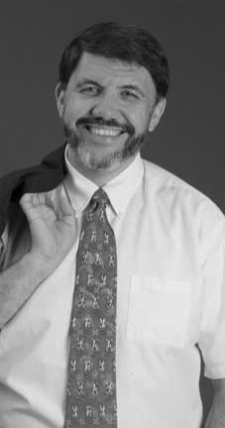

Slide 76
“The challenge is not for me to pontificate; the challenge is for my students to interrogate. I know I have met this challenge when my students ask me more questions in class than I ask them.”
-Kevin J. Graziano

Slide 77
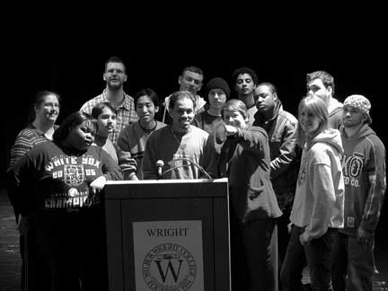

Slide 78
“Mediocrity is not an option, and leadership is inspiring others to strive for greatness. These principles have mentored me for years, and I include them in every endeavor I undertake."
-Jeffrey Kennedy

Slide 79
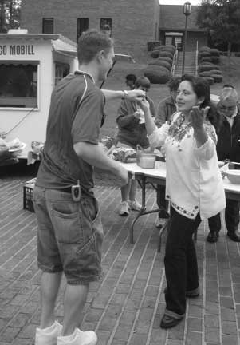

Slide 80
“When I stop having fun, then I’ll stop teaching.”
-Rita Gress

Slide 81
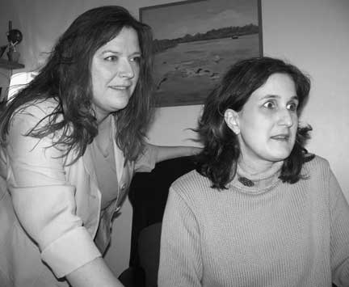

Slide 82
“In order to be successful in the workplace, you have to be confident and secure in yourself. Those are the skills that I enjoy developing in my students.”
-Ashley Moore

Slide 83
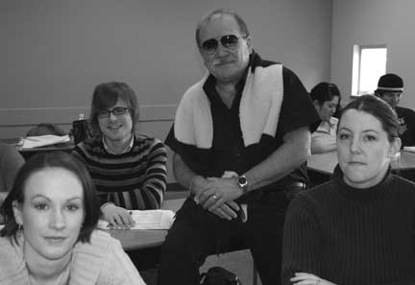

Slide 84
“The best tool to inspire students for me is to share my own life experiences as a Japan-born, visual artist working and maintaining studio practice daily and exhibiting nationally. Learning occurs when knowledge is applied in real-life situations. My role is to connect that gap in-between.”
-Mari Omori

Slide 85
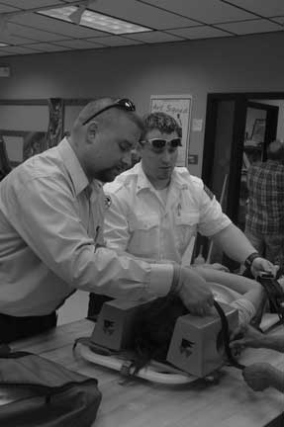

Slide 86
“Learning is a journey that takes a lifetime, and everyday that I walk into a classroom, my students share a part of their journey with me. Inevitably, some will stumble and fall along the way, just like I did. My job, though, isn’t to stop and pick them up but to provide them with the guidance that is necessary to move them from this part of their journey and help them succeed in the next.”
-David W. Putz

Slide 87
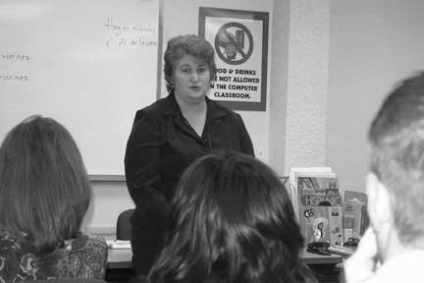

Slide 88
“I agree with Bakhtin: Meaning is made somewhere between self and Other. I gently encourage a sort of mutual awakening process—in myself by questioning everything I do and in the students by showing them how to examine their own thinking processes in terms of the Other.”
-Annie Gray

Slide 89
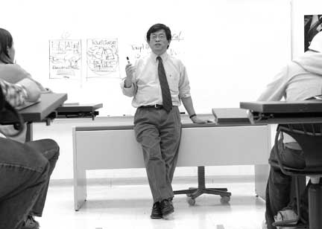

Slide 90
“Toss it in the air, and let all your ideas for teaching fall on your students. Every student will find something they like. It might be working in groups, role playing, interactive lectures where they teach, or it may be a teacher that allows them to reach for their goals. Motivation for me is a smile, a thank you or a card that says, “you’re a first rate teacher.”’
-Glenda Boling

Slide 91
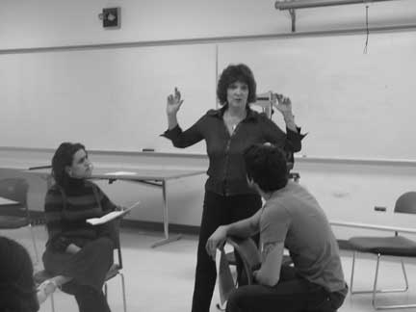

Slide 92
“Students need to become connected to the land in which they live. This connection comes from experience with the land - seeing, feeling, listening, and smelling are crucial to understanding. We need to make sure that every student realizes that a PowerPoint photograph of a saguaro is not a saguaro.”
-Tim Whittier

Slide 93
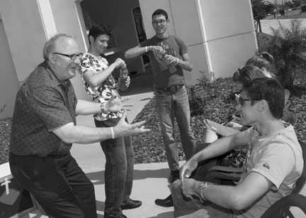

Slide 94
“A good setting for everyday is good, but flexibility lets me survive.”
-Queen Williams

Slide 95
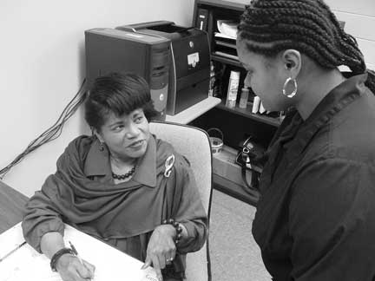

Slide 96
“I find that some of my most enjoyable classes are those that allow the free exchange of opinions and ideas within the classroom setting. My business ethics course usually starts off with a quiet group of students and evolves into a great discussion group by the end of the semester. I am able to watch them expand their thinking and conversations to reach areas many had not even considered. These students have a neutral ground to express their ideas and to learn about others.”
-Gary Tucker

Slide 97
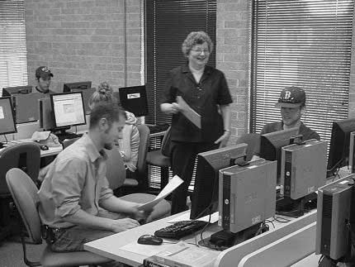

Slide 98
“The mediocre teacher tells. The good teacher explains. The superior teacher demonstrates. The great teacher inspires.”
-Stephanie Russ Penn

Slide 99
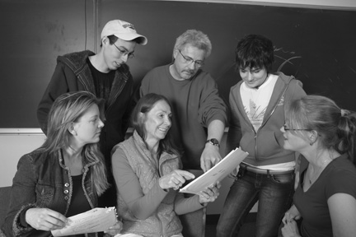

Slide 100
“I believe in simplicity and plain speech. My advice to other instructors—"Try to see materials through students' eyes.”’
-Ben Brink

Slide 101
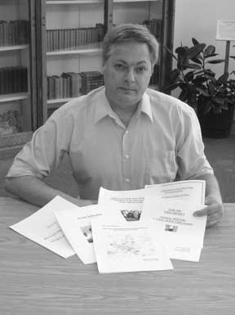

Slide 102
“When I first began my teaching career my department chair told me “you teach everyday but the most important lessons you teach are not what comes out of books it is how you live your life and the examples you set in your daily actions, this is what students remember and what they admire most about you.” Wow those were heavy words. Twenty years later those are the same words that motivate me today. I work very hard at what I do in order to be a positive role model to everyone I teach.”
-Debbie Reed

Slide 104
“I strive to teach myself out of a job by empowering students to understand and change their world.”
-Sasha Tarrant

Slide 106
“I am inspired and motivated by students learning and achieving goals they thought impossible. Their excitement becomes contagious as they gain confidence and dream of unlimited possibilities.”
-Kathy Pillans

Slide 108
“Know your material; know your students,’ Mutual respect in the student-teacher relationship, a contagious enthusiasm in the enjoyment of science, a high expectation for achievement nurtured by generous encouragement, and the development of critical thinking skills for scientific literacy and global service is teaching at its best.”
-Kevin Conley

Slide 110
“Teaching developmental math is so much more than teaching math. I teach self confidence and self esteem, also. And quite frankly, since these are issues I have dealt with my entire life, I consider these even more important than the mathematics. Gasp!”
-Nan Strebeck

Slide 112
“What inspires me is that fact that I know I make a difference. I hear that when the students come to me and say, "I finally get it." I see it when they give me the smile, the smile that says, "I did not understand it, until today.”’
-Arkady Hanjiev

Slide 114
“I am encouraged when I see my passion of nursing transform the student into a compassionate, competent caregiver.”
-Lena Warner

Slide 116
“Education is not simply about stuffing information into students’ heads. What really matters is enabling people to do something with that information – to analyze it, evaluate it, apply it meaningfully to their own lives. When students begin to use information, they become confident, engaged human beings. That is my everyday inspiration.”
-Thomas Hodgkin

Slide 117
“Smiles and enthusiasm motivate me. Whether I'm teaching someone to fly an airplane or to manage a business, students must be 'touching and feeling the subject to learn. One of my most valued rewards in life is when students have fun, develop confidence, and take ownership of their own learning.”
-Michael Boyd

Slide 119
“When I teach, my goal is to create an atmosphere of discovery in which each class becomes a journey and learning an adventure. I combine the elements of concentration and focus with a kind of creative chaos that encourages risk taking. As a teacher of acting, I am fortunate to have the opportunity to explore in an emotionally charged environment what it means to be human.”
-Mary Clifford

Slide 121
“My teaching is a model of my best teachers.”
-Kevin Harris

Slide 123
“I work with students who are academically at risk, and what motivates me the most is to see once apathetic students with high stress and low self-esteem, transform into engaged students with new hope for their future. Get to know your students, let them get to know you, and show them that you care.”
-Suzanna Borawski

Slide 125
“Teaching is a calling and a passion. The key to being a successful teacher is to love your discipline and love sharing your knowledge of it. Students must be taught with both courtesy and respect–respect for the individual student and the student’s abilities, efforts, and dreams.”
-Charles Gordon Moore

Slide 127
“Students will rise to our expectations. If you let students know what you want and expect, you will usually get it.”
-Connie Weber

Slide 129
“Many of my DEV students have challenges most of us can only imagine, so my job is not just teaching them how to write but also to believe in themselves. I understand they have to try harder to be successful, and their efforts motivate me to be a better teacher.”
-Karen L. Fleming

Slide 131
“What motivates me is the joy of helping students achieve something new, whether it is mastering a new algebra skill, exploring a pattern or a relationship between topics, or overcoming their fear of mathematics and learning they CAN apply it with confidence when they encounter a new problem.”
-Catherine Hess

Slide 133
“Literacy empowers. Refine a student's ability to read and write, and you increase her odds. Literature cultivates. It humanizes. Fictional, it contains Truth. We read and we ask, "Can I be more tolerant?" "More passionate?" "More meaningful?" I'm inspired when my students begin to think the answers might be "yes.”’
-Steven Canaday

Slide 135
“My philosophy in the classroom is– if you don’t know the answer, then it is not a dumb question. In addition to teaching math concepts, I work on subtracting their math anxiety. If I can multiply their positive experiences in the classroom then I won’t have the large division between my expectations and their less than perfect performance.”
-Janice Hubbard

Slide 137
‘“I hate history—it's boring!” This typical response to my favorite subject inspires my teaching every semester. Changing students into proactive thinkers, opening their minds to see the world in a new context, and creating meaning for our collective future as well as our past, makes the ultimate difference to me as a teacher.”
-Larry Davis

Slide 139
“As a teacher, I possess the power to make a person's experience miserable or joyous. What I do can harm, heal, humiliate, or inspire. This is a responsibility I do not take lightly and which motivates me to be the best teacher I can be.”
-Maria Kelly

Slide 141
“In teaching students: Challenge them; expect the most from them; work them; work for them; work with them; expect their respect; provide them with the tools for success; teach them how to use the tools; help them help themselves; give them responsibilities; make them responsible.”
-Barbara Barrett

Slide 143
“My goal is to help my students become their own best teachers. Therefore, our classroom is a workshop in which the students function as both teachers and learners in the construction of knowledge. At the end of the semester, I bid them farewell and watch them walk confidently toward the next challenge.”
-Martha McGovern

Slide 145
“Words create the world we live in. Good language skills allow us to express ideas, solve problems, and empathize with others. I teach English because I love to watch students take control of their worlds through written and spoken language. I hope I help create caring, confident, and articulate people.”
-Jane Elkington Wohl

Slide 147
“I love teaching; my passion is reflected in my interactions with students in and out of the classroom. You don't always know WHEN you make a difference but you DO.”
-Gayle Fisher

Slide 149
“I believe that ‘wisdom’ more likely resides in my students than in myself and that my ‘work’ is to help them articulate that wisdom in the service of their own learning. What inspires me is the privilege of seeing learners take these steps, to make new connections and to see their ‘aha’ moments.”
-Laurie Phipps

Slide 151
“As long as I remain a passionate learner, I’ll be a worthy teacher.
My classroom is a scheduled engagement, where I attempt to answer the students’ question; “What’s in it for me?” I believe that lesson plans should revolve around student participation, not cross-examination.”
-Gary Slivenik

Slide 153
“Co-workers and students alike stimulate growth. Such a setting is a catalyst to sharing new ideas. It’s a pleasure to be among people who are so open to discovery and so eager for success."
-Alain Paradis

Slide 155
“I am inspired and energized when students say that their lives have changed, when good honest people are given second chances, when single parents see success, when refugees find hope, when people finally see the potential they have, and when graduates become my advisors and give back to the program.”
-John Harrison

Slide 157
“My inspiration and motivation come from students. I model techniques that students can use when they become classroom teachers. I give them opportunities to be the teacher, for “To teach is to learn twice” (Joseph Joubert, Pensees, 1842).”
-Katharine Rhodes

Slide 159
“I believe that I bring a high level of energy, enthusiasm, and commitment to my teaching, and that I learn from my students at least as much as they learn from me. I aim to supply a positive role model for students, one of energetic, vital and serious engagement with the process of art making, with ideas, and with society.”
-Rafael Goldchain

Slide 161
“I know learning American Sign Language effectively encourages students to respect the diversity of contemporary America. When my students interact with the Deaf -World I see in them a rise in enthusiasm towards "owning" ASL; in turn, their enthusiasm gives rise in me a sense that what I do makes a difference.”
-Debra Drobney

Slide 163
"Each semester, I am inspired to reach out to every student, remembering the joy of former students who found dreams to follow."
-Kumkum Prabhakar

Slide 165
“Throughout my 43 years of teaching, my philosophy has served me well. It is: Love students unconditionally, communicate on their level, and let them know I want to teach them. Pose questions to students that require critically thought out responses, and ask what they think.”
-Floyd Young

Slide 167
“I am a teacher because of the opportunity to influence students in a subject for which I am passionate. I know the power of a healthy lifestyle and am privileged to pass along my knowledge and enthusiasm. When I make a positive difference in a student’s life, it inspires me to teach again tomorrow.”
-Nancy Anderson

Slide 169
“Teaching is an adventure, an exchange of gifts, a diving into the unknown. It’s seeing the light bulb click on above my students’ heads, watching the shy ones find their voices, and gain confidence in their skills. It’s being moved by those who hated Shakespeare until they saw a live performance of King Lear. When they succeed in their careers because of something they learned in my class, I know this is best profession for me.”
-Judy Rosenberg

Slide 171
“Giving your best develops the best students.”
-Pattie A. Robinson

Slide 173
“Driven daily by signature themes of strategic, connectedness, relator, responsibility, and achiever help me to understand my inherent responsibility, lift as I climb.”
-Vernard Grice

Slide 175
“Driven daily by signature themes of strategic, connectedness, relator, responsibility, and achiever help me to understand my inherent responsibility, lift as I climb.”
-Vernard Grice

