Slide 1
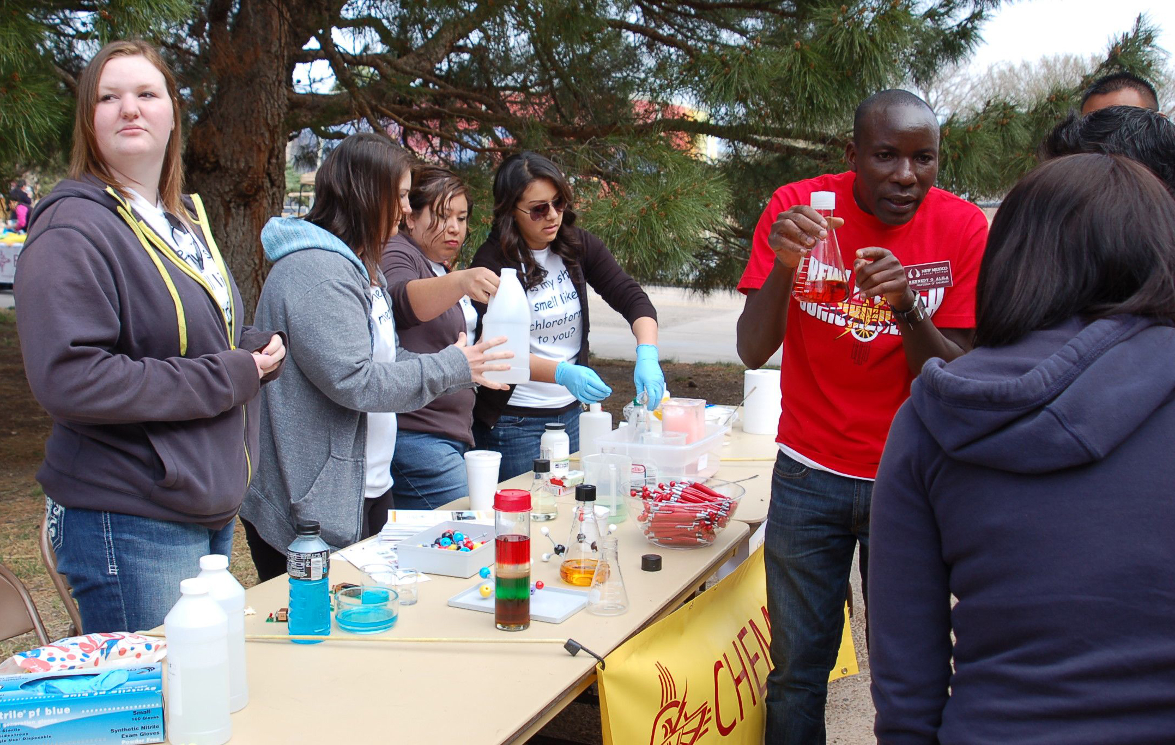
Knowing that I teach to make a difference in a student's future life is so inspiring. Also, teaching and learning chemistry indoors or outdoors can be fun and motivating. Here at New Mexico Junior College, we promote student's success through learning.
—Kennedy Alila, New Mexico Junior College

Slide 2
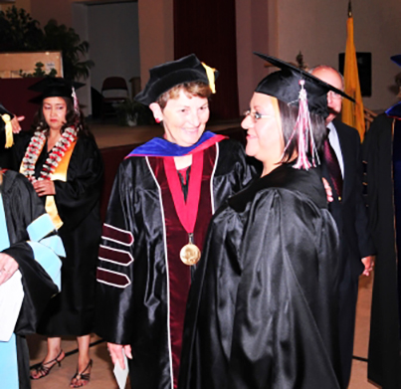
Students inspire me! Most of my students have jobs and families. Their determination to achieve and finish a degree motivates me to offer supportive high-quality instruction. My strategies for success and words of wisdom are simple: work hard, never give up, be open to learn more, and improve.
—Joyce Hill, New Mexico State University-Alamogordo

Slide 3
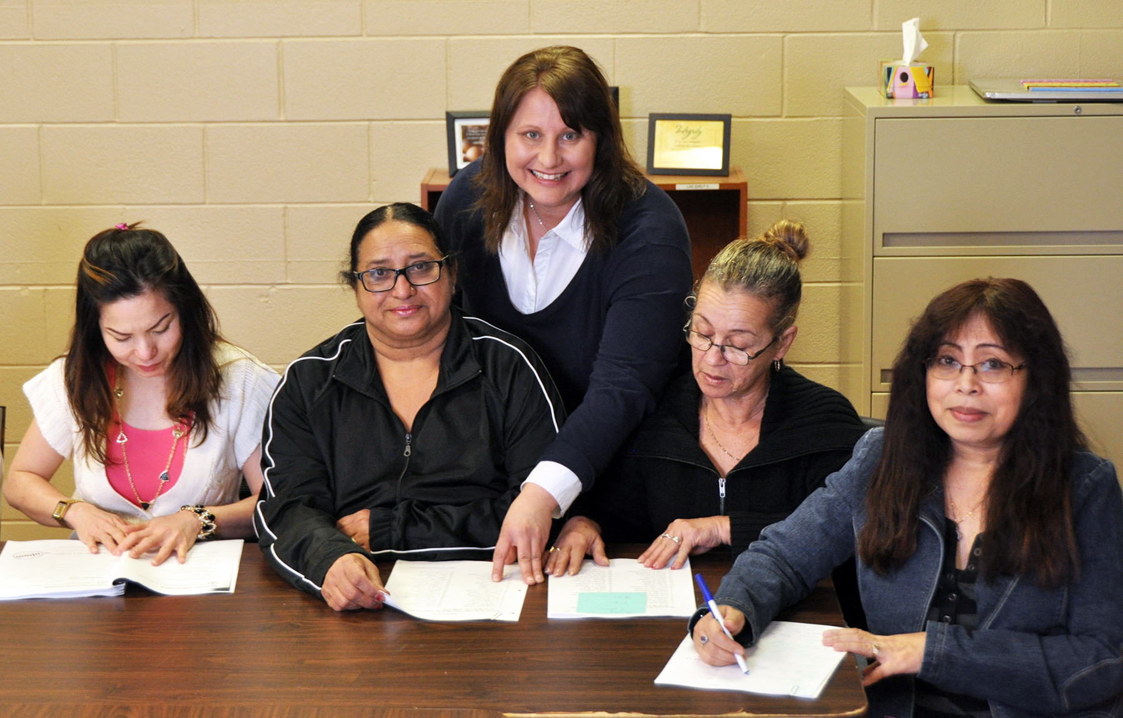
For upgrading students, classroom culture is at the heart of every success story. These students are working, parenting, and overcoming obstacles all day long. If life is chaotic and lonely, the classroom needs to be calm, warm, and supportive. If life is exhausting, the classroom needs to be bursting with light, curiosity, and laughter. When coming to class feels like coming home, our students have a safe place to take risks and surprise themselves.
—Sandra Faust, North Island College

Slide 4
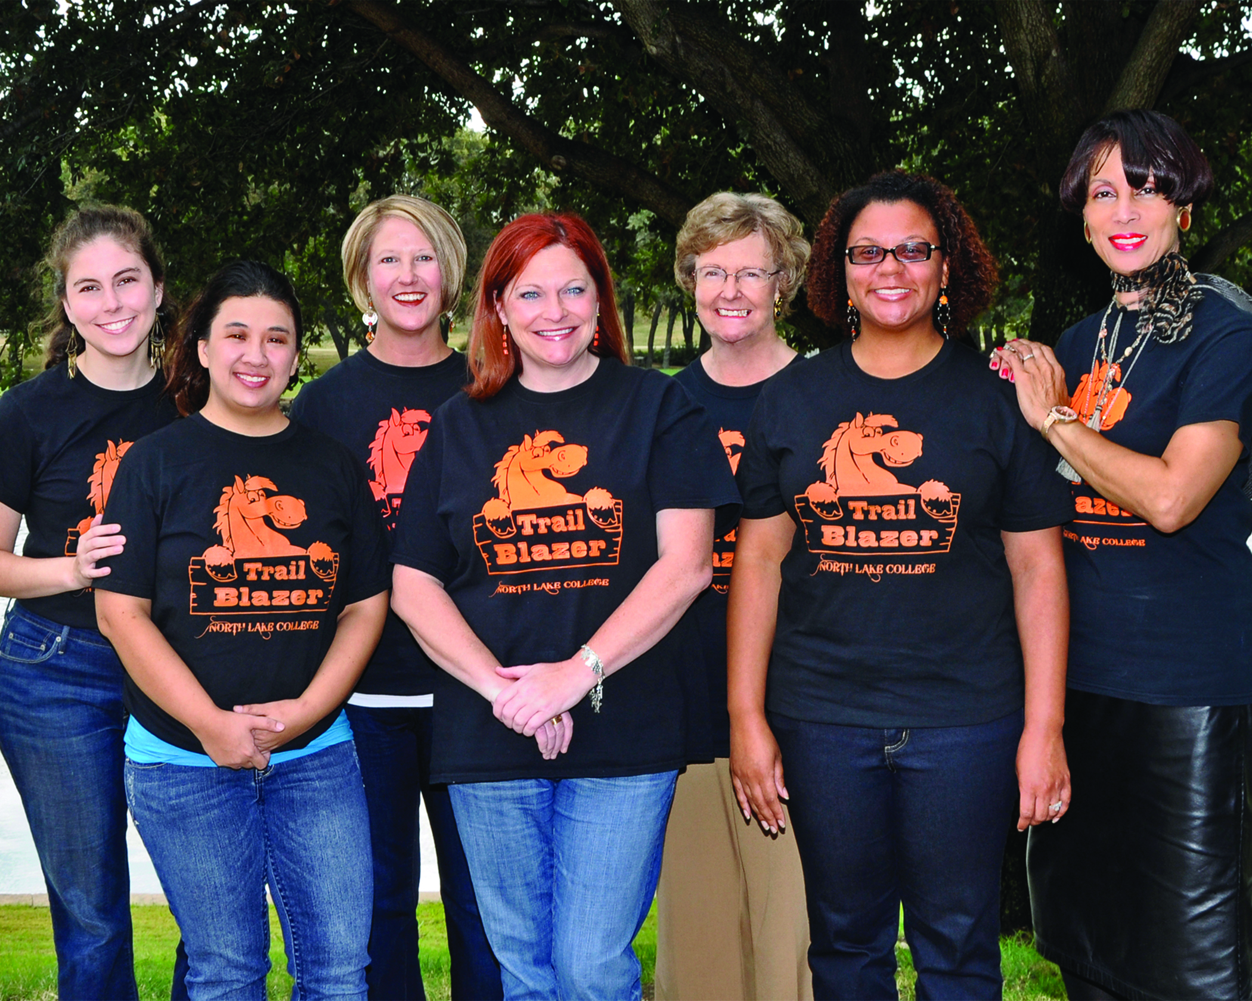
The Trail Blazer Orientation involves student leaders who engage new students with every facet of North Lake College. The innovative program promotes participation in campus services and organizations which fosters retention. The quality and success of the program can be measured by the extent of campus involvement.
—Emilie Turner, Debra Jenson, Beth Nikopoulos, Candace Eldridge, Virginia Jones, Andreshia Kelley and Adrianne Settles, North Lake College

Slide 5
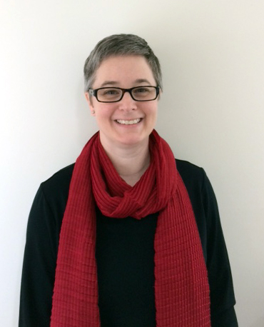
—Kara Kaufman, North Shore Community College

Slide 6
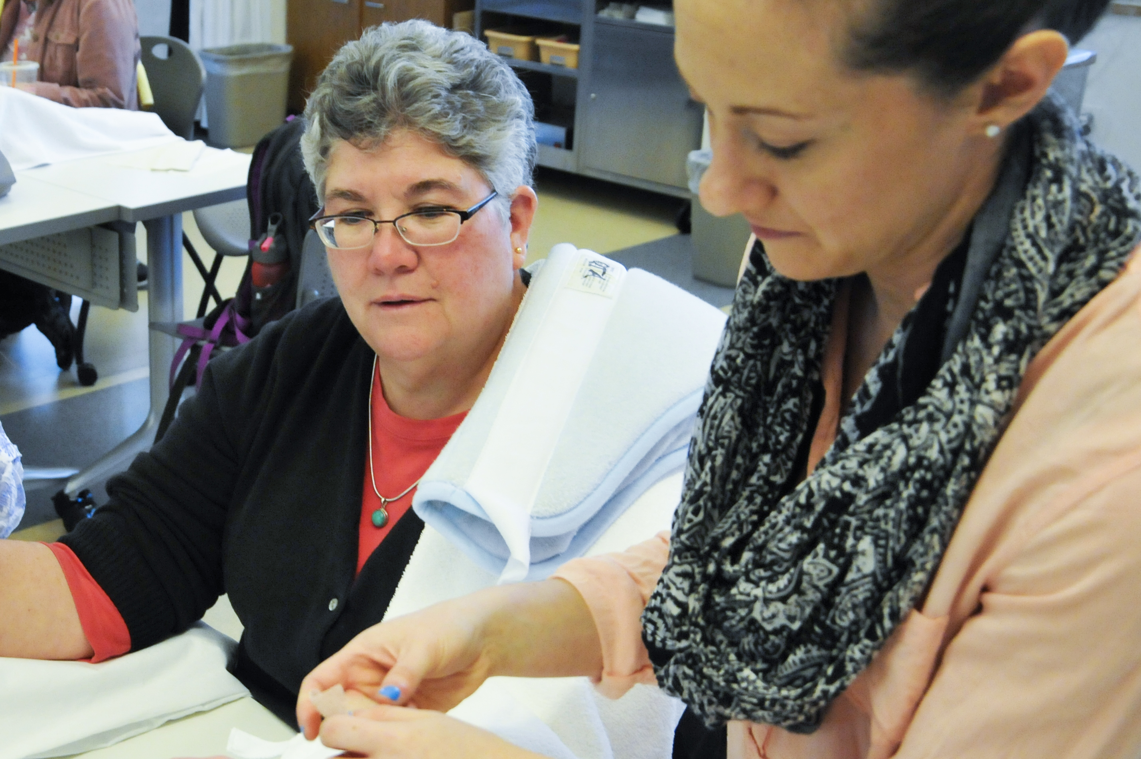
The inspiration of my teaching comes from the profession of occupational therapy where we do "with" our clients to allow engagement in the roles that bring meaning to the human experience. I encourage my students to "occupy" their learning with action and interaction. Frequently reminding the student, "Don't anticipate, participate.”
—Mary Malone, North Shore Community College

Slide 7
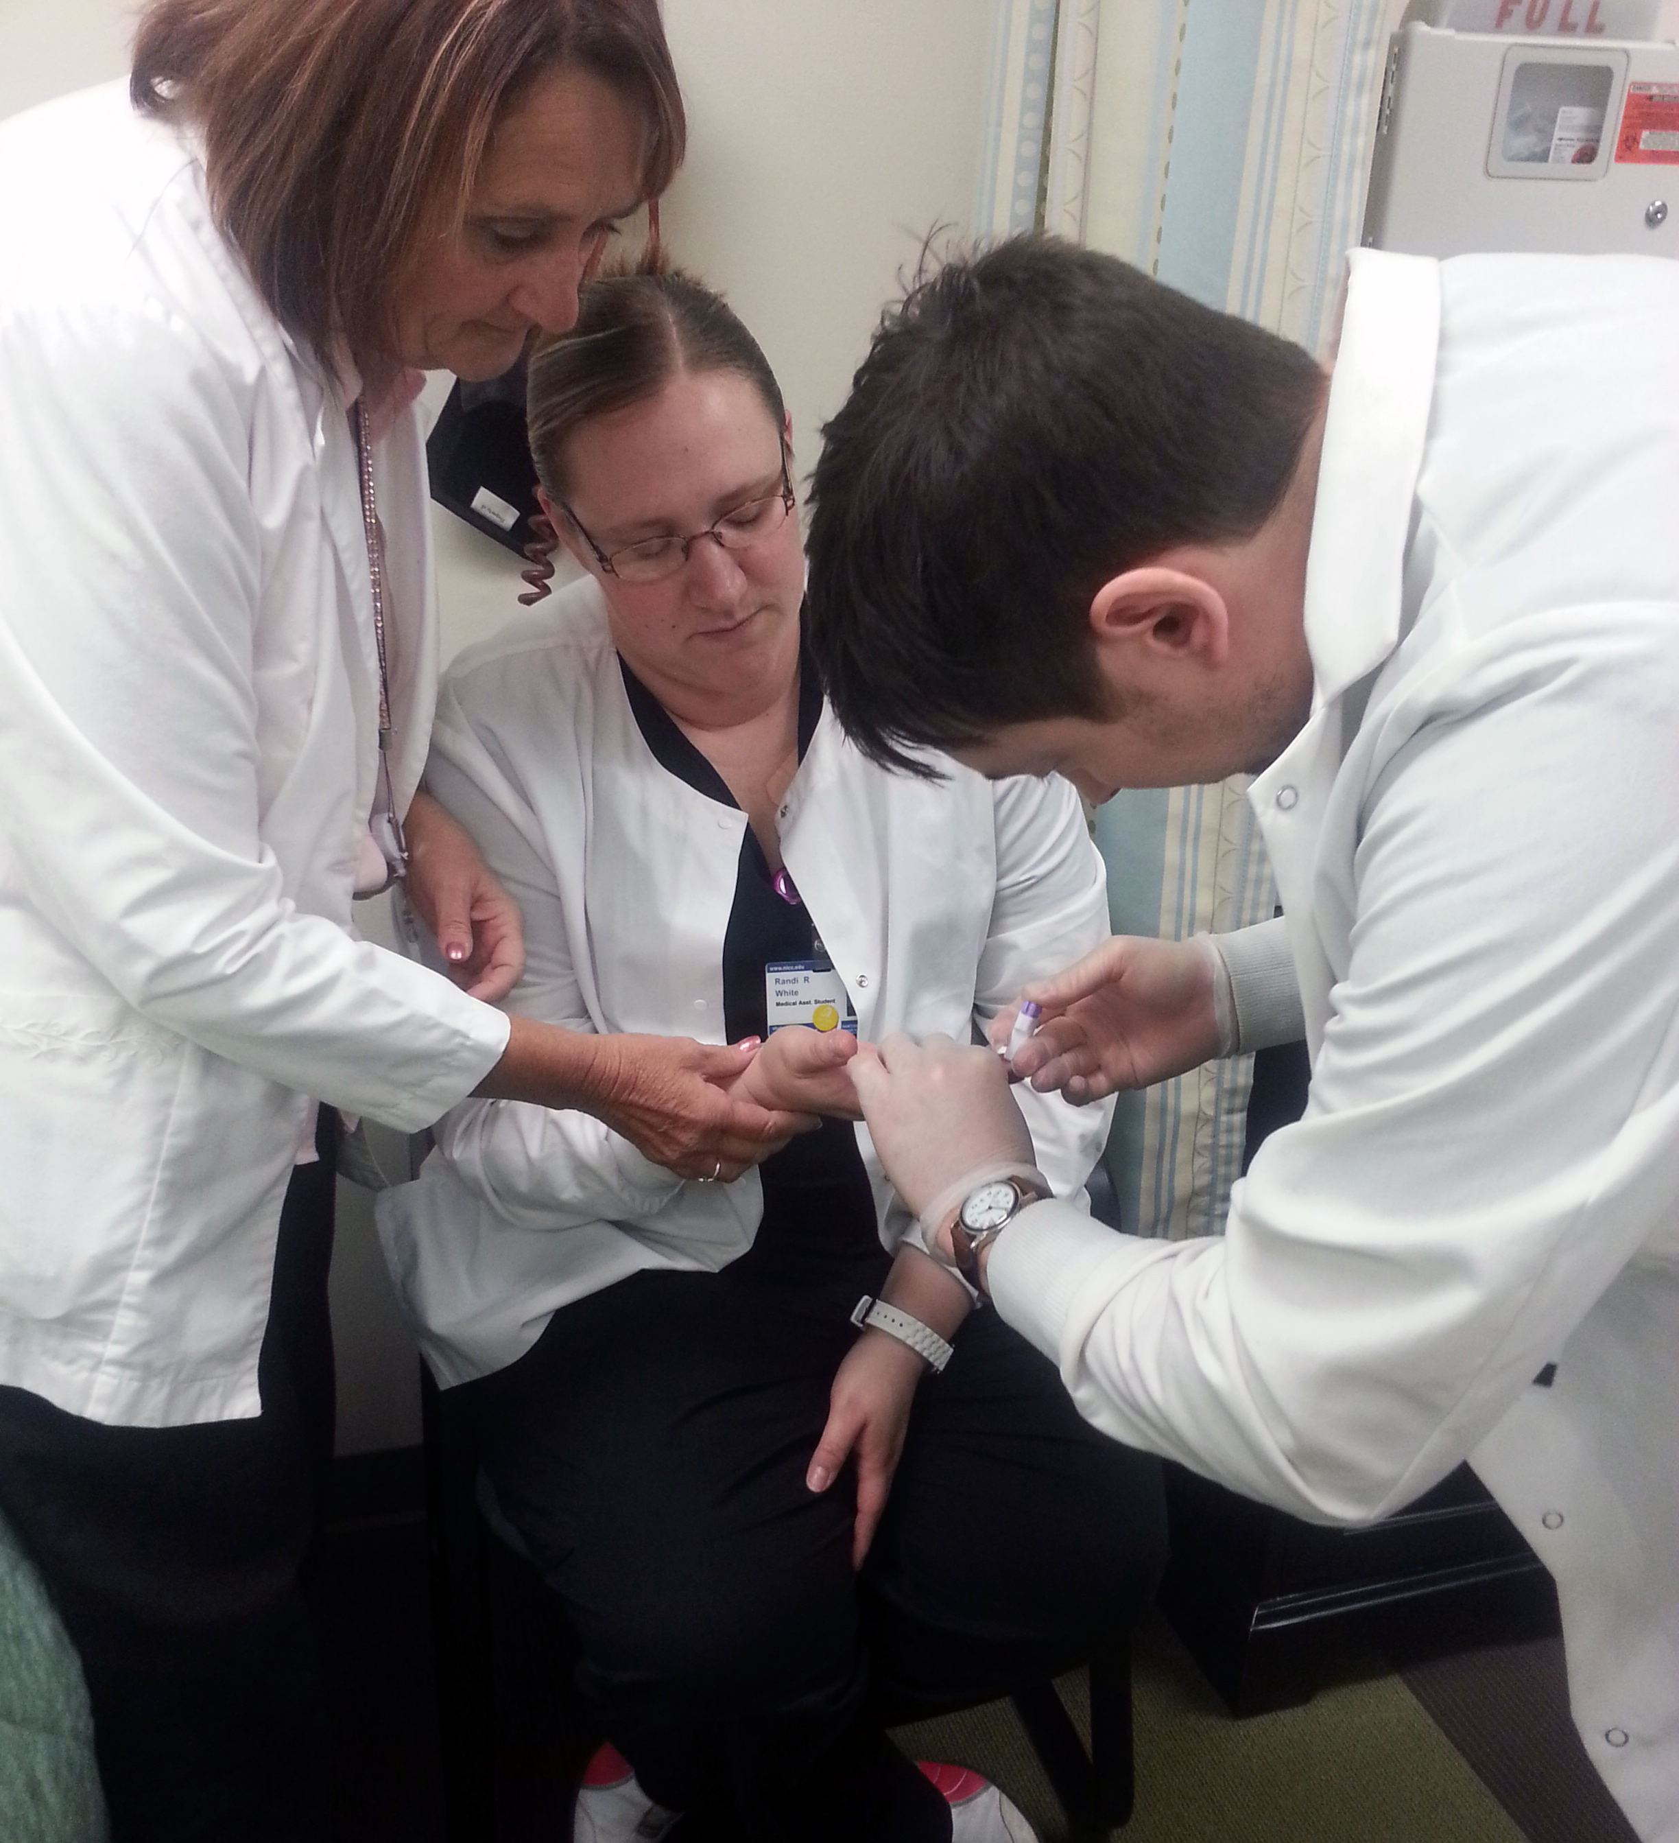
—Sandi Welsh, Northeast Iowa Community College

Slide 8
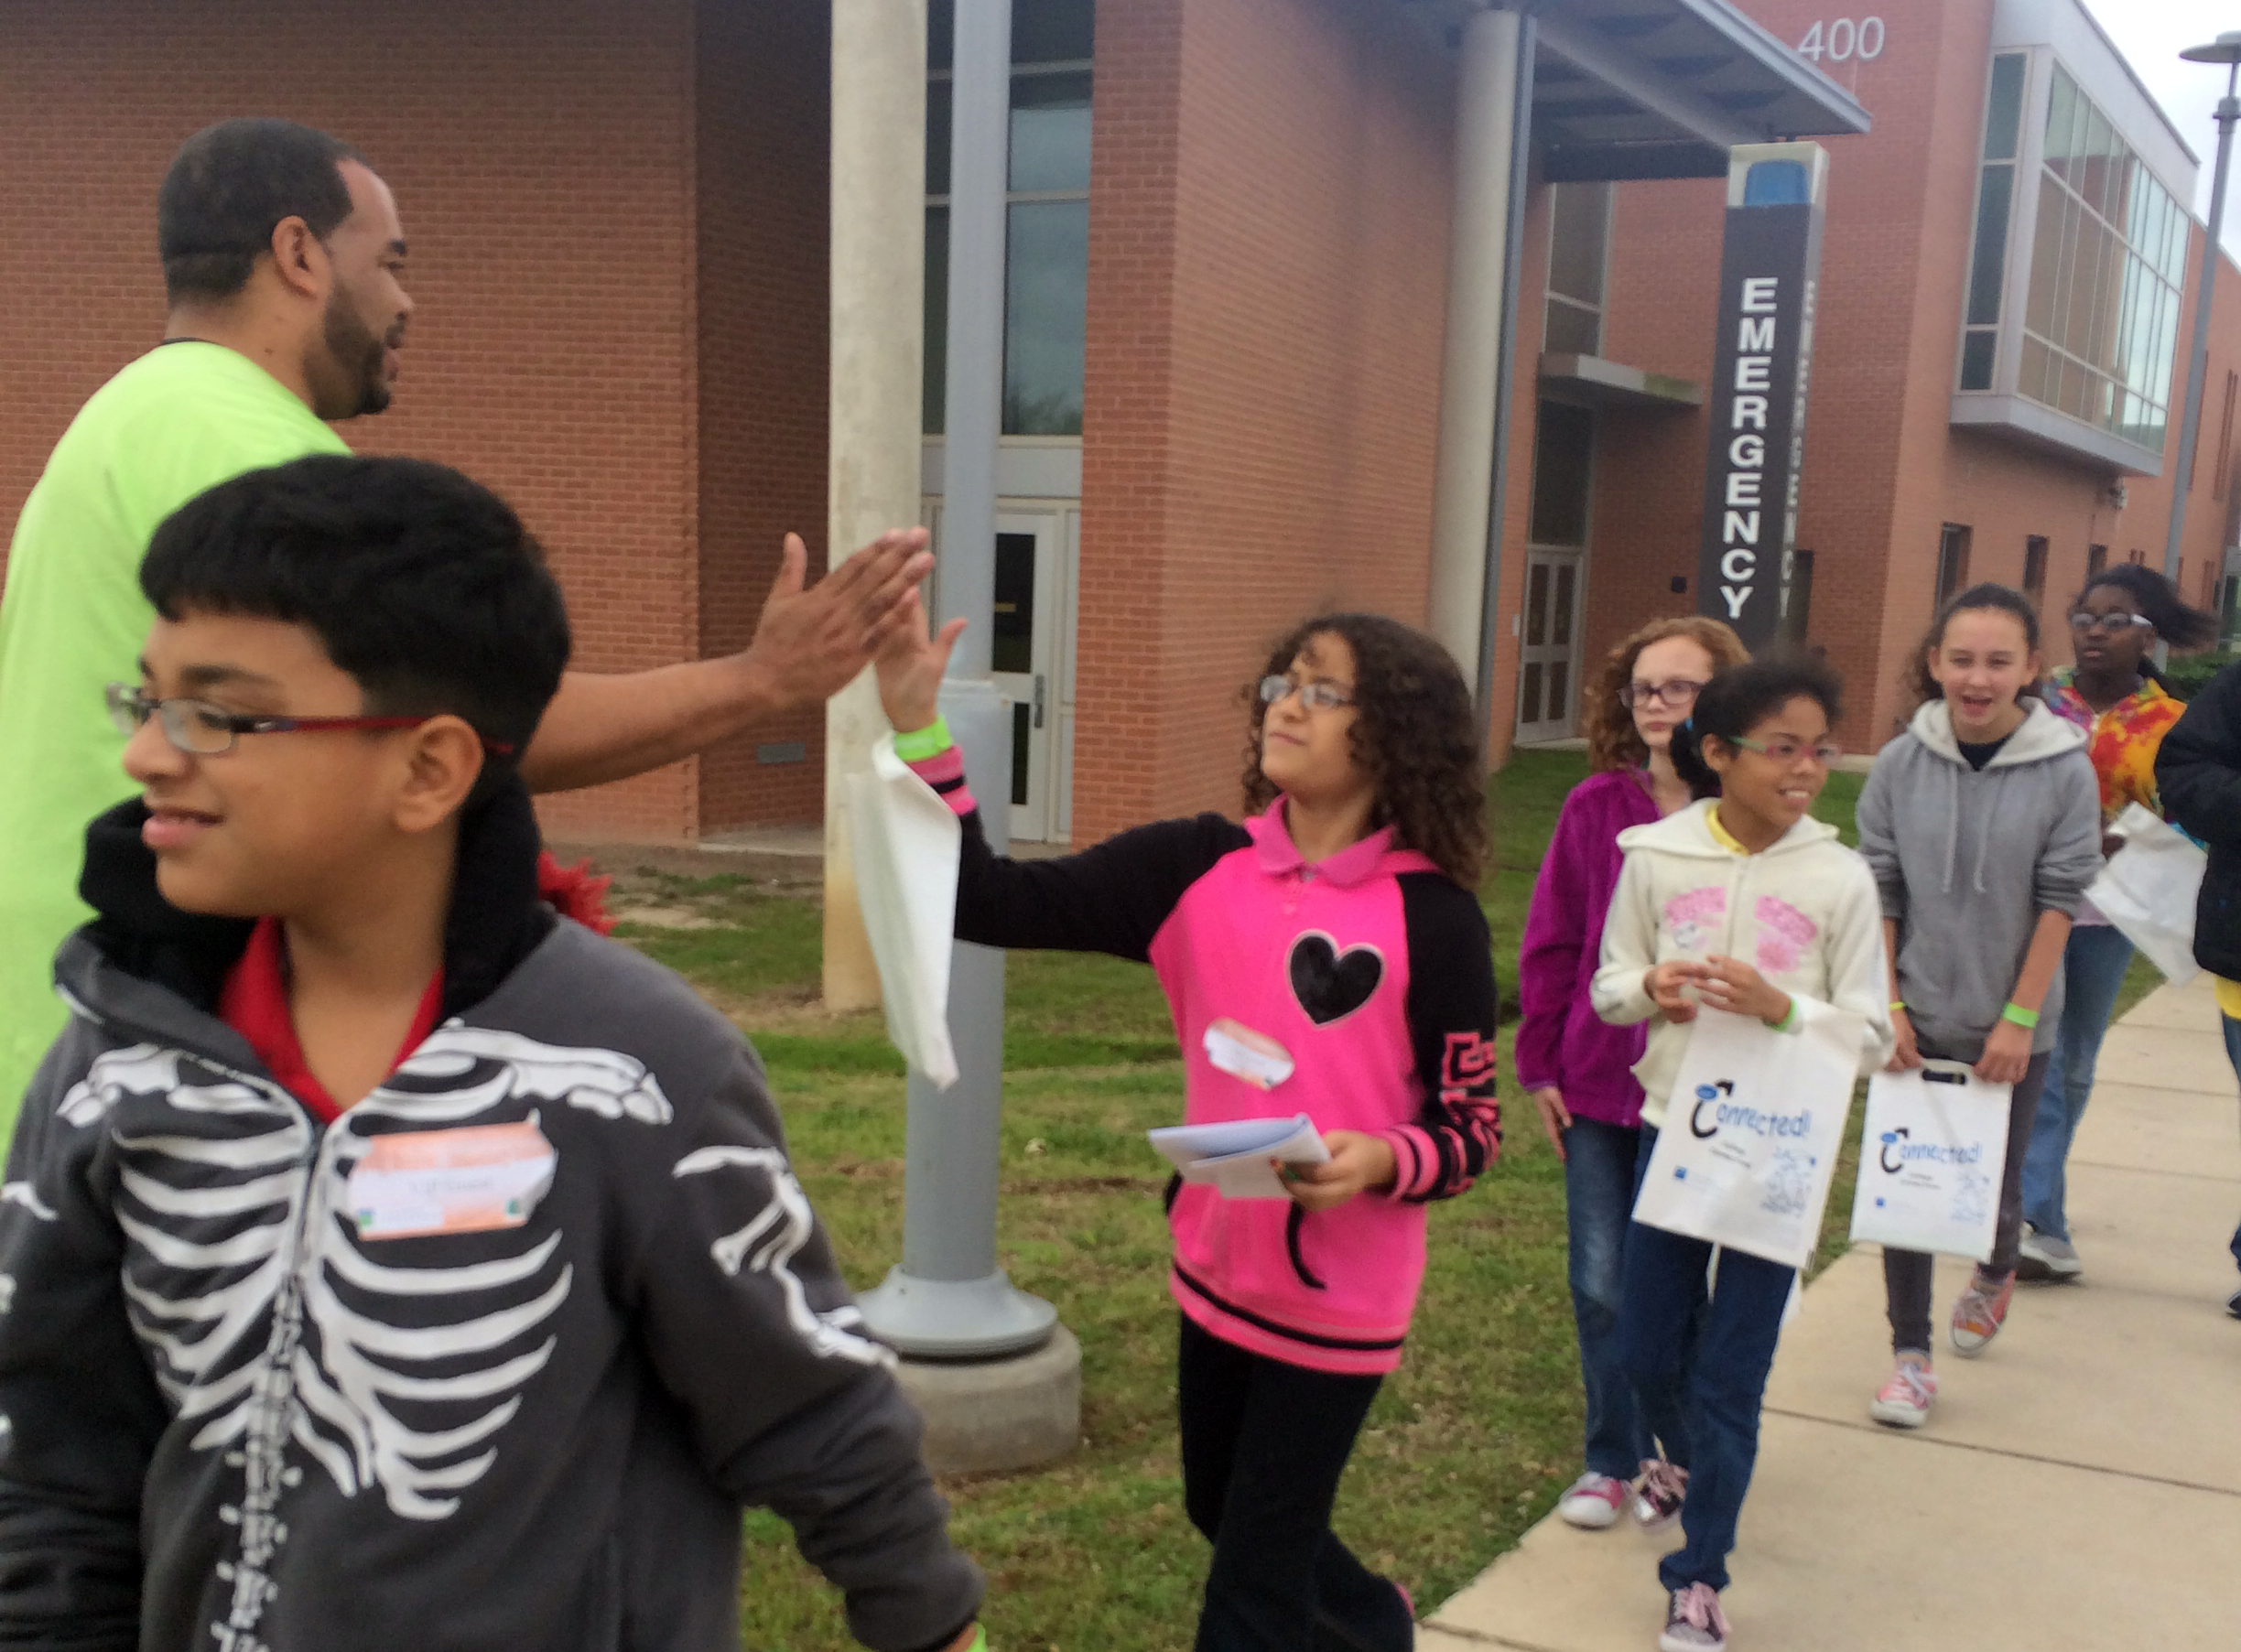
Elementary and middle school students will better understand that a college degree is attainable and in their future when they have the opportunity to visit a college campus, hear from college representatives, and speak to college students. Investing in these schools causes long-term change within the community.
—Phillip Hicks, Northeast Lakeview College

Slide 9
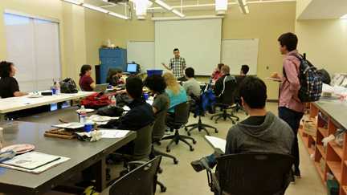
The students that I love working with the most are creative, collaborative, and kind. It only makes sense that I should try to learn from them to teach that way.
—Karl Frey, Northeast Lakeview College

Slide 10
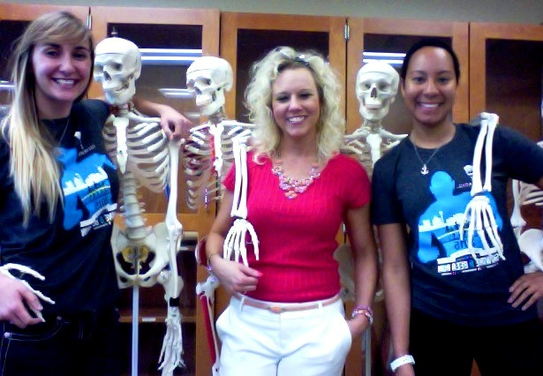
Teaching is my passion, and it allows me the opportunity to engage, enlighten, and excite students about the science of the human body. Every semester, my students become an extension of my family, and I'm truly grateful to share my passion with students who are interested in learning from me!
—Karla Ann Kosub-Coronado, Northeast Lakeview College

Slide 11
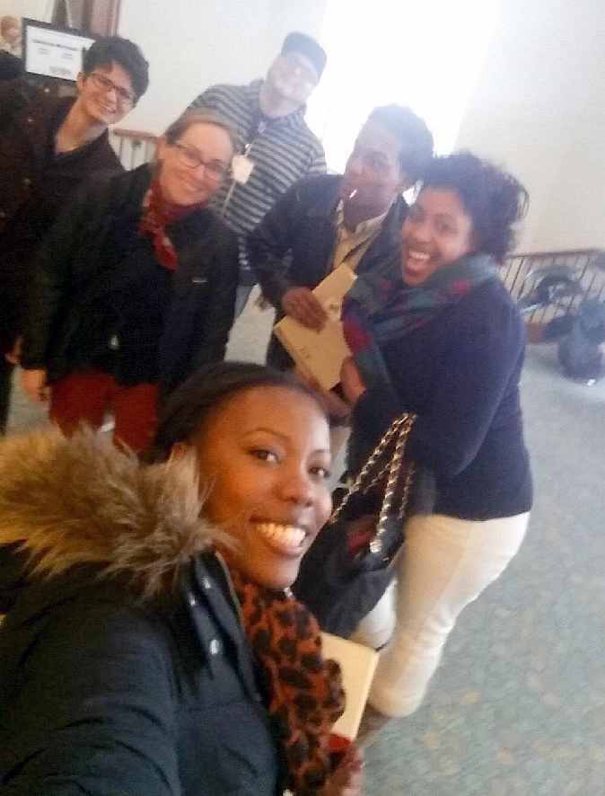
I want my students to learn to communicate effectively with others, understand the complexities of the free press and free speech, find their own voice, and explore the various media through which to express themselves. I consider this a very important job.
—Amy Callahan, Northern Essex Community College

Slide 12
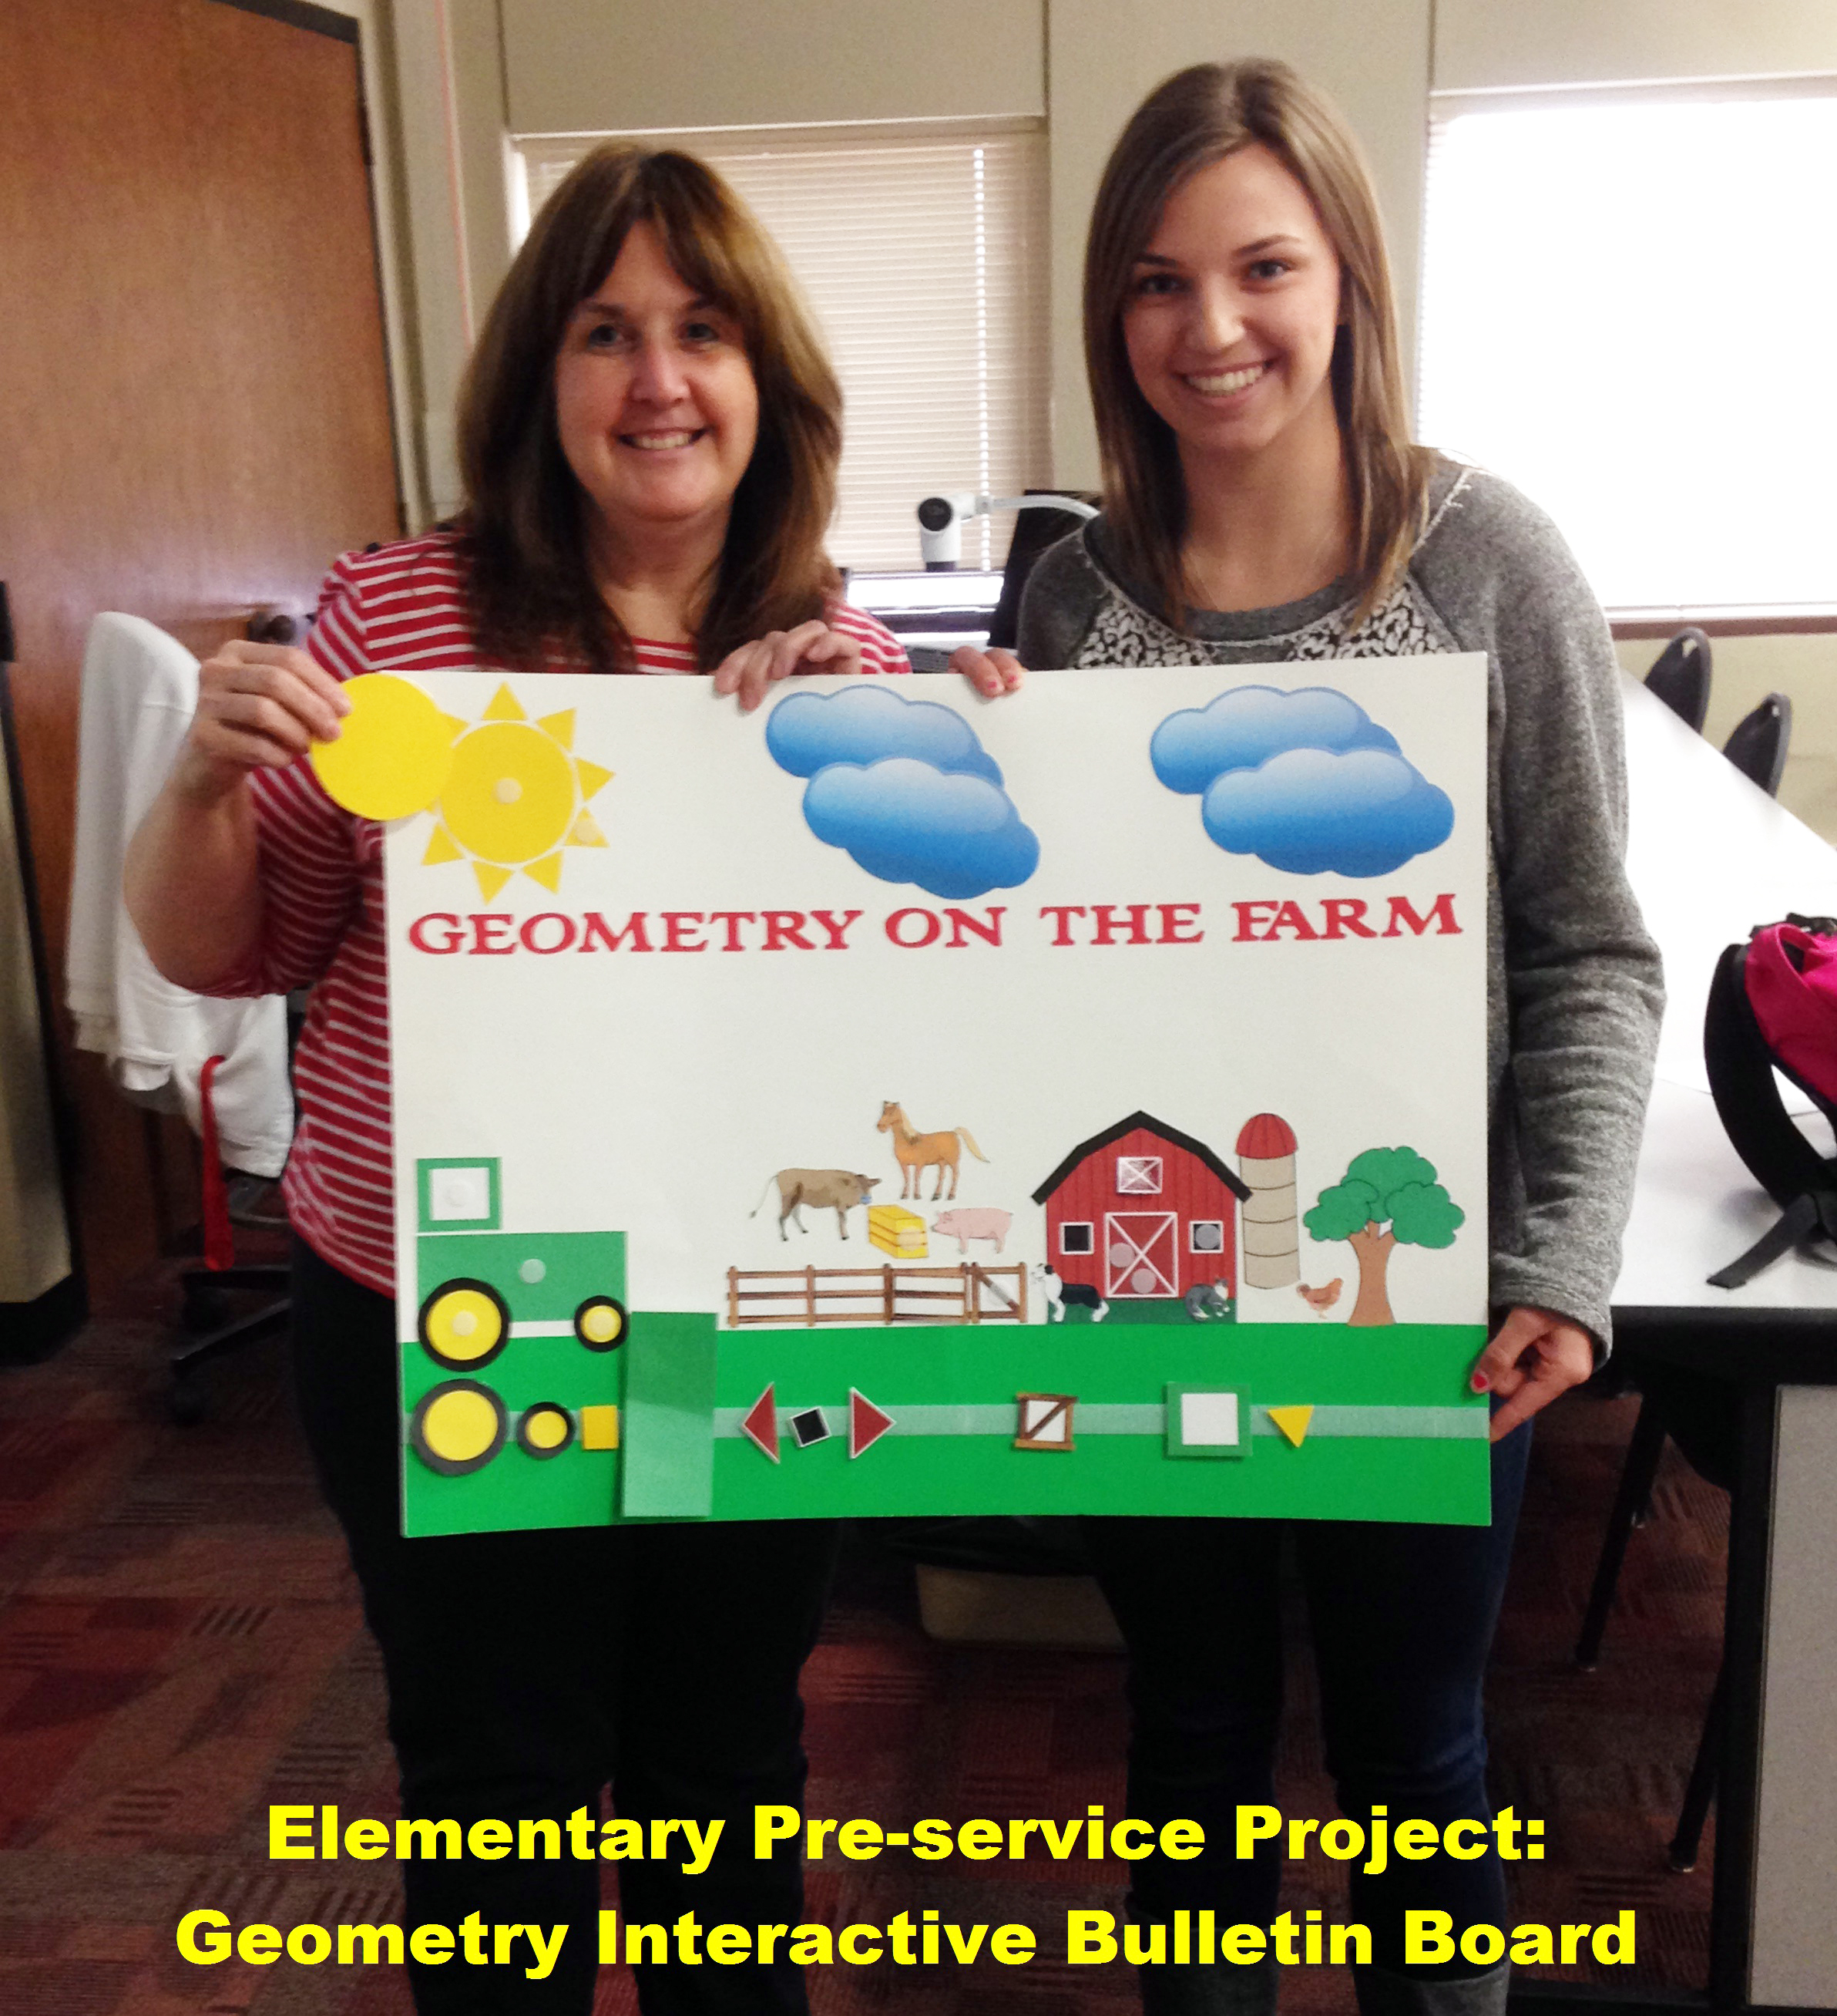
Algebra is like a computer: students must comprehend the operation of the keys on a keyboard before they can maneuver Word, PowerPoint, or engage in computer programming. I find joy in demonstrating algebra rules and terminology so students can use algebra collectively in science, nursing, or their future career.
—Dee Cooper, Northern Oklahoma College

Slide 13
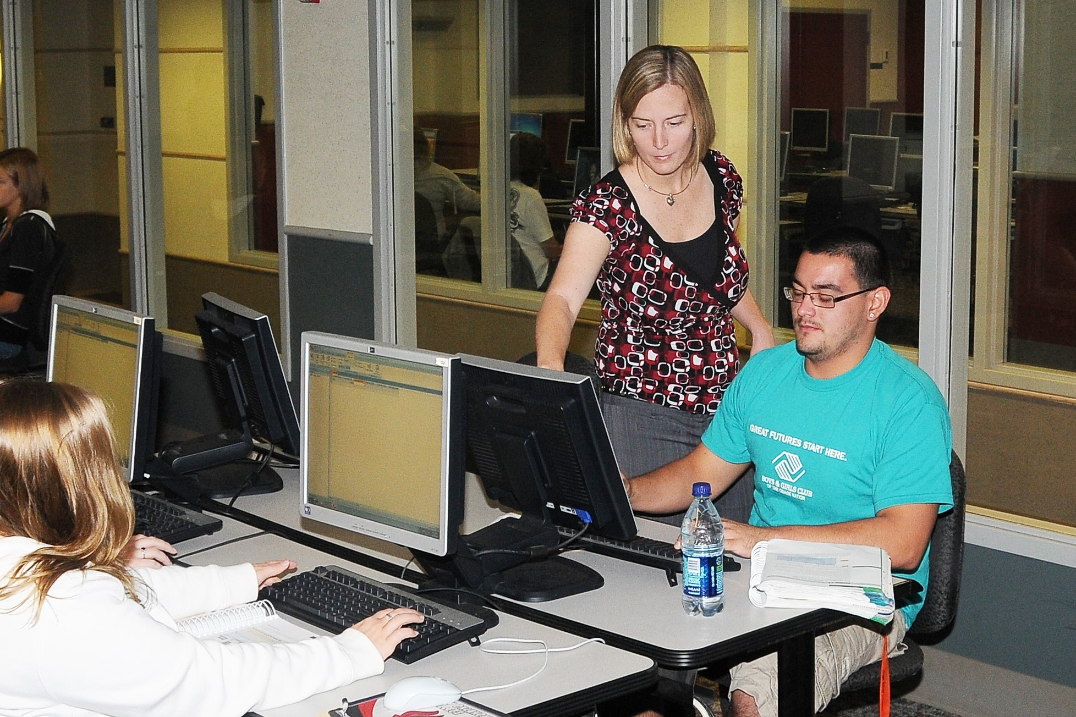
—Jill Harmon, Northern Oklahoma College

Slide 14
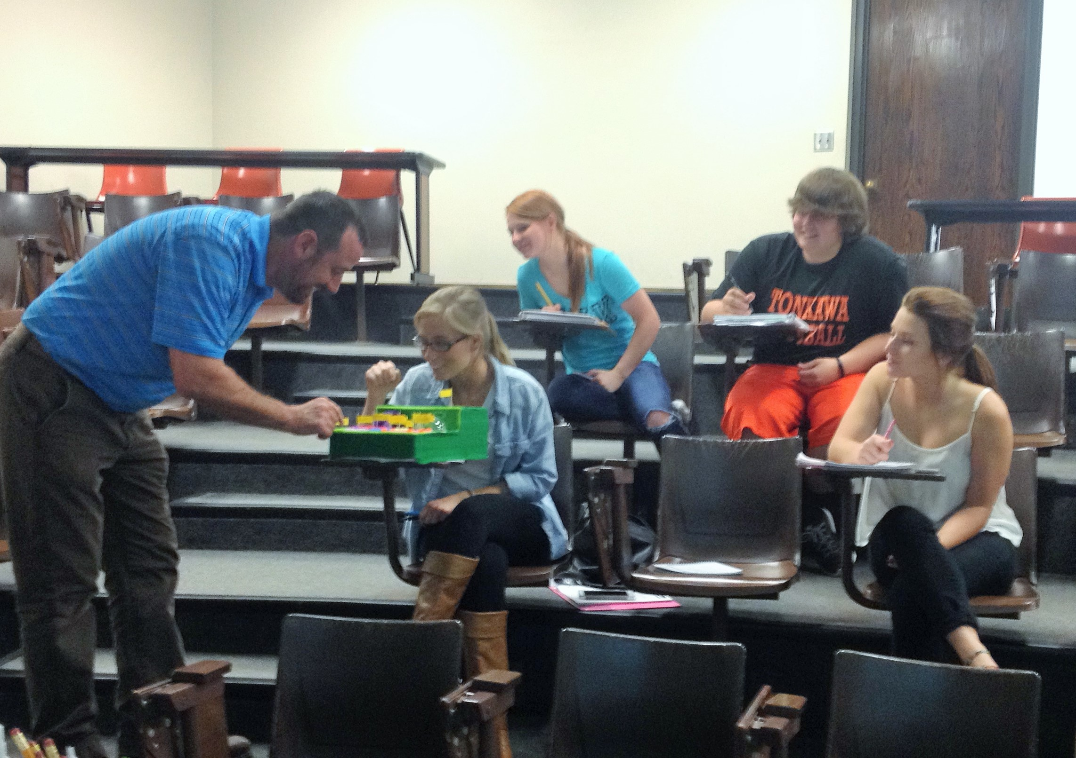
—Scott Harmon, Northern Oklahoma College

Slide 15
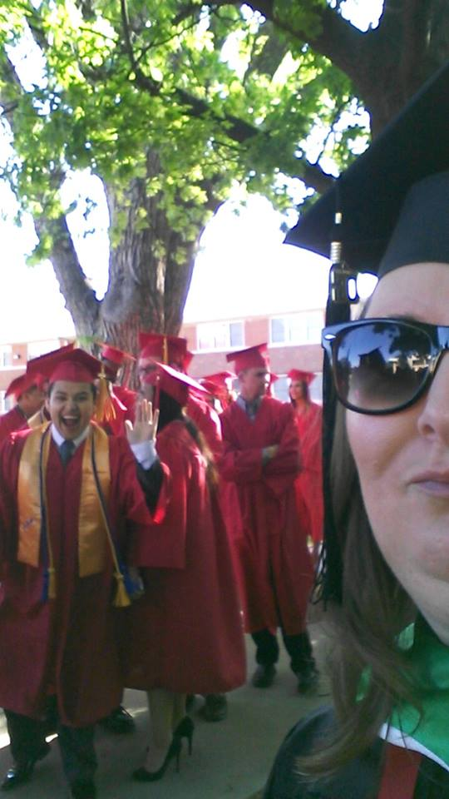
Teaching comes from the heart. I wear my heart on my sleeve in the classroom, and I ask the same of my students. We are a part of each other's lives for 16 weeks. I'm so proud of who they become and the role I play in their lives.
—Alicia Sharp, Northern Oklahoma College

Slide 16
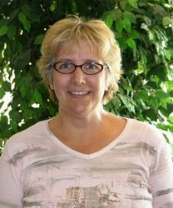
My passion for teaching started at a young age. The early educators in my life guided me on a journey limited only by my imagination and my appetite for discovery. As an adult today the journey continues. My hope is to inspire students to begin their own journey and to help their students discover worlds in which we have only dreamt.
—Peggy Rogers, Northland College and Technical College

Slide 17
One of the things I try to do is connect with my students. I think by making a “connection” with my students, I seem more approachable and caring, while reducing some of the anxiety and stress that they may feel about the subject, which, ultimately, results in their success.
—Blake Key, Northwestern Michigan College

Slide 18
Education is a sacred trust. It involves the intentional watering of the seeds of true self, found inside each person, in order to draw out or “harvest” the glory of their life for the benefit of others. It’s not to be taken lightly, for we are dealing with eternity here.
—Steven Rice, Northwestern Michigan College

Slide 19
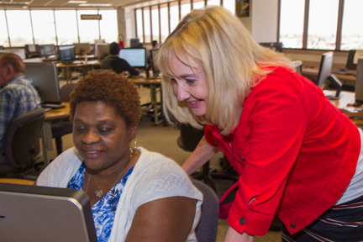
—Vicki Gibson, Oklahoma City Community College

Slide 20
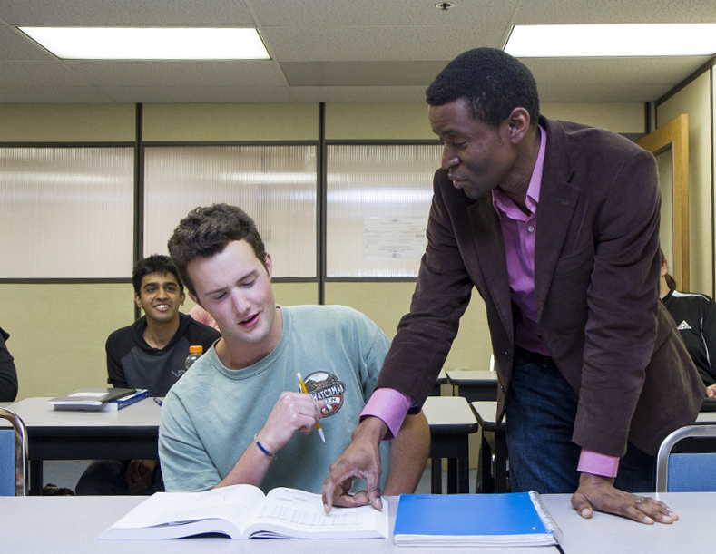
My goal is to create the burning desire to learn in my students. When the passion I have for the subjects I teach is transmitted to the students, raising their interest in the subject matter and making them feel empowered, is when I realize I have touched their lives.
—Germain Pichop, Oklahoma City Community College

Slide 21
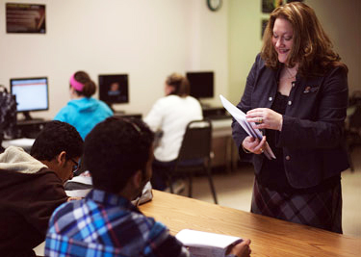
Every opportunity is a teachable moment. I learn as much from my students as they learn from me. We are lifelong learners, and teaching is an opportunity to learn alongside my students. It is important to remember the sacrifices our students make, because together we are improving our world.
—Maria Christian, Oklahoma State University Institute of Technology

Slide 22
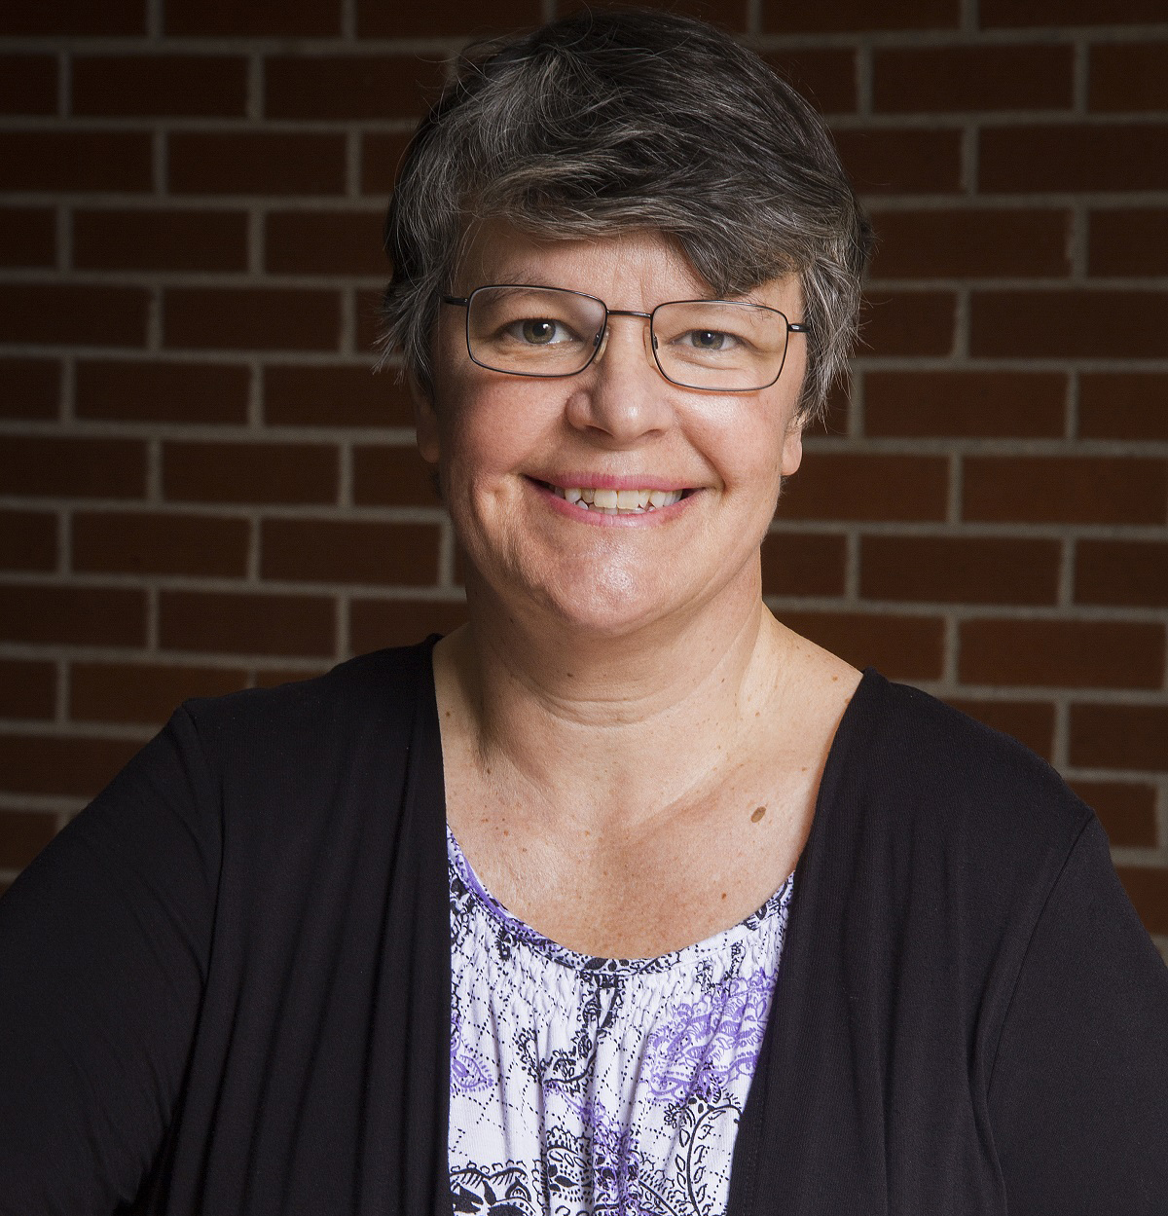
I love the look on a student’s face right at the moment they understand something. I often share books and articles with students and love when students recommend something to me. I believe science is a way of thinking. I want students to consistently think scientifically about the world.
—Regina Foster, Oklahoma State University Institute of Technology

Slide 23
—Trisha White, Ozarks Technical Community College

Slide 24
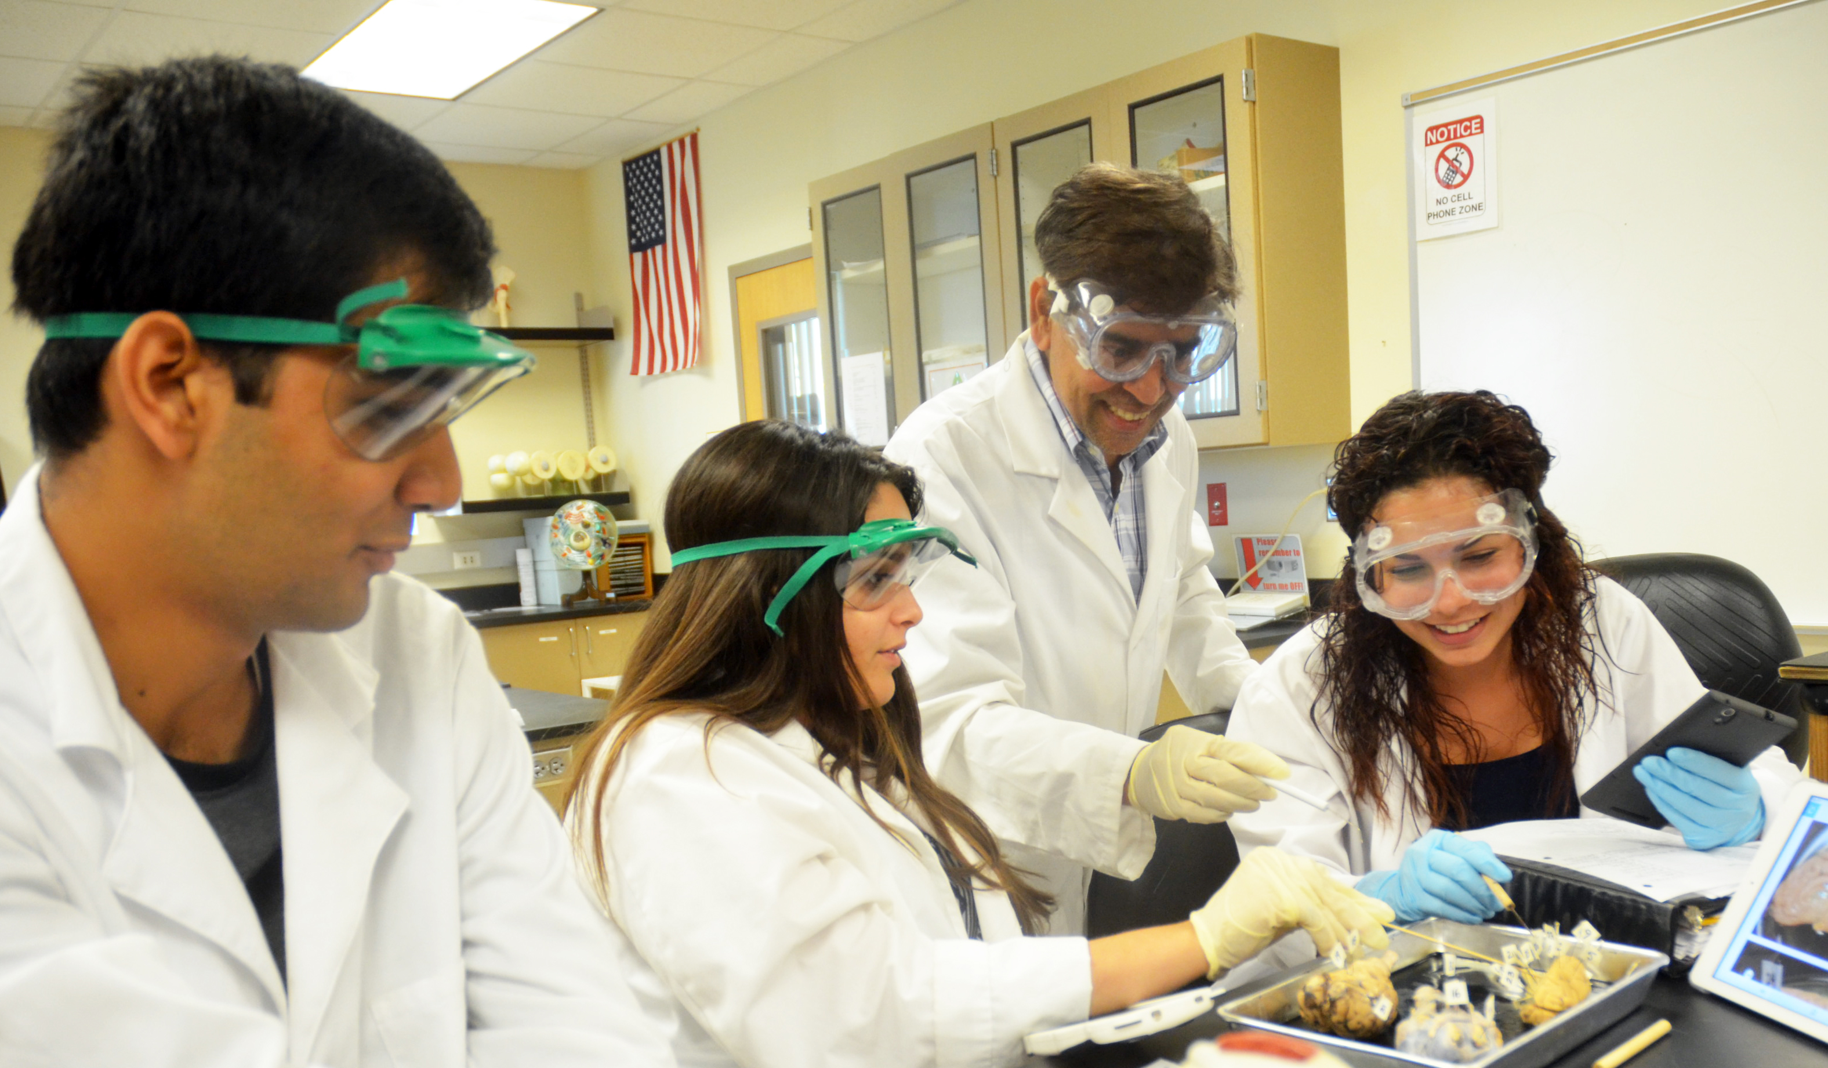
Connecting one-on-one with students motivates me in my work. Technology helps me engage students and drive them and me to succeed. Passion, patience, and perseverance must be the foundation for faculty to succeed.
—Sankaranarayana Chandramohan, Palm Beach State College

Slide 25
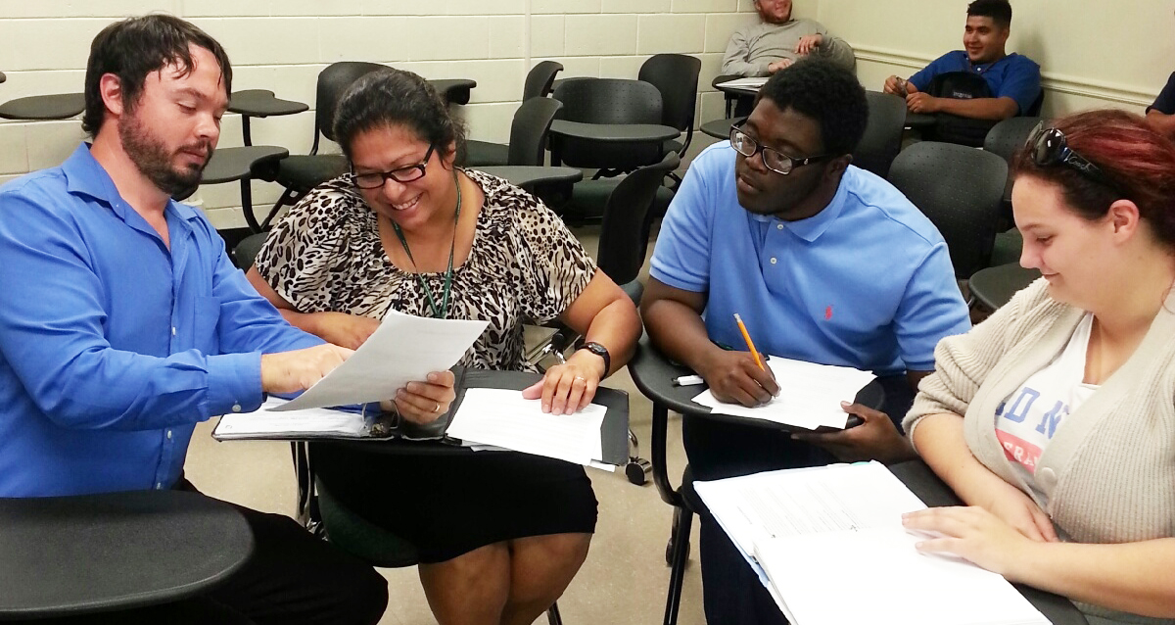
Show students that lurking behind every set of eyes is a great thinker. Give them pride in their work and themselves. Foster an environment of success and let students know when they have contributed. When dealing with an error, point out the good with the bad.
—Christopher Schmersahl, Palm Beach State College

Slide 26
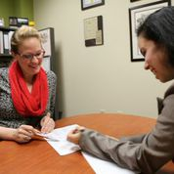
I am truly honored to receive this award and feel strongly that the students, faculty, and staff of Palo Alto College have been integral to my success. I aim to help our students in the best way possible and work diligently to develop processes and procedures that serve them well.
—Katherine Beaumont Doss, Palo Alto College

Slide 27
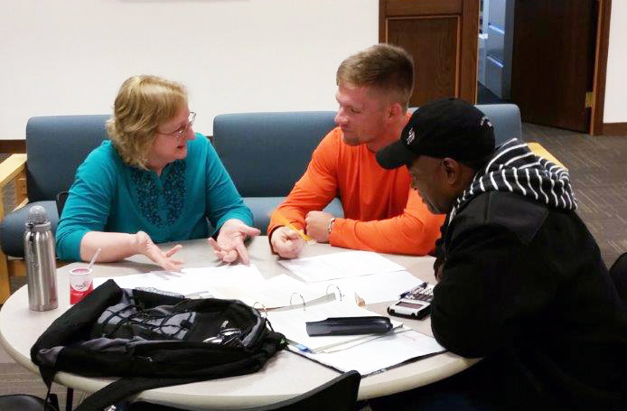
Seeing that light bulb of understanding spark to life, fanning the flame of curiosity by engaging students in learning, and seeing material change in a student's life because of my encouragement is more than I dreamed possible for my life's work. What a tremendous responsibility and amazing gift!
—Amy Myers, Parkland College

Slide 28
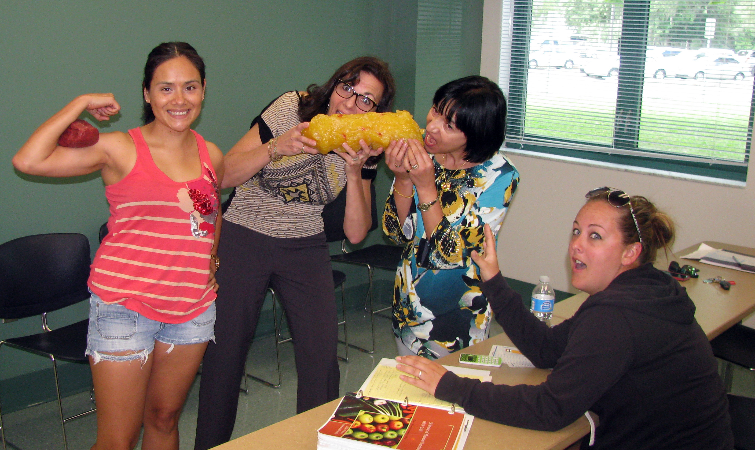
I love “A-ha! moments”—when a student gets a concept. But the more valuable A-ha moments...when students realize that their path may not be right, and it’s okay! Perhaps better stated: textbook - $179; tuition - $1,500; realizing college is not for you – PRICELESS!
—Rosanna Licht, Pasco-Hernando State College

Slide 29
Teaching is an act of radical inspiration. In a world saturated by information, great teachers must offer meaning. That is something students cannot easily find; it is the thing that captures imaginations, inspires creative and critical thought, and generates passion.
—Wendy Neeld, Pasco-Hernando State College

Slide 30
Through years of teaching students, I have learned so much about how they learn. Delivering concepts, knowledge, and application of critical thinking skills enhance their success in health information management. Real-life examples, case studies, using specialized technology, and projects turn the LIGHTS on!
—Donna Shumway, Pensacola State College

Slide 31
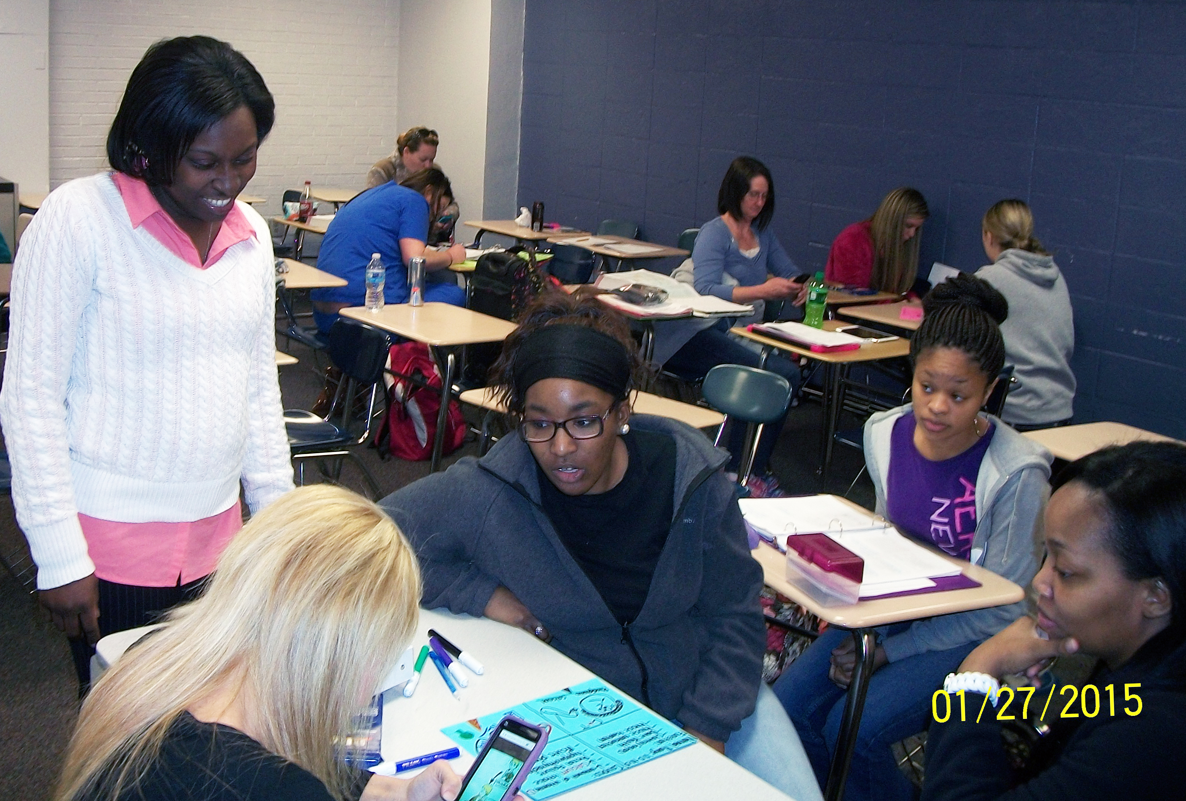
My inspiration is driven by contagious qualities of eagerness for learning found within my students. I am honored to be a participant of their personal journeys. Each of them demonstrates dedication as they seek to become not just “a nurse,” but the most proficient and patient-centered nurse possible.
—Stephanie Cannady, Piedmont Technical College

Slide 32
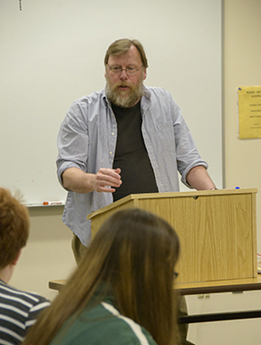
I was asked once if I was working hard to mold my students' minds. I remember thinking that it's not about molding students’ minds at all. It's about breaking their minds out of molds; it's about liberating their minds from prepackaged sound bites that get passed along as actual thought.
—Duncan McClinton, Pierce College District

Slide 33
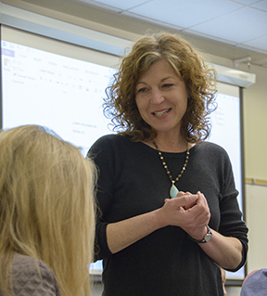
Good writing derives from the ongoing, intentional practice of acquired skills. To help students develop these skills, I show them the tools needed to construct an effective text, and we examine how earlier writers handled those tools. Then, I put the tools in their hands and encourage them to practice.
—Corrina Wycoff, Pierce College District

Slide 34
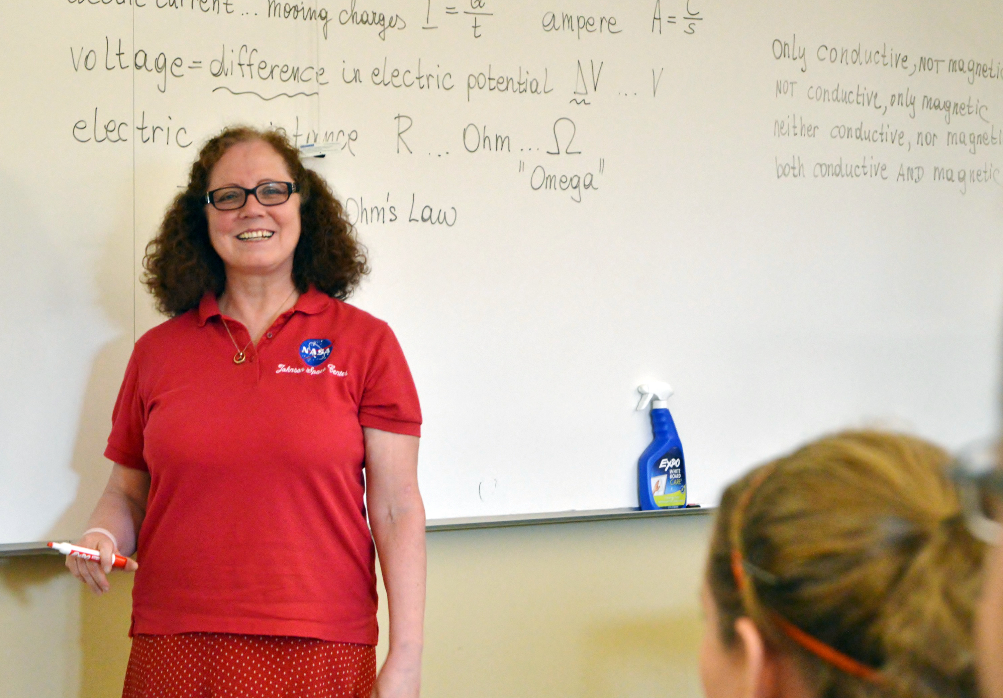
Let them talk while you listen! When I give quizzes with the student response system, students can talk with their neighbors. Walking around the room, I listen to them talking about physics! I learn about their misconceptions and what I have to discuss in more detail with the entire class.
—Martina Bachlechner, Pierpont Community and Technical College

Slide 35
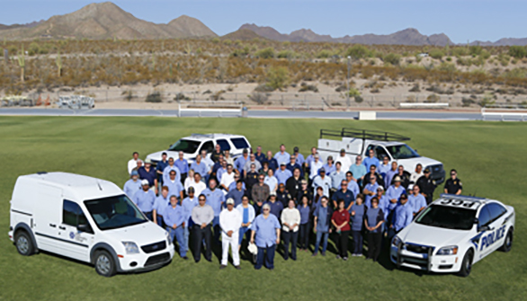
—William Ward, II, Pima Community College

Slide 36
From a student’s first moments on campus, they deserve to feel a sense of belonging and connectedness. They should know that they matter and we are all here to help them succeed. They should feel that Polk State is their academic home. That's my mission, ensuring Every Eagle Counts.
—Catherine (Cate) Igo, Polk State College

Slide 37
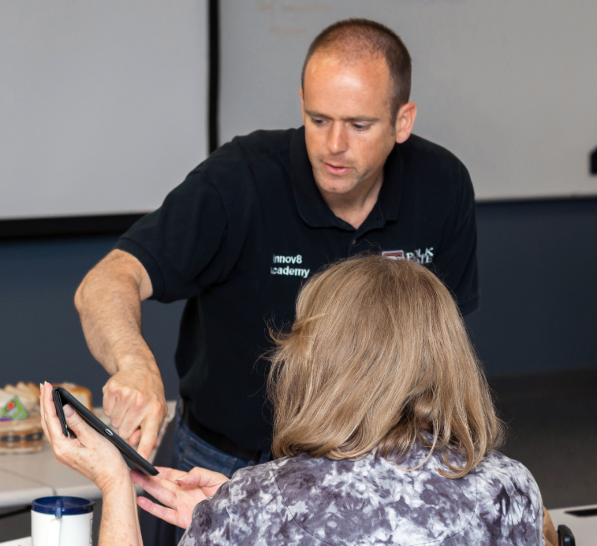
When my students create an experience through innovative student-centered methods, a profound life-changing learning experience occurs.
—Nathan Neuman, Polk State College

Slide 38
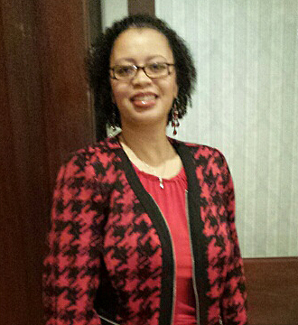
"Neither a wise man nor a brave man lies down on the tracks of history to wait for the train of the future to run over him." (Dwight D. Eisenhower) This sums up my career in education. My journey is one that focuses on innovation and compassion.
—Crystal Smith, Prince George's Community College

Slide 39
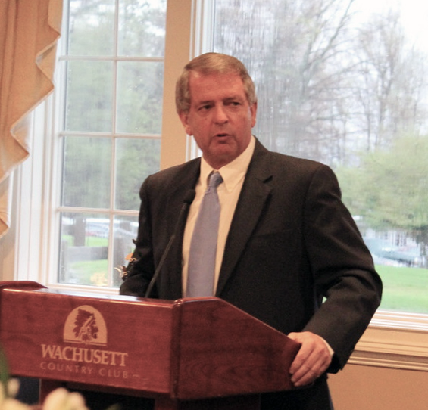
Each student holds a key to the future and it is our job, as faculty, to prepare them to open as many doors as possible in order to fulfill their dreams.
—Paul LaCava, Quinsigamond Community College

Slide 40
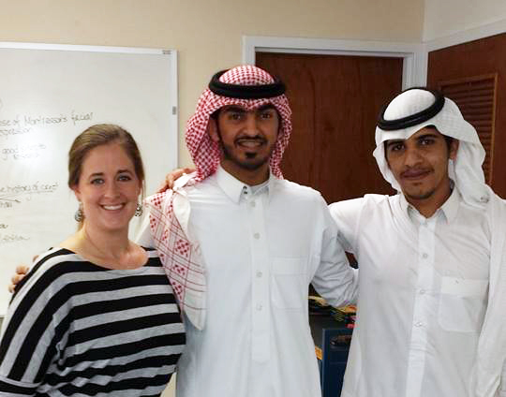
As a teacher, my motivation for students’ academic success is fueled by an innate desire to use my prior academic and personal challenges and my capacity to overcome as a model of success beyond objective data that hide the subjectivity that exists for so many developmental education students.
—Heather Ortiz, Ranger College

Slide 41
John Wayne said, “Courage is being scared to death, but saddling up anyways.” When taking the CFO role two years ago, I kept repeating this quote to myself. I am honored to be a leader and use my skills to help our community and the students we serve.
—Jena Marr, Redlands Community College

Slide 42
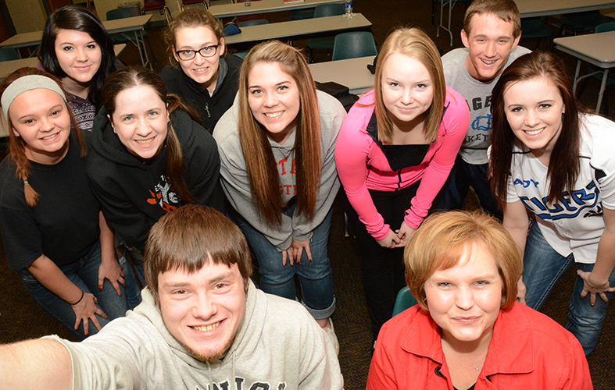
If my students can look back five or ten years after leaving my classroom and remember working through a short story or poem. That it could stick with them as a fond memory; that would be a tremendous legacy.
—Marcia Shottenkirk, Redlands Community College

Slide 43
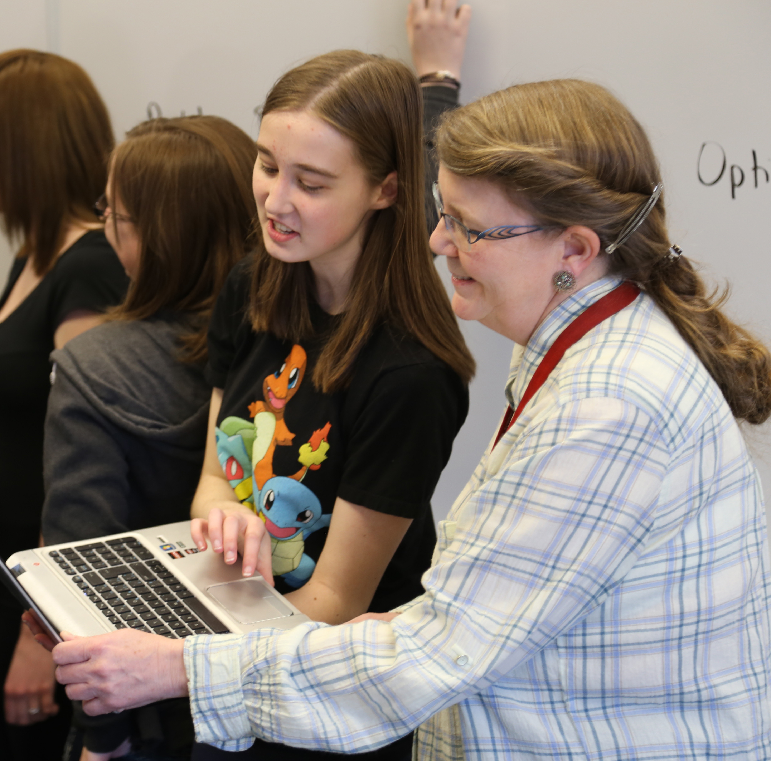
Teaching is much more than lesson plans and learning outcomes. It is believing in every student’s success, inspiring him/her to release his/her passions and strive to be the best he/she can. It is a shared journey that we as educators are privileged to take with our students.
—Donna Campbell, SAIT Polytechnic

Slide 44
I feel privileged to teach at a college with high-caliber students and an amazing electrical team. I have had the opportunity to be a part of all parts of my program, supported by a team that makes me better. An excellent team makes teaching a very rewarding experience.
—Glenn Hedderick, SAIT Polytechnic

Slide 45
I work on two simple beliefs: that people should use their skills in the way that will make the biggest positive difference for others, and that a society grows great when we “plant trees under whose shade we will never sit.” Education is where I can realize these beliefs.
—Susan Espinoza, San Antonio College

Slide 46
There's no better way to give back to my community than to educate our future workforce. Since I teach early childhood studies, I will also impact each child that my students touch throughout their careers. It has been a privilege to be a part of the Texas community college system.
—Linda Lowman, San Antonio College

Slide 47
Teaching is not my occupation, it's my passion, and I teach passionately, in the same way I would want to be taught. Higher education should be something prized, pursued, challenging, but never frustrating, and above all, enjoyed, by the student and the professor.
—Ryan Lozano, San Antonio College

Slide 48
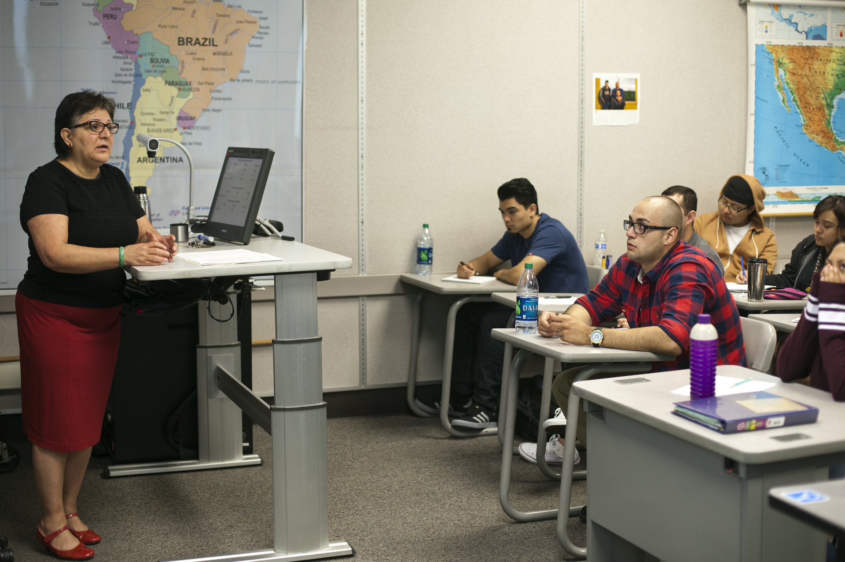
—Laura Larque, Santa Rosa Junior College

Slide 49
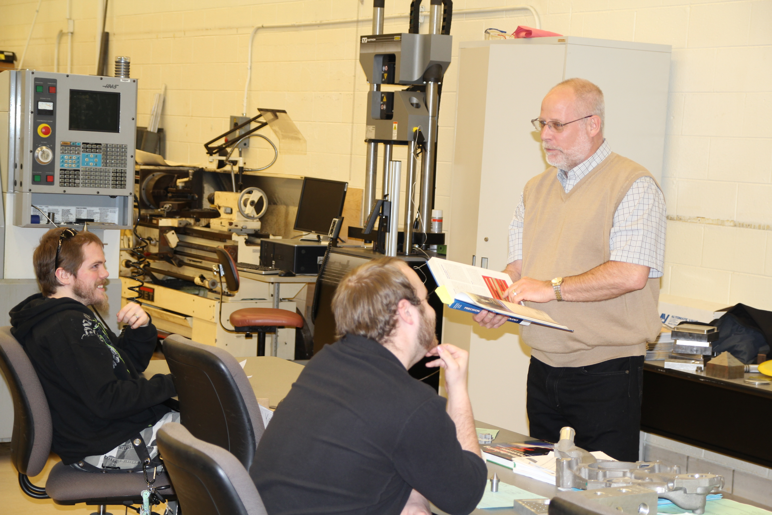
I teach manufacturing and in keeping the classroom light, I find students adventurous. When the wheels start to turn, light bulbs ignite, creative juices flow, and they learn manufacturing is not difficult. Helping students find a job motivates me, and I always find a way to help those who need help.
—Gene Keyes, Schoolcraft College

Slide 50
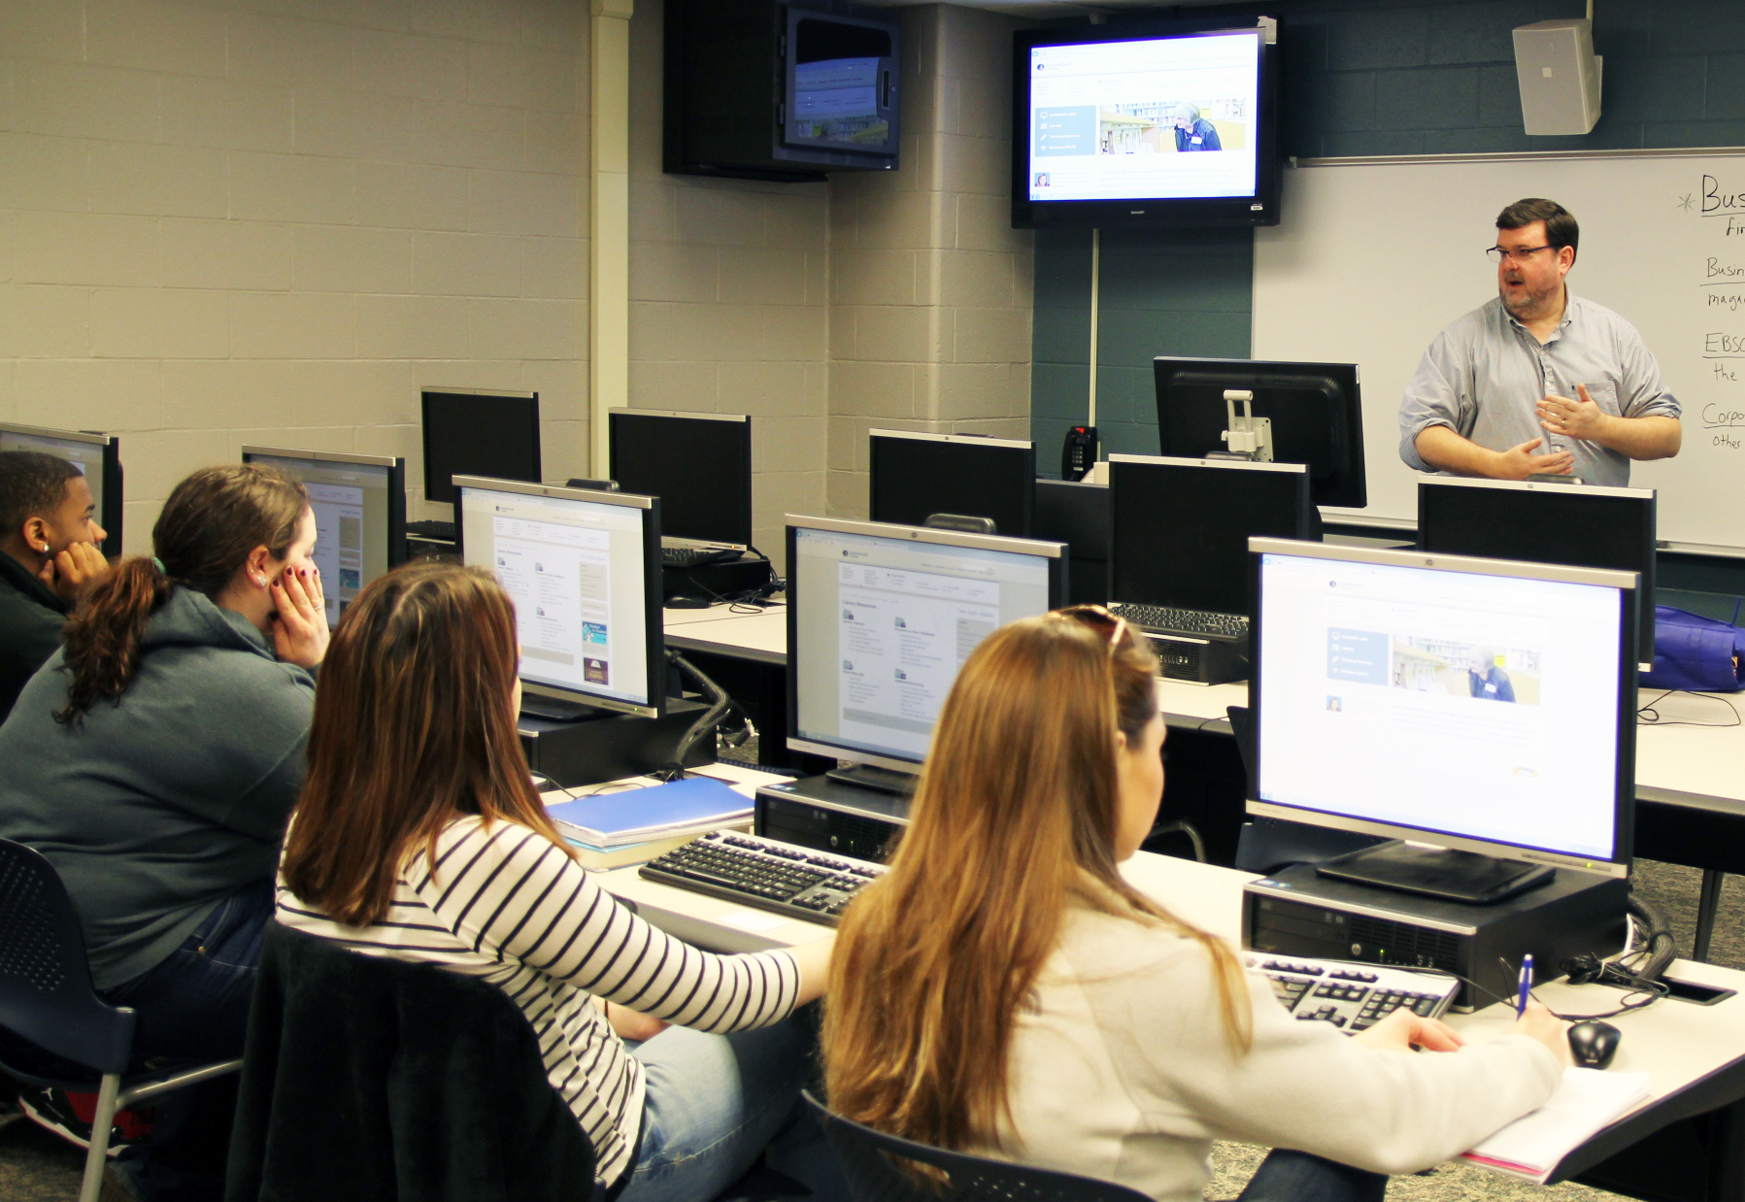
In the words of Carl Rogers, “Can I discover the interests of each individual and permit him or her to follow those interests? Can I be creative in putting them in touch with people, experiences, books—resources of all kinds—which stimulate their curiosity and feed their interests?”
—Wayne Pricer, Schoolcraft College

Slide 51
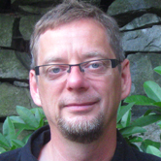
I teach peace studies. I love it when students who are naturally skeptical and critical thinkers become inspired by personal stories of people who have made a difference. I love it when students who are full of hope and compassion become adept at the skills of critical thinking.
—Randy Janzen, Selkirk College

Slide 52
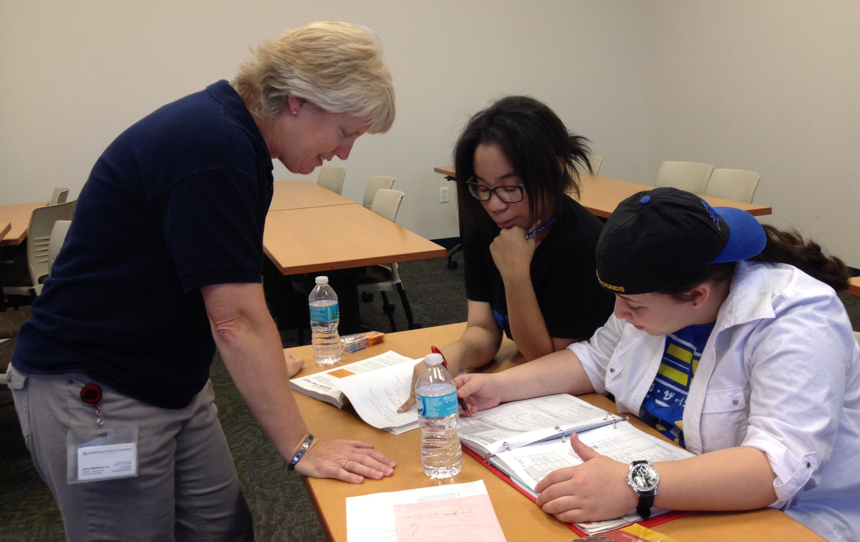
I have always known I was a teacher at heart. Being a professor has allowed me to express that passion. Teaching student life skills puts me in the trenches, practicing academic triage. Helping students make the connection to information that makes difference in their lives...priceless!
—Jenny Middleton, Seminole State College of Florida

Slide 53
Students engaged in critical literacy develop a disposition that helps them articulate their experiences, pose questions about the world, and derive their own conclusions. I try to design learning interactions that favor students and their literacies. Engaging in that dynamic dialogue with students is invigorating.
—Vanessa Wynn, Seminole State College of Florida

Slide 54
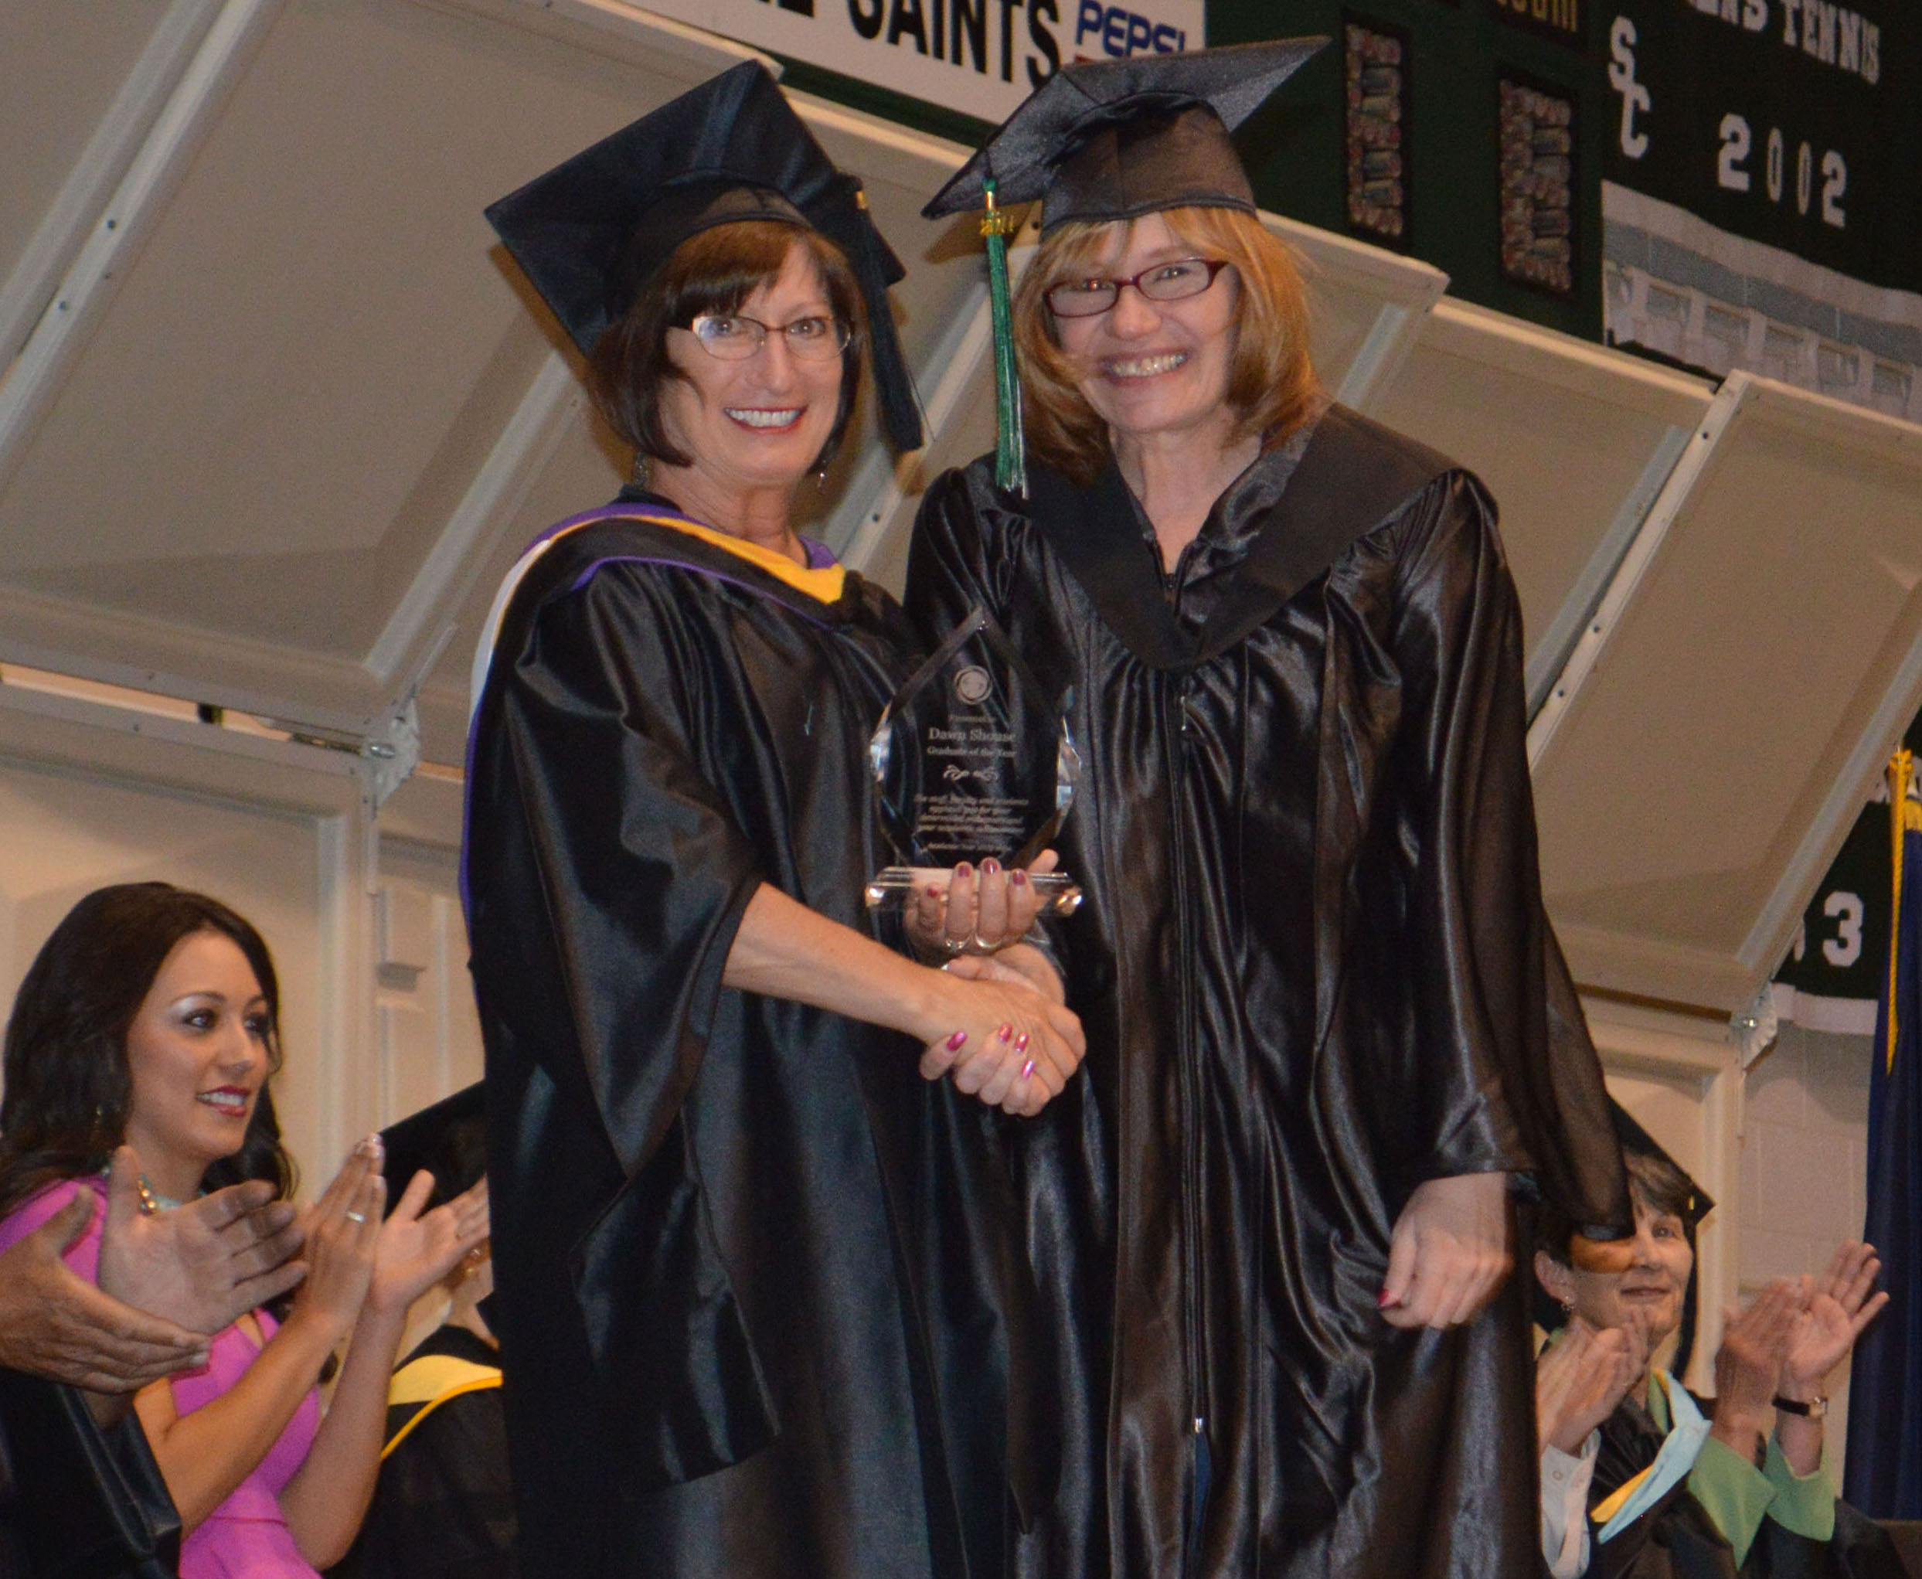
Dr. Elton Mayo once said, “One friend, one person who is truly understanding, who takes the trouble to listen to us as we consider our problems, can change our whole outlook on the world.” Working in a profession where you can see lives transform every day is inspirational.
—Celeste Donovan, Seward County Community College/Area Technical School

Slide 55
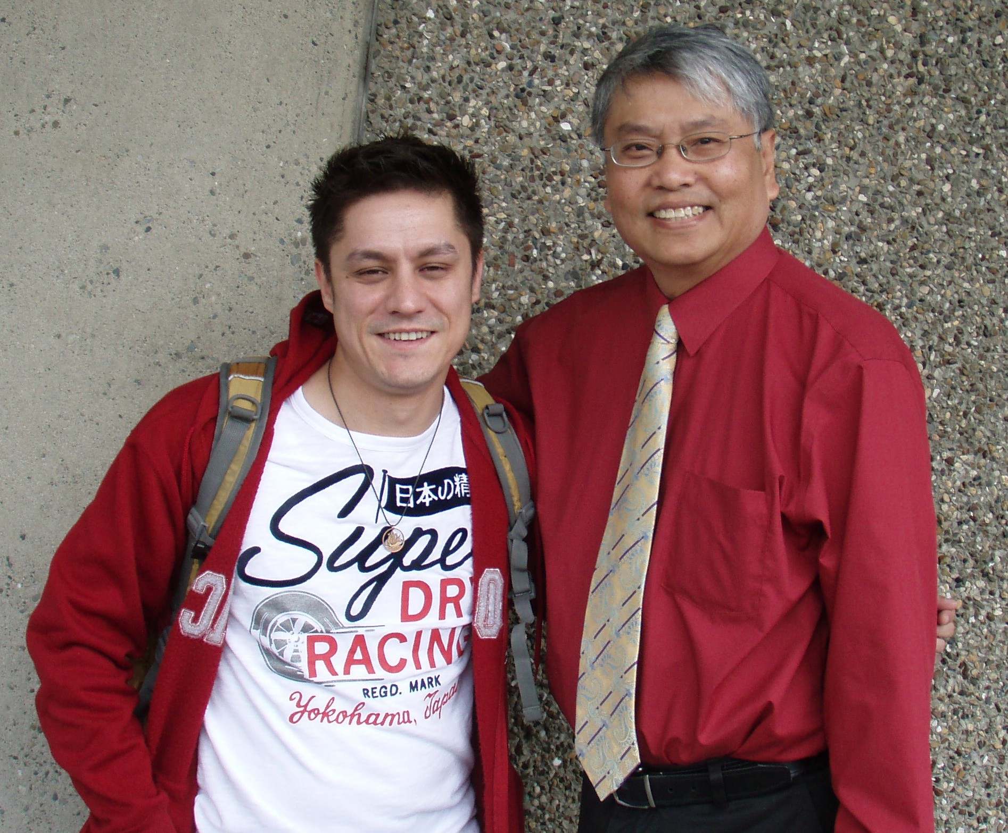
As an English instructor, I am often asked the practicality of my subject, especially when it comes to literature. My response is that other subjects such as the sciences and mathematics are important. But it's only in literature where 2 + 2 can equal 5.
—Robert Dela-Cruz, South Seattle College and David Yama who has been recognized as the nation’s top community college scholar by the honor society Phi Theta Kappa

Slide 56
I hope my students are better people upon leaving South Texas College, having learned the value of education and the joy that comes from learning. Furthermore, I hope they recognize the importance of giving back to the community so that together we may make the world a better place.
—Darci Cather, South Texas College

Slide 57
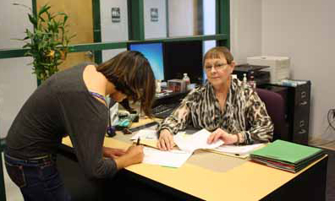
My goal is to never send anyone away from my desk without an answer to the question that brought him/her to me. My challenge is to find and relay the answer. My promise is to always keep my word—never promise to call someone back and then break that promise.
—Anna Pauline Herron, South Texas College

Slide 58
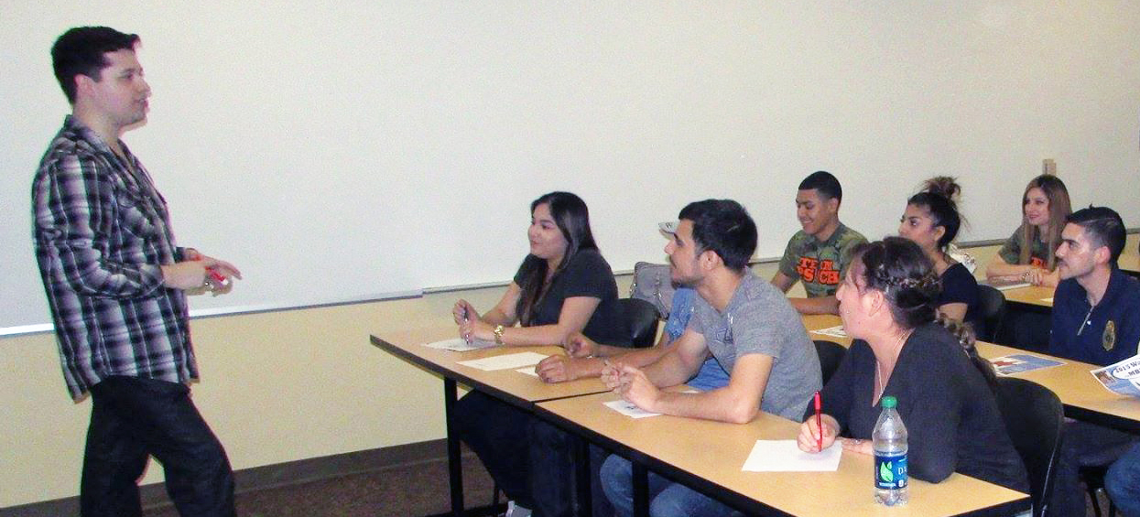
It's very rewarding to make a positive impact on students' lives—the future doctors, attorneys, educators, counselors, nurses, engineers, politicians, and community leaders. Teaching has always been a passion of mine. I strive to provide students with skills, knowledge, and motivation every day. Learning from students as one teaches is priceless.
—Alexandro Sarabia, South Texas College

Slide 59
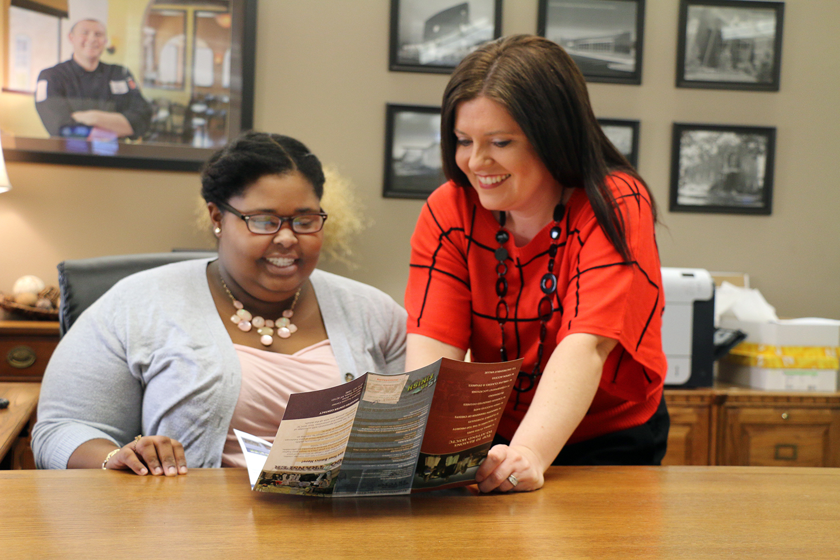
I am often one of the first individuals with whom a new student speaks. A first impression is often a lasting impression. This is why the ability to be approachable is one of the most important qualities one must obtain to be successful and looked upon as a mentor.
—Amy Cannon, Southcentral Kentucky Community and Technical College

Slide 60
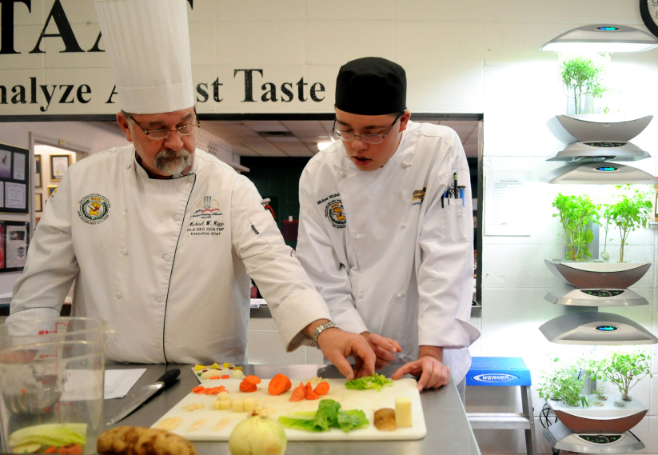
I tell my students that “the world is full of average people, don't be one of them.” Receiving the NISOD Excellence Award means that for a time in my career someone believed that I practice what I preach.
—Michael Riggs, Southcentral Kentucky Community and Technical College

Slide 61
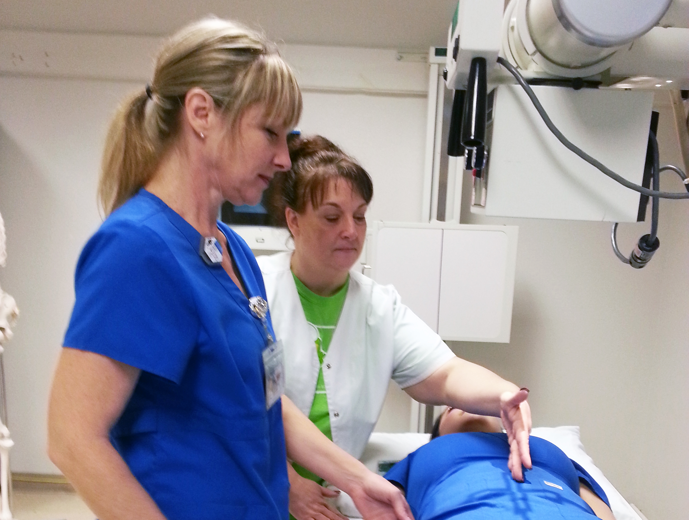
My strategy in the classroom and lab is to keep learning fun, interactive, and engaging! Watching students go from shy and timid in their first semester to confident medical professionals motivates and inspires me to continue to educate students and uphold the standards of radiologic technology.
—Bonnie Clinebell, Southwest Texas Junior College

Slide 62
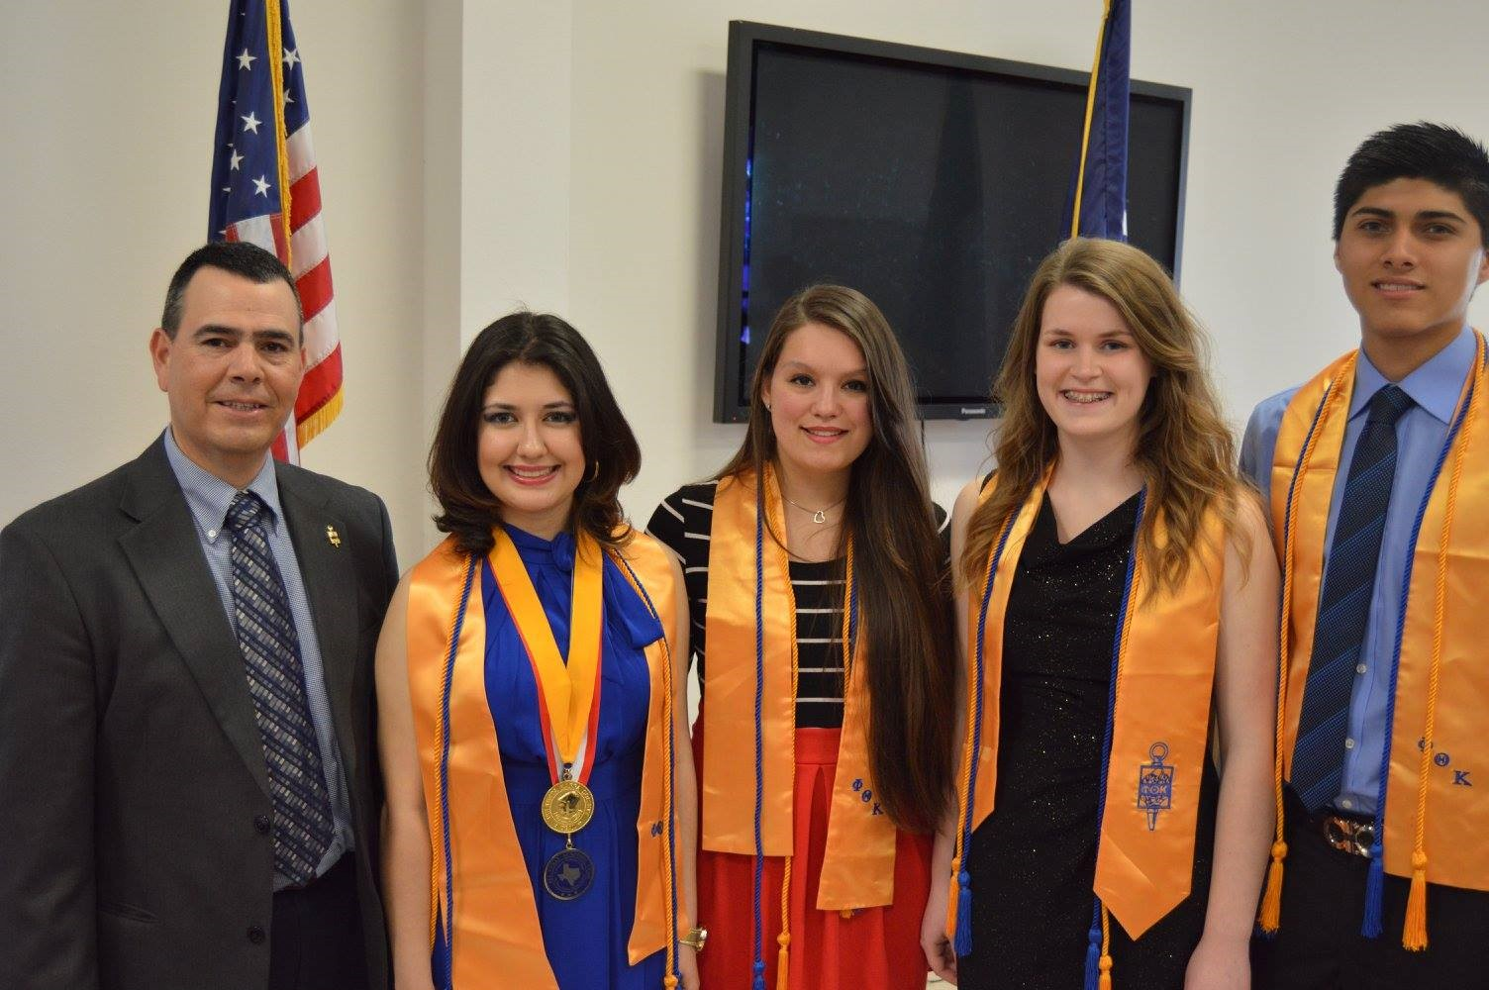
Today's community college students face personal insecurities, weak self-esteems, and difficult life situations. Today's community college educators must persist where no one else can, encourage when no one has before them, and see the bright future ahead for those he encounters. Success is achieved when commitment never ends.
—Paul Kimble, Southwest Texas Junior College

Slide 63
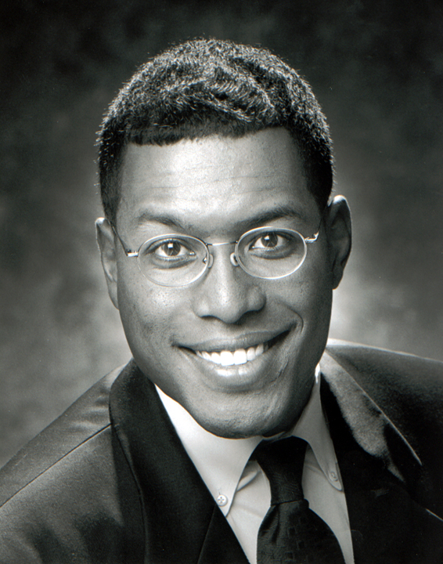
—Art Hall, St. Philip's College

Slide 64
—Suzanne Bechtol, State College of Florida, Manatee-Sarasota

Slide 65
Through awareness, intuition, and action, I am able to realize my potential for excellence. I apply these same concepts when teaching. I capitalize on strengths and use intuition to advise my students. I am highly motivated, and I use action as a means of motivating students to achieve excellence.
—Joseph "Joe" Loccisano, State College of Florida, Manatee-Sarasota

Slide 66
My students’ success keeps me motivated. I am determined to help my students succeed and get them interested in the economy. Incorporating social media into my classes really helps keep students engaged. I am kind, fair, and humorous, which students appreciate.
—Kristen Zaborski, State College of Florida, Manatee-Sarasota

Slide 67
My students certainly inspire and motivate me. To promote an enriching learning experience, I plan ahead. I ensure that my lesson plans are carefully thought out and learning outcomes are unambiguously stated. Student feedback is important to me, so I listen attentively to my students and cater to their needs.
—Forster Agama, Tallahassee Community College

Slide 68
Think first what moved you. As a student, it was professors who interacted and enjoyed when the class responded. “Few people care what you know until they know you care.” Use this motivational tool to impart knowledge. Get to know students to make your lessons truly relevant.
—Braze Brickwedel, Tallahassee Community College

Slide 69
I was empowered to love math by a teacher who challenged me to take control of my own learning. I strive to lead students to the same revelation by sharing my love for math with them in a safe, engaging, supportive environment where they can excel academically and socially.
—Suzanne Ferrell-Locke, Tallahassee Community College

Slide 70
Over the last 10 years, I have seen my students motivated to change their lives. I teach a combination of theory and skills that enhances their lives personally and professionally. Students engage in self-discovery to understand how communication is so integral to our lives and to reaching our goals.
—Irene Thrower, Tarrant County College District

Slide 71
President John Adams said, “If your actions inspire others to dream, learn, do, and become more, you are a leader.” I aim to help our graduates find lifelong careers that fulfill their dreams and to learn, do, and become more because they are truly the future leaders.
—Benji Cantu, Texas State Technical College

Slide 72
We make a difference by starting with an image of what an unfettered student is capable of achieving. The image is shared, so that their goals may be set higher and higher. Finally, we do everything in our power to create the environment where our students’ dreams are realized.
—Kelly Filgo, Texas State Technical College

Slide 73
—Kim Porter, Texas State Technical College

Slide 74
We need to think differently about student success and find a way—or create a way—for them to succeed!
—Cheryl Antonich, Triton College

Slide 75
I believe that each student is a unique individual who needs a secure, caring, and stimulating atmosphere in which to mature emotionally, intellectually, and socially. It is my desire as an educator to help students meet their fullest potential in these areas by providing an environment that is stimulating.
—William Griffin, Triton College

Slide 76
—Tom Phillips, Triton College

Slide 77
As educators, what we have learned is history, what we teach is for the future. I strive to make my students education modern, relevant, and timely for the challenges of the future by imparting the lessons of the past.
—Darryl Cleveland, Truckee Meadows Community College

Slide 78
Students in a community college are unique in the experiences they bring to the classroom. My task is to bring out those experiences for all to share. My philosophy is to have fun or go home!
—Gregory Ellis, Truckee Meadows Community College

Slide 79
We don’t achieve great teams, departments, divisions, or schools alone. As we get the right people on the bus, our teams must trust us to stop doing what is not working to become great. I am humbled daily by that trust.
—Andrew Hughes, Truckee Meadows Community College

Slide 80
I can learn something from each and every student in my classes. Making personal connections creates an atmosphere of mutual respect.
“Regard man as a mine rich in gems of inestimable value. Education can, alone, cause it to reveal its treasures, and enable mankind to benefit therefrom.” Abdu'l-Baha
—Karen Anglin, Tyler Junior College

Slide 81
As educators, we need to push our students beyond their expectations, to challenge and encourage them to be critical thinkers and problem solvers. We need to show them how to be committed and compassionate. Our students are our legacy and the next generation of Einsteins, Mozarts, and Hawkings.
—Sherry Heidary, Union County College

Slide 82
Thinking is the key. As faculty, we model subject-area thinking. We teach to illuminate how we think. Student learning is developing those thinking processes. Our goal is student development at its zenith—individuals who think well and use thinking to make sense of themselves, their lives, and the world.
—Rhonda Atkinson, Valencia College

Slide 83
One of the pleasures of teaching is the ability to share in the lives of our students. Through the many conversations and activities in the classroom, we forge a collective growth—professor and student—learning from one another. Seeking the key to unlock student potential is my driving force.
—Diana Ciesko, Valencia College

Slide 84
Perhaps the most treasured aspect of my teaching career is what I have been able to learn from my students. They have challenged me by their questions and analyses to think about concepts from new and different perspectives. Indeed, the whole journey has been a lesson in humility.
—Lois Crichlow, Valencia College

Slide 85
I am focusing on my ultimate goal – helping students succeed in science. To this end, I am more active in coaching students and helping them understand the dedication required to succeed in a challenging field of study. I emphasize the importance of goal setting, purpose, and individual choices.
—Kristiann Dougherty, Valencia College

Slide 86
I firmly believe in the importance of connecting the subject matter at hand with what is going on in the real world. Also, if an instructor is able to make the subject matter personally relevant, students will tend to be more involved in the learning process.
—Javier Garces, Valencia College

Slide 87
Teaching originates in the belief that every student can be motivated to learn no matter what his or her background is. Students need to feel empowered to learn so that they can succeed.
—Gerald Hensel, Valencia College

Slide 88
Those of us who have experienced postsecondary education can attest that there is as much learning about one’s self as there is about the course curriculum. The successful student will learn how to prioritize, practice good time management, become an effective communicator, and, most importantly, think and act responsibly.
—Steven Tullo, Valencia College

Slide 89
Teaching is not just an art or a calling, it is an identity. My goal is to be a lifelong teacher as well as a lifelong learner. For me, the two are symbiotic. I am thankful to my colleagues for sharing ideas that will improve my own teaching and learning.
—Emily Moore, Wake Tech Community College

Slide 90
I try to help students discover the practical applications of what they have learned in the classroom. I find it extremely satisfying when students say that what they learned during their education in psychology made them more effective as parents, as employees, as students, and as members of society.
—Heather LaCost, Waubonsee Community College

Slide 91
Never stop learning! I love to learn from my peers, from our community partners, and from my students. Every interaction is an opportunity to learn something new and to apply it to what is already known. Education is always changing and educators must be intentional in their own professional growth.
—Kara Hoffmann, Waukesha County Technical College

Slide 92
Nelson Mandela was quoted as saying, "that the most powerful weapon that can change the world is education." I have always believed that education is the catalyst that sparks ingenuity, self-esteem, accomplishment, and purpose. It prompts us to grow and stretch in ways that we can only imagine.
—Brett McCarthy, Western Iowa Tech Community College

Slide 93
Inspirational teachers bring the best out of their students, even though the subject matter may be the hardest. He/she can instill a passion of learning in students, which arguably is the most important ingredient in achieving academic success.
—Manoj Patil, Western Iowa Tech Community College

Slide 94
Shakespeare wrote, “No profit grows where is no pleasure ta'en: In brief, sir, study what you most affect.” What I appreciate most about community college is that we focus on the real skills needed and help students learn and blossom in the areas that they enjoy.
—Michael Rohlena, Western Iowa Tech Community College

Slide 95
My mission as a biology instructor is for my students to obtain the same amount of passion I have for the subject. I enjoy coming every day to class knowing that my enthusiasm for teaching the subject is a motivating force for student success.
—Johnson Cherukara, Wharton County Junior College

Slide 96
It is such a joy to do what I love and love what I do, and my radiology students are a huge part of that. I am inspired each and every day by them. The reward of seeing their journey to becoming a medical professional is nothing short of amazing!
—Allyson Matheaus, Wharton County Junior College

Slide 97
My inspiration comes from helping students reach excellence one step at a time.
—Eddie Vandewalker, Wharton County Junior College

Slide 98
My primary motivation in teaching is the desire to help people reach their goals. Mathematics is difficult for many students, and I enjoy the opportunity to help them be successful in the subject and discover the many applications that mathematics has in their professional and personal lives.
—Molly Beauchman, Yavapai College

Slide 99
Teaching is my way of paying it forward, and I believe that student needs are primary. I strive to make mathematics easier for students, lessening their fears, and giving them a more positive attitude towards the subject.
—Becke Butler, Zane State College

