Slide 1
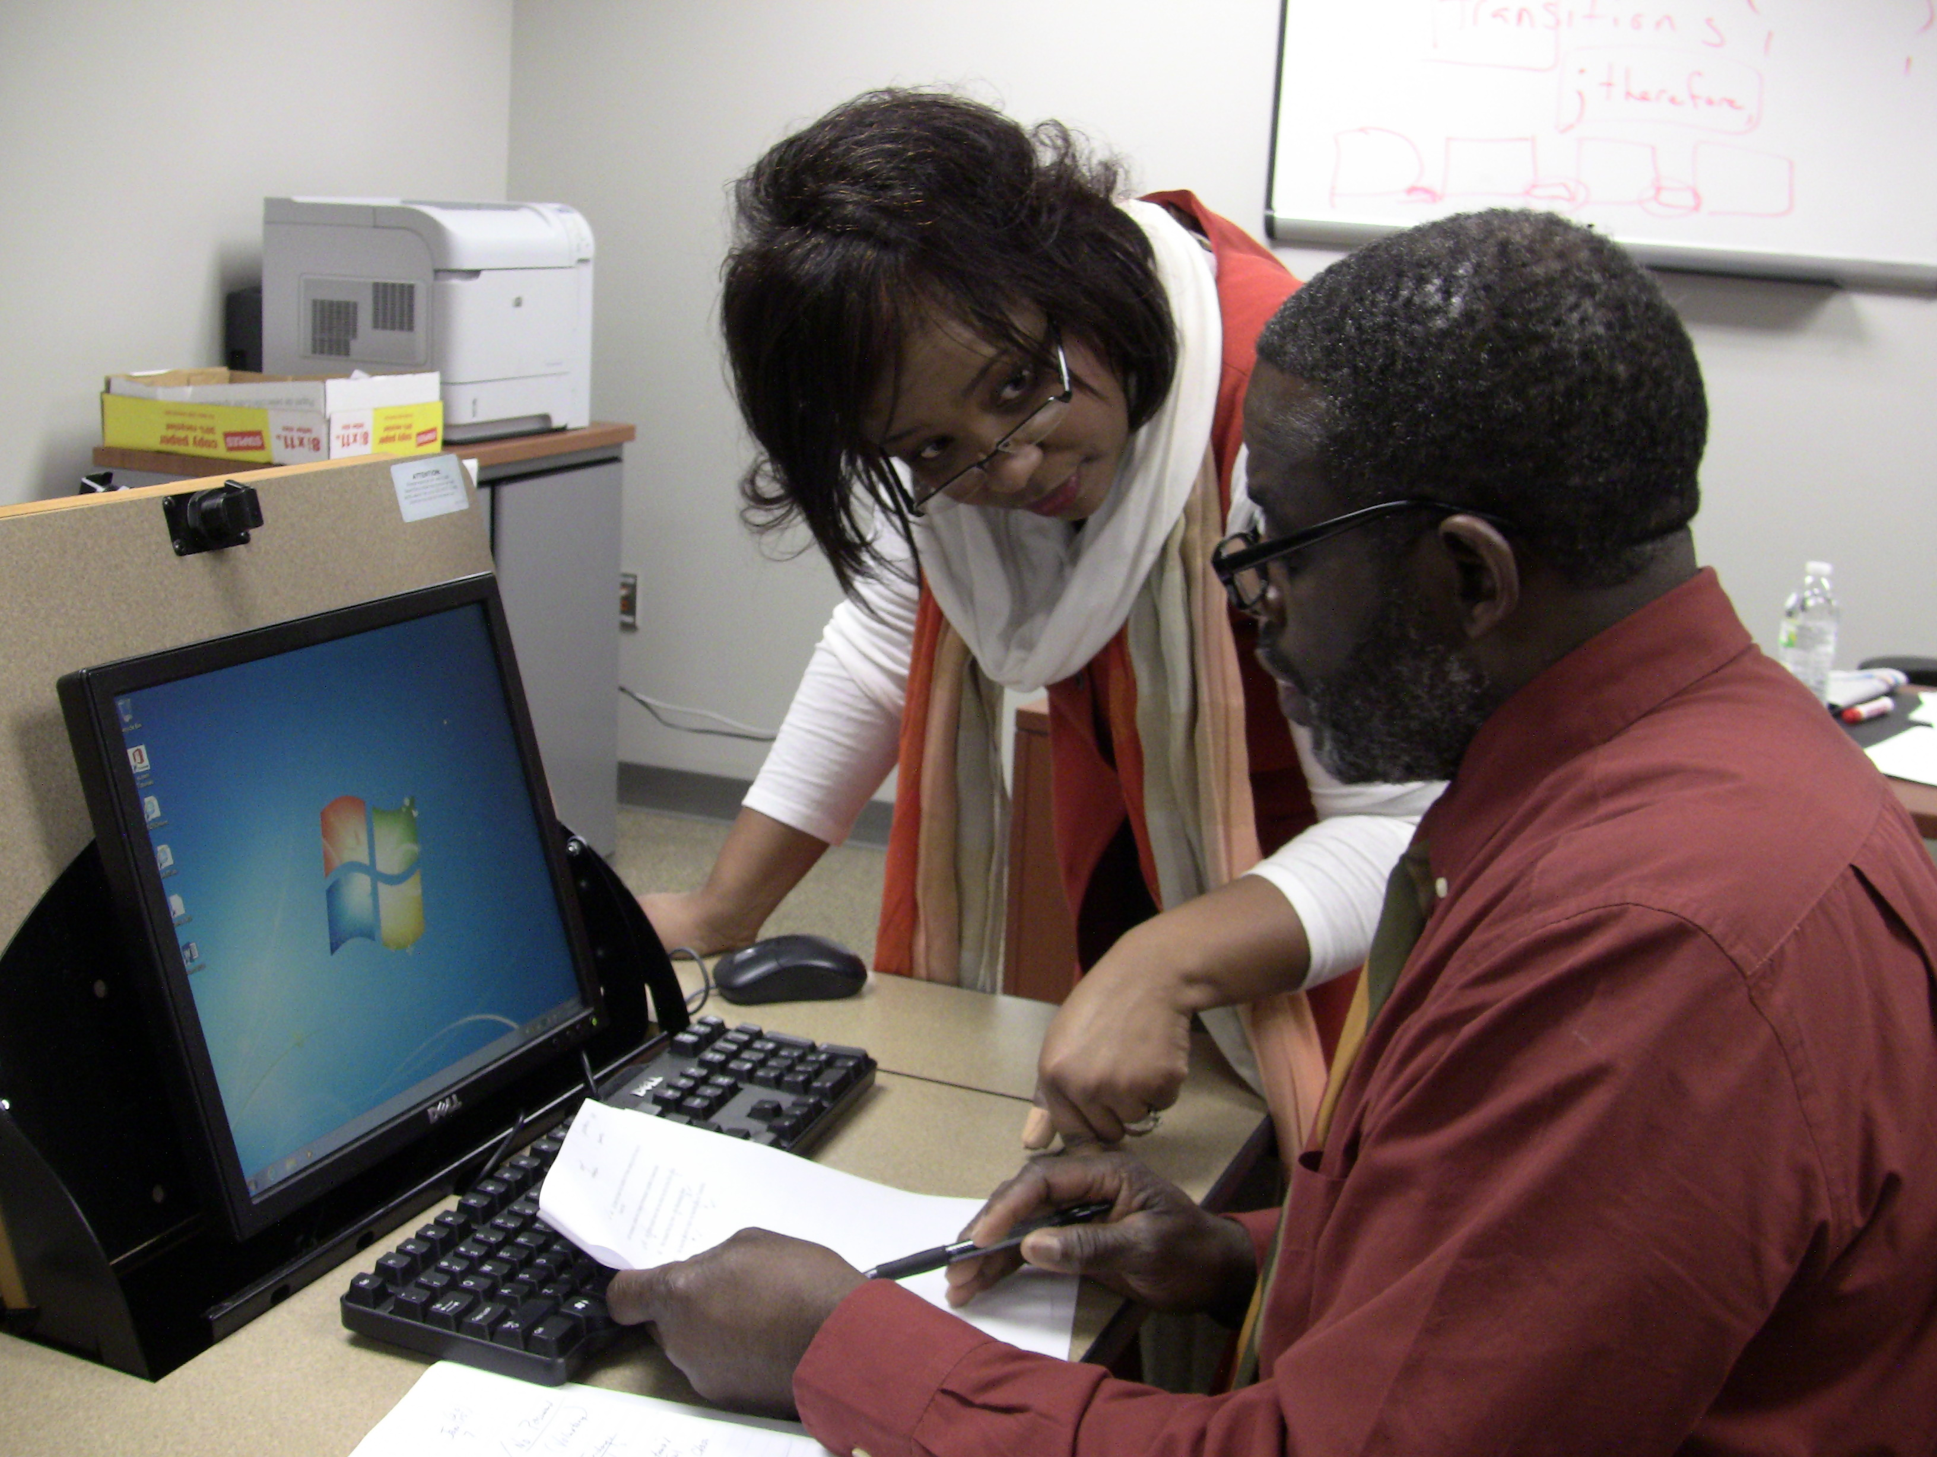
I remember saying that I did not want to be like my mother, who was a science and social studies teacher. Luckily, God has a sense of humor because I can't imagine NOT being a teacher. Caring and teaching students is not a chore, it is an adventure!
—Frederia Sampson, Albany Technical College

Slide 2
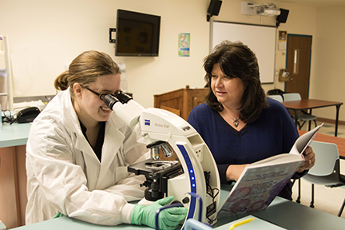
I am inspired and motivated to coach my students throughout their journey. I enjoy watching them grow personally and professionally as they transform into competent and confident laboratory professionals.
—Stacey Rohrbaugh, Allegany College of Maryland

Slide 3
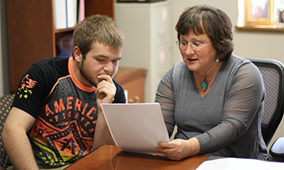
I am motivated by the students who walk through my door feeling overwhelmed. I encourage them and point out that they need a plan A and a plan B, and we work towards that goal. They leave feeling confident and ready to achieve their dreams, which makes my job worthwhile.
—Phyllis Worthington, Arkansas State University-Newport

Slide 4
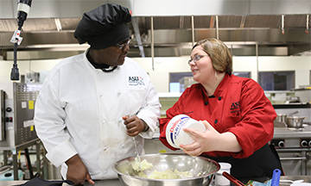
There are many aspects of my career that motivate. The most important inspiration is student success—when students conquer new techniques, create a beautiful tasty dish, or accomplish their career goals. I love the hospitality industry. Nothing makes me happier than serving good food and making folks happy.
—Jessica Wrenfrow, Arkansas State University-Newport

Slide 5
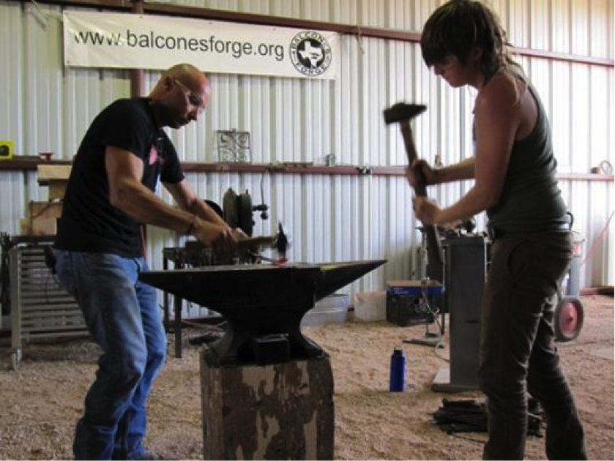
Success at teaching equates to making the curriculum fun and relevant making things happen even if the resources are unavailable; having patience even after the fifth explanation; measuring to what extent no, can't, or shouldn't mean; and showing up and bringing it even if you are not feeling it.
—William Bastas, Austin Community College

Slide 6
As an adult educator, my students bring a wealth of experiences to the classroom. The relationship between the person designated "student" and the person designated "teacher" should be one of equality. We as teachers should be as willing to be changed by the experience as the students.
—Elizabeth Coccia, Austin Community College

Slide 7
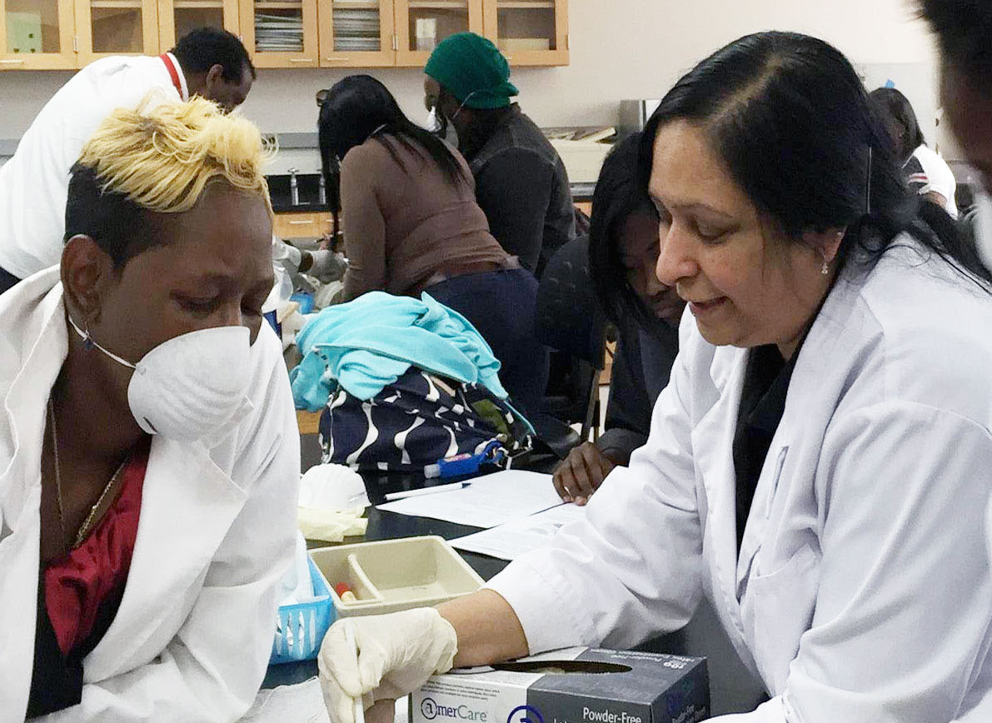
As a professor, I care about the success of my students and want to help them succeed. Inculcating knowledge in the minds of students is one of the important tools for their success. What inspires and drives me as a professor is the “ah-ha” moment when a student makes the connection and understands what I am teaching. I want to be instrumental in motivating, encouraging, and developing that spark of interest in the minds of students. Being a part of something important like this gives me fulfillment. I thoroughly enjoy seeing students succeed. It is not just a career to me, it is my passion, and the satisfaction I get from the “ah-ha” moment makes it all worthwhile.
—Malathi Radhakrishnan, Baltimore City Community College

Slide 8
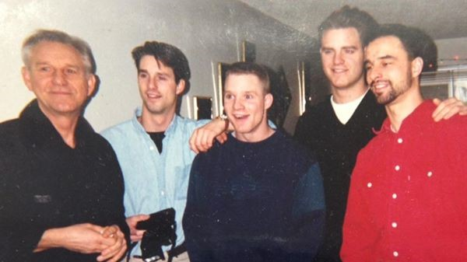
I spent a career in the Army and the Army is all about education; training young people to reach their potential as soldiers and as individuals. As a teacher for the past 24 years, my main focus to help students reach their potential as students and as individuals.
—Ed Young, Bates Technical College

Slide 9
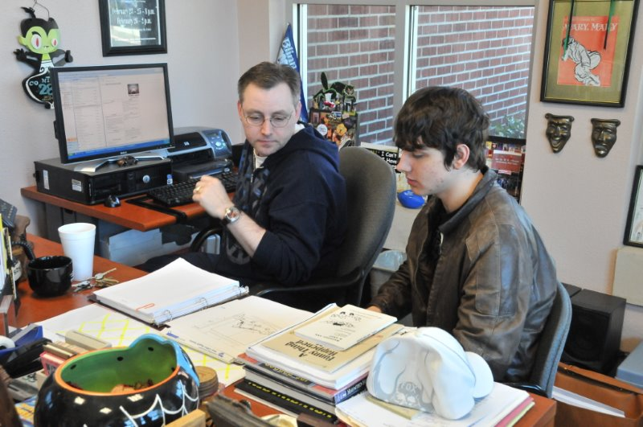
I've always believed that there is magic in the theatre, and the theatre is magic. Blessed are those who create that magic!
—Bradley Nies, Blinn College

Slide 10
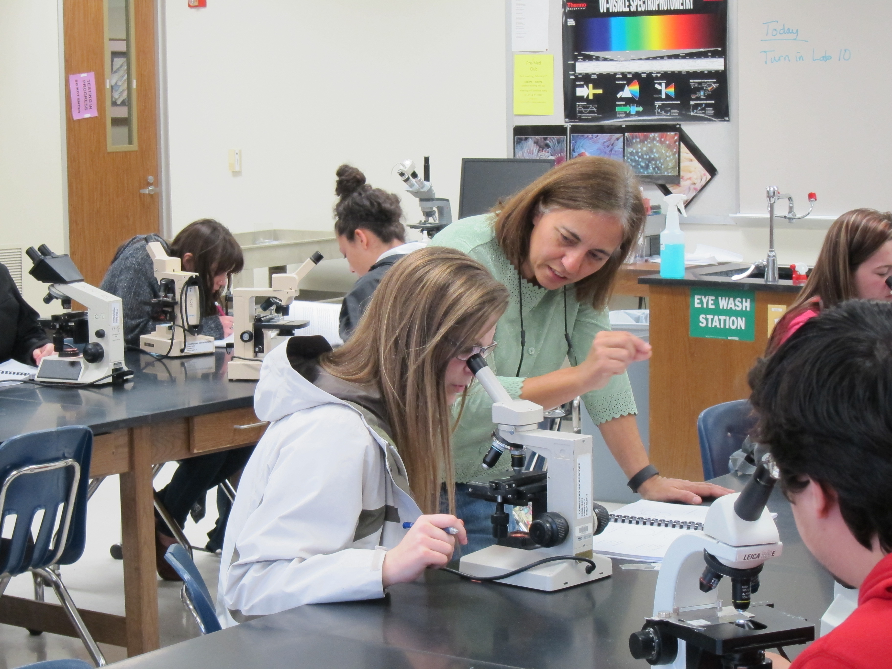
Teaching for me has grown into a passion to help students develop their critical thinking skills. I strive to cultivate lifelong learners by helping them drill down to basic concepts and then back up again to make key connections in order to generate those aha moments.
—Linda Richardson, Blinn College

Slide 11
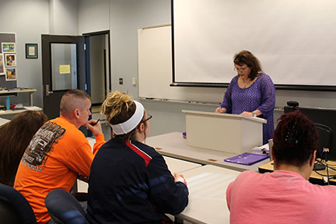
I love to see anxiety fade as they learn to express themselves. I enjoy the young energy and ideas. It inspires me to see the passion they have for the world. I’m proud of students who make the A's; even more of those who give their all for the C.
—Melanie Lea, Bossier Parish Community College

Slide 12
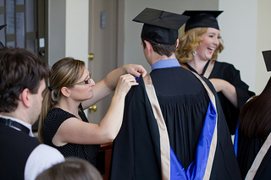
What inspires me? That’s a difficult question to answer, but it always seems to come down to two words: students and success. I am constantly amazed by the dedication and commitment that I see in my students year after year. It is incredibly rewarding to see them succeed as students, and then progress into working professionals. One of my past students once told me “You are an instrument put here to help guide us down that path” –Caleb Woiwod, Camosun College 2013 BSFL Graduate. How could I not be inspired?
—Charity Calder, Camosun College

Slide 13
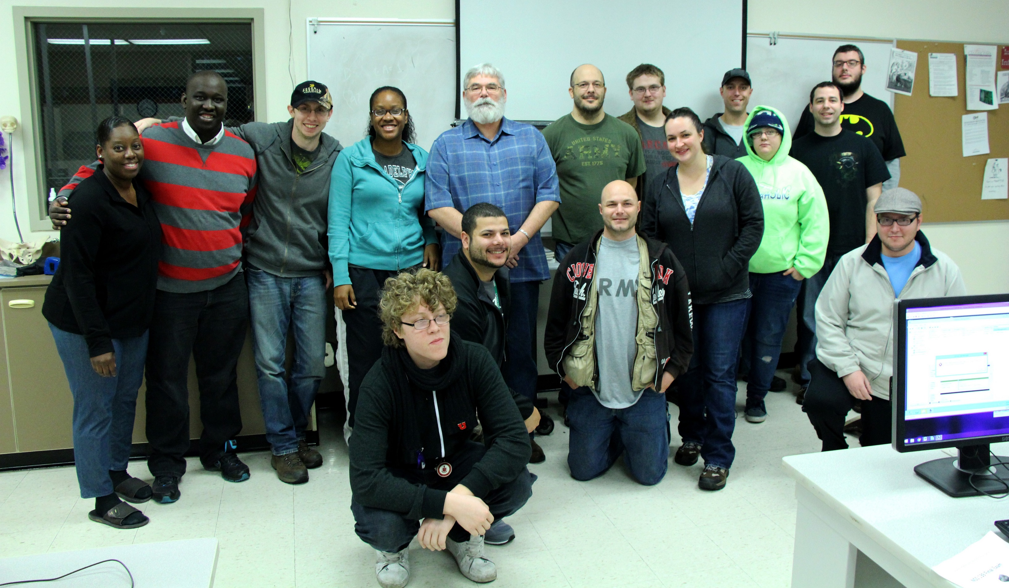
Seeing new students each quarter, observing their minds turning as new subjects are presented, then seeing the “Aha moment” when they get it is what keeps me going. I’m one of the lucky ones. I don’t have to go to work each day, I get to play each day.
—Don Souza, Clover Park Technical College

Slide 14
I am continuously inspired by the students we serve who dream of furthering their education despite daunting obstacles. Many of our students are first-generation and unable to rely on family expertise to navigate college. It is a privilege to work with these students as they attain their career goals.
—Marguerite Conners, Cochise College

Slide 15
I teach mathematics because knowledge of mathematics can help my students in whatever career or educational goals they may have. Even if they are not planning on going into a scientific field, the critical thinking and problem-solving strategies that I pass onto my students are invaluable.
—Amy Curry, College of Lake County

Slide 16
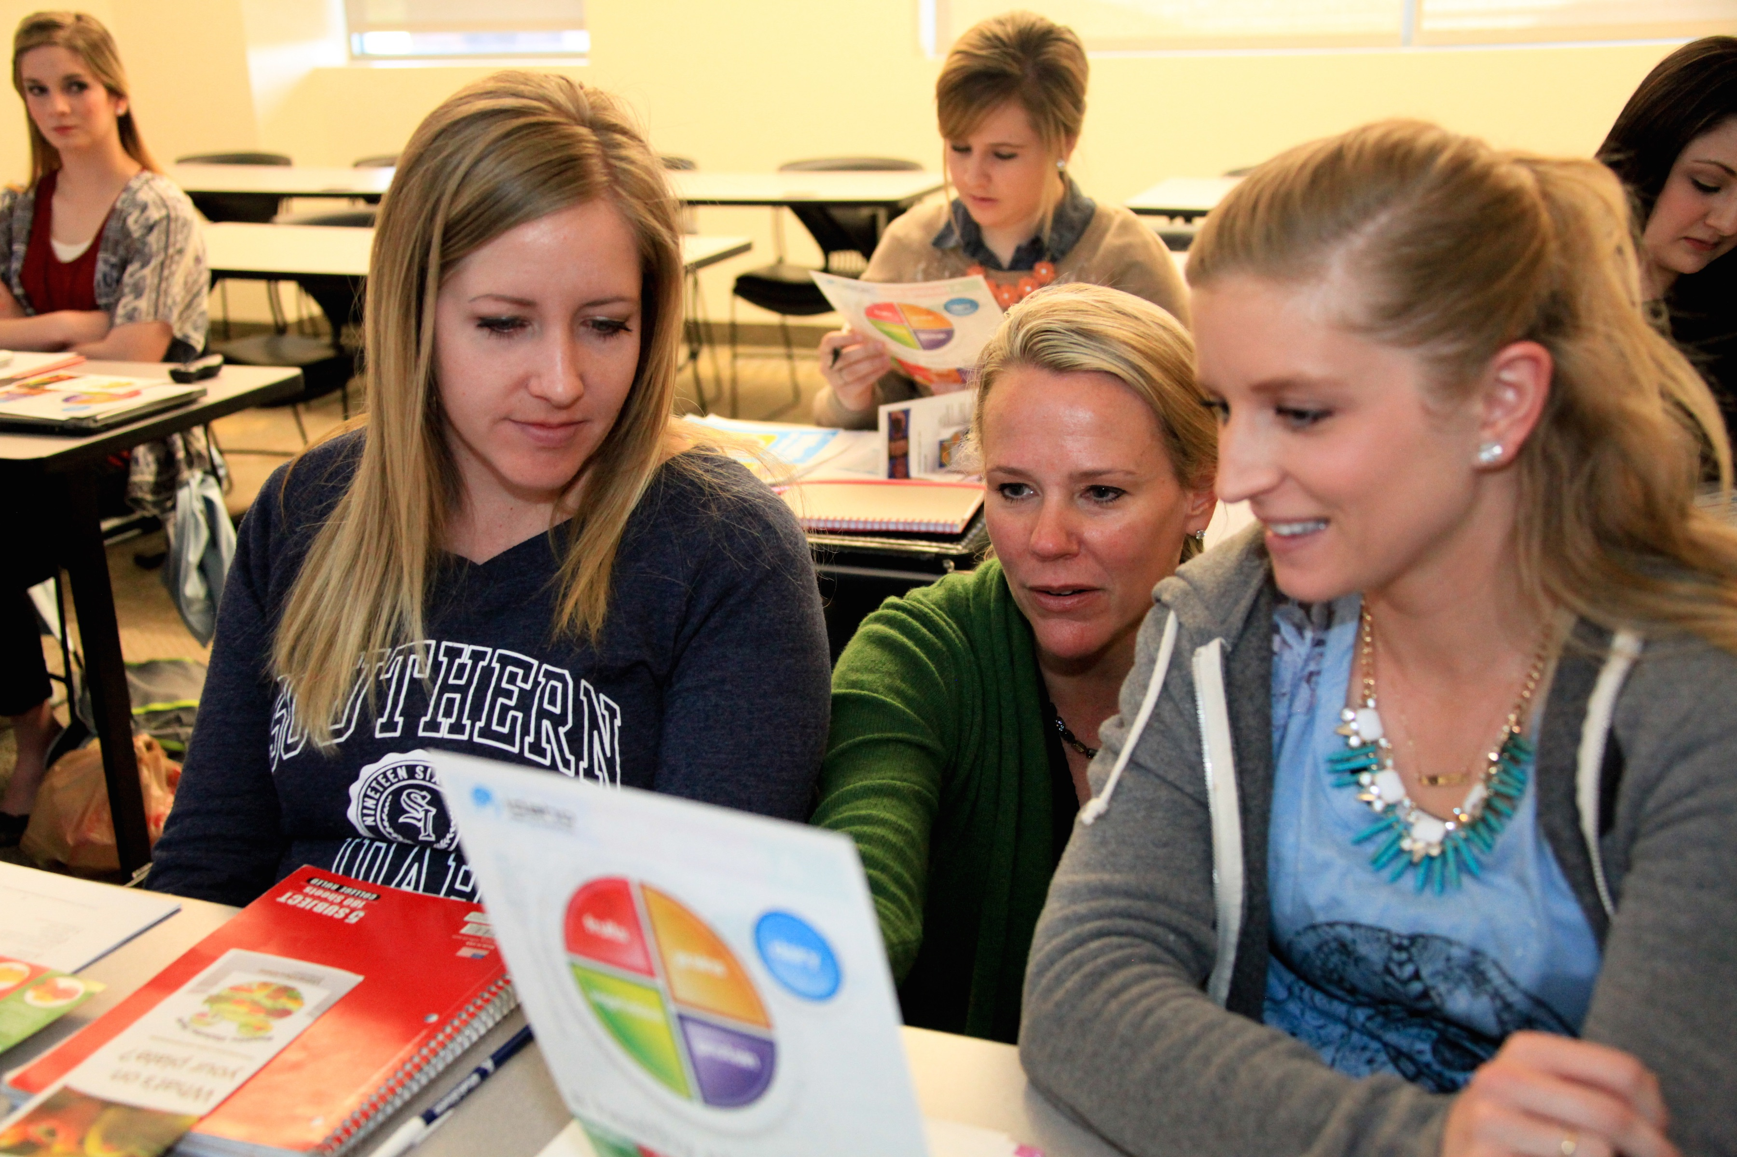
There are many educators who want to teach, but may fail to inspire. It isn’t about me, but the ability to discuss and engage students with personal stories over my career as a Registered Dietitian. My goal is to augment student learning in the classroom with my “real-life” experiences.
—RoseAnna Holliday, College of Southern Idaho

Slide 17
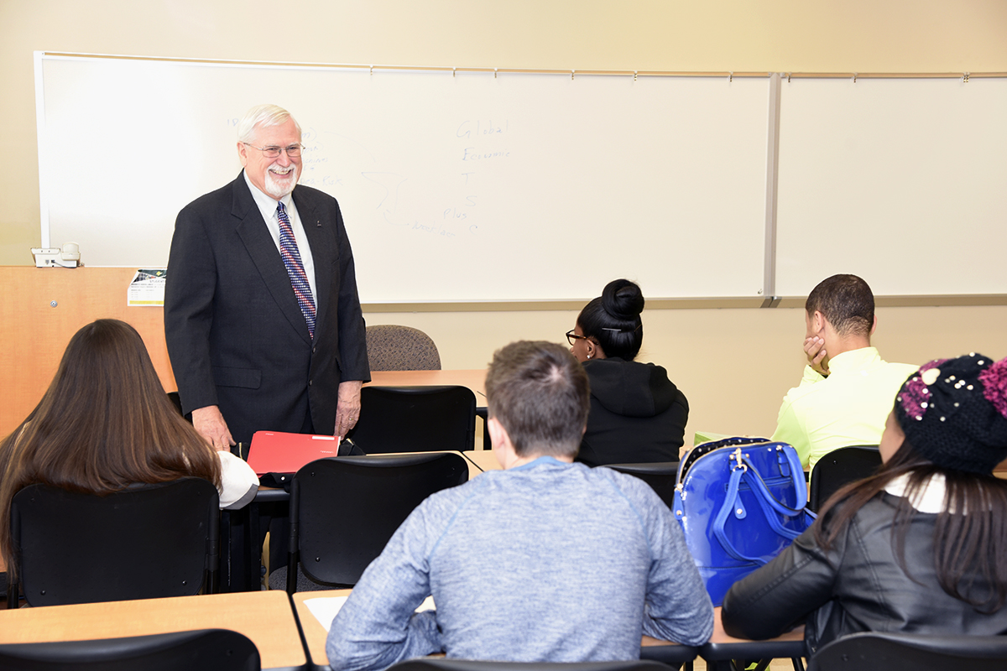
Today’s effective teacher not only presents content, but manages an integrated learning system that encourages all students to reach their full potential. An ideal class, traditional or online, uses appropriate technology and balances teacher-directed instruction with student-to-student learning, thus accommodating diverse learning styles and encouraging student engagement.
—Rex Bishop, College of Southern Maryland

Slide 18
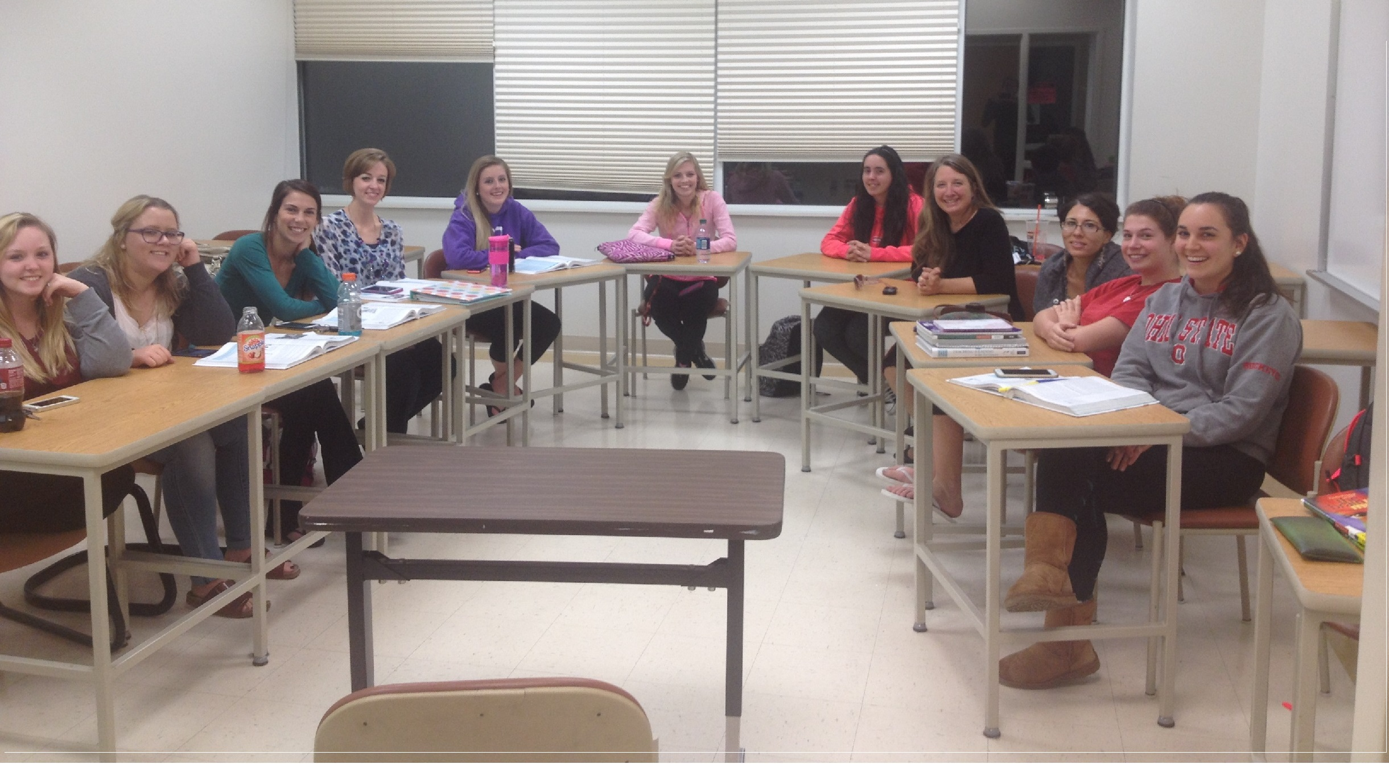
My personal experiences in child development and as a mother of seven give me the ability to connect with my students. I can relate to what they are experiencing day to day on their jobs, and we can discuss topics with academic vigor for personal and professional growth.
—Yvette Dodson, College of Southern Maryland

Slide 19
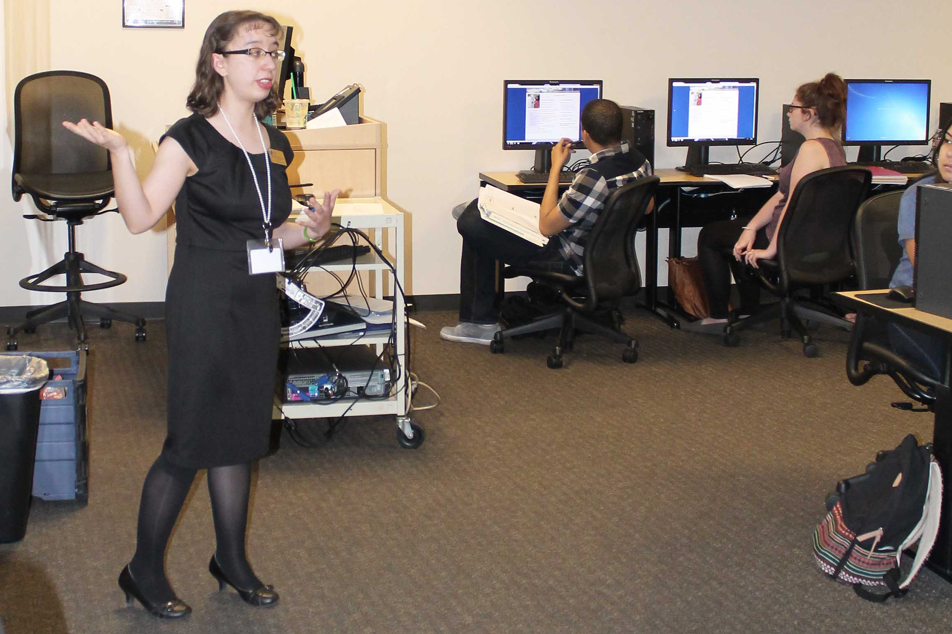
My goal is to teach with patience, empathy, and a dedication to answer questions. No one should ever feel bad asking for help—that’s how we learn. As a community college librarian, I help students of all backgrounds and experiences navigate through research, technology, and college overall. That’s my job!
—Stephanie Espinoza, College of Southern Nevada

Slide 20
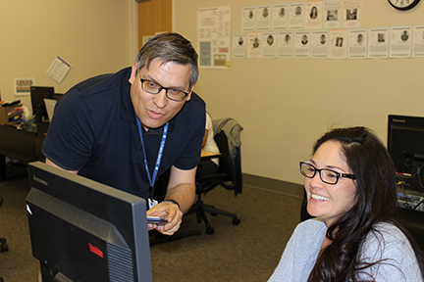
One of the greatest moments is seeing my students graduate and enter the workforce doing something that they enjoy. One of my former pre-calculus students became a dental assistant and worked with my dentist. How great is it seeing your students doing something they enjoy after earning their degree!
—Eric Hutchinson, College of Southern Nevada

Slide 21
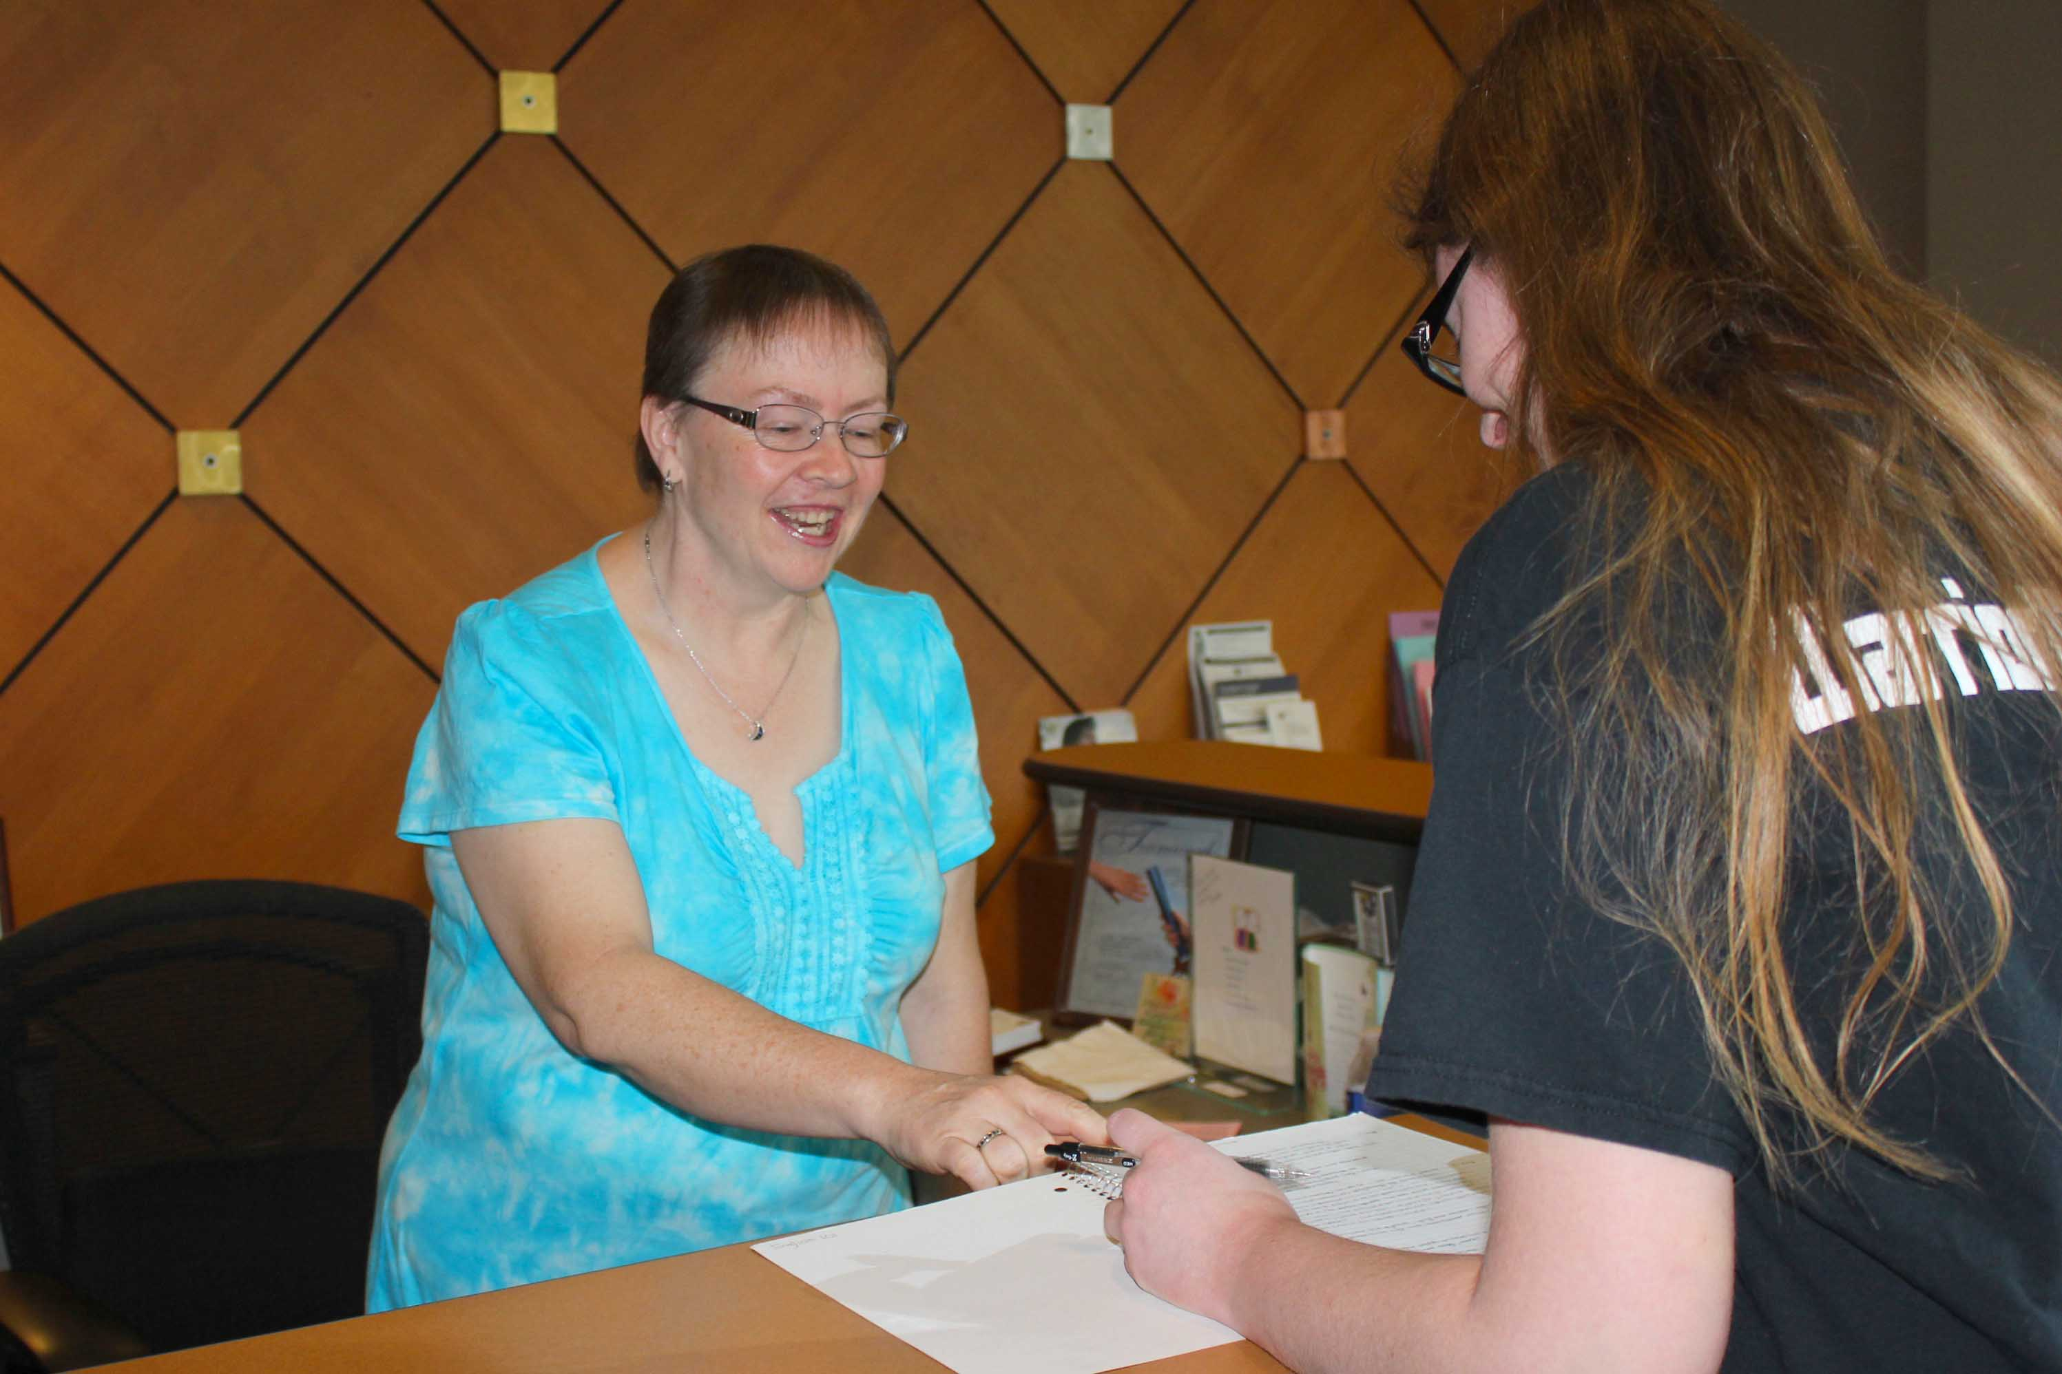
I believe that respect is something that must be taught early and repeated often. Students who have respect for their country, parents, instructors, and peers will develop respect for themselves. It is my privilege to share my wisdom and respect with students and guide them to become independent, productive individuals.
—Georgia Martini, College of Southern Nevada

Slide 22
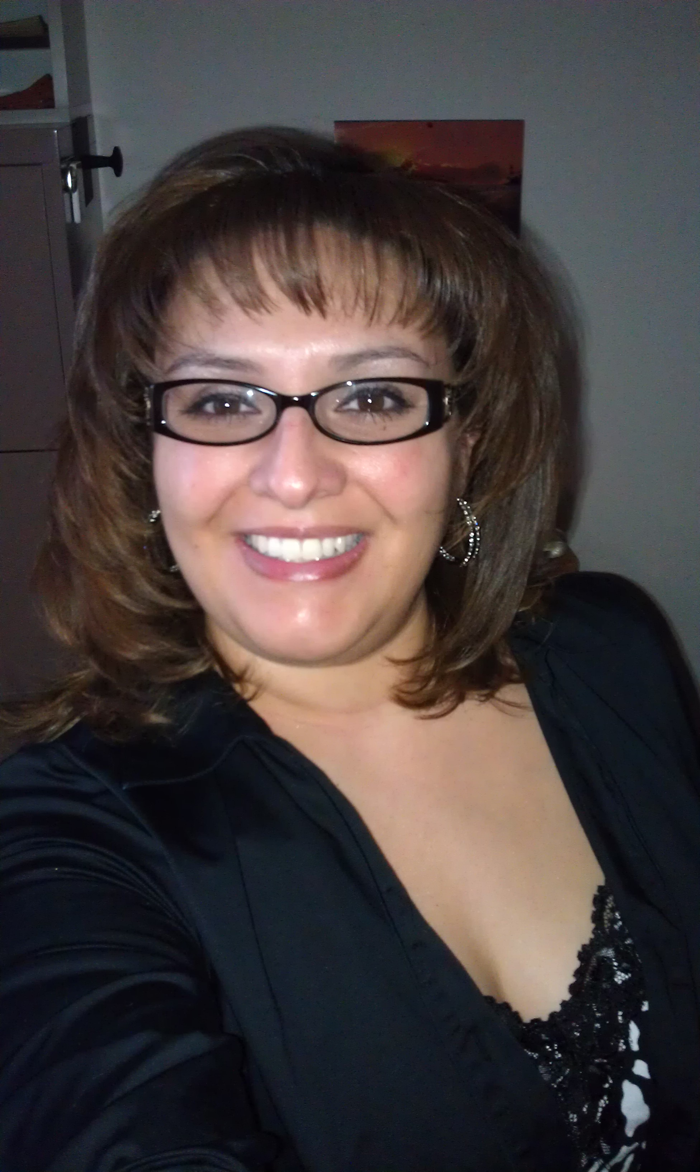
I like to help students succeed in their educational goals. When that time comes and you know that you have helped students realize that their education will set the biggest pathway to the rest of their lives is an amazing feeling.
—Cindy Ray, College of Southern Nevada

Slide 23
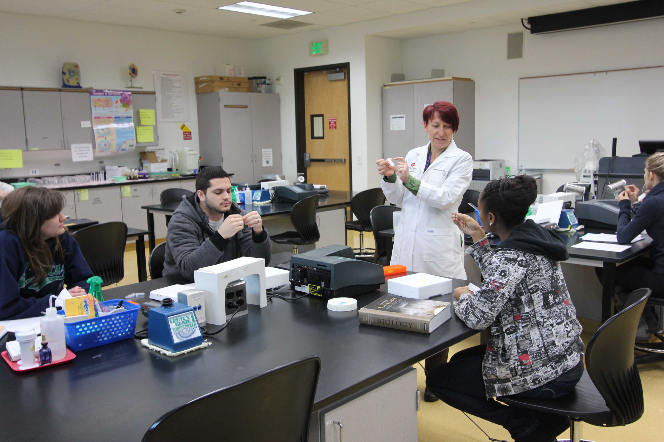
I love biology and enthusiastically teach the science that changes our world. I inspire students with terrific content. I work hard to teach students to recognize their strengths and weaknesses and parlay them into success. My rewards are students who accomplish their goals and keep in touch.
—Denise Signorelli, College of Southern Nevada

Slide 24
The greatest honor is seeing our students have a better quality of life and to understand the importance of having an education. Every day, I try to encourage and help them succeed in achieving their academic and personal goals.
—Linda Boshers, Columbia State Community College

Slide 25
Seeing students reach their educational goals motivates me the most! Graduation day is always a special day for me—the joy and excitement on the graduates’ faces and those of their family and friends invigorates me and makes me realize why I chose a profession in higher education.
—Betty Yates, Columbia State Community College

Slide 26
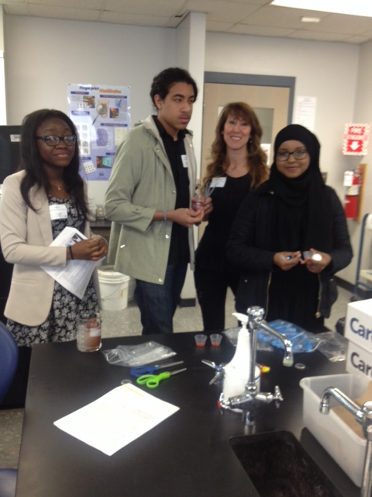
—Julie Posey, Columbus State Community College

Slide 27
My motivation comes when former students call or write to let me know that they have successfully passed the NCLEX exam and they thank me for helping them achieve their goal. Rules to teach by—set expectations high and treat everyone with respect.
—Jeanne McColl, Community College of Rhode Island

Slide 28
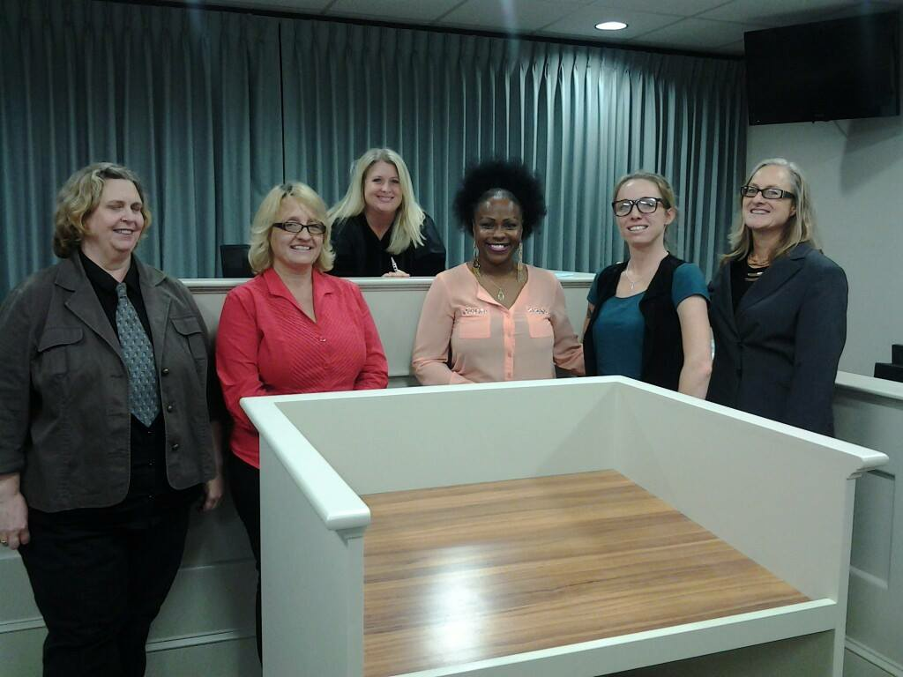
Watching colleagues and students grow and develop through my workshops and classes motivates me to “Walk the Talk” because John Maxwell says leaders must, “know the way, go the way, and show the way,” and I learn as much from them as I hope they do from me!
—Shana Deyo, Daytona State College

Slide 29
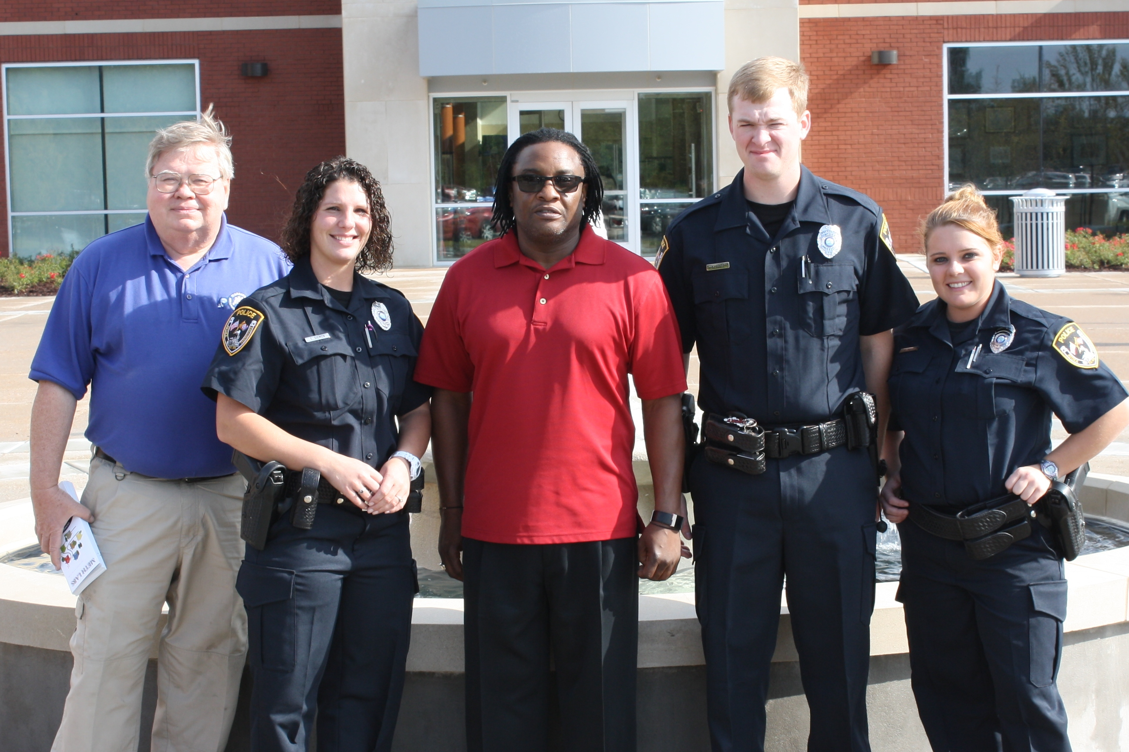
As a prior real-life practitioner in law enforcement, I am excited to be able to share the lessons I have learned and present them into case-based scenarios for my students. This approach allows for collaboration, critical thinking, and logical conclusions to real-world problems in law enforcement.
—Michael Brooks, Dyersburg State Community College

Slide 30
What a privilege it is to be paid to do something I love! Those moments when I hear "aha!" just make my day. It is so great to see a student who just figured something out turn around and want to explain it to the rest of the class!
—Darlene Klassen, Eastern New Mexico University-Roswell

Slide 31
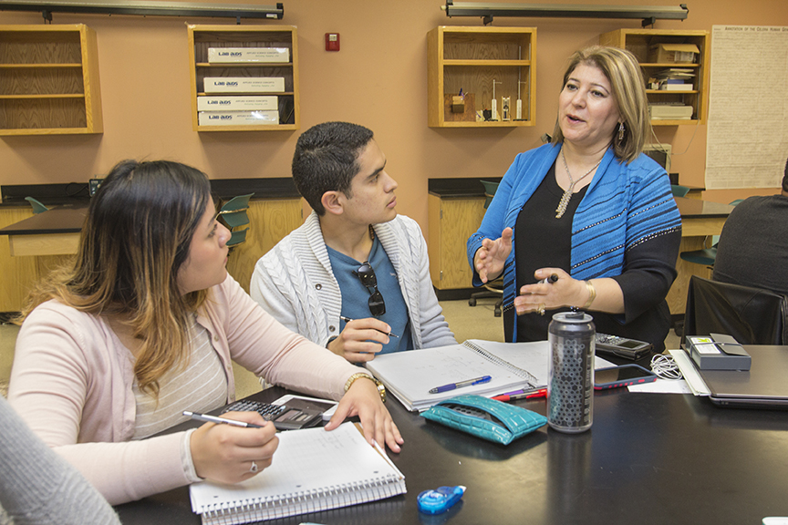
My students are my inspiration. Their expressions brightening into an “Aha!” moment are a strong reward. I constantly devise new strategies to interest and challenge them. I never give up on a student. I believe in them and make sure they learn to believe in themselves and their possibilities.
—Fariba Ansari, El Paso Community College

Slide 32
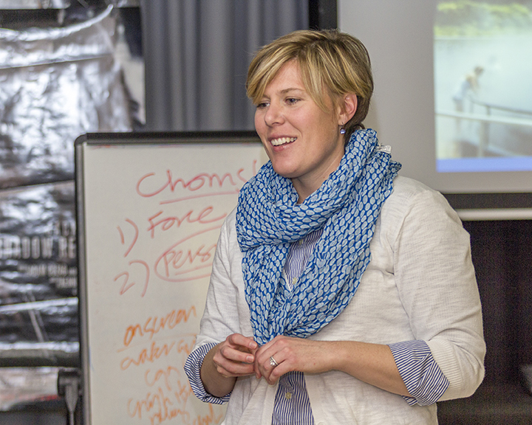
I’m an excavator—I help unearth talents and abilities that are hidden below the surface. I help students see what they are capable of accomplishing and how to go about doing it. Helping students realize their potential, giving them the confidence and knowledge to pursue it, that’s why I teach.
—Lisa Elliott, El Paso Community College

Slide 33
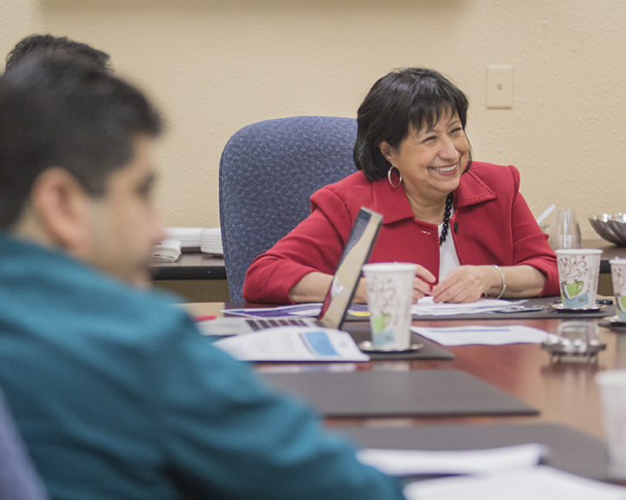
Two fundamental principles have driven me during my career in education. First, I believe everyone has the right to learn and be educated. Second, education should be accessible. I've had the opportunity to develop programs and provide accessible resources to ensure learners succeed in achieving their educational objectives.
—Jenny Girón, El Paso Community College

Slide 34
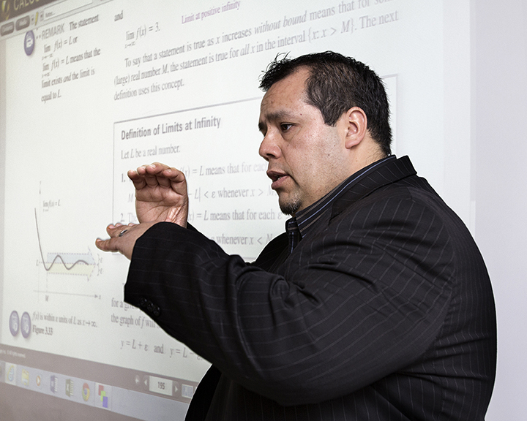
Education allows people to make dreams become a reality. It is an opportunity to strive and achieve a better quality of life. This stability is not only for the individual, but for the community. I enjoy helping my students achieve educational goals and inspiring them to become lifelong learners.
—Gabriel Mendoza, El Paso Community College

Slide 35
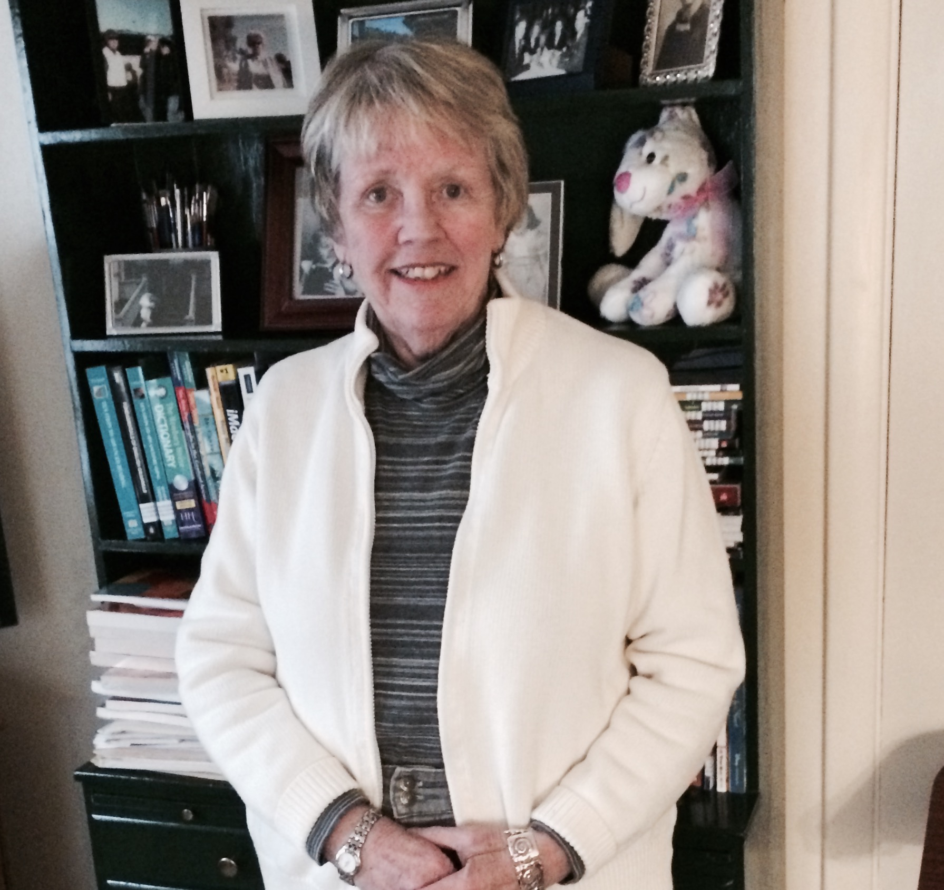
Teaching is one of my greatest blessings. The diversity and richness of cultures that my students bring to the classroom, make every day and class unique. They inspire me to strive to be creative, innovative, and to continue to work to enrich every learning experience. My goal is to have students develop a love for the quest of learning, and communication skills that will stay with them for their entire lives. The fulfillment that we all derive from helping our students to successfully attain their goals is a privilege that I treasure.
—Marilee Halpin, Elgin Community College

Slide 36
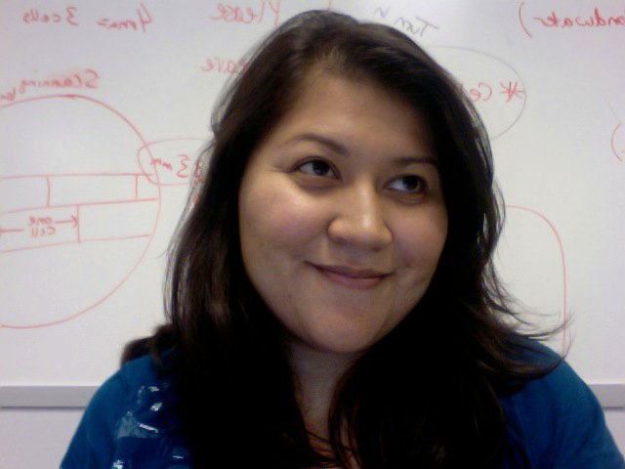
I value student engagement in the classroom. When students enter my classroom, engaging is not an option, it’s a requirement. There are many activities to support this type of learning environment, but the most important is to establish a safe environment where students feel comfortable. I know it’s a hurry to get into content and cover as much as possible, as soon as possible. However, I suggest taking the time to help students get to know you and each other. This helps the learning environment significantly. Once established, teaching will be more enjoyable and rewarding.
—Shannon Manuelito, Estrella Mountain Community College

Slide 37
Teaching to become excellent is something that is never stagnant; it is a process that requires continuous evolvement. This is done by creating and developing learning activities that will help nursing students understand difficult concepts by using real-world connections.
—Sonya Cooks, Gateway Technical College

Slide 38
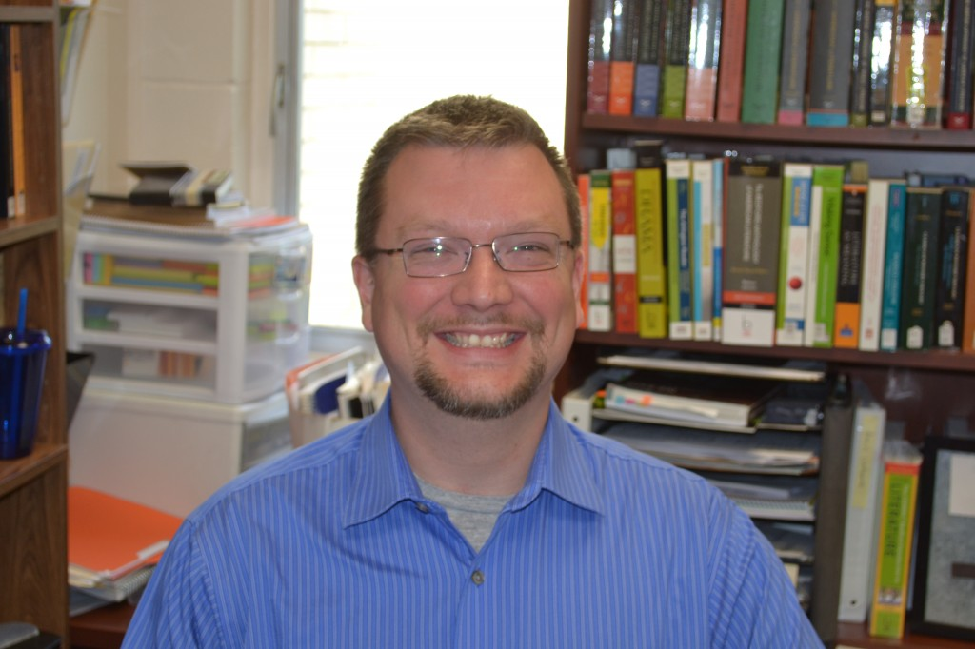
John Dewey said, "The most important attitude that can be formed [in education] is that of the desire to go on learning." My main focus as a teacher is to show students that education is that which makes us human, not that which makes us money.
—Troy Appling, Florida Gateway College

Slide 39
Transitioning from clinical practice to the classroom has allowed me to combine my love of the physical therapy profession and teaching in order to mentor the physical therapist assistants of the future. Education is a path to a brighter future that can lead my students to a fulfilling career.
—Kimberly Salyers, Florida Gateway College

Slide 40
To teach, one must be constantly willing to learn, adapt, and acknowledge change and differences. I want my students to feel valued, know that their goals are significant, engage as a community of learners, and feel safe to make mistakes in order to move forward. Mathematics is not the enemy!
—Rebecca Gubitti, Florida SouthWestern State College

Slide 41
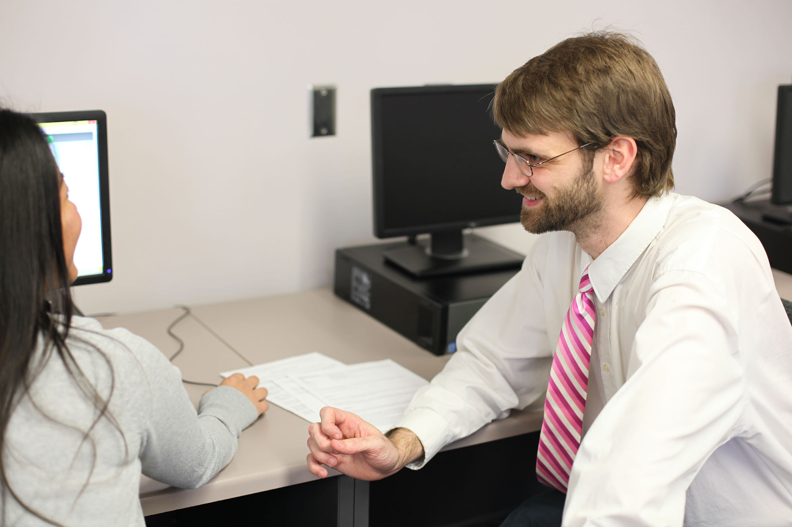
—Christopher Jacobson, Frederick Community College

Slide 42
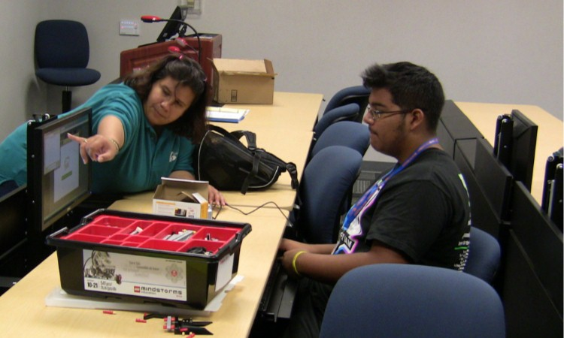
Over weeks, months, and sometimes years, I get the chance to ask students, “Why not…?” “Have you considered…?” and “What if?” and slowly see them transform from students into tomorrow’s informed thinkers, decision makers, and leaders. I know I helped them in this process. This is why I teach.
—Connie Gomez, Galveston College

Slide 43
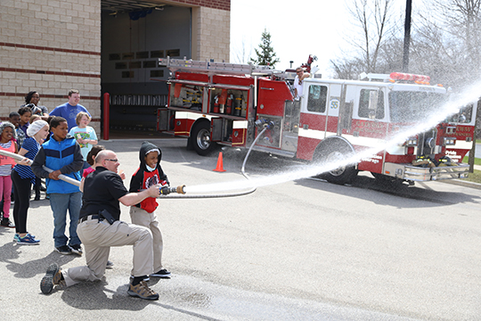
—John Dahms, Gateway Technical College

Slide 44
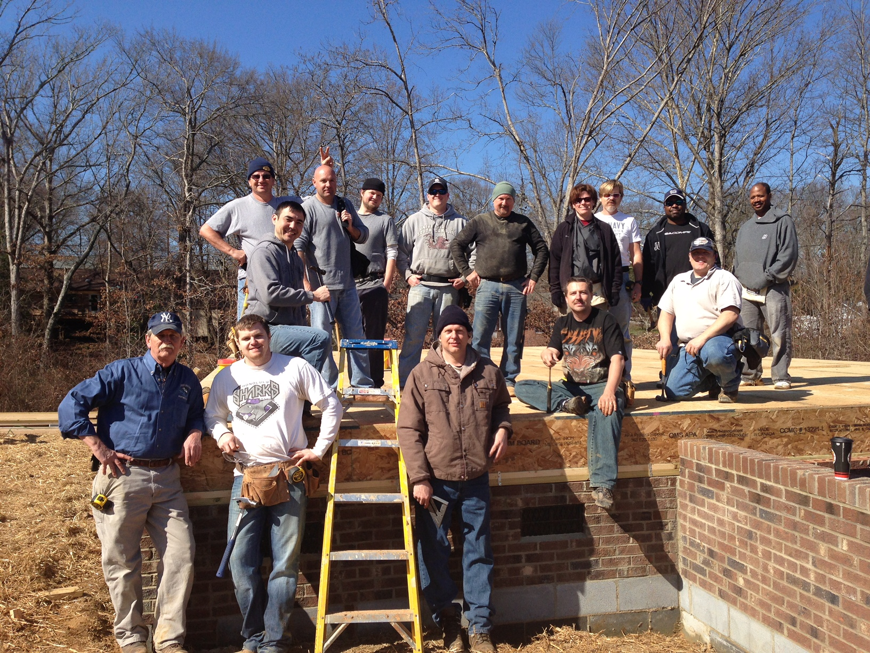
The influence we have on our students’ lives should not be restricted to purely academic knowledge. It should also include a foundation for personal and economic growth in their lives.
—David Ackerman, Greenville Technical College

Slide 45
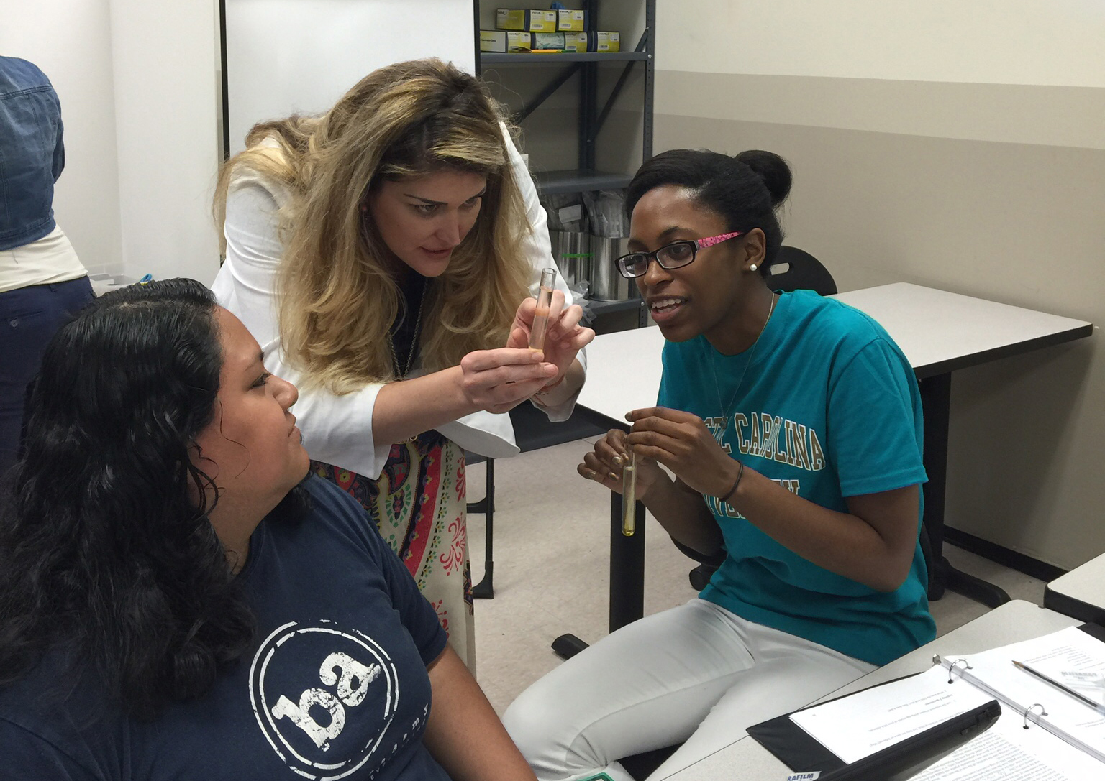
How many people get to work where they can act, role-play, dance, wear cool lab coats, make people laugh, change the course of someone’s life, empower and groom future community leaders, and impart knowledge to help students achieve their dreams? I do. We are not just teachers, we’re community builders.
—Heather Forrester, Greenville Technical College

Slide 46
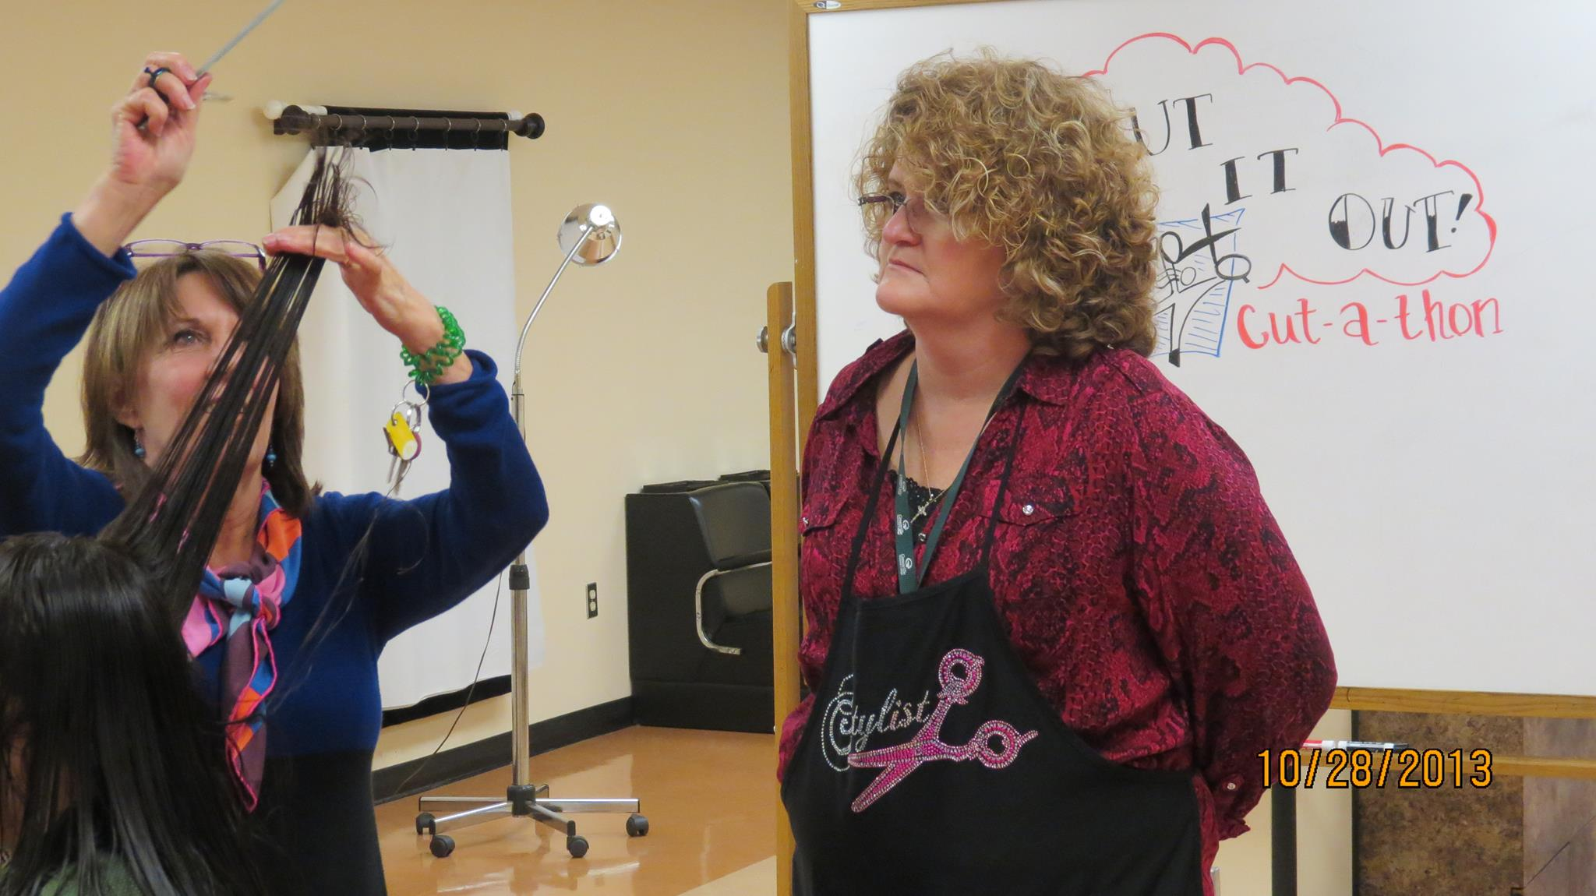
The roles of students and teachers are fluid. Each member brings a unique learning experience to the stage. I have no doubt I have learned as much, if not more, from my students as they have from me.
—Mary Rock, Greenville Technical College

Slide 47
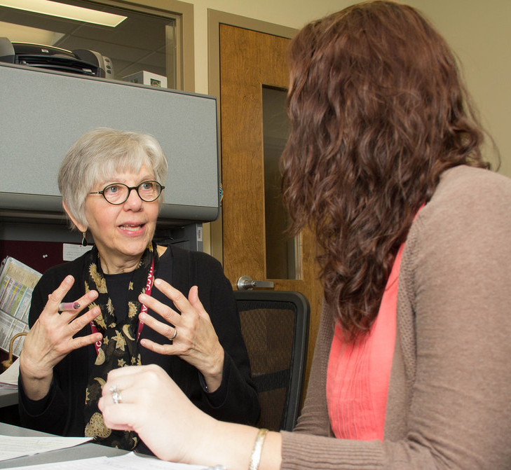
I’m inspired by students, many of whom have had to overcome very difficult situations such as incarceration, addiction, abusive parents, or studying by candlelight. These students’ hard work to change their lives makes coming to work worthwhile.
—Patrice Beittel, Harrisburg Area Community College

Slide 48
As a professor of mathematics, I often have students arrive at my door the first day of class with a look of fear and anxiety in their eyes. What inspires me the most is when those looks of fear change to looks of empowerment, self-gratification, and perhaps even enjoyment.
—Susan Cooper-Nguyen, Harrisburg Area Community College

Slide 49
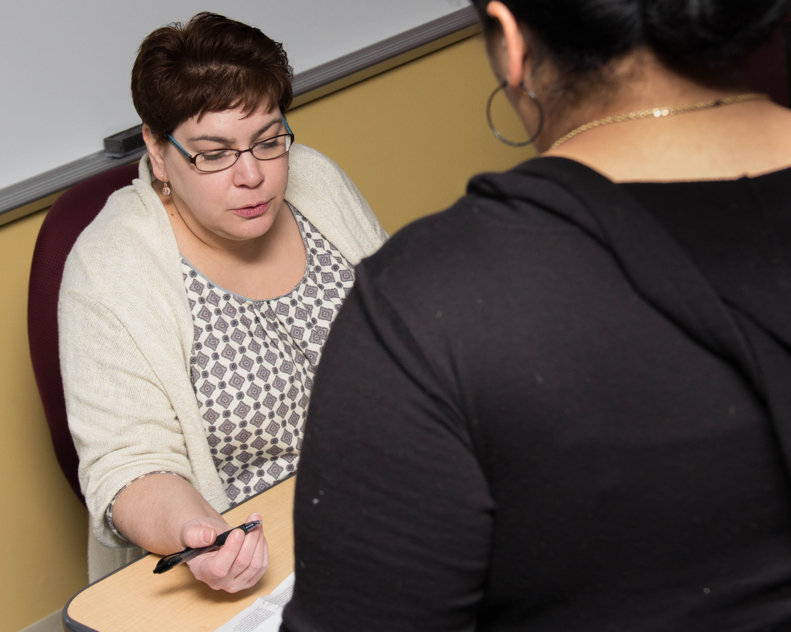
Make the community your classroom. Help students apply their skills in real-world situations. Show them their knowledge is valued and their work matters. Expose them to real-life learning environments where they can prove themselves (to themselves) by solving problems, teaching others, and leading their communities.
—Cristal Renzo, Harrisburg Area Community College

Slide 50
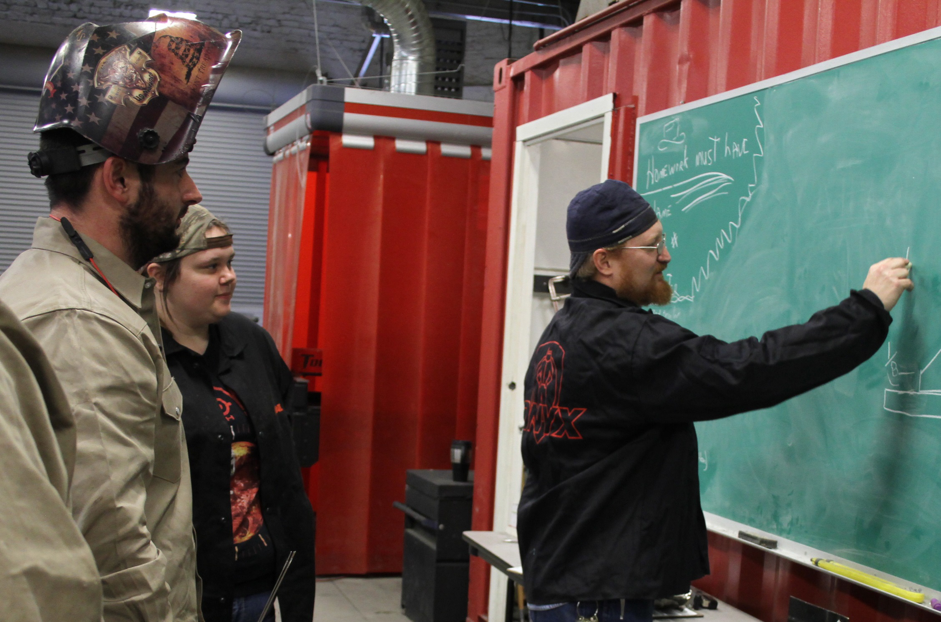
I view education as a doorway to a better future. My goal is for my students to leave with the skill mastery and confidence in their ability to not only better their employment options, but to also have a goal for excellence in every aspect of their lives.
—Brian Bennett, Hill College

Slide 51
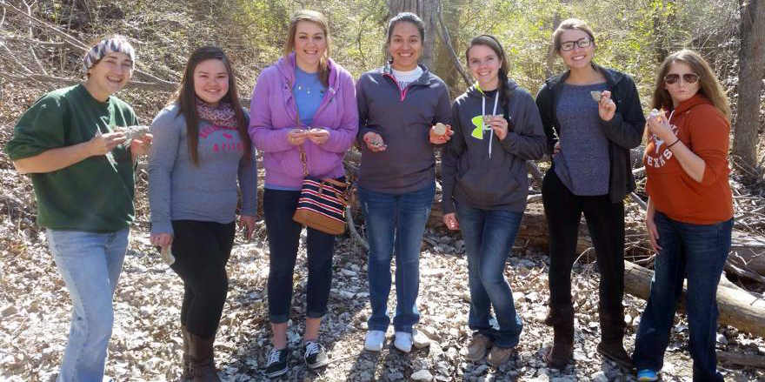
These two quotes describe my teaching philosophy: "Don't make money your goal. Instead pursue the things you love doing and then do them so well that people can't take their eyes off of you" (Maya Angelou) and "Educating the mind without educating the heart is no education” (Aristotle).
—Lori Rose, Hill College

Slide 52
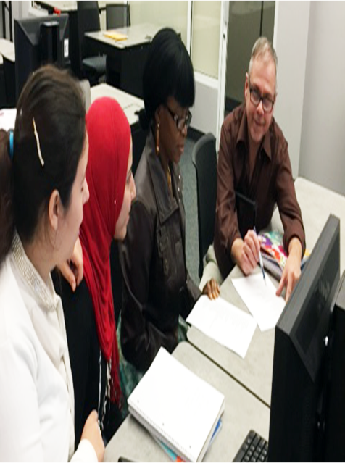
I see the classroom as a co-constructed learning environment—one between my students and me. We learn together, from one another. I want everyone with whom I interact to feel that it’s time well spent. I strive to be relevant, and I really do want to make a difference.
—Stephen Johns, Hillsborough Community College

Slide 53
Ask questions, take risks, immerse yourself in your art and the process. Fail miserably in the safety of the classroom and learn from those mistakes. Focus on making the best images you can and the grades will follow. Once you leave this room, the world will be far less forgiving.
—Andre Hermann, Houston Community College

Slide 54
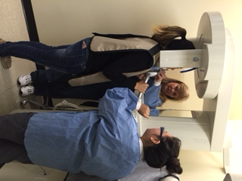
—Kay Jukes, Houston Community College

Slide 55
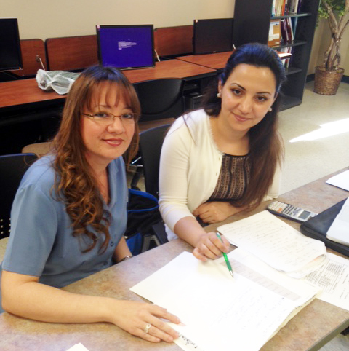
I enjoy making a difference in students’ lives. My motivation is the smiles across my students’ faces when they finally grasp a difficult topic or concept. I believe all students can learn, but it's my job to convince them of that by providing the support and motivation they need.
—Marisol Montemayor, Houston Community College

Slide 56
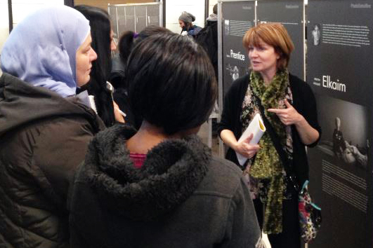
I figured out along the way that questions are more powerful than answers. Ask the right question at the right time and see what happens. Critical thinking rarely comes from being told; it comes from pondering and considering deeply. Why? What does this mean? How can we change this?
—Linda Hill, Humber College Institute of Technology & Advanced Learning

Slide 57
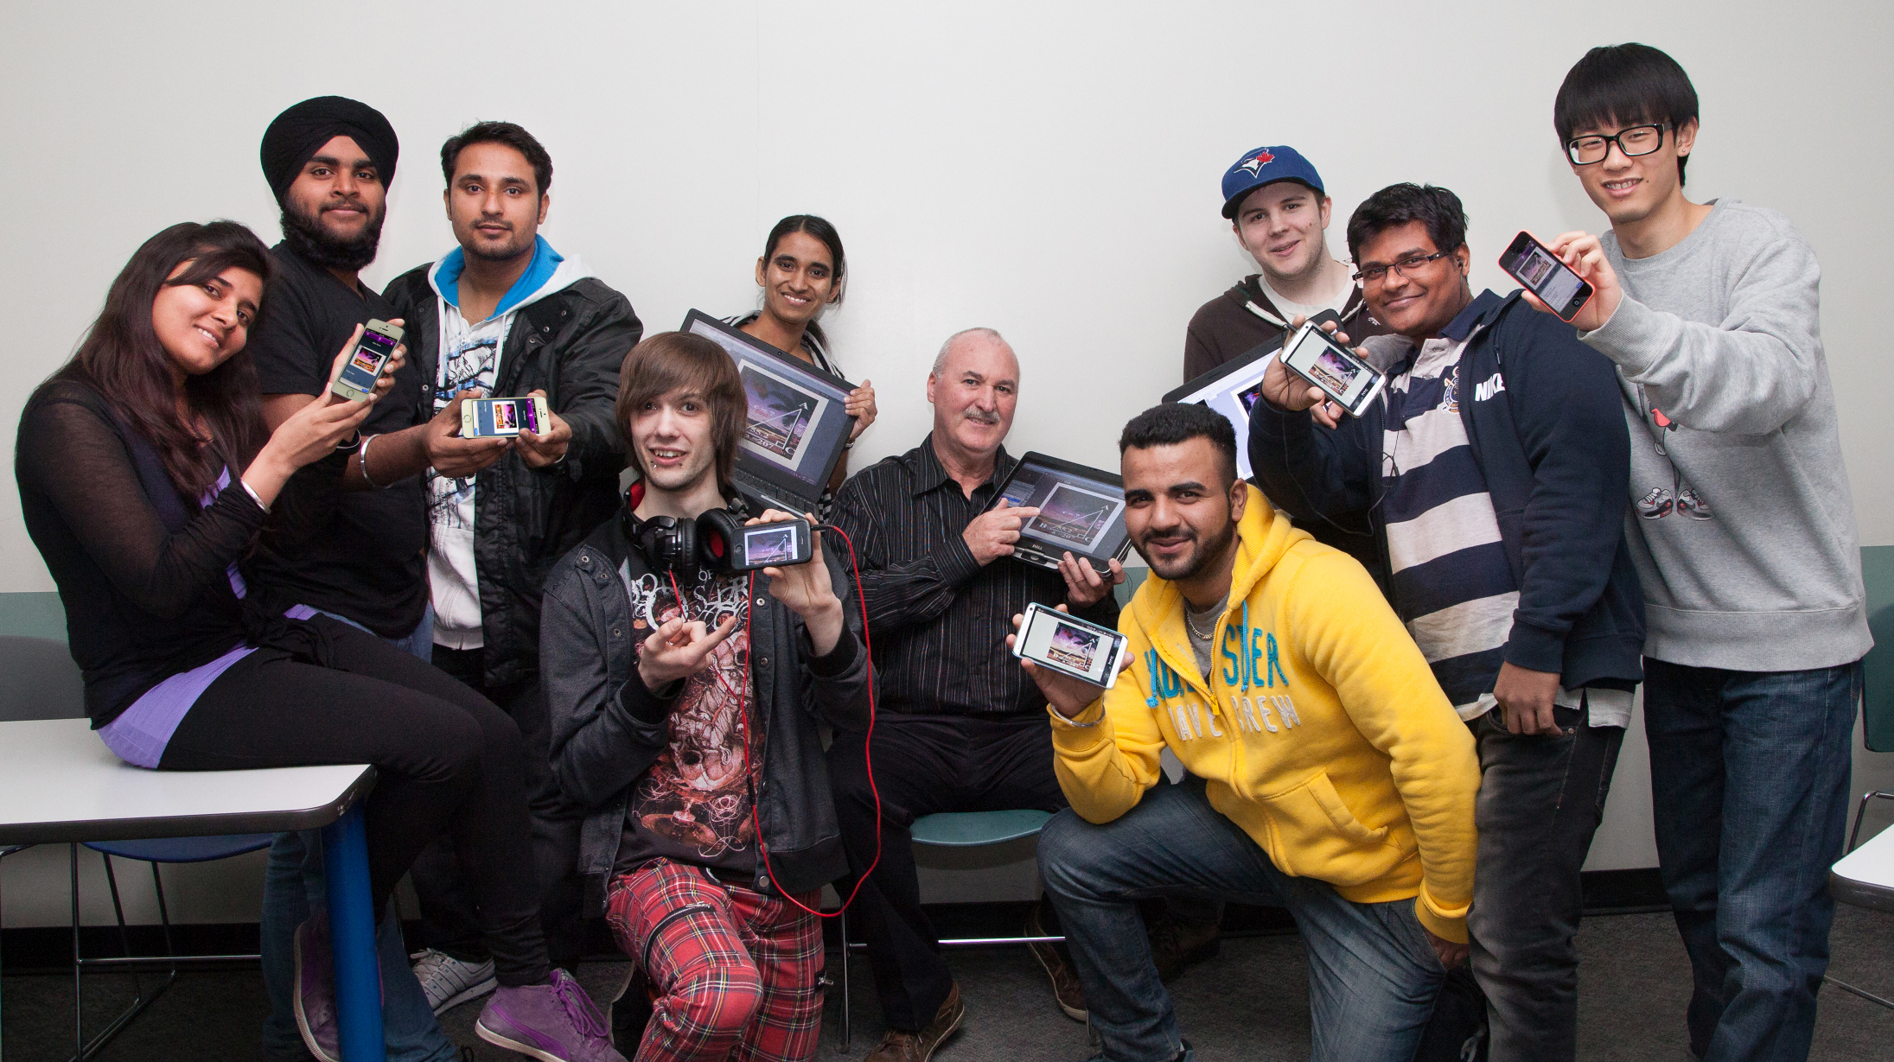
A wise man once said, “Our challenges don’t define us. Our actions do…” Now, I can’t take credit for writing these inspirational words, but I can take credit for encouraging others to abide by them. For these words not only give rise to excellence in teaching, but excellence in life.
—Richard Mitchell, Humber College Institute of Technology and Advanced Learning

Slide 58
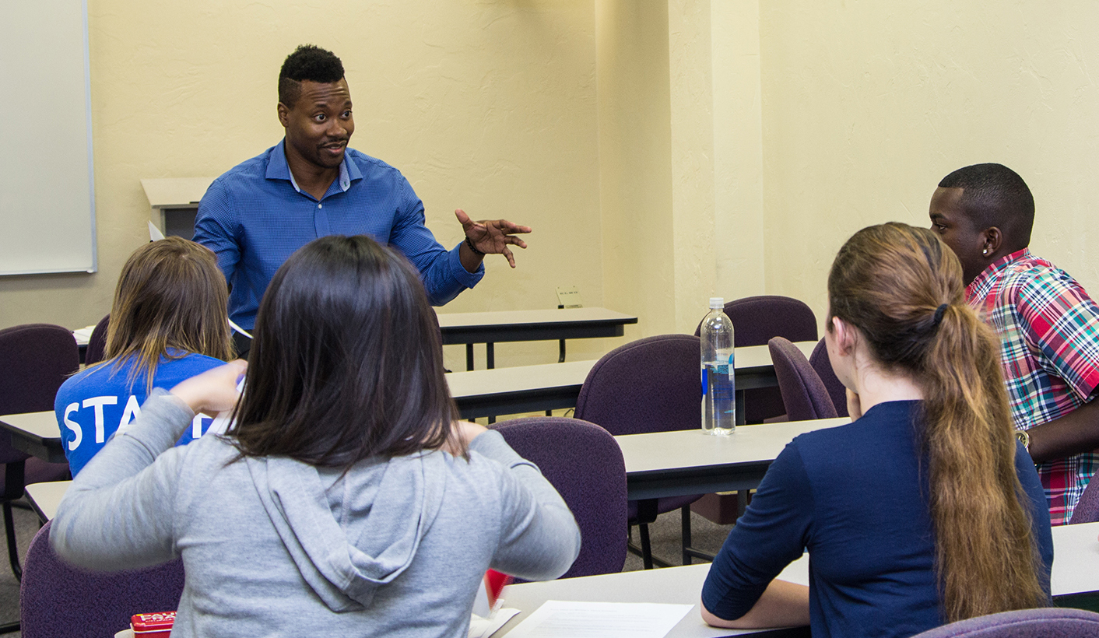
—Danny Hoey, Indian River State College

Slide 59
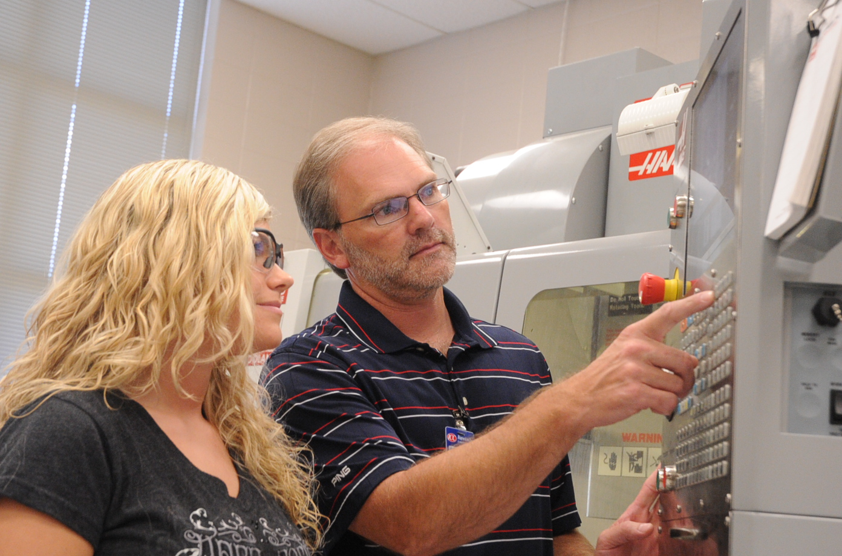
I once heard that teaching is like learning in reverse. Thinking about how I learn, I attempt to break difficult concepts down to their simplest form in hopes of making difficult concepts easy. Therefore, as an instructor, I should introduce easy, dissected parts so students can grow the more difficult whole.
—Barry Emison, Itawamba Community College

Slide 60
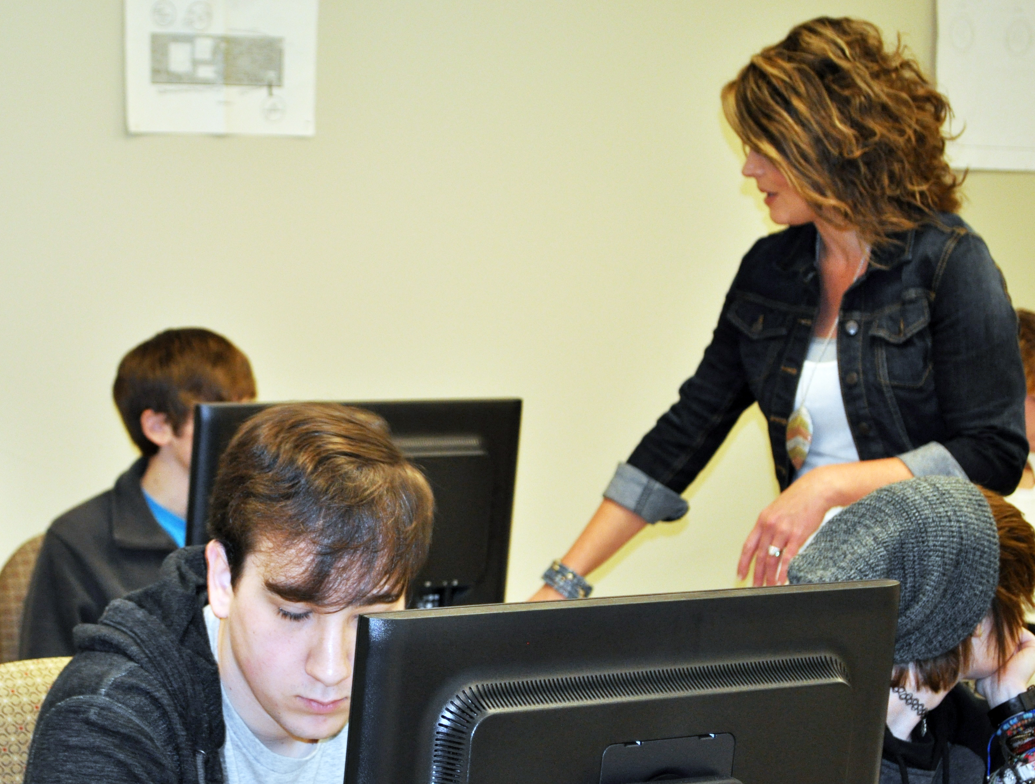
From workforce classes to academic transfer classes, what has worked in the past may not progress learners to future goals. To not first succeed is not to fail, but to stop trying is. Instead of “try, try, try again,” choose to “try, try something new, try something totally different.”
—Denise Gillespie, Itawamba Community College

Slide 61
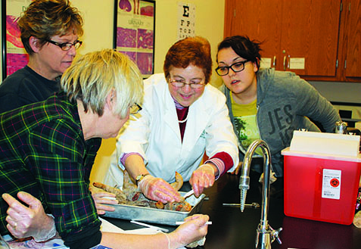
—Janet Brodsky, Ivy Tech Community College–Lafayette

Slide 62
Humility helps me realize that it isn't about me and what I have done. It is about all the things I can do to help students be successful. Ultimately, it is what they can do and achieve that is the foundation of what we do together as educators.
—Joseph Hostetler, Ivy Tech Community College–Southwest

Slide 63
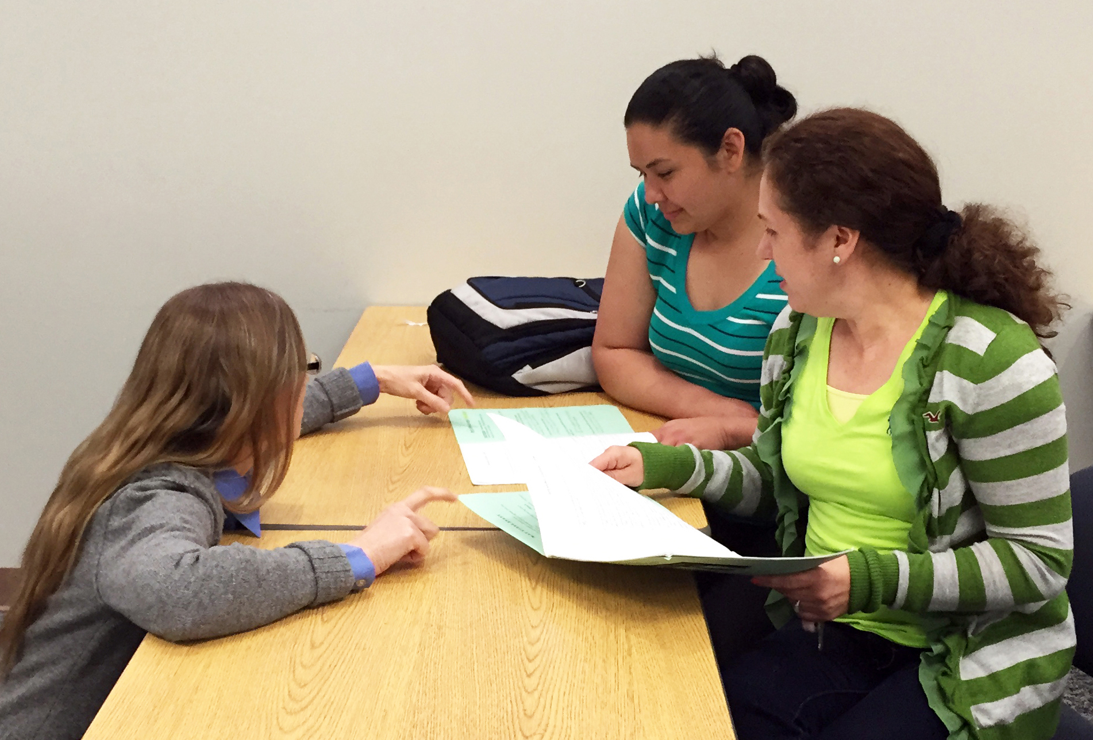
Whenever my patience level wanes with students, I think of Makor. Despite enduring unspeakable horrors of genocide and civil war, he always met each day with a smile on his face and boundless hope in his heart. His resolve to graduate from college showed me why I chose this profession.
—Holly Milkowart, Johnson County Community College

Slide 64
—Ellyn Mulcahy, Johnson County Community College

Slide 65
Good teachers are passionate about what they teach. I try to instill in students the desire to be lifelong learners by trying out all kinds of different techniques in the classroom to help them utilize critical thinking, apply their knowledge and creativity, and do service in their community.
—Anna Page, Johnson County Community College

Slide 66
—Nancy Lamouroux, Kilgore College

Slide 67
Margaret Mead said, “Never believe that a few caring people can’t change the world. For, indeed, that’s all who ever have.” Sadly, many students haven’t been told they are capable, good, or can succeed. It's our job to motivate the unmotivated and to teach the uncared for to care.
—Dawn Katz, Lamar Institute of Technology

Slide 68
My students inspire me to work hard in what I do. I constantly teach students to strive for the best and never give up. Teaching allows me to bring in real-life events and turn them into lessons, which allows my students to see the world from their own perspective.
—Humberto Cardenas, Laredo Community College

Slide 69
—Richard Warner, Lehigh Carbon Community College

Slide 70
—Sharon Cheek, Lincoln Land Community College

Slide 71
The strength of our country is rooted in its diversity, and I see this each day in my classroom. I am humbled and inspired by my students’ bravery as they begin again in the United States with optimism, resilience, and the desire to learn.
—Anne Damiecka, Lone Star College System

Slide 72
Despite being forced to drop out of school in fourth grade, my grandmother believed in the value of an education. Like her, my students share their own stories of adversity. I teach to inspire, and I am inspired to teach, providing opportunities to others that my grandmother never had.
—Britney Jeffrey, Lone Star College System

Slide 73
Teaching is “paying it forward” in the deepest respect. To be a professor is to touch countless students so that they can go on to affect hundreds more. The influence is limitless, and as instructors we must be mindful of our profound ability to impact another human’s life.
—Andrea Seay, Lone Star College System

Slide 74
Maya Angelou said, “My mission in life is not merely to survive, but to thrive; and to do so with passion, compassion, humor, and style.” My goal is to provide students with the qualities and tools they need to become successful, competent nurses.
—Doris Jackson, Lone Star College–Kingwood

Slide 75
I became a teacher because nothing makes me happier than seeing my students succeed in life and professionally.
—Thilo Schimmel, Lone Star College–Kingwood

Slide 76
I am inspired every day by my hard-working students. They balance family, coursework, careers, and somehow manage to keep it all together to produce quality work in the classroom! Their creative energy and commitment to fulfilling their dreams keeps me motivated!
—Lori R. Hughes, Lone Star College–Montgomery

Slide 77
The ESOL students that I teach are the best students in the world! I hope that I can teach them as much about language as they teach me about life. It is truly a rewarding profession.
—Renee La Rue, Lone Star College–Montgomery

Slide 78
“You are lucky,” my Algerian student said, dressed in bright pinks-oranges-yellows, smiling. Students are leaving after their presentations, I’m picking up folders of papers to grade, shoving them into my heavy bag, rushing to erase the board, log out and get to my next class. I smile back, eyebrows raised. “Yes!” she said, “because you love your work…and it suits you.”
—Katie Hurter, Lone Star College – North Harris

Slide 79
My mother taught me to see goodness in the world; my sisters compromise. My husband supported my desire to see the globe; and my students and children give me hope for the future. Studying history taught me humanity’s resilience. May we constantly be inspired by the narratives of the past
—Mary Marki, Long Beach City College

Slide 80
—Janice Grant, Macomb Community College

Slide 81
—Joseph Michalewicz, Macomb Community College

Slide 82
—Susanna Williams, Macomb Community College

Slide 83
I am inspired by my students who give up time now—time that could be spent on work, hobbies, children, friends, sleeping—in order to be successful and gain a better future for themselves and their families. Their daily sacrifices can add up to impressive accomplishments.
—Jennifer Welch, Madisonville Community College

Slide 84
In addition to employing student-centered and active learning techniques, my commitment to excellence and integrity in instruction lies in my work to save students money and foster collaboration by advocating for open-educational resources and to get students metacognitively engaged with learning by offering courses in a flex-attendance hybrid format.
—Matthew Bloom, Maricopa Community Colleges

Slide 85
Teacher and student are often the same. My students must be creative in their approach to solving problems and then discuss their ideas with me. Our discussions teach me about students and their creative thought process, and I teach them how to expand their ideas and to implement them.
—Thomas Beggs, McHenry County College

Slide 86
I believe that education is the key to solving problems in the world. Knowing the work that I do contributes to making a difference in my community and working with people who are always looking for improvement continues to motivate me.
—Marianne Devenny, McHenry County College

Slide 87
“Education is not the learning of facts; it is the training of the mind to think” (Albert Einstein). As professors, we give our students hope by demonstrating in our interactions with them that we believe in and care about them. After all, hope lies at the heart of what education is all about—hope for a better life for ourselves, our families, our communities, and our world.
—Cynthia Morris, McLennan Community College

Slide 88
—Marc Nicholas, McLennan Community College

Slide 89
My mission is to provide my students with sound radiographic imaging principles and skills in order for them to become productive members of a health care team. In addition to that I try to encourage them to transform from student to future employee.
—Deborah Quinn, McLennan Community College

Slide 90
I am blessed to learn from my students every day. I am truly touched by every one of them and am extremely proud to be a part of their initial education to become excellent nurses.
—Nicole Kissinger, Mid-Plains Community College

Slide 91
My belief in my students’ abilities and my desire to help them achieve their goals is what guides me every day. I feel so fortunate to be a part of this process. I recognize the importance of every student interaction, and I strive to make those moments meaningful and relevant.
—Kimberly Morrissey, Middlesex Community College

Slide 92
Excellent community colleges offer students a touch point. This is achieved by creating a welcoming environment where students can feel supported. I am honored to be one of those “touch points”—where students can share their triumphs, fears, and experiences as they learn to successfully navigate their life.
—Aimee Rusman, Middlesex Community College

Slide 93
—Randy Roberts, Minnesota State Community and Technical College

Slide 94
I feel a special connection to community college students, and I know that if I can immerse them in Hispanic cultures and show them how to appreciate our differences, then I can change their lives through teaching.
—Joseph Brockway, Mountain View College

Slide 95
The need for skilled educators has become an integral part of an increasing global marketplace. Educators are students' connection into a world of endless possibilities. This concept is what drives my passion for students and their success.
—Johnathan Moss, Mountain View College

Slide 96
—Rosa Rosales, Mountain View College

Slide 97
Seated at my computer, I look at my wall and see the quote, “Life is a book unwritten, only you hold the pen.” This expression helps me provide motivation to my students while communicating that success is attainable.
—Patricia Webb, Mountain View College

