Slide 1
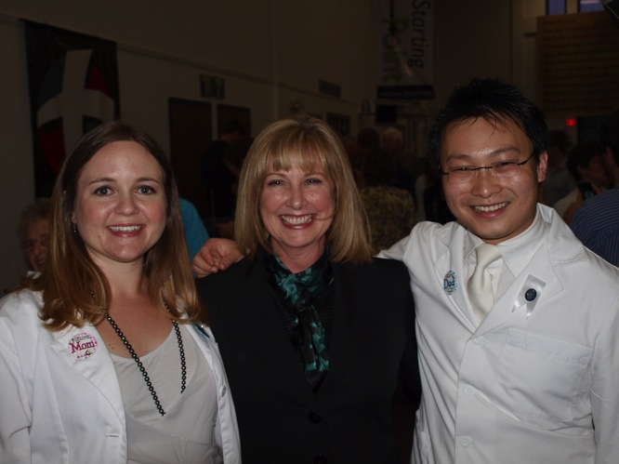
I am not sure a person can have a higher purpose than to be of service to others in need. I get to teach bright, committed students who will graduate and make significant differences in the lives of thousands of people.
—Brenda Cobb, Tarrant County College District (TX)

Slide 2
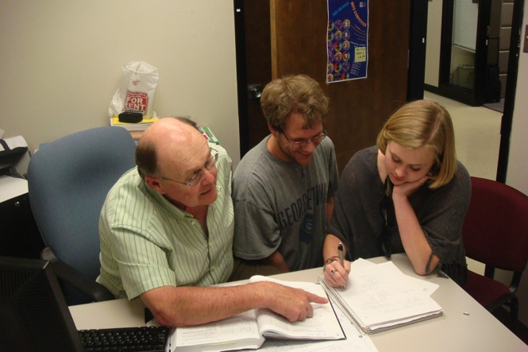
Students often ask when they will ever need to use what I am trying to teach them. I tell them that they can never use something that they know nothing about. With compassion and humor, the concepts of mathematics are shared in my classroom with the hope that each student will one day apply that knowledge to make a better life for themselves and others.
—David Gustafson, Tarrant County College District (TX)

Slide 3
I fill each classroom with active learning, promote the development of critical thinking skills, and treat students as if they were members of my family. I impart lifelong skills to my students and encourage them to become involved in student organizations and acts of charity throughout their career and lifetime. Use humor! I found a place for it in accounting, so I know you can, too!
—Karen Haun, Tarrant County College District (TX)

Slide 4
My greatest lesson over the past 25 years of teaching: My students are my teachers. Every student approaches learning in a unique way. They inspire me to create new paths to discovery. Somewhere along the way the students discover that life is a classroom for all of us.
—Linda Quinn, Tarrant County College District (TX)

Slide 5
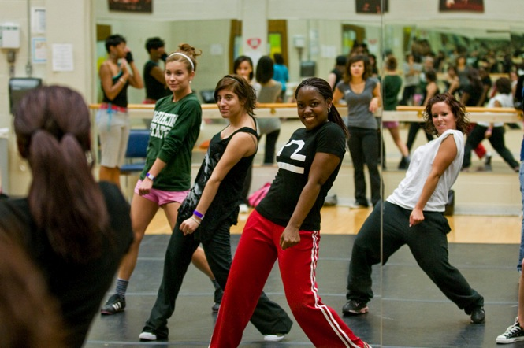
I am inspired by the varying journeys and path my dance students choose. A good education includes stepping out of your comfort zones, and I challenge students to push beyond preconceived ideas about what can be accomplished. As a result, learning goes far beyond the subject matter and becomes transformational.
—Lacreacia Sanders, Tarrant County College District (TX)

Slide 6
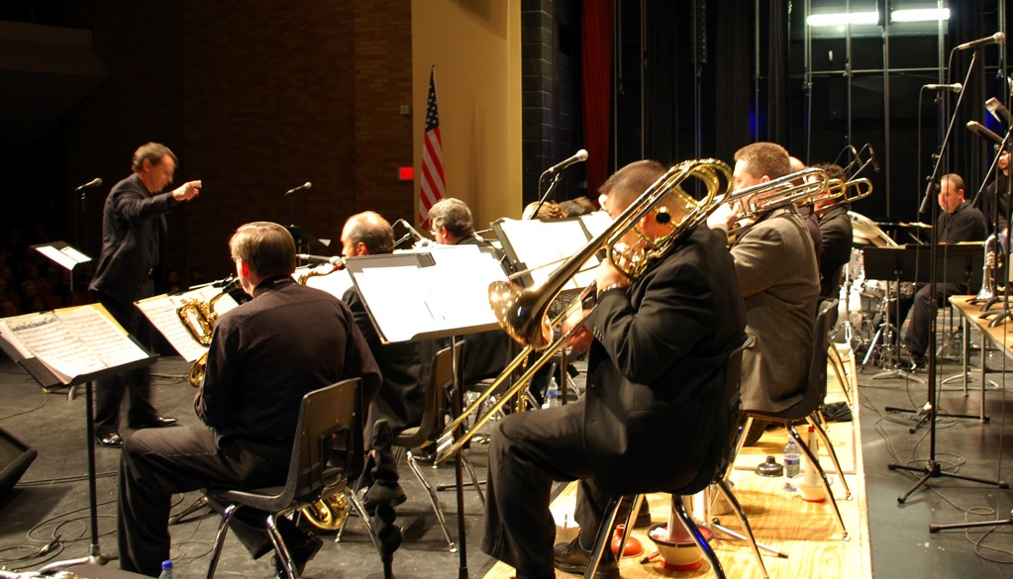
—Thomas Fairlie, Temple College (TX)

Slide 7
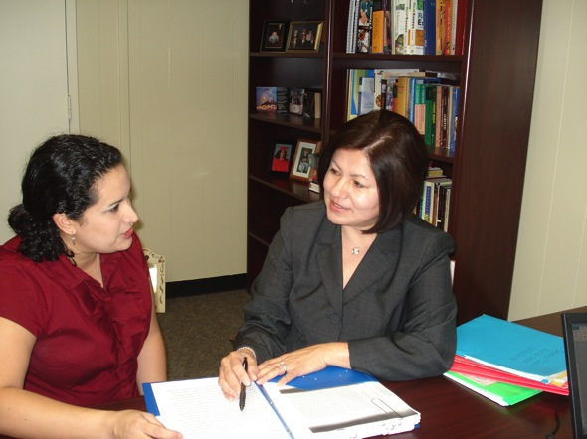
I have loved teaching since I was “playing school” with my five younger siblings. My fourth-grade teacher transformed me, from a struggling student to a successful one. Her words, actions, and beliefs made me realize that I can have the same impact on my students. I strive to do that every day.
—Susan Guzman-Trevino, Temple College (TX)

Slide 8
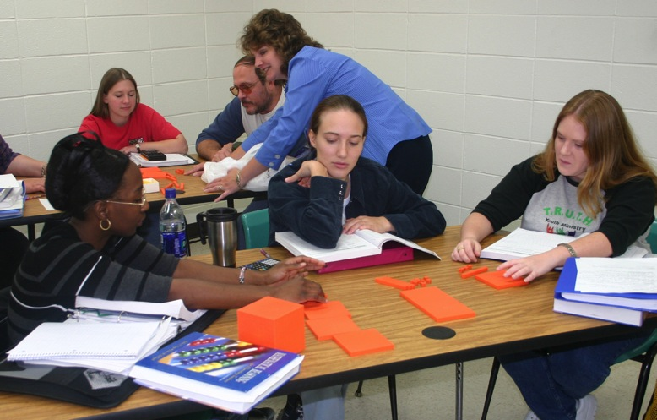
Making a difference in the lives of students, both as they struggle to understand and master content and as they work to achieve their dreams, motivates me as an educator. I am challenged to implement strategies that are collaborative, hands-on, contextualized, and technology-rich.
—Jamie Ashby, Texarkana College (TX)

Slide 9
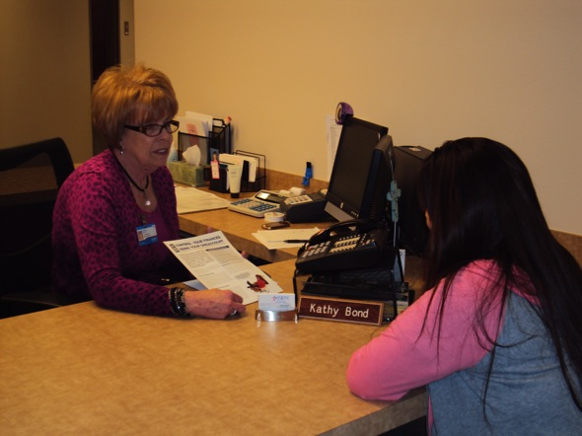
Excellence is living your life doing the right thing—living good ethics (professionally or personally); treating individuals with respect, courtesy, and decency; going above and beyond while having a good attitude. Excellence is holding oneself to a higher standard than is expected.
—Kathy Bond, Texas State Technical College System (TX)

Slide 10
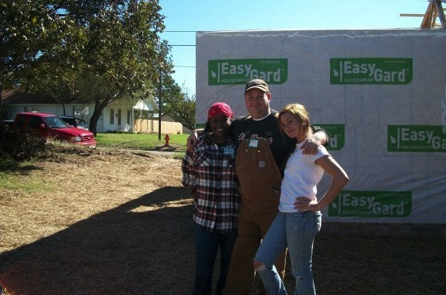
The students are my inspiration. The maturation over a brief period of time to become leaders that exude self-confidence is a dramatic transformation. They not only achieve academic success, but they develop lifelong skills that will enhance future generations.
—Brett Bright, Texas State Technical College System (TX)

Slide 11
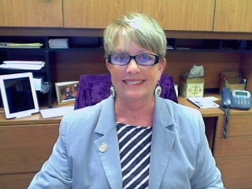
Literature is my passion, and I convey that passion to my students through whatever method I can find. Helping my students to better understand themselves and the world around them, through the study of literature, helps them to be more successful students, individuals, family members, and productive members of society.
—Nicki Cone, Texas State Technical College System (TX)

Slide 12
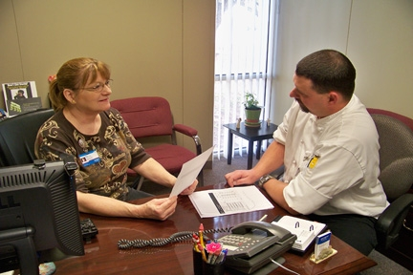
Excellence is not a destination but a continuous journey of learning from past actions and using this knowledge to excel in future endeavors. Working toward our New Paradigm, I have provided extended hours of availability to customers, strived to improve customer service, and focused on the individuality of each customer.
—Kay Johnson, Texas State Technical College System (TX)

Slide 13
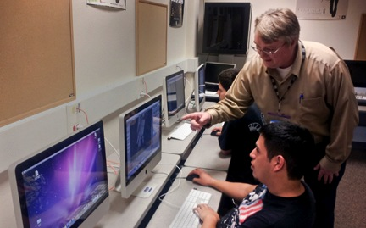
Giving someone the ability to succeed is the greatest satisfaction there is. As teachers, we prepare instruction to impart knowledge and to inspire creativity. There is no better moment than seeing students take new information, process it with their own insights, and finally, create something new and unique.
—Casey Jones, Texas State Technical College System (TX)

Slide 14
Excellence means striving to meet the academic needs of the students in my developmental education classes. It also means helping EVERY student I encounter apply the professional and academic skills they have learned at TSTC in order to become successful and productive members of the Texas workforce.
—Dana McElroy, Texas State Technical College System (TX)

Slide 15
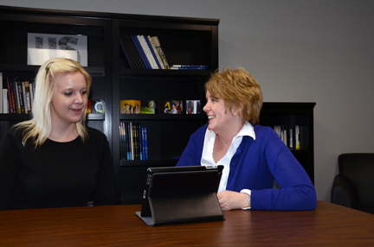
Our students inspire me. They come to us with so much hope and promise. And when they walk across the stage, they remind me how fortunate I am to be in education because I have been given the opportunity to help change lives. How could I give them anything less than my best?
—Jan Osburn, Texas State Technical College System (TX)

Slide 16
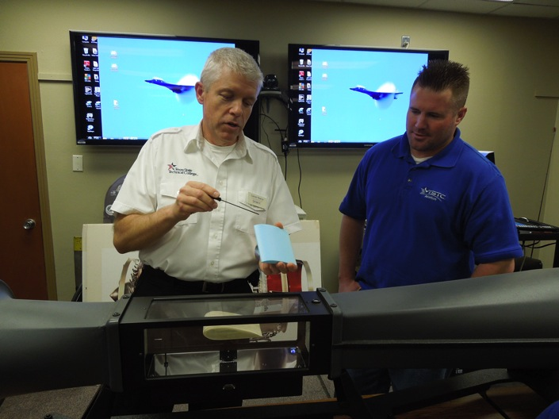
Seeing the light bulb come on in a student is one of the biggest joys for me in teaching. Seeing the student take the information you creatively give and put a practical and meaningful application to it makes the role of being a teacher so rewarding.
—V. Carson Pearce, Texas State Technical College System (TX)

Slide 17
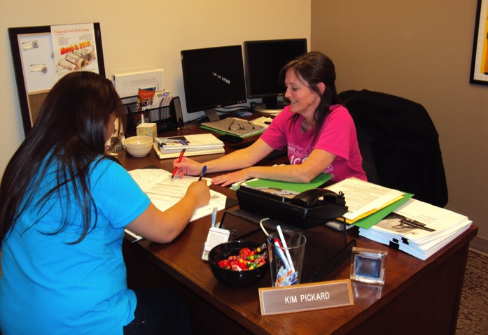
Students excelling in the midst of challenging situations inspire me. Excellence requires looking beyond the challenges in front of you. It is the result of a positive attitude backed by belief, commitment, motivation, hard work, and responsibility to a higher standard.
—Kimberly Pickard, Texas State Technical College System (TX)

Slide 18
Excellence is a vital part of my life. It is going over and beyond what is considered standard. My integrity, loyalty, dedication, and punctuality are characteristics that define excellence for me. These qualities are vital to my beliefs and help me perform every task to the best of my abilities.
—Jo Ann Raymond, Texas State Technical College System (TX)

Slide 19
Graduation is my favorite day of the semester. Helping students maneuver through the trials of the college experience as they persist through graduation and obtain new careers is incredibly rewarding. Each student success is a victory to be celebrated.
—Stephen Tanton, Texas State Technical College System (TX)

Slide 20
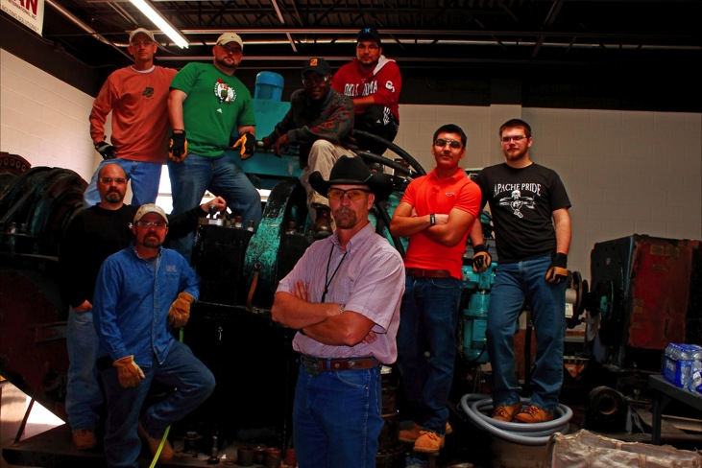
Perfection is rarely attainable. In our pursuit of perfection, we must pay attention to small details, make them as important as the totality; then with faith and drive, excellence can be achieved. I teach my students to finish well; that is what will be remembered. This is our legacy.
—Shawn Weaver, Texas State Technical College System (TX)

Slide 21
I believe that excellence at work is achieved by performing one's role in an organization capably, calmly, consistently, and with sustained energy on a daily basis. Coupled with a positive attitude, this approach facilitates constant improvements and leads to excellent results.
—Teri Zamora, Texas State Technical College System (TX)

Slide 22
Have a positive effect upon the lives of students, value/role model the teaching-learning relationship and community of colleagues, and contribute to a better world through influencing student responsible leadership, personal growth, and humane coexistence.
—Joyce Davis, Treasure Valley Community College (OR)

Slide 23
I am inspired every day by the students I serve. As an educator I know that I need to evolve with students while honoring their experiences, challenging their abilities, and preparing them for the future. I believe that if I keep student success at the center of everything I do, I cannot fail.
—Deborah Baness King, Triton College (IL)

Slide 24
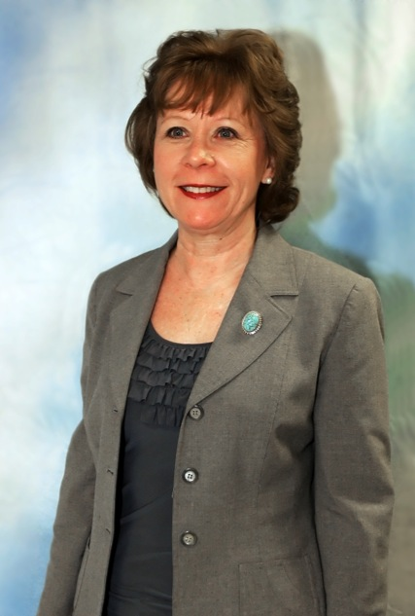
My greatest satisfaction is seeing students utilize the services, equipment, and software programs we have to offer, successfully complete their academic goal, and transition to their career or next educational endeavor.
—Deborah Ford, Triton College (IL)

Slide 25
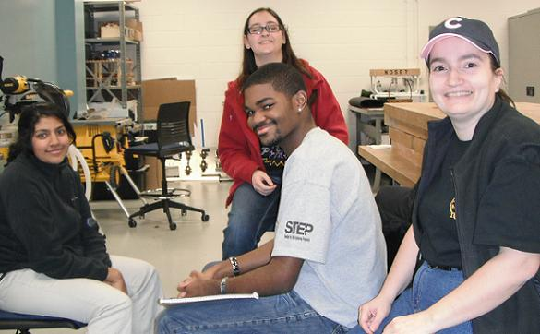
Embrace change. Get involved. Drive results! Advancement doesn’t happen easily, absent resistance to change or getting past mistakes, moving forward. Empowering students and the youth and teachers I work with in the community with the tools and encouragement needed to be thinkers, inventors, doers. This is what it’s all about!
—Antigone Sharris, Triton College (IL)

Slide 26
To become even better at what we do, we have to discover what our students know. Keeping the focus of assessment on student learning and academic integrity, we are on our way to a culture of assessment that is student-centered, authentic, meaningful, and sustainable. Onward!
—Bridgett Blaque, Lance Bowen, and Pam Hawkins, Truckee Meadows Community College (NV)

Slide 27
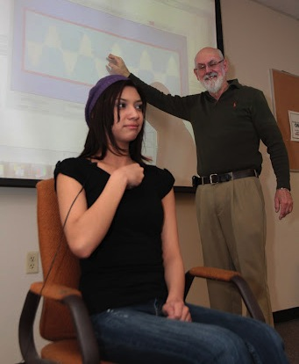
A professor has the marvelous opportunity of changing lives. Whether by challenging, by listening, by speaking, or by facilitating, a strong professor helps to transform student minds and bring hearts to new levels of maturity. What better joy or better service or better vantage point for perceiving wonder than this?
—John Coles, Truckee Meadows Community College (NV)

Slide 28
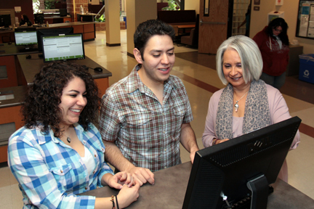
Working with students in higher education has been my passion for the past 30 years! I am dedicated to serving students who aspire to graduate and obtain their dream job.
—Mona Concha-Buckheart, Truckee Meadows Community
College (NV)

Slide 29
Interacting with students continues to be my daily motivating factor. From assisting students with general information to educational planning for the nontraditional student, each contact affirms that, indeed, what we do does change lives.
—Marcia Hoch, Truckee Meadows Community College (NV)

Slide 30
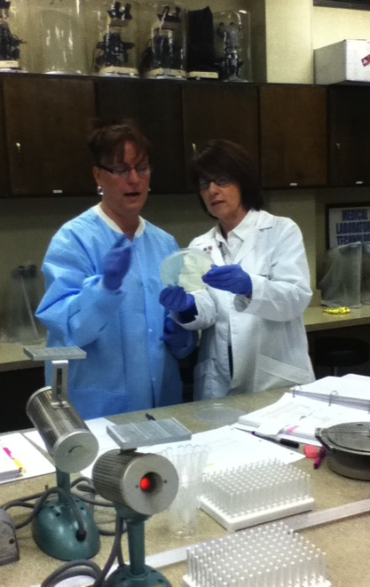
“Students may forget what you said, but they will never forget the way you made them feel.” I believe you must have a passion for the subject you teach and a compassion for the students you are teaching; this is what makes one an excellent teacher.
—Lisa Baker, Tyler Junior College (TX)

Slide 31
At the end of the day, it is the people who produce results—the intersections where professor and student meet, the combination of 1001 little things that inspire commitment and encourage discovery. This is my joy and hope in teaching.
—Lindsey Gainer, Tyler Junior College (TX)

Slide 32
I have a sign in my office that says: “Teaching is the profession that creates ALL others. For without teachers, doctors could not read, musicians could not compose, and engineers could not calculate.” What an honor and privilege it is to be a teacher!
—Jeanne Ivy, Tyler Junior College (TX)

Slide 33
It is always an honor to get up every morning and go to a job I love. There is no other profession that allows a person to spend the day helping and seeing others discover new and great things about themselves.
—Kathrine Murray, Tyler Junior College (TX)

Slide 34
Teaching is my passion. This is how I can change my student's life and affect all of the patients that they will serve in the future. What could be better than this?
—Kathy Wilson, Tyler Junior College (TX)

Slide 35
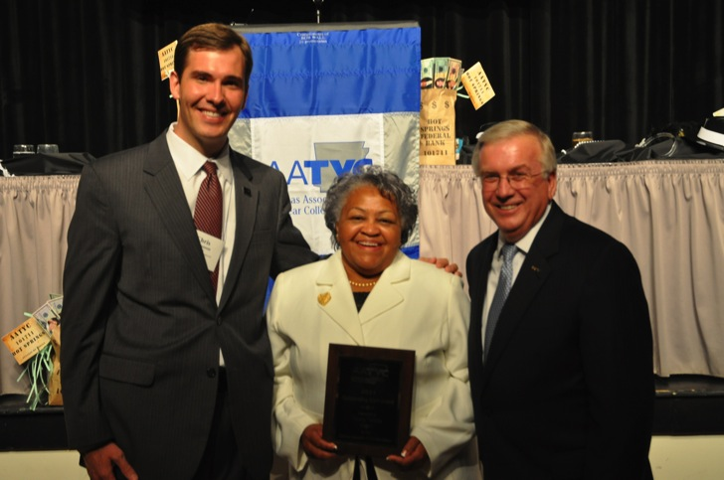
My life mission is to provide support and services to participants to achieve greater accomplishments in their future. I encourage each participant to have peace of mind, to think the best, to work for the best. The best will come back to them. I model a cheerful expression daily, and I am happy to accept the presence of trouble or fear. I learn from participants, and they learn from me. We proclaim our knowledge to the world, not in loud words, but in great deeds. We are true to the best that is in each of us.
—Mary White, University of Arkansas Community College at Hope (AR)

Slide 36
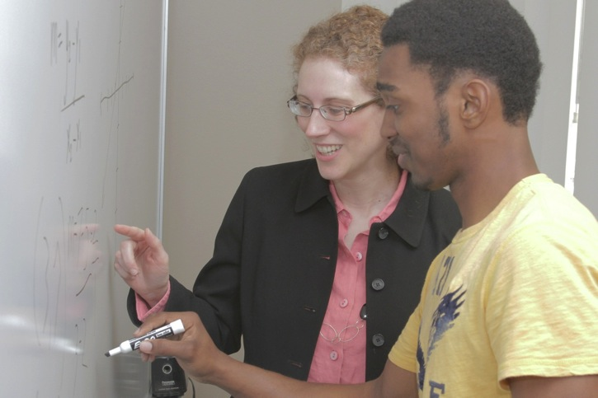
DeAndra, a UACCM graduate, said, “When you feel that your students don’t appreciate your efforts, always know that more than likely the ones you help the most don’t say thank you. Thank you for everything you have done to help. You have made all the difference in teaching me algebra.”
—Nanette Berry, University of Arkansas Community College at Morrilton (AR)

Slide 37
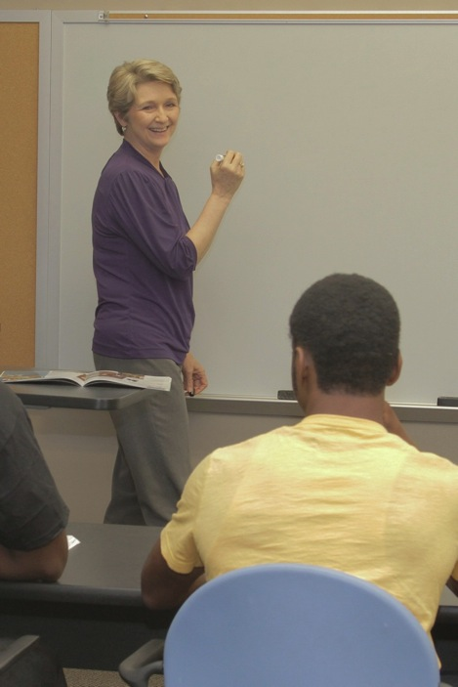
Shhhhhh! Listen! Students have valuable information to share with educational institutions, so never underestimate the value of student feedback. I am heartened by our students’ willingness to complete surveys and evaluations from which they will not directly see any benefit, but that will benefit future students. So listen carefully and learn.
—Clara Paquette, University of Arkansas Community College at Morrilton (AR)

Slide 38
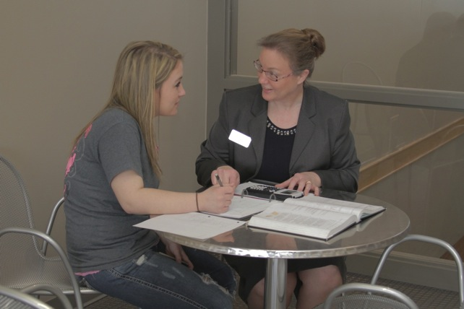
Many things are fun to teach, but they may not be relevant to prepare students to enter the workforce. For everything I teach and challenge my students to do, I ask if it is relevant to what the students will do on the job. I am inspired when my students enter the workforce and the employers say, “Wow, how did you know to do that?” It is then that I know that I have made their learning relevant to the needs of our employers.
—Linda Zambrano, University of Arkansas Community College at Morrilton (AR)

Slide 39
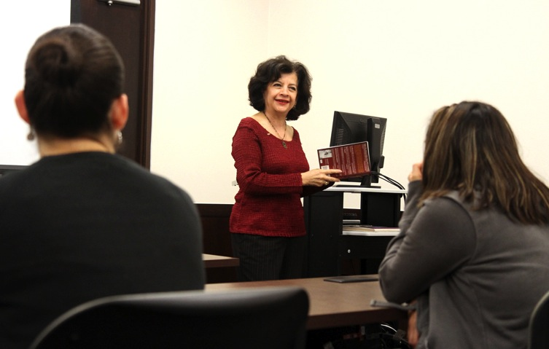
In addition to the coursework, I want my students to remember my passion, feel my support, and engage completely when learning a second language. Their success is my success when they take pride in not settling for sub-par work.
—Martie DiGregorio, University of Texas at Brownsville/Texas Southmost College (TX)

Slide 40
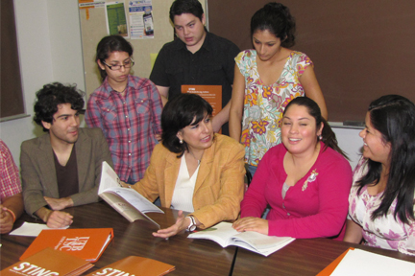
I believe that students can succeed with the proper support. My work is constantly evolving to identify and reduce barriers that preclude our students from reaching their academic goals. We cannot change variables outside the educational setting, but we have the ability to change how we operate within our institution through policy, practices, and programming to assist students to reach their full potential.
—Sylvia Leal, University of Texas at Brownsville/Texas Southmost College (TX)

Slide 41
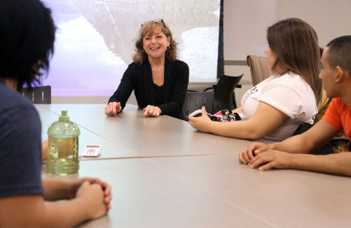
Education is something that no one can take away. It doesn’t follow you; it leads you. There is no greater satisfaction than watching faculty foster and nurture learning, and students leaving class, empowered with knowledge, forever tucked away in their minds and in their hearts to lead the new generation.
—Betsy Price, University of Texas at Brownsville/Texas Southmost College (TX)

Slide 42
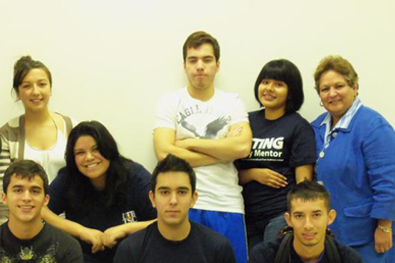
Over 32 years of working in higher education with minority, low-socioeconomic, and first-generation college students has taught me that academic, social, and personal aptitude are equally valuable parts of helping the whole student succeed. Students’ chances for success increase dramatically when they are supported by people in their lives that believe they can succeed, help them along the way, and create conditions that foster their academic and personal growth and advancement.
—Hilda Silva, University of Texas at Brownsville/Texas Southmost College (TX)

Slide 43
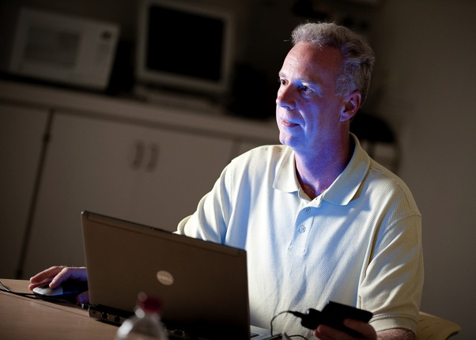
The secret, if there is one, is to make students comfortable enough to convey to them what they need; to be listening to them when they do; and to respond effectively. Doing this with the online student in a practical way can be achieved. The students live online. We can go there, too, and cultivate real connections.
—Colin Archibald, Valencia College (FL)

Slide 44
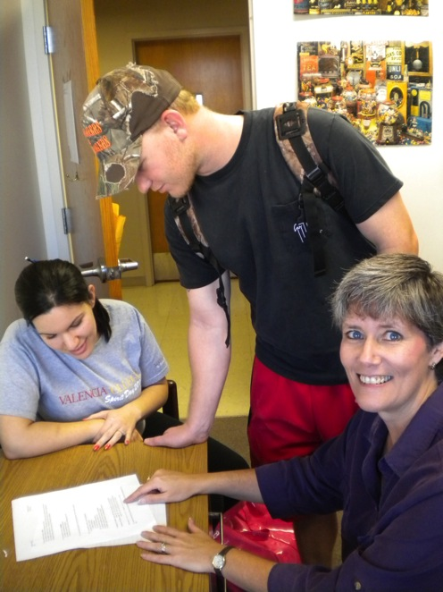
I enjoy trying to find ways to open my student’s eyes to the mathematics all around them. My hope is that when they leave my class, they appreciate the value of math and have discovered that a person does not need a "math gene" in order to learn math.
—Jody Devoe, Valencia College (FL)

Slide 45
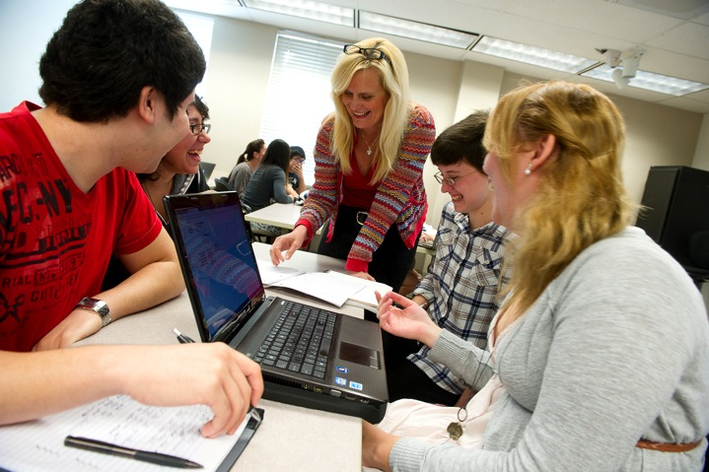
I have always been inspired by people who are hopeful. There seems to be this positive energy that flows from their very being that has the ability to influence anyone in its path. And then there are those people who are connected—connected to others and to their purpose. This connection is full of a strength that is contagious. When I enter my classroom, I hope to be that professor for my students—full of hope and connected.
—Suzette Dohany, Valencia College (FL)

Slide 46
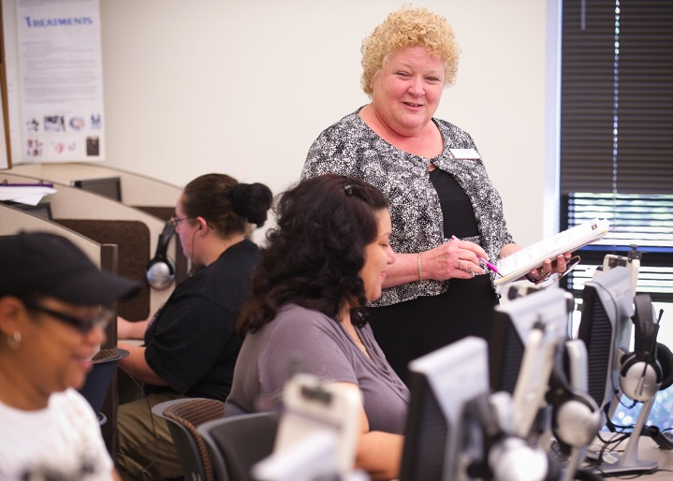
One of my favorite quotes is: “The mediocre teacher tells. The good teacher explains. The superior teacher demonstrates. The great teacher inspires.” If I can have students involved in their learning (i.e., hands on), then they will continue to want to learn.
—Coleen Jones, Valencia College (FL)

Slide 47
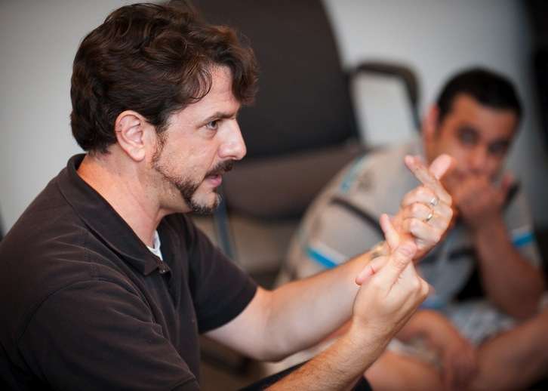
Students should be respected as fellow travelers on a lifelong road of learning. I have to recognize areas where they have traveled further than I have, show them the trails I have found and be honest with them when I don’t know the way. Ultimately, I have to get them to see themselves as travelers responsible for the paths they take.
—Robert McCaffrey, Valencia College (FL)

Slide 48
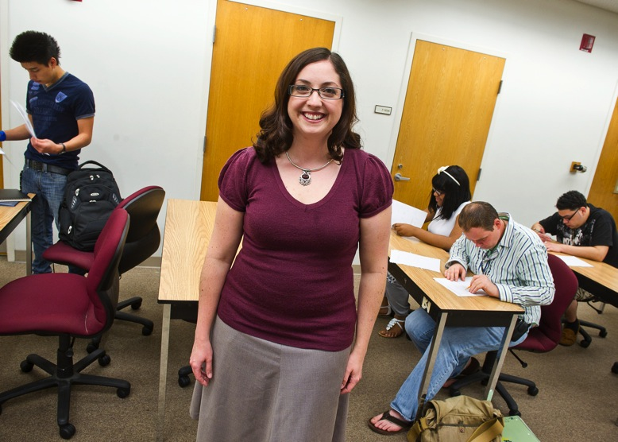
I hear it at least once a day: Math is not my subject. Although I do not expect every student to develop a deep appreciation for math, I find extreme satisfaction in being instrumental to their success in every topic they master, topics they previously claimed as insurmountable roadblocks.
—Amanda Saxman, Valencia College (FL)

Slide 49
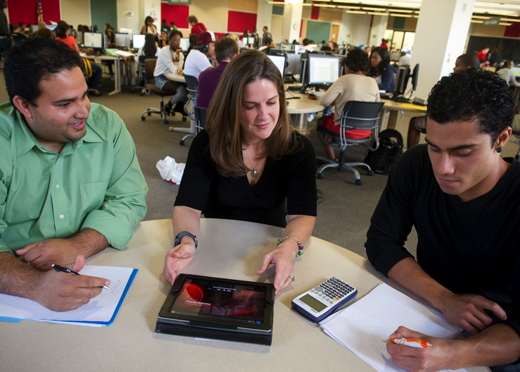
John Dewey once said, "Education is not preparation for life; education is life itself." Making "life" attainable and realistic for everyone inspires and motivates me to find new ways to reach students, provide support, and help them recognize what education and life have to offer.
—Kimberly Traynor-Foster, Valencia College (FL)

Slide 50
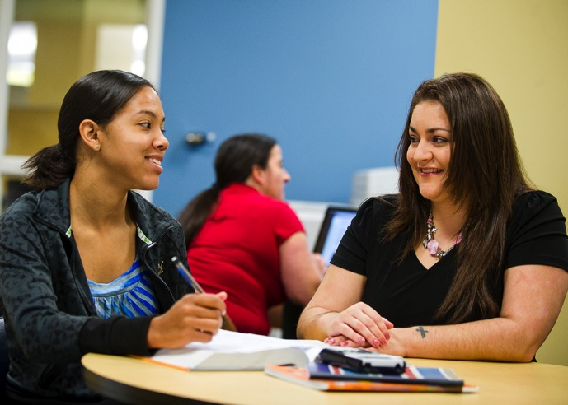
As an educator I push students to not only learn math, but to also discover how they learn. Responsibility and dedication are just some of my expectations for students. I take pride in learning students’ names and creating an atmosphere where students are comfortable learning from their mistakes.
—Elizabeth Washington, Valencia College (FL)

Slide 51
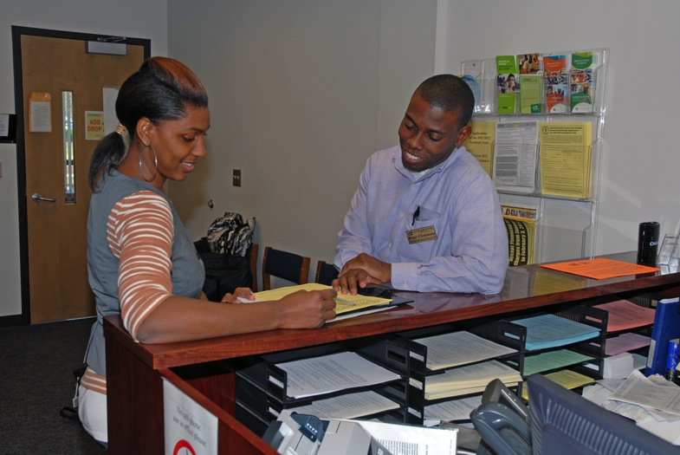
Knowing that I may have a positive impact on helping to change lives inspires and motivates me. We must remember that there is a story behind every face we see; and in order for us to help them, we must truly try to understand that story.
—Brian Clemmons, Vance-Granville Community College (NC)

Slide 52
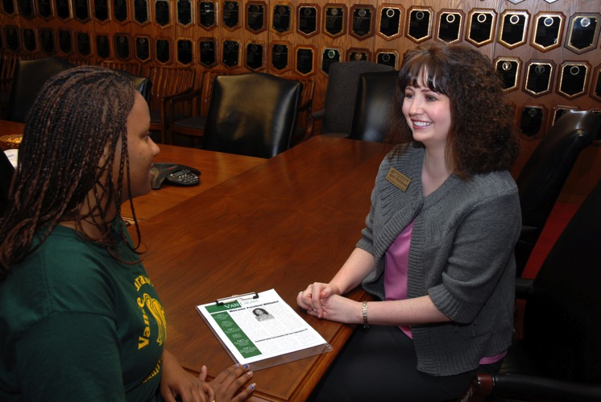
My great experience as a former community college student motivates me in my job now at VGCC. I will never forget the faculty and staff who were genuinely interested in me as a student. I want our students to feel I take that same genuine interest in them.
—April Perkinson, Vance-Granville Community College (NC)

Slide 53
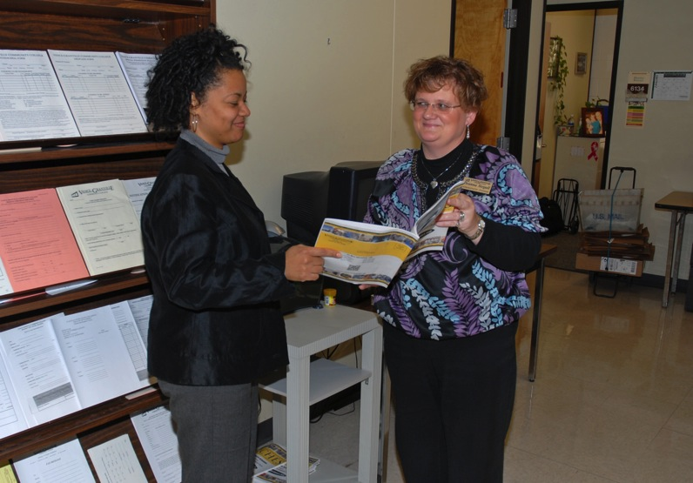
As a community college graduate, I am deeply committed to the principles of the community college system. Because of my deep beliefs in community college values, I am dedicated to doing all I can to help faculty, other staff members, and students.
—Deanna Stegall, Vance-Granville Community College (NC)

Slide 54
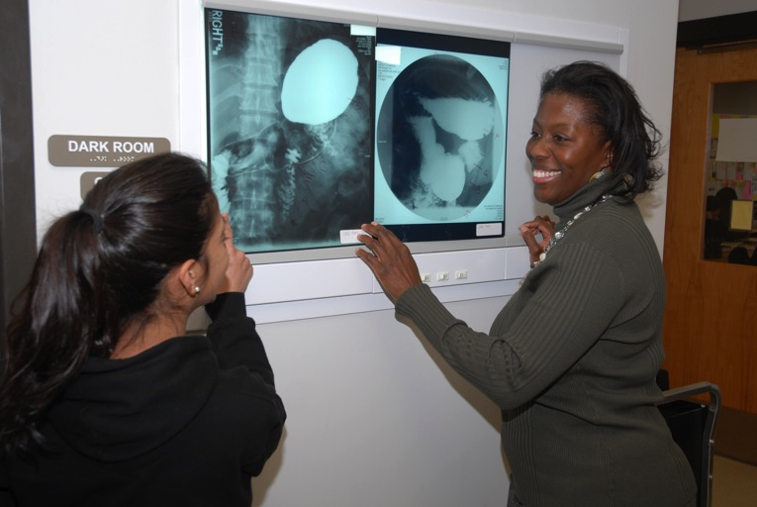
I am faced with individuals who have challenges grasping the information. To see a group of energetic students who are willing to absorb all that is offered, put forth all they have to obtain the information, and then get it, is what inspires and motivates me in my work.
—Angela Thomas, Vance-Granville Community College (NC)

Slide 55
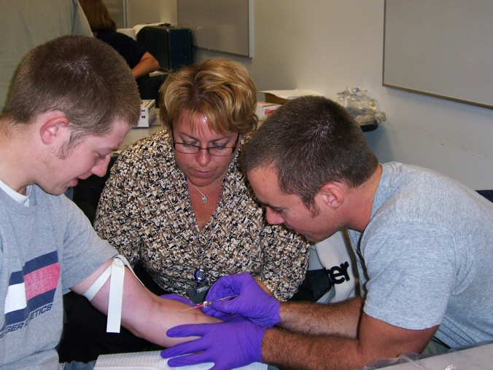
Our job is not just to teach students everything in a course, but to help create the desire to pursue learning as a lifelong process. As educators, we need to keep the learning process fresh and engaging. That takes a lot of time, investment, and reinvention, but the return is phenomenal!
—Michelle Bourget, Waukesha County Technical College (WI)

Slide 56
As a law enforcement officer, I noticed that many officers had minimal interest in working with kids. The majority of my career was spent mentoring kids. Teaching allows me to continue to work with young people while emphasizing how a police officer can make a difference in a child's life.
—Daniel Noordyk, Waukesha County Technical College (WI)

Slide 57
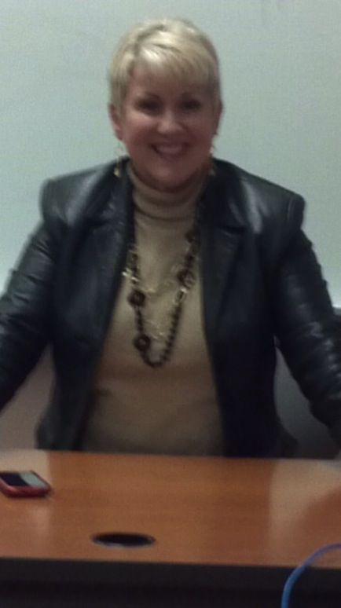
Each day that I enter the classroom, I try to give my students the opportunity to find their voices and to realize their dreams. For me to be given the opportunity to help my students recognize and value writing and literature, to effectively communicate their feelings and ideas, and to contribute more meaningfully to the world, gives me purpose in my profession.
—Kimberly Sheffield, West Hills Community College (CA)

Slide 58
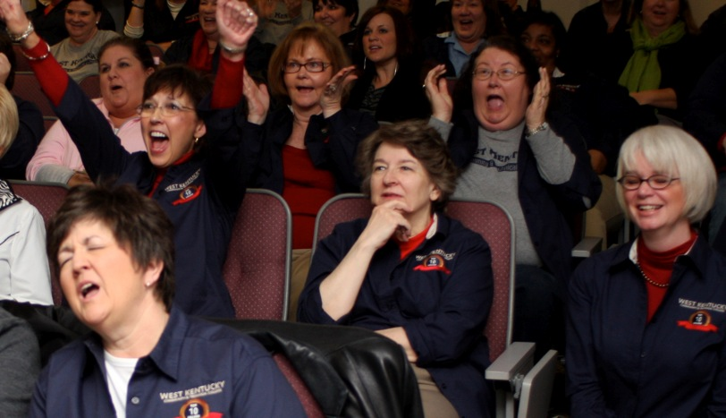
Is praising an institutional researcher like praising the weatherman for a sunny day? She doesn’t make it; she just reports it. And yet, she also tells us when a tornado threatens, and it is that function—the ability to forecast the future—that is so important in turbulent times.
—Karen Boyd, West Kentucky Community & Technical College (KY)

Slide 59
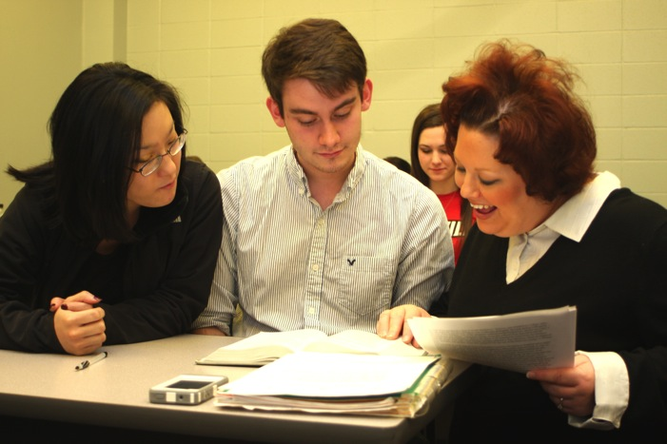
My most fervent hope and my foremost goal are to, in all my interactions with students, exude the passion and the joy that I feel for my chosen profession and for lifelong learning. By doing so, I hope to not only inspire them to embrace the subject I teach but also to discover their own passion and potential, and find true fulfillment in whatever it is they choose to do with their education.
—Kimberly Russell, West Kentucky Community & Technical College (KY)

Slide 60
Teaching is my passion. I love working with the nursing students in the classroom and the clinical setting. It is a privilege to watch that light bulb moment in their eyes when they get it. I learn as much from them as they do from me.
—Kathy Frum, West Virginia University at Parkersburg (WV)

Slide 61
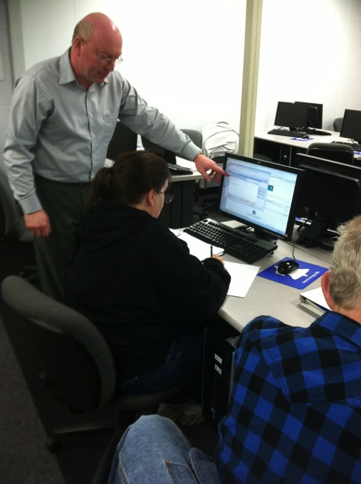
I teach students to focus on the most important information and help them develop the most important skills necessary in learning a new material. The students are involved in the process of learning and actively participate in discussions during the class. This gives me an opportunity to have a continuous feedback. I believe it’s important for teachers, like students, to continually grow and learn.
—Mikhail Styrt, West Virginia University at Parkersburg (WV)

Slide 62
I can honestly say that my job and my students are truly such a great part of my life. Since I was a student at WCC, I knew that my place would be behind the podium, in the laboratory, and at clinical with students. I absolutely love to teach and am delighted every semester when the light bulb goes off above the students’ heads! I consider myself one of the lucky ones, for I do something I love for a living, and I am able to pass on to my students a wonderful profession that I still enjoy.
—Hildy Oberstein, Westchester Community College (NY)

Slide 63
Teaching and interacting with students excites me! Though I have taught for more than 35 years, I still wake up each morning excited to get back into the classroom. I have a desire to make the lives of my students better each day that I am with them and to help them achieve their academic goals.
—Mitzi Kirwan, Western Iowa Tech Community College (IA)

Slide 64
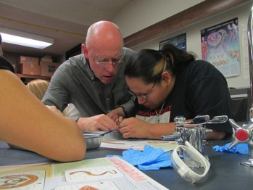
Instructors have an amazing responsibility and challenge to help students learn and integrate information into their lives. One of my greatest joys is when students see something outside of the classroom that makes connections with concepts we learned in class, leading to a greater understanding of the world around them.
—David Nash, Western Nebraska Community College (NE)

Slide 65
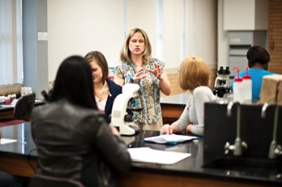
—Kim Raun, Wharton County Junior College (TX)

Slide 66
I feel that I learn much more from my students then they learn from me, and I am amazed at the lengths some will go to in pursuit of their education. A student once told me that I saved her life. She was living in a difficult marriage; and by my assisting her in completing her studies, she was able to obtain a good job to support herself and her children. This was truly a humbling experience and one that I will never forget.
—Betty Salas, Wharton County Junior College (TX)

Slide 67
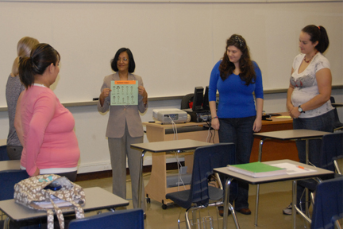
Partnering with students in the teaching-learning process is an exhilarating experience, creating beautiful human connections socially, emotionally, and cognitively. These connections are what make the classroom a meeting place for minds and hearts that spark the brain and ignite the spirit with the light of learning.
—Mushira Shamsi, Wharton County Junior College (TX)

Slide 68
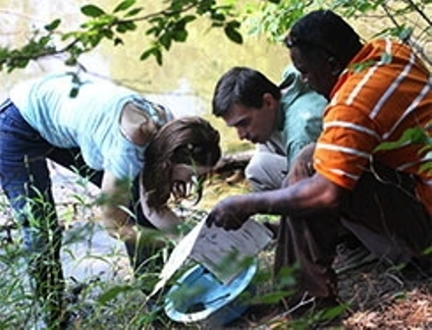
Teaching is not figuring out who the F or A students will be. It is about motivating, realizing that students learn more when we are not talking, accepting the same life lessons will be repeated with each new class, treating students as if they have the best intentions, setting clear expectations, and (us) not making excuses.
—John McGill, York Technical College (SC)

Slide 69
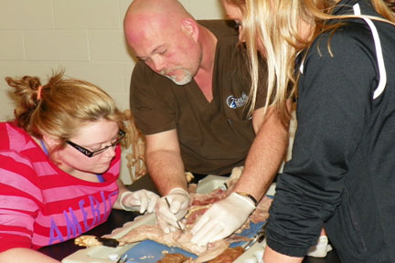
Students have asked me why I became a teacher. To me, teaching is fun. I enjoy challenging my students to reach beyond what they think they can do. I want to see them succeed and develop the confidence required to achieve their goals. I want them to become life-long learners.
—Steve Kish, Zane State College (OH)

