Slide 1
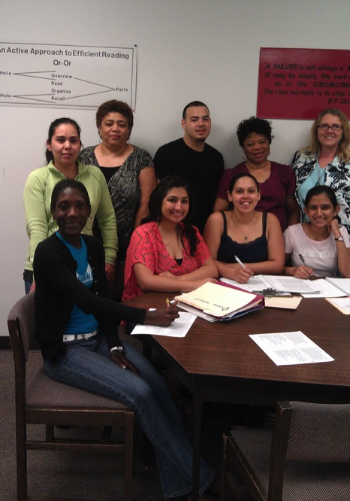
—Joyce Lehe, Eastfield College (TX)

Slide 2
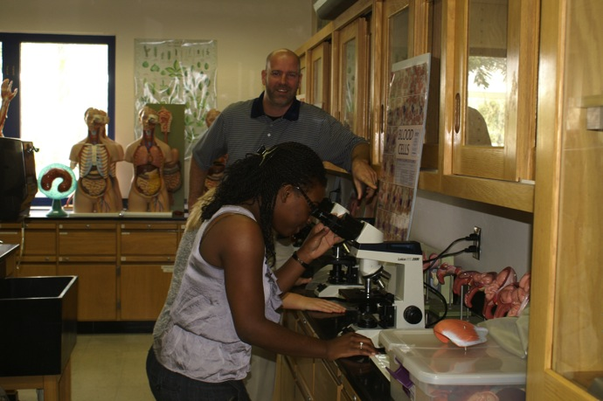
—Jay Koepke, Edison State College (FL)

Slide 3
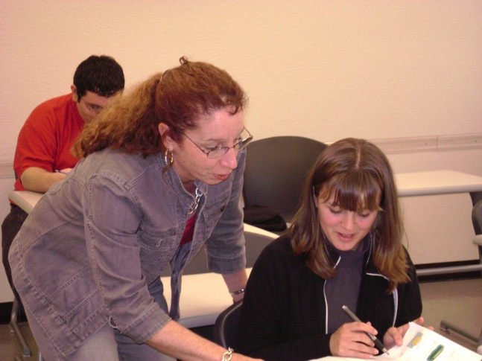
Teaching is a gift that gives continually to both learner and teacher. Each day you are afforded the opportunity to share your passion for teaching and mathematics with others. What a joyous day when the fire in your heart ignites a yearning for more knowledge in another.
—Christy Smith, Edison State College (FL)

Slide 4
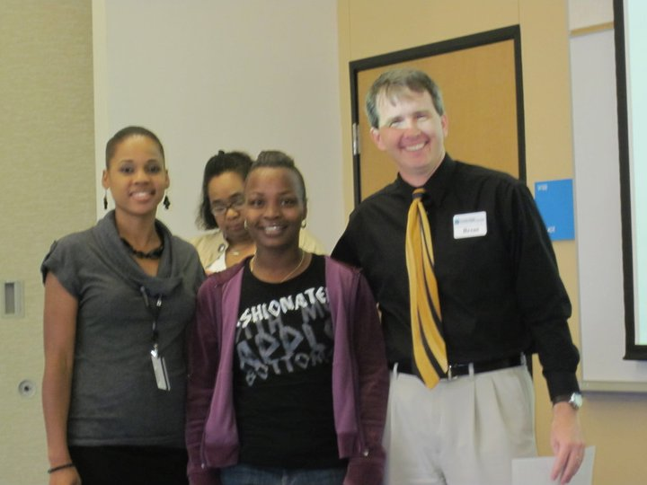
We only have one shot at changing lives when first-time-in-college students walk through our doors. We must set affordable, scalable systems in place that empower them to successfully pass through our programs on their way toward fulfilling the American dream.
—Brent Barnard, El Centro College (TX)

Slide 5
I strongly believe that education and training are an ongoing process that never ends and that opportunities for learning are present every day. My role as an “educator” allows me to stimulate the development of another’s mental and moral growth: one who serves as an instrument—a conduit—for passing on knowledge and skills required for survival in today’s society.
—Terrel Blair, El Centro College (TX)

Slide 6
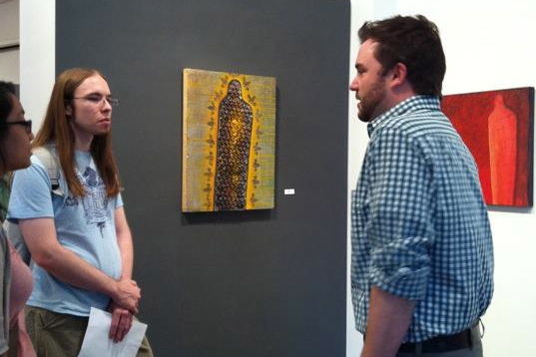
Teachers and students are one and the same. Teachers were all once, and continue to be, students to society and life. When an adult chooses to continue to learn after adolescence, the process never ceases with the proper motivation and instruction. Students are teachers to themselves, their peers, and their educators. Both coexist evolving with one another to create a stronger culture of future creativity and prosperity.
—Brett Dyer, El Centro College (TX)

Slide 7
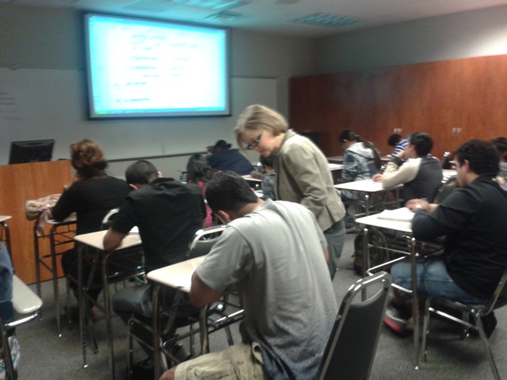
You’ve got to love people and be enthusiastic to get the best out of your students. They are more likely to learn if they are having a measure of fun and are engaged in the class. Being approachable and showing personal interest creates a positive atmosphere in which students can learn and be engaged with no fear of judgment.
—Eva Zamirski, El Centro College (TX)

Slide 8
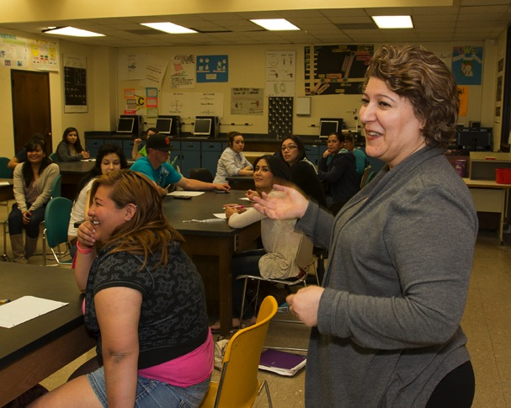
The future is our responsibility. This thought inspires me. My participation in workshops has shown me new ways to reach students, ensure they master my subject, and lead them to reach their full potential.
—Fariba Ansari, El Paso Community College (TX)

Slide 9
I’ve always felt that I have the best job in the world. I go to work to talk about what I love all day long. I converse, interact, teach, and learn from people who are actively trying to improve their lives. It doesn’t get any better.
—Gabriel Camacho, El Paso Community College (TX)

Slide 10
A teacher can make a difference in a student’s life that will last forever. As a teacher, I do my best to provide an atmosphere in which students are comfortable asking questions and a place where students want to come back and learn. Math is one of those subjects that students dislike very much; and if I can change some of those negative feelings to positive feelings, then that is one of the best rewards. Teaching doesn't make us rich monetarily, but impacting the many lives that we touch everyday makes us rich spiritually.
—Ivette Chuca, El Paso Community College (TX)

Slide 11
Art is as essential for a healthy human existence as water, food, and shelter. Sharing this passion for art with my students, making connections with the past and the present, and learning from my students’ insights are the gifts I treasure. My community college education literally changed my life, and I hope to help open doors for my students as they continue their education.
—Marybeth Koos, Elgin Community College (IL)

Slide 12
I strive to provide students with a fundamental base of knowledge on which to build and develop lifelong learning, ongoing opportunities to practice skills and apply knowledge, opportunities to develop ethnic and cultural awareness, and a climate of respect for the attitudes and beliefs of other groups and individuals.
—Kimberly Tarver, Elgin Community College (IL)

Slide 13
I try to help my students think about what they want out of life and to help them relate those goals to their college experience. Then they can value what they are learning because they will see it as helping them advance towards one of their goals.
—Susan Malmo, Estrella Mountain Community College (AZ)

Slide 14
I tell my students that by the end of the semester I will have learned a lot about them and that they will have learned a lot about themselves. I remind them to listen to their truth and to be committed to their commitment (finishing their education).
—Bertha Medina, Estrella Mountain Community College (AZ)

Slide 15
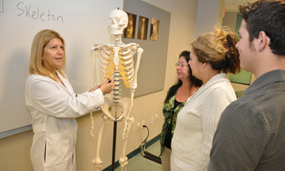
My goal is to guide students along their path and give them tools to make decisions that will lead them to succeed in life.
—Doris Lombo, Florida Gateway College (FL)

Slide 16
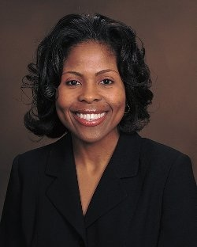
—Monica Franklin, Florida State College at Jacksonville (FL)

Slide 17
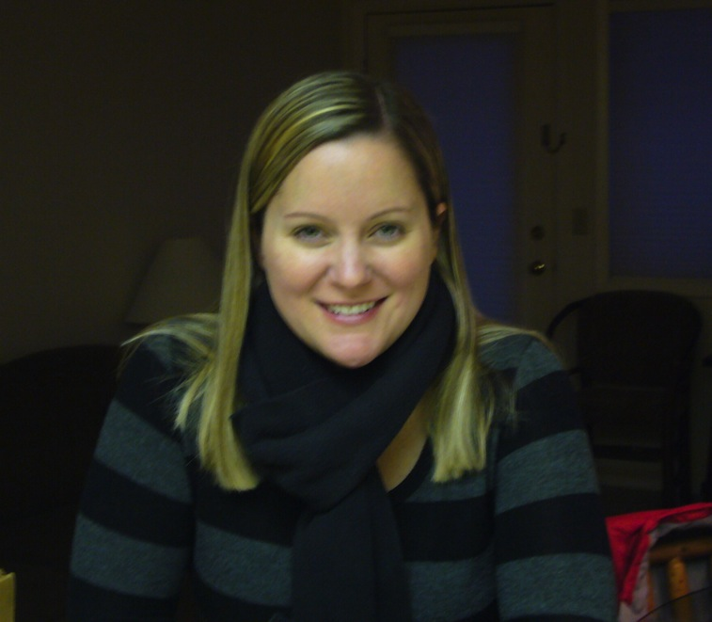
—Heidi Marshall, Florida State College at Jacksonville (FL)

Slide 18
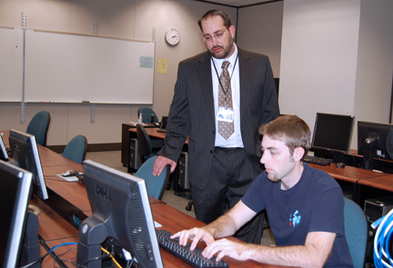
I take great pride in knowing that I’ve had a hand in helping others change their lives, and doing so in a field I enjoy and excel at is very satisfying. I.T. can give people a chance at life they never thought possible, where hard work and dedication truly pay off.
—Shawn Toderick, Forsyth Technical Community College (NC)

Slide 19
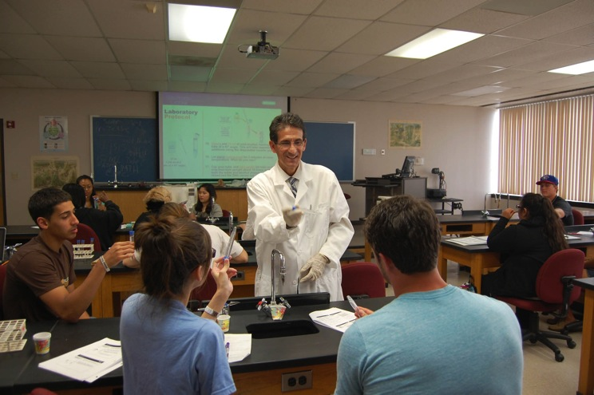
—James Salazar, Galveston College (TX)

Slide 20
Teaching gains value only when students come away from the classroom inspired, impassioned, and full of curiosity and excitement. My job is to help students make connections between theories, the realities of life, and nature outside classroom walls, and to provide them the skills to become true stewards of the earth.
—Kathleen Jerome, Gateway Technical College (WI)

Slide 21
Students’ success depends on their critical thinking, academic preparation, and my competence as a nurse educator. The journey to success reflects stories—some funny, some tearful—full of caring, concern, and compassion. My goal for students is to be the best at anything they may face in nursing, from applying a Band-Aid to comforting a family member.
—Vanessa Kramasz, Gateway Technical College (WI)

Slide 22
My role as an educator is to be an educational partner. I hope my students see me not only as a professional resource, but as a mentor and cheerleader—all in one! I enjoy helping them grow in knowledge and confidence as they transition into our community with their newfound talents!!
—Thomas Kressin, Gateway Technical College (WI)

Slide 23
I majored in English, not mathematics—which came easier—because I like challenges. Now, I teach because I enjoy helping students face their own writing challenges in becoming competent writers. My joy is turning their dread of writing into their discovery and competence. That challenge keeps me teaching.
—Carole Creekmore, Georgia Perimeter College (GA)

Slide 24
Our students are our future. Most of my students are going on to become nurses, dental hygienists, pharmacists, and more. It is of great importance that we help them understand the material so that they can critically apply it to future courses and succeed in their chosen career, rather than just pass our course.
—Mark Hollier, Georgia Perimeter College (GA)

Slide 25
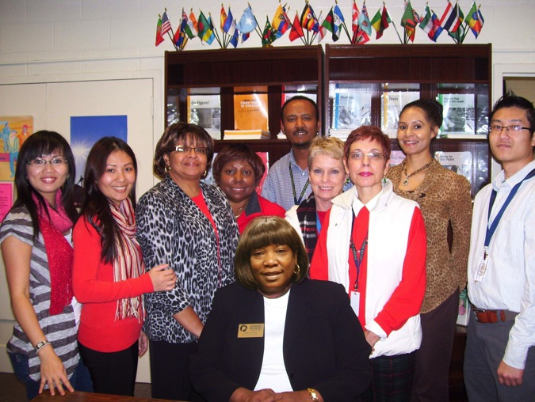
The most rewarding part of directing the Student Success Center is seeing students make progress from being inquisitive first-year students to confident technical graduates. Our role in the Center is to assist the underprepared to become prepared; to motivate the prepared to remain steadfast; and to encourage the advanced to reach excellence.
—Kimberley Sloan, Georgia Piedmont Technical College (GA)

Slide 26
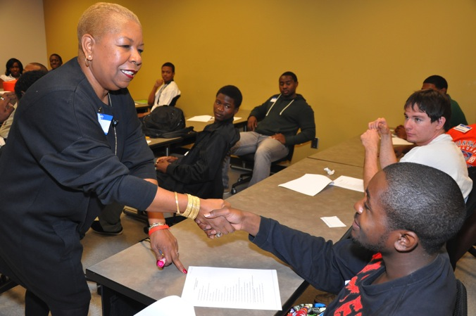
GPTC is purpose-driven with a mission set on preparing students for the global workforce. Technical education encompasses the old adage—"It takes a village." I am proud to be a steward of Georgia Piedmont and a villager.
—Amanda Taylor-Rodriguez, Georgia Piedmont Technical College (GA)

Slide 27
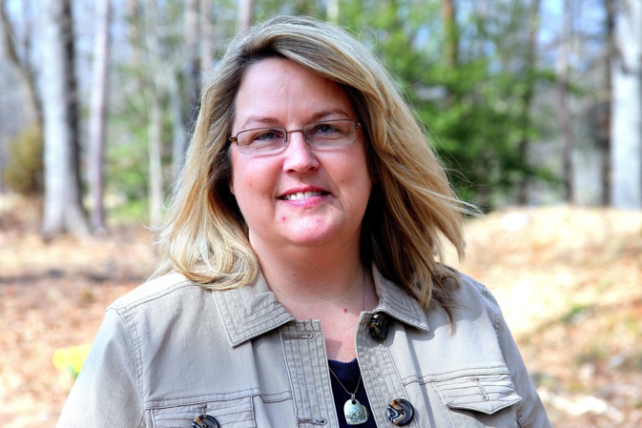
—Juliette Mersiowsky, Germanna Community College (VA)

Slide 28
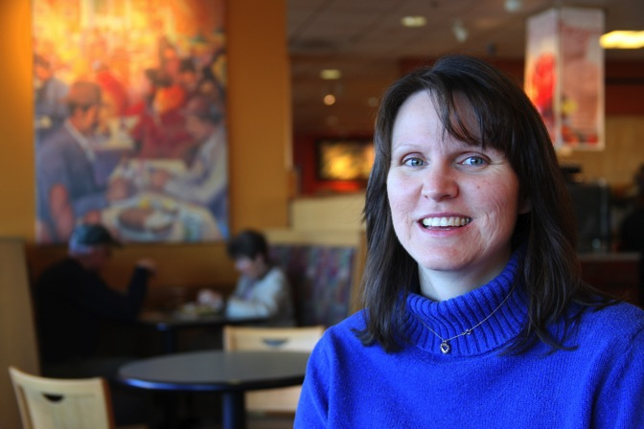
My motivation for teaching is the moment a light goes on in students’ eyes as they first understand a difficult concept. At this spark of comprehension, they realize that learning physiology is possible, and they hunger for more. This is the greatest reward for both educator and student.
—Season Thomson, Germanna Community College (VA)

Slide 29
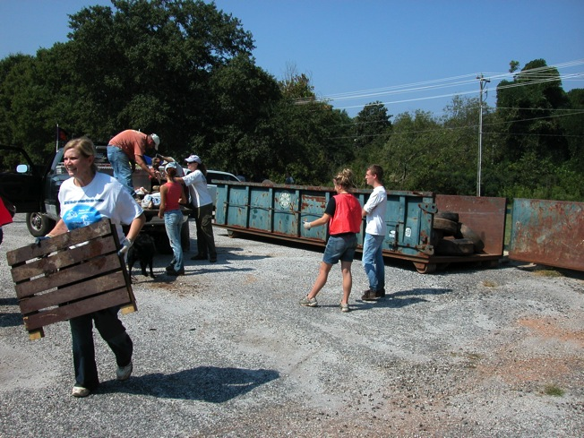
As a biology and environmental science instructor, I see the drastic impact our decisions have on the environment. I am inspired by the students who share my passion for protecting the resources we have.
—Kathy Ferrell, Greenville Technical College (SC)

Slide 30
When I left the programming field, I began as an adjunct instructor teaching programming classes and loved sharing my work experience in the classroom. Twelve years later as a department chair and full-time faculty member, I am still sharing and learning from the students. I believe the best teachers never stop learning.
—Mary Locke, Greenville Technical College (SC)

Slide 31
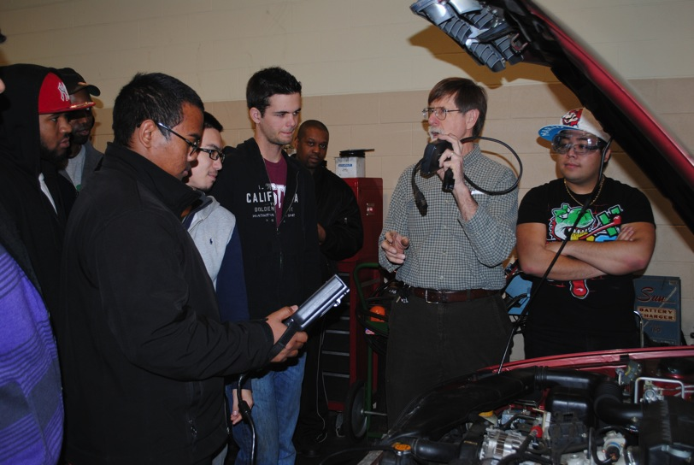
—Rankin Barnes, Guilford Technical Community College (NC)

Slide 32
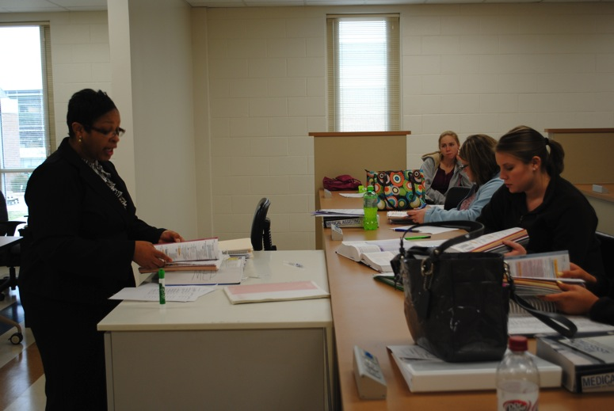
—Deborah Flowers, Guilford Technical Community College (NC)

Slide 33
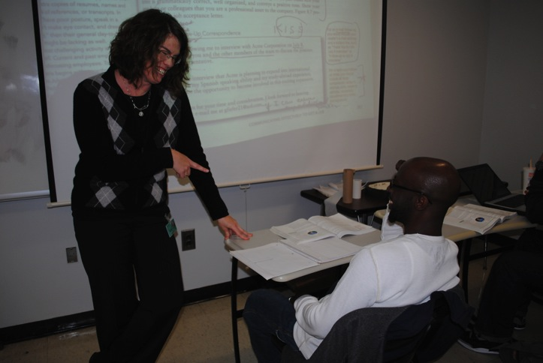
Teaching is the bridge you help your students build between themselves, the class concepts, and the wider world. I love when students start connecting our discussions to what they’ve experienced in their lives outside the classroom because this shows our bridge holds weight.
—Melissa Maley, Guilford Technical Community College (NC)

Slide 34
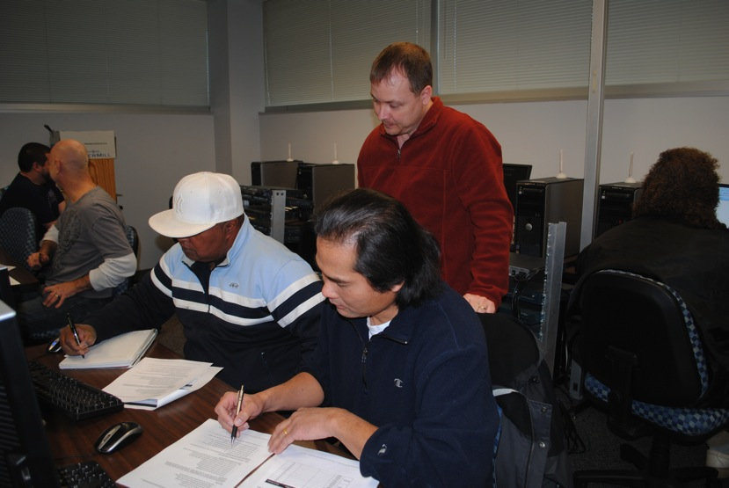
—Bryan Orr, Guilford Technical Community College (NC)

Slide 35
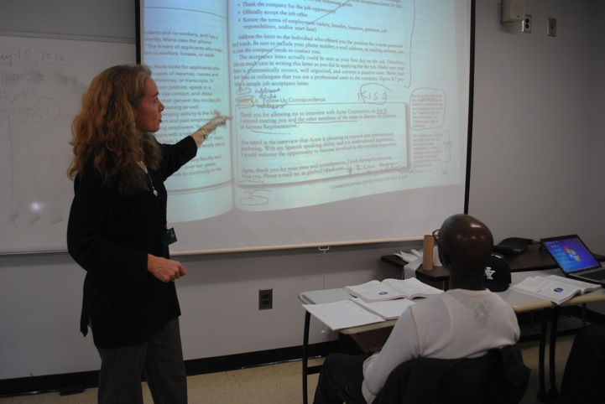
Every semester, I hear at least one student’s story that inspires me. From this student, I learn compassion, creativity, and humanity. Every individual is valuable and deserves respect. When students become numbers, a quick survey of the faces reminds me that my students are individuals with hopes and dreams.
—Amanda Rivers, Guilford Technical Community College (NC)

Slide 36
Teaching and learning should be exciting, meaningful, and relevant. As an educator I keep an open mind and continually communicate with peers and students. I am prepared to rise to the challenges of teaching, and I promise to try to provide an honest, well-rounded education to every student I encounter. All educators should remember: To teach is to learn; to learn is to teach.
—Lloyd Harris, Gulf Coast State College (FL)

Slide 37
If a teacher is not interested in the subject she is teaching, how can she expect the students to care? For me, enthusiasm is the easy part. I became a biologist because I am passionate about science. I incorporate an activity into each lecture to make the science relevant to the students.
—Jennifer Trusty, Gulf Coast State College (FL)

