Slide 1
SOS LMS: Using your LMS as an Adjunct Connector
Presented by Sherri Singer

Slide 2
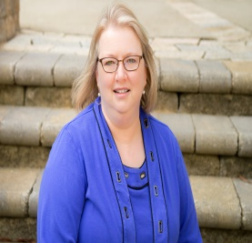
Sherri Singer, Faculty Partners Network
Coordinator of the Adjunct Institute
Alamance Community College
Contact information: sherri.singer@alamancecc.edu

Slide 4
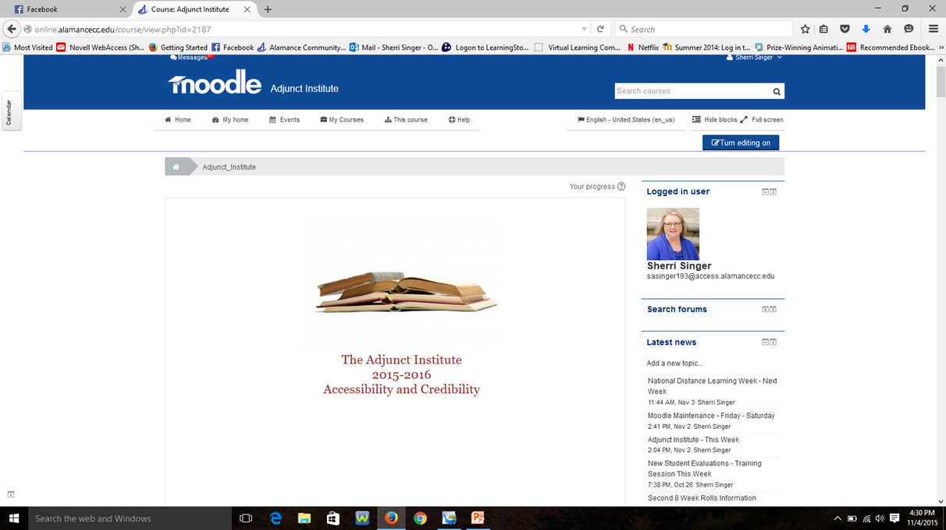

Slide 5
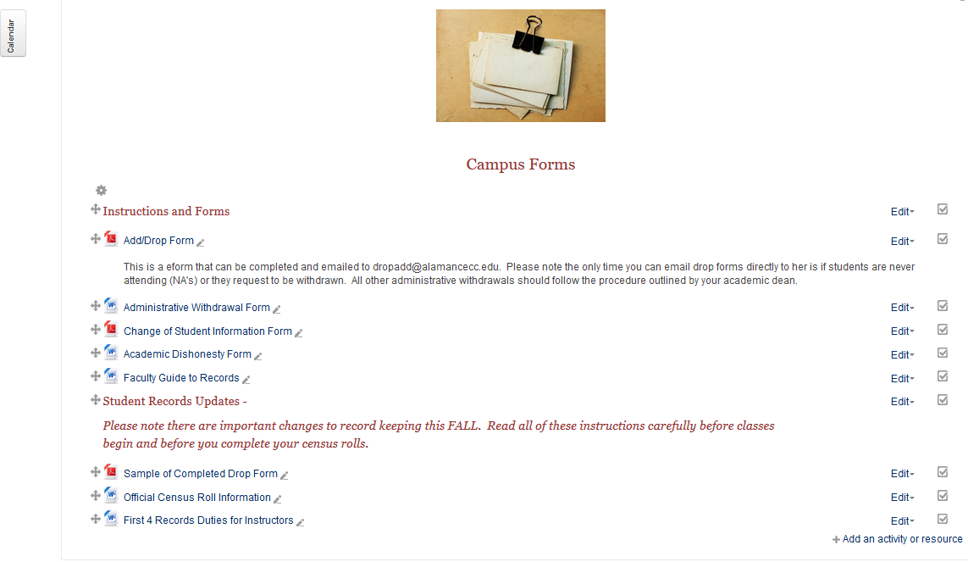

Slide 7
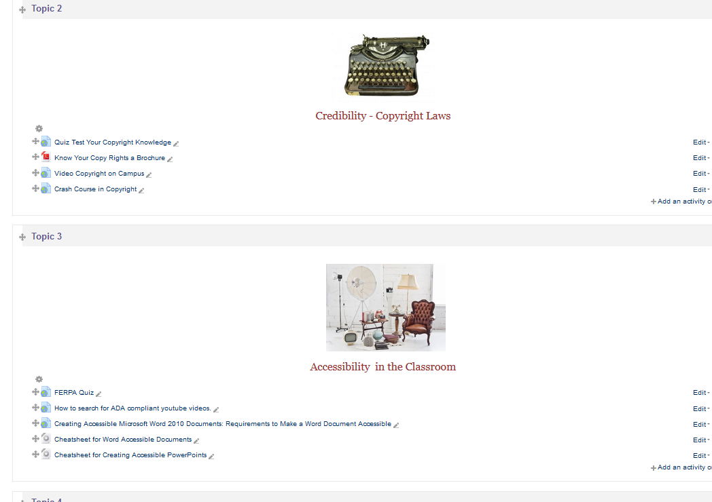

Slide 8
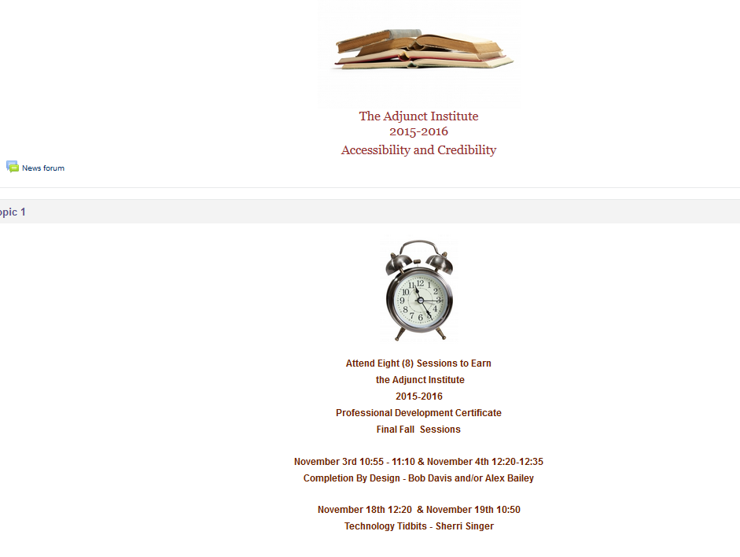

Slide 9
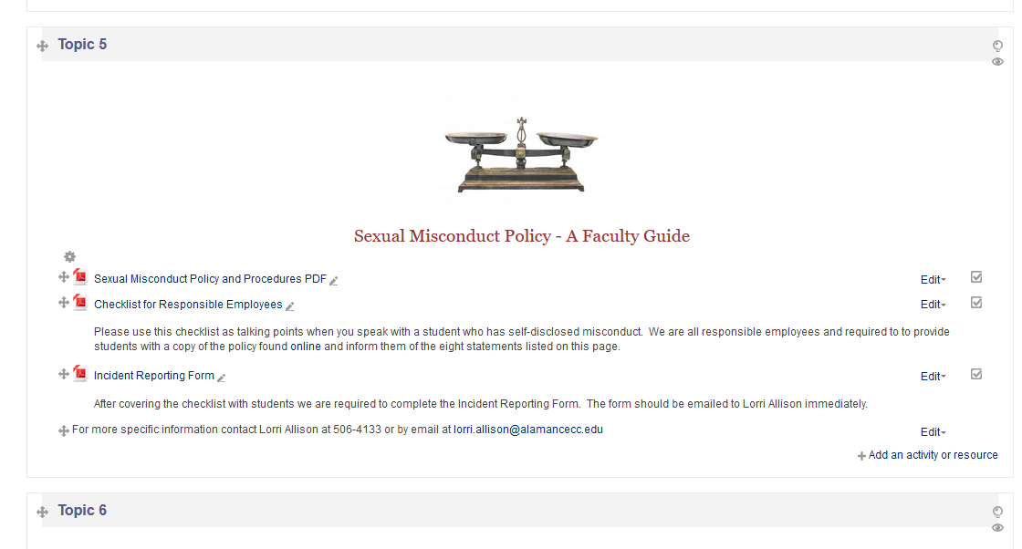

Slide 10
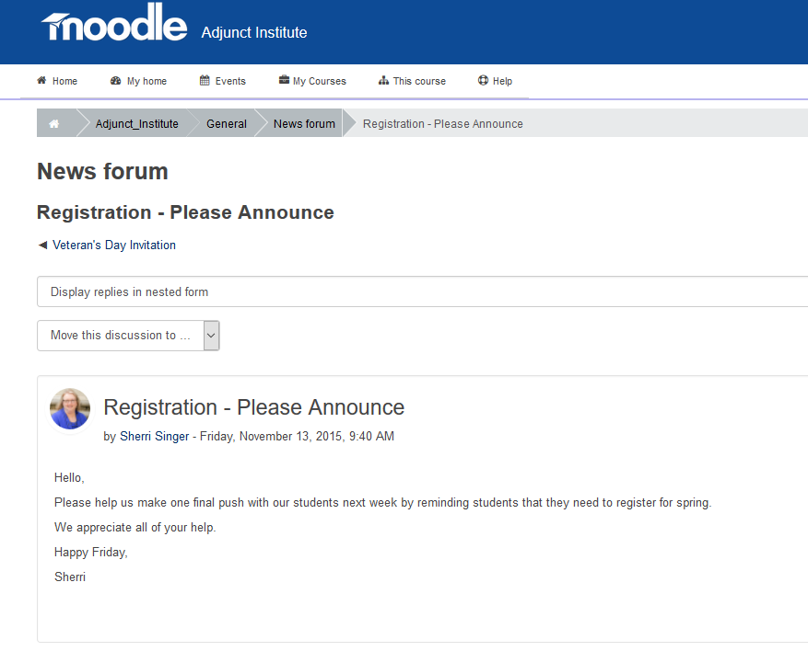
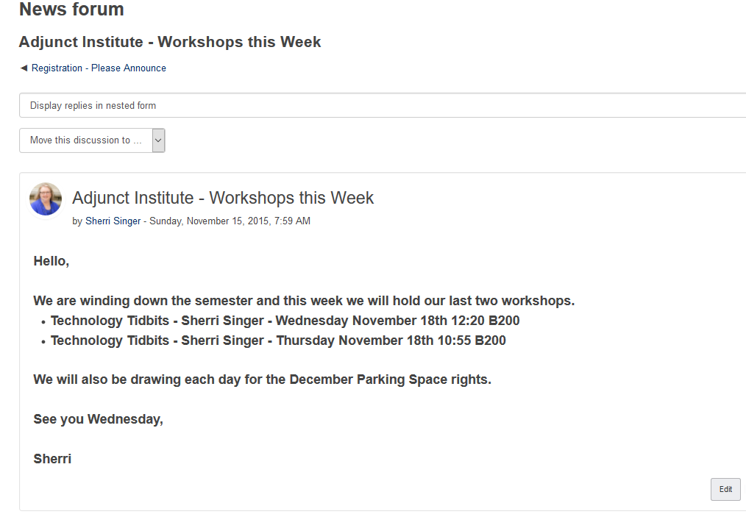

Slide 11
QUESTIONS? COMMENTS?

Slide 12
THANK YOU!
Sherri Singer, Faculty Partners Network
Contact information: sherri.singer@alamancecc.edu

