Slide 1
Designing Engaging Professional Development
Presented by Sherri Singer

Slide 2
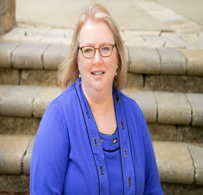
Sherri Singer, Faculty Partners Network
    Coordinator of the Adjunct Institute
    Alamance Community College
    Contact information: sherri.singer@alamancecc.edu

Slide 3


Slide 4


Goals, Goals, Goals
  What are Your Institutional Goals
    Audience
    Institutional Coverage
    Pedagogy
    Value Recognition
    Collegiality
    Help Zone

Slide 5


  What do Adjuncts Want?
    Application/Relevancy
    Compact/Condensed Training
    Activity Based Sessions
    Time for Questions
    Take Away Skills

Slide 6

What Makes Engaging Professional Development for Adjuncts?
Interactive
Inside Scoop
Tech Take Aways
Connections
Sounding Boards

Slide 7

What do Adjuncts need?
  Technology
  Campus Inclusion
  Classroom Management Pedagogy

Slide 8

What works?
  Variety Works
  Short Sessions on a Set Schedule
  Adjunct Only Sessions for Discussion
  Themed approach with a focus on different areas
  Skill Training
  Target Problem Areas

Slide 9


Slide 10


Slide 11
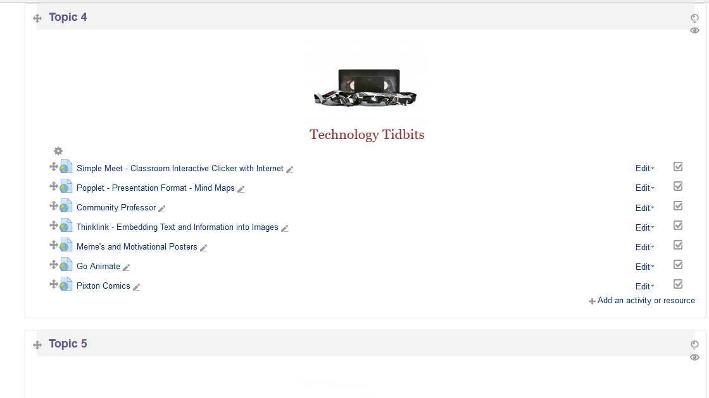

Slide 12
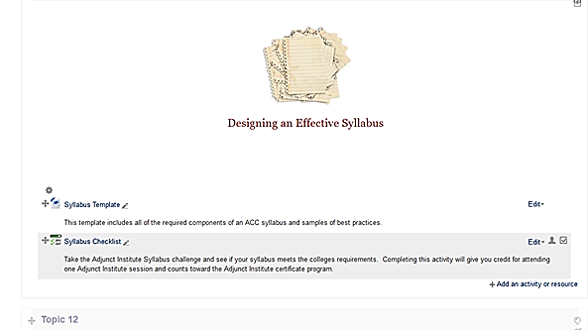
Take Aways
New Trends for Sessions
  Syllabus Design and First Day of Class Best Practices
  Online Course Design Best Practices
  Managing Hallway Discussions
  Retention Best Practices

Slide 13

Reality Check – Don’t be Disappointed
  Your time vs. Adjunct Time
  Attendance
  To pay or not to pay?
  How to Judge Your Own Success

Slide 14
QUESTIONS? COMMENTS?

Slide 15
THANK YOU!
Sherri Singer, Faculty Partners Network
    Contact information: sherri.singer@alamancecc.edu

